Slide 1
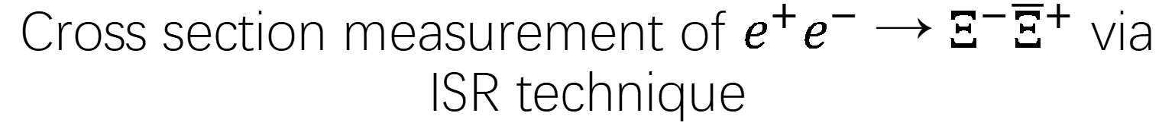
Cross section measurement of $e^{+}e^{−}$ → $Ξ^{−}{\overline{Ξ}}^{+}$ via ISR technique

Slide 2
Outline
Motivation
Data set and event selections
Background study
Systematic uncertainty
Results
Summary

Slide 3
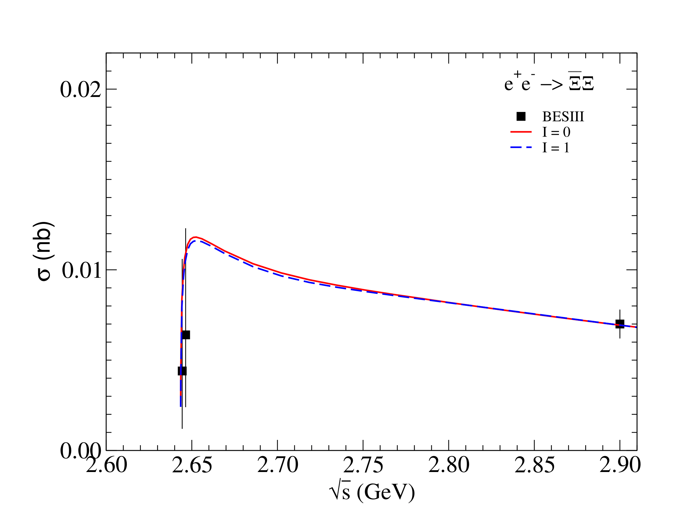
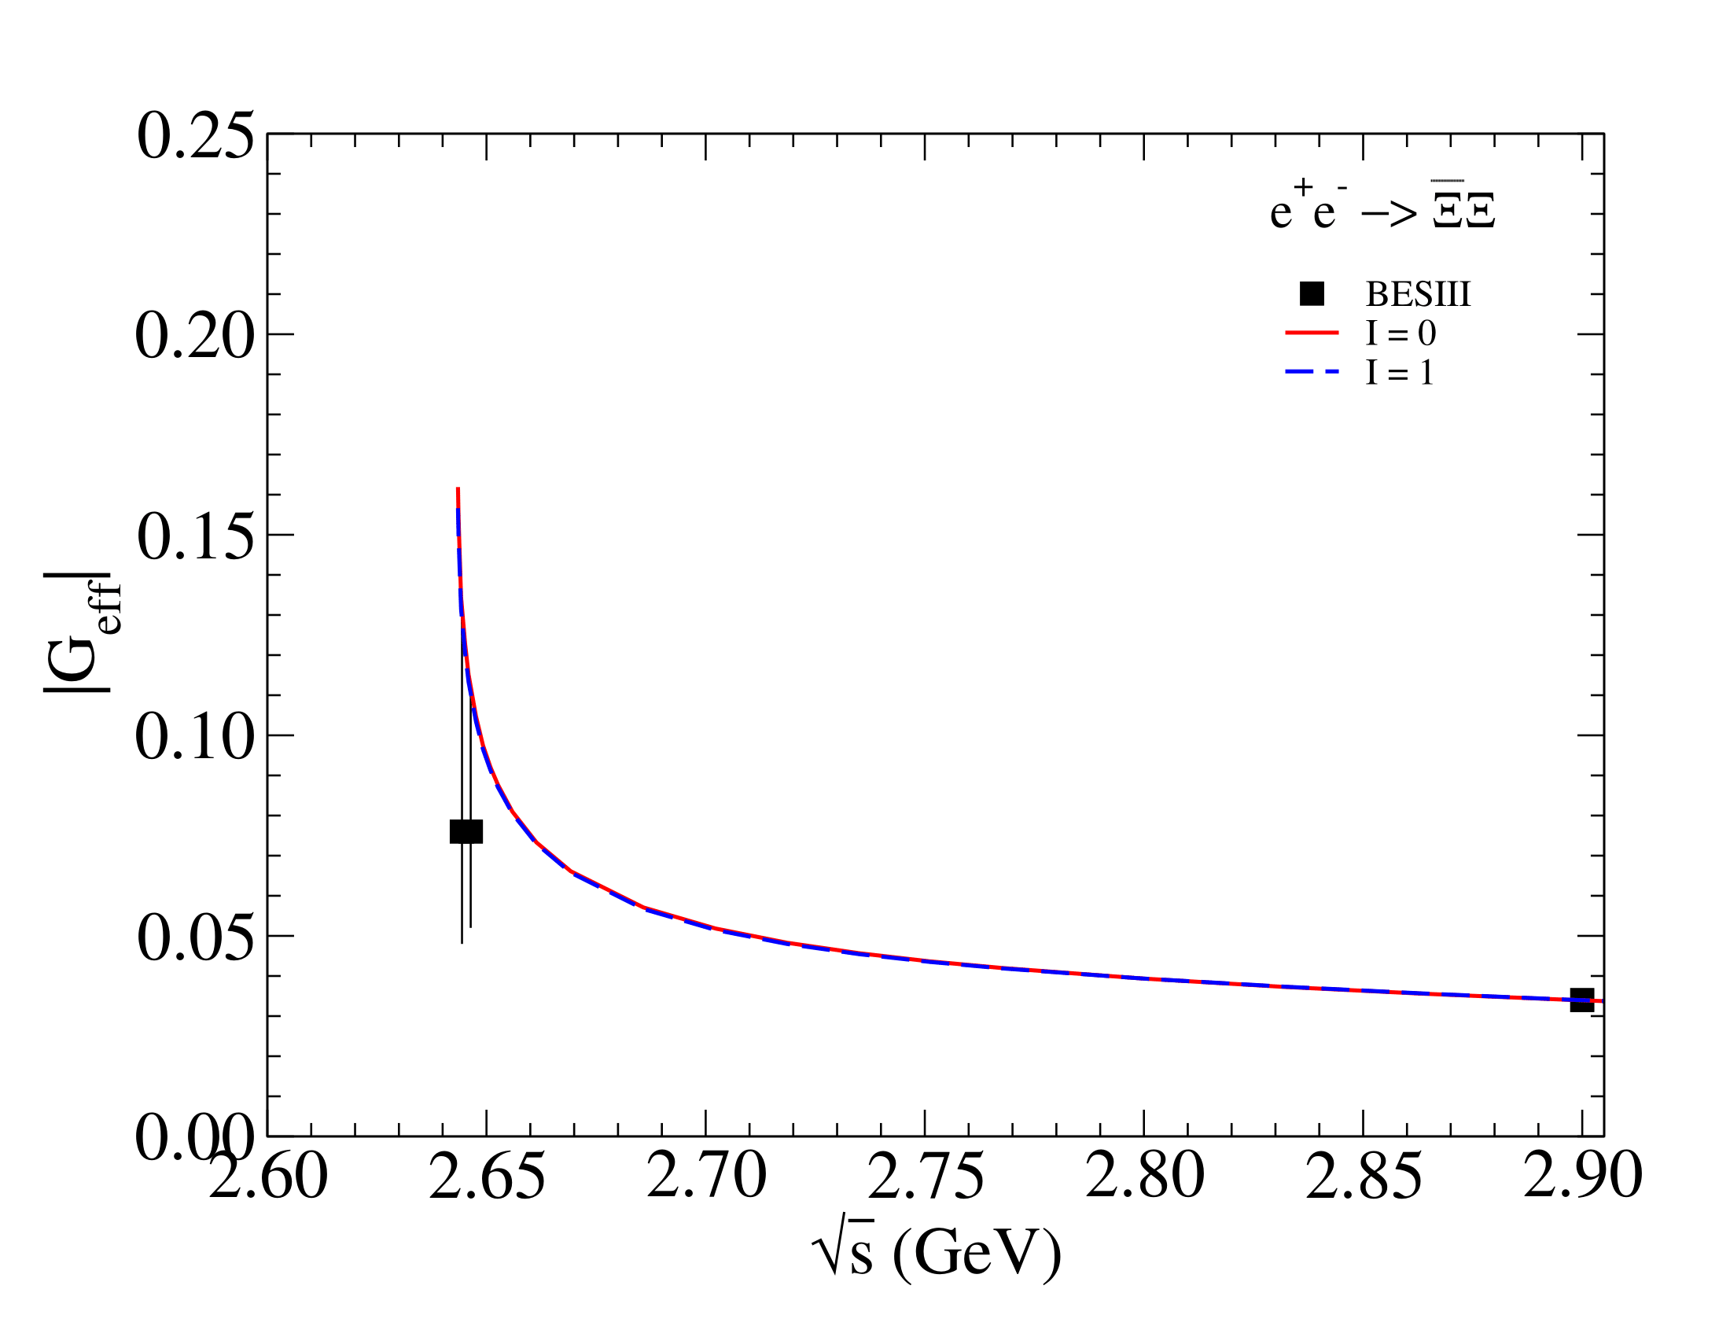



Introduction
HaydenBaul et al. used a model of final state interactions to study the Electromagnetic Form Factors (EMFFs) and cross section.
$$σ(nb)$$
$${|G}_{eff}|$$
$$\sqrt{s} (GeV)$$
$$\sqrt{s} (GeV)$$
PRD 103, 014028(2021)

Slide 4
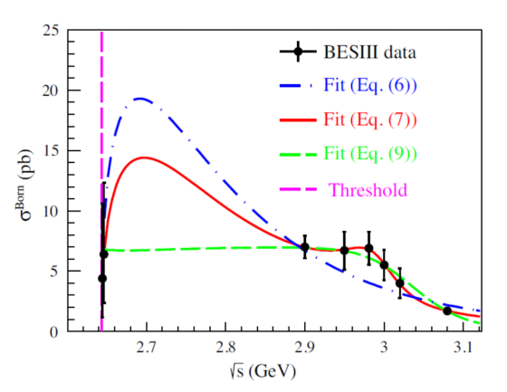
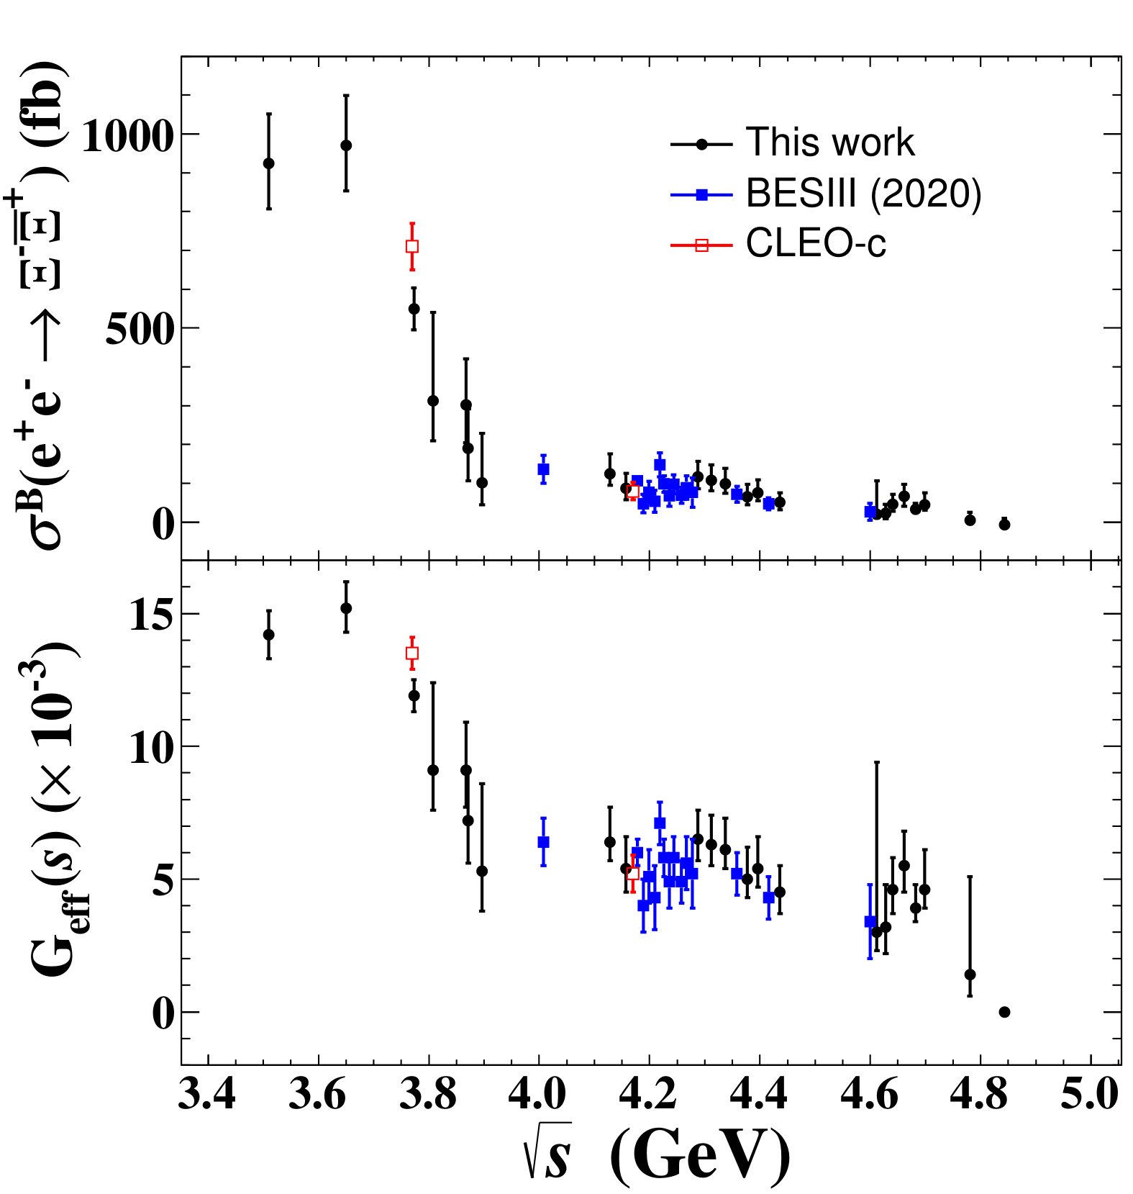
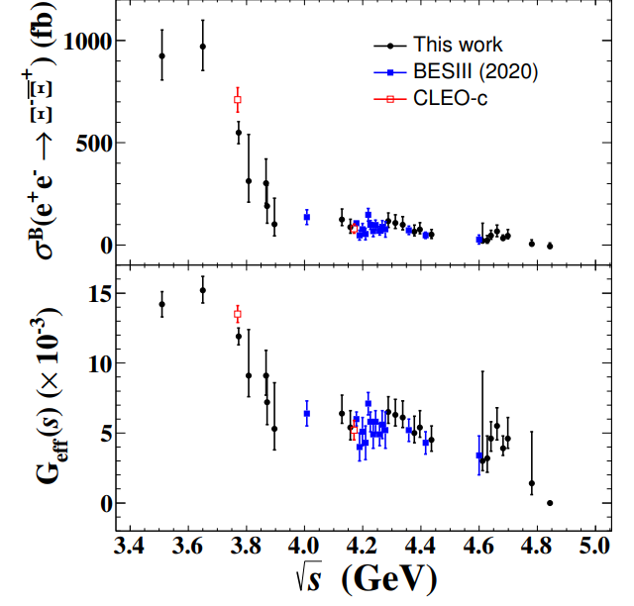


Introduction
Current status of experimental research on the $e^{+}e^{−}→Ξ^{−} {\overline{Ξ}}^{+} c$ross section via energy scanning.
$$\left(pb\right)$$
BESIII(2023)
BESIII(2020)
CLEO-c
$$\sqrt{s} (GeV)$$
PRD 103,012005(2021)
JHEP 11,228(2023)

Slide 5
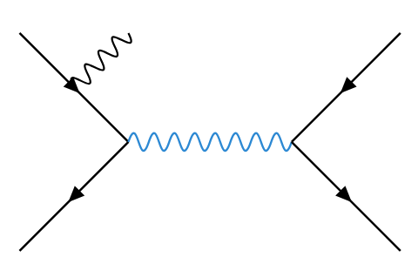
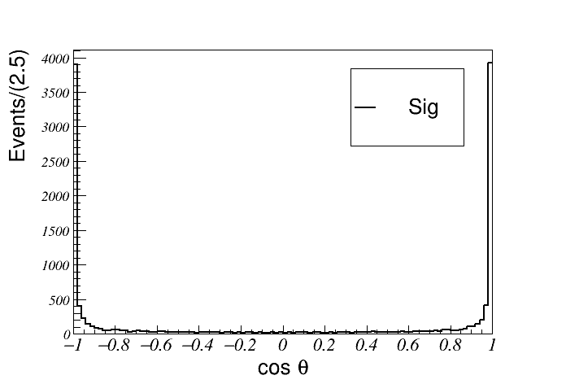





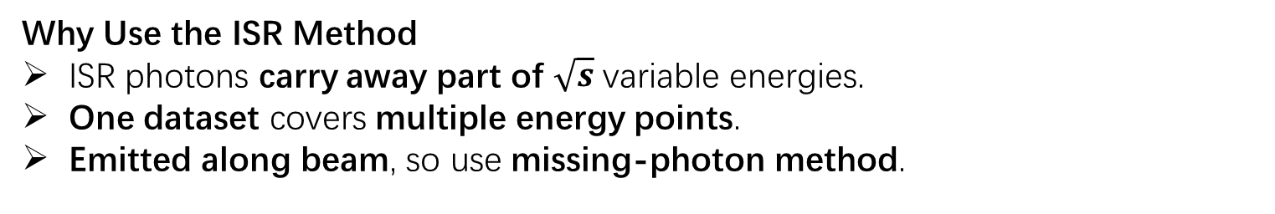



Introduction
Why Use the ISR Method
ISR photons carry away part of $\sqrt{s}$ variable energies.
One dataset covers multiple energy points.
Emitted along beam, so use missing-photon method.
$$e^{−}$$
$$γ$$
$${\overline{Ξ}}^{+}$$
Signal
$γ$∗$(q)$
$Event /0$.01
$$Ξ^{−}$$
$$e^{+}$$
$$\cos{θ_{γ}}$$

Slide 6
Outline
Motivation
Data set and event selections
Background study
Systematic uncertainty
Results
Summary

Slide 7
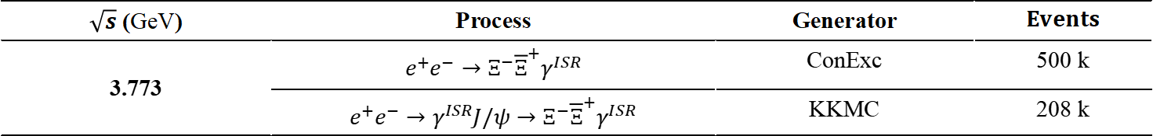
Data sets ：
Signal MC：
$\sqrt{s}$ (GeV) | Process | Generator | $$Events$$
3.773 | $$e^{+}e^{−}→Ξ^{−}{\overline{Ξ}}^{+}γ^{ISR}$$ | ConExc | 500 k
 | $$e^{+}e^{−}→γ^{ISR}{J/ψ→Ξ}^{−}{\overline{Ξ}}^{+}γ^{ISR}$$ | KKMC | 208 k
Inclusive MC: generated $e^{+}e^{−}→q\overline{q}$ samples by charm group.
Data samples : from BOSS 7.1.2
Sample (GeV) | Luminosity (fb⁻¹) | Round | Run number
3.773 | 2.932±0.014^{[1]} | 03 04 | 11414-13988 14395-14604 20448-23454
 | 4.995±0.019^{[2]} | 15 | 70522-73929
 | 8.157±0.031^{[2]} | 16 | 74031-78536
 | 4.191±0.016^{[2]} | 17 | 78615-81094
Total | 20.275 ± 0.077
[1] Phys. Lett. B 753, 629 (2016) [2] Chinese Phys. C 48, 123001(2024)

Slide 8
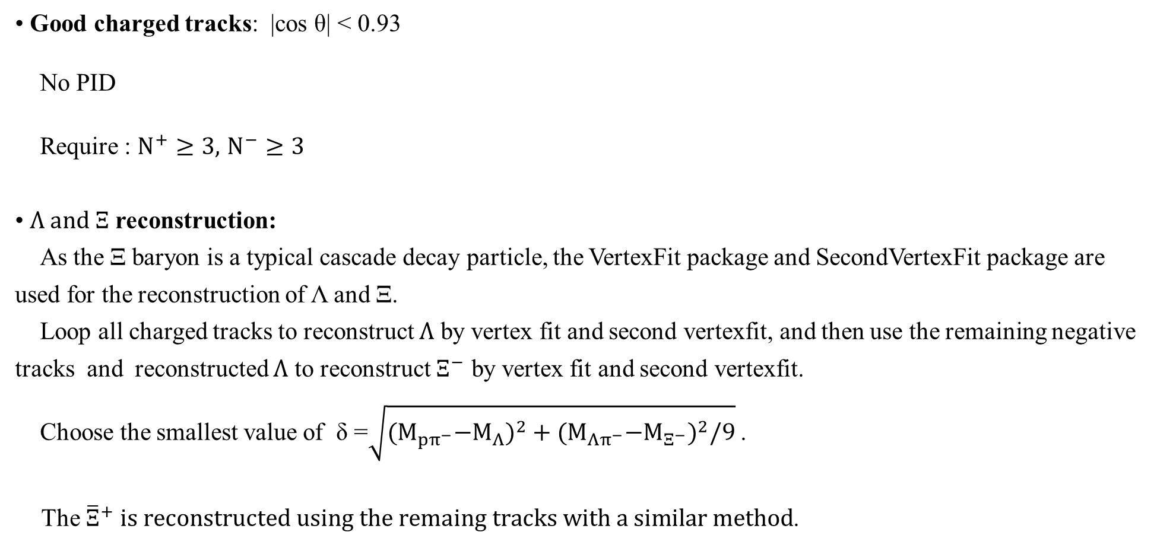
Primary selection:
• Good charged tracks: |cos θ| < 0.93
No PID
Require : $N^{+}≥3,$ $N^{−}≥3$
• $Λ and Ξ$ reconstruction:
As the Ξ baryon is a typical cascade decay particle, the VertexFit package and SecondVertexFit package are used for the reconstruction of Λ and Ξ.
Loop all charged tracks to reconstruct $Λ$ by vertex fit and second vertexfit, and then use the remaining negative tracks and reconstructed $Λ$ to reconstruct $Ξ^{−}$ by vertex fit and second vertexfit.
Choose the smallest value of δ =$\sqrt{{{(M}_{pπ^{−}}−M_{Λ})}^{2}+{{(M}_{Λπ^{−}}−M_{Ξ^{−}})}^{2}/9}$ .
The ${\overline{Ξ}}^{+} is reconstructed using the remaing tracks with a similar method$.

Slide 9
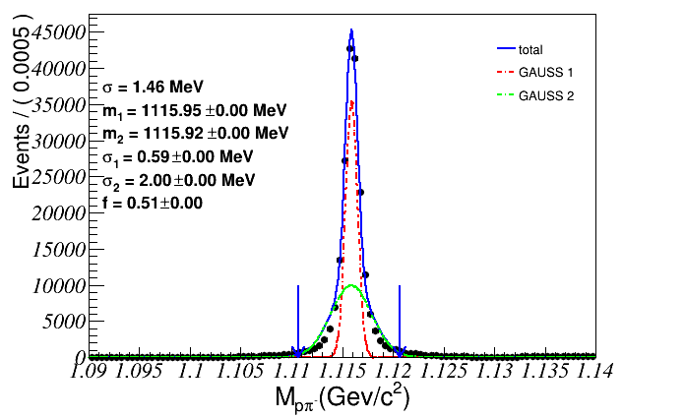
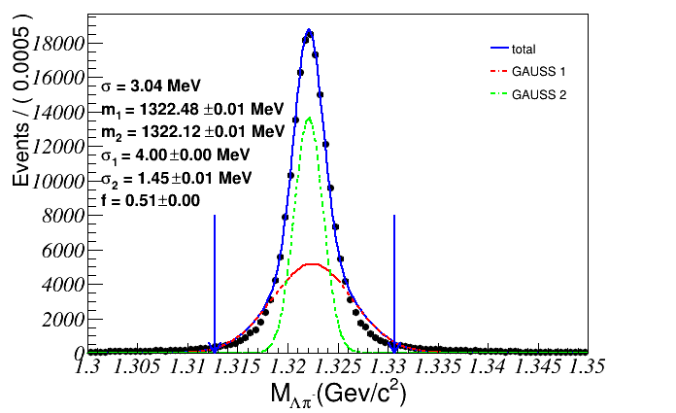



Mass resolution of $Λ$ and $Ξ$
Signal MC :
$$σ=\sqrt{fσ_{1}^{2}+\left(1−f\right)σ_{2}^{2}+f(1−f){(m_{1}−m_{2})}^{2}}$$
Total
Gauss 1
Gauss 2
Total
Gauss 1
Gauss 2
$$Event/5MeV$$
$$Event /5MeV$$
$σ=1.46 MeV$ $σ=3.04 MeV$
Notes:
The above two picture show $Λ$'s reconstruction results, using double Gaussian fitting and calculating the signal sigma of double Gaussian using weight factors and two Gaussian sigma. $Ξ$ used a similar method

Slide 10
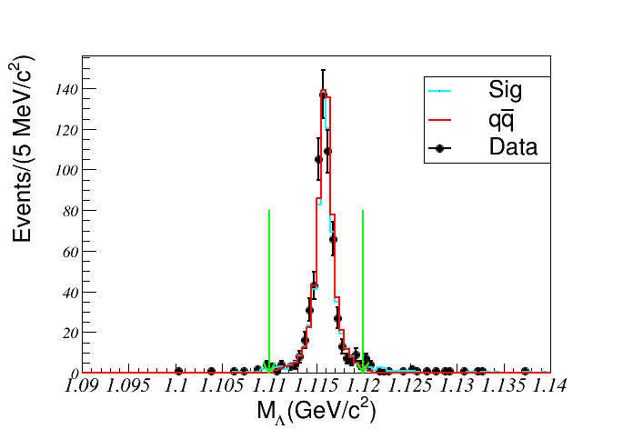
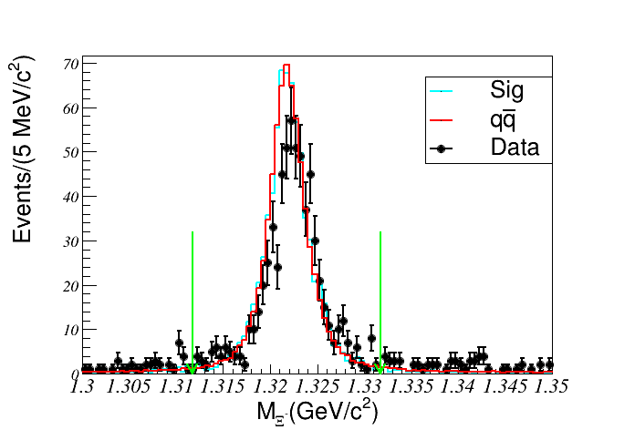
$M_{Λ}$ and $M_{Ξ}$
To further suppress the hadronic background , require :
$|M_{pπ}−M_{Λ}|<5 MeV/c^{2}$ , ${|M}_{Λπ}−M_{Ξ}|<10 MeV/c^{2}$, about 3$σ.$

Slide 11
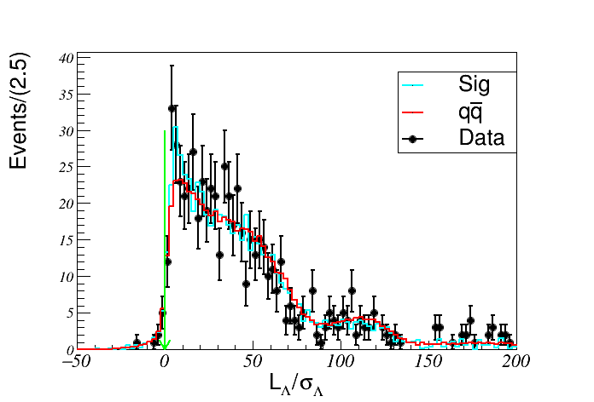
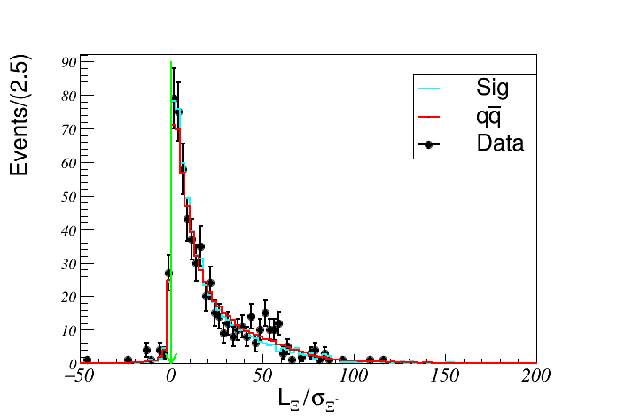
Decay length
To further suppress the hadronic background, require :
$$L/σ>0$$

Slide 12
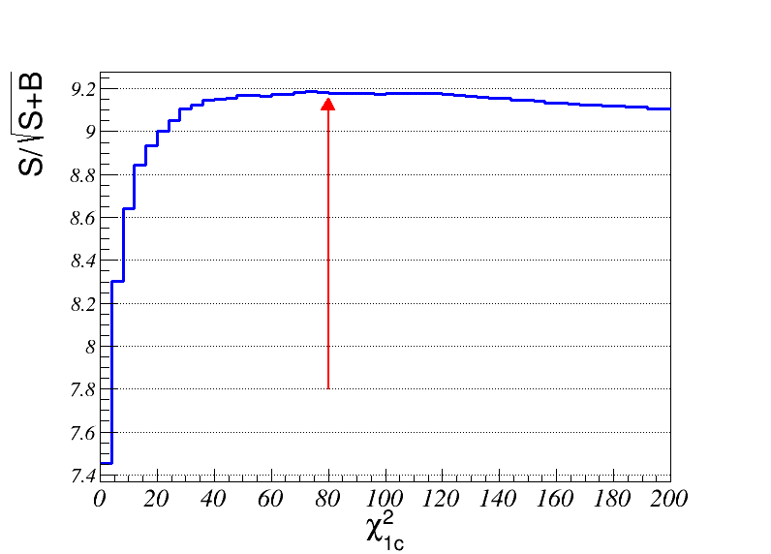
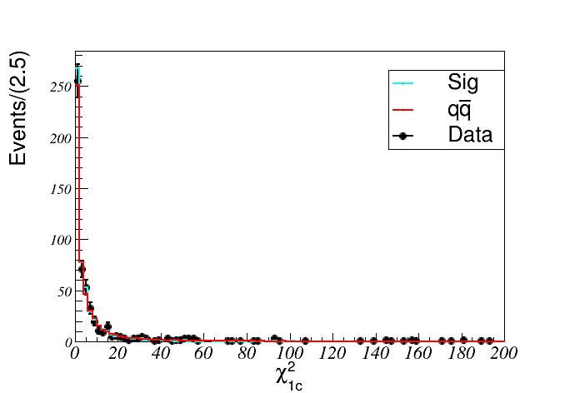
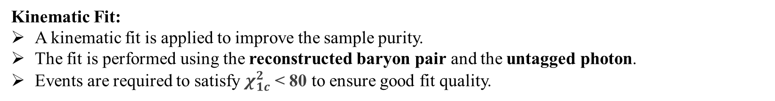
Kinematic fit
Kinematic Fit:
A kinematic fit is applied to improve the sample purity.
The fit is performed using the reconstructed baryon pair and the untagged photon.
Events are required to satisfy $χ_{1c}^{2}$< 80 to ensure good fit quality.

Slide 13
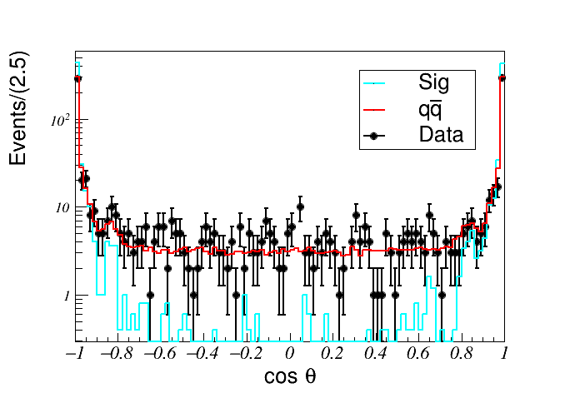
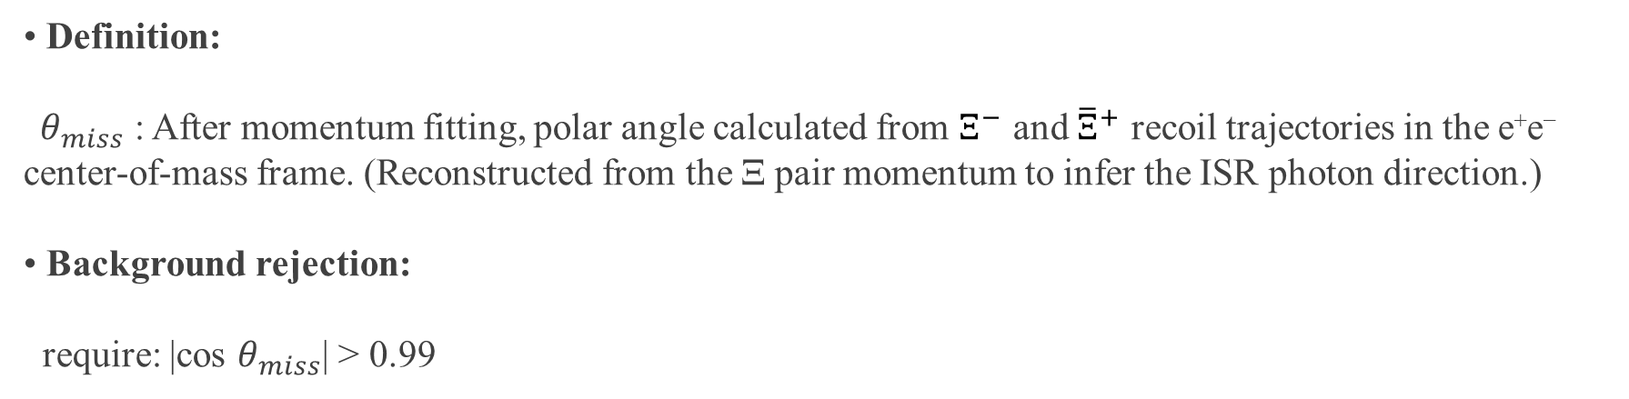



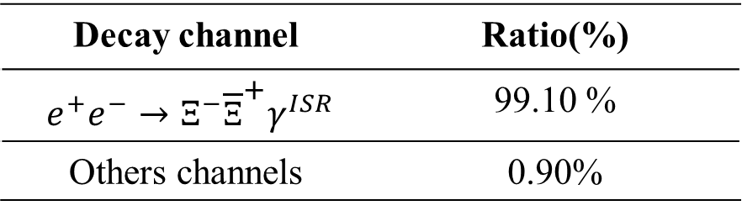

Untagged $γ$
• Definition:
$θ_{miss}$ : After momentum fitting, polar angle calculated from $Ξ^{−}$ and ${\overline{Ξ}}^{+}$ recoil trajectories in the e⁺e⁻ center-of-mass frame. (Reconstructed from the Ξ pair momentum to infer the ISR photon direction.)
• Background rejection:
require: |cos $θ_{miss}$| > 0.99
$Event /0$.01
Background from $q\overline{q}$ sample
Decay channel | Ratio(%)
$e^{+}e^{−}→Ξ^{−}{\overline{Ξ}}^{+}γ^{ISR}$ | 99.10 %
Others channels | 0.90%
$$\cos{θ_{γ}}$$

Slide 14
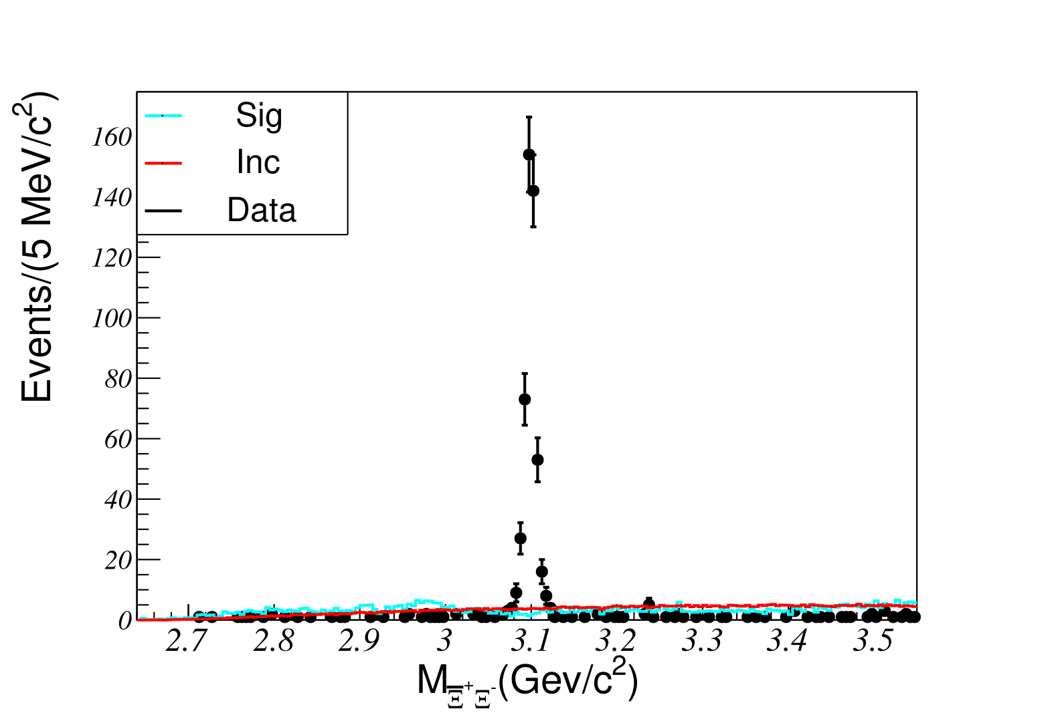
Mass spectra from data
Event Distribution：
A clear J/ψ peak is observed in the mass spectrum.
Very few events survive outside the J/ψ region.
After excluding J/ψ, only about 100 events remain in total.

Slide 15
Outline
Motivation
Data set and event selections
Background study
Systematic uncertainty
Results
Summary

Slide 16
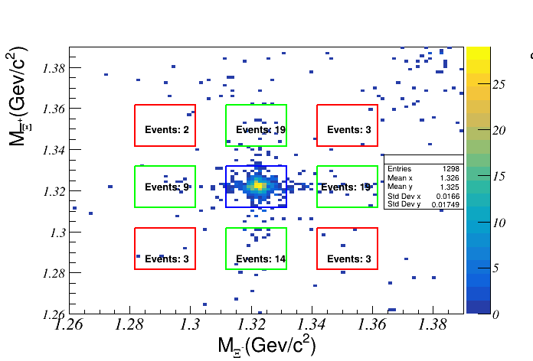
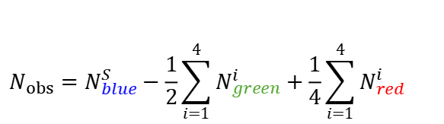
Background study
Background estimation :
Remaining background evaluated via sideband analysis
Red boxes and green boxes : denotes the sideband region.
Blue box : denotes the signal region.
$$N_{obs}=N_{blue}^{S}−\frac{1}{2}\sum_{i=1}^{4}{N_{green}^{i}}+\frac{1}{4}\sum_{i=1}^{4}{N_{red}^{i}}$$
No surviving events were observed for the processes 𝒆⁺𝒆⁻ → D⁰𝐃̅⁰, D⁺D⁻, and 𝝁⁺𝝁⁻.

Slide 17
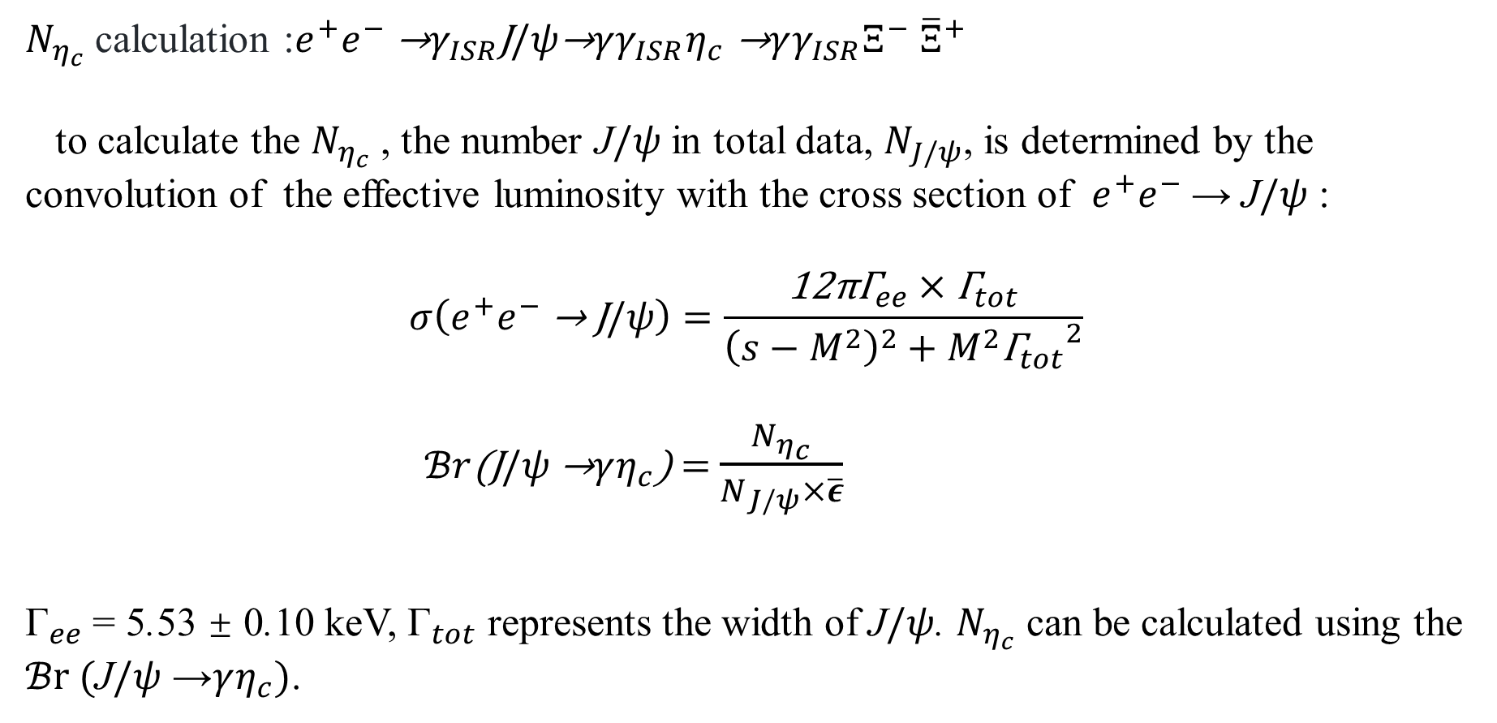
Background study
$N_{η_{c}}$ calculation :$e^{+}e^{−} \text{→}γ_{ISR}\text{J}/ψ\text{→}γγ_{ISR}η_{c}$ $\text{→}γγ_{ISR}Ξ^{−} {\overline{Ξ}}^{+}$
to calculate the $N_{η_{c}}$ , the number J$/ψ$ in total data, $N_{J/ψ}$, is determined by the convolution of the effective luminosity with the cross section of $e^{+}e^{−}$→ J$/ψ$ :
$$σ\left(e^{+}e^{−} \text{→ }\text{J}/ψ\right)=\frac{\text{12}\text{π}{\text{Γ}}_{ee}×{\text{Γ}}_{tot}}{{\left(s−M^{2}\right)}^{2}+M^{2}{{\text{Γ}}_{tot}}^{2}}$$
$ℬr$(J$/ψ$ →$γη_{c}$) = $\frac{N_{η_{c}}}{N_{J/ψ}×\overline{ε}}$
${\text{Γ}}_{ee}$= 5.53 ± 0.10 keV, ${\text{Γ}}_{tot}$ represents the width of J$/ψ$. $N_{η_{c}}$ can be calculated using the $ℬr ($J$/ψ$ →$γη_{c})$.

Slide 18

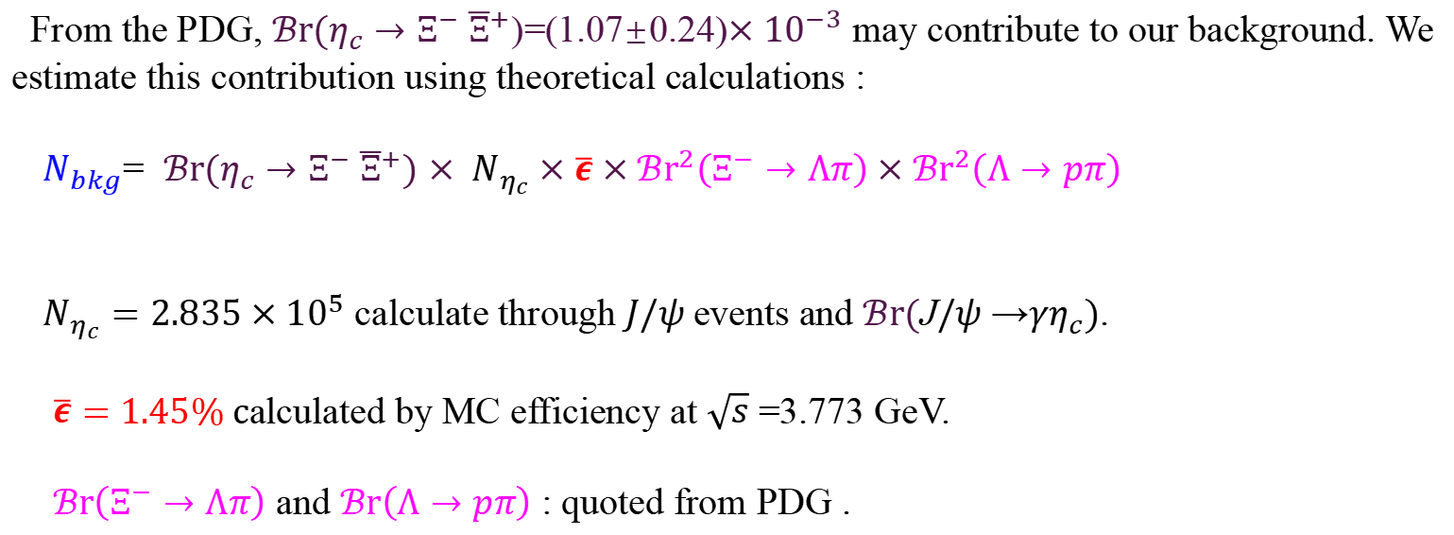

Calculated $η_{c}$ background
From the PDG, $ℬr(η_{c}→Ξ^{−} {\overline{Ξ}}^{+}$)=(1.07±0.24)$×{10}^{−3}$ may contribute to our background. We estimate this contribution using theoretical calculations :
$N_{bkg}$= $ℬr(η_{c}→Ξ^{−} {\overline{Ξ}}^{+})$ $×{ N}_{η_{c}}×\overline{ε}×{ℬr}^{2}\left(Ξ^{−}→Λπ\right)×{ℬr}^{2}\left(Λ→pπ\right)$
$N_{η_{c}}=2.835×{10}^{5}$ calculate through $J/ψ$events and $ℬr($J$/ψ$ →$γη_{c})$.
$\overline{ε}=$ 1.45% calculated by MC efficiency at $\sqrt{s}$ =3.773 GeV.
$ℬr\left(Ξ^{−}→Λπ\right)$ and $ℬr\left(Λ→pπ\right)$ : quoted from PDG .
$$N_{bkg}=1.81±0.41$$
This part of the background only affects the region of $M_{Ξ^{−} {\overline{Ξ}}^{+}}$ =2.97-3.05 GeV

Slide 19
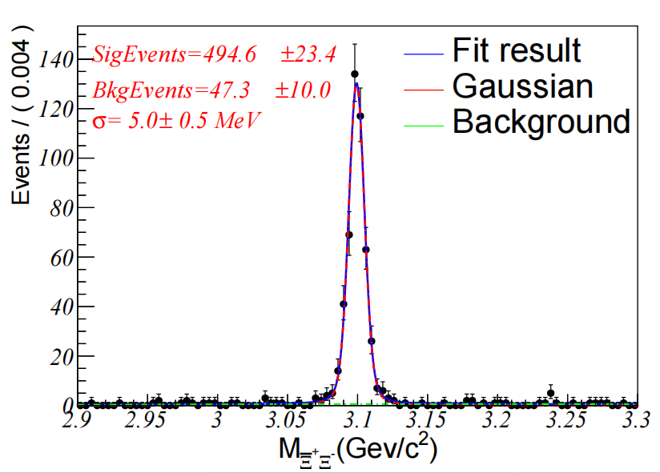


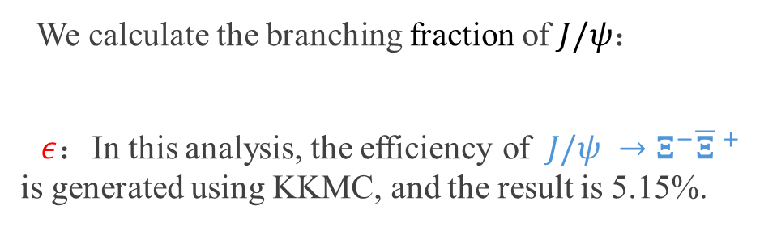
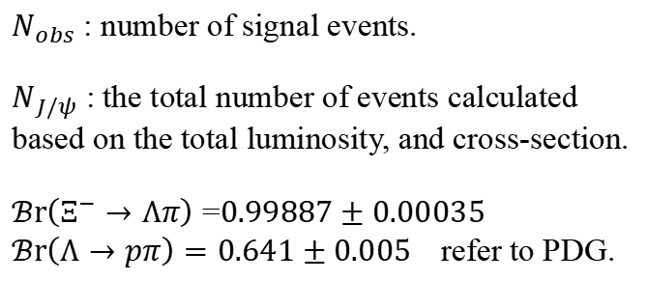
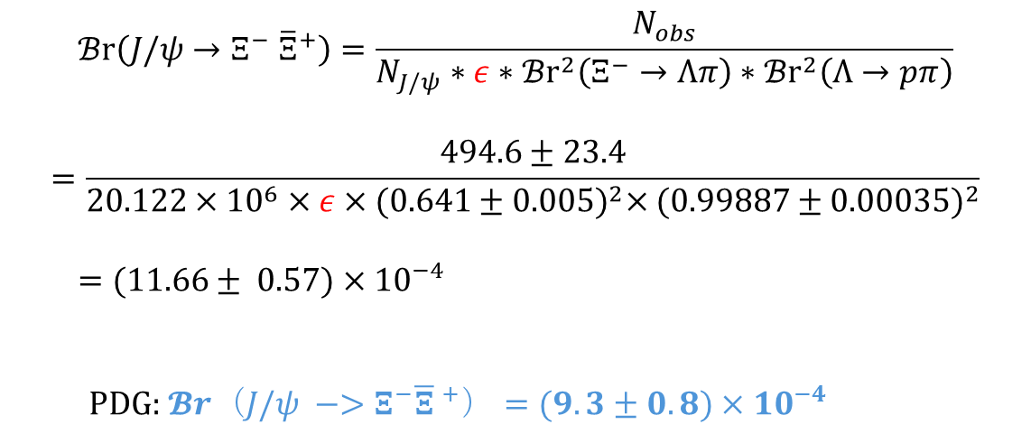
Fit J/$ψ$
We calculate the branching fraction of $J/ψ$：
$ε$：In this analysis, the efficiency of $J/ψ →Ξ^{−}{\overline{Ξ} }^{+}$ is generated using KKMC, and the result is 5.15%.
$$Event/4MeV$$
$$ℬr\left(J/ψ→Ξ^{−} {\overline{Ξ}}^{+}\right)=\frac{N_{obs}}{N_{J/ψ}∗ε∗{ℬr}^{2}\left(Ξ^{−}→Λπ\right)∗{ℬr}^{2}\left(Λ→pπ\right)}$$
$$=\frac{494.6±23.4}{20.122×{10}^{6}×ε×{(0.641±0.005)}^{2}×({0.99887±0.00035)}^{2}}$$
$=$ $(11.66± 0.57)×{10}^{−4}$
PDG: $𝓑r（J/ψ −>Ξ^{−}{\overline{Ξ} }^{+}）=(9.3±0.8)×{10}^{−4}$
$N_{obs}$ : number of signal events.
$N_{J/ψ}$ : the total number of events calculated based on the total luminosity, and cross-section.
$ℬr\left(Ξ^{−}→Λπ\right)$ =$0.99887±0.00035$
$ℬr\left(Λ→pπ\right)=0.641±0.005$ refer to PDG.

Slide 20
Outline
Motivation
Data set and event selections
Background study
Systematic uncertainty
Results
Summary

Slide 21
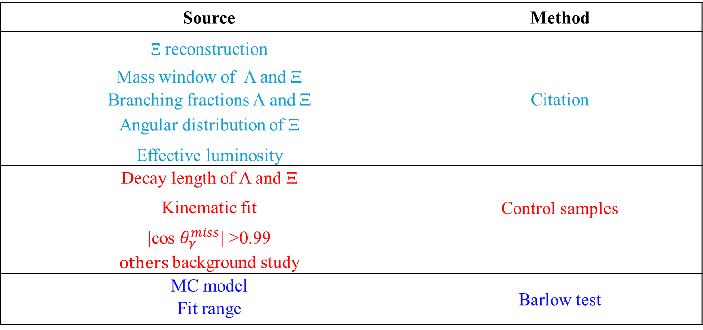
Summary of systematic uncertainties:
Source | Method
$Ξ$ reconstruction | Citation
Mass window of Λ and Ξ
Branching fractions Λ and Ξ
Angular distribution of Ξ
Effective luminosity
Decay length of Λ and Ξ | Control samples
Kinematic fit
|cos $θ_{γ}^{miss}$| >0.99
$others$background study
MC model | Barlow test
Fit range
All the systemic uncertainties analyzed in this report are shown in the table.

Slide 22
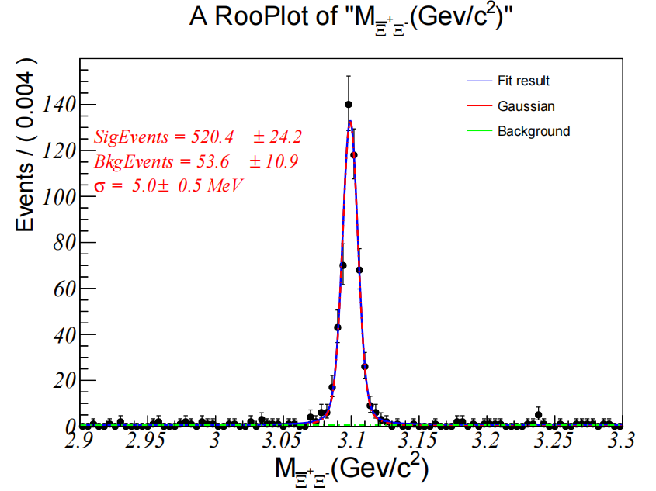
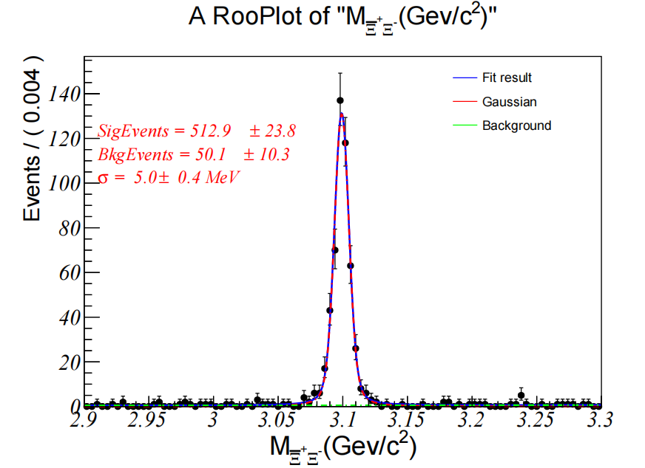
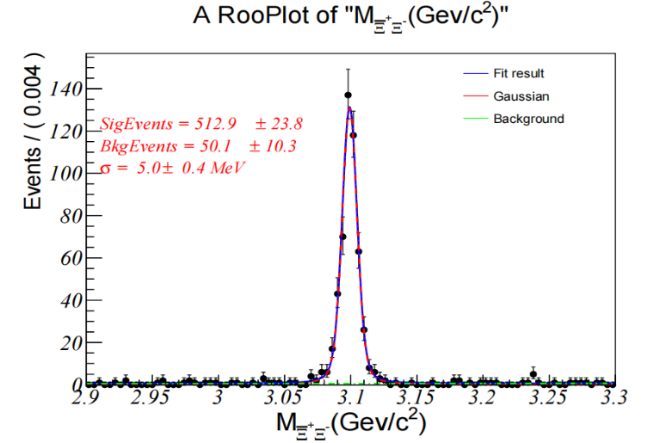
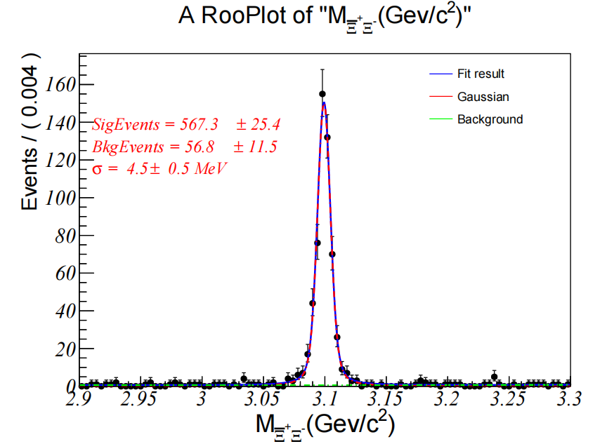
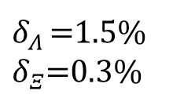

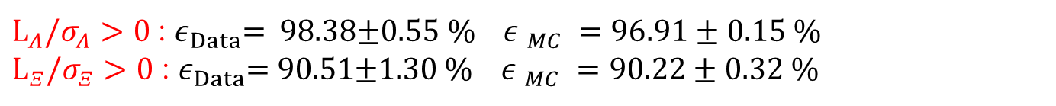



Decay length
Compare the $J/ψ$ samples generated by KKMC with the data samples.
Before this cut
After this cut
Fit result
Gauss
Background
For Λ:
$$Event/4MeV$$
$$Event/4MeV$$
Before this cut
After this cut
$$Event/4MeV$$
$$Event/4MeV$$
For Ξ :
$L_{Λ}/σ_{Λ}>0$: $ε_{Data}$= 98.38$±$0.55 % ${ε }_{MC} =96.91±0.15 \%$
$L_{Ξ}/σ_{Ξ}>0$ : $ε_{Data}$= 90.51$±$1.30 % ${ε }_{MC} =90.22±0.32 \%$
$δ_{Λ }$=1.5%
$δ_{Ξ}$=0.3%

Slide 23
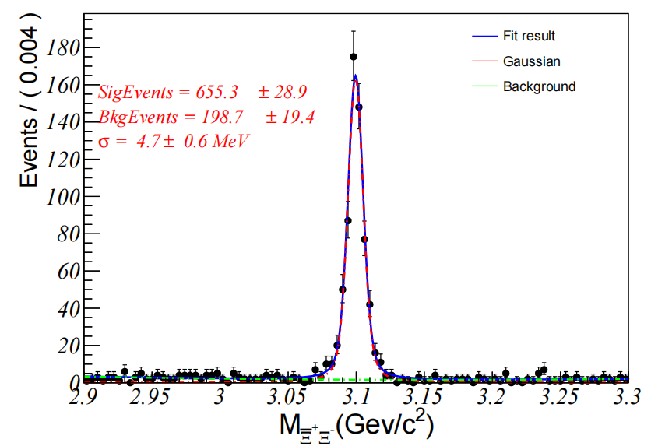

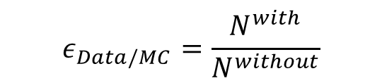
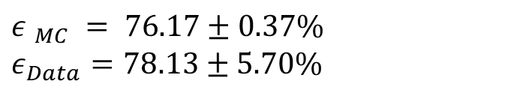

$|c$os$θ_{γ}^{miss}|>0.99$
Before this cut
After this cut
Fit result
Gauss
Background
Fit result
Gauss
Background
$$Event/4MeV$$
$$Event/4MeV$$
$$ε_{Data/MC}=\frac{N^{with}}{N^{without}}$$
$${ε }_{MC} = 76.17±0.37\%$$
$$ε_{Data}=78.13±\text{5.7}0\%$$
$δ=|1−ε_{Data}/ε_{MC}|=2.51\%$

Slide 24
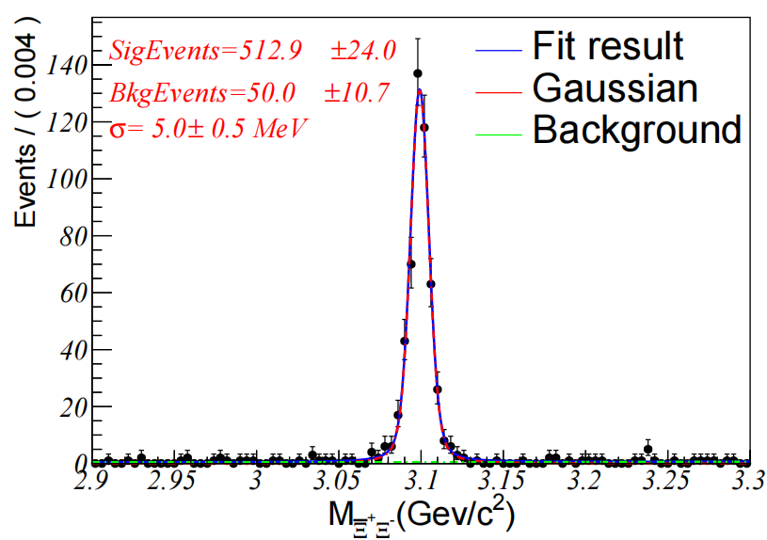
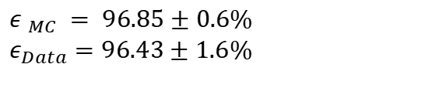



Kinematic fit
Before this cut
After this cut
Fit result
Gauss
Background
Fit result
Gauss
Background
$$Event/4MeV$$
$$Event/4MeV$$
$${ε }_{MC} = 96.85±0.6\%$$
$$ε_{Data}=96.43±1.6\%$$
$δ=|1−ε_{Data}/ε_{MC}|=0.44\%$

Slide 25
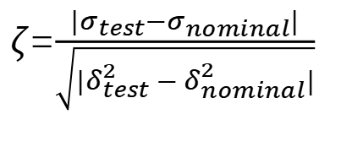
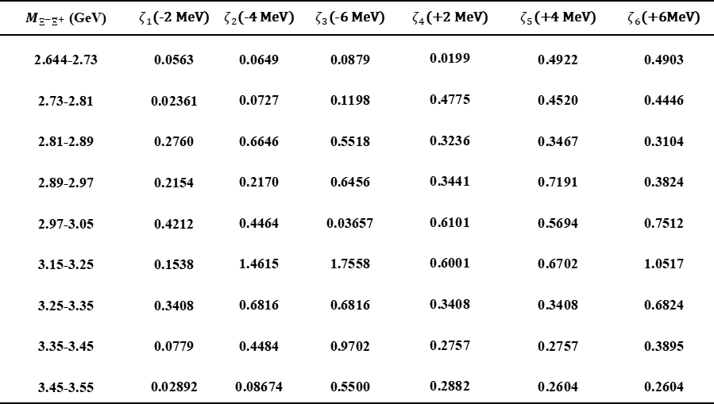
Systematic uncertainty from 2D sidebands
$M_{Ξ^{−}{\overline{Ξ}}^{+}}$ (GeV) | $ζ_{1}$(-2 MeV) | $ζ_{2}$(-4 MeV) | $ζ_{3}$(-6 MeV) | $ζ_{4}$(+2 MeV) | $ζ_{5}$(+4 MeV) | $ζ_{6}$(+6MeV)
2.644-2.73 | 0.0563 | 0.0649 | 0.0879 | 0.0199 | 0.4922 | 0.4903
2.73-2.81 | 0.02361 | 0.0727 | 0.1198 | 0.4775 | 0.4520 | 0.4446
2.81-2.89 | 0.2760 | 0.6646 | 0.5518 | 0.3236 | 0.3467 | 0.3104
2.89-2.97 | 0.2154 | 0.2170 | 0.6456 | 0.3441 | 0.7191 | 0.3824
2.97-3.05 | 0.4212 | 0.4464 | 0.03657 | 0.6101 | 0.5694 | 0.7512
3.15-3.25 | 0.1538 | 1.4615 | 1.7558 | 0.6001 | 0.6702 | 1.0517
3.25-3.35 | 0.3408 | 0.6816 | 0.6816 | 0.3408 | 0.3408 | 0.6824
3.35-3.45 | 0.0779 | 0.4484 | 0.9702 | 0.2757 | 0.2757 | 0.3895
3.45-3.55 | 0.02892 | 0.08674 | 0.5500 | 0.2882 | 0.2604 | 0.2604
$ζ$=$\frac{|σ_{test}−σ_{nominal}|}{\sqrt{{|δ}_{test}^{2}−δ_{nominal}^{2}|}}$
ζ < 2, so we ignore the systematic error caused by this item.

Slide 26

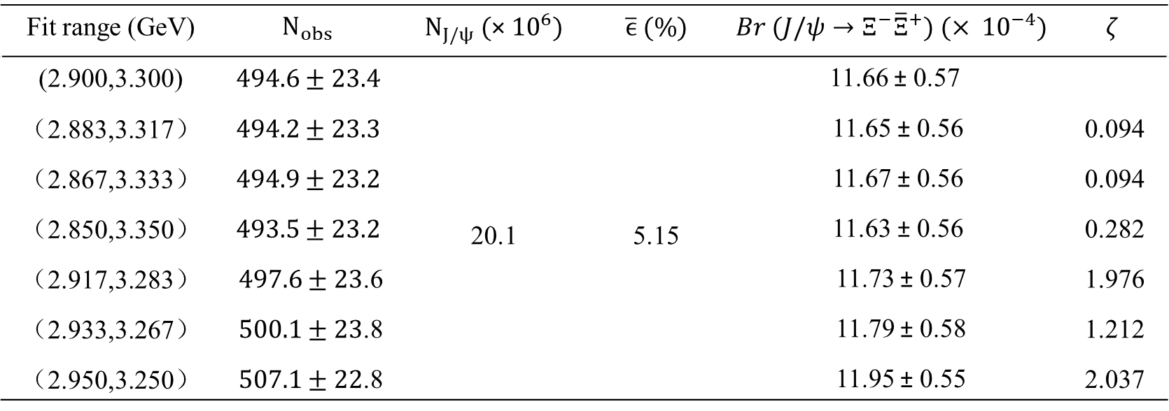
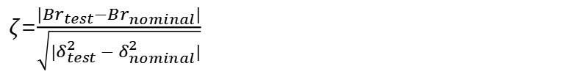
Systematic uncertainty from fit range
$ζ$=$\frac{|{Br}_{test}−{Br}_{nominal}|}{\sqrt{{|δ}_{test}^{2}−δ_{nominal}^{2}|}}$
Fit range (GeV) | $$N_{obs}$$ | $N_{J/ψ}$ (× ${10}^{6}$) | $\overline{ϵ}$ ($\%$) | $$Br (J/ψ→Ξ^{−}{\overline{Ξ}}^{+}) (× {10}^{−4})$$ | $$ζ$$
(2.900,3.300) | $$494.6±23.4$$ | 20.1 | 5.15 | 11.66 ± 0.57
（2.883,3.317） | $$494.2±23.3$$ |  |  | 11.65 ± 0.56 | 0.094
（2.867,3.333） | $$494.9±23.2$$ |  |  | 11.67 ± 0.56 | 0.094
（2.850,3.350） | $$493.5±23.2$$ |  |  | 11.63 ± 0.56 | 0.282
（2.917,3.283） | $497.6±23$.6 |  |  | 11.73 ± 0.57 | 1.976
（2.933,3.267） | $500.1±23$.8 |  |  | 11.79 ± 0.58 | 1.212
（2.950,3.250） | $507.1±22$.8 |  |  | 11.95 ± 0.55 | 2.037
The difference between the branching fraction with the largest 𝜁 deviation and the nominal value is taken as the systematic uncertainty.
$$δ=2.5\%$$

Slide 27
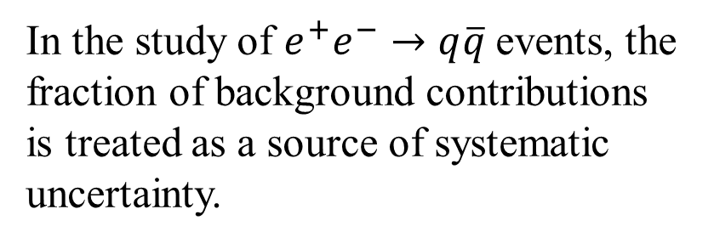
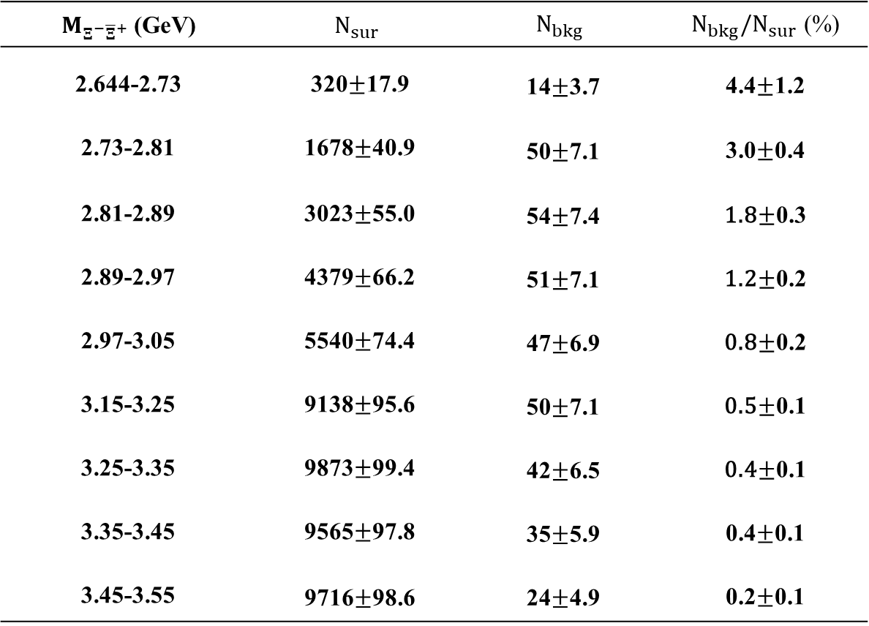
Others background
$M_{Ξ^{−}{\overline{Ξ}}^{+}}$ (GeV) | $$N_{sur}$$ | $$N_{bkg}$$ | ${N_{bkg}/N}_{sur}$ (%)
2.644-2.73 | 320$±$17.9 | 14$±$3.7 | 4.4$±$1.2
2.73-2.81 | 1678$±$40.9 | 50$±$7.1 | 3.0$±$0.4
2.81-2.89 | 3023$±$55.0 | 54$±$7.4 | 1.8$±$0.3
2.89-2.97 | 4379$±$66.2 | 51$±$7.1 | 1.2$±$0.2
2.97-3.05 | 5540$±$74.4 | 47$±$6.9 | 0.8$±$0.2
3.15-3.25 | 9138$±$95.6 | 50$±$7.1 | 0.5$±$0.1
3.25-3.35 | 9873$±$99.4 | 42$±$6.5 | 0.4$±$0.1
3.35-3.45 | 9565$±$97.8 | 35$±$5.9 | 0.4$±$0.1
3.45-3.55 | 9716$±$98.6 | 24$±$4.9 | 0.2$±$0.1
In the study of $e^{+}e^{−}→q\overline{q}$events, the fraction of background contributions is treated as a source of systematic uncertainty.

Slide 28

Summary of systematic uncertainties:
Source | Method | Cross section | $$Br(J/ψ→Ξ^{−} {\overline{Ξ}}^{+})$$
$Ξ$ reconstruction | Citation | 1.96
 |  | 0.90
Mass window of Λ |  | 0.90
Mass window of Ξ |  | 2.82
Branching fractions Ξ and Λ |  | 2.26
Angular distribution |  | 3.57
Effective luminosity |  | 0.70
Decay length of Λ | Control samples | 1.50
Decay length of Ξ |  | 0.30
Kinematic fit |  | 0.44
|cos $θ_{γ}^{miss}$| >0.99 |  | 2.51
others background study |  | 0.2~4.4
MC model | Barlow test |  | 2.9
Fit range |  |  | 2.5
Total |  | 6.30~7.69 | 6.49

Slide 29
Outline
Motivation
Data set and event selections
Background study
Systematic uncertainty
Results
Summary

Slide 30




Resolution of ${\text{M}}_{Ξ^{−} {\overline{Ξ}}^{+}}$
Due to the distribution of the event numbers, this analysis requires consideration of dividing the data into quality intervals.
$M_{Ξ^{−} {\overline{Ξ}}^{+}}^{rec}−$ $M_{Ξ^{−} {\overline{Ξ}}^{+}}^{truth}$(GeV/$c^{2}$)
The invariant mass σ of the fitted reconstruction for this analysis is 10 MeV, but due to the small number of surviving events analyzed:
2.64-3.05 GeV with a bin width of 80 MeV
3.15-3.55 GeV with a bin width of 100 MeV

Slide 31



Cross-section
Cross section is calculated by:
$$σ_{Ξ^{−} {\overline{Ξ}}^{+}}^{B}=\frac{N_{sig}}{\overline{ε}×L_{eff}{×ℬr}^{2}\left(Ξ^{−}→Λπ\right)×{ℬr}^{2}\left(Λ→pπ\right)×\frac{1}{{|1−Π|}^{2}}}$$
$N_{sig}$: the number of signal events in each interval in $M_{Ξ^{−} {\overline{Ξ}}^{+}}$ spectrum after background subtraction .
$\overline{ε}$: the average selection MC efficiency in each invariant mass interval .
$L_{eff}$: effective ISR luminosity .
$$L_{eff}=W(\text{s}\text{, }\text{x})∗L_{int}$$
$L_{int}$:the integrated luminosity collected at the c.m. energy ( $\sqrt{s}$ = 3.773 GeV) .
W$(\text{s}\text{, }\text{x})$ : ISR radiation function.
$\frac{1}{{|1−Π|}^{2}}:$ VP factor.

Slide 32




Cross-section results
$M_{Ξ^{−}{\overline{Ξ}}^{+}}$ (GeV) | $$N_{sur}$$ | $$N_{bkg}$$ | $\overline{ε}$ (%) | $$L_{eff}({pb}^{−1})$$ | $$\frac{1}{{|1−Π|}^{2}}$$ | $$σ_{Ξ^{−} {\overline{Ξ}}^{+}}^{B}(pb)$$
2.64-2.73 | 2.0±1.4 | 0.00±0.00 | 0.89 | 70.399 | 1.04 | 7.49±5.33
2.73-2.81 | 9.0±3.0 | 0.20±0.45 | 2.27 | 70.705 | 1.04 | 12.82±4.52
2.81-2.89 | 6.0±2.5 | 1.00±0.53 | 3.25 | 79.780 | 1.04 | 4.77±2.30
2.89-2.97 | 5.0±2.3 | 0.12±0.35 | 4.87 | 90.723 | 1.03 | 2.41±1.22
2.97-3.05 | 15.0±3.9 | 1.83±1.39 | 5.63 | 104.124 | 1.02 | 6.03±1.90
3.15-3.25 | 18.0±4.2 | 0.04±0.20 | 6.89 | 189.423 | 1.07 | 3.11±0.77
3.25-3.35 | 10.0±3.2 | 0.20±0.45 | 7.22 | 240.496 | 1.05 | 1.26±0.44
3.35-3.45 | 11.0±3.3 | 0.04±0.20 | 7.38 | 319.225 | 1.05 | 1.11±0.34
3.45-3.55 | 16.0±4.0 | 0.04±0.20 | 6.59 | 455.787 | 1.05 | 1.19±0.31
$σ(e^{+}e^{−}→Ξ^{−} {\overline{Ξ}}^{+})$(pb)
$$\sqrt{s} (GeV)$$

Slide 33



Calculate the electromagnetic effective form factor
Electromagnetic effective form factor is calculated by:
$$G_{eff}(s)=\sqrt{\frac{2τ{|G_{M}(s)|}^{2}+{|G_{E}(s)|}^{2}}{2τ+1} }$$
$$σ_{Ξ^{−} {\overline{Ξ}}^{+}}=\frac{4πα^{2}Cβ}{3s}[{|G_{M}(s)|}^{2}+\frac{1}{2τ}{|G_{E}(s)|}^{2}]$$
$α=1/137.036$
$β=\sqrt{1−4M_{Ξ}^{2}/s} is the velocity$
$τ=s/4M_{Ξ}^{2}$: $M_{Ξ}$ is the mass of the baryon, as given by PDG
$C=y/(1−e^{−y}) , y=πα(1+β^{2})$ : Coulomb correction factor

Slide 34



EMFF results
$M_{Ξ^{−}{\overline{Ξ}}^{+}}$ (GeV) | $$N_{sur}$$ | $$N_{bkg}$$ | $\overline{ε}$ (%) | $$L_{eff}({pb}^{−1})$$ | $G_{eff}$(s) ($×{10}^{−2}$)
2.644-2.73 | 2.0±1.4 | 0.06±0.70 | 0.95 | 70.399 | 4.68±3.34
2.73-2.81 | 9.0±3.0 | 1.00±1.20 | 2.62 | 70.705 | 5.00±1.76
2.81-2.89 | 8.0±2.8 | 1.00±1.10 | 4.04 | 79.780 | 2.84±1.37
2.89-2.97 | 9.0±3.0 | 1.00±1.00 | 5.16 | 90.723 | 1.95±0.99
2.97-3.05 | 17.0±4.1 | 1.81±1.32 | 6.03 | 104.124 | 3.04±0.96
3.15-3.25 | 18.0±4.2 | 1.00±1.00 | 7.46 | 189.423 | 2.17±0.55
3.25-3.35 | 11.0±3.3 | 1.00±1.00 | 7.98 | 240.496 | 1.40±0.49
3.35-3.45 | 11.0±3.3 | 0.03±0.50 | 8.01 | 319.225 | 1.33±0.41
3.45-3.55 | 17.0±4.1 | 0.03±0.50 | 7.58 | 455.787 | 1.39±0.36
$$G_{eff}\left(s\right)(×{10}^{−2})$$
$$\sqrt{s} (GeV)$$

Slide 35
Outline
Motivation
Data set and event selections
Background study
Systematic uncertainty
Results
Summary

Slide 36

Summary
The background estimation has been finalized.
Systematic uncertainties have been evaluated.
Measured the $Br(J/ψ → Ξ^{−} {\overline{Ξ}}^{+})$ = $(11.66±0.57±0.76)×{10}^{−4}$.
Measured the $e^{+}e^{−}→Ξ^{−} {\overline{Ξ}}^{+}$ production cross section and extracted the $Ξ^{−} {\overline{Ξ}}^{+}$ effective electromagnetic form factor in nine mass intervals using the missing-photon method on 20.273 ${\text{fb}}^{−1}$ of data at $\sqrt{s}=3.773$ GeV.
Analysis memo has been prepared.
Thanks

Slide 37
Back up

Slide 38


Back up
$\sqrt{s}$ = 3.773 GeV : Mass Resolution

Slide 39






Mass resolution of $Λ$ and $Ξ$
Signal MC :
Total
Gauss 1
Gauss 2
Total
Gauss 1
Gauss 2
$$Event/0.5MeV$$
$$Event/0.5MeV$$
$$σ=1.43MeV$$
$$σ=3.07MeV$$
$$σ=\sqrt{fσ_{1}^{2}+\left(1−f\right)σ_{2}^{2}+f(1−f){(m_{1}−m_{2})}^{2}}$$
Notes:
The above two picture show $Λ$'s reconstruction results, using double Gaussian fitting and calculating the signal sigma of double Gaussian using weight factors and two Gaussian sigma. $Ξ$ used a similar method

Slide 40



$M_{Λ}$ and $M_{Ξ}$
To further suppress the hadron background , required ：
$|M_{pπ}−M_{Λ}|<5 MeV/c^{2}$ , ${|M}_{Λπ}−M_{Ξ}|<10 MeV/c^{2}$, About 3$σ.$
Notes:
The above two pictures show the distribution of the reconstructed $Λ$invariant mass, while the following is the distribution of the reconstructed $Ξ$invariant mass.

Slide 41




Background Study
Sidebands:
$N_{S}$： Blue signal area S.
$N_{bkg}^{i}$=BkgEvent5- (BkgEvent1+BkgEvent2)/2
$$N_{obs}=N_{S}−\frac{1}{4}\sum_{i=1}^{4}{N_{bkg}^{i}}$$
BkgEvent5
The invariant mass distribution of each box .
BkgEvent1
BkgEvent2
Notes:
To suppress the background of a single Xi, we selected eight regions, with four red regions serving as the background for the green region, similar to this formula, and a total of four backgrounds serving as the background for the S region.
We subtract the invariant mass distribution of Nbkg from the XiXibar invariant distribution in the S region to obtain the number of cases in each bin

Slide 42





Back up
Background Study
BkgEvent6
BkgEvent2
BkgEvent3
BkgEvent6-(BkgEvent2 +BkgEvent3)/2：
BkgEvent7-( BkgEvent3+BkgEvent4)/2：
BkgEvent8-( BkgEvent4+BkgEvent1)/2：
BkgEvent7
BkgEvent3
BkgEvent4
BkgEvent8
BkgEvent4
BkgEvent1

Slide 43


Back up
$\sqrt{s}$ = 3.773 GeV Full reconstruction:
$M_{Ξ^{−}{\overline{Ξ}}^{+}}$(GeV/c²) | $$N_{sur}$$ | $\overline{ε}$(%) | $$L_{eff}({pb}^{−1})$$ | $$σ (pb)$$
2.644-2.73 | 3.0±1.7 | 0.78 | 70.399
2.73-2.81 | 0.0±0.0 | 0.91 | 70.705
2.81-2.89 | 6.0±2.5 | 1.15 | 79.780
2.89-2.97 | 8±2.8 | 1.42 | 90.723
2.97-3.05 | 5.0±2.2 | 1.66 | 104.124
3.15-3.25 | 12.0±3.5 | 1.88 | 189.423
3.25-3.35 | 3±1.7 | 2.08 | 240.496
3.35-3.45 | 26±5.1 | 1.95 | 319.225
3.45-3.55 | 5±2.2 | 1.72 | 455.787

Slide 44

Background Study
The results of the selected qqbar samples were analyzed by topology as follows( not set |cos $θ_{miss}$| > 0.99);
Notes:
Through topology analysis, the green line marks our Signal channel, while the red box represents the main background

Slide 45


Back up
$\sqrt{s}$ = 4.180 GeV data result:

Slide 46
Systematic uncertainty from background model
Blow test:
𝜎 (-2MeV)(𝒑𝒃) | 𝜎 (-4MeV)(𝒑𝒃) | 𝜎 (-6MeV)(𝒑𝒃) | 𝜎 (+2MeV)(𝒑𝒃) | 𝜎 (+4MeV)(𝒑𝒃) | 𝜎 (+6MeV)(𝒑𝒃)
7.99±6.32 | 8.01±6.34 | 8.04±6.36 | 7.96±6.29 | 6.95±5.96 | 6.94±5.95
10.98±4.26 | 11.01±4.27 | 11.05±4.29 | 11.61±4.04 | 11.59±4.03 | 11.58±4.03
6.87±2.37 | 7.10±2.40 | 6.93±2.37 | 6.67±2.32 | 6.66±2.32 | 6.66±2.31
4.07±1.73 | 3.96±1.75 | 3.71±1.79 | 3.94±1.70 | 3.80±1.69 | 3.93±1.70
6.08±1.694 | 6.11±1.70 | 6.03±1.71 | 6.17±1.67 | 6.16±1.67 | 6.25±1.66
2.09±0.84 | 1.88±0.84 | 1.67±0.88 | 2.18±0.83 | 2.22±0.82 | 2.34±0.81
1.41±0.431 | 1.42±0.431 | 1.42±0.431 | 1.41±0.431 | 1.41±0.431 | 1.38±0.429
0.99±0.33 | 1.01±0.333 | 1.04±0.334 | 0.98±0.328 | 0.98±0.328 | 0.98±0.329
1.229±0.298 | 1.227±0.298 | 1.20±0.295 | 1.229±0.302 | 1.21±0.29 | 1.21±0.29

