Slide 1
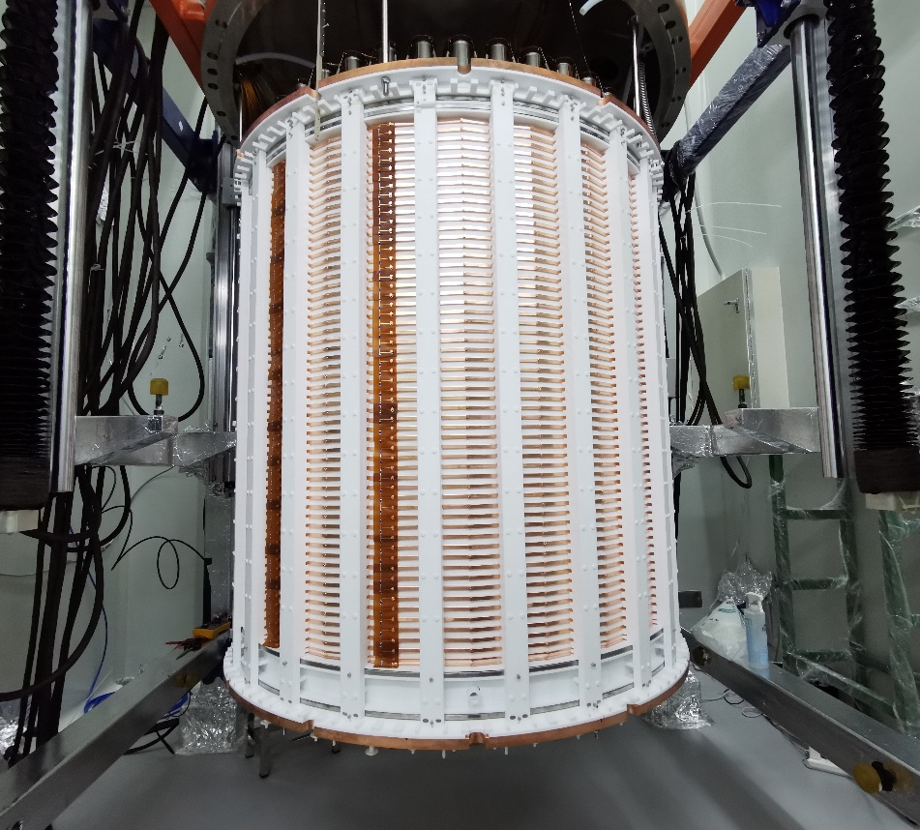
Search for Axions and Other New Physics
Signals with PandaX-4T
Xiaopeng Zhou, PandaX
轴子暗物质理论与观测研讨会 2025/5/10
Notes:
Good afternoon, everyone!
This is Xinning Zeng from PandaX,
and I am a PHD student from Shanghai Jiao Tong University.
Today, I’m very honored to be here to give a presentation about the physics research with PandaX-4T electron recoil data.

Slide 2
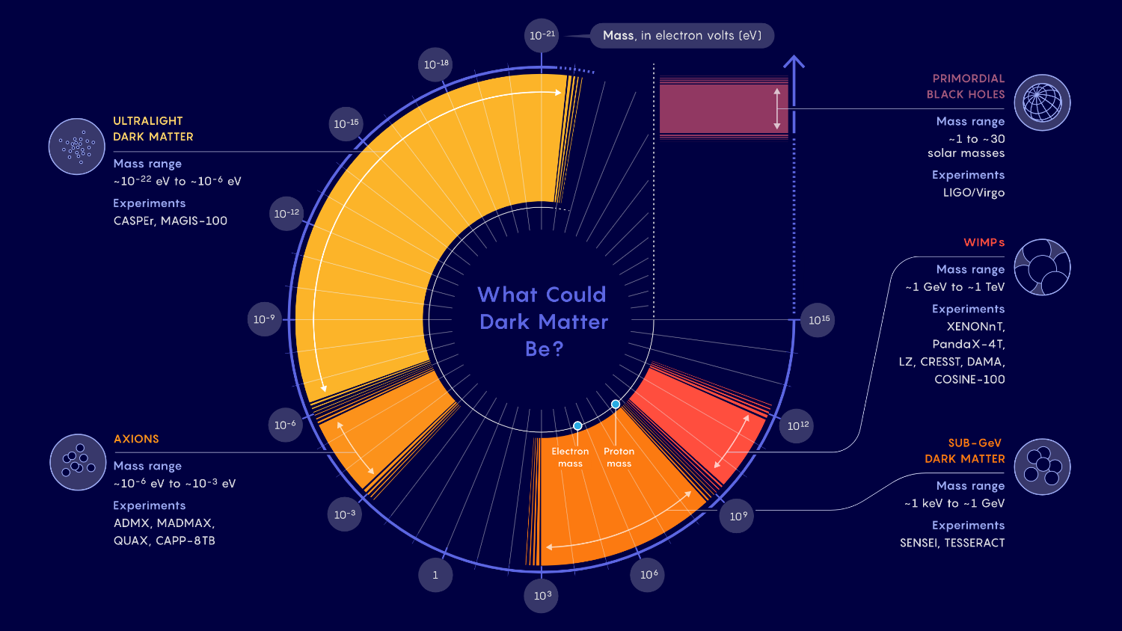
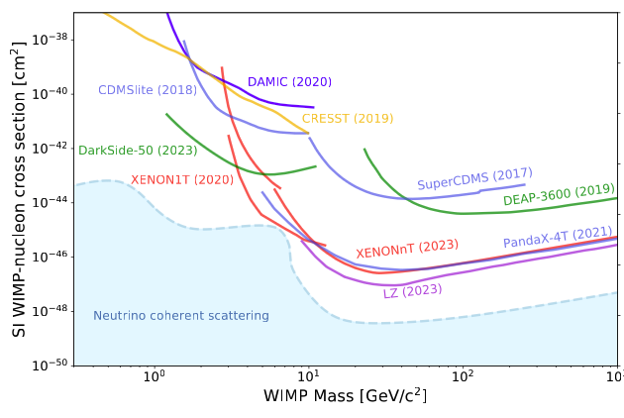
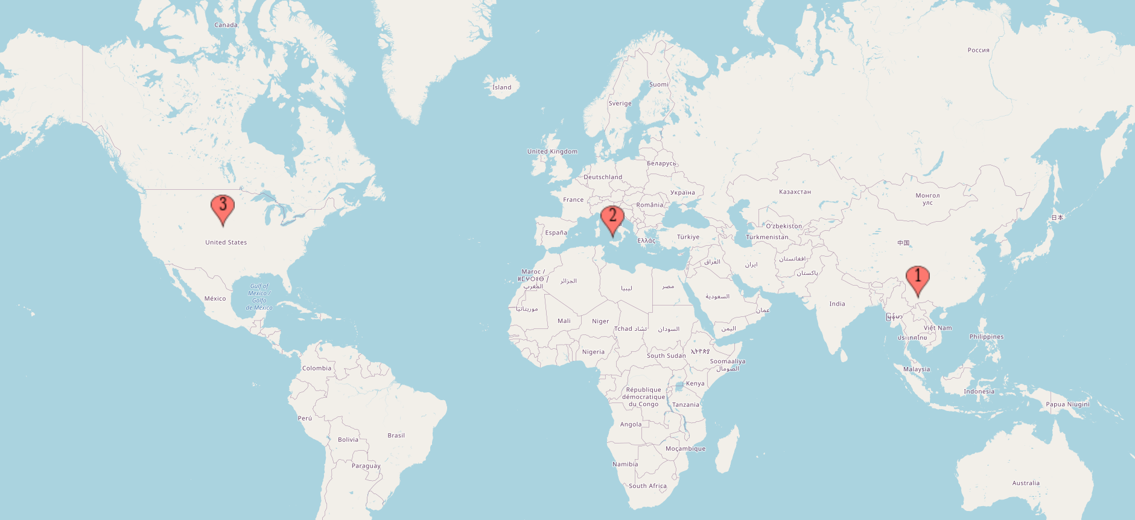
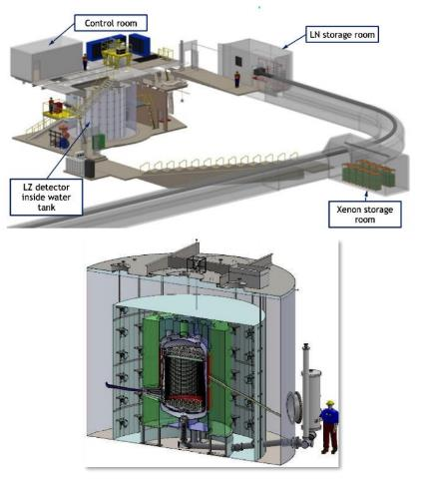
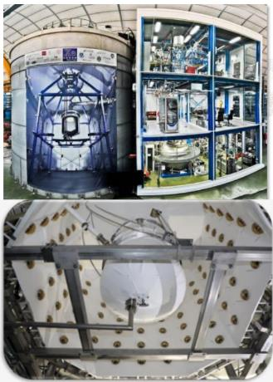
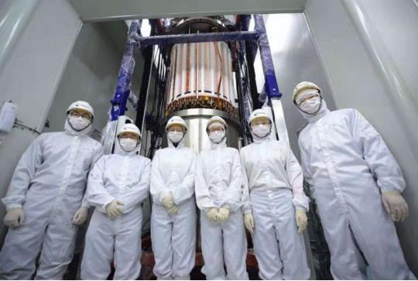
Dark Matter
Normal matter
Dark matter
Dark energy
XENON
LZ
PandaX
Notes:
The is brief introduction about PandaX, we located in China Jinping Underground Labratory and the detector is taking data now.

Slide 3
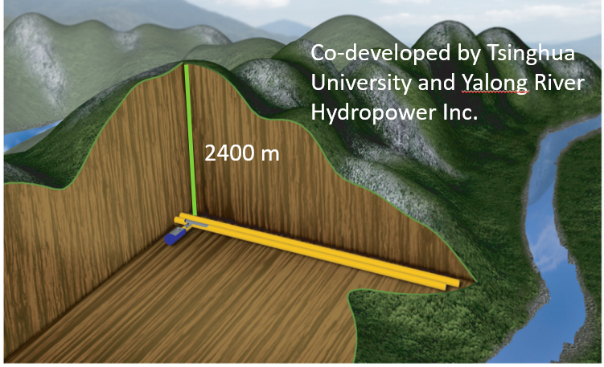
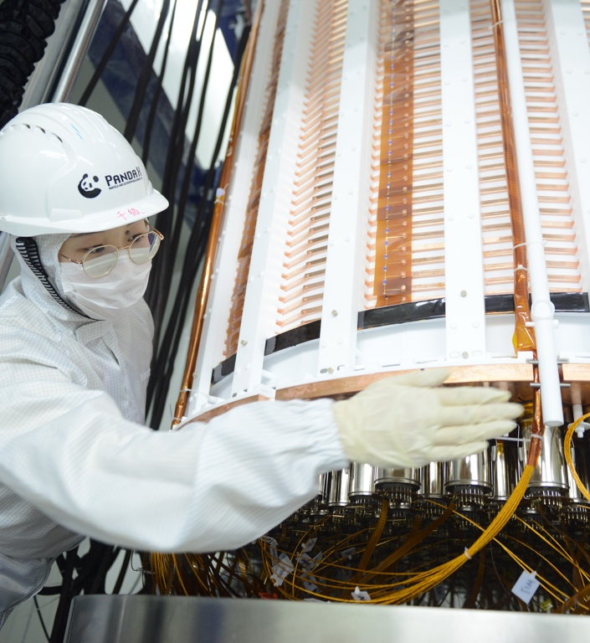
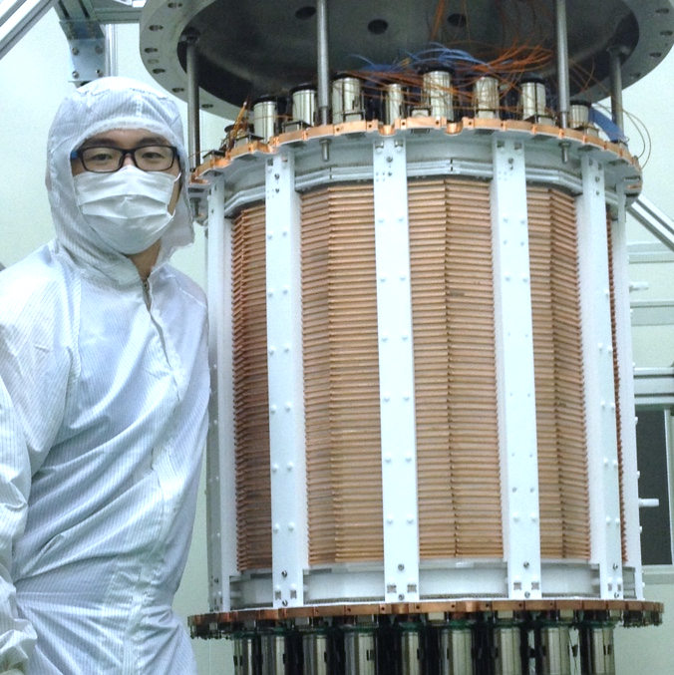
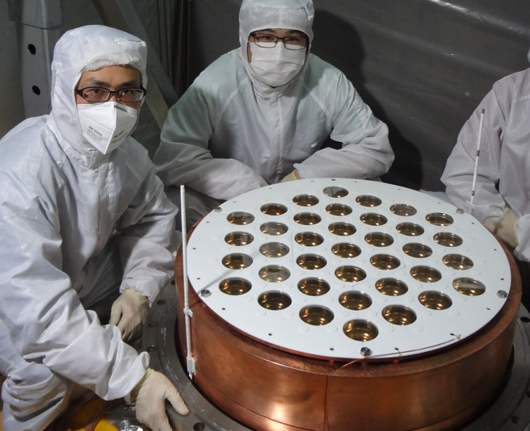
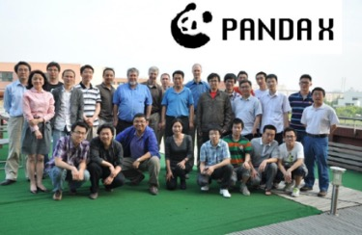
PandaX: Particle and Astrophysical Xenon Experiments
16 institutions, ∼100 collaborators
CJPL: Deepest (2400 m rock, 6800 m.w.e);
PandaX-4T data-taking is ongoing now.
PandaX-xT(20 ton)
PandaX-4T(3.7 ton)
China Jinping Underground
Laboratory (CJPL)
PandaX-II 580kg
PandaX-I 120kg
PandaX start
2009.3
2010 - 2014
2015 - 2019
2020 - Current
~ 2027
Notes:
The is brief introduction about PandaX, we located in China Jinping Underground Labratory and the detector is taking data now.

Slide 4
Dual-Phase Xenon Time Projection Chamber
Liquid Xenon Properities
Large atomic number Z = 54; High mass number ⟨A⟩ = 131.3
High density @ 177K, ⟨𝞺⟩ = 2.86 g/cm³
No long-lived radioisotopes in WIMP ROI
Efficient UV scintillator (178 nm)
Gas Xe
E_{g}
Liquid Xe
S2
DM
Liquid Xenon As DM Detection Medium
Maximised interaction cross section for WIMP (∝ A²)
High stopping power and self-shielding
Ultra-low intrinsic background
Scintillation and Ionization Combined: Discrimination of nuclear recoil and electron recoil; 3D position reconstruction
Scalable – further sensitivity improvement
E_{d}
S1
PMT array
https://indico.bnl.gov/event/9858/
Notes:
and we use the dual phase xenon time projection chamber.
The principlesof Dual-Phase Xenon Time Projection Chamber has been introduced by many previous talks, so I will just skip this one.

Slide 5
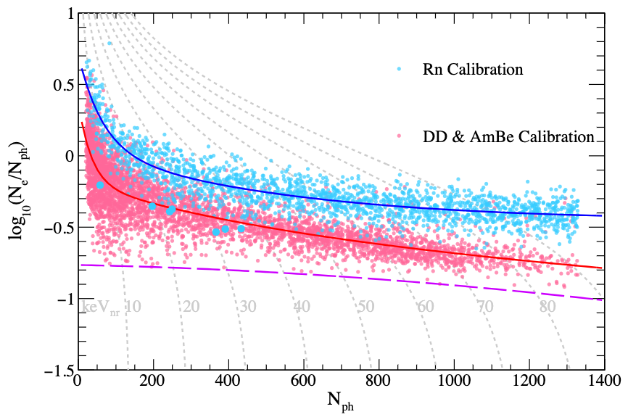
Nuclear Recoil V.S. Electron Recoil
S2
S1
ER
Time
Electron Recoil (ER)
S2
NR median
S1
NR
Time
Nuclear Recoil (NR)
The ratio: (S2/S1)_{ER} >> (S2/S1)_{NR} (NR has lower ionization rate but higher charge density);
Most of the backgrounds are ER events.
ER and NR response are calibrated separately: ²²⁰Rn (ER), DD + AmBe (NR);
Notes:
The Dual-Phase Xenon Time Projection Chamber is distinguished by its unprecedentable ability to discriminate between nuclear recoils and electron recoils.
Since most background signals manifest as electron recoils, this unique characteristic endows the chamber with unparalleled advantages in the search for WIMPs.
However, as detector technology advances and background suppression techniques improve, exploring the electron recoil region also holds promise for discovering new physics.
In the PandaX experiment, we employed an internal calibration source, Rn-220, to calibrate the electron recoil response. For nuclear recoil response calibration, we used external sources such as Deuterium-Deuterium neutrons and AmBe.
This figure presents the separations of the electron recoil and nuclear recoil calibration data.

Slide 6
Rich Physics with Electron Recoil Data
 | sub keV | 1keV | 10 keV | 100 keV | 1MeV | 10 MeV
¹³⁶Xe(~9%)
¹³⁴Xe(~10%)
¹²⁴Xe(~0.1%)
Natural Xenon
ALPs, DPs, boosted dark matters...
Solar Axion
Muons ...
Notes:
There are lots of valuable topics in electron recoil data, like the double weak decays, and also Solar axions, light dark matters like Axion-like particles and Dark photons.

Slide 7
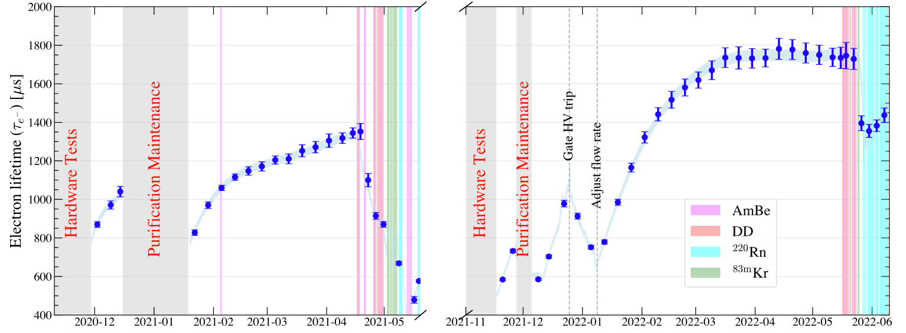
Data-taking of PandaX-4T
Run0
Run1
PandaX-4T has finished two phyiscs runs: Run0 and Run1, a total exposure of 1.54 ton⨉year after removed low-quality data;
Run0 results published @ 2021; Run0 + Run1 combined blind-analysis published @ 2025.
Notes:
PandaX-4T has finished two phyiscs runs: the Run0 and Run1,
After dedicated reconstructions and selections, a total exposure of 1.54 ton-year electron recoil data was obtained.
We published the results of the run0-only analysis in 2021, and earlier this year, we released the findings from the combined analysis of Run0 and Run1.

Slide 8
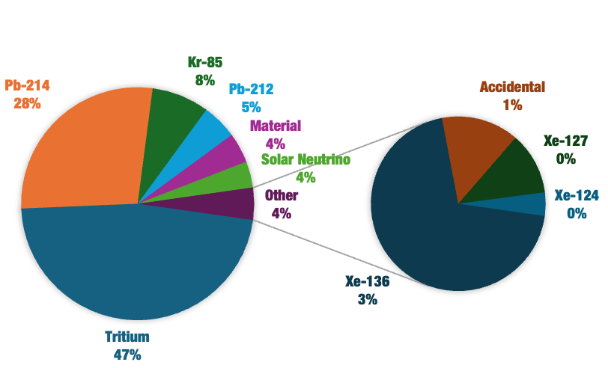
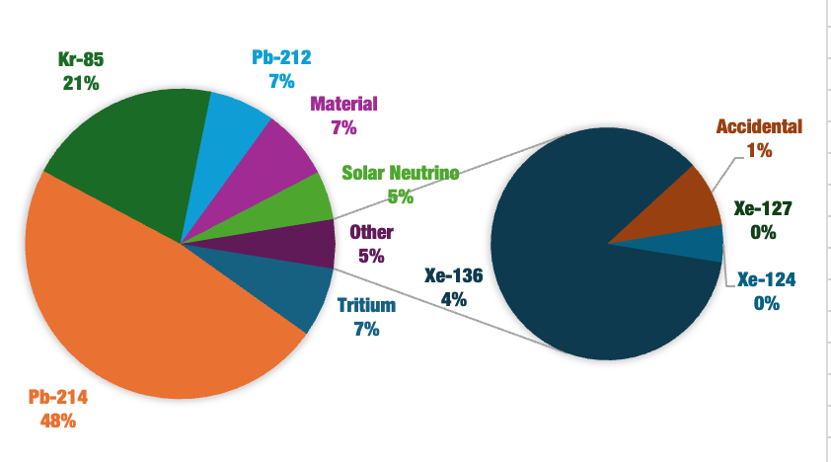
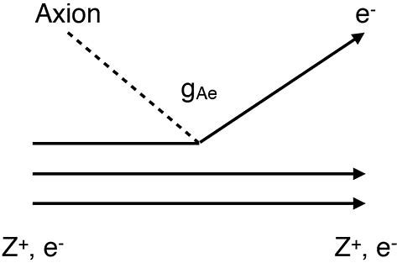
Background Model for keV region
Run0
Run1
Energy Region of Interest: S1 > 2 Photoelectrons (PE), E _{rec} < 30 keV, and ER 99.5% acceptance;
Background Composition: Tritium, ²¹⁴Pb, ⁸⁵Kr dominates the background level
Run0: 0.20 events/day/ton/keV Run1: 0.14 events/day/ton/keV
Xinning Zeng, PandaX (Shanghai Jiao Tong University)
Notes:
Solar axions will deposit energy on the scale of keV in our detector;
for instance, through the so-called axio-electric effect.
In this process, akin to the photo-electric effect, an axion is absorbed and an electron is ionized.
To search for such signals, we restricted the energy range to 30 keV. This allows better control of backgrounds like Pb-214 and avoids backgrounds from other sources like Xe-127.
Here, shows he background compositions for Run0 and Run1.
As can be seen, the key contributions come from Tritium, Pb-214, and Kr-85.
especially for run 0 tritium contribute nearly 50% of the background.

Slide 9
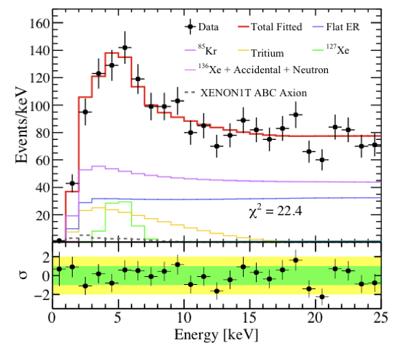
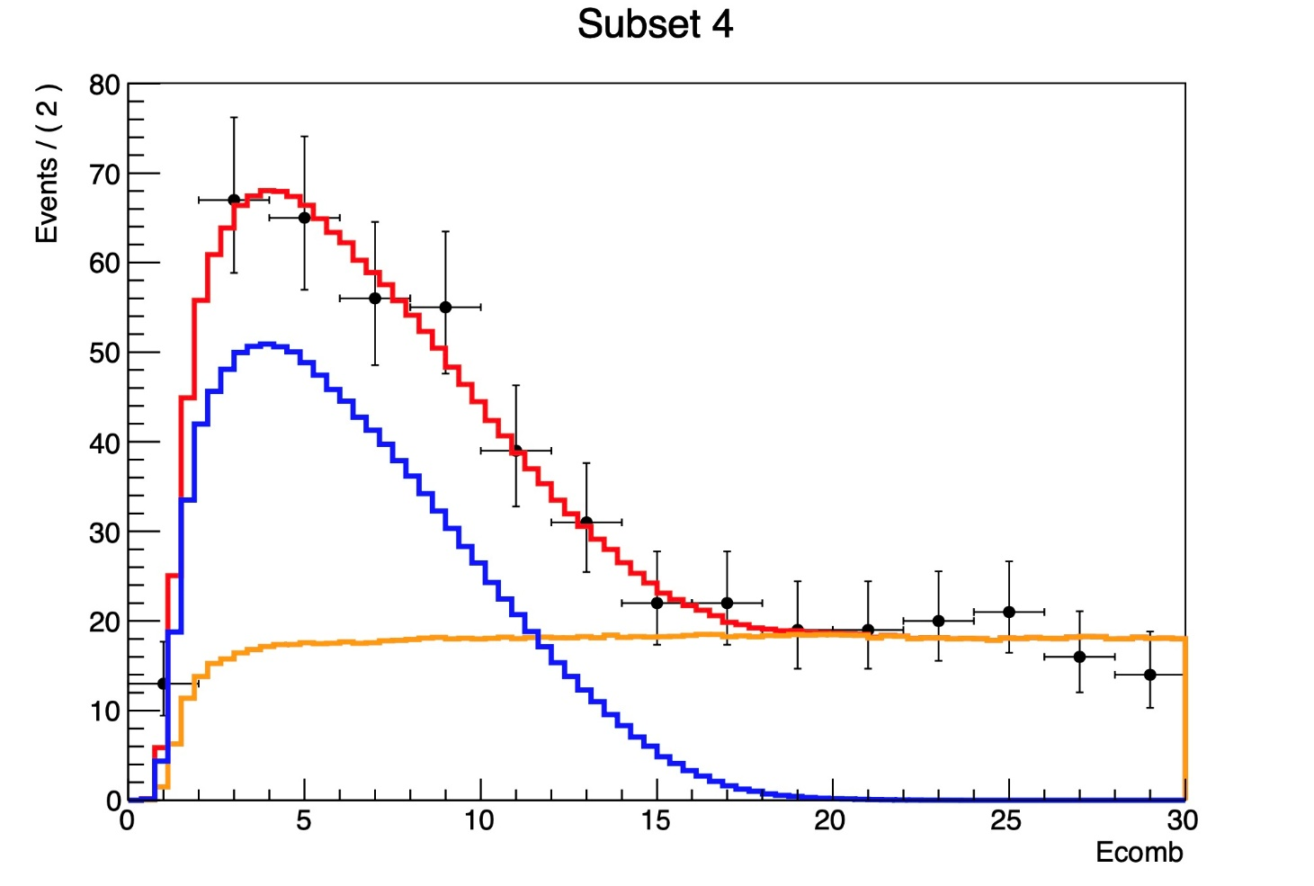
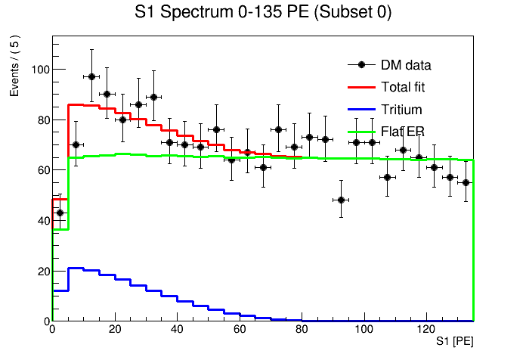
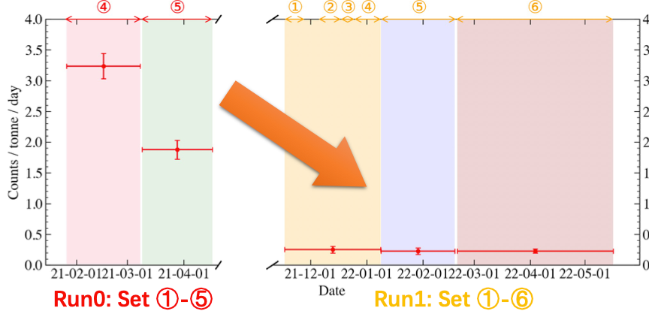
Tritium
Toy fit – only
Tritium + flat background
PandaX-II Full Exposure
PandaX-4T Run0
PandaX-4T Run1
E_{rec} (keV)
Tritium spectrum identified in the data;
Likely originated from the tritium calibration at the end of PandaX-II；
Estimation of tritium level in Run 1: fitting S1 spectrum, keeping S2 blinded (Set to free in fit ).
Xinning Zeng, PandaX (Shanghai Jiao Tong University)
Notes:
The tritium in PandaX-4T, is likely stemming from the tritium calibration at the end of PandaX-II.
Given tritium's 12-year half-life, it continues to contribute in Run1.
To estimate the tritium rate, we performed an S1 toy-fit with S2 blinded.
Rest assured, this estimation doesn't compromise the blind analysis, as tritium is set free in subsequent fitting.
The results show that tritium in Run1 has decreased by about five times compared to Run0.

Slide 10
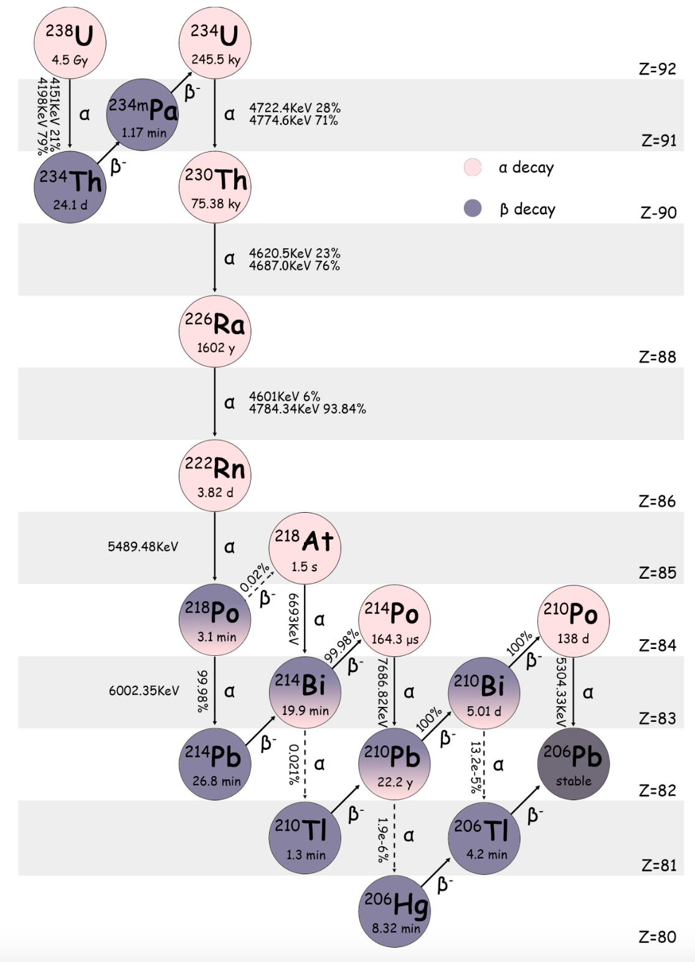
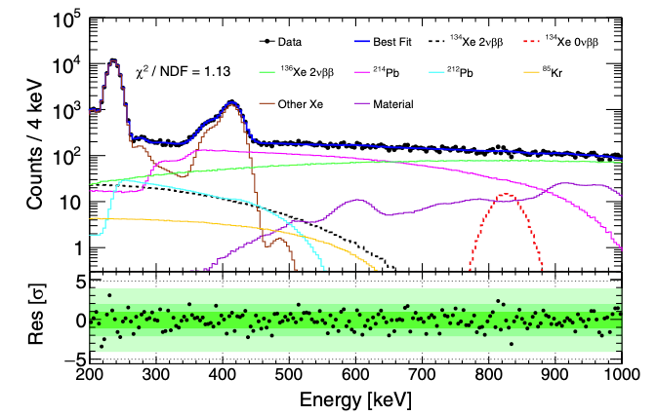
Radon
Raw Charge
Corrected Charge
Rn level | μBq/kg
Run 0 | 7.07 ± 0.02(stat.) ± 0.23(sys.)
Run 1 | 8.67 ± 0.01(stat.) ± 0.27(sys.)
Depletion effect: decreased concentration of longer-lived daughter nuclide compared to the parent;
Side band fit to determine exact contribution: from 200 keV to 1000 keV.
Xinning Zeng, PandaX (Shanghai Jiao Tong University)
Notes:
Pb-214 originates from the Rn-222 decay chain, dissolving in liquid xenon and proving difficult to eliminate.
After a series of corrections, particularly an additional one to eliminate the vertical dependence between S1 and drift time,
the alphas from Rn-222 and Po-218 can be seprated, and the activity of Rn can be precisely estimated.
Run1 Rn level is slightly higher than run0, likely due to the replacement of the diaphragms of the circulation pump.
However, due to daughter nucleus depletion, Rn-222 activity cannot directly represent Pb-214 activity.
This depletion effect is associated with the movement of charged daughter ions.
Therefore, we use Rn-222 as input and fit the exact activity using the 200 keV - 1 MeV energy spectrum.

Slide 11
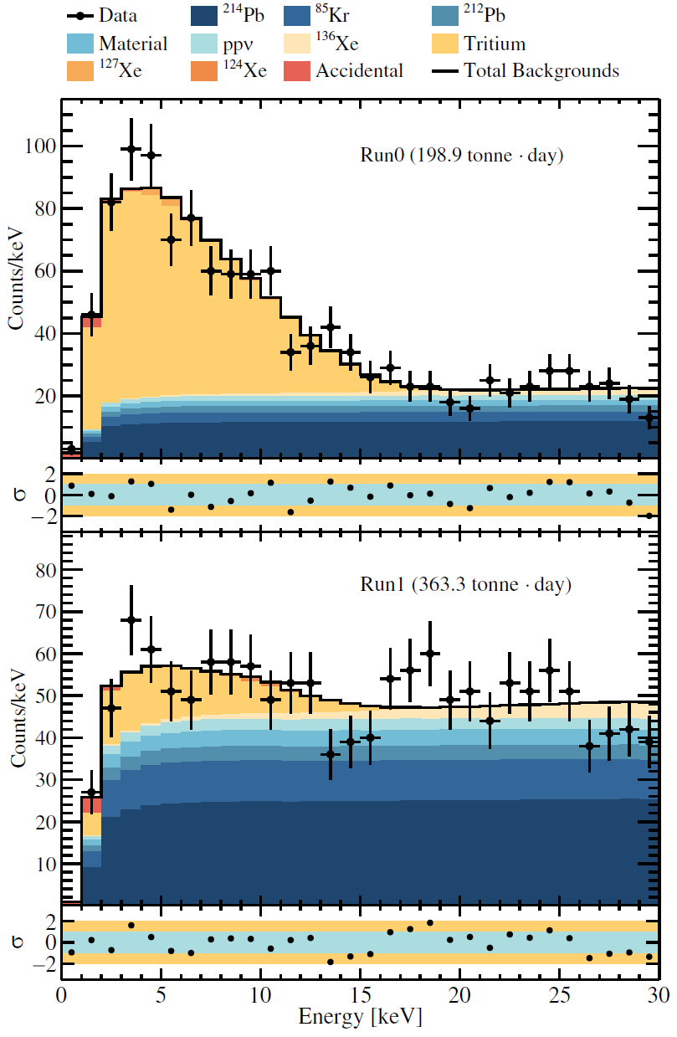
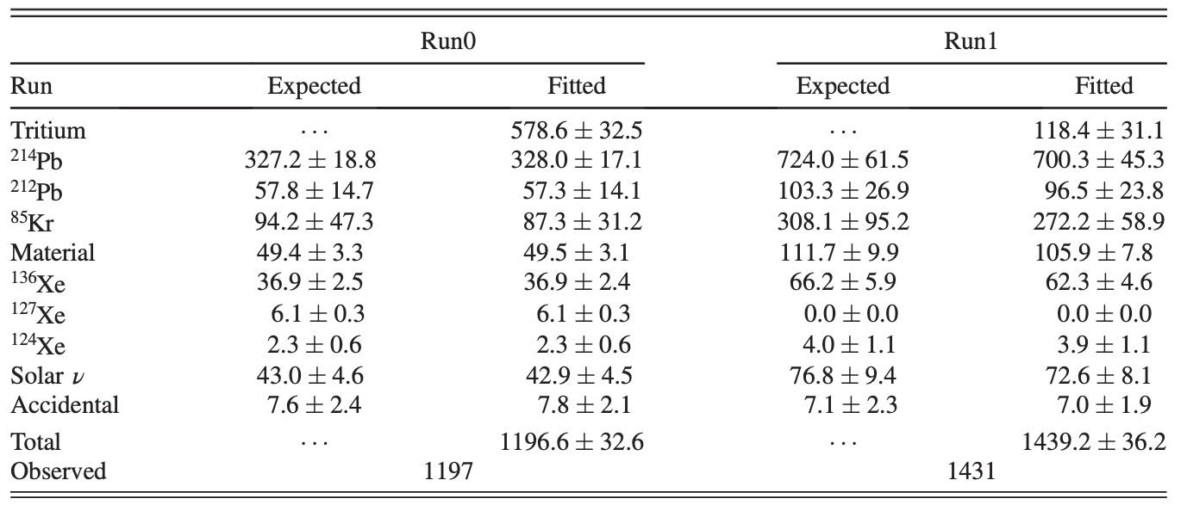
Best-fit of keV Background Model
A combined fit of Run0 and Run1 in 1D energy space;
Tritium is set to free in fit;
No excess found: consistent with background model (p-value = 0.16).
Xinning Zeng, PandaX (Shanghai Jiao Tong University)
Notes:
All other backgrounds were independently estimated, with results presented in the table.
We performed a combined fit for Run0 and Run1 in the 1D energy space using the maximum likelihood method.
The fit results indicate no significant excess, aligning with our background model with a p-value of 0.16;

Slide 12
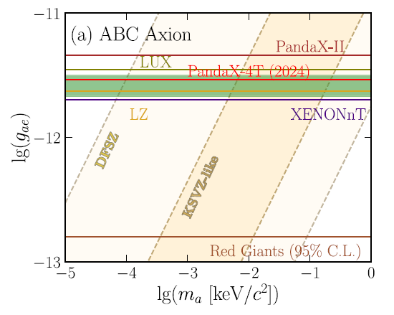
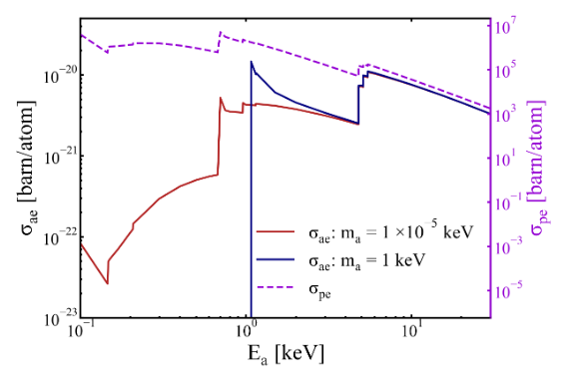
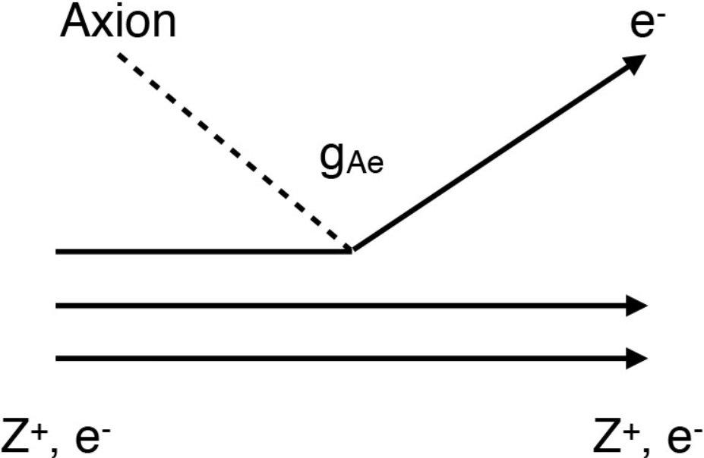
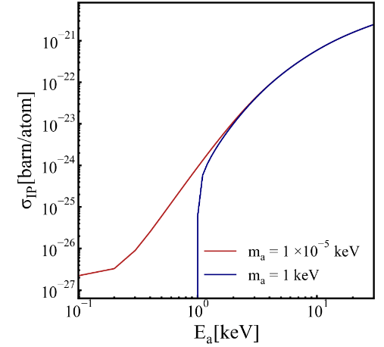
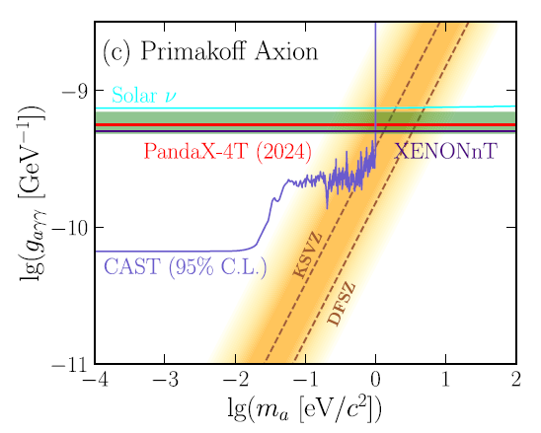
Solar Axions
axio-electric
inverse Primakoff
Phys. Rev. Lett. a134, 041001
Xinning Zeng, PandaX (Shanghai Jiao Tong University)
Notes:
In addition to the previously mentioned axio-electric effect, another detection channel, the inverse Primakoff effect via the g-a-gamma-gamma interaction, is also considered.
In this process, an axion interacts with an atom's entire electromagnetic field, converting into a gamma that deposits energy in the detector.
We utilize these two detection channels to independently test g-a-e and g-a-gamma-gamma.
The figure here presents the model-independent limits.

Slide 13
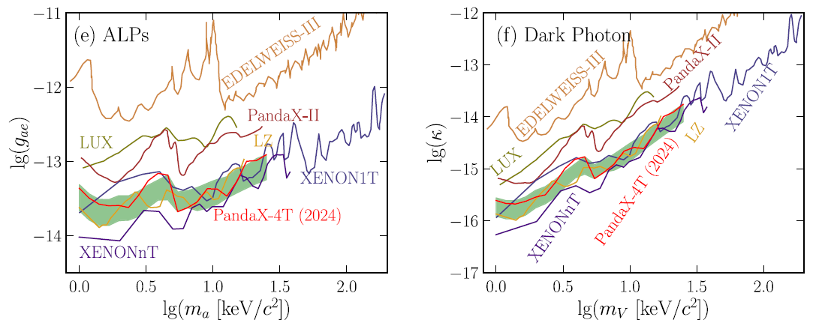
Light Dark Matters
Light Dark matter searching: Mono-energetic signals scan.
Axionlike Particles (ALPs) and Dark Photons (DPs)
Fermionic Dark Matter
Data fluctuation yields a 1.9𝛔 (local) excess @ 3-5 keV;
Phys. Rev. Lett. 134, 041001
Xinning Zeng, PandaX (Shanghai Jiao Tong University)
Notes:
We've also explored light dark matter signals from axion-like particles (ALPs), dark photons, and Fermionic dark matter - neutrino conversions.
Given these signals' mono-energetic or quasi-mono-energetic nature, we conducted a mass scan.
The results show a 1.9-sigma local significance excess at 3 - 5 keV, Which is more likely attributable to local fluctuations.

Slide 14
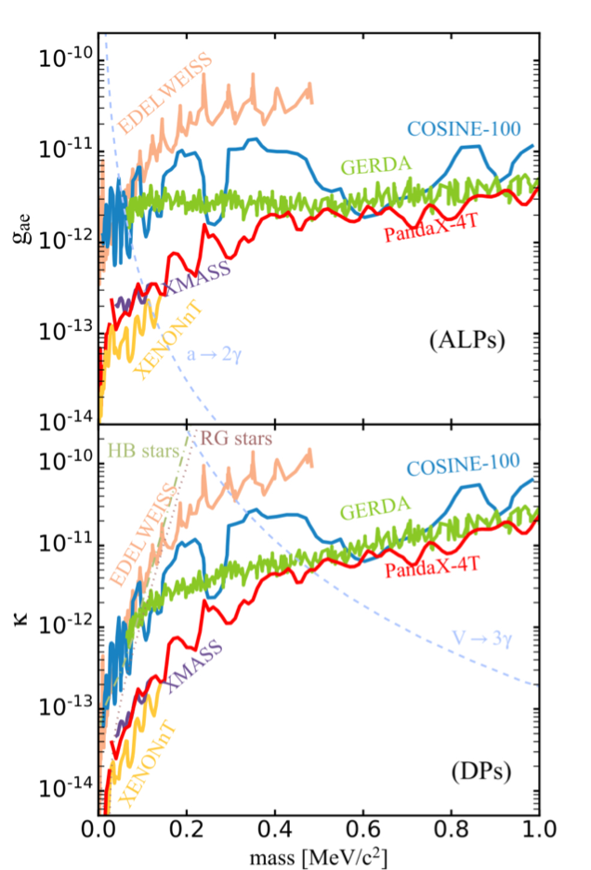
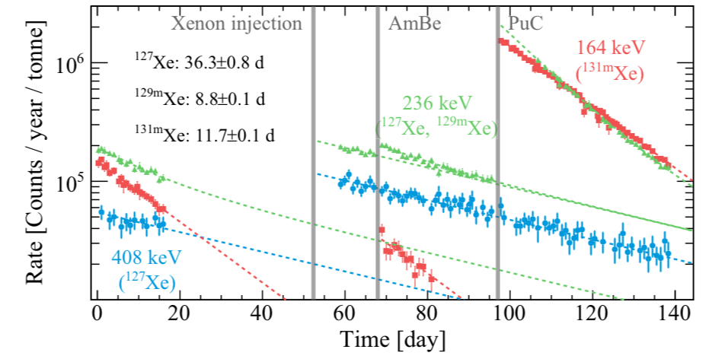
MeV ALPs and DPs
Phys. Rev. Lett. 134, 071004
Xinning Zeng, PandaX (Shanghai Jiao Tong University)
Notes:
We've also explored light dark matter signals from axion-like particles (ALPs), dark photons, and Fermionic dark matter - neutrino conversions.
Given these signals' mono-energetic or quasi-mono-energetic nature, we conducted a mass scan.
The results show a 1.9-sigma local significance excess at 3 - 5 keV, Which is more likely attributable to local fluctuations.

Slide 15
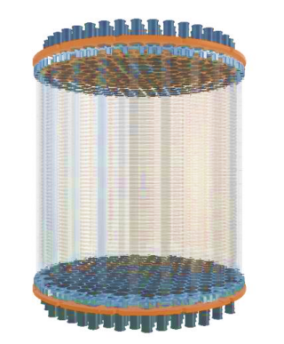
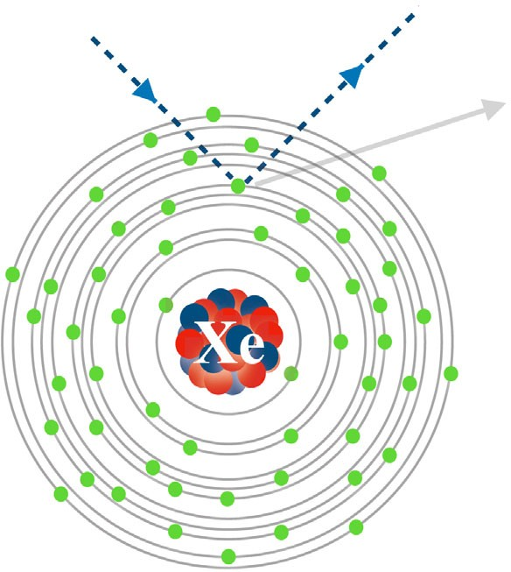
Solar Boosted Dark Matter
Light Dark Matter scattering off free electrons in the Sun generates a new (more energetic) component of the flux impinging on the Earth.
Dark Matter mass:
10keV-10MeV
Energy deposition:
10 to ~10³eV
Sun
keV range
Solar electrons
Xinning Zeng, PandaX (Shanghai Jiao Tong University)
Notes:
for these light DM particle , it can be boosted by the cosmic ray 、the sun and other mechanism. For lighter DM like 10keV to 10MeV, for these DM , Dark matter scattering off free electrons in the Sun generates a new (more energetic) component of the flux impinging on the Earth and hit the Xenon target. The energy deposition can exceed PandaX-4T threshold.(1kV)

Slide 16
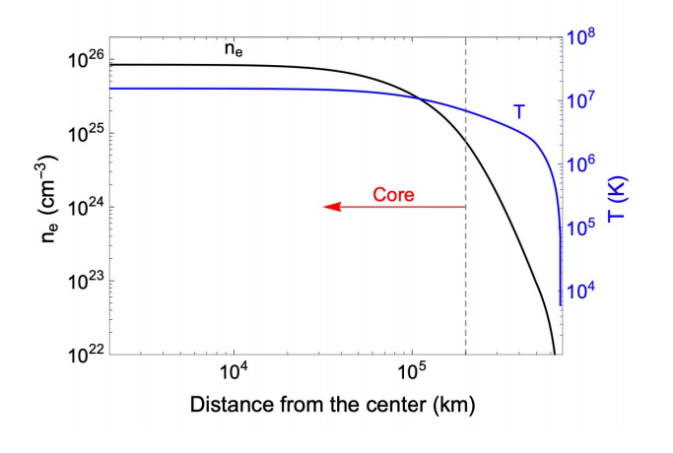
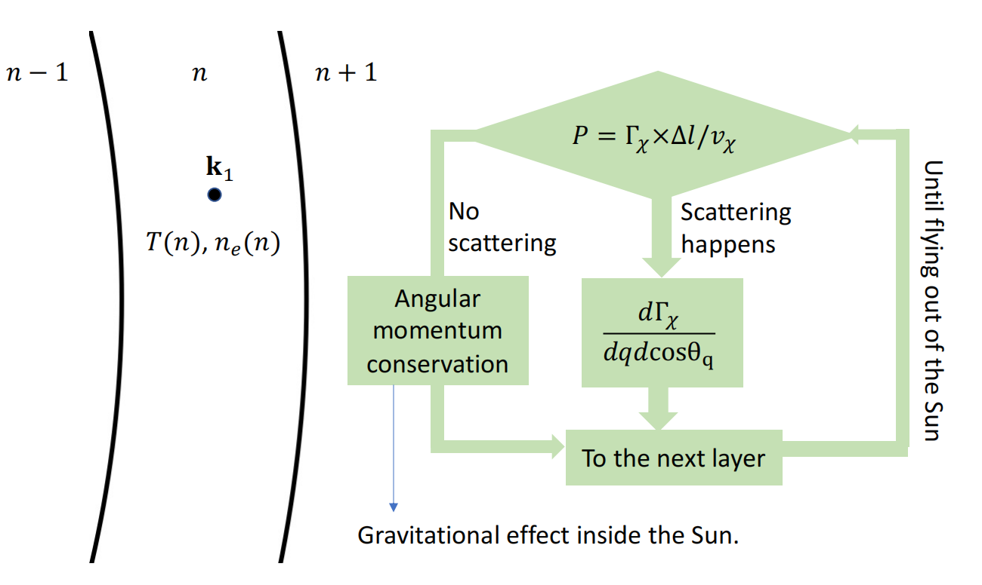
Solar Boosted Dark Matter
arxiv：2108.10332v2
The details of the simulation
Assume the temperature and electron density distributions are isotropic.
divide the Sun into slices. The collision probability in each slice is much smaller than one.
Gravitational effect—consider the effective R = 4R_sun
Xinning Zeng, PandaX (Shanghai Jiao Tong University)
Notes:
for these light DM particle , it can be boosted by the cosmic ray 、the sun and other mechanism. For lighter DM like 10keV to 10MeV, for these DM , Dark matter scattering off free electrons in the Sun generates a new (more energetic) component of the flux impinging on the Earth and hit the Xenon target. The energy deposition can exceed PandaX-4T threshold.(1kV)

Slide 17
Solar Boosted Dark Matter
Target density
Target density of Xenon
Sigma e
Reference cross section
Solar Reflected DM Flux
Normalized distribution per eV
Ionization Form Factor
Depends on momentum transfer q and final state electron momentum.
DarkART （used）same as CRBDM
Dark Matter Form Factor
F_{DM} = 1 heavy mediator(contact interaction)
F_{DM} ~ 1/q² light mediator
Xinning Zeng, PandaX (Shanghai Jiao Tong University)
Notes:
for these light DM particle , it can be boosted by the cosmic ray 、the sun and other mechanism. For lighter DM like 10keV to 10MeV, for these DM , Dark matter scattering off free electrons in the Sun generates a new (more energetic) component of the flux impinging on the Earth and hit the Xenon target. The energy deposition can exceed PandaX-4T threshold.(1kV)

Slide 18
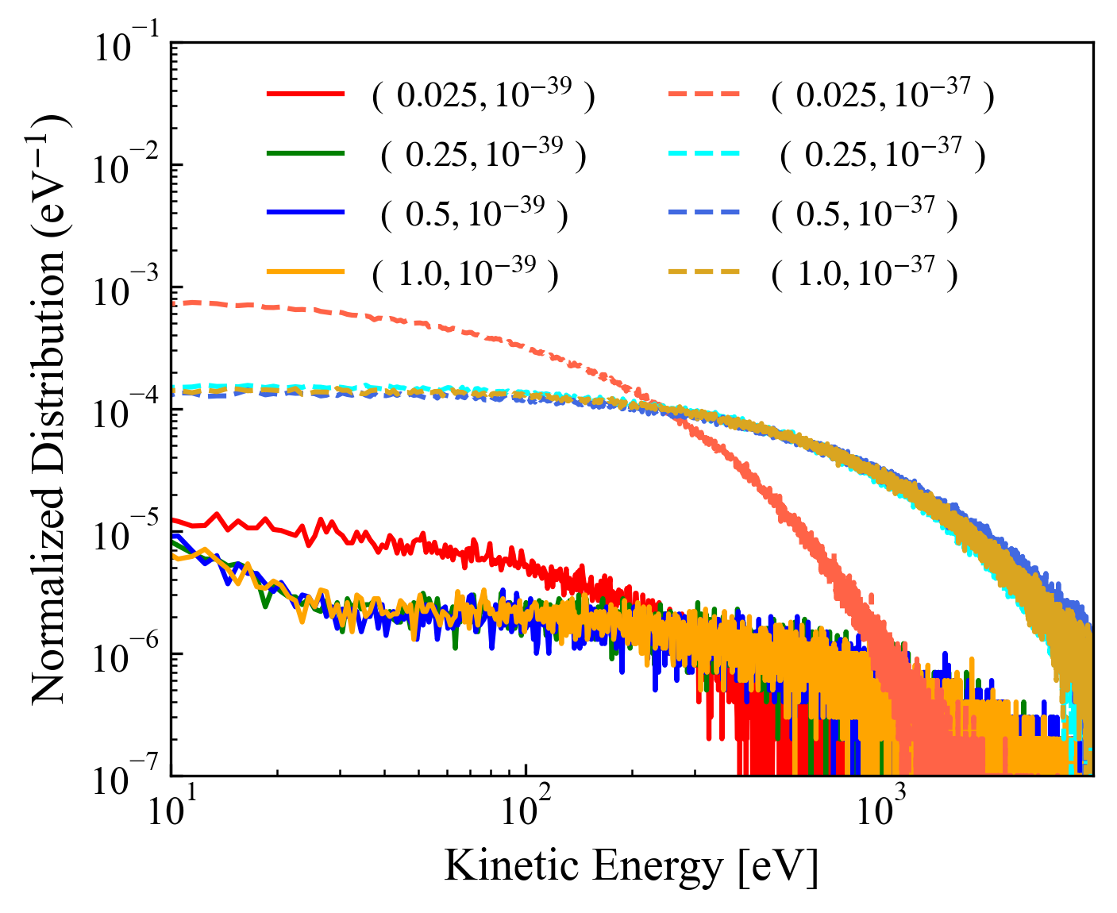
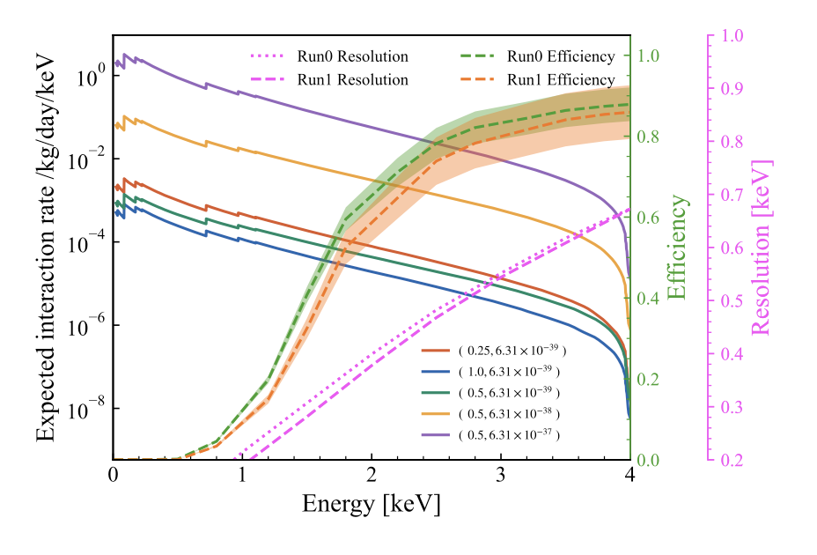
Solar Boosted Dark Matter
Target density
Target density of Xenon
Sigma e
Reference cross section
Solar Reflected DM Flux
Normalized distribution per eV
Ionization Form Factor
Depends on momentum transfer q and final state electron momentum.
DarkART （used）same as CRBDM
Dark Matter Form Factor
F_{DM} = 1 heavy mediator(contact interaction)
F_{DM} ~ 1/q² light mediator
Xinning Zeng, PandaX (Shanghai Jiao Tong University)
Notes:
for these light DM particle , it can be boosted by the cosmic ray 、the sun and other mechanism. For lighter DM like 10keV to 10MeV, for these DM , Dark matter scattering off free electrons in the Sun generates a new (more energetic) component of the flux impinging on the Earth and hit the Xenon target. The energy deposition can exceed PandaX-4T threshold.(1kV)

Slide 19
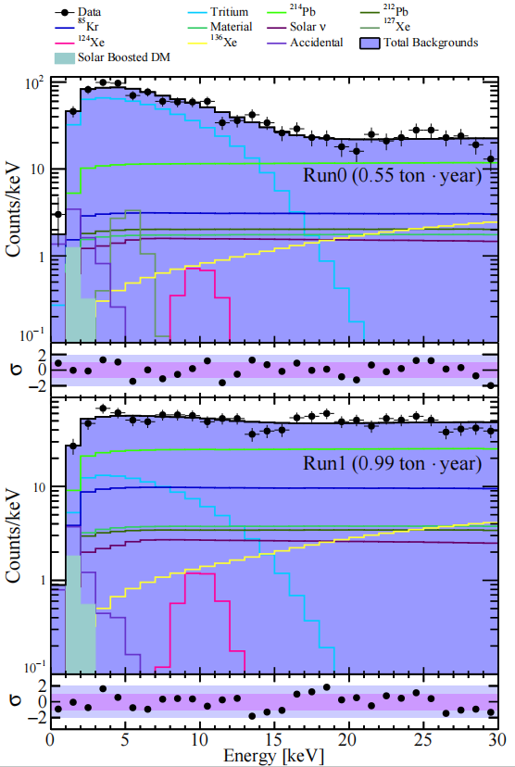
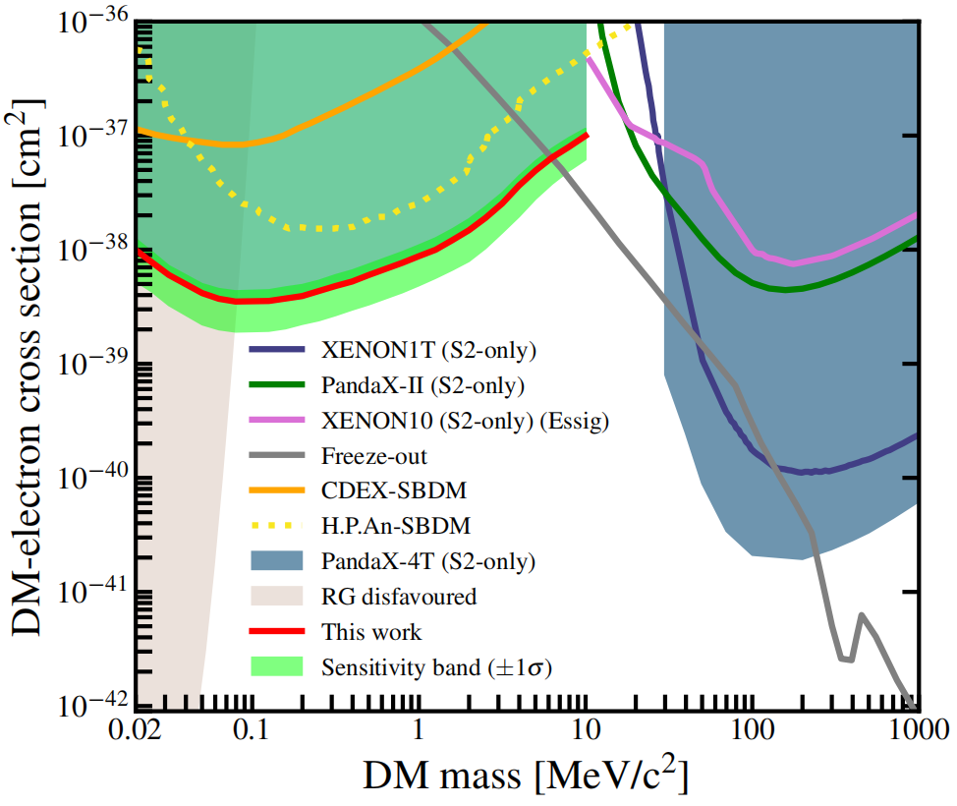
Solar Boosted Dark Matter
Phys. Rev. Lett. 134, 161003
Xinning Zeng, PandaX (Shanghai Jiao Tong University)
Notes:
for these light DM particle , it can be boosted by the cosmic ray 、the sun and other mechanism. For lighter DM like 10keV to 10MeV, for these DM , Dark matter scattering off free electrons in the Sun generates a new (more energetic) component of the flux impinging on the Earth and hit the Xenon target. The energy deposition can exceed PandaX-4T threshold.(1kV)

Slide 20
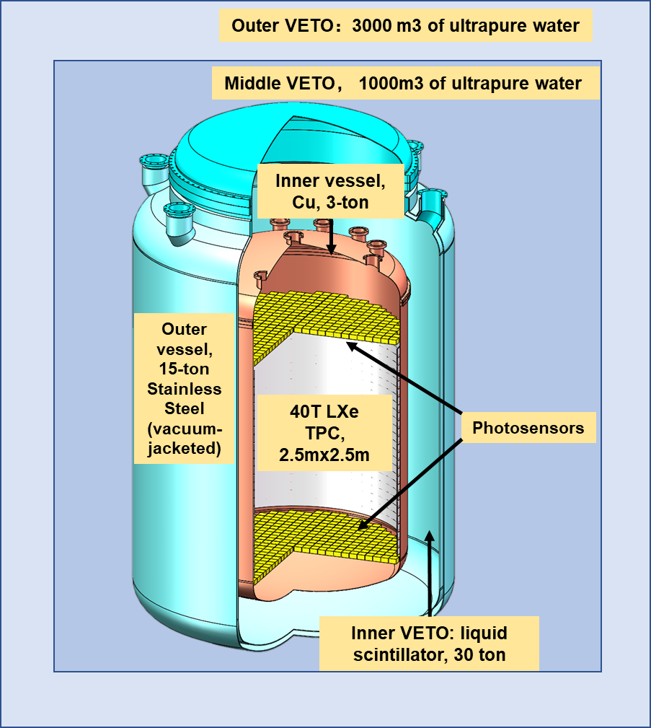
Solar Boosted Dark Matter
47-ton xenon, including 43-ton sensitive volume
2.7 meters in diameter and height
Eliminate LXe veto
Cold LS veto right outside Cu cryostat
Staged and upgradable
Dual-phase or single-phase options
Xinning Zeng, PandaX (Shanghai Jiao Tong University)
Notes:
for these light DM particle , it can be boosted by the cosmic ray 、the sun and other mechanism. For lighter DM like 10keV to 10MeV, for these DM , Dark matter scattering off free electrons in the Sun generates a new (more energetic) component of the flux impinging on the Earth and hit the Xenon target. The energy deposition can exceed PandaX-4T threshold.(1kV)

Slide 21
Backup
Xinning Zeng, PandaX (Shanghai Jiao Tong University)
Notes:
for these light DM particle , it can be boosted by the cosmic ray 、the sun and other mechanism. For lighter DM like 10keV to 10MeV, for these DM , Dark matter scattering off free electrons in the Sun generates a new (more energetic) component of the flux impinging on the Earth and hit the Xenon target. The energy deposition can exceed PandaX-4T threshold.(1kV)

Slide 22
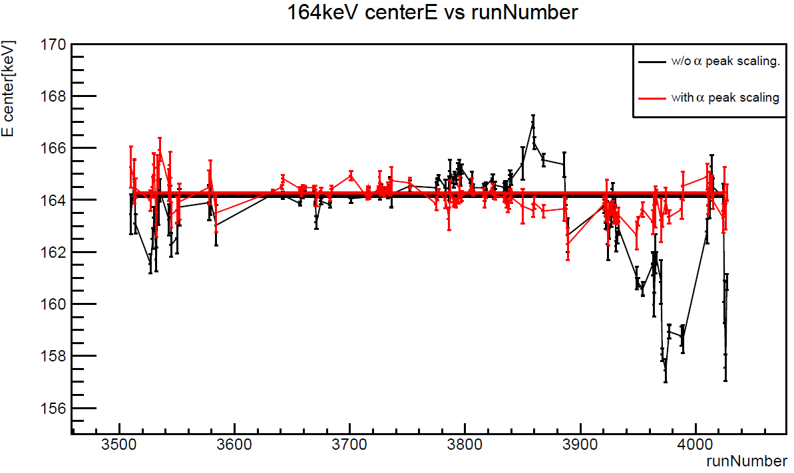
Updates in Data Reconstruction
Additional 10 top PMTs turn-off
Degrading of PMTs: LED-calibration to Self-calibration
Temporal variation of signal yield
Event builder: Fix-window and S1 quality in prior
others ......
after self-calibration
164 keV from ^{131m}Xe
Phys. Rev. D 110, 023029
LED calibration vs Self-calibration
Xinning Zeng, PandaX (Shanghai Jiao Tong University)
Notes:
Compared to the Run0-only analysis, numerous updates have been implemented in the combined analysis of Run0 and Run1.
For instance, in terms of low-level processes, the PMT-gain calibration has transitioned from LED calibration to self-calibration due to PMT degradation.
As evident from the results, the self-calibration method evolves smooothly, compared to the weekly LED calibration.
Additionally, we identified certain temporal instabilities in the signal yield and utilized mono-energetic peaks to correct these temporal variations.
Furthermore, improvements have been made to the event building and quality selection processes.

Slide 23
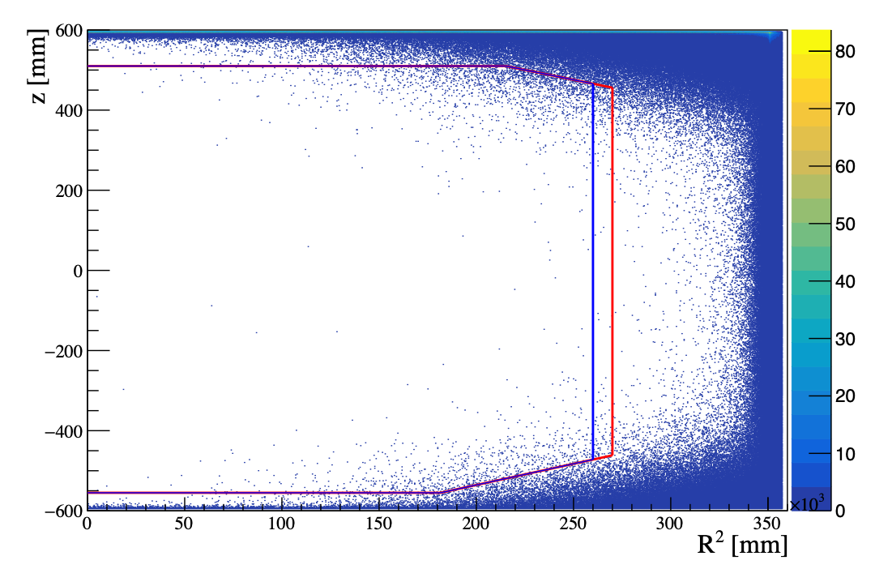
Building the Background Model
1. Material Screening and Geant4-based Simulation
HPGe, ICP-MS, etc
BambooMC
2. Fiducial Volume and Quality Selection
r - dependent material background
S1/S2 pulse shape and hit pattern
Run0
Run1
3. Side band analysis:
high energy alphas in decay chain
spectrum fitting in high energy: uncertainty reduction
Xinning Zeng, PandaX (Shanghai Jiao Tong University)
Notes:
uncertainties from HPGe is large, side band can help to reduce. [a figure to show???]

Slide 24
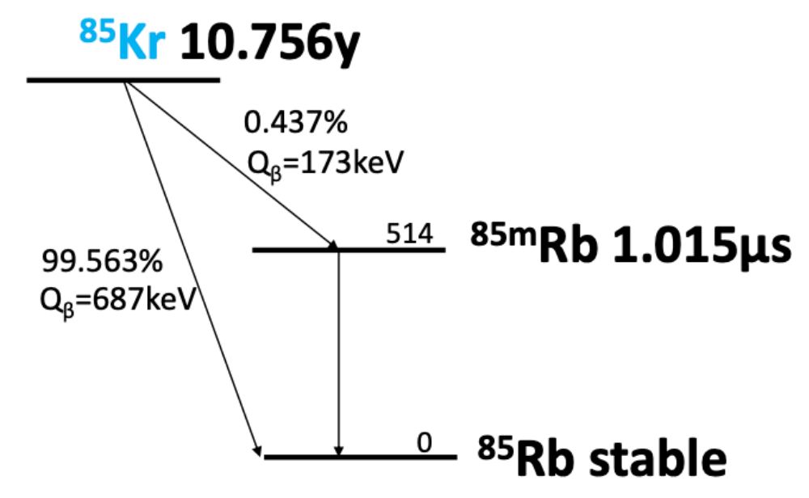
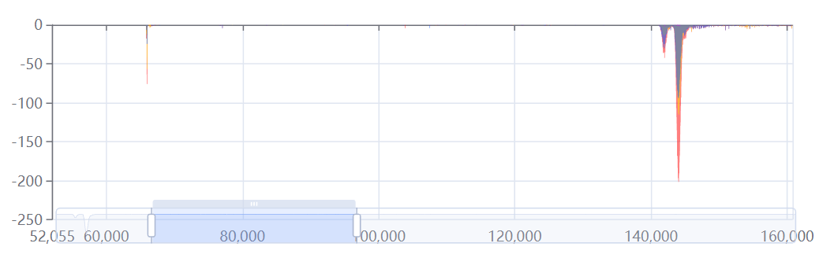
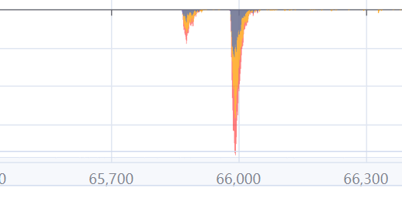
Krypton
⁸⁵Kr 10.75y
 |  | accidental events | Kr/Xe [ppt (10⁻¹²)]
Run0 | 4 | 0.14 ± 0.04 | 0.5 ± 0.3
Run1 | 12 | 0.25 ± 0.05 | 0.9 ± 0.3
Run0
Run1
^{85m}Rb 1.015μs
⁸⁵Rb stable
a typical waveform
β S2
β S1
γ S1
γ S2
Xinning Zeng, PandaX (Shanghai Jiao Tong University)

Slide 25
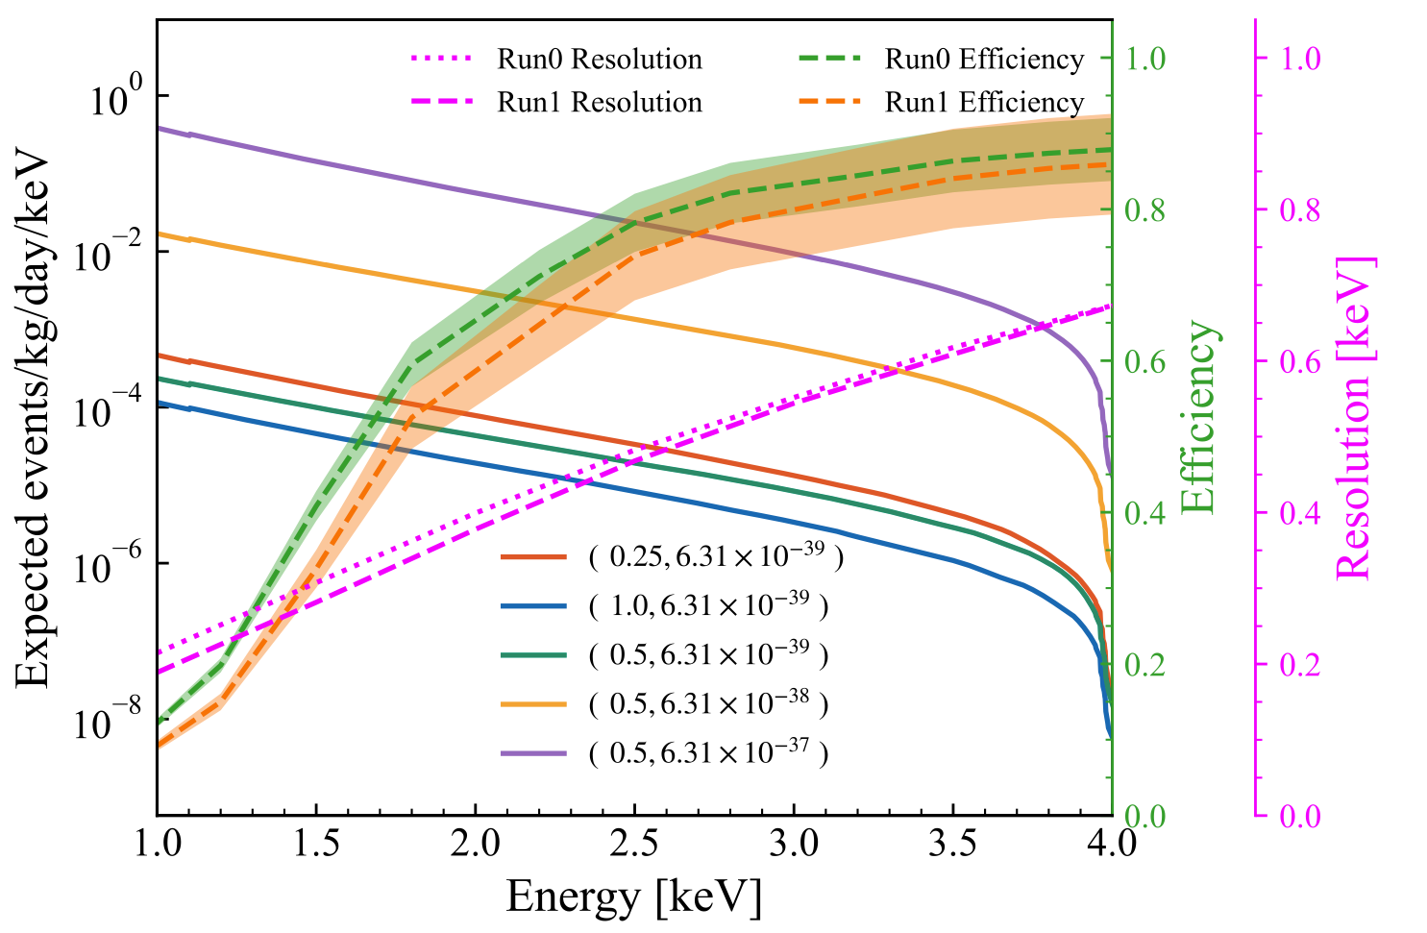
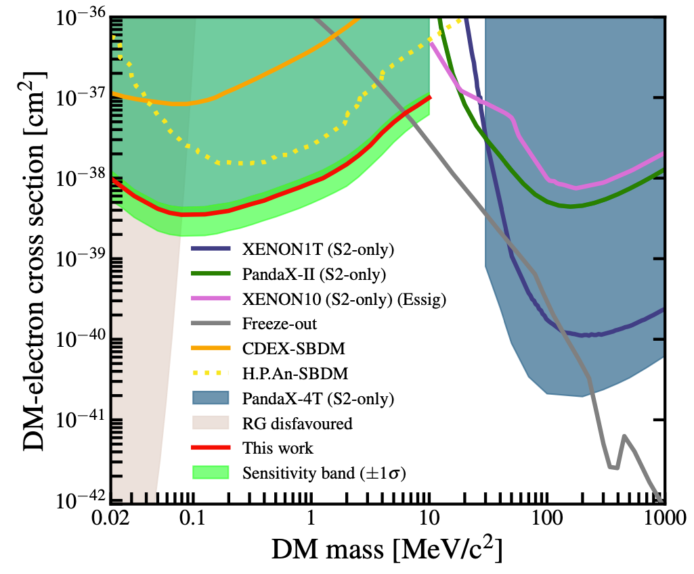
Solar Boosted Dark Matter
Assume the temperature and electron density distributions are isotropic;
The first experimental search results using the xenon detector yield the most stringent cross-section for mass ranging from 0.02 to 10 MeV/c², (23 fold improvement compared with earlier studies)
arXiv:2412.19970
Xinning Zeng, PandaX (Shanghai Jiao Tong University)
Notes:
Briefly introduction of the process of DM accelerated in the sun. The thermal plasma inside the Sun is composed of electrons and ions
Assume the temperature and electron density distributions are isotropic.
Now just consider the DM interacts with electrons. DM could be accelerated by the electrons inside the sun.
The energetic energy could reach to 5 keV, above the 1keV can meet pandaX-4T threshold and have large flux. For 0.025MeV when hits Xe, it can obtain a little kinetic energy,, but the number density is more. So in the low energy ,the flux is large then others.

Slide 26
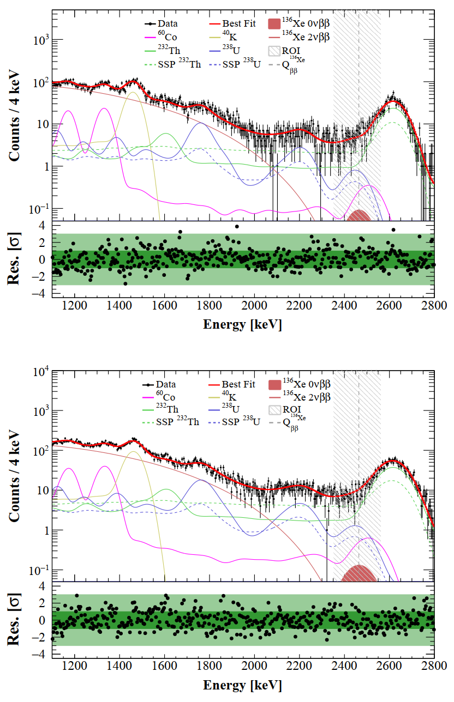
Neutrinoless Double Beta Decay of Xe-136
Improvement to our previous PandaX-II results by an order of magnitude and to the XENON1T results by a factor of 1.8
Science Bulletin, 2025.03.009
Xinning Zeng, PandaX (Shanghai Jiao Tong University)

Slide 27
arXiv:2411.14355
Xinning Zeng, PandaX (Shanghai Jiao Tong University)
Notes:
In addition to the dark matter and dark matter related analysis, the PandaX-4T detector can actually do a lot of other physics. For example, double beta decays. Here, I'll use Xe-124 as an example, because this is my own work. I'll give you a brief introduction on measuring the half-life of the two-neutrino double electron capture(2𝝊DEC) of Xe-124 using pandax-4t.
This process is allowed by the Standard Model, and signal is featured by the two blue peaks in the spectrum, between 25 to 75 keV, which is our ROI.
The biggest challenge in this analysis is the Iodine-125 background, which are the purple peaks near here. The concentration of Iodine-125 in the detector can change over time. So, we developed a time-dependent background model and performed a two-dimensional likelihood fit in energy and time.
With the estimation of background in this region, the final fit results are shown here, with projection on energy and time axes. From here we can see how the time dependent backgrounds are modeled.
The measured half-life, represented here by the red band, is compared with both theoretical calculations the and recent results from XENON-nT and LZ. And it is consistent with others.
Getting this precise measurement of this process can act as a reference point for many nuclear matrix element (NME) calculation methods. Plus, it’s pretty much the foundation for detecting neutrino-less double electron capture of Xe-124.
Looking ahead, we’re planning to go further in this direction by studying other decay channels and search for the neutrino-less modes of Xe-124 in PandaX detector.
[13min]

Slide 28
Cosmic-Ray Boosted Dark Matter
Cosmic-Ray electron Boosted DM have the same interaction mechanism with DM- electron detection in the detector;
Self-developed MC simulation for the calculation of the DM Earth attenuation;
push the current mass range down by two orders of magnitude, achieve the minimum fermionic DM mass allowed by the Pauli principle;
Phys. Rev. Lett. 133, 101805
Xinning Zeng, PandaX (Shanghai Jiao Tong University)
Xinning Zeng, PandaX (Shanghai Jiao Tong University)

Slide 29
Particle and Astrophysical Xenon observatory

Slide 30
China Jinping underground Laboratory

Slide 31
2016.3

Slide 33
2018.4 water tank construction
2019.8 PandaX-4T instllation
2020.5 liquid xenon filling
2020/6-2020/11 integration tests

