Slide 1
Probing Axion-like Particles via Primordial Black Hole Evaporation
Based on arXiv: 2504.14185, PhysRevD.106.095034
Speaker: 张瑞珈(Rui-jia Zhang, NKU)
In collaboration with 李佟(Tong Li, NKU)
轴子暗物质：理论与观测（Axion Dark Matter: Theory and Phenomenology)
2025.5.9—5.12 山东，青岛

Slide 2
Outline
1. Introduction to PBH
2. Search for ALP at terrestrial detector
Event rates
Detection and constraints in neutrino experiments
3. Search for ALP at gamma-ray experiments
Event rates
Projected sensitivity for PBH-DM fraction and ALP couplings
4. Summary

Slide 3
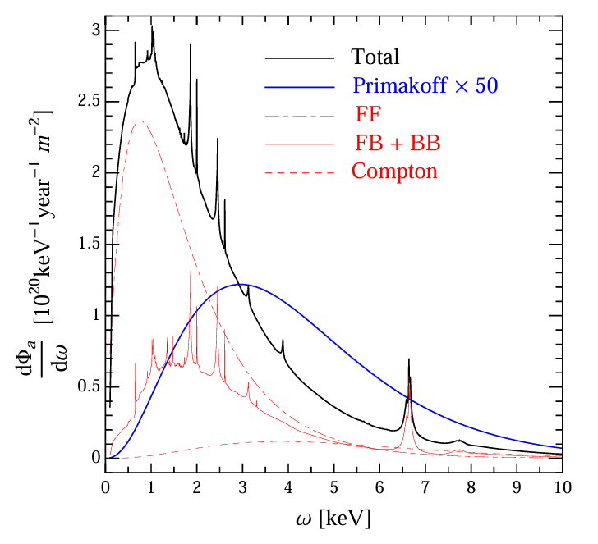
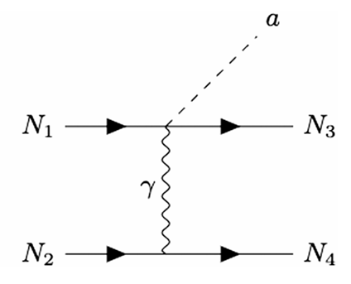
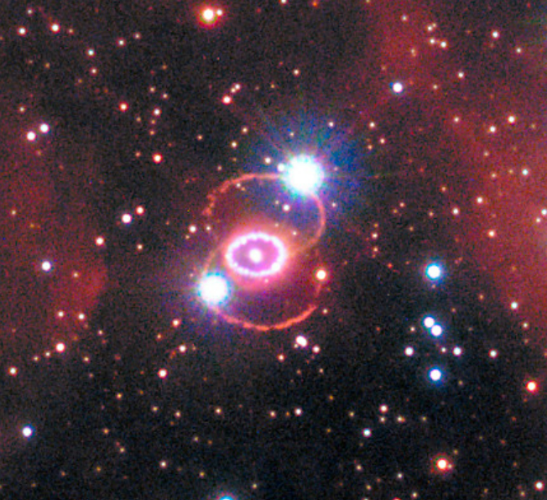
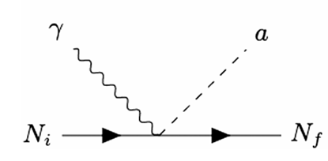
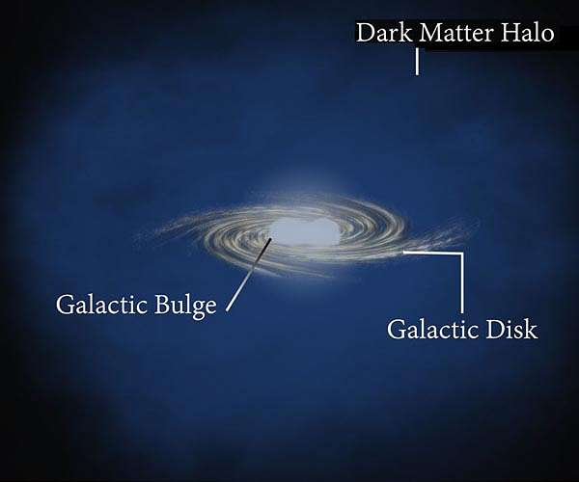
1. Solar axion :
The Primakoff production process [i.e., γZ →aZ] $g_{aγγ}$
ABC process(the atomic deexcitation and recombination,
bremsstrahlung, and Compton scattering process. ) $g_{ae}$
2. Supernova axion:
bremsstrahlung $g_{d,N}$
The Primakoff production process $g_{aγγ}$
3. DM axion, etc.
Misalignment Mechanism (CDM)
Exhibits classical field-like behavior, with a local velocity $v\sim 10⁻³c$
Various celestial bodies in the universe can serve as potential axion sources...

Slide 4
Introduction to PBH
In 1975, Stephen Hawking proved that black holes are not entirely “black”.
Instead, due to quantum effects near the event horizon, they emit radiation (primarily photons and other elementary particles), leading to an evaporation and potentially complete disappearance.
New particles of a mass less than $T_{PBH}$ can be emitted during PBH evaporation
$E$ is the emitted particle energy,
$Γ$ is the “graybody” factor,
$a^{∗}$is the PBH spin,
$g$ and $s$ denote the degree of freedom
and spin of emitted particle, respectively

Slide 5
The particle flux emitted from PBHs
= the galactic flux + the extragalactic flux
the Navarro-Frenk-White
(NFW) DM profile
$s$ is the line-of-sight distance.
The flux $Φ_{gal}$ requires integrating
over the galactic coordinates $(l,b)$
within the RoI.
At cosmologcial distance,
we must account for reshift effects.

Slide 6
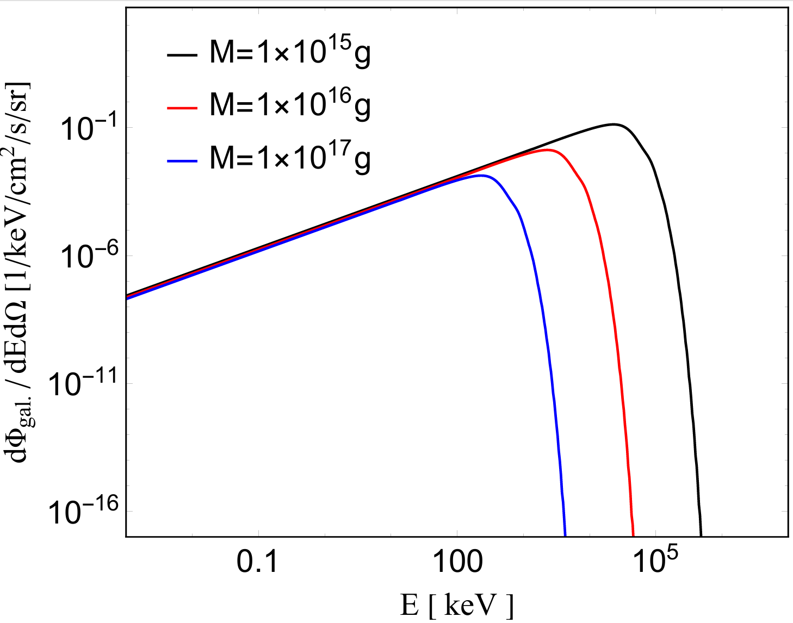
We utilize the package BlackHawk v2.1 to obtain the spectrum of PBH emitted particles with different PBH mass.
PBH galactic flux of emitted light ALPs:
Detection energy windows
for some typical interactions:
1. Axioelectric (AE) effect for ${}_{ }^{131}{Xe}$:
0.01keV—40 keV
2. Inverse Primakoff for ${}_{ }^{131}{Xe} /H_{2}O$:
$E>𝒪\left(100\right)$ keV ($m_{a}=1$ keV)
(dependent on ALP mass)
3. ALPs conversion under magnetic field:
$E>𝒪\left(1\right)$ MeV ($m_{a}={10}^{−10}$ eV)
(dependent on ALP mass)
$f_{PBH}$ is uniformly set to 1,
$$a^{∗}=0$$

Slide 7
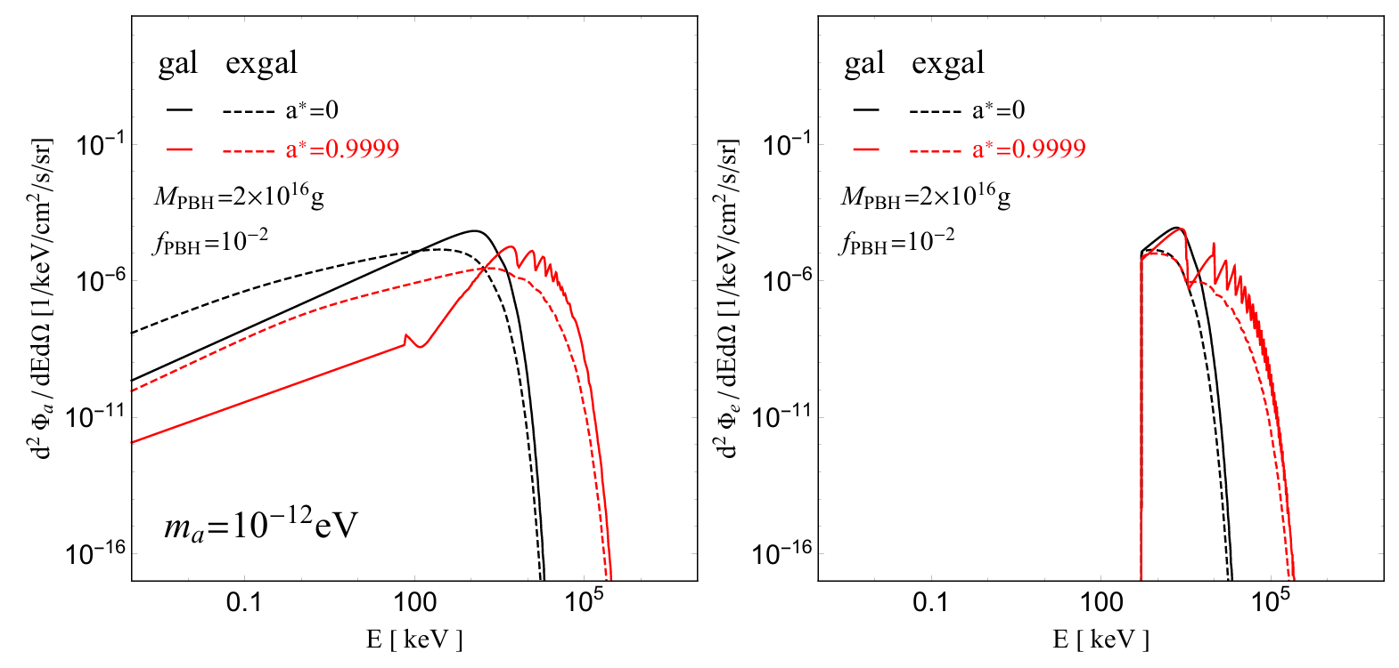
Spectrum of elementary particles radiated by PBH
PBH ALPs
PBH electrons
The spectrum of ALPs(left) and electrons(right) from PBH evaporation.
For the same PBH mass, a larger spin shifts the emission to higher energies.
This is a consequence of angular momentum-enhanced Hawking evaporation.

Slide 8
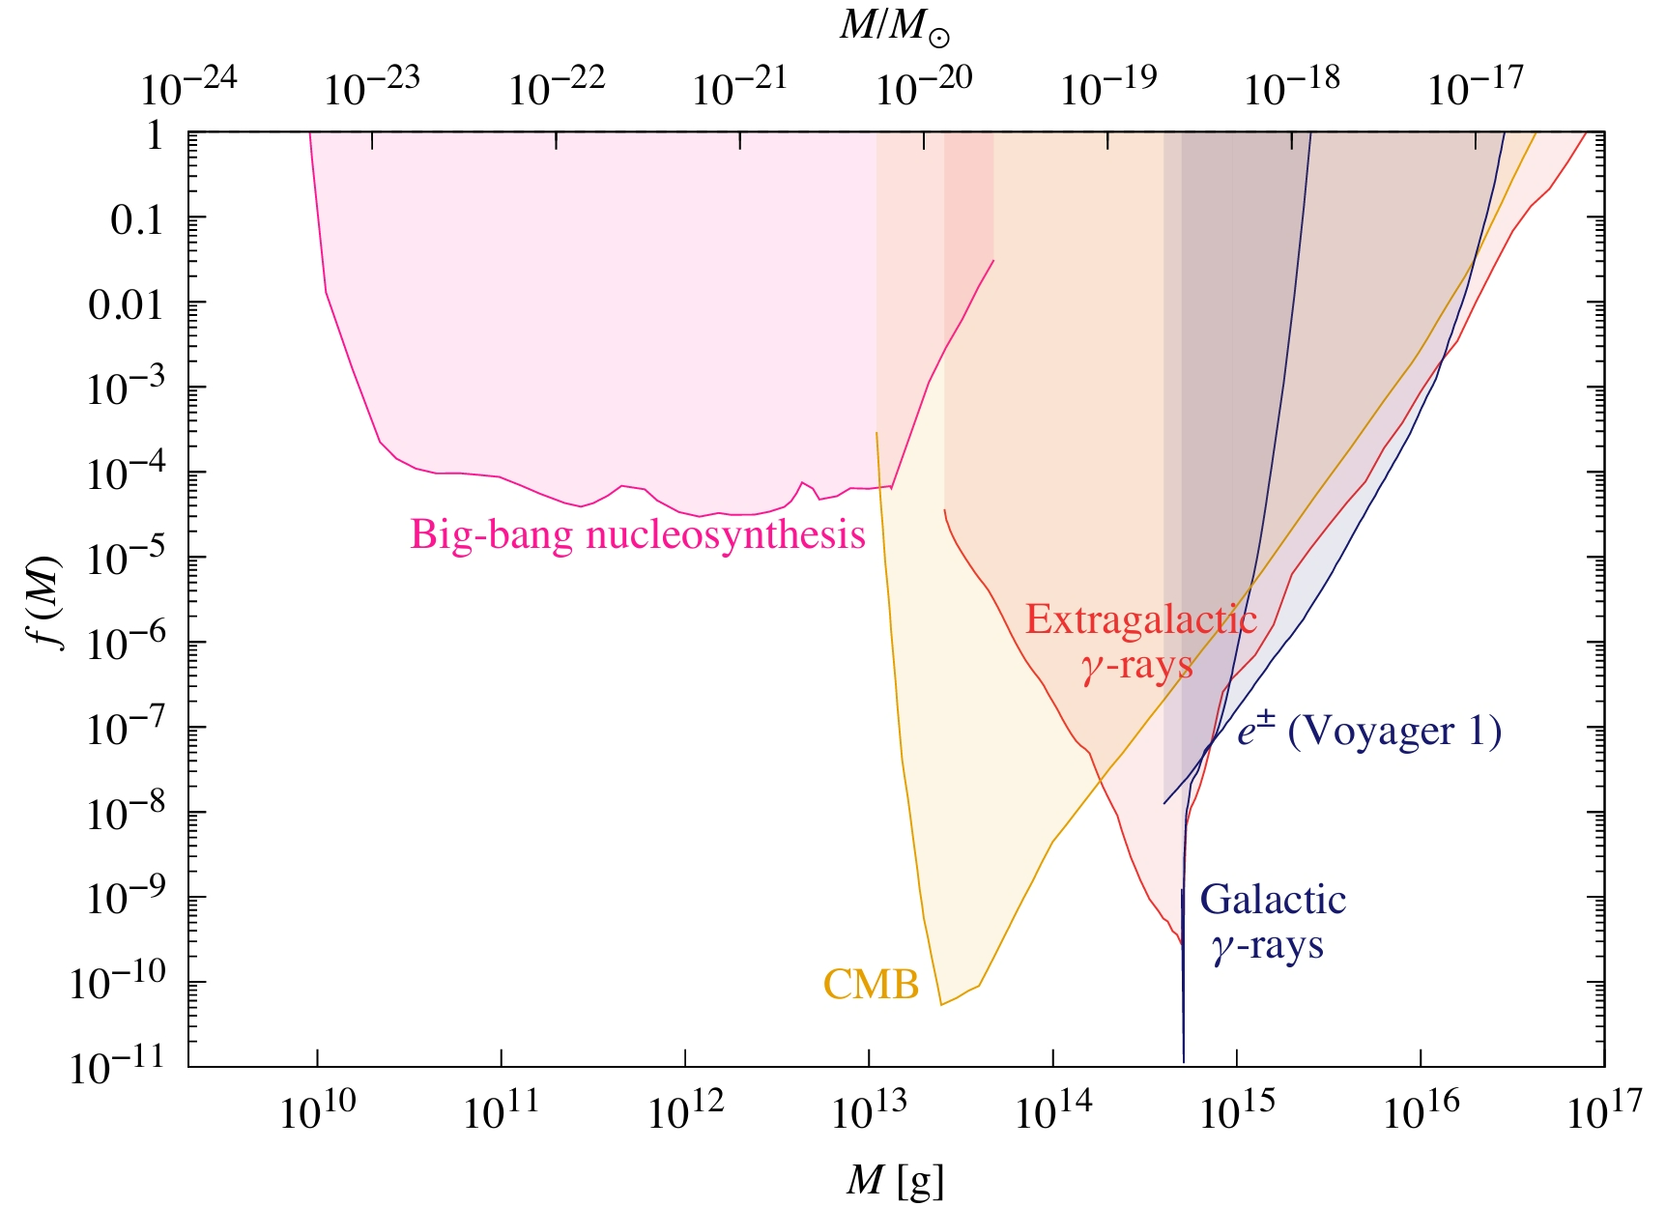
Constraints $f_{PBH}−M_{PBH}$ on Primordial Black Holes
Evaporation constraints from BBN, CMB spectral distortions and anisotropies, extragalactic γ-rays, Galactic γ-rays and Voyager-1$e^{±}$.
Cited from
Bernard Carr, Kazunori Kohri, Yuuiti Sendouda, and Junichi Yokoyama, “Constraints on Primordial Black Holes,” (2020), arXiv.2002.12778

Slide 9
How to establish the connection between PBHs and ALPs?
$$g_{ae}$$
$$f_{PBH}$$
$$M_{PBH}$$
$$g_{aγγ}$$
$$g_{d,N}$$
ALPs themselves are products of PBH radiation:
(a). ALPs convert into detectable photonic signals during their propagation through the interstellar medium.
(b). When reaching terrestrial detectors, ALPs undergo conversion into observable signals.
1-(a). Interstellar medium
1-(b). Terrestrial detectors
PBH
γ
PBH ALPs
PBH ALPs
Magnetic filed
DM ALPs
PBH fermion
γ
2. Inverse Compton process
2. The fermionic particles radiated by PBHs interact with ALPs that constitute DM,
then emit photons. (inverse Compton process)

Slide 10
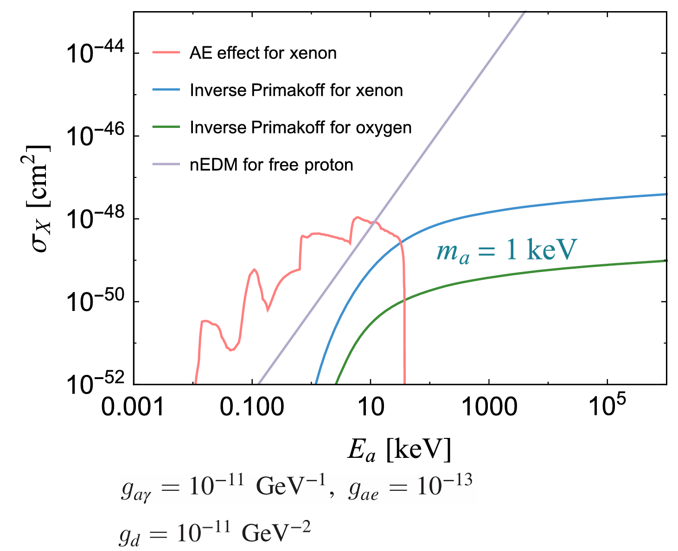
2. Search for ALP at terrestrial detector
Events rates
Terrestrial detectors
PBH
PBH ALPs
The axioelectric effect: ~ $g_{ae}$
the process that the ALP is absorbed by a bound-state electron of
the target atom and leads to an ionization signal.
Our work: PhysRevD.106.095034
$σ_{\text{PE}}$ is the photoabsorption cross section of atoms measured by low-energy x-ray experiment
B. The inverse Primakoff process:
$${\sim g}_{aγγ}$$
(depends on axion mass)
$${\sim g}_{d,N}$$
C. The nucleon dipole portal:
This reaction produces a visible flux of photons within the detector.（ free-proton-rich water Cherenkov detector such as Hyper-K ）

Slide 11
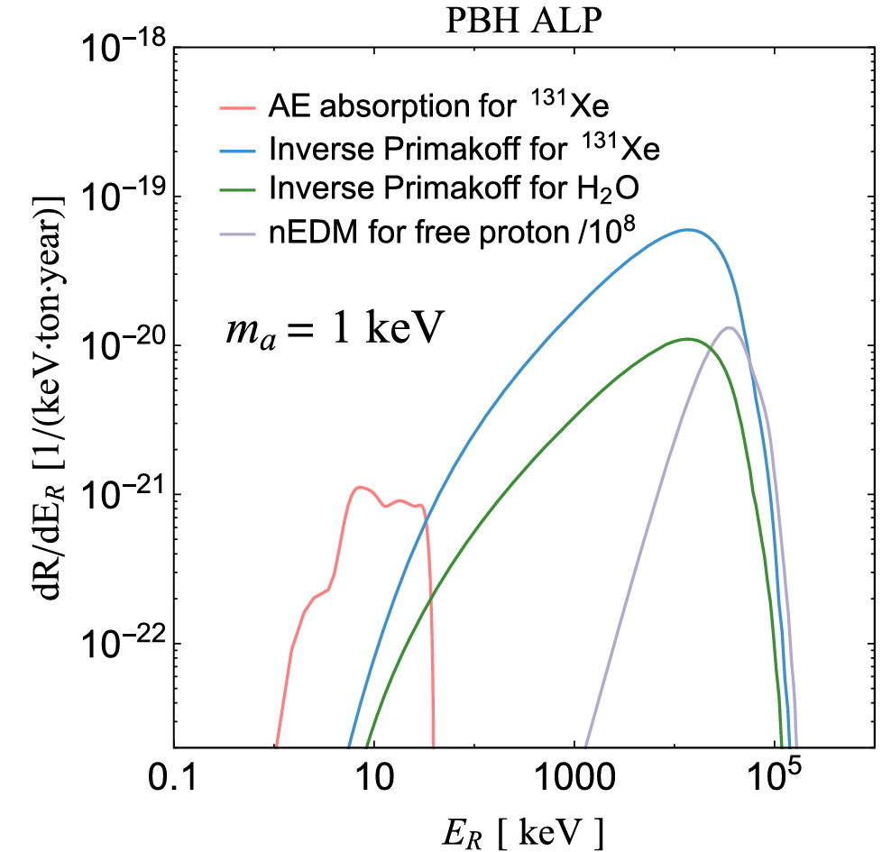
Event rates of a PBH ALP from
AE absorption ($σ_{AE}$)/ IP($σ_{IP}$)/ nEDM ($σ_{nEDM}$)
Since the axion mass is much smaller than that of the electron or nucleus, the recoil energy delivered by the axion is approximately equal to the incoming axion energy $E_{R}≈E_{a}$.

Slide 12
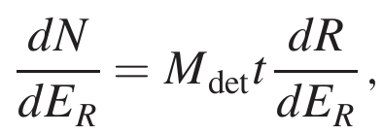
b) Detection and constraints in neutrino experiments
sensitive only to visible energy ＞ 100 MeV
The event number per recoil energy is given by
where $M_{det}$ is the fiducial mass of the detector and $t$ is the exposure time.
2628.1 days of running in a single tank consisting of 22.5 kiloton (kt) fiducial volume pure water
Super-K
162 kt · yr
Three energy bins with 100 MeV < E <1.33 GeV, 1.33GeV< E< 20GeV, and E >20 GeV for the “electron elastic scatter like” events
To set bounds on the PBH ALP parameter space from Super-K, we define the $χ^{2}$ with regard to the three energy bins:

Slide 13
2628.1 days of running in a single tank consisting of 22.5 kiloton (kt) fiducial volume pure water
Super-K
162 kt · yr
The background-only hypothesis yields a $χ_{0}^{2}=2.7$ and the $2σ$ exclusion bound is set with ${Δχ}^{2}=χ^{2}−$ $χ_{0}^{2}≥4.0$
$$N_{SK}=49.1$$
C. Kachulis et al. (Super-Kamiokande Collaboration),
Phys. Rev. Lett. 120, 221301 (2018).
5 (10) years of running in a single tank consisting of 374 (187) kiloton (kt) fiducial volume pure water
Hyper-K
1870 kt · yr

Slide 14
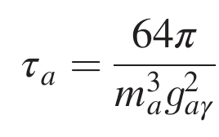
The attenuation of ALPs
PBH ALPs travel a distance in the atmosphere and underground before reaching terrestrial detectors and would be stopped due to the process a+p → p+γ therein.
$d^{⊕}≃1$ km, $d^{atm}≃86$ km
The ALP lifetime
Require the ALP lifetime to be longer than the era of matter-radiation equality
The supernova bounds and others
The observation of the SN 1987A neutrino burst →$g_{ad}$ by evaluating the axion luminosity.
There are also other constraints on $g_{aγγ}$ from visible decays of ALPs produced in SN 1987A and beam dump experiments.

Slide 15
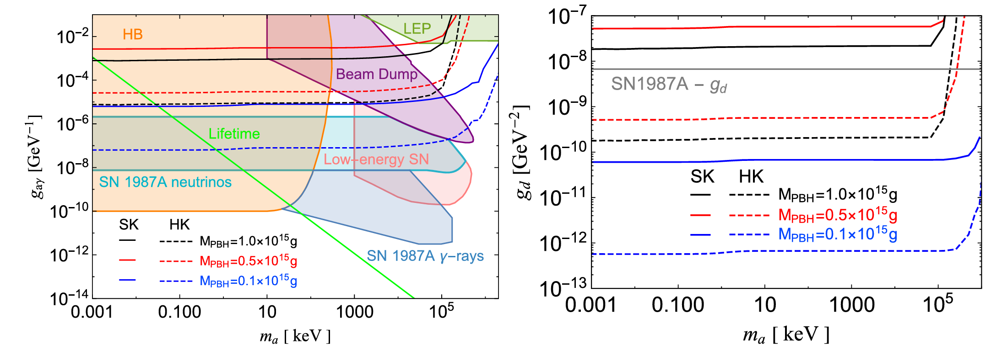
Projected sensitivity for PBH-DM fraction and ALP couplings
The bounds from Super-K(solid) and projected sensitivity at Hyper-K(dashed) on $g_{aγ}$(left) and $g_{d}$(right) as a function of $m_{a}$.

Slide 16
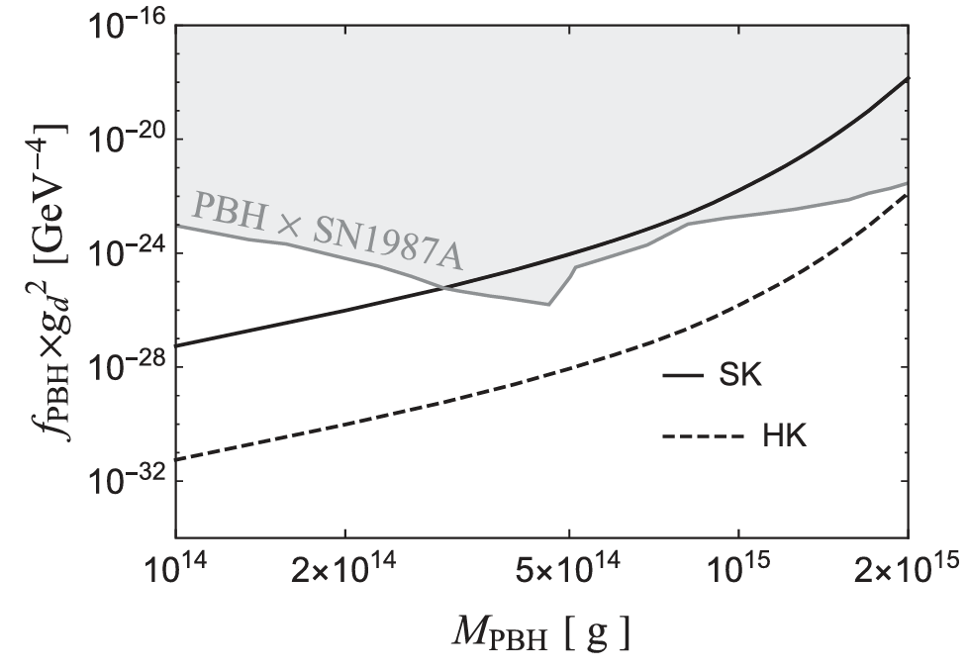
Projected sensitivity for PBH-DM fraction and ALP couplings
The bounds on $f_{PBH}×g_{d}^{2}$as a function of $M_{PBH}$ from Super-K(solid) and Hyper-K(dashed) for $m_{a}=$1 keV as an illustration.
The current evaporation constraint on $f_{PBH}$ from extragalactic gamma rays, the SN1987A bound on $g_{d}$ are combined, and the excluded region is shown in gray for comparison.

Slide 17
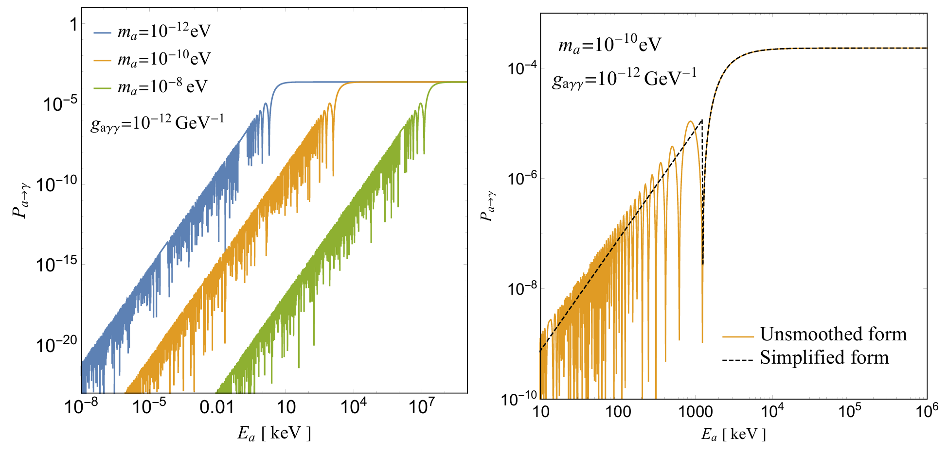
2. Search for ALP at gamma-ray experiments
b) Events rates
Our work: 2504.14185
Oscillation of PBH emitted ALP under magnetic: ~ $g_{aγγ}$
Under the resonant condition, axion-photon coupling induces coherent ALP-photon oscillations, there by converting ALPs into detectable photons.
There is a critical energy which marks the end of the final oscillation cycle in $P_{a→γ}$

Slide 18
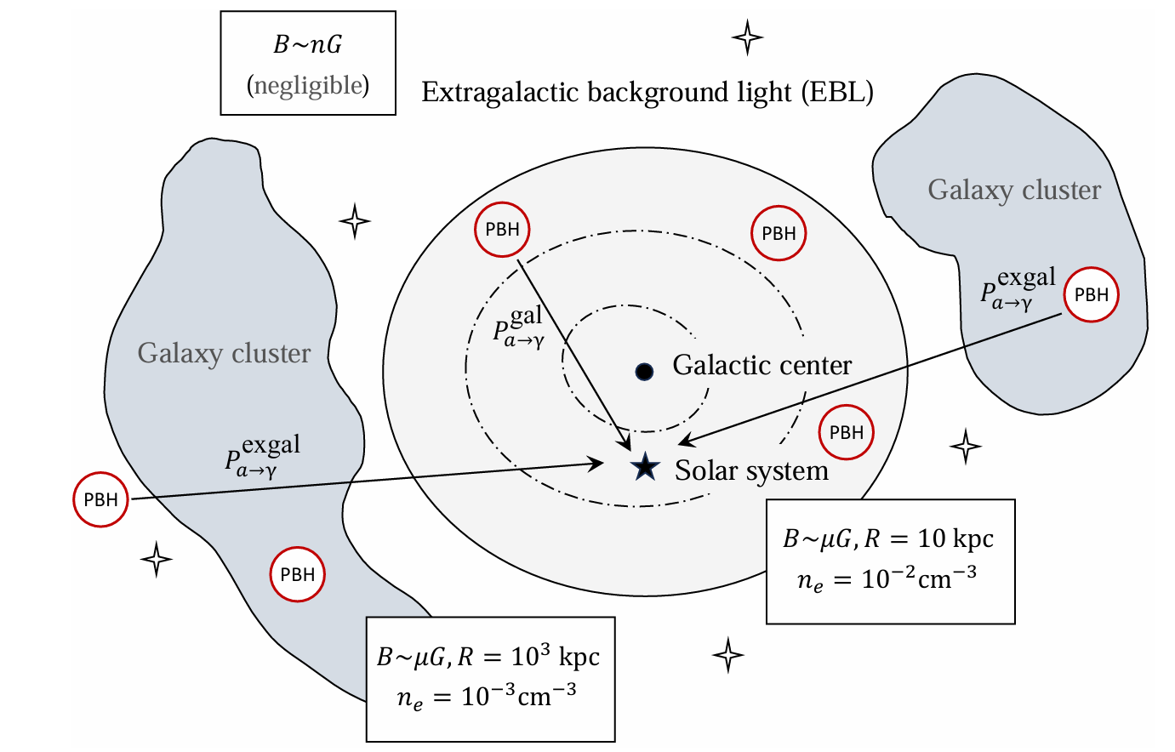
RoI
Proposed gamma-ray experiments:
AMEGO [NASA]
(All-sky Medium Energy
Gamma-ray Observatory)
e-ASTROGAM [ESA]
(`enhanced` ASTROGAM))
MAST [Russia]
(Massive Argon Space Telescope)

Slide 19
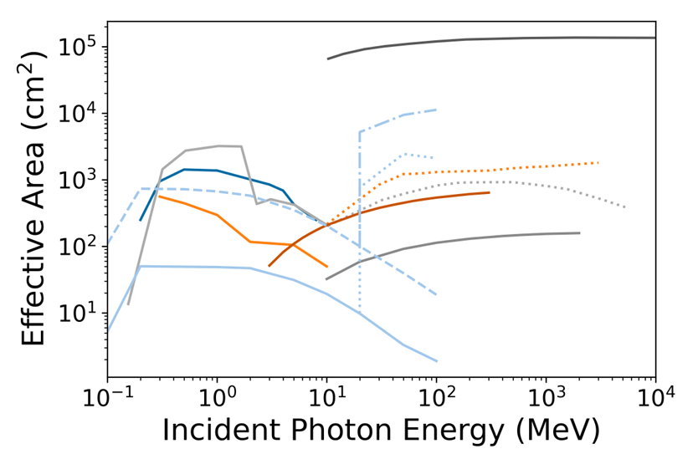
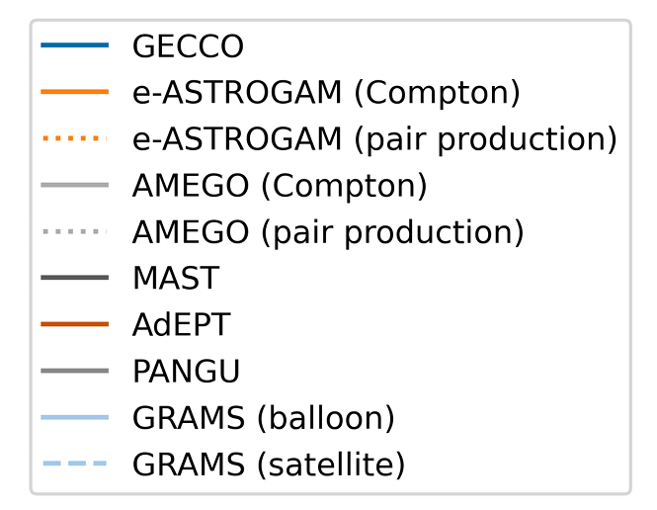
Energy window
Experiments
PBH mass (spin0)
AMEGO [NASA]
(All-sky Medium Energy
Gamma-ray Observatory)
e-ASTROGAM [ESA]
(`enhanced` ASTROGAM))
MAST [Russia]
(Massive Argon Space Telescope)
150keV−5MeV
100MeV−3GeV
${5×10}^{12}$g
$f_{PBH}$ is uniformly set to 1,
$$a^{∗}=0$$
100MeV−3GeV
${5×10}^{12}$g
150keV−5MeV
100MeV−3GeV
cited from Phys.Rev.D 111 (2025) 8, 8

Slide 20
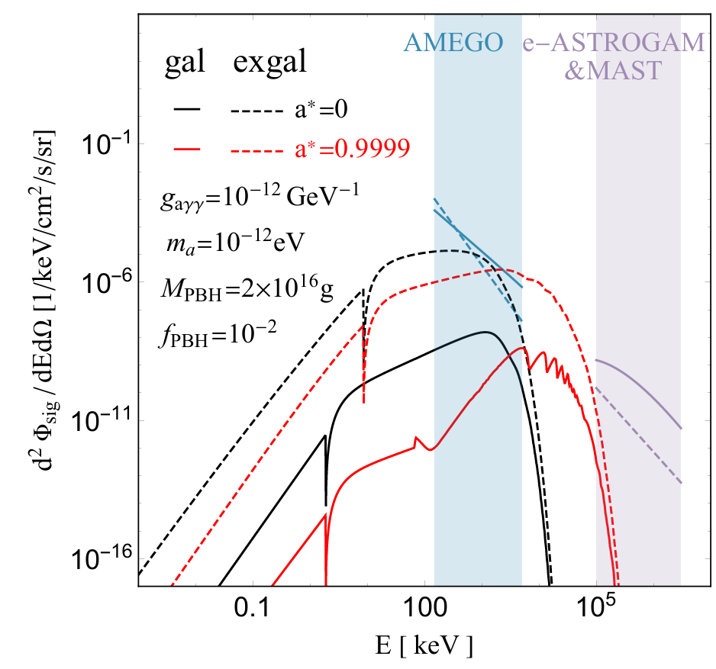
Differential gamma-ray flux from PBH emitted ALPs after propagating through the galactic (solid lines) or extragalactic (dashed lines) background magnetic fields.
The background flux of extragalactic gamma-rays
Phys. Lett. B 808, 135624 (2020).
Fermi-LAT, Astrophys. J. 799, 86 (2015)
The background flux of galactic gamma-rays

Slide 21
How to establish the connection between PBHs and ALPs?
$$g_{ae}$$
$$f_{PBH}$$
$$M_{PBH}$$
$$g_{aγγ}$$
$$g_{d,N}$$
ALPs themselves are products of PBH radiation:
(a). ALPs convert into detectable photonic signals during their propagation through the interstellar medium.
(b). When reaching terrestrial detectors, ALPs undergo conversion into observable signals.
1-(a). Interstellar medium
1-(b). Terrestrial detectors
PBH
γ
PBH ALPs
PBH ALPs
Magnetic filed
DM ALPs
PBH fermion
γ
2. Inverse Compton process
2. The fermionic particles radiated by PBHs interact with ALPs that constitute DM,
then emit photons. (inverse Compton process)

Slide 22
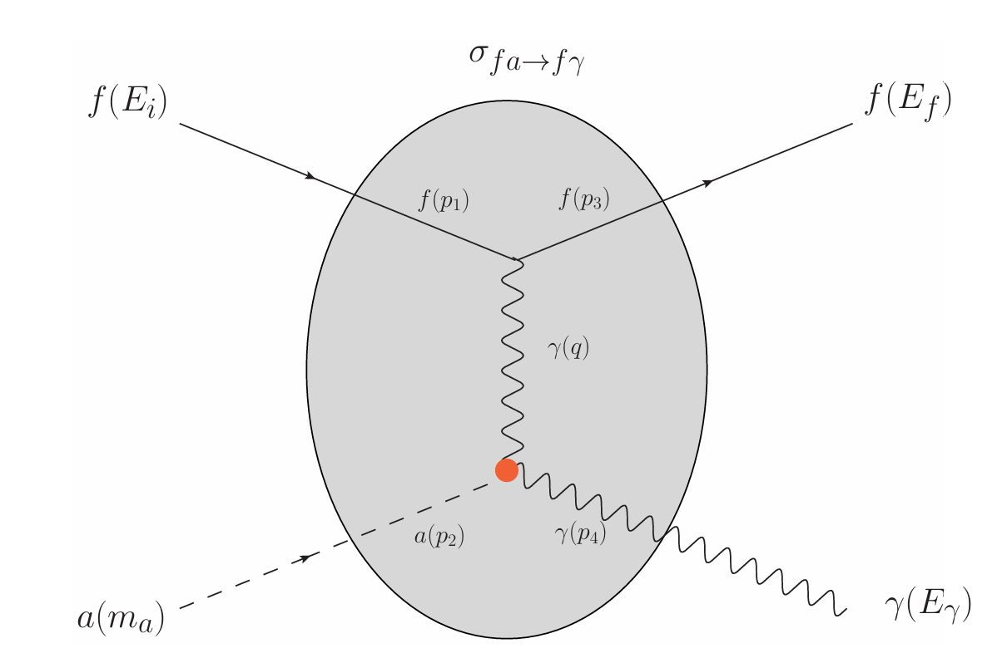
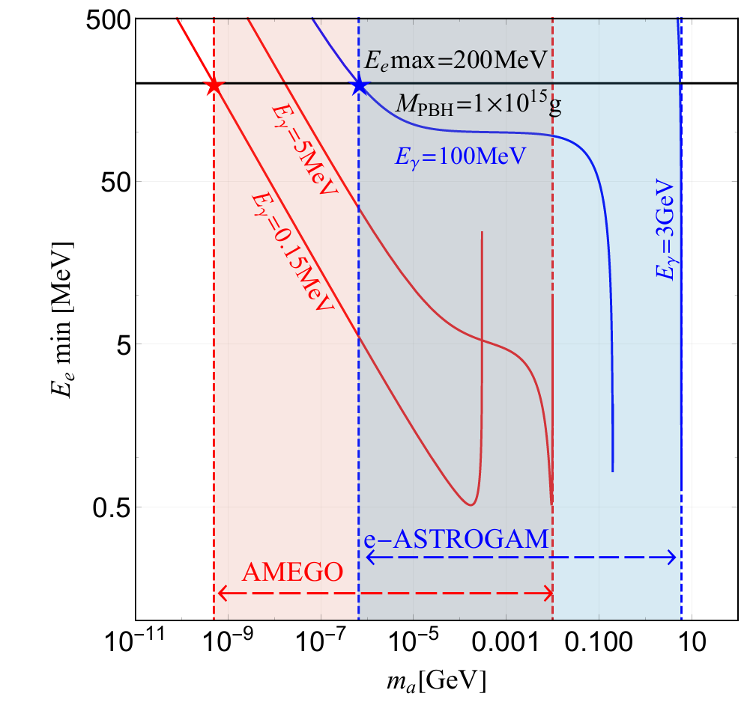
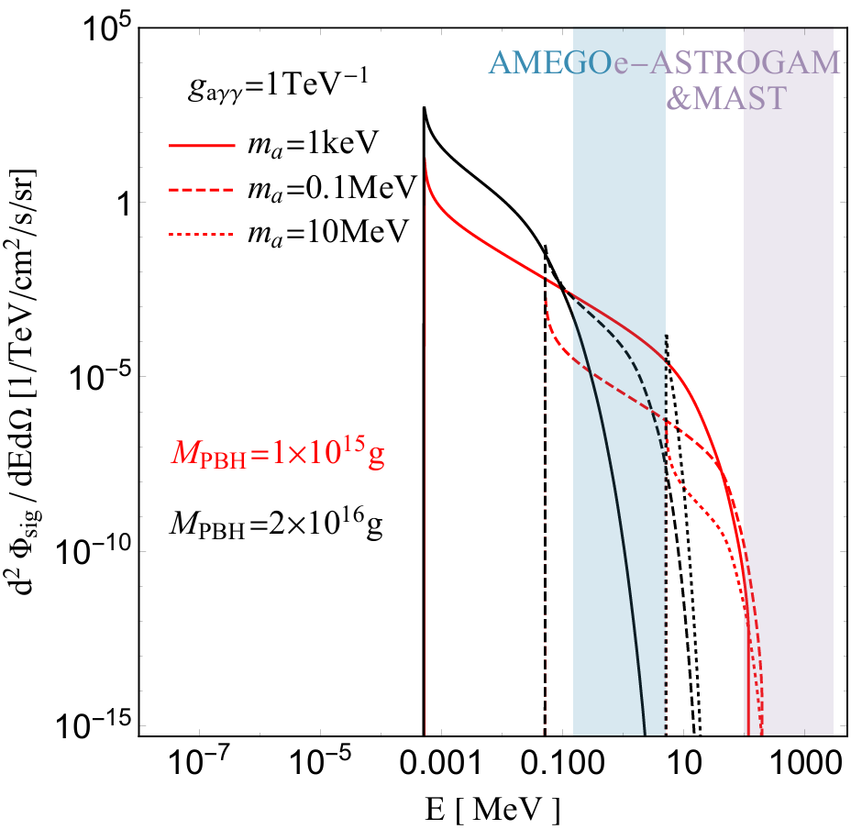
B. Scattering of PBH emitted electron with ALP DM halo : ~ $g_{aγγ}$
Phys.Rev.D 111 (2025) 4, 043011
Kinematical condition confines
the axion mass range!

Slide 23
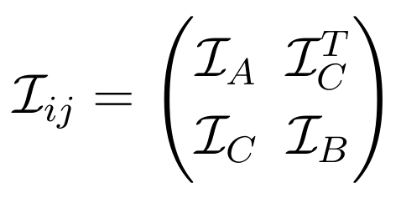
JCAP 02, 021 (2018),
We employ the Fisher forecasting method to numerically evaluate the detection prospects for PBHs and light ALPs.
with respect to n-dimensional parameter vector $\vec{θ}$given data set $𝒟$
The core principle is to utilize the Fisher information matrix (computed from the first and second derivatives of the signal spectrum function) to quantify the sensitivity of observed data to selected parameters.
 | AMEGO | e-ASTROGAM(MAST)
parameter of interest (PoI) | $$f_{PBH}$$ | $$f_{PBH}$$
the nuisance parameters | $A_{bkg}^{exgal}$, $α^{exgal}$, $A_{bkg}^{gal}, α^{gal}$, $E_{C}$, $γ^{gal}$ | $A_{bkg}^{gal}, α^{gal}$, $E_{C}$, $γ^{gal}$
One can evaluate the profiled Fisher information matrix,

Slide 24
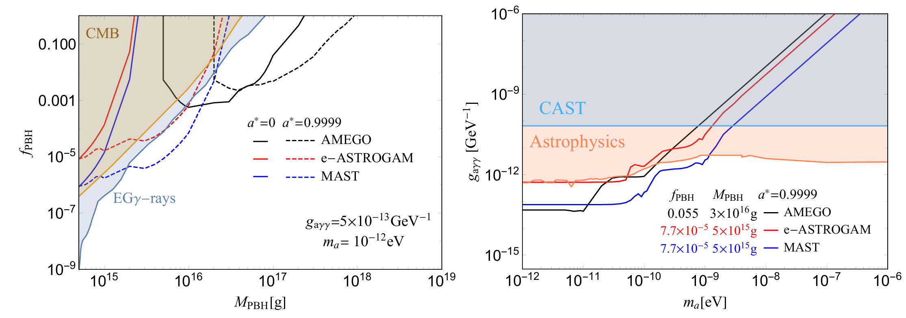
b) Projected sensitivity for PBH-DM fraction and ALP couplings
Oscillation of PBH emitted ALP under magnetic: ~ $g_{aγγ}$
Projected 95% C.L. upper limits on the $f_{PBH}−M_{PBH}$
Projected 95% C.L. upper limits on $g_{aγγ}−m_{a}$

Slide 25
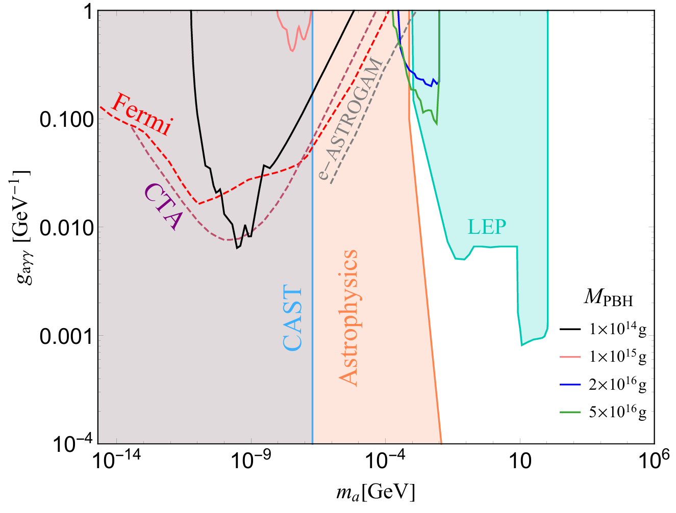
B. Scattering of PBH emitted electron with ALP DM halo : ~ $g_{aγγ}$
Projected limits on $g_{aγγ}$ from AMEGO for the evaporation-scattering scenario.
We selected four PBHs with different masses and ${\text{a}}^{\text{∗}}$ = 0 as electron sources.
The constraints on $g_{aγγ}$ obtained by cosmic-ray scattering in Fermi, CTA and e-ASTROGAM are also presented (dashed lines).

Slide 26
4. Summary
Scenario 1: PBH-ALP detection in terrestrial neutrino experiments
The ALP constraints derived from SK: weak and have already been ruled out.
The constraints obtained from HK parameters(2 events hypothesis)—100 × stronger than SK.
For the parameter combination $f_{PBH}×g_{d}^{2}$, SK/HK limits beat gamma-ray × SN 1987A bounds.
Scenario 2: PBH emitted particle detection via gamma-ray experiments
Evaporation-conversion scenario:
AMEGO: Enhanced low-energy sensitivity → probes extended PBH mass range & more stringent constraints $f_{PBH}$. Reaches ${\text{g}}_{\text{a}\text{γγ}}\sim {5×10}^{−14}{GeV}^{\text{−1}}$ for $m_{a}<{10}^{−11}$ eV.
e-ASTROGAM/MAST : High-energy coverage → targets lighter PBHs ($f_{PBH}$most already excluded).
MAST provides complementary ${\text{g}}_{\text{a}\text{γγ}}$coverage to AMEGO’s results in $m_{a}>{10}^{−11}$ eV.
Evaporation-scattering scenario:
Weak constraints on the $f_{PBH}$ and $g_{aγγ}$due to tiny cross-sections.

Slide 27
Thanks!

