Slide 1
CERN forum on IHEP career opportunities
Career Opportunities of Nuclear Technology and Applications Division
Mohan Li
1/21/2025
Notes:
Hi everyone! My name is Mohan Li and I’m a senior engineer from the Nuclear Technology and Applications Division. Today, I would like to introduce the job openings of our division.

Slide 2
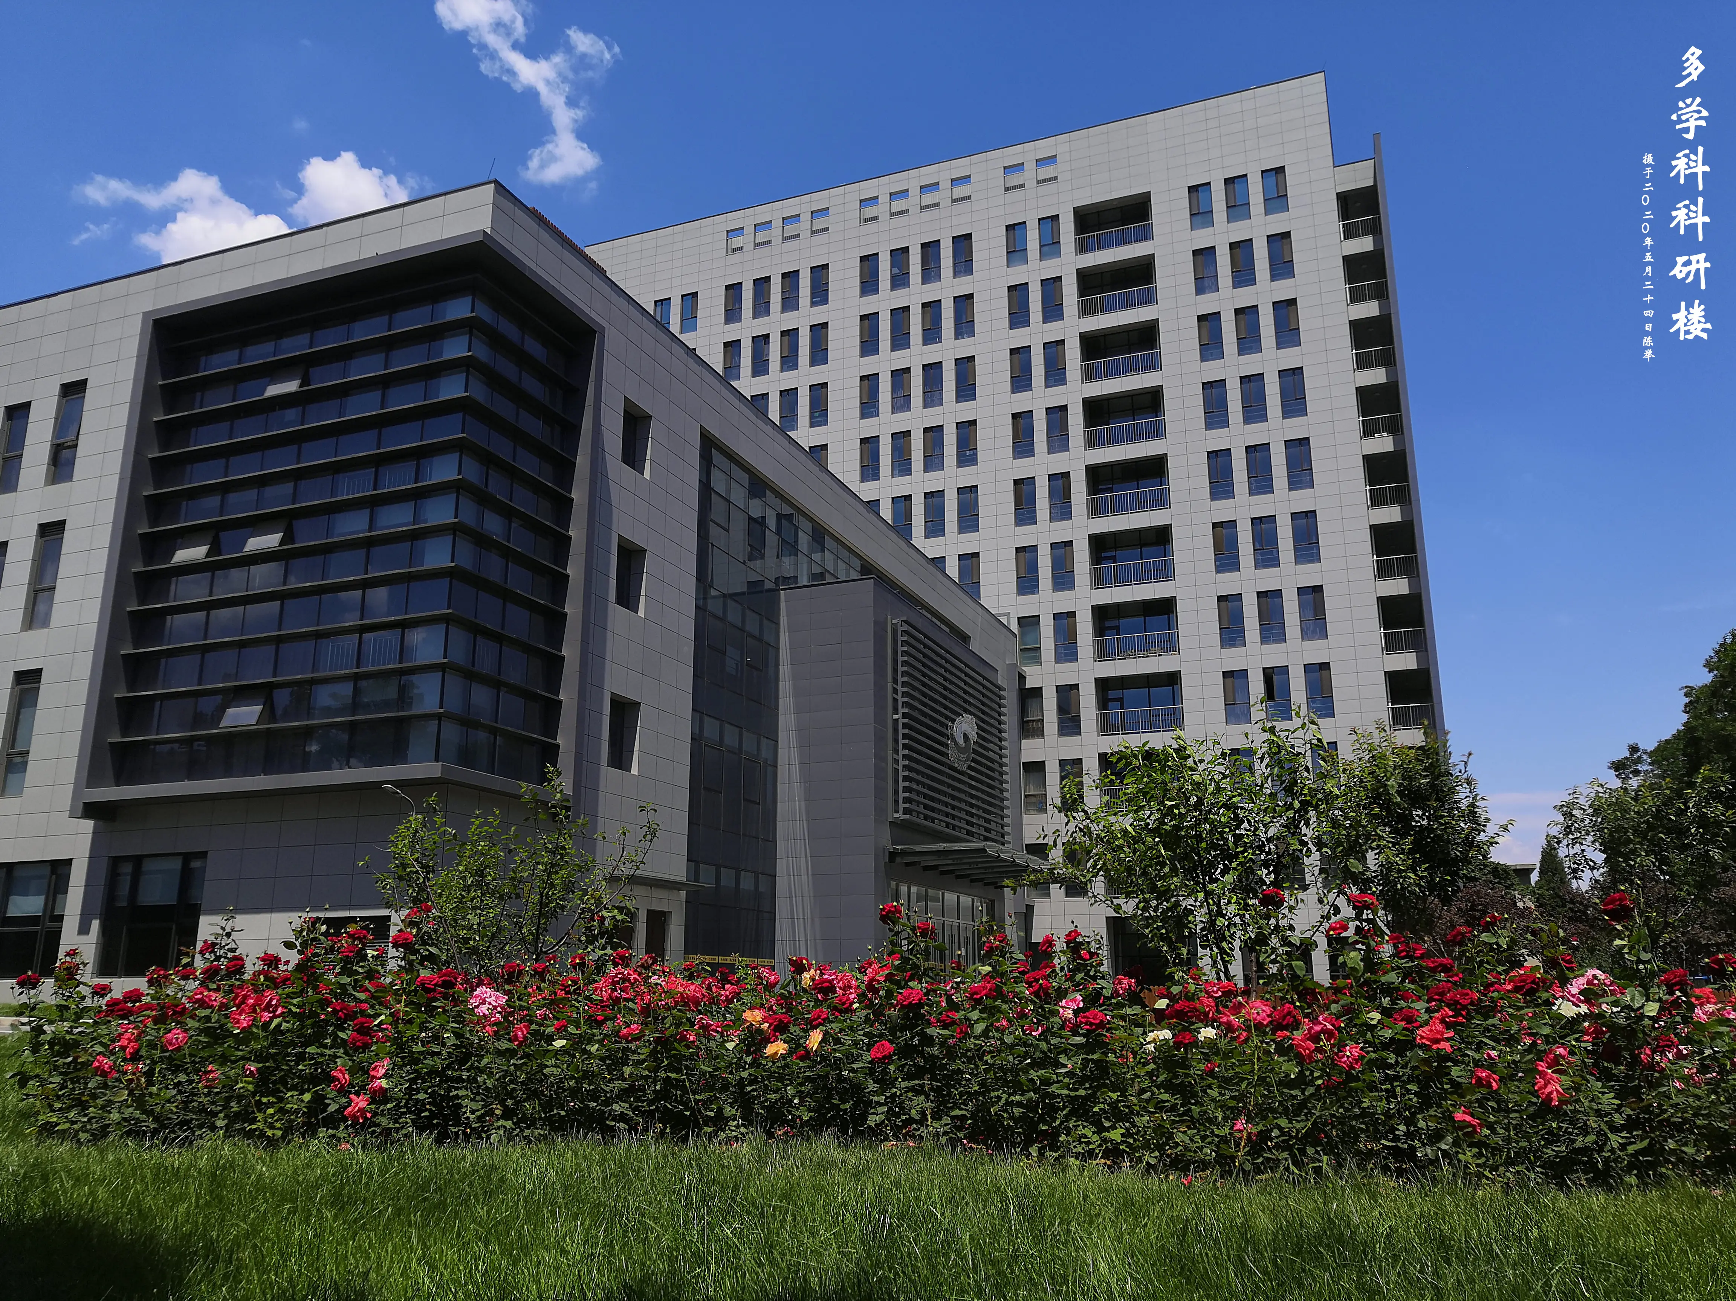
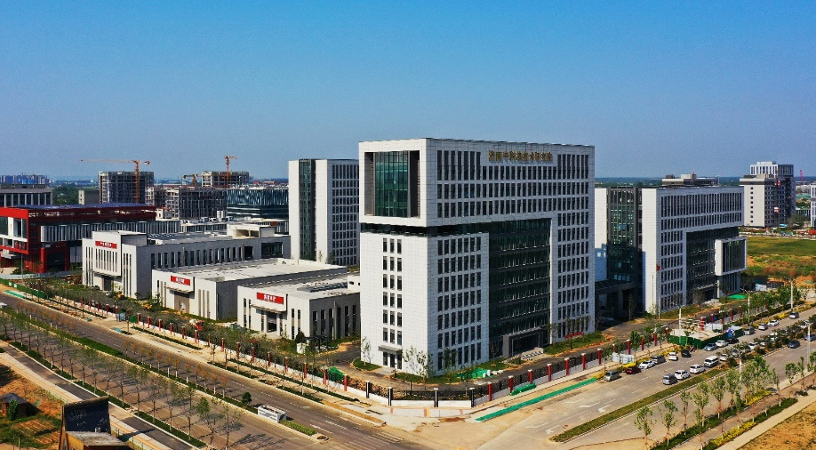
Introduction
Our mission: Nuclear Technology and Applications Division (NTAD) is an application-oriented, non-profit R&D affiliation of the IHEP, aiming at technology transfer and product industrialization
Our areas: Medical imaging devices for pre-clinical research and diagnosis, irradiation accelerators, industrial CT, radiation safety monitoring, low-toxic tumor therapy nano-medicine, etc.
Beijing office
Jinan Laboratory
Notes:
Since the technical achievements made in the high energy physics can also contribute to other fields, our mission is to transfer those technology to medicine, industry and to support the research of other disciplines. Our products include imaging devices, radiation detectors, irradiation accelerators and radioactive probes. Besides the office in the main campus in Beijing, we also have another laboratory in Jinan, Shandong province, with ample supporting facilities, such as cyclotron, bunker, clean room, radioactive medicine synthesis platform, high performance workstations, etc.

Slide 3
Introduction
Staff and graduate students: 126 in total
Full-time faculties: 58
Post doctorate: 9
Graduate students: 56
Others: 3
Our focus: device and technology for:
Imaging for clinic diagnosis and life science
Nondestructive testing (NDT) for industry and laboratory
Radiation safety monitoring
Advanced compact accelerator
Notes:
There are 126 employees in our division, among them 58 are full-time faculty and 9 are postdocs. We especially focus on 4 aspects: imaging devices for diagnosis and life science research, nondestructive testing for industry, radiation safety monitoring and compact accelerator.

Slide 4
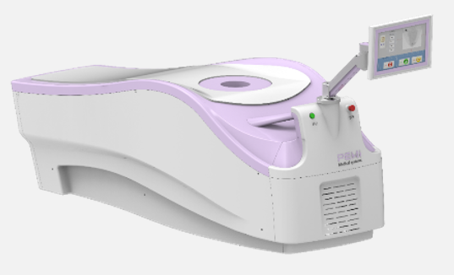
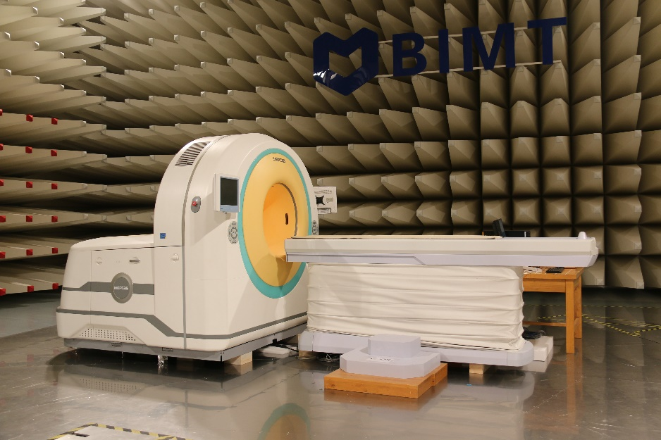
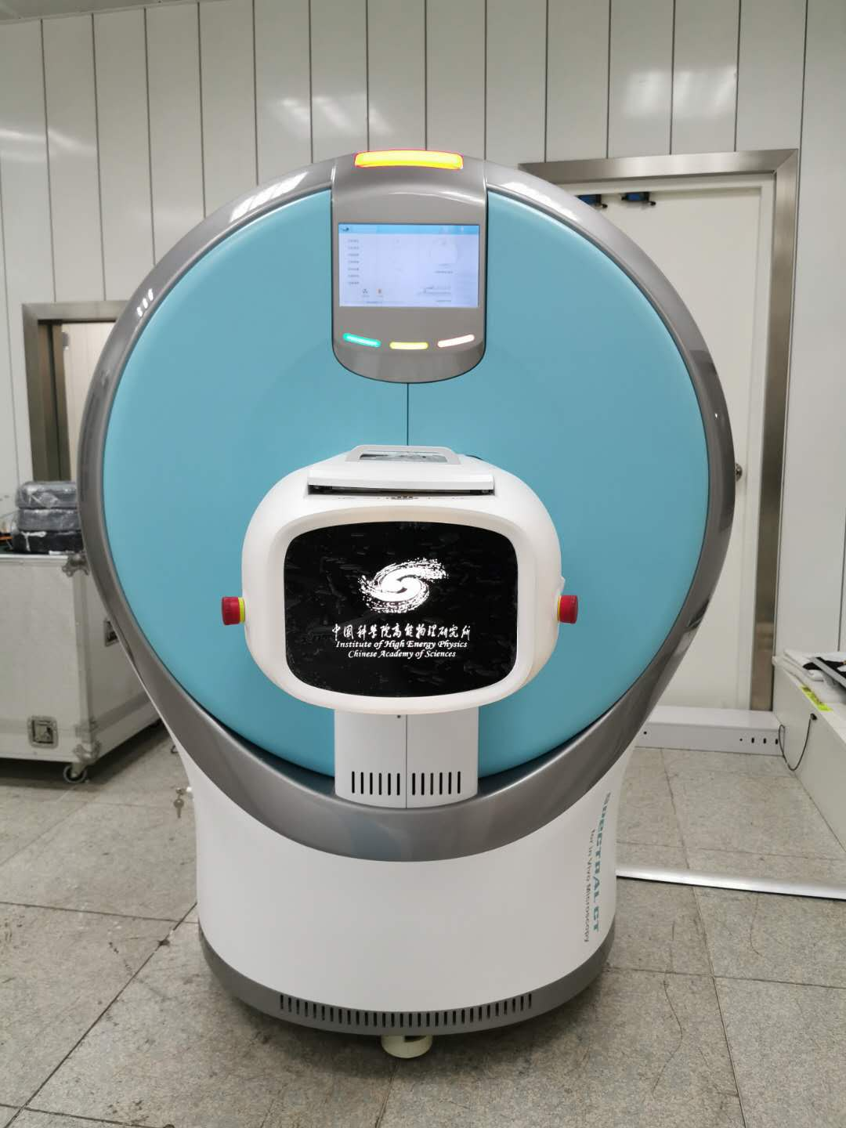
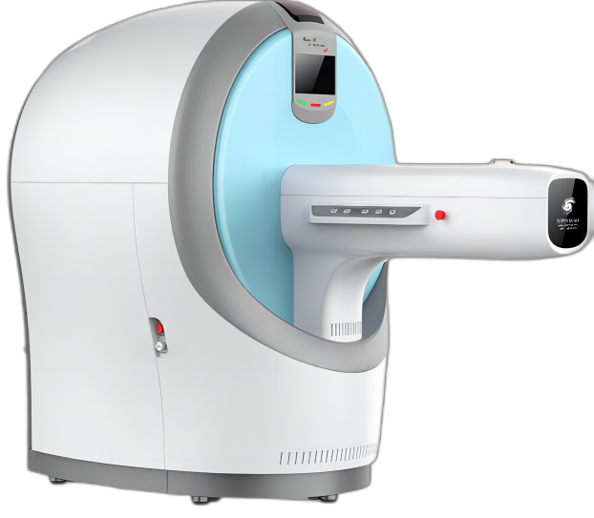
Our Achievements
Imaging devices for diagnosis and pre-clinical research
Positron Emission Mammography
(with CFDA registration)
Positron Emission Tomography (PET)
Whole-body PET/CT for small animals
Spectral CT for small animals
Notes:
We developed a PET scanner and the picture on the left shows the scene it’s being tested. Another equipment we developed for medical use is the positron emission mammography, which has received the sale approval of the Chinese Food and Drug Administration. Besides, we also developed imaging devices for pre-clinical research. Our spectral CT for small animals has been sold to our customer, Guangzhou University of Chinese Medicine. And the small animal whole-body PET/CT is the project we are focusing on right now.

Slide 5


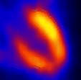
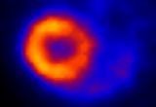
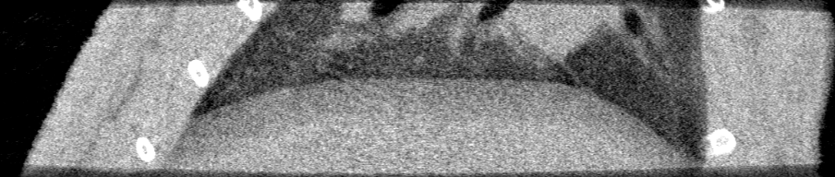









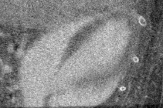
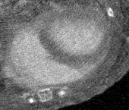
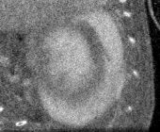
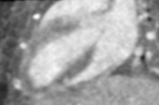
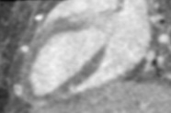
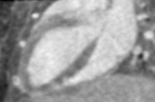
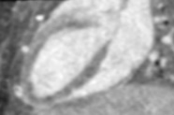

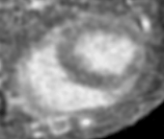
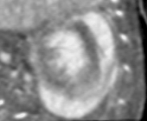
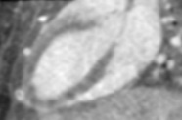
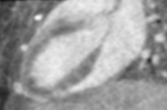
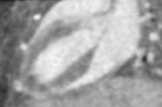
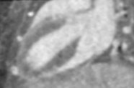
Our Achievements
Gated PET/CT technique for lung and heart 4D imaging
normal CT scan
respiratory gated CT scan
0
1
2
3
4
5
6
7
different periods in a cardia cycle
cardiac gated PET scan
cardiac gated CT scan
Notes:
I myself take part in this project, so I’d like to share some pretty cool stuff we get first. The gated imaging technique we develop brings very good 4D results of the moving organs, like lungs, heart, in the in-vivo scanning. The sharp edges show the motion artifacts are effectively suppressed.

Slide 6
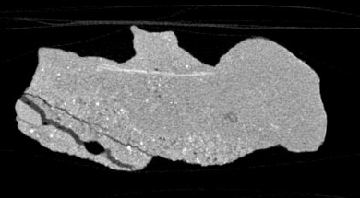
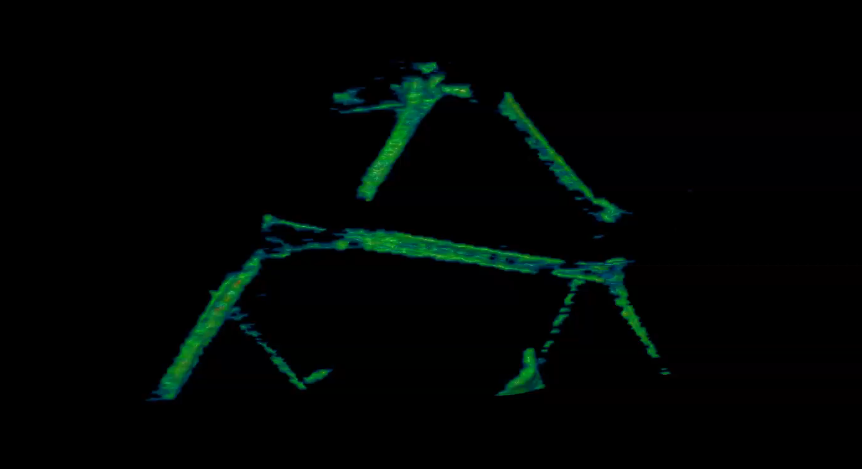
Our Achievements
Photon counting spectral CT material decomposition and analysis
fossil bone extraction from the rock
quantitative analysis of pearls
Notes:
The photon counting detector based spectral CT, namely the PCCT, is a new trend of CT development and the material decomposition is a very typical and promising technique of the PCCT. One example is the scanning of a pterosaur egg fossil. We extract the bone of the embryo from the rock using the material decomposition method, which would be quite tricky by using the thresholding segmentation of the traditional CT. Another example is the analysis of pearls. We scan the clam even without open it. The upper shell is removed virtually with the software. We evaluate the effective atomic number and density of the pearls. Hopefully, this method can be applied in the pearl industry.

Slide 7
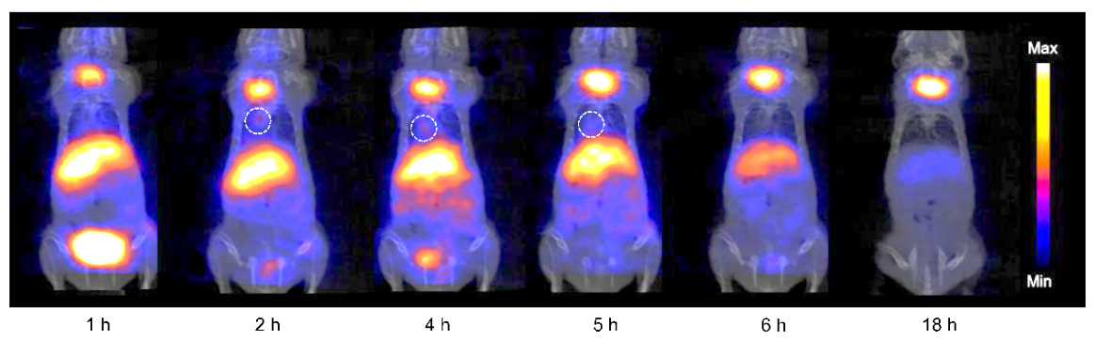
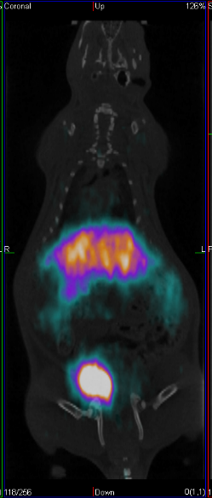
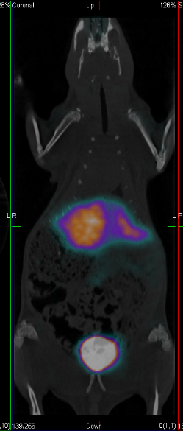
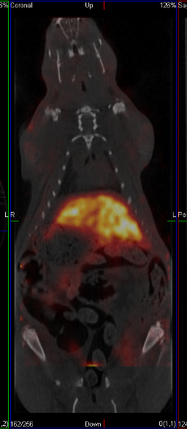
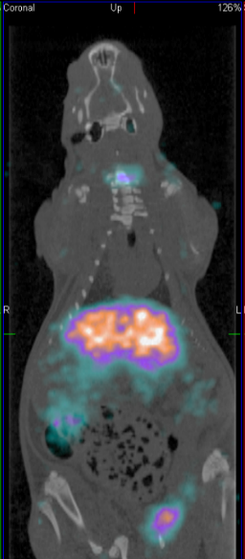
Our Achievements
Molecular probe developing
Rat PET and SPECT imaging
Rat lung cancer PET imaging
^{99m}Tc SPECT
⁶⁸Ga PET
⁶⁴Cu PET
¹²⁴I PET
Nude mouse lung cancer PET imaging
Notes:
Our radiochemistry group works on the molecular probes that can be imaged by PET or SPECT and they can be used in brain and cancer study.

Slide 8

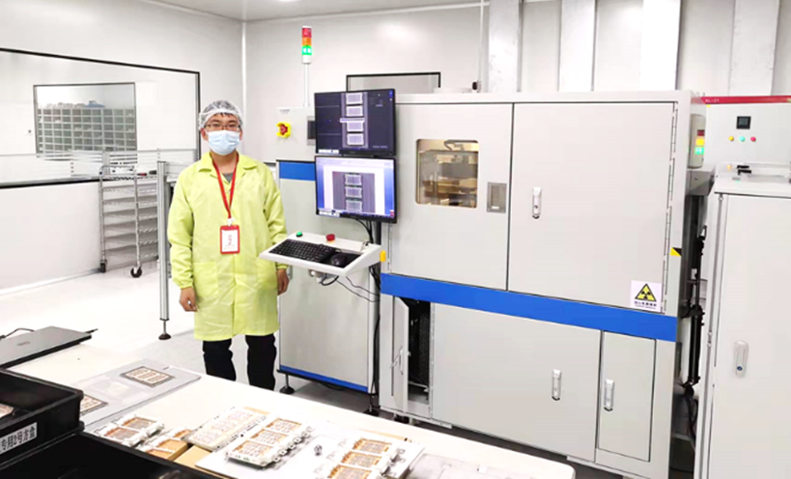
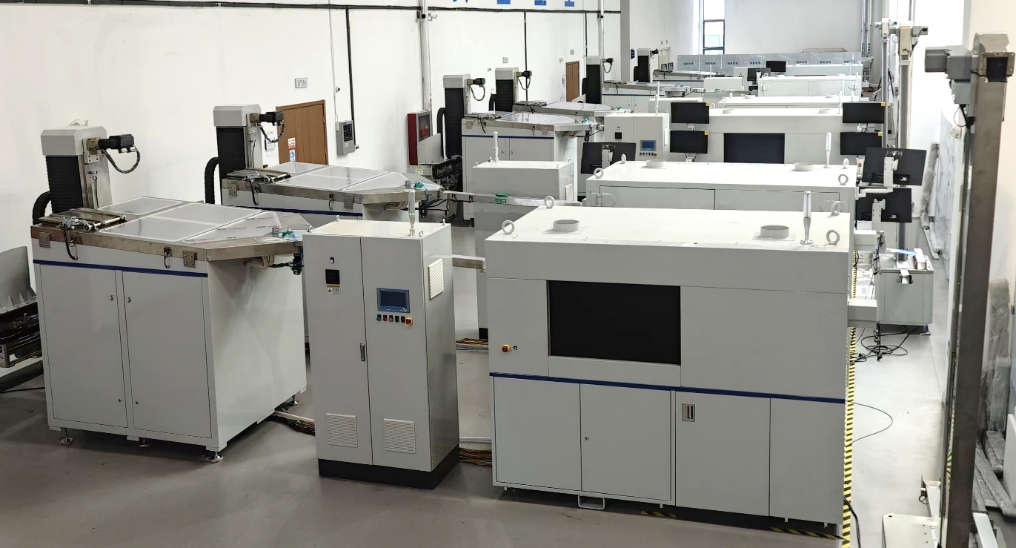
Our Achievements
CT equipment commercialization
computed laminography for IGBT
industry CTs ready for delivery
Notes:
We have our own spin-off company, Rayim, which is specialized in industry and research NDT. 2024 was a very busy year for our company because more products had been delivered to our customers. The company has achieved profitability now.

Slide 9
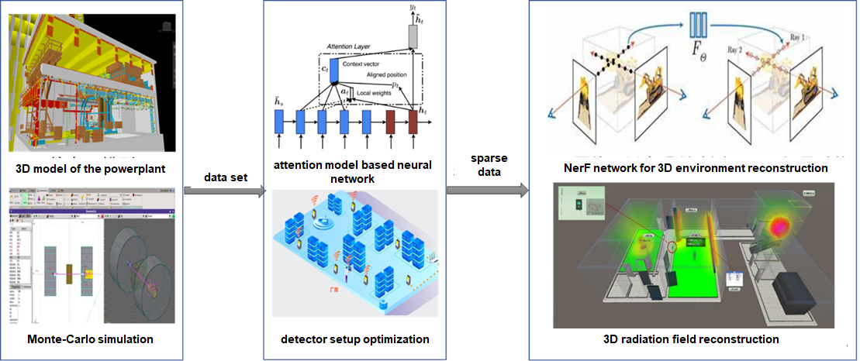
Our Achievements
Radiation safety monitoring solution
AI-based 3D radiation field reconstruction
Notes:
Artificial intelligence is one of the cutting-edge technologies nowadays. Our team has been working on this for several years. We trained a neural network based on the attention model to reconstruct the 3D radiation field.

Slide 10
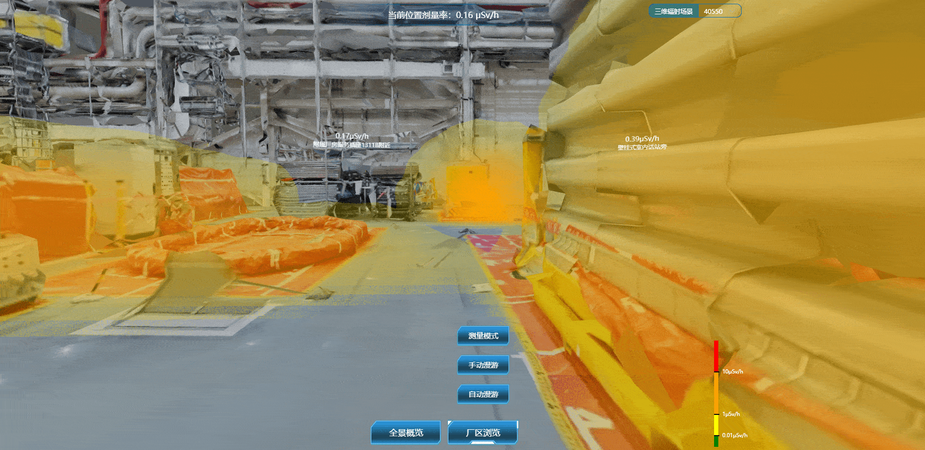
Our Achievements
Radiation safety monitoring solution
virtual roaming in nuclear powerplant with image fusion of optical and radioactive signals
Notes:
One possible scenario this technique can be used is the radiation safety monitoring for nuclear powerplant. We can merge the optical 3D model of the plant and the radiation field, enables people to observe the distribution of radiation and notice a potential hazard in time.

Slide 11
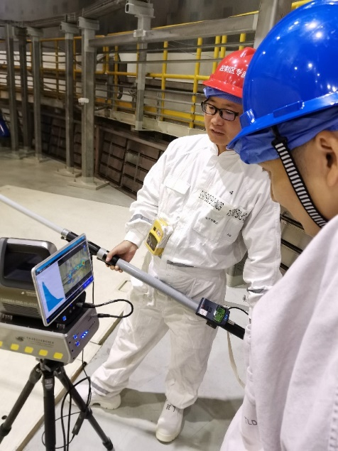
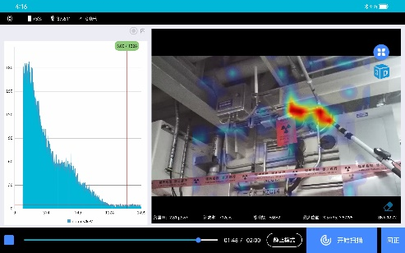
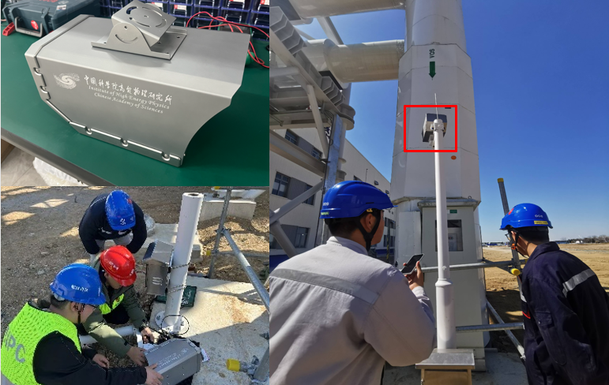
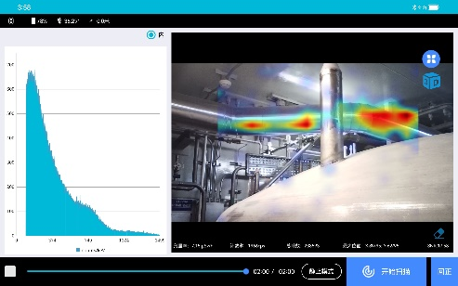
Our Achievements
Radiation safety monitoring solution
pipeline radiation monitoring
radioactive chemical leakage detection and analysis
Notes:
Different types of radiation detectors are developed by our division to meet various requirements of our customers.

Slide 12
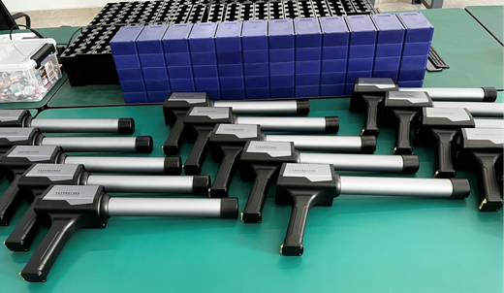
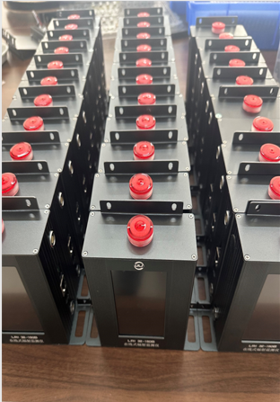
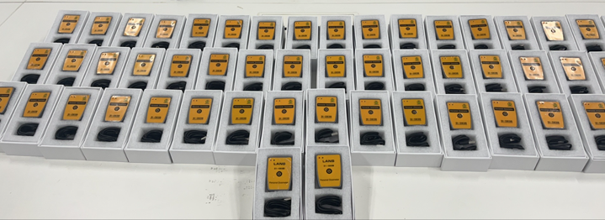
Our Achievements
Serialized and commercialized dosimeter products
radiation probes
personal radiation dosimeters
stationary radiation detectors
Notes:
Besides the gamma ray cameras, personal radiation dosimeters process a large market, too. Nearly 1000 dosimeters produced by our division had been sold in the previous year.

Slide 13
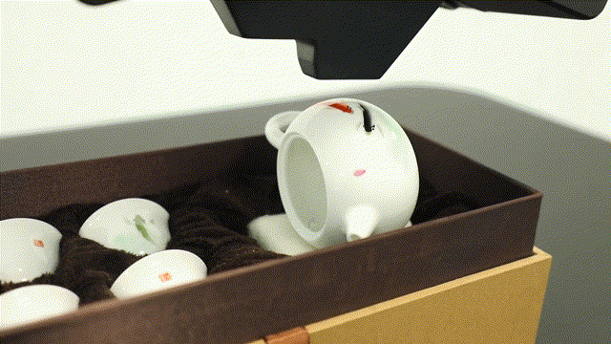
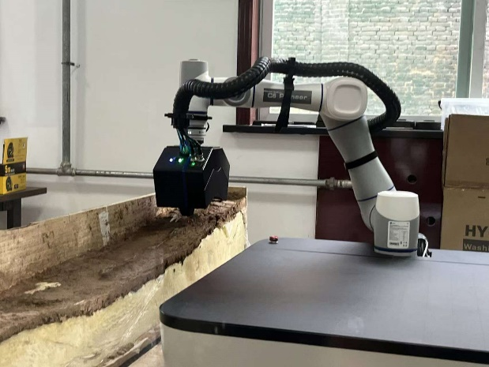
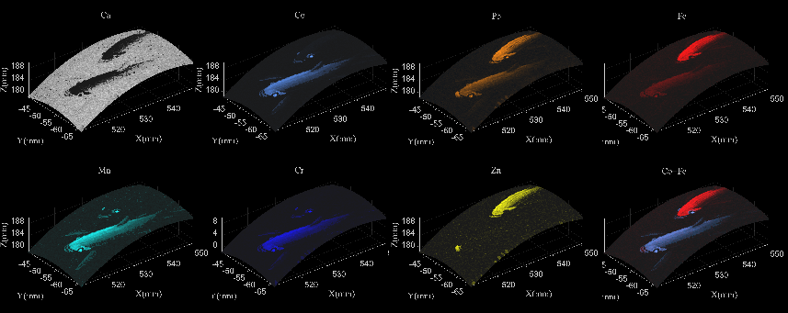
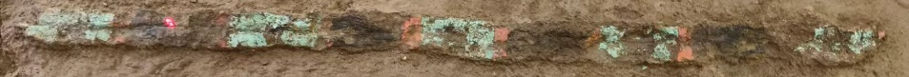
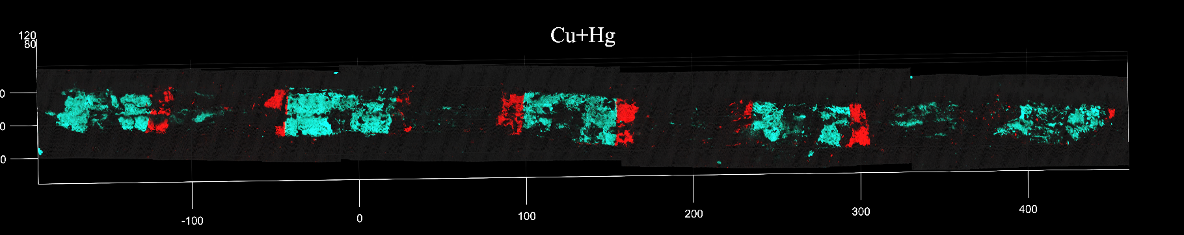
Our Achievements
Robotic XRF for archeology and cultural heritage study
glaze chemical component analysis
ceremonial relic on-the-spot scanning
Notes:
As we know, China is a country with long history and numerous cultural heritages. The enthusiasm to study the historical relics never ends. Our division also devotes many resources to archeological NDT instruments. The robotic X-ray fluorescence device is designed to have excellent flexibility and mobility to fulfill the special requirements of the archeological research. Since its born, it becomes very popular among our customers, including Palace Museum, National Cultural Heritage Administration, Institute of Archeology, etc.

Slide 14
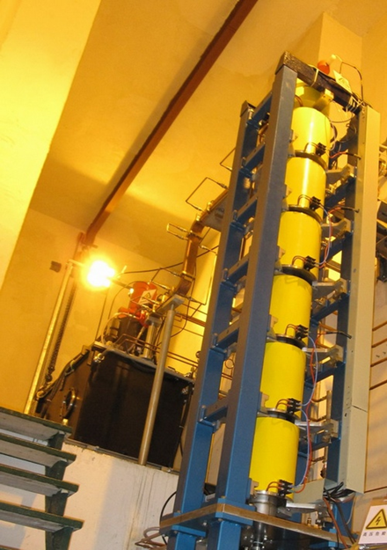
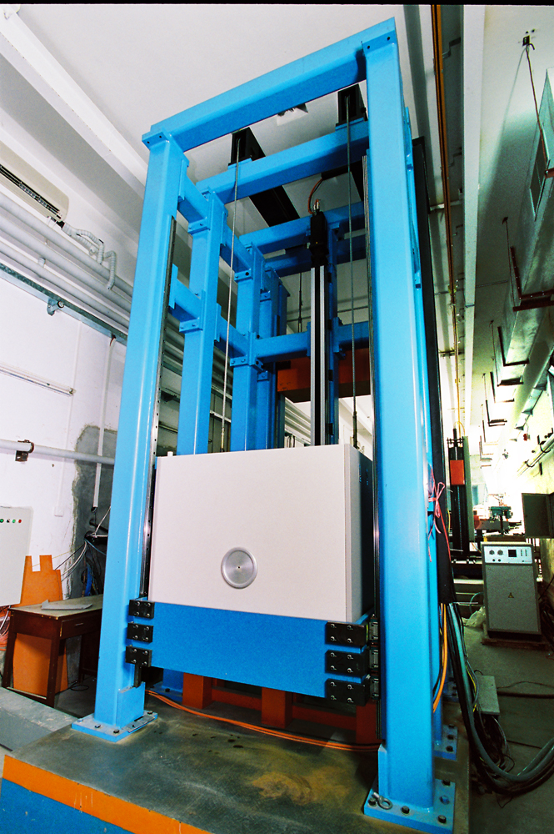
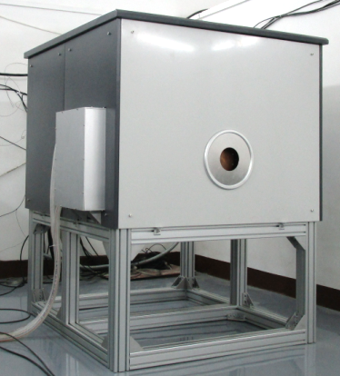
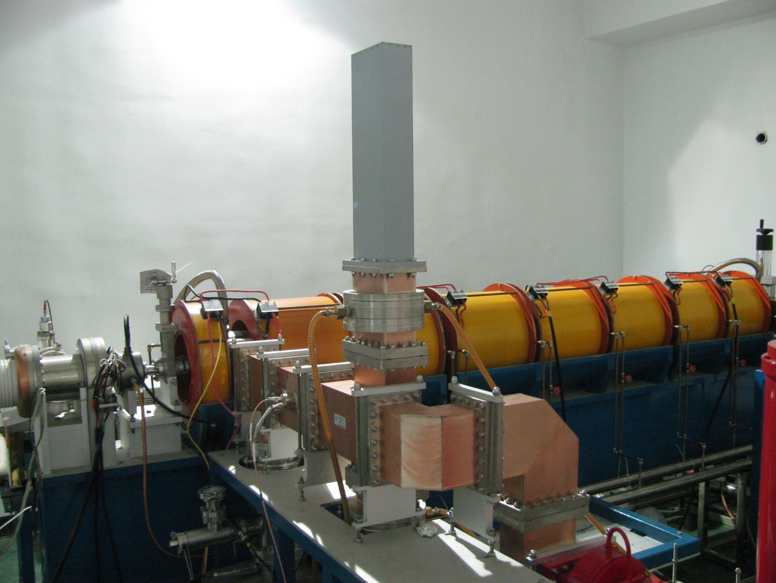
Our Achievements
Compact accelerators
L-band 10MeV industrial irradiation accelerator
9MeV accelerator X-ray source
S-band 10MeV industrial irradiation accelerator
6MeV accelerator X-ray source
Notes:
The irradiation technology has played indispensable role in food and material processing industry. We have a long history in developing irradiation accelerators, not only for industry, but also for fresco protection and high energy X-ray imaging.

Slide 15
Position Description
Opening: Professor
Research area: Nuclear medical imaging technology
Professional background requirements:
Professor or equivalent rank
Experienced in PET/SPECT algorithm or instrumentation
Notes:
So here we come to the introduction of our openings. Now we have 3 professor positions and 3 postdoc positions. Since we are focusing on commercialized products, the job openings here include several R&D positions. The first full rank professor position is for nuclear medical imaging technology. The position will support a researcher with professor or equivalent rank and experienced in PET or SEPCT algorithm or instrumentation.

Slide 16
Position Description
Opening: Associate professor
Research area: Nuclear medical imaging technology
Professional background requirements:
Associate professor or post doctorate experience abroad
Experienced in PET/SPECT algorithm or instrumentation
Notes:
We also have an associate professor opening in the same area. And correspondingly, an associate professor rank is required, and applicant with postdoc experience overseas is also qualified. The working experience is the same with the previous one.

Slide 17
Position Description
Opening: Associate professor
Research area: Radiation detector and system R&D
Professional background requirements:
Associate professor or post doctorate experience abroad
Experienced in advanced radiation detector R&D
Notes:
Another associate professor opening is available in our division, which is for the R&D of radiation detector and system. The requirement in academic rank is the same with the previous associate professor, and the working experience is in detector R&D.

Slide 18
Position Description
Opening: Post doctorate
Research area: X-ray imaging technology
Professional background requirements:
1) CT imaging theories, including reconstruction and data correction or 2) frontier basic research of physics and mathematics
Innovative technology research of static CT and spectral CT, their applications in industry and medicine
Notes:
When it comes to the postdoc openings, the first one is for X-ray imaging technology. We are looking for a candidate with one of these two types of background: the reconstruction and correction theory, or the imaging physics and mathematics. We are especially interested in the techniques of the next generation CT, such as the static CT and the spectral CT. We would also like to have someone professional in the industrial and medical use of CT to join us.

Slide 19
Position Description
Opening: Post doctorate
Research area: Nuclear detection and imaging
Professional background requirements:
Nuclear detection technology research and detection system development
Majoring in physics, nuclear science and technology, biomedical engineering; being familiar with particle physics and nuclear physics
Good communication and cooperation
Notes:
The second postdoc opening is for the nuclear detection and imaging system development. The candidate should be majoring in physics or nuclear science and technology or biomedical engineering and familiar with particle physics and nuclear physics. Since the development is mainly on a team work basis, we would like to have someone with good communication and cooperation skill.

Slide 20
Position Description
Opening: Post doctorate
Research area: Molecular probe
Professional background requirements:
Frontier research of chemistry of radioactive medicine
Diagnosis and treatment dual-purpose radioactive probe design and synthesis
Notes:
The postdoc position for the radioactive probe provides a good chance to carry out research in radiochemistry, especially in the design and synthesis of dual-purpose radioactive probe.

Slide 21
Position Description
Opening: Post doctorate
Research area: Accelerator technology and application
Professional background requirements:
Advanced accelerator technology research and application
Majoring in accelerator physics, accelerator technology and other relative area
Experienced in accelerator system and key component R&D
Notes:
Our last opening is for the irradiation accelerator R&D. We are looking for a candidate majoring in accelerator physics or accelerator technology or other relative area, and with experience in either system design or key component R&D for the irradiation accelerator.

Slide 22
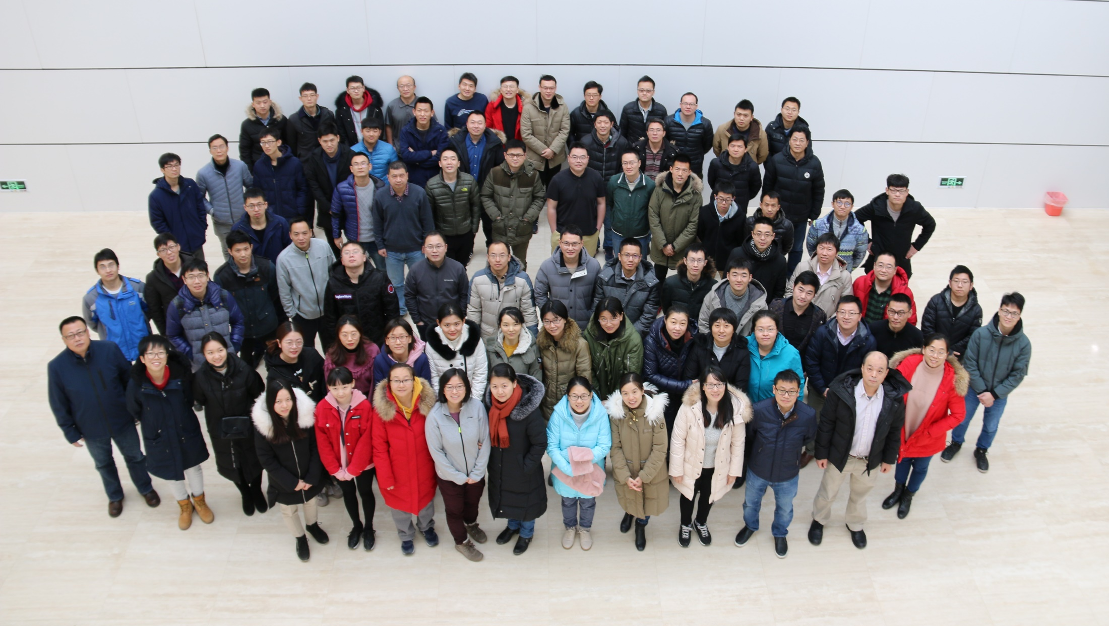
Welcome to join us!
Dr. Wei, Cunfeng, Director of NTAD
Email: weicf@ihep.ac.cn
Notes:
So that would be all of our introduction and thank you for listening! If you are interested in more information, please feel free to contact our director, Dr. Wei, Cunfeng, by the email shown on the bottom right.

