Slide 1
The role of thermal photons in a magnetized plasma and their significance in heavy ion collisions
Xinyang Wang
Center for Fundamental physics
Anhui University of Science and Technology

Slide 2
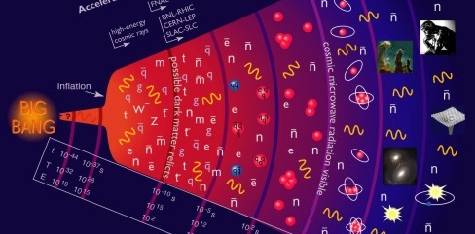
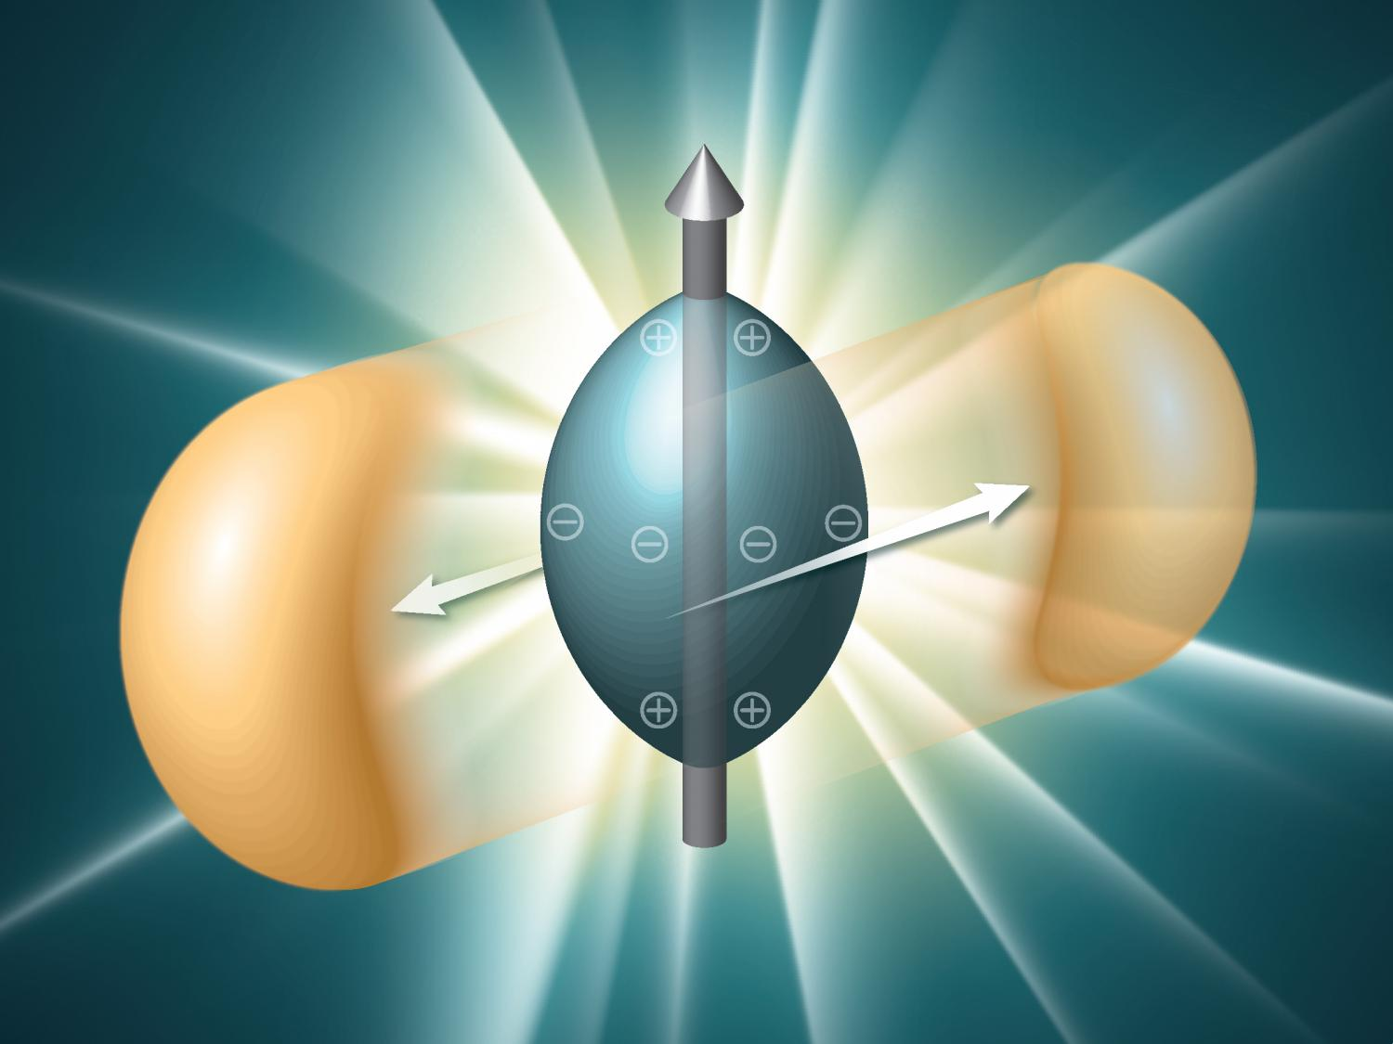
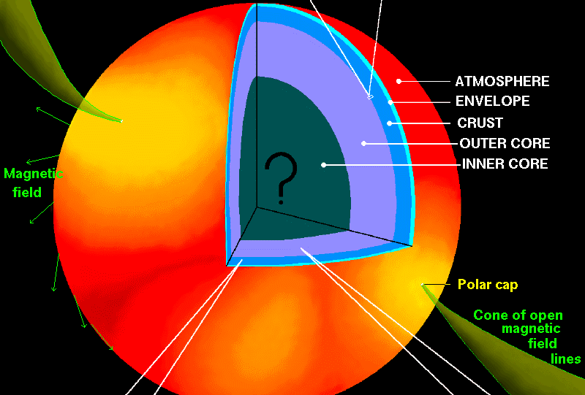
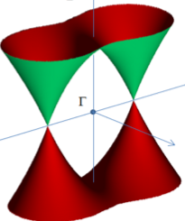
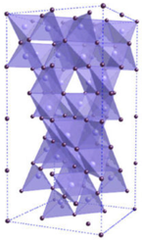
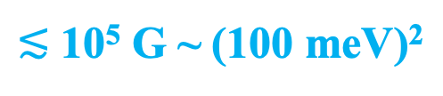
Magnetized plasmas
Early Universe
Heavy-ion collisions
Super-dense matter in magnetars
Electrons in Dirac/Weyl (semi-)metals
10²⁰ to 10²⁴ G ~ (1 GeV)² to (100 GeV)²
10¹⁸ to 10¹⁹ G ~ (100 MeV)²
10¹⁴ to 10¹⁶ G ~ (1 MeV)² to (10 MeV)²
$≲$ 10⁵ G ~ (100 meV)²

Slide 3
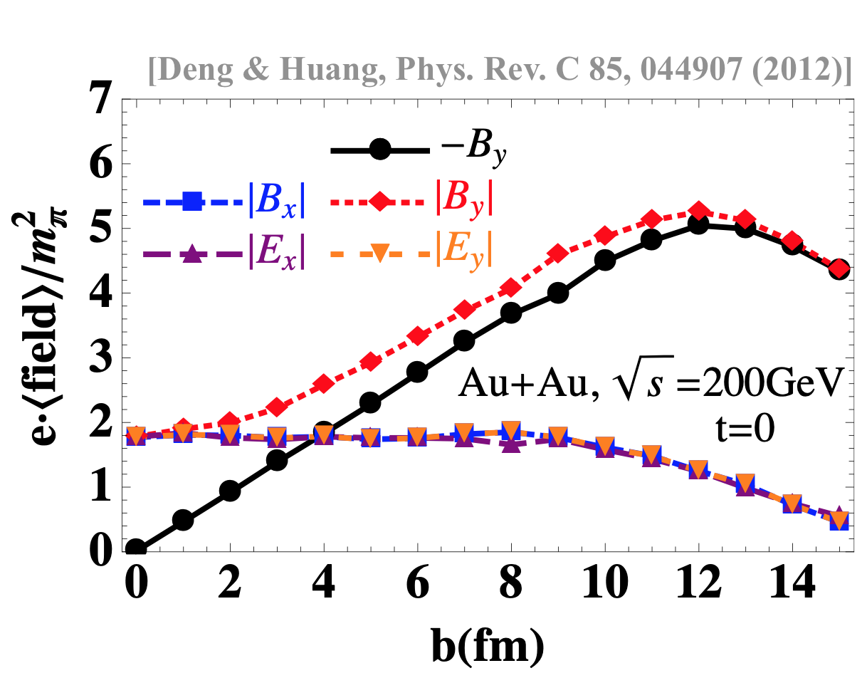
Magnetic field in Heavy-ion collisions
QGP produced at RHIC/LHC is magnetized
Using Lienard-Wiechert potential, one finds
z
z
B
y
+
v
+
+
v
+
y
x
[Rafelski & Müller, PRL, 1976]
[Kharzeev et al., Nucl.Phys.A, 2008]
[Skokov et al., Int J. Mod. Phys. A, 2009]
[Voronyuk et al., PRC, 2011]
[Bzdak &. Skokov, PLB, 2012]
[Deng & Huang, PRC, 2012]
[Bloczynski et al, PLB, 2013]
…

Slide 4

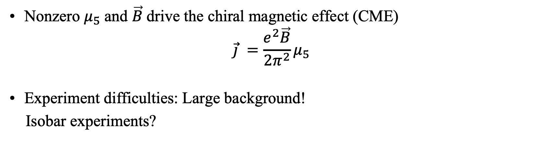
Magnetic field in HIC
Nonzero $μ_{5}$ and $\vec{B}$drive the chiral magnetic effect (CME)
$$\vec{j} =\frac{e^{2}\vec{B}}{2π^{2}}μ_{5}$$
Experiment difficulties: Large background!
Isobar experiments?
Any other possible idea?
[STAR Collaboration, 2014]
No positive official results now!

Slide 5
Photons in HIC
Photons is a Thermometer of QGP
Photons are emitted at all stages of evolution
Weak interacting with matter
https://u.osu.edu/vishnu/category/visualization/

Slide 6
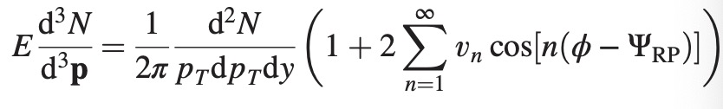
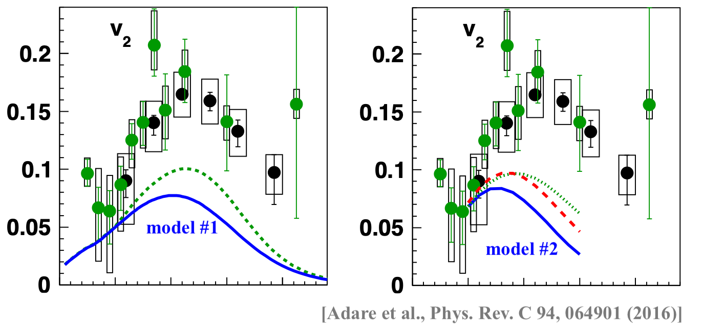
Photon v₂ puzzle
Most photons are produced early (before flow develops)
Thus, v₂ for photons should be very small

Slide 7
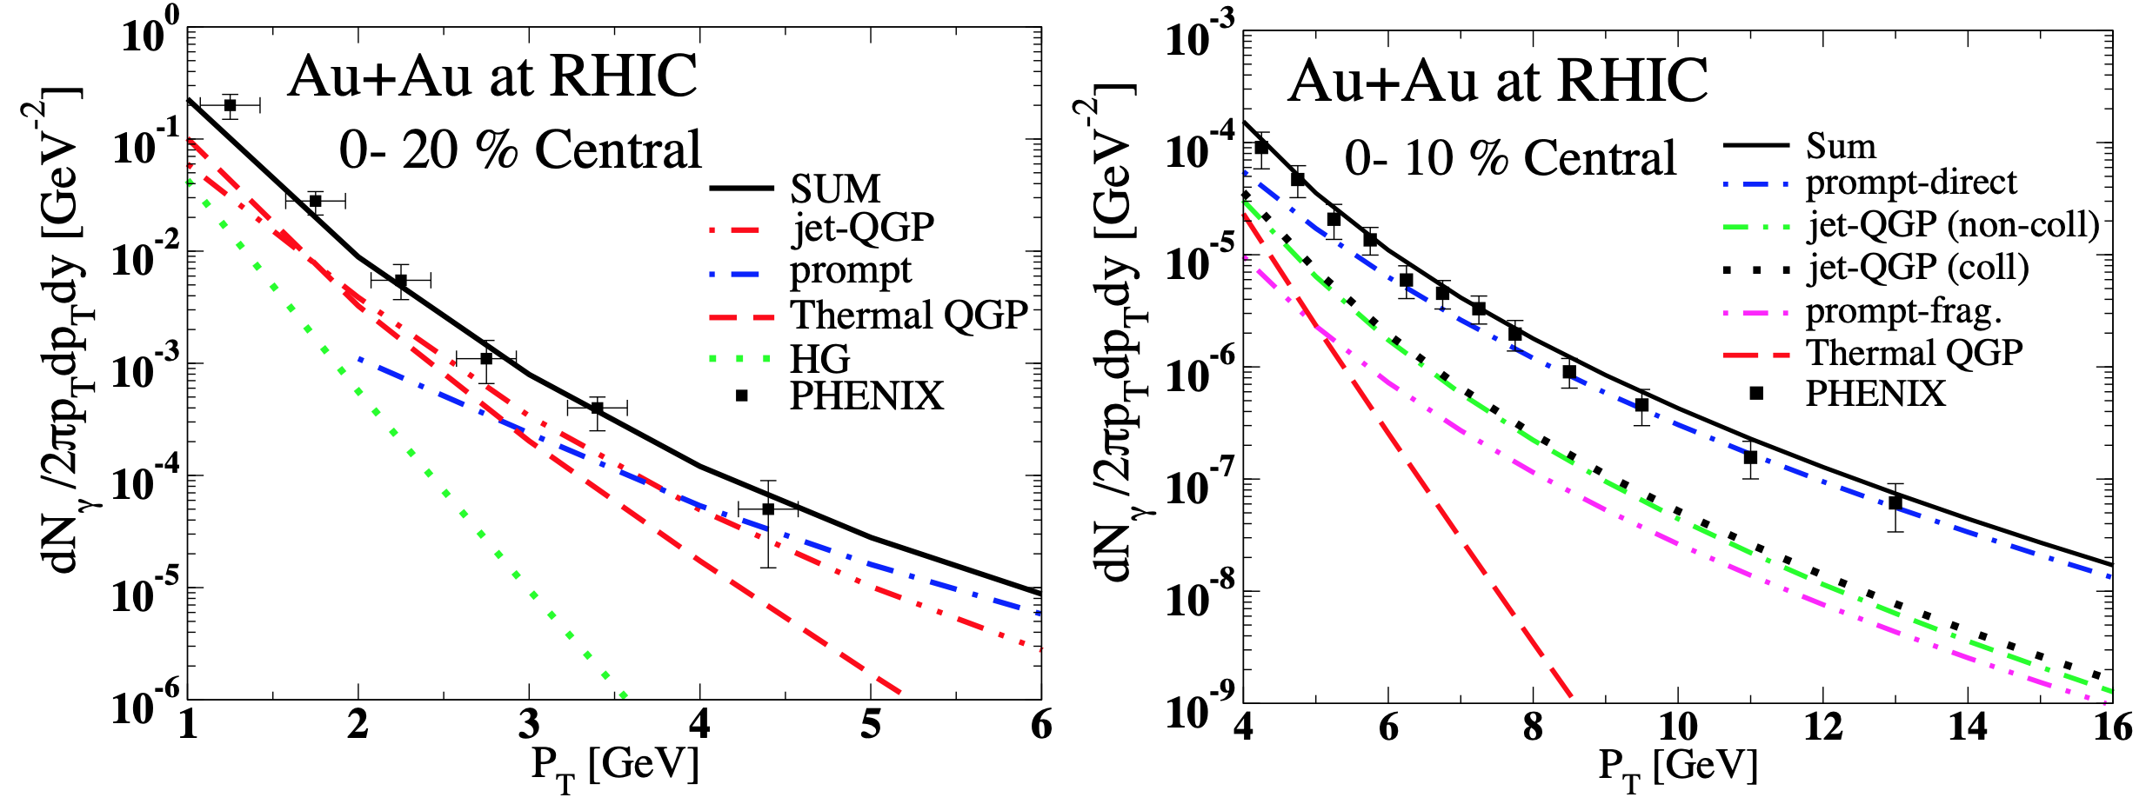
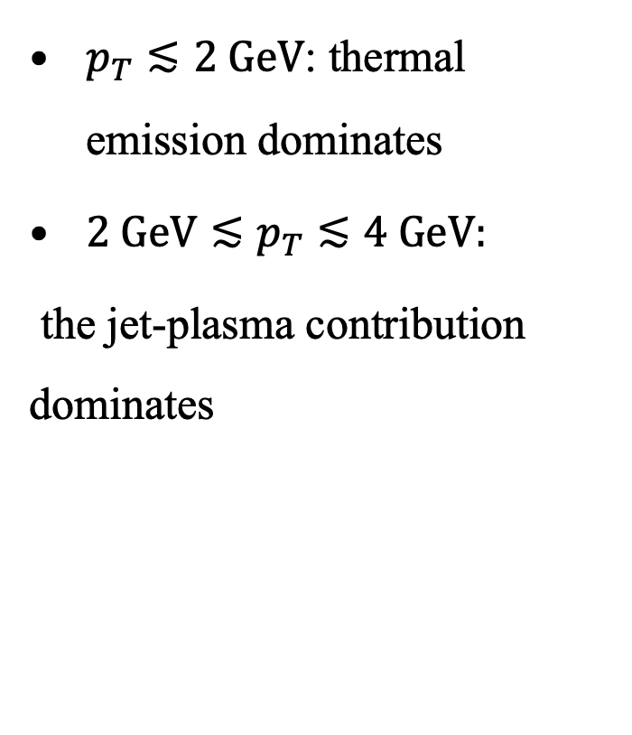
Photon sources in HIC
[Turbide et al,, Phys. Rev. D, 2008]
$p_{T}≲2 GeV$: thermal emission dominates
${2 GeV≲p}_{T}≲4 GeV:$
the jet-plasma contribution dominates

Slide 8



Thermal photons
The rate of the thermal emission of photons (the energy loss rate) is
In the case of hot QCD plasma,
Processes:
$$✗$$
$$✓$$
$$✓$$
[Kapusta et al., PRD, 1991]
[Baier et al., Z. Physik C, 1992]

Slide 9
The approximate result is given by
There are important corrections from bremsstrahlung and inelastic pair annihilation
Corrections are ~ 100%
[Arnold et al., JHEP, 2001]
[Ghiglieri et al., JHEP, 2013]

Slide 10

Photons from magnetized plasma
At $\vec{B}≠0$, the leading-order polarization tensor
leads to a nonzero result!
All three processes i.e.,
are allowed by the energy conservation.

Slide 11
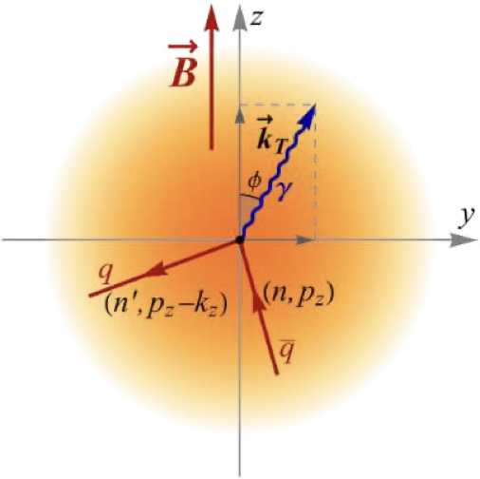

Photon thermal rate
The expression for the rate is
At $\vec{B}≠0$, the imaginary part is
[X.W., Igor Shovkovy, Lang Yu, Mei Huang, PRD, 2020]
[X.W., Igor Shovkovy, PRD, 2021]

Slide 12

The thermal photon production rate
  decreases with energy ($k_{T}$) at large $k_{T}$
  increases with temperature
  goes to zero when $k_{T}→0$ (quantization effects), has a peak at small nonzero $k_{T}$
  relatively large

Slide 13
Physics processes
Real solutions to the energy conservation equation
can be found under the following conditions:

Slide 14


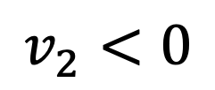
Angular dependence: small $k_{T}$
Non-smooth dependence on $φ$ (due to many thresholds)
Parametrization: $k_{x}=0$, $k_{y}=k_{T}\cos{φ}$ and $k_{z}=k_{T}\sin{φ}$
Average rate is maximal at $φ=\frac{π}{2}$ (i.e., $⊥$ to the reaction plane)
reaction
plane
$$v_{2}<0$$

Slide 15


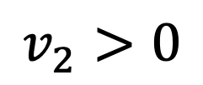
Angular dependence: large $k_{T}$
Rate quickly decreases with $k_{T}$
Average rate is maximal at $φ=0$ (i.e., $∥$to the reaction plane)
reaction
plane
$$v_{2}>0$$

Slide 16



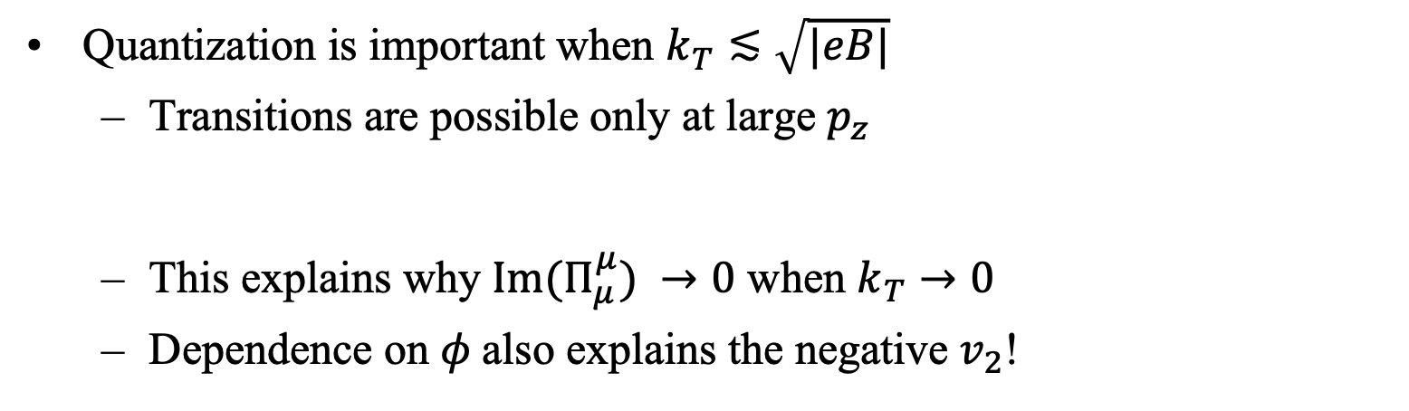


Quantization @ small $k_{T}$
Quantization is important when $k_{T}≲\sqrt{|eB|}$
  Transitions are possible only at large $p_{z}$
  This explains why $Im(Π_{μ}^{μ}) →0$ when $k_{T}→0$
  Dependence on $φ$also explains the negative $v_{2}$!
$⊥$to reaction plane:
$⊥$to reaction plane:
$∥$to reaction plane:
$∥$to reaction plane:

Slide 17
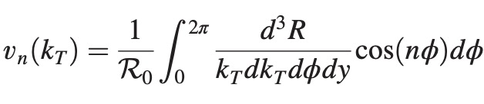
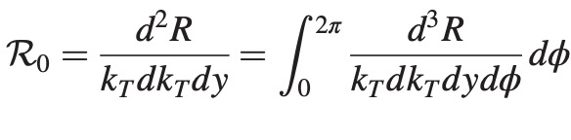
Nonzero elliptic “flow” ($v_{2}$)

Slide 18

Photon $v_{4 }and{ v}_{6}$
[X.W., Igor Shovkovy, PRD, 2024]

Slide 19
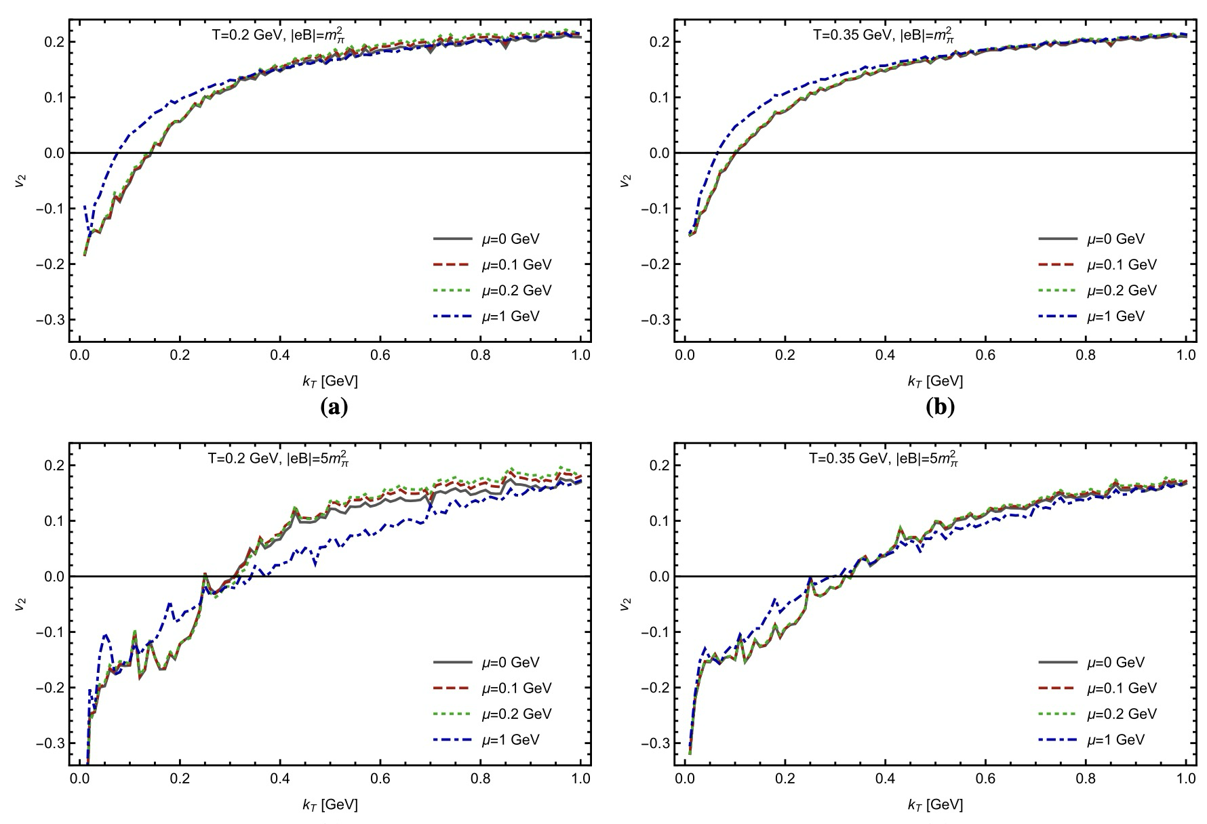
Finite chemical potential
[X.W., Igor Shovkovy, EPJC, 2021]

Slide 20
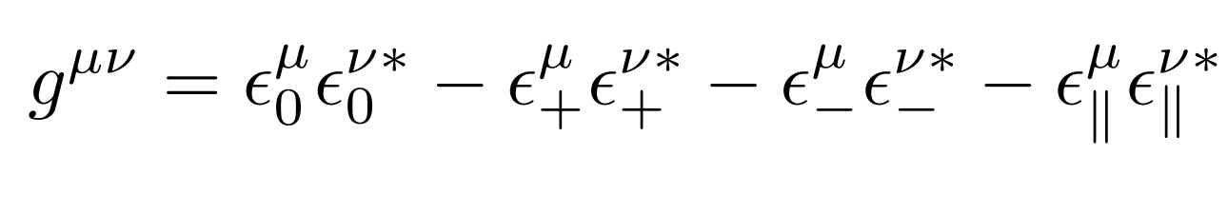
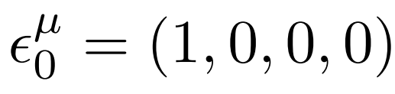
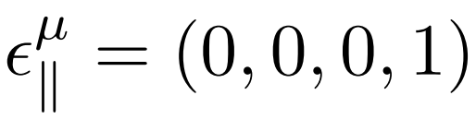
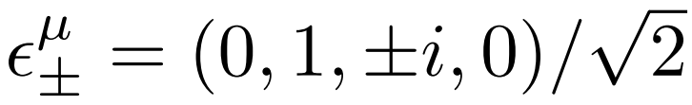
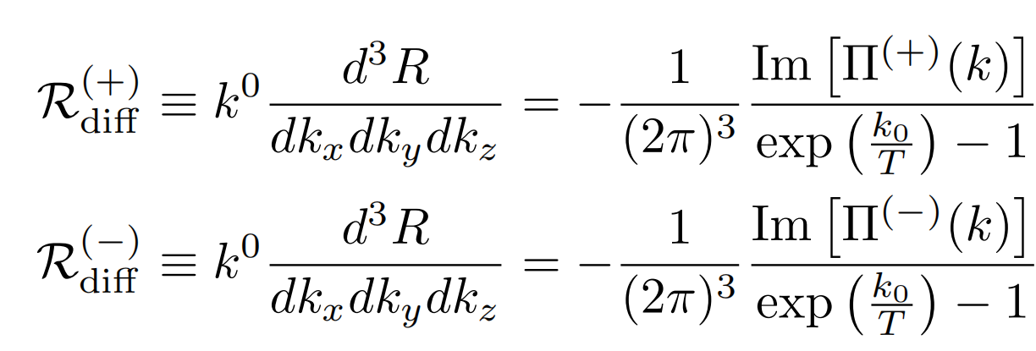
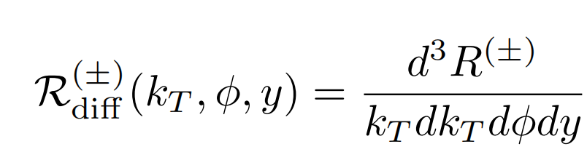
Polarization decomposition
[X.W., Igor Shovkovy, Accepted by PRD, 2024]

Slide 21
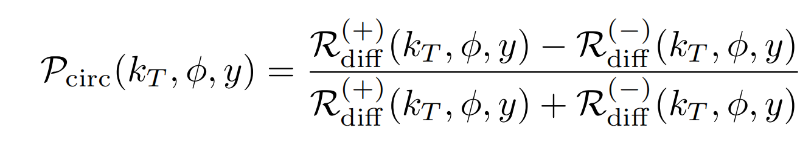
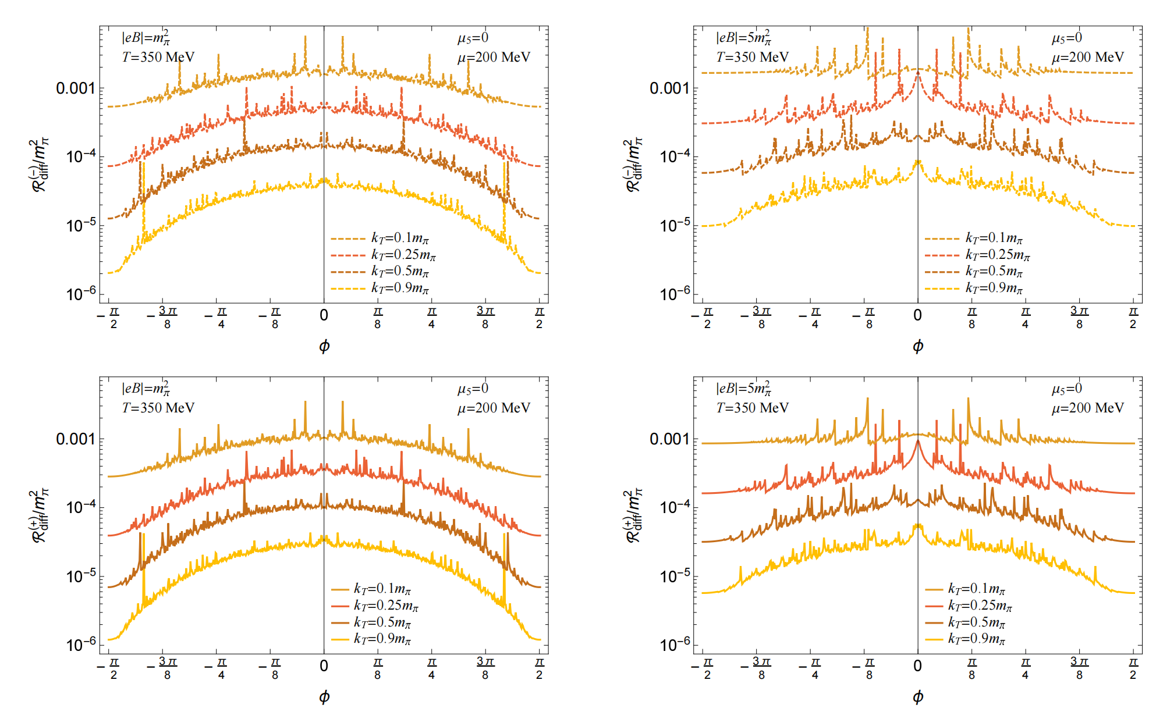
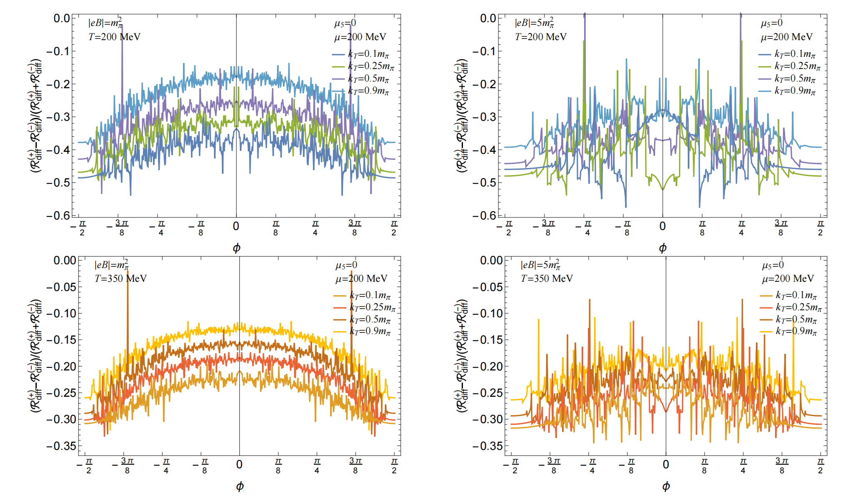
𝛍≠0

Slide 22
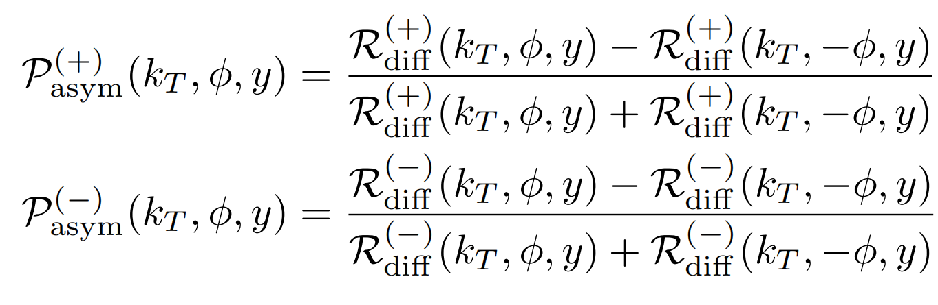
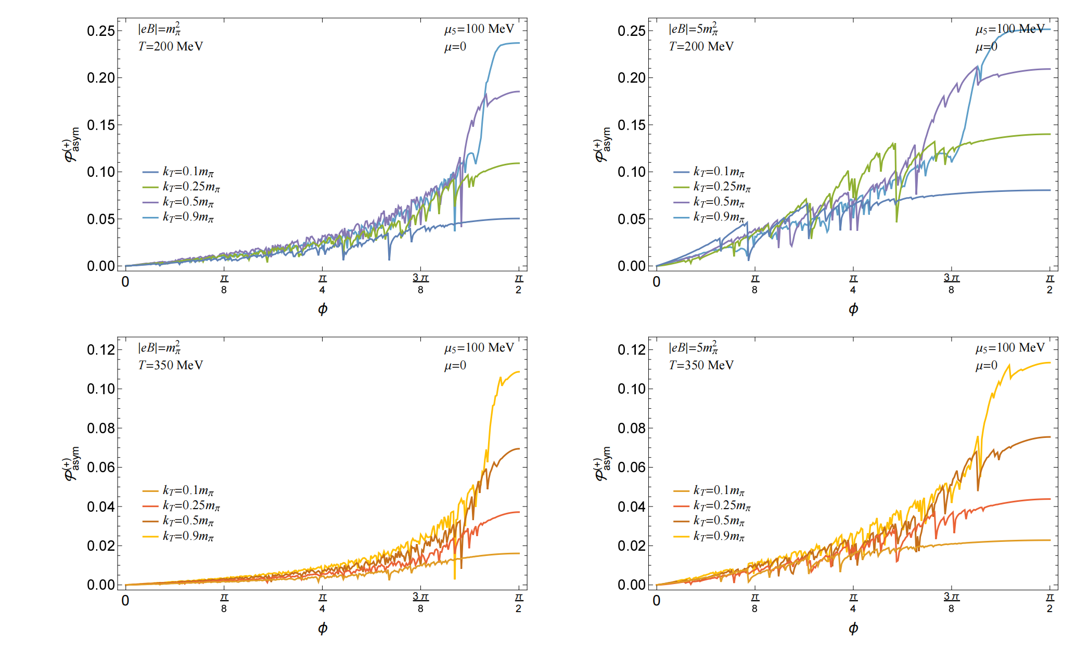
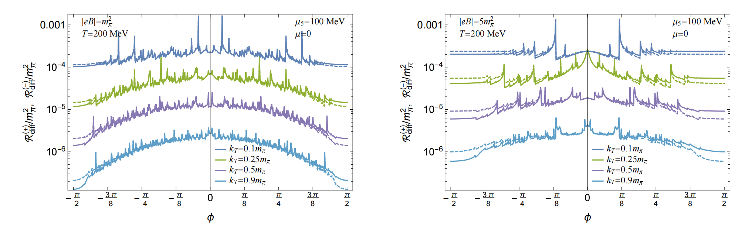
𝛍₅≠0

Slide 23
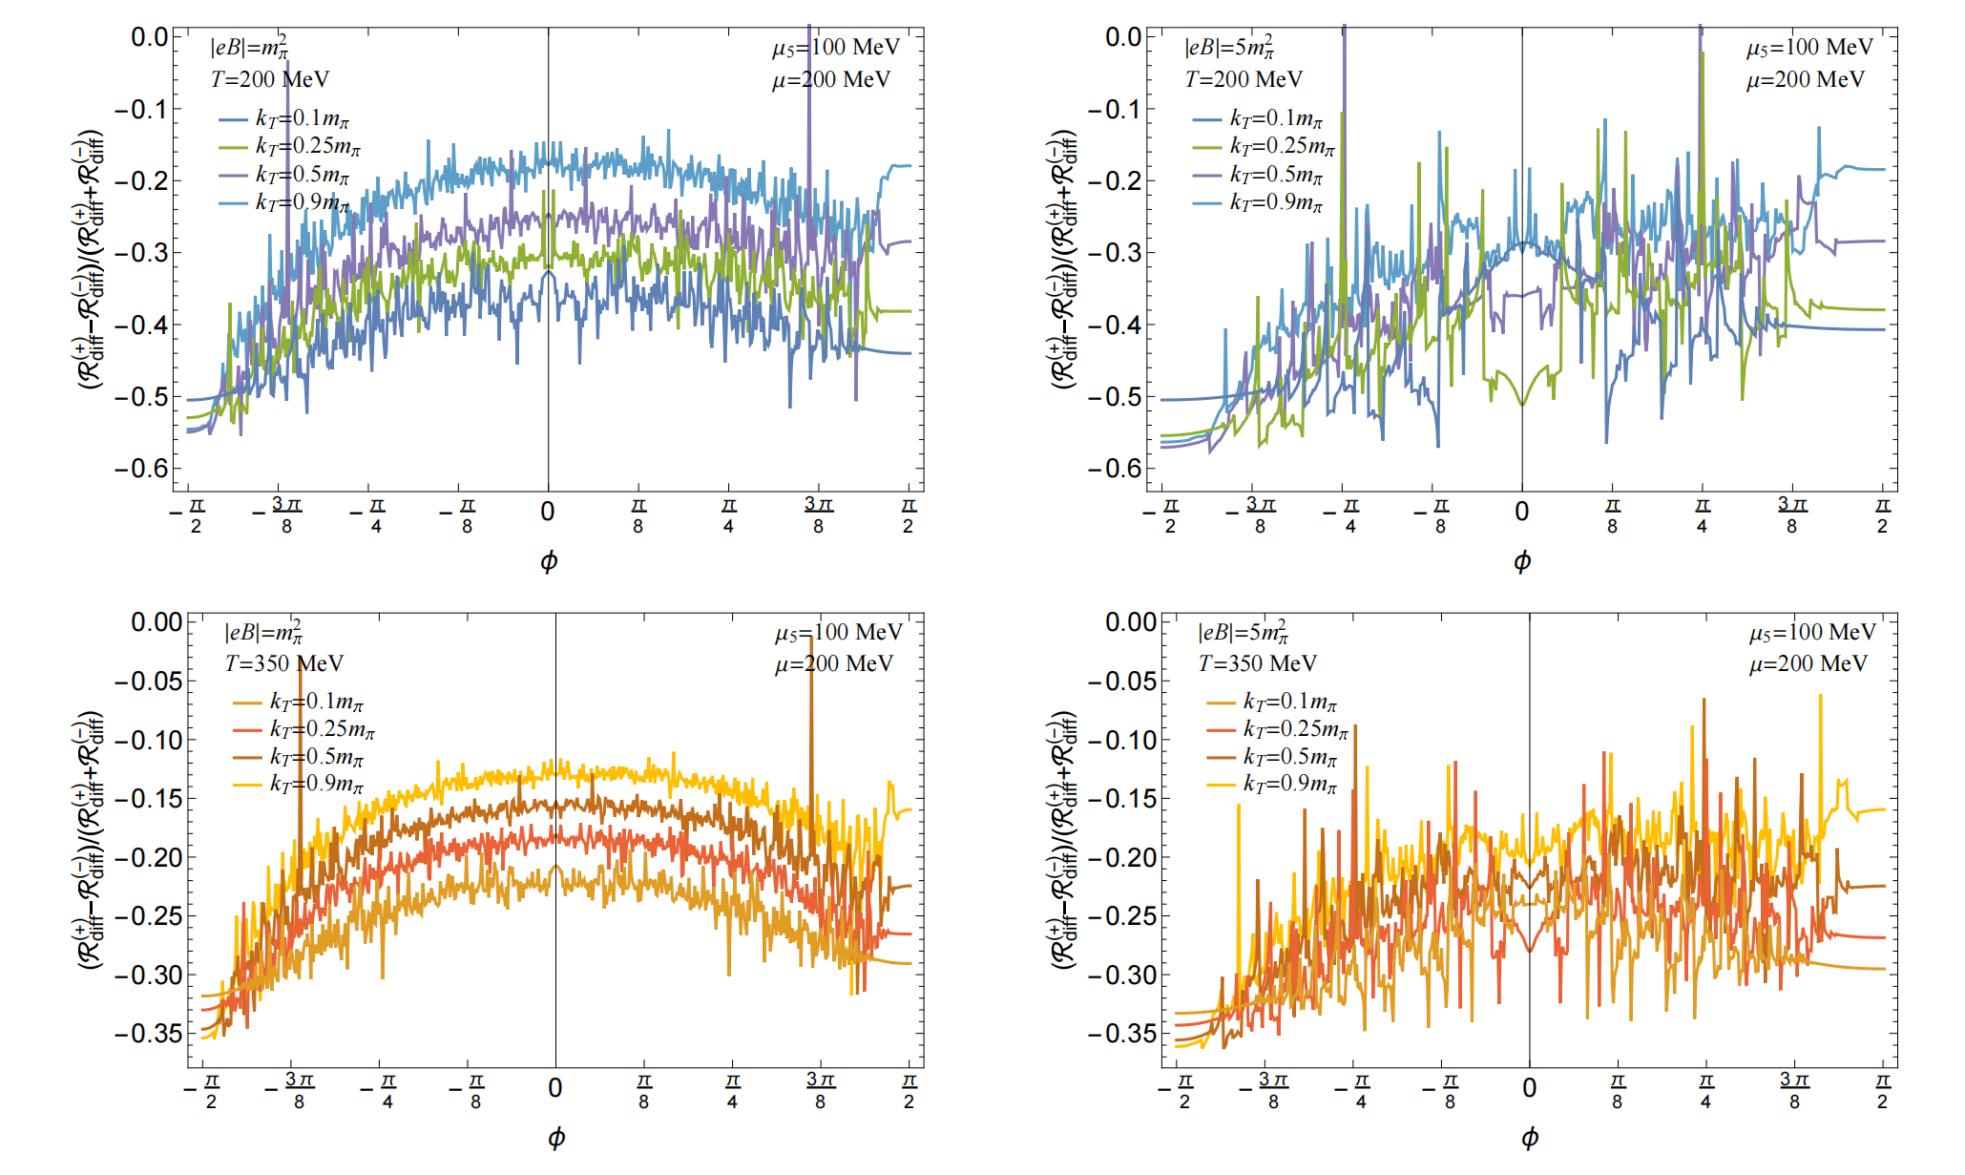
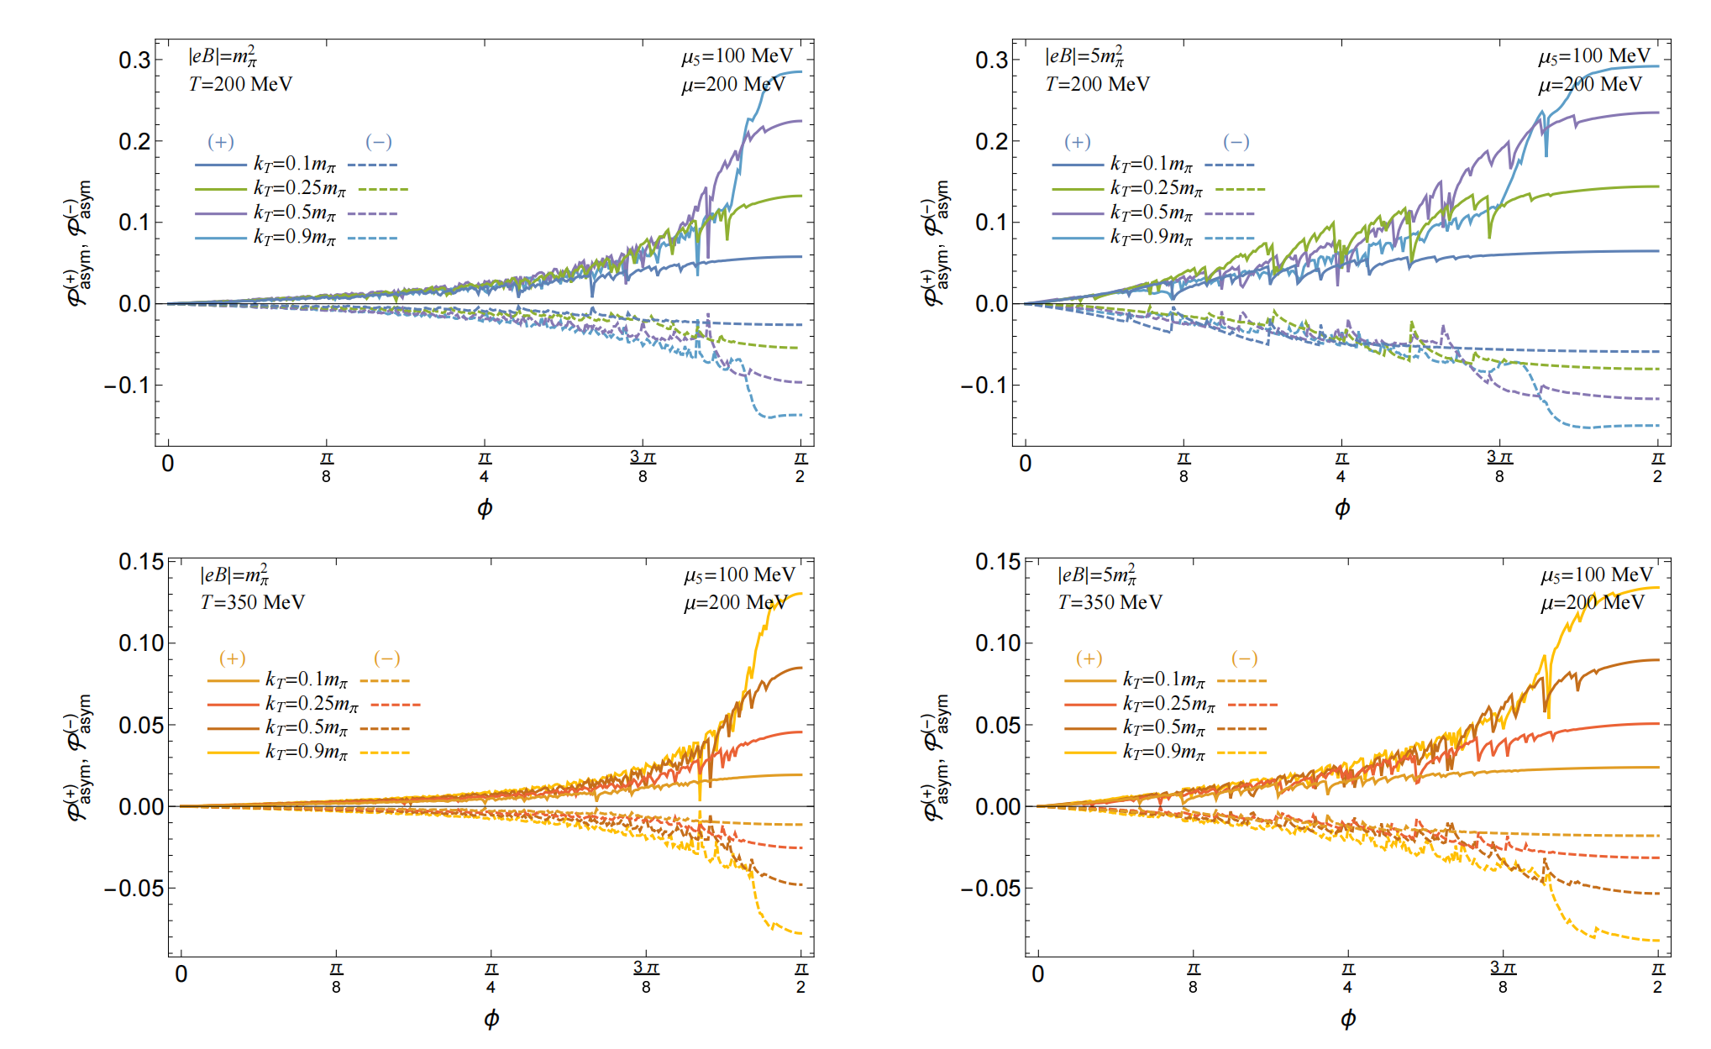
𝛍, 𝛍₅ ≠0

Slide 24
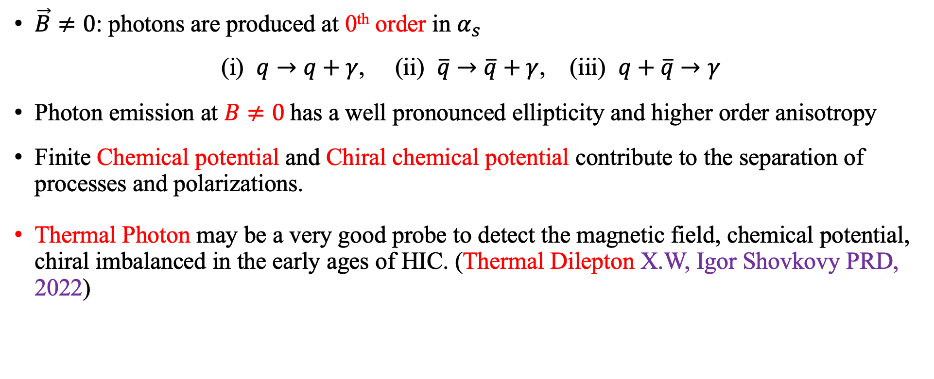
Summary
$\vec{B}≠0$: photons are produced at 0th order in $α_{s}$
(i) $q→q+γ$, (ii) $\overline{q}→\overline{q}+γ$, (iii) $q+\overline{q}→γ$
Photon emission at $B≠0$has a well pronounced ellipticity and higher order anisotropy
Finite Chemical potential and Chiral chemical potential contribute to the separation of processes and polarizations.
Thermal Photon may be a very good probe to detect the magnetic field, chemical potential, chiral imbalanced in the early ages of HIC. (Thermal Dilepton X.W, Igor Shovkovy PRD, 2022)

Slide 25
Thank you!

