Slide 1
Status of MDC noise issues
Mingyi Dong
On behalf of the working group dongmy@ihep.ac.cn
IHEP, CAS
2025.1.11

Slide 2
Outline
Noise issues after CGEM installation
Shielding Improvement for CGEM patch cards and MDC preamplifiers
Summary and discussion

Slide 3
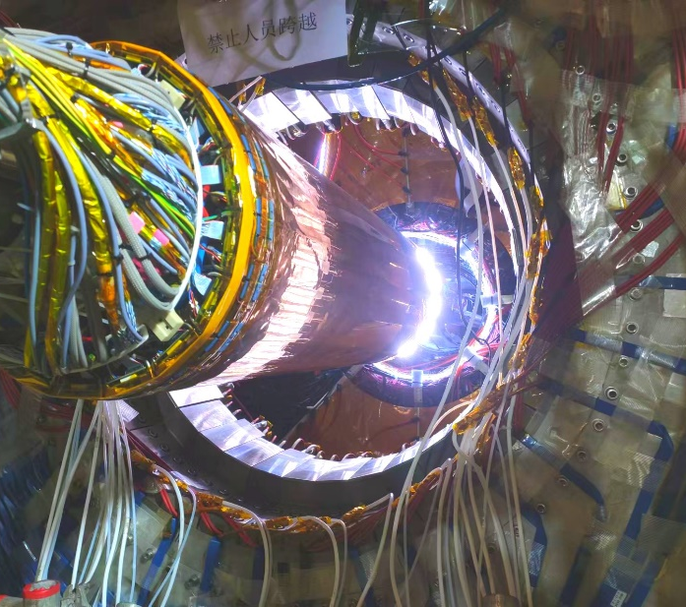
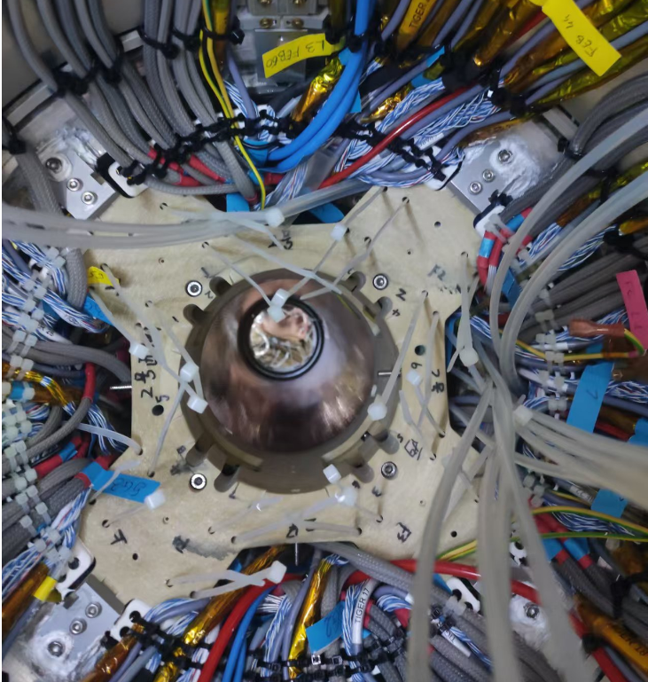
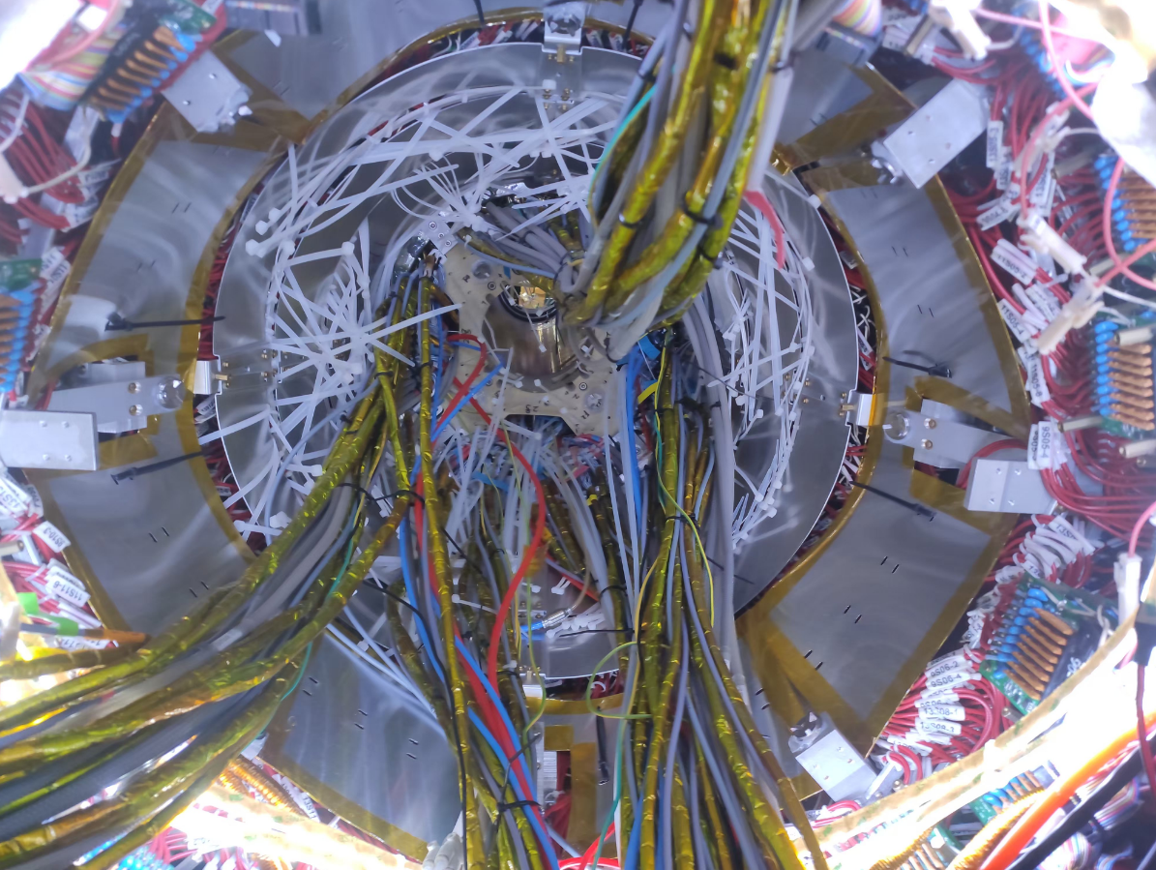
Installation of CGEM
CGEM was inserted into the BESIII and fixed on MDC flange2 through FR4 flanges on both sides
Grounding was separated from MDC physically
A aluminum shielding layer was installed to separate MDC cables and CGEM cables

Slide 4
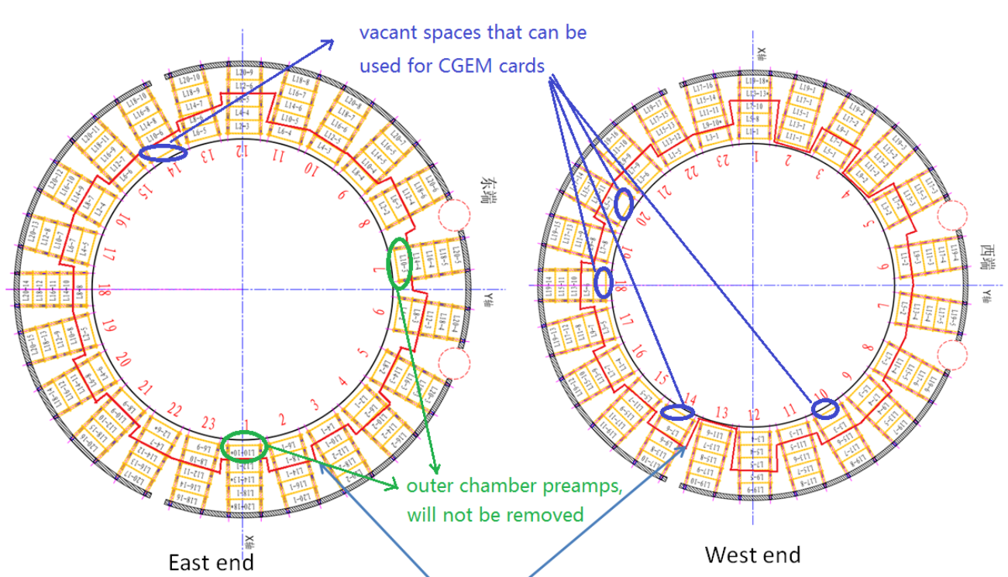
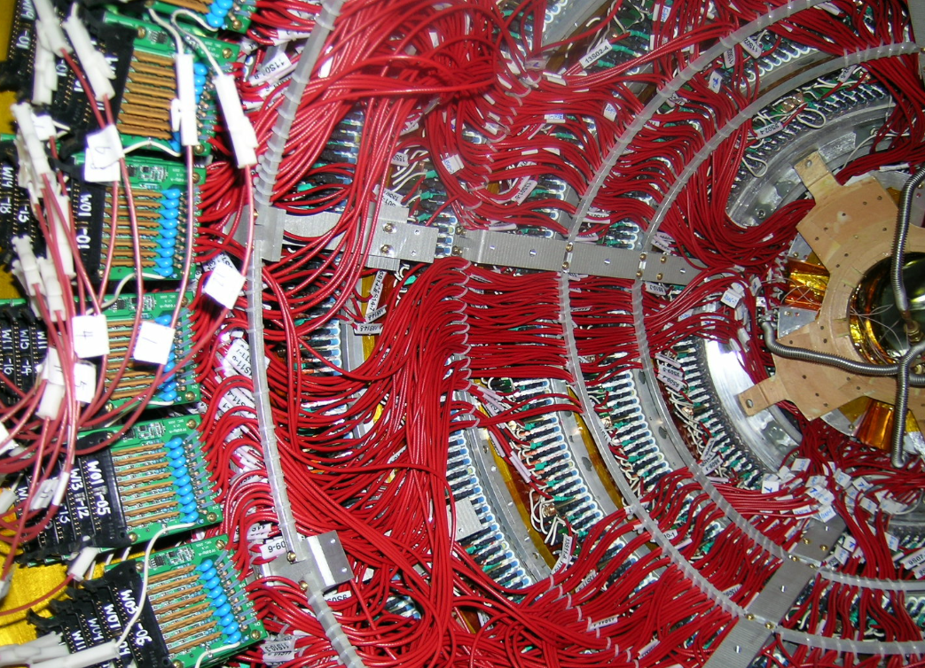
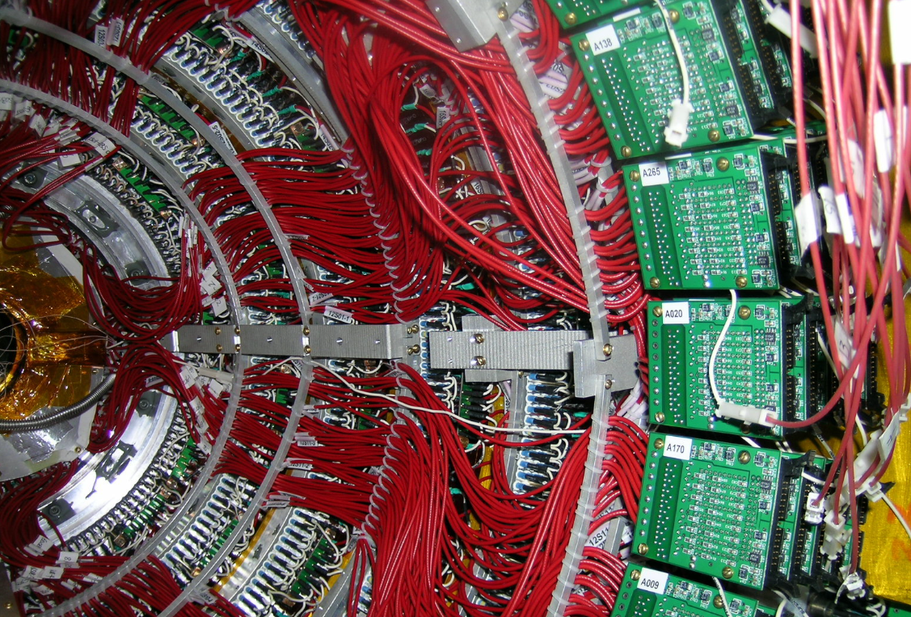
CGEM Patch cards installation
MDC preamp tower
The preamplifier boards of inner chamber were removed, and the space was used to install CGEM patch cards

Slide 5
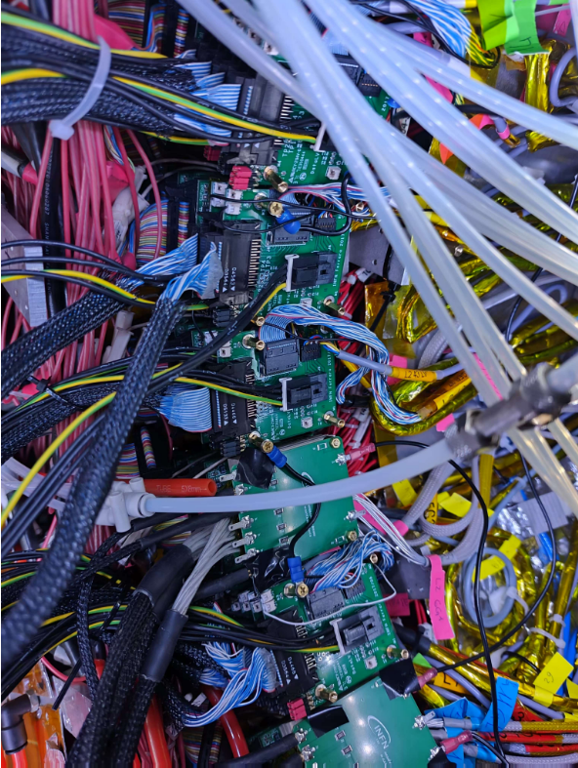
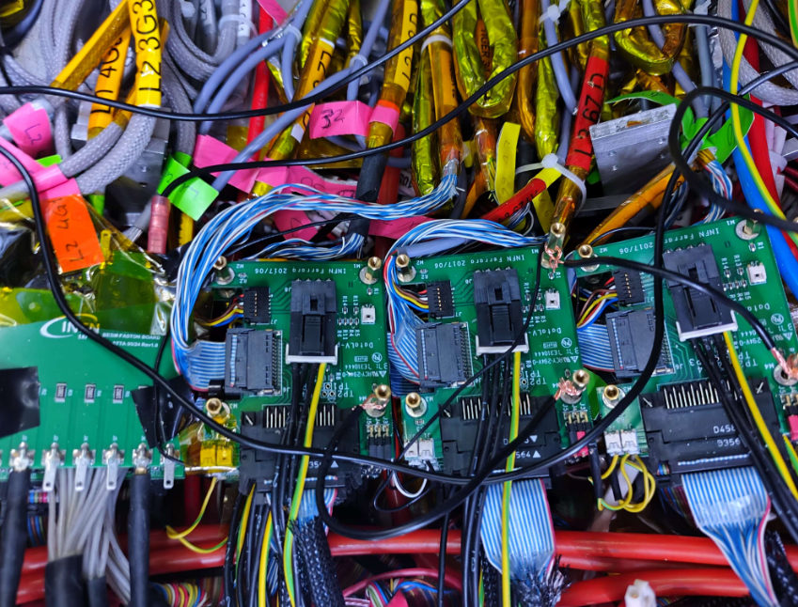
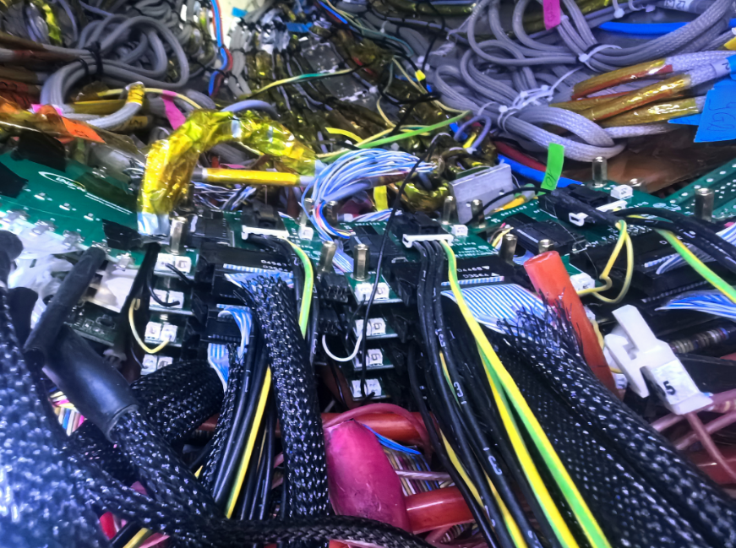
CGEM Patch cards installation
CGEM patch cards are fixed on the “tower” of the MDC preamplifier boards
Insulated screws are used to separate the grounding of CGEM and MDC
Due to the limited space, at the beginning, there is no shielding layer between MDC preamplifier boards and CGEM patch cards

Slide 6
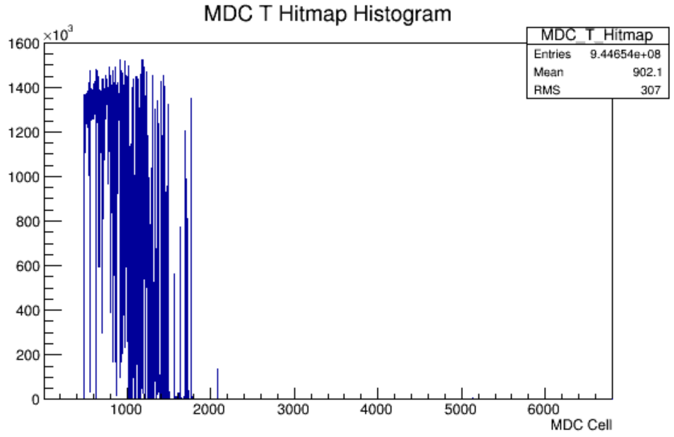
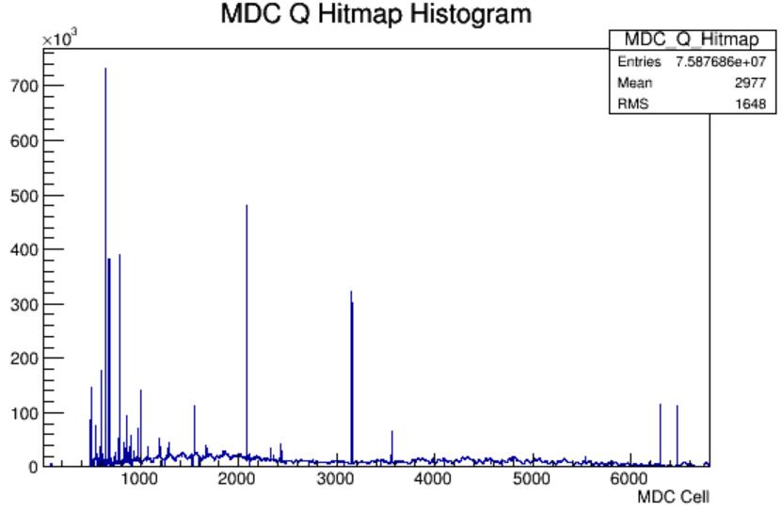
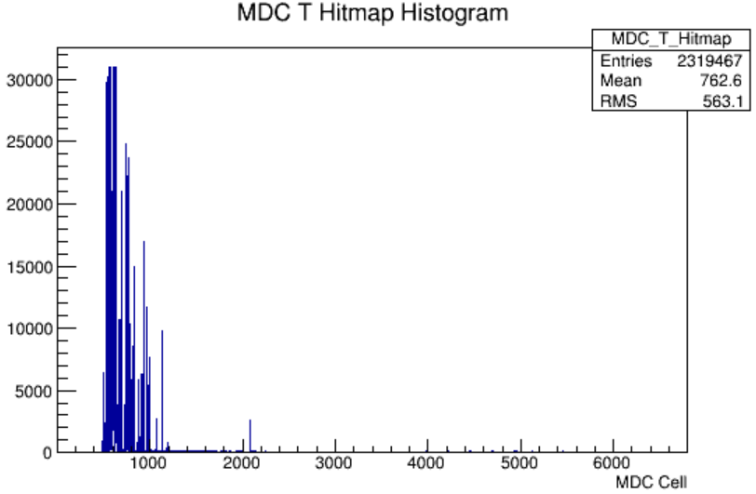
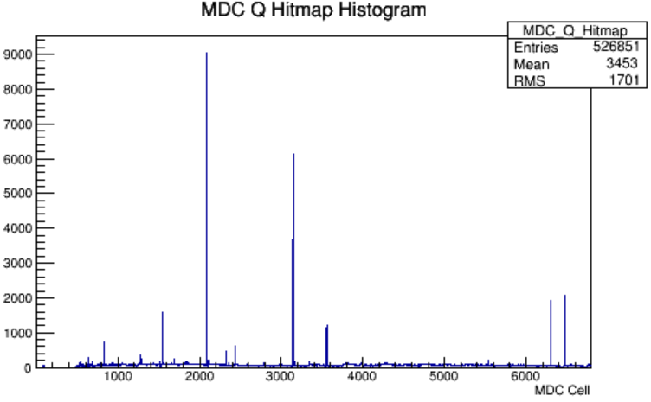
Noise issues
After CGEM installation, noise was found in MDC stepped part during the joint test.
The noise is in the step part of the MDC
The inner layers are larger, and the outer layers become smaller
Noise mainly impact on Time measurement, almost no impacts on Charge measurement
Noise has a larger impact on the even layers of MDC (readout electronics is at the east end)
Even if CGEM is powered off, there are still some channels with noise
Lots of grounding and shielding tests have been done. no significant effect on reducing noise
Run 83079
CGEM on
Run 83079
CGEM on
Run 83202
CGEM off
Run 83202
CGEM off

Slide 7
Dedicated meeting on noise issues
On Dec. 2, a special meeting was organized and 9 experts were invited to join the meeting on noise issues.
After the discussion, the consensus is that the patch cards of CGEM may be the main cause of the noise since they are mounted on the preamplifier “towers” of the MDC. Therefore, it is necessary to shield the patch cards of CGEM and meanwhile improve the shielding of the MDC stepped part.

Slide 8
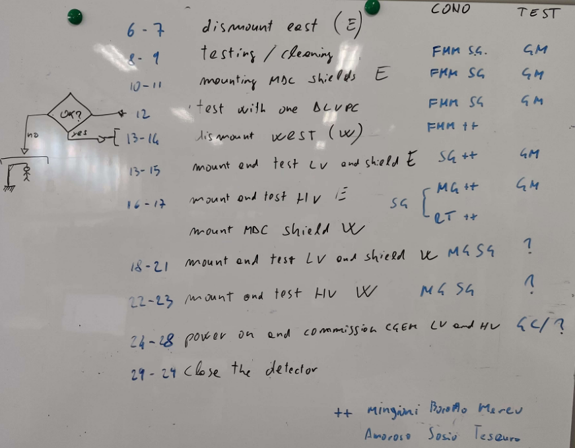
The detailed plan
The related work includes dismounting, adding shielding plates, reinstalling CGEM patch cards, testing, etc., and will be completed on Dec. 23
The recovery work of IP will start on Dec.24
Causing a 3 weeks delay in the project schedule (accelerator startup: Jan.8 -> Jan. 27).
The plan was approved

Slide 9
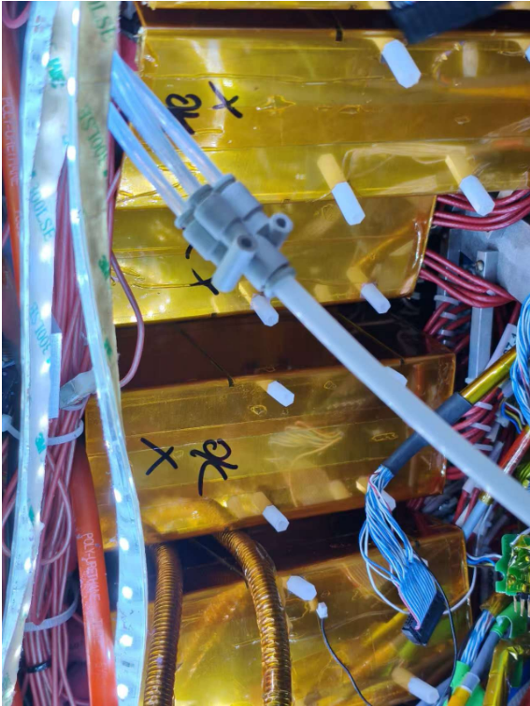
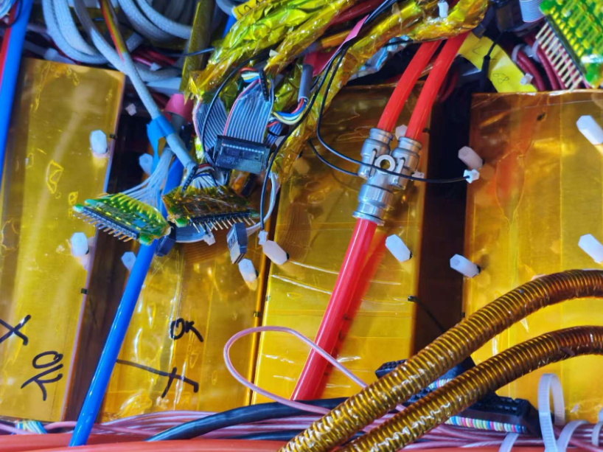
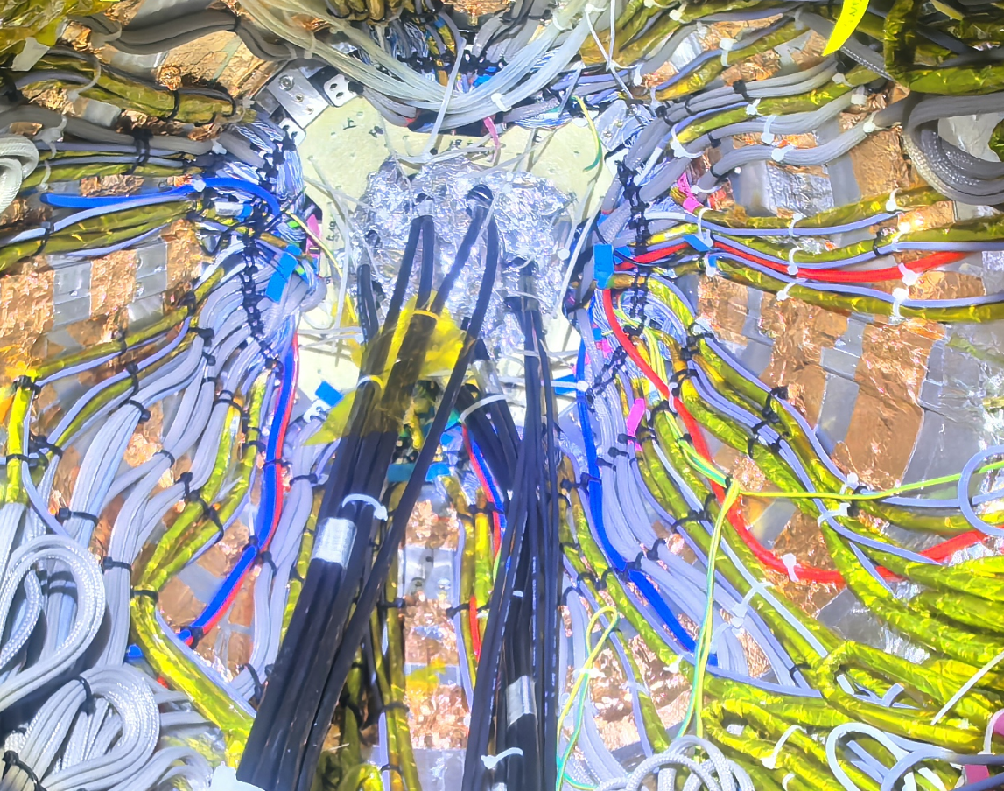
Improvement of MDC shielding
Improving the shielding layer between MDC cables and CGEM cables
Adding shielding boxes for MDC preamplifiers (copper, thickness: 1mm)

Slide 10
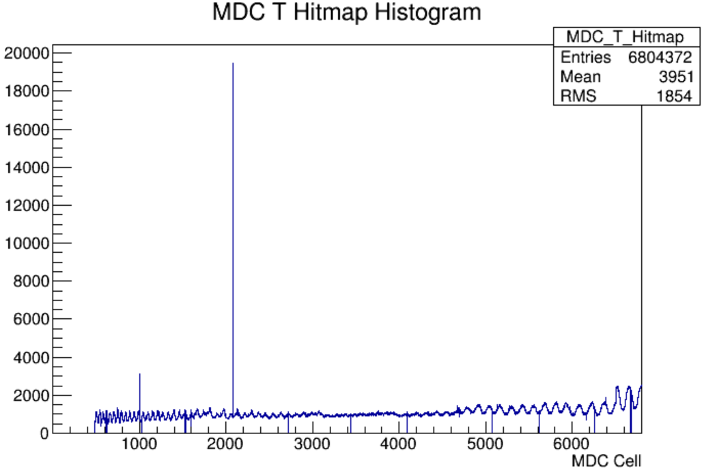
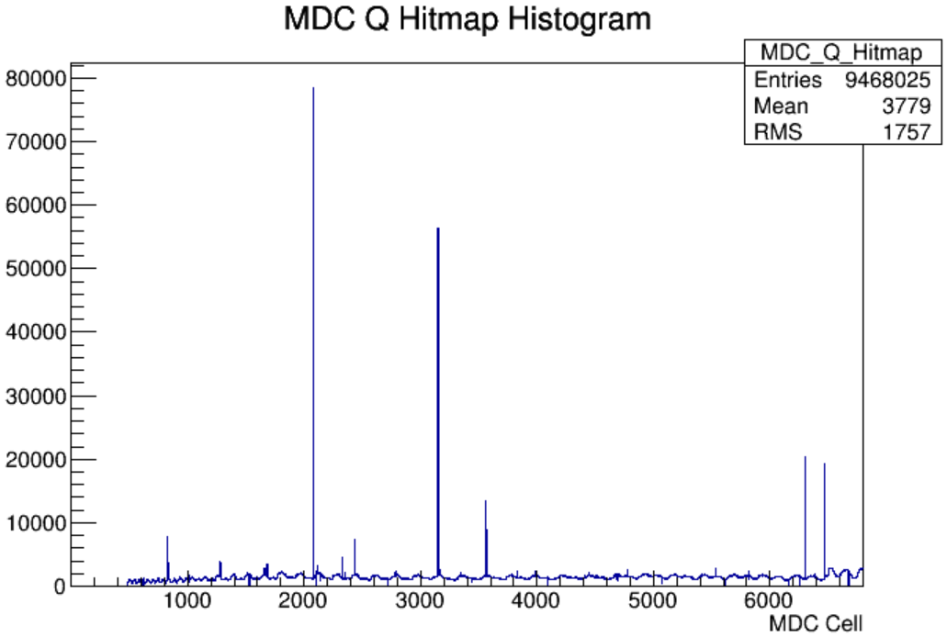
Cosmic-ray tests
After the installation of the shielding boxes for MDC preamplifiers , cosmic-ray testing was conducted
Without connecting the CGEM path cards, no noise was found in MDC
Run 83736
Dec.15
Run 83736
Dec.15

Slide 11
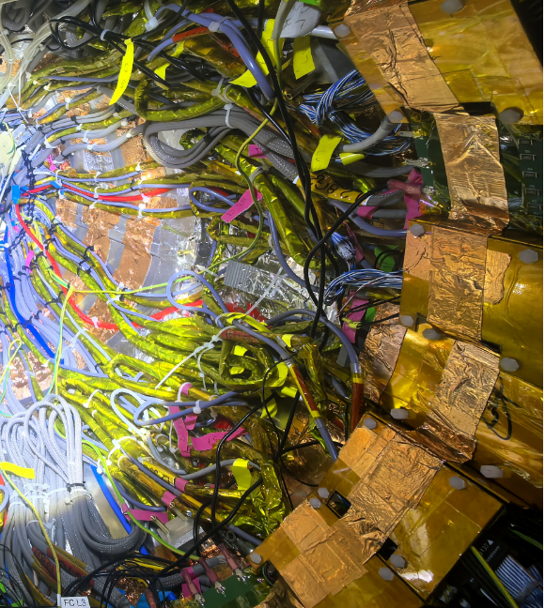
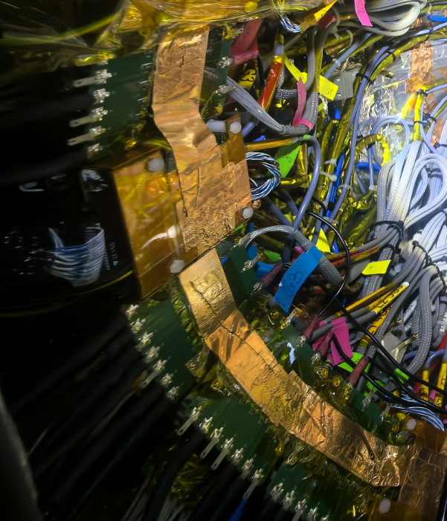
Installation of shielding boxes for CGEM patch cards
Reinstalling CGEM patch cards
Adding shielding boxes for CGEM patch cards (signal and low voltage)
No boxes for high voltage patch cards

Slide 12
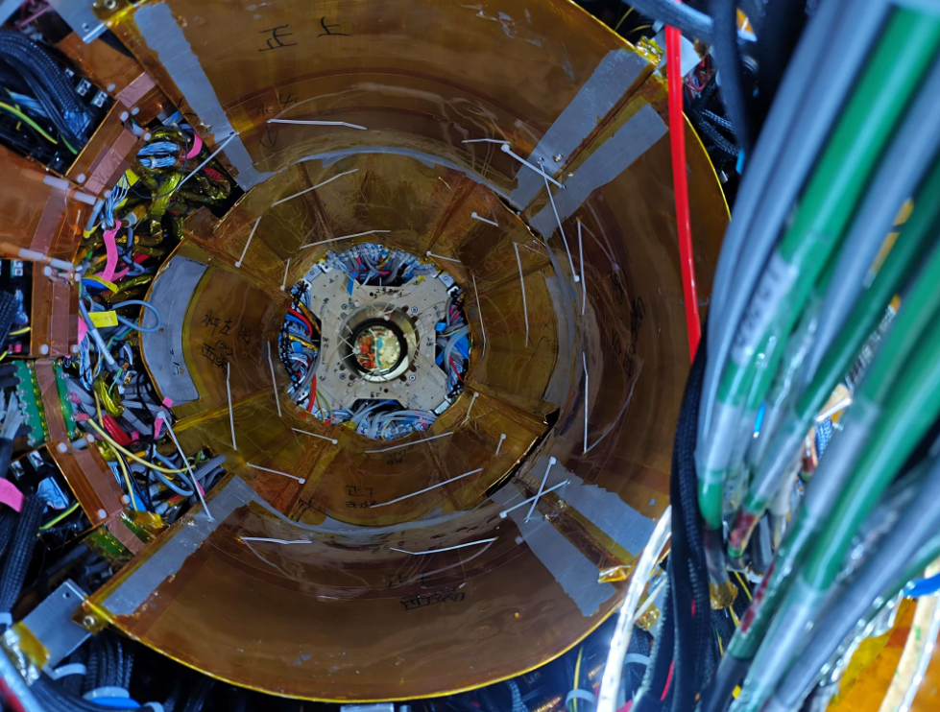
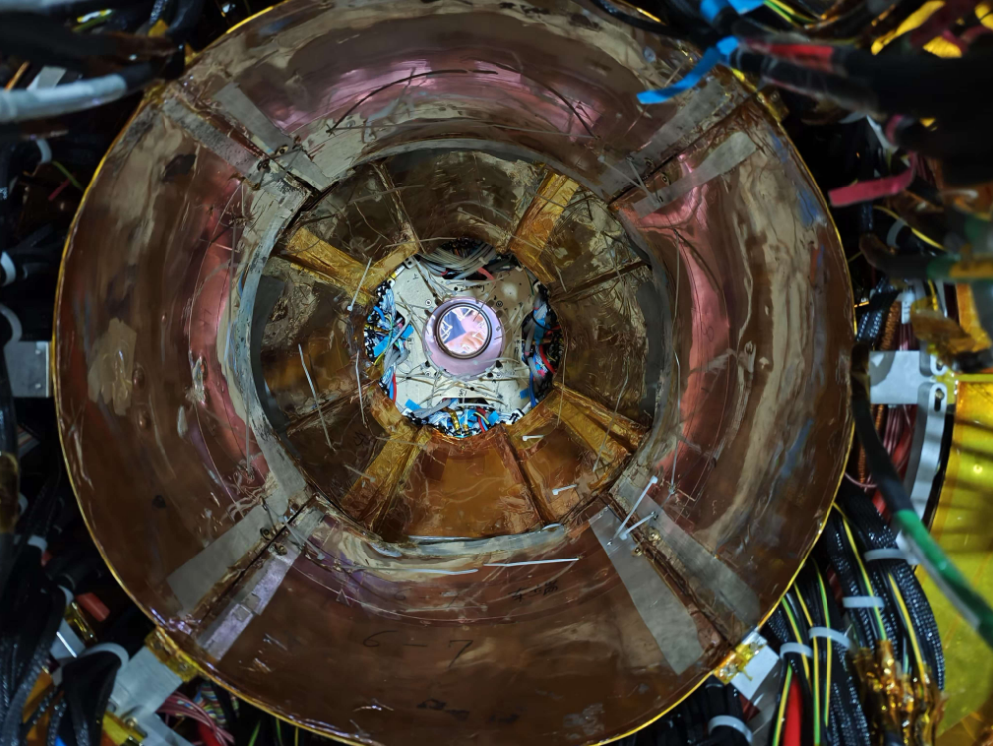
Installation of final shielding plates
Dec. 23
After the installation of shielding boxes for CGEM patch cards, we installed the final shielding plates upon CGEM cables

Slide 13
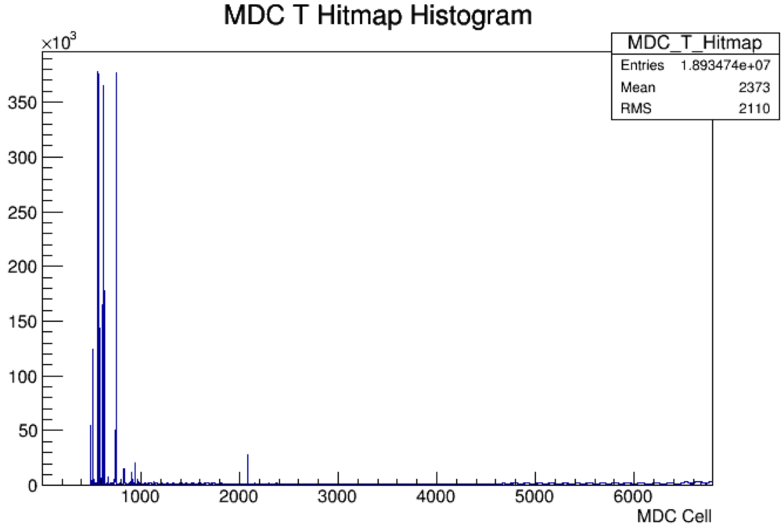
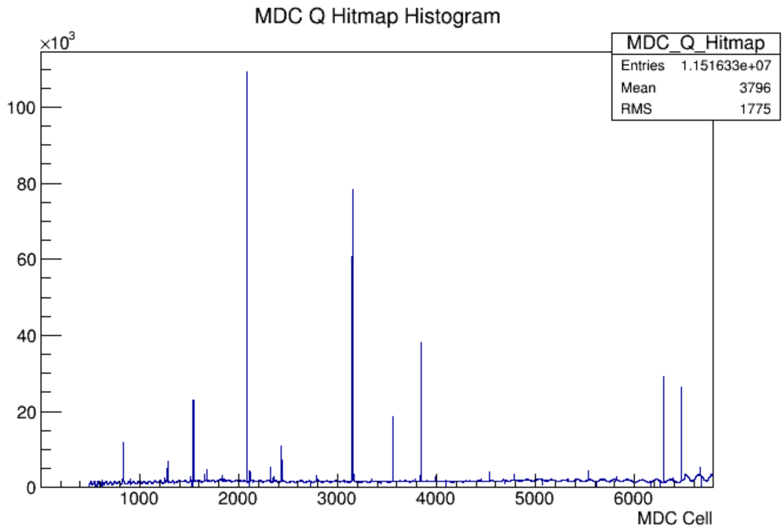
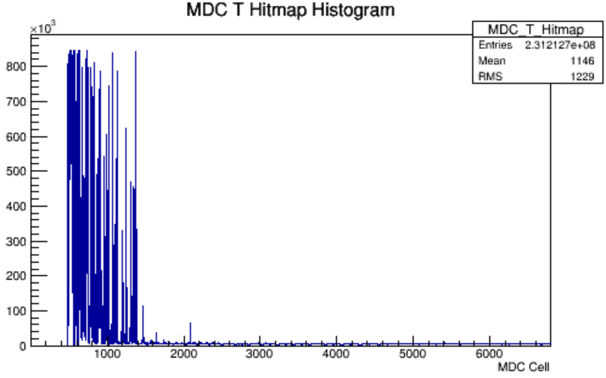
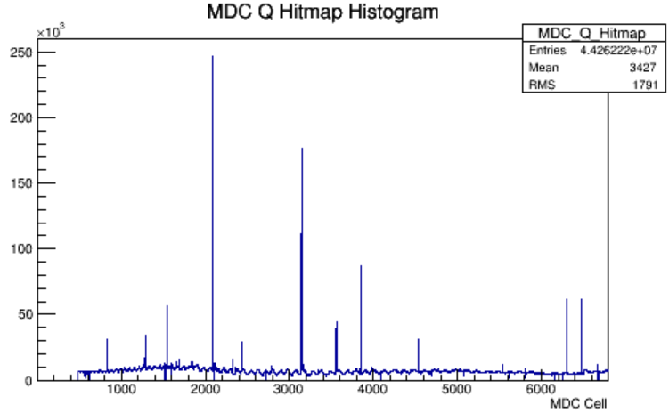
Noise status after installation of shielding boxes
Run83876
(CGEM off)
Run83876
(CGEM off)
Run83985
(CGEM on)
Run83985
(CGEM on)

Slide 14
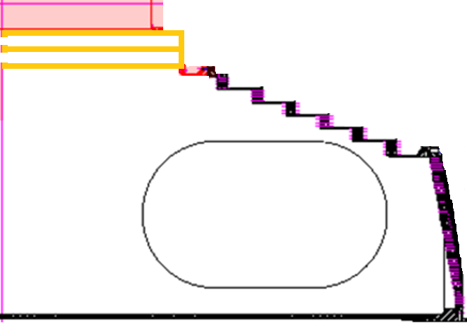
Schematic diagram of grounding
Coaxial cables of MDC
Cables of CGEM
CGEM patch cards
Preamplifier boards of MDC
CGEM HV crate on Floor2
CGEM Electronics on north side of BESIII
CGEM
MDC
18m differential cable with shielding layer
MDC HV crate on floor 1
MDC Electronics on floor 1-3
Connect to EMC physically
EMC+SSM +MUC
BESIII ground

Slide 15
Schematic diagram of shielding
Al shielding plates for both CGEM and MDC
Shielding boxes for CGEM patch cards
No shielding layer on CGEM FEBs
CF cylinder with two Al shielding layers on both sides (50μm/layer)
CGEM
CGEM cables
MDC cables
MDC
Al shielding plates to separate MDC cables and CGEM cables
Shielding boxes for MDC preamplifier boards

Slide 16
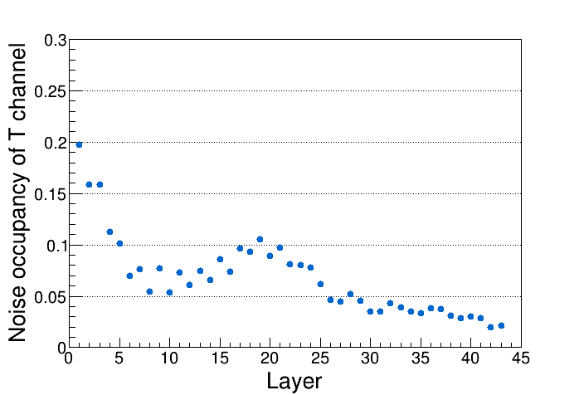
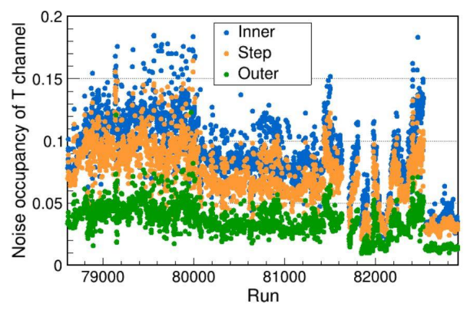
Noise occupancy of T during data taking in last run period
Run 79000
Step section

Slide 17
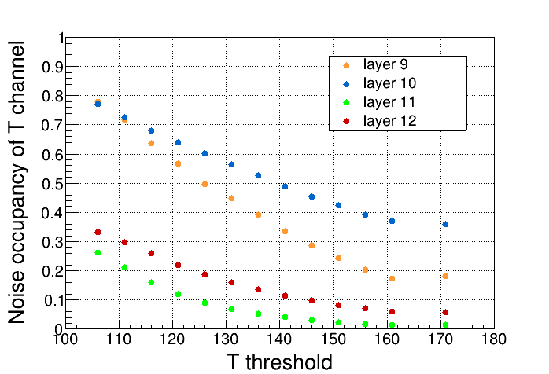
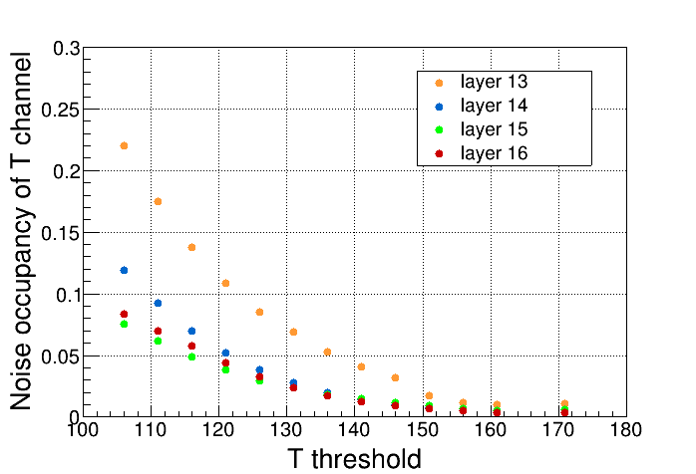
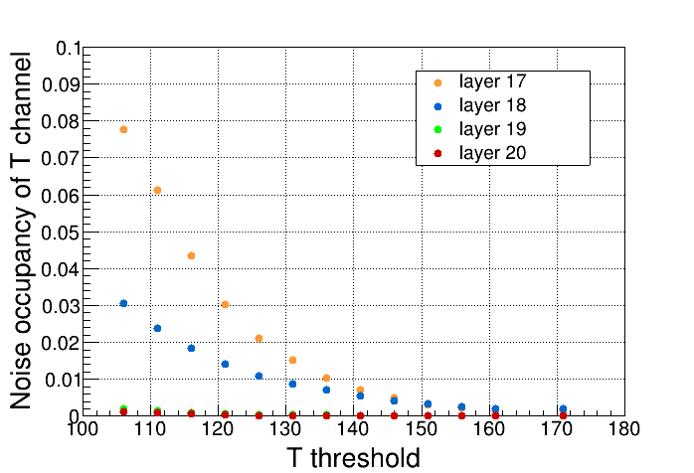
MDC Time threshold scan
Scanned MDC T threshold with CGEM running (1kHz random trigger)
Original T threshold for stepped part: 110 (High Threshold)
Based on the noise occupancy during data taking, different T thresholds should be set for different layers

Slide 18
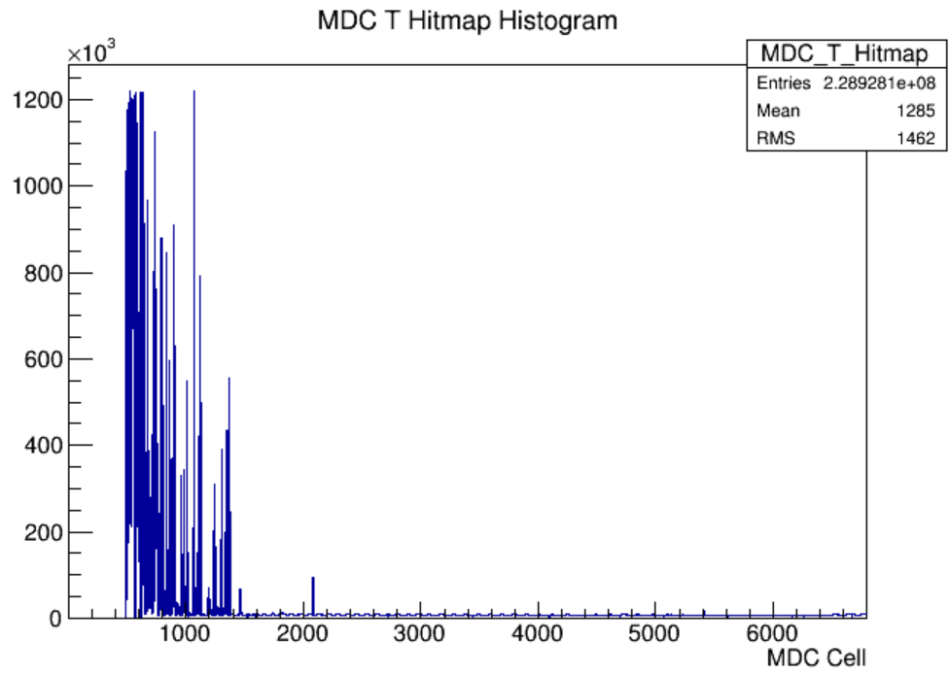
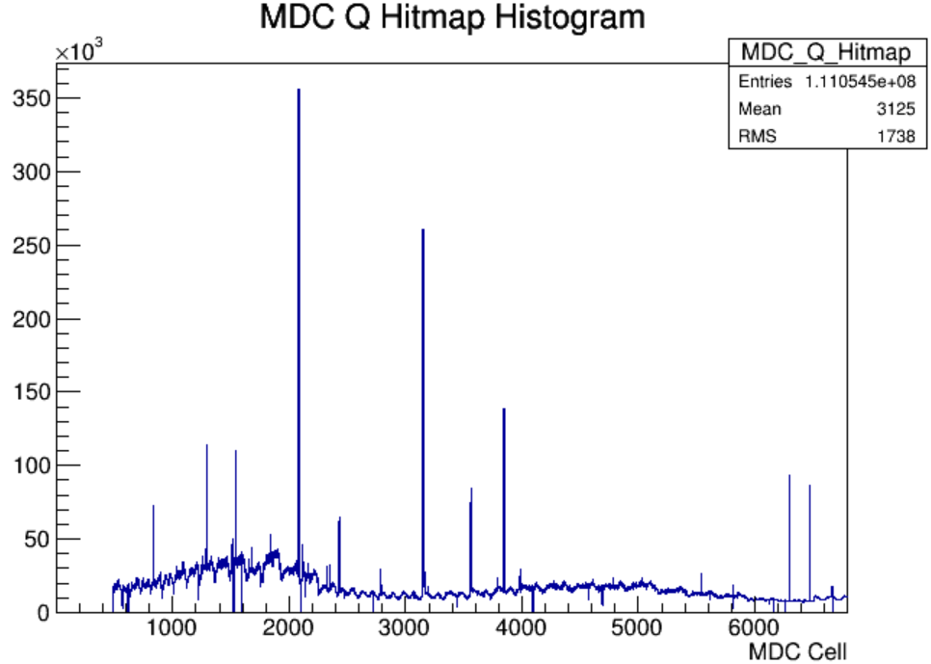
Cosmic-ray tests with different T thresholds
MDC cosmic-ray tests with different thresholds (120, 130,140,150, 160) (CGEM powered on)
At T threshold = 140, the first four layers have relatively high noise on T channel, especially layer 9 and layer 10
Run83977
Run83977

Slide 19
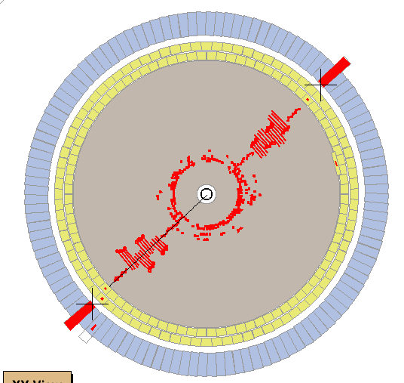
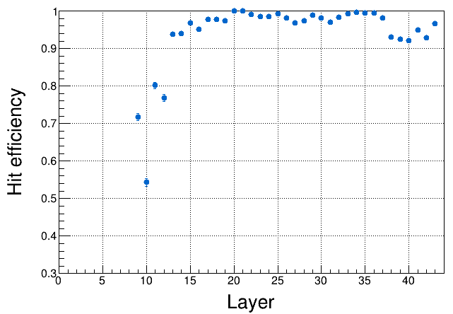
Efficiency @ T threshold=140
At T threshold = 140, layer10 has the worst reconstruction efficiency (~55%), the efficiency of layer14-20 is ok
In the next testing, different thresholds will be set for different layers
The spatial resolution will also be evaluated
Construction efficiency @ T threshold = 140

Slide 20
Summary
Both MDC and CGEM can work normally at nominal HV in joint cosmic-ray testing
Noise issues was found during the tests
Lots of tests has been done. Shielding boxes have no significant effect on reducing noise coming from CGEM, but have effect on reducing noise coming outside
Threshold scan have been done. Further performance study is needed with different threshold
Thanks for your attention!

Slide 21
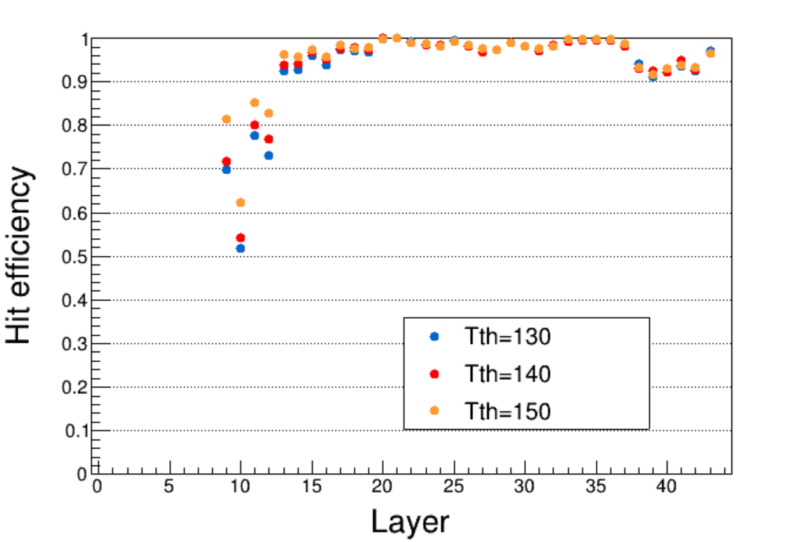
MDC reconstruction efficiency with difference T thresholds

Slide 22
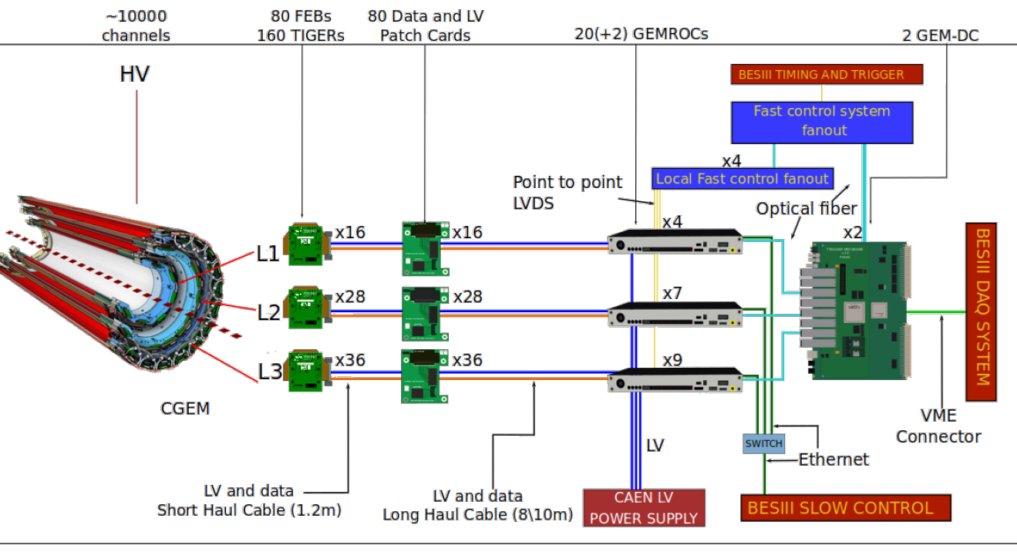
CGEM readout
On detector
On MDC preamp “tower”

