Slide 1
Muon electronics
Jie Zhang (IHEP) on behalf of CEPC muon detector

Slide 2
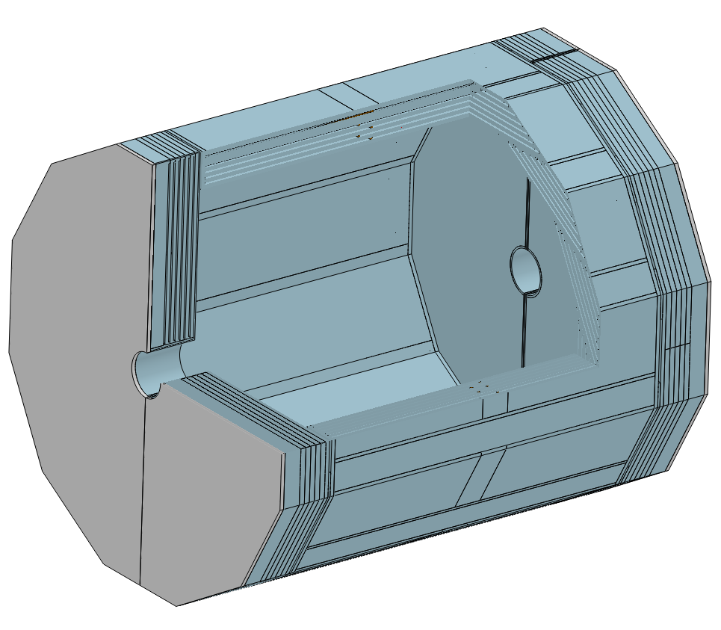
Muon detector
Barrel
  12 sectors
Endcap
  2 endcaps
    Inner
    Outer

Slide 3
Baseline for SiPM readout
Reuse the ASIC scheme (ChoMin) from ECAL or HCAL
Revise according to the constraints from cooling and mechanical structure of the detector

Slide 4
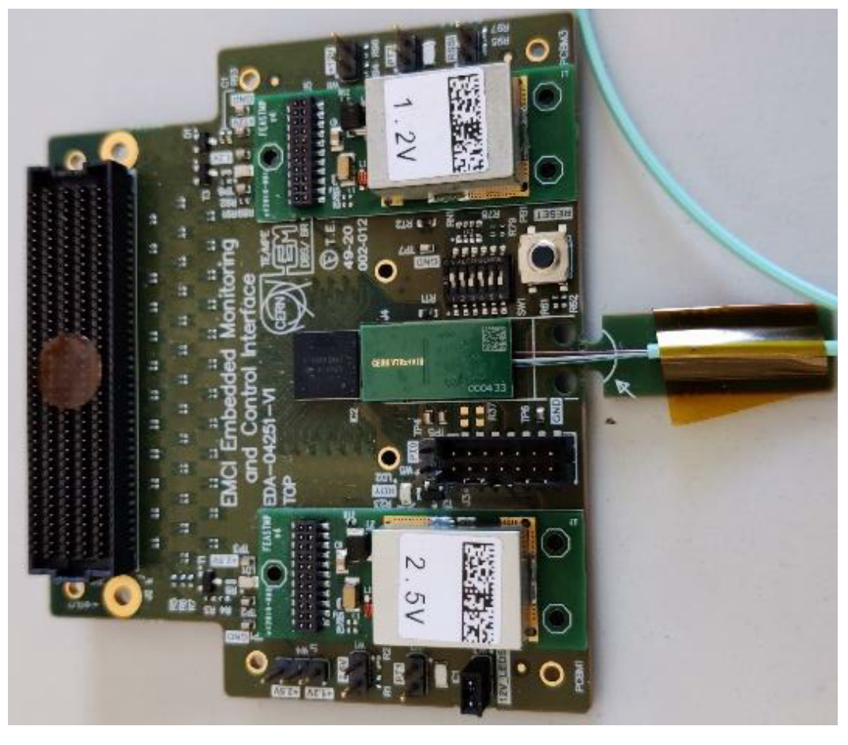
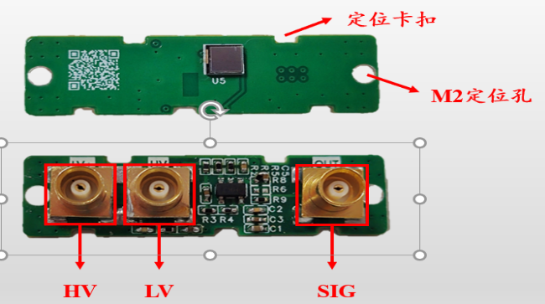
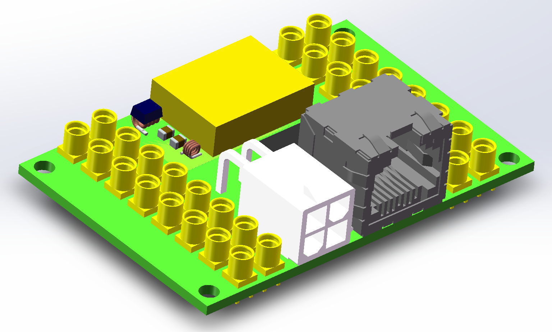
Stage scheme (M x N x O)
SiPM
ChoMin32 ch
TaoTie
Data Aggregation & Data Buffering & Event Building
ChiTu Data Interface
KinWoo
Optical Module
TDAQ
uFB
LV-2
LV-1
LV-2
HV-1
HV-Filter
HV-2
uMB
xM
xN
xO
Example:
For each ch
For each module
For each sector

Slide 5
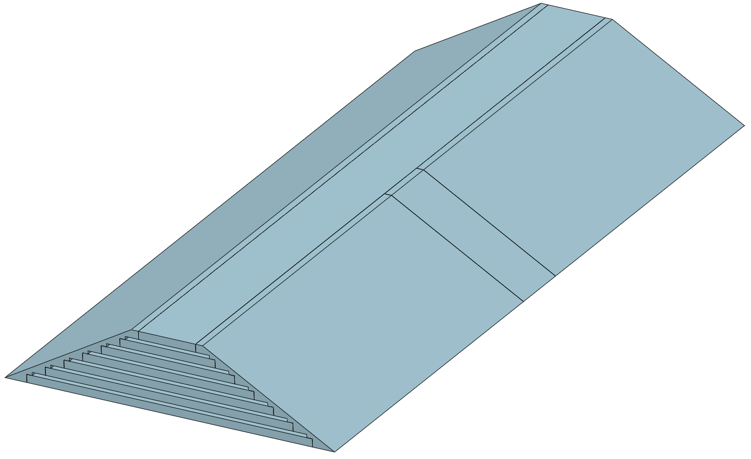
Electronics at B side
Row 6, Col 110
uSiPM tile: Muon SiPM tile, 660 pcs
  Small FR4 PCB
  FPC connector
uFlex14: Muon flex cable, 48 pcs
  Up to 14 lengths according to the locations of SiPM and uFB
uFB: Muon front-end board, 24 pcs
  32 ch input, two FPC connector2
  RJ45 and power connector
A
B
B
A
uMB: Muon management board, 1 pc
  Up to 24 RJ45 connectors, CAT6 shielded cable (5mm diameter, up to 2.5 meters) to uMB
  Fiber to backend
  Power input (AWG16 x4), 48V

Slide 6
Electronics at A side
6 Row
uSiPM tile: Muon SiPM tile, 660 pcs
  Small FR4 PCB
  FPC connector
uFlex14: Muon flex cable, 48 pcs
  Up to 14 lengths according to the locations of SiPM and uFB
uFB: Muon front-end board, 24 pcs
  32 ch input, two FPC connector2
  RJ45 and power connector
A
B
B
A
uMB: Muon management board, 1 pc
  Up to 24 RJ45 connectors, CAT6 shielded cable (5mm diameter, up to 2.5 meters) to uMB
  Fiber to backend
  Power input (AWG16 x4), 48V

Slide 7
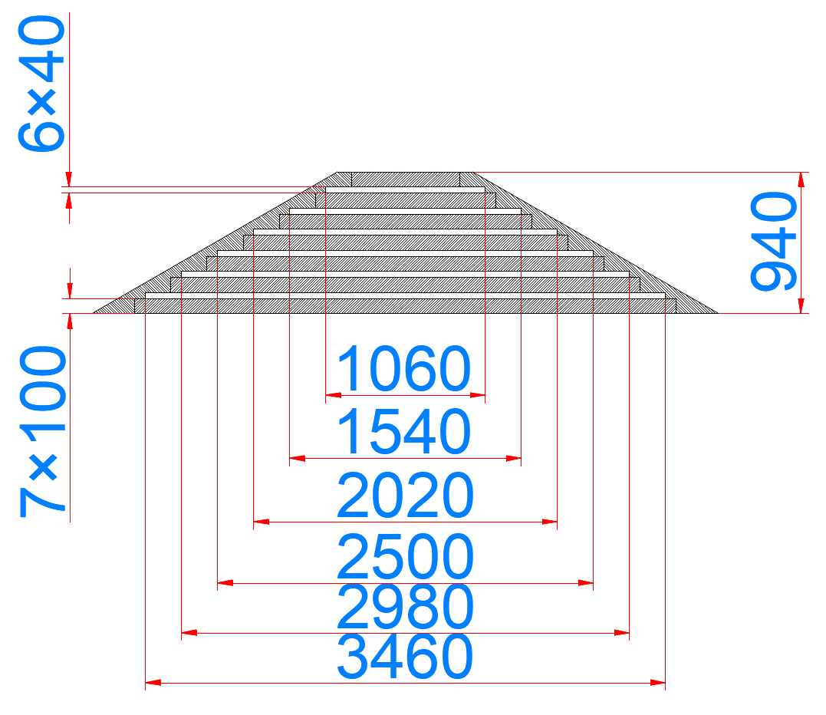
Barrel sector
 | M (uSiPM) | N (uFB) |  | O (uMB)
 | ch | 32-ch TDC board | Raw data rate / bps | Management board
A | 426 | 17 | 161.28 M | 1
B | 660 | 24 | 318.24 M | 1
Total per sector | 2172 | 82 | 959.04 M | 4
Total barrel (12 sectors) | 26064 | 894 | 11.51 G | 48
A
B
B
4.6m
A
A
B

Slide 8
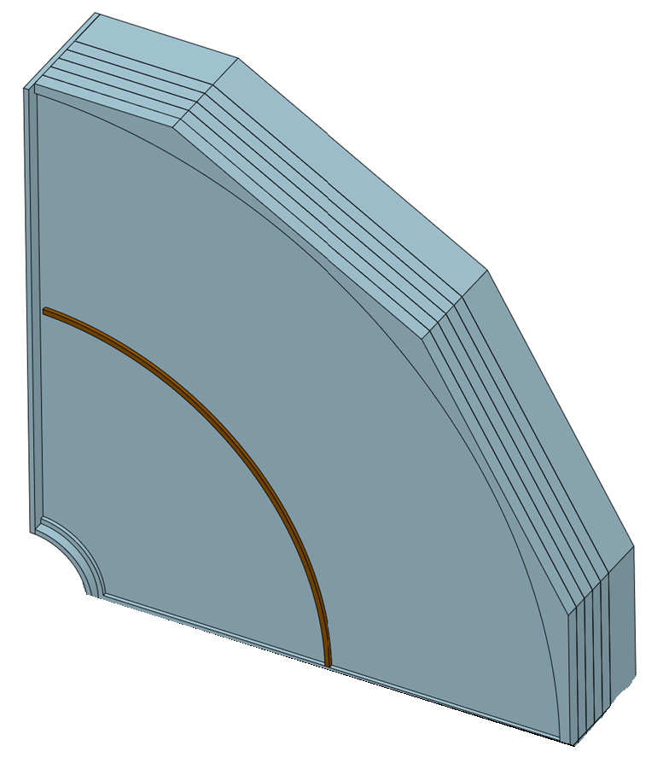
Electronics at Endcap
uSiPM tile: Muon SiPM tile, 198 pcs
  Small FR4 PCB
  MMCX
Coaxial cable
  2mm diameter
uFB: Muon front-end board, 8 pcs
  50 mm x 40 mm FR4 PCB
  32 ch input, MMCX
  RJ45 and power connector
31
32
32
17
18
18
uMB: Muon management board, 1 pc for 24 uFBs
  Up to 24 RJ45 connectors, CAT6 shielded cable (5mm diameter, up to 2.5 meters) to uMB
  Fiber to backend
  Power input (AWG16 x4), 48V
32
18
12 layers
One layer

Slide 9
Endcap quadrant
 |  | M (uSiPM) | N (uFB) |  | O (uMB)
 |  | ch | 32-ch TDC board | Raw data rate / bps | Management board
Inner | layer | 71 | 4 | - | -
 | quadrant | 852 | 48 | 276.5 M | 2
 | endcap | 3408 | 192 | 3.32 G | 8
 | Total | 6816 | 384 | 6.64 G | 16
Outer | layer | 127 | 4 | - | -
 | quadrant | 1524 | 48 | 737.3 M | 2
 | endcap | 6096 | 192 | 2.95 G | 8
 | Total | 12192 | 384 | 5.90 G | 16

Slide 10
安装
1. 组装并测试“单元”（SiPM小板+光纤+闪烁体）
2. 多“单元”插入支撑结构，形成“双层”

Slide 11
安装
3. 安装柔性板，与SiPM小板之间是卡扣连接器。每个柔性板负责10~15个SiPM小板

Slide 12
安装
3. 安装uFB，与柔性板之间也是卡扣连接器，每个uFB负责2个柔性板

Slide 13
安装
4. 连接uFB到patch panel的线缆（屏蔽双绞线和屏蔽电源线）
完成一个“双层”的安装

Slide 14
需要给电子学留的高度：1 mm （SiPM连接器高度）+ 0.3 mm （flex PCB厚度）+ 15mm （uFB高度）+ 6 mm（线缆直径）

Slide 15
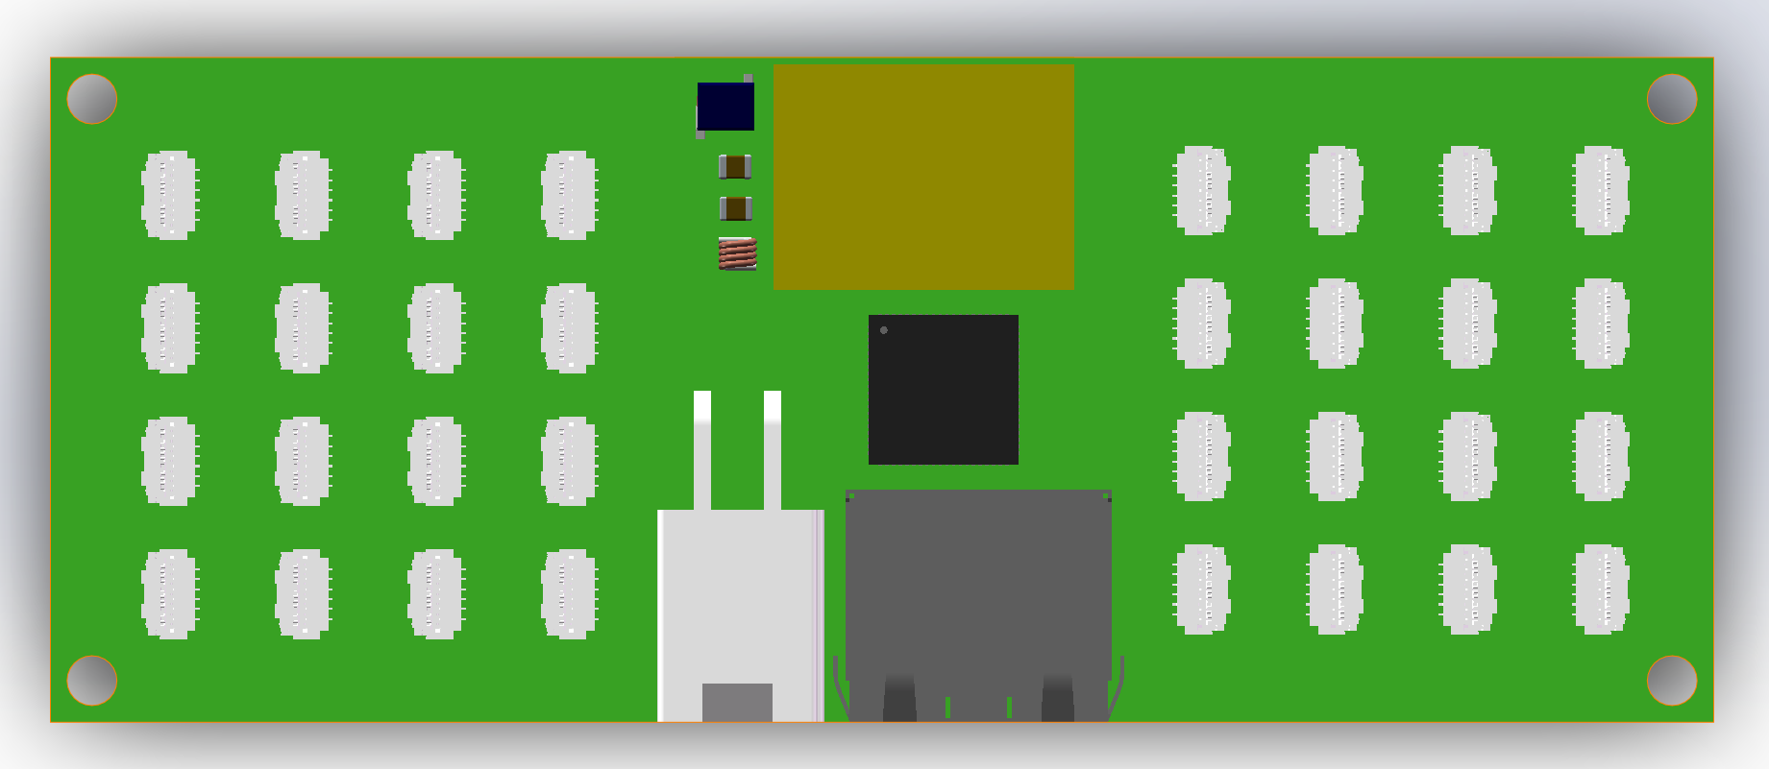
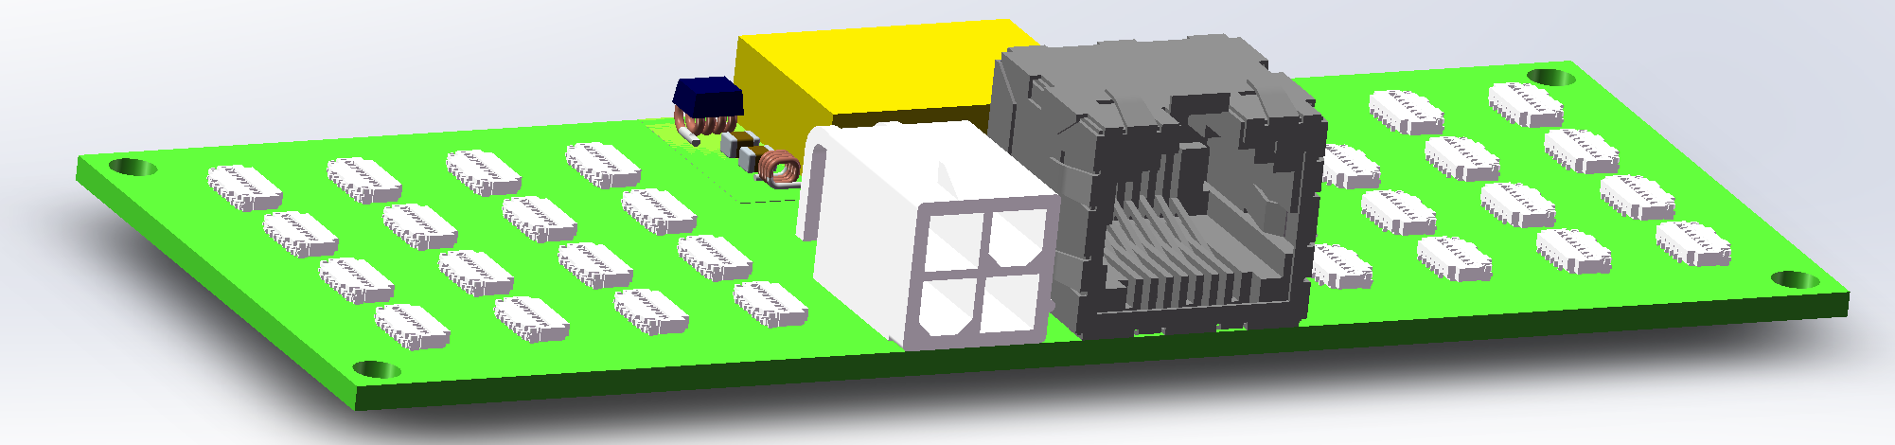
uFB (Muon front-end board，待更新)
100 mm x 40 mm FR4 PCB
Front-end Interface
  32-ch input, FPC to SiPM
    0.2mm thickness flex-PCB cable, width 8mm, up to 16 lengths
Back-end Interface
  RJ45 connector to uMB
    5 mm diameter CAT6 shielded cable
  Mini-Fit Jr (Power) to back-end
    AWG 18
Chip
  Chomin, ADC+TDC
DC/DC with shielding and filters
  1.2V output
3D step file:
  https://ihepbox.ihep.ac.cn/ihepbox/index.php/s/YNFSZHb9lvgJq31

Slide 16
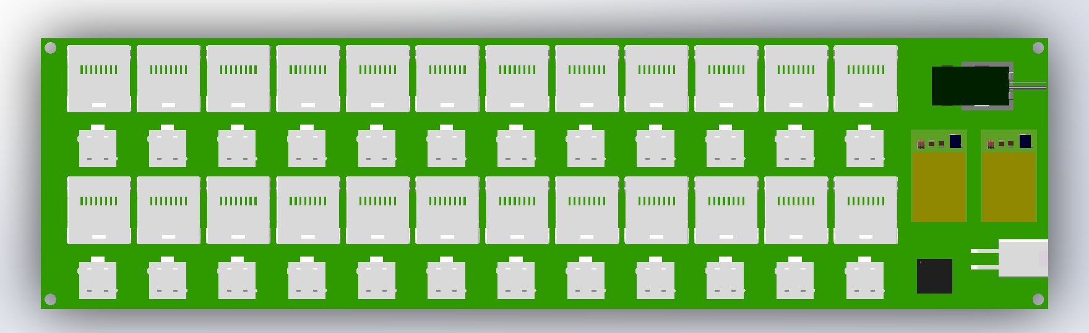
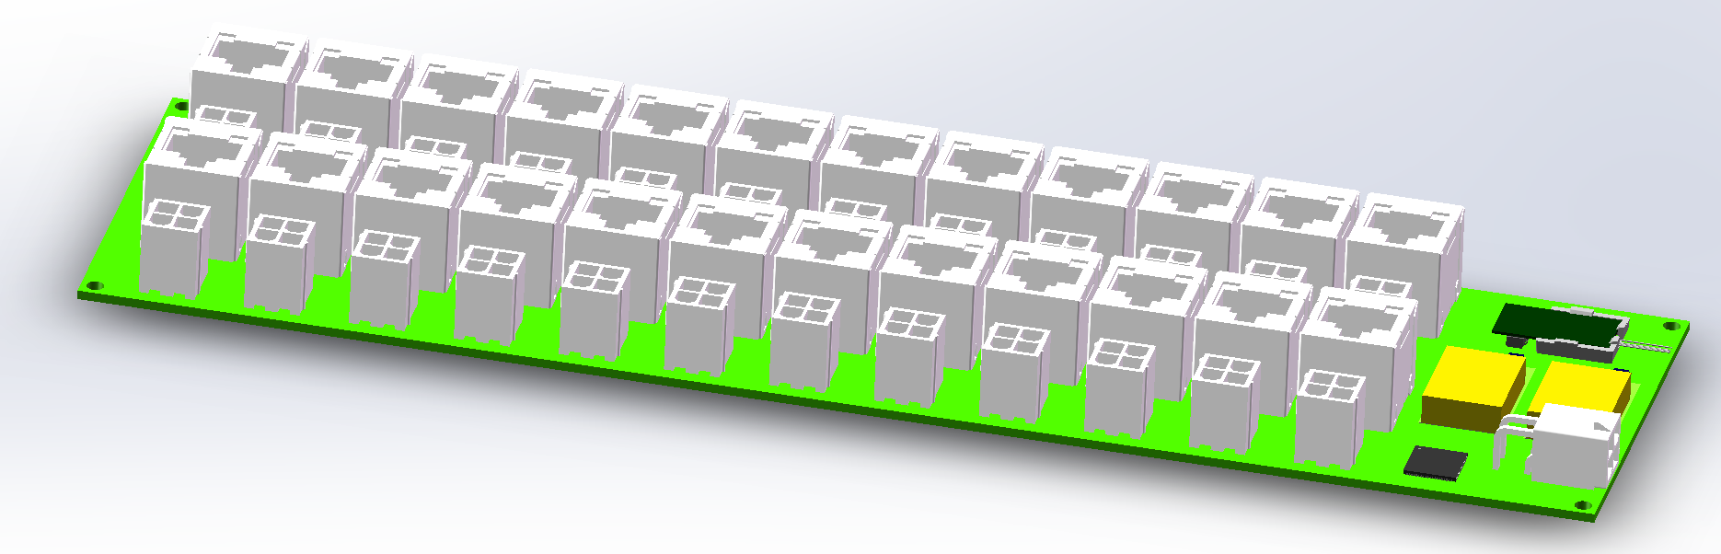
uMB (Muon management board)
260 mm x 70 mm FR4 PCB
Front-end Interface
  24-ch RJ45 connector to uMB
    5 mm diameter CAT6 shielded cable
  24-ch Mini-Fit Jr (Power) to uMB
    AWG 18
Back-end Interface
  Fiber
    1.1 mm diameter
  Mini-Fit Jr (Power) to back-end
    AWG 16 (2.35mm)
Chips
  TaoTie, ChiTu, KinWoo
DC/DC with shielding and filters
  2.5V output
  1.2V output
3D step file:
  https://ihepbox.ihep.ac.cn/ihepbox/index.php/s/IiyBhv4ApmZs8Bx

Slide 17
Back-end cables
Fiber
  1.1 mm diameter
  Quantity: 80
Power
  AWG 16 (2.35mm)
  Quantity: 80 x 4

Slide 18
Bandwidth requirement
Muon | Readout Channel | Hit rate/Hz (preliminary worst case) | Data format | Raw data rate / Gbps
Barrel | 26064 | 10 k | 48bit (8b BX+ 10b ADC + 2b range + 9b TOT + 7b TOA+ 4b chn ID + 8b chip ID) | 11.51
Inner endcaps | 6816 | 10k~100 k, Average 20 k |  | 6.64
Outer endcaps | 12192 | 10 k |  | 5.90
Total | ~45 k |  |  | ~24.04

Slide 19
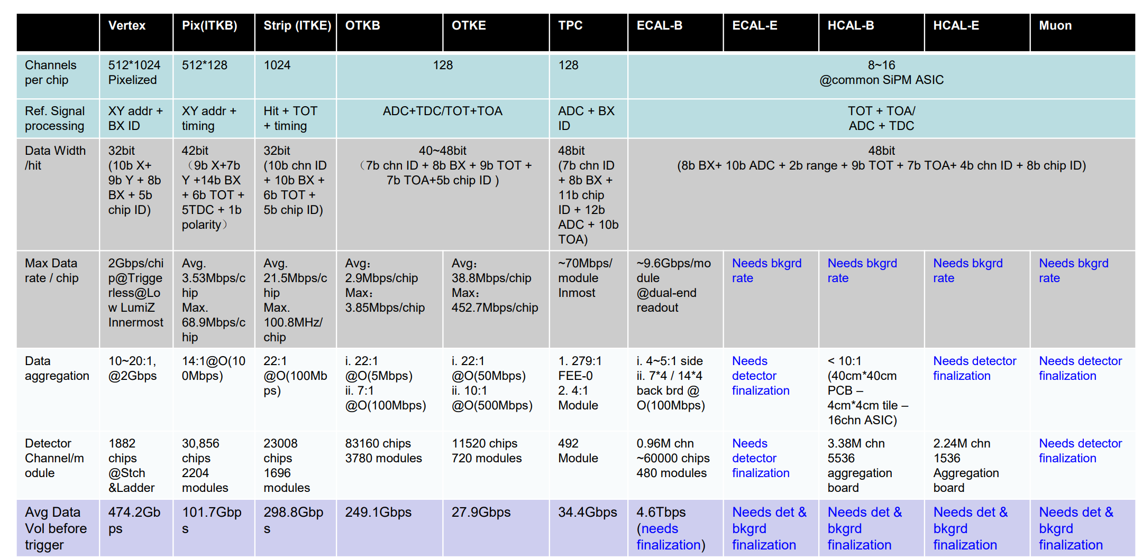
bandwidth requirement
Avg. 15.36 Mbps/chip
Max. 153.6 Mbps/chip
<=24:1
@ O (368.7 Mbps)
43.2k ch
80 Aggregation board
~ 24.04 Gbps

Slide 20
Backup

Slide 21
Alternative: discrete device scheme
FEB (Front-end Electronics Board)
  Commercial chips with radiation tolerance based on past studies for particle physics experiments
  FPGA based TDC for TOA and TOT measurement with ~1 ns time resolution
  ADC for charge measurement or TOT calibration
  DAC for threshold setting or SiPM bias voltage adjustment

Slide 22
Near-term test environment
Reuse JUNO-TAO electronics for readout, clock synchronization and TDAQ
  To accelerate the development schedule

Slide 23
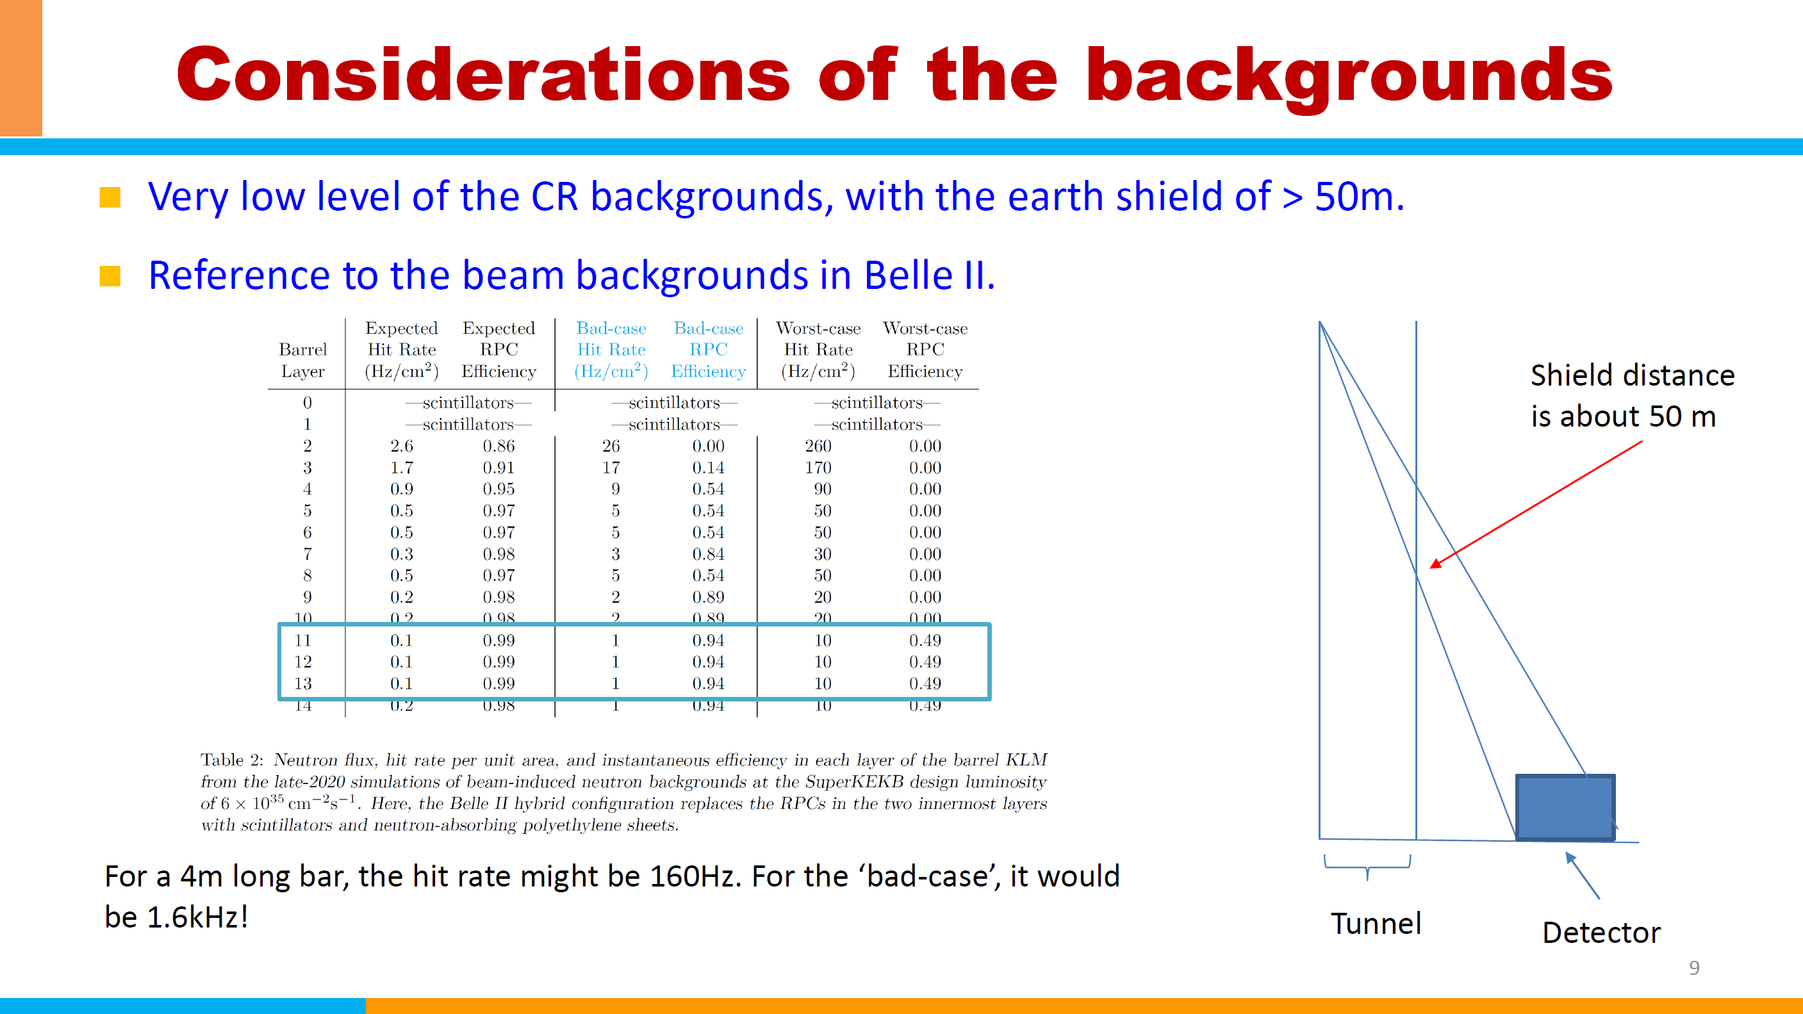

Slide 24
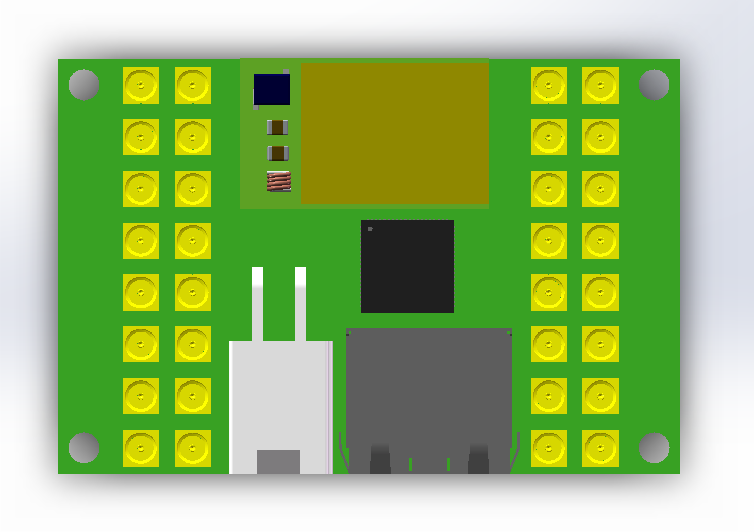
uFB (Muon front-end board)
60 mm x 40 mm FR4 PCB
Front-end Interface
  32-ch input, MMCX to SiPM
    2 mm diameter coaxial cable
Back-end Interface
  RJ45 connector to uMB
    5 mm diameter CAT6 shielded cable
  Mini-Fit Jr (Power) to back-end
    AWG 18
Chip
  Chomin, ADC+TDC
DC/DC with shielding and filters
  1.2V output
3D step file:
  https://ihepbox.ihep.ac.cn/ihepbox/index.php/s/g365tprrMhNDxs3

Slide 25
B side
A
B
B
A
A
A side
B
B
A

