Slide 1
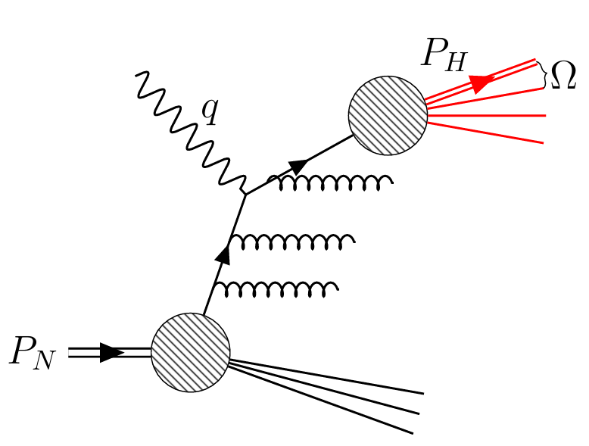
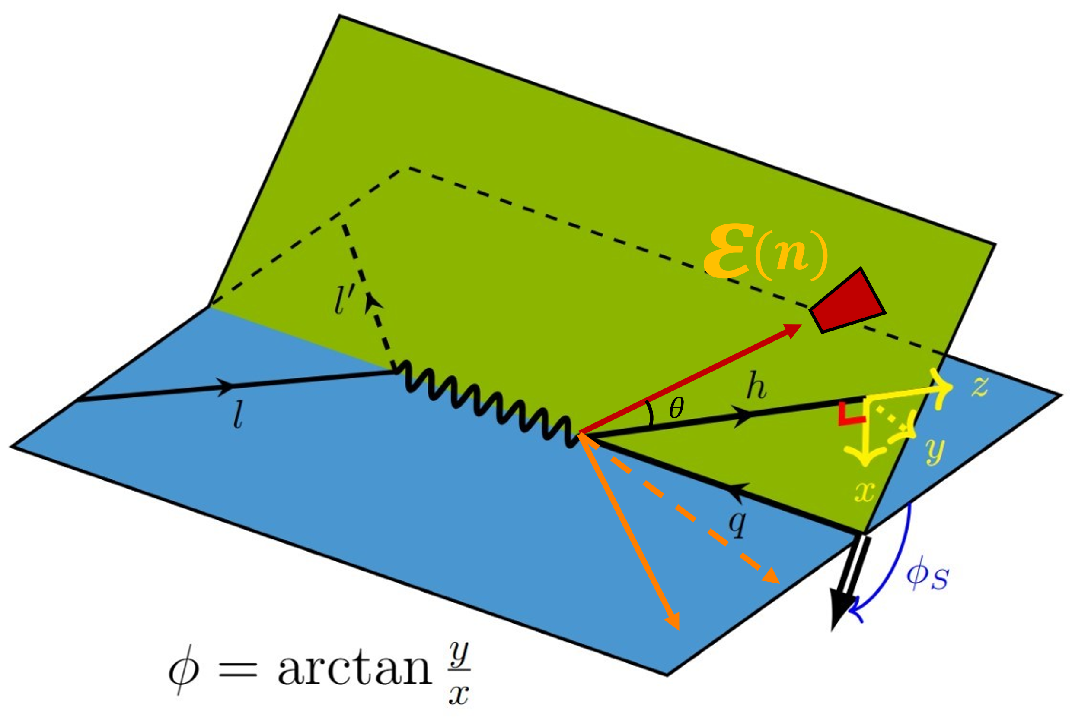
Fragmentation Energy Correlators in SIDIS
$$l′$$
$$l$$
Shutao Zhang
Peking University
$$γ^{∗}$$
In collaboration with:
Qing-Hong Cao, Zhite Yu, C.-P. Yuan, HuaXing Zhu
Paper in preparation:
arXiv: 2505.xxxxx
C3NT
03.05.2025, Wuhan, China
Notes:
Hello everyone, I am Shutao Zhang. Today I want to introduce Fagmentation Energy Correlators in SIDIS process. This work is in collaboration with Zhite Yu, Professor Zhu, Professor C.-P. Yuan *(how to read?)* and Professor Qing-Hong Cao.
This work is in preparation for publication. The representation is organized as follows: Firstly, I introduce motivation, then I spend some time to introduce the observable and new non-perturbative function to factorize. I will show some nice properties of the Fragmentation energy correlator during this part. Secondly, I introduce the relation of our new-defined Fragmentation energy correlator to TMDs, which gives a simple moment correspondence between them. Finally, I will quickly go through our calculation of hard factors.
So The **SIDIS** means semi-inclusive deep inelastic scattering process, which I believe many of you have already been familiar with. Basically, it studies $ep$ collision, and a high energy virtual photon is emmited by an electron and hit the proton, according to the asymptotic freedom, the photon interact with partons inside a proton. The final state is many hadrons generated by parton fragmentation. The observable of SIDIS is differential cross section with respect to outgoing electron and a specific hadron you want to tag.
OK, now lets get into some details.

Slide 2
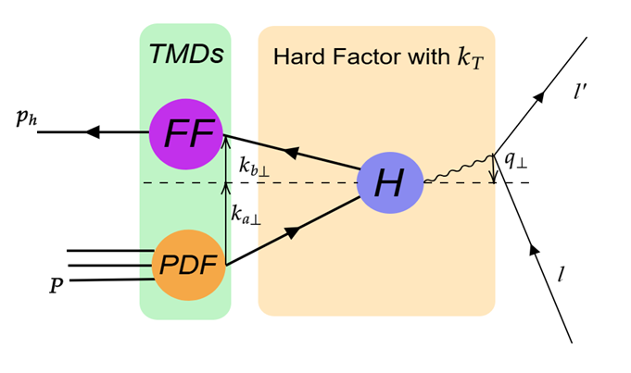
Why Fragmentation Energy Correlator (FEC)
John Collins, 1993
TMD Fragmentation Functions are extracted from convolution!
Extraction Problem:
Entanglement with TMD PDF.
Notes:
% TMDs have different meanings for confinement.
% TMD FF tells transverse direction information of fragmentation.
% Phenomenon to confinement.
% Small qT region factorization valid. Showering gives Sudakov effects, exponential of log ^2 bt distribution
In SIDIS, traditionally, Transverse momentum dependent parton distribution function (or TMD PDF) is used to probe the three dimensional structure of nucleon. And TMD fragmentation function or TMD FF tells the transverse direction of fragmentation
%and TMD fragmentation function (or TMD FF) describes the inverse process, parton to hadron. But the TMD FF not just a simple inverse process because it involves different final state interactions.
The biggest motivation to investigate these functions is to learn confinement by phenomenon, which we can’t solve under perturbation calculation.
This is TMD Factorization for SIDIS. It’s valid under small q_T region. This is diagrammatic sketch of the process(pt to pic), each parton and the photon have a small transverse momentum, that is so called small qT region. As one should notice from this equation, there is a convolution integral of ka perp and kb perp! That means TMD FF is entangled with TMD PDF. This leads to the extraction problem of TMD FF. And, the Sudakov effects complicate the extraction more.
Let put TMDs aside temporarily, and get some insights from Energy energy correlator.

Slide 3
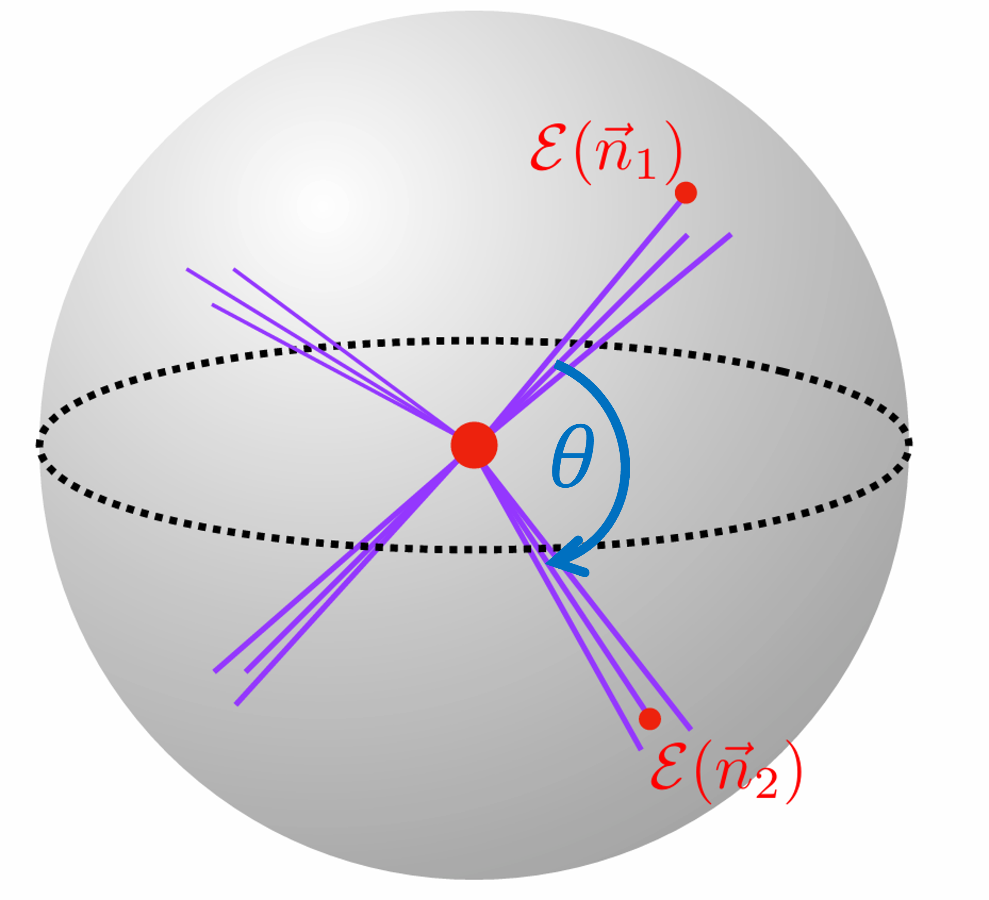
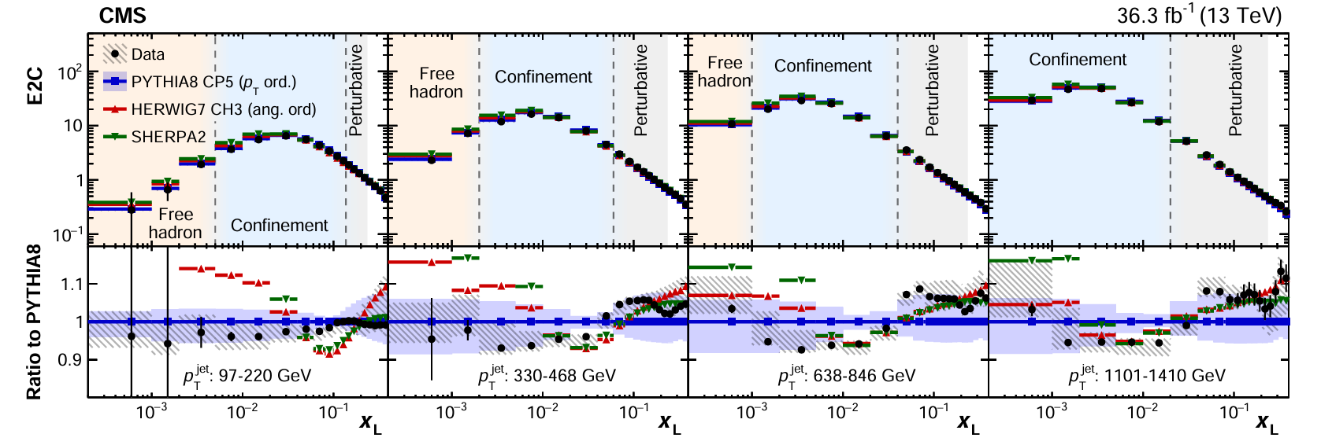
The Energy-Energy Correlator
Basham, Brown, Ellis and Love, 1978
Infrared and Collinear Safe (IRC safe) Observable
Scaling Law of EEC
[CMS, 2024]
Notes:
% Explain pic1, red point hard process, energy flux: weight by energy.
% IRC safe observables, not sensitive to non-perturbative. Reliably compare between theory and exp.
% High order compute, well defined detection
% Add xL definition \sims theta, draw theta
% Region 1, 3 precise; 2 confinement
Energy energy correlator or eec is defined just like the ball pic, red point in the middle is hard process, two energy flux are tracked and also their spreading angle theta and azimuthal angle. It is Infrared and collinear(co linear) safe or IRC safe observable. Which allows precise calculation, well-defined detection and reliable comparison between theory and exp.
% linear depends on energy, IRC safe not sensitive to non-perturbative effect.
So the following is precise experimental data. xL here is defined with this and is just as theta shown in the ball. It shows pretty scaling law in the hadron free region and the perturbative region. And give us information about confinement.

Slide 4
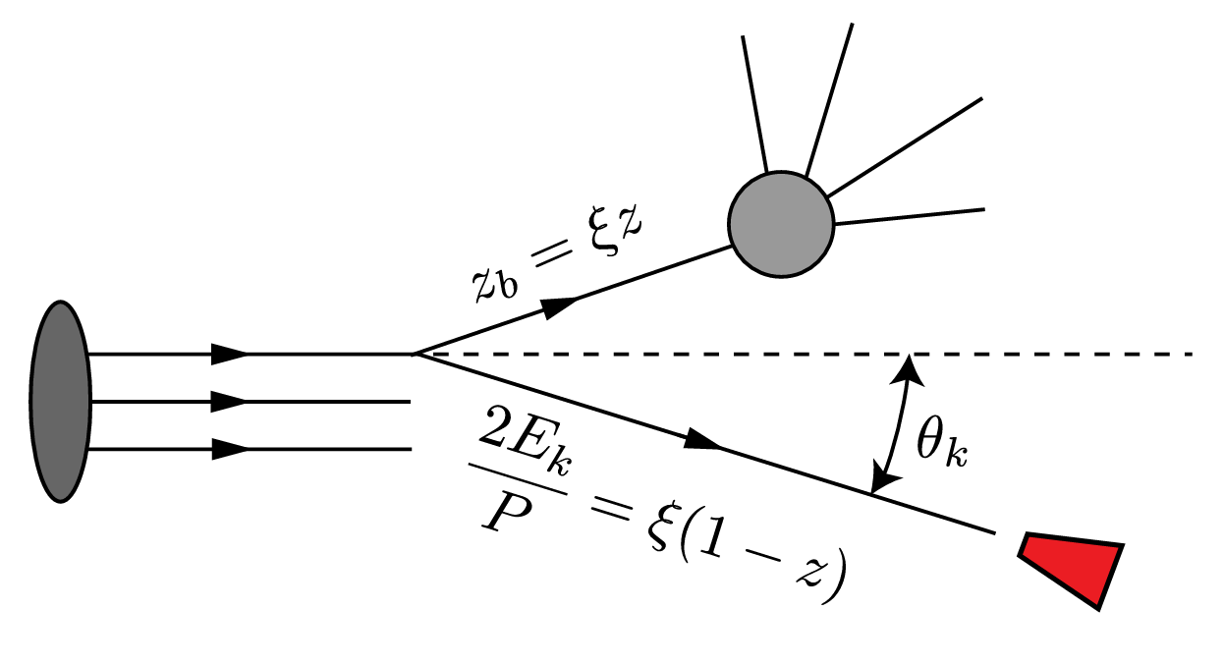
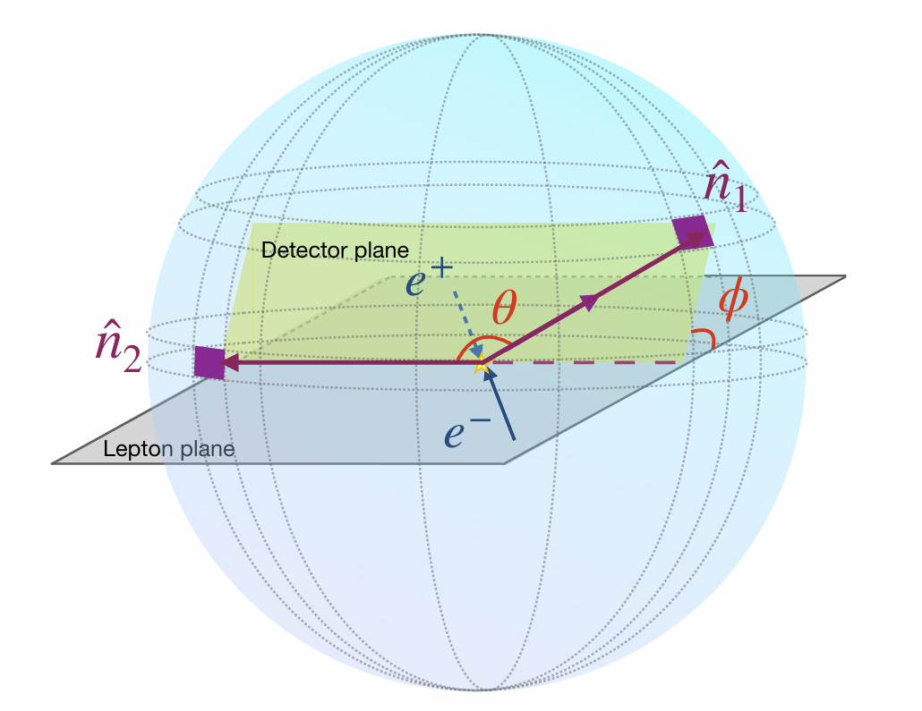
The Energy-Energy Correlator
EEC has been widely used for probing microscopic details.
Strong Coupling Constant
The CMS Collaboration, 2402.13846
K. Lee, A. Pathak, I. W. Stewart, Z. Sun, PRL 133, 231902
Z.B. Kang, J. Penttala, C. Zhang, 2410.21435
Nucleon Structure
X.H. Liu, H.X. Zhu, 2209.02080
H.Y. Liu, X.H. Liu, J.C. Pan, F. Yuan, H.X. Zhu, 2301.01788
X.L. Li, X.H. Liu, F. Yuan, H.X. Zhu, 2308.10942
Z.B. Kang, K, Lee, D.Y. Shao, F. Zhao, 2310.15159
Many Other Applications
…
[X.H. Liu, H.X. Zhu, 2022]
[Z.B. Kang, K, Lee, D.Y. Shao, F. Zhao, 2022]
Notes:
EEC has been widely used for microscopic probing. For example, the strong coupling constant, nucleon structure and many more.
Recently, liu and zhu proposed nucleon EEC (or NEEC), which uses energy correlator as an extra handle to probe inner structure of nucleon.
So the insight is, EEC offers an extra handle to probe non-perturbation phenomenon compared to pure SIDIS. We can generalize the discussion of NEEC to fragmentation.

Slide 5
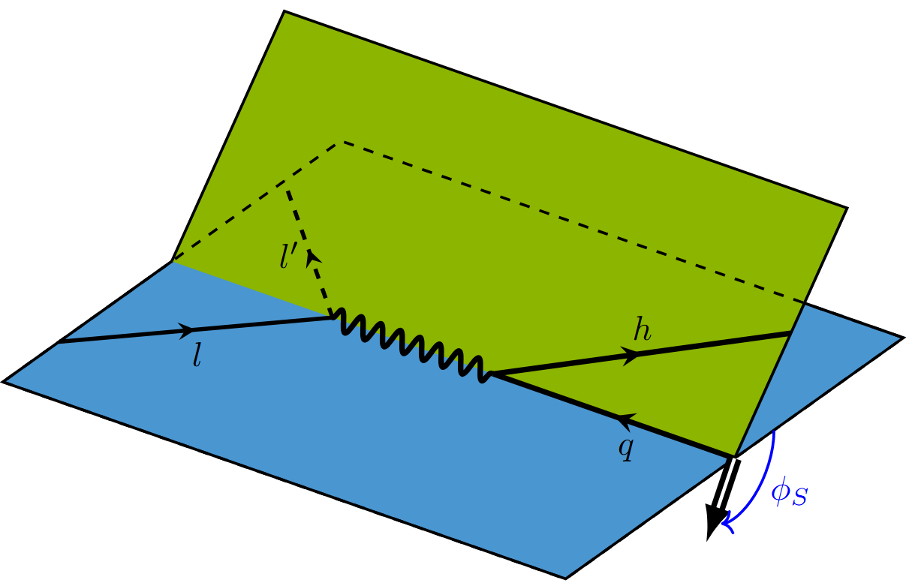
Observable Definition
Observe final state hadron, with energy flux around it
$$φ$$
$$x$$
$$y$$
$$S_{T}$$
$$S_{T}$$
Notes:
% Explain the picture, sim to SIDIS; parallel pictures.
% Theta and phi, non-perturbative;
% Particularly phi distribution. Rotation around z asymmetry; parton spin; transversity function transfer to quark.
% Plane picture to draw phi.
Here’s what we did. The left-hand side is normal SIDIS. In the middle is what we want to observe and the right side is projected plane of hadron frame. Compared to SIDIS, we not only observe some specific hadron, but also an energy flux around it. And the direction of the energy flux is defined in the hadron reference and not necessarily lying in the x-y plane. The spreading angle theta provides another probe for non-perturbative information. As shown to the right, the energy flux projection in the hadron frame’s xy plane has an angle with the x-axis, which is phi we defined.
What is particularly interesting in this work, is the azimuthal distribution of phi. There is an asymmetry in phi distribution. So how it comes out? That’s from the azimuthal asymmetry of the outgoing parton. For the initial state, proton may possess a transverse spin, which can be transferred to the incident parton by transversity function, and then transferred to outgoing parton. This effect happens to be under description of our Fragmentation energy correlator.

Slide 6
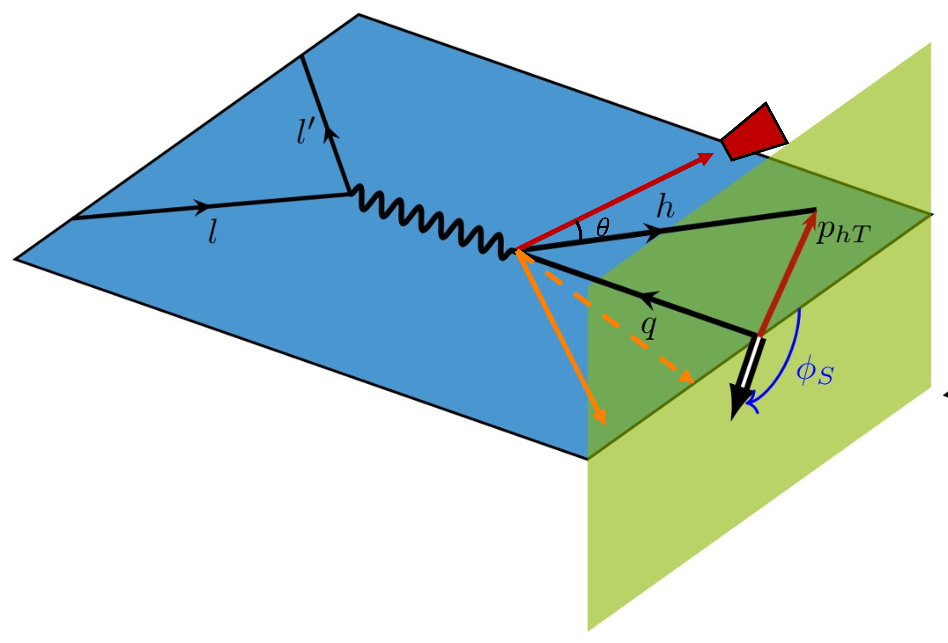
Observable Definition
Inclusively
observe final state hadron, with energy flux around it
$$ε$$
$$(n)$$
Integrate hadron $p_{hT}$
$$φ_{h}$$
Notes:
% Inclusive observation LO match to recoil of a quark
% Explain each factor in the equation
Then we do an inclusive observation by integrating over the transverse momentum of hadron h. The differential section for FEC is as follows. (pt at eq)
The first term is the normal SIDIS phase space, then it’s a sum over final state X, and delta function is just the momentum conservation. In the second line, we have amplitude square and energy weight to define the fragmentation energy correlator. This simplifies our structure of FEC.
The integral of phT2 and phih is to inclusively include all the pion with same z.
In the small theta angle region, this observation of energy flux and hadron should be factorized out as a whole because they are in the same collinear subgraph, just like the hadron factorized out in SIDIS.

Slide 7
Fragmentation Energy Correlator Factorization
Operator Definition of Fragmentation Energy Correlator (FEC)
Factorization Formula
For SIDIS
Notes:
We can define a non-perturbative function called fragmentation energy correlator (FEC) here, which is very similar to the definition fragmentation function. Which is absent of this red energy flux operator.
And we also have a collinear factorization similar to SIDIS, with same kinematic region, same hadron probed. But we have these extra theta and phi angle to handle the non-perturbative effect, which can let us further explore the transverse structure.
But a small problem here is that, energy and theta angle is not boost invariant. Which means the non-perturbative function we extract from the experiment is not universal. Is there a way to make it a boost-invariant function?

Slide 8
Boost Invariant FEC
Angle $θ$ and Energy is not boost invariant.
Our modification
Notes:
In the definition of FEC, energy flux violates boost-invariance. So We can replace the energy flux operator by longitudinal energy flux. which extracts the plux momentum of the flux at specific direction. And The spreading angle is replaced by pseudo-rapidity of the flux along hadron momentum direction.
The transformation property under boost is the same with a plus momentum, which can be cancelled by dividing over the plus momentum of tagging hadron.

Slide 9
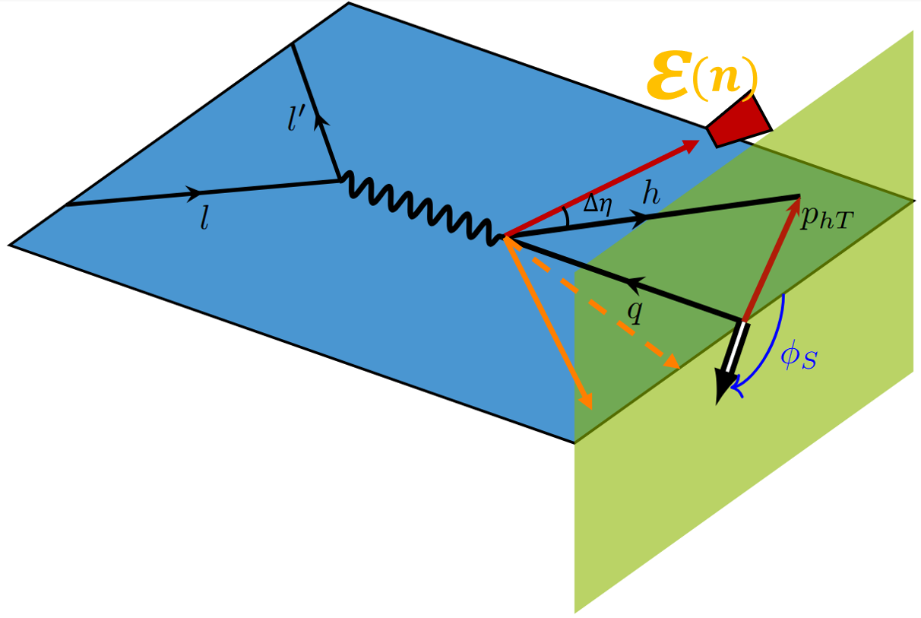
Boost Invariant FEC
Modify the Energy weight for Boost-Invariance
$$φ_{h}$$
Notes:
Also, we modify the definition of observables slightly, replace enery times delta of cos theta to p plus ratio times delta function of pseudo-rapidity.
In massless and small theta approximation, this p plus is just the energy of the flux, and delta eta here, defined as y_h-eta_i, describes spreading angle between the energy flux and the hadron. Which actually is related to each other by an energy scale.

Slide 10
Boost Invariant FEC
Energy scale naturally induced from the new FEC.
$$φ_{h}$$
The only energy scale in the boost-inv. FEC function
Proportional to the spreading angle in collinear limit
Describe the transverse energy scale
Notes:
We see that an energy scale naturally emerge from the FEC, which is actually the only energy scale in the FEC. we can call it q_F. It’s defined as mh times exponential of Delta eta or y_h-eta. We see that it is related to spreading angle, and it’s exactly linear proportional to theta in collinear limit. It does not surprise us actually. As mentioned in the morning by Ian Moult, the theta angle images the intrinsic energy scales of QCD.
This qF conveniently and essentially describe the transverse energy scale, and image the non-perturbative structure in a more universal way. OK, words or mouth guarantee nothing, How to show that? One important point to clarify its universality is how does this function vary with different system energy?

Slide 11
Pythia Simulation
EEC dependence on theta varies with Energy scale
[CMS, 2024]
Notes:
We do a pythia simulation to prove this point. First I want to remind you that the original EEC-theta(or xL here) distribution changes its maximum with energy scale.

Slide 12
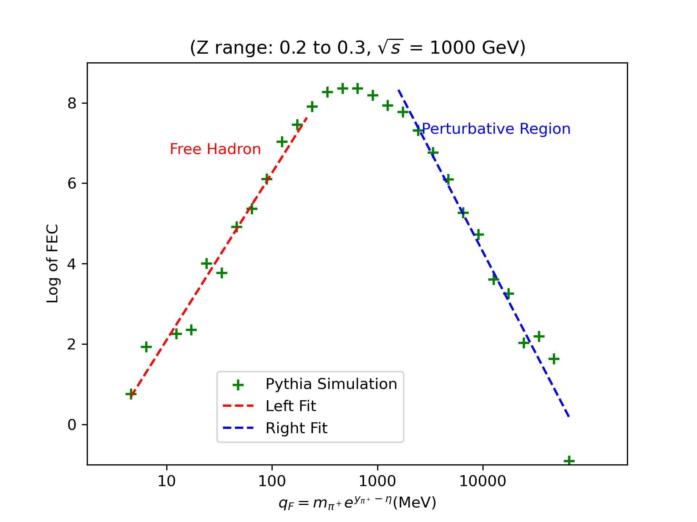
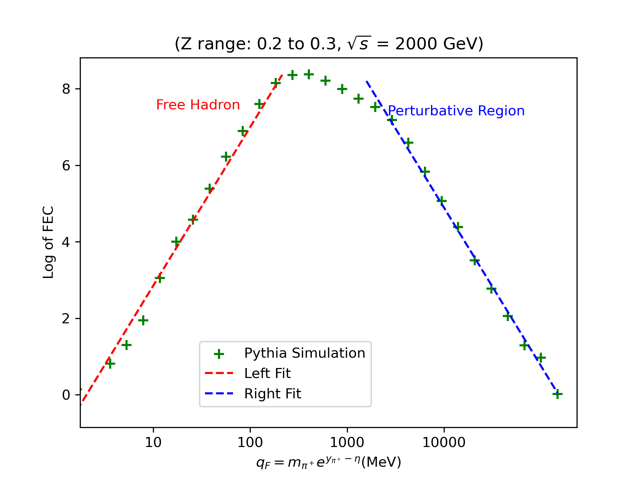
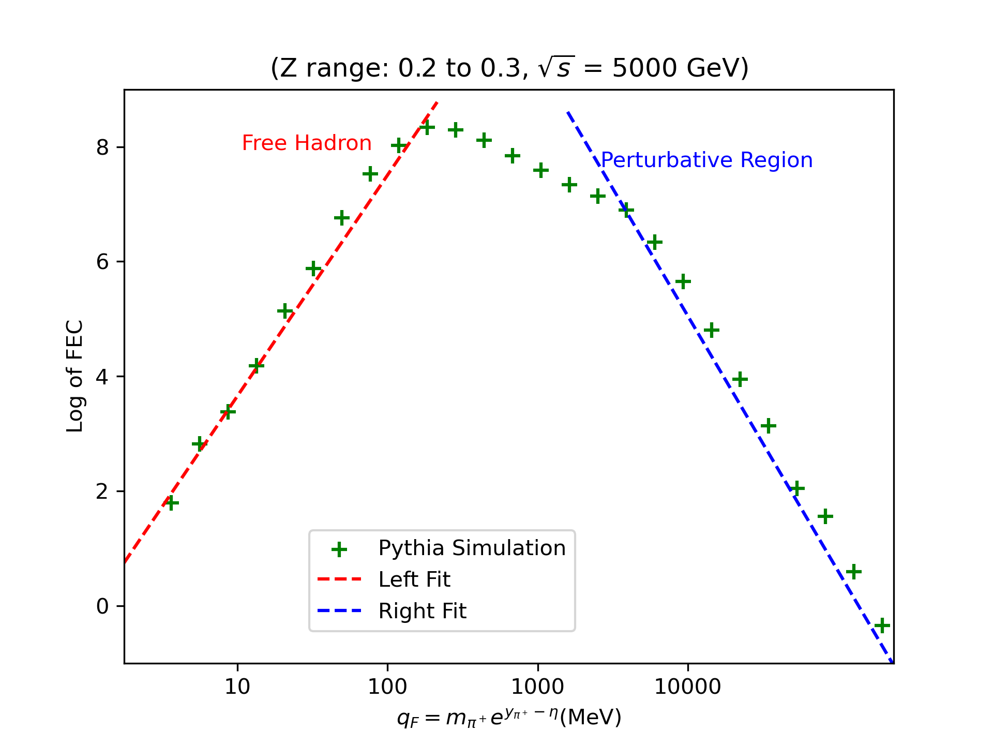
Pythia Simulation
Use Pythia to show confinement with FEC.
Confinement
Confinement
Confinement
Notes:
And what we do here is to simulate the jet production in the e+ e- annihilation. We choose the same z fraction with different center mass energy.
To the left is free hadron, slope approximately 2, to the right is perturbative region. They are in great agreement of the scaling law of EEC.
And the interesting thing we can see is that the confinement place at each system energy is the same, which gives proof of our universality.

Slide 13
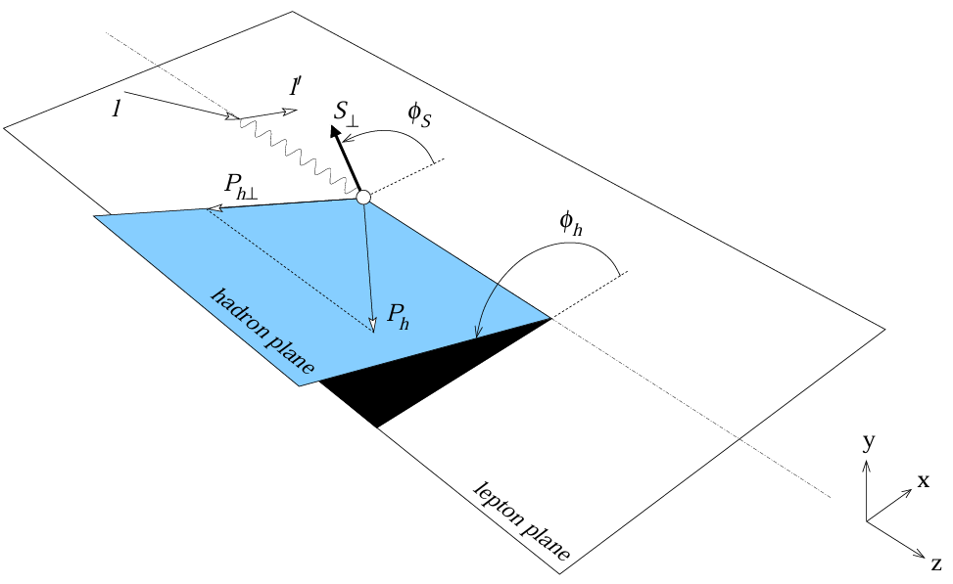
Difference from TMD
FEC
[A. Bacchetta, U. D’Alesio, M. Diehl, C. A. Miller, 2004]
[John Collins, 1993]
SIDIS
Notes:
Back to the very beginning, we talked about the motivation for TMDs, they are used for probing transverse structure of fragmenting or inner nucleon. Here we can use FEC to do the similar thing, but with a very nice collinear factorization without convolution of k_perp.

Slide 14
Relate Fragmentation Energy Correlator to TMD Fragmentation Function
From momentum conservation
X.H. Liu, H.X. Zhu, 2403.08874
Notes:
Follow work by Professor Liu and Zhu, we also find the moment of TMDs and FEC equation from momentum conservation, here is how we calculate.

Slide 15
Relate to TMD Moments
X.H. Liu, H.X. Zhu, 2024
Start from the operator definition of TMD FF.
Do integral over $y_{T}$
Using that $P_{X,T}=\int{dΩε(n)n_{T}}$
the moment of TMD moment of EEC
Notes:
Here n_T is normalized as sin\theta
With a delta function insertion into the collinear FF, we find it can equal TMD FF. And we do a replacement of PXT as energy flux integral, it shows that TMD FF performs as generating function of energy energy correlator. Or you may say there is a moment equation of TMDs and EECs.

Slide 16
Boost Invariant FEC
Relate to original definition
Relate the moment
For the Collins type
Simple Relation
Notes:
The moment relation is also simple for the boost-invariant FEC. And also, the integral bound for the moment relation is very clear compared to the original theta angle integral.
Phi distribution is carried by collins type, write down definition.

Slide 17
Hard Coefficients
Perturbative calculation for consistent, IR-safe hard scattering Coefficients up to NLO
Notes:
In this part, we show our calculation for hard coefficients, and we prove the IR cancellation of 1/eps^2 pole.

Slide 18
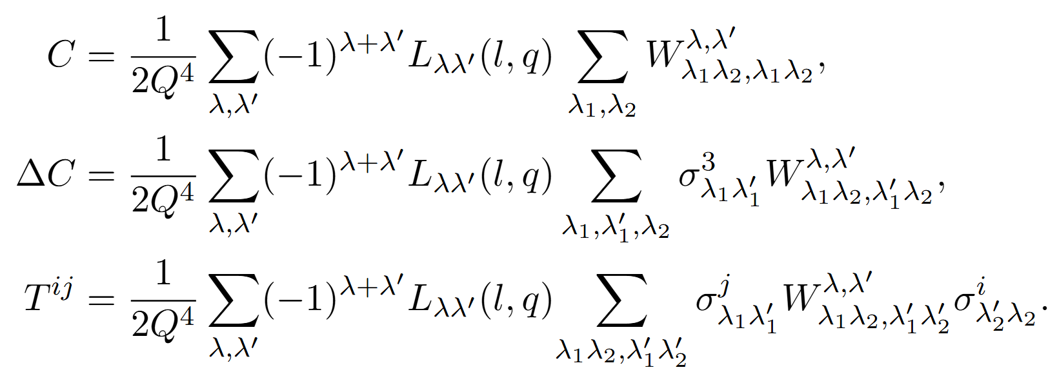
Full Factorization
Full Factorization Formula
Hard Factors
Focus on Collins Type FEC
Unpolarized Lepton for Simplicity
Notes:
Green block: modified FEC
Yellow for pdf; blue for hard factor; purple for fragmentation.(maybe remove yellow)
Hadron tensor W has superscripts for virtual photon and subscripts for partons. While lepton tensor only involve virtual photon helicity, with sum over electron spins. The lepton tensor describe the density matrix of virtual photon induced by kinematics of electrons.
Focus on Tij, which convoluted by Collins type mFEC.
The physical meaning of the term is spin transfer matrix in the scattering process.
Why Collins? As Collins Type mEEC brings interesting phi distribution(? More fancy reasons)

Slide 19
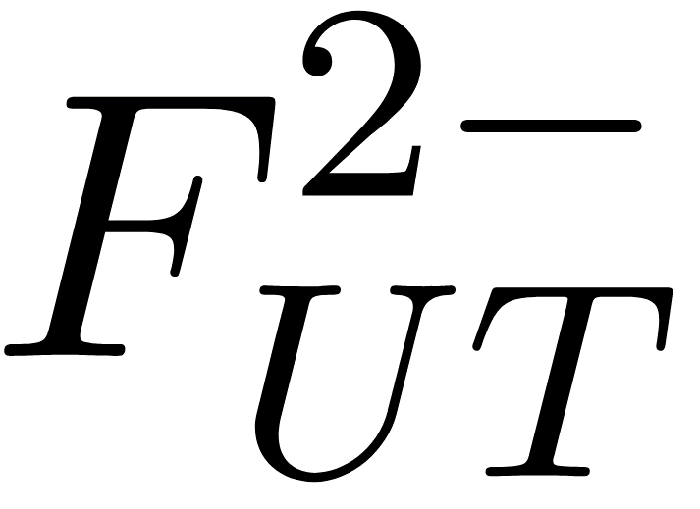
Spin Transfer Matrix
Calculate the $L$ Tensors and Substitute the $W$ Tensors with Structure Function
Unpolarized Electrons
Helicity Interference for Quarks
$∆λ$ in Photon Helicity Interference
Notes:
The R matrix are 2x2 rotation matrix parameterized by an angle phi. The rotation matrix basically rotate the transverse spin direction by a phi angle.
And the structure function here has several scripts. The orange one means no polarization of electron, the blue one means transverse spin of partons. Which basically is the same as the interference of different helicity of outgoing quarks.

Slide 20
Spin Transfer Matrix
Calculate the $L$ Tensors and Substitute the $W$ Tensors with Structure Function
Naturally Survive under $p_{hT}$ Integration
Die in the $p_{hT}$ Integration?
Notes:
Now that we finally integrate over phT, let’s see what survive under the integration.
The delta ij term naturally survive because of its plain distribution of phi angle.
But The strange thing happens on the F 2minus factor. It is multiplied with a rotation of phih, which involves some cos phi or sin phi dependence. These two function die out under integration. But is it true?

Slide 21
Spin Transfer Matrix
Or in cross section level, they read
Naturally Survive under $p_{hT}$ Integration
Die in the $p_{hT}$ Integration?
Notes:
In the cross section level, it reads like this. A expectation value times the sin factor, seemingly the last term die out under integration.
But the problem is, at LO, this F2 minus is the only contributor to the differential section. Let’s take a glance of the Feynman Diagram.

Slide 22
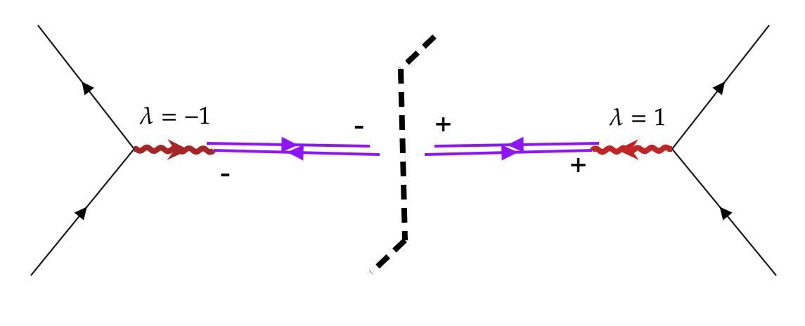
Spin Transfer Matrix
Feynman Diagram correspond to the Structure Function
Die in the $p_{hT}$ Integration? Helicity Configuration at LO!
Notes:
The diagram shows, according to angular momentum conservation, the interference diagram must involve virtual photon interference of Delta lambda = 2.

Slide 23
Spin Transfer Matrix
Need Careful Regulation at $p_{hT}=0$ !
Notes:
The Regulation is actually non-trivial. The details is shown in the back up, due to time limit, maybe we can discuss later.

Slide 24
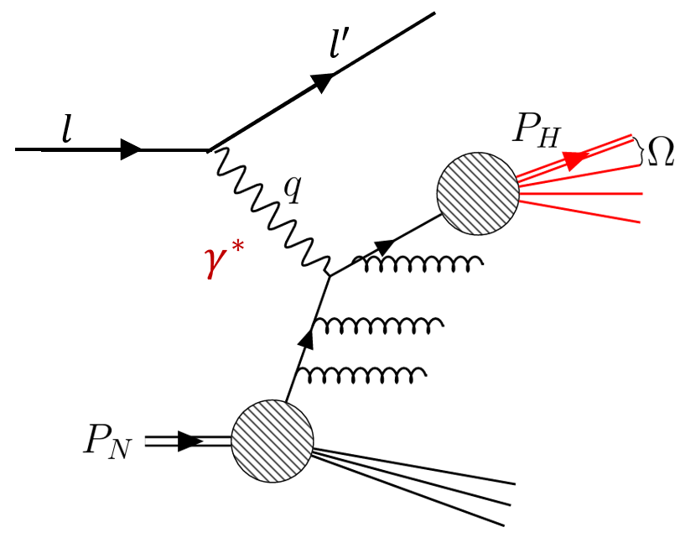
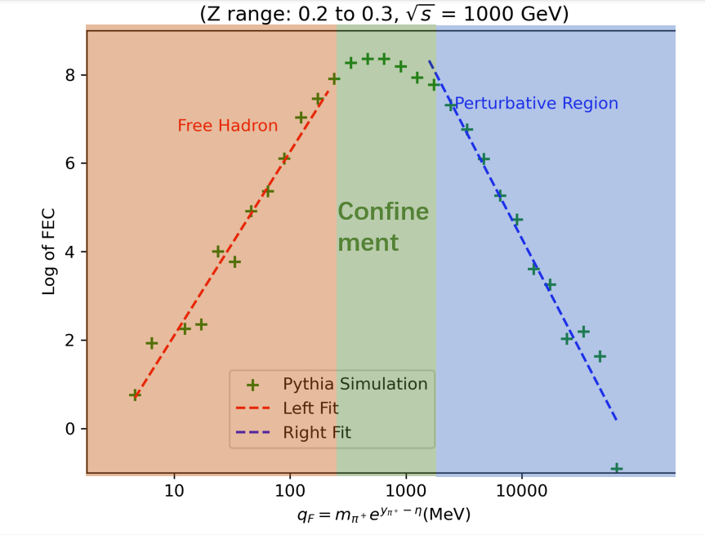
Summary
Introduce the boost invariant Fragmentation Energy Correlators as a probe for transverse structure of fragmenting hadrons.
Naturally connecting to TMD moments.
Spin asymmetry can be shown via Collins type FEC, with a nice collinear factorization.
Show the calculation of hard function up to NLO within consistence of physical insight.

Slide 25
Thank You!

Slide 26
Back Ups

Slide 27
Symmetry Property
Symmetry of W Tensor
Decompose Structure Functions

Slide 28
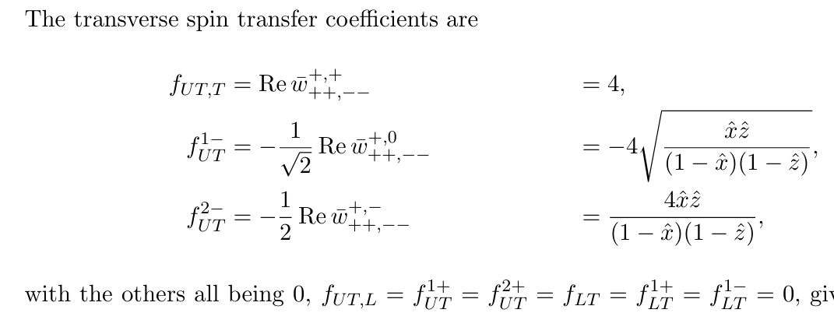
Structure Functions
Some structure functions (before phase space integral)

Slide 29
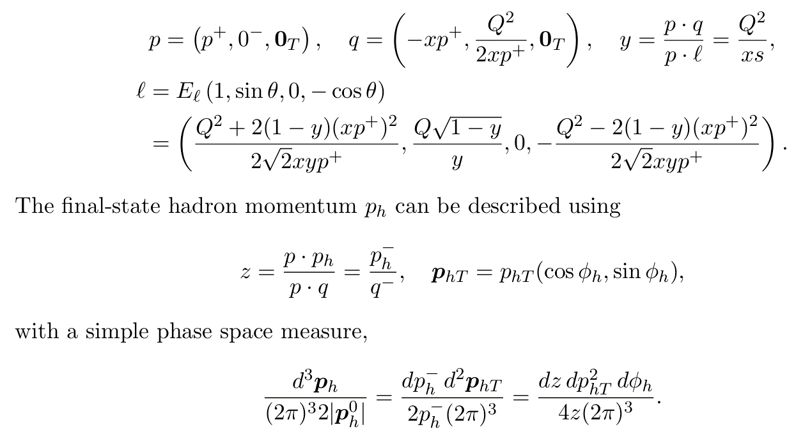
SIDIS kinematics
Kinematics

Slide 30
SIDIS kinematics
Kinematics

Slide 31
Regulation
Phase space
General Regulation for $P_{hT}=0$

