Slide 1


Hydrodynamic response on the celestial sphere
New Opportunities in Particle and Nuclear Physics with Energy Correlators
Andrey Sadofyev
LIP, Lisbon

Slide 2
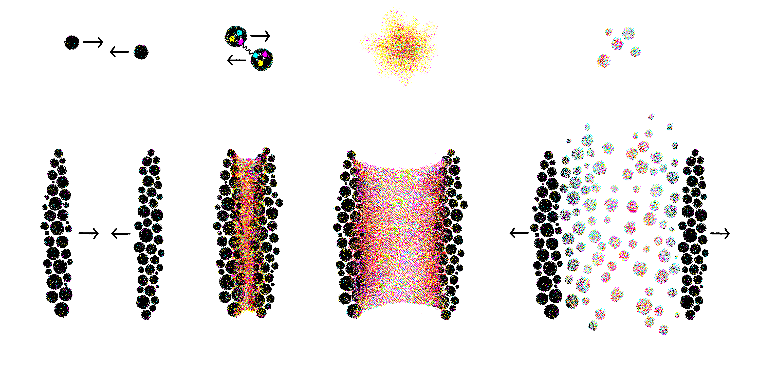
The origin of complex matter
elementary
constituents
small
system
complex
nuclear matter
large
system
simplest
complex matter
2

Slide 3
Some motivation
Learning about QCD in Early Universe (”Big Bang” matter)
Probing QCD phase diagram (extreme conditions)
Understanding matter formation (and its evolution)
Probing nuclear structure (probing partons)
…
Add your favorite option here
3

Slide 4

Probes of matter in HIC
4

Slide 5

Probes of matter in HIC
5

Slide 6
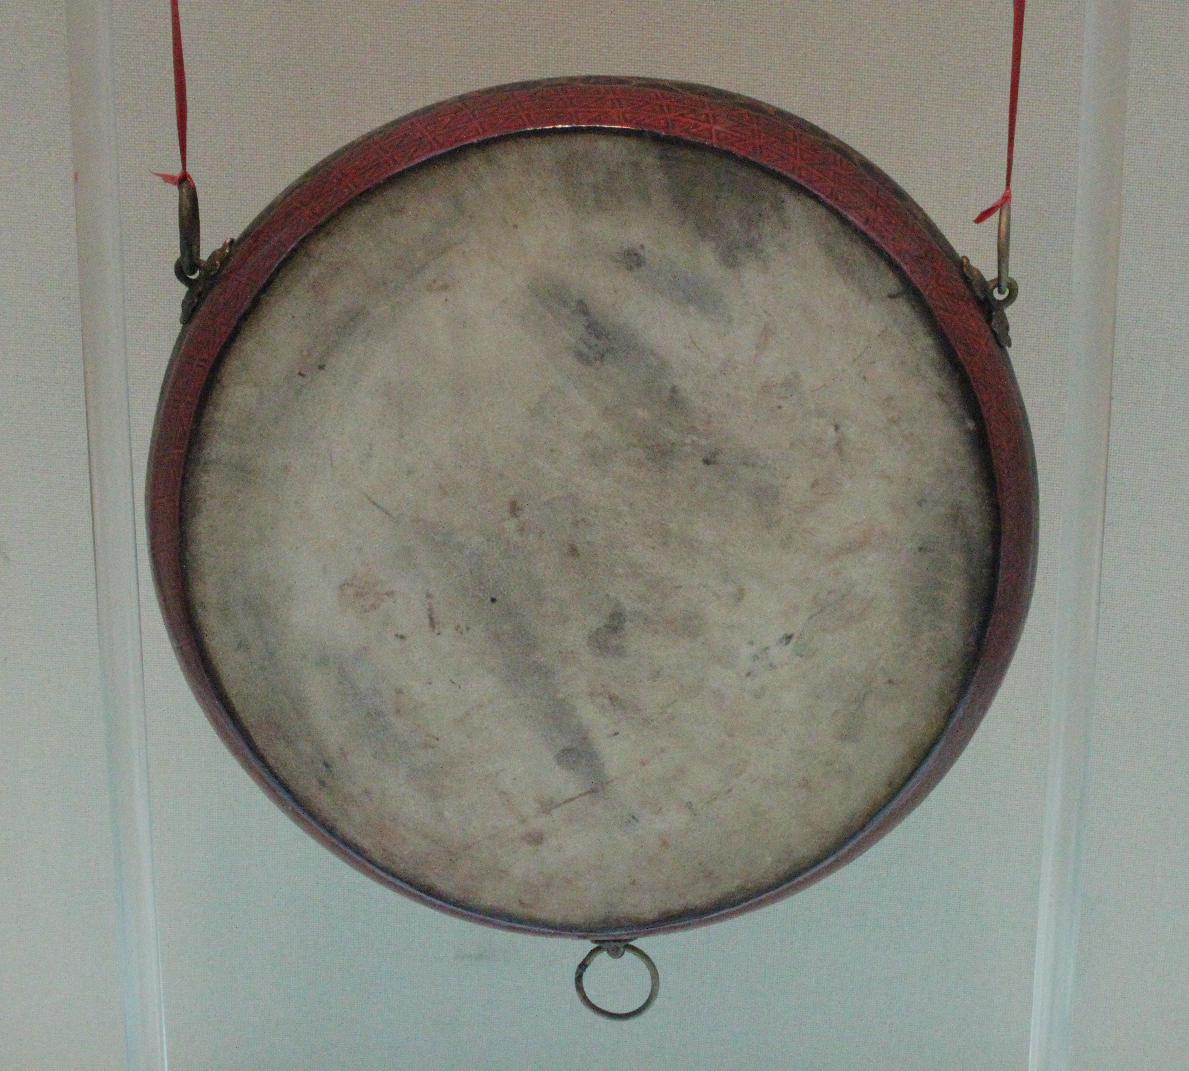
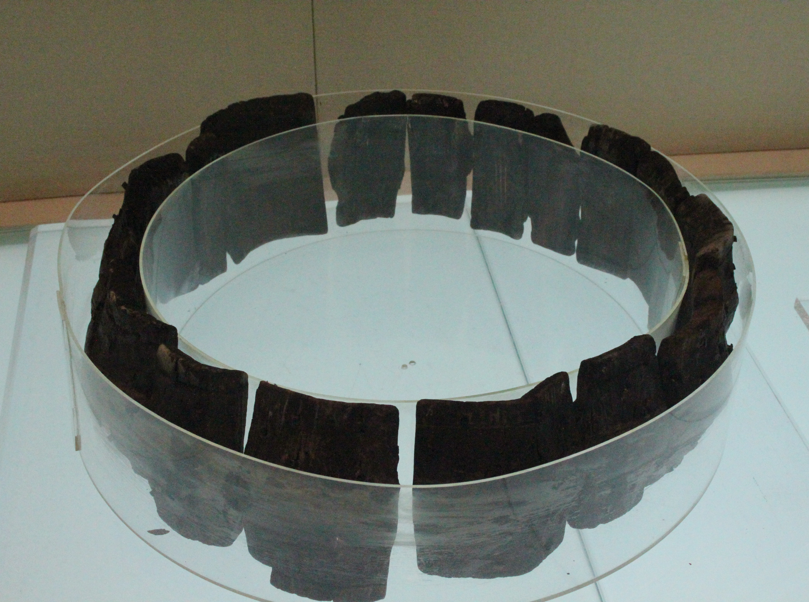
湖北省博物馆 (Hubei Provincial Museum)
Probes of matter in HIC
6

Slide 7
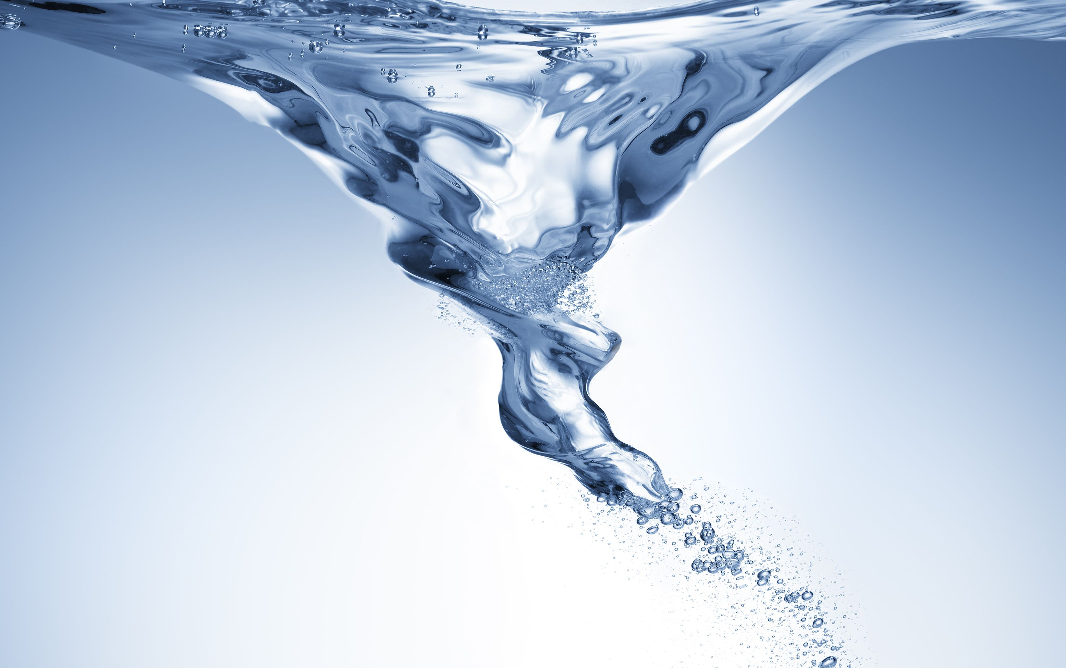
Probes of matter in HIC
7

Slide 8
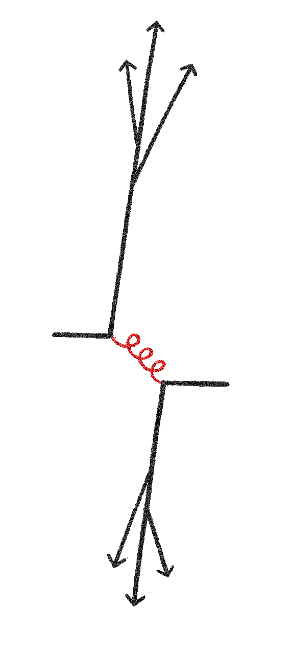
Probes of matter in HIC
8

Slide 9
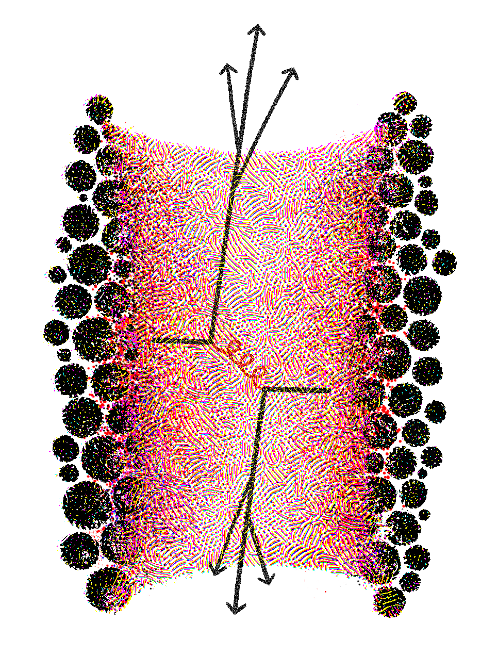
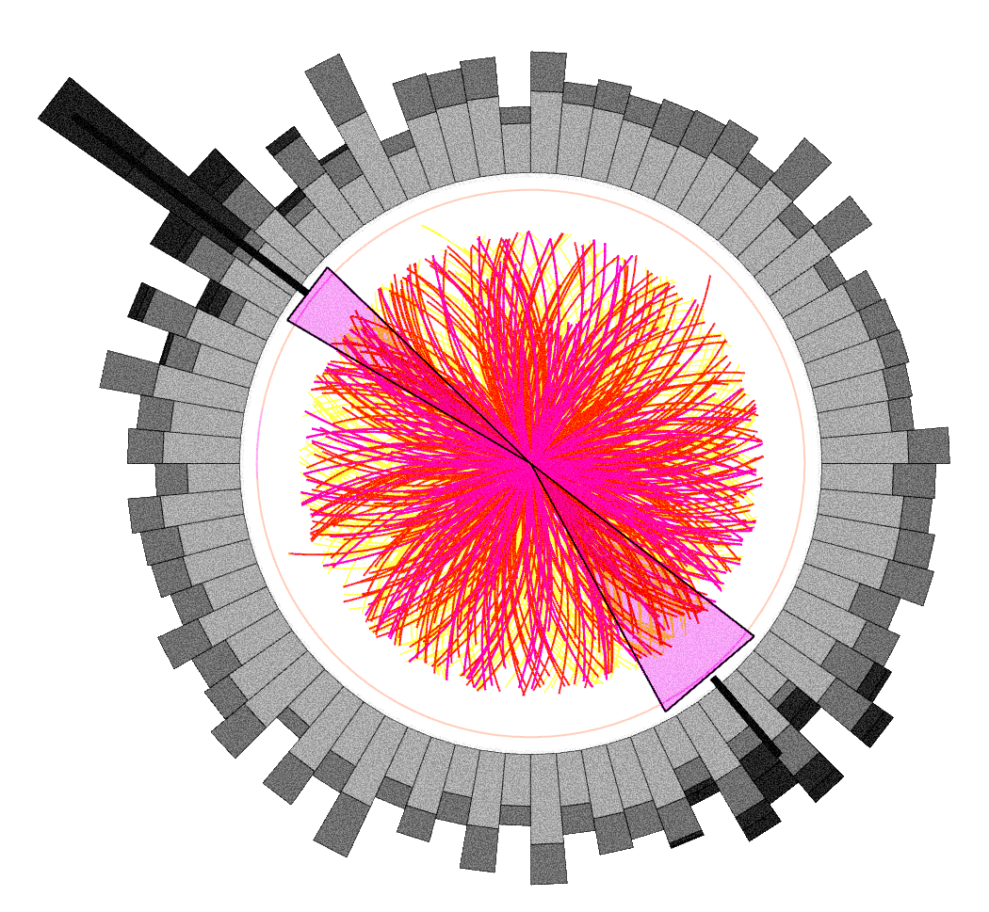

Jet quenching
calorimeter tower
jet quenching
jets lose energy as they propagate through nuclear matter
9

Slide 10

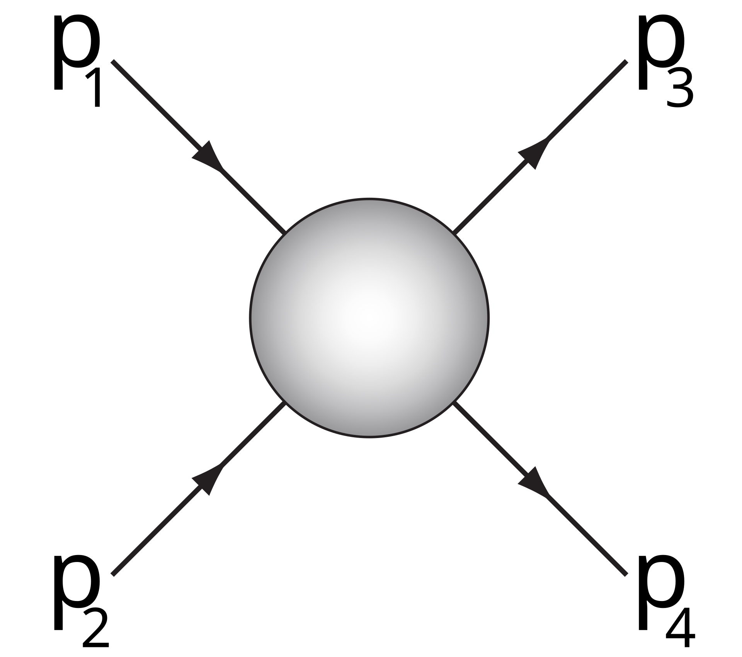
M. Gyulassy , X.-N. Wang, NPB, 1994
R. Baier et al, NPB, 1997
B. G. Zakharov, JETP, 1997
R. Baier et al, NPB, 1998
M. Gyulassy et al, NPB, 2000
X.-F. Guo, X.-N. Wang, PRL, 2000
M. Gyulassy et al, NPB, 2001
AMY, JHEP, 2002
Jet quenching
10

Slide 11
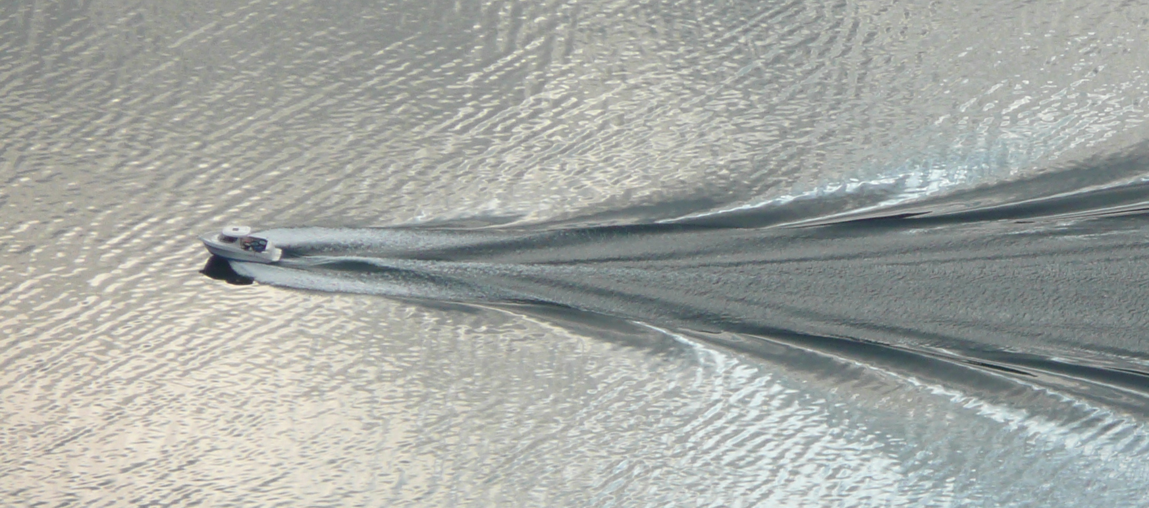
Medium response
11

Slide 12
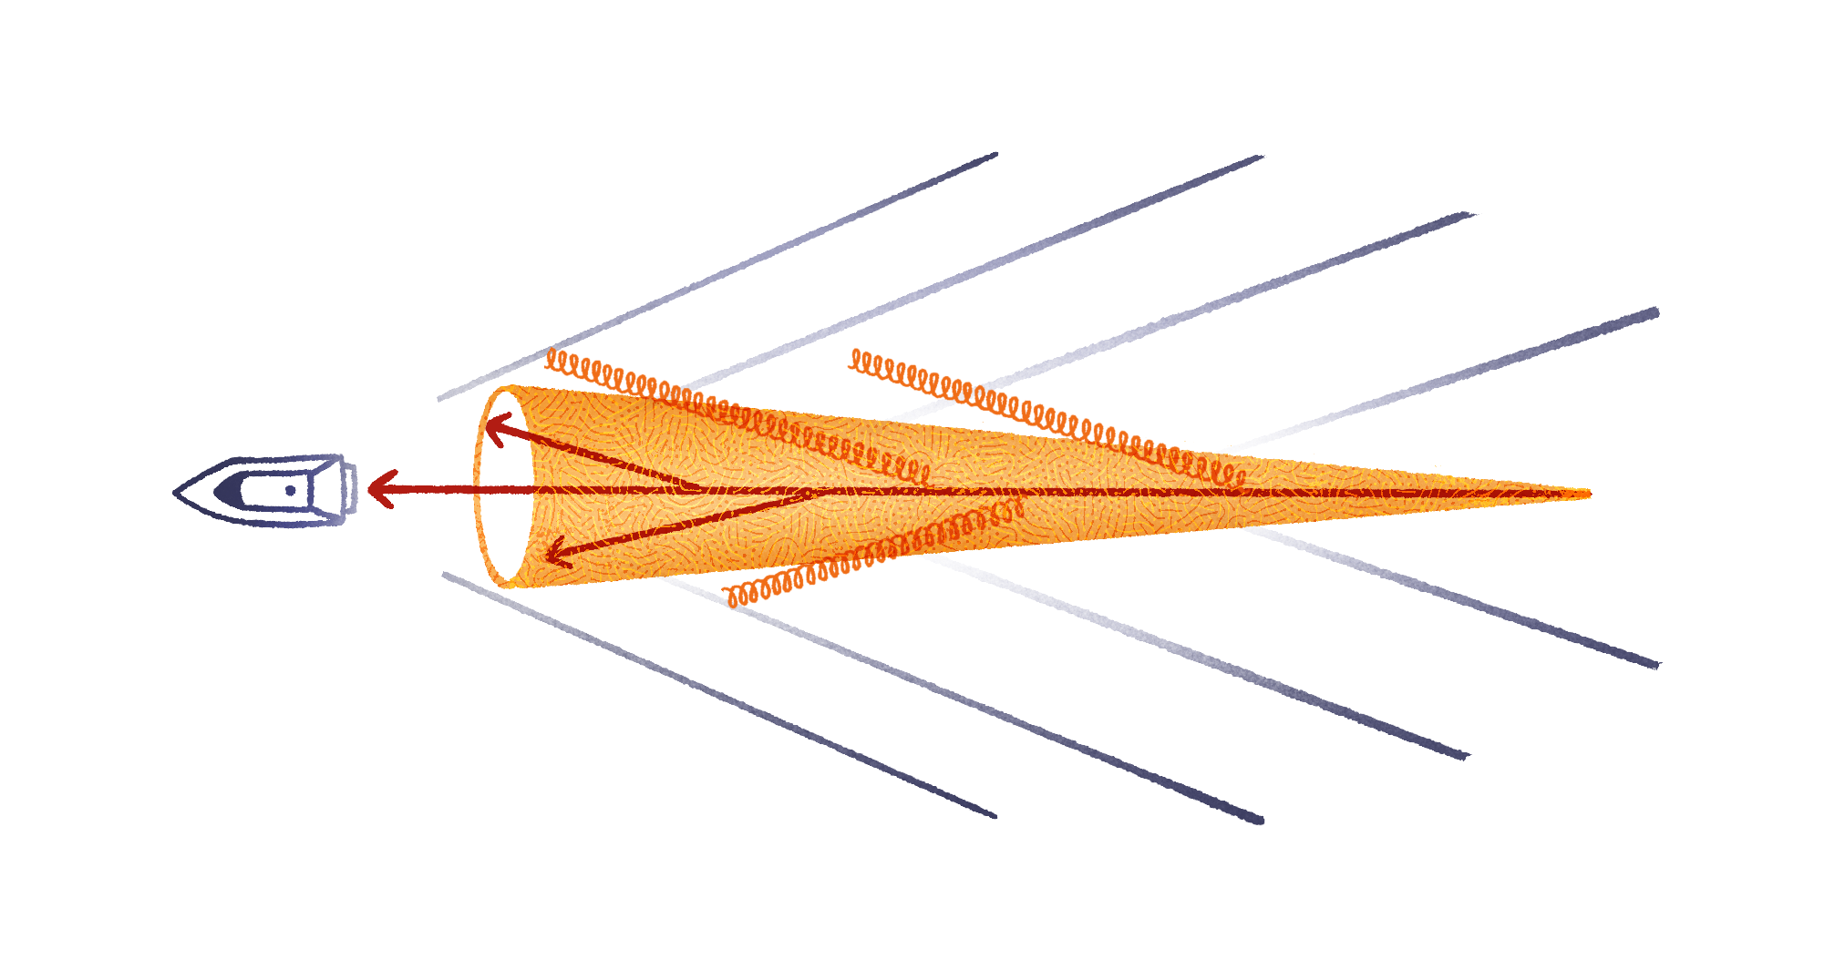
J. Casalderrey-Solana et al, 2004
L.M. Satarov et al, PLB, 2005
J. Ruppert et al, PLB. 2005
A. K. Chaudhuri et al, PRL, 2006
J. Casalderrey-Solana et al, 2006
R. Neufeld et al, PRL, 2009
G.-Y. Qin, PRL, 2009
Medium response
12

Slide 13
Probes of matter in HIC
Matter modifies the probes
Matter responses to the probes and mixes with them
We generally need a better description
We generally need a better way to look into that system
13

Slide 14
Probes of matter in HIC
Matter modifies the probes
Matter responses to the probes and mixes with them
We generally need a better description
We generally need a better way to look into that system
14

Slide 15
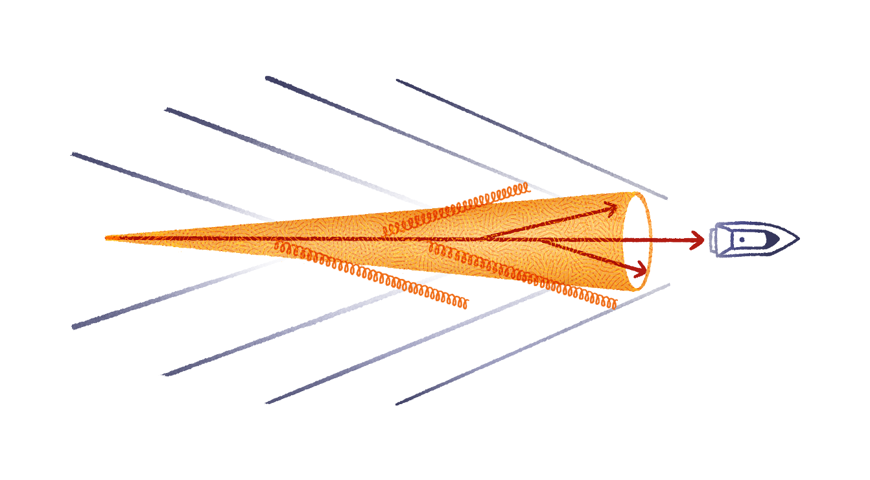
Y. He, T. Luo, X.-N. Wang, Y. Zhu, PRC, 2015
Y. Tachibana, N.-B. Chang, G.-Y. Qin, PRC, 2017
J. Casalderrey-Solana et al, JHEP, 2021
W. Chen, Z. Yang, Y. He, W. Ke, L. Pang, X.-N. Wang, PRL, 2021
Z. Yang, T. Luo, W. Chen, L.-G. Pang, X.-N. Wang, PRL, 2023
Probing the response
Renewed interest in the medium response: recent consideration e.g. within CoLBT, JEWEL, Hybrid model
Experimental needs, see e.g. ALICE, PRC, 2023; ATLAS, PRC, 2025; CMS, 2025
15

Slide 16
H. Bossi, A. S. Kudinoor, I. Moult, D. Pablos, A. Rai, K. Rajagopal, JHEP, 2024
Z. Yang, Y. He, I. Moult, X.-N. Wang, PRL, 2024
Probing the response
see also sides by Ian and Zhong
Renewed interest in the medium response: recent consideration within CoLBT, JEWEL, and Hybrid model
Experimental needs, see e.g. ALICE, PRC, 2023; ATLAS, PRC, 2025; CMS, 2025
EEC as a new way to look into the details?
16

Slide 17
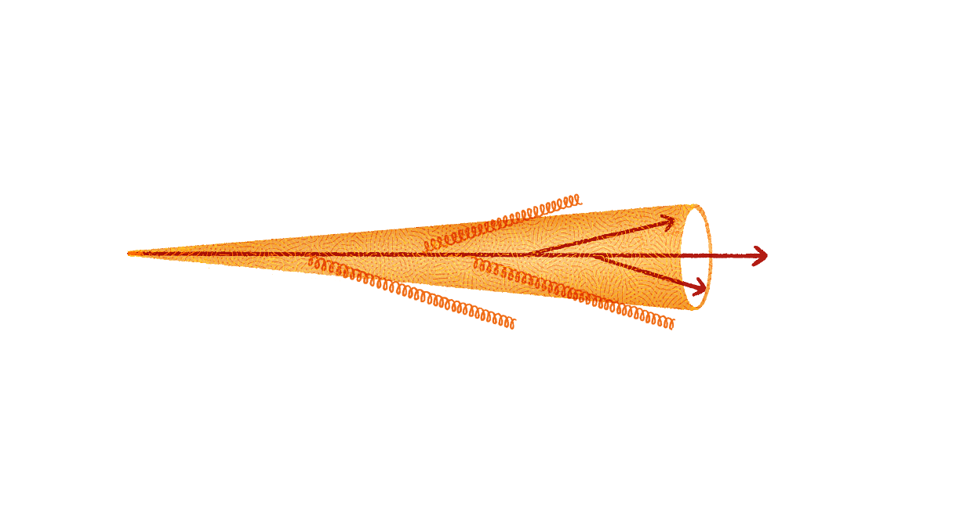
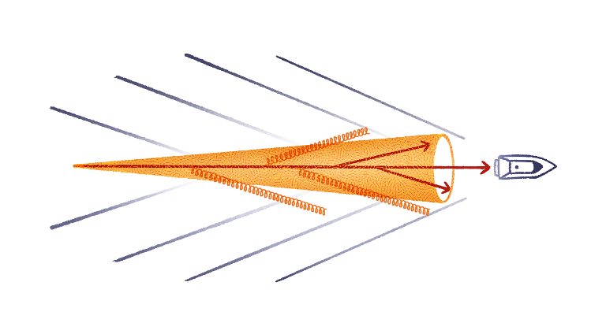

Probing the response
17

Slide 18
Probing the response
An illustration: static background
18

Slide 19

Probing the response
An illustration: static background
19

Slide 20
Probing the response
An illustration: static background
diffusive modes (wake)
sound modes
20

Slide 21
Probing the response
wake
sound
wake
21

Slide 22
e.g. L. Fister, E. Iancu, JHEP, 2015
Probing the response
An approximate in-medium evolution of the single gluon inclusive distribution:
22

Slide 23
e.g. L. Fister, E. Iancu, JHEP, 2015
Probing the response
An approximate in-medium evolution of the single gluon inclusive distribution:
23

Slide 24
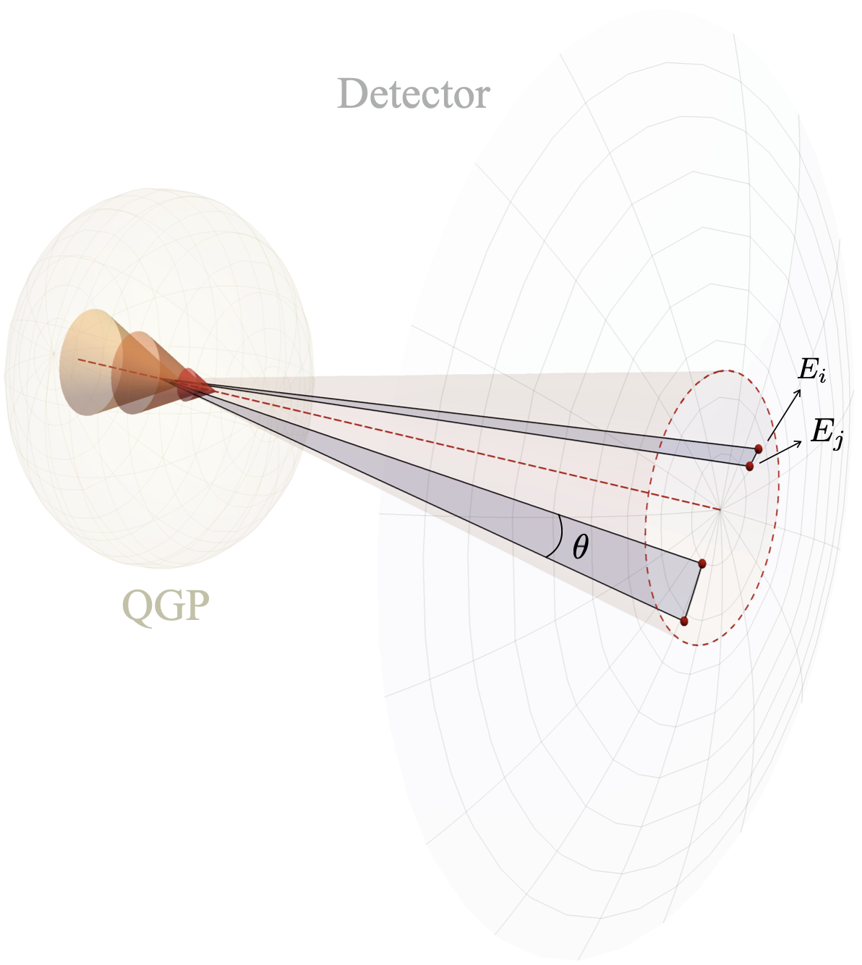
J. Barata, M. Kuzmin, G. Milhano, AS, 2024
Probing the response
The hydrodynamic description of a flowing medium is classical
24

Slide 25
J. Barata, M. Kuzmin, G. Milhano, AS, 2024
Probing the response
The hydrodynamic description of a flowing medium is classical
So are the most of the current treatments of the medium response
25

Slide 26
J. Barata, M. Kuzmin, G. Milhano, AS, 2024
Probing the response
The hydrodynamic description of a flowing medium is classical
So are the most of the current treatments of the medium response
But what would happen if a classical flow were plugged into the ECs?
26

Slide 27
J. Barata, M. Kuzmin, G. Milhano, AS, 2024
Probing the response
The hydrodynamic description of a flowing medium is classical
So are the most of the current treatments of the medium response
But what would happen if a classical flow were plugged into the ECs?
27

Slide 28
J. Barata, M. Kuzmin, G. Milhano, AS, 2024
Probing the response
The hydrodynamic description of a flowing medium is classical
So are the most of the current treatments of the medium response
Uncorrelated energy flux contributes through geometric correlations
28

Slide 29
J. Barata, M. Kuzmin, G. Milhano, AS, 2024
Probing the response
The hydrodynamic description of a flowing medium is classical
So are the most of the current treatments of the medium response
Uncorrelated energy flux contributes through geometric correlations
the leading structure is unmodified
by the stochastic contribution
29

Slide 30
J. Barata, M. Kuzmin, G. Milhano, AS, 2024
Probing the response
30

Slide 31
J. Barata, M. Kuzmin, G. Milhano, AS, 2024
Probing the response
Specific model is needed to fix the factors (cannot be done at this level)
Classical flux leads to universal features (e.g. positivity of the leading term)
The same behavior for different descriptions (hydro, EKT, etc)
31

Slide 32
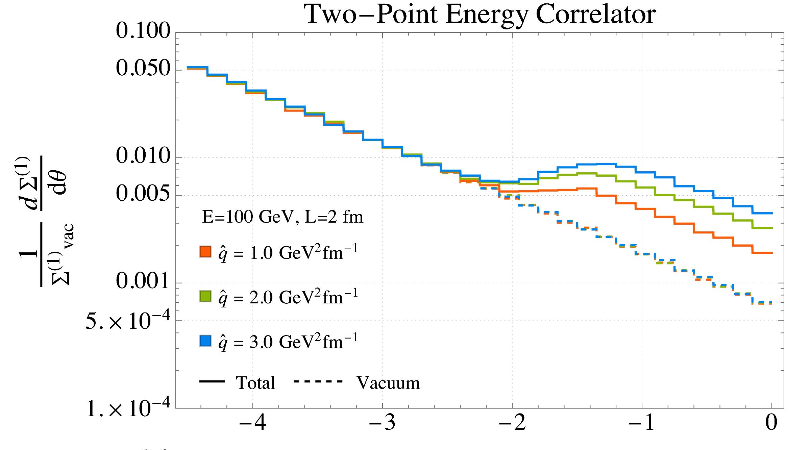
J. Barata, M. Kuzmin, G. Milhano, AS, 2024
C. Andres et al, PRL, 2023
Probing the response
Specific model is needed to fix the factors (cannot be done at this level)
Classical flux leads to universal features (e.g. positivity of the leading term)
The same behavior for different descriptions (hydro, EKT, etc)
32

Slide 33
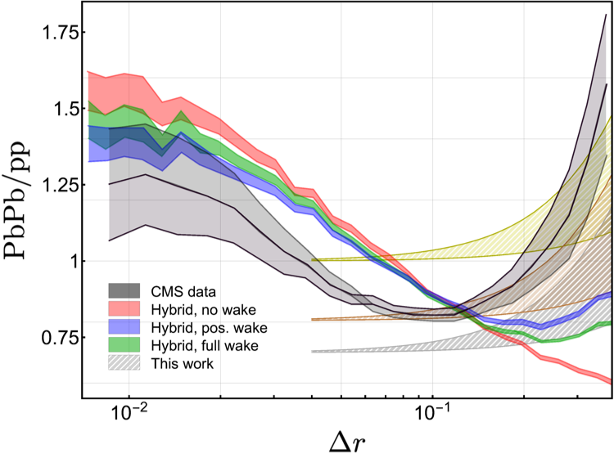
J. Barata, M. Kuzmin, G. Milhano, AS, 2024
preliminary data from CMS, 2024
Probing the response
Specific model is needed to fix the factors (cannot be done at this level)
Classical flux leads to universal features (e.g. positivity of the leading term)
The same behavior for different descriptions (hydro, EKT, etc)
33

Slide 34
J. Barata, I. Moult, AS, J. Silva, 2025
H. Bossi et al, JHEP, 2024
Probing the response
Specific model is needed to fix the factors (cannot be done at this level)
Classical flux leads to universal features (e.g. positivity of the leading term)
The same behavior for different descriptions (hydro, EKT, etc)
34

Slide 35
J. Barata, I. Moult, AS, J. Silva, 2025
H. Bossi et al, JHEP, 2024
Probing the response
Specific model is needed to fix the factors (cannot be done at this level)
Classical flux leads to universal features (e.g. positivity of the leading term)
The same behavior for different descriptions (hydro, EKT, etc)
35

Slide 36
J. Barata, I. Moult, AS, J. Silva, 2025
Probing the response
An illustration: and no perturbative medium modification
chh, regularized
36

Slide 37
J. Barata, I. Moult, AS, J. Silva, 2025
H. Bossi et al, JHEP, 2024
Probing the response
An illustration:
see João’s talk for more details
37

Slide 38
J. Barata, I. Moult, AS, J. Silva, 2025
Universality of the geometric ECs
The vac. PENC in the OPE limit:
The medium-induced part of PENC: (for a static and homogeneous matter)
The medium response contribution: (no azimuthal structure, leading terms)
38

Slide 39
Summary and outlook
The “uncorrelated” energy fluxes lead to geometric ECs
These contributions have highly universal structure, allowing to understand their qualitative feature
Only accounting for all the types of contributions one can systematically study the medium properties with ECs in HIC
PECs suggest an alternative way to access the anisotropy of the medium properties (azimuthal structure leads to even powers)
The geometric contributions to E3C closely follows the pattern set by the celestial block decomposition
39

