Slide 1
Examination of T/CP Invariance in the $e^{+}e^{−}→^{+}^{−}$Reaction at BESIII
Yunhe Yang¹, Ziyu Zhang¹, Zhiyong Wang³, Aiqiang Guo², Chunxu Yu¹
¹NanKai University
²Institute of Modern Physics, Chinese Academy of Sciences
³Institute of High Energy Physics

Slide 2
Outline
Motivation
MC sample
Event selection
Further selection
Background analysis
<A> and R

Slide 3
Motivation
Understand CPV is a key to understand the preponderance of matter over antimatter in our universe.
CPV in collider Physics:
DAΦNE (KLOE, 𝜙 peak): Br(𝜙 → K+K-) = 49.2%
e+e- @1019.4 MeV Br(𝜙 → K0K0-bar) = 33.8%
KEKB/BELLE, PEP-II/BABAR Tevatron (D0/CDF) LHC (ATLAS/CMS)
e+e- @10.58 GeV, ץ(4S) pp-bar @1.98 TeV pp @14 TeV
CKM says: no CPV should not occur in the leptonic sector, which must be tested!

Slide 4
MC sample
BOSS version: 7.0.9
Data:
Inclusive MC: 2300M
Signal MC: $1×{10}^{6}$
MC sample | Generated Model
$$τ^{+}→e^{+}ν_{e}{\overline{ν}}_{τ}$$ $τ^{−}→μ^{−}{\overline{ν}}_{μ}ν_{τ}$ | PHOTOS TAULNUNU
$$τ^{+}→e^{+}ν_{e}{\overline{ν}}_{τ}$$ $τ^{−}→μ^{−}{\overline{ν}}_{μ}ν_{τ}$ | PHOTOS TAULNUNU

Slide 5
Event selection
Good Charged Choose
$\left|V_{r}\right|<1.0cm, \left|V_{Z}\right|<10cm, \left|cosθ\right|<0.93, N_{total}=2$
Good Photon Choose
$N_{γ}=0, dang≥{10}^{◦}, 0≤TDC≤700ns$
$Barrel EMC: \left|cosθ\right|≤0.8, E_{γ}≥25MeV$
$Endcap EMC: 0.86≤\left|cosθ\right|≤0.92, E_{γ}≥50MeV$
PID
$For e: P_{e}>0.001, P_{e}>P_{μ}, P_{e}>P_{π}, P_{e}>P_{K}, P_{e}>P_{p}, n_{e}=1$
$For muon: P_{μ}>0.001, P_{μ}>P_{e}, P_{μ}>P_{π}, P_{μ}>P_{K}, P_{μ}>P_{p}, n_{μ}=1$
Vertex fit

Slide 6
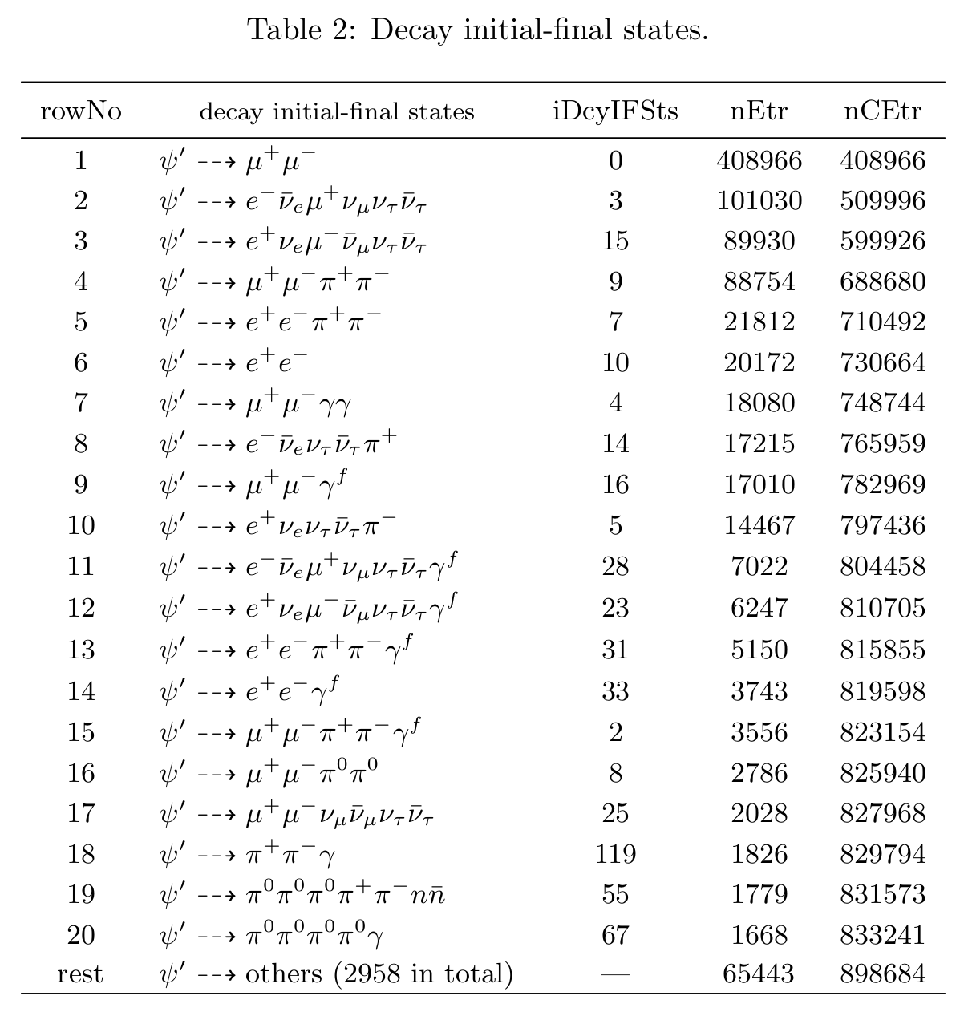
Further selection
$ψ\left(2S\right)→μ^{+}μ^{−}$
$ψ\left(2S\right)→e^{+}e^{−}$
$ψ\left(2S\right)→π^{+}π^{−}J/ψ→μ^{+}μ^{−}π^{+}π^{−}$
$ψ\left(2S\right)→π^{+}π^{−}J/ψ→e^{+}e^{−}π^{+}π^{−}$
$ψ\left(2S\right)→τ^{+}τ^{−}→e^{+}π^{−}3ν+c.c.$
$ψ\left(2S\right)→ηJ/{ψ→}μ^{+}μ^{−}γγ$
……
Need to give more cut!

Slide 7
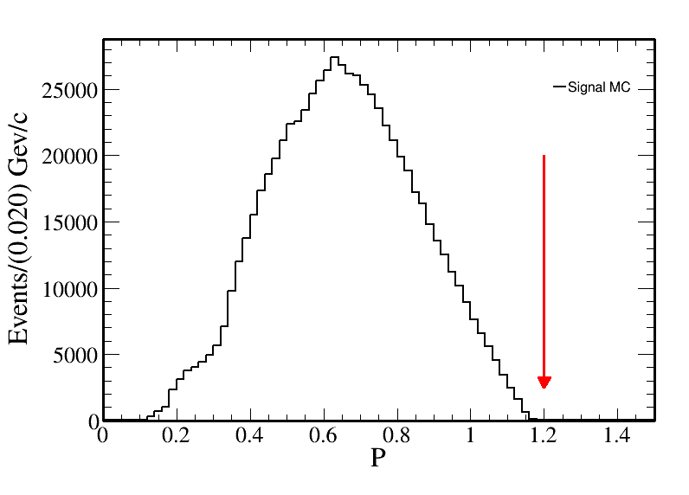
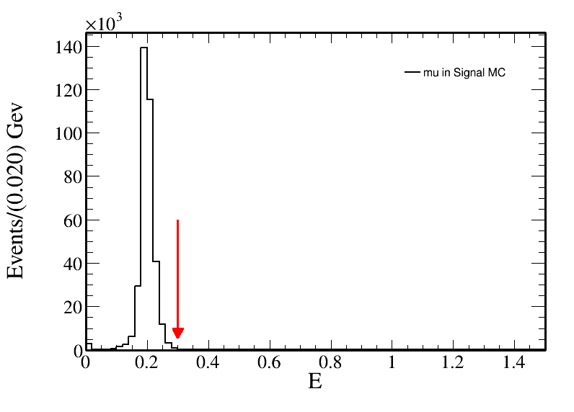
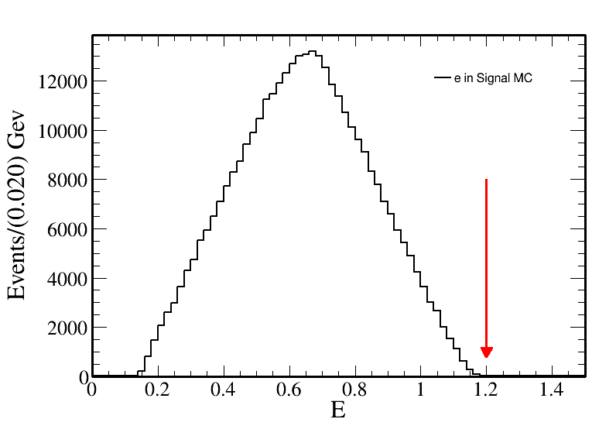
Further selection
For electron and muon:
Momentum in MDC: $P<1.2$
The energy in EMC: $E_{e}<1.2$
The energy in EMC: $E_{μ}<0.3$

Slide 8
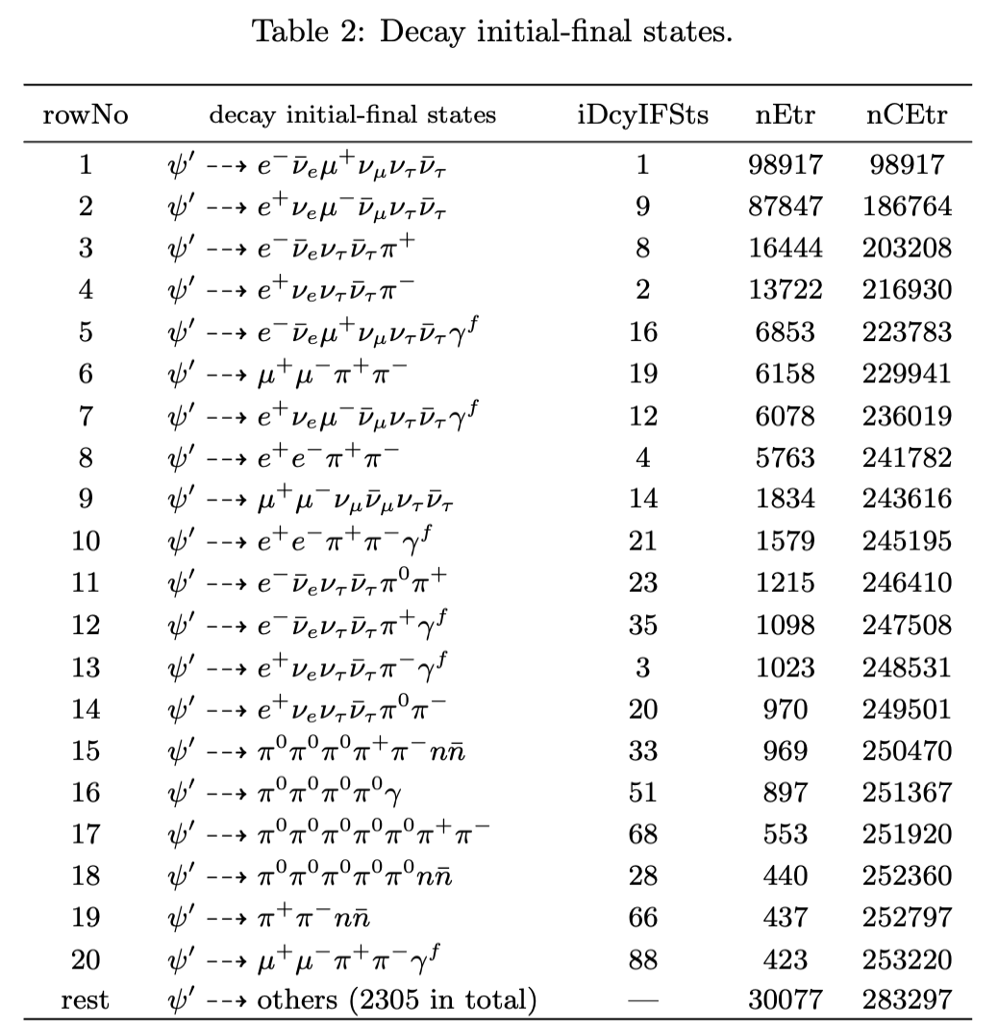
Further selection
Muon and Pion, need MUC information.
Electron, Muon
Need ep-ratio information

Slide 9
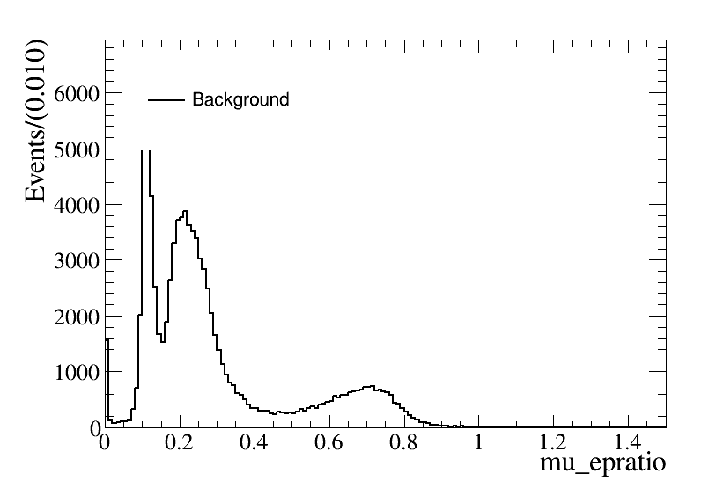
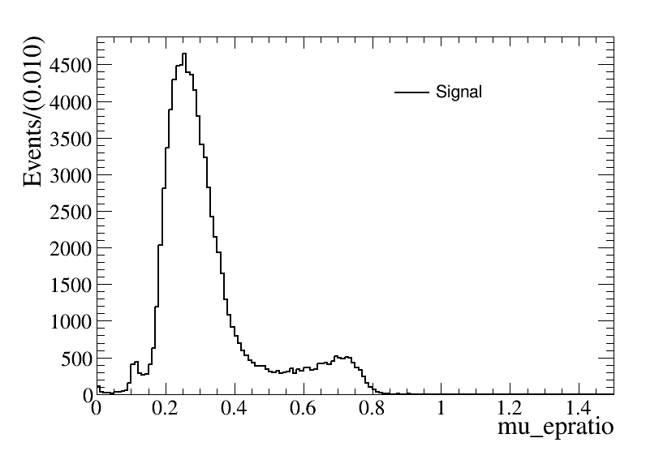
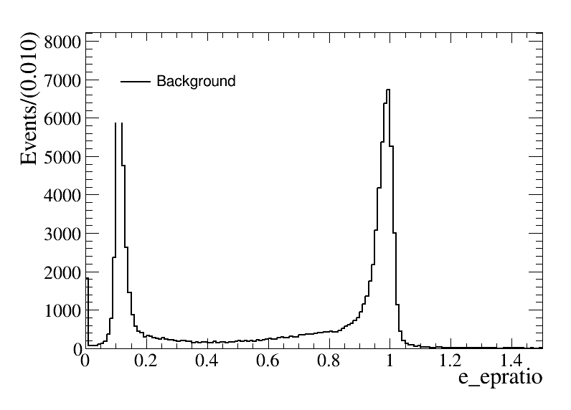
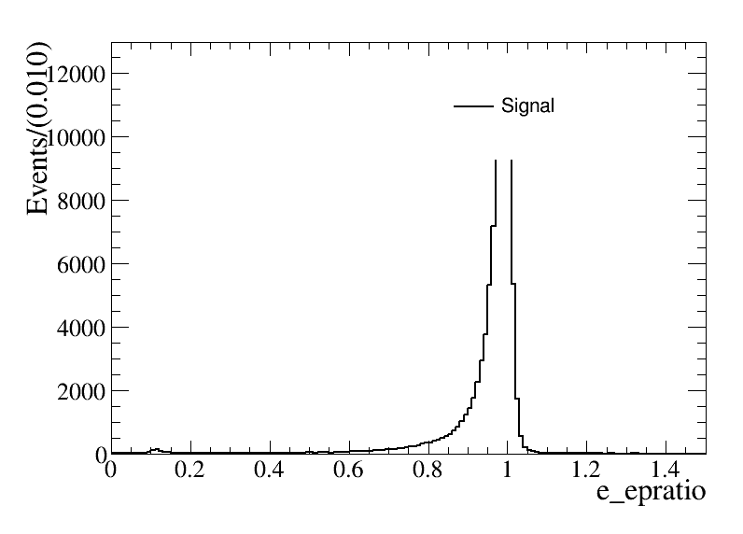
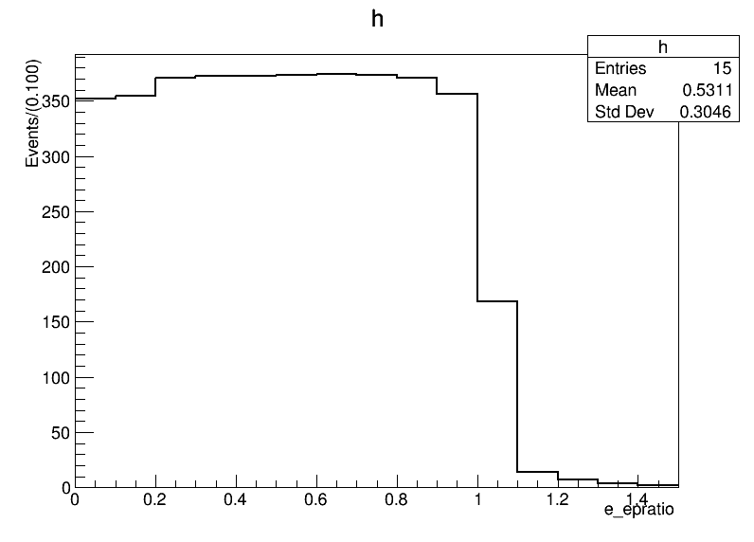
Further selection
For electron:
$FOM=S/{\sqrt{S+B}}$
$E/P>0.8$

Slide 10
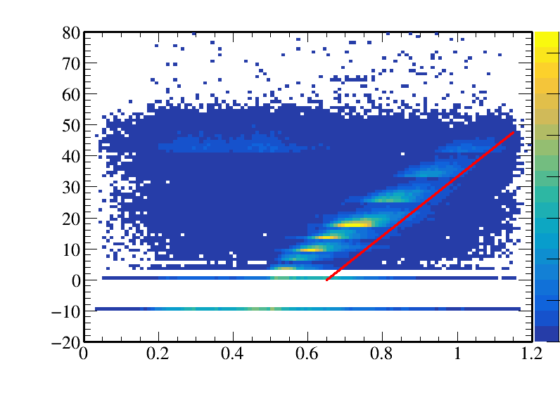
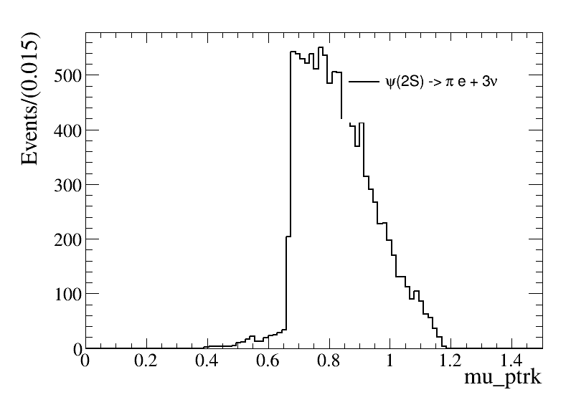
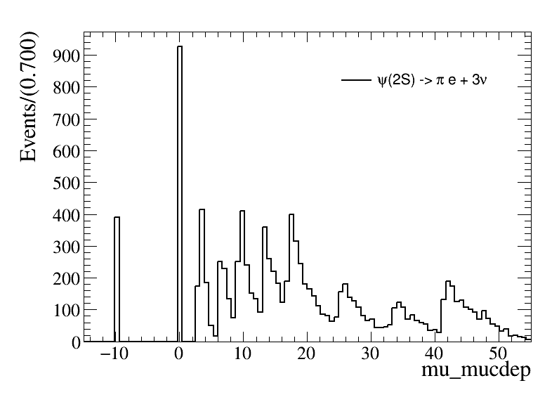
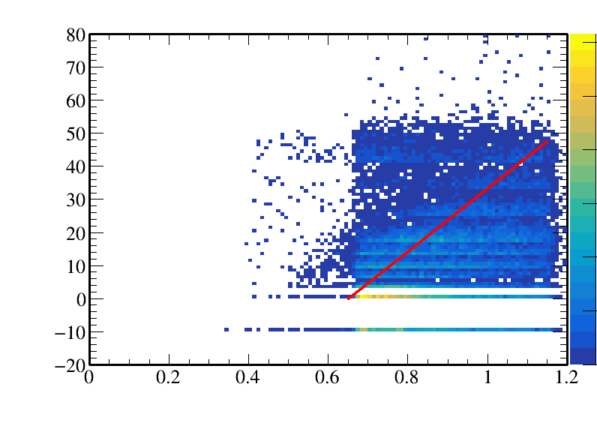
Further selection
Use the relationship between P and depth in the MUC
$FOM=S/{\sqrt{S+B}}$
$MUC_{depth}>95×(P−0.65)$

Slide 11
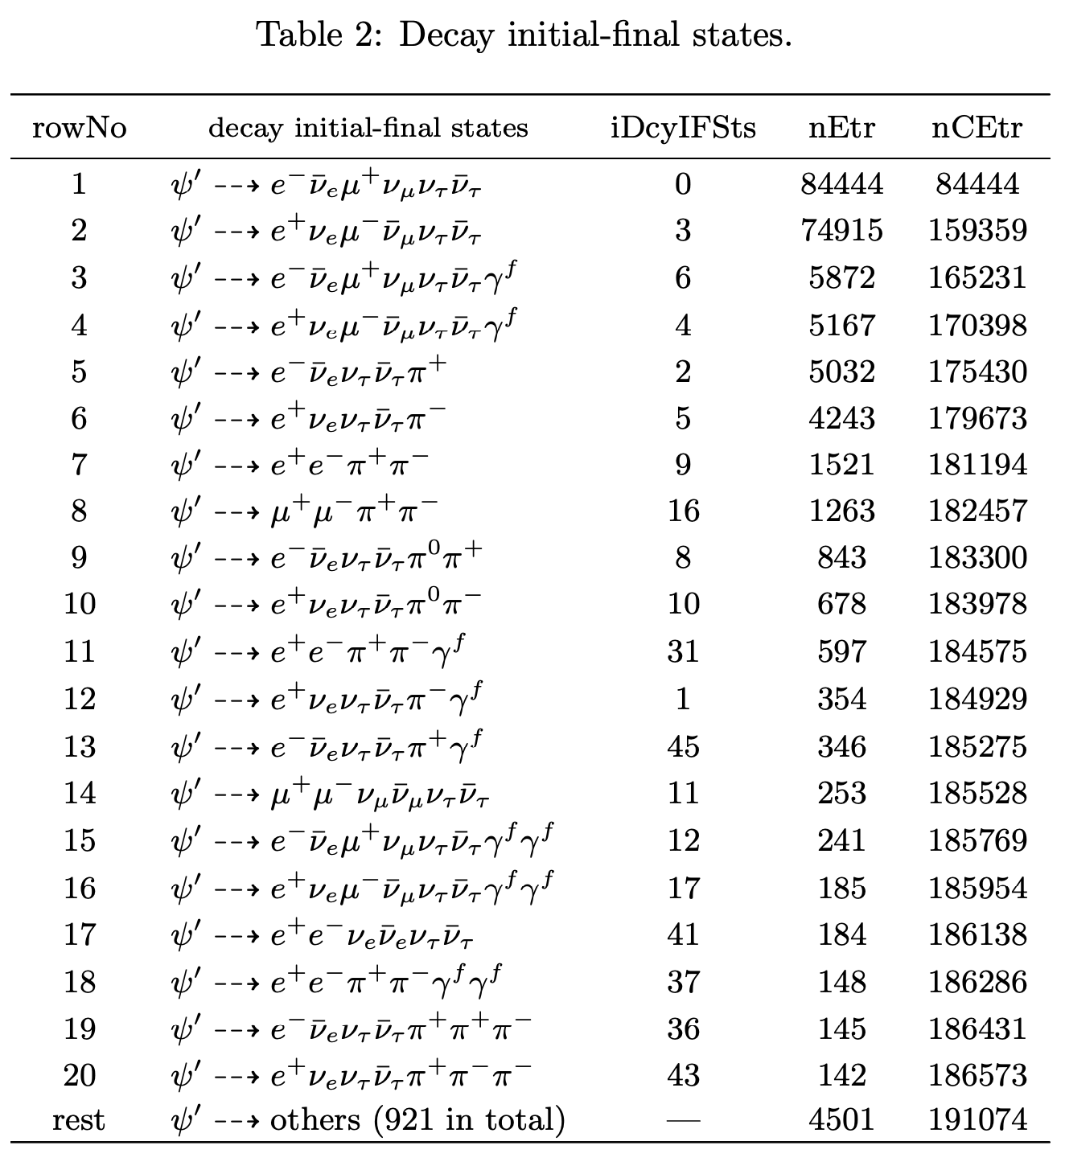
Further selection
The left background
Need the miss mass and miss $cosθ$
$M_{miss}=\left(P4_{ψ\left(2S\right)}−P4_{ll}\right)∙m()$
$cosθ_{miss}=\frac{−{\left(p_{1}+p_{2}\right)}_{z}}{|p_{1}+p_{2}|}$

Slide 12
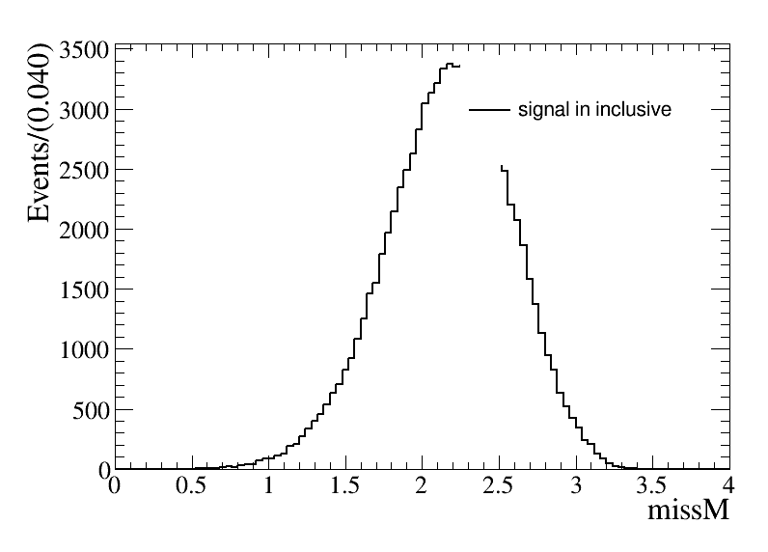
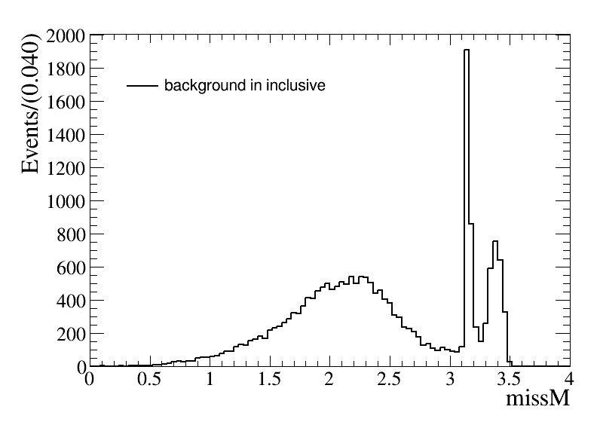
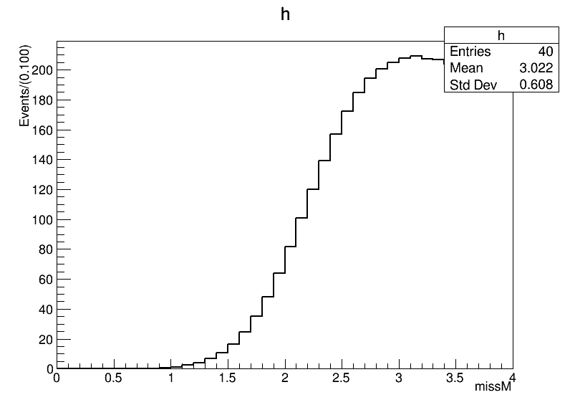
Further selection
$M_{miss}=\left(P4_{ψ\left(2S\right)}−P4_{ll}\right)∙m()$
The missing mass: $M_{miss}<3.05$

Slide 13
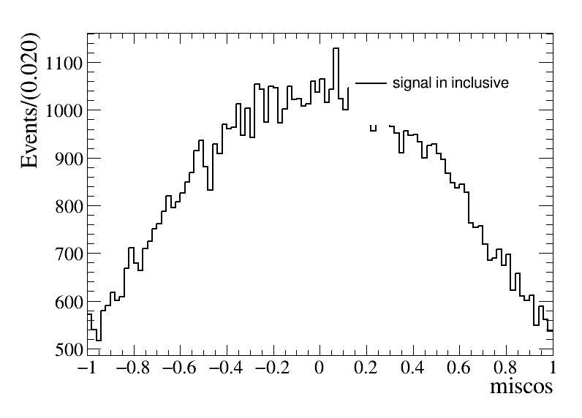
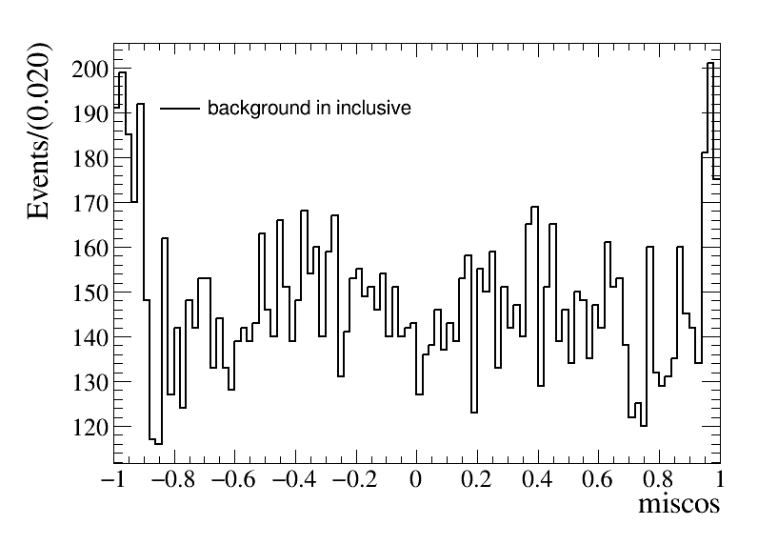
Further selection
$cosθ_{miss}=\frac{−{\left(p_{1}+p_{2}\right)}_{z}}{|p_{1}+p_{2}|}$
The missing $cosθ$: $|cosθ_{miss}|<0.8$

Slide 14
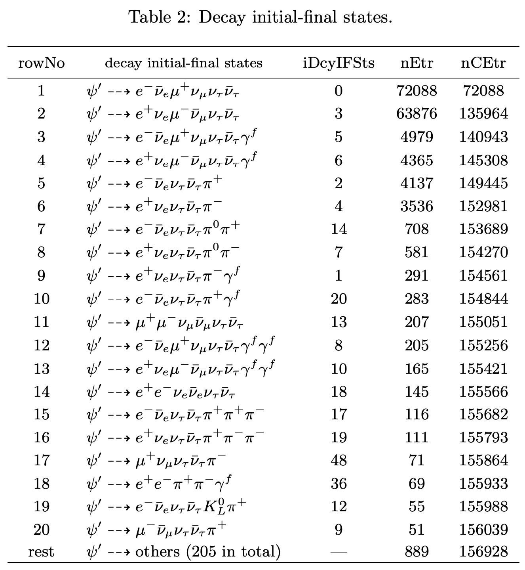
Background analysis
Main background
$ψ\left(2S\right)→τ^{+}τ^{−}→e^{+}π^{−}3ν+c.c.$
The number of background events is about 14760 in total, about 7.40% to inclusive MC.
$\tilde{R}$ from background:
$$\tilde{R}=R_{μ^{+}e^{−}}^{T}∙R_{e^{+}μ^{−}}^{T}=R_{μ^{+}e^{−}}^{CP}∙R_{e^{+}μ^{−}}^{CP}=1+4δ$$
$\tilde{R}=1.019219$ and $δ=0.00480475$
Need consider uncertainty from background!

Slide 15
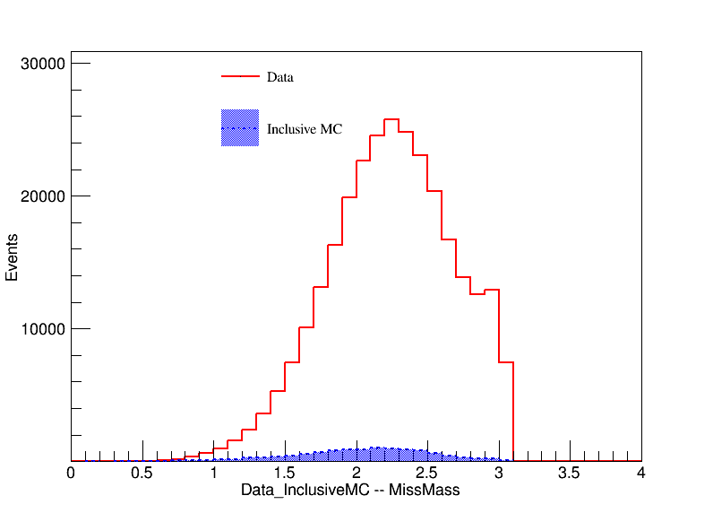
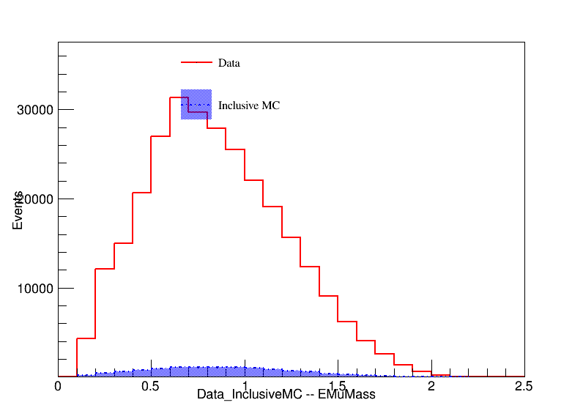
Background analysis
To ensure the inclusive MC can describe the background.

Slide 16
Background analysis

Slide 17
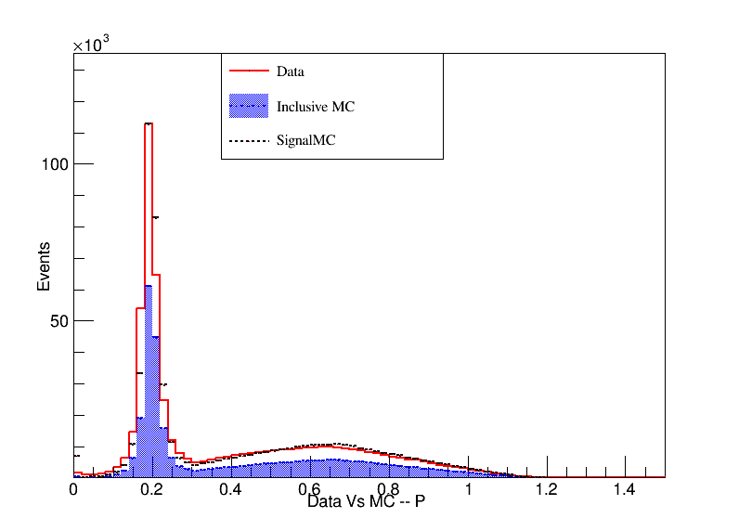
Data vs MC

Slide 18
Next week work
Run the inclusive MC with CP violation.
Consider how to calculate the impact of background on the result.

