Slide 1




Institute of High Energy Physics, CAS
Quark model for hadrons
Qiang Zhao
Institute of High Energy Physics, CAS
zhaoq@ihep.ac.cn
理论物理专款前沿讲习班
2025.08.19.郑州

Slide 2
Outline
A brief review of hadron physics
Non-relativistic constituent quark model (NRCQM) for mesons and baryons
Electromagnetic (EM) and strong interactions of hadrons in the NRCQM
Quark model with heavy flavors
A brief summary

Slide 3
References:
N. Isgur and G. Karl, Phys.Rev. D18 (1978) 4187
N. Isgur and G. Karl, Phys.Rev. D20 (1979) 1191-1194
N. Isgur and G. Karl, Phys.Rev. D19 (1979) 2653
S. Godfrey and N. Isgur, Phys.Rev. D32 (1985) 189-231
S. Capstick and N. Isgur, Phys.Rev. D34 (1986) 2809
E. Eichten, K. Gottfried, T. Kinoshita, K.D. Lane, and T.-M. Yan, Phys.Rev. D17 (1978) 3090, Phys.Rev. D21 (1980) 313
E. Eichten, K. Gottfried, T. Kinoshita, K.D. Lane, and T.-M. Yan, Phys.Rev. D21 (1980) 203
S. Capstick and W. Roberts, Prog.Part.Nucl.Phys. 45 (2000) S241-S331
F. E. Close, An introduction to quarks and partons, Academic Press, 1979
A. Le Yaouanc, et al., Hadron transitions in the quark model, Gordon and Breach Science Publishers, 1988
R.G. Edwards, J.J. Dudek, D.G. Richards and S.J. Wallace, Phys. Rev. D 84, 074508 (2011)

Slide 4
1. A brief review of hadron physics

Slide 5
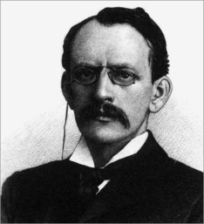
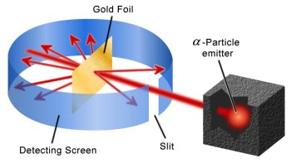
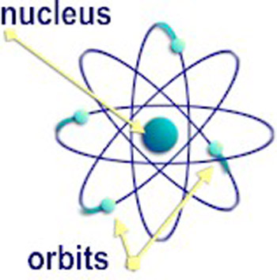
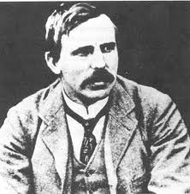
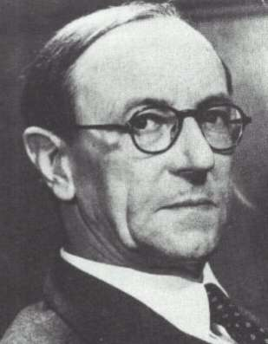
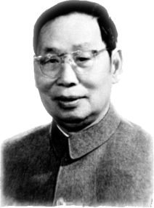
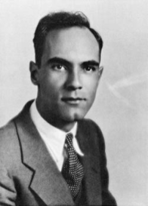
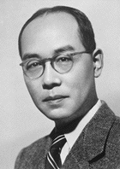

粒子物理标准模型建立之前，人类对亚原子结构的认知
1897: 电子
1919: 质子
1932: 中子
1932: 正电子
1935: Yukawa (汤川)预言$π$介子
1909: Geiger & Marsden exp., and Rutherford’s atomic model
Thomson
1906
Rutherford
1908
卢瑟福的原子核式结构对理解元素光谱具有重要意义
推动了量子力学的发展
Chadwick
1935
C.-Y. Chao
Anderson
1936
Yukawa
1949

Slide 6











粒子物理标准模型建立之前，人类对亚原子结构的认知
1897: 电子
1919: 质子
1932: 中子
1932: 正电子
1935: Yukawa (汤川)预言$π$介子
正电子的发现
1929：C.-Y. Chao实验
Thomson
1906
$$γ^{′}$$
$$γ,E$$
$$γ,E$$
$${e, E}_{k}$$
$$γ^{′′}$$
$$γ^{′′}$$
Rutherford
1908
$$(I)$$
$$(II)$$
$$Al$$
$$Pb$$
Chadwick
1935
$$(II)$$
C.-Y. Chao
Anderson
1936
Chao, Proc. Nat. Acad. Sci. 16, 431 (1930); C.Y. Chao, Phys. Rev. 36, 1519 (1930)
Yukawa
1949

Slide 7
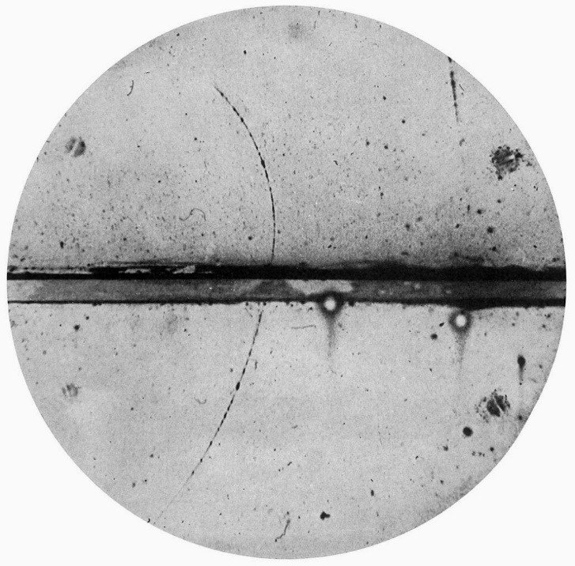




粒子物理标准模型建立之前，人类对亚原子结构的认知
1897: 电子
1919: 质子
1932: 中子
1932: 正电子
1935: Yukawa (汤川)预言$π$介子
正电子的发现
1932：Anderson实验
Thomson
1906
洛伦兹力：$F=q\vec{v}×\vec{B}$
高能宇宙线
$$q>0$$
Rutherford
1908
$$γ^{∗}$$
Chadwick
1935
$$q<0$$
C.-Y. Chao
Anderson
1936
云室
C.D. Anderson, Science 76, 238 (1932)
Yukawa
1949

Slide 8

粒子物理标准模型建立之前，人类对亚原子结构的认知
1897: 电子
1919: 质子
1932: 中子
1932: 正电子
1935: Yukawa (汤川)预言$π$介子
正电子的发现
1928：Dirac equation
Thomson
1906
1928: Dirac (Nobel prize, 1933) equation was postulated, the existence of anti-electron, i.e. positron, was predicted.
1929: Chao, Proc. Nat. Acad. Sci. 16, 431 (1930);
1930: C.Y. Chao, Phys. Rev. 36, 1519 (1930);
1932: C.D. Anderson, Science 76, 238 (1932);
Rutherford
1908
Chadwick
1935
1936, Anderson and Neddermeyer discovered the muon
质子
$$π, σ, ρ, ω$$
C.-Y. Chao
Anderson
1936
氘核
中子
Yukawa
1949

Slide 9
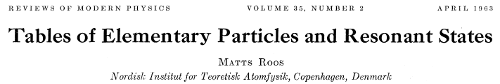
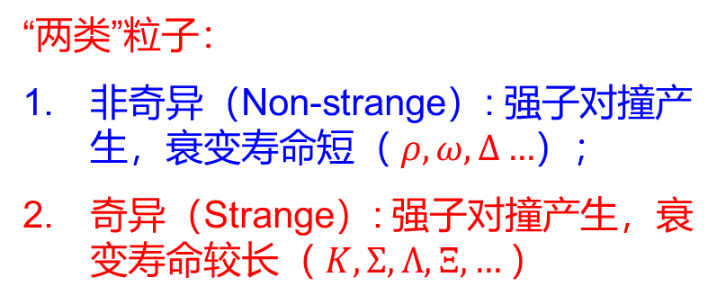
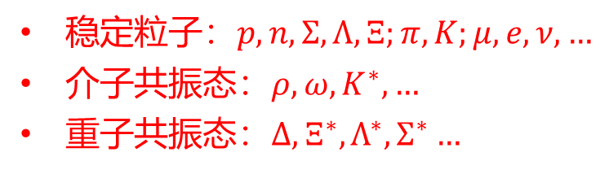
1963年的粒子数据表（Particle Data Group）Review of Modern Physics 35 (1963) 314-324, 共10页
稳定粒子：$p, n, Σ, Λ, Ξ;π, K;μ, e, ν, …$
介子共振态：$ρ, ω, K^{∗},…$
重子共振态：$Δ, Ξ^{∗}, Λ^{∗}, Σ^{∗}…$
“两类”粒子：
非奇异（Non-strange）: 强子对撞产生，衰变寿命短（ $ρ, ω,Δ…$）；
奇异（Strange）: 强子对撞产生，衰变寿命较长（ $K,Σ, Λ, Ξ,…$）

Slide 10
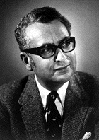
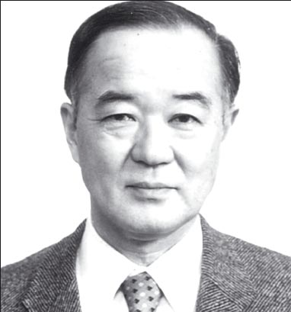
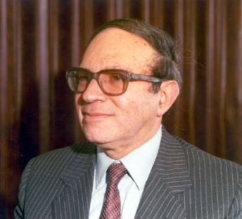
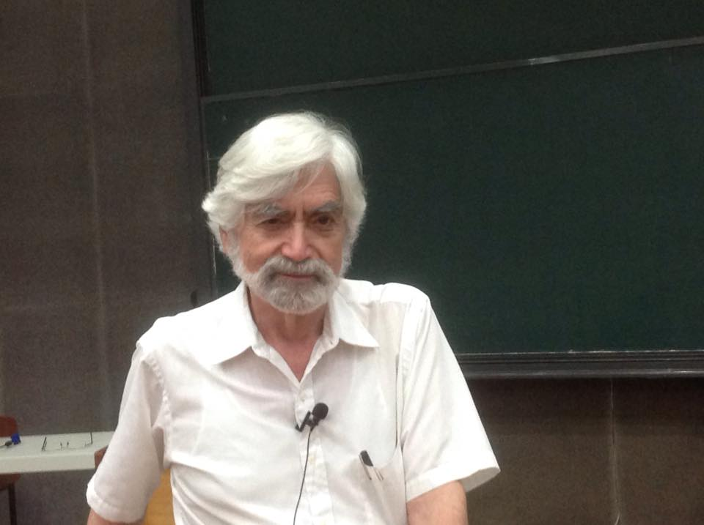

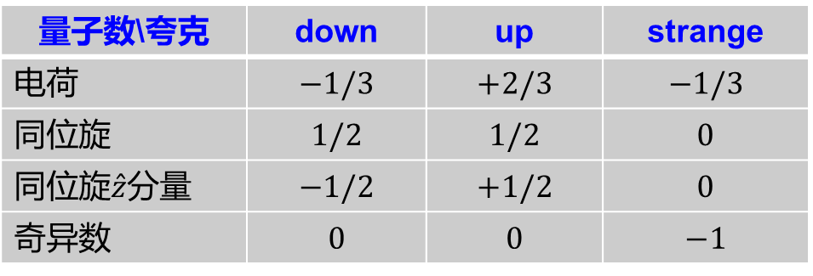

1961: Gell-Mann, Nishijima & Nee’man: The Eightfold Way (八重法)
The Nobel Prize in Physics 1969 was awarded to Murray Gell-Mann "for his contributions and discoveries concerning the classification of elementary particles and their interactions."
三类轻味夸克：
Gell-Mann
Nishijima
Nee’man
量子数\夸克 | down | up | strange
电荷 | $$−1/3$$ | $$+2/3$$ | $$−1/3$$
同位旋 | $$1/2$$ | $$1/2$$ | $$0$$
同位旋$\hat{z}$分量 | $$−1/2$$ | $$+1/2$$ | $$0$$
奇异数 | $$0$$ | $$0$$ | $$−1$$
George Zweig
夸克的基本性质：
1）具有1/2自旋，重子数为1/3；
2）夸克具有正宇称，反夸克具有负宇称；
3）夸克“味道”量子数的符号与其电荷的符号一致。
介子$(q\overline{q})$
重子$(qqq)$

Slide 11

‾qq SU(3) flavor nonet: ‾3⊗3 =1⊕8
S
J^{PC} = 0⁻⁺
K⁰ (‾sd)
K⁺ (‾su)
m₁
m₂
+1
I₃
–1
+1
π– (‾ud)
π⁰, η, η′
π⁺(‾du)
−1
K⁻(‾us)
‾K⁰ (‾ds)

Slide 12


SU(3) multiplets of baryons made of u, d, and s
SU(3) octet
with J^{P}=1/2⁺
S
Ξ– (ssd)
Ξ⁰ (ssu)
−2
Gell-Mann - Nishijima:
Q=I₃+Y/2=I₃+(B+S)/2
3⊗3⊗3
=(‾3⊕ 6) ⊗ 3
=(1⊕8) ⊕ (8⊕10)
Σ–
(sdd)
−1
Σ⁺
(suu)
Σ⁰, Λ (sud)
I₃
–1
n (dud)
0
p (uud)
1

Slide 13
SU(3) multiplets of baryons made of u, d, and s
S
SU(3) decuplet 10
with J^{P}=3/2⁺
−3
Ω–(sss)
Decuplet 10:
Ω–(sss)
Ξ*– (ssd)
Ξ*⁰ (ssu)
−2
Σ*–
(sdd)
−1
Σ*⁺
(suu)
Σ*⁰ (sud)
−3/2
3/2
−1
1
I₃
Δ–(ddd)
Δ⁰(udd)
0
Δ⁺(uud)
Δ⁺⁺(uuu)

Slide 14
m₃
Symmetric spin wavefunction: S=3/2
Symmetric flavor wavefunction: sss
Symmetric spatial wavefunction: L=0
m₁
√6λ/2
r₃
m₂
√2ρ
A problem encountered:
Violation of the Pauli principle and Fermi-Dirac statistics for the identical strange quark system?
r₁
r₂
Jacobi coordinate
An additional degrees of freedom, Colour, is introduced.
Quark carries colour, while hadrons are colour neutral objects.
3 ⊗ 3 ⊗ 3
= (‾3 ⊕ 6) ⊗ 3
= (1⊕ 8) ⊕ (8 ⊕ 10)

Slide 15
60-70年代
1970, Glashow-Iliopoulos-Maiani (GIM) mechanism, 味道改变中性流(FCNC)需要存在第四种味道的夸克。
1961年，电弱理论统一（Weinberg-Salam-Glashaw模型，1979 Nobel Prize）
1964年，Gell-Mann (1969 Nobel Prize)和Zweig提出夸克模型
1971-74年，量子色动力学(t’Hooft, Veltman, 1999); Politzer, Wilczek, Gross, 2004)
1974年，丁肇中-Richter发现J/ψ (1976 Nobel Prize)
1977年，FermiLab发现底(bottom)夸克(Leon Lederman, et al.)
1988
Leon Lederman, Melvin Schwartz and Jack Steinberger, “for … the discovery of the muon neutrino”
1995年，FermiLab发现顶(top)夸克
2012年，LHC发现希格斯(Higgs)玻色子…

Slide 16
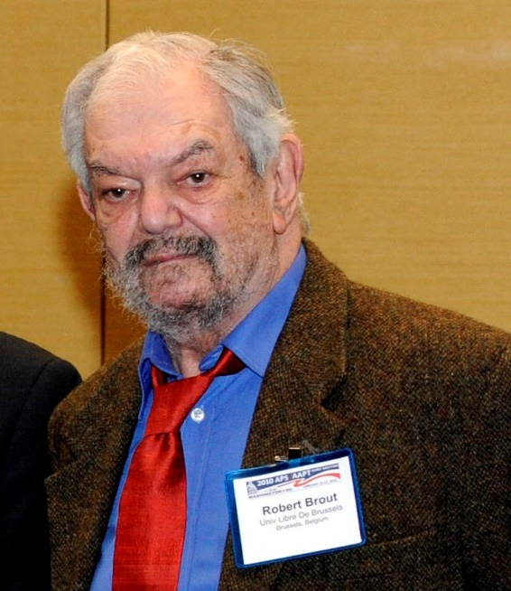
Robert Brout
(1928-06-14, 2011-05-03)
“for the theoretical discovery of a mechanism that contributes to our understanding of the origin of mass of subatomic particles, and which recently was confirmed through the discovery of the predicted fundamental particle, by the ATLAS and CMS experiments at CERN‘s Large Hadron Collider”

Slide 17

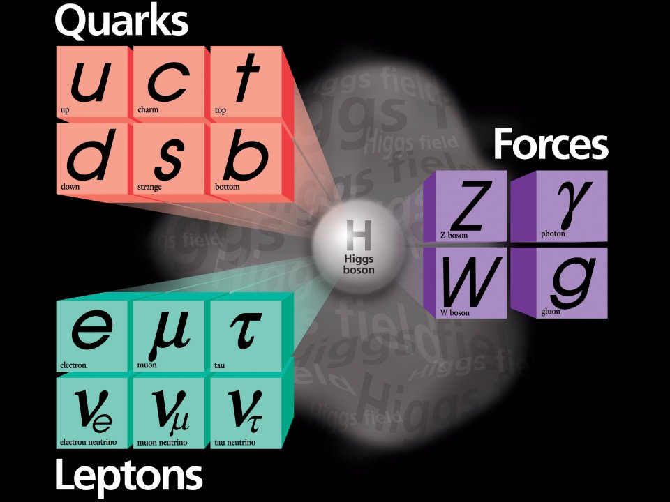
基本粒子标准模型

Slide 18
After the discovery of Higgs …
高能量前沿
  我们知道的：
  粒子物理标准模型虽然很成功，但它只是低能标下的一个有效理论。
  我们不知道的：
  Higgs粒子是否是基本粒子？
  Higgs粒子的质量起源是什么？
  Higgs粒子与宇宙起源有怎样的联系？
  Higgs如何与暗物质粒子发生相互作用？
  粒子物理标准模型如何与引力自洽统一？
  暗能量的本质是什么？
  。。。
质量起源
物质与反物质不对称
暗物质
宇宙起源
自然力的统一
味物理
暗能量
新物理
中微子物理
黑洞
质子衰变
宇宙线起源
非微扰QCD
高亮度前沿
宇宙学前沿

Slide 19
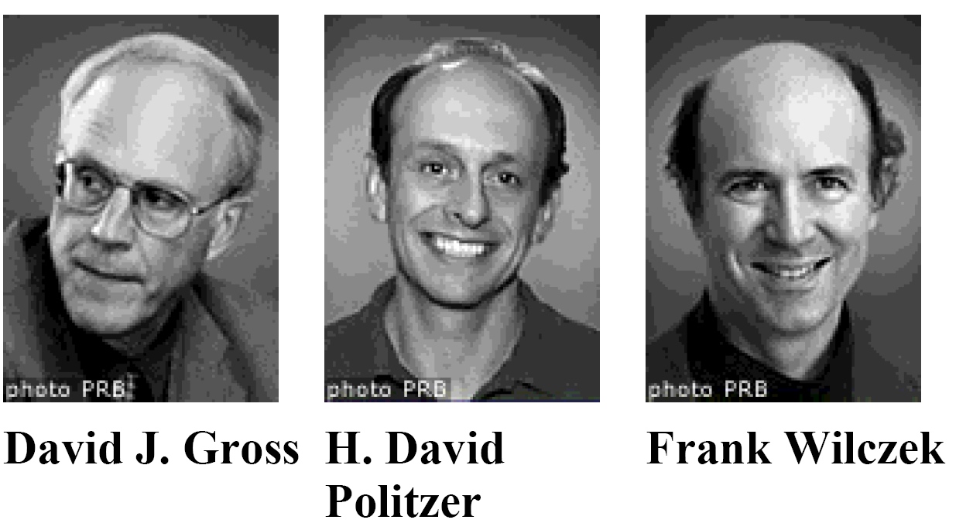
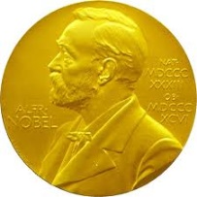
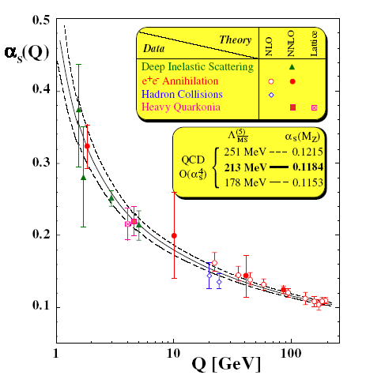
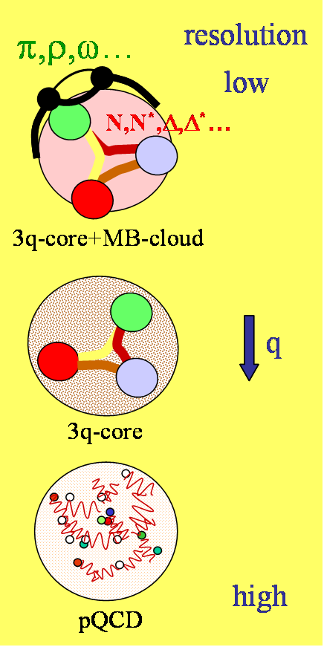

量子色动力学(Quantum Chromo-Dynamics)
-- 目前最成功地描述强相互作用的基本理论
2004
SU(3)非阿贝尔规范理论
Higgs机制使得夸克获得质量，但是不足以解释强子主要的质量来源
色禁闭
质子的质量来源：
Higgs机制：~ 1%
强相互作用：~ 95%
$m_{p}=938$ MeV
强相互作用如何将夸克胶子束缚在强子内部形成“稳定的”束缚态？
渐近自由
“简单的”微观动力学规律如何衍生出复杂的物质形态？

Slide 20
Again: Are quarks real objects?

Slide 21

Probe coloured quarks in electron-positron collisions
e+
e_{q}
q
γ*
e+
e
μ+
γ*
Hadrons
‾q
μ−
e−
e−
Electron-Positron annihilations
R ≡
≅ ∑ ê_{q}²
= (2/3)² + (1/3)² + (1/3)² + …
u d s …

Slide 22
R ≅ ∑ ê_{q}²
q : u(3/2) d(-1/3) s(-1/3) c(2/3) b(-1/3) t(2/3) R
(2/3)² + (1/3)² + (1/3)² = [2/3]
[2/3] + (2/3)² = [10/9]
[10/9] +(1/3)² = [11/9]
[11/9] + (2/3)² = [15/9]
But if quark carries color, one should have
R ≅ 3×∑ ê_{q}²

Slide 23
R ≅ 3×∑ ê_{q}²
q : u(3/2) d(-1/3) s(-1/3) c(2/3) b(-1/3) t(2/3) R
2
10/3
11/3
5
(2/3)² + (1/3)² + (1/3)² = [2/3]
[2/3] + (2/3)² = [10/9]
[10/9] +(1/3)² = [11/9]
[11/9] + (2/3)² = [15/9]

Slide 24
思考：列举一些你认为能证明“夸克”是真实微观粒子的证据或方法。
2/3
Particle Data Group 2010

Slide 25
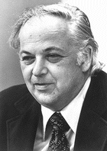
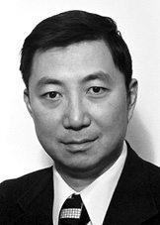
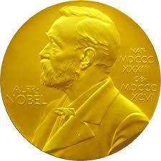
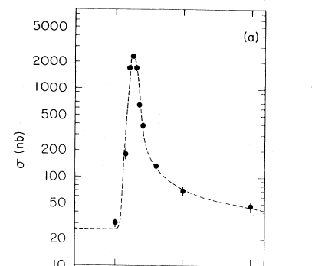
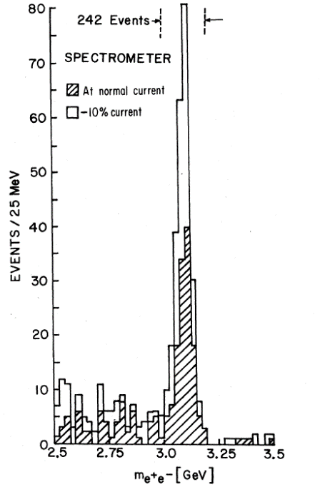

1976 Nobel Prize:
B. Richter and S. C.-C. Ting
"for their pioneering work in the discovery of a heavy elementary particle of a new kind"
ψ
Also seen in pN→e⁺e⁻X
J
R=2.2
>>2/3
10
J.E. Augustine et al., PRL 33, 1406 (1974)
J.J. Aubert et al., PRL 33, 1404 (1974)

Slide 26
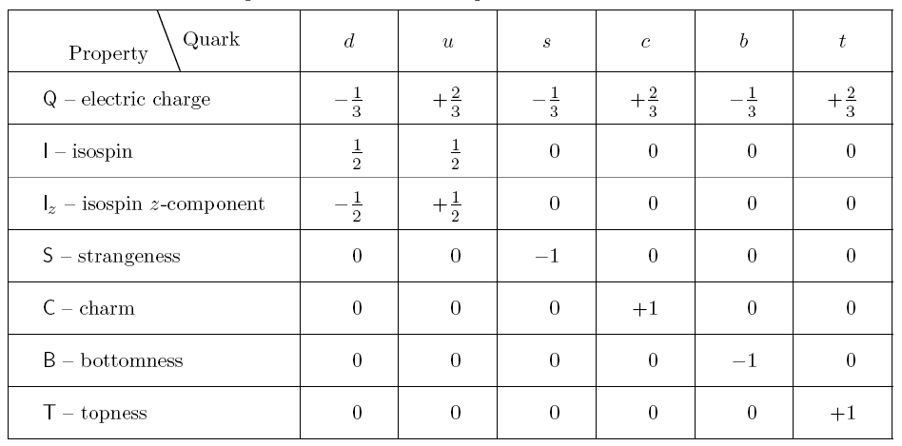
Quarks are real building blocks of hadrons: meson ($q\overline{q}$), baryon ($qqq$)
Convention (Particle Data Group):
1) Quark has spin 1/2 and baryon number 1/3;
2) Quark has positive parity and antiquark has negative parity;
3) The flavor of a quark has the same sign as its charge.

Slide 27
Quarks are real building blocks of hadrons: meson ($q\overline{q}$), baryon ($qqq$)
Quarks are not free due to QCD colour force (colour confinement).
Chiral symmetry spontaneous breaking gives masses to quarks.
Hadrons, with rich internal structures, are the smallest objects in Nature that cannot be separated to be further finer free particles.
Convention (Particle Data Group):
1) Quark has spin 1/2 and baryon number 1/3;
2) Quark has positive parity and antiquark has negative parity;
3) The flavor of a quark has the same sign as its charge.

Slide 28
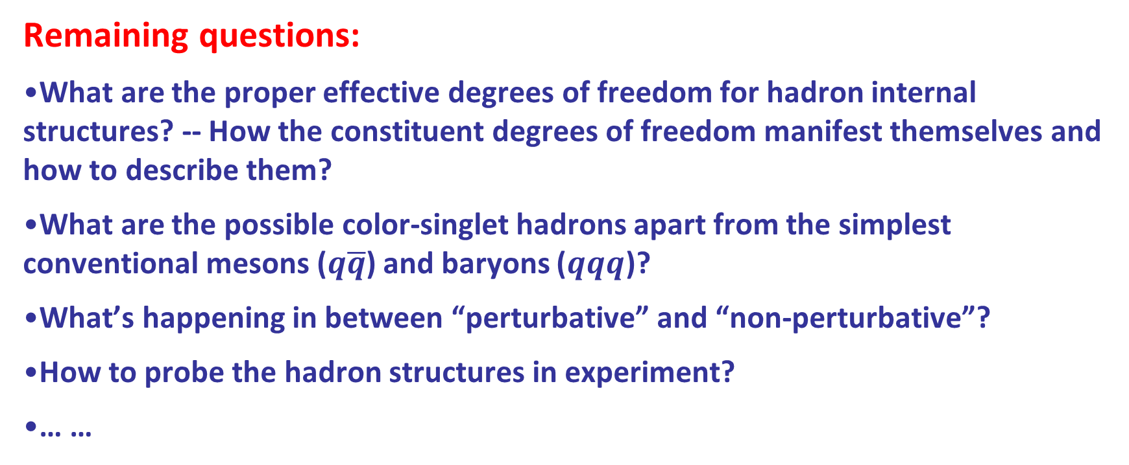
Remaining questions:
What are the proper effective degrees of freedom for hadron internal structures? -- How the constituent degrees of freedom manifest themselves and how to describe them?
What are the possible color-singlet hadrons apart from the simplest conventional mesons ($q\overline{q}$) and baryons ($qqq$)?
What’s happening in between “perturbative” and “non-perturbative”?
How to probe the hadron structures in experiment?
… …

Slide 29
Multi-faces of QCD:
Exotic hadrons beyond conventional QM
Hybrid
Glueball
Tetraquark
Hadronic molecule
Pentaquark
The study of hadron structures and hadron spectroscopy should deepen our insights into the Nature of strong QCD.

Slide 30
Recent reviews on hadron spectroscopy and QCD exotics:
F.K. Guo, C. Hanhart, U. G. Meißner, Q. Wang, Q. Zhao and B.S. Zou, Rev. Mod. Phys. 90, no.1, 015004 (2018);
H.X. Chen, W. Chen, X. Liu and S.L. Zhu, Phys. Rept. 639, 1-121 (2016);
A. Esposito, A. Pilloni and A. D. Polosa, Phys. Rept. 668, 1-97 (2017);
A. Ali, J.S. Lange and S. Stone, Prog. Part. Nucl. Phys. 97, 123-198 (2017);
Y.R. Liu, H. X. Chen, W. Chen, X. Liu and S.L. Zhu, Prog. Part. Nucl. Phys. 107, 237-320 (2019);
N. Brambilla, S. Eidelman, C. Hanhart, A. Nefediev, C.P. Shen, C.E. Thomas, A. Vairo and C.Z. Yuan, Phys. Rept. 873, 1-154 (2020);
R.F. Lebed, R.E. Mitchell and E.S. Swanson, Prog. Part. Nucl. Phys. 93, 143-194 (2017);
Y. Yamaguchi, A. Hosaka, S. Takeuchi and M. Takizawa, J. Phys. G 47, no.5, 053001 (2020).
R.M. Albuquerque, J.M. Dias, K.P. Khemchandani, A. Martinez Torres, F.S. Navarra, M. Nielsen and C. M. Zanetti, J. Phys. G 46, no.9, 093002 (2019).

Slide 31
2. Non-relativistic constituent quark model (NRCQM) for mesons and baryons

Slide 32
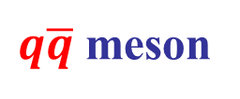

Basic assumptions of NRCQM
Chiral symmetry spantaneous breaking leads to the presence of massive constituent quarks as effective degrees of freedom inside hadrons.
Hadrons can be viewed as quark systems in which the gluon fields generate effective potentials that depend on the spins and positions of the massive quarks.
Thus, meson is a $q\overline{q}$ system and baryon is made of $qqq$.
$q\overline{q}$ meson
$qqq$ baryon

Slide 33
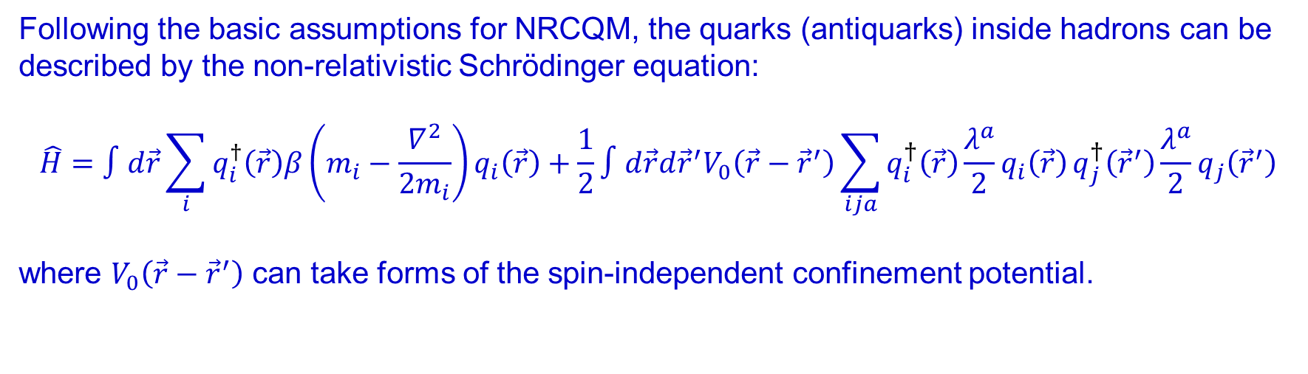
Quark-quark (-antiquark) interaction potential
Following the basic assumptions for NRCQM, the quarks (antiquarks) inside hadrons can be described by the non-relativistic Schrödinger equation:
$$\hat{H}=∫d\vec{r}\sum_{i}{q_{i}^{†}\left(\vec{r}\right)β\left(m_{i}−\frac{∇^{2}}{2m_{i}}\right)q_{i}\left(\vec{r}\right)}+\frac{1}{2}∫d\vec{r}d{\vec{r}}^{′}V_{0}\left(\vec{r}−{\vec{r}}^{′}\right)\sum_{ija}{q_{i}^{†}\left(\vec{r}\right)\frac{λ^{a}}{2}q_{i}\left(\vec{r}\right)}q_{j}^{†}\left({\vec{r}}^{′}\right)\frac{λ^{a}}{2}q_{j}\left({\vec{r}}^{′}\right)$$
where $V_{0}\left(\vec{r}−{\vec{r}}^{′}\right)$ can take forms of the spin-independent confinement potential.
The number of quarks (anti-quarks) does not change, i.e. quarks and anti-quarks are “constituents”.
The implementation of the spin-independent confinement potential means that the total spin and total orbital angular momentum are conserved.
The spin-dependent interactions are relatively small “perturbations” in comparison with the confinement potential.

Slide 34
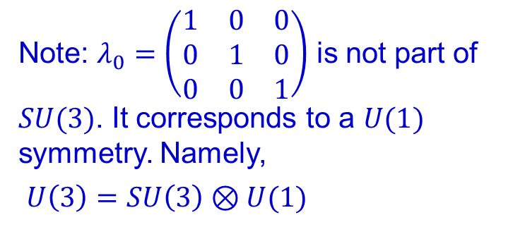
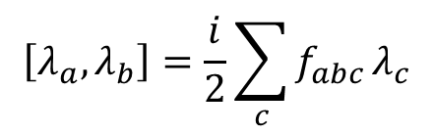
The algebra of infinitesimal SU(3) transformations is spanned by the 8 Gell-Mann’s matrices
The Gell-Mann matrices are the generators of the SU(3) group which will act on quarks. Quark is the SU(3)-group representation of 3.
Note: $λ_{0}=\left(\begin{matrix}1 & 0 & 0 \\ 0 & 1 & 0 \\ 0 & 0 & 1\end{matrix}\right)$ is not part of $SU(3)$. It corresponds to a $U(1)$ symmetry. Namely,
$U\left(3\right)=SU\left(3\right)⊗U(1)$
$$\left[λ_{a},λ_{b}\right]=\frac{i}{2}\sum_{c}{f_{abc}}λ_{c}$$

Slide 35

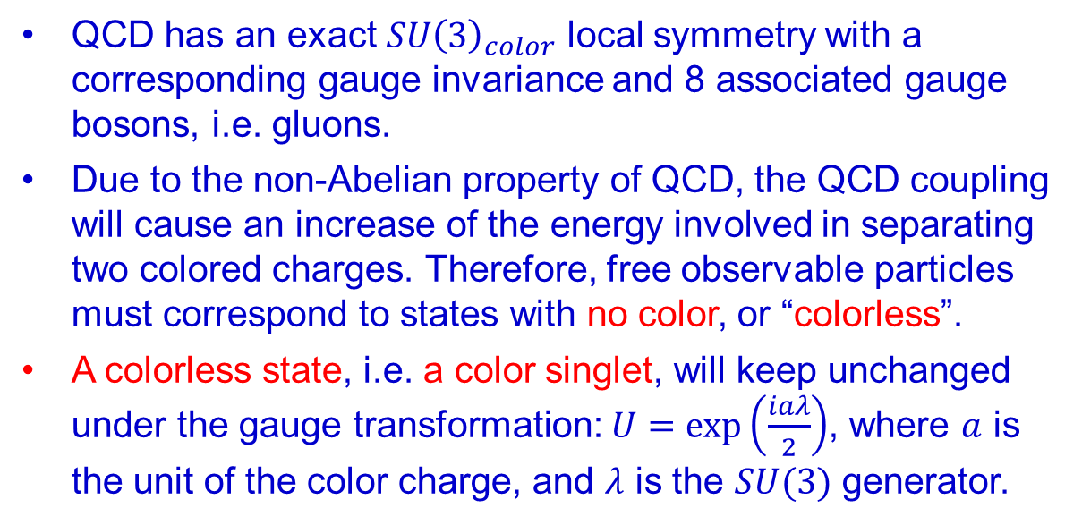
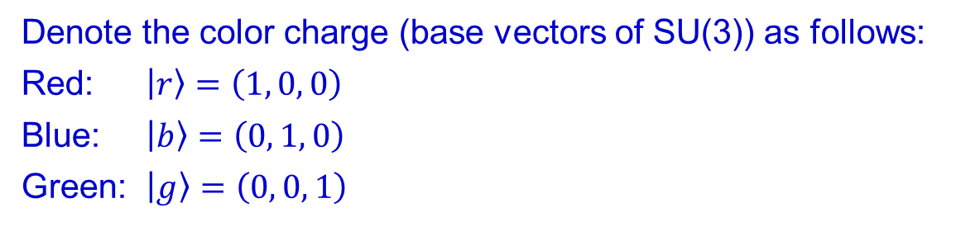

Color charges of quarks and gluons in QCD
$$E$$
QCD has an exact $SU{\left(3\right)}_{color}$ local symmetry with a corresponding gauge invariance and 8 associated gauge bosons, i.e. gluons.
Due to the non-Abelian property of QCD, the QCD coupling will cause an increase of the energy involved in separating two colored charges. Therefore, free observable particles must correspond to states with no color, or “colorless”.
A colorless state, i.e. a color singlet, will keep unchanged under the gauge transformation: $U=\exp\left(\frac{iaλ}{2}\right)$, where $a$ is the unit of the color charge, and $λ$ is the $SU(3)$ generator.
$$r$$
Denote the color charge (base vectors of SU(3)) as follows:
Red: $|r〉=\left(1, 0, 0\right)$
Blue: $|b〉=\left(0, 1, 0\right)$
Green: $|g〉=\left(0, 0, 1\right)$

Slide 36
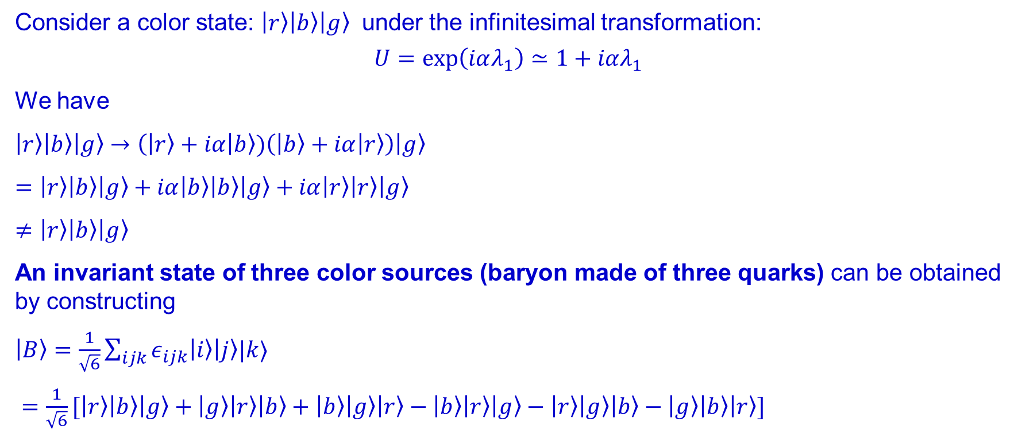
The color states of hadrons
Consider a color state: $|r〉|b〉|g〉$ under the infinitesimal transformation:
$$U=\exp\left(iαλ_{1}\right)≃1+iαλ_{1}$$
We have
$|r〉|b〉|g〉→(|r〉+iα | b〉)\left(|b〉+iα|r〉\right)|g〉$
$=|r〉|b〉|g〉+iα|b〉|b〉|g〉+iα|r〉|r〉|g〉$
$≠|r〉|b〉|g〉$
An invariant state of three color sources (baryon made of three quarks) can be obtained by constructing
$|B〉=\frac{1}{\sqrt{6}}\sum_{ijk}{ε_{ijk}|i〉|j〉|k〉}$
$=\frac{1}{\sqrt{6}}[|r〉|b〉|g〉+|g〉|r〉|b〉+|b〉|g〉|r〉−|b〉|r〉|g〉−|r〉|g〉|b〉−|g〉|b〉|r〉]$

Slide 37
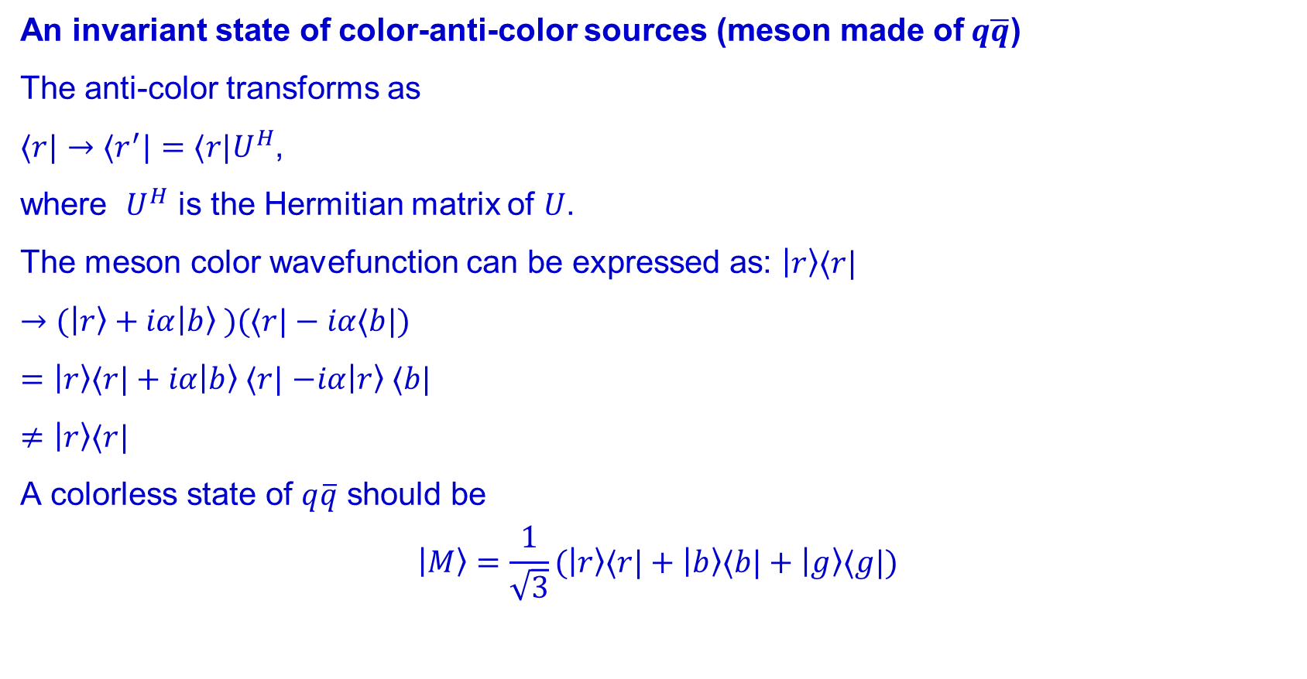
An invariant state of color-anti-color sources (meson made of$q\overline{q}$)
The anti-color transforms as
$〈r|→〈r^{′}|=〈r|U^{H}$,
where $U^{H}$ is the Hermitian matrix of $U$.
The meson color wavefunction can be expressed as: $|r〉〈r|$
$→(|r〉+iα|b〉 )(〈r|−iα〈b|)$
$=|r〉〈r|+iα|b〉 〈r|$ $−iα|r〉 〈b|$
$≠|r〉〈r|$
A colorless state of $q\overline{q}$ should be
$$|M〉=\frac{1}{\sqrt{3}}(|r〉〈r|+|b〉〈b|+|g〉〈g|)$$
Question: Prove $|M〉$ is invariant under the transformation of $U=\exp\left(iαλ_{1}\right)≃1+iαλ_{1}$ and $U^{H}$.

Slide 38

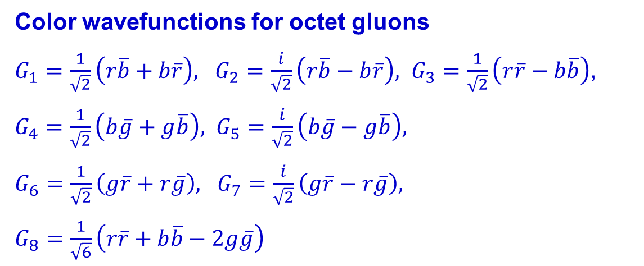
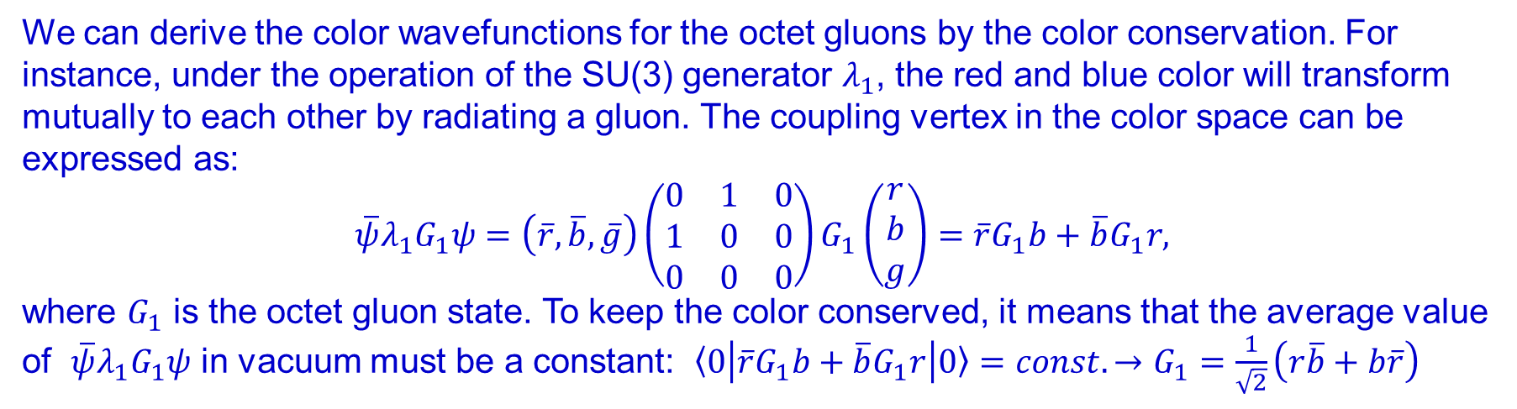


$$|b〉$$
Color wavefunctions for octet gluons
$G_{1}=\frac{1}{\sqrt{2}}\left(r\overline{b}+b\overline{r}\right), G_{2}=\frac{i}{\sqrt{2}}\left(r\overline{b}−b\overline{r}\right), G_{3}=\frac{1}{\sqrt{2}}\left(r\overline{r}−b\overline{b}\right)$,
$G_{4}=\frac{1}{\sqrt{2}}\left(b\overline{g}+g\overline{b}\right), G_{5}=\frac{i}{\sqrt{2}}\left(b\overline{g}−g\overline{b}\right),$
$G_{6}=\frac{1}{\sqrt{2}}\left(g\overline{r}+r\overline{g}\right),$ $G_{7}=\frac{i}{\sqrt{2}}\left(g\overline{r}−r\overline{g}\right),$
$G_{8}=\frac{1}{\sqrt{6}}\left(r\overline{r}+b\overline{b}−2g\overline{g}\right)$
$$|G_{1}〉$$
$$|r〉$$
We can derive the color wavefunctions for the octet gluons by the color conservation. For instance, under the operation of the SU(3) generator $λ_{1}$, the red and blue color will transform mutually to each other by radiating a gluon. The coupling vertex in the color space can be expressed as:
$$\overline{ψ}λ_{1}G_{1}ψ=\left(\overline{r}, \overline{b},\overline{g}\right)\left(\begin{matrix}0 & 1 & 0 \\ 1 & 0 & 0 \\ 0 & 0 & 0\end{matrix}\right)G_{1}\left(\begin{matrix}r \\ b \\ g\end{matrix}\right)=\overline{r}G_{1}b+\overline{b}G_{1}r,$$
where $G_{1}$ is the octet gluon state. To keep the color conserved, it means that the average value of $\overline{ψ}λ_{1}G_{1}ψ$ in vacuum must be a constant: $〈0\left|\overline{r}G_{1}b+\overline{b}G_{1}r\right|0〉=const.→G_{1}=\frac{1}{\sqrt{2}}\left(r\overline{b}+b\overline{r}\right)$

Slide 39
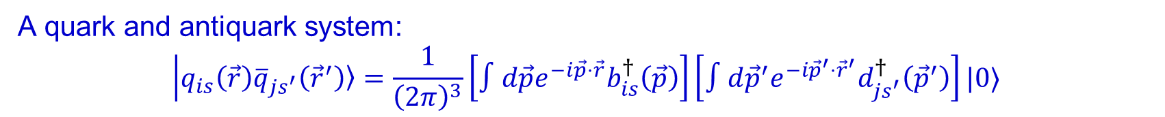
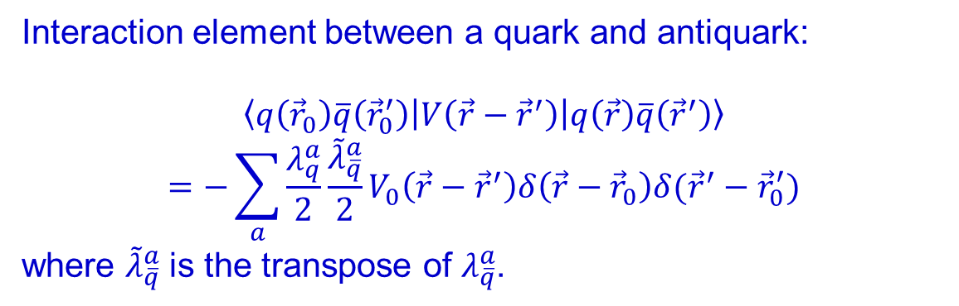
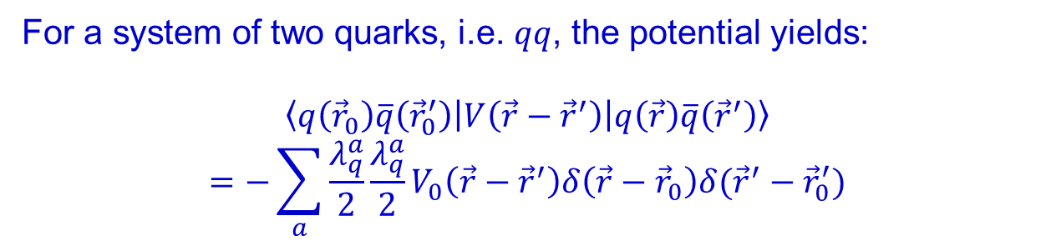
With the interaction Hamiltonian one can calculate the interaction element between quark and antiquark within a quark-antiquark system.
A quark and antiquark system:
$$|q_{is}\left(\vec{r}\right){\overline{q}}_{js^{′}}\left({\vec{r}}^{′}\right)〉=\frac{1}{{\left(2π\right)}^{3}}\left[∫d\vec{p}e^{−i\vec{p}⋅\vec{r}}b_{is}^{†}\left(\vec{p}\right)\right]\left[∫d{\vec{p}}^{′}e^{−i{\vec{p}}^{′}⋅{\vec{r}}^{′}}d_{{js}^{′}}^{†}\left({\vec{p}}^{′}\right)\right]|0〉$$
Interaction element between a quark and antiquark:
$$〈q\left({\vec{r}}_{0}\right)\overline{q}\left({\vec{r}}_{0}^{′}\right)\left|V\left(\vec{r}−{\vec{r}}^{′}\right)\right|q\left(\vec{r}\right)\overline{q}\left({\vec{r}}^{′}\right)〉$$
$$=−\sum_{a}{\frac{λ_{q}^{a}}{2}}\frac{{\tilde{λ}}_{\overline{q}}^{a}}{2}V_{0}\left(\vec{r}−{\vec{r}}^{′}\right)δ\left(\vec{r}−{\vec{r}}_{0}\right)δ({\vec{r}}^{′}−{\vec{r}}_{0}^{′})$$
where ${\tilde{λ}}_{\overline{q}}^{a}$ is the transpose of $λ_{\overline{q}}^{a}$.
(5)
For a system of two quarks, i.e. $qq$, the potential yields:
$$〈q\left({\vec{r}}_{0}\right)\overline{q}\left({\vec{r}}_{0}^{′}\right)\left|V\left(\vec{r}−{\vec{r}}^{′}\right)\right|q\left(\vec{r}\right)\overline{q}\left({\vec{r}}^{′}\right)〉$$
$$=−\sum_{a}{\frac{λ_{q}^{a}}{2}}\frac{λ_{q}^{a}}{2}V_{0}\left(\vec{r}−{\vec{r}}^{′}\right)δ\left(\vec{r}−{\vec{r}}_{0}\right)δ({\vec{r}}^{′}−{\vec{r}}_{0}^{′})$$

Slide 40
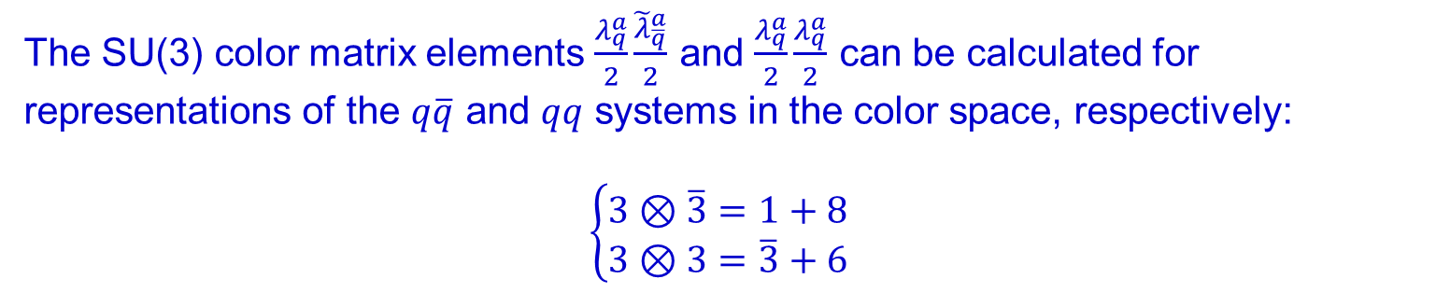
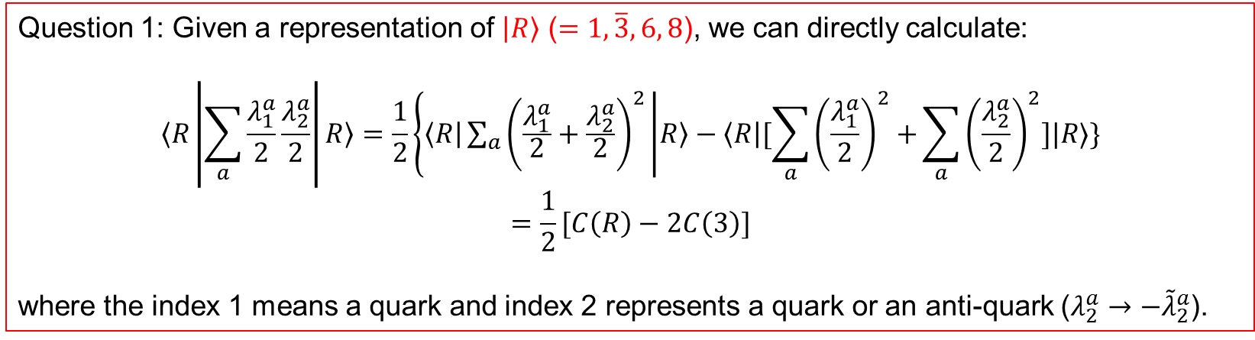
The SU(3) color matrix elements $\frac{λ_{q}^{a}}{2}\frac{{\tilde{λ}}_{\overline{q}}^{a}}{2}$ and $\frac{λ_{q}^{a}}{2}\frac{λ_{q}^{a}}{2}$ can be calculated for representations of the $q\overline{q}$ and $qq$ systems in the color space, respectively:
$$\left\{\begin{aligned}3⊗\overline{3}=1+8 \\ 3⊗3=\overline{3}+6 \end{aligned}\right.$$
Question 1: Given a representation of $|R〉$ ($=1, \overline{3}, 6, 8$), we can directly calculate:
$$〈R\left|\sum_{a}{\frac{λ_{1}^{a}}{2}}\frac{λ_{2}^{a}}{2}\right|R〉=\frac{1}{2}\{〈R|\sum_{a}{{\left(\frac{λ_{1}^{a}}{2}+\frac{λ_{2}^{a}}{2}\right)}^{2}} | R〉−〈R|[\sum_{a}{{\left(\frac{λ_{1}^{a}}{2}\right)}^{2}+}\sum_{a}{{\left(\frac{λ_{2}^{a}}{2}\right)}^{2}}]|R〉\}$$
$$=\frac{1}{2}[C\left(R\right)−2C\left(3\right)]$$
where the index 1 means a quark and index 2 represents a quark or an anti-quark ($λ_{2}^{a}→−{\tilde{λ}}_{2}^{a}$).

Slide 41
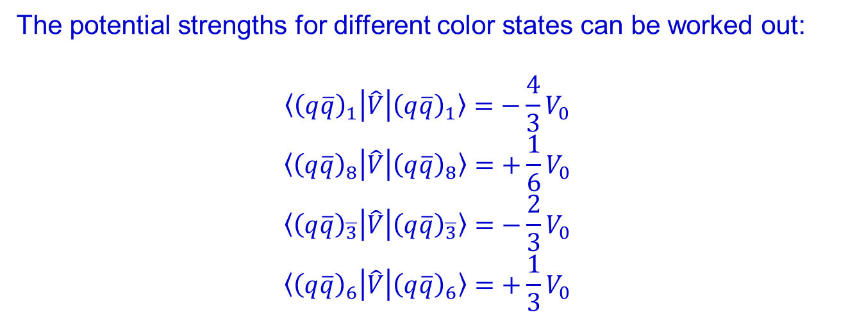
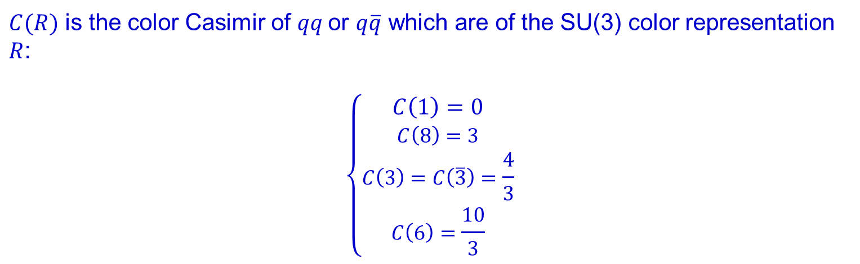
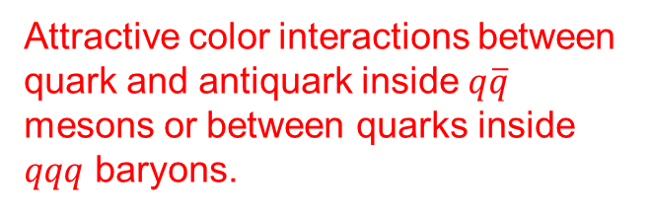
$C(R)$ is the color Casimir of $qq$or $q\overline{q}$ which are of the SU(3) color representation $R$:
$$\left\{\begin{aligned}C\left(1\right)=0 \\ C\left(8\right)=3 \\ C\left(3\right)=C\left(\overline{3}\right)=\frac{4}{3} \\ C\left(6\right)=\frac{10}{3}\end{aligned}\right.$$
The potential strengths for different color states can be worked out:
$$〈{\left(q\overline{q}\right)}_{1}\left|\hat{V}\right|{\left(q\overline{q}\right)}_{1}〉=−\frac{4}{3}V_{0}$$
$$〈{\left(q\overline{q}\right)}_{8}\left|\hat{V}\right|{\left(q\overline{q}\right)}_{8}〉=+\frac{1}{6}V_{0}$$
$$〈{\left(q\overline{q}\right)}_{\overline{3}}\left|\hat{V}\right|{\left(q\overline{q}\right)}_{\overline{3}}〉=−\frac{2}{3}V_{0}$$
$$〈{\left(q\overline{q}\right)}_{6}\left|\hat{V}\right|{\left(q\overline{q}\right)}_{6}〉=+\frac{1}{3}V_{0}$$
Attractive color interactions between quark and antiquark inside $q\overline{q}$ mesons or between quarks inside $qqq$ baryons.

Slide 42
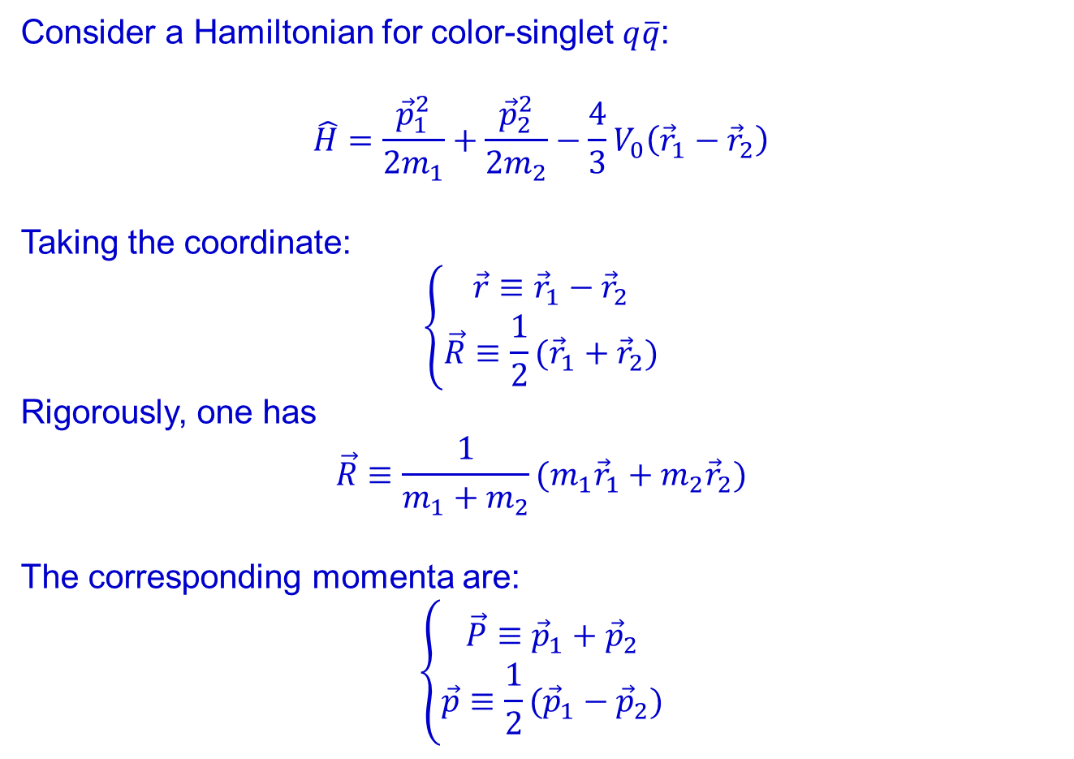
Mesons in SU(6)⊗O(3) symmetric quark model
Consider a Hamiltonian for color-singlet $q\overline{q}$:
$$\hat{H}=\frac{{\vec{p}}_{1}^{2}}{2m_{1}}+\frac{{\vec{p}}_{2}^{2}}{2m_{2}}−\frac{4}{3}V_{0}\left({\vec{r}}_{1}−{\vec{r}}_{2}\right)$$
Taking the coordinate:
$$\left\{\begin{aligned}\vec{r}≡{\vec{r}}_{1}−{\vec{r}}_{2} \\ \vec{R}≡\frac{1}{2}({\vec{r}}_{1}+{\vec{r}}_{2})\end{aligned}\right.$$
Rigorously, one has
$$\vec{R}≡\frac{1}{m_{1}+m_{2}}(m_{1}{\vec{r}}_{1}+m_{2}{\vec{r}}_{2})$$
The corresponding momenta are:
$$\left\{\begin{aligned}\vec{P}≡{\vec{p}}_{1}+{\vec{p}}_{2} \\ \vec{p}≡\frac{1}{2}({\vec{p}}_{1}−{\vec{p}}_{2})\end{aligned}\right.$$

Slide 43


Assuming $V\left(\vec{r}\right)=−\frac{4}{3}V_{0}(\vec{r})$ is a spin-independent central potential, we rewrite $\hat{H}$ as
$\hat{H}=\frac{{\vec{P}}^{2}}{4m_{q}}+\frac{{\vec{p}}^{2}}{m_{q}}+V\left(\vec{r}\right)$with $m_{1}=m_{2}=m_{q}$.
Rigorously, one has
$\hat{H}=\frac{{\vec{P}}^{2}}{2M_{R}}+\frac{{\vec{p}}^{2}}{{2μ}_{q}}+V\left(\vec{r}\right)$with $M_{R}=m_{1}+m_{2}$, and $μ_{q}≡m_{1}m_{2}/(m_{1}+m_{2})$.
The c.m. motion is described by a plane wave with:
$${\hat{H}}_{0}=\frac{{\vec{P}}^{2}}{2M_{R}}$$
The eigen-equation is
$${\hat{H}}_{0}ψ_{R}\left(\vec{R}\right)=\frac{{\vec{P}}^{2}}{2M_{R}}ψ_{R}\left(\vec{R}\right)=−\frac{ℏ^{2}}{2M_{R}}∇_{R}^{2}ψ_{R}\left(\vec{R}\right)=E_{0}ψ_{R}\left(\vec{R}\right)$$

Slide 44


The plane wave solution is: $ψ_{R}\left(\vec{R}\right)=\frac{1}{N_{R}}e^{±i\vec{P}⋅\vec{R}}$
For the relative motion of $m_{1}$ and $m_{2}$, the eigen equation is
$${\hat{H}}_{I}ψ\left(\vec{r}\right)=[\frac{{\vec{p}}^{2}}{2μ_{q}}+V\left(\vec{r}\right)]ψ(\vec{r})=Eψ\left(\vec{r}\right)$$
with
$$ψ\left(\vec{r}\right)=ψ_{L}^{M}\left(\vec{r}\right)=Y_{LM}\left(\hat{\vec{r}}\right)\frac{v_{L}\left(r\right)}{r}$$
and $v_{L}\left(r\right)$ is the radial wave function.
The main quantum number $N$ defined by the quantization condition is $N≥L+1$. Thus, the energy level for each eigenstate $ψ_{L}^{M}\left(\vec{r}\right)$ can be labelled by $N^{ 2S+1}L_{J}$ with $\vec{J}=\vec{L}+\vec{S}$ being the total angular momentum of the $q\overline{q}$ system.

Slide 45

For the central potential $\hat{V}$, both total spin $\vec{S}$ and total orbital angular momentum $\vec{L}$ are conserved. Thus, in the light quark sector, the spin-flavor-spatial wavefunctions are representations of $SU{\left(3\right)}_{f}⊗SU\left(2\right)⊗O\left(3\right)∈SU\left(6\right)⊗O(3)$ symmetry.
Spin: $2⊗2=1+3$
Flavor: $3⊗\overline{3}=1+8$
Spin-Flavor: $6⊗\overline{6}=1+35$
Or
$$\left(2⊗2\right)⊗\left(3⊗\overline{3}\right)=\left(1+3\right)⊗\left(1+8\right)=\left(1,1\right)+\left(1,8\right)+\left(3,1\right)+(3,8)$$
Singlet
35 multiplets

Slide 46
‾qq SU(3) flavor nonet: ‾3⊗3 =1⊕8
S
J^{PC} = 0⁻⁺
K⁰ (‾sd)
K⁺ (‾su)
+1
I₃
–1
+1
π– (‾ud)
π⁰, η, η′
π⁺(‾du)
−1
K⁻(‾us)
‾K⁰ (‾ds)

Slide 47

‾qq SU(3) flavor nonet: ‾3⊗3 =1⊕8
S
J^{PC} = 1⁻⁻
K*⁰ (‾sd)
K*⁺ (‾su)
+1
I₃
–1
+1
$$ρ^{0}=(u\overline{u}−d\overline{d})/√2$$
$$ω=(u\overline{u}+d\overline{d})/√2$$
$$φ=s\overline{s}$$
ρ– (‾ud)
ρ⁰, ω, φ
ρ⁺(‾du)
−1
K*⁻(‾us)
‾K*⁰ (‾ds)

Slide 48



Typical wavefunction for ($q\overline{q}$) with fixed total angular momentum $J$ can be written as
$$ψ_{NJM}\left(\vec{r}\right)=φ_{c}φ_{F}\sum_{m}{〈L\left(M−m\right),Sm | JM〉χ_{Sm}ψ_{NL\left(M−m\right)}(\vec{r})}$$
where $N$ is the main quantum number, $S$ and $L$ are the total spin and relative orbital angular momentum, respectively.
The overall wavefunctions for $q\overline{q}$ (spin, flavor, spatial, and color) should be antisymmetrized as required by Fermi statistics.

Slide 49




Taking into account the negative intrinsic parity of the antiquark, the wavefunctions for the ground state mesons ($L=0$):
m₁
m₂
$S$: symmetric after interchange the quark labels.
$A$: antisymmetric after interchange the quark labels.

Slide 50
1964- Gell-Mann, “Quark model”
1970- Deep Inelastic Scattering, Feymann’s partons, Bjorken scaling; Gell-Mann: “What are these put-ons (sic); are they quarks?”
  -- The strong force also might be described by a theory based on quarks and gluons began to take hold…
  -- Yang-Mills gauge theory can be a candidate.
1972- David Polizter, David Gross, Frank Wilczek found a negative beta function; (t’ Hooft has found it in 1971).
1973- SPEAR/SLAC experiment found charm flavor
1974- Sam Ting and Richter found J/psi
1975- QCD established

Slide 51


Baryons in SU(6)⊗O(3) symmetric quark model
We concentrate on the baryons made of u, d, s quarks.
Color
Spin
Flavor
Spin-flavor
Spatial
s, ρ, λ, a
For a three-quark Fermion system, the Pauli principle requires that the total wavefunction is antisymmetric under exchange of any two quarks. Therefore, the total wavefunction must be antisymmetrized.
Baryon wavefunction as representation of 3-dimension permutation group:
symmetric

Slide 52

Property of dimension-3 permutation group
e.g. The SU(2) spin wavefunction for a three-quark system

Slide 53

For a system involving two degrees of freedom $δ_{1}^{σ}$ and $δ_{2}^{σ}$, they can form combined symmetries as the representations of the $S_{3}$ permutation group.
Symmetric: $S=δ_{1}^{λ}δ_{2}^{λ}+δ_{1}^{ρ}δ_{2}^{ρ} ,$
Anti-symm: $A=δ_{1}^{λ}δ_{2}^{ρ}−δ_{1}^{ρ}δ_{2}^{λ} ,$
Mixed-symm: $λ=δ_{1}^{ρ}δ_{2}^{ρ}−δ_{1}^{λ}δ_{2}^{λ}$ ,
Mixed-anti-symm: $ρ=δ_{1}^{ρ}δ_{2}^{λ}+δ_{1}^{λ}δ_{2}^{ρ} .$

Slide 54
Spin and flavor wavefunctions of S3 representations
Spin
Flavor
Flavor wavefunctions:

Slide 56
SU(3) multiplets of baryons made of u, d, and s
SU(3) octet
with J^{P}=1/2⁺
S
Ξ– (ssd)
Ξ⁰ (ssu)
−2
Gell-Mann - Nishijima:
Q=I₃+Y/2=I₃+(B+S)/2
3⊗3⊗3
=(3*⊕ 6) ⊗ 3
=(1⊕8) ⊕ (8⊕10)
Σ–
(sdd)
−1
Σ⁺
(suu)
Σ⁰, Λ (sud)
I₃
–1
n (dud)
0
p (uud)
1

Slide 57
SU(3) multiplets of baryons made of u, d, and s
S
SU(3) decuplet 10
with J^{P}=3/2⁺
−3
Ω–(sss)
Decuplet 10:
Ω–(sss)
Ξ*– (ssd)
Ξ*⁰ (ssu)
−2
Σ*–
(sdd)
−1
Σ*⁺
(suu)
Anti-decuplet 10:
Ω⁺(sss)
Σ*⁰ (sud)
−3/2
3/2
−1
1
I₃
Δ–(ddd)
Δ⁰(udd)
0
Δ⁺(uud)
Δ⁺⁺(uuu)
3⊗3⊗3

Slide 58
SU(6) Spin-flavor wavefunctions of S3 representations

Slide 59
Success of potential quark model:
Hadrons are made of quarks (antiquarks) as QCD color singlet
Typical quark model prescription (e.g. Godfrey Isgur model):

Slide 60
The spin-independent potential for quark-quark interactions

Slide 61


Spatial wavefunction in a spin-independent potential
m₃
Hamiltonian
√6λ/2
m₁
r₃
m₂
√2ρ
r₁
r₂
Jacobi coordinate
With an equal mass for $u$, $d$, and $s$ quark, and $k=m_{q}ω_{h}^{2}/3$, the Hamiltonian can be expressed as
Isgur, and Karl, PLB109, 72(1977); PRD18, 4187(1978); PRD19, 2653(1979)

Slide 62

Spatial wavefunction in a spin-independent potential
m₃
Jacobi coordinate
m₁
√6λ/2
r₃
√2ρ
r₁
r₂
Harmonic oscillator wavefunction

Slide 63


Taking the notation of Karl and Obryk, the harmonic oscillator wavefunction can be written as
with $ρ_{±}≡∓\frac{1}{\sqrt{2}}\left(ρ_{x}±iρ_{y}\right);$
$$λ_{±}≡∓\frac{1}{\sqrt{2}}\left(λ_{x}±iλ_{y}\right)$$

Slide 64

Total wavefunction of SU(6)⊗O(3) symmetry
π, 0⁻
P₃₃(1232) Δ
P₁₁(1440)
S₁₁(1535)
D₁₃(1520)
…
Naming convention for baryon:
N*, Δ*, L_{2I,2J}
N, ½⁺
Isgur, and Karl, PLB109, 72(1977); PRD18, 4187(1978); PRD19, 2653(1979)

Slide 65
m₃
m₁
√6λ/2
r₃
m₂
√2ρ
r₁
r₂
Jacobi coordinate

Slide 67


Slide 68


Slide 69


Slide 71

$$l_{ρ}=1;l_{λ}=1$$
$$L=l_{ρ}+l_{λ}=0, 1, 2$$

Slide 72

Anharmonic and spin-dependent potential
Based on the SU(6)⊗O(3) symmetry, the quark model succeeded in the classification of the baryon spectrum. But quantitative results could not be expected since more elaborate details about the dynamics were needed.
For instance, the Roper resonance P11(1440) was assigned to the radial excitation state with N = 2, and L = 0, which was found to have lower mass than the first orbital excition multiplets S11(1535) etc with N = 1 and L = 1. The inclusion of the anharmonic and spin-dependent quark potential turned to be necessary.
S11(1535)
P11(1440)
n is the radial quantum number, and L is the orbital angular momentum.
N1/2⁺
N=2, L=0
N1/2⁻
N=1, L=1

Slide 73
习题：在谐振子波函数下证明（39）式，并导出（38）式中的自旋-自旋相互作用哈密顿量平均值，即（41）式。

Slide 76
PDG 2020

Slide 77
3. Electromagnetic (EM) and strong interactions of hadrons in the NRCQM

Slide 78
Electromagnetic moments of ground state baryons
One of the most impressive successes of the NRCQM could be its description of the electromagnetic moments of ground state baryons. The simple assumption is that all constituent quarks are in S-wave orbitals, i.e. except for the spin of the constituents, no orbital angular momentum would contribute to the electromagnetic moment.

Slide 80
作业：验证公式(47-51).

Slide 81
One essential point is that one cannot neglect the “color” degrees of freedom at all. If one anti-symmetrizes the total wavefunction without the color part taken into account, the ratio of the magnetic moment between proton and neutron will be -1/2, which is far away from reality.
The CQM is indeed tackling something essential, we are however confronted with big difficulties to disentangle it based on this model itself. More elaborate models are needed for the study the baryon properties at more accurate level.
Lattice QCD studies, which are base on the first principle, are also needed for understanding not only the non-perturbative phenomena, but also successes of phenomenological models.

Slide 82


Baryon EM transitions
Supposing the constituent quark has a mass m_{i} (≈ 330 MeV for the u and d), the magnetic moment of the constituent quark thus can be expressed as
N*, J^{P}
N, ½⁺
The electromagnetic field of a photon in form of the second quantization is

Slide 83
Taking the direction of the photon momentum k as the z-axis, and taking the advantage of the permutation symmetry of the baryon wavefunctions, we can express the EM interaction Hamiltonian as

Slide 84
A more compact form for the transition operator:
Given the initial and final state baryon wavefunctions, one can calculate the EM transition amplitudes between these two states in terms of two independent helicity amplitudes.

Slide 85


Two independent helicity amplitudes $A_{λ_{γ}−λ_{N}}$ for the initial photon-nucleon helicity parallel or anti-parallel, respectively. :

Slide 87
Given the spin and flavor wavefunctions, one can easily compute the following elements in spin and flavor space:
作业：证明左面方框列出的关系式，并推导（66）式。

Slide 88
and the orthogonal relation for the spherical
harmonics is used,

Slide 89
Some numerical results
Relativistic corrections (I)

Slide 90


Relativistic corrections (II)
Including O(v²/c²) terms in the EM operator and QCD mixings:
Relativistic quark models
See review:
Aznauryan, Burkert and Lee, arXiv:0810.0997 [nucl-th].
Possible five-quark component inside S11(1535)?
See e.g. Prof. B.S. Zou’s talk.

Slide 91

Some other results from NRCQM symmetry

Slide 92


Slide 93
4. Quark model with heavy flavors

Slide 94
Fully-heavy tetraquarks as ideal exotic candidates
LHCb Collaboration, arXiv:2006.16957v1 [hep-ex]

Slide 95
Unbound fully-heavy tetraquarks:
J.~P.~Ader, J.~M.~Richard and P.~Taxil, Phys.\ Rev.\ D {\bf 25}, 2370 (1982)
J.~M.~Richard, A.~Valcarce and J.~Vijande, Phys.\ Rev.\ D {\bf 95}, 054019 (2017); Phys.\ Rev.\ C {\bf 97}, 035211 (2018)
M.~Karliner, S.~Nussinov and J.~L.~Rosner, Phys.\ Rev.\ D {\bf 95}, 034011 (2017)
J.~Wu, Y.~R.~Liu, K.~Chen, X.~Liu, and S.~L.~Zhu, Phys.\ Rev.\ D {\bf 97}, 094015 (2018)
M. S. Liu, Q. F. Lu, X. H. Zhong and Q. Zhao, Phys. Rev. D 100, 016006 (2019).
M.S. Liu, F.X. Liu, X.H. Zhong and Q. Zhao, 2006.11952 [hep-ph].
X.Z. Weng, X.L. Chen, W.Z. Deng, and S.L. Zhu, arXiv:2010.05163v1 [hep-ph]
Bound fully-heavy tetraquarks:
L.~Heller and J.~A.~Tjon, Phys.\ Rev.\ D {\bf 32}, 755 (1985)
R.~J.~Lloyd and J.~P.~Vary, Phys.\ Rev.\ D {\bf 70}, 014009 (2004)
N.~Barnea, J.~Vijande and A.~Valcarce, Phys.\ Rev.\ D {\bf 73}, 054004 (2006);
M.~N.~Anwar, J.~Ferretti, F.~K.~Guo, E.~Santopinto and B.~S.~Zou, Eur.\ Phys.\ J.\ C {\bf 78}, 647 (2018)
Y.~Bai, S.~Lu and J.~Osborne, Phys.Lett.B 798 (2019) 134930

Slide 97


di-$J/ψ$
$J/ψ$-$ψ(2S)$
ATLAS Colla., arXiv:2304.08962v1 [hep-ex]

Slide 98

$J^{PC}=2^{++}$ are favored for all these three states

Slide 100
Constituent quark models:
X. Jin et al., Eur.Phys.J.C 80 (2020) 11, 1083
G. Yang, J.L. Ping, J. Segovia, Symmetry 12 (2020) 11, 1869
X.Z. Wen et al., Phys.Rev.D 103 (2021) 3, 034001 [only the color-magnetic interaction included]
Q.F. Lyu et al., Eur.Phys.J.C 80 (2020) 9, 871 [Extended relativized quark model]
M.C. Gordillo, F. De. Soto, J. Segovia, Phys.Rev.D 102 (2020) 11, 114007 [Difussion Monto Carlo mechod]
M.S. Liu, F.X. Liu, X.H. Zhong, Q. Zhao, 2006.11952 [hep-ph]
F.X. Liu, M.S. Liu, X.H. Zhong, and Q. Zhao, PRD 104, 116029 (2021)
G.J. Wang, L. Meng, M. Oka, S.L. Zhu, PRD 104, 036016 (2021)
J. Hu, B.R. He, and J.L. Ping, Eur.Phys.J.C 83 (2023) 7, 559
Coupled-channel approach:
X.K. Dong, V. Baru, C. Hanhart, F.K. Guo, A. Nefediev, Phys.Rev.Lett. 126 (2021) 13, 132001
C. Gong, M.C. Du, Q. Zhao, X.H. Zhong, B. Zhou, Phys.Lett.B 824 (2022) 136794
Z. Zhang et al., Phys.Rev.D 105 (2022) 5, 054026
Z.H. Guo, J.A. Oller, Phys.Rev.D 103 (2021) 3, 034024
C. Gong, M.C. Du, Q. Zhao, Phys.Rev.D 106 (2022), 054011
Diquark model:
M.A. Bedolla et al., Eur.Phys.J.C 80 (2020) 11, 1004
J.F. Giron, R.F. Lebed, Phys.Rev.D 102 (2020) 7, 074003
M. Karliner, J.L. Rosner, Phys.Rev.D 102 (2020) 11, 114039
R.N. Faustov, et al., Universe 7 (2021) 4, 94
H.W. Ke, X.H. Liu, Y.L. Shi, Eur.Phys.J.C 81 (2021) 5, 427
Hybrid tetraquark:
L.B. Wang and C.F. Qiao, Phys.Lett.B 817 (2021) 136339
QCD sum rules:
Z.G. Wang, Int.J.Mod.Phys.A 36 (2021) 02, 2150014
Q.N. Wang, Z.Y. Yang, W. Chen, Phys.Rev.D 104 (2021) 11, 114037
R.H. Wu et al., JHEP 11 (2022) 023
Production and decay mechanisms:
C. Becchi, A. Giachino, L. Maiani, E. Santopinto, Phys.Lett.B 811 (2020) 135952
J.Z. Wang, D.Y. Chen, X. Liu, T. Matsuki, Phys.Rev.D 103 (2021) 7, 071503
R.L. Zhu, Nucl.Phys.B 966 (2021) 115393
Rafał Maciuła et al., Phys.Lett.B 812 (2021) 136010
Y.Q. Ma and H.F. Zhang, 2009.08376 [hep-ph]
F. Feng et al., Phys.Rev.D 106 (2022) 11, 114029
V. P. Gonçalves, Bruno D. Moreira, Phys.Lett.B 816 (2021) 136249
Now, all the calculated masses are above the di-charmonium threshold!

Slide 101


Tetraquark states in the potential quark model
$$T=Q_{1}Q_{2}{\overline{Q}}_{3}{\overline{Q}}_{4} (cc\overline{c}\overline{c}, bb\overline{b}\overline{b}, cc\overline{b}\overline{b}, bc\overline{b}\overline{c}, bc\overline{c}\overline{c},bc\overline{b}\overline{b}, …)$$
Diquark (anti-diquark) configurations:
Spin: $2⊗2=1+3$
Color: $3⊗3=\overline{3}+6 ; \overline{3}⊗\overline{3}=3+\overline{6}$
Flavor: $\left\{Q_{1}Q_{2}\right\}=(Q_{1}Q_{2}+Q_{2}Q_{1})/\sqrt{2}$ ; $[Q_{1}Q_{2}]=(Q_{1}Q_{2}−Q_{2}Q_{1})/\sqrt{2}$
For $cc\overline{c}\overline{c}, bb\overline{b}\overline{b}$ system, Pauli principle imposes a local constraint if two quarks (two antiquarks) interchange

Slide 102


Reminder of the Hamiltonian adopted
Hamiltonian in a non-relativistic quark model:
$$T_{i}=\frac{p_{i}^{2}}{2m_{i}}$$
Color matrix elements:

Slide 104





Dynamic feature for fully-heavy tetraquark system
Jacobi coordinates:
m₁
m₃
$$ξ_{3}$$
$$ξ_{1}$$
$$ξ_{2}$$
$$ξ_{4}$$
m₂
m₄
$$r_{2}$$
Trial wavefunction for the ground states expanded
by a series of Gaussian functions (i.e. GEM):
Jacobi coordinate
E. Hiyama, Y. Kino, and M. Kamimura, Gaussian expansion method for few-body systems, Prog. Part. Nucl. Phys. 51, 223 (2003).
M. S. Liu, Q. F. Lu, X. H. Zhong and Q. Zhao, PRD 100, 016006 (2019).
M.S. Liu, F.X. Liu, X.H. Zhong and Q. Zhao, 2006.11952 [hep-ph], PRD 109, 076017 (2024).

Slide 105







First orbital excitation states
The radial part of the wavefunction is expanded with a series of harmonic oscillator functions:
m₁
m₃
where
$$ξ_{3}$$
$$ξ_{1}$$
$$ξ_{2}$$
$$ξ_{4}$$
m₂
m₄
$$r_{2}$$
Parameter $d_{ξl}$ is oscillator length and is related to the harmonic oscillator frequency $ω_{ξl}$:
$$\frac{1}{d_{ξl}^{2}}=M_{ξ}ω_{ξl}$$
The number of harmonic oscillator functions $n$ is fitted together with $d_{ξl}$ with $l=1, 2, …n$, via relation:
$d_{ξl}=d_{ξ1}a^{l−1},$ with $a$ the ratio coefficient.
Jacobi coordinate
With $S=0, 1, 2$, and $L=1$, the total spin of a tetraquark state can be: $J=S+L=0, 1, 2, 3$.

Slide 106

  Energy decomposition of the $cc\overline{c}\overline{c}$ and $bb\overline{b}\overline{b}$ ground states ($L=0$) in units of MeV
The confining potential contributes a positive energy and cannot be neglected.
This implies that the four-quark systems are located above the two-heavy meson thresholds.
The treatment of the confinement potential seems to distinguish models in the literature.
(M. S. Liu, Q. F. Lu, X. H. Zhong and Q. Zhao, Phys. Rev. D 100, 016006 (2019).)
Predicted masses (MeV) for the $cc\overline{c}\overline{c}$ system compared with other models.

Slide 107
[11] W. Chen, H. X. Chen, X. Liu, T. G. Steele, and S. L. Zhu, Phys. Lett. B 773, 247 (2017).
[12] J. P. Ader, J.M. Richard, and P. Taxil, Phys. Rev. D 25, 2370 (1982),
[13] Y. Iwasaki, Prog. Theor. Phys. 54, 492 (1975)
[16] R. J. Lloyd and J. P. Vary, Phys. Rev. D 70, 014009 (2004)
[17] N. Barnea, J. Vijande, and A. Valcarce, Phys. Rev. D73, 054004 (2006).
[21] M. N. Anwar, J. Ferretti, F. K. Guo, E. Santopinto, and B. S. Zou, Eur. Phys. J. C 78, 647 (2018).
[22] M. Karliner, S. Nussinov, and J. L. Rosner, Phys. Rev. D 95, 034011 (2017).
[23] Y. Bai, S. Lu, and J. Osborne, arXiv:1612.00012.
[24] A. V. Berezhnoy, A. V. Luchinsky, and A. A. Novoselov, Phys. Rev. D 86, 034004 (2012).
[25] Z. G. Wang, Eur. Phys. J. C 77, 432 (2017).
[26] Z. G. Wang and Z. Y. Di, arXiv:1807.08520.
[27] V. R. Debastiani and F. S. Navarra, Chin. Phys. C 43, 013105 (2019).
[29] J. Wu, Y. R. Liu, K. Chen, X. Liu, and S. L. Zhu, Phys. Rev. D 97, 094015 (2018).
[30] C. Hughes, E. Eichten, and C. T. H. Davies, Phys. Rev. D 97, 054505 (2018).

Slide 108
Predicted mass spectra for the $cc\overline{c}\overline{c}$, $bb\overline{b}\overline{b}$ and $bb\overline{c}\overline{c}$ systems.
For $J^{PC}=0^{++}$, the transition between color representations $6⊗\overline{6}$ and $3⊗\overline{3}$ seems to be small.
For $J^{PC}=2^{++}$, only $3⊗\overline{3}$ configuration is allowed.
M. S. Liu, Q. F. Lu, X. H. Zhong and Q. Zhao, Phys. Rev. D 100, 016006 (2019)
G.J. Wang, L. Meng, M. Oka, S.L. Zhu, PRD 104, 036016 (2021)

Slide 109
For excited states of the 4-quark system, the spectra become complicated and crowded. However, for $J^{PC}=2^{++}$, only 3 states are expected!
M.S. Liu, F.X. Liu, X.H. Zhong and Q. Zhao, 2006.11952 [hep-ph], PRD 109, 076017 (2024).
F.X. Liu, M.S. Liu, X.H. Zhong, and Q. Zhao, PRD 104, 116029 (2021)

Slide 110
Predicted masses for the P-wave $cc\overline{c}\overline{c}$ states. ${(ξ}_{1},ξ_{2})$ stands for a configuration containing both $ξ_{1}$ and $ξ_{2}$-mode of orbital excitations, while $(ξ_{3})$ stands for a configuration containing $ξ_{3}$-mode of orbital excitation.
X(6900) mass region

Slide 111
The contributions from each part of the Hamiltonian of the $cc\overline{c}\overline{c}$ systems in units of MeV with $L=1$.
One still sees significant contributions from the confinement potential which push the energy level further beyond the two-heavy meson thresholds.

Slide 113
Predicted mass spectrum for the 2S- and 3S-wave $T_{cc\overline{c}\overline{c}}$ states
F.X. Liu, M.S. Liu, X.H. Zhong, and Q. Zhao, PRD 104, 116029 (2021)

Slide 114
5. A brief summary
Symmetries and effective degrees of freedom in the quark model
A genuine color-singlet multiquark state may not exist as a stable physical state. However, it should exist as the short-distance component in the physical state.
The nearby threshold may bring down the energy to stabilize the system which bridges it to the hadronic molecule scenario.
LQCD can tell more…
Advantages and disadvantages of the quark model.
Thanks for your attention!

