Slide 1

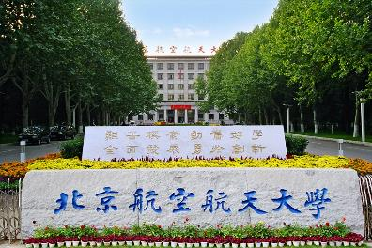

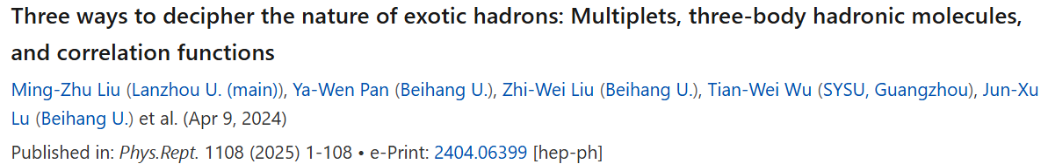
Three ways to decipher the nature of hadronic molecules
Li-Sheng Geng（耿立升）@ Beihang U.

Slide 2
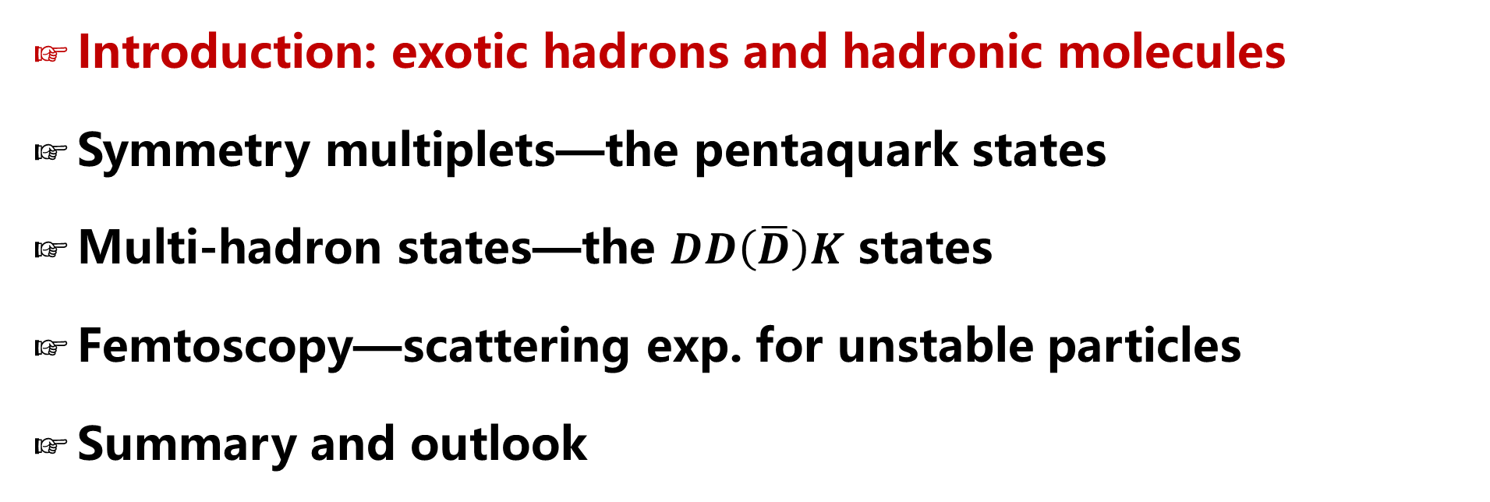
Contents
Introduction: exotic hadrons and hadronic molecules
Symmetry multiplets—the pentaquark states
Multi-hadron states—the $DD\left(\overline{D}\right)K$ states
Femtoscopy—scattering exp. for unstable particles
Summary and outlook

Slide 3

One central theme in physics (Science)
What are the basic building blocks of NATURE?
How do they interact with each other?
The Thinker by Auguste Rodin

Slide 4
The world was once very simple
Very preliminary!
Particles discovered before 1932

Slide 5
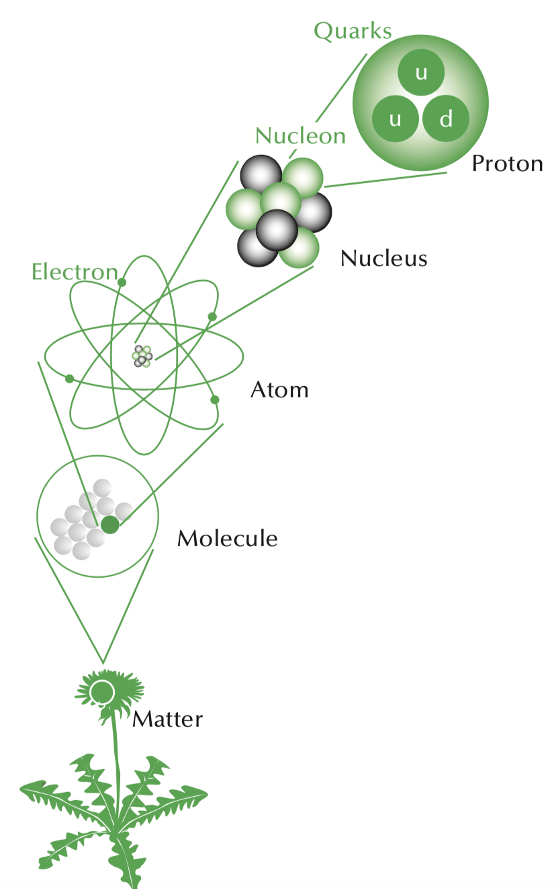
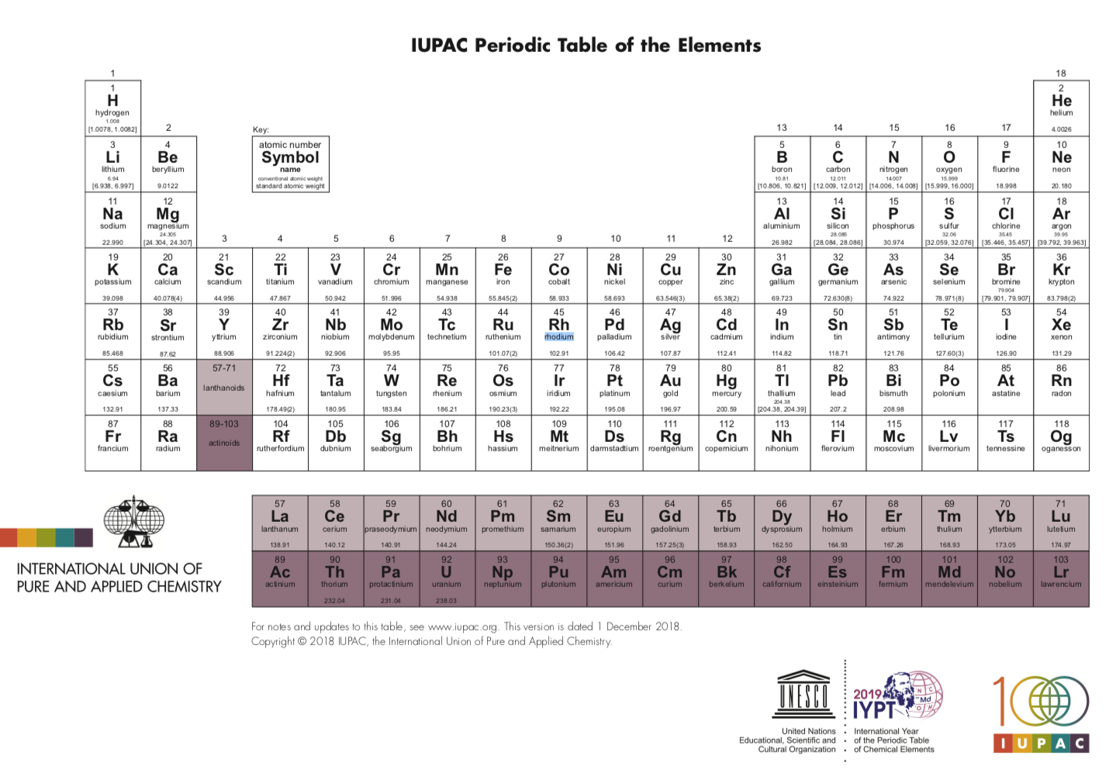
10⁻¹⁵
10⁻¹⁴
10⁻¹⁰
10⁻⁶
Building up the atomic world
10⁻¹

Slide 6
Many particles observed in the 1950/60s
Very preliminary!

Slide 7
Many particles observed in the 1950/60s
Very preliminary!
They cannot all be “elementary”!

Slide 8
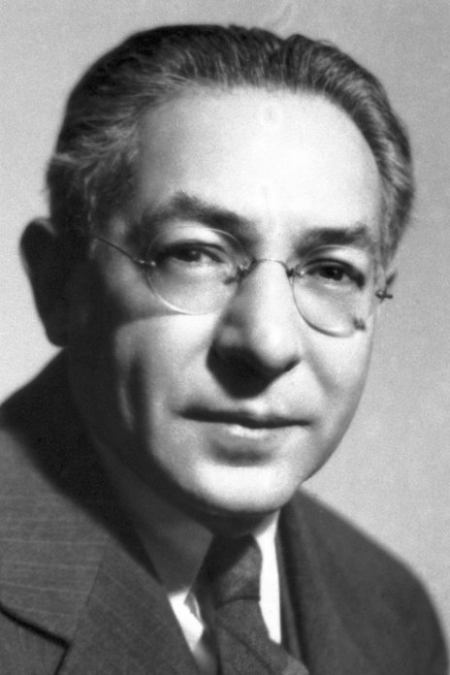
However, in 1936 the muon was discovered – a new particle having such surprising properties that Nobel laureate I.I. Rabi quipped, "who ordered that?" when informed of the discovery
The Nobel Prize in Physics 1944 was awarded to Isidor Isaac Rabi "for his resonance method for recording the magnetic properties of atomic nuclei"

Slide 9
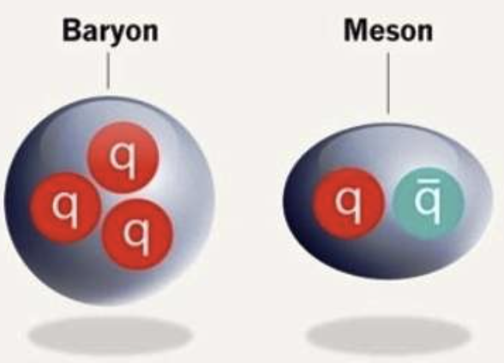
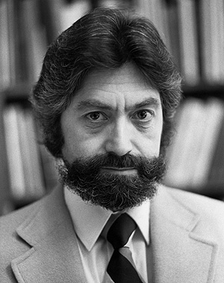
Naive QM: hadron structure
1964
Murray Gell-Mann
George Zweig

Slide 10
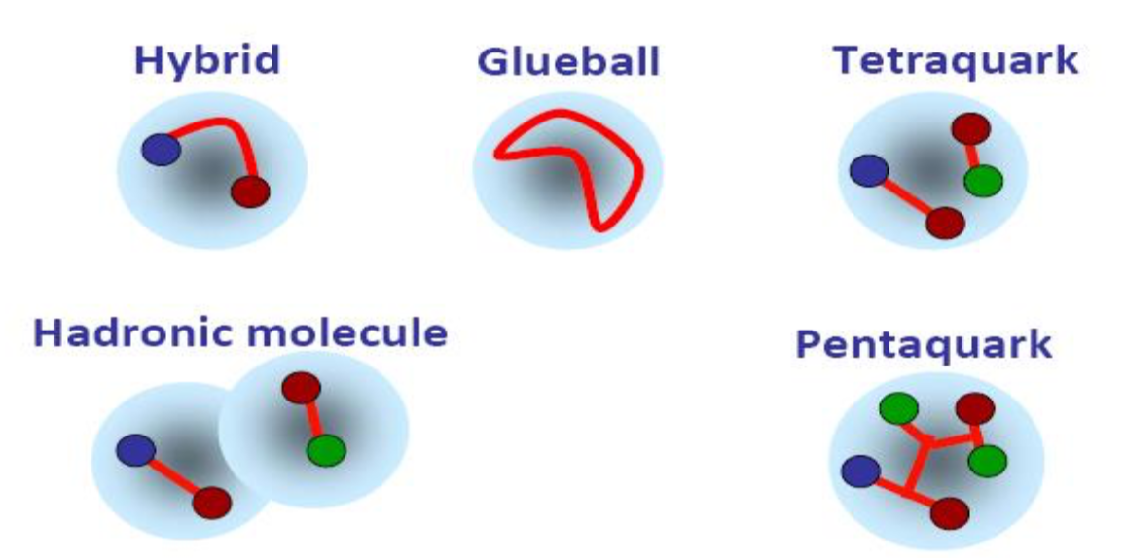
Beyond Naïve QM hadrons, more complicated structures allowed
Conventional Hadrons
Exotic Hadrons

Slide 11

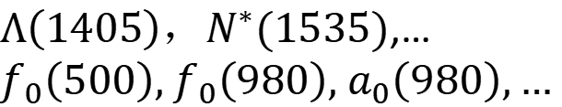
Naïve quark models more or less fine until 2003
$Λ（1405），N^{∗}(1535)$,…
$f_{0}\left(500\right),$ $f_{0}\left(980\right),$ $a_{0}\left(980\right),…$

Slide 12




2003—the beginning of a new era
as of 2025.08.20
Belle, 0309032
2804 citations
BaBar, 0304021
1038 citations
LEPS, 0301020
1206 citations

Slide 13










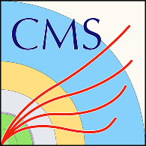







































Many more exotic hadrons discovered
$$X_{0}(2866)$$
$$X_{1}(2904)$$
$D_{s1}$(2460)
$$\text{X}\text{(4160)}$$
$$\text{Y}\text{(4220)}$$
$Z_{c}$(4100)
$$\text{Y}\text{(4660)}$$
$Z_{c}$(4020)
$$P_{c}(4380)$$
$Ξ$(1620)
$$X(6900)$$
X(6900)
X(7200)
$D_{s0}$(2317)
$$\text{Y}\text{(4260)}$$
$$\text{X}\text{(3915)}$$
$$\text{X}\text{(4274)}$$
$Z_{c}$(3900)
$$P_{c}(4450)$$
$$\text{Y}\text{(4390)}$$
$$P_{cs}(4459)$$
$$\text{Y}\text{(4500)}$$
$$\text{Y}\text{(4360)}$$
$Ω$(2012)
$$P_{c}(4337)$$
2003
2005
2006
2007
2009
2011
2013
2014
2015
2016
2018
2019
2020
2021
2022
2023
$$\text{X}\text{(3960)}$$
$$\text{X}\text{(3872)}$$
$Z_{c}$(4430)
$X$(4140)
$Z_{c}$(4200)
$$P_{c}(4457)$$
$$P_{cs}(4338)$$
X(6900)
X(6600)
X(7100)
$$\text{X}\text{(5568)}$$
$$P_{c}(4440)$$
$Z_{cs}$(3985)
$$T_{cs}(2900)$$
$Y$(3940)
$$P_{c}(4312)$$
$T_{cc}$(3875)
$Z_{b}$(10610)
$Z_{b}$(10650)
$Λ_{c}$(2940)

Slide 14
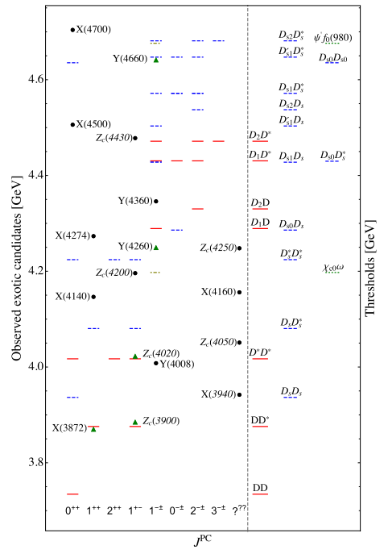
Most of them close to thresholds— hadronic molecules
Feng-Kun Guo, Christoph Hanhart,
Ulf-G. Meißner, Qian Wang,
Qiang Zhao, Bing-Song Zou.
Rev.Mod.Phys. 90 (2018) 015004
Richard F. Lebed, Ryan E. Mitchell,
Eric S. Swanson,
Prog.Part.Nucl.Phys. 93 (2017) 143
Atsushi Hosaka, Toru Iijima, Kenkichi Miyabayashi, Yoshihide Sakai , Shigehiro Yasui,
PTEP 2016 (2016) 062C01
Hua-Xing Chen, Wei Chen, Xiang Liu
Shi-Lin Zhu,
Phys. Rept.639 (2016) 1
……

Slide 15
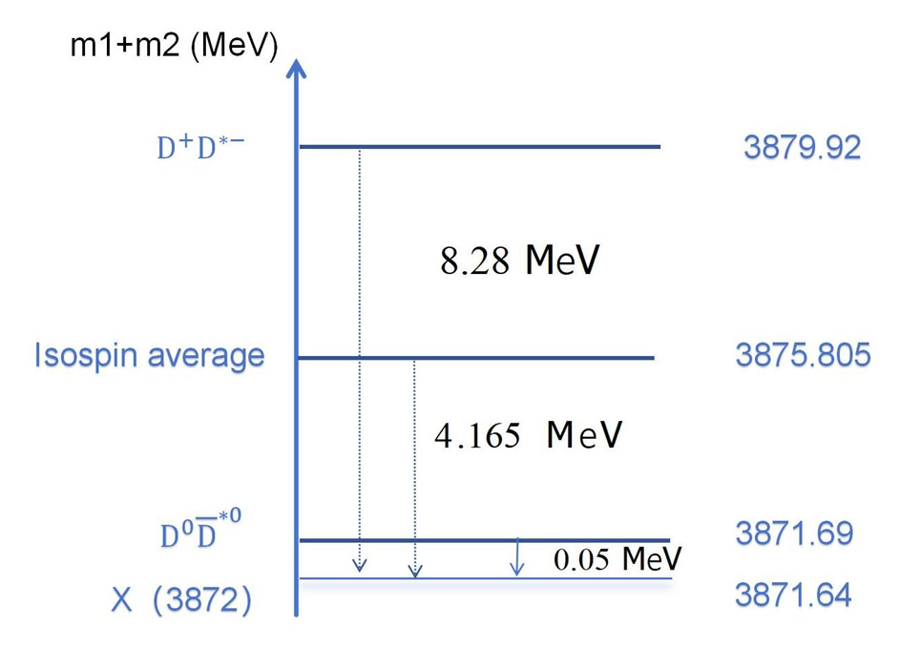
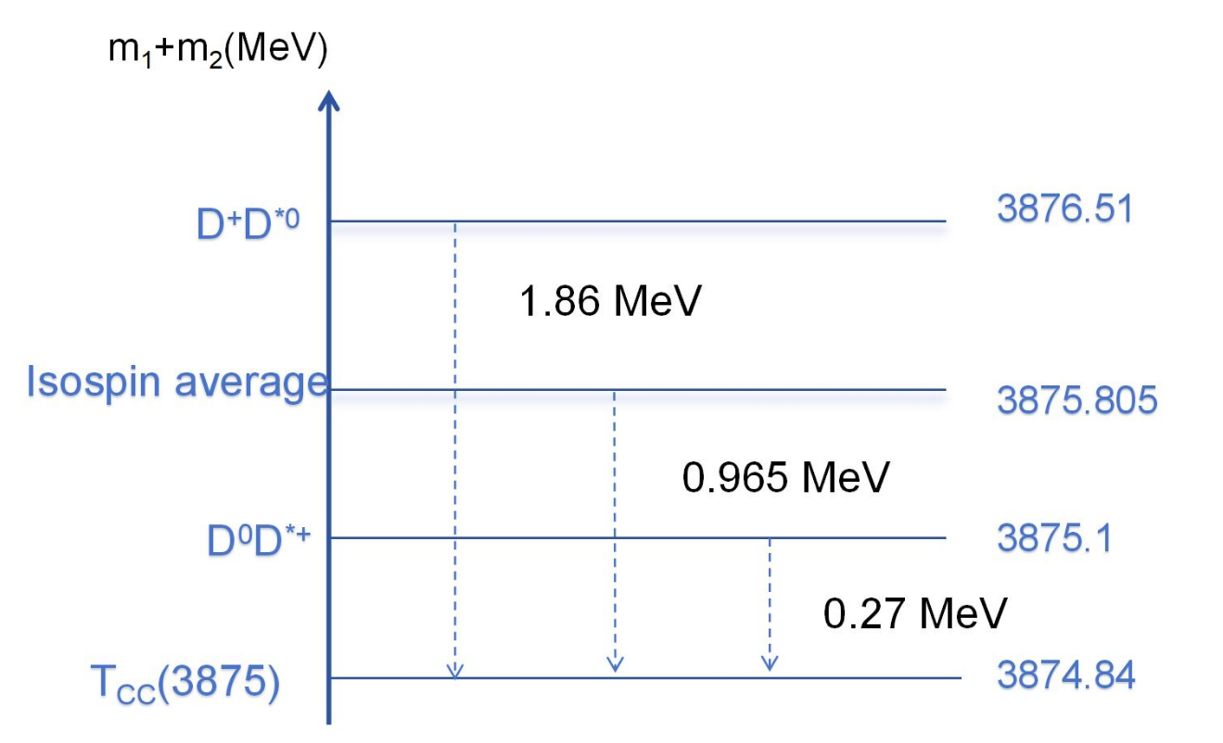
X(3872) & Tcc(3875)
Below or above

Slide 16

How to check the molecular picture?

Slide 17
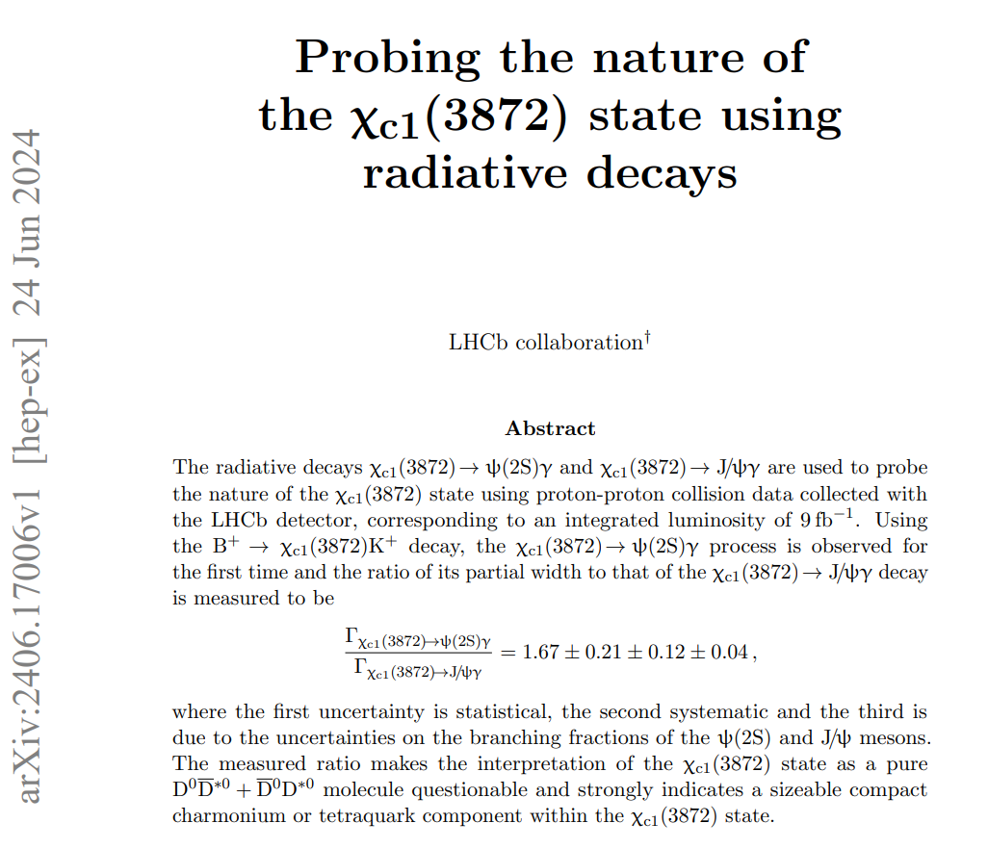
How to check the molecular picture?

Slide 18
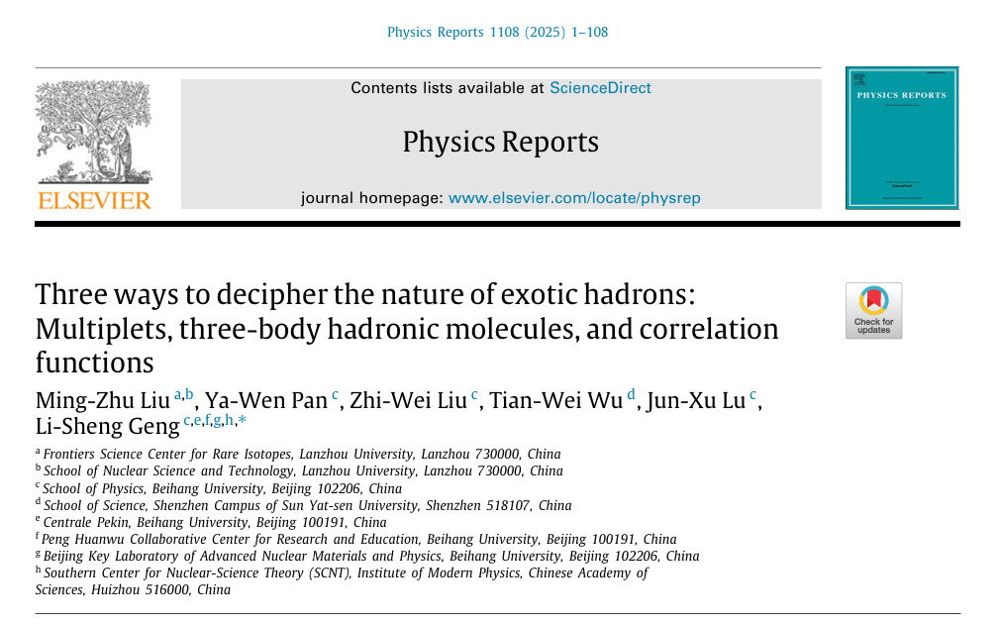

Slide 19
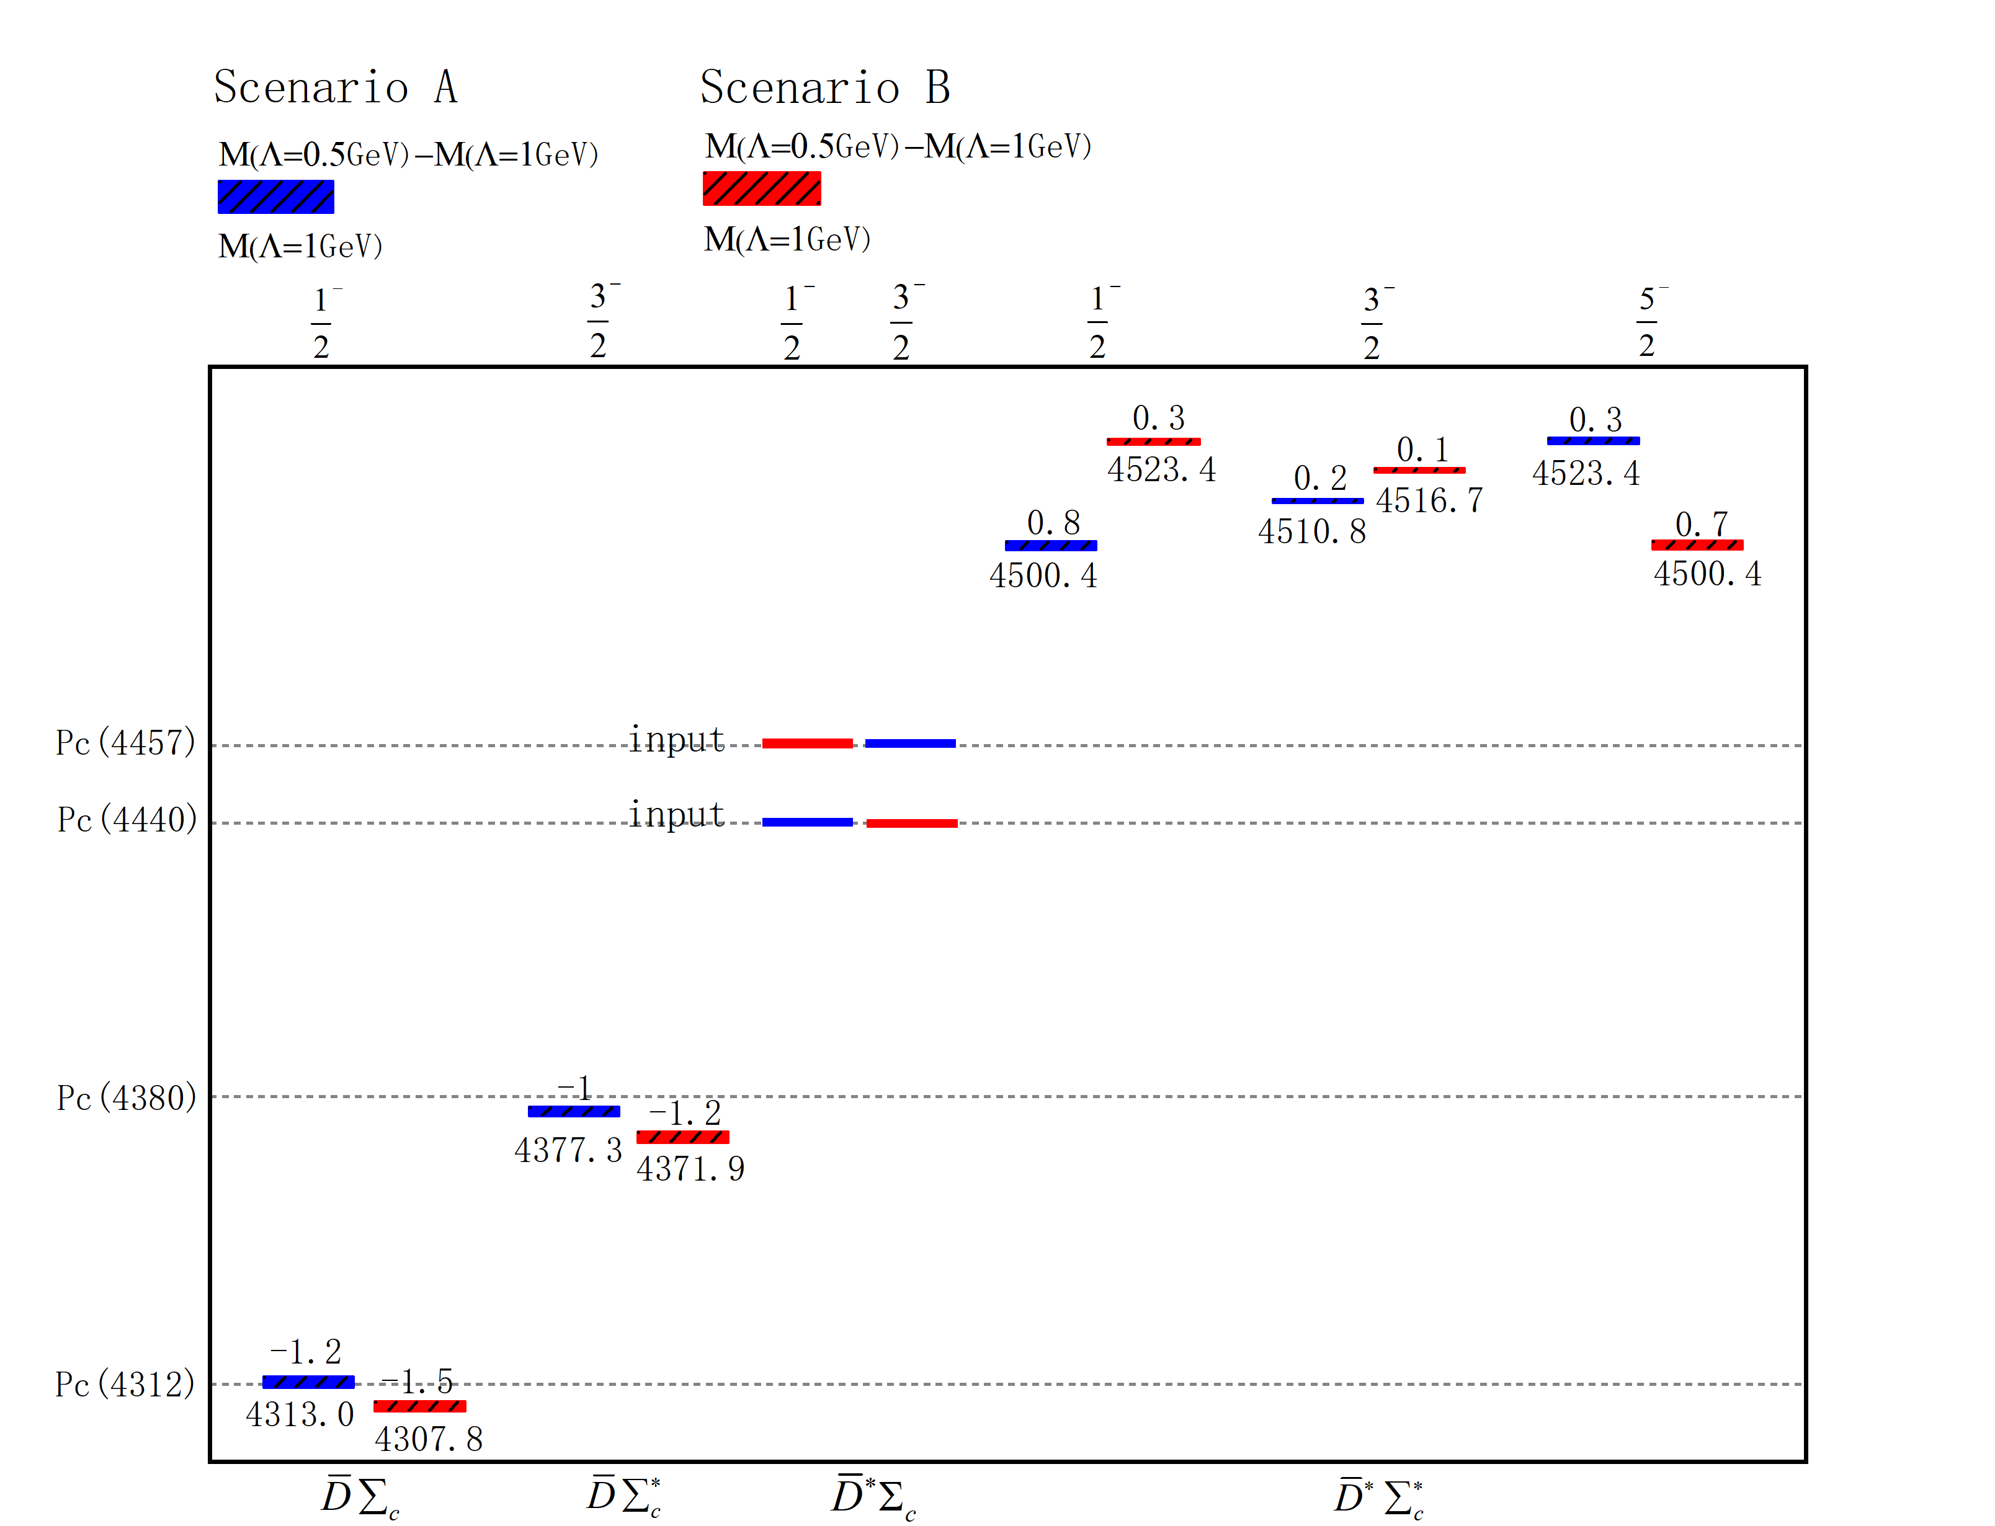
How to verify the molecular picture
Ming-Zhu Liu, Ya-Wen Pan, Zhi-Wei Liu, Tian-Wei Wu, Jun-Xu Lu, LSG*， Phys.Rept. 1108 (2025) 1-108
Symmetries in the two-hadron interactions imply the existence of multiplets of hadronic molecules
  Heavy-quark spin/flavor symmetry: there are seven Pc states
LHCb, PRL 122 (2019) 222001
Liu, Pan, Peng, Sánchez, LSG, Hosaka, Valderrama, PRL122, 242001 (2019)

Slide 20
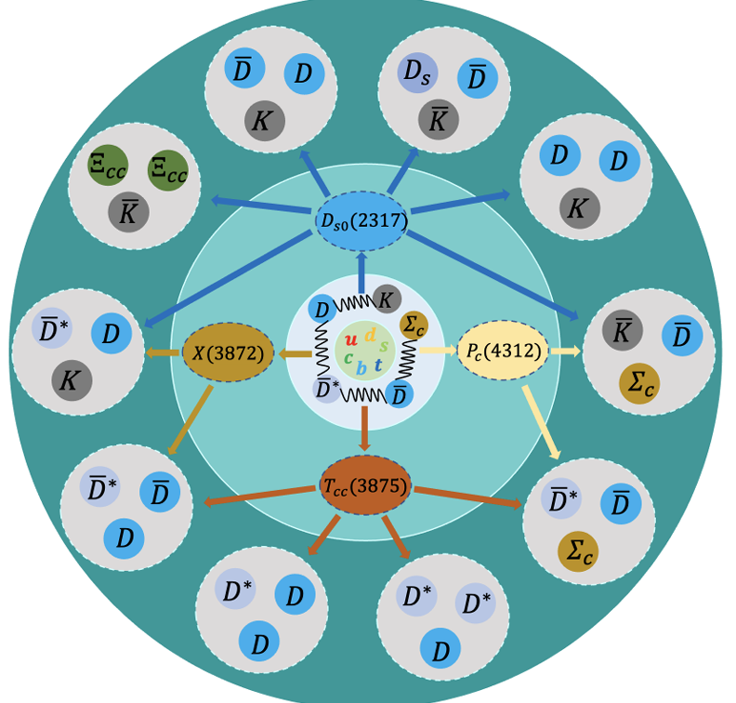
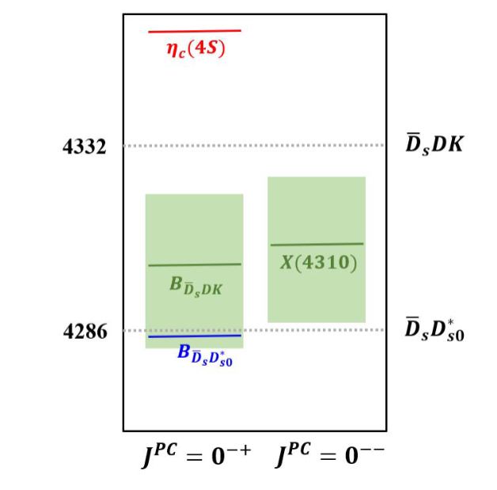
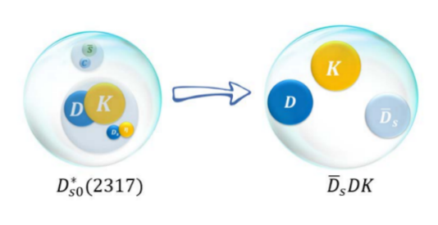
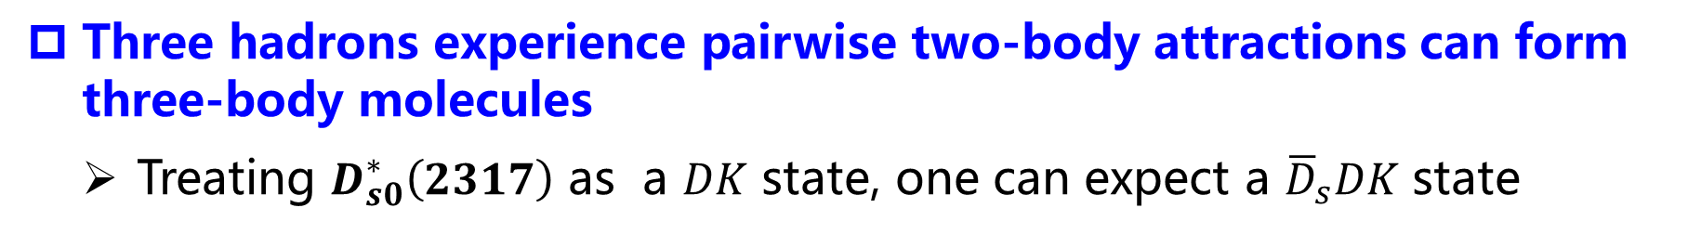
How to verify the molecular picture
Ming-Zhu Liu, Ya-Wen Pan, Zhi-Wei Liu, Tian-Wei Wu, Jun-Xu Lu, LSG*， Phys.Rept. 1108 (2025) 1-108
Three hadrons experience pairwise two-body attractions can form three-body molecules
  Treating $D_{s0}^{∗}\left(2317\right)$ as a $DK$ state, one can expect a ${\overline{D}}_{s}DK$ state
T.W. Wu and LSG, Sci.Bull. 67 (2022) 1735-1738
T.W Wu, M.Z Liu, and LSG, PRL(2025) 031902

Slide 21
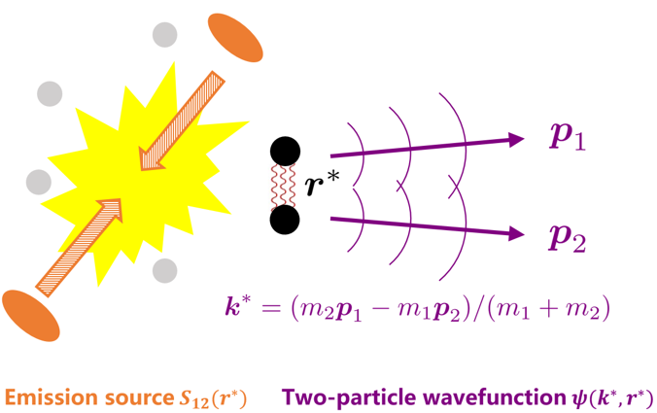
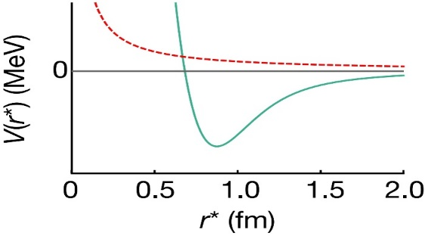
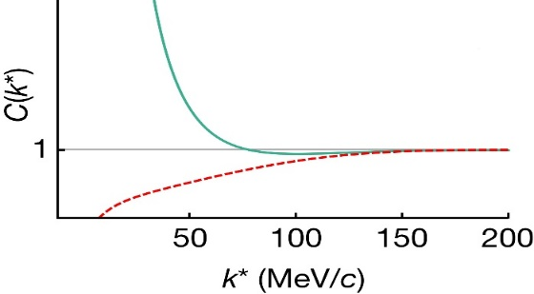

How to verify the molecular picture
Ming-Zhu Liu, Ya-Wen Pan, Zhi-Wei Liu, Tian-Wei Wu, Jun-Xu Lu, LSG*， Phys.Rept. 1108 (2025) 1-108
Direct measurement of the two-hadron interactions
Interacting potential
Correlation function
repulsive
attractive
attractive
repulsive
Schrödinger equation
Two-particle wavefunction$ψ(k^{∗}, r^{∗})$

Slide 22
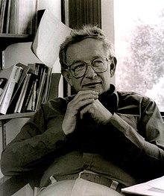
Part 1: symmetry mutiplets
Symmetry in physics has been generalized to mean invariance—that is, lack of change—under any kind of transformation
Important symmetries in physics include continuous symmetries and discrete symmetries of spacetime; internal symmetries of particles; and supersymmetry of physical theories.
“it is only slightly overstating the case to say that physics is the study of symmetry.“—More is different, 1972
Notes:
.

Slide 23
Hadron spectroscopy—QM—QCD
Put an end to the then chaotic situation
Murray Gell-Mann
Eightfold way-1961
Quark model-1964
QCD/SM
V. E. Barnes et al., Phys. Rev. Lett. 12, 204 (1964)
Yuval Ne'eman.
Notes:
In particle/hadron physics, the eightfold way paved the way for the quark model, which has an important position in the so-called standard model of particle physics. on the basis of their symmetrical properties, the number of members of each group being 1, 8 (most frequently), 10, or 27. The system was proposed in 1961 by the American physicist Murray Gell-Mann and the Israeli physicist Yuval Neʾeman. It is based on the mathematical symmetry group SU(3); however, the name of the system was suggested by analogy with the Eightfold Path of Buddhism because of the centrality of the number eight. One of the early triumphs of the Eightfold Way was the prediction of the existence of a heavy subatomic particle required to complete one of the groups. The particle, called omega-minus, was discovered in 1964. That same year, Gell-Mann set forth the concept of quarks as the physical basis for the classification system, thereby establishing the foundation for the modern quark model of hadrons. See also quark.

Slide 24
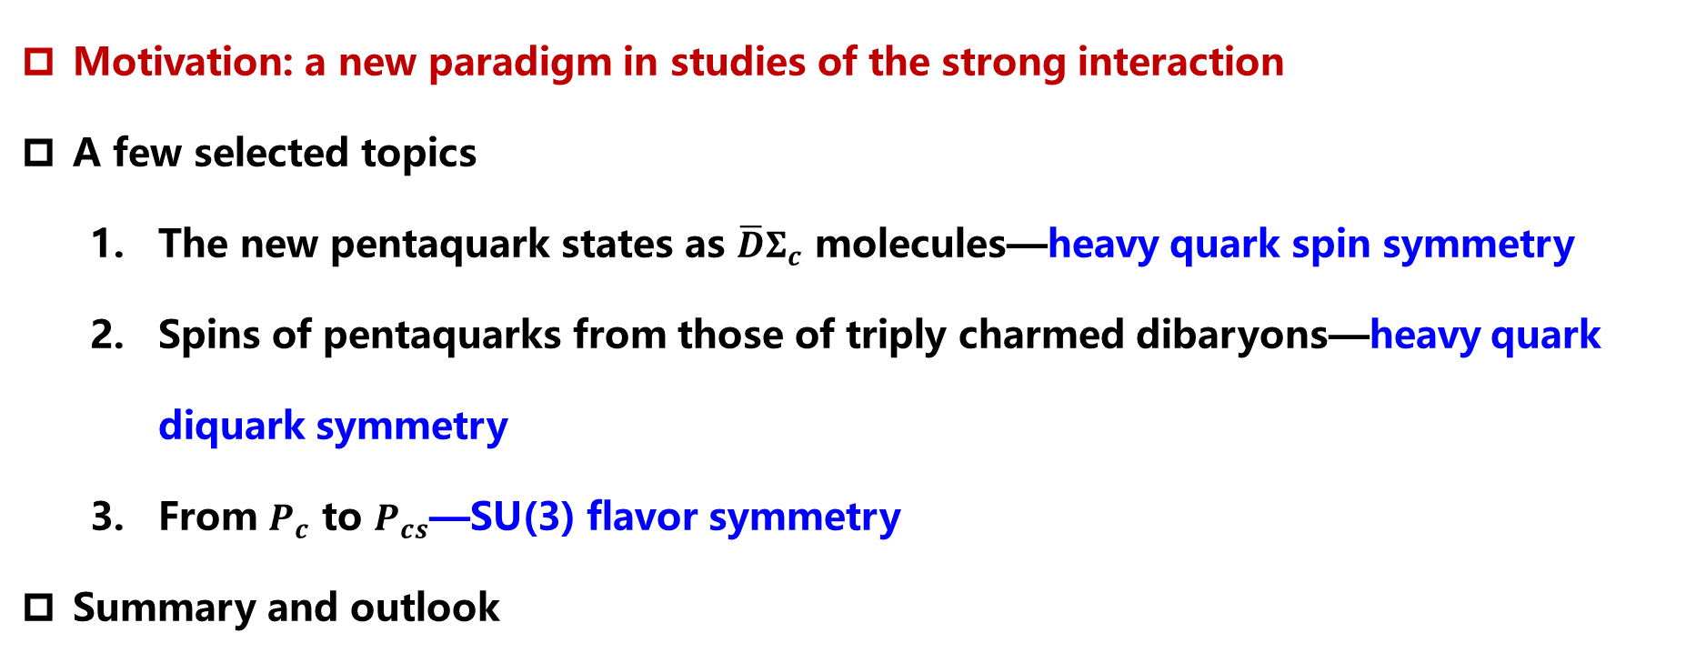
Contents
Motivation: a new paradigm in studies of the strong interaction
A few selected topics
  The new pentaquark states as $\overline{D}Σ_{c}$ molecules—heavy quark spin symmetry
  Spins of pentaquarks from those of triply charmed dibaryons—heavy quark diquark symmetry
  From $P_{c}$ to $P_{cs}$—SU(3) flavor symmetry
Summary and outlook
Notes:
.

Slide 25

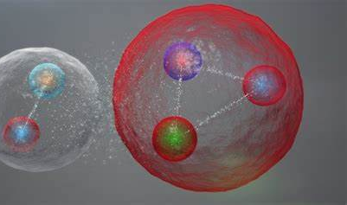
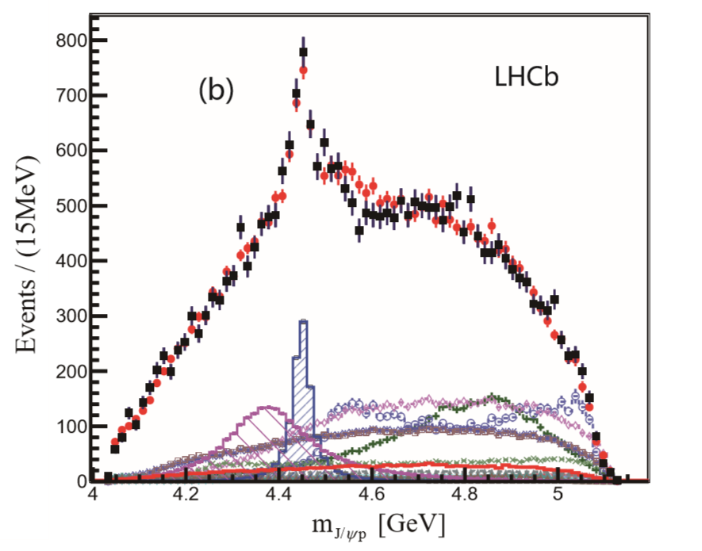
$$2015:2 pentaquarks from Λ_{b}^{0}→J/ψpK^{−}$$
2015
PRL 115 (2015) 072001
1894 citations
Highlights of the year, Particle High Five/LHCb
the research covered in Physics that really made waves in and beyond the physics community
25

Slide 26
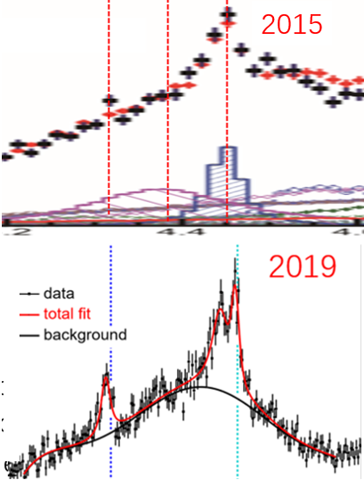
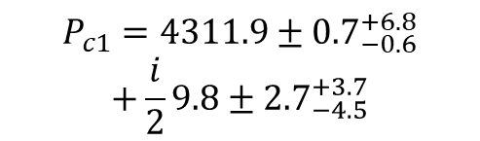
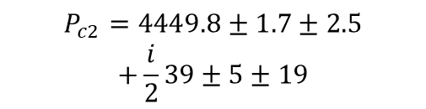
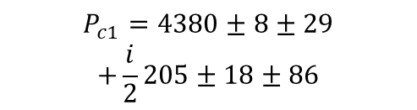
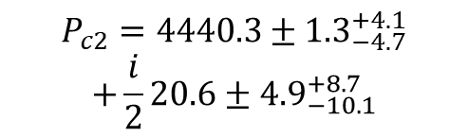
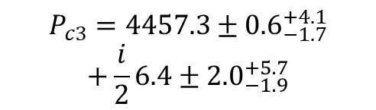
2019: 3 p$entaquarks from Λ_{b}^{0}→J/ψpK^{−}$
2015
$$P_{c1}=4380±8±29$$
$$+\frac{i}{2}205±18±86$$
4320
4380
4450
$$P_{c2}=4449.8±1.7±2.5$$
$$+\frac{i}{2}39±5±19$$
2015
2019
$$P_{c1}=4311.9±{0.7}_{−0.6}^{+6.8}$$
$$+\frac{i}{2}9.8±{2.7}_{−4.5}^{+3.7}$$
$$P_{c2}=4440.3±{1.3}_{−4.7}^{+4.1}$$
$$+\frac{i}{2}20.6±{4.9}_{−10.1}^{+8.7}$$
$$P_{c3}=4457.3±{0.6}_{−1.7}^{+4.1}$$
$$+\frac{i}{2}6.4±{2.0}_{−1.9}^{+5.7}$$
PRL 115 (2015) 072001
1894 citations
PRL 122 (2019) 222001
850 citations
26

Slide 27
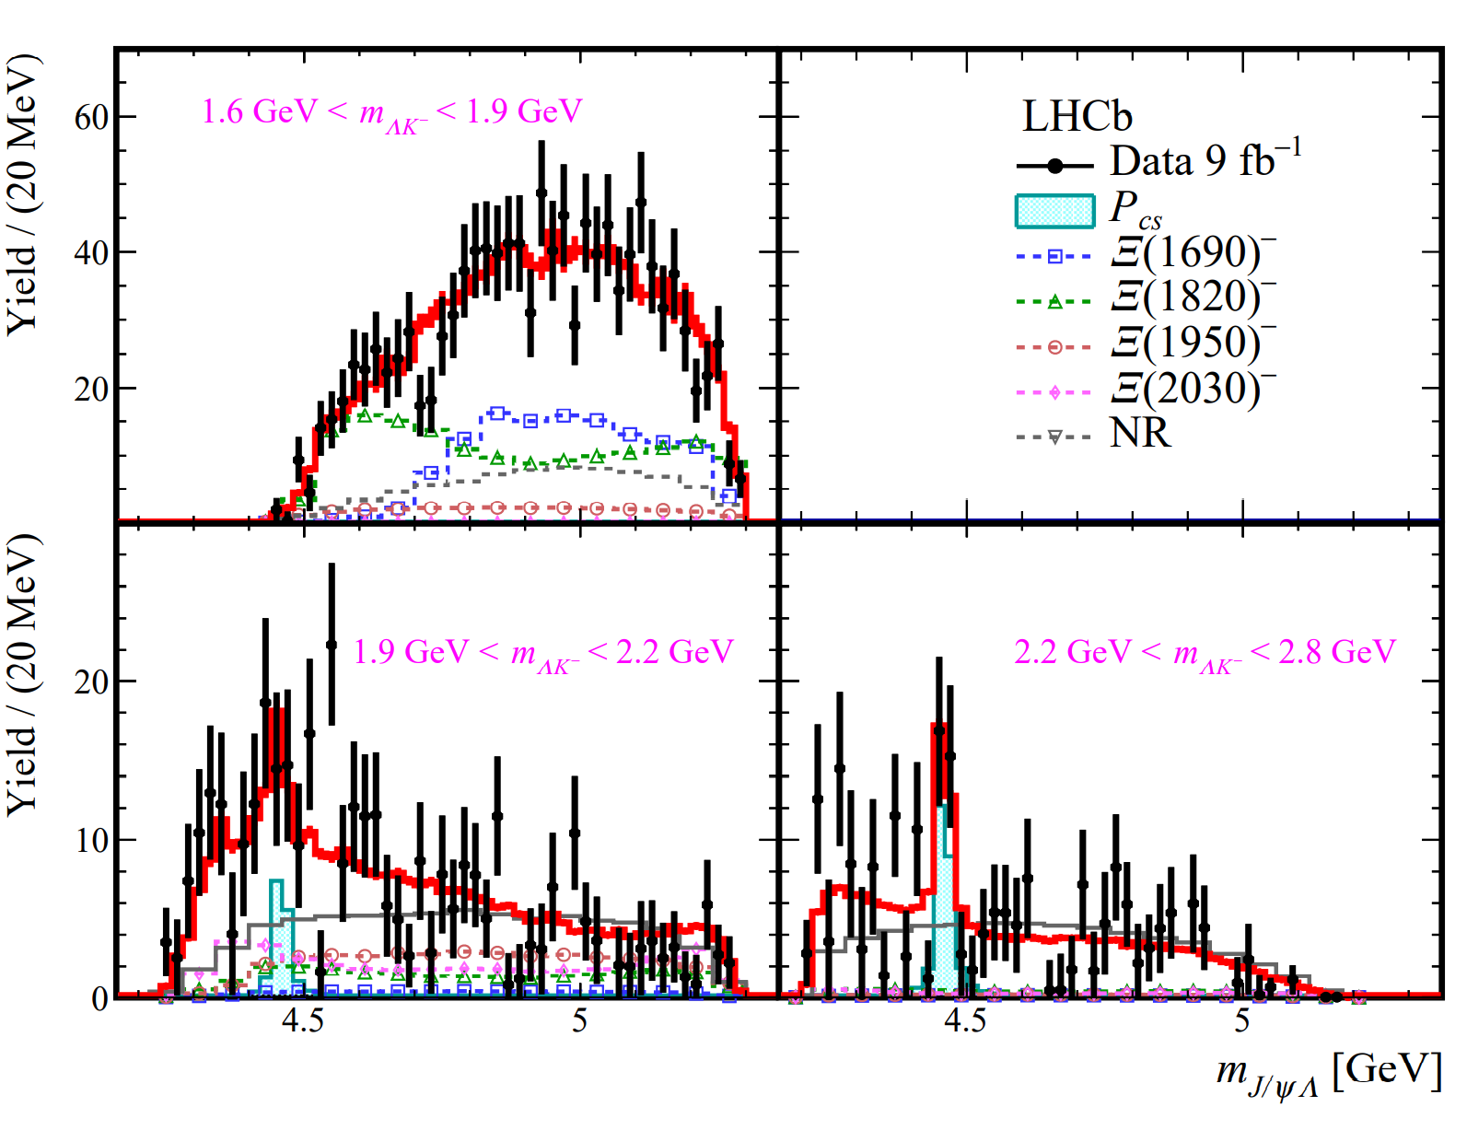
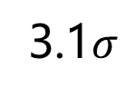
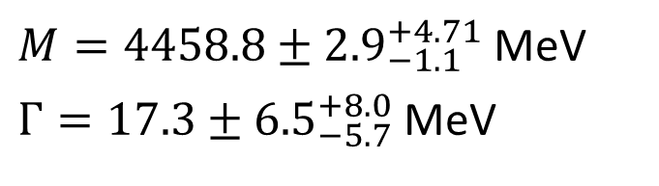
$$A pentaquark candidate from Ξ_{b}^{−}→J/ψΛK^{−}$$
2020
3.1$σ$
Pcs​(4459)
Pcs​(4459)
$M=4458.8±{2.9}_{−1.1}^{+4.71}$ MeV
$Γ=17.3±{6.5}_{−5.7}^{+8.0}$ MeV
Sci.Bull. 66 (2021) 1278-1287 267 citations
27

Slide 28
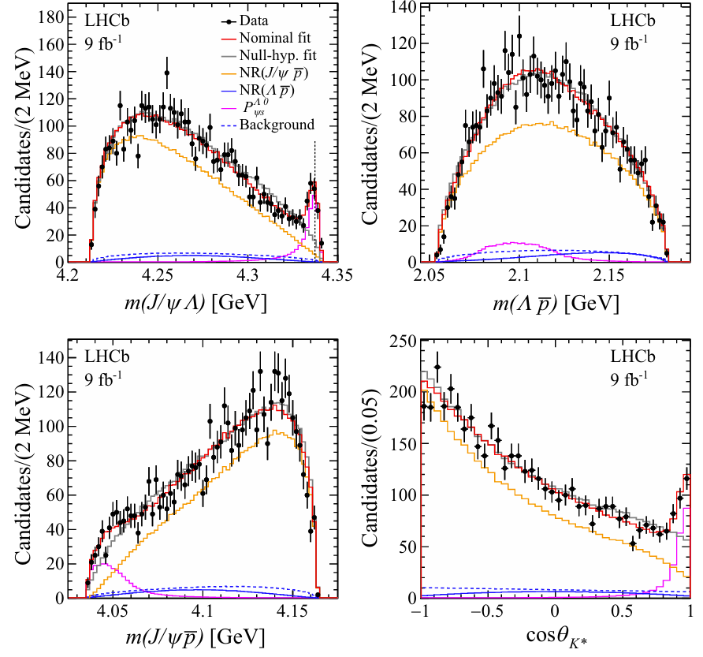
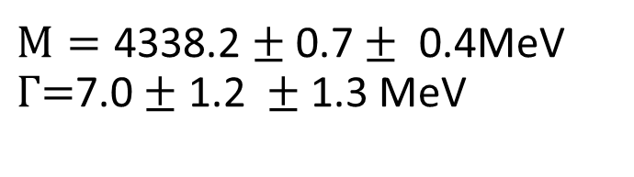
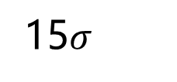
A pentaquark candidate from $B^{−}→J/ψΛ\overline{p}$
2023
Pcs​(4338)
15$σ$
$M=\text{4338.2}±\text{0.7}±\text{ 0.4}$MeV $Γ\text{=}\text{7.0}±\text{1.2 }±\text{1.3} \text{MeV}$
Phys.Rev.Lett. 131 (2023) 031901 163 citations
28

Slide 29
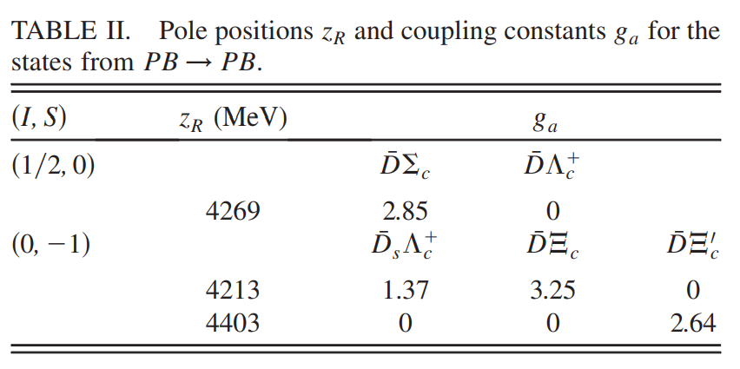
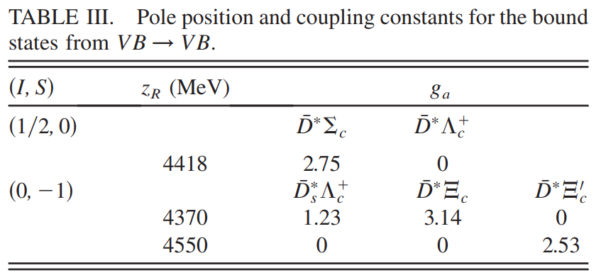
Before the 2015 LHCb discovery
Wu, Molina, Oset, Zou, PRL105, 232001(2010)
Wang, Huang, Zhang, Zou, PRC84, 015203(2011)
Yang, Sun, He, Liu, Zhu, CPC36,6(2012)
Wu, Lee, Zou, PRC85,044002(2012)
Xiao, Nieves, Oset, PRD88,056012(2013)
Karliner, Rosner, PRL115, 122001(2015)
Hofmann, Lutz, NPA763,90(2005)

Slide 30
Fine structure–new era of exotic hadrons
The existence of 7 molecules
—likely existence of
a (first) complete multiplet

Slide 31
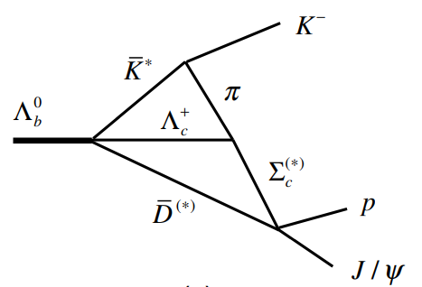
After the 2019 LHCb discovery
Molecular states
  Rui Chen et al., 1903.11013
  Mingzhu Liu et al., 1903.11560
  Jun He et al., 1903.11872
  Chuwen Xiao et al., 1904.01296
  Jun He et al., 1909.05681
  T.J. Burns et al., 1908.03528
  Yasuhiro Yamaguchi et al.,1907.04684
  Mingzhu Liu et al., 1907.06093
  Menglin Du et al., 1910.11846
  …
hadrocharmonium states
  Michael I. Eides et al., 1904.11616
Virtual states -- Pc(4312)
  JPAC, 1904.10021
Triangle singularities or cusp effects
  Satoshi. X. Nakamura, 2103.06817,Pc(4312), Pc(4380), Pc(4457)
Compact pentaquark states
  Ahmed Ali, 1904.00446
  Zhi-Gang Wang et al., 1905.0892
  Jian-Bo Chen et al., 1905.08605
  X. –Z. Weng et al., 1904.09891
  R. Zhu et al., 1904.10285
  …

Slide 32
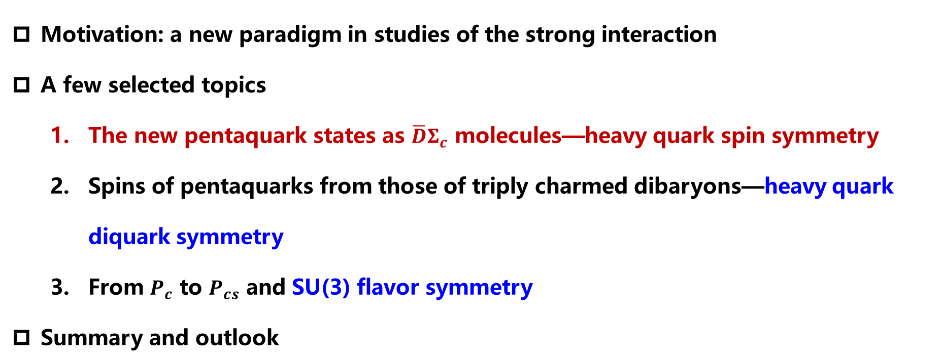
Contents
Motivation: a new paradigm in studies of the strong interaction
A few selected topics
  The new pentaquark states as $\overline{D}Σ_{c}$ molecules—heavy quark spin symmetry
  Spins of pentaquarks from those of triply charmed dibaryons—heavy quark diquark symmetry
  From $P_{c}$ to $P_{cs}$ and SU(3) flavor symmetry
Summary and outlook
Liu, Pan, Peng, Sánchez, Geng, Hosaka, Valderrama, PRL122, 242001 (2019)
Notes:
.

Slide 33
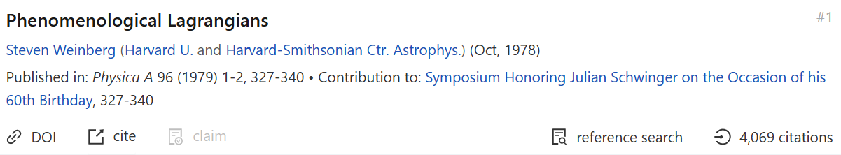
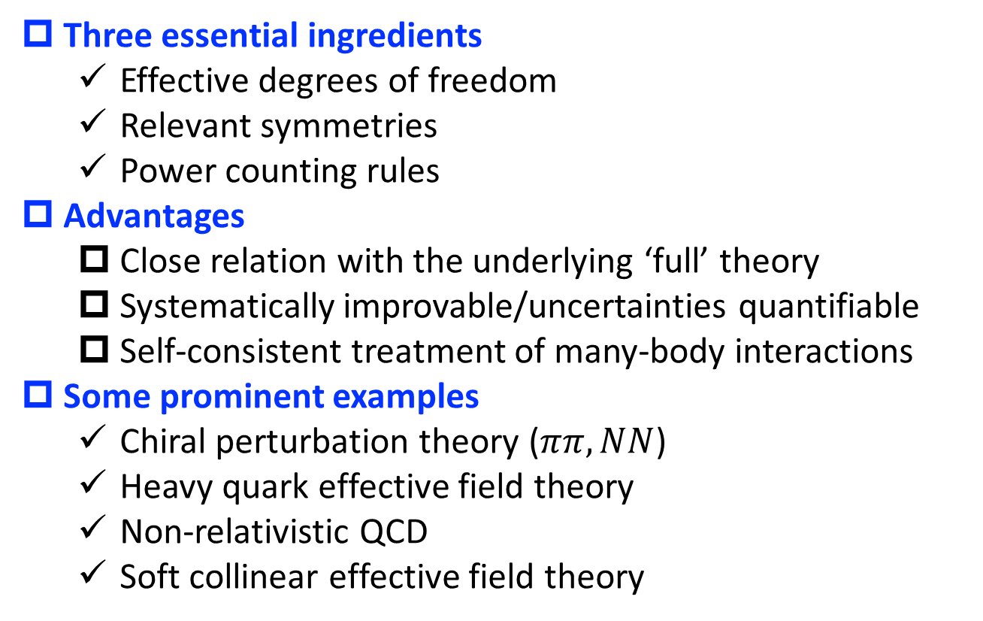
Effective field theories
Three essential ingredients
  Effective degrees of freedom
  Relevant symmetries
  Power counting rules
Advantages
  Close relation with the underlying ‘full’ theory
  Systematically improvable/uncertainties quantifiable
  Self-consistent treatment of many-body interactions
Some prominent examples
  Chiral perturbation theory ($ππ,NN$)
  Heavy quark effective field theory
  Non-relativistic QCD
  Soft collinear effective field theory
Steven Weinberg

Slide 34
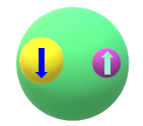
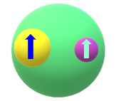
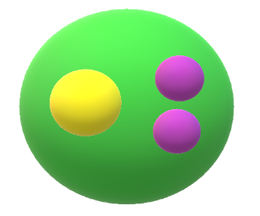









Heavy quark spin symmetry
$m_{Q}→∞$ the strong interaction is independent of the spin of heavy quark
HQSS is broken in charm and bottom sector
$$J=J_{l}−\frac{1}{2}$$
$$m_{D^{∗}}{−m}_{D}=142 MeV$$
$$m_{B^{∗}}{−m}_{B}=46 MeV$$
$$J=J_{l}+\frac{1}{2}$$
$$J=J_{l}−\frac{1}{2}$$
$$m_{Σ_{c}^{∗}}−m_{Σ_{c}}=64MeV$$
$$m_{Σ_{b}^{∗}}−m_{Σ_{b}}=21MeV$$
$$J=J_{l}+\frac{1}{2}$$

Slide 35

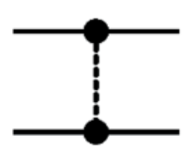

Effective field theory: $\overline{D}（\overline{D^{∗}}）Σ_{c}（Σ_{c}^{∗}）$
Power counting: naïve dimensional analysis
Contact
pionless
Leading order
One pion exchange
OPE is perturbative in charm hadronic interactions—Jun-Xu Lu et al., PRD99 (2019) 074026
M. Valderrama, 1907.05294
Next to leading order—pion full
Lu Meng et al., PRD100 (2019) 014031; Bo Wang et al., 1909.13054

Slide 36







Leading order Lagrangian satisfying HQS
$L=C_{a}Tr[{H_{c}^{†}H}_{c}]{\vec{S}}_{c}∙{{\vec{S}}_{c}}^{†}$+$C_{b}\sum_{i=1}^{3}{Tr[{H_{c}^{†}σ_{i}H}_{c}]{\vec{S}}_{c}∙{(J}_{i}{{\vec{S}}_{c}}^{†})}$
$$H_{c}=\frac{1}{\sqrt{2}}(D+{\vec{D}}^{∗}\vec{σ})$$
$${\vec{S}}_{c}=\frac{1}{\sqrt{3}}(Σ_{c}\vec{σ}+{{\vec{Σ}}^{∗}}_{c})$$
Spin 1 matrices
Threshold
0
64 MeV
142 MeV
208 MeV

Slide 37









Leading order potentials
${V({\frac{1}{2}}^{−},Σ}_{c}\overline{D} )=C_{a}$
$V\left({1/2}^{−},Σ_{c}^{∗}{\overline{D}}^{∗}\right)=C_{a}−\frac{5}{3} C_{b}$
$V({\frac{3}{2}}^{−},Σ_{c}^{∗}\overline{D})=C_{a}$
$$V\left({3/2}^{−},Σ_{c}^{∗}{\overline{D}}^{∗}\right)=C_{a}−\frac{2}{3} C_{b}$$
$$V({1/2}^{−},Σ_{c}{\overline{D}}^{∗})=C_{a}−\frac{4}{3} C_{b}$$
$$V\left({5/2}^{−},Σ_{c}^{∗}{\overline{D}}^{∗}\right)=C_{a}+ C_{b}$$
$$V\left({3/2}^{−},Σ_{c}{\overline{D}}^{∗}\right)=C_{a}+\frac{2}{3} C_{b}$$
$C_{a}$:responsible for overall interaction
$C_{b}$: responsible for spin splitting
Without experimental inputs, there is
no (not much) predictive power
Two inputs are needed to fix the two
LECs, LHCb provides three
Ambiguity: two $\overline{D^{∗}} Σ_{c}$ bound states
Pc(4440)/Pc(4457)

Slide 38



Searching for bound states
Lippmann-Schwinger Equation
$$\left.\left\langle {\vec{k}}^{′}\right.|T|\vec{k}\right\rangle =\left.\left\langle {\vec{k}}^{′}\right.|T|\vec{k}\right\rangle +\int{\frac{d^{3}\vec{q}}{{(2π)}^{3}}\left.\left\langle {\vec{k}}^{′}\right.|V|\vec{q}\right\rangle }\frac{1}{E−\frac{{\vec{q}}^{2}}{2μ}}\left.\left\langle \vec{q}\right.|T|\vec{k}\right\rangle$$
$$\left.\left\langle \vec{k}\right.|V|\vec{q}\right\rangle =C\left(Λ\right)f\left(Λ,\left|\vec{k}\right|\right)f(Λ,\left|\vec{q}\right|)$$
Separable potential
$1+\int{\frac{d^{3}\vec{q}}{{(2π)}^{3}}}\frac{{C\left(Λ\right)f}^{2}(Λ,\left|\vec{q}\right|)}{B+\frac{{\vec{q}}^{2}}{2μ}}$=0
RGI

Slide 39










Fits to the LHCb data: two scenarios
LHCb data
$${V({1/2}^{−},Σ}_{c}\overline{D} )=C_{a}$$
$$P_{c1}=4311.9±{0.7}_{−0.6}^{+6.8}+\frac{i}{2}9.8±{2.7}_{−4.5}^{+3.7}$$
$$V({3/2}^{−},Σ_{c}^{∗}\overline{D})=C_{a}$$
$$V({1/2}^{−},Σ_{c}{\overline{D}}^{∗})=C_{a}−\frac{4}{3} C_{b}$$
$$P_{c2}=4440.3±{1.3}_{−4.7}^{+4.1}+\frac{i}{2}20.6±{4.9}_{−10.1}^{+8.7}$$
$$V\left({3/2}^{−},Σ_{c}{\overline{D}}^{∗}\right)=C_{a}+\frac{2}{3} C_{b}$$
$$P_{c3}=4457.3±{0.6}_{−1.7}^{+4.1}+\frac{i}{2}6.4±{2.0}_{−1.9}^{+5.7}$$
$$V\left({1/2}^{−},Σ_{c}^{∗}{\overline{D}}^{∗}\right)=C_{a}−\frac{5}{3} C_{b}$$
Three experimental data and two unknown coupling constants
$$V\left({3/2}^{−},Σ_{c}^{∗}{\overline{D}}^{∗}\right)=C_{a}−\frac{2}{3} C_{b}$$
$C_{a}$ and $C_{b}$ can be determined !
$$V\left({5/2}^{−},Σ_{c}^{∗}{\overline{D}}^{∗}\right)=C_{a}+ C_{b}$$
Input
$${A \overline{D}}^{∗}Σ_{c} \left({3/2}^{−}\right) Pc\left(4457\right) {\overline{D}}^{∗}Σ_{c} \left({1/2}^{−}\right) Pc\left(4440\right)$$
$${B \overline{D}}^{∗}Σ_{c} \left({1/2}^{−}\right) Pc\left(4457\right){ \overline{D}}^{∗}Σ_{c} \left({3/2}^{−}\right) Pc\left(4440\right)$$

Slide 40

Emergence of a complete HQS multiplet (7)
3 new states

Slide 41
RGI of binding energy of the pentaquarks

Slide 42

Supported by all the following studies
Meng-Lin Du, Vadim Baru, Feng-Kun Guo, Christoph Hanhar, Ulf-G Meißner, Jose A Oller, Qian Wang, Phys.Rev.Lett. 124 (2020) 072001

Slide 43


Even considering 5q
Yamaguchi et al. Phys.Rev.D 101 (2020) 091502

Slide 44

Contents
Motivation: a new paradigm in studies of the strong interaction
A few selected topics
  The new pentaquark states as $\overline{D}Σ_{c}$ molecules—heavy quark spin symmetry
  Spins of pentaquarks from those of triply charmed dibaryons—heavy quark diquark symmetry
  From $P_{c}$ to $P_{cs}$ and SU(3) flavor symmetry
Summary and outlook
Pan, Liu , Peng, Sánchez, Geng , Valderrama1, PRD102, 011504(R) (2020)
Notes:
.

Slide 45
Spin-parities important to understand the Pcs
Spins of the Pc(4457) and Pc(4440) undetermined
Different molecular models show different preferences
Other model predictions are even more distinct
Pc(4457): 3/2⁻
Pc(4440): 1/2⁻
Pc(4457): 1/2⁻
Pc(4440): 3/2⁻
Vs.
Rui Chen et al., 1903.11013
Jun He et al., 1903.11872
Chuwen Xiao et al., 1904.01296
Jun He et al., 1909.05681
Y. Yamaguchi et al.,1907.04684
Mingzhu Liu et al., 1907.06093
Compact diquark model
Ahmed Ali et al., 1904.00446
Pc(4457): 5/2⁺
Pc(4440): 3/2⁺
Pc(4312): 3/2⁻
QCD sum rule (M)
H. X. Chen et al., 1904.00446
Pc(4457): 3/2⁻ (5/2⁻ )
Pc(4440): 3/2⁻(1/2⁻)
Pc(4312): 1/2⁻
NR Quark model
Ruilin Zhu et al., 1904.00446
Pc(4457): 1/2⁻
Pc(4440): 1/2⁻
Pc(4312): 3/2⁻ (1/2⁻)
QCD sum rule (C)
Zhi-Gang Wang et al., 1905.0892
Pc(4457): 1,3/2⁻
Pc(4440): 1,3,5/2⁻
Pc(4312): 1/2⁻

Slide 46

Turn to lattice QCD?
Coupled channel study difficult
Up to now, only three groups studied $J/ψN$ interactions, and no pentaquark states found
2019, a study of 1+ ${Ξ_{cc}Σ}_{c}$ baryons was successfully performed, and some bound states were found
We showed that it is possible to determine the spins of the pentaquark states by studying the spectroscopy of the dibaryon system via heavy antidquark diquark symmetry.
T. Sugiura et al., 1905.02336.
U. Skerbis et al., 1811.02285.
Yan Lyu et al. 2410.22755
B=8(17)MeV, Parikshit Junnarkar et al., 1906.06054
Ya-Wen Pan et al., 1907.11220

Slide 47











Heavy Antiquark Diquark symmetry (HADS)
Heavy diquark behaves as a heavy anti-quark from color freedom
Savage et al., PLB248 (1990) 177; Hu et al., PRD73 (2006) 054003
$$3⊗3=6⨁\overline{3}$$
$$\overline{D}$$
HADS
$$Ξ_{cc}$$
$$\overline{3}$$
$$Σ_{c}$$
$$Σ_{c}$$
Predictions tested in lattice QCD (satisfied at the level of 25%)
$$m_{Ξ_{cc 3/2}}{−m}_{Ξ_{cc 1/2}}=\frac{3}{4}\left(m_{D∗}−m_{D}\right)≈106.5MeV$$
$$m_{Ω_{cc 3/2}}{−m}_{Ω_{cc 1/2}}=\frac{3}{4}\left(m_{Ds∗}−m_{Ds}\right)≈107.9MeV$$
M. Padmanath et al., Phys. Rev. D91, 094502 (2015), 1502.01845; Y.-C. Chen et al., Phys. Lett. B767, 193 (2017), 1701.02581;
C. Alexandrou et al., Phys. Rev. D96, 034511 (2017), 1704.02647; N. Mathur et al., Phys. Rev. D99, 031501 (2019), 1807.00174.

Slide 48


Dibaryon systems
$L_{DΣ_{c}}=C_{a}Tr[{H_{c}^{†}H}_{c}]{\vec{S}}_{c}∙{{\vec{S}}_{c}}^{†}$+$C_{b}\sum_{i=1}^{3}{Tr[{H_{c}^{†}σ_{i}H}_{c}]{\vec{S}}_{c}∙{(J}_{i}{{\vec{S}}_{c}}^{†})}$
$$H_{c}= \frac{1}{\sqrt{2}}(D+{\vec{D}}^{∗}\vec{σ})$$
$${\vec{T}}_{cc}=\frac{1}{\sqrt{3}}(Ξ_{cc}\vec{σ}+{{\vec{Ξ}}^{∗}}_{cc})$$
$L_{Ξ_{cc}Σ_{c}}=C_{a}Tr[{\vec{T}}_{cc}^{†}{\vec{T}}_{cc}]{\vec{S}}_{c}∙{{\vec{S}}_{c}}^{†}$+$C_{b}\sum_{i=1}^{3}{Tr[{\vec{T}}_{cc}^{†}σ_{i}{\vec{T}}_{cc}]{\vec{S}}_{c}∙{(J}_{i}{{\vec{S}}_{c}}^{†})}$

Slide 49

The same potentials in the HQS limit
LHCb data lead to 10 molecular dibaryon states

Slide 50









From (10) dibaryons to (7）pentquarks
Mass splitting of $Ξ_{cc}Σ_{c}$ system
Lattice QCD
1906.06054
$$1^{+}−0^{+}=−8.4 MeV$$
$$1^{+}−0^{+}=9.7 MeV$$
$$∆_{m}<0$$
$$∆_{m}>0$$

Slide 51






Correlations seem to be robust
$$\frac{Λ_{QCD}}{m_{c}}≈15\%$$
Heavy quark spin symmetry breaking
Heavy antiquark diquark symmetry breaking
$$\frac{Λ_{QCD}}{m_{c} ν}≈25\%$$
$$1^{+}−0^{+}=−(4.9\sim 11.8)MeV$$
$$1^{+}−0^{+}=6.3\sim 13.1 MeV$$
$$∆_{m}<0$$
$$∆_{m}>0$$
Scenario A
3/2 higher
1/2 lower
Scenario B
1/2 higher
3/2 lower

Slide 52
HADS Breaking up to 39%
Pc(4457): 3/2
Pc(4440): 1/2
Pc(4457): 1/2
Pc(4440): 3/2

Slide 53
Correlation in case of even larger breaking
Scattering lengths
Notes:
This is a coupled channel system, although Dspi and Ds eta do not paly an important role here. We use a particular method developed by the valencia group to solve the three-body fadieev equation. Details do not matter here, because we will use another method to check.

Slide 54

Contents
Motivation: a new paradigm in studies of the strong interaction
A few selected topics
  The new pentaquark states as $\overline{D}Σ_{c}$ molecules—heavy quark spin symmetry
  Spins of pentaquarks from those of triply charmed dibaryons—heavy quark diquark symmetry
  From $P_{c}$ to $P_{cs}$ and SU(3) flavor symmetry
Summary and outlook
Liu, Pan, Geng, PRD(2021)034003
Notes:
.

Slide 55



SU(3) flavor symmetry
$${\overline{D}}_{}^{(∗)}Σ_{c}^{(∗)}⟶{\overline{D}}_{}^{(∗)}Ξ_{c}^{(′∗)}$$
From $Σ_{c}$ to $Ξ_{c}^{′}$ is straightforward, the same light quark spin

Slide 56



SU(3) flavor symmetry
$${\overline{D}}_{}^{(∗)}Σ_{c}^{(∗)}⟶{\overline{D}}_{}^{(∗)}Ξ_{c}^{(∗)}$$
From $Σ_{c}$ to $Ξ_{c}^{}$is more assumptions are needed
For ${\overline{D}}_{}^{(∗)}Ξ_{c}^{′(∗)}$, one can denote the contact range interaction by $F_{1/2}^{′}$and $F_{3/2}^{′}$
$\frac{1}{2}⨂{1=\frac{1}{2}⊕\frac{3}{2}}$
For ${\overline{D}}_{}^{(∗)}Ξ_{c}^{}$, one can denote the contact range interaction by $F_{1/2}^{}$
$\frac{1}{2}⨂{0=\frac{1}{2}}$

Slide 57




Two scenarios: undetermined
${F_{1/2}=F}_{1/2}^{′}=C_{a}−2C_{b}$
$F_{1/2}=LHG$
1906.0901
$C_{a}$ and $C_{b}$ can be determined from reproducing Pc(4440) and Pc(4457)

Slide 58


Seven ${\overline{D}}_{}^{(∗)}Ξ_{c}^{′(∗)}$ molecules (I=1/2)
Consistent with Chu-Wen Xiao et al [1906.0901], Bo Wang et al. [1912.12592], which favor that Pc(4440) ½ and Pc(4457) 3/2

Slide 59



Three ${\overline{D}}_{}^{(∗)}Ξ_{c}^{}$ molecules (I=1/2)
Binding energies from the LHG theory are much larger
${\overline{D}}_{}^{∗}Ξ_{c}^{}$ states could correspond to Pcs(4459), but spin could be either 1/2 or 3/2

Slide 60


Slide 61
Our scenario 1 is preferred

Slide 62

Summary
We studied the LHCb pentaquark states using a contact-range effective field theory. We showed that they can be accommodated rather nicely as $\overline{D}Σ_{c}$ bound states and predicted the existence of three more states.
Their spins are correlated with their HADS partners—triply charmed dibaryons, which could be useful for lattice QCD studies
Their SU(3) partners, i.e., Pcs, are very likely to exist,

