Slide 1

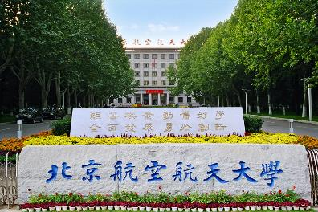

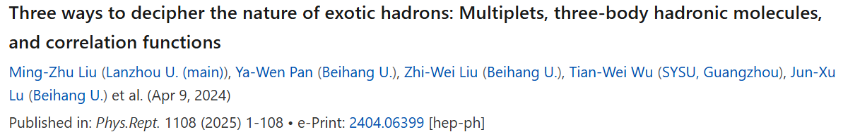
Three ways to decipher the nature of hadronic molecules
Li-Sheng Geng（耿立升）@ Beihang U.

Slide 2
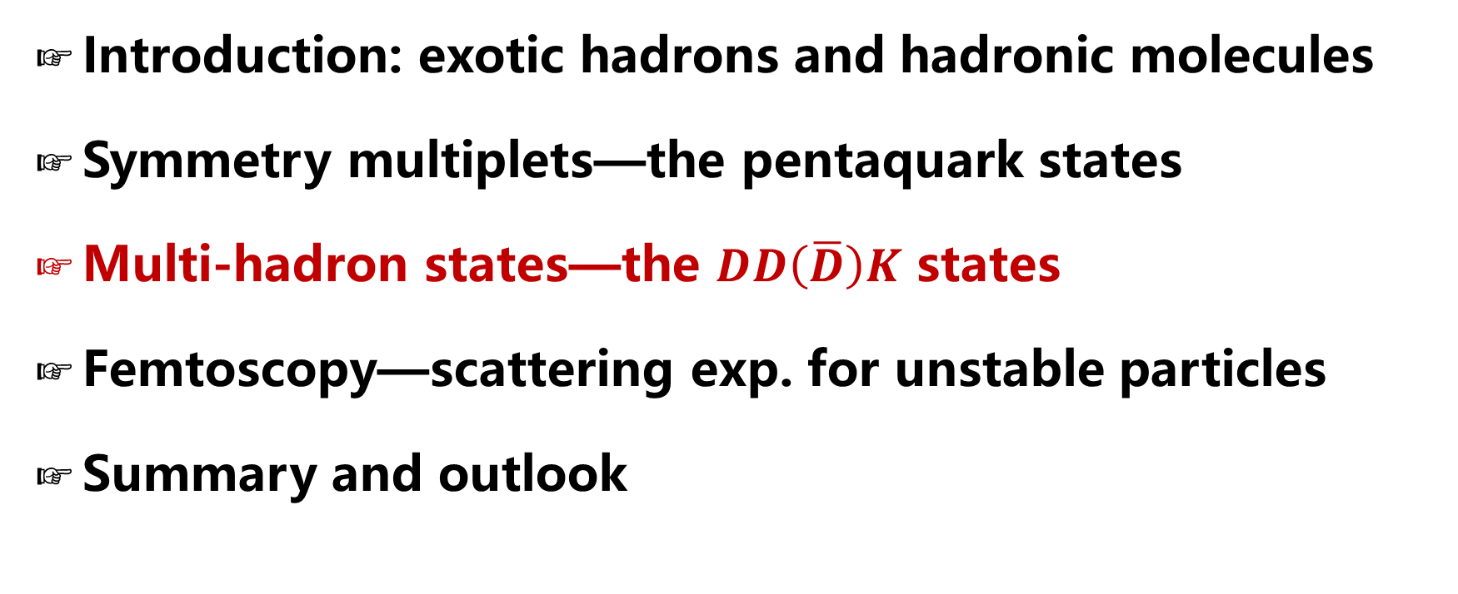
Contents
Introduction: exotic hadrons and hadronic molecules
Symmetry multiplets—the pentaquark states
Multi-hadron states—the $DD\left(\overline{D}\right)K$ states
Femtoscopy—scattering exp. for unstable particles
Summary and outlook

Slide 3
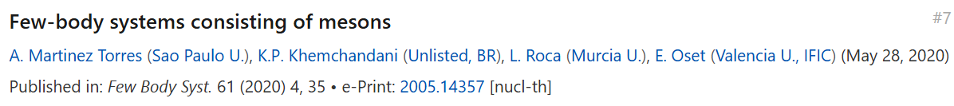
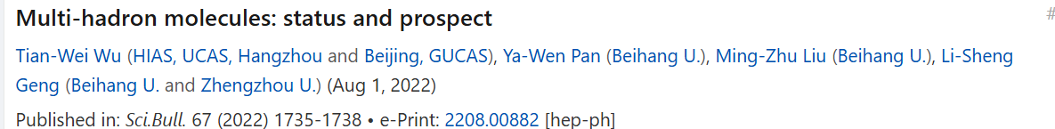

Slide 4
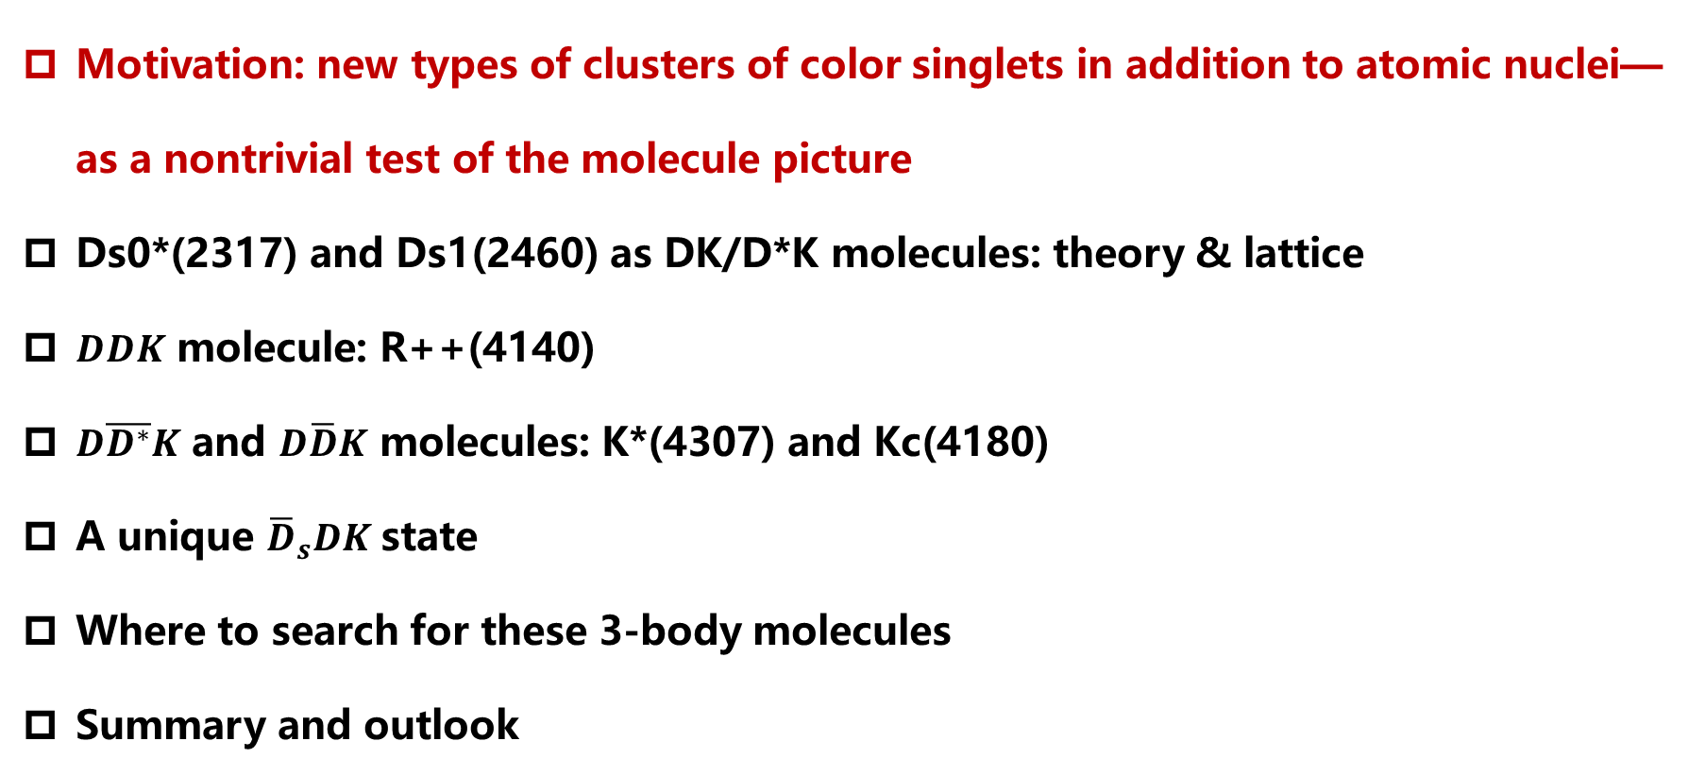
Lecture II contents
Motivation: new types of clusters of color singlets in addition to atomic nuclei—as a nontrivial test of the molecule picture
Ds0*(2317) and Ds1(2460) as DK/D*K molecules: theory & lattice
$DDK$ molecule: R++(4140)
$D\overline{D^{∗}}K$ and $D\overline{D}K$ molecules: K*(4307) and Kc(4180)
A unique ${\overline{D}}_{s}DK$state
Where to search for these 3-body molecules
Summary and outlook

Slide 5
+
+
alpha
+
triton
+
deuteron
Notes:
这可以从核物理的研究中得到启示

Slide 6
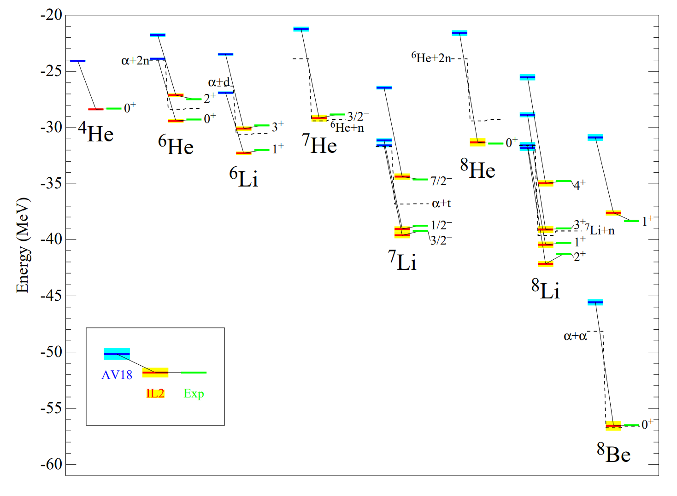
Quantum Monte Carlo Calculations of light Nuclei
Annu. Rev. Nucl. Part. Sci. 2001. 51:53–90

Slide 7
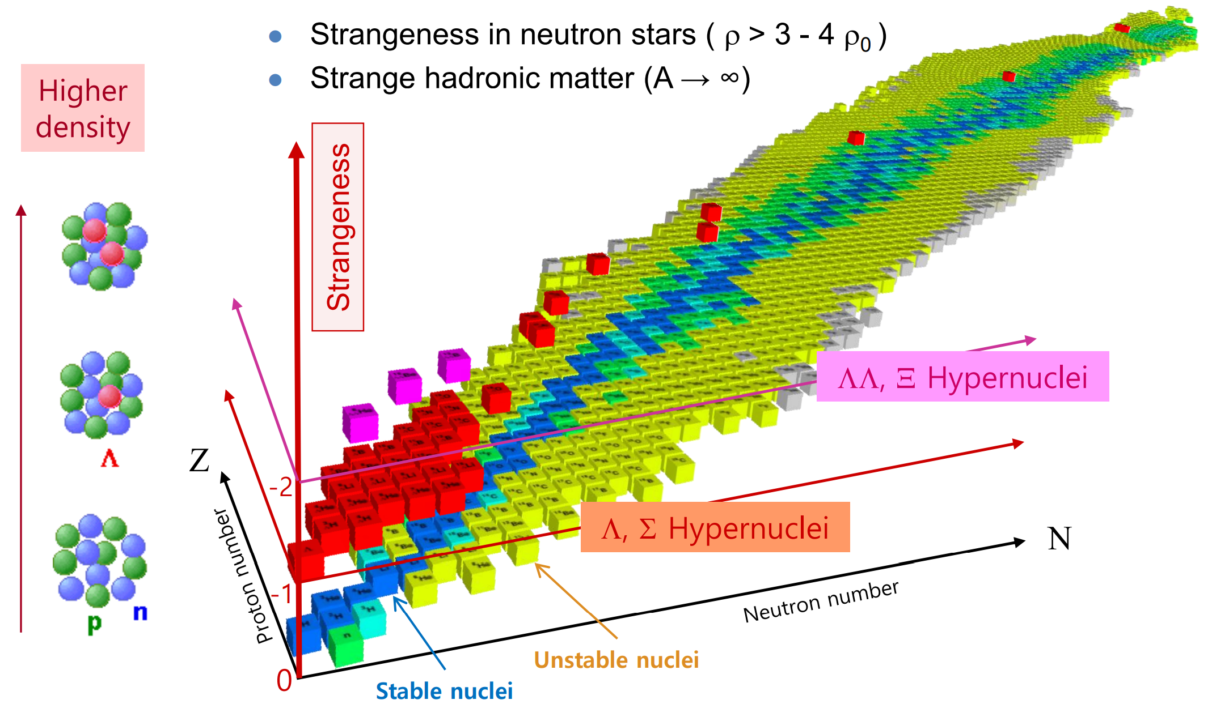
Adding hyperons→ the 3-D nuclear chart

Slide 8
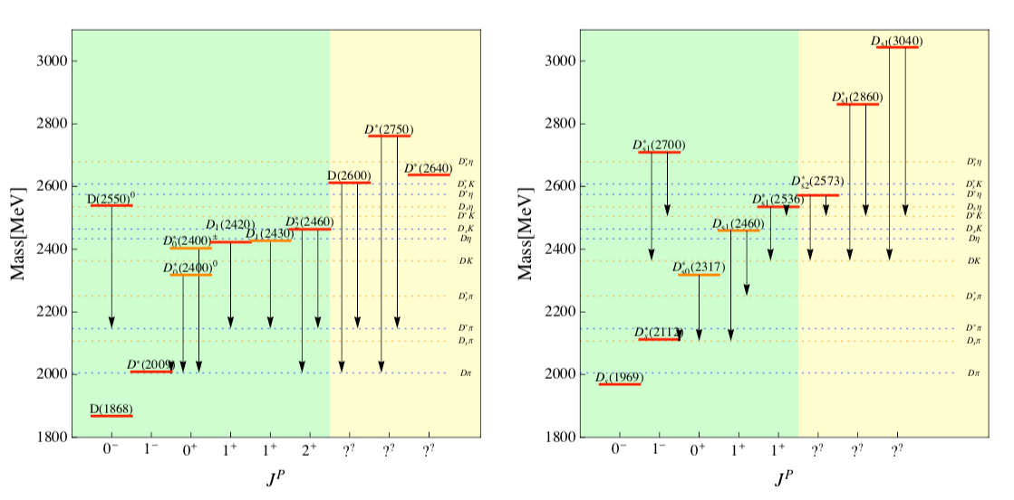
Next best two-body molecule candidates
adding charm
Ds0*(2317)
Ds1(2460)

Slide 9
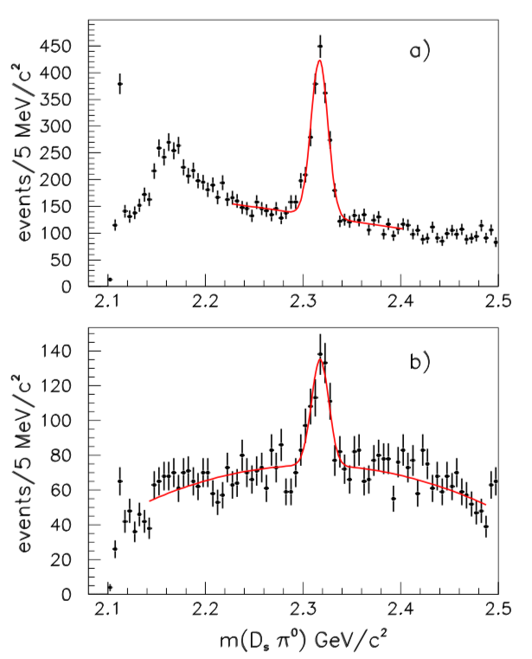
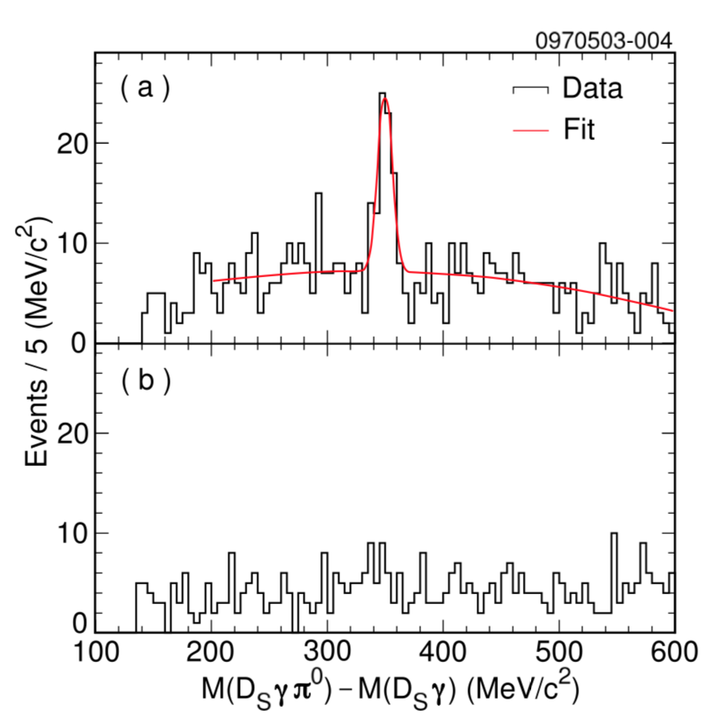
Discovery channels
Ds0*(2317)
Ds1(2460)
BaBar PRL90,242001(2003)
CLEO PRD68,032002(2003)
Notes:
Ds0*(2317): BaBar, confirmed by CLEO
Ds0*(2460): indicated by BaBar, discovered by CLEO

Slide 10
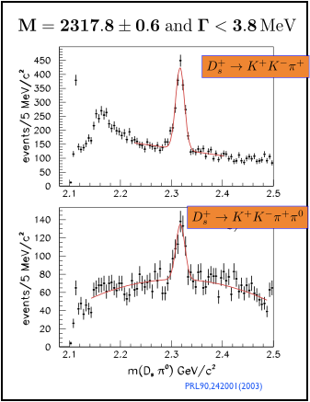

What are special about these two states
BaBar
160/70 MeV lower than the GI quark model predictions--difficult to be understood as conventional csbar states.
“Dynamically generated” from strong DK interaction
  E. E. Kolomeitsev 2004,
  F. K. Guo 2006,
  D. Gamermann 2007
827 citations (20180911)
Feng-Kun Guo, EPJ Web of Conferences 202, 02001 (2019)

Slide 11
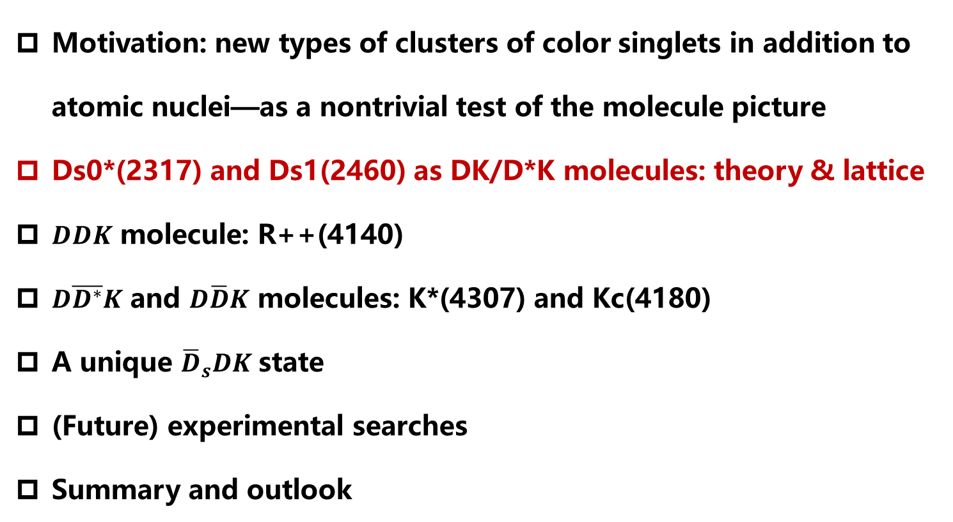
Contents
Motivation: new types of clusters of color singlets in addition to atomic nuclei—as a nontrivial test of the molecule picture
Ds0*(2317) and Ds1(2460) as DK/D*K molecules: theory & lattice
$DDK$ molecule: R++(4140)
$D\overline{D^{∗}}K$ and $D\overline{D}K$ molecules: K*(4307) and Kc(4180)
A unique ${\overline{D}}_{s}DK$state
(Future) experimental searches
Summary and outlook

Slide 12
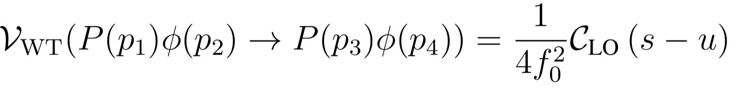
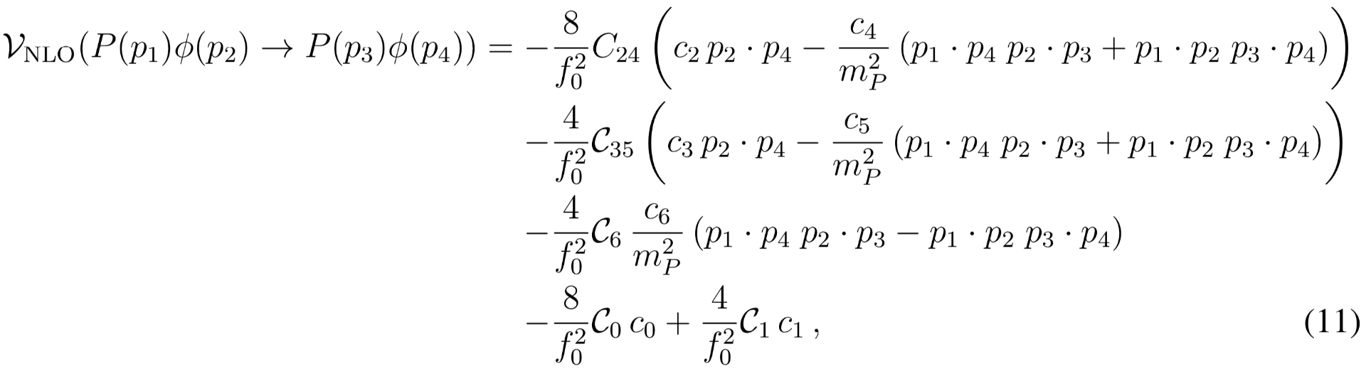
UChPT in Bethe-Salpeter equation
Altenbuchinger, Geng, Weise, PRD89 (2014)014026
Model independent DK interaction from ChPT
Weinberg-Tomazawa
Resumed in the Bethe-Salpeter equation (two-body elastic unitarity)
Notes:
Chiral perturbation theory is the Low energy effective field theory of QCD

Slide 13
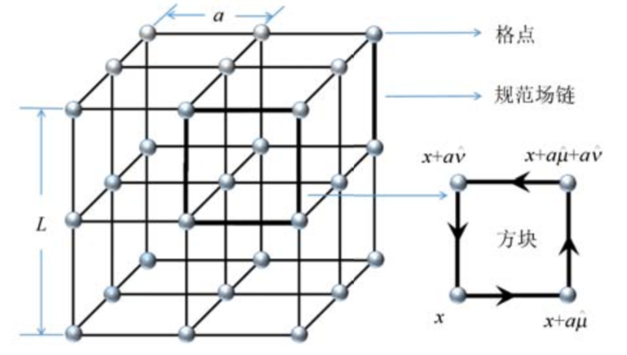
Fixing the LECs using latest LQCD* data
Altenbuchinger, Geng, Weise, PRD89 (2014)014026
NLO ChPT kernel: 5 LECs
A quite good description of the 20 Lattice scattering lengths of pseudoscalar mesons and D mesons （I=0 DK excluded） can be achieved.

Slide 14
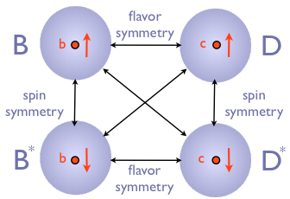
Ds0 and Ds1 dynamically generated
Altenbuchinger, Geng, Weise, PRD89 (2014)014026
Charm sector
“Post-diction”
Bottom Sector

Slide 15
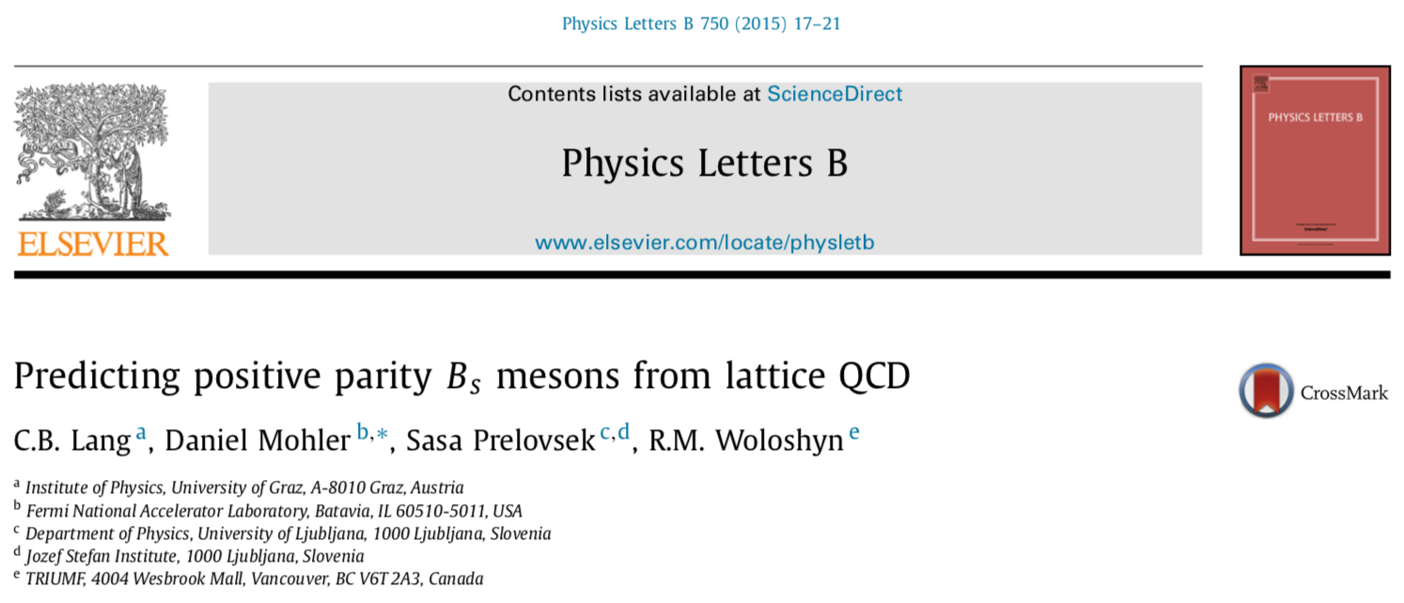
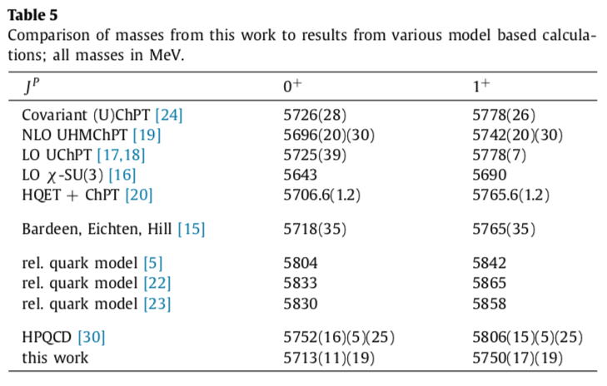
Predicted Bs0 and Bs1 states
Altenbuchinger, Geng, Weise, PRD89 (2014)014026
In agreement with lQCD

Slide 16
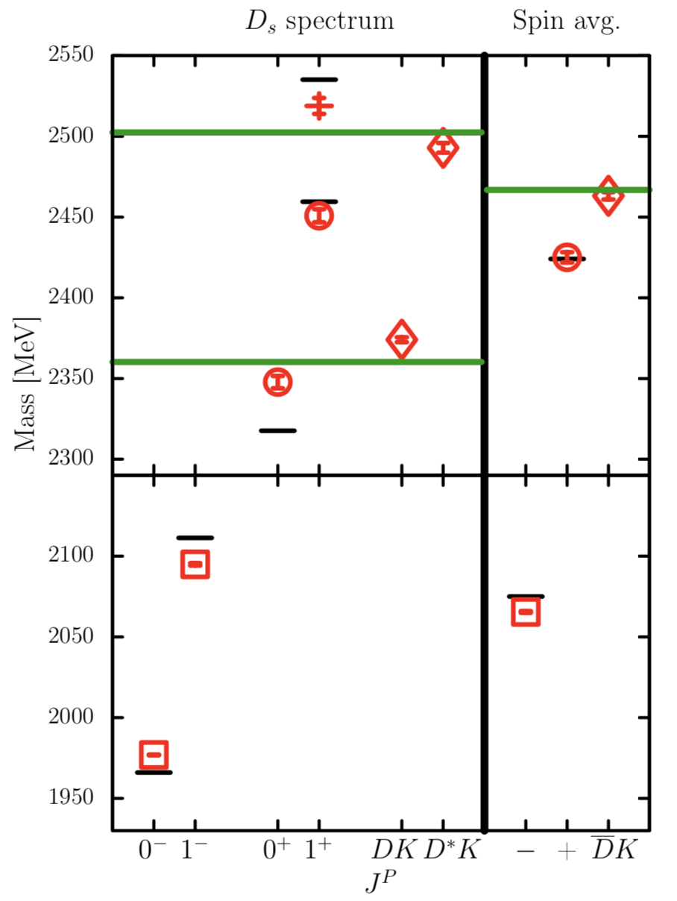
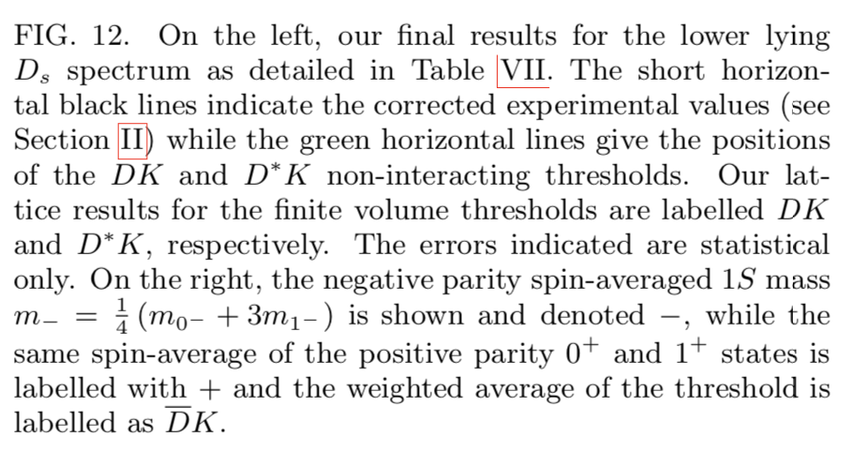
More support from recent lQCD studies
G.K.C. Cheung et al., arXiv:2008.06432[hep-lat].
G. S. Bali et al., arXiv:1706.01247 [hep-lat].
C. B. Lang et al., arXiv:1403.8103 [hep-lat].
D. Mohler et al., arXiv:1308.3175 [hep-lat].
“DK components substantial”
See as well Miguel Albaladejo et al. arXiv:1805.07104

Slide 17
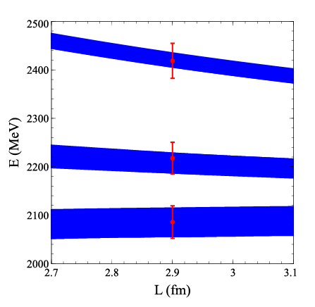
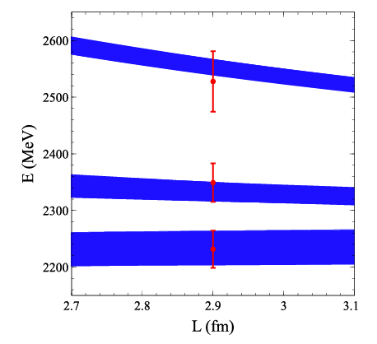
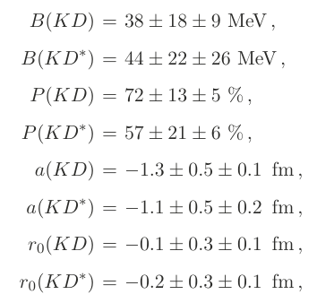
Many re-analyses of the lattice finite volume data
Torres, Oset, Prelovsekc, and Ramos，JHEP 05 (2015) 153

Slide 18
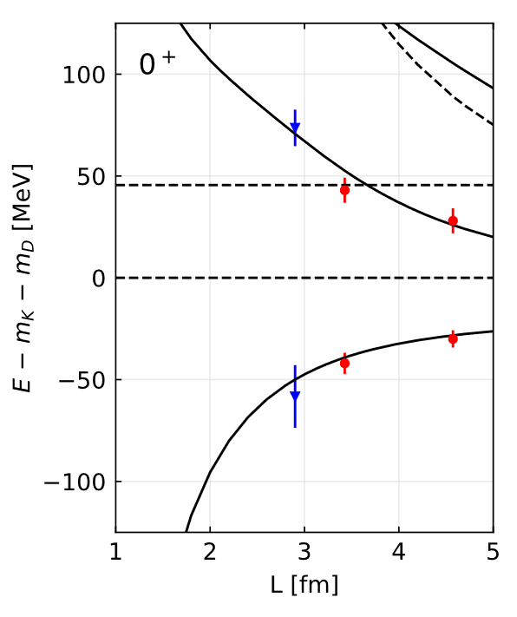
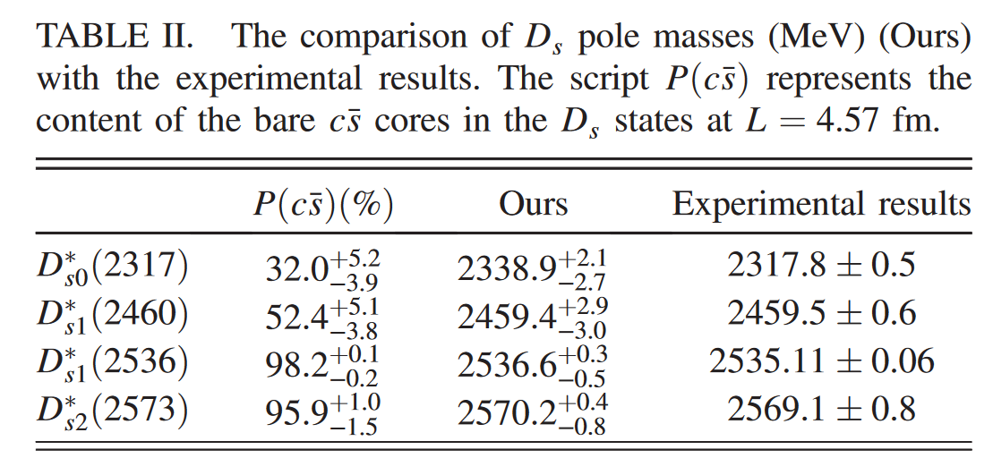


Support from LQCD+unquenched QM
Yang, Wang, Wu, Oka, Zhu,
Phys. Rev. Lett. 128, 112001 (2022)
$$M\left(D_{s1}(2460)\right)−M\left(D_{s0}(2317)\right)=120‼!$$
$DK$ about 70%

Slide 19
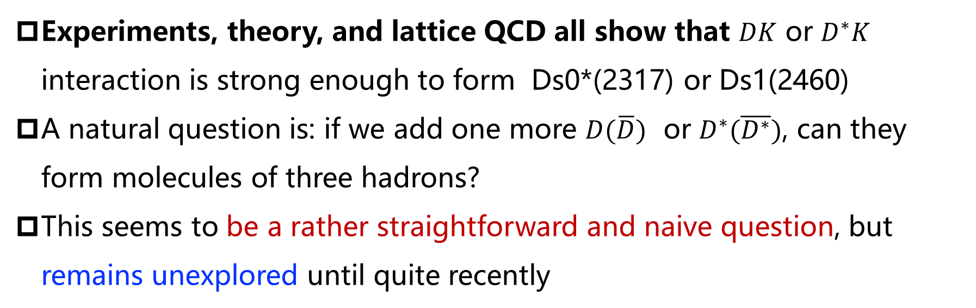
Further tests of the DK interaction
Experiments, theory, and lattice QCD all show that $DK$ or $D^{∗}K$ interaction is strong enough to form Ds0*(2317) or Ds1(2460)
A natural question is: if we add one more $D(\overline{D})$ or $D^{∗}(\overline{D^{∗}})$, can they form molecules of three hadrons?
This seems to be a rather straightforward and naive question, but remains unexplored until quite recently

Slide 20
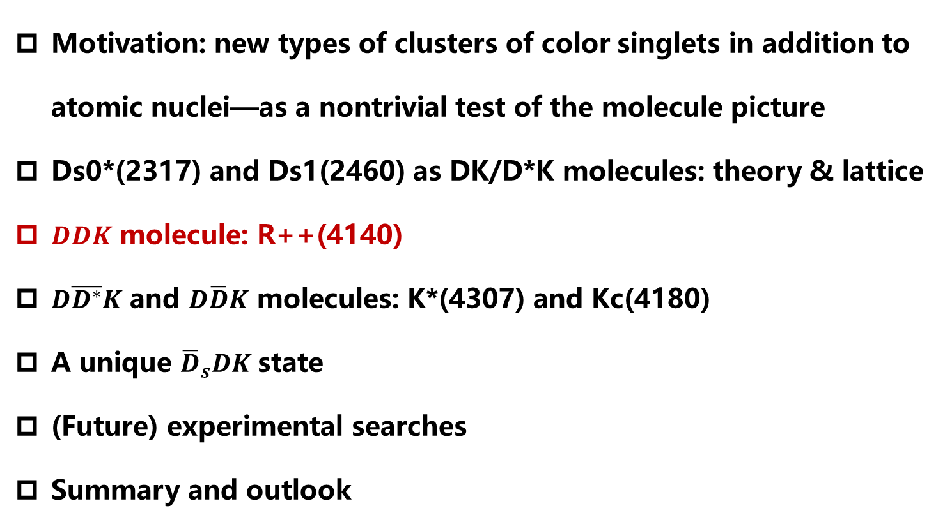
Contents
Motivation: new types of clusters of color singlets in addition to atomic nuclei—as a nontrivial test of the molecule picture
Ds0*(2317) and Ds1(2460) as DK/D*K molecules: theory & lattice
$DDK$ molecule: R++(4140)
$D\overline{D^{∗}}K$ and $D\overline{D}K$ molecules: K*(4307) and Kc(4180)
A unique ${\overline{D}}_{s}DK$state
(Future) experimental searches
Summary and outlook

Slide 21
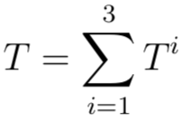
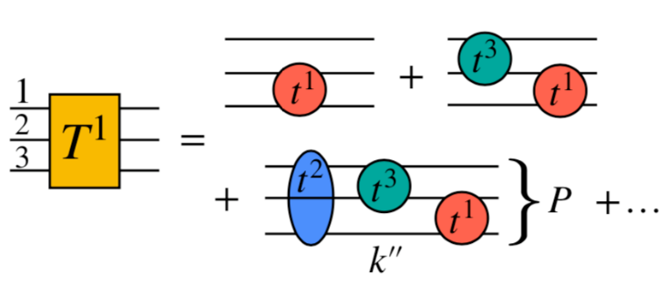
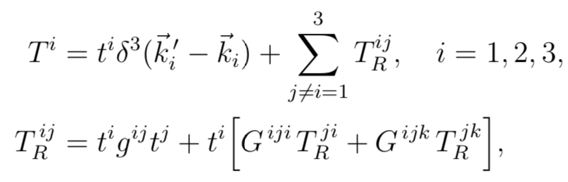
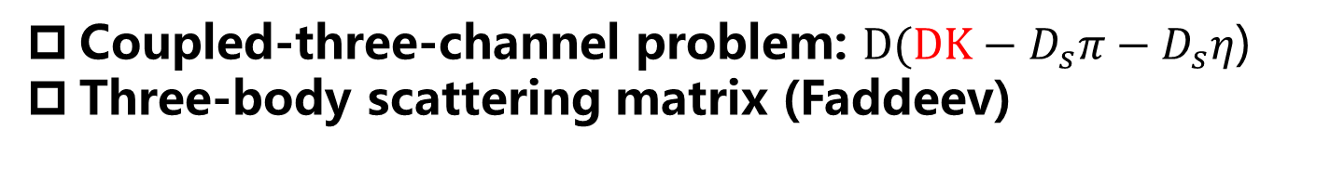
An explicit three-body study of DDK
Torres, Khemchandani, Geng, PRD99, 076017 (2019)
Coupled-three-channel problem: $D(DK−D_{s}π−D_{s}η$)
Three-body scattering matrix (Faddeev)
A. Martínez Torres, K. P. Khemchandani, and E. Oset PRC 77, 042203(R)
A. Martinez Torres, K.P. Khemchandani, LSG, M. Napsuciale, E. Oset, PRD78 (2008) 074031

Slide 22

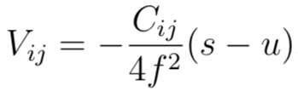
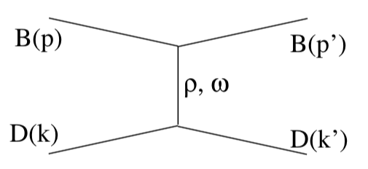
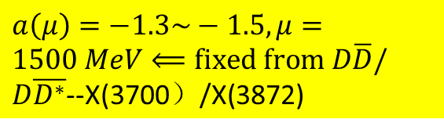
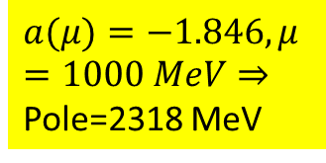
Two-body inputs
Torres, Khemchandani, Geng, PRD99, 076017 (2019)
DK: leading order UChPT
$$a(μ)=−1.846, μ=1000 MeV⇒$$
Pole=2318 MeV
F.-K. Guo, P.-N. Shen, H.-C. Chiang, R.-G. Ping, and B.-S. Zou, PL B641, 278 (2006).
DD(Ds): local hidden gauge theory
$a\left(μ\right)=−1.3\sim −1.5, μ=1500 MeV⟸\text{fixed} \text{from} D\overline{D}/D\overline{D^{∗}}$--X(3700）/X(3872)
S. Sakai, L. Roca, and E. Oset, PRD96, 054023 (2017).

Slide 23
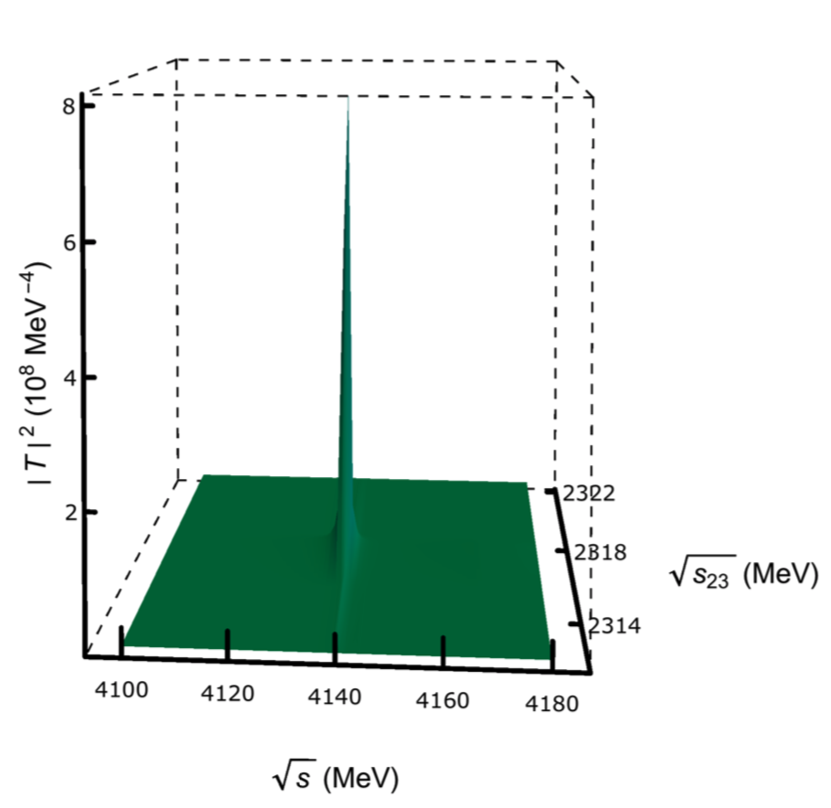
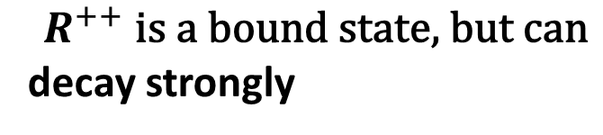

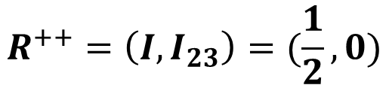
Three-body amplitudes
Torres, Khemchandani, Geng, PRD99, 076017 (2019)
$$R^{++}=（I,I_{23}）=(\frac{1}{2},0)$$
$$R^{+}\text{should} \text{also} \text{exist}$$
$$R^{++} \text{is} \text{a} \text{bound} \text{state}\text{,} \text{but} \text{can}$$
decay strongly

Slide 24
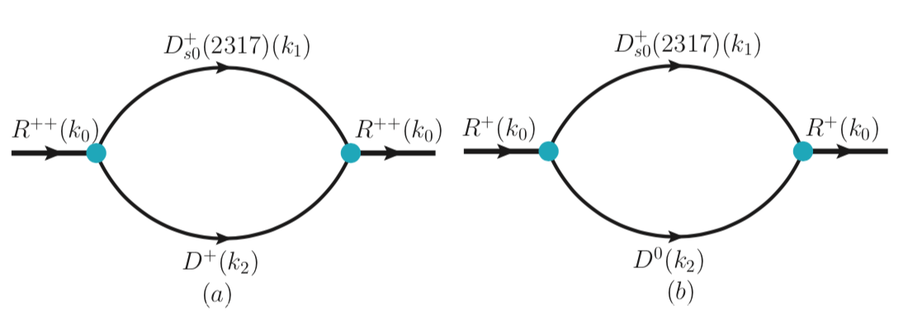
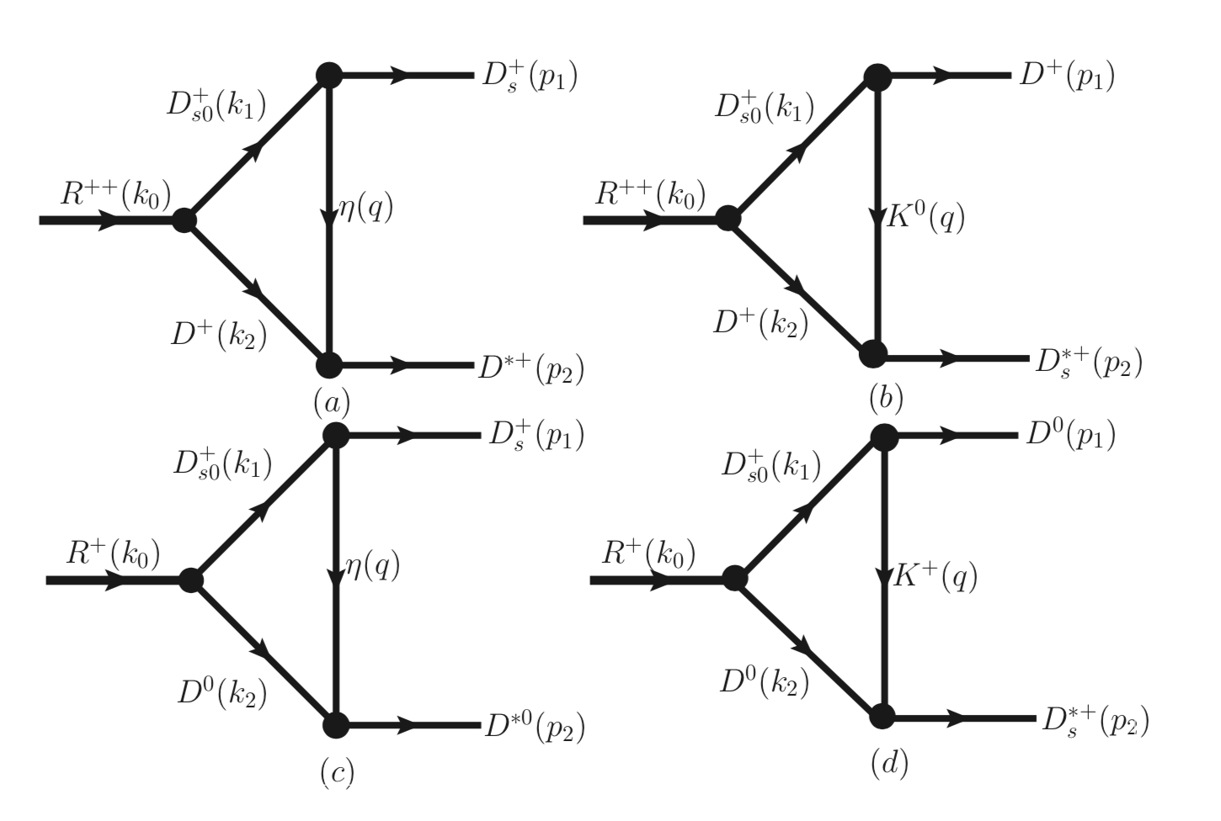
Two-body decay width
Huang , Liu, Pan, Geng, Torres, Khemchandan, PRD101, 014022 (2020)
Notes:
It cannot decay into DDK but can decay strongly nevertheless via triangle diagrams shown here

Slide 25
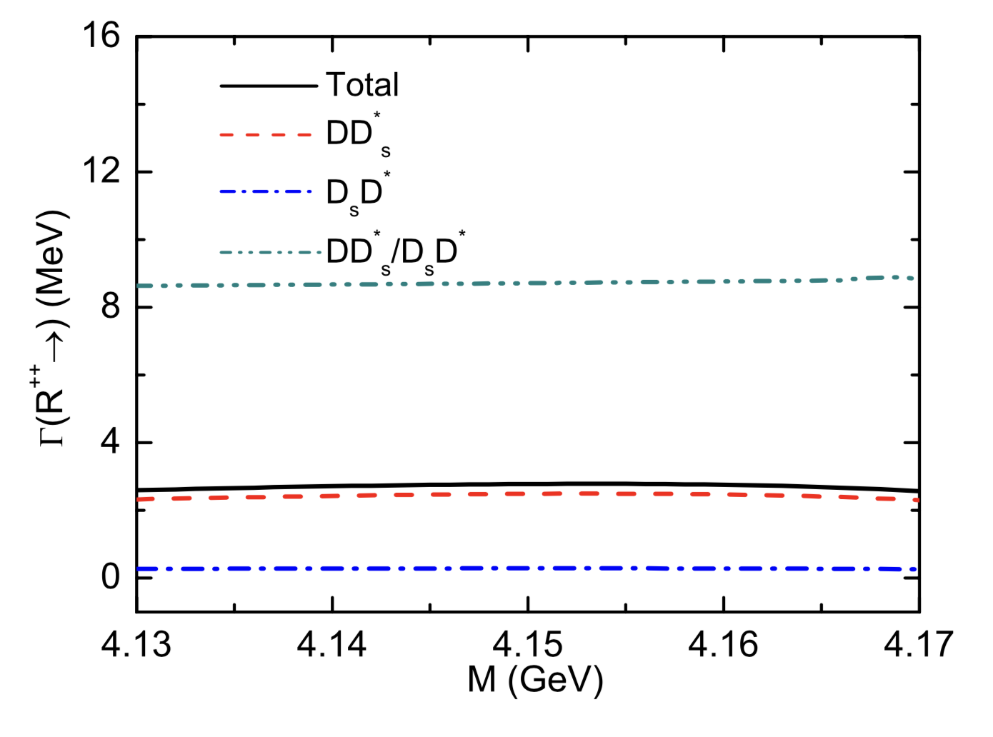
Two-body decay width
Kaon-Exchange Dominant
Huang , Liu, Pan, Geng, Torres, Khemchandan, PRD101, 014022 (2020)

Slide 26
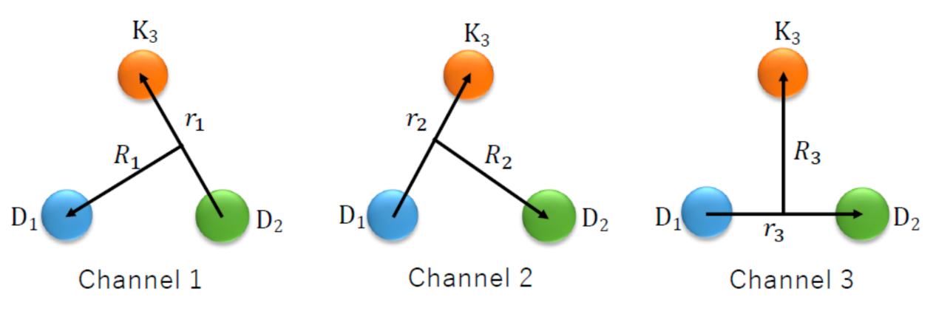
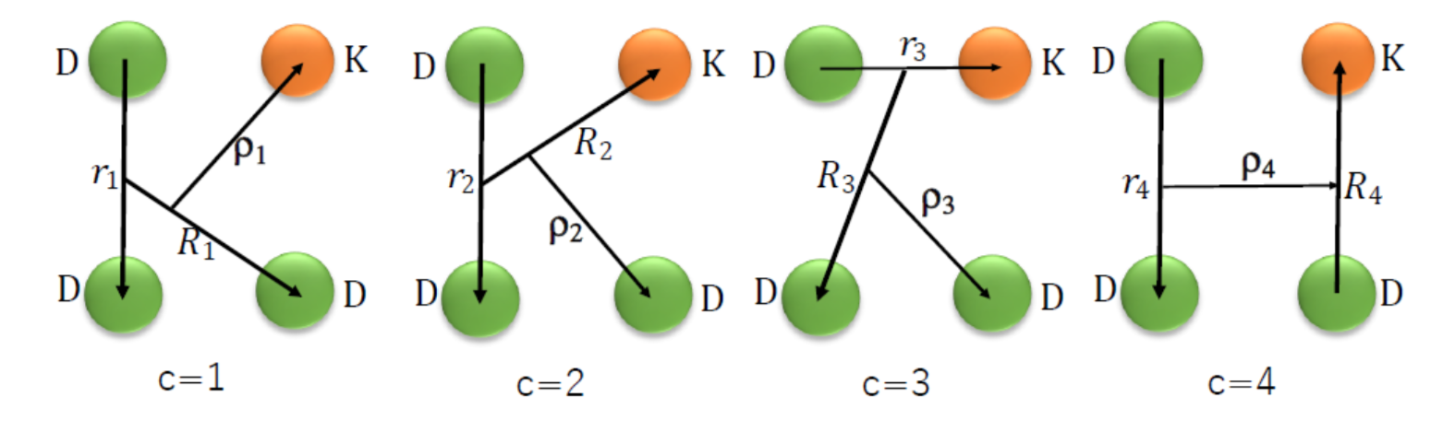
A DDDK state
Wu, Liu, Geng, Hiyama, Valderrama, PRD100, 034029 (2019)
1(0⁺)
What if we add one more D?
Gaussian Expansion Method

Slide 27
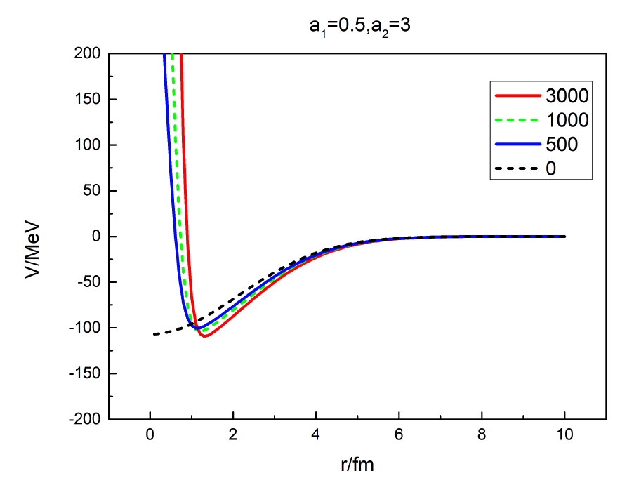
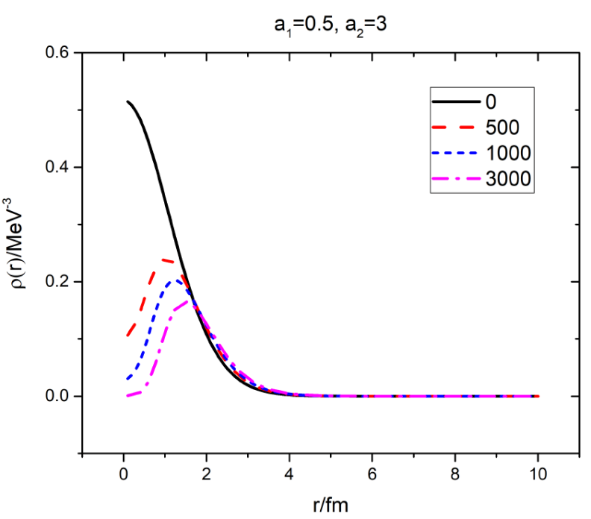

A DDDK state
1(0⁺)
Wu, Liu, Geng, Hiyama, Valderrama, PRD100, 034029 (2019)
Our study shows that a DDDK state exists as well
Uncertainties are at the order of 10-20 MeV
 | DK* | DDK | DDDK
Binding energy | 45 MeV | (67-71) MeV | 91-107 MeV

Slide 28
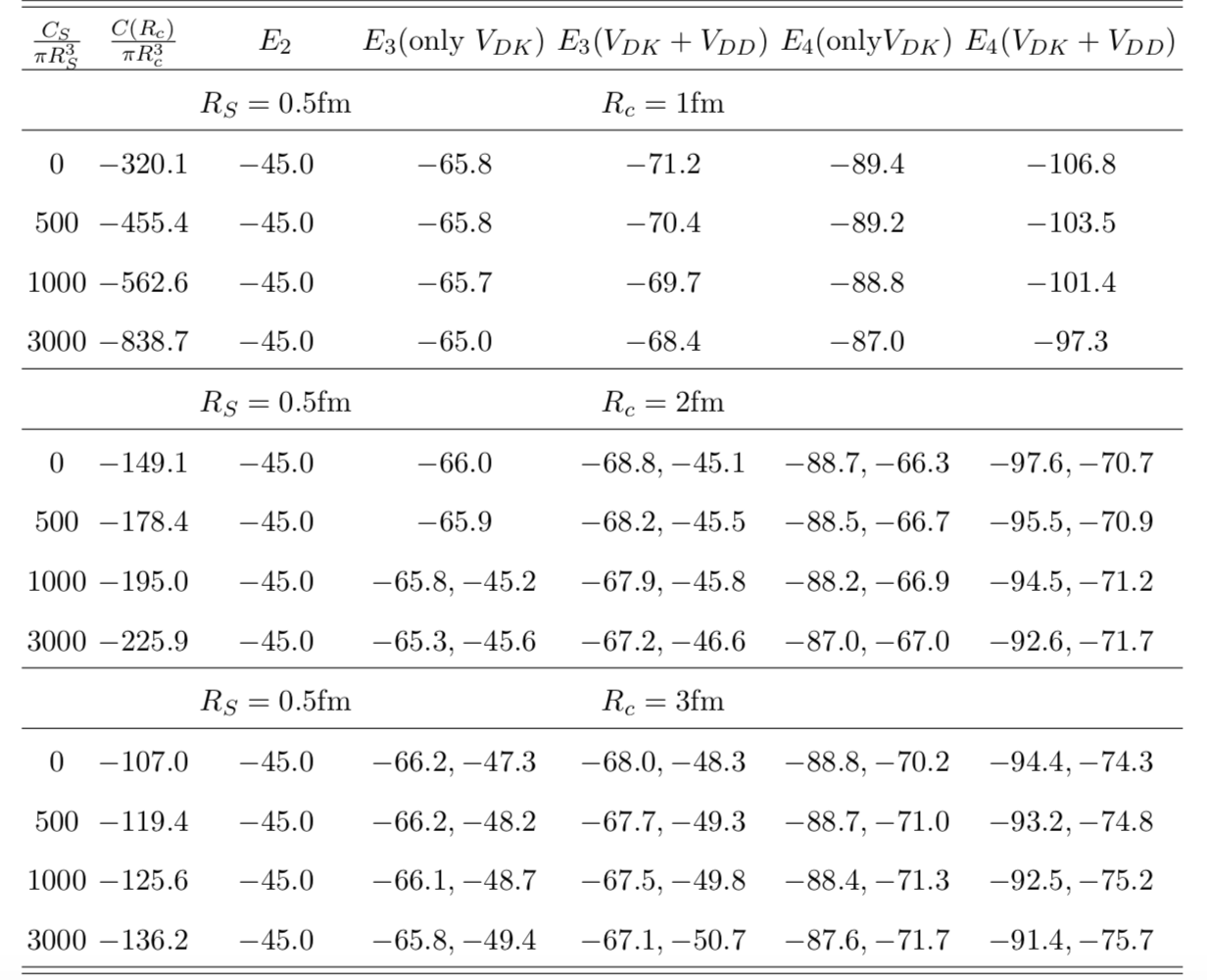
DD interactions play a minor role
Wu, Liu, Geng, Hiyama, Valderrama, PRD100, 034029 (2019)

Slide 29
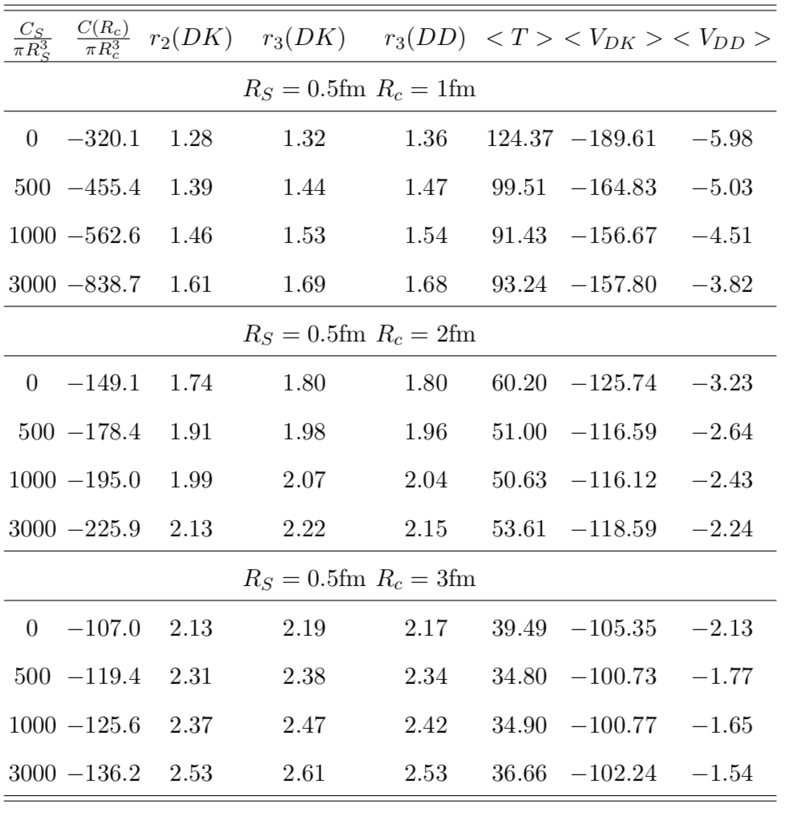
Spatial distributions
Wu, Liu, Geng, Hiyama, Valderrama, PRD100, 034029 (2019)
Ds0*(2317)
1.74 fm
D
K
R(4140)
K
1.8 fm
1.8 fm
D
D
1.8 fm

Slide 30
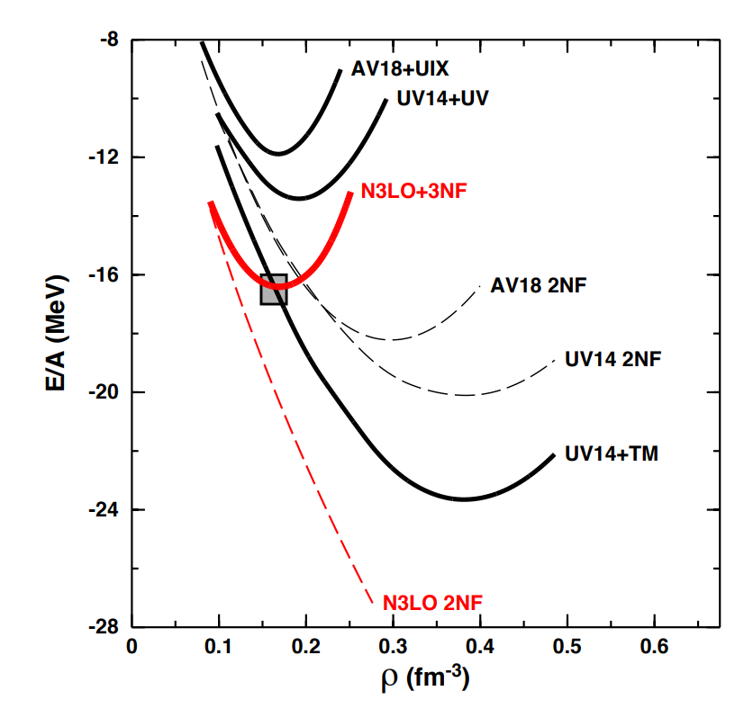
Three-body force—empirical evidence
Annu. Rev. Nucl. Part. Sci. 2001. 51:53–90
Machleidt & Sammarruca 2402.14032

Slide 31
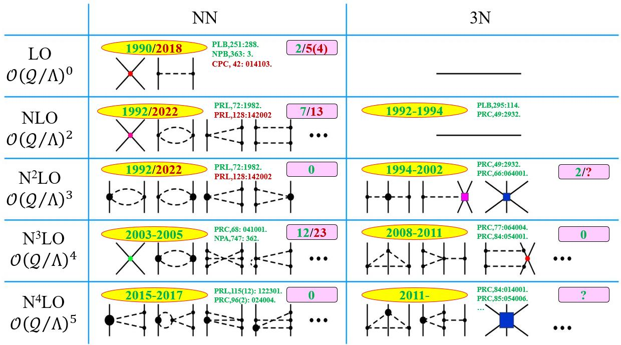
Three-body force—EFT arguments

Slide 32




Adding a three-boby force to the DDK system
Pan, Lu, Hiyama, Geng, Hosaka, 2502.00438
Leading order Lagrangian
$$ℒ_{DD^{∗}K}=c_{3}Tr⁡\left[H𝒟_{μ}H^{†}H𝒟^{μ}H^{†}\right]$$
$$φ=\left(\begin{matrix}\frac{π^{0}}{\sqrt{2}}+\frac{η}{\sqrt{6}} & π^{+} & K^{+} \\ π^{−} & −\frac{π^{0}}{\sqrt{2}}+\frac{η}{\sqrt{6}} & K^{0} \\ K^{−} & K^{0} & −\frac{2η}{\sqrt{6}}\end{matrix}\right)$$
$$𝒟_{μ}={\vec{∂}}_{μ}−{\overset{←}{∂}}_{μ}+{\left(u^{†}∂_{μ}u+u∂_{μ}u^{†}\right)}/2$$
$H_{a}=P_{a}+V_{a}⋅σ,$ $P_{a}={\left({D^{0} \atop D^{+}}\right)}_{a}, V_{a}={\left({D^{∗0} \atop D^{∗+}}\right)}_{a}$
Momentum space potential
$$V_{DD^{∗}K}=\frac{c_{3}}{4f_{π}^{2}}\left(p_{1}+p_{1}^{′}+p_{2}+p_{2}^{′}\right)\left(p_{3}+p_{3}^{′}\right)$$
Coordinate space potential
$$V_{DD^{∗}K}(r,R)=C\frac{e^{−r^{2}/a_{1}}}{π^{3/2}a_{1}^{3}}\frac{e^{−R^{2}/a_{2}}}{π^{3/2}a_{2}^{3}}$$

Slide 33

Adding a three-boby force to the DDK system
Pan, Lu, Hiyama, Geng, Hosaka, 2502.00438
Motivated by Qian Wang and others and in agreement with their results

Slide 34

Distance between the particle pairs
Pan, Lu, Hiyama, Geng, Hosaka, 2502.00438

Slide 35

Effective potential between K and the DD* pair
Pan, Lu, Hiyama, Geng, Hosaka, 2502.00438

Slide 36

Contents
Motivation: new types of clusters of color singlets in addition to atomic nuclei—as a nontrivial test of the molecule picture
Ds0*(2317) and Ds1(2460) as DK/D*K molecules: theory & lattice
$DDK$ molecule: R++(4140)
$D\overline{D^{∗}}K$ and $D\overline{D}K$ molecules: K*(4307) and Kc(4180)
A unique ${\overline{D}}_{s}DK$state
(Future) experimental searches
Summary and outlook

Slide 37

Instead of a $D,$ adding a $\overline{D^{∗}}$ to the DK pair
Ren, Malabarba, Geng,Khemchandanie, Torres, PLB 785(2018)112
Fixed center approximation (FCA):
$$K\left(D\overline{D^{∗}}+\overline{D}D^{∗}\right)\sim KX\left(3872\right)/Zc(3900)$$
Notes:
.

Slide 38


K*(4307)
Ren, Malabarba, Geng,Khemchandanie, Torres, PLB 785(2018)112
Treating KX and KZ as coupled channel systems
A resonance with M=(4307 ± 2) − i(9 ± 2) MeV with I(J^{P} ) = 1/2(1⁻)
In agreement with Li Ma, Qian Wang, Ulf-G. Meißner, 1711.06143, but with completely different dynamics

Slide 39


Instead of a $D,$ adding a $\overline{D}$ to the DK pair
Wu, Liu, and Geng, PRD103 (2021) L031501
The Three Musketeers
Kc(4180)
K*(4307)
R(4140)

Slide 40


$K_{c}(4180)$ decay
Wu, Liu, and Geng, PRD103 (2021) L031501
~1 MeV
~1 MeV

Slide 41
K*(4307)/Kc(4180)—bosonic counterpart of Pc
but with 3 constituents
Pentaquark (N*) by LHCb
Phys.Rev.Lett. 115 (2015) 072001
Prediction of narrow N* and Λ* resonances with hidden charm above 4 GeV,
Jia-Jun Wu, R. Molina, E. Oset, B.S. Zou, 1007.0573

Slide 42

Analogy between $KD$ and $\overset{̿}{K}N$
$$Λ(1405)$$
DK bound state
Dynamically generated--Unitary heavy hadron chiral perturbation theory
N-Kbar bound state
Dynamically generated--Unitary baryon chiral perturbation theory
The interaction between a kaon and a heavy particle seems to play an important role

Slide 43

“Current” status on “$K^{−}pp$”
A. Dote, Menu2019
J-PARC E27
DISTO
J-PARC E15
Faddeev-AGS
Pheno. pot. (E-indep.)
Variational (Gauss)
Pheno. pot. (E-indep.)
FINUDA
Variational (Gauss)
Chial. pot. (E-dep.)
Faddeev-AGS
Chiral pot. (E-dep.)

Slide 44



$\overline{K}NN$ in our framework vs. more refined study
$NN$: OPE fixed by reproducing the deuteron
$\overline{K}N$: Weinberg-Tomozawa fixed by reproducing $Λ(1405)$
Variational method
20-40 2.09-2.26 1.85-2.01
Akinobu Dote, Tetsuo Hyodo , Wolfram Weise, 0806.4917 [nucl-th], PRC 79 (2009)014003

Slide 45

Contents
Motivation: new types of clusters of color singlets in addition to atomic nuclei—as a nontrivial test of the molecule picture
Ds0*(2317) and Ds1(2460) as DK/D*K molecules: theory & lattice
$DDK$ molecule: R++(4140)
$D\overline{D^{∗}}K$ and $D\overline{D}K$ molecules: K*(4307) and Kc(4180)
A unique ${\overline{D}}_{s}DK$state
Where to search for these 3-body molecules
Summary and outlook

Slide 46


Why ${\overline{D}}_{s}DK$ is different
✓ Study on three-body systems with C-parity
C-parity interaction included
✓ No mixture of conventional hadrons
${ 0}^{−−}$ exotic quantum numbers
✓ Two-body system can not bind
Suppressed by the OBE model or OZI rule
✓ Produced in both $e^{+}e^{−}$and pp collisions
Hidden charm/strange state easier to observe

Slide 47







Wave function of ${\overline{D}}_{s}DK$ with C parity
Two-body interaction
C-parity interaction

Slide 48


Two-body interactions
DK interaction parameterized by a constant $C_{a}$
with Contact-range EFT approach
${DK−D}_{s}η$ coupled channel interaction in matrix form
$V_{DK}$ in a Gaussian form in coordinate space
With SU(3) flavor symmtry and experimental fitting

Slide 49




DK interaction fitting $D_{S0}(2317)$
Considering $D_{S0}(2317)$ as a ${DK−D}_{s}η$ molecule +c$\overline{s}$ state
Momentum space
100% molecule
70 % molecule+30 % $c\overline{s}$
Coordinate space
${DK−D}_{s}η>$c$\overline{s}$ $BDK$ < 45 MeV

Slide 50






C-parity interaction
η exchange potential
simplified as

Slide 51






C-parity interaction
$${\overline{D}}_{s}$$
?
$$D_{s}$$
$$D$$
$$\overline{D}$$
$$K$$
$$\overline{K}$$
η exchange potential
simplified as

Slide 52




Binding, weights and spatial structure
${0^{−−} \overline{D}}_{s}DK$ molecule: X(4310)
Mainly contributed by
Cutoff

Slide 53





Comparion with $0^{−+}$
${0^{−+} \overline{D}}_{s}DK$ molecule: 4304 MeV
${0^{−+} \overline{D}}_{s}DK:$ coupling with $c\overline{c}$and${ \overline{D}}_{s}D_{s0}^{∗}$
${0^{−−} \overline{D}}_{s}DK:$ no coupling with ${c\overline{c} and \overline{D}}_{s}D_{s0}^{∗}$

Slide 54




Decays of ${0^{−−} \overline{D}}_{s}DK$ molecule X(4310)
Triangle diagrams of the strong decays

Slide 55






Productions of ${0^{−−} \overline{D}}_{s}DK$ molecule
${0^{−−} \overline{D}}_{s}DK$ molecule:
Production rate:

Slide 56





Partial decay widths
Dominant decay:

Slide 57

Hints at LHCb
LHCb, Phys. Rev. Lett. 133,131902(2024)

Slide 58

Hints at LHCb
LHCb, Phys. Rev. Lett. 133,131902(2024)

Slide 59

Estimation of events at LHC
BaBar, Phys. Rev. D 83, 032004(2011)
LHCb, Phys. Rev. Lett. 133,131902(2024) 9fb⁻¹
LHCb, JHEP 12, 139 (2020)
Process:
LHC integrated luminosity: 50 fb⁻¹ Events: 10
350 fb⁻¹ 100

Slide 60

Contents
Motivation: new types of clusters of color singlets in addition to atomic nuclei—as a nontrivial test of the molecule picture
Ds0*(2317) and Ds1(2460) as DK/D*K molecules: theory & lattice
$DDK$ molecule: R++(4140)
$D\overline{D^{∗}}K$ and $D\overline{D}K$ molecules: K*(4307) and Kc(4180)
A unique ${\overline{D}}_{s}DK$state
Where to search for these 3-body molecules
Summary and outlook

Slide 61

Search for the DDK bound state by Belle
2008.13341
Notes:
Because of the limited statistics, and the open charm nature of the DDK state, no signal was found and only an upper limit on production yield was given.

Slide 62

Search for the DDK bound state by Belle
2008.13341

Slide 63


Where to search for Kc(4180)
$$Λ_{b}→J/ψKP$$
LHCb:1507.03414: an integrated luminosity of 3 ${fb}^{−1}$

Slide 64


Where to search for Kc(4180)
$$B_{s}→J/ψKK$$
LHCb: 1704.08217: an integrated luminosity of 3 ${fb}^{−1}$

Slide 65


Where to search for Kcc(4180)
$$e^{+}e^{−}→KD^{∗}{\overline{D}}_{s}$$
$$Z_{cs}（3985）$$
BESIII: 2011.07855: an integrated luminosity of 3.7 ${fb}^{−1}$

Slide 66



Where to search for Kc(4180)
a few pb
$${\left(ISR\right) e}^{+}e^{−}→K^{+}K^{−}J/ψ$$
Belle: 1402.6578 : 980${fb}^{−1}$
Notes:
We did not have any signal yet. It should be searched for once more data are accumulated

Slide 67



Where to search for Kcc(4180)
$$e^{+}e^{−}→c\overline{c}$$

Slide 68




Where to search for Kcc(4180)
Wu & Geng, PRD108, 014015 (2023)
$$e^{+}e^{−}→c\overline{c}$$
Production yield of $D_{s0}^{∗}\left(2317\right)\sim {10}^{−3}$
Production yield of $K_{cc}(4180)\sim {10}^{−6}$
can be observed at Belle II

Slide 69

Summary and outlook
Many interpretations exist for newly discovered exotic hadrons and are difficult to distinguish from each other
We proposed a novel way to validate the molecule picture. Taking the Ds0*(2317) as an example, if it is indeed a molecule of DK, then new forms of matter may be built upon them, similar to the build up of the nuclear chart.
We have performed explicit few-body studies–demonstrating that indeed all $DDK,D\overline{D^{∗}}K,D\overline{D}K$ and DDDK states bind
Now we need experimental or lattice QCD confirmations and further theoretical studies on their production and decay mechanisms

Slide 70


Thanks for
your attention
Science Bulletin 67 (2022) 1735–1738

Slide 71

The Tao-te Ching
Laozi (about 571 BC – 470 BC ]
an ancient Chinese thinker, philosopher, writer, and historian, as well as the founder and a key representative of the Daoist school
The Tao produced One; One produced Two; Two produced Three; Three produced All things.

