Slide 1

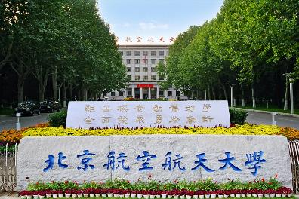

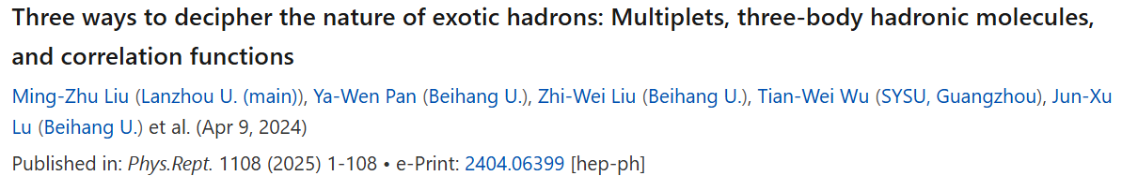
Three ways to decipher the nature of hadronic molecules
Li-Sheng Geng（耿立升）@ Beihang U.

Slide 2
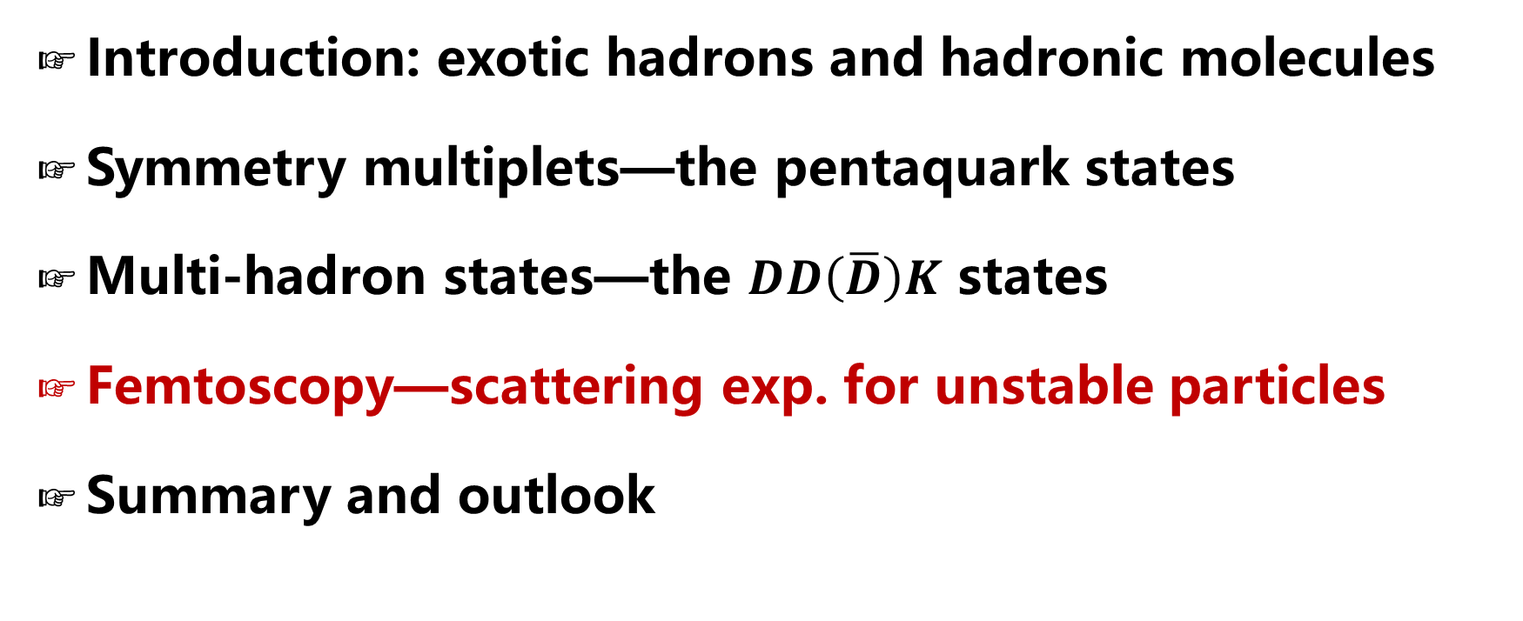
Contents
Introduction: exotic hadrons and hadronic molecules
Symmetry multiplets—the pentaquark states
Multi-hadron states—the $DD\left(\overline{D}\right)K$ states
Femtoscopy—scattering exp. for unstable particles
Summary and outlook

Slide 3
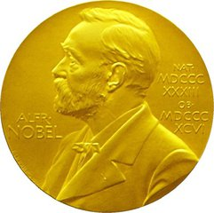
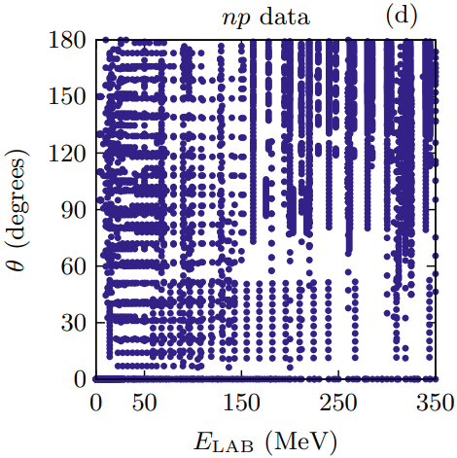
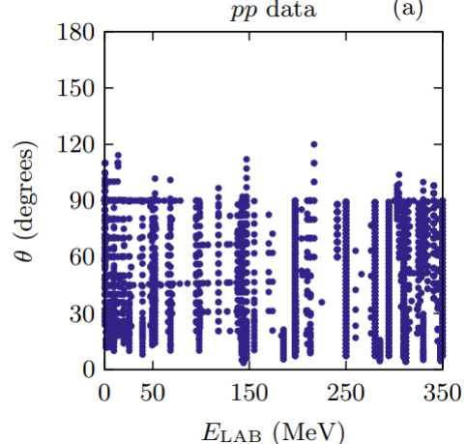
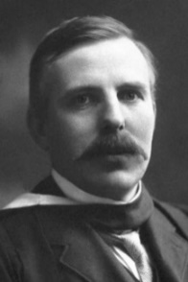
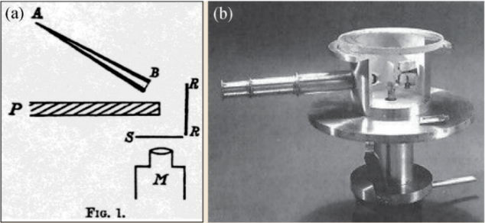
立项依据—传统散射实验
Lecture III—Femtoscopy
For stable hadrons, scattering experiments are extremely valuable in extracting their interactions
NN scattering，8125 data
Foundation of high-precision nuclear force
Ernest Rutherford
Rutherford Scattering Experiment
Notes:
传统上，散射实验是研究相互作用的主要实验方法
最成功的例子是卢瑟福散射实验，其揭示原子的核式结构模型，至今仍然是研究强相互作用的基本手段
例如核子散射实验，8000多个NN散射数据是开展高精度核力研究的坚实基础。
然而，对于不稳定了强子，传统的散射实验非常困难。短寿命的强子，很难产生大量炮弹粒子，也无法制作固定靶。
例如，超子-核子的散射数据只有35个，这也进一步制约了核物理、天体物理领域的发展。

Slide 4
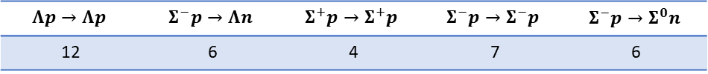
立项依据—传统散射实验
Lecture III—Femtoscopy
For stable hadrons, scattering experiments are extremely valuable in extracting their interactions
NN scattering，8125 data
Foundation of high-precision nuclear force
Ernest Rutherford
Rutherford Scattering Experiment
For unstable particles, direct scattering experiments are impossible!
  Difficult to get large quantity of beam particles
  No fixed targets available
$$Λp→Λp$$ | $$Σ^{−}p→Λn$$ | $$Σ^{+}p→Σ^{+}p$$ | $$Σ^{−}p→Σ^{−}p$$ | $$Σ^{−}p→Σ^{0}n$$
12 | 6 | 4 | 7 | 6
Hyperon-nucleon low energy scattering, 35 data
Hindering hyper-nuclear physics and neutron star studies
Notes:
传统上，散射实验是研究相互作用的主要实验方法
最成功的例子是卢瑟福散射实验，其揭示原子的核式结构模型，至今仍然是研究强相互作用的基本手段
例如核子散射实验，8000多个NN散射数据是开展高精度核力研究的坚实基础。
然而，对于不稳定了强子，传统的散射实验非常困难。短寿命的强子，很难产生大量炮弹粒子，也无法制作固定靶。
例如，超子-核子的散射数据只有35个，这也进一步制约了核物理、天体物理领域的发展。

Slide 5




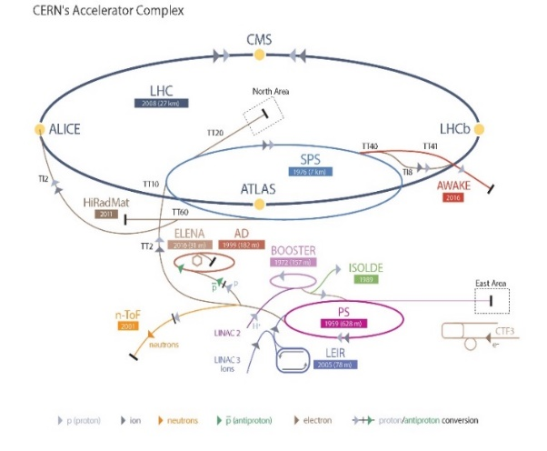
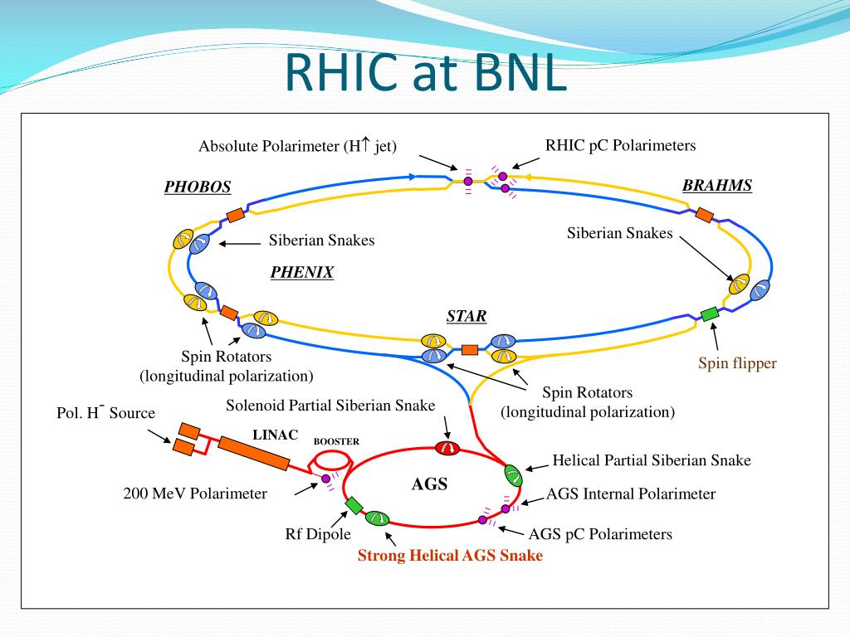
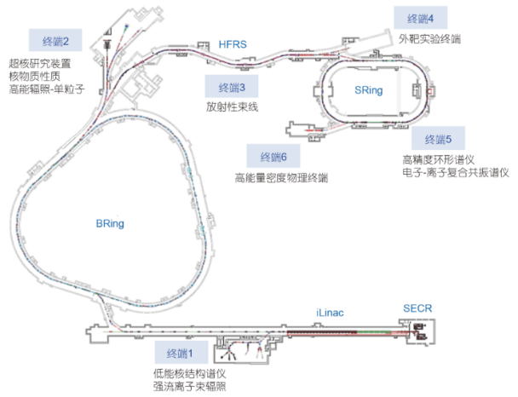
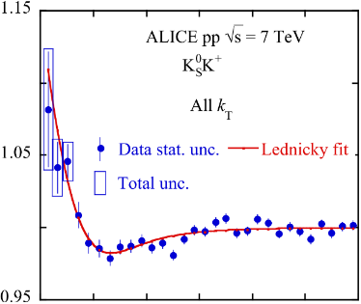
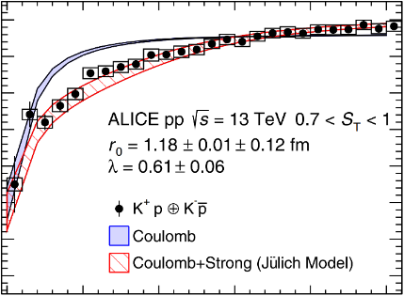
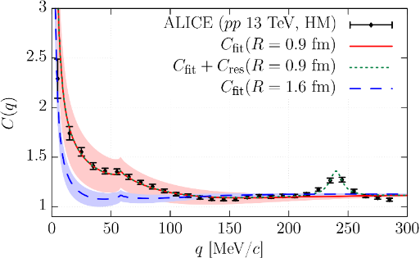
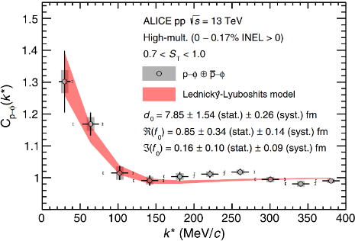
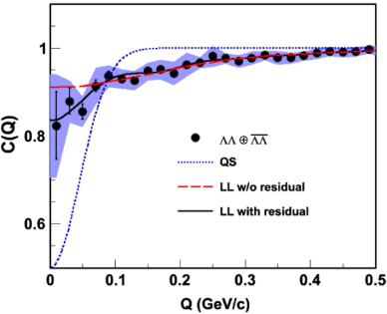
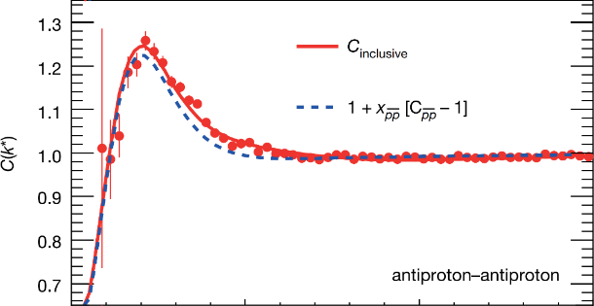
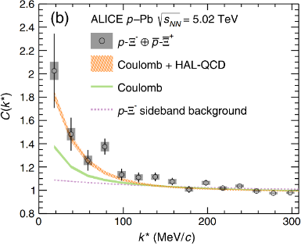
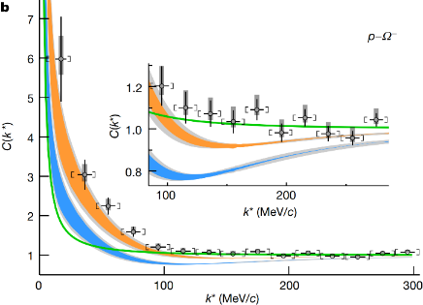
















New probe—femtoscopic correlation functions
$$K_{S}^{0}K^{±}$$
$$K^{±}p$$
$$K^{−}p$$
$$ϕp$$
$$\overline{p}\overline{p}$$
$\text{Λ} \text{Λ}$
$${\text{X}}^{−}p$$
$$^{−}p$$
$$K^{−}d$$
$$Σ^{0}p$$
$$ΛΞ$$
$$ΞΞ$$
$$ΩΩ$$
$$pD$$
$$ppp$$
PLB 2019
PRL 2020
PRL 2020
PRL 2021
Nature 2015
PRL 2015
PRL 2019
Nature 2020
$$ppΛ$$

Slide 6
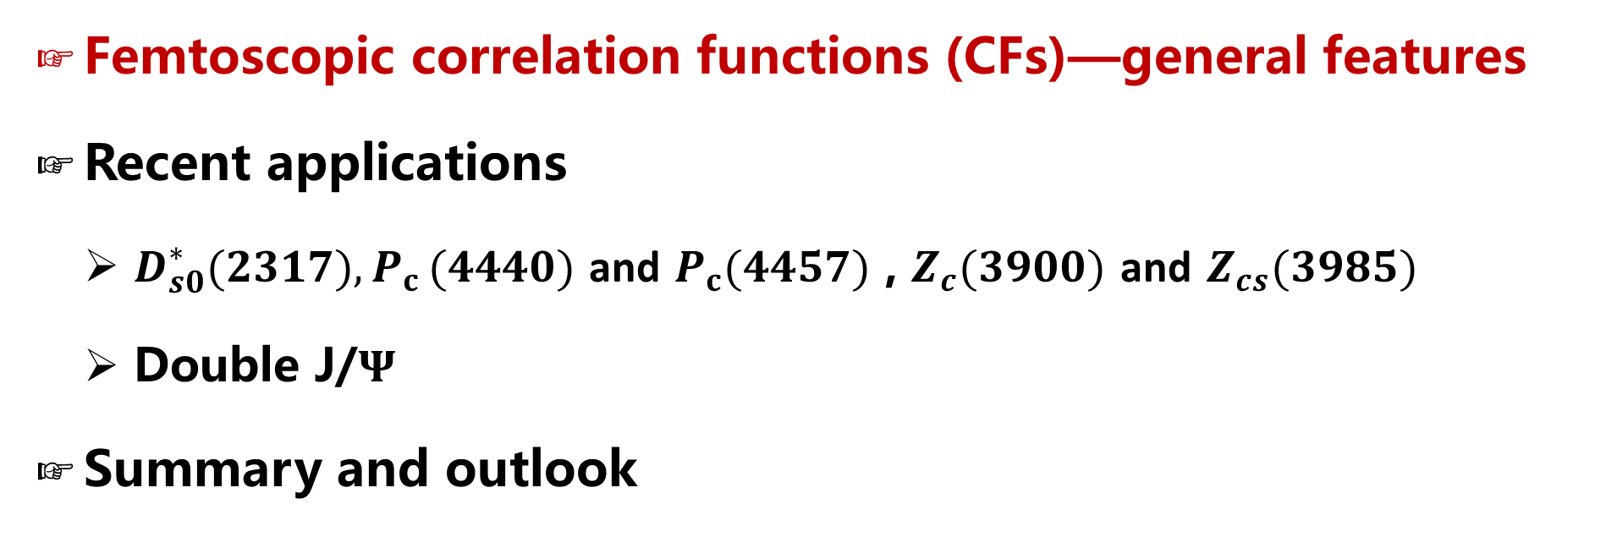
Contents
Femtoscopic correlation functions (CFs)—general features
Recent applications
  $D_{s0}^{∗}(2317){,P}_{c}(4440)$ and $P_{c}(4457)$ , $Z_{c}(3900)$ and $Z_{cs}(3985)$
  Double J/$Ψ$
Summary and outlook

Slide 7
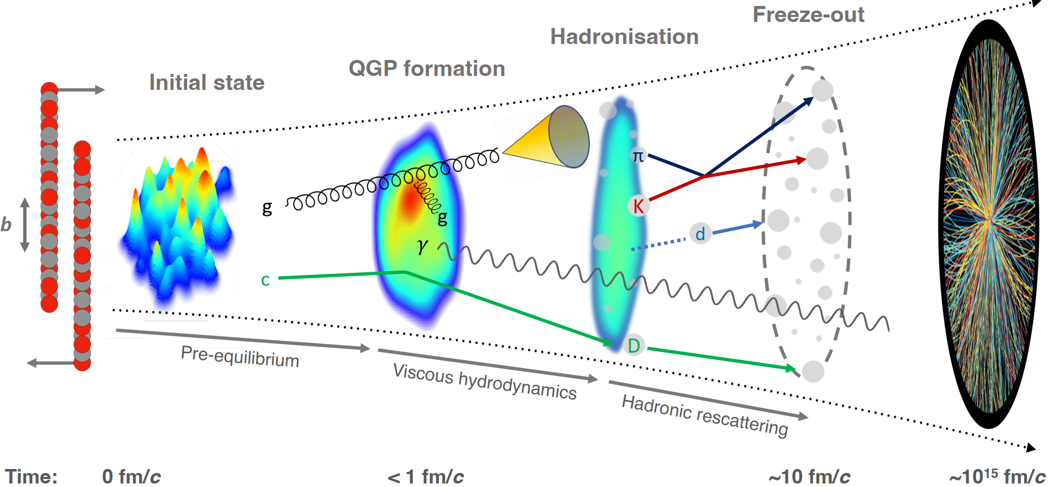
Abundant particles produced in AA, pA, and pp collisions
Final-State Interaction

Slide 8
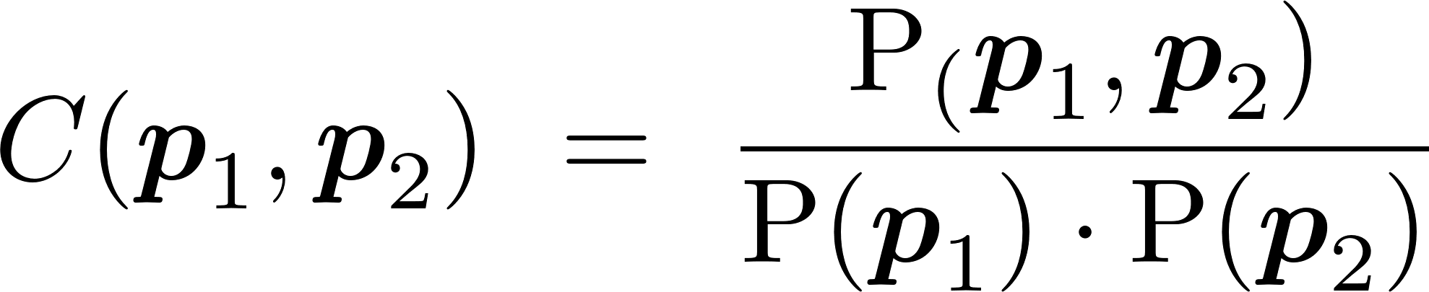
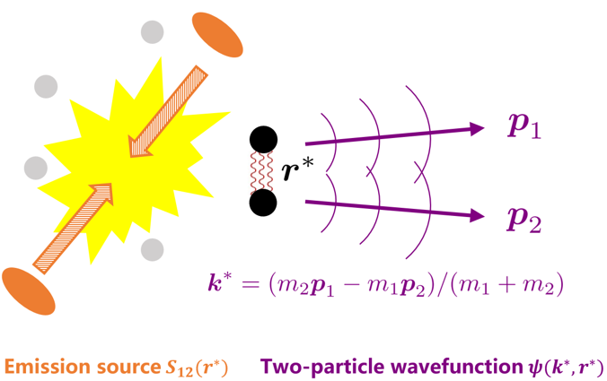
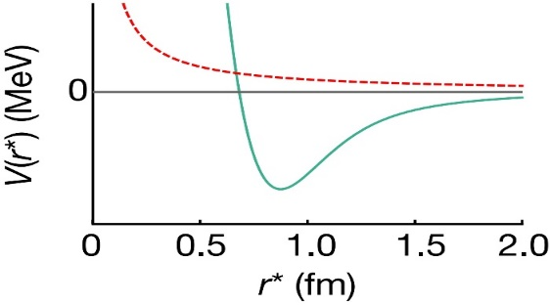
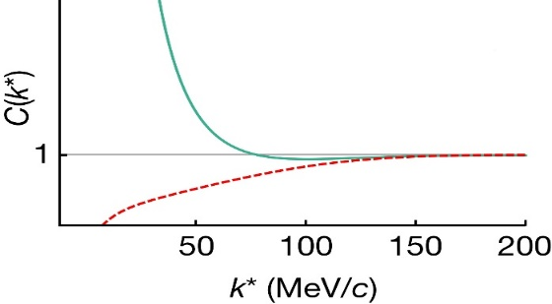
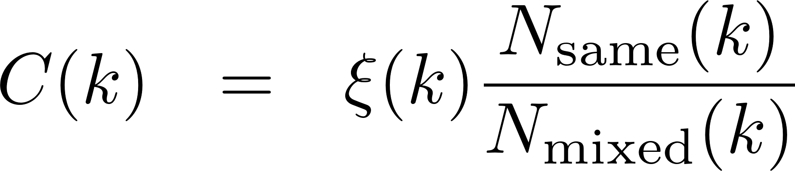
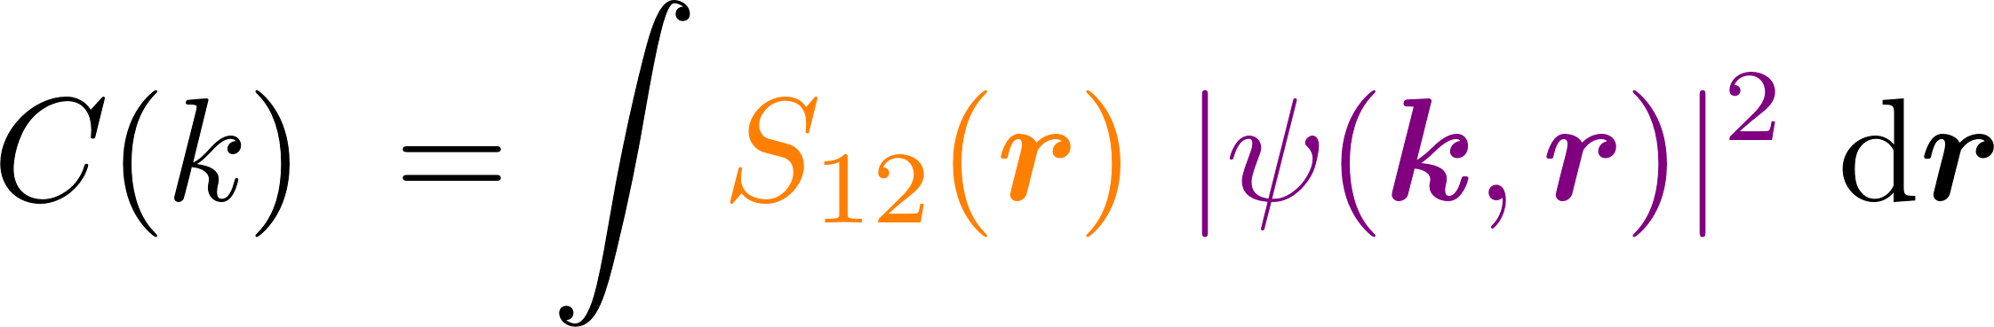
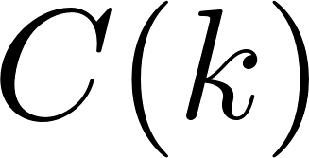


Femtoscopic correlation functions (CFs)
Interacting potential
Correlation function
repulsive
attractive
attractive
repulsive
Schrödinger equation
Two-particle wavefunction$ψ(k^{∗}, r^{∗})$
Exp. measurement
mixed-event technique
Theo. description
Koonin–Pratt formula
Basic Properties
>1 if the interaction is attractive
=1 if there is no interaction
<1 if the interaction is repulsive
$N_{same}$: the same event distributions
$N_{mixed}$: the mixed event distributions
$ξ$: the corrections for experimental effects
final-state interactions
quantum statistics effects
coupled-channel effects
spacial structure

Slide 9
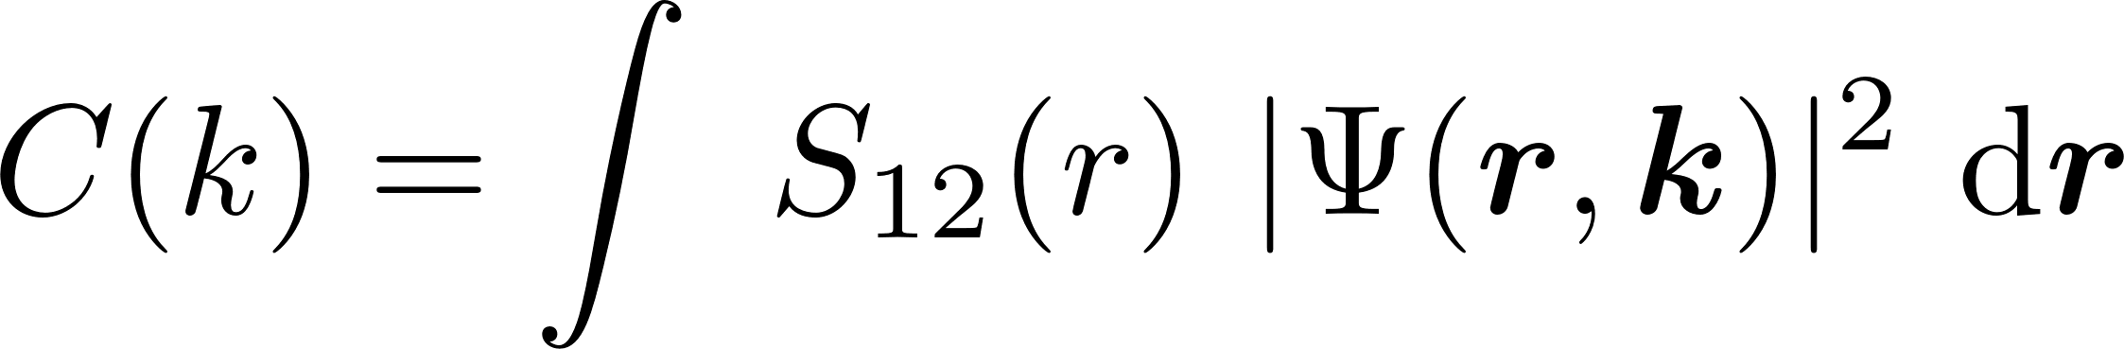
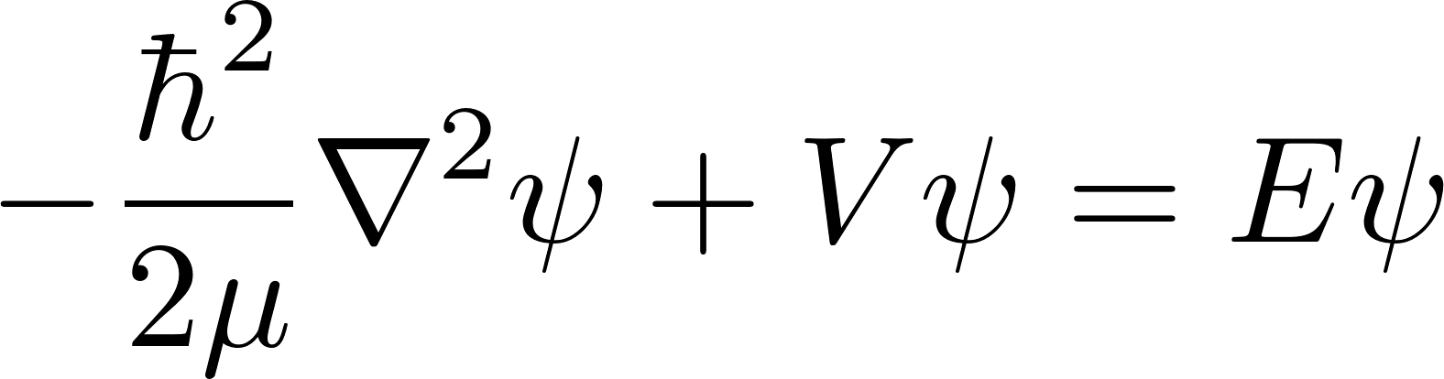
Femtoscopic correlation functions (CFs)
S. E. Koonin, Phys. Lett. B 70 (1) (1977) 43
A. Ohnishi, Nucl. Phys. A 954 (2016) 294
Koonin–Pratt (KP) formula
Only S-waves
Common static and spherical Gaussian source
Scattering wave function
the Schrödinger equation
the Lippmann-Schwinger equation

Slide 10
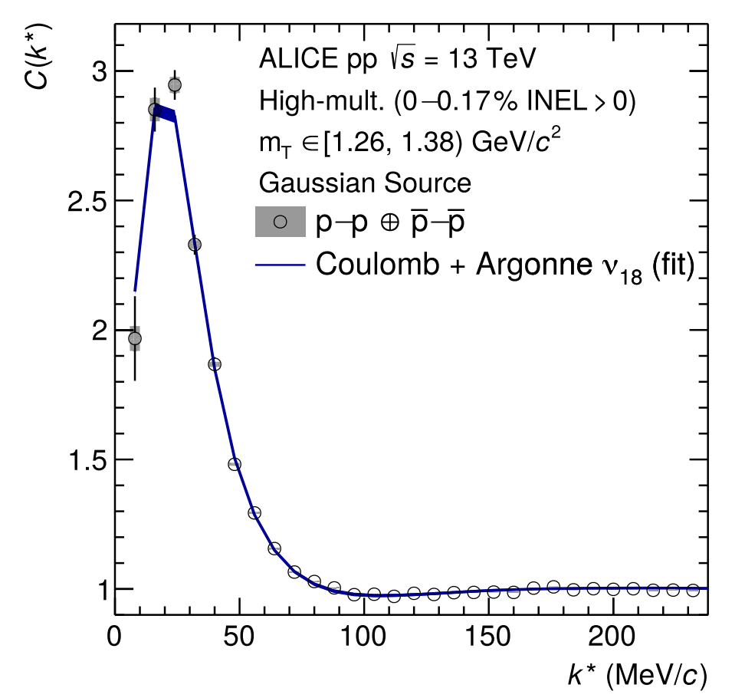
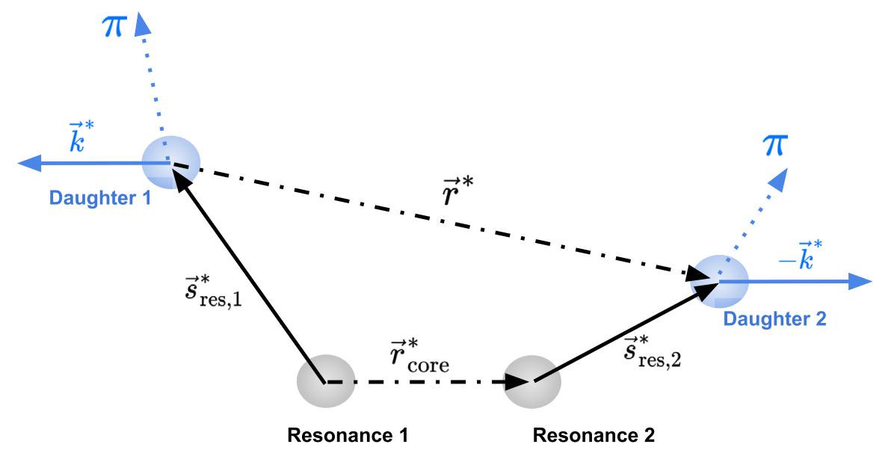

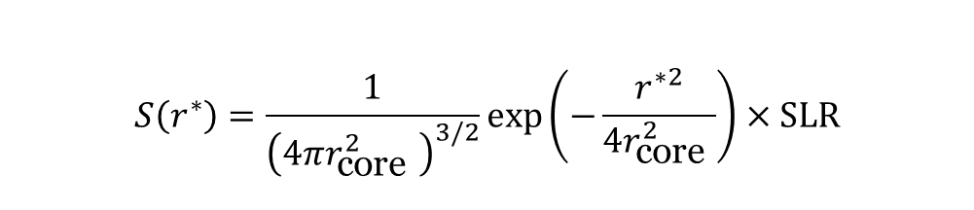
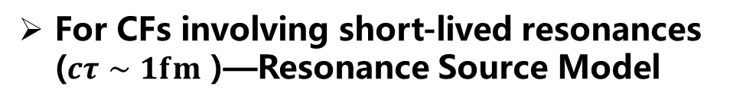
Constraining the source function
Using the well-known proton-proton interaction to calibrate the source
$$C\left(k^{∗}\right)=\int{S}\left({\vec{r}}^{∗}\right){\left|ψ\left({\vec{k}}^{∗},{\vec{r}}^{∗}\right)\right|}^{2}d^{3}{\vec{r}}^{∗}$$
For CFs involving short-lived resonances ($cτ∼1fm$ )—Resonance Source Model
$$S\left(r^{∗}\right)=\frac{1}{{\left(4πr_{\text{core} }^{2}\right)}^{3/2}}exp⁡\left(−\frac{r^{∗2}}{4r_{\text{core} }^{2}}\right)×SLR$$
ALICE, PLB, 811 (2020) 135849

Slide 11

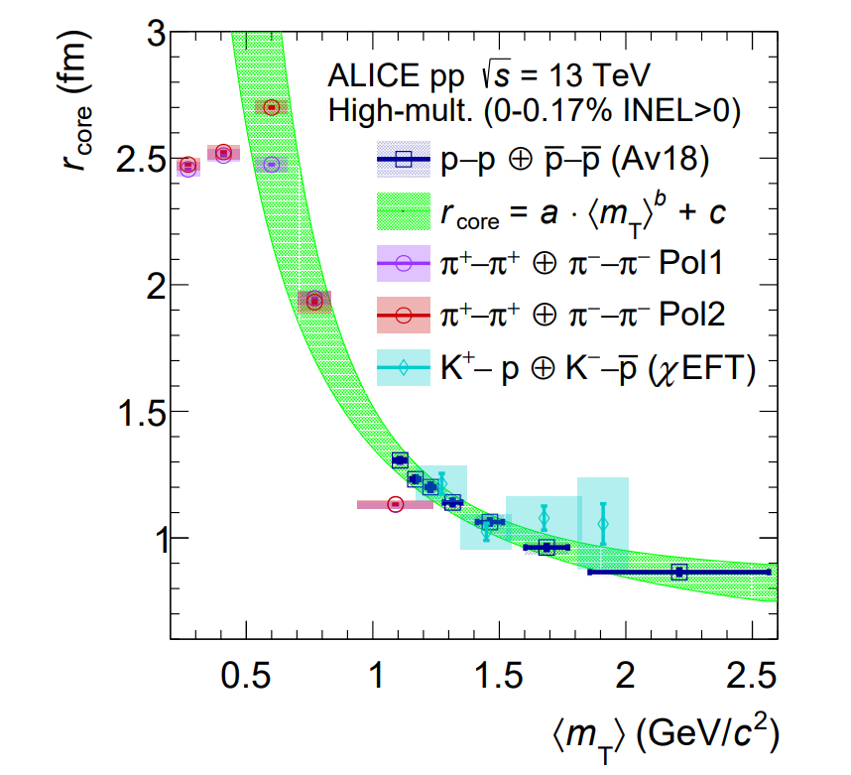
Constraining the source function
2311.14527v1.
… “providing compelling evidence for the presence of a common emission source for all hadrons in small collision systems at the LHC …”

Slide 12
Basic philosophy
The interaction is known from, e.g., experiments, lattice QCD, or effective field theories
Direct
Predict
Inverse
Experiments measure the correlation functions
Extract

Slide 13


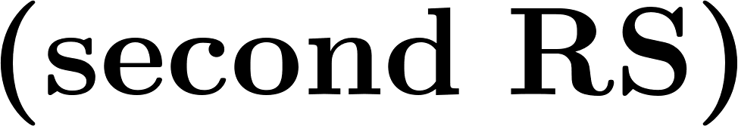

Classification of hadron-hadron interactions
repulsive
attractive
nonexistent
weaker attraction
resonant
state
stronger attraction
weak attraction
deeply bound state
shallow bound state
virtual
state

Slide 14
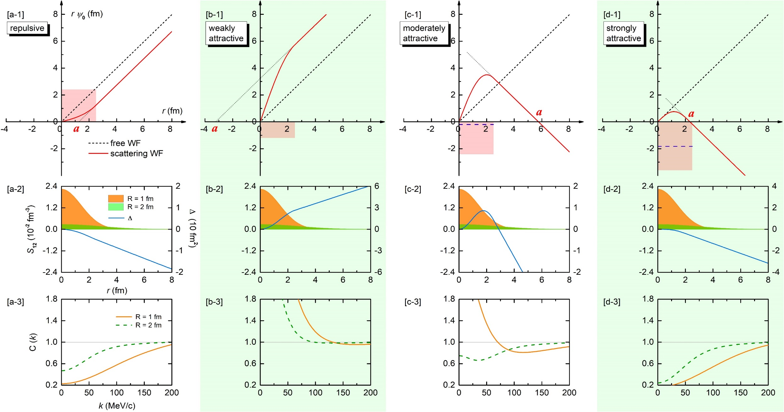
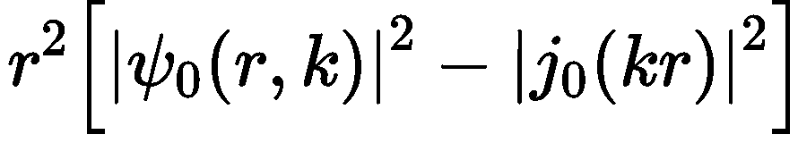
CFs in the presence of bound states
Zhi-Wei Liu, Jun-Xu Lu and LSG*, PRD 107, 074019 (2023)
Notes:
In the same plot, the difference between the free and scattering wave functions squared ∆ ≡ r 2 (|ψl=0| 2 − |jl=0| 2 ) in Eq. (7) is also shown as the blue solid line. Panels (a3–d3): Correlation function as a function of the relative momentum k.

Slide 15
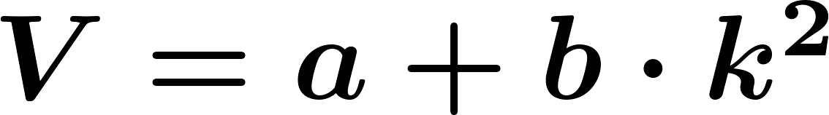
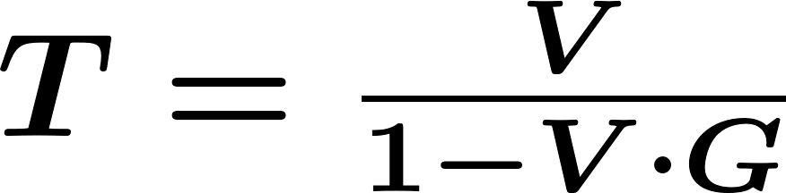
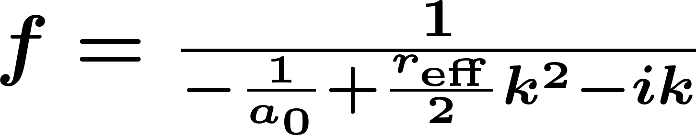
CFs in the presence of resonant and virtual states
Zhi-Wei Liu, Ming-Zhu Liu, Jun-Xu Lu and LSG*, 2404.18607
vs

Slide 16
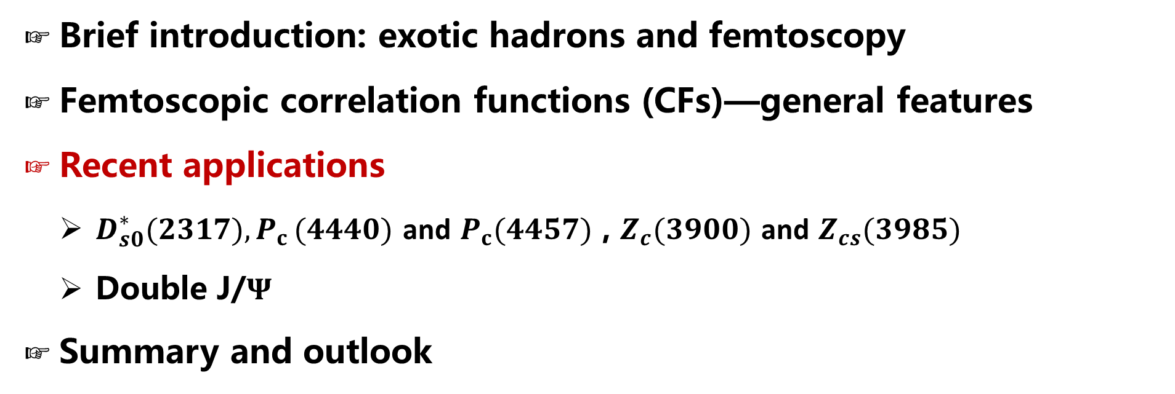
Contents
Brief introduction: exotic hadrons and femtoscopy
Femtoscopic correlation functions (CFs)—general features
Recent applications
  $D_{s0}^{∗}(2317){,P}_{c}(4440)$ and $P_{c}(4457)$ , $Z_{c}(3900)$ and $Z_{cs}(3985)$
  Double J/$Ψ$
Summary and outlook

Slide 17
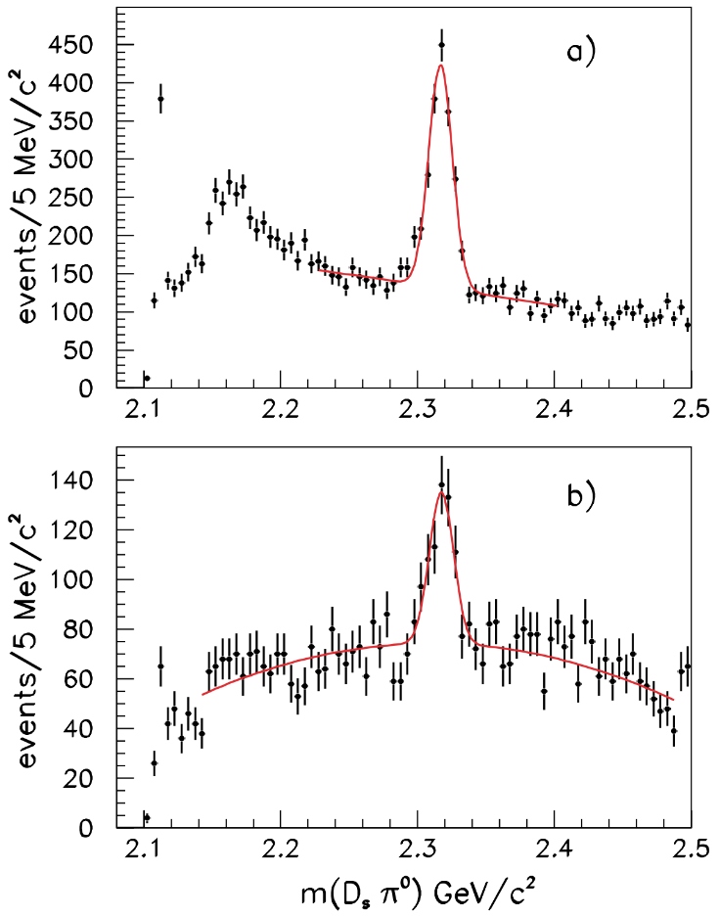
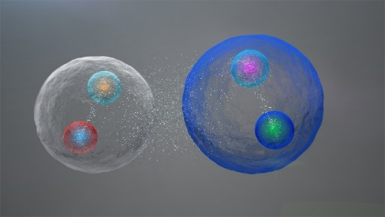
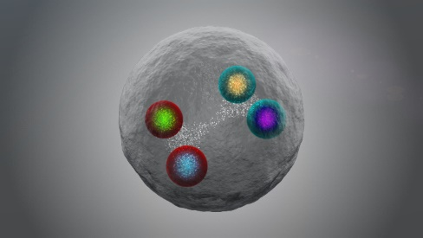


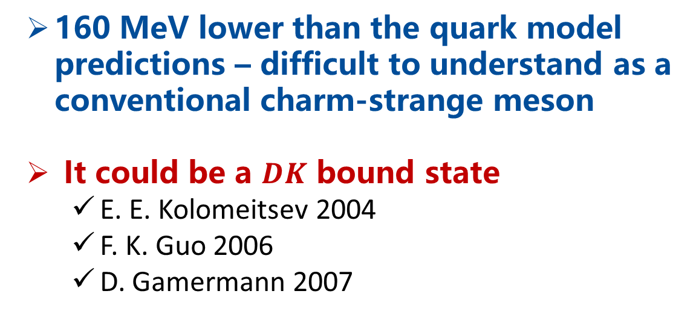
Mysterious exotic hadron $D_{s0}^{∗}(2317)$
160 MeV lower than the quark model predictions – difficult to understand as a conventional charm-strange meson
It could be a $DK$ bound state
  E. E. Kolomeitsev 2004
  F. K. Guo 2006
  D. Gamermann 2007
$$D_{s}^{+}→K^{+}K^{−}π^{+}$$
$$D_{s}^{+}→K^{+}K^{−}π^{+}π^{0}$$
VS
BABAR, PRL90 (2003) 242001

Slide 18
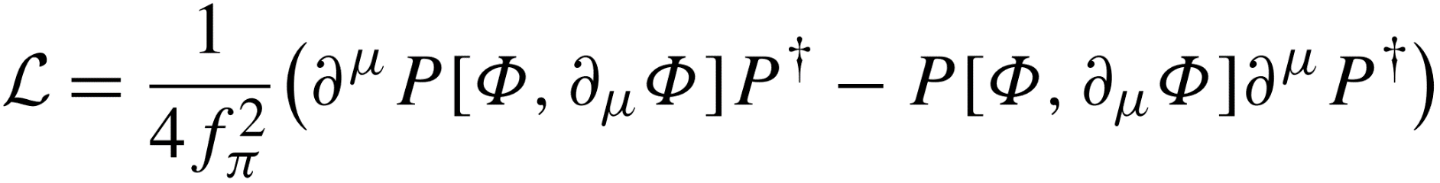
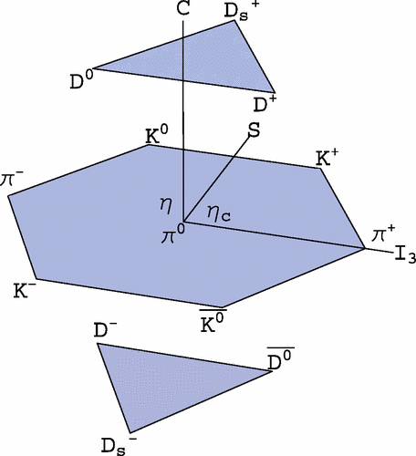



Weinberg-Tomozawa Interaction (leading order)
LO interaction between a NGB and a heavy pseudoscalar boson
Weinberg-Tomozawa (WT) potential – parameter free

Slide 19




Scattering wave function
Coupled-channel scat. eq.
S-wave scattering wave function (including off-shell effect)

Slide 20



$DK$CFs and its source size dependence
$$D^{+}K^{0} → D^{0}K^{+}$$
Typical feature of deeply bound states
Zhi-Wei Liu, Jun-Xu Lu and LSG*, PRD107(2023)074019

Slide 21




Confirmed by two subsequent studies

Slide 22



Probing the structure of exotic hadrons through CFs
A mixture of a $DK$molecular state and a bare state
A pure $DK$ molecular state
Yi-Bo Shen, Zhi-Wei Liu, Jun-Xu Lu, Ming-Zhu Liu* and LSG*, 2506.23476

Slide 23

Probing the structure of exotic hadrons through CFs
CF variation with the molecular component
The larger the proportion of molecular configurations, the larger the deviation of the CFs from 1.
VS
Yi-Bo Shen, Zhi-Wei Liu, Jun-Xu Lu, Ming-Zhu Liu* and LSG*, 2506.23476

Slide 24

Contents
Brief introduction: exotic states and femtoscopy
Femtoscopic correlation functions (CFs)—general features
Recent applications
  $D_{s0}^{∗}(2317){,P}_{c}(4440)$ and $P_{c}(4457)$ , $Z_{c}(3900)$ and $Z_{cs}(3985)$
  Double J/$Ψ$
Summary and outlook

Slide 25





Pentaquark states $P_{c}(4440)$ & $P_{c}(4457)$
LHCb, PRL115 (2015) 072001
LHCb, PRL122 (2019) 222001
Pentaquark states · 2015 APS Highlights
They can be nicely arranged into a $Σ_{c}^{(∗)} {\overline{D}}^{(∗)}$ multiplet
M. Z. Liu, Y. W. Pan, F. Z. Peng, M. Sánchez S, LSG*, A. Hosaka, M. P. Valderrama, PR122 (2019) 242001
How to distinguish the spins of $P_{c}(4440)$ and $P_{c}(4457)$ ?

Slide 26




Light vector meson exchange interactions
Interactions in the hidden local symmetry approach – parameter free
Isospin basis
Charge basis

Slide 27










Two different spin assignments
Interaction strengths
deep bound state of $Σ_{c}{\overline{D}}^{∗}$
shallow bound state of $Σ_{c}{\overline{D}}^{∗}$
CF for the shallow bound state is significantly larger than that for the deep bound
Experimental CFs – spin-averaged
Scenarios A
Scenarios B

Slide 28



Spin-averaged $Σ_{c}{\overline{D}}^{∗}$CFs
$\text{Scenario} \text{A}$: higher mass, larger spin
model independent
CF for shallow bound state
$$Σ_{c}^{++}D^{∗−}→Σ_{c}^{+}{\overline{D}}^{∗0}$$
CF for deep bound state
Scenario B: higher mass, smaller spin
Zhi-Wei Liu, Ming-Zhu Liu, Jun-Xu Lu and LSG*, PRD108(2023)L031503

Slide 29

Contents
Brief introduction: exotic hadrons and femtoscopy
Femtoscopic correlation functions (CFs)—general features
Recent applications
  $D_{s0}^{∗}(2317){,P}_{c}(4440)$ and $P_{c}(4457)$ , $Z_{c}(3900)$ and $Z_{cs}(3985)$
  Double J/𝚿
Summary and outlook

Slide 30






Tetraquark states $Z_{c}(3900)$ & $Z_{cs}(3985)$
$$Z_{c}(3900)$$
$$Z_{cs}(3985)$$
BESIII, PRL110 (2013) 252001
BESIII, PRL126 (2021) 102001
Tetraquark states · 2013 APS Highlights
$Z_{c}(3900)$ & $Z_{cs}(3985)$: Resonant VS Virtual states
Particle Data Group, PTEP 2022 (2022) 083C01
M.-L. Du, M. Albaladejo, F.-K. Guo and J. Nieves, PRD 105 (2022) 074018
T. Ji, X.-K. Dong, M. Albaladejo, M.-L. Du, F.-K. Guo and J. Nieves, PRD106 (2022) 094002
L.-W. Yan, Z.-H. Guo, F.-K. Guo, D.-L. Yao and Z.-Y. Zhou, PRD109 (2024) 014026

Slide 31


Invariant mass distributions fail to distinguish vir. or res.
Virtual state scenario
Resonant state scenario
M.-L. Du, M. Albaladejo, F.-K. Guo, and J. Nieves, PRD105(2022)074018
Data are compatible with either a resonant or virtual state.
How to tell which is reality?

Slide 32



General potential from EFTs
Interaction between heavy pseudoscalar bosons
energy-dependent potential $−→$ resonant state
contact-range potential $−→$ bound or virtual state
Scattering equation – unitarity
Loop function G with cutoff regularization

Slide 33


Interaction strengths determined by fitting to data
【104】 Particle Data Group, PTEP 2022,(2022)083C01

Slide 34


T-matrix & Invariant mass spectrum & phase shift

Slide 35




Correlation functions with the on-shell approximation
Vidana, Feijoo, Albaladejo, Nieves, Oset, PLB 846, 138201(2023)
CFs$↔$ phase-shifts

Slide 36

$D^{0}D^{∗−}$CFs for $Z_{c}(3900)$
Zhi-Wei Liu, Ming-Zhu Liu, Jun-Xu Lu and LSG*, 2404.18607
Resonant state scenario
Virtual state scenario
Bound state scenario
Typical feature of broad resonant state

Slide 37

$D^{0}D_{s}^{∗−}$CFs $Z_{cs}(3985)$
Zhi-Wei Liu, Ming-Zhu Liu, Jun-Xu Lu and LSG*, 2404.18607
Resonant state scenario
Virtual state scenario
Bound state scenario
Typical feature of narrow resonant state

Slide 38

Contents
Brief introduction: exotic hadrons and femtoscopy
Femtoscopic correlation functions (CFs)—general features
Recent applications
  $D_{s0}^{∗}(2317){,P}_{c}(4440)$ and $P_{c}(4457)$ , $Z_{c}(3900)$ and $Z_{cs}(3985)$
  Double J/$Ψ$
Summary and outlook

Slide 39








Tetracharm states — LHCb & ATLAS
A narrow structure around 6.9 GeV — X(6900)
A broad structure just above twice the $J/Ψ$ mass
Di- $J/Ψ$
$J/Ψ$ + $Ψ$(2S)
X(6900) and a broad structure at threshold
A resonance structure at about 7.2 GeV

Slide 40



Tetracharm states — CMS
X(6900) structure
Two new structure X(6600) and X(7100)
broad structure

Slide 41








Tetracharm states — near $J/ΨJ/Ψ$ threshold
Two coupled-channel: $J/ΨJ/Ψ$, $J/ΨΨ(2S)$
near $J/ΨJ/Ψ$ threshold:
virtual state
resonance
bound state
Three coupled-channel: $J/ΨJ/Ψ$, $J/ΨΨ(2S)$, $J/ΨΨ(3770)$
near $J/ΨJ/Ψ$ threshold:
virtual state
bound state
How to decipher the nature of possible state near the $J/Ψ$-pair threshold ?

Slide 42







X(6200)
General potential from EFTs
Strength of potential from double J/$Ψ$ spectrum
Resonant
Bound
Virtual
Taken from X.-K. Dong, V. Baru, F.-K. Guo, C. Hanhart, and A. Nefediev, Phys. Rev. Lett. 126, 132001 (2021)
Identical neutral mesons (J=1) correlation function
Spatial part of wave function
Symmetric (for 1S0, 5S2)
Anti-symmetric (for 3S1)
Quantum Statistic (QS) effect
Final State Interaction (FSI) effect

Slide 43


Preliminary $J/Ψ$-pair CFs
Attraction:
resonant < virtual < bound state
Typical low-momentum features of different pole positions
BEc + bound state < BEc
BEc + resonant state > BEc
BEc + virtual state > BEc

Slide 44

Contents
Brief introduction: exotic hadrons and femtoscopy
Femtoscopic correlation functions (CFs)—general features
Recent applications
  $D_{s0}^{∗}(2317){,P}_{c}(4440)$ and $P_{c}(4457)$ , $Z_{c}(3900)$ and $Z_{cs}(3985)$
  Double J/$Ψ$
Summary and outlook

Slide 45

Summary and outlook
  Femtoscopy offers high-precision tests of the strong interaction between pairs of (un)stable particles and can be valuable to decipher the nature of the many exotic hadrons discovered so far.
    $DK$ correlation functions can be used to verify or refute the molecular picture of $D_{s0}^{∗}(2317)$
    $Σ_{c}{\overline{D}}^{(∗)}$ correlation functions can be used to discriminate the spins of $P_{c}(4440)$ and $P_{c}(4457)$
    $D{\overline{D}}^{∗}/D{\overline{D}}_{s}^{∗}$ correlation functions can tell whether $Z_{c}(3900)/Z_{cs}(3985)$ is a resonance, virtual state, or bound state
    Double $J/Ψ$ correlation functions can be used to decipher the nature of possible $X(6200)$

Slide 46












Summary and outlook
$$Σ_{c}{\overline{D}}^{∗}$$
  More two-hadron correlations involving s, c, b quarks
$$BD$$
$DD^{∗}$, I. Vidana, A. Feijoo, M. Albaladejo, J. Nieves, and E. Oset, PLB 846 (2023) 138201
$DD^{∗}$, Y. Kamiya, T. Hyodo, and A. Ohnishi, EPJA 58 (2022) 131
${BB}^{∗}$, A. Feijoo, L. R. Dai, L. M. Abreu, and E. Oset, PRD 109 (2024) 016014
$\text{B}D,$ H.P. Li, J.Y. Yi, C.W. Xiao, D.L. Yao, W.H. Liang, and E. Oset, CPC (2024)
……
$$N\overline{D}$$
$$ΞN$$
$$ΛN$$
$$ΛΛ$$
$$D{\overline{D}}^{∗}$$
$$NN$$
$$DK$$
  Three-particle correlations — genuine three-body effects
ppp, pp$Λ$, ALICE Collaboration, Eur. Phys. J. A 59 (2023) 145
pp$K^{±}$, ALICE Collaboration, Eur. Phys. J. A 59 (2023) 298
ppp, A. Kievsky and et al., Phys. Rev. C 109 (2024) 034006

Slide 47



Better understanding of the nonperturbative strong interaction
Asymptotic Freedom
Color Confinement
Millennium Problems
Yang–Mills and Mass Gap
Experiment and computer simulations suggest the existence of a "mass gap" in the solution to the quantum versions of the Yang-Mills equations. But no proof of this property is known.

Slide 48

Thanks a lot for your attention!
(Image: CERN)

Slide 49


Summary and outlook
One can also perform inverse studies and extract hadron-hadron interaction from the exp. CF data
Inverse problem in femtoscopic correlation functions: The Tcc(3875)+ state,
Albaladejo , Feijoo , Vidaña , Nieves , and Oset, 2307.09873

Slide 50


Off-shell ambiguities
“The analysis of the differences between the correlations of the various interactions shows that for momenta between 0 and 500 MeV there are variations of up to 5.9 % for the nn system, of up to 1.8 % for the np system, and of 1.4 % for the pp system.”
2505.13433v1.

Slide 51



Off-shell ambiguities
2506.03669v1.
“We find that using realistic interactions based on chiral dynamics the uncertainties are small, of the order of 2 - 3 %, but could be much bigger if other methods are used.”

