Slide 1
Belle/Belle II实验上强子物理前沿进展
沈成平，复旦大学
shencp@fudan.edu.cn
2025年理论物理专款前沿讲习班

Slide 2
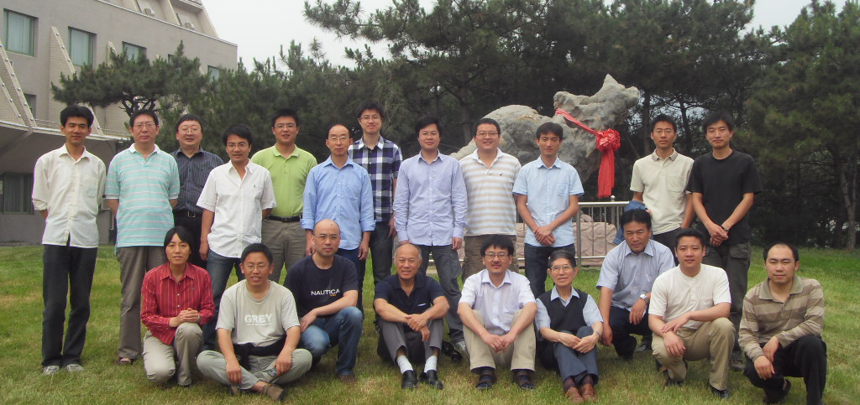
第一届Belle合作中国组会议
2010年6月11-12日，怀柔
2010年（Belle）
高能所（7+8）
北京大学（1+2）
中国科技大学（2+3）
共23人
2
2

Slide 3
Belle(II)发表论文情况(中国大陆组主要贡献)
B 物理： Phys. Rev. D 8篇, JHEP 2篇， Phys. Rev. Lett. 1篇
粲偶素： Phys. Rev. D 3篇
粲介子+粲重子： Sci. Bull. 1篇，JHEP 7篇，Phys. Rev. D 13篇，Phys. Rev. Lett. 6篇， EPJC 2篇
底偶素能谱及底偶素衰变：Phys. Rev. D 9 篇， Phys. Rev. Lett. 2篇， JHEP 1篇
奇特态： JHEP 3篇，Phys. Rev. D 21篇, Phys. Rev. Lett. 6篇
新物理：Phys. Rev. Lett. 1篇
重子： Phys. Rev. D 2篇
积分亮度： Chin. Phys. C 2篇
CKM 矩阵元：JHEP 1篇
合计：90篇，包括PRL 16篇。
3
3

Slide 4
引用次数最多的几篇论文
D&Dbar mixing【PRL96, 151801(2006)】 153次
Y(2175)【PRD80, 031101(R) (2009)】 150次
Y(4360、4660)【PRD91, 112007 (2015)】 194次
Y(4660)【PRL99, 142002(2007)】 559次
Y(4008)【PRL99, 182004(2007)】 559次
X(4350)【PRL104, 112004(2010)】 212次
Zc(3900)【PRL110, 252002(2013)】 983次
关于D介子混合的工作也是一个近年前沿和热门的研究领域，B工厂升级的重要物理目标之一即高精度进行D介子混合研究。
关于Zc(3900)、Y(4008)和Y(4660)的工作几乎在高能物理所有的国际、国内会议上被报告和引用，“XYZ”粒子研究，依然是一个前沿和热门研究领域。
4

Slide 5
The study of hadron spectrum
5

Slide 6
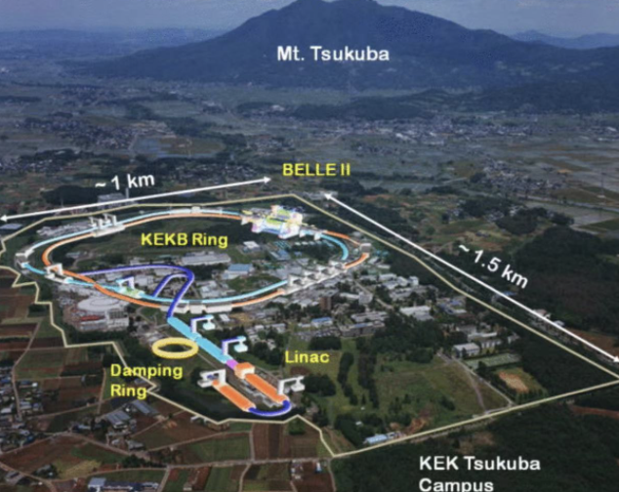
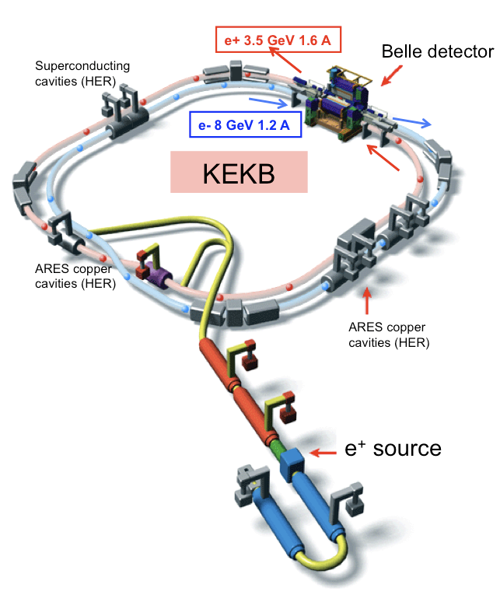
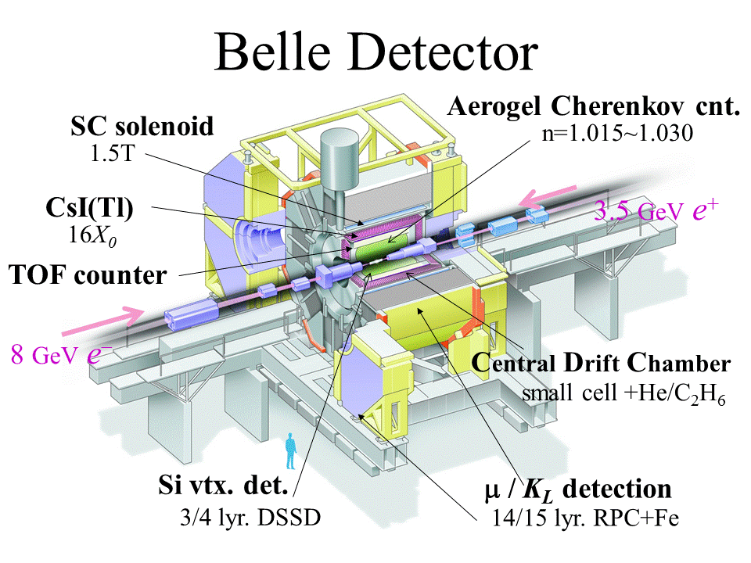
KEKB and Belle
Peak luminosity: $2.11×{10}^{34}cm^{−1}s^{−1}$
Integrated luminosity (~980 fb⁻¹ in total):
$Υ(5S)$: 121 fb⁻¹, $Υ(4S)$: 711 fb⁻¹, $Υ(3S)$: 3 fb⁻¹,
$Υ(2S)$: 25 fb⁻¹, $Υ(1S)$: 6 fb⁻¹, continuum: 90 fb⁻¹
$\sqrt{s} \sim 10.6$ GeV
6

Slide 7
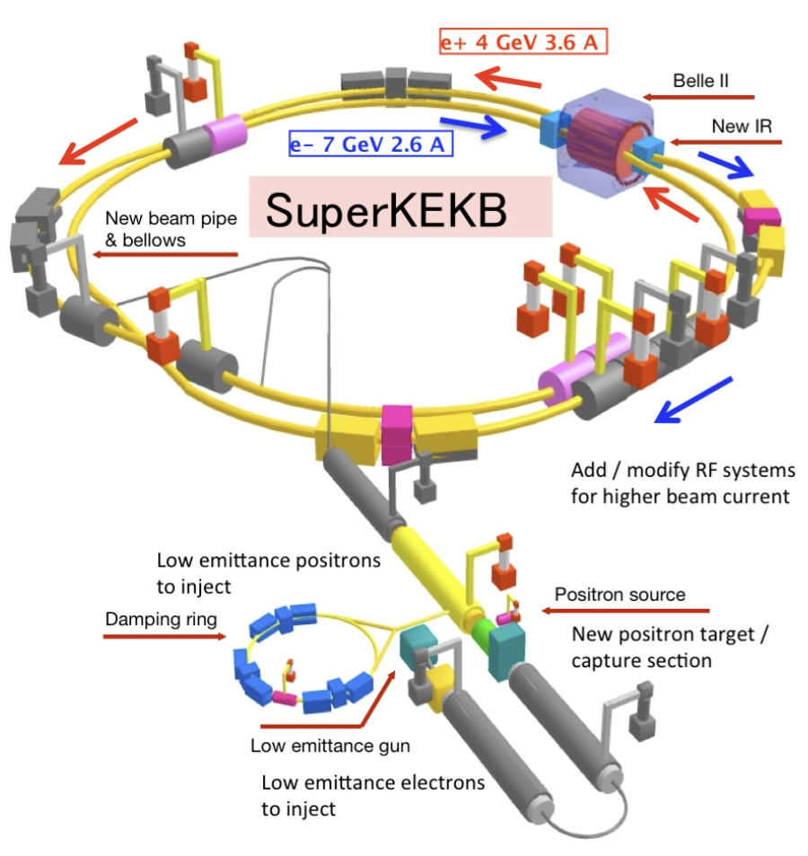
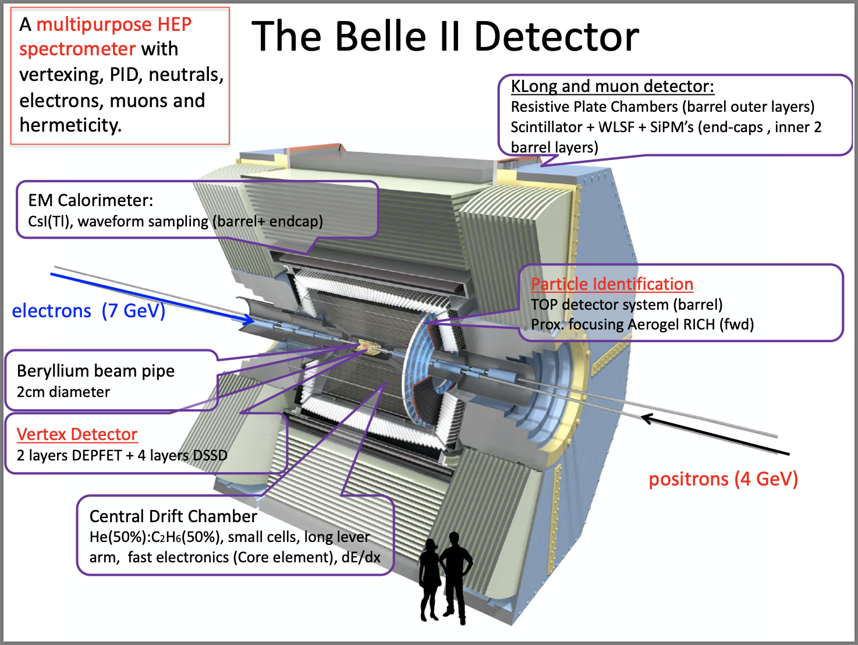
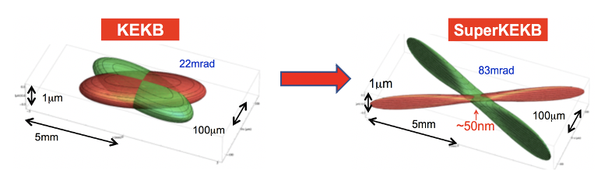
SuperKEKB and Belle II
Achieved peak luminosity: 5.1×10³⁴ cm⁻²s⁻¹
Integrated luminosity: 435/fb
$\sqrt{s}$ ~ 10.58 GeV
Nano-beam design:
Beam squeezing: $×$20 smaller
Target luminosity: KEKB$×$40
7

Slide 8
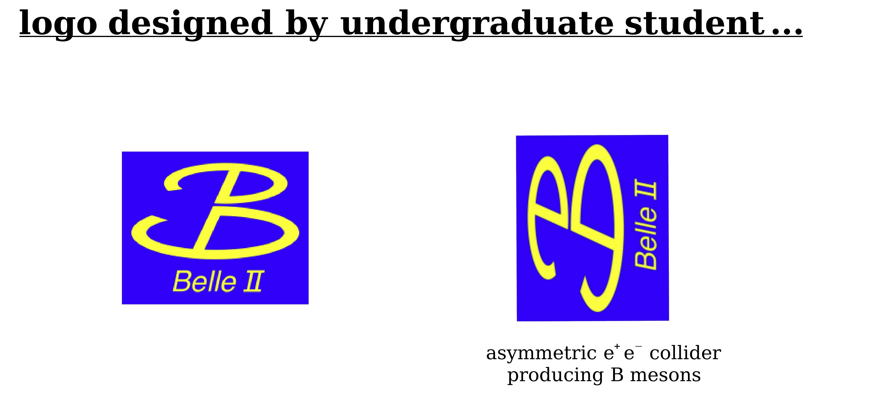
8

Slide 9
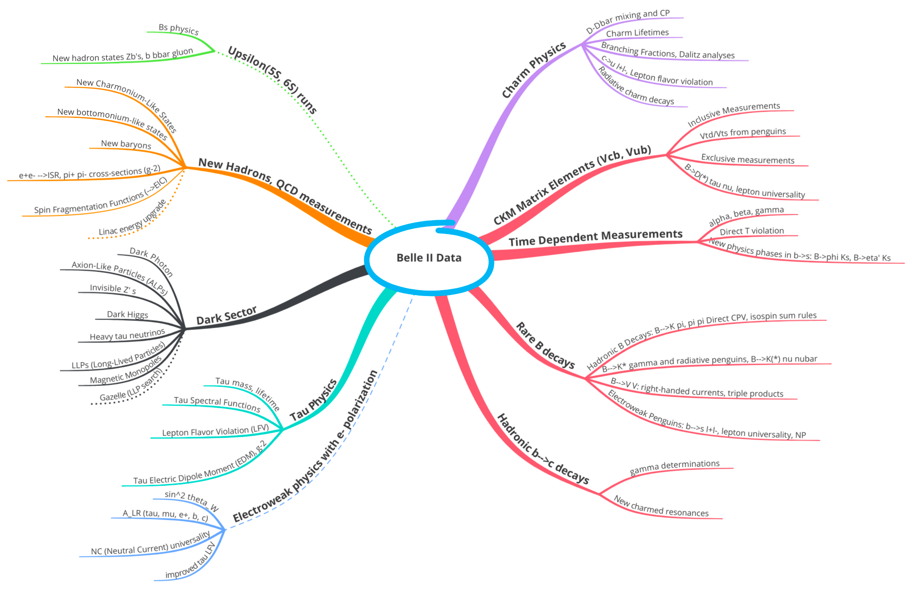

Productions in Belle II
Belle II Physics
$$B\overline{B}$$
Wealth of new physics possibilities in different domains of HEP (weak, strong, electroweak interactions). Many opportunities for initiatives by young scientists.
9

Slide 10
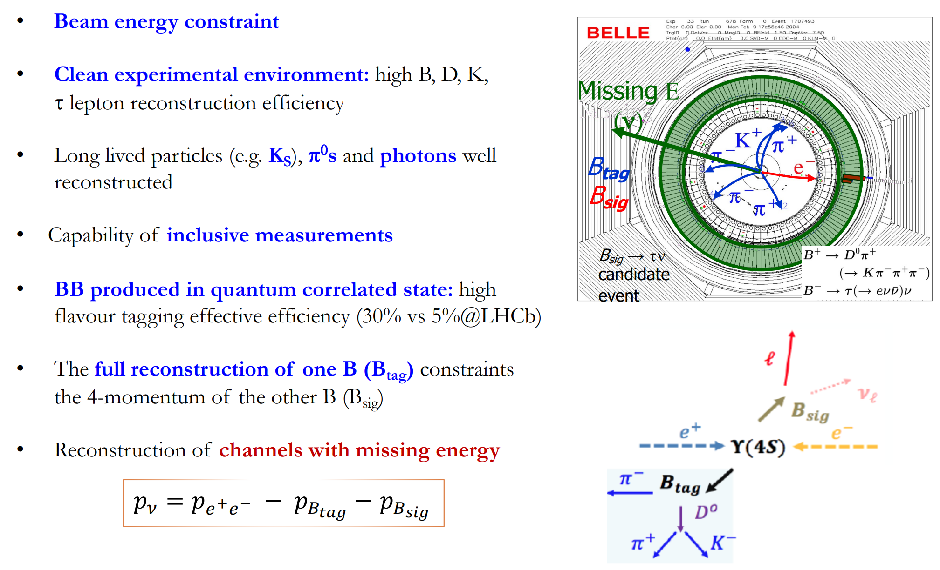
Unique capabilities of Belle/Belle II
10

Slide 11
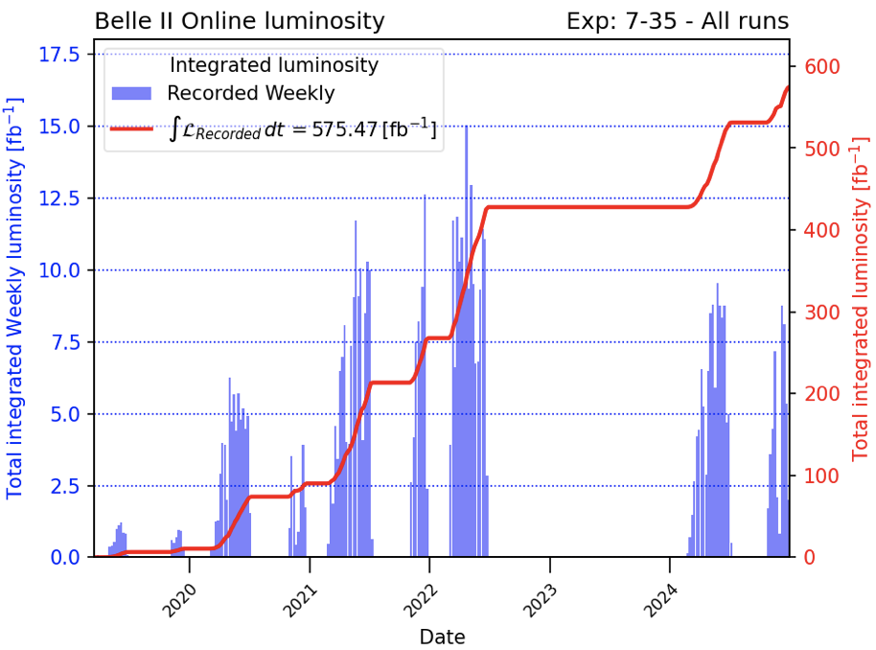
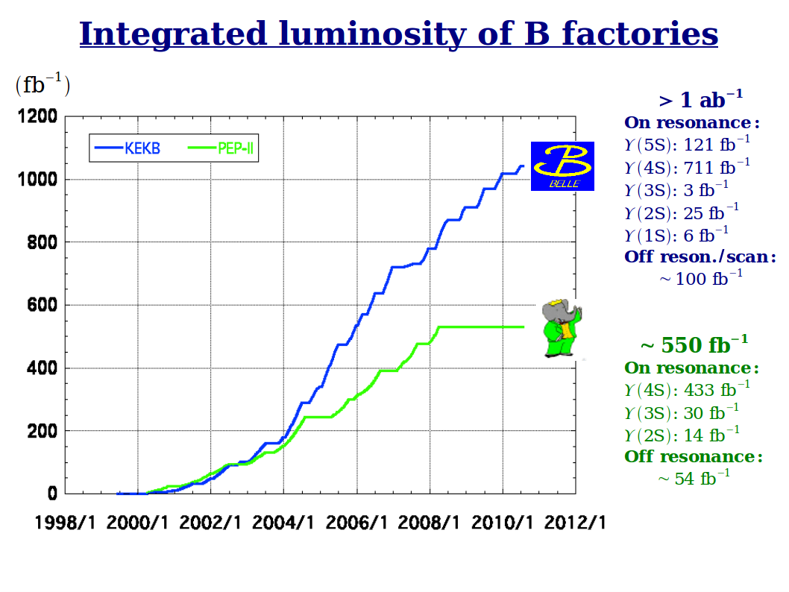

Belle and Belle II Datasets
Belle (1999 - 2012)
Belle II RUN-I (2019 - 2023)
Belle II RUN-II (2024 - 2025)
In December 2024
WORLD RECORD: $5.1×{10}^{34}$ ${cm}^{−2}s^{−1}$
Most data at or near the $Υ(4S)$ resonance, some below/above $Υ(4S).$
11

Slide 12
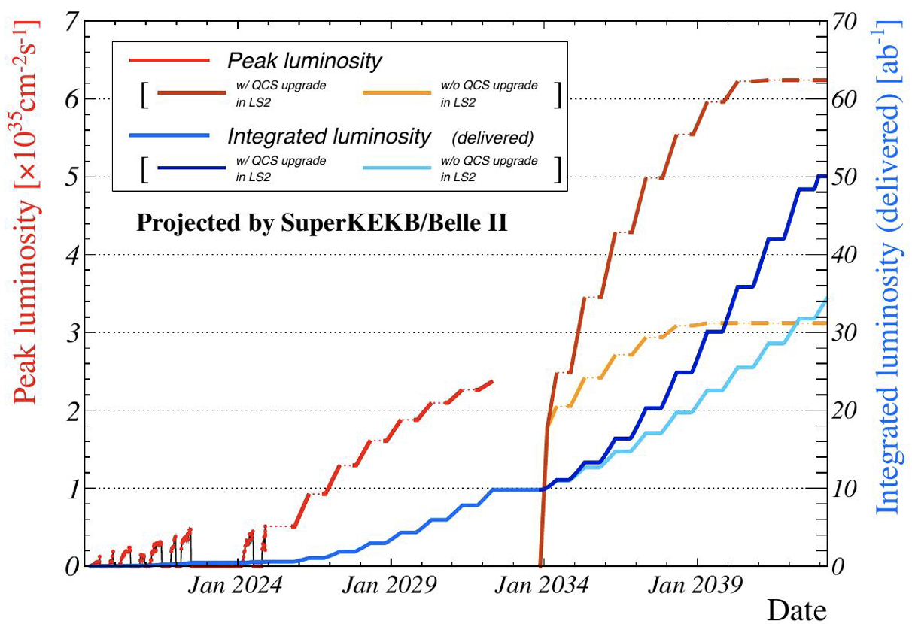

Data-taking plan at Belle II
Until 2026, about 1 ${ab}^{−1}$ data, comparable to Belle
Until 2029, about 4 ${ab}^{−1}$ data.
12

Slide 13
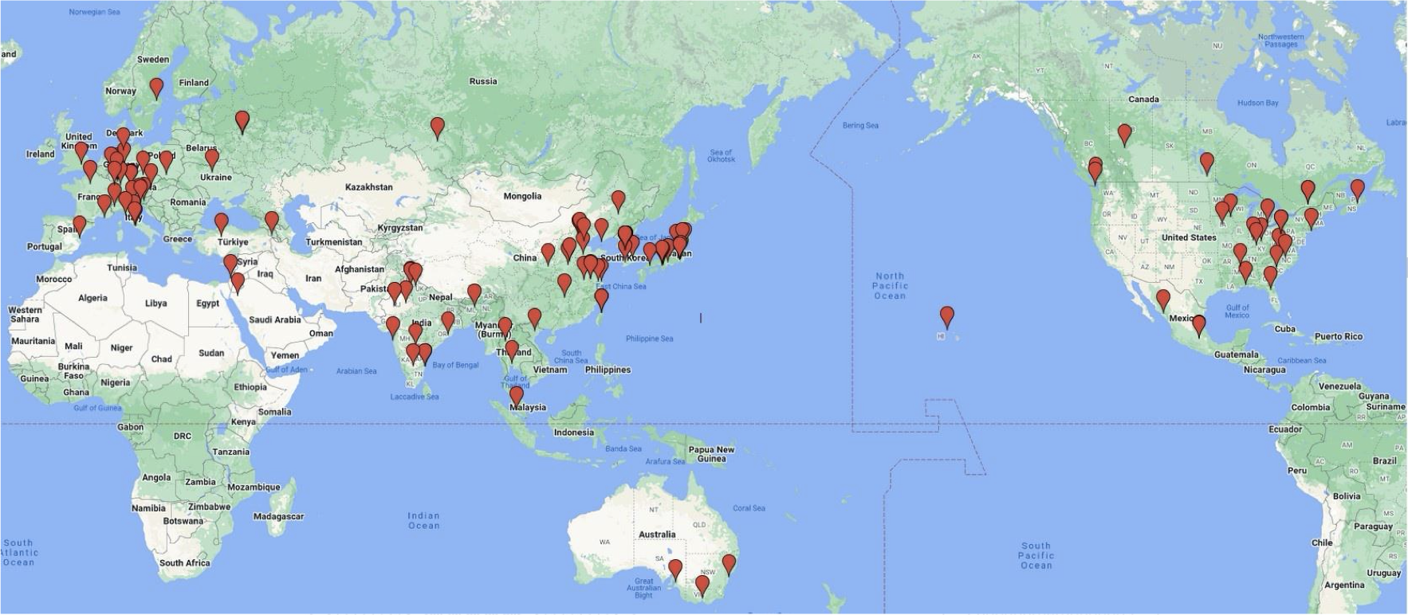
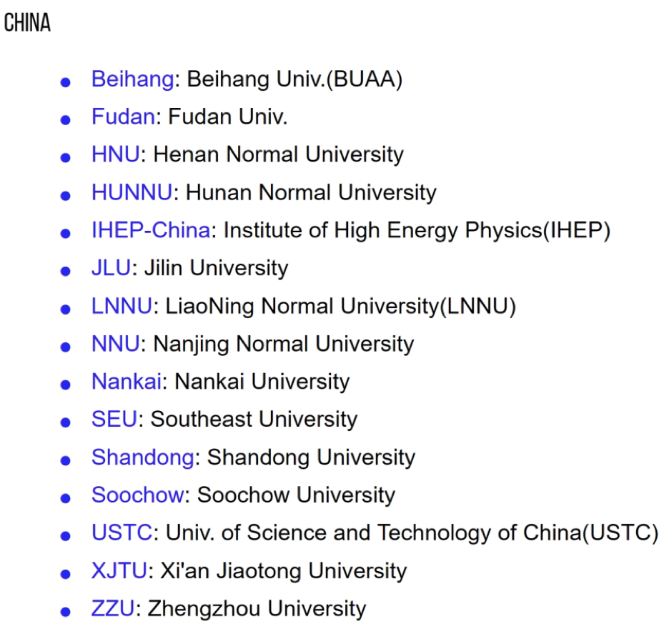
International Belle II collaboration
Belle和Belle II实验上强子的相关研究
Belle II now has grown to 1229
researchers from 28 countries/regions.
13

Slide 14
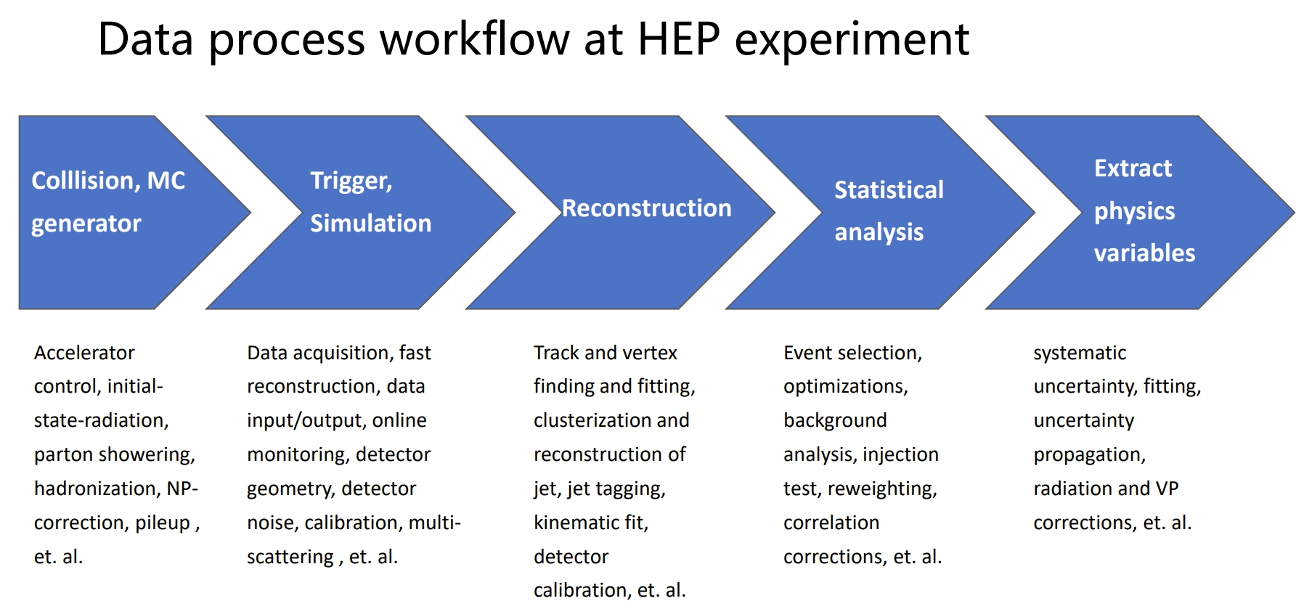
14

Slide 15
Light hadrons
15

Slide 16
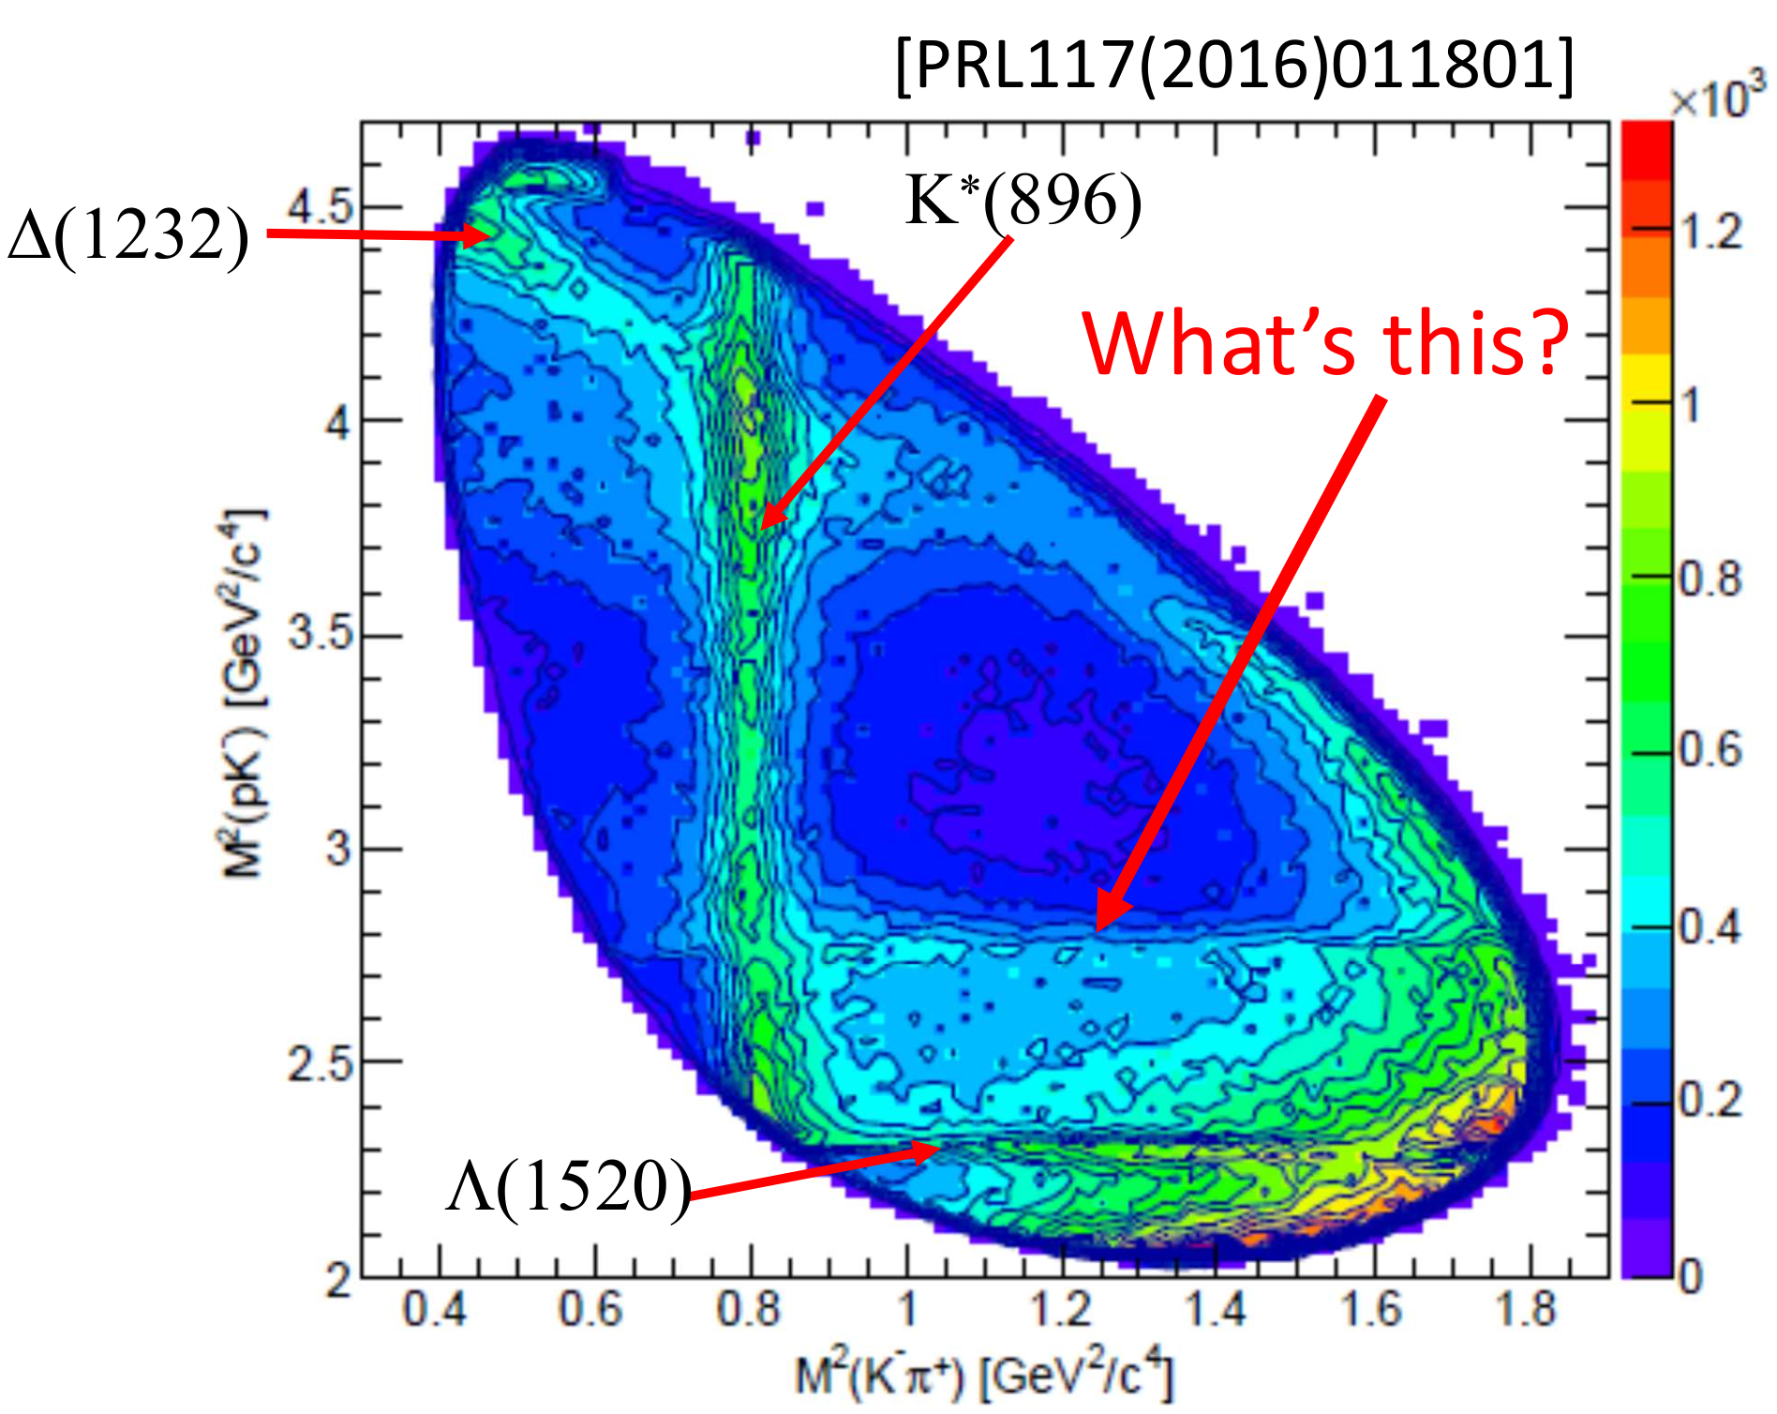
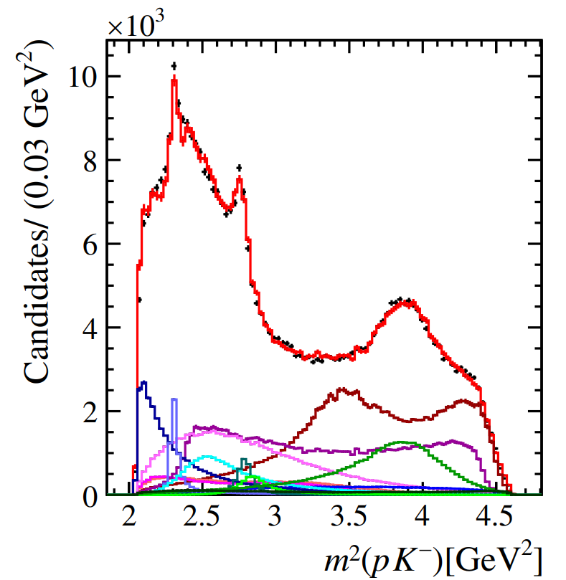
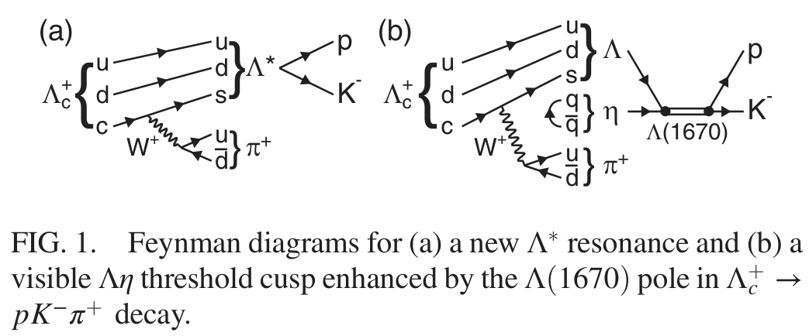


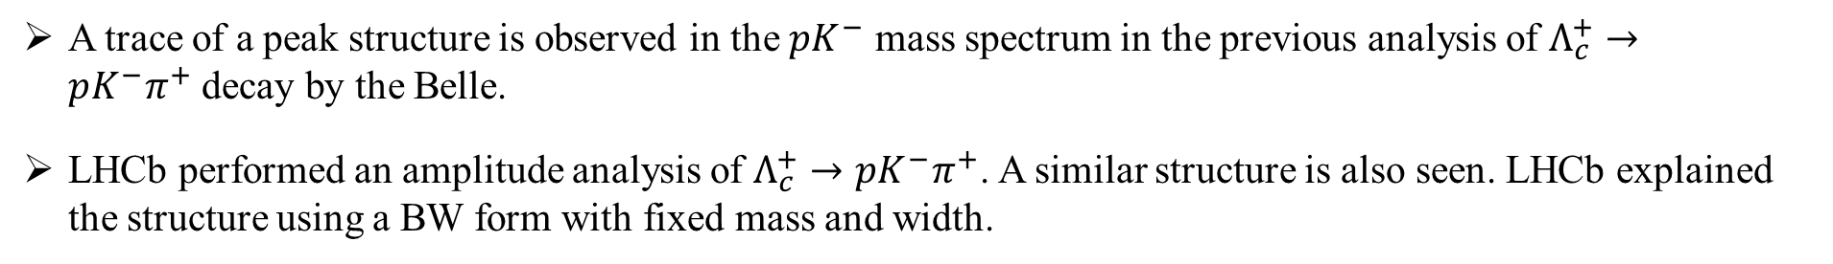
A peak at $Λη$ threshold
A trace of a peak structure is observed in the $pK^{−}$ mass spectrum in the previous analysis of $Λ_{c}^{+}→pK^{−}π^{+}$decay by the Belle.
LHCb performed an amplitude analysis of $Λ_{c}^{+}→pK^{−}π^{+}$. A similar structure is also seen. LHCb explained the structure using a BW form with fixed mass and width.
PRL, 117, 011801 (2016)
PRD 108, 012023 (2023)
$$Λ(1670)$$
Two approachs to describe this peak:
BW function
k Flatt ́e function
16

Slide 17
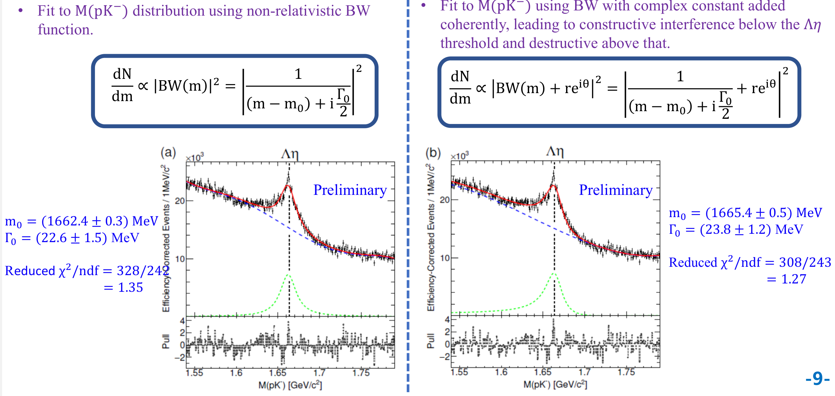
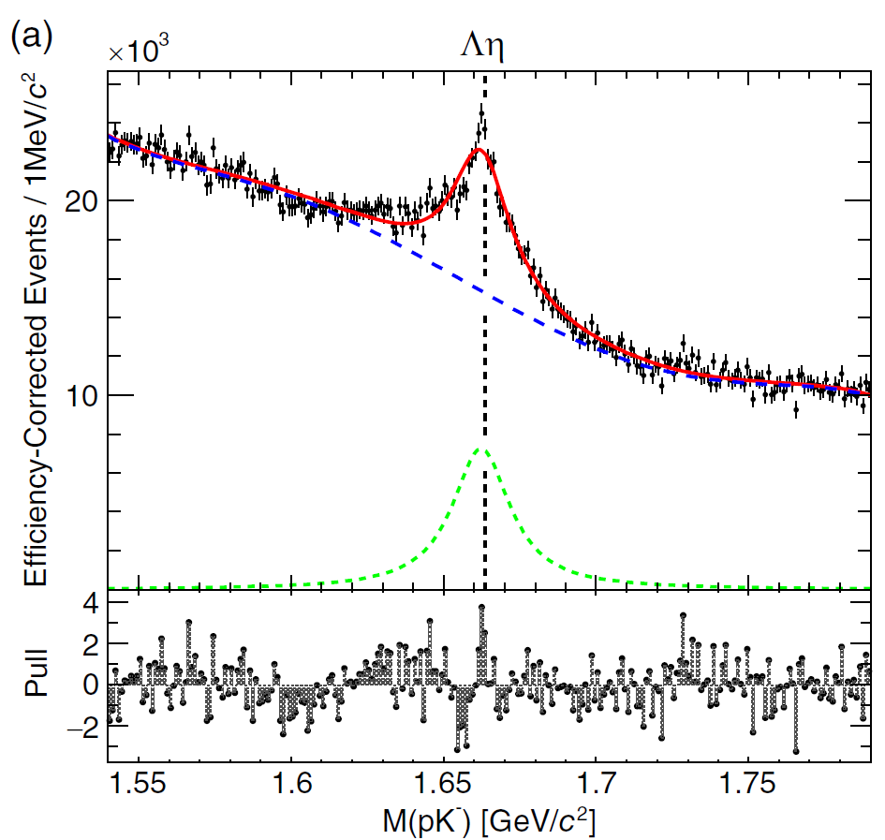
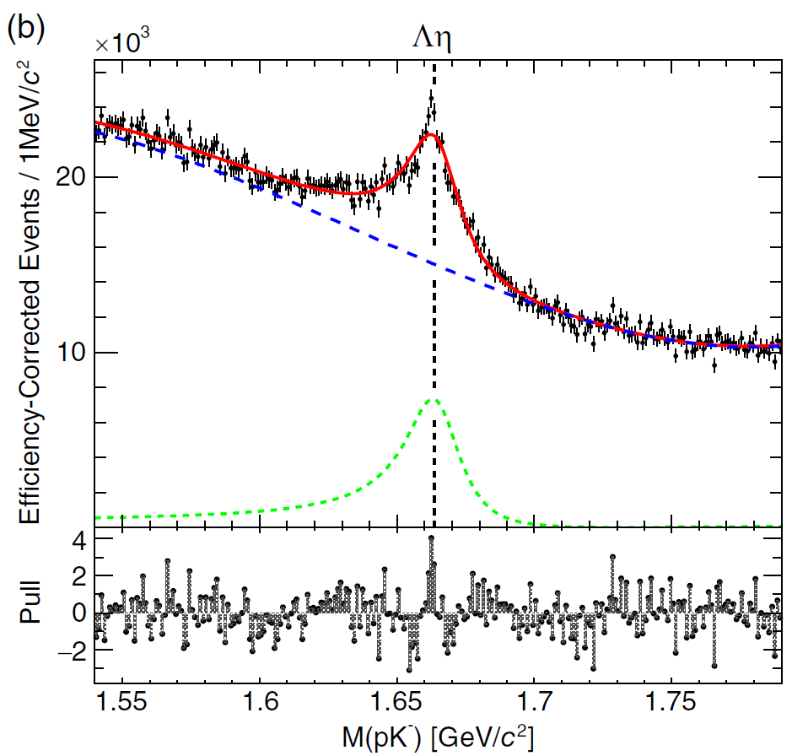


From the perspective of a new resonance
[PRD 108, L031104 (2023)]
17

Slide 18
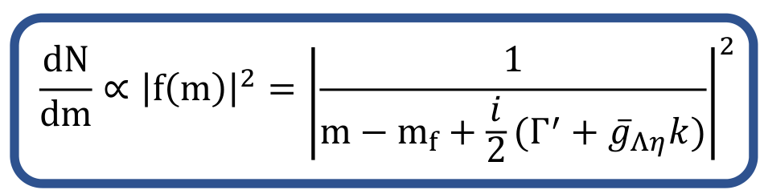
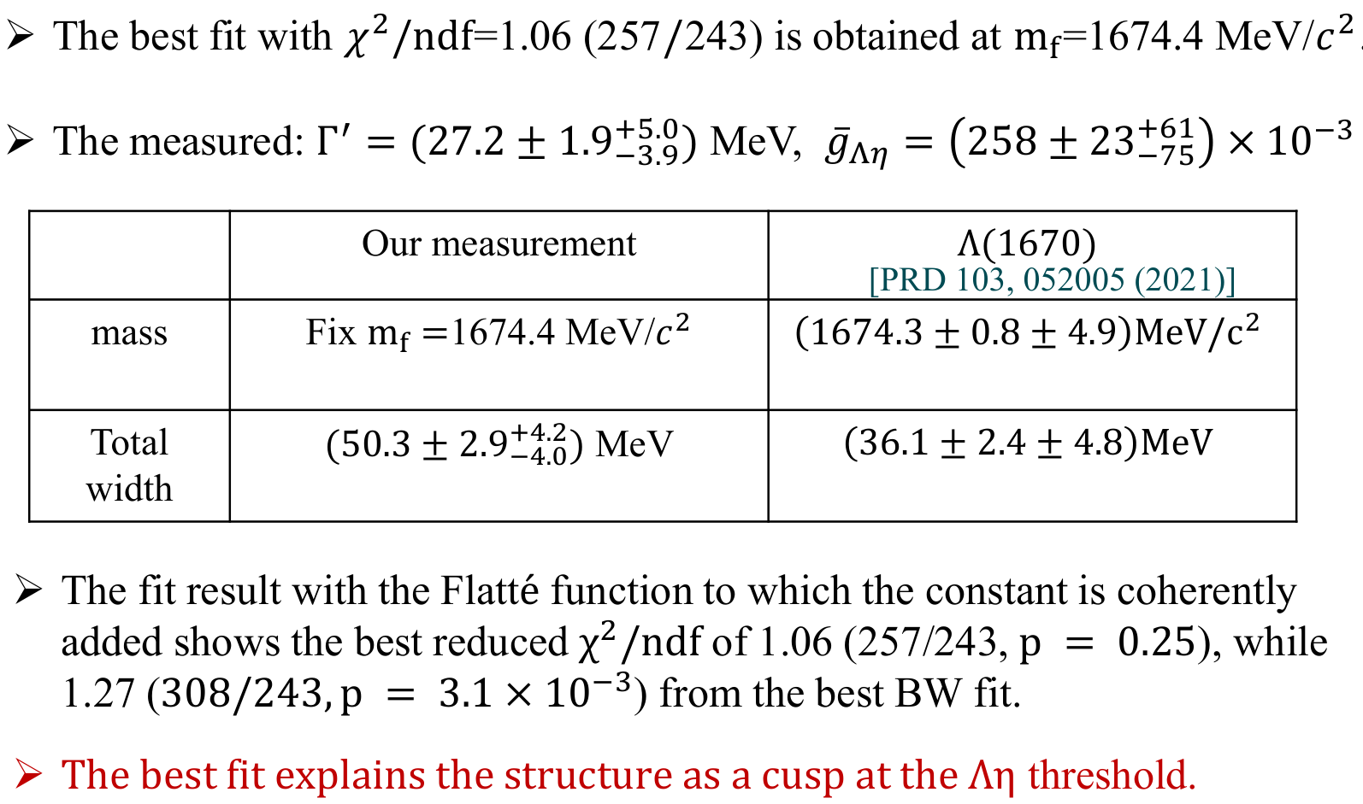

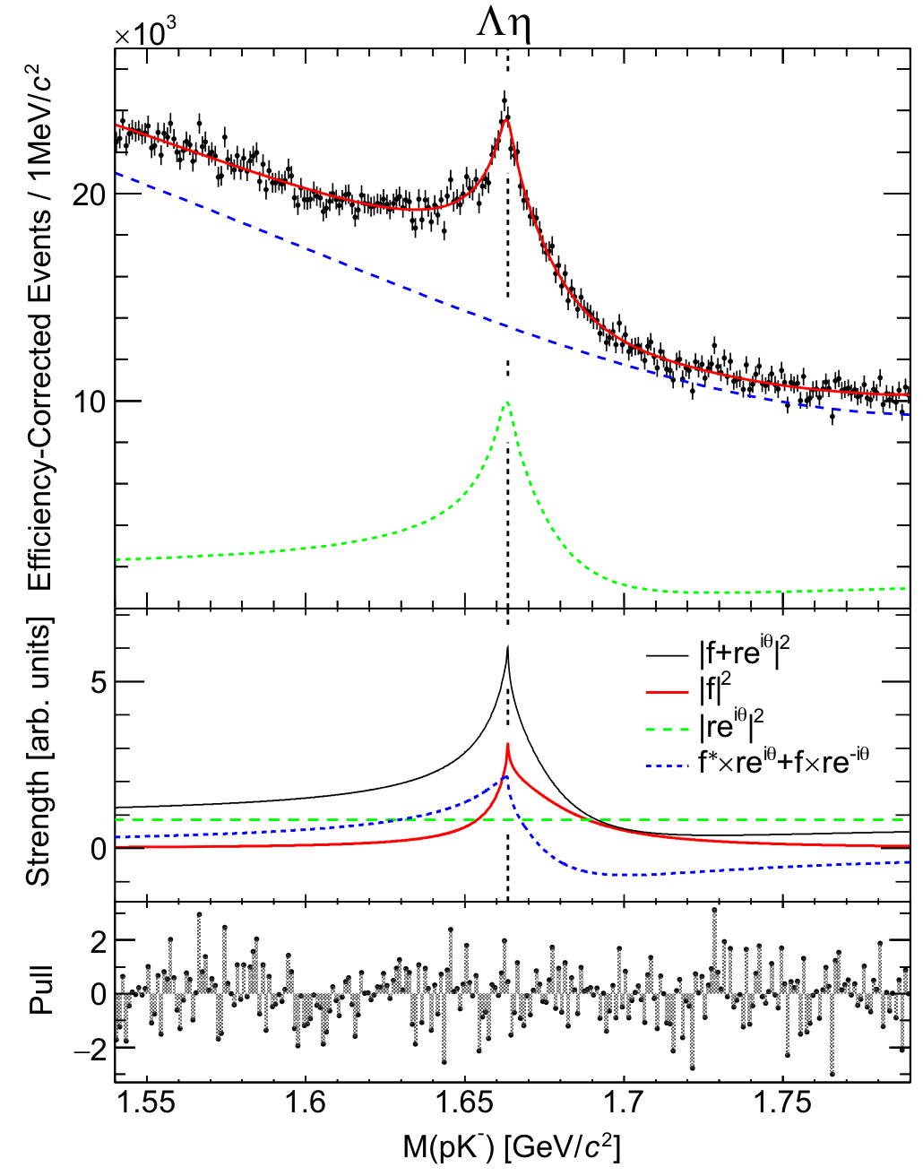
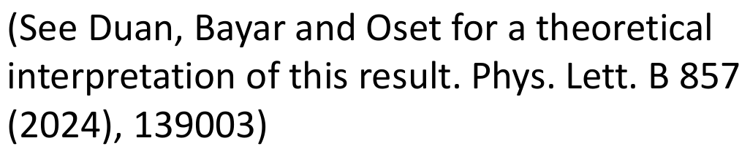


From the perspective of a cusp at $Λη$ threshold
non-relativistic
Flatt ́e function
First identification of a threshold cusp in hadrons from the spectrum shape
18

Slide 19
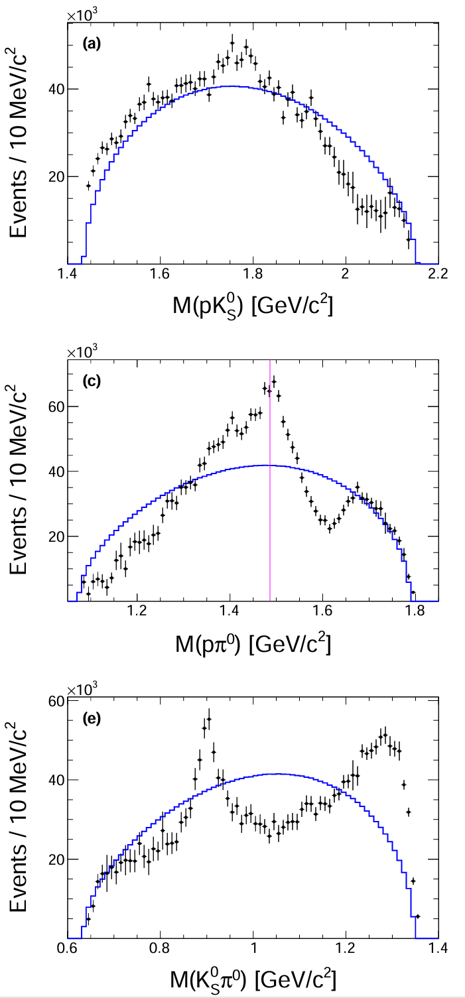
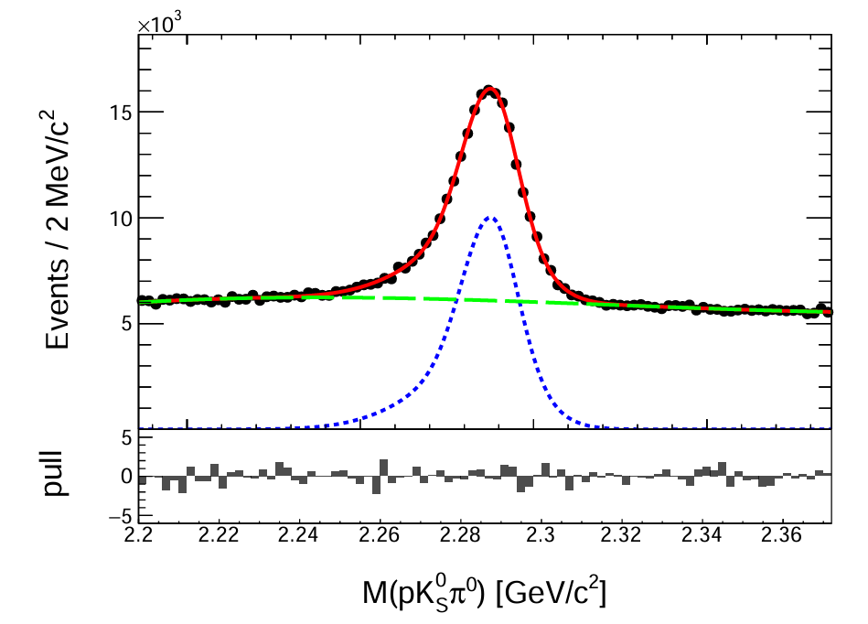
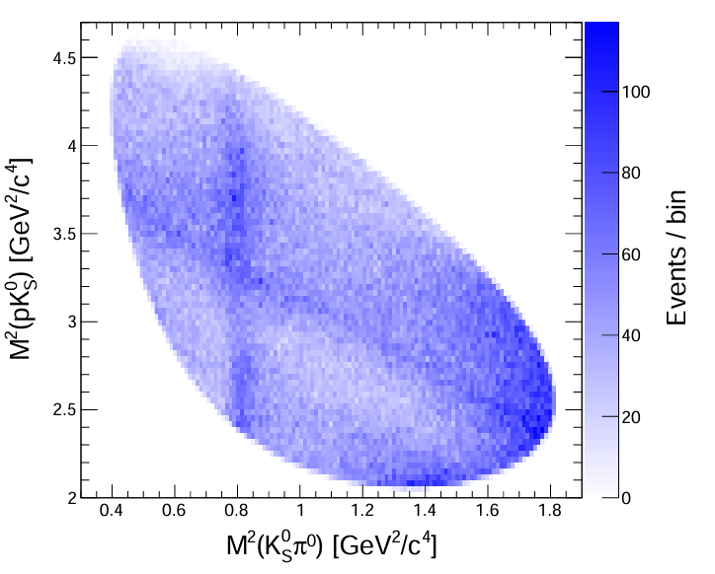

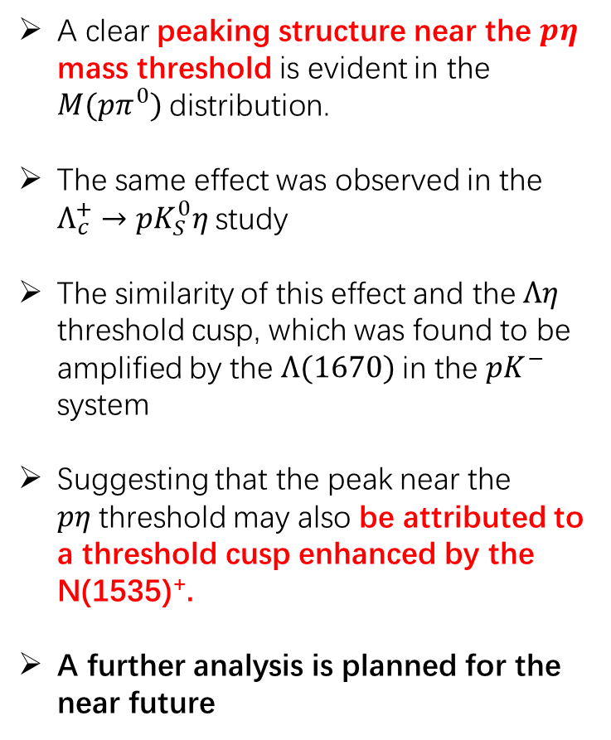
Peak at $pη$ threshold in $Λ_{c}^{+}→pK_{S}^{0}π^{0}$
arXiv:2503.04371
A clear peaking structure near the $pη$ mass threshold is evident in the $M(pπ^{0})$distribution.
The same effect was observed in the $Λ_{c}^{+}→pK_{S}^{0}η$study
The similarity of this effect and the $Λη$ threshold cusp, which was found to be amplified by the $Λ(1670)$in the $pK^{−}$ system
Suggesting that the peak near the $pη$threshold may also be attributed to a threshold cusp enhanced by the N(1535)⁺.
A further analysis is planned for the near future
19

Slide 20
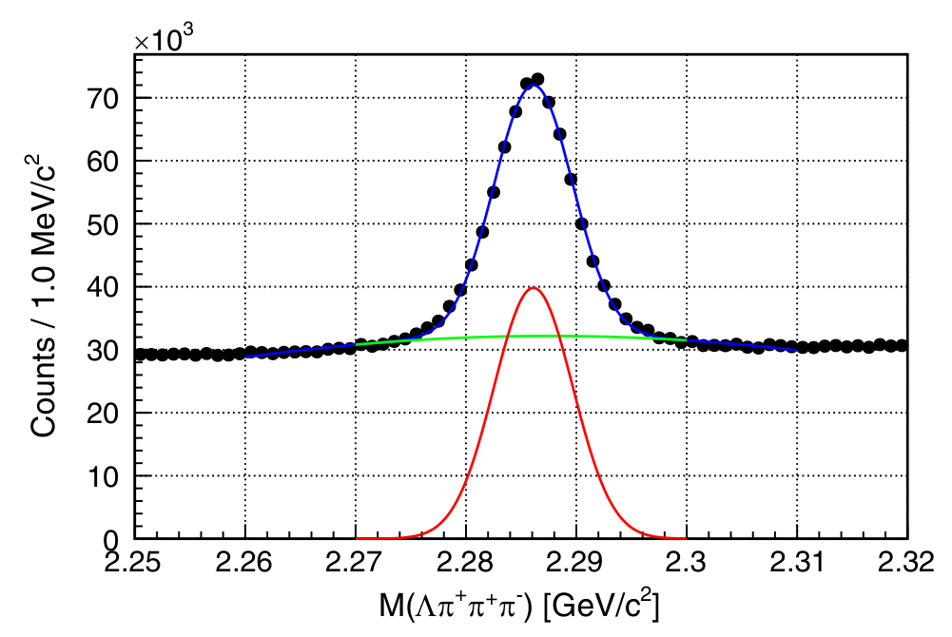
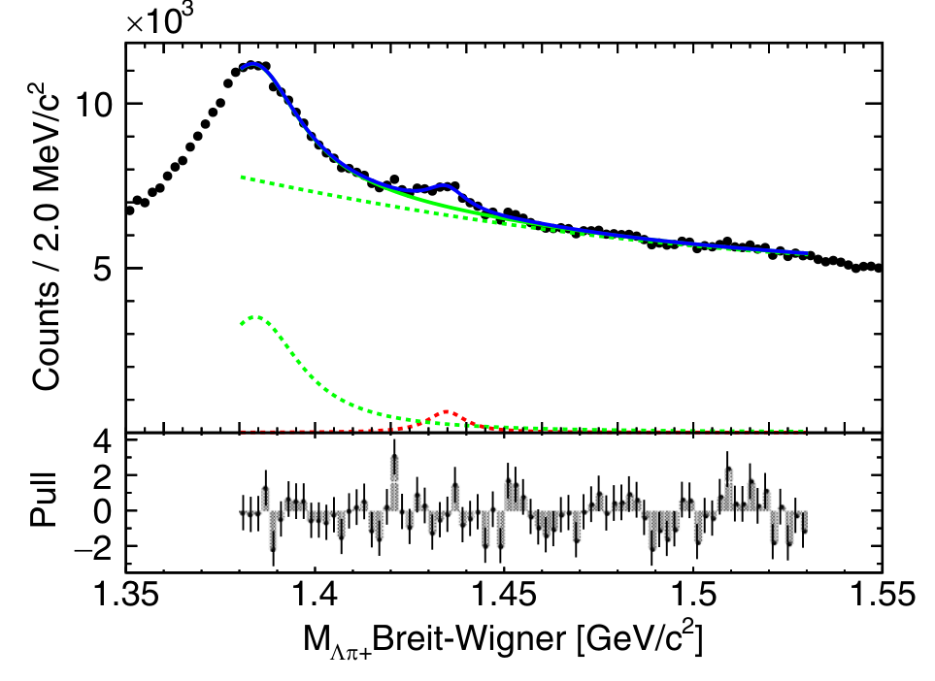
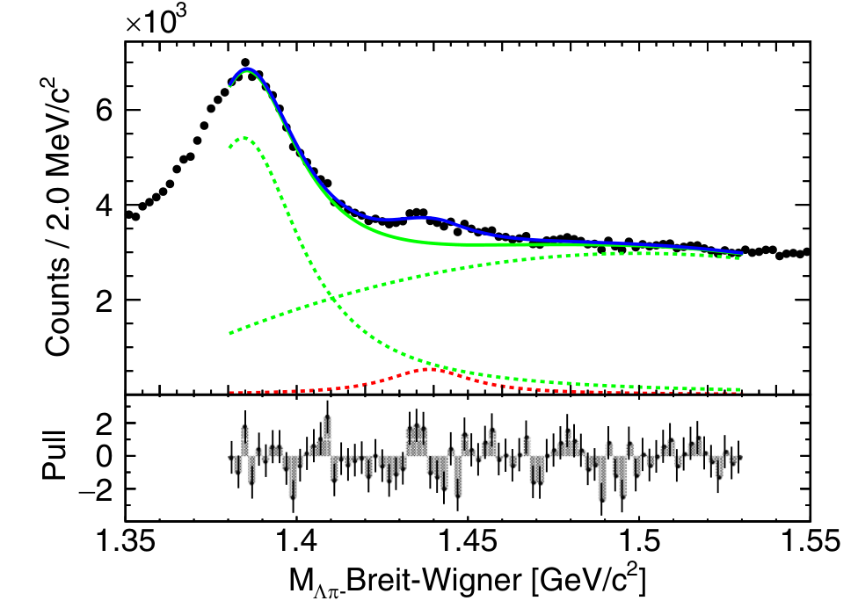

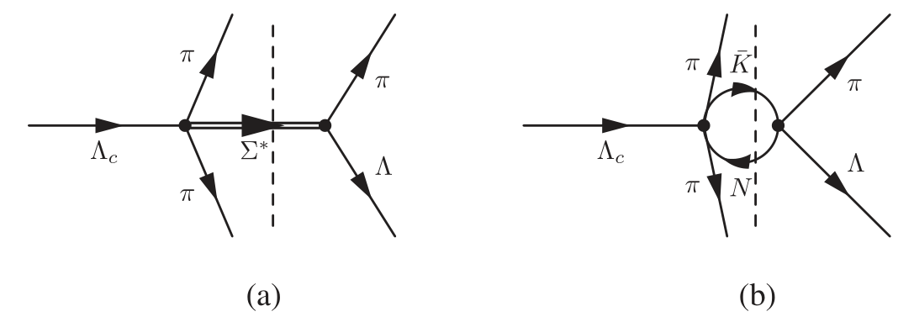
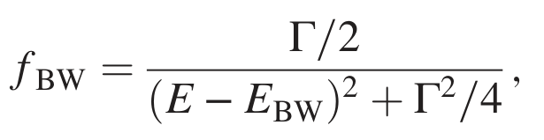
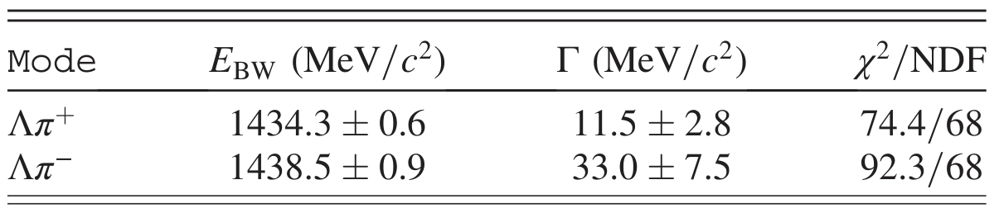
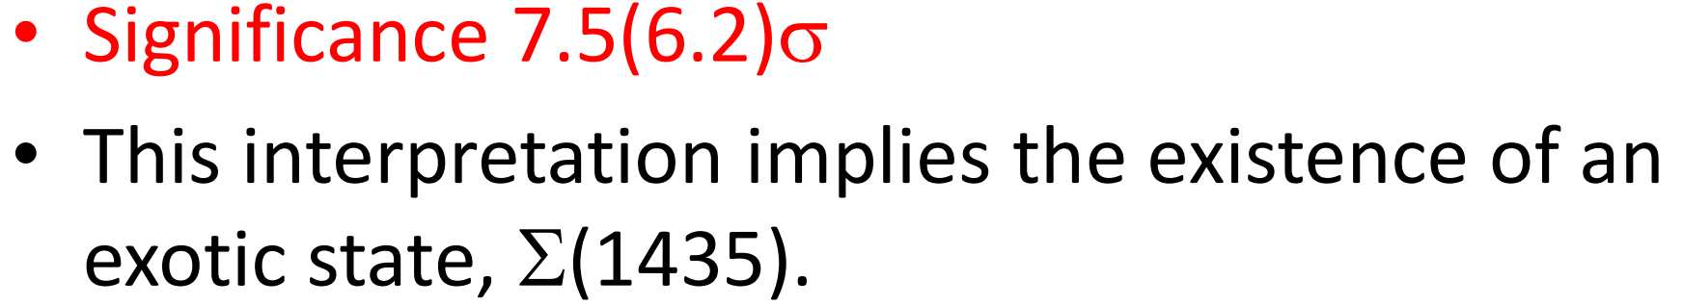




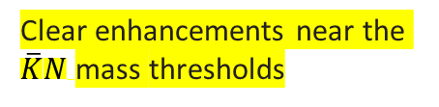


Investigation of the $Λπ^{±}$ substructure
[PRL 130, 151903 (2023)]
Cusp candidates are observed in $Λπ^{±}$ invariant mass spectra in $Λ_{c}^{+}→Λπ^{+}π^{+}π^{−}$ decay
A binned least-$χ^{2}$ fit
$$Σ(1385)$$
Clear enhancements near the $\overline{K}N$mass thresholds
To interpret the signals as $Σ^{∗}$ resonances, we use a nonrelativistic Breit-Wigner:
(a) search for $Σ^{∗}$ resonances
(b) study $\overline{K}N$rescattering with a cusp
20

Slide 21
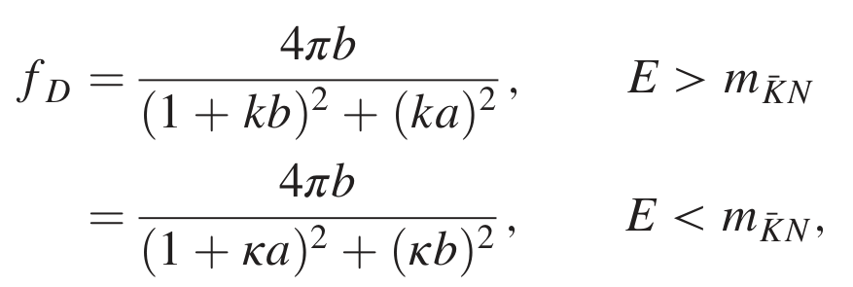
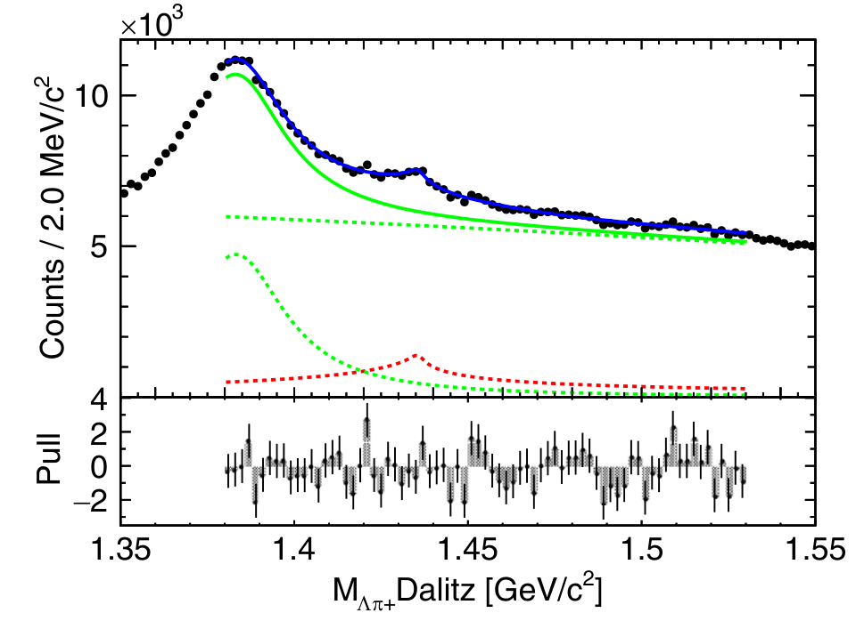
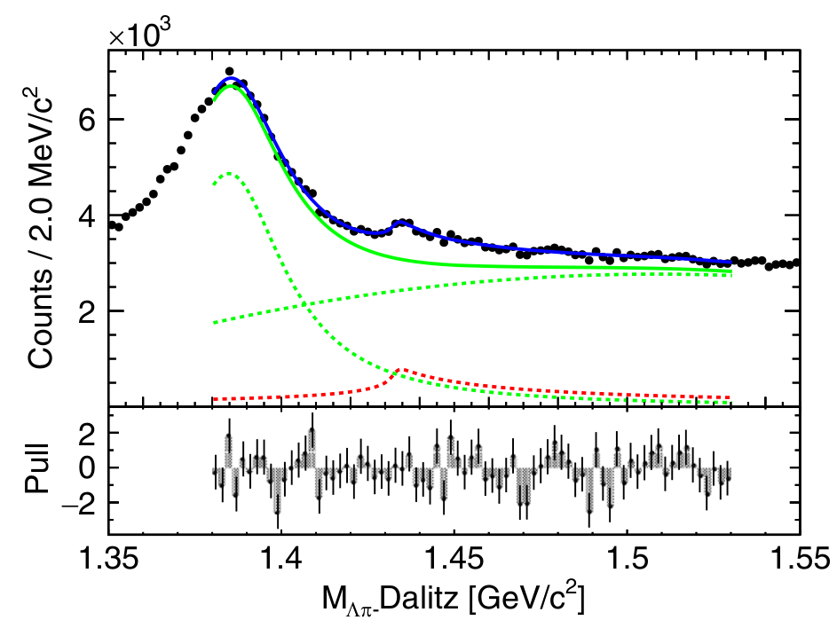
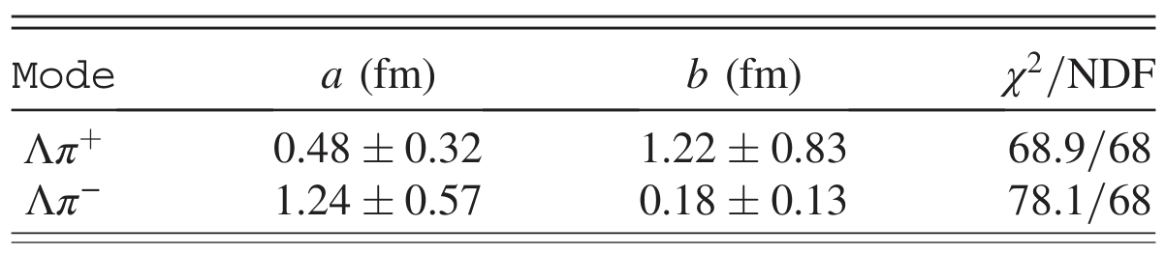
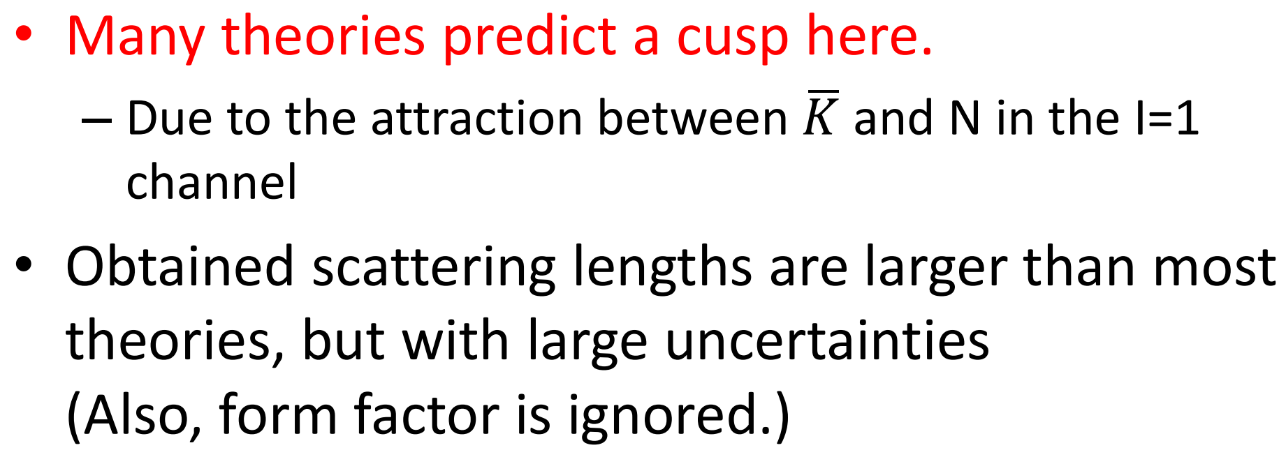
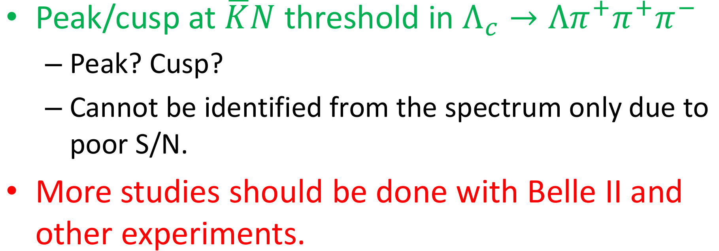

Investigation of the $Λπ^{±}$ substructure
Dalitz model (describe a $\overline{K}N$ cusp) [Czech. J. Phys. B32, 1021 (1982)]
$\overline{K}N$ cusp is related to the $\overline{K}N$ scattering length $A=a+ib$and decay momentum k/|k|.
A binned least-$χ^{2}$ fit
Dalitz model gives slightly better $χ^{2}$, but the difference is not significant.
21

Slide 22
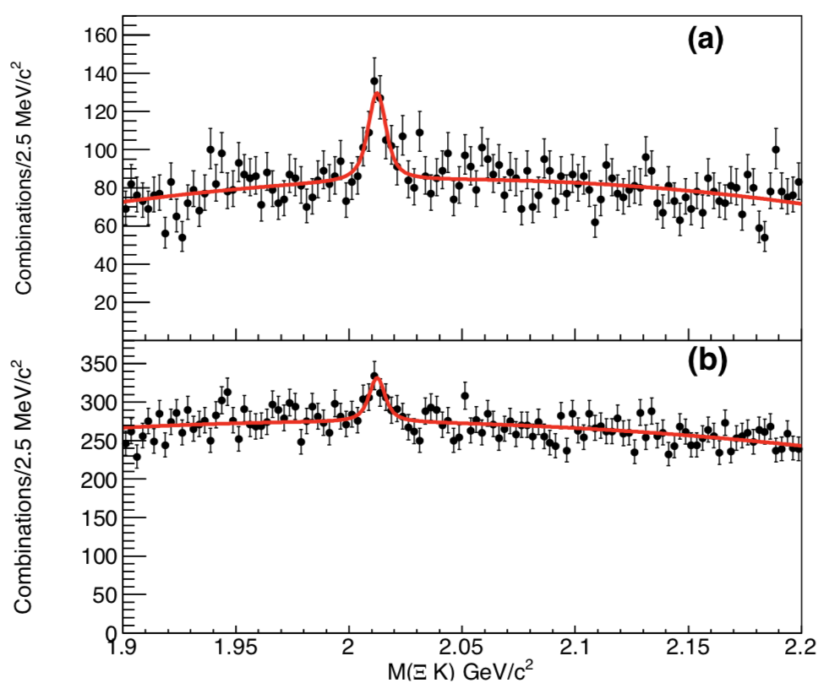


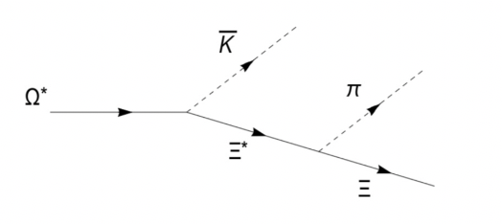
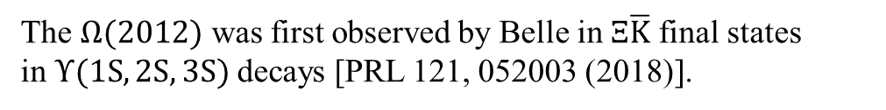

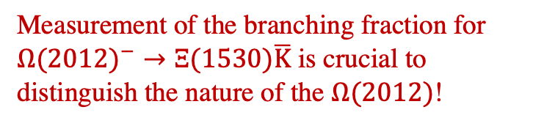

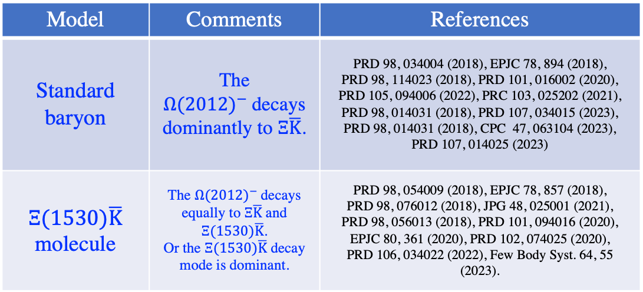

The ${Ω(2012)}^{−}$ baryon
The ${Ω(2012)}^{−}$was interpreted as a standard baryon or a $Ξ(1530)\overline{K}$ molecule.
The $Ω(2012)$ was first observed by Belle in $Ξ\overline{K}$ final states in$Υ(1S,2S,3S)$ decays [PRL 121, 052003 (2018)].
Model | Comments | References
Standard baryon | The ${Ω(2012)}^{−}$decays dominantly to $Ξ\overline{K}$. | PRD 98, 034004 (2018), EPJC 78, 894 (2018), PRD 98, 114023 (2018), PRD 101, 016002 (2020), PRD 105, 094006 (2022), PRC 103, 025202 (2021), PRD 98, 014031 (2018), PRD 107, 034015 (2023), PRD 98, 014031 (2018), CPC 47, 063104 (2023), PRD 107, 014025 (2023)
$Ξ(1530)\overline{K}$ molecule | The ${Ω(2012)}^{−}$decays equally to $Ξ\overline{K}$ and $Ξ(1530)\overline{K}$. Or the $Ξ(1530)\overline{K}$ decay mode is dominant. | PRD 98, 054009 (2018), EPJC 78, 857 (2018), PRD 98, 076012 (2018), JPG 48, 025001 (2021), PRD 98, 056013 (2018), PRD 101, 094016 (2020), EPJC 80, 361 (2020), PRD 102, 074025 (2020), PRD 106, 034022 (2022), Few Body Syst. 64, 55 (2023).
$$Ξ^{0}K^{−}$$
$$Ξ^{−}K_{S}^{0}$$
${Ω(2012)}^{−}→Ξ(1530)\overline{K}$
Measurement of the branching fraction for ${Ω(2012)}^{−}→Ξ(1530)\overline{K}$ is crucial to distinguish the nature of the $Ω(2012)$!
22

Slide 23






Discovery of $Ω{\left(2012\right)}^{−}$
PRL 134, 131903 (2025)
$Ω(2012)$ was first observed by Belle in two-body ($ΞK$) decays,
Confirmed by BESIII (low statistics) and ALICE (15σ).
arXiv:2502.18063
PRL, 121, 052003 (2018)
23
The $Ω(2012)$ was interpreted as a standard baryon or a $Ξ\left(1530\right)\overline{K}$ molecule.

Slide 24









Search for $Ω(2012)→KΞ$(1530) $→KπΞ$
PRD 100, 032006 (2019)
We use the same data samples to search for $Ω(2012)→KΞ$(1530) $→KπΞ$ in the decay of the narrow resonances $Υ$(1S), $Υ$(2S), and $Υ$(3S).
$Ω→Ξ(1530)^{0}$($→Ξ^{−}π^{+}$)$K^{−}$
$Ω→Ξ(1530)^{−}$($→Ξ^{−}π^{0}$)$K_{S}^{0}$
1.8$σ$
$Ω→Ξ(1530)^{−}$($→Ξ^{0}π^{−}$)$K_{S}^{0}$
$Ω→Ξ(1530)^{0}$($→Ξ^{0}π^{0}$)$K^{−}$
$R_{ΞK}^{ΞπK}=\frac{ℬ(Ω→Ξ(1530)(→Ξπ)K)}{ℬ(Ω→ΞK)}$ = (6.0$±$3.7(stat.)$±$1.3(syst.))%
$R_{ΞK}^{ΞπK}=\frac{ℬ(Ω→Ξ(1530)(→Ξπ)K)}{ℬ(Ω→ΞK)}$ < 11.9% at 90% C.L.
No clear $Ω(2012)$ signals are observed.
We give the upper limit on the ratio of the branching fractions at 90% C.L.
24

Slide 25





Revisit ${Ω(2012)}^{−}→Ξ(1530)\overline{K}→Ξπ\overline{K}$
PLB 860, 139224 (2025)
The comparisons between the previous analysis [PRD 100, 032006 (2019)] and this work.
The Flatt$\acute{e}$-like function [PRD 81, 094028 (2010)]
$g_{n}$ is the effective coupling of to the n–body final state.
$k_{n}$ and $κ_{n}$ parameterize the real and imaginary parts of the ${Ω(2012)}^{−}$self-energy.
Above 2.02 GeV, the phase space k₃ increases sharply to cover more signal candidates.
The red arrow for this updated work; The blue arrow for the previous analysis.
25

Slide 26



Revisit ${Ω(2012)}^{−}→Ξ(1530)\overline{K}→Ξπ\overline{K}$
PLB 860, 139224 (2025)
We fit simultaneously to the binned $Ξ^{−}π^{+}K^{−}$, $Ξ^{−}π^{0}K_{S}^{0},Ξ^{0}π^{−}K_{S}^{0},Ξ^{0}π^{0}K^{−},Ξ^{0}K^{−}$ and $Ξ^{−}K_{S}^{0}$ mass distributions from $Υ$(1S,2S,3S) data samples.
The mass and effective couplings :
5.4 σ
${Ω(2012)}^{−}$ mass | (2012.5±0.7±0.5) MeV
The coupling to $Ξ\overline{K}$ | (1.7±0.3±0.3)×10⁻²
The coupling to $Ξ(1530)\overline{K}$ | (${39}_{−39}^{+31}\text{±}\text{9}$)×10⁻²
0.99±0.26(stat.)±0.06(syst.)
Our result is consistent with the molecular model of ${Ω(2012)}^{−}$, which predicts comparable rates for ${Ω(2012)}^{−}$decay to $Ξ(1530)\overline{K}$ and $Ξ\overline{K}$ .
26

Slide 27


Evidence for $Ω_{c}^{0}→π^{+}Ω{\left(2012\right)}^{−}→π^{+}{\left(\overline{K}Ξ\right)}^{−}$
PRD 104, 052005 (2021)
Searching for a new production mechanism is important to further understand the nature of the $Ω{\left(2012\right)}^{−}$.
A theoretical study of the $Ω{\left(2012\right)}^{−}$ in the nonleptonic weak decays $Ω_{c}^{0}→π^{+}{\left(\overline{K}πΞ\right)}^{−}$ and $π^{+}{\left(\overline{K}Ξ\right)}^{−}$predicts a clear $Ω{\left(2012\right)}^{−}$signal in the ${\left(\overline{K}Ξ\right)}^{−}$ invariant-mass spectrum of the $Ω_{c}^{0}→π^{+}{\left(\overline{K}Ξ\right)}^{−}$ decay.
Using all 980$fb^{−1}$ Belle data, we present evidence for the $Ω{\left(2012\right)}^{−}$ in the resonant substructure of $Ω_{c}^{0}→π^{+}{\left(\overline{K}Ξ\right)}^{−} [{\left(\overline{K}Ξ\right)}^{−}=K^{−}Ξ^{0}+{\overline{K}}^{0}Ξ^{−}]$ decays.
[PRD 102, 076009 (2020)]
Signal significance: $4.2σ$ [including systematic uncertainties]
$$N^{sig}=46.6±12.3$$
[PRD 102, 076009 (2020)]
$\frac{ℬ\left(Ω_{c}^{0}→π^{+}Ω{\left(2012\right)}^{−}\right)ℬ(Ω{\left(2012\right)}^{−}→{\left(\overline{K}Ξ\right)}^{−})}{ℬ(Ω_{c}^{0}→π^{+}Ω^{−})}=(0.220±0.059\left(stat.\right)±0.035(syst.))$
27

Slide 28




Search for ${Ω(2012)}^{−}$ → γ$Ω^{−}$ in the $Ω_{c}^{0}$ → $π^{+}{Ω(2012)}^{−}$ decay
Measurements involving different decay patterns are important to further understand the nature of the $Ω{\left(2012\right)}^{−}$.
Theoretical calculations predict that the Ω(2012)− state has a large potential to be observed in the ${γΩ}^{−}$ channel.
Using $575 fb^{−1}$ Belle II data, we establish the $Ω_{c}^{0}$ → ${Ω^{−}π}^{+}$ as the reference mode and measure the relative branching fraction: $\frac{ℬ(Ω_{c}^{0} → π^{+}{Ω(2012)}^{−})×ℬ({Ω(2012)}^{−}→ γΩ^{−})}{ℬ{(Ω}_{c}^{0} → {Ω^{−}π}^{+})}.$
[PRD 101, 016002 (2020)]
[CPL 41, 081402 (2024)]
$$N_{input}=20$$
Signal significance: $2.8σ$
28

Slide 29




$φ\left(2170\right)$ History
$$6.9σ$$
29

Slide 30






M($ηφ$) distributions from ISR production
[PRD 107, 012006 (2023)]
No significant $φ(2170)$signal is seen
Clear $J/ψ$ and $φ(1680)$ signals.
Perform unbinned maximum likelihood fit to the $M(ηφ)$
30

Slide 31


Extraction of Resonant Parameters
31

Slide 32



Cross section of $e^{+}e^{−}→ηφ$
32

Slide 33
Charmed baryons
33

Slide 34

粲重子的发现和研究
检验量子色动力学（QCD）
  粒子物理基本理论的两个重要组成部分之一
  夸克间作用很强时无法计算，迫切需要实验引导理论的发展!
  Belle和Belle II实验是主要进行粲重子研究的实验之一
困难：数据量少、信噪比低、分析难度大。
34
20

Slide 35




$Ξ_{c}{(2930)}^{0}$in $B^{+}→K^{+}Λ_{c}^{+}{\overline{Λ}}_{c}^{−}$
Belle reported a structure, called Y(4630), in the $Λ_{c}^{+}{\overline{Λ}}_{c}^{−}$ invariant mass distribution in $e^{+}e^{−}→γ_{ISR}Λ_{c}^{+}{\overline{Λ}}_{c}^{−}$ PRL 101, 172001 (2008)
BarBar once studied $B^{+}→K^{+}Λ_{c}^{+}{\overline{Λ}}_{c}^{−}$ and found two small peaks in $M_{Λ_{c}^{+}{\overline{Λ}}_{c}^{−}}$ spectrum and a vague structure named $Ξ_{c}\left(2930\right)$is seen in the distribution of $M_{K^{ }Λ_{c}^{ }}$. Larger data is needed to verify them. PRD 77, 031101 (2007)
Also, some theory explained that Y(4660) has a large partial decay width to $Λ_{c}^{+}{\overline{Λ}}_{c}^{−}$ and it’s isospin partner Y(4616) is predicted. PRD 82, 094008; PRL102, 242004
PRL 101, 172001
PRD 77, 031101
35

Slide 36



$Ξ_{c}{(2930)}^{0}$in $B^{+}→K^{+}Λ_{c}^{+}{\overline{Λ}}_{c}^{−}$
36
36

Slide 37



Observation of $Ξ_{c}{(2930)}^{0}$in $B^{+}→K^{+}Λ_{c}^{+}{\overline{Λ}}_{c}^{−} at Belle$
Y. B. Li. *C.P.Shen et al., Eur. Phys. J. C78, 252 (2018)
No Y(4660) and its spin partner $Y_{η}$ were observed. in the $Λ_{c}^{+}{\overline{Λ}}_{c}^{−}$ invariant mass distribution
37

Slide 38




Evidence of charged $Ξ_{c}(2930)$ in $B^{0}→K_{ }^{0}Λ_{c}^{+}{\overline{Λ}}_{c}^{−}$
Eur. Phys. J. C78, 928 (2018)
Based on full $Υ(4S)$ data set (772 M $B\overline{B}$ pairs) at Belle
Three $Λ_{c}^{ }$ decay channels: $Λ_{c}^{+}→{pK}^{−}π^{+}$, $Λ_{c}^{+}→pK_{s}(π^{+}π^{−})$and $Λ_{c}^{+}→Λ\left({pπ}^{−}\right)π^{+}.$
$B$ candidates extracted via 2D fit to $M_{bc}$ and $ΔM_{B}$
38

Slide 39





Evidence of charged $Ξ_{c}(2930)$ in $B^{0}→K_{ }^{0}Λ_{c}^{+}{\overline{Λ}}_{c}^{−}$
Charged $Ξ_{c}(2930)$ extracted by fitting $M_{K_{s}^{0}Λ_{c}}$
3.9σ
Y. B. Li. *C.P.Shen et al., Eur. Phys. J. C78, 928 (2018)
39
39

Slide 40
40

Slide 41
41

Slide 42
42

Slide 43

43

Slide 44

44

Slide 45
45

Slide 46





Measurement of $Ξ_{c}^{+}$ absolute BRs
Measurement $ℬ\left({\overline{B}}^{0}→{\overline{Λ}}_{c}^{−}Ξ_{c}^{+}\right)$ with $Ξ_{c}^{+}→anythings$
$$3.2 σ$$
Reconstruct ${\overline{Λ}}_{c}^{−}$ via $\overline{p}K^{+}π^{−}$ decay mode
tag a $B^{0}$ with neural network based Full-Reconstruction algorithm.
An unbinned maximum likelihood fit: $N\left(Ξ_{c}^{+}\right)=18.8±6.8$
$ℬ\left({\overline{B}}^{0}→{\overline{Λ}}_{c}^{−}Ξ_{c}^{+}\right)=\left[1.16±0.42\left(stat.\right)±0.15\left(syst.\right)\right]×{10}^{−3}$
 | Y.B.Li, *C.P.Shen et al (Belle) PRD 100, 031101 (2019)
46

Slide 47





Measurement of $Ξ_{c}^{+}$ absolute BRs
Measurement $ℬ\left({\overline{B}}^{0}→{\overline{Λ}}_{c}^{−}Ξ_{c}^{+}\right)$ with $Ξ_{c}^{+}→Ξ^{−}π^{+}π^{+}$ or ${pK}^{−}π^{+}$
$$6.9σ$$
4.5$σ$
$$Ξ_{c}^{+}→Ξ^{−}π^{+}π^{+}$$
$$N=24.2±5.4$$
$$Ξ_{c}^{+}→pK^{−}π^{+}$$
$$N=24.0±6.9$$
Y. B. Li. *C. P. Shen et al (Belle) | PRD 100, 031101 (2019)
47

Slide 48


Measurements of the branching fractions of $B^{−}→{\overline{Λ}}_{c}^{−}Ξ_{c}^{∗0}$
Branching fractions of $B^{−/0}→{\overline{Λ}}_{c}^{−}Ξ_{c}^{0/+}$ as well as the absolute branching fractions of $Ξ_{c}^{+/0}$ were measured by Belle.
In those works, only $Ξ_{c}^{+/0}$ signal region of ${\overline{Λ}}_{c}^{−}$ recoil mass spectrum is focused on.
A nature question is: can we observe the excited $Ξ_{c}$ states in the higher
region of the ${\overline{Λ}}_{c}^{−}$recoil mass spectrum.
In this analysis, we checked the higher
region of the ${\overline{Λ}}_{c}^{−}$recoil mass spectrum.
We present the first measurements of
branching fractions of the decays
$B^{−}→{\overline{Λ}}_{c}^{−}Ξ_{c}^{′0}$, $B^{−}→{\overline{Λ}}_{c}^{−}Ξ_{c}{\left(2645\right)}^{0}$, and $B^{−}→{\overline{Λ}}_{c}^{−}Ξ_{c}{\left(2790\right)}^{0}$, using a missing-mass technique.
[PRL 122, 082001 (2019)]
[PRD 100, 031101(R) (2019) ]
48

Slide 49



Measurements of the branching fractions of $B^{−}→{\overline{Λ}}_{c}^{−}Ξ_{c}^{∗0}$
Recoil mass spectrum from data:
Y. Li. *C.P.Shen et al., PRD 100, 112010 (2019)
The empty space between the fitted background level and the normalized sideband is the contribution from other multi-body$B^{−}→{\overline{Λ}}_{c}^{−}+anything$ decays.
Since the statistical significances of $Ξ_{c}^{′0}$and $Ξ_{c}{\left(2645\right)}^{0}$ are less than 3$σ$, the 90% C.L. upper limits on the numbers of $Ξ_{c}^{′0}$ and $Ξ_{c}{\left(2645\right)}^{0}$ signal events are determined.
49

Slide 50







Observation of the decay $B→Σ_{c}\left(2455\right){\overline{Ξ}}_{c}$
[arXiv: 2507.05094]
The tree-level two-body baryonic $B$ decays can proceed through $W$-exchange ($W_{ex}$), $W$-annihilation ($W_{an}$), and internal $W$-emission ($W_{em}$) diagrams.
$W_{ex}$ and $W_{an}:$ helicity suppressed
$W_{em}:$ nonfactorizable amplitude
The decays $B→Σ_{c}\left(2455\right){\overline{Ξ}}_{c}$ proceed through a pure $W_{em}$ diagram, providing a clean and ideal environment for studying nonfactorizable effects.
The QCD sum rule predicts $ℬ\left(B→Σ_{c}\left(2455\right){\overline{Ξ}}_{c}\right)\sim 4×{10}^{−3}$ [NPB 345 137 (1990)], while the diquark model estimates$ℬ\left(B→Σ_{c}\left(2455\right){\overline{Ξ}}_{c}\right)$to be 30%$–$70% of $ℬ\left(B→Λ_{c}{\overline{Ξ}}_{c}\right)\sim {10}^{−3}$ [ZPC 51 445 (1991)].
$Σ_{c}\left(2455\right)$: a sextet of flavor-symmetric states ${\overline{Ξ}}_{c}$: an antitriplet of flavor-antisymmetric states
50

Slide 51








Observation of the decay $B→Σ_{c}\left(2455\right){\overline{Ξ}}_{c}$
[arXiv: 2507.05094]
We report the first observation of the decays $B^{+}→Σ_{c}{\left(2455\right)}^{++}{\overline{Ξ}}_{c}^{−}$ and $B^{0}→Σ_{c}{\left(2455\right)}^{0}{\overline{Ξ}}_{c}^{0}$, using the $772×{10}^{6}$ and $387×{10}^{6}$ $Υ(4S)$ events collected by Belle and Belle II, respectively.
We perform a 2D fit to the unbinned $M(Λ_{c}^{+}π^{±})$ and $ΔE$ distributions, simultaneously using four data sets: events from the signal and sideband regions of $M({\overline{Ξ}}_{c}^{−,0})$.
$$ℬ\left(B^{+}→Σ_{c}{\left(2455\right)}^{++}{\overline{Ξ}}_{c}^{−}\right)$$
$=\left(5.74±1.11±{0.42}_{−1.53}^{+2.47}\right)×{10}^{−4}$
$$7.3 σ$$
$$ℬ\left(B^{0}→Σ_{c}{\left(2455\right)}^{0}{\overline{Ξ}}_{c}^{0}\right)$$
$$=\left(4.83±1.12±{0.37}_{−0.60}^{+0.72}\right)×{10}^{−4}$$
$ℬ(B→Σ_{c}\left(2455\right){\overline{Ξ}}_{c})$ are larger than those of $B^{+}→{\overline{Σ}}_{c}{\left(2455\right)}^{0}p$ and $B^{0}→{\overline{Σ}}_{c}{\left(2455\right)}^{−}p:$
Similar size of CKM matrix elements:
$V_{bc}∗V_{cs}\sim V_{bc}∗V_{ud}$
Smaller phase-space
$$6.2 σ$$
[Int. J. Mod. Phys. A 21(2006) 4209]
One possible mechanism is that hard gluons are not necessarily required for double-charm decays.
51

Slide 52


Baryon production at B-factory
$$\frac{B\left(Signal\right)}{B\left(RM\right)}=\frac{N^{obs}(Signal)}{ε^{MC}(Signal)}×\frac{ε^{MC}(RM)}{N^{obs}(RM)}$$
52

Slide 53

Measurement of $Λ_{c}^{+}→pπ^{0}$ $(→γγ)$decay
S.X.Li, *C.P. Shen et al., PRD103, 072004 (2021)
Singly Cabibbo-suppressed (SCS) decay
There is no obvious signal excess in M($pπ^{0}$) from data. We set an upper limit on branching fraction of $B\left(Λ_{c}^{+}→pπ^{0}\right)<8×{10}^{−5}$ at 90% C.L., reducing the value to more than half of the current best upper limit of $2.7×{10}^{−4}$.
Left: fit to the invariant mass distribution of $pπ^{0}$ with a fixed signal yield of 1269. Right: The likelihood distribution changing with the branching fraction with the systematic uncertainty involved.
53
53

Slide 54



Measurement of $Λ_{c}^{+}→pη(→γγ)$decay
S.X.Li, *C.P. Shen et al., PRD103, 072004 (2021)
Singly Cabibbo-suppressed (SCS) decay
Gaussian + CB for signal.
Second-order polynomial for background.
Yield: 7734 ± 263
$χ^{2}/ndf$=1.23
A significant $Λ_{c}^{+}$signal is observed in M($pη$) distribution from data. The branching fraction is $B\left(Λ_{c}^{+}→pη\right)=\left(1.42±0.05±0.11\right)×10^{−3}$ , which is consistent with the latest BESIII measured result of $\left(1.24±0.30\right)×10^{−3}$with much improved precision.
The measured $B\left(Λ_{c}^{+}→pη\right)$is at least an order of magnitude larger than $B\left(Λ_{c}^{+}→pπ^{0}\right)$, which is consistent with the theoretical prediction of an internal W-emission mechanism involving an s quark in $Λ_{c}^{+}→pη$.
54
54

Slide 55





Precise Measurement of $Λ_{c}^{+}→pω$
S.X.Li. *C.P.Shen et al.,
PRD 104, 072008 (2021)
Signal $mode$
$$ω→π^{+}π^{−}π^{0}$$
$$9.1σ$$
Simultaneous fit for events in the ω signal region and the normalized ω sideband regions.
Most precise result to data
This result is consistent with the LHCb result $(9.4±3.9)×{10}^{−4}$.
This result agrees with the of theoretical predictions within uncertainties based on the SU(3)_{F} flavor symmetry.
55

Slide 56



First Observation of $Λ_{c}^{+}→pη′$
S.X.Li, *C.P.Shen et al., JHEP03(2022)090
R$eference mode$
Signal $mode$
B($Λ_{c}^{+}→pη′$ )=(4.73±0.82±0.47±0.24)×10⁻⁴
First observation of $Λ_{c}^{+}$in $Λ_{c}^{+}→pη′$
Our result is consistent with the most theoretical calculations based on $SU{\left(3\right)}_{F}$symmetry.
56

Slide 57








First Study of $Ξ_{c}^{0}→Ξ^{0}π^{0}/η/η^{′}$
Hadronic two-body decay of charmed baryons:
JHEP 10 (2024) 045
Nonfactorizable amplitudes from internal W-emission and W-exchange diagram lead to the difficulties for theoretical predictions.
Feynman diagrams [CJPH 78, 324 (2022)] for Cabibbo-favored signal modes $Ξ_{c}^{0}→Ξ^{0}h^{0},$ $h^{0}=π^{0},η,η^{′},$only nonfactorizable amplitudes contribute to.
Serval theoretical approaches developed to deal with nonfactorizable contributions, give various predictions on branching fractions (in unit of ${10}^{−3}$) and decay asymmetry parameter.
[5] Z. Phys. C 55, 659 (1992)
[6] PRD 57, 6532 (1998)
[7] PRD 46, 270 (1992)
[8] PRD 48, 4188 (1993)
[9] PRD 50, 5787 (1994)
[10] PRD 101, 014011 (2020)
[11] EPJC 7, 217 (1999)
[12] PRD 97, 073006 (2018)
[13] PLB 794, 19 (2019)
[14] JHEP 02, 165 (2020)
[15] JHEP 03, 143 (2022)
[16] JHEP 09, 35 (2022)
[17] JHEP 02, 235 (2023)
[18] PRD 108, 053004 (2023)
Internal $W$-emission
$W$-exchange
Need experiment measurement to clarify the theoretical picture.
Belle has reported abundant measurements on $Ξ_{c}^{0}$.
First combined Belle and Belle II charm measurement.
57

Slide 58









First Study of $Ξ_{c}^{0}→Ξ^{0}π^{0}/η/η^{′}$
Belle + Belle II ~1.4/ab:
Invariant mass spectra for $Ξ_{c}^{0}$ candidates
First measurements of the branching fractions using combined data:
$$ℬ\left(Ξ_{c}^{0}→Ξ^{0}π^{0}\right) =\left(6.9±0.3\left(stat.\right)±0.5(syst.)±1.5\left(norm.\right)\right)×{10}^{−3}$$
$$ℬ\left(Ξ_{c}^{0}→Ξ^{0}η\right) =\left(1.6±0.2\left(stat.\right)±0.2(syst.)±0.4\left(norm.\right)\right)×{10}^{−3}$$
$$ℬ\left(Ξ_{c}^{0}→Ξ^{0}η′\right) =\left(1.2±0.3\left(stat.\right)±0.1(syst.)±0.3\left(norm.\right)\right)×{10}^{−3}$$
taking $Ξ_{c}^{0}→Ξ^{−}π^{+}$ as reference mode (BR error dominate the uncertainties), favoriting predictions in SU(3) flavor symmetry [JHEP 02, 235 (2023)]
First asymmetry parameter $α(Ξ_{c}^{0}→Ξ^{0}π^{0})$ measurement depending on
$$\frac{dN}{dcosθ_{Ξ^{0}}} ∝1+α\left(Ξ_{c}^{0}→Ξ^{0}h^{0}\right)α\left(Ξ^{0}→Λπ^{0}\right)cosθ_{Ξ^{0}}$$
through a simultaneous fit to Belle and Belle II data samples
$$α\left(Ξ_{c}^{0}→Ξ^{0}π^{0}\right)=−0.90±0.15\left(stat.\right)±0.23\left(syst.\right)$$
taking $α$($Ξ^{0}→Λπ^{0}$) = $−$0.349$±$0.009(PDG)
PRELIMINARY
PRELIMINARY
$$Ξ_{c}^{0}→Ξ^{0}π^{0}$$
$$Ξ_{c}^{0}→Ξ^{0}η$$
PRELIMINARY
PRELIMINARY
PRELIMINARY
PRELIMINARY
PRELIMINARY
PRELIMINARY
JHEP 10 (2024) 045
$$Ξ_{c}^{0}→Ξ^{0}η′$$
58

Slide 59



Measurements of $B(Ξ_{c}^{0}→Λ_{c}^{+}π^{−})$
There is a special class of weak decay, the heavy-flavor-conserving nonleptonic decays, in charmed baryons containing both an s and a c quark, that proceeds via the decay of the s quark, i.e. $Ξ_{c}^{0}→Λ_{c}^{+}π^{−}$. The decay width of $Ξ_{c}^{0}→Λ_{c}^{+}π^{−}$ is based on the size of the s quark decay amplitude of $s→u(\overline{u}d)$ and the weak scattering amplitude $cs →dc$.
The branching fraction of $Ξ_{c}^{0}→Λ_{c}^{+}π^{−}$have been predicted based on the heavy quark expansion, and the heavy quark symmetry(HQS).
The Feynman diagrams of the (a) $s→u(\overline{u}d)$ and (b) $cs →dc$ modes of $Ξ_{c}^{0}→Λ_{c}^{+}π^{−}$.
Mode | [Phys. Rev. D 46, 5060 (1992)] | [Phys. Rev. D 100, 114030 (2019)] | [Phys. Lett. B 757, 330 (2016)] | [Phys. Lett. B 750, 653 (2015)]
$$Ξ_{c}^{0}→Λ_{c}^{+}π^{−}$$ | $$0.39×{10}^{−3}$$ | $$>\left(0.25±0.15\right)×{10}^{−3}$$ | $$\left(1.34±0.53\right)×{10}^{−3}$$ | < 0.39
59

Slide 60



Measurements of $B(Ξ_{c}^{0}→Λ_{c}^{+}π^{−})$
In this analysis, we present the measurement of branching fraction of $Ξ_{c}^{0}→Λ_{c}^{+}π^{−}$ using all Belle data.
Reference mode
PRD 107, 032005 (2023)
$N^{fit}=$ $1467.7±134.5$
$\frac{B(Ξ_{c}^{0}→Λ_{c}^{+}π^{−})}{B(Ξ_{c}^{0}→Ξ^{−}π^{+})}$= 0.38 ± 0.04 (stat.) ± 0.04 (syst.)
$B(Ξ_{c}^{0}→Λ_{c}^{+}π^{−})$ = (0.54 ± 0.05 ± 0.05$\text{±}0.12$)%
The result is consistent with previous measurement by LHCb experiment and recent theoretical calculation, and larger than the previous theoretical predictions.
60

Slide 61








Evidence for the singly Cabibbo-suppressed decay$Ω_{c}^{0}→Ξ^{−}π^{+}$ and search for ${Ω_{c}^{0}→Ξ}^{−}K^{+}$ and $Ω^{−}K^{+}$ decays at Belle
JHEP 01, 055 (2023)
We report the first evidence of $Ω_{c}^{0}→Ξ^{−}π^{+}$ with a signal significance of 4.5σ including systematic uncertainties.
No significant signals are found in $Ω_{c}^{0}→Ω^{−}K^{+}$ and ${Ω_{c}^{0}→Ω}^{−}π^{+}$.
signal mode
$$Ω_{c}^{0}→Ξ^{−}π^{+}$$
signal mode
$$Ω_{c}^{0}→Ξ^{−}K^{+}$$
$$ℬ(Ω_{c}^{0}→Ξ^{−}π^{+})/ℬ({Ω_{c}^{0}→Ω}^{−}π^{+}) = 0.253 ± 0.053(stat.) ± 0.030(syst.).$$
Normalization
mode ${Ω_{c}^{0}→Ω}^{−}π^{+}$
The branching fraction ratio is larger than the theoretical calculations of 0.104 and 1.96 × 10⁻³ using the current algebra [PRD 101, 094033 (2020)] and light-front quark model [CPC 42, 093101 (2018)] methods.
signal mode
$$Ω_{c}^{0}→Ω^{−}K^{+}$$
61

Slide 62








Measurements of $ℬ\left(Ω_{c}^{0}→Ω^{−}l^{+}ν_{ }\right) and ℬ\left(Ξ_{c}^{0}→Ξ^{−}l^{ }ν_{ }\right)$
Semileptonic decays of charmed baryons:
Ideal test of QCD in transition region of (non-)perturbative.
The cleanest processes among charmed decays; Verify lepton flavor universality (LFU).
Experimentally:
BESIII measured the $ℬ\left(Λ_{c}^{+}→Λl^{+}ν\right)$
ARGUS and CLEOII measured $ℬ{(Ξ}_{c}^{ }→Ξ^{ }l^{+}ν_{ })$
CLEO measured $ℬ{(Ω}_{c}^{0}→Ω^{−}e^{+}ν_{ })$
$𝓑\left(Λ_{c}^{+}→Λ{ e}^{+}ν_{e}\right)=\left(3.6±0.4\right)\%$ PRL 115, 221805(2015)
$𝓑\left(Λ_{c}^{+}→Λ{ μ}^{+}ν_{e}\right)=\left(3.5±0.4\right)\%$ PLB 767, 42 (2017)
large uncertainty
CLEOII
PRL 89 171803
$\frac{ℬ(Ω_{c}^{0}→Ω^{−}e^{+}ν)}{ℬ(Ω_{c}^{0}→Ω^{−}π^{+})}$ = $2.4±1.2$
ARGUS
PLB 303 368
$\frac{ℬ(Ξ_{c}^{ }→Ξ^{−}ℓ^{+}ν_{ })}{ℬ(Ξ_{c}^{ }→Ξ^{−}π^{+})}$ = $0.96±0.47$
$3.1±1.1= \frac{ℬ(Ξ_{c}^{ }→Ξ^{−}e^{+}ν_{ })}{ℬ(Ξ_{c}^{ }→Ξ^{−}π^{+})}$
62

Slide 63





Measurement of $ℬ\left(Ξ_{c}^{0}→Ξ^{−}l^{ }ν_{ }\right)$
Y. B. Li. *C.P.Shen et al., PRL 127, 121803 (2021)
Fit component:
Signal : True signal histogram
BKG1: $Ξ^{−}$ sideband
BKG2: $Ξ^{−}ℓ^{−}$ - $Ξ^{−}$ sideband
BKG3: ${Ξ_{c}^{0}→Ξ}^{−}π^{+}ℓν$ histogram
BKG5: ${Ξ_{c}^{0}→Ξ}^{−}π+h$ histogram
BKG4: Bkg histogram from B decay
data-driven method for bkg extraction
$$𝓑\left(Ξ_{c}^{0}→Ξ^{−}{ e}^{+}ν_{e}\right)=\left(1.31±0.39\right)\%$$
Previous: $\left(2.34±1.59\right)\%$
$$𝓑\left(Ξ_{c}^{0}→Ξ^{−}{ μ}^{+}ν_{μ}\right)=\left(1.27±0.39\right)\%$$
Consistent with LFU
63

Slide 64





Measurement of $ℬ\left(Ω_{c}^{0}→Ω^{−}l^{+}ν_{ }\right)$
Y. B. Li, *C.P.Shen et al., Phys. Rev. D 105, L091101 (2022)
$Ω_{c}^{0}→Ω^{−}μ^{+}ν_{ }$: signal extraction
Similar data-driven method used in $Ξ_{c}^{0}→Ξ^{−}l^{ }ν_{ }$
$\frac{𝓑(Ω_{c}^{0}→Ω^{−}e^{+}ν)}{𝓑(Ω_{c}^{0}→Ω^{−}π^{+})}$ = $1.98±0.15$
$\frac{𝓑(Ω_{c}^{0}→Ω^{−}μ^{+}ν)}{𝓑(Ω_{c}^{0}→Ω^{−}π^{+})}$ = $1.94±0.21$
Previous: $2.4±1.2$
Consistent with LFU
64

Slide 65





Study of $Λ_{c}^{+}$ excited state
$Λ_{c}\left(2940\right)→Σ_{c}\left(2455\right)π:$ the highest excited $Λ_{c}$ state
LHCb favor the $J^{P}={\frac{3}{2}}^{−}$，but other values can not be excluded JHEP 05, 030 (2017).
The mass of $Λ_{c}\left(2940\right)$ lower than the traditional expectation of quark model
Int J Theor Phys 59, 1129 (2020)
[9]. Phys. Lett. B 659, 612 (2008).
[10]. Phys. Rev. D 84, 014025 (2011).
[11]. Phys. Rev. D 91, 054034 (2015).
[16]. Phys. Rev. D 92, 114029 (2015).
[21]. Eur. Phys. J. C 77, 154 (2017).
Regge trajectories
Theoretical interpretation：
$Λ_{c}\left(2940\right): J^{P}={\frac{1}{2}}^{−}$ state，lies in other Regge trajectories
Search for $Λ_{c}(3005)$
Similar to $Λ\left(1405\right),D_{s}\left(2317\right),X(3872)$, $D^{∗}N contribute in Λ_{c}\left(2940\right)$
Mass of $Λ_{c}\left({\frac{1}{2}}^{−},2P\right)$ invese，and larger than $Λ_{c}\left({\frac{3}{2}}^{−},2P\right)$
${\overline{B}}_{ }^{0}→Λ_{c}^{∗} \overline{p}, Λ_{c}^{∗}→Σ_{c}π$：
Search for $Λ_{c}$ excetied stats，
also can constraint on $J^{P}$
65

Slide 66


Evidence of a new $Λ_{c}^{+}$ excited state ?
PRL 130, 031901 (2023)
A new structure in $M_{Σ_{c}π}$ spectrum is seen
$m_{ }=(2913.8±5.6+3.8) \text{MeV}\text{/}\text{c}\text{2}$
$Γ_{ }=\left(51.8±20.0±18.8\right) MeV$
Statistic significance: $6.1σ$
most conservative significance include syst. err: 4$.2σ$
Possible $J^{p}=$ ${\frac{1}{2}}^{−}$, agrees with $Λ_{c}\left({\frac{1}{2}}^{−},2P\right),$ named: $Λ_{c}(2910)$
Need more study to confirm its nature
66

Slide 67







MC-based PWA of$Ξ_{c}^{+}→Ξ^{−}π^{+}π^{+}$
PRD 111, 074039 (2025)
$Ξ_{c}^{+}→Ξ^{−}π^{+}π^{+}$is a golden channel to study properties of the $Ξ^{∗}$ excited baryons.
Belle has reported a research on this process. They reported:
first observation of $Ξ{\left(1620\right)}^{0}$
$4.0σ$ evidence of the $Ξ{\left(1690\right)}^{0}$
An unknown structure in the range 1.8−2.1 GeV/$c^{2}$, expected to be due to resonances such as $Ξ{\left(1820\right)}^{0}$, $Ξ{\left(1950\right)}^{0}$, and $Ξ{\left(2030\right)}^{0}$.
$$Ξ^{−}π_{L}^{+}$$
$$Ξ^{−}π_{L}^{+}$$
$$Ξ^{−}π_{H}^{+}$$
PRL 122 072501 (2019)
The spin-parities of $Ξ{\left(1620\right)}^{0},Ξ{\left(1950\right)}^{0}$, and $Ξ{\left(2030\right)}^{0}$ have not been determined yet.
PWA is one of the best techniques to study the internal dynamics of three-body decays and the large statistic of $Ξ_{c}^{+}→Ξ^{−}π^{+}π^{−}$in Belle (II) makes the PWA possible.
67

Slide 68




MC-based PWA of$Ξ_{c}^{+}→Ξ^{−}π^{+}π^{+}$
PRD 111, 074039 (2025)
In this work, we demonstrate the reliability of PWA method for analyzing the $Ξ_{c}^{+}→Ξ^{−}π^{+}π^{+}$decay using the toy MC simulations.
Decay amplitude of $Ξ_{c}^{+}→Ξ^{∗}π^{+},Ξ^{∗}→Ξ^{−}π^{+}$ is constructed using the covariant tensor formalism, expressed as:
$M_{i}=\overline{u}V_{Ξ^{∗}→Ξ^{−}π^{+}}G_{Ξ^{∗}}^{(J^{P})}V_{Ξ_{c}^{+}→Ξ^{∗}π^{+}}u$
$u(\overline{u})$ is the spinor for a baryon,$V$ is the effective vertex, $G$ is the propagator of the $Ξ^{∗}$ resonance.
The total decay amplitude of $Ξ_{c}^{+}→ Ξ^{−}π^{+}π^{+}$ is
$$M=\sum_{i}{c_{i}M_{i}}$$
We generate a set of toy MC samples using the properties:
Use maximum likelihood fit. The joint probability density is
$$L=\prod_{i=1}^{N}{P(x_{i})}=\prod_{i=1}^{N}{\frac{ω(x_{i})}{\int{ω\left(x\right)dΦ}}}$$
The differential cross section is given by $ω\left(x\right)={\left|\sum_{i}{c_{i}M_{i}}\right|}^{2}$
68

Slide 69



MC-based PWA of$Ξ_{c}^{+}→Ξ^{−}π^{+}π^{+}$
PRD 111, 074039 (2025)
Best fit results to toy MC sample
Significances of rejection of alternative $J_{alt}^{P}$ over favored $J_{fav}^{P}$
Based on the current Belle integrated luminosity, the rejection significance of $J_{alt}^{P}$over $J_{fav}^{P}$is strong for different spins, but weak for different parities.
Further data collection is needed to improve the sensitivity of parity determination in the future, e.g., Belle II.
69

Slide 70
B meson decays
70

Slide 71
B Flavor tagging at Belle II
[Eur. Phys. J 82, 283 (2022)]
Phys.Rev.D 110 (2024) 012001
71

Slide 72



CKM matrix: |V_{cb}| & |V_{ub}|
72

Slide 73
Semileptonic B decay: V_{cb}
New exclusive measurements from BaBar with B→Dlv and Belle with B→D*lv using full differential information for the first time
• 𝑉_{𝑐𝑏} = (41.1 ± 1.2) × 10⁻³
[Babar arXiv:2311.15071]
• 𝑉_{𝑐𝑏} = (41.0 ± 0.7) × 10⁻³
[Belle PRL 133, 131801 (2024)]
Compatible with inclusive – perhaps we are on the right path to resolve these tensions?
73

Slide 74


Simultaneous measurements of B⁰→π⁻ℓ⁺ν and B⁺→ρ⁰ℓ⁺ ν
arXiv:2407.17403
74

Slide 75

Simultaneous measurements of B⁰→π⁻ℓ⁺ν and B⁺→ρ⁰ℓ⁺ ν
arXiv:2407.17403
75

Slide 76


Simultaneous measurements of B⁰→π⁻ℓ⁺ν and B⁺→ρ⁰ℓ⁺ ν
arXiv:2407.17403
76

Slide 77

Lepton-Flavor Universality
77

Slide 78


R(D*) using hadronic B tagging at Belle II
PRD 110, 072020 (2024)
78

Slide 79

R(D*) using hadronic B tagging at Belle II
PRD 110, 072020 (2024)
79

Slide 80
Measurement of R(X)
Inclusive ratio R(X) = B(B→Xτν)/B(B→Xℓν)
with τ leptonic decays
Hadronic-tagging method with 189 fb⁻¹
Hadronic tag pioneered by BaBar [PRL 92, 071802]; MVA version at Belle II [Comput. Softw. Big Sci. 3 (2019) 1, 6]
Use missing-mass squared and B candidate momentum to extract signal
Result agrees with SM prediction: R(X)SM = 0.223 ± 0.005
80

Slide 81

Electroweak Penguin and LFV @ Belle (II) experiment
81

Slide 82


Big Bang Theory Episode (FCNCs)
Sheldon, what about FCNCs ?
John Ellis, the CERN theorist who coined the name “Penguin” (a type of FCNC).
Examine the following b→s γ decay modes in the Belle II Phase 3 dataset.
So how do penguins (FCNCs) work ?
FCNC’s are forbidden at 1st order in the SM
82

Slide 83


Radiative penguin: B$→γK^{∗}$
83

Slide 84


Radiative penguin: B$→γK^{∗}$
2D M_{bc}-$∆$E fit to extract Simultaneously yields of B and anti-B for self-tagged modes for A_{CP} and B
arXiv:2411.10127
84

Slide 85



: BSM without hadronic uncertainties
The B→K^{(*)} $ν \overline{ν}$ missing energy modes are accessible to Belle II (and Belle), but might be difficult at a hadron experiment.
Signal: B→K ν $\overline{ν}$
Tag mode: B→Dπ; D→Kπ
A b quark has charge -1/3, an s quark has charge -1/3 so this decay is a flavor changing neutral current (FCNC).
85

Slide 86


a 3.5$σ$ excess or “evidence” signal: B→K ν $\overline{ν}$
PRD 109, 112006 (2024)
New Technique from Belle II
with inclusive ROE
(Rest of the Event) tagging. (X 10-20 $ε$ compared to FEI, but large bkgs).
Now add on some ML/AI (boosted decision trees or BDTs) to help us tame the large backgrounds.
Distributions for the signal-enhanced region in the ITA (Inclusive tagged analysis)
Fits in bins of BDT2 and q²
86
86

Slide 87


a 3.5$σ$ excess or “evidence” signal: B→K ν $\overline{ν}$
PRD 109, 112006 (2024)
Consistency check with the lower sensitivity FEI hadronic tag.
Inclusive tagged analysis
87

Slide 88

Combination and comparison with other measurements
PRD 109, 112006 (2024)
Significance of signal excess is 3.5 standard deviations. The signal is 2.7$σ$ above the SM expectation.
Maybe third generation couplings b → s $τ^{+}τ^{−}$ are enhanced
Program: In the future, Belle II should be able to measure B→K nu nubar, K* nu nubar, q² spectra and K* polarization.
88

Slide 89

Search for 𝙱^{𝟶}→ $K_{s}^{0}$τ±ℓ∓ at Belle and Belle II
The BSM extensions predict that the decay rates for LFV 𝚋→ sτℓ decays are close to current experimental sensitivity
Third-generation couplings + τ lepton mass → sensitivity to new physics
89

Slide 90
Search for 𝙱^{𝟶}→ $K_{s}^{0}$τ±ℓ∓ at Belle and Belle II
arXiv:2412.16470
90

Slide 91

Study of the rare decay B⁰ → γγ decay at Belle and Belle II
1 Yue-Long Shen et al. (2020), Journal of High Energy Physics, 169 (2020)
91

Slide 92

Study of the rare decay B⁰ → γγ decay at Belle and Belle II
Phys. Rev. D 110, L031106 (2024)
92

Slide 93



Study of the rare decay B⁰ → γγ decay at Belle and Belle II
Phys. Rev. D 110, L031106 (2024)
93

Slide 94
τ lepton physics
94

Slide 95
Belle II τ physics program
95

Slide 96

Lepton Flavour Universality measurement in τ decays
96

Slide 97




Lepton Flavour Universality measurement in τ decays
JHEP 08 (2024) 205
97

Slide 98
Lepton Flavour Violation (LFV) searches in τ decays
98

Slide 99
LFV : search for τ± → μ± μ∓ μ±
JHEP 2024, 62 (2024)
99

Slide 100





Search for BNV decay $τ→Λ\left(\overline{Λ}\right)π$ at Belle II
PRD 110, 112003 (2024)
Signal efficiencies are 9.5% and 9.9% for $τ→Λπ$ and $τ→\overline{Λ}π$;
Poisson counting experiment technique in signal region in the $M\left(Λπ\right)=\sqrt{E_{Λπ}^{2}−P_{Λπ}^{2}}$and $ΔE=E_{Λπ}^{CM}−\sqrt{s}/2$ plane;
Expected events are 1 and 0.5 for $τ→Λπ$ and $τ→\overline{Λ}π$;
No observed events;
World's best upper limits at 90% C.L. of $4.7×{10}^{−8}$ for $ℬ\left(τ→Λπ\right)$ and $4.3×{10}^{−8}$ for $ℬ\left(τ→\overline{Λ}π\right)$;
100

Slide 101
Charmonium States
101

Slide 102


Charmonium Spectrum
At short distance
Cornell model works pretty well
V(r) = -4α_{s}/3r+kr
102

Slide 103


Charmonium(-like) Spectrum
At short distance
Cornell model works pretty well
V(r) = -4α_{s}/3r+kr
Godfrey & Isgur, PRD32, 189 (1985)
103

Slide 104






$η_{c2}(1D)$: spin-singlet low-lying D-wave charmonium
Mass: in the range of 3.80 to 3.88 GeV/c², and lies between $D\overline{D}$ and $D^{∗}\overline{D}$ threshold [PRD 72, 054026 (2005), PRD 79, 094004 (2009)].
Width: very narrow
Decay mode: branching fraction of $η_{c2}(1D)→γh_{c}(1P)$ is large (> 50%) [PRD 80, 014001 (2009)].
The $η_{c2}(1D)$ was searched in B decays and e⁺e⁻ annihilations by Belle, but no signal was found [JHEP 05, 034 (2020), PRD 104, 012012 (2021)].
$$e^{+}e^{−}→γη_{c2}(1D)$$
$$B^{+}→η_{c2}(1D)K^{+}$$
$$B^{0}→η_{c2}(1D)K_{s}^{0}$$
104

Slide 105
Bottomonium States
105

Slide 106
Bottomonium Spectrum
106

Slide 107


Bottomonium Spectrum
Four main ways to access Bottomonia:
Direct production from e⁺e⁻: J^{PC} = $1^{−−}$: $Υ(nS)$
ISR production: J^{PC} = $1^{−−}$: $Υ(nS)$
Hadronic transitions from $Υ(nS)$ through $η$, $ππ$, etc
J^{PC} = $0^{−+}$, $1^{−−}$, $1^{+−}$ … : $Υ(nS$), $η_{b}(nS)$, $h_{b}(nS)$, …
Radiative transitions from $Υ(nS)$
J^{PC} = $0^{−+}$,$0^{++}$, $1^{++}$, $2^{++}$: $η_{b}(nS)$, $χ_{b}$
107

Slide 108









First observation of bottomonium: $Υ(1S)$
The first bottomonium resonance, i.e. $Υ(1S)$, was discovered in 1977 in the bombardment of a beam of high energy protons to a stationary nuclear target [PRL 39, 252 (1977), PRL 39, 1240 (1977)].
Soon, in the $e^{+}e^{−}$ collisions to the $μ^{+}μ^{−}$ final states, $Υ(1S)$ was confirmed, and $Υ(2S)$and $Υ(3S)$were also observed [PLB 76, 243 (1978), PLB 76, 246 (1978), PLB 78, 360 (1978), PRL 44, 1108 (1980)].
[PRL 44, 1108 (1980)]
[PRL 39, 252 (1977)]
[PLB 78, 360 (1978)]
$$Υ(1S)$$
$$Υ(1S)$$
$$Υ(3S)$$
$$Υ(2S)$$
108

Slide 109




Masses, widths, and dominant decay modes of $Υ(1S)$, $Υ(2S)$, and $Υ(3S)$
Parameters | $$Υ(1S)$$ | $$Υ(2S)$$ | $$Υ(3S)$$
Mass (MeV/c²) | 9460.40$±$0.10 | 10023.4$±$0.5 | 10355.1$±$0.5
Width (keV) | 54.02$±$1.25 | 31.98$±$2.63 | 20.32$±$1.85
$ℬ(Υ→ggg)$ (%) | 81.7$±$0.7 | 58.8$±$1.2 | 35.7$±$2.6
$ℬ(Υ→γgg)$ (%) | 2.2$±$0.6 | 1.87$±$0.28 | 1.1$±$0.2
These numbers are from the latest PDG2023.
Measurement of $ℬ(Υ→γgg)$ from CLEO [PRD 74, 012003 (2006)]
Photon energy spectra ($X_{γ}=p_{γ}/E_{beam}$):
Below the $B\overline{B}$ threshold, $Υ(1S,2S,3S)$ decay via this Okubo-Zweig-Iizuka (OZI) suppressed way, thus leading to a narrow natural width.
They decay into three gluons ($ggg$) or two gluons plus a photon ($γgg$) with large branching fractions, providing an entry to many potential final states, including glueballs, light Higgs bosons, and states made of light quarks.
109

Slide 110




“80% rule” for $Υ(1S)$ and $Υ(2S)$ decays?
From the pQCD calculations [PRL 34, 43 (1975)]:
The 12% rule for charmonium decay
The 80% rule for bottomonium decay
Blue dots from Belle [PRD 86, 031102 (2012), PRD 88, 011102 (2013)]
Black dots from CLEO [PRD 86, 052003 (2012)]
The band shows the theoretical prediction.
The 12% rule was found to be severely violated for $ρπ$ and other Vector–Pseudoscalar and Vector–Tensor final states [PRL 51, 963 (1983), PRD 69, 072001 (2004)]. This is the so-called “$ρπ$ puzzle”.
So, how about bottomonium decays?
110

Slide 111
















Radiative decays of $Υ\left(1S\right),$ $Υ\left(2S\right)$, and $Υ\left(3S\right)$
BaBar
PRL 101, 071801 (2008)
$$Υ(3S)→γχ_{bJ}(2P)$$
The radiative decays of $Υ(nS)$ can be used to search for $η_{b}$ and $χ_{bJ}$.
From CLEO, PRL 94, 032001 (2005)
$$ISR Υ(1S)$$
$$Υ(3S)→γη_{b}(1S)$$
Belle
PRL 124,122001 (2020)
$$Υ(2S)→γχ_{b1}(1P)$$
$$Υ(3S)→γχ_{b2}(2P)$$
$$Υ(1S)→γχ_{c1}$$
$$Υ(2S)→γχ_{b2}(1P)$$
$$Υ(3S)→γχ_{b1}(2P)$$
$$Υ(2S)→γχ_{b0}(1P)$$
$$Υ(3S)→γχ_{b0}(2P)$$
111

Slide 112






$η$ transition
Hadronic transitions among $Υ\left(nS\right)$
$$Υ(2S)→ηΥ(1S)$$
Belle,
PRD 87, 011104 (2013)
$π^{+}π^{−}$ transition
BaBar,
PRD 78, 112002 (2008)
This ratio is slightly lower than the value calculated by the QCD multipole expansion method in Ref. [Front. Phys. 1, 19 (2006)].
112

Slide 113









Evidence for $h_{b}$(2P) → $Υ$(1S)η
Belle: PRL 13, 261901 (2024)
$η$ signal
$$3.5σ$$
$h_{b}$(2P) → $Υ$(1S)η
$h_{b}$(2P) → $Υ$(1S)$π^{0}$
$h_{b}$(2P) signal
Decay channel:
$Υ\left(10860\right)→π^{+}π^{−}h_{b}\left(2P\right), h_{b}$(2P) → $Υ$(1S)$η$
$Υ$(1S)$→μ^{+}μ^{−}/e^{+}e^{−}$, $η→γγ$
$$3.5σ$$
$$𝓑\left(h_{b}\text{(2}\text{P}\text{) →}Υ\text{(1}\text{S}\text{)}\text{η}\right)=\left({7.1}_{−3.2}^{+3.7}±0.8\right)×{10}^{−3}$$
113

Slide 114



Decays of $χ_{b}$:
The branching fractions of the known decay modes are far below 100%, in which $χ_{b}→γΥ(1S)$ are dominant.
Open question:
The more hadronic decay modes of $χ_{b}$ are needed to be found.
Prob the physics of soft gluon emission and hadronization.
Study the non-perturbative QCD
Can exotic states be found?
Glueball?
XYZ via $hχ_{b0}$ final states or in $χ_{b0}$ decays daughters?
Fragmentation function: part of the great blueprint for QCD
Where is $χ_{b0}(3P)$?
Detect new physics?
Invisible decay?
Supersymmetric quarkonia transition?
states | Known channels | $χ_{b}→γΥ(nS)$
$$χ_{b0}(1P)$$ | 1.94% | 1.94%
$$χ_{b1}(1P)$$ | 52.7% | 35.2%
$$χ_{b2}(1P)$$ | <26.0% | 18.0%
$$χ_{b0}(2P)$$ | 1.38% | 1.38%
$$χ_{b1}(2P)$$ | 38.4% | 29.6%
$$χ_{b2}(2P)$$ | <27.9% | 25.5%
$$χ_{b1}(3P)$$ | - | Only observed mode
$$χ_{b2}(3P)$$ | - | Only observed mode
114

Slide 115

B factories
115

Slide 116

Bs factory
116

Slide 117

117

Slide 118





$Υ$(5S) and $Υ$(6S)
Belle PRD93,011101(2016)
_
σ [e⁺e– → bb ]
σ [e⁺e– → h_{b}(nP) π⁺π–]
σ [e⁺e– → ϒ(nS) π⁺π–]
ϒ(5S)
ϒ(6S)
n=1
ϒ(5S)
ϒ(6S)
ϒ(5S)
n=1
ϒ(6S)
n=2
50pb^{–1}/point
n=2
1fb^{–1}/point
BaBar:PRL102, 012001 (2009)
n=3
PRL 117, 142001 (2016)
Belle PRD93,011101(2016)
Only ϒ(5S) and ϒ(6S) peaks in all cross sections.
118

Slide 119
Exotic States
Note: In the light meson energy range exotic states overlap with conventional states; in the charmonium/bottomonium states the density is lower and also the overlap, but it is easier.
119

Slide 120

Hadrons: normal & multiquarks (exotic)
Quark model: hadrons are composed from 2 (meson) quarks or 3 (baryon) quarks
QCD does not forbid hadrons with N_{quarks}≠2, 3
  Glueball： N_{quarks} = 0 (gg, ggg, …)
  Hybrid： N_{quarks} = 2 (or more) + excited gluon
  Multiquark state： N_{quarks} > 3
  Molecule： bound state of more than 2 hadrons
  …
Nature Reviews Physics 1, 480 (2019)
120

Slide 121












Variety of recorded reactions
Main suppliers
Υ decay
B decay
BESIII
Belle (II)
Double chamonia production
J^{PC}=0⁻⁺, 1⁻ ⁻, 1⁺⁺ in factorization limit.
C=+1.
Continuum
γγ collision
Initial state radiation
LHCb
CMS
J^{PC}=1⁻ ⁻.
J^{PC}=0⁻⁺, 2⁺⁺.
ATLAS
121
BaBar

Slide 122




XYZ states
Classification:
$Q\overline{Q}q\overline{q}$
X: Neutral, $J^{PC}≠1^{−−}$; Y: Neutral,
$J^{PC}=1^{−−}$; Z: Charged
$Q\overline{Q}qqq$: $P_{c}^{+}$
Study of exotic hadrons can
  provide new insights into internal structure and dynamics of hadrons
  act as a unique probe to non-perturbative behavior of QCD
Success=X+Y+Z
Quarkonium: $q\overline{q}$, the simplest system of a hadron.
Below $D\overline{D}$/$B\overline{B}$ thresholds – both charmonium and bottomonium are successful stories of QCD.
But there are many exotic states observed in the past decade, and they are hard to fit in the two families.
122

Slide 123

123

Slide 124
X States
Due to the time limitation, it is impossible to cover all of the XYZ states in this lecture. I select some typical results.
124

Slide 125

125

Slide 126


What is the X(3872)?
Mass: Very close to D⁰D^{*0} threshold
Width: Very narrow, 1.19$±0.21$ MeV [LHCb, PRD102, 092005; JHEP (2008) 123]
J^{PC}=1⁺⁺
Production
  in ‾pp/pp collision – rate similar to charmonia
  In B decays – KX similar to ‾cc, K*X smaller than ‾cc
  Y(4260)→γ+X(3872)
Decay BR: open charm ~ 50%, charmonium~O(%)
Nature (very likely exotic)
  Loosely ‾D⁰D^{*0} bound state (like deuteron)?
  Mixture of excited χ_{c1} and ‾D⁰D^{*0} bound state?
Belle, 2003
140 fb⁻¹
M(ππJ/ψ) –M(J/ψ) [GeV]
126

Slide 127








The most-cited article at Belle: >2000
First observed by Belle in $B→K J/ψπ^{+}π^{−}$
M_{X} close to $D^{0}{\overline{D}}^{∗0}$ threshold M = (3871.68$±$0.17) MeV
Surprisingly narrow: $Γ_{tot}<1.2$ MeV at 90% C.L.
PRL112, 092001 (2014)
127

Slide 128



What can we learn from this story ?
128

Slide 129








How to understand X(3872)?
129

Slide 130





First determination of B(B±→X(3872)K±)
The determination of the B(B±→X(3872)K±) leads to B(X(3872)→J/ψπ⁺π⁻), bringing useful information regarding the complex nature of the X(3872).
The original tetraquark model [PRD 71, 014028 (2005)] predicts it to be about 50%. Various molecular models [PRD 72, 054022 (2005); PRD 69, 054008 (2004)] predict it to be ≲10%.
Branching fraction | Structure
$$ℬ\left(X(3872)→J/ψπ^{+}π^{−}\right)$$ $$～ 50\%$$ | Tetraquark State [PRD 71, 014028 (2005)]
$$ℬ\left(X\left(3872\right)→J/ψπ^{+}π^{−}\right)<10\%$$ | Molecular state [PRD 72, 054022 (2005), PRD 69, 054008 (2004)]
BaBar, 424 fb⁻¹, PRL 124, 152001 (2020)
Increase signal efficiency by a factor of 3 by retaining all B tag candidates instead of the best one.
There is 3σ evidence of the decay B±→X(3872)K±, detected for the first time using this recoil technique.
B(B±→X(3872)K±) =( 2.1±0.6±0.3) $×$10⁻⁴
130

Slide 131


Absolute branching fractions of X(3872) decays
Globally analyzing the measurements by BESIII, Belle, Babar, LHCb
The absolute branching fractions of X(3872) are free parameters in the fitting
Statistical uncertainties are dominant for most measurements.
Possible correlation between the systematics of different measurements in an experiments is neglected.
C.H.Li, C.Z.Yuan, Phys.Rev. D100 (2019) 094003
131

Slide 132


Absolute branching fractions of X(3872) decays
X(3872)→π⁺π⁻J/ψ ~ (${4.1}_{−1.1}^{+1.9}$)%
X(3872)→D⁰D*⁰ ~ (${52.4}_{−14.3}^{+25.3}$)%
Unknown decay ~ (${31.9}_{−31.5}^{+18.1}$)%
Statistical uncertainties are dominant.
At Belle II, we need improve the measurements related with X(3872) decays
C.H.Li, C.Z.Yuan, Phys.Rev. D100 (2019) 094003
132

Slide 133

X(3872) radiative decays at LHCb
Radiative decays of X(3872) into the ψ(2S)γ and J/ψγ provides an alternative way to probe its nature
The ratio of the partial radiative decay widths into ψ(2S)γ and J/ψγ vary widely depending on the different hypothesis for X(3872)
large values of this ratio (>=1) are expected for a conventional charmonium χ_{c1}(2P) state; smaller values for pure DD∗-molecular hypothesis (R_{ψγ} ≪ 1)
the mixture of a predominantly DD∗ molecular state and a compact component cover a wide range of R_{ψγ}
The significance of the X(3872)→ ψ(2S)γ signal is 4.8$σ$ and 6.0$σ$ for the Run 1 and Run 2
A strong argument in favour of a compact component in the X(3872) structure
133

Slide 134
X(3872) radiative decays at Belle II
Current available data set
o Belle : 711 fb⁻¹
o Belle II : 363 fb⁻¹
Belle II reconstruction efficiency is 15-20% more than Belle II.
o Thanks to the better tracking and reconstruction algorithm.
Rough estimate suggest :
➢~50 events for B⁺ →X(3872) K⁺ ,
X(3872) → J/ψγ
➢ ~ 24-34 events for B⁺ →X(3872) K⁺ , X(3872) → ψ(2S)γ (using recent LHCb result)
Background study

Slide 135




Evidence for X(3872)$→π^{+}π^{−}J/ψ$ produced in single-tag
two-photon interactions
PRL 126, 122001 (2021)
X(3872) with $J^{PC}= 1^{++}$ could be produced if one or both photons are highly virtual [Nucl. Phys. B 523, 423 (1998)].
The measurement of X(3872) in two-photon reactions help to understand its internal structure.
Data sample:
825 ${fb}^{−1}$ in $e^{+}e^{−}$
collisions near 10.6 GeV
${−Q}^{2}$ is the invariant mass-squared of the virtual photon.
135
135

Slide 136



Evidence for X(3872)$→π^{+}π^{−}J/ψ$ produced in single-tag two-photon interactions
The veto regions
PRL 126, 122001 (2021)
3 events
0 events
M(X(3872)) = (3.8723$±$0.0012) GeV/$c^{2}$
With 0.11$±$0.10 background events, the number of signal events is $N_{sig}$ = ${2.9}_{−2.0}^{+2.2}(stat.)±0.1(syst.)$ with a significance of 3.2$σ$ (Feldman-Cousins method applied [Phys. Rev. D 57, 3873 (1998)]).
${\tilde{Γ}}_{γγ}𝓑(X(3872)→π^{+}π^{−}J/ψ)$ = ${5.5}_{−3.8}^{+4.1}(stat.)±0.7(syst.)$ eV using the $Q^{2}$ dependence expected from a $c\overline{c}$ meson model.
136

Slide 137





Search for X_{b} in e⁺e⁻ → ɣπ⁺π⁻π⁰Y(1S) at 10.867 GeV
The X(3872) counterpart in the bottomonium sector X_{b}, NOT observed decay channel π⁺π⁻ϒ(1S).
As X_{b} is above ωY(1S) threshold, this Isospin-conserving process should be a more promising decay mode. [PRD88, 054007].
PLB 727, 57 (2013)
12σ
118 fb⁻¹
5.9σ
Large Brs of Y(5S) to π⁺π⁻π⁰χ_{b1/b2}, ωχ_{b1/b2}are observed for the first time and their ratios are measured: hadronic loop effect ?
arXiv:1406.6763
4.9σ
PRL 113, 142001 (2014)
3.1σ
Assuming X_{b} is narrow, the upper limit on the product branching fraction was given.
137

Slide 138








Other productions for charmonium-like states
138

Slide 139
Y States
139

Slide 140








e⁺e⁻→π⁺π⁻J/ψ cross section : Y(4260)
BABAR PRL95,142001(2005)
140

Slide 141


141
141

Slide 142




The Y states
PRL98, 212001. 298/fb
PRL99, 142002
670/fb
PRL99, 182004
550/fb
Y(4008) Y(4260)
Y(4360) Y(4660)
142

Slide 143





The Y states
Belle: PRL99,142002, 670/fb
BaBar: PRD89, 111103, 520/fb
PRL110,252002
967/fb
Y(4660): confirmed by BaBar
PRL 131, 191901 (2023)
PRD86,051102
454/fb
PRL101,172001
695/fb
Puzzling
Y(4008): confirmed by Belle with more data; events observed at BaBar, fit with exponential
M(Λ_{c}⁺Λ_{c}⁻)
143
M(Λ_{c}⁺Λ_{c}⁻)
143

Slide 144


Y(4260)→Y(4230)+Y(4320)
PRL118, 092001 (2017)
data
data
8.2 fb⁻¹
19 points
0.8 fb⁻¹
103 points
Fit I =|BW₁+BW₂*e^{iφ2}+BW₃*e^{iφ3}|² or Fit II =|exp+BW₂*e^{iφ2}+BW₃*e^{iφ3}|² (other fits ruled out)
M = 4222.0±3.1±1.4 MeV (lower)
Γ = 44.1±4.3±2.0 MeV (narrower)
A 2nd resonance Y₂ with M=4320.0±10.4±7.0 MeV/c²
Γ=101.4^{+25.3}_{-19.7}±10.2 MeV
Observed for the first time, significance > 7.6σ
144

Slide 145



$$π^{+}π^{−}′$$
145

Slide 146






测量$e^{+}e^{−}→h^{+}h^{−}J/ψ (h=π/K/p)$过程截面并寻找奇特强子态
利用Belle II实验$427.9{ fb}^{−1}$数据样本，利用初态辐射测量$e^{+}e^{−}→h^{+}h^{−}J/ψ (h=π/K/p)$的截面谱。
$e^{+}e^{−}→π^{+}π^{−}J/ψ$和$e^{+}e^{−}→K^{+}K^{−}J/ψ$截面测量结果与Belle和BESIII实验在两倍标准偏差内一致
同时，观测到清楚的$Z_{c}(3900)$信号
$e^{+}e^{−}→p\overline{p}J/ψ$截面为首次测量，6 GeV处截面上限测量结果(<0.15 pb)与理论预测*一致(~4 fb)
* arxiv:2508.08694
文章即将进入CWR2阶段，预期一个月内推出
146

Slide 147















DD
DD*
D*D*
DDπ
DD*π
Exclusive cross sections contribution
to the total cross section
Blue: R-measurement
Red: Cross section measurements
Λ_{c}Λ_{c}
D_{s}D_{s} +D_{s}D_{s}* +D_{s}*D_{s}*
Contributions of D⁺D*–, D^{*+}D*–, D⁰D–π⁺ and D⁰D*–π⁺ are scaled following isospin symmetry
147

Slide 148








Discovery of $Υ$(10753)
Belle: several $\sim$1fb⁻¹ scan points below $Υ(5S)$
New structure observed in $π^{+}π^{−}Υ(nS)$ transitions
5.2$σ$
JHEP 10, 220 (2019)
Chin. Phys. C 44 (2020) 8, 083001
A dip at 10.75 GeV may correspond to $Υ$(10753).
148

Slide 149


Theoretical interpretations
Godfrey and Moats, PRD 92, 054034 (2015)
Conventional bottomonium
Eur. Phys. J. C 80, 59 (2020)
Phys. Rev. D 101, 014020 (2020)
Phys. Rev. D 102, 014036 (2020)
Phys. Lett. B 803, 135340 (2020)
Phys. Rev. D 104, 034036 (2021)
Prog. Part. Nucl. Phys. 117, 103845 (2021)
Eur. Phys. J. Plus 137, 357 (2022)
Phys. Rev. D 105, 114041 (2022)
Phys. Rev. D 106, 094013 (2022)
Phys. Rev. D 105, 074007 (2022)
arXiv: 2312.02761
Hybrid
Phys. Rept. 873, 1 (2020)
Phys. Rev. D 104, 034019 (2021)
Tetraquark
Chin. Phys. C 43, 123102 (2019)
Phys. Lett. B 802, 135217 (2020)
Phys. Rev. D 103, 074507 (2021)
Phys. Rev. D 107, 094515 (2023)
Mass does not match $Υ$(3D) theoretical predictions, and D-wave states are not seen in e⁺e⁻ collisions.
$Υ$(4S) - $Υ$(3D) mixing can be enhanced due to hadron loops.
149

Slide 150


Unique scan data near $\sqrt{s}$ = 10.75 GeV
In November 2021, Belle II collected 19 fb⁻¹ of unique data at energies above the $Υ$(4S): four energy scan points around 10.75 GeV.
Belle II collected the data in the gaps between Belle energy scan points.
Physics goal: understand the nature of the $Υ$(10753) energy region.
150

Slide 151


Motivation to search for $Υ$(10753) $→$ $ωχ_{bJ}$
Theory: Branching fractions of 10⁻³ for $Υ(10753)$ $→$ $ωχ_{bJ}$ [PRD 104, 034036 (2021)] and $Υ(10753)$ $→$ $π^{+}π^{−}Υ(nS)$ [PRD 105, 074007 (2022)] assuming $Υ$(4S) - $Υ$(3D) mixing state for $Υ$(10753).
Charmonium sector: Two close peaks observed in the cross sections for $e^{+}e^{−}→$ $π^{+}π^{−}J/ψ$by BESIII and $e^{+}e^{−}→$ $π^{+}π^{−}Υ(nS)$ by Belle, respectively, may suggest similar natures; Y(4220) $→$ $γ$X(3872) and $ωχ_{c0}$ observed by BESIII; So we expect the observations of $Υ(10753)$ $→$ $γ\text{X}\text{b}$ and $ωχ_{bJ}$.
151

Slide 152






Observation of $Υ$(10753)$→ωχ_{bJ}$
Two dimensional unbinned maximum likelihood fits to the M($γΥ(1S)$) and M($π^{+}π^{−}π^{0}$) distributions.
PRL 130, 091902 (2023)
Channel | $\sqrt{s}$ (GeV) | N^{sig} | $σ_{Born}^{(UL)}$ (pb)
$$ωχ_{b1}$$ | 10.745 | $${68.9}_{−13.5}^{+13.7}$$ | $$3{.6}_{−0.7}^{+0.7}±0.4$$
$$ωχ_{b2}$$ |  | $${27.6}_{−10.0}^{+11.6}$$ | $$2{.8}_{−1.0}^{+1.2}±0.5$$
$$ωχ_{b1}$$ | 10.805 | $${15.0}_{−6.2}^{+6.8}$$ | 1.6 @90% C.L.
$$ωχ_{b2}$$ |  | $${3.3}_{−3.8}^{+5.3}$$ | 1.5 @90% C.L.
11.1σ
The $e^{+}e^{−}→ωχ_{bJ}$ (J = 1, 2) cross sections peak at $Υ$(10753).
The points at $\sqrt{s}$ = 10.867 GeV are from Belle measurements [PRL 113, 142001 (2014)].
4.5σ
152

Slide 153

Discussion
$\sim$1.5 at $\sqrt{s}$ = 10.745 GeV [PRL 130, 091902 (2023)]
$\frac{\text{σ}\text{(}{\text{e}}^{\text{+}}{\text{e}}^{\text{−}}\text{→}{\text{χ}}_{\text{bJ}}\text{(1}\text{P}\text{)}\text{ω}\text{)}}{\text{σ}\text{(}{\text{e}}^{\text{+}}{\text{e}}^{\text{−}}\text{→}\text{Υ}\text{(}\text{nS}\text{)}{\text{π}}^{\text{+}}{\text{π}}^{\text{−}}\text{)}}$ $\sim$
$\sim$0.15 at $\sqrt{s}$ = 10.867 GeV [PRL 113, 142001 (2014)]
$Υ$(5S) and $Υ$(10753) have same quantum numbers and similar masses, but the difference on the above ratio is large. This may indicate the difference in the internal structures of these two states.
$\frac{\text{σ}\text{(}{\text{e}}^{\text{+}}{\text{e}}^{\text{−}}\text{→}{\text{χ}}_{\text{b}\text{1}}\text{(1}\text{P}\text{)}\text{ω}\text{)}}{\text{σ}\text{(}{\text{e}}^{\text{+}}{\text{e}}^{\text{−}}\text{→}{\text{χ}}_{\text{b}\text{2}}\text{(1}\text{P}\text{)}\text{ω}\text{)}}$ $=$ 1.3$±$0.6 at $\sqrt{s}$ = 10.745 GeV [PRL 130, 091902 (2023)]
Contradicts the expectation for a pure D−wave bottomonium state of 15 [Phys. Lett. B 738, 172 (2014)]
An observation of 1.8σ difference with the prediction for a S−D−mixed state of 0.2 [Phys. Rev. D 104, 034036 (2021)]
153

Slide 154




Search for X_{b}
PRL 130, 091902 (2023)
No significant X_{b} signal is observed.
The peaks are the reflections of $e^{+}e^{−}→ωχ_{bJ}$.
From simulated events with m(X_{b}) = 10.6 GeV/c²
The yield is fixed at the upper limit at 90% C.L.
Upper limits at 90% C.L. on $σ_{B}\left(e^{+}e^{−}→γX_{b}\right)∙$ $$ℬ(X_{b}→ωΥ\left(1S\right))$$ (pb) | $\sqrt{s}$ (GeV) | 10.653 | 10.701 | 10.745 | 10.805
 | m(X_{b}) = 10.6 GeV/c² | 0.46 | 0.33 | 0.10 | 0.14
 | m(X_{b}) = (10.45, 10.65) GeV/c² | (0.14, 0.55) | (0.25, 0.84) | (0.06, 0.14) | (0.08, 0.37)
154

Slide 155



Search for $e^{+}e^{−}\text{→}ωη_{b}(1S)$ and $e^{+}e^{−}\text{→}{ωχ}_{b0}(1P)$
Tetraquark (diquark-antidiquark) interpretation of this state predicts enhancement of Υ(10753) → $ωη_{b}(1S)$ transition [Chin. Phys. C 43, no.12, 123102 (2019)].
The $e^{+}e^{−}\text{→}{ωχ}_{bJ}(1P)$ (J = 1, 2) were found to be enhanced at $\sqrt{\text{s}}$ = 10.745 GeV (PRL 130, 091902 (2023)). The $e^{+}e^{−}\text{→}{ωχ}_{b0}(1P)$ transition was not observed due to low $ℬ$[$χ_{b0}(1P)→γΥ(1S)$] = (1.94$±$0.27)%.
We reconstruct only $ω→π^{+}π^{−}π^{0}$ and use its recoil mass to identify the signal.
155

Slide 156





Recoil mass spectra of $π^{+}π^{−}π^{0}$
A 3rd polynomial for $η_{b}(1S)$
A product of a 4th polynomial and a square root function for $χ_{b0}(1P)$
Polynomial orders are chosen with maximum p-values
The yields for $χ_{b1}(1P)$ and $χ_{b2}(1P)$ are fixed [PRL 130, 091902 (2023)].
Data - background
No clear $η_{b}(1S)$ and $χ_{b0}(1P)$ signals are observed.
Phys. Rev. D 109, 072013 (2024)
156

Slide 157




Born cross sections
Phys. Rev. D 109, 072013 (2024)
Upper limits at the 90% CL are set using the Feldman-Cousins method [Phys. Rev. D 57, 3873 (1998)]
Tetraquark model in Ref. [CPC 43, 123102 (2019)]:
This measurement and JHEP 10, 220 (2019):
Our results do not support the prediction within the tetraquark model that the $Υ(10753)\text{→}ωη_{b}(1S)$ decay is enhanced.
157

Slide 158






Measurement of $Υ$(10753) →$π^{+}π^{−}Υ$(nS) at Belle II
JHEP 07 2024, 116
The full reconstruction: $e^{+}e^{−}→[Υ(nS)→μ^{+}μ^{−}]π^{+}π^{−}$
$∆M=M\left(μ^{+}μ^{−}π^{+}π^{−}\right)−M(μ^{+}μ^{−})$
$$Υ(10753)→Υ(2S)$$
$$Υ(10753)→Υ(1S)$$
$$Υ(2S)→Υ(1S)$$
$$Υ(3S)→Υ(1S)$$
$$ISR Υ(2S,3S)→Υ(1S)π^{+}π^{−}$$
Signal: $e^{+}e^{−}→[Υ(nS)→μ^{+}μ^{−}]π^{+}π^{−}$
If we require $p^{∗}\left(π^{+}π^{−}μ^{+}μ^{−}\right)<100$ MeV/c, the background from non-prompt production of the $Υ$(10753) is suppressed.
158

Slide 159








Measurement of $Υ$(10753) →$π^{+}π^{−}Υ$(nS) at Belle II
JHEP 07 2024, 116
New measurement confirms previous Belle result.
Fit: Use coherent sum of Breit-Wigner amplitudes, convolve with a Gaussian to account for energy spread.
$$Υ(1S)π^{+}π^{−}$$
$$4.1σ$$
$$Υ(2S)π^{+}π^{−}$$
7$.5σ$
Mass | (10756.6$±$2.7$±$0.9) MeV/$c^{2}$
Width | (29.0$±$8.8$±$1.2) MeV
$$𝓡_{σ(1S/2S)}^{Υ(10753)}$$ | $${0.46}_{−0.12}^{+0.15}$$
$$𝓡_{σ(3S/2S)}^{Υ(10753)}$$ | $${0.10}_{−0.04}^{+0.05}$$
$$Υ(3S)π^{+}π^{−}$$
0$.2σ$
159

Slide 160


Measurement of $Υ$(10753) →$π^{+}π^{−}Υ$(nS) at Belle II
No signal of intermediate Zb⁺(10610) or Zb⁺(10650)；
𝜋⁺𝜋⁻𝜰(1S) : M(𝜋⁺𝜋⁻) distribution is consistent with PHSP；
𝜋⁺𝜋⁻𝜰(2S) : large values of M(𝜋⁺𝜋⁻) which is similar to 𝜰(2S) to 𝜋⁺𝜋⁻𝜰(1S)
160

Slide 161







$$e^{+}e^{−}→ηΥ(2S)$$
preliminary
Clear signal found in $ηΥ\left(2S\right)$ signal region.
Simultaneous fit performed: $>6σ$ significance
Energy depdenent distributions:
161

Slide 162





$e^{+}e^{−}→ηΥ(2S)$ cross sections
preliminary
Unbinned maximum likelihood fit to the $σ^{Born}$ together with Belle measurement.
Fit the with 3 different hypotheses:
$Υ(5S)$ only;
$Υ\left(5S\right)+Υ(10753)$
$Υ\left(5S\right)+Υ\left(10753\right)+Υ_{new}$, default
Parameters of $Υ_{new}$ are fixed, which is obtained from $e^{+}e^{−}→B^{∗}{\overline{B}}^{∗}$ measurement
162

Slide 163





$$e^{+}e^{−}→ηΥ(1S)$$
preliminary
$$e^{+}e^{−}→γX_{b}[ππχ_{bJ}]$$
No evident signal of $ηΥ(1S)$ nor $γX_{b}[ππχ_{bJ}]$
163

Slide 164




Search for the radiative decay of $Υ(10753)$
The study of the radiative decay of $Υ(10753)$ is helpful to understand its nature.
If $Υ(10753)$ is a pure 2D state, the BF for $Υ\left(10753\right)→γχ_{b1}$ can reach $12\%$[PRD 92,054034(2015), EPJC 78,915(2018)].
We search for $e^{+}e^{−}→γχ_{bJ}(J=0,1,2)$ using $19.6 fb^{−1}$ Belle II data samples near $\sqrt{s}=10.746$ GeV.
No signal found
90% C.L. upper limit on the Born corss sections are set ($σ_{Born}^{UL}(e^{+}e^{−}→γχ_{b1} at 10.746 GeV)$ = 0.26 pb).
W.T. Xiong, S. Jia, C.P. Shen et.al (Belle II Collaboration) arXiv:2508.16036

Slide 165
Z States
165

Slide 166




PRL 100, 142001 (2008)
166

Slide 167




Z_{c}(4430)± exist or not ?
“For the fit … equivalent to the Belle analysis…we obtain mass & width values that are consistent with theirs,… but only ~1.9s from zero; fixing mass and width increases this to only ~3.1s.”
PRL 100, 142001 (2008)
Belle PRL: (4.1±1.0±1.4)x10⁻⁵
Phys.Rev.D 79 (2009) 112001
167

Slide 168

PRL 112 (2014), 222002
168

Slide 169


Belle observed Two Z±→χ_{c1}π±
Dalitz-plot analysis of B⁰→χ_{c1}π⁺K⁻ χ_{c1} →J/ψγ with 657M BB
Dalitz plot models: known K*→Kπ only
K*’s + one Z →χ_{c1}π±
K*’s + two Z± states ⇨ favored by data
PRD 78, 072004 (2008)
Significance: 5.7σ
–̶̶̶̶̶̶ –̶̶̶̶̶̶ fit for model with K*’s
–̶̶̶̶̶̶ –̶̶̶̶̶̶ fit for double Z model
–̶̶̶̶̶̶ –̶̶̶̶̶̶ Z₁ contribution
–̶̶̶̶̶̶ –̶̶̶̶̶̶ Z₂ contribution
M(χ_{c1}π⁺)
for 1<M²(K⁻π⁺)<1.75GeV²
169

Slide 170



BaBar doesn’t see significant Z±→χ_{c1}π±
PRD85, 052003 (2012)
Belle: (3.0^{+1.5}_{-0.8}^{+3.7}_{-1.6})x10⁻⁵
Belle: (4.0^{+2.3}_{-0.9}^{+19.7}_{-0.5})x10⁻⁵
“We find that it is possible to obtain a good description of our data without the need for additional resonances in the χ_{c1}π system.”
for 1<M²(K⁻π⁺)<1.75GeV²
170
170

Slide 171




Zc(3900)± from Belle
PRL 110, 252002 (2013)
Almost full Belle data sample used: Lum=967 fb⁻¹ data.
Using ISR photon non-tagged method, Y(4260) was observed significantly.
4.15<M(p⁺p⁻J/y)<4.45 GeV to select Y(4260) resonance.
Dalitz plot also shows structures.
171

Slide 172

Zc(3900)± from Belle
S-Wave BW, p*q phase space factor, efficiency applied, to fit M_{max}(π±J/ψ) distribution
Belle observed 689 events, with 139 background.
M=(3894.5±6.6±4.5) MeV; Γ=(63±24±26) MeV.
Significance:5.2σ.
Comment: Since Zc(3900) is charged and can decay into πJ/ψ, it must have at least four quarks.
172

Slide 173




BESIII + Belle + CLEO’s data
PRL 110, 252001 (2013)
BESIII
Seth
PRL 110, 252002 (2013)
PLB 727, 366 (2013)
CLEO’s data at 4.17 GeV by K. Seth.
M=3885±5 MeV, Γ=34±13 MeV.
Significance: 6σ
173

Slide 174




174

Slide 175









$Z_{b}^{±}$ → Open Beauty
Assuming that Z_{b} decays are saturated by the ϒ(nS)π, h_{b}(mP)π and B⁽*⁾B* channels, branching fractions are here:
Model-0 : Z_{b}(10650) only
Model-1: Z_{b}(10610) + Non-res.
Model-2: Z_{b}(10610) + Z_{b}(10650)
with interference
Model-3: Non-resonance
175

Slide 176




Z_{b} Production at ϒ(6S)
±
ϒ(6S) Data:
5 fb⁻¹
ϒ(6S) → h_{b}(mP)π⁺π⁻ transition is dominated (saturated) by the intermediate Z_{b}± production.
Two Z_{b} can be separated at Belle II !
1st obs. of ϒ(6S)→π⁺π⁻h_{b}(nP)
3.5σ for 1P, 5.3σ for 2P.
The two Z_{b} states can not be separated with current statistics
176

Slide 177

Comparison
177

Slide 178
Pc States
178

Slide 179






Open the pentaquark door: LHCb observation in 2015
Two $J/ψp$ resonant structures are revealed by a full 6D amplitude analysis
  $P_{c}{\left(4450\right)}^{+}$ ⬅ the prominent peak
  $P_{c}{\left(4380\right)}^{+}$ ⬅ required to obtain a good fit to the data
  Consistent with pentaquarks with minimal quark content of $uudc\overline{c}$
26k $Λ_{b}$ signals
PRL 115 (2015) 072001 (most cited paper at LHCb so far)
$$J/ψ$$
$$p$$
 | P_{c}(4380)± | P_{c}(4450)±
Mass (MeV) | 4380 ± 8 ± 29 | 4449.8 ± 1.7 ± 2.5
Width (MeV) | 205 ± 18 ± 86 | 39 ± 5 ± 19
Fit Fraction (%) | 8.4 ± 0.7 ± 4.2 | 4.1 ± 0.5 ± 1.1
$$P_{c}{\left(4450\right)}^{+}$$
$$P_{c}{\left(4380\right)}^{+}$$
179

Slide 180




Fine structures from update
246k $Λ_{b}$ signals
PRL 122 (2019) 222001
Run1+Run2, x10 $Λ_{b}^{0}→J/ψpK^{−}$ yield
  Inclusion of Run 2 data (x 5)
  Improved data selection (x 2)
$P_{c}{\left(4312\right)}^{+}$ is observed
$P_{c}{\left(4450\right)}^{+}$ peak structure is an overlap of two narrower states, $P_{c}{\left(4440\right)}^{+}$and $P_{c}{\left(4457\right)}^{+}$
Their near-threshold masses favor the predicted “molecular” pentaquarks with meson-baryon substructure, but other hypotheses are not ruled out
1D $m_{J/ψp}$ is fitted, ongoing amplitude
analysis is in advanced stage
180

Slide 181






Search for Ps states at Belle
PRD96, 051102(R) (2017); 915fb⁻¹
No significant Ps signal
Best fit yields a peak at M=(2025±5) MeV/c² and Γ=(22±12) MeV
181

Slide 182



Search for $P_{c}^{+}→pJ/ψ$
LHCb ﻿discovered $P_{c}(4312)^{+},P_{c}(4440)^{+}$, and $P_{c}(4457)^{+}$ decaying into $pJ/ψ$ in the process $Λ_{b}^{+}→KpJ/ψ$ [PRL 122, 222001 (2019)].
The $Υ$(1S, 2S, 3S) decay into three gluons ($ggg$) or two gluons plus a photon ($γgg$) with large branching fractions, providing an entry to many potential final states, including glueballs, light Higgs bosons, and states made of light quarks.
$Υ$(1S,2S,3S) datasets at $e^{+}e^{−}$ colliders:
182

Slide 183




Search for $P_{c}^{+}→pJ/ψ$
[arXiv:2403.04340]
Accepted by JHEP
Belle $Υ$(1S,2S) dataset
Yield / UL | $Υ$(1S) inclusive decay |  |  | $Υ$(2S) inclusive decay
$P_{c}$ state | $$P_{c}(4312)^{+}$$ | $$P_{c}(4440)^{+}$$ | $P_{c}(4457)^{+}$ | $$P_{c}(4312)^{+}$$ | $$P_{c}(4440)^{+}$$ | $P_{c}(4457)^{+}$
N^{fit} | 10$±$8 | 14$±$12 | -3$±$9 | 30$±$16 | 33$±$15 | 0$±$3
N^{UL} | 26 | 37 | 14 | 52 | 60 | 6
$ℬ^{UL}$ ($×{10}^{−6}$) | 4.5 | 6.8 | 4.9 | 5.3 | 7.2 | 2.4
$ℬ^{UL}$ is the upper limit on
﻿$ℬ$($Υ→P_{c}^{+}$+ anything) · $ℬ$($P_{c}^{+}→pJ/ψ$) at 90% C.L.
183

Slide 184


Evidence of $P_{cs}(4459)$ at Belle
Phys. Rev. Lett. 135, 041901 (2025)
- OZI suppressed decays of $Υ(1S)$ and $Υ(2S)$ rich in gluons:
enhanced baryon production
Pentaquarks?
Select inclusive $Υ(1S,2S)→J/ψΛ$ + X decays, then search for $P_{cs}$ $→J/ψΛ$ in M($J/ψΛ$ )
4.0$σ$ local significance with free mass and width
3.3$σ$ significance with the Gaussian constraints from LHCb measurement [Sci. Bull. 66, 1278 (2021)]
3.3$σ$

Slide 185
New hadrons Summary at Belle
185

Slide 186

https://qwg.ph.nat.tum.de/exoticshub/
35 new hadrons were found at Belle. 10 of these are "exotic" and cannot be explained in the conventional quark model while the nature of 8 of them are still under investigation. The remaining 17 states are consistent with the quark model. Measurements of all these states will provide critical insights for QCD.
186

Slide 187

We found more questions to answer, works to do
In the Experiments sector
  Search for flavor analog exotic states (Z_{s}, X_{b}, …)
  Confirm marginal states (X(3940), Y(4008), Z₁(4050), X(4160), Z₂(4250), X(4350)….)
  Search for missing charmonium/bottomonium states ($η_{c2}$, , h_{c}(2P) … )
  Are there excited Z_{c} states and Z_{cs} states [D*D_{s} or DD_{s}*]?
  Search for flavor analogs of the P_{cs} (P_{s}, …)
  Search for quantum number partners of XYZ states
  Precise measurements of relative strength to different final states
  Check more di-charmonium systems or di-bottomonium systems
  Correlation between charm production & charmonium transitions?
  Make experimental results more accessible for subsequent interpretation (publish Dalitz plot in text format, supply also efficiency curve …)
  Publish upper limits for negative searches
  …….
187

Slide 188
XYZ particles: review articles, books, & web pages
H.-X. Chen et al., The hidden-charm pentaquark and tetraquark states, Phys. Rept. 639 (2016) 1
A. Hosaka et al., Exotic hadrons with heavy flavors: X, Y, Z, and related states, PTEP 2016 (2016) 062C01
J.-M. Richard, Exotic hadrons: review and perspectives, Few Body Syst. 57 (2016) 1185
R. F. Lebed, R. E. Mitchell, E. Swanson, Heavy-quark QCD exotica, PPNP 93 (2017) 143
A. Esposito, A. Pilloni, A. D. Polosa, Multiquark resonances, Phys. Rept. 668 (2017) 1
A. Ali, J. S. Lange, S. Stone, Exotics: Heavy pentaquarks and tetraquarks, PPNP 97 (2017) 123
F. K. Guo, C. Hanhart, U.-G. Meißner, Q. Wang, Q. Zhao, B.-S. Zou, Hadronic molecules, RMP 90 (2018) 015004
S. L. Olsen, T. Skwarnicki, Nonstandard heavy mesons and baryons: Experimental evidence, RMP 90 (2018) 015003
Y.-R. Liu et al., Pentaquark and tetraquark states, PPNP107 (2019) 237
N. Brambilla et al., The XYZ states: experimental and theoretical status and perspectives, Phys. Rept. 873 (2020) 1
Y. Yamaguchi et al., Heavy hadronic molecules with pion exchange and quark core couplings: a guide for practitioners, JPG 47 (2020) 053001
F. K. Guo, X.-H. Liu, S. Sakai, Threshold cusps and triangle singularities in hadronic reactions, PPNP 112 (2020) 103757
G. Yang, J. Ping, J. Segovia, Tetra- and penta-quark structures in the constituent quark model, Symmetry 12 (2020) 1869
C. Z. Yuan, Charmonium and charmoniumlike states at the BESIII experiment, Natl. Sci. Rev. 8 (2021) nwab182
H.-X. Chen, W. Chen, X. Liu, Y.-R. Liu, S.-L. Zhu, An updated review of the new hadron states, RPP 86 (2023) 026201
L. Meng, B. Wang, G.-J. Wang, S.-L. Zhu, Chiral perturbation theory for heavy hadrons and chiral effective field theory for heavy hadronic molecules, Phys. Rept. 1019 (2023) 1
A. Ali, L. Maiani, A. D. Polosa, Multiquark Hadrons, Cambridge University Press (2019)
QWG: https://qwg.ph.nat.tum.de/exoticshub/
188

Slide 189

核科学与技术前沿课堂
The future development of science lies in you ！
Welcome to join the study of hadrons！
189

