Slide 1

2025强子物理与有效场论前沿讲习班
格点QCD及其在强子物理中的应用
冯旭
北京大学
2025.08.27

Slide 2
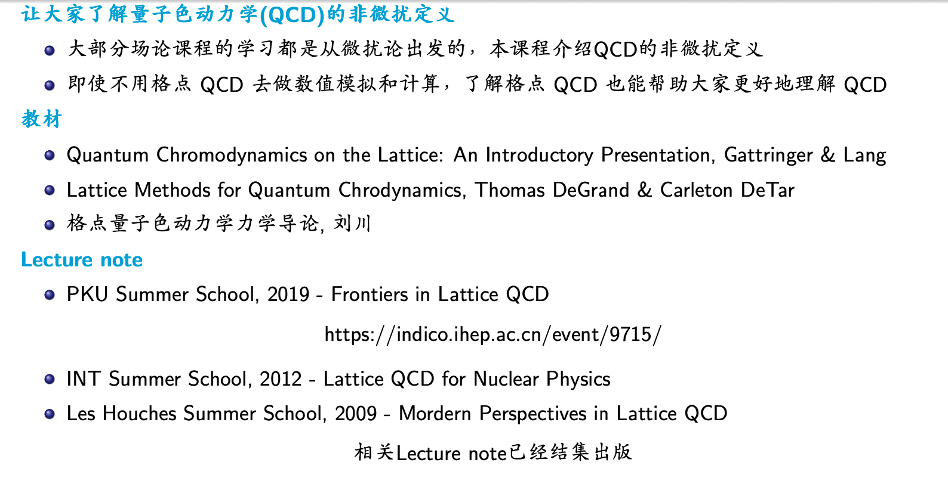
前言

Slide 3
预设问题
根据规范不变性，胶子无质量，一个无质量的粒子，为什么不能长程传播
微扰的每一阶都有对称性，非微扰下是否也保持该对称性
计算机处理的是一堆数，没有量纲，最后怎么得到有量纲的物理量，格距如何确定
QCD模拟的是夸克和胶子，形形色色的非微扰强子态如何从格点QCD中得到

Slide 4
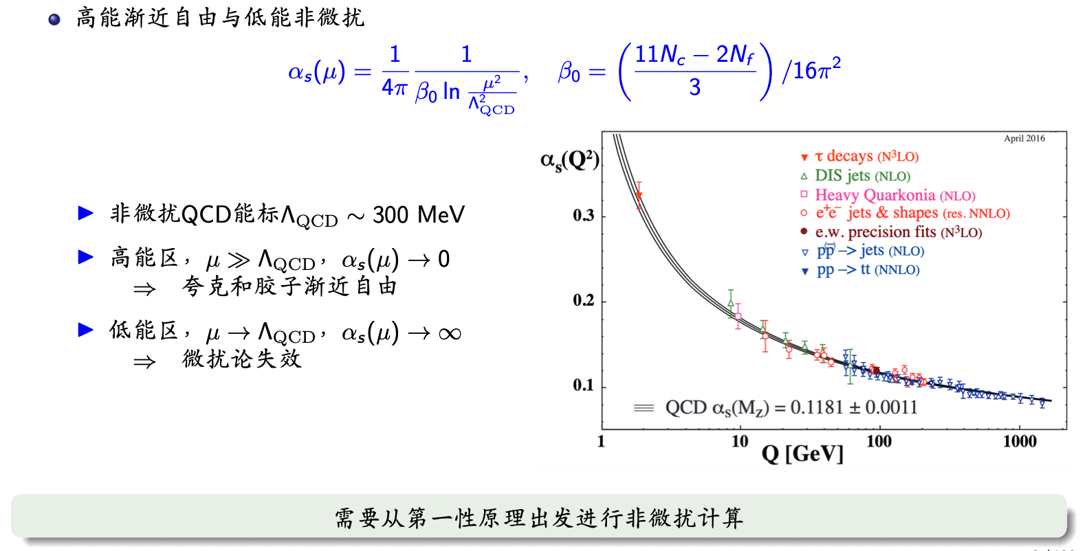
QCD的特殊性质（一）

Slide 5
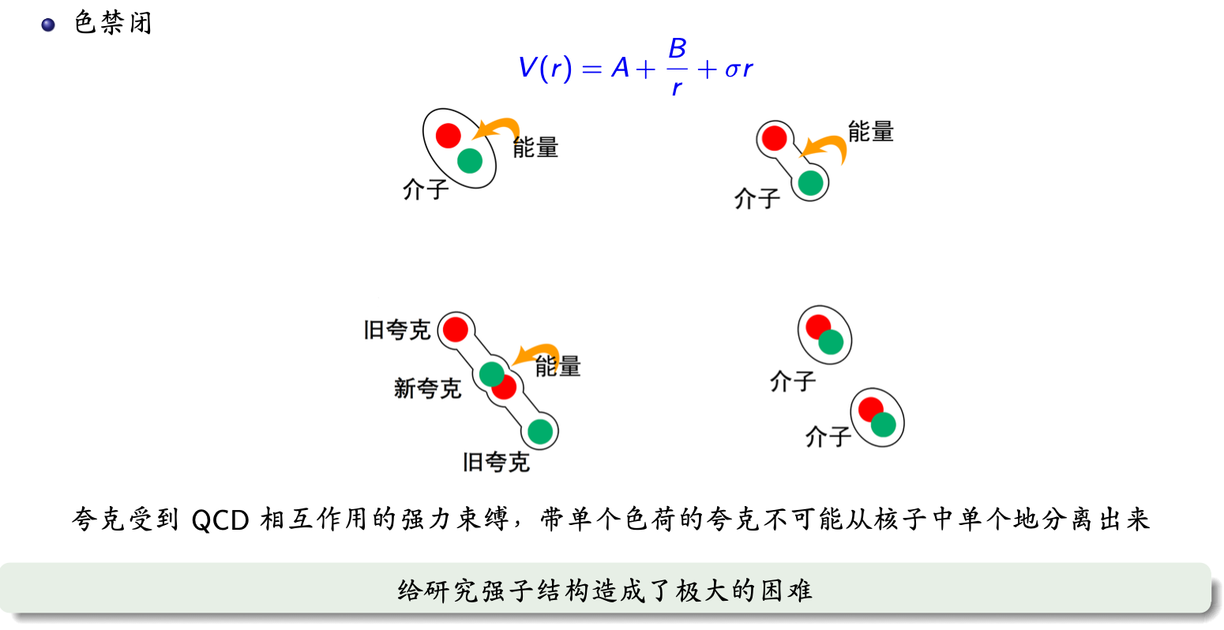
QCD的特殊性质（二）

Slide 6
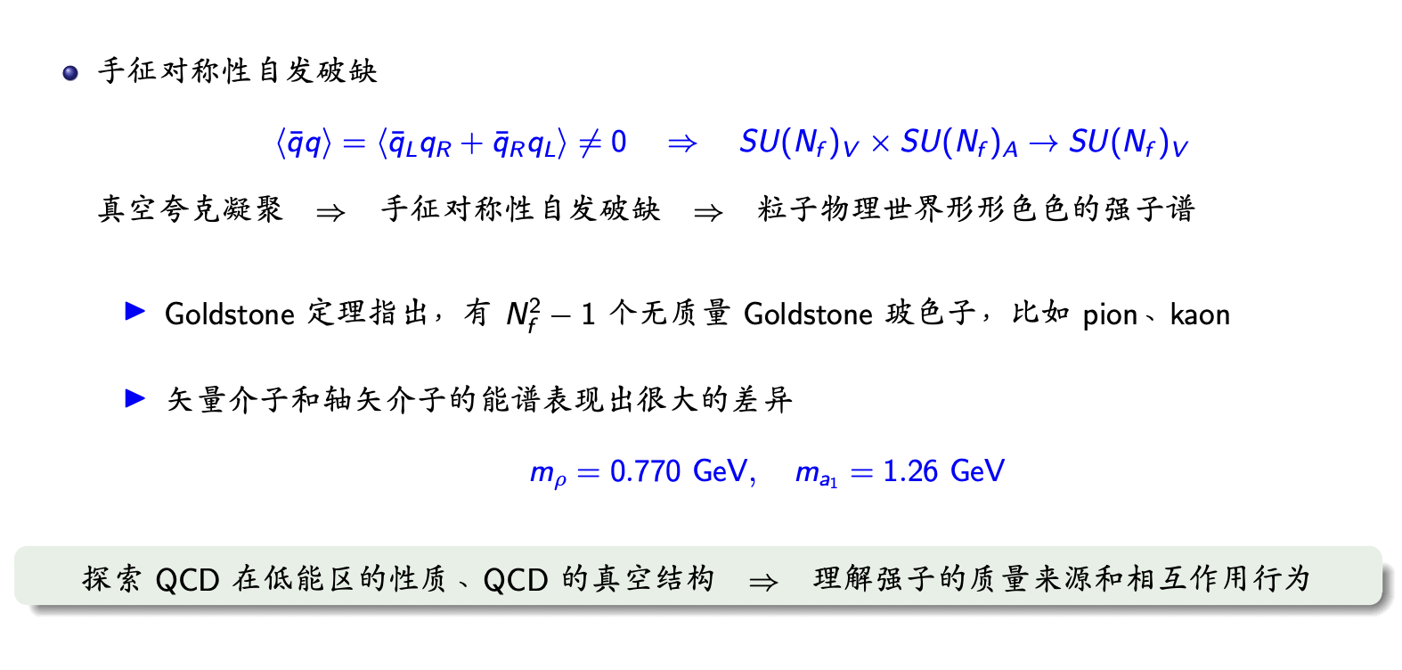
QCD的特殊性质（三）

Slide 7
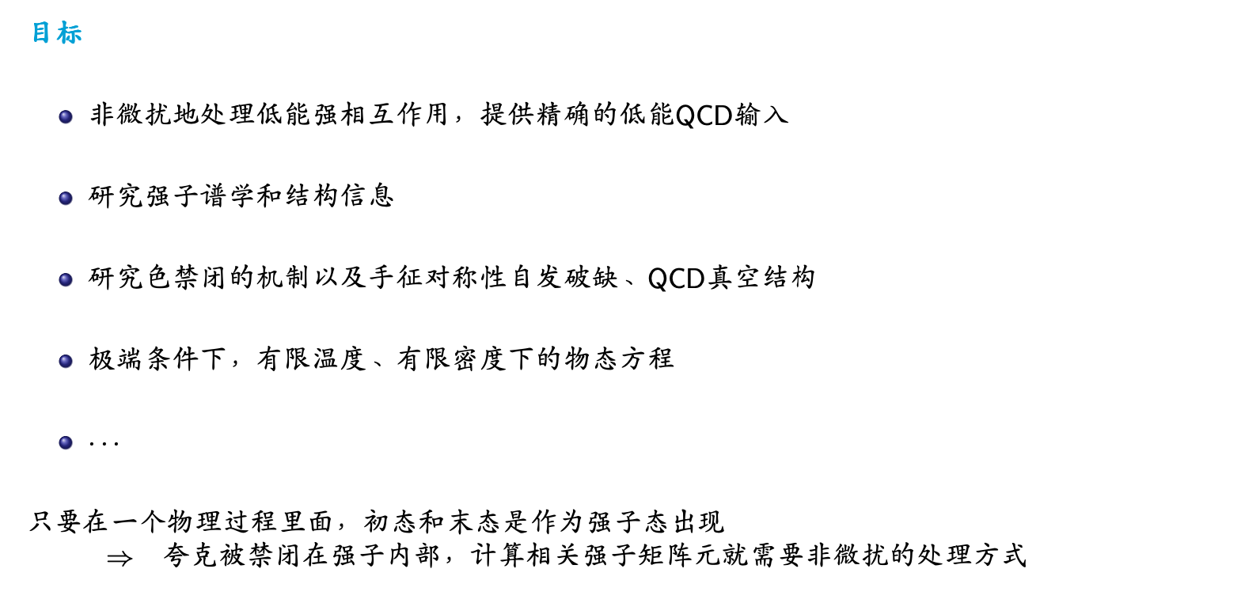
格点QCD的应运而生

Slide 8
格点QCD的三个关键词
——定义在欧氏时空上的场论
——时空离散化的格点正规化方案
——正确的非微扰QCD理论

Slide 9
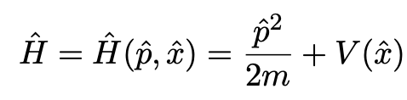
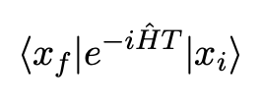
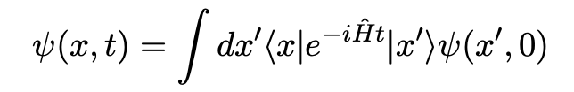


一个简单的数值路径积分案例
考虑一个1维的量子力学系统，哈密顿量为H：
量子力学的一个核心概念是从初态到末态的跃迁振幅
利用坐标表象下的跃迁振幅，任何量子态的时间演化可以写成如下形式
波函数
问题是从初态 到末态 的跃迁振幅如何计算？

Slide 10
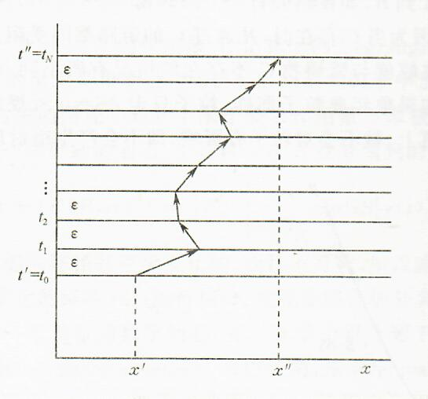




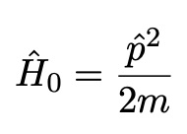
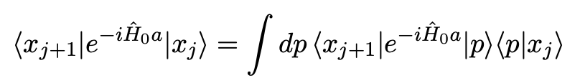
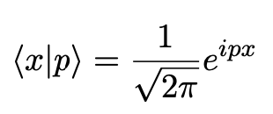
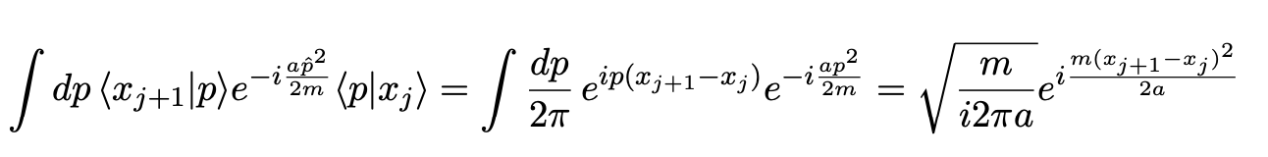
时间方向离散化
等分时间间隔 T=t_{N}-t₀
我们想要的组态由一个 维的矢量给出
让我们先考虑一个简单一点的哈密顿量
这里最基本的单元是
利用平面波的定义

Slide 11
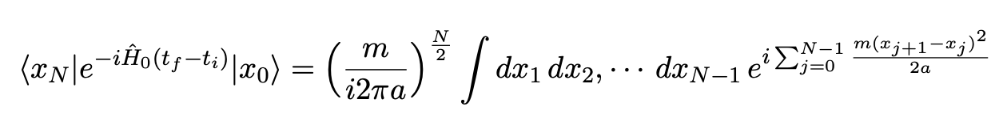
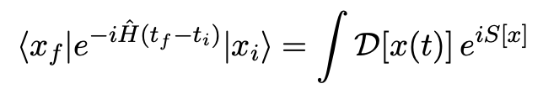
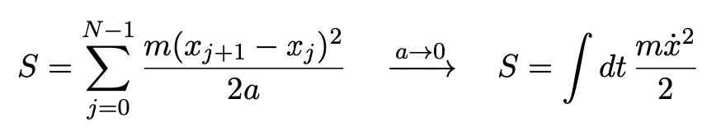
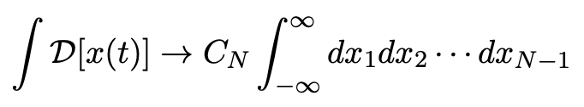
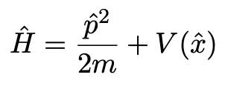

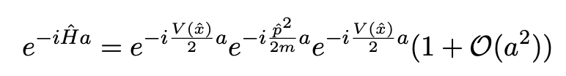
用路径积分表达跃迁振幅
将跃迁振幅改写为
加入哈密顿量具有相互作用
利用 Zassenhaus 公式

Slide 12

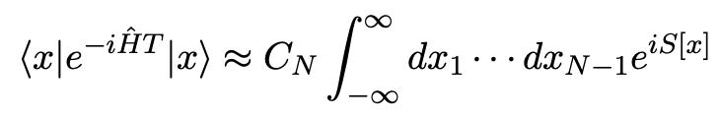
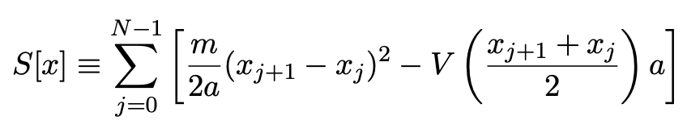
定义在离散时间上的作用量
跃迁振幅
定义在离散时间上的作用量

Slide 13


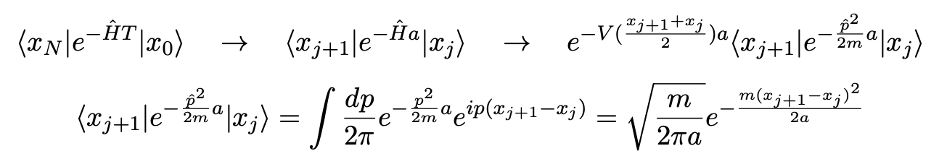
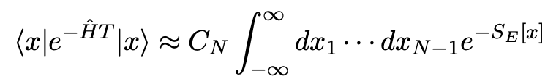
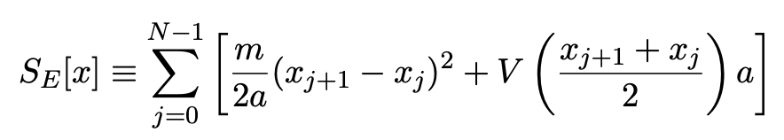
引入欧氏时空的必要性
欧氏时空路径积分
在 Wick 转动下，跃迁矩阵元变为
这里的核心关键是欧氏时空下，哈密顿量保持不变
继续时间方向的格点离散化
跃迁振幅
欧氏时空下的格点作用量
保持了正定性！

Slide 14
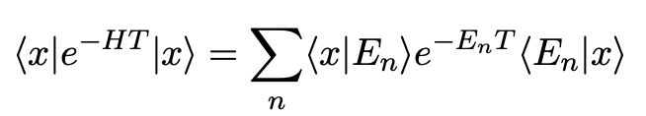


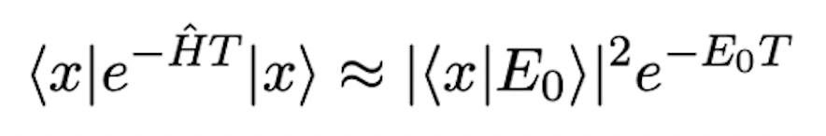
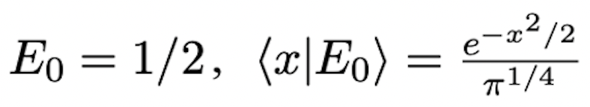
物理量的等价性
插入哈密顿量的完备态
足够大时，只有基态贡献
基态波函数
基态能量本征值
Exercise:
Take a=1/2, N=8. V(x) takes the form of harmonics oscillator V(x)=x²/2. The mass is m=1. Please compute the amplitude at several different positions x using a 7-dimensional integral, for instance, from x=0 to 2, and then verify
where

Slide 15
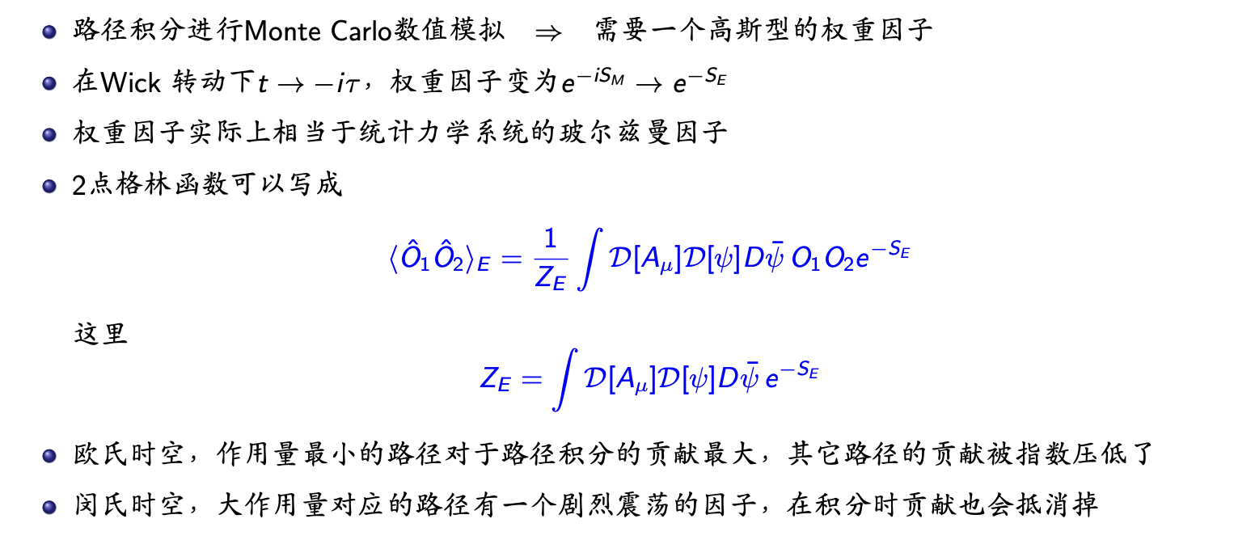
小结：欧氏时空路径积分

Slide 16
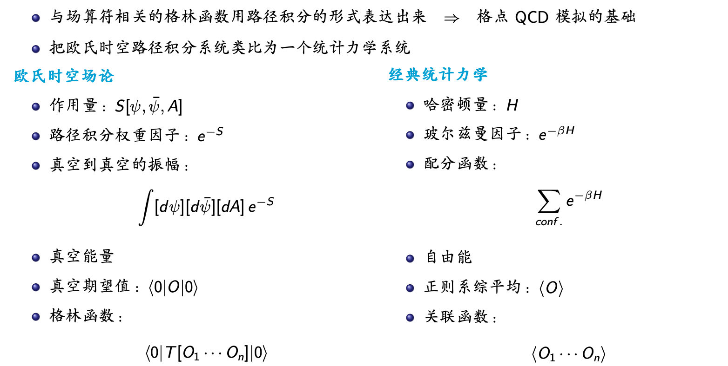
欧氏时空场论 vs 经典统计力学

Slide 17
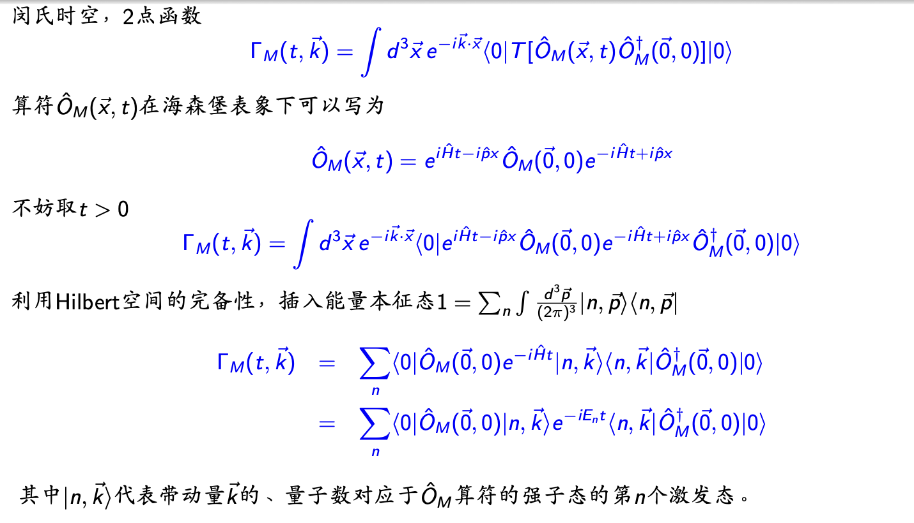
闵氏时空下的关联函数

Slide 18
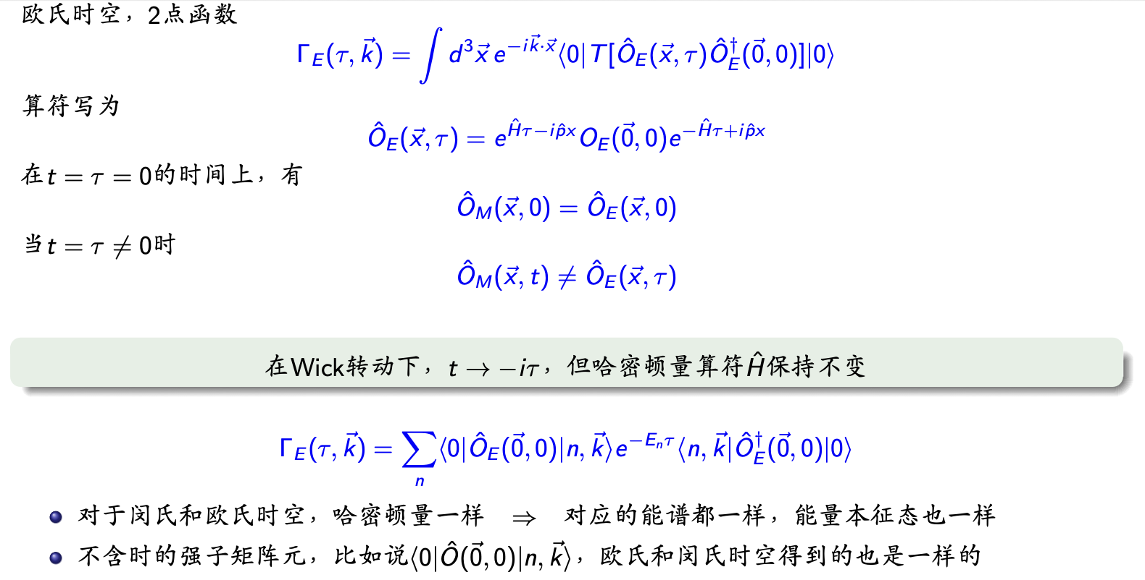
欧氏时空下的关联函数

Slide 19
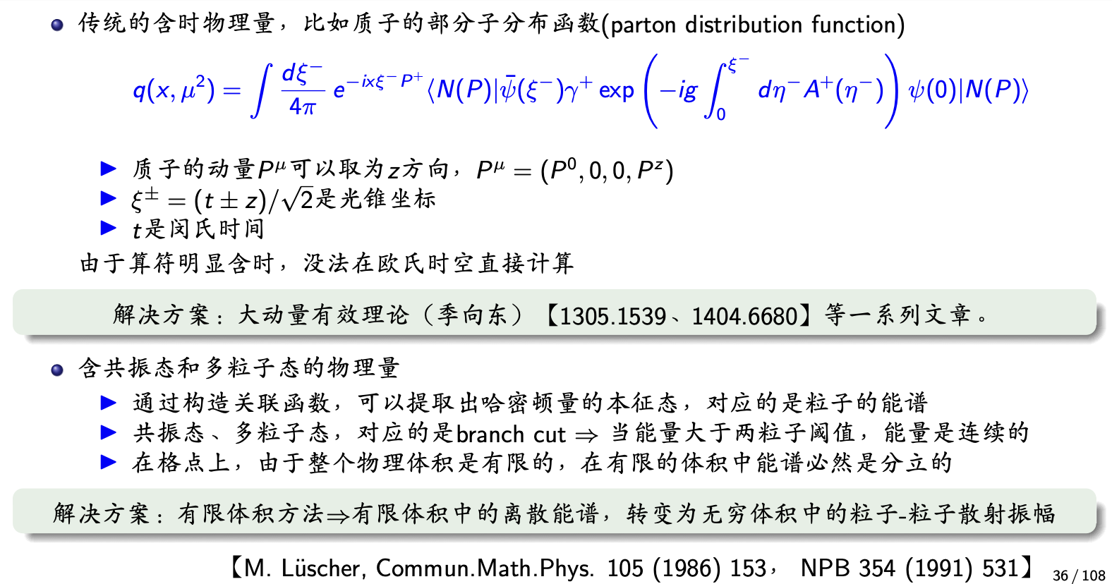
闵氏时空和欧氏时空物理的不同

Slide 20
格点QCD的三个关键词
——定义在欧氏时空上的场论
——时空离散化的一种格点正规化方案
——正确的非微扰QCD理论

Slide 21
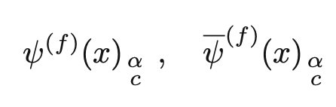

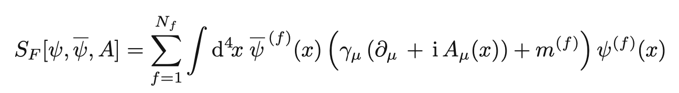
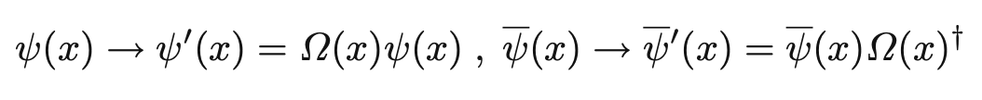


Starting from Euclidean spacetime, continuous field theory
Quark and gluon field
flavor
Gluon field
Quark field
spin
Hermitian, traceless
color
Defined in Euclidean spacetime
Action for quark field
Gauge transformation
here is a SU(3) matrix
Under a gauge transformation, the action must remain invariant, so the gluon field must follow the certain transformation

Slide 22
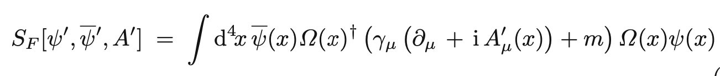
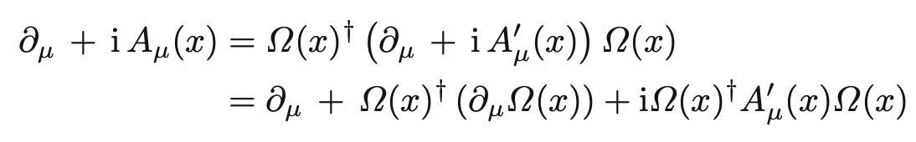

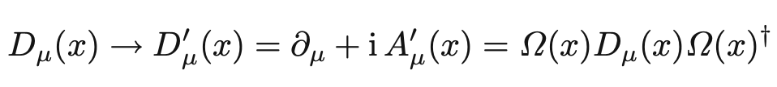
Starting from Euclidean spacetime, continuous field theory
Under a gauge transformation, the action becomes
The action is gauge invariant, requiring
Define covariant derivative
satisfying transformation

Slide 23

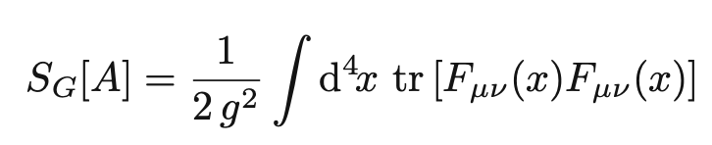
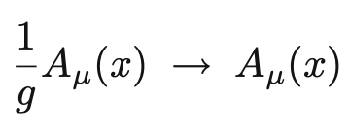


Starting from Euclidean spacetime, continuous field theory
Benefits of defining a covariant derivative
satisfying transformation
Therefore, one defines the action of gauge fields
If letting
then the coefficient disappears, and the covariant derivative will change to

Slide 24

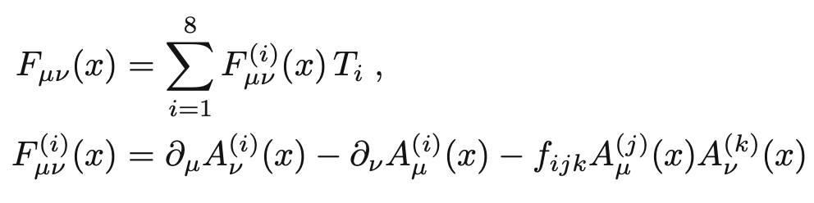
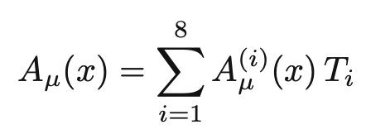
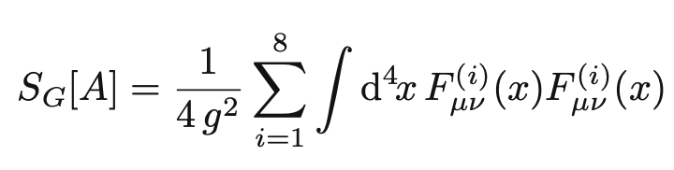
Starting from Euclidean spacetime, continuous field theory
If we expand in terms of generators
Finally, the gauge field action can be expressed as
In Euclidean spacetime, the action is positive definite!

Slide 25
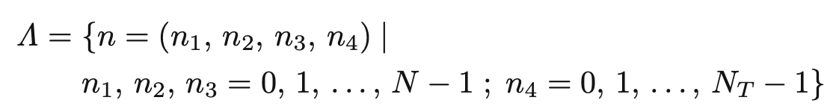

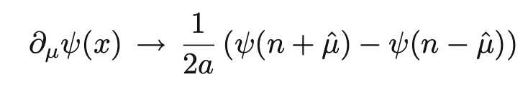
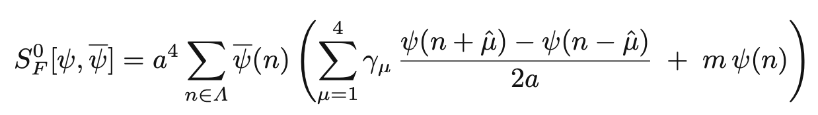


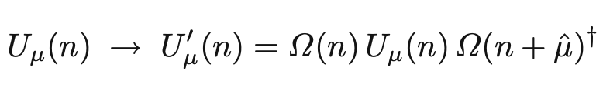
Discretization of spacetime
The action for free fermion
is not gauge invariant
Introducing gauge fields using gauge transformations
The combination can be gauge invariant as long as the gauge field satisfies the transformations

Slide 26
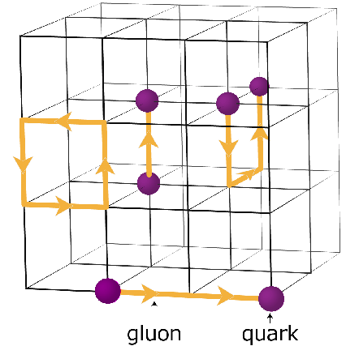
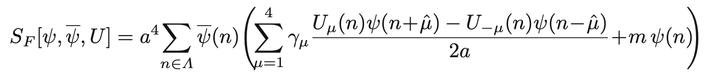


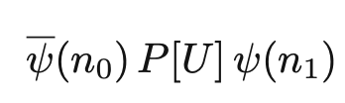

Discretization of spacetime
The action with fermions coupled to gauge fields
The relationship between two gauge fields
group elements
Lie algebra
In the continuum limit, this returns to the action of a continuous field theory
Gauge-invariant quantities
or

Slide 27





Discretization of spacetime
Gauge field action
In the continuum limit
Exercise 1: Demonstrate that the the action has the correct continuum limit
Exercise 2: How to design a gauge-invariant CP-violating term?
How about in discrete spacetime?

Slide 28

格点离散化小结

Slide 29

紫外和红外截断

Slide 30

大格点体积的好处

Slide 31

Establishment of lattice QCD
Confinement of quarks, K. G. Wilson PRD 10 (1974) 2445

Slide 32








A pure gauge field system
Partition function
Measure of path integral
Action
called inverse coupling
Integral is invariant under variable transformations; similarly, path integrals are invariant under gauge transformations

Slide 33






A pure gauge field system
Due to the arbitrariness of the gauge transformation matrix, the integral measure must satisfy
Mathematically known as the Haar measure
Introduce a normalization condition
A very useful integral expression
It yields a consequence

Slide 34




A pure gauge field system
If the integrand is not gauge invariant, then the integral result must be 0
Question: Why can the results of the integrals be non-zero for the latter two expressions?
A useful result
integrate out the common links

Slide 35





Calculation of Wilson loops
Choose a specific gauge
Wilson loops are given by links in two spatial directions

Slide 36



Calculation of Wilson loops
In the strong coupling limit

Slide 37




Calculation of Wilson loops
The denominator part
The numerator part
describes the area of the Wilson loop—the area law

Slide 38










Calculation of Wilson loops
Leaving strong coupling limit
Define the force
Compare with exp. data for and spectra
Find for lattice spacing

Slide 39

格距的意义
如果没有相互作用，计算上是没法区分这两套格子，是格距不一样，还是体积不一样，因为都是无量纲的数
但QCD系统是存在相互作用的，通过耦合常数来表示
裸耦合常数不同，代表格距不同 → 裸耦合常数随截断能标跑动

Slide 40




Interpretation of the Wilson loop
Fermion action
Mass term
Gauge link term
Wilson Fermion

Slide 41




Interpretation of the Wilson loop
Dirac matrix
Quark propagator

Slide 42


Interpretation of the Wilson loop
In the static limit, leading-order effects are provided by the shortest Wilson line
The Wilson loop provides the static quark potential for a pair of infinitely heavy quarks

Slide 43
Establishment of lattice QCD
Confinement of quarks, K. G. Wilson PRD 10 (1974) 2445
As the strong coupling constant approaches infinity, the potential energy between static quarks, calculated analytically, increases linearly with distance

Slide 44
格点QCD的三个关键词
——定义在欧氏时空上的场论
——时空离散化的一种格点正规化方案
——正确的非微扰QCD理论

Slide 45

对称性

Slide 46

对称性

Slide 47




手征对称性的破缺
On the lattice, the action with fermions coupled to gauge fields
Set
Fourier transformation for Dirac matrix

Slide 48



手征对称性的破缺
In the continuum limit
Propagator for massless fermion has pole at
On the lattice, Dirac operator has unphysical poles, known as doublers
Wilson solves the problem by introducing the Wilson term
However, it breaks the chiral symmetry

Slide 49




手征对称性的破缺
Perform a chiral rotation of fermion fields
If fermion mass is zero, then Lagrangian density is invariant under chiral rotation
The mass term break the invariance with
The chiral symmetry can be summarized as
On the lattice, this relation does not hold - Nielsen-Ninomiya no-go theorem
Locality
Gauge invariance
No doublers
Chiral symmetry
cannot be satisfied simultaneously

Slide 50




手征对称性的破缺
Violation of the chiral symmetry in the minimal way – Ginsparg-Wilson relation
where is the lattice spacing
M. Luscher pointed out that one can define a chiral symmetry for lattice
Interesting to change or modify the definition of chiral rotation on the lattice
Lagrangian is now invariant under modified chiral rotation if Ginsparg-Wilson relation holds

Slide 51






Consequence of G-W relation
Spectrum of Dirac operator on the lattice
Dirac operator satisfies the γ₅ hermitian
Eigenvalue are either real or come in complex conjugate pairs
Combine with G-W relation
Combining with G-W relation, eigenvalue satisfies

Slide 52


Consequence of G-W relation
Combining with G-W relation, eigenvalue satisfies
Eigenvector satisfies
This implies

Slide 53




Consequence of G-W relation
Zero modes for the Dirac operator
In the last step, G-W relation. are used.
On the subspace of zero modes, the Dirac operator commute with
Eigenstates of Dirac operator can be chosen as eigenstates of
Since , the eigenvalues of must be +1 or -1
Lattice equivalent of Atiyah-Singer index theorem

Slide 54



Define topological charge density
Topological charge
Topological charge density
Non-trivial topological charge density fluctuation

Slide 55






Consequence of G-W relation
Chiral anomaly
As chiral rotation is modified, the integration measure for the fermions is not invariant
indicates the flavor space: or
Integration measure changes as

Slide 56





Ginsparg-Wilson relation 的实现
在数值计算中，直接对大型矩阵求符号函数是极其昂贵的，所以会采取近似

Slide 57






路径积分的数值运算
配分函数
物理量
将场 定义在 32⁴-64⁴ 的格子上，则对应百万-千万维的高维积分
由于欧氏时空下， 是正定的，积分的大部分区域都被 指数压低了
重点抽样：提取积分中最重要的部分是完成路径积分的核心

Slide 58







蒙特卡洛方法
蒙特卡洛方法归根结底是个取样的思想
计算某个积分，可在积分区间随机撒点，随机点 出现的几率密度是
如果有个权重因子
这里。 的取样满足几率分布密度

Slide 59


马尔可夫链演化
按照某个几率产生的组态很难直接获得，但可以从另一个组态中被“修改”出来
从一个初始组态出发，按照一定规则+随机演化构造下一个组态
继续这个过程，直到构造出满足分布几率的组态

Slide 60









演化规律
在马尔可夫过程中，定义 到 跃迁几率密度为
定义了跃迁的规则，它满足
把组态 出现的几率密度记为
通过跃迁规则进行演化，不停地更新可以产生一系列几率密度
跃迁规则满足两个条件：
各态历经：系统空间每个点都被走到，不存在死角
稳定性条件：最后达到的几率分布，在 作用下是稳定的

Slide 61






Metropolis 算法实现马尔可夫过程
第一步：预选一种跃迁几率 ，使得组态 能够以几率 的形式跃迁到
第二步：设置一定几率决定是否接受 作为新的组态，接收几率为
第三步：重新回到第一步
结合前两步，从 到 的跃迁几率为
它同时满足各态历经和比稳定性条件更强的细致平衡条件

Slide 62



面临的几个挑战
临界减速(Critical Slowing Down)
样本高度关联性，随格距变小，急剧增长
符号问题
有限密度，化学势不为零， 非正定
反问题
定义在欧氏时间上的关联函数
需提取谱权重

Slide 63



人工智能应用举例：流映射采样
利用正则化流映射(normalizing flow)采样
流映射采样的初步体验——Box Muller 方法
任务：产生按f(x)分布的随机数
对于正态分布，
若分布的峰很窄，
舍选的效率将比较低。
舍选法——简单直观
应用举例：舍选法估计圆周率
在区域X∈(a, b), Y ∈(0, h) 内多次均匀撒点，若(X,Y)落在曲线f(x)以下，保留X作为一个抽样值，则生成的样本按照密度函数 f(x)分布
保留
舍弃
h
f(x)
a
b

Slide 64








人工智能应用举例：流映射采样
Box Muller 方法
回忆 Gaussian 积分中的技巧：
做变量替换
定义了流映射 f
如果
x₁ 与 x₂ 服从均值为0，方差为1的高斯分布；效率高，计算过程简单
总结： 的. 的几率密度为 ， 的几率密度为

Slide 65




人工智能应用举例：流映射采样
希望满足采样的规范场组态
Normalizing flow 的核心思想
通过训练，使得生成

Slide 66





人工智能应用举例：流映射采样
M. S. Albergo, G. Kanwar, and P. E. Shanahan Phys. Rev. D 100 no. 3, (2019) 034515
先验分布
(比如正态分布)
神经网络位于每个耦合层中，负责对输入数据进行缩放和偏移，以逐步调整分布
目标是调整神经网络的参数，使得流模型生成的分布 ，尽可能逼近目标分布
通过叠加多个耦合层构造流模型
通常较复杂，难以直接生成
雅可比行列式可通过链式法则得到

Slide 67







人工智能应用举例：流映射采样
和 是神经网络，进行变换操作
表示元素逐位相乘
变换 被设计成一种特殊形式，即使 和 是复杂的神经网络，整个变换 依然是可逆的

Slide 68

人工智能应用举例：流映射采样
雅可比矩阵是个下三角，行列式很容易计算
可逆性对于流映射至关重要，因为需要根据变换后的样本计算其概率密度
如果每一层的变换是显式可逆的，就可以快速地进行采样和密度计算，而不会引入额外的计算负担。

Slide 69





人工智能应用举例：流映射采样
目标分布
训练方法：最小化损失函数
使用的损失函数是目标分布 与生成分布 之间的偏移Kullback-Leibler散度
KL散度是一种衡量两个概率分布之间差异的指标
通过最小化 KL 散度，可以逐步优化神经网络，使得生成分布趋近于目标分布
实际应用中，损失值通过随机抽样来估算
从流映射生成的分布 中抽取一批样本 ，然后通过计算样本均值来得到损失的近似值

Slide 70







人工智能应用举例：流映射采样
自训练特性
流映射允许从自身分布 中高效采样，因此训练过程可以完全基于模型生成的样本进行
无需依赖目标分布 的现有样本，这在计算目标分布样本代价高昂时尤其有用
具体算法流程
训练流生成模型以使得输出分布 接近目标分布 ，损失函数使用 KL 散度
从生成模型中采样 N个样本 (可并行采样)，并计算每个样本的作用量
使用 Metropolis算法，依次接受或拒绝这些提案样本，构建长度为 N的马尔可夫链
作为蒙特卡洛的初始点，提高 decorrelation 和拓扑穿越效率
理论保证
分布的正定性：如果先验分布 r(z)严格为正，并且流映射 f 可逆且连续，则生成分布 p~f(ϕ) 保证严格为正
各态历经：对于所有具有有限作用量的模型，由此生成的马尔可夫链被证明具有遍历性

Slide 71





Numerical computation
Integrate out fermionic fields using Grassmann algebra
Importance sampling: generating gauge configurations according to probability distribution
The integral over gauge fields is obtained by approximating it with average over gauge configurations
The more configurations there are, the smaller the statistical error. Error is reduced by

Slide 72




Correlation function
Operator construction
x is the coordinate of spacetime
Diquark is designed to have isospin I=0 and spin J=0
Momentum projection
In Euclidean spacetime, the time dependence of operator is given by
Take the pion operator as an example, one can construct correlation function
Lowest energy is given by pion mass

Slide 73

Realization of correlation function
For any product of operators, denoted by A, one has to evaluate
After integrating out the fermionic fields, ψ in S_{F} results in derterminant; ψ in the observable results in quark propagator
Then the integrand becomes a quantity purely depending on gauge field
Average over configurations

Slide 74

关于散射

Slide 75

关于散射

Slide 76

类时形状因子

Slide 77

散射相移和类时形状因子的格点数据

Slide 78

关联函数与能谱的关系
定义在欧氏时间上的关联函数

Slide 79


预设问题
根据规范不变性，胶子无质量，一个无质量的粒子，为什么不能长程传播
微扰的每一阶都有对称性，非微扰下是否也保持该对称性
计算机处理的是一堆数，没有量纲，最后怎么得到有量纲的物理量，格距如何确定
✔️
QCD模拟的是夸克和胶子，形形色色的非微扰强子态如何从格点QCD中得到
✔️

Slide 80


预设问题
根据规范不变性，胶子无质量，一个无质量的粒子，为什么不能长程传播
微扰的每一阶都有对称性，非微扰下是否也保持该对称性
计算机处理的是一堆数，没有量纲，最后怎么得到有量纲的物理量，格距如何确定
✔️
QCD模拟的是夸克和胶子，形形色色的非微扰强子态如何从格点QCD中得到
✔️
对于手征拉氏量-微扰论的每一阶都有手征对称性
但QCD真空可以有手征对称性自发破缺
无穷多0相加可以不等于0

Slide 81
Applications

Slide 82


Lattice QCD~50 years
First proposed by K. G. Wilson in 1974
First numerical simulation on a computer was implemented by M. Creutz in 1979
First computation of the light hadron spectrum in lattice QCD was completed by H. Hamber and G. Parisi in 1981

Slide 83



Quenched approximation
Quenched approximation
Quenched approximation is equivalent to the heavy-quark limit approximation
Under the quenched approximation, the effects of sea quarks are completely removed, resulting in uncontrollable errors

Slide 84
Development of Lattice QCD
The development of lattice QCD mainly relies on
the advancement of supercomputing
the improvement of algorithms
the breakthroughs in lattice methodology
After entering the year 2000, there has been rapid development in the field of lattice QCD
Quenched approximation (no sea quark)
→ Full QCD simulation (N_{f}=2, 2+1, 2+1+1)
→ Physical point simulation (physical quark mass)
→ Inclusion of isopsin breaking effects (both from quark mass and QED effects)

Slide 85




Experiment vs Lattice QCD
Collider (Energy, Luminosity)
Supercomputer (Performance, Memory)
Collision, Events
Simulation, QCD vacuum
Detector, measurement
Lattice QCD calculation

Slide 86

Low-lying hadron spectroscopy
Input:
Fundamental parameters of Standard Model
α_{s}, quark mass
Output:
Prediction of low-energy hadron spectrum v.s. experiment
A. Kronfeld, Ann.Rev.Nucl.Part.Sci. 62 (2012) 265-284
21st Century Lattice Gauge Theory: Results from the QCD Lagrangian

Slide 87



Extraction of hadronic matrix elements
Take the K→π semileptonic decay form factor as an example
Construct 2-point correlation function for π and K
Construct 3-point correlation function for K→π transition
Take
Matrix element can be extracted

Slide 88

K/π systems provide idea laboratory for lattice QCD Study
Nearly no signal/noise problem
Quark field contractions easily performed
Simple final states: purely leptonic, 1 π， 2 π (K→ππ already very challenging!)
Small recoil for hadronic particle in the final state
Long-distance processes: much less low-lying intermediate states

Slide 89

Precision achievable in lattice QCD
FLAG average, updated on 2023
89

Slide 90


Precision achievable in lattice QCD
Based on FLAG review 2021
Error < 1%
Error < 5%
Time to explore high-precision frontier

Slide 91




高精度前沿
直接寻找——高能量前沿，LHC、CEPC等各种大型对撞机
寻找标准模型以外的新物理
间接寻找——高精度前沿，各种高精度、中小型实验装置
高精度前沿
实验驱动
超冷中子衰变
美国LANL实验室
缪子反常磁矩
美国费米实验室
高阶电弱过程
低能QCD效应
稀有K介子衰变
欧洲核子研究中心
无中微子双贝塔衰变
中国锦屏地下实验室
低能强相互作用贡献显著

Slide 92


Magnetic moment of a current-carrying coil
Size of the magnetic moment:
current intensity ✖️ area of current circuit
In 1820, Ampère's experiment
A. Ampère
1775-1836
Size of orbital angular momentum
Relationship between magnetic moment and angular momentum:
is Landé g-factor

Slide 93

Magnetic moment of a charged gyroscope
Imagine a charged gyroscope rotating to form a ring of circular electric current
The faster the gyroscope spins
The more charge it carries
The stronger the circular electric current
Magnetic moment of a rotating charged body is directly proportional to its charge and angular velocity
angular velocity = rotation angular momentum ➗ mass
spin
finally
Magnetic moment is proportional to charge✖️spin➗mass

Slide 94


The spin magnetic moment in the quantum world
In addition to the classical magnetic moment produced by orbital motion, microscopic particles also carry an intrinsic magnetic moment
Stern-Gerlach experiment
Without any movement, an electron itself is also a small magnet
The proposal of spin
Orbital angular momentum L should be an integer
The silver atom beam should split into 2L+1 lines
Splitting into two lines means L=1/2
In 1925, Uhlenbeck & Goudsmit proposed the spin with a quantum number of 1/2
Silver atoms deflect in a magnetic field, with magnetic moment mainly contributed by electron spin

Slide 95


Dirac's theory predicts the spin magnetic moment
Relationship between magnetic moment and angular momentum:
Current-carrying coil
Electron spin
Relationship between magnetic moment and spin:
？
In the classical world, there are no answers to this questions
In 1928, Paul Dirac proposed the relativistic quantum mechanical equation describing the motion of electrons - the Dirac equation
1933

Slide 96
Landé g-factor of various particles
CODATA provides experimental measurements of g factors
Electron
Muon
Proton
Neutron
g factors of four spin-1/2 particles are not strictly equal to 2
Anomalous magnetic moment
Why is there such a big difference in the anomalous magnetic moments (e, μ vs p, n)?

Slide 97



Schwinger's contribution
The leading-order calculation of the electron's anomalous magnetic moment was first provided by Julian Schwinger in 1948
J. Schwinger

Slide 98


Quantum fluctuations can be very complex
There can also be fluctuations within fluctuations
Virtual particles themselves can generate other virtual particles
Theoretical calculation of lepton's anomalous magnetic moment has reached O(α⁵)

Slide 99



Experimental measurement
Dehmelt drew inspiration from Penning's designed magnetron and invented ion trap technology, naming it the Penning ion trap
In 1987, using this technology, the electron's magnetic moment was precisely measured
In 2011, Harvard University utilized Penning ion trap technology to measure the electron g-2 with extremely high precision
H. Dehmelt
1989

Slide 100


The electron g-2 laid foundation for QED
Theory
Experiment
For establishing Quantum Electrodynamics, received the Nobel Prize in Physics in 1965
S. Tomonaga
J. Schwinger
R. Feynman

Slide 101

Discovery of Muon
In 1936, Neddermeyer & Anderson observed cosmic rays from high mountains and discovered charged particles with mass of ~100 MeV, called μ meson (essentially not a meson)
Rabi's question: Who ordered this?
Maybe we should ask: why three generations

Slide 102




Exploring new physics - muon anomalous magnetic moment
Similarities and differences among the three generations of leptons
In SM, apart from their different masses, all other properties are the same
Exp. measurements of electron g-2 are much more precise, why muon g-2?
At lowest order, the contribution of new physics to the lepton g-2 may be represented by a very heavy virtual particle with an energy scale of
Compared to electron g-2, although exp. precision of the muon g-2 is O(10³) times worse, its sensitivity to new physics is still tens of times higher
Although tau is the most sensitive to new physics, precision experiments are too difficult because its lifetime is 7×10⁶ times shorter than that of muon

Slide 103



Past Experiments
1959: start of 1st muon g-2 experiments at CERN
1984: start of BNL experiment
Precision of ~10ppm
Require more accurate theoretical prediction
Good agreement on results

Slide 104


Past Experiments
By 2006: BNL experiment
New experiment at Fermilab
Very precise 0.54ppm
But disagree with theory

Slide 105



Most updated results
Exp. precision reach 124ppb

Slide 106



Theoretical calculation
Contributions of different parts of the Standard Model

Slide 107

Theoretical calculation
Contributions of different parts of the Standard Model

Slide 108

Theoretical calculation
Contributions of different parts of the Standard Model

Slide 109



Exploring new physics - muon anomalous magnetic moment
Challenges of nonperturbative strong interactions

Slide 110






HVP contribution from lattice QCD
Compute
from a known QED kernel function and the polarization tensor
Time-momentum representation
with a known QED kernel function and lattice correlation function
x₀ is the Euclidean time

Slide 111

Lattice QCD calculation of hadronic vacuum polarization
Muon g-2 Theory Initiative
White paper 2020

Slide 112

2021 BMW result reached a precision of 1.1%

Slide 113


Intermediate window
is a smooth step function

Slide 114

Agreement in the intermediate window

Slide 115

2025 white paper

Slide 116

2025 white paper

Slide 117

2025 white paper

Slide 118

2025 white paper

Slide 119


2025 white paper
Published results
With corrections when compiling white paper

Slide 120
Conclusion
Lattice QCD has played a central role in turning QCD into a quantitative theory of strong interactions.
It provides a non-perturbative, first-principles approach to explore the rich structure of QCD, from hadron spectra to topological effects.
Understanding the full physical implications of non-perturbative QCD through lattice calculations remains a deep and long-term endeavor.
I would like to express my sincere gratitude to the organizers for this highly successful summer school!

