Slide 1




$e^{+}e^{−}→γD\overline{D}$中粲偶素2P 态的发现潜力
高天乐
合作者：钱日庆，刘翔
PRD 111, 054021 (2025)
强子物理与有效场论前沿讲习班 河南郑州 2025-8-22

Slide 2
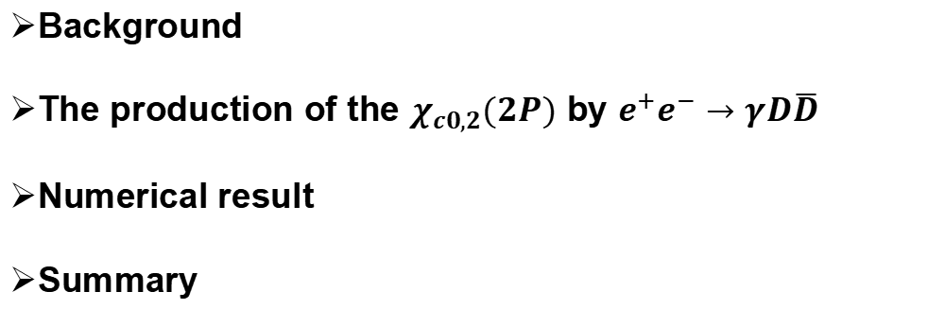
Outlook
Background
The production of the $χ_{c0,2}(2P)$ by $e^{+}e^{−}→γD\overline{D}$
Numerical result
Summary

Slide 3
Background

Slide 4
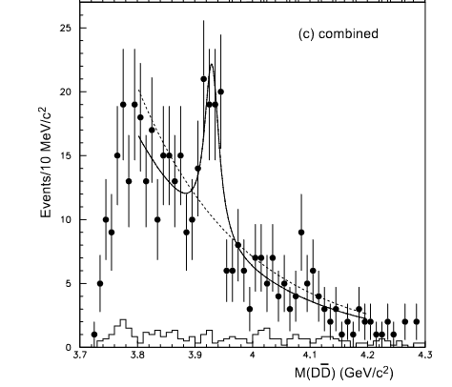
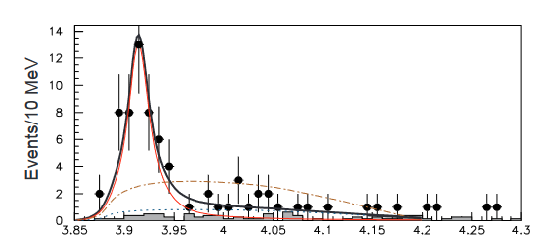
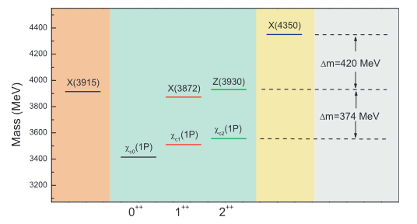
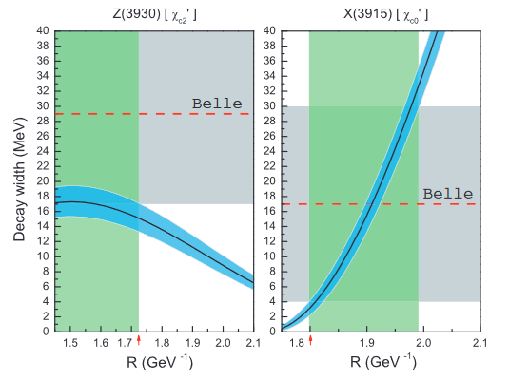




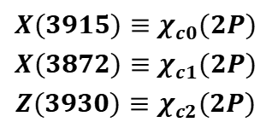



X(3915) & Z(3930)
$$γγ→D\overline{D}$$
$$γγ→J/ψω$$
$$Z(3930)$$
$$X(3915)$$
$$2^{++}$$
Belle PRL 104, 092001 (2010)
$0^{++}$or${ 2}^{++}$
${ χ}_{c2}(2P)$ candidate
Belle PRL 96, 082003 (2006)
$$X(3915)≡χ_{c0}(2P)$$
$$X(3872)≡χ_{c1}(2P)$$
$$Z(3930)≡χ_{c2}(2P)$$
Xiang Liu, Luo-Zhi Gang and Zhi-Feng Sun PRL 96, 082003 (2010)
Consistent with Belle

Slide 5
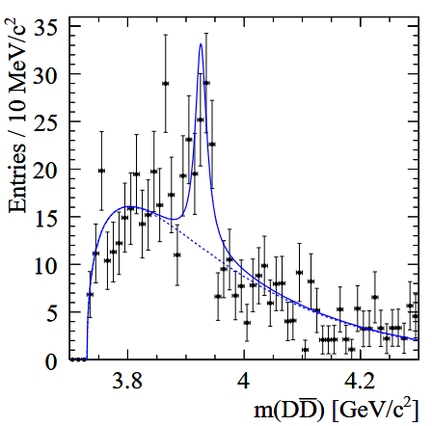
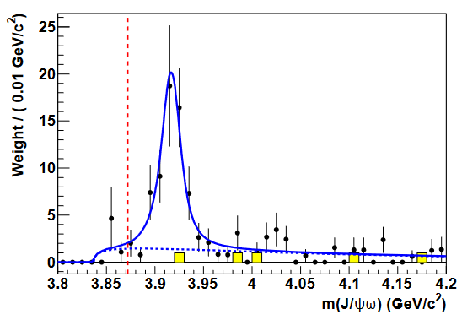
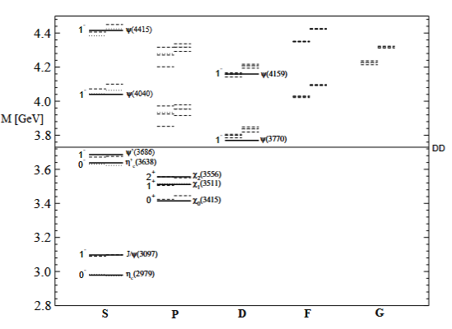


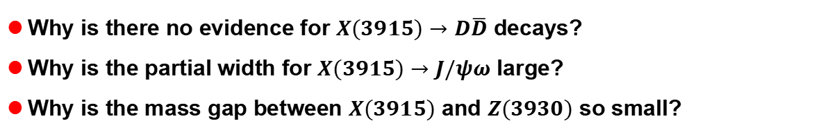



Three questions
$$γγ→D\overline{D}$$
$$γγ→J/ψω$$
$$Z(3930)$$
$$X(3915)$$
$$0^{++}$$
Babar PRD 86, 072002 (2012)
T. Barnes, S. Godfrey, and E. S. Swanson
PRD 72, 054026 (2005)
Babar PRD 81, 092003 (2010)
Why is there no evidence for $X(3915)→D\overline{D}$ decays?
Why is the partial width for $X(3915)→J/ψω$ large?
Why is the mass gap between $X(3915)$ and $Z(3930)$ so small?

Slide 6
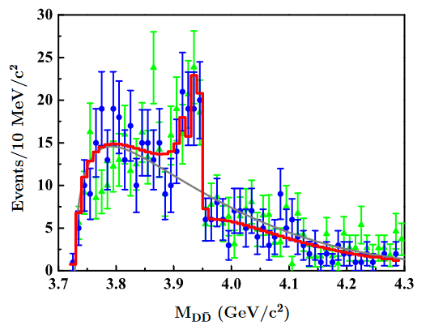
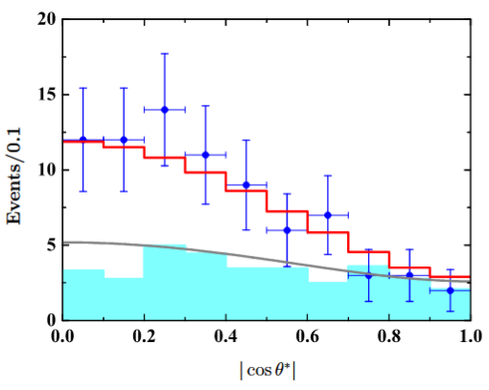
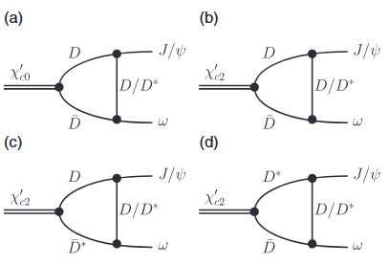
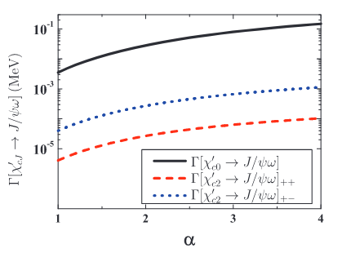
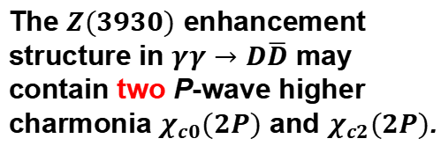
Three answers
①
The $Z(3930)$ enhancement structure in $γγ→D\overline{D}$ may contain two P-wave higher charmonia $χ_{c0}(2P)$ and $χ_{c2}(2P)$.
Dian-Yong Chen, Jun He, Xiang Liu and Takayuki Matsuki EPJC 72, 2226(2012)
②
Consistent with the experimental measurements.
Dian-Yong Chen, Jun He, Xiang Liu and Takayuki Matsuki PTEP 043B05(2015)

Slide 7
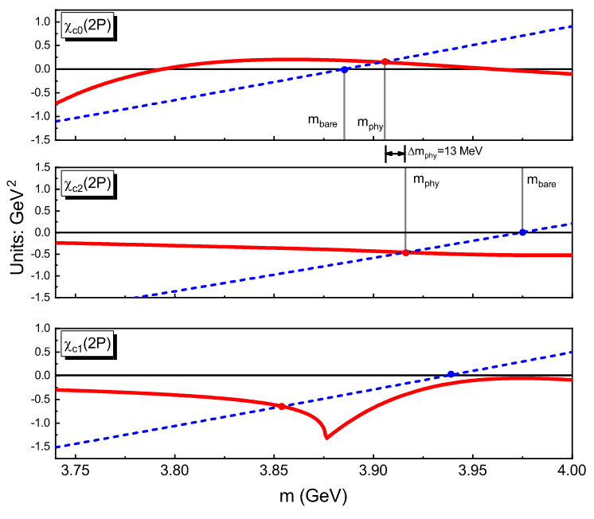
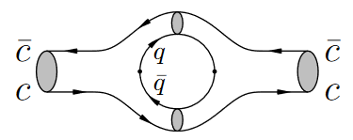
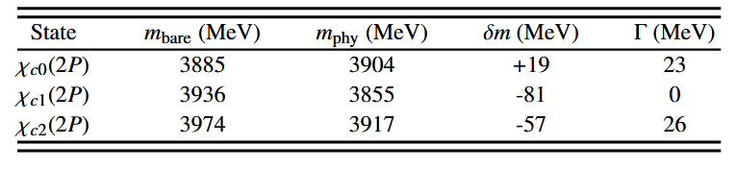
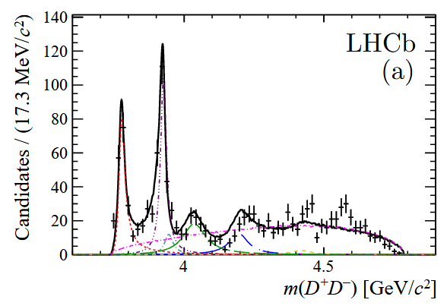
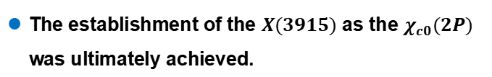
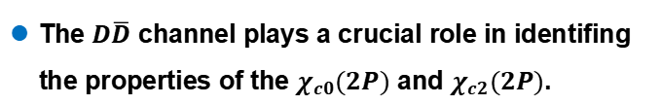
Three answers
③
narrow
Small mass gap can be well reproduced.
Ming-Xiao Duan, Si-Qiang Luo, Xiang Liu and Takayuki Matsuki PRD 101, 054029 (2020)
EXP
The establishment of the $X(3915)$ as the $χ_{c0}(2P)$ was ultimately achieved.
The $D\overline{D}$ channel plays a crucial role in identifing the properties of the $χ_{c0}(2P)$ and $χ_{c2}(2P)$.
LHCb PRD 102, 112003 (2020)

Slide 8
The production of the $χ_{c0,2}(2P)$ by $e^{+}e^{−}→γD\overline{D}$

Slide 9
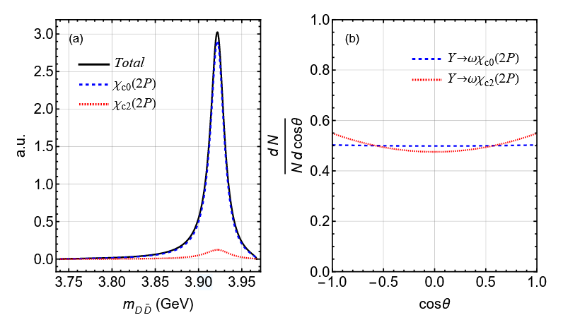
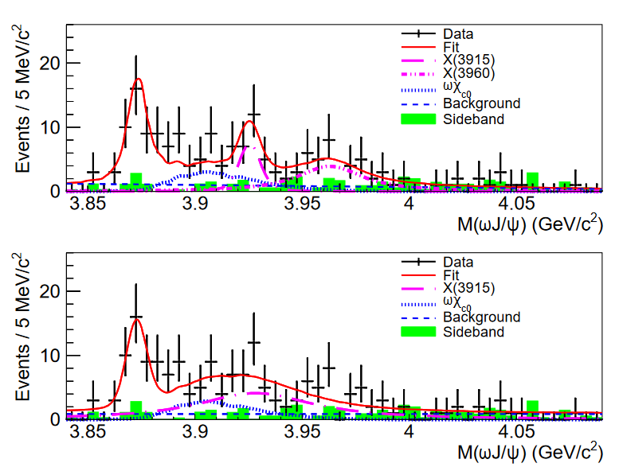
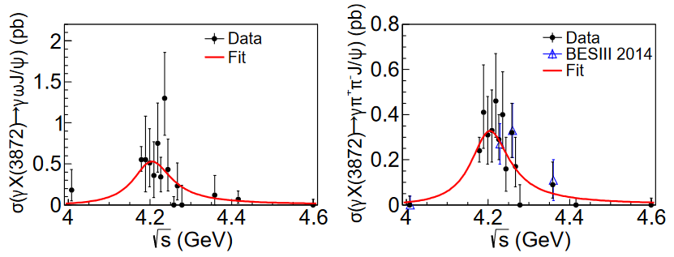

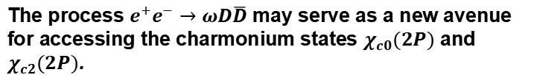

Additional production mechanisms
The process $e^{+}e^{−}→ωD\overline{D}$ may serve as a new avenue for accessing the charmonium states $χ_{c0}(2P)$ and $χ_{c2}(2P)$.
Ri-Qing Qian and Xiang Liu PRD 108, 094046 (2023)
Similarly
$$e^{+}e^{−}→ψ→γχ_{c0,2}(2P)→γD\overline{D}$$
BESIII PRL 122, 232002 (2019)

Slide 10
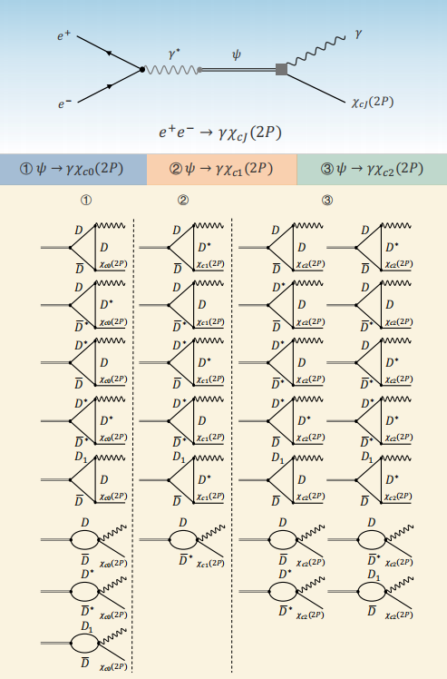

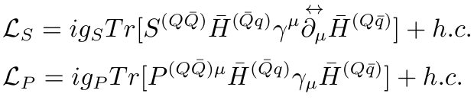

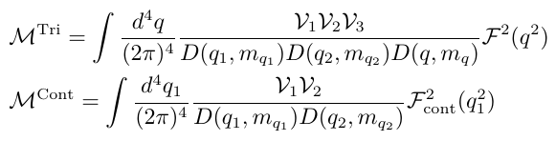




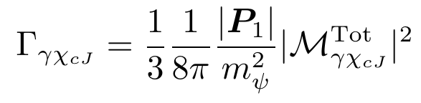

Analyse of $e^{+}e^{−}→γχ_{cJ}(2P)$
Coupled-channel effects: hadronic loops mechanism.
Gauge invariance

Slide 11
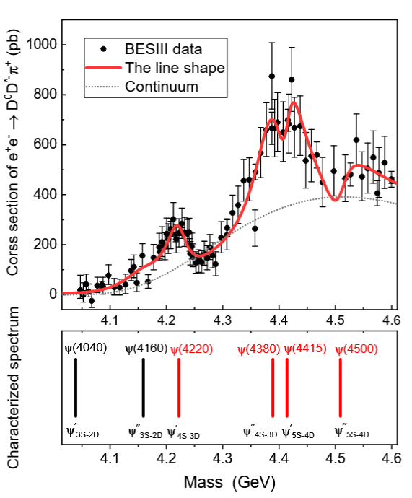

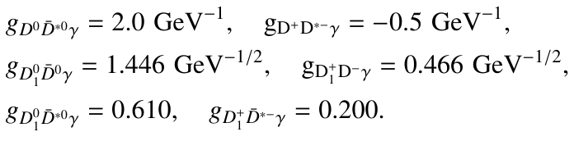
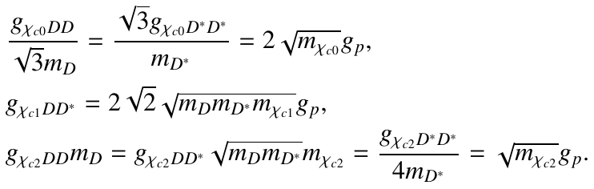
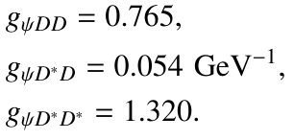

The coupling constants
$$D^{0}$$
$$ψ(4230)$$
$${{\overline{D}}_{1}(2420)}^{0}$$
$$π^{+}$$
$$D^{∗−}$$
Additional intermediate states contribute to $π^{+}D^{∗−}D^{0}$, including $D^{∗−}D_{0}^{∗}(2300)^{+}$, $D^{0}{\overline{D}}_{1}(2430)$ and $D^{0}{\overline{D}}_{2}^{∗}(2460)^{0}$.
Significant couplings
Zi-Long Man, Si-Qiang Luo, Zi-Yue Bai and Xiang Liu arXiv:2502.08072
Jun-zhang Wang and Xiang Liu PLB 849, 138456(2024)

Slide 12
Numerical result

Slide 13
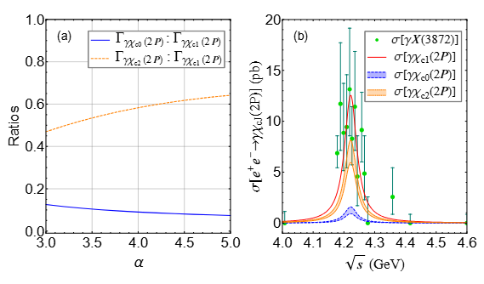


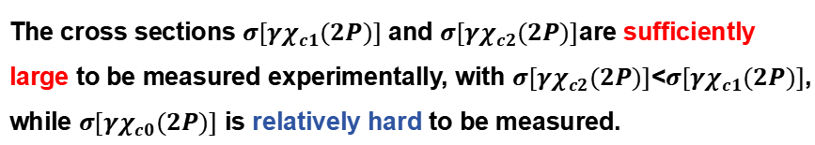
The cross section
The ratios vary smoothly with $α$.
3.5%
The cross sections $σ[γχ_{c1}(2P)]$ and $σ[γχ_{c2}(2P)]$are sufficiently large to be measured experimentally, with $σ[γχ_{c2}(2P)]$<$σ[γχ_{c1}(2P)]$,
while $σ[γχ_{c0}(2P)]$ is relatively hard to be measured.

Slide 14
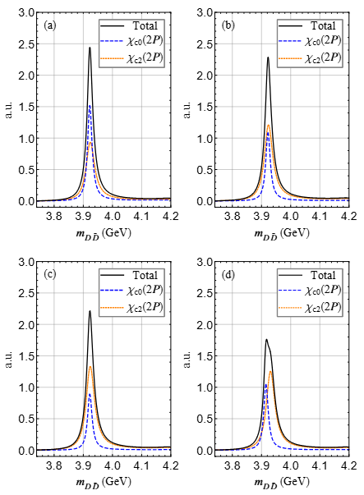

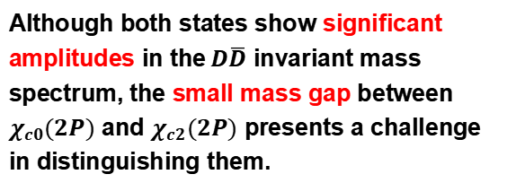
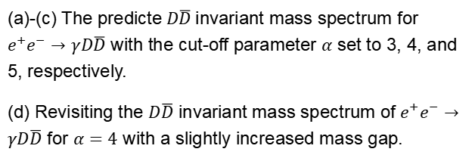
The $D\overline{D}$ invariant mass spectrum
(a)-(c) The predicte$D\overline{D}$invariant mass spectrum for $e^{+}e^{−}→γD\overline{D}$ with the cut-off parameter $α$ set to 3, 4, and 5, respectively.
(d) Revisiting the $D\overline{D}$ invariant mass spectrum of $e^{+}e^{−}→γD\overline{D}$ for $α=4$ with a slightly increased mass gap.
Although both states show significant amplitudes in the$D\overline{D}$ invariant mass spectrum, the small mass gap between $χ_{c0}(2P)$ and $χ_{c2}(2P)$ presents a challenge in distinguishing them.

Slide 15



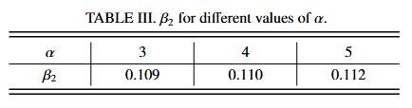



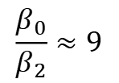


The angular distributions
$$e^{+}$$
$$γ$$
$$γ^{∗}$$
$$ψ$$
$$e^{−}$$
$$χ_{cJ}(2P)$$
For $χ_{c0}(2P)$
$β_{0}=1$, independent of the model.
For $χ_{c2}(2P)$
$$\frac{β_{0}}{β_{2}}≈9$$
We hope that these results will be useful in experimentally distinguishing between the $χ_{c0}(2P)$ and $χ_{c2}(2P)$ states.

Slide 16

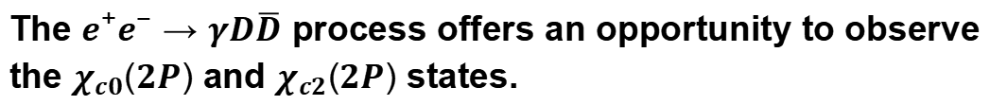
Summary
The calculated cross sections for $e^{+}e^{−}→γχ_{c0}(2P)$ and $e^{+}e^{−}→γχ_{c2}(2P)$ are fall within the measurable range of future experiments.
Both $χ_{c0}(2P)$ and $χ_{c2}(2P)$ show significant amplitudes in the $D\overline{D}$
invariant mass spectrum of $e^{+}e^{−}→γD\overline{D}$.
The ratio between angular distributions parameters $β_{0}$ and $β_{2}$ is
approximately 9 for $ψ→γχ_{c0,2}(2P)$ systems.
The $e^{+}e^{−}→γD\overline{D}$ process offers an opportunity to observe the $χ_{c0}(2P)$ and $χ_{c2}(2P)$ states.
Thanks

