Slide 1
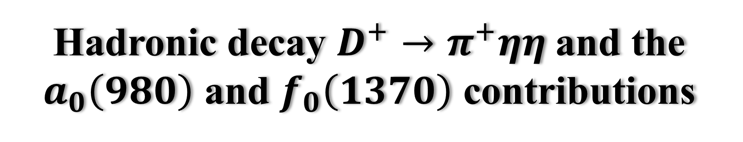
Hadronic decay $D^{+}→π^{+}ηη$and the $a_{0}\left(980\right)$ and $f_{0}\left(1370\right)$ contributions
2025年强子物理与有效场论前沿讲习班
arXiv:2508.04936
吕文韬 郑州大学
合作者：魏乐乐(CCNU)，李德民(ZZU)，王恩(ZZU)
2025年8月22日@河南•郑州
Notes:
…

Slide 2
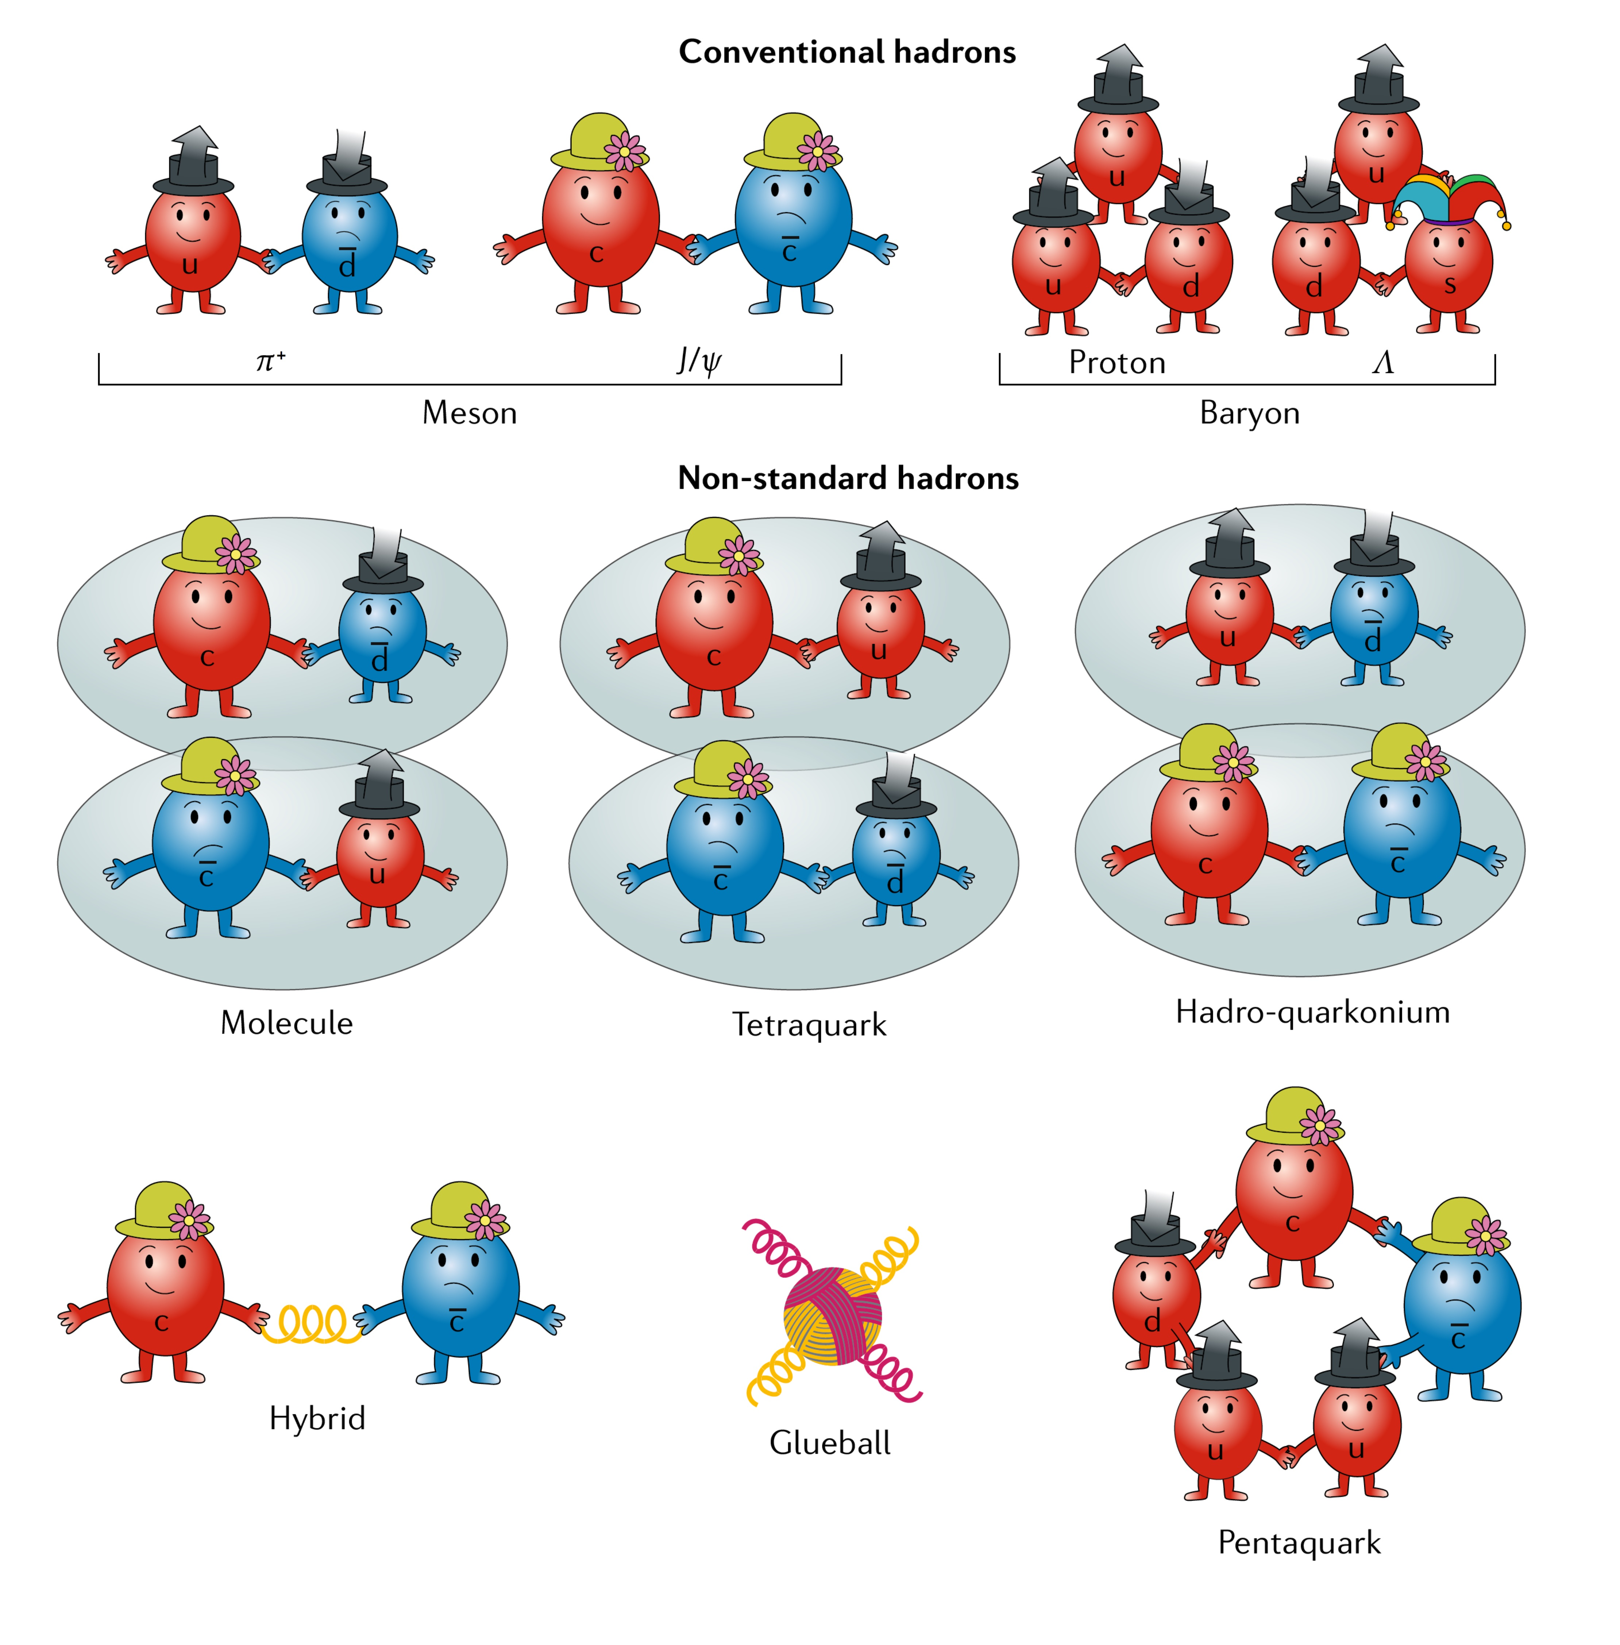
Background
Conventional hadrons:
Meson
Baryon
Non-standard hadrons:
Molecule
Tetraquark
Pentaquark
Hybrid
Glueball
Nature Rev. Phys. 1 , 480 (2019)

Slide 3
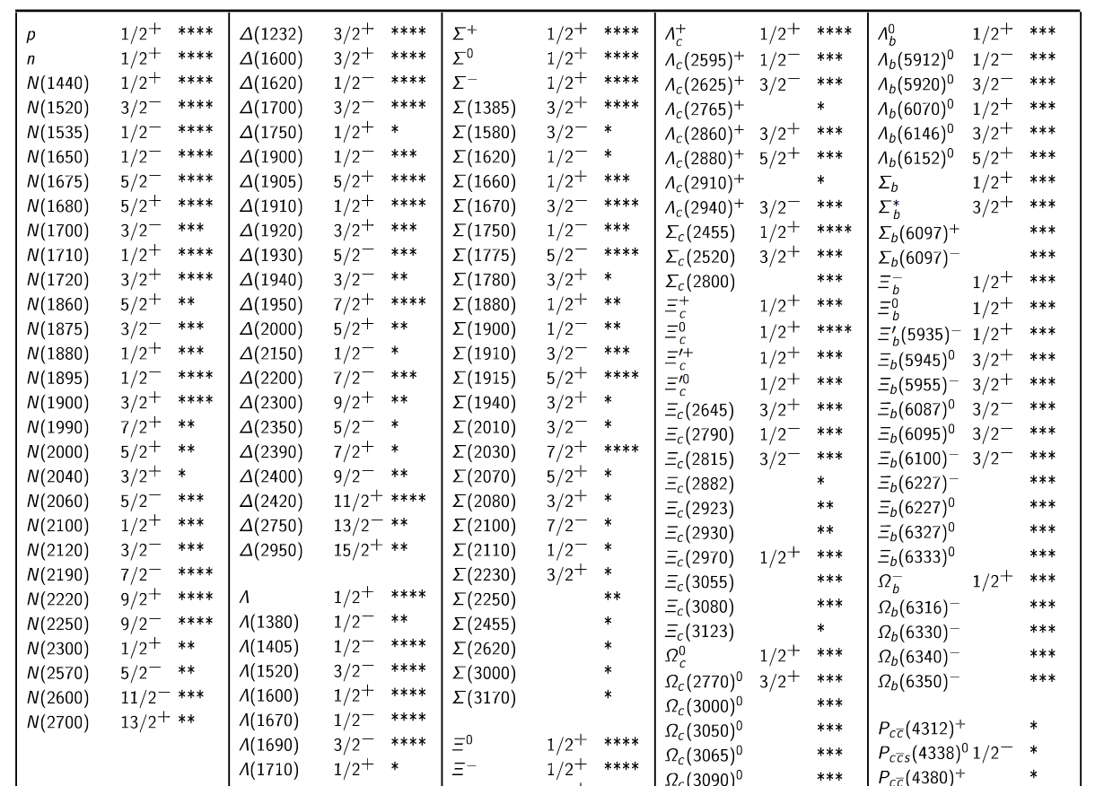
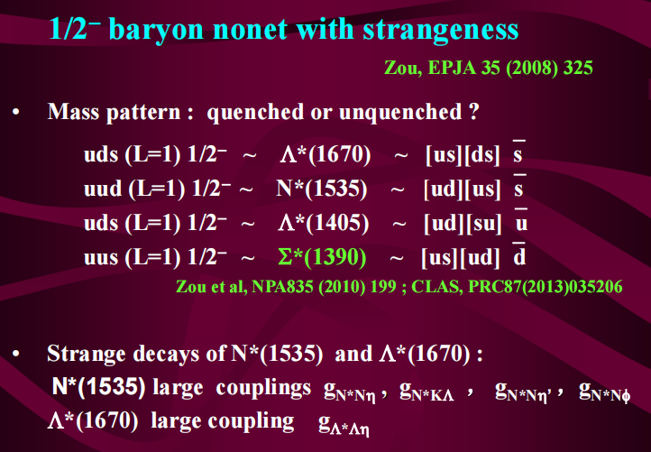
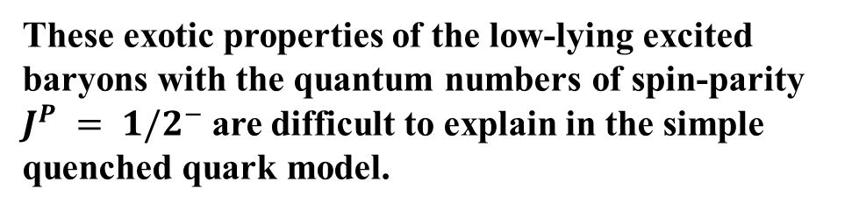
Low-lying baryons with J^{P}=1/2⁻
Workman R L, et al., Review of Particle Physics (2024).
These exotic properties of the low-lying excited baryons with the quantum numbers of spin-parity $J^{P} = 1/2^{−}$are difficult to explain in the simple quenched quark model.
EW-Geng-Wu-Xie-Zou, CPL. 41 (2024) 101401
Report of Bing-Song Zou

Slide 4
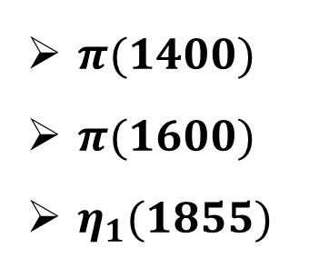
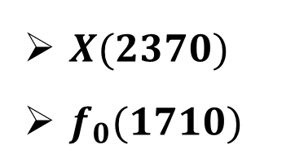
Light meson
Masses puzzle of light scalar meson
Candidates for glueball
$X(2370)$
$f_{0}(1710)$
Traditional quark model
$$f_{0}(500)≈a_{0}(980)<K_{0}^{∗}(700)<f_{0}(980)$$
Candidates for hybrid
Experiment
$π(1400)$
$π(1600)$
$η_{1}(1855)$
$$f_{0}(500)<K_{0}^{∗}(700)<a_{0}(980)<f_{0}(980)$$

Slide 5

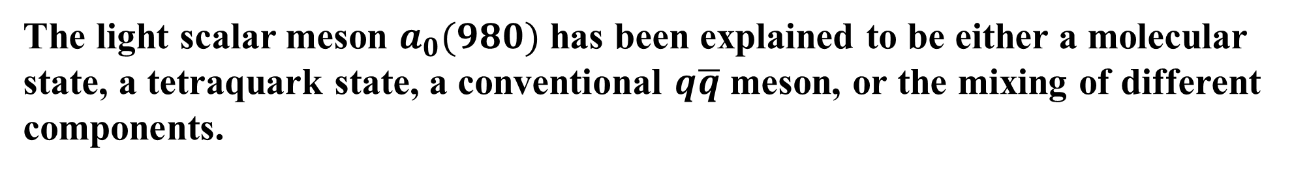
Light scalar meson
The light scalar meson $a_{0}(980)$ has been explained to be either a molecular state, a tetraquark state, a conventional $q\overline{q}$ meson, or the mixing of different components.
PART of theoretical interpretation of $a_{0}(980)$
$K\overline{K}$ molecular state:
Compact tetraquark state:
Phys. Rev. Lett. 48 (1982) 659
Phys. Rev. D 41 (1990) 2236
Phys. Rev. Lett. 92 (2004) 102001
Eur. Phys. J. A 30 (2006) 423-426
Dynamically generated states:
Phys. Rev. Lett. 111 (2013) 062001
Phys. Rev. D 52 (1995) 2690
Phys. Lett. B 803 (2020) 135279
Phys. Lett. B 846 (2023) 138185

Slide 6
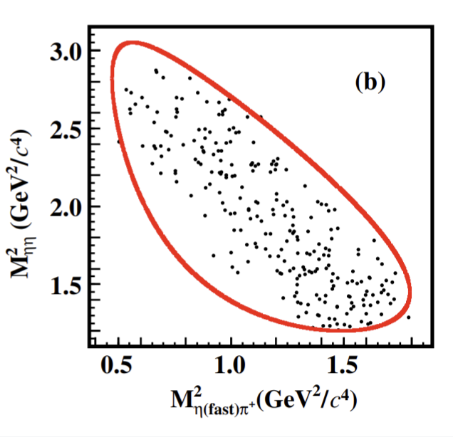
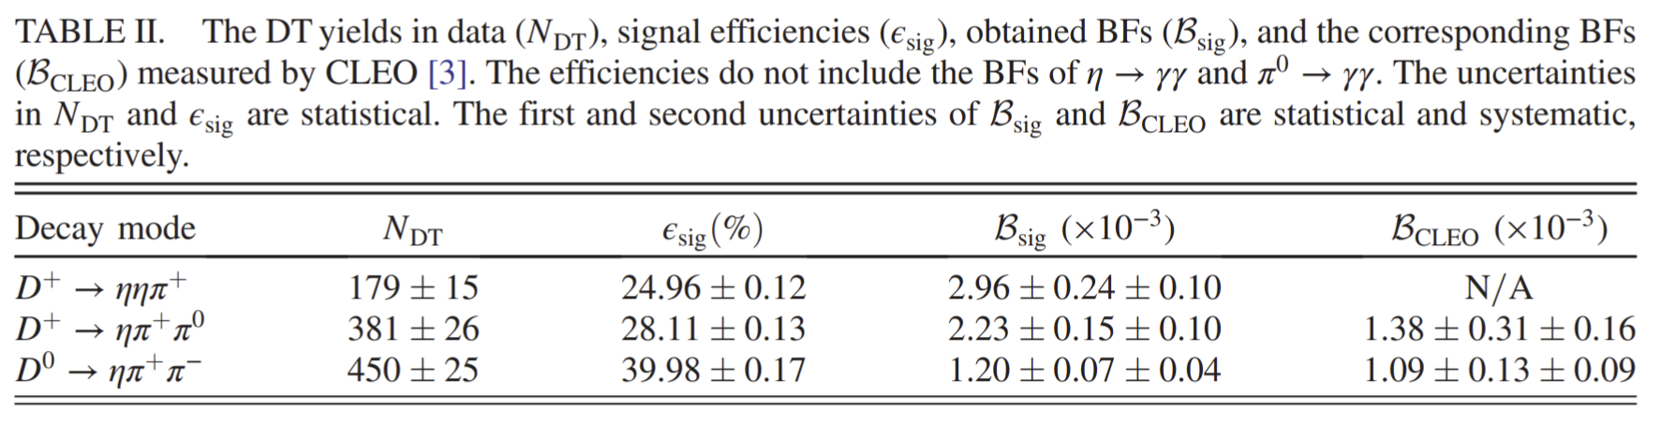
The BESIII measurement
In 2020, $D^{+}→π^{+}ηη$ has been observed for the first time by the BESIII Collaboration and reported the absolute branching fraction
BESIII Collaboration, PRD. 101(2020) 052009
$$𝓑(D^{+}→ηηπ^{+})=(2.96±0.24±0.10)×{10}^{−3}$$

Slide 7
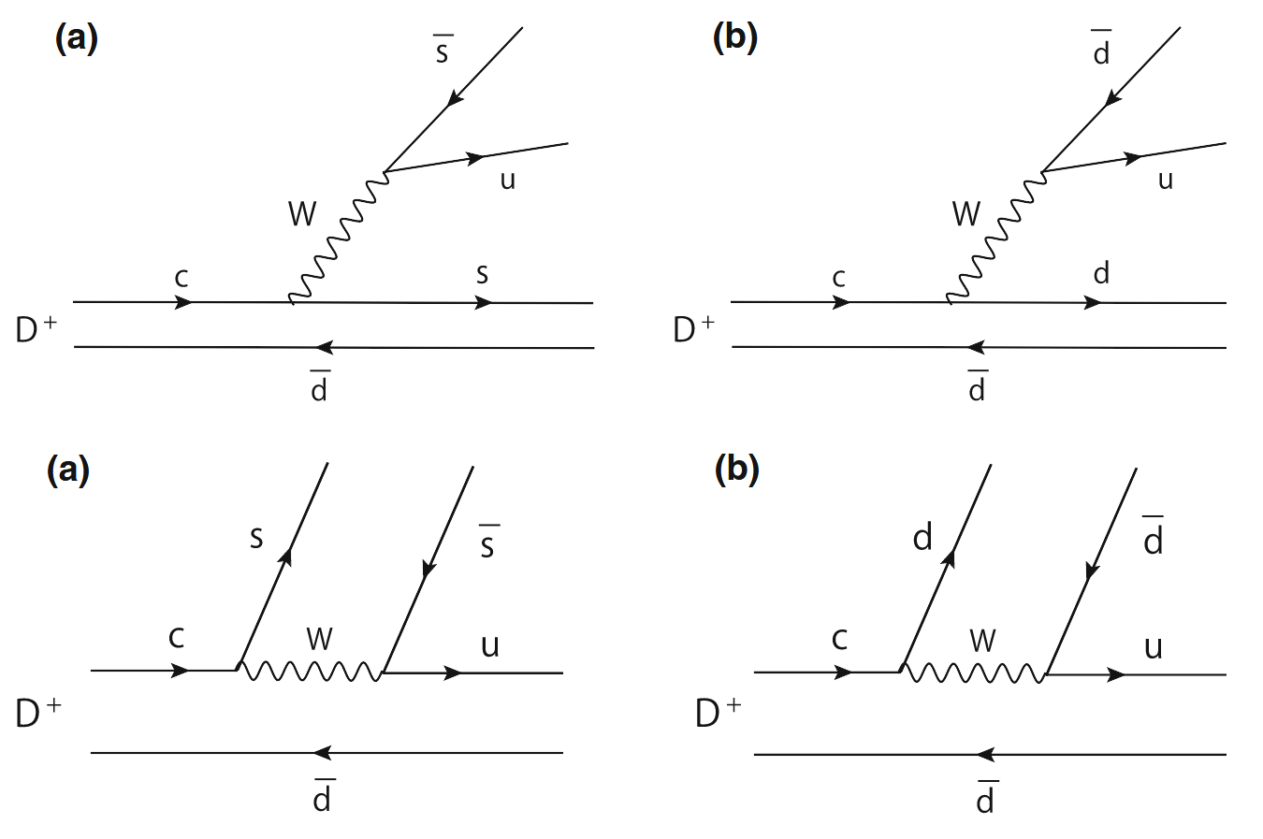
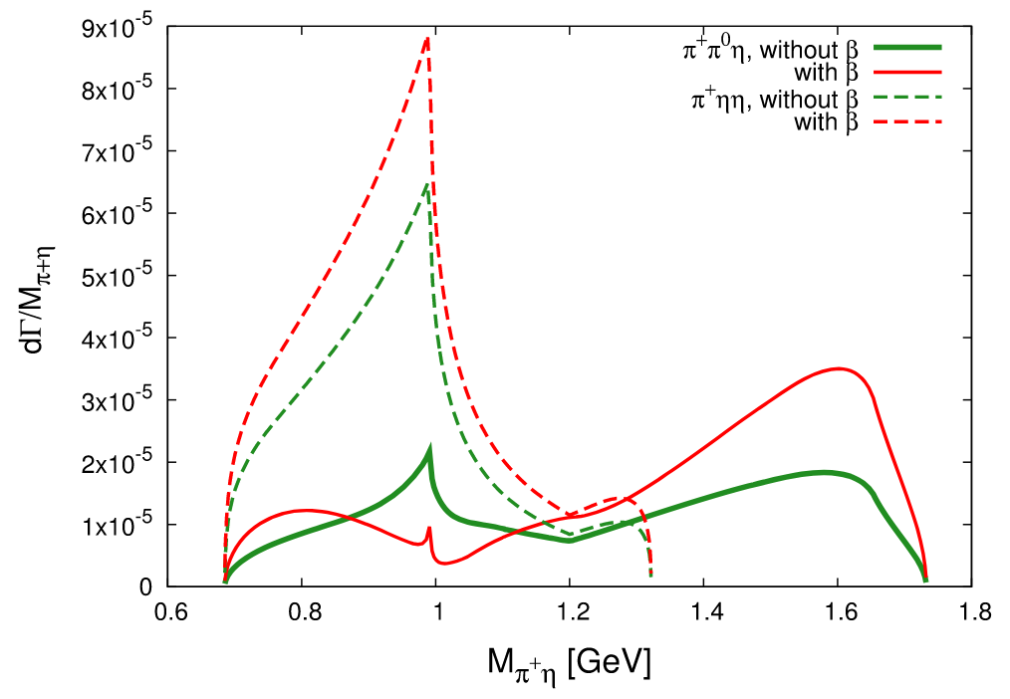
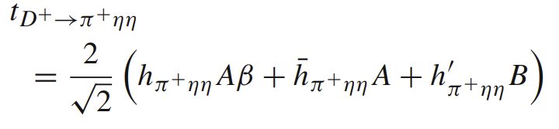
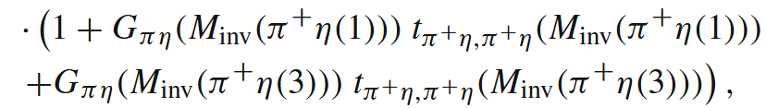
Analysis this process
In 2021, $D^{+}→π^{+}ηη$ and $D^{+}→π^{+}π^{0}η$ have been studied by Oset et al.
Eur. Phys. J. C (2021) 81:377
They results show a significant signal of the $a_{0}(980)$

Slide 8
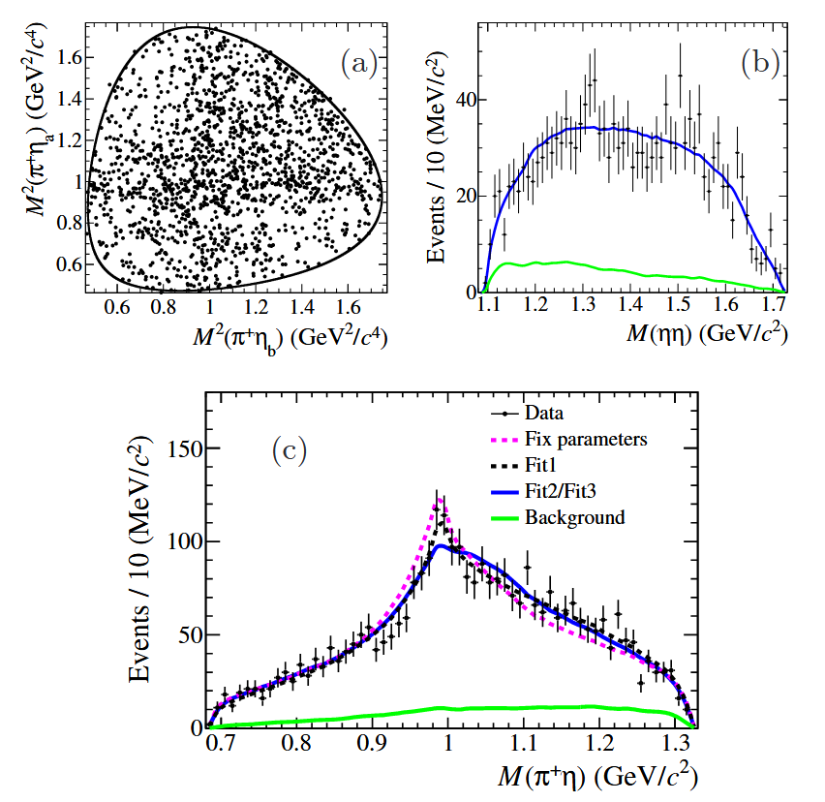
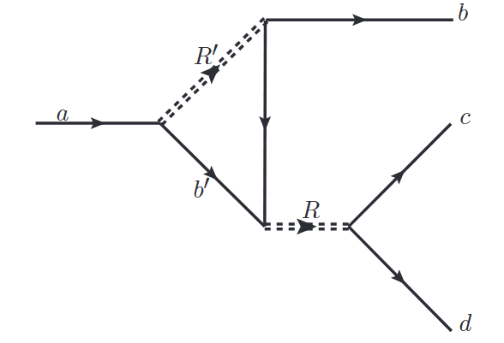






The BESIII reanalysis
In 2025, $D^{+}→π^{+}ηη$ has been posteriorly measured by the BESIII Collaboration
BESIII Collaboration, arXiv:2505.12086
$$η$$
$${\overline{K}}_{0}^{∗}{\left(1430\right)}^{0}$$
$${\overline{K}}^{0}$$
$$η$$
$$K^{+}$$
$$π^{+}$$
$$D^{+}→{\overline{K}}_{0}^{∗}{\left(1430\right)}^{0}K^{+}→η{\overline{K}}^{0}K^{+}→ηa_{0}^{+}→ηηπ^{+}$$
By considering the triangle loop rescattering effect, BESIII could well describe line-shape of mass distribution

Slide 9
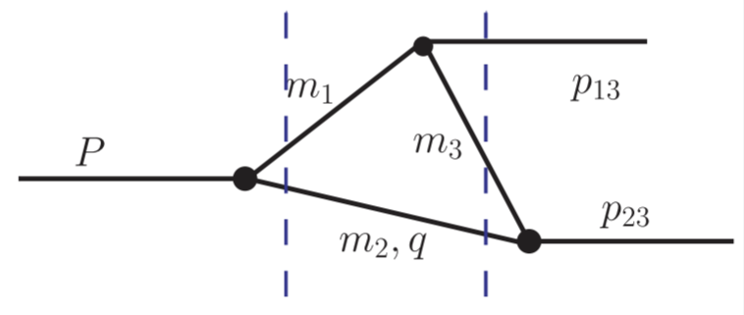


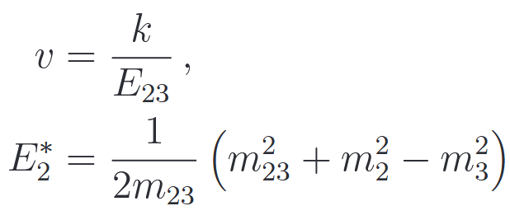
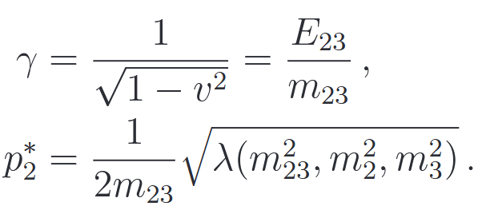
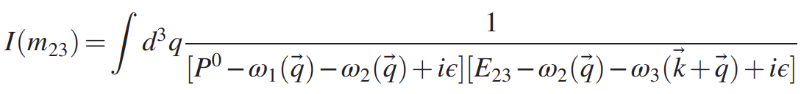
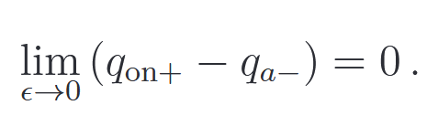
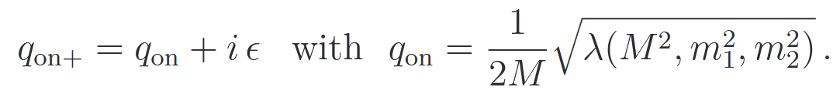
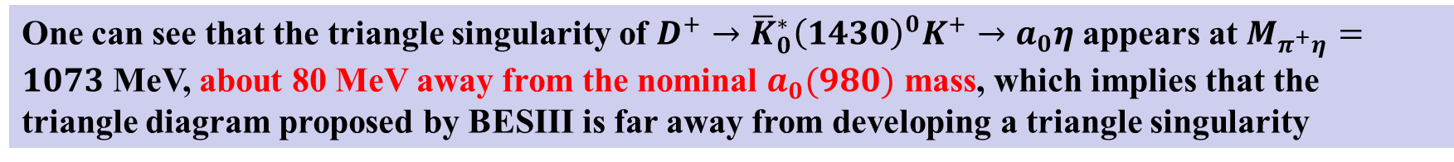
The triangle singularity
PRD 94 (2016) 074039
$$I=i\int{\frac{d^{4}q}{(2{π)}^{4}}\frac{1}{\left(q^{2}−m_{2}^{2}+iε\right)\left[{\left(P−q\right)}^{2}−m_{1}^{2}+iε\right][{\left(P−q−p_{13}\right)}^{2}−m_{3}+iε] }}$$
One can see that the triangle singularity of $D^{+}→{\overline{K}}_{0}^{∗}{\left(1430\right)}^{0}K^{+}→a_{0}η$ appears at $M_{π^{+}η}=1073$ MeV, about 80 MeV away from the nominal $a_{0}(980)$ mass, which implies that the triangle diagram proposed by BESIII is far away from developing a triangle singularity

Slide 10
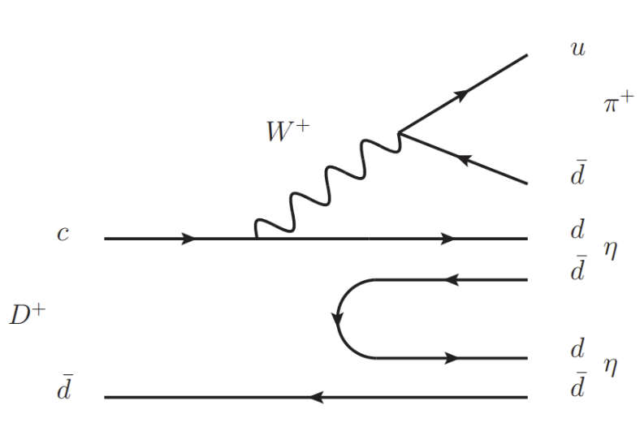
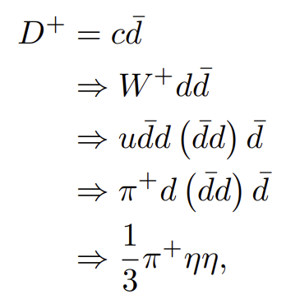
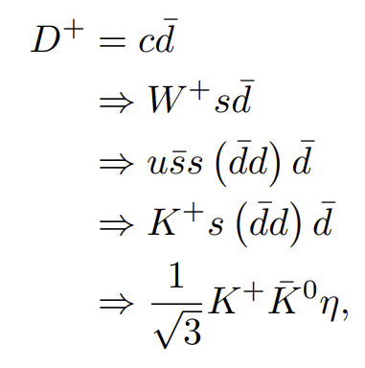
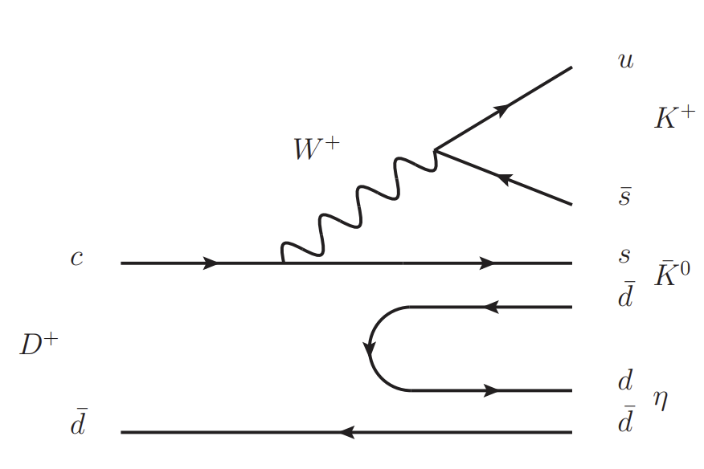
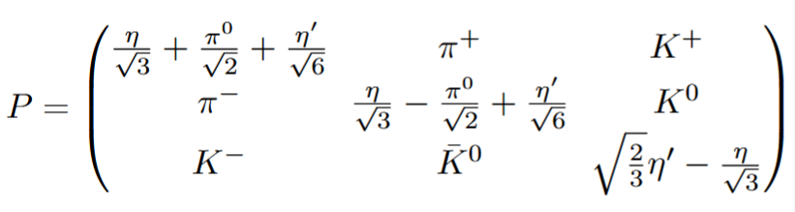
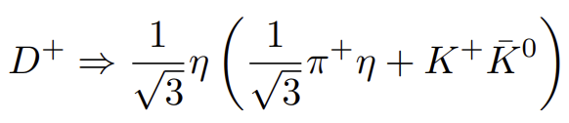
Formalism
Quark level diagram
Hadronization

Slide 11
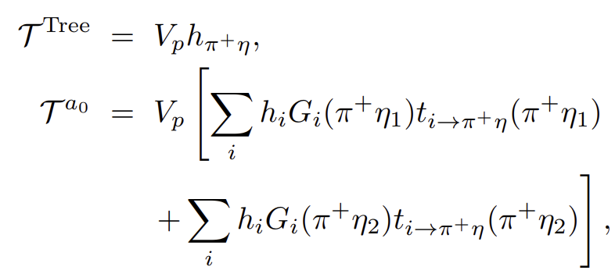
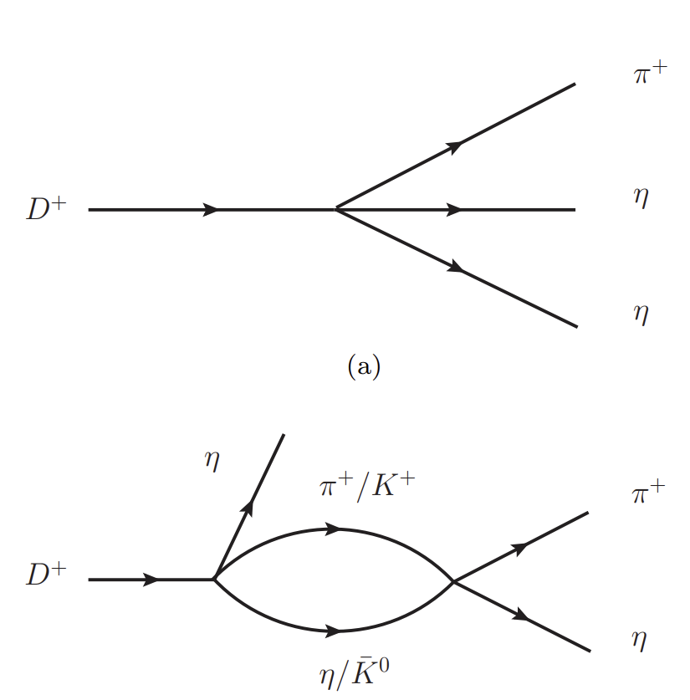
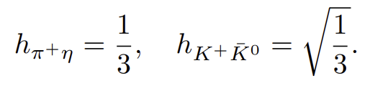

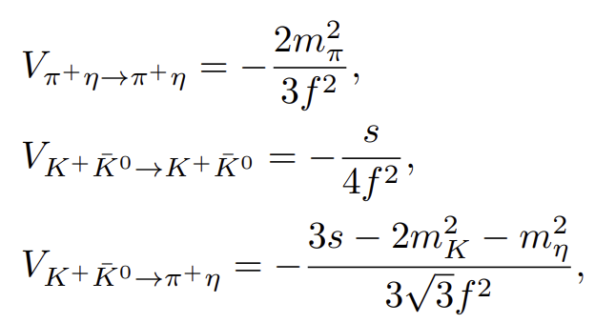
Formalism
Mechanisms for tree level and rescattering
The decay amplitudes

Slide 12
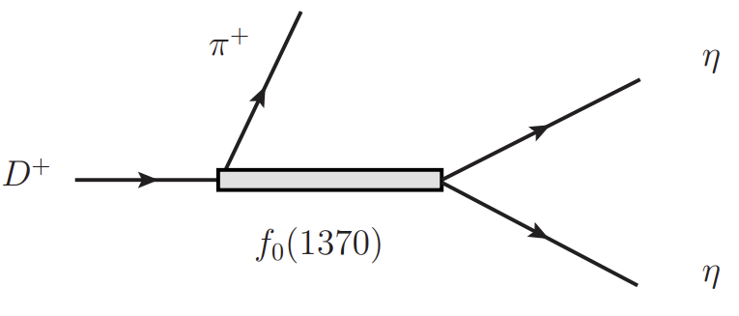

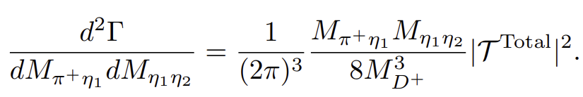
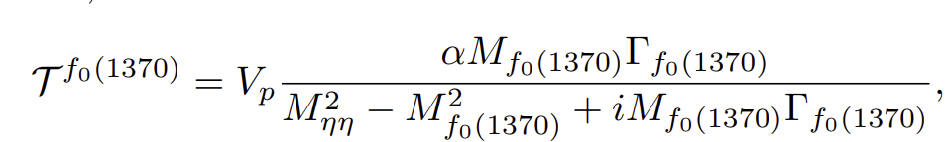
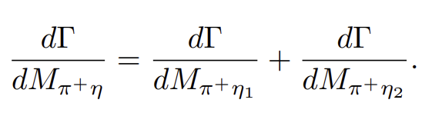
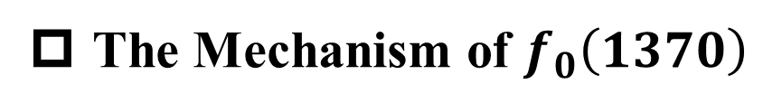
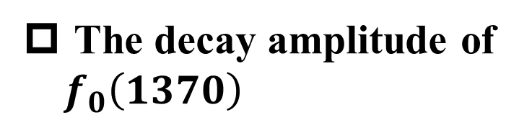
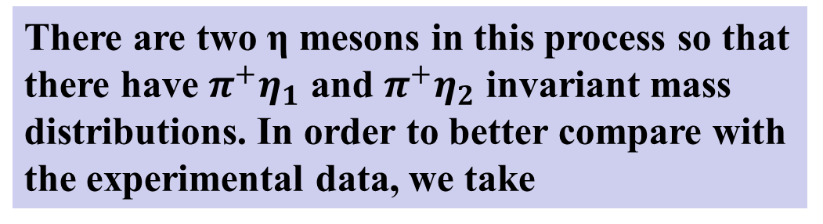
Formalism
The Mechanism of $f_{0}\left(1370\right)$
The total amplitudes
The decay amplitude of $f_{0}\left(1370\right)$
There are two η mesons in this process so that there have $π^{+}η_{1}$ and $π^{+}η_{2}$ invariant mass distributions. In order to better compare with the experimental data, we take

Slide 13
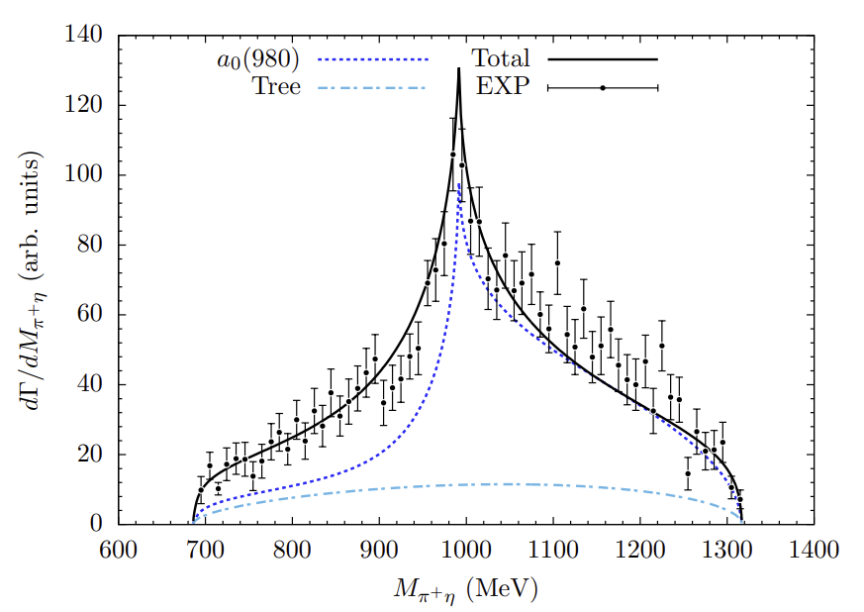
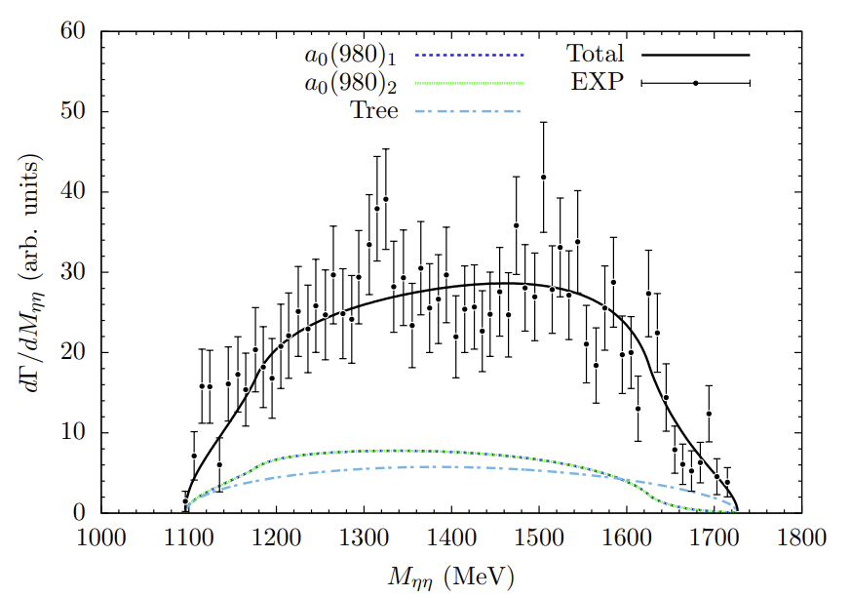
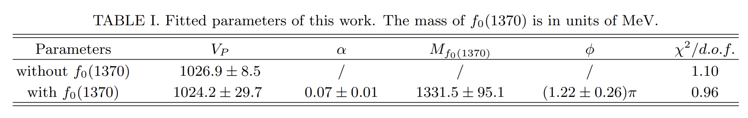
Results
The invariant mass distributions of the $D^{+}→π^{+}ηη$ decay without $f_{0}\left(1370\right)$

Slide 14
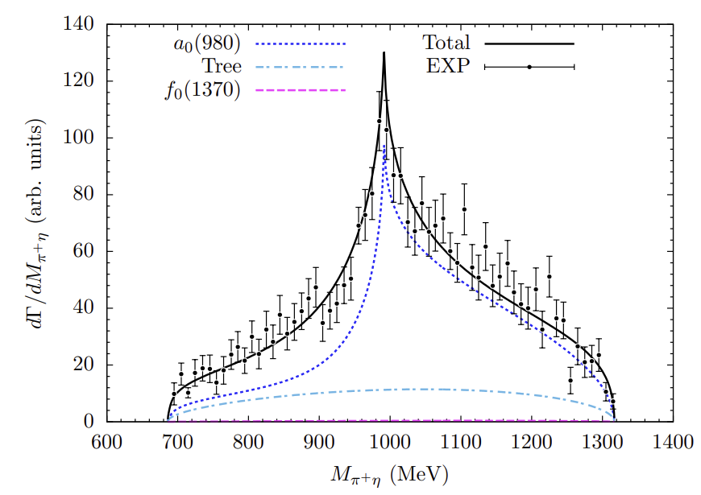
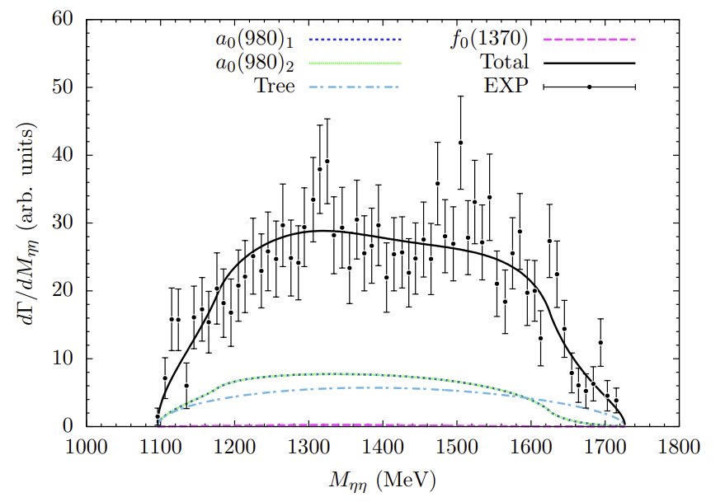
Results
The invariant mass distributions of the $D^{+}→π^{+}ηη$ decay with $f_{0}\left(1370\right)$

Slide 15
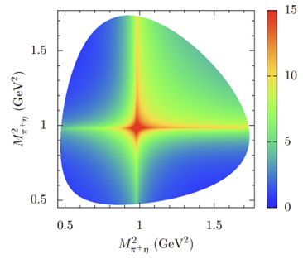
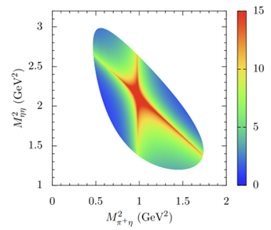
Results
The Dalitz plots of the $D^{+}→π^{+}ηη$ decay with $f_{0}\left(1370\right)$

Slide 16
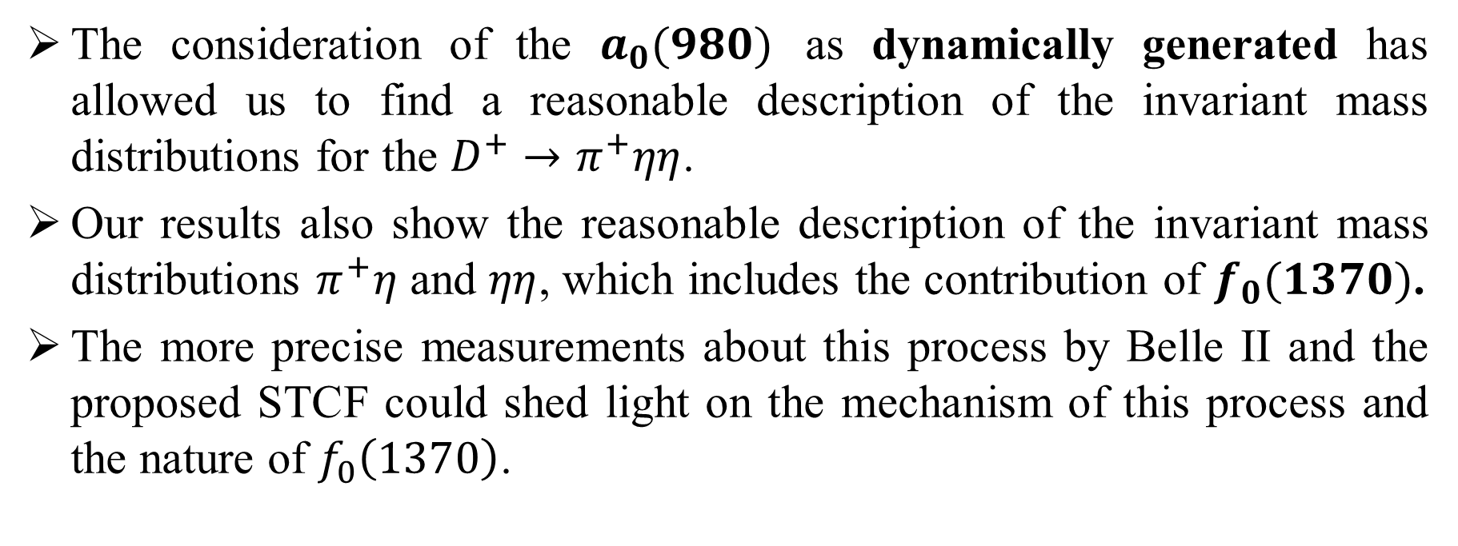
Summary
The consideration of the $a_{0}(980)$ as dynamically generated has allowed us to find a reasonable description of the invariant mass distributions for the $D^{+}→π^{+}ηη$.
Our results also show the reasonable description of the invariant mass distributions $π^{+}η$ and $ηη$, which includes the contribution of $f_{0}(1370)$.
The more precise measurements about this process by Belle II and the proposed STCF could shed light on the mechanism of this process and the nature of $f_{0}\left(1370\right)$.
Thank you very much！

