Slide 1
Study of Lepton ID
Changhua Hao, Ligang Xia
Nanjing University

Slide 2
MC Samples
MC samples are produced with the CEPCSW master(2024.12.19)+ Chenguang’s TofRecAlg package and the CyberPFA algorithm
particles: electron, muon and pion
momentum:2~10GeV and 1000 events for each momentum
angle: 45 degree

Slide 4
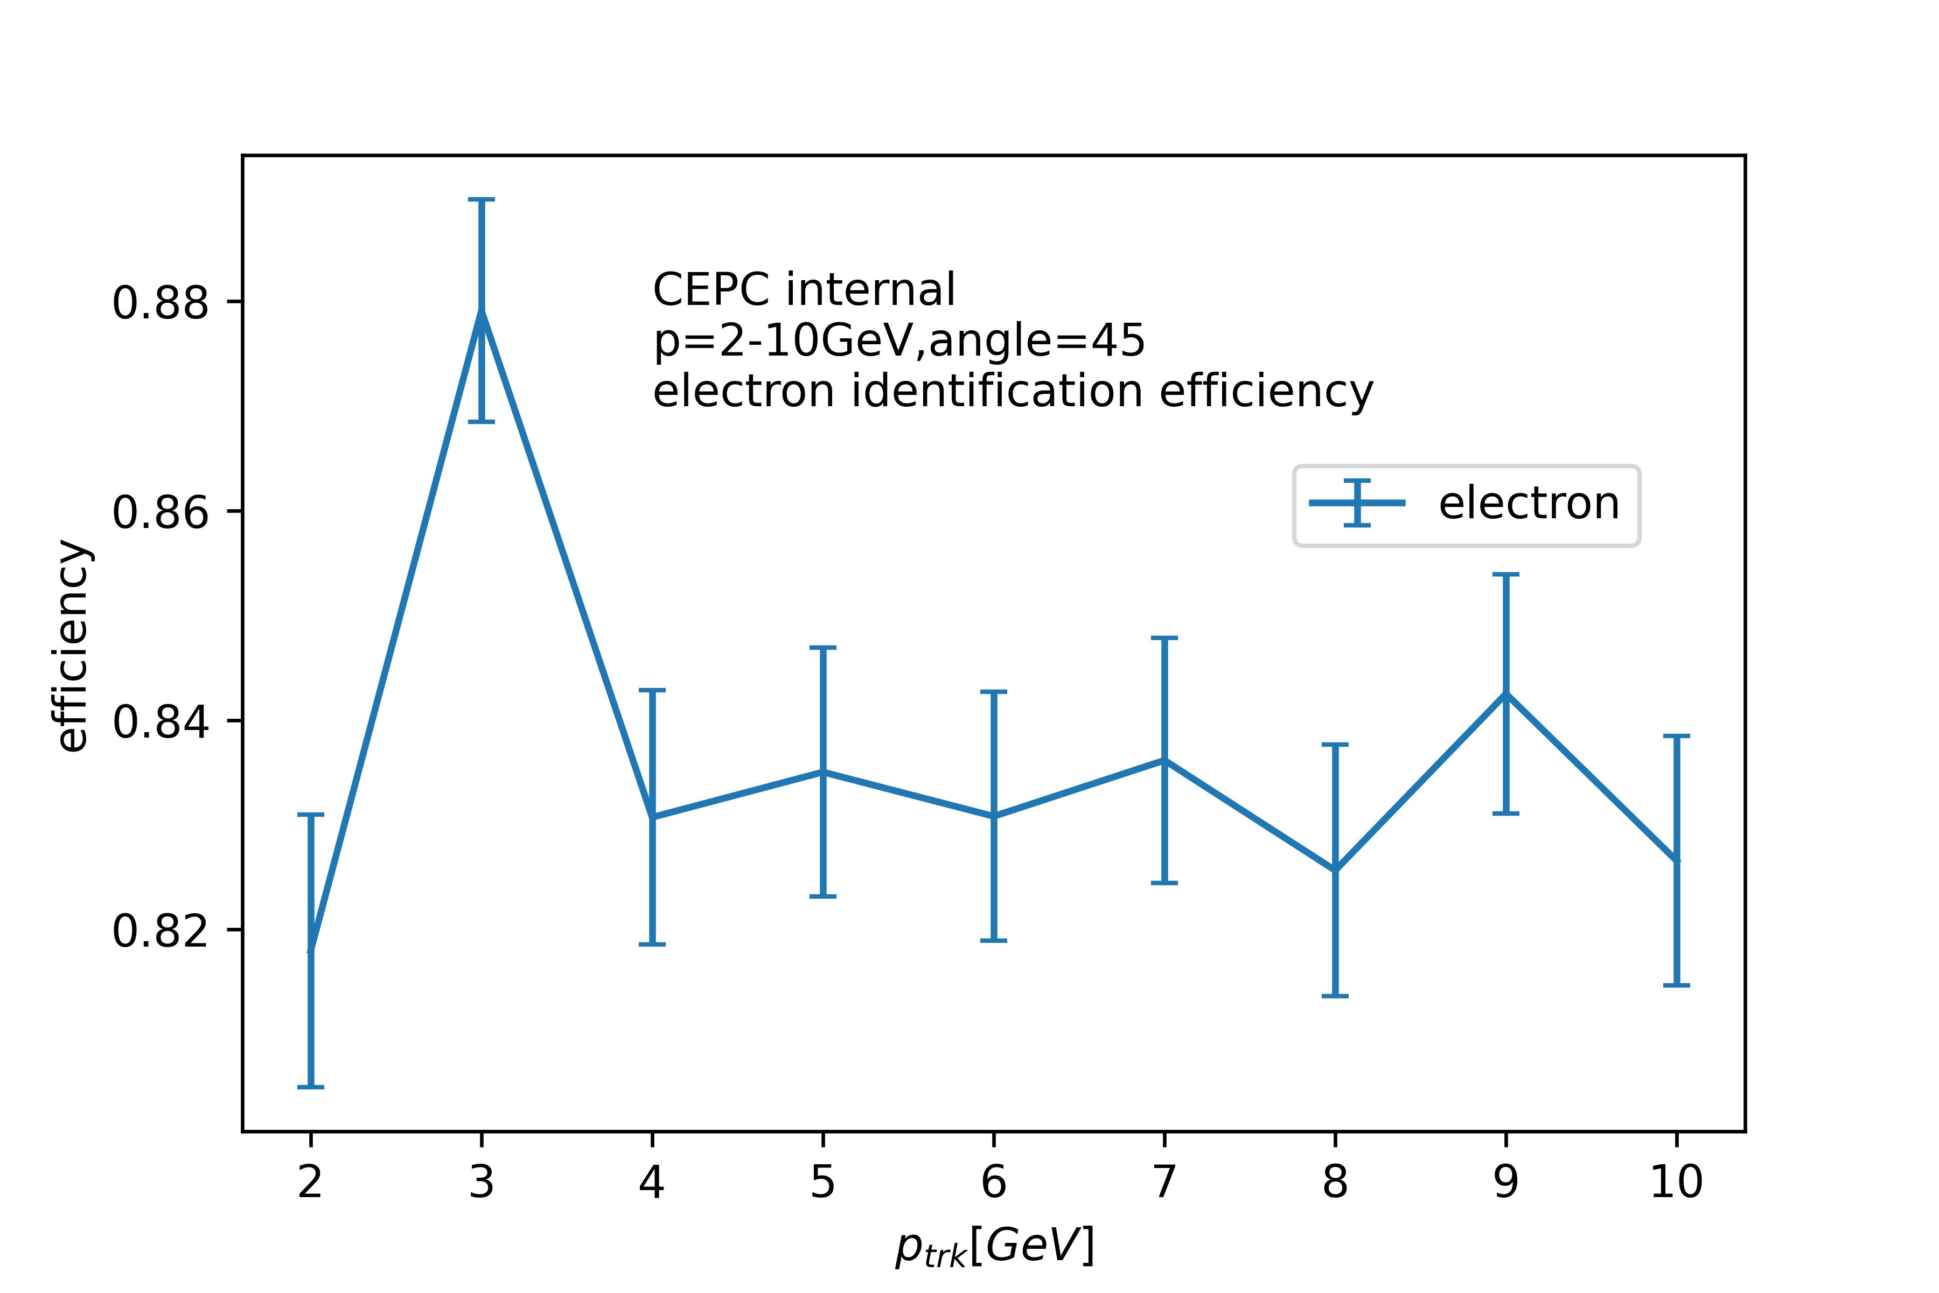
Electron ID Efficiency and background rejection power
Electron ID efficiency: about 83%
Muon faking rate: about 0.2%
Pion faking rate: about 1%

Slide 5
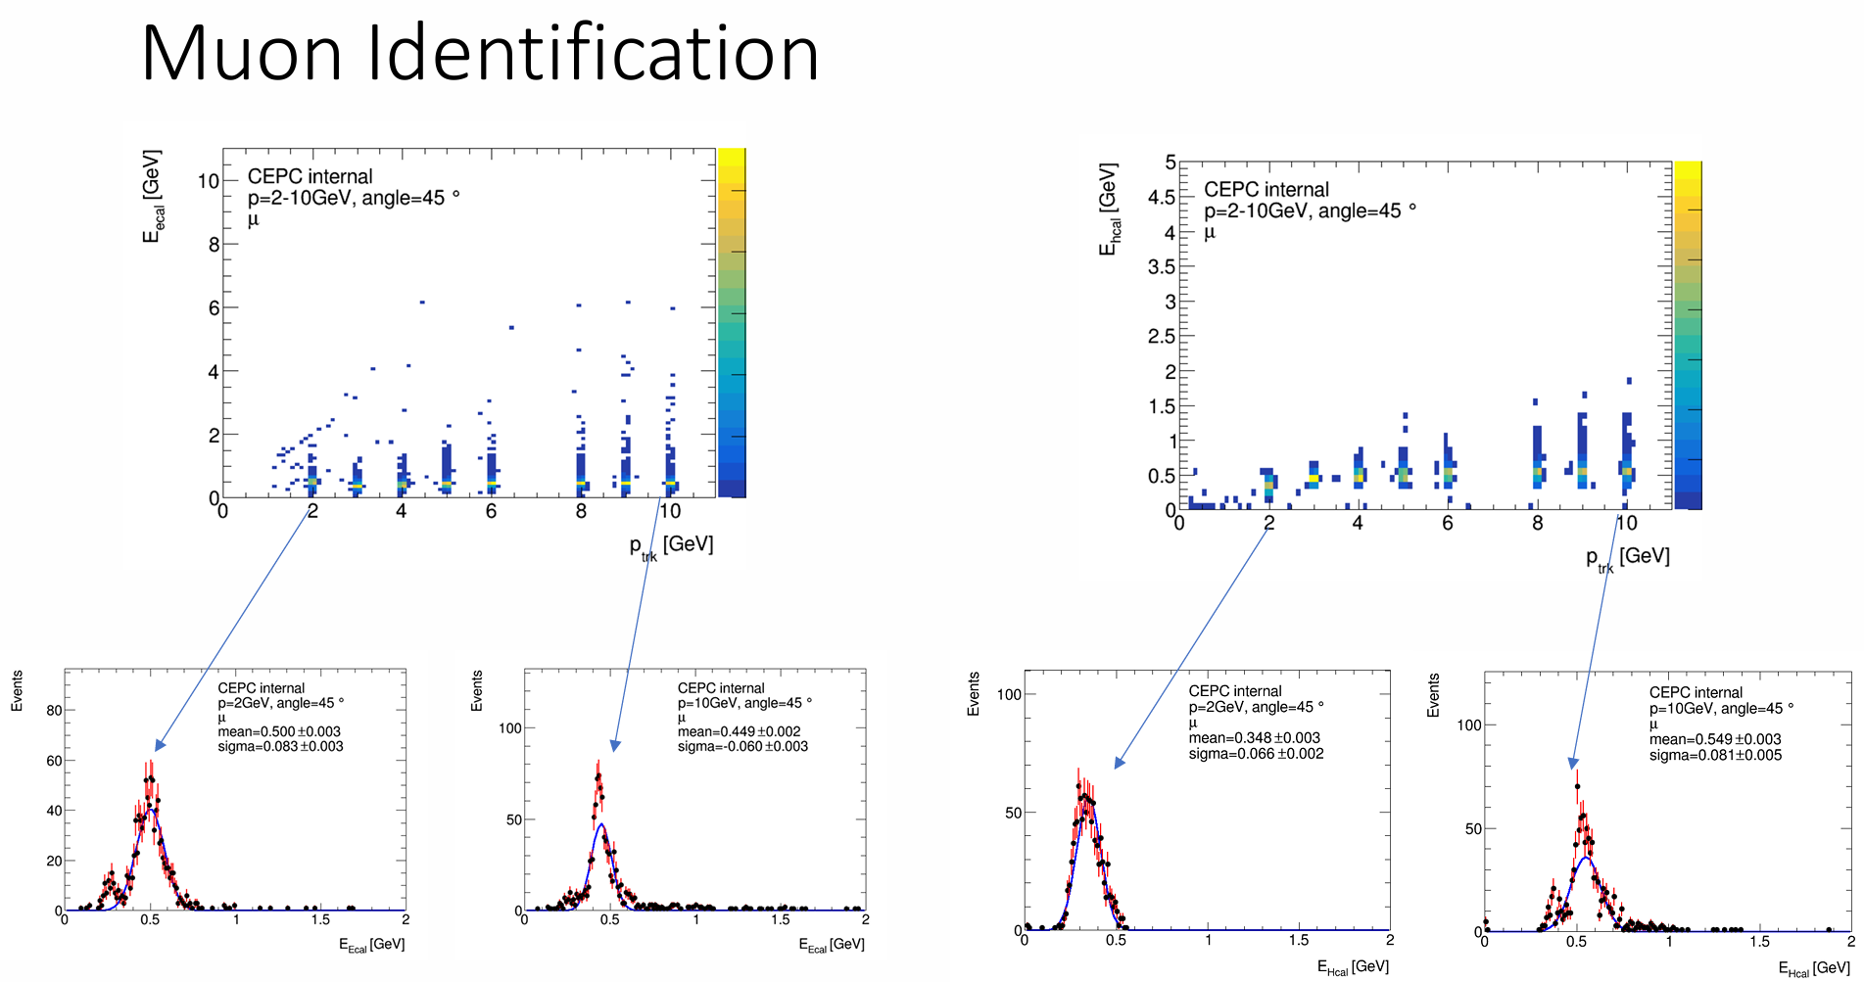

Slide 7
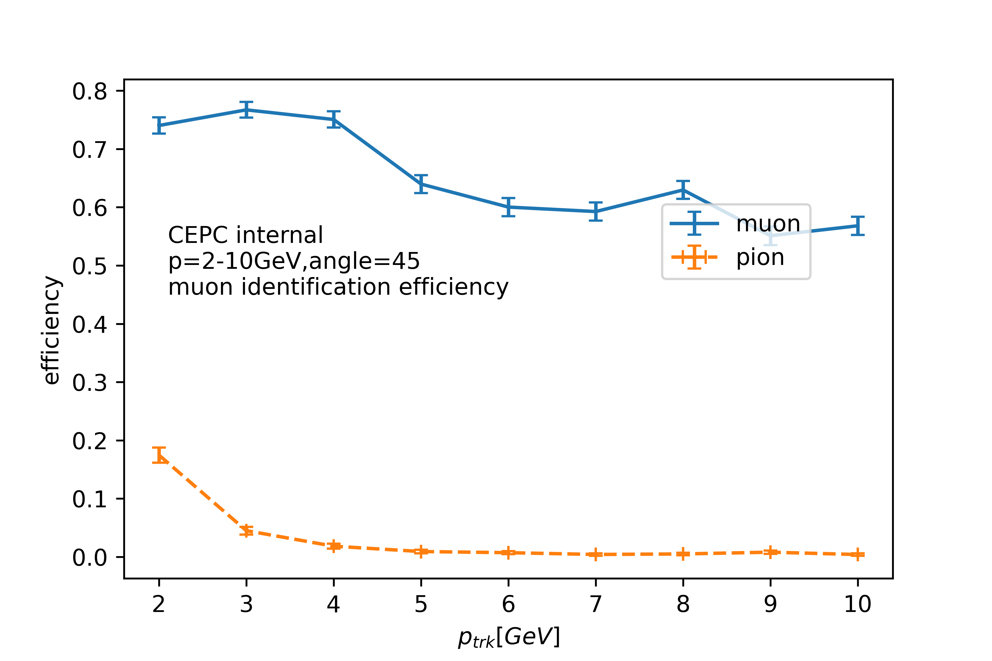
Muon ID Efficiency and background rejection power
Muon ID efficiency: about 75-60%
Pion faking rate: about 18%-0.5%

Slide 8
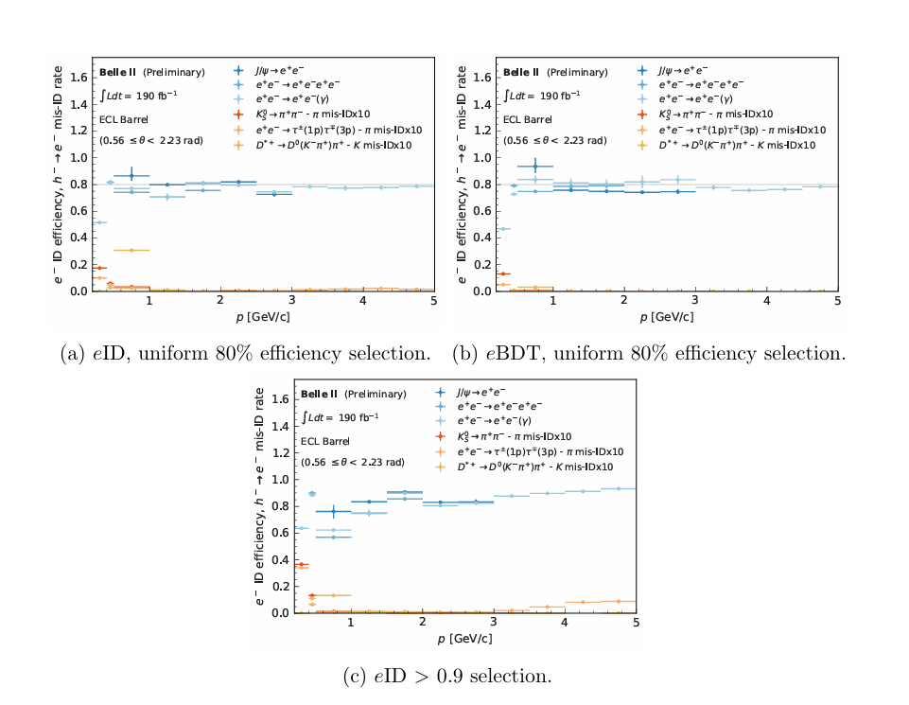
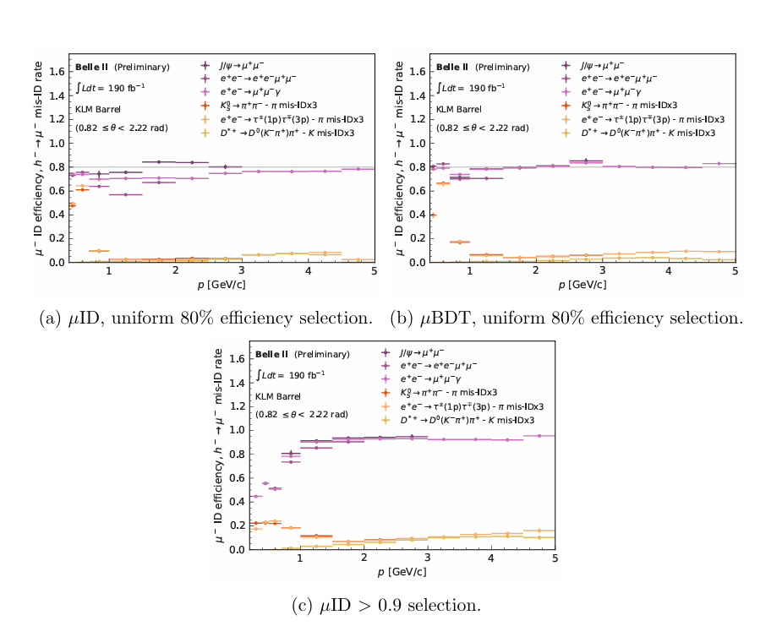
Lepton ID in Belle 2

Slide 9
Summary
Calculate electron/muon ID efficiency and background faking rate for different momenta 2-10 GeV
FCC-ee CDR: https://cds.cern.ch/record/2651299/files/CERN-ACC-2018-0057.pdf
No lepton ID found in the CDR for a comparison
Have a comparison with the lepton ID in Belle2
They provided WPs for uniform 60%, 70%, 80%, 90% and 95%.
They used all subdetector systems: CDC, TOP, ARICH, ECL, KLM.

Slide 10
