Slide 1

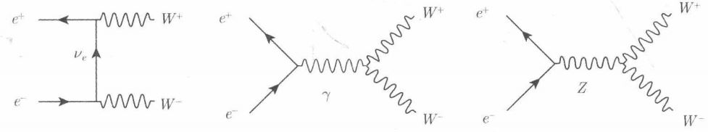
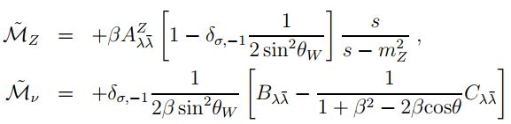
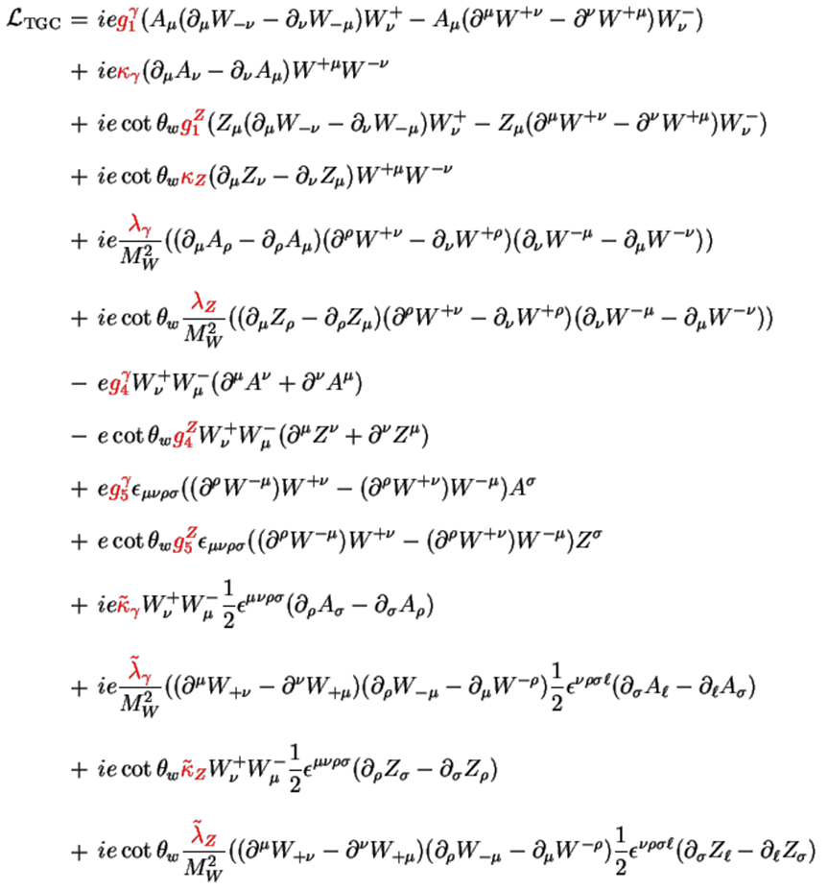
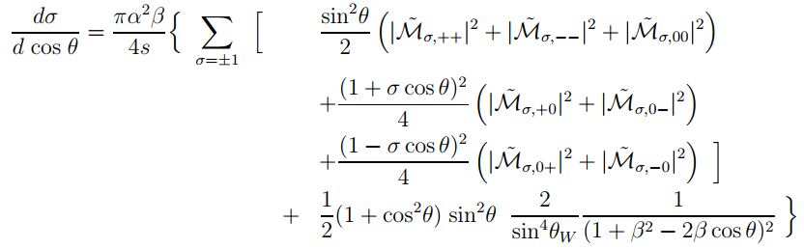
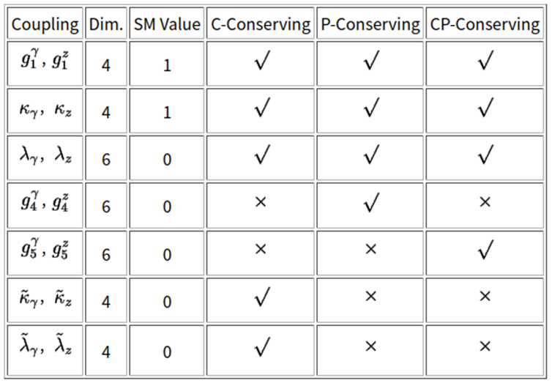

‣ 根据场论中“对初态粒子自旋求平均、对末态粒子自旋求和，来计算平均微分截面和微分宽度”，我们可在whizard产生子中进行拆解，约束正负电子束流的纵向极化并对末态粒子W pair进行极化分组，再利用Standard Model中仅存在左手中微子和右手反中微子的结论，给出了仅含TGC过程 (s-channel)的一维微分截面分布。
‣ 给出了本底过程 (t-channel)分布的平台形状。
‣ 给出了质心能量分别为190 GeV、240 GeV和360 GeV下s-channel和t-channel的截面大小。
本底过程 (t-channel)
TGC过程 (s-channel)
W对的微分散射截面（角分布）公式，s道信号+t道交换中微子本底

Slide 2
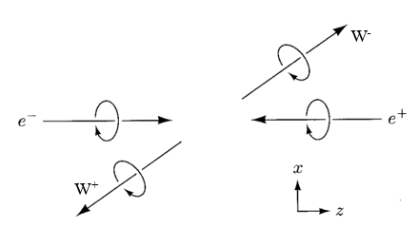
‣ 对末态W pair的螺旋度分组：
(-1 -1) + (+1 +1)
(0 0)
(0 -1) + (+1 0)
(0 +1) + (-1 0)
(+1 -1) + (-1 +1)

Slide 3
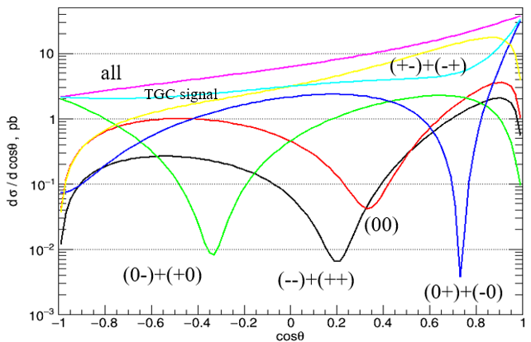
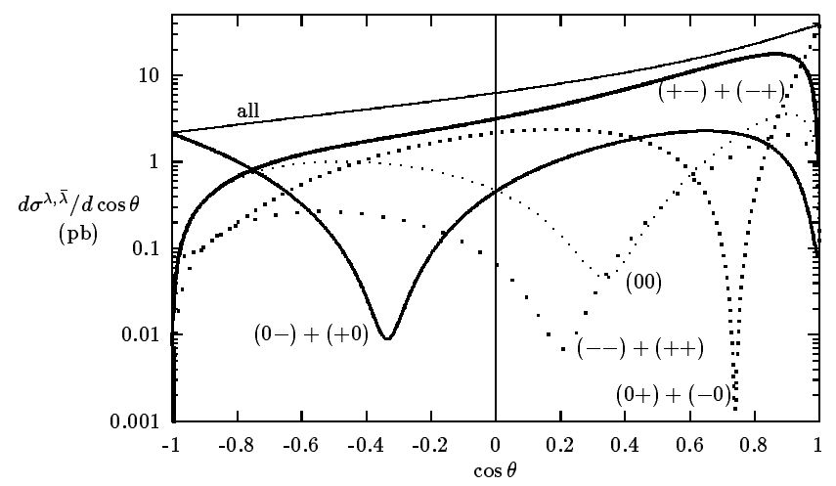
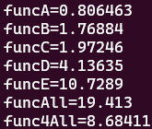
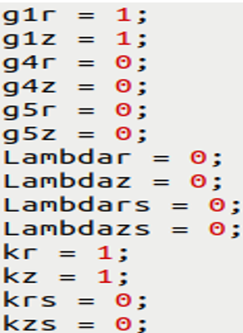
arXiv:hep-ph/9601233v1
190 GeV, angular distribution of W pairs
不同极化分组的截面大小 (pb)
TGC Couplings (Standard Model)

Slide 4
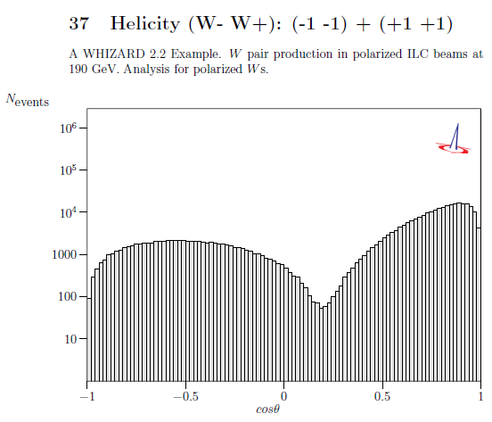
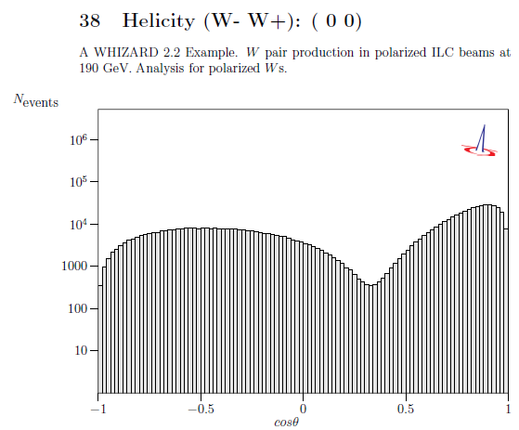
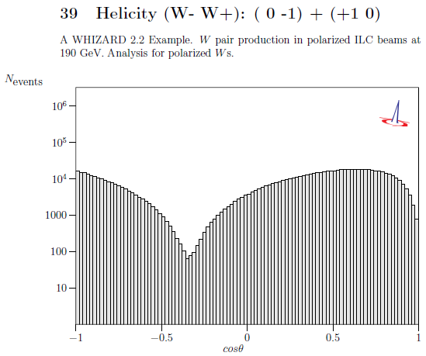
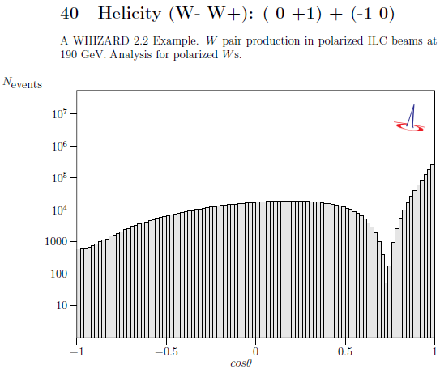
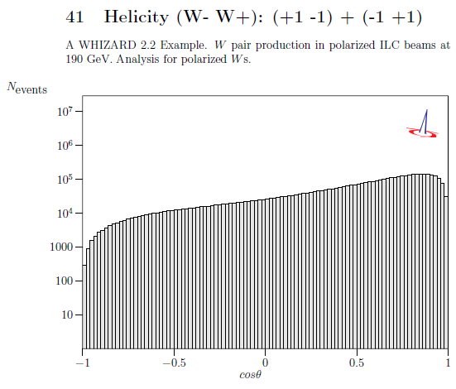
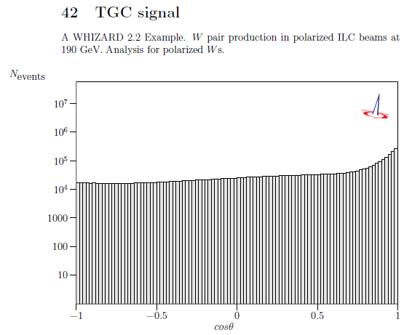
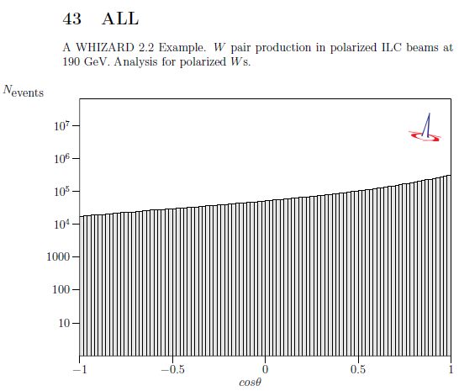
190 GeV, angular distribution of W pairs, all amplitude, y_log

Slide 5
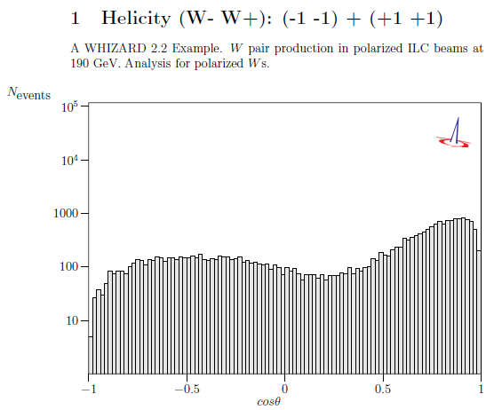
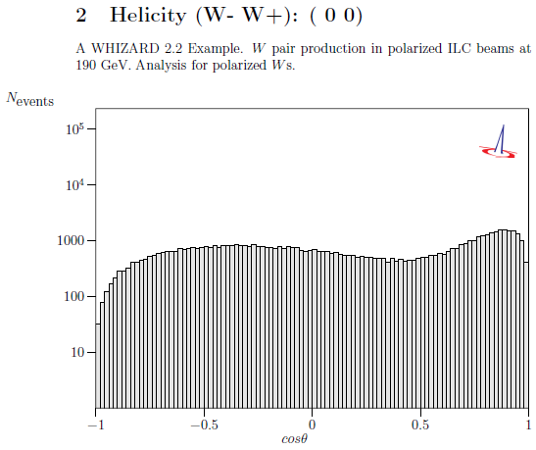
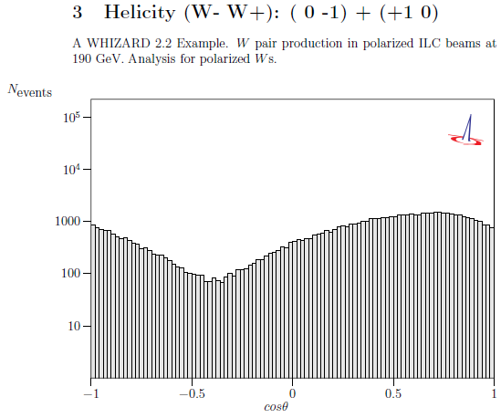
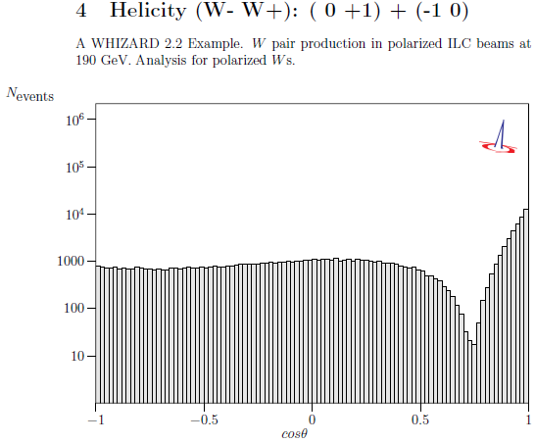
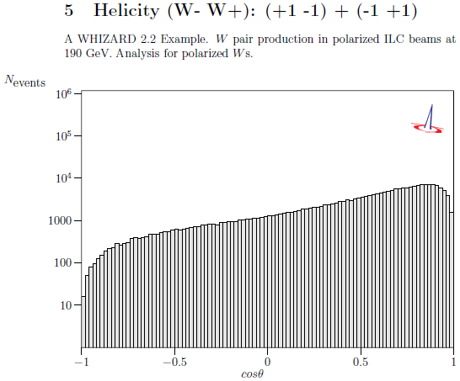
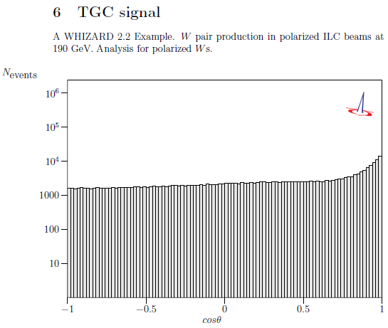
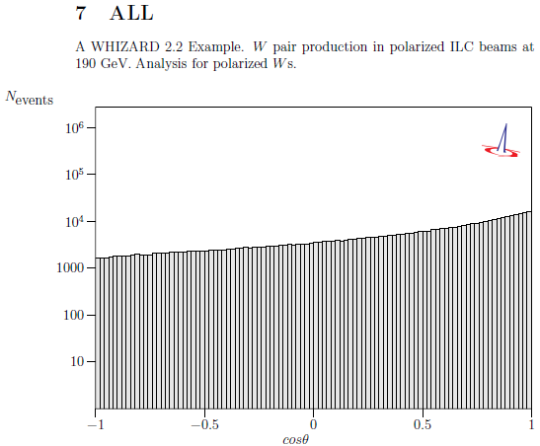
190 GeV, angular distribution of W pairs, just e+e- Helicity -1/2 (80%) +1/2 (50%) (all amplitude, y_log)

Slide 6
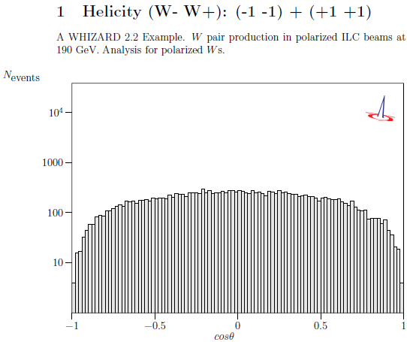
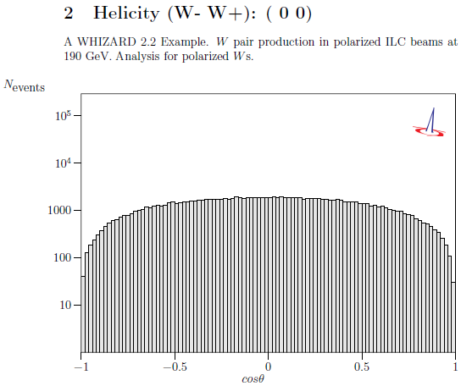
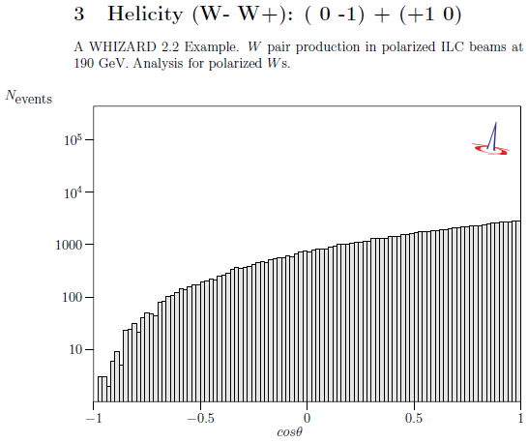
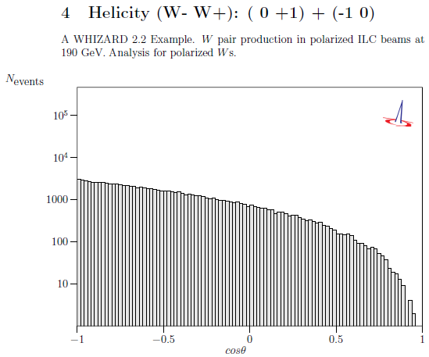
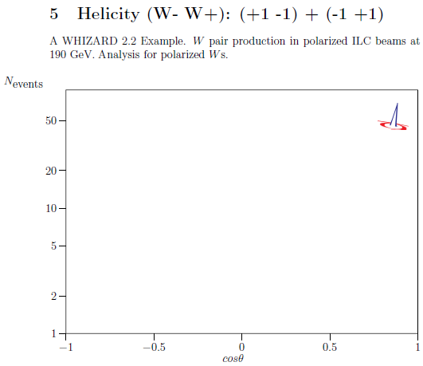
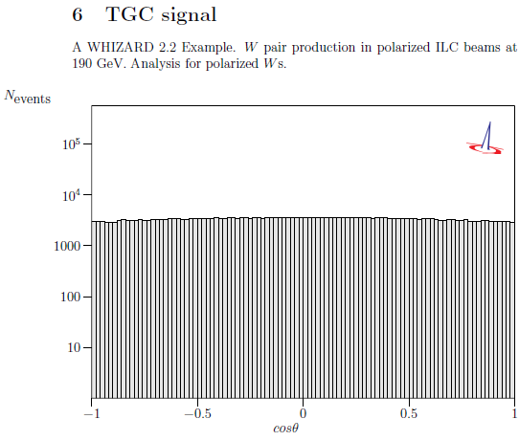
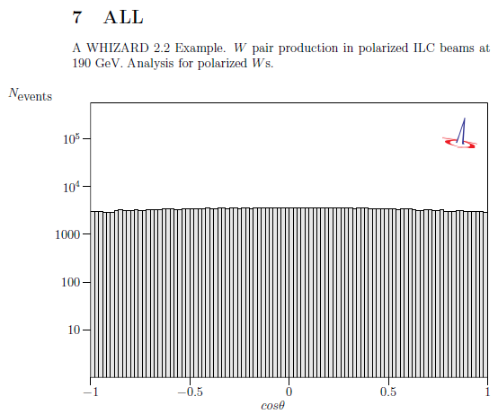
190 GeV, angular distribution of W pairs, just e+e- Helicity -1/2 +1/2 (all amplitude, y_log)

Slide 7
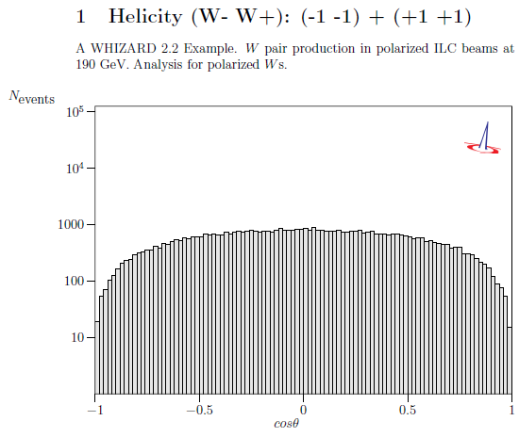
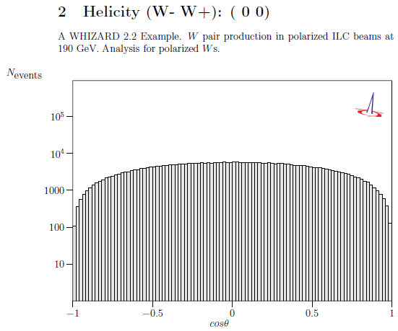
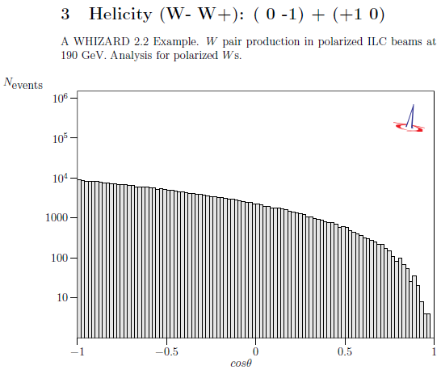
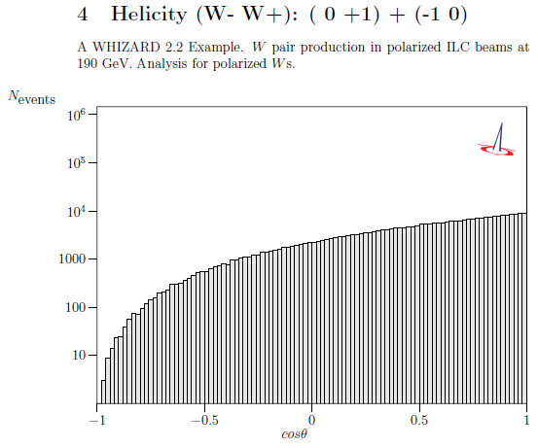
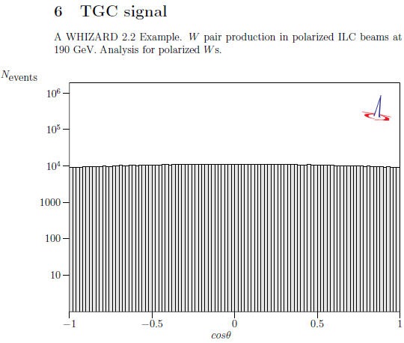
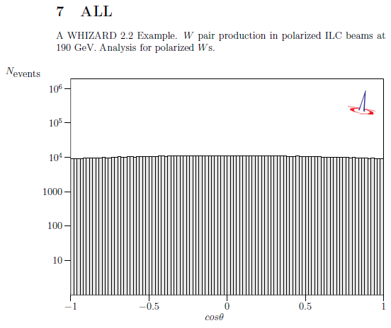
190 GeV, angular distribution of W pairs, just e+e- Helicity +1/2 -1/2 (just s channel amplitude, y_log)

Slide 8
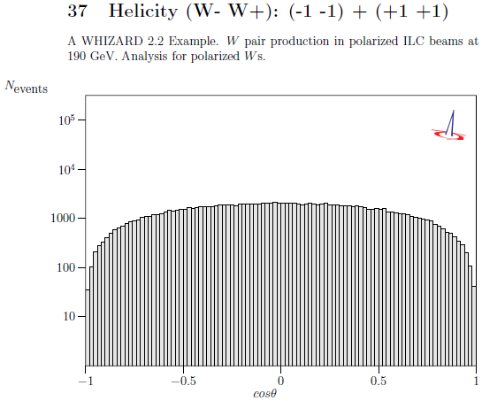
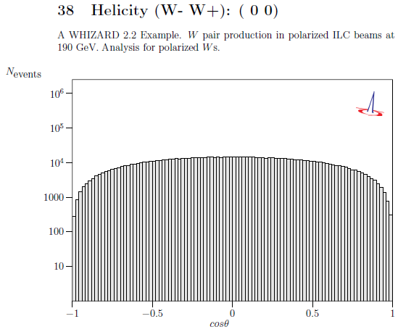
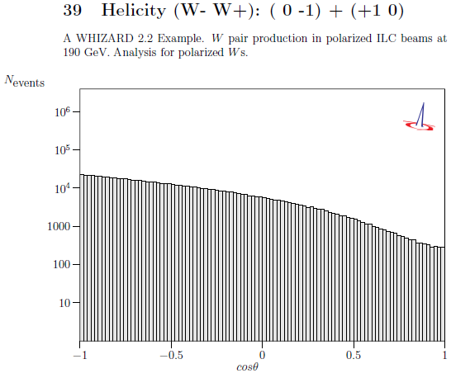
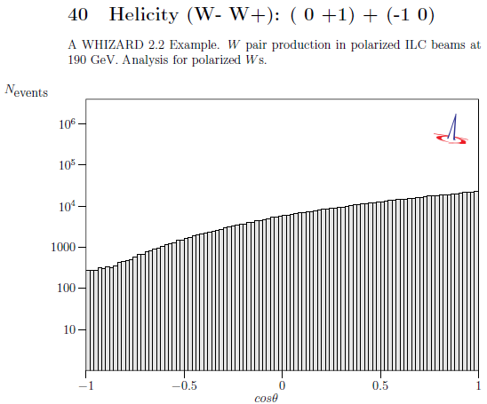
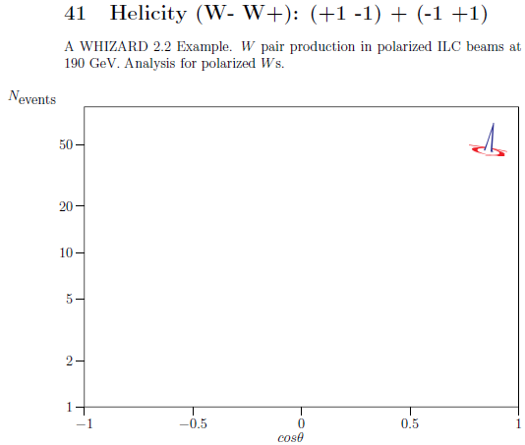
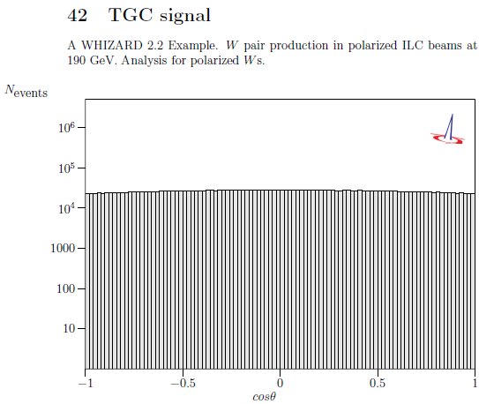
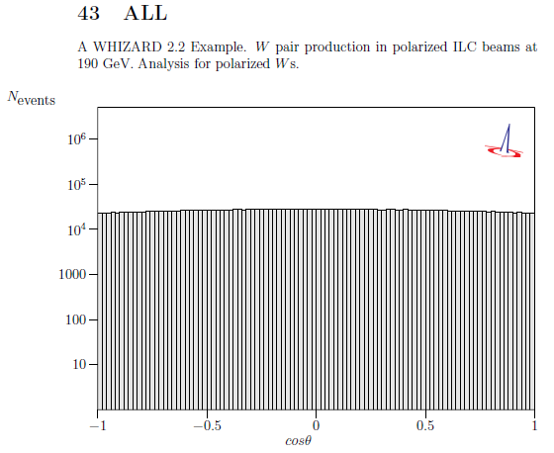
190 GeV, angular distribution of W pairs, just s channel amplitude , y_log

Slide 9
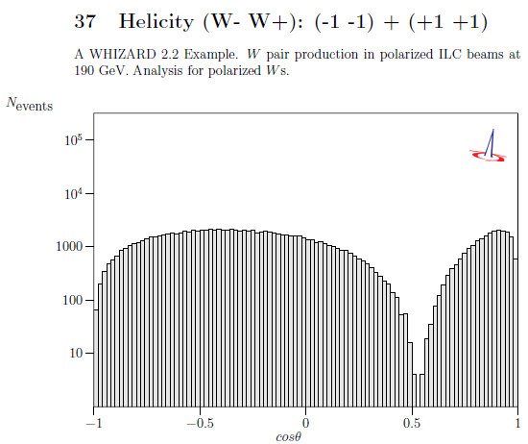
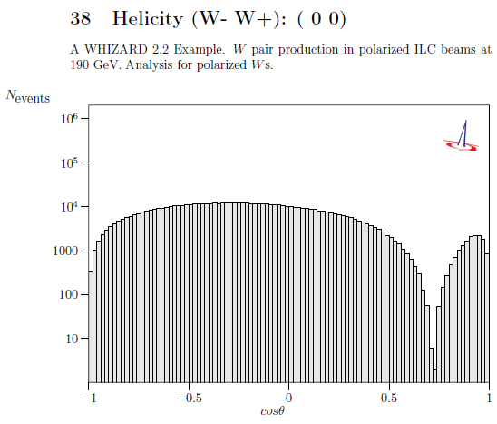
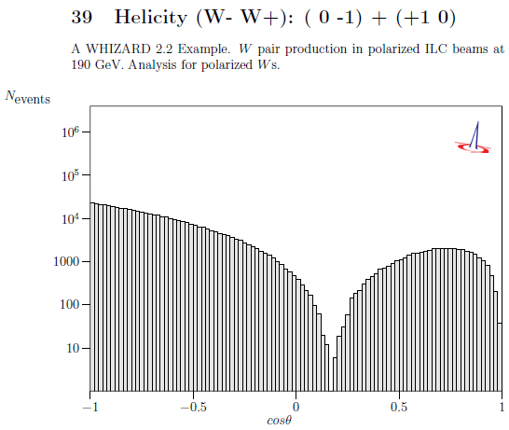
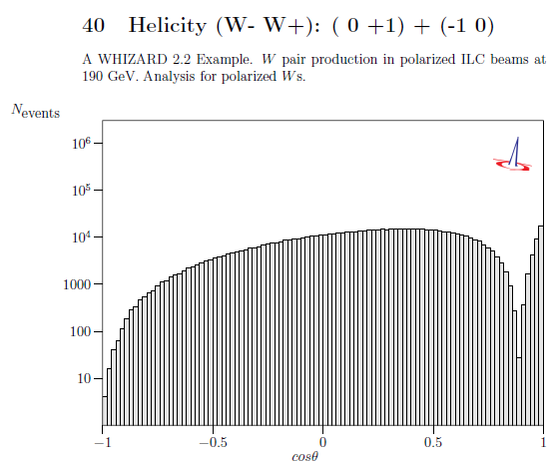
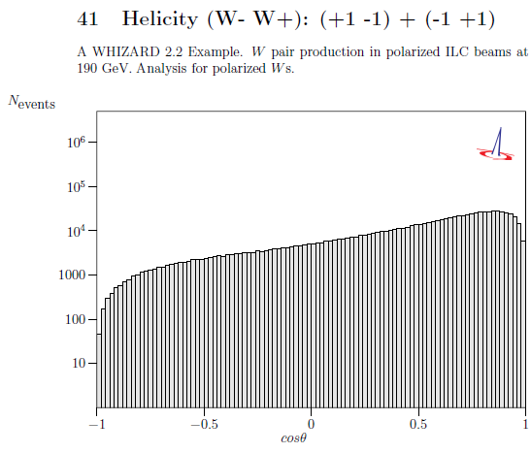
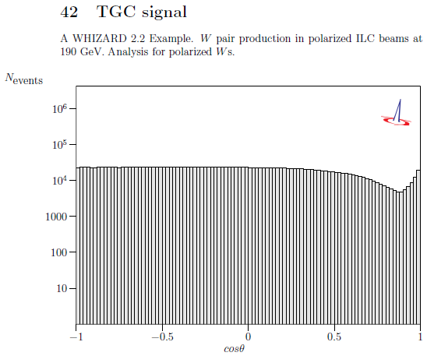

190 GeV, angular distribution of W pairs, just t channel amplitude , y_log

Slide 10






e+e-: -1/2 +1/2 all amplitude | 0.67 pb
e+e-: +1/2 -1/2 all amplitude | 77.06 pb
e+e-: +1/2 -1/2 just t channel amplitude | 141.73 pb
e+e-: +1/2 -1/2 just s channel amplitude | 51.71 pb
e+e-: +1/2 -1/2 just s channel (Z) amplitude | 19.81 pb
e+e-: +1/2 -1/2 just s channel (Gamma) amplitude | 7.5 pb
e+e-: -1/2 +1/2 just s channel amplitude | 0.67 pb
e+e-: -1/2 +1/2 just s channel (Z) amplitude | 12.68 pb
e+e-: -1/2 +1/2 just s channel (Gamma) amplitude | 7.5 pb
e+e-: -1/2 +1/2 all amplitude | 0.63 pb
e+e-: +1/2 -1/2 all amplitude | 68.05 pb
e+e-: +1/2 -1/2 just t channel amplitude | 231.2 pb
e+e-: +1/2 -1/2 just s channel amplitude | 134.43 pb
e+e-: +1/2 -1/2 just s channel (Z) amplitude | 47.36 pb
e+e-: +1/2 -1/2 just s channel (Gamma) amplitude | 22.21 pb
e+e-: -1/2 +1/2 just s channel amplitude | 0.63 pb
e+e-: -1/2 +1/2 just s channel (Z) amplitude | 30.34 pb
e+e-: -1/2 +1/2 just s channel (Gamma) amplitude | 22.21 pb
e+e-: -1/2 +1/2 all amplitude | 0.25 pb
e+e-: +1/2 -1/2 all amplitude | 43.47 pb
e+e-: +1/2 -1/2 just t channel amplitude | 362.88 pb
e+e-: +1/2 -1/2 just s channel amplitude | 284.9 pb
e+e-: +1/2 -1/2 just s channel (Z) amplitude | 93.15 pb
e+e-: +1/2 -1/2 just s channel (Gamma) amplitude | 52.26 pb
e+e-: -1/2 +1/2 just s channel amplitude | 0.25 pb
e+e-: -1/2 +1/2 just s channel (Z) amplitude | 59.67 pb
e+e-: -1/2 +1/2 just s channel (Gamma) amplitude | 52.26 pb
190 GeV (non-polarization 19.42 pb)
240 GeV (non-polarization 17.17 pb)
360 GeV (non-polarization 10.94 pb)

Slide 11






190 GeV, all amplitude

Slide 12






190 GeV, just e+e- Helicity -1/2 +1/2 (all amplitude)

Slide 13






190 GeV, just s channel amplitude

Slide 14






190 GeV, just t channel amplitude

