Slide 1
A precise determination of top quark
electro-weak couplings at the ILC
Huayu Liu
huayuliu9499@163.com
Sun Yat-sen University
14/2/2025
Notes:
幻灯片制作：中山大学党委宣传部 陈柏辰
幻灯片内置的所有示例图片、手绘建筑元素版权归中山大学党委宣传部和供稿人所有，不得移作他用。

Slide 2
Outline
Introduction
Top quark production at the ILC
Event generation and technical remarks
Event selection
Measurement of the forward backward asymmetry
The slope of the helicity angle distribution
Precision of Form Factors
Summary and outlook

Slide 3
Introduction
It can be generated by the existence of a new strong sector, inspired by QCD that may manifest itself at energies of around 1 TeV.
Standard Model fields would couple to the new sector with a strength that is proportional to their mass.
Motivation:
To understand the nature of electro-weak symmetry breaking, the t quark is expected to be a window to any new physics(which will modify the electro-weak $t\overline{t}$γ/$t\overline{t}Z^{0}$vertex) at the TeV energy scale.
$t\overline{t}$γ/ $t\overline{t}Z$ vertex(Born level):
Within the Standard Model the Fi have the following values:
Applying the Gordon identity to the vector and axial vector:
In ILC there is no concurrent QCD production of t quark pairs whcih means a greatly clean measurement
$s_{w}$ and $c_{w}$ are the sine and the cosine of the Weinberg angle $θ_{w}$.

Slide 4
Introduction
Form Factors:
The coupling $F_{2V}^{γ}$ is related via $F_{2V}^{γ}=\frac{Q_{t}\left(g−2\right)}{2},$the anomalous magnetic moment (g − 2) and electrical charge of the t quark $Q_{t}$
The coupling $F_{2A}^{γ}$ is related to the dipole moment $d=(\frac{e}{2mt})F_{2A}(0)$ that violates the combined Charge and Parity symmetry CP. Here it is fixed to 0 because no significant damage has been observed so far.
There are six CP conserving form factors defined for the Z and the photon, $F_{1V}^{} {,F_{1A}^{},F}_{2V}^{}$but because close to the tt threshold the observables depend always on the sum $F_{1V}^{}$ + $F_{2V}^{}$ . Therefore a full disentangling of the form factors will be imprecise for energies below about 1 TeV.
Hence, in the present study either the four form factors $F_{1V,A}^{}$ are varied simultaneously, while the two $F_{2V}^{}$ are kept at theirStandard Model values or vice versa.

Slide 5
Introduction
International Linear Collider, ILC
ILC Centre-of-mass energies: from $Z^{0}$ mass to 1TeV
Integrated luminosity:500${fb}^{−1}$
Polarised electron and positron beams are used in ILC so $t$ and $\overline{t}$oriented toward different angular regions in the detector are enriched in left-handed or righthanded t quark helicity.
The Realistic values of beam polarisations at the ILC(P,P’ is the polarization degree of beam) :
P,P’=+0.8,-0.3: 0.8 left-handed electron beams and 0.3 for right-handed positrons.
P,P’=-0.8,+0.3: 0.8 right-handed electron beams and 0.3 for left-handed positrons.
This means that the experiments can independently access the couplings of left- and right-handed chiral parts of the t quark wave function to the $Z^{0}$ boson and the photon.
For left-handed helicity state $t_{L}$,and right-handed helicity state $t_{R}$ , there are therefore six independent observables:
The cross section;
The forward backward asymmetry $A_{FB}^{t}$;
The slope of the distribution of the helicity angle(the angle of the decay lepton in semi-leptonic decays of the $t\overline{t}$ in the rest frame of the t quark).

Slide 6
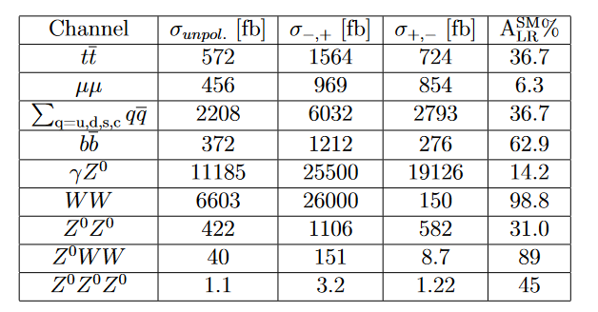
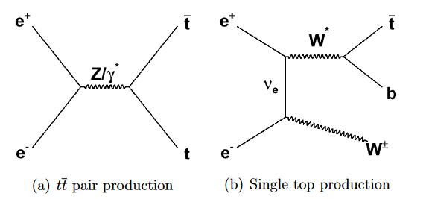
Top quark production at the ILC
Signal process: $e^{+}e^{−}$→ $t\tilde{t}$ →$l^{±}vb\overline{b}q^{′}\overline{q}$ (’lepton+jets’ final state)
Several other SM processes give rise to the same final state.:
Most important source(10%): Single-top production $e^{+}e^{−}$→$WW^{∗}$ →$Wt\overline{b}$ →$l^{±}vb\overline{b}q^{′}\overline{q}$
Other source:$Z^{0}WW(5\%)$, $Z^{0}$ $Z^{0}$, $Z^{0}$ $Z^{0}$ $Z^{0}$,WW, $q\overline{q}$
At a more fundamental level, interference between between single-top production and top quark pair production renders the separation physically meaningless.
Cross Section Table
These can be distinguished rather efficiently from top quark pair production.

Slide 7
Top quark production at the ILC
Observables and Form Factors
The cross section for any process in $e^{+}e^{−}$collisions in case of polarised beams can be written as:
The symbols − and + indicate full polarisation of the incoming beams with electrons and positrons of left-handed, L, or right-handed, R, helicity, respectively.
$σ_{−−}$ and $σ_{++}$ have been neglected due to helicity conservation at the electron vertex in the high energy limit.
The degree of polarisation of the incoming beams is expressed by P, for electrons, and P′, for positrons.
The Born level cross section for $t\overline{t}$ quark production for electron beam polarisation I = L, R reads:
The forward-backward asymmetry $A_{FB}^{t}$can be expressed as:
The fraction of right-handed tops related to the defined helicity angle is given by the following expression:
Here is the form factors in terms of the helicity of the incoming electrons

Slide 8
Event generation and technical remarks
Events are generated with WHIZARD 1.95 in the form of:
Six things final state for signal.
Two and four final state for background.
The most relevant background contributions are the W W and $b\overline{b}$ final states as well as fully hadronic and fully leptonic decays of $t\overline{t}$ pairs.
The study has been carried out on a fully polarised sample.Because the σ can scales with the polarization and $A_{FB}^{t}$,λ vary only very mildly with the beam polarisation.
Other Configuration ：
Using PYTHIA to generate parton showers and subsequent hadronisation.
Full Simulation of the ILD detector
Using the version ILD o1 v05 of the ILC software to do reconstruction.
WHIZARD cut:
In case of the signal sample events are flagged for which the difference between the invariant masses of the three fermion systems forming a top and the input t mass to WHIZARD of 174 GeV is smaller than 5Γ. (Here the Γ is the total decay width of the t quark.)
In this level only about 70% of the generated events can betreated accordingly by PYTHIA.
Different will introduce a different systematic uncertainty which is however expected to be reasonable small.

Slide 9
Event selection
In the SM the fraction of semi-leptonic final states is about 43%.
Such processes can yield additional particles Interfering reconstruction:
$γγ$ → hadrons (removed by longitudinally invariant $k_{t}$ algorithm)
electron-positron pairs etc. (removed by a next Durham algorithm)
Top quark reconstruction:
The charged lepton allows for the determination of the t quark charge.
In general leptons(is either the most energetic particle in a jet or has a sizable transverse momentum w.r.t. neighboured jets.) are identified using typical selection criteria :
where $E_{lepton}$is the energy and $p_{T,lepton}$ is the transverse momentum of the lepton within a jet with energy $E_{jet}$and mass $M_{jet}$ .
Efficiency: 85% for electron and muon,70 for τ。
The t quark mass is reconstructed from the hadronically decaying W which is combined with one of the b-quark jets.

Slide 10
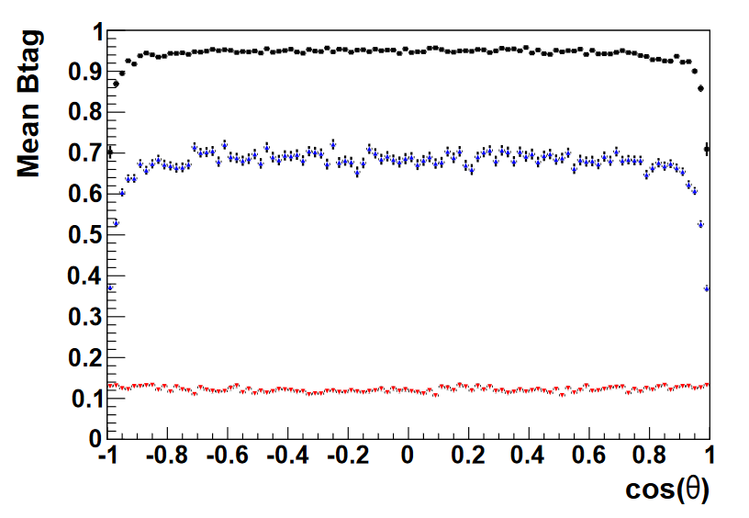
Event selection
Top quark reconstruction
The t quark mass is reconstructed from the hadronically decaying W which is combined with one of the b-quark jets.
Cut on jet: thrust<0.9,total hadronic mass of the final state $∈$(180,420) GeV.
Two of these must be identified as being produced by the b-quarks of the t quark decay. The b-likeness or b-tag is determined with the LCFIPlus package,
The two highest B-tag values ​​(black and blue dots) are associated to B quark jets. the third set of values ​​(red dots) is obtained for jets from light quarks.
Select two of the remaining jets candidates with b-jets to reconstruct the top quark to minimize the following equation:
Further cut : W mass $∈\left(50,250\right)GeV,$t mass $∈\left(120,270\right)GeV$
The higher b-tag value is typically 0.92 while the smaller one is still around 0.65 which is greatly more than the one from jets light quarks

Slide 11
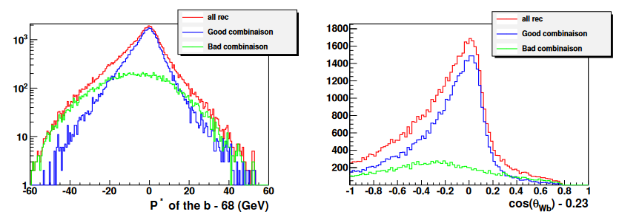
Event selection
Top quark reconstruction
Comparison of combination results:
Reconstruction efficiency:
P,P’=+0.8,-0.3: 54.4% for signal events and 9% for background events.
P,P’=-0.8,+0.3: 55.9% for signal events and 7.2% for background events.
This background is predominantly composed by events from non-semileptonic decays of the $t\overline{t}$.
The Reconstruction efficiency will be worse if considering the generated sample is contaminated by single top events.

Slide 12
Measurement of the forward backward asymmetry
The determination of the $A_{FB}^{t}$:
After getting the reconstruction level information, the $A_{FB}^{t}$ can be calculated by the number of events in the hemispheres of the detector and the the polar angle θ of the t quark:
For a left-handed polarised electron beam:
The W boson decays into two energetic jets. The b quark from the decay of the t quark are comparatively soft. Therefore, the direction of the t quark is essentially reconstructed from the direction of the energetic jets from the W boson decay.
For a left-handed polarised electron beam:
The W boson is nearly at rest and the b quarks are very energetic therefore dominate the reconstruction of the polar angle of the t quark.
The wrong association of the jet from the b quark decay to the jets from the W boson decay will only affect the left-handed situation.(In fact it will flip the reconstructed polar angle by π giving rise to migrations in the polar angle distribution of the t quark.)

Slide 13
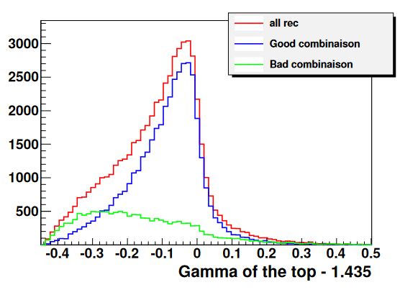
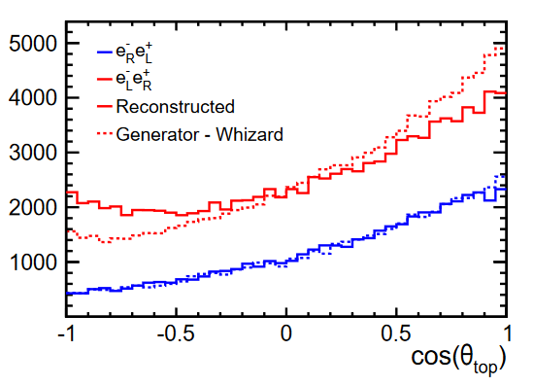
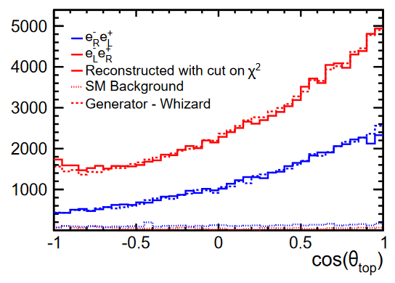
Measurement of the forward backward asymmetry
Optimization of left-handed situation:
The combination of b-jet and W is required to ensure that the distribution of θ is as consistent as possible with the truth level.
After the correct association of the of jets from b quarks to that from W bosons which is checked with the MC truth information ,there are such distribution about the Lorentz factor $γ_{t}=E_{t}/M_{t}$,$E_{t}^{∗}$,$cosθ_{bW}$
The quality of the reconstructed events is estimated by this:
For setting cut $χ^{2}<$15, the reconstructed spectrum agrees very well with the generated one with the reconstruction efficiency 28.5%.
Reconstructed forward backward asymmetry compared with the prediction by the event generator before and after cut.

Slide 14
Measurement of the forward backward asymmetry
Result:

Slide 15
Slope of the helicity angle distribution
Determination of the slope of the helicity angle distribution:
In the rest system of the t quark, the angle of the lepton from the W boson is distributed like:
Here Γ is cross section,$F_{R }$ is the fraction of right-handed tops,$θ_{hel}$is the angle of the decay lepton in semi-leptonic decays of the $t\overline{t}$ in the rest frame of the t quark and the z-axis defined by the direction of motion of the t quark in the laboratory.
This angular distribution is therefore linear and very contrasted between $t_{L}$ and $t_{R}$ . In practice there will be a mixture of two kinds of fully polarised samples.
If initial state radiation effects (with the photon lost in the beam pipe) are neglected, by means of the energy-momentum of the t quark decaying hadronically, allows for deducing the energy-momentum of the t quark decaying semi-leptonically.

Slide 16
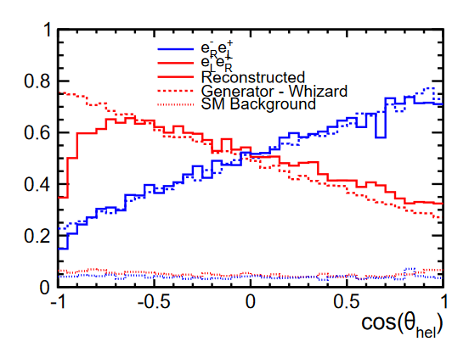
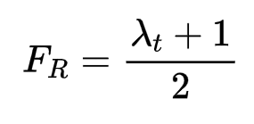
Slope of the helicity angle distribution
Analysis of the helicity angle distribution
The angular distribution of the decay lepton in the rest frame of the t quark
The background is small relative to the signal and to a good approximation flat so it can be neglected.
For the left-handed polarised electron beam ,The distribution exhibits a drop in reconstructed events towards
${cosθ}_{hel}$=-1 because :
The wrong association of b and W
It leads to a wrong top quark decaying hadronically
In turn, it leads to wrong four- momentum of the t quark decaying leptonically.
In fact it suppresses leptons with small energies and lead to this phenomenon
The parameter $λ_{t}$can be derived from the slope of the helicity angle distribution that is obtained by a fit to the linear part of the angular distribution in the range:
P,P’=-1,+1: linear part is [-0.6,0.9].
P,P’=-1,+1: linear part is [-0.9,0.9].
The values expected in the Standard Model are

Slide 17
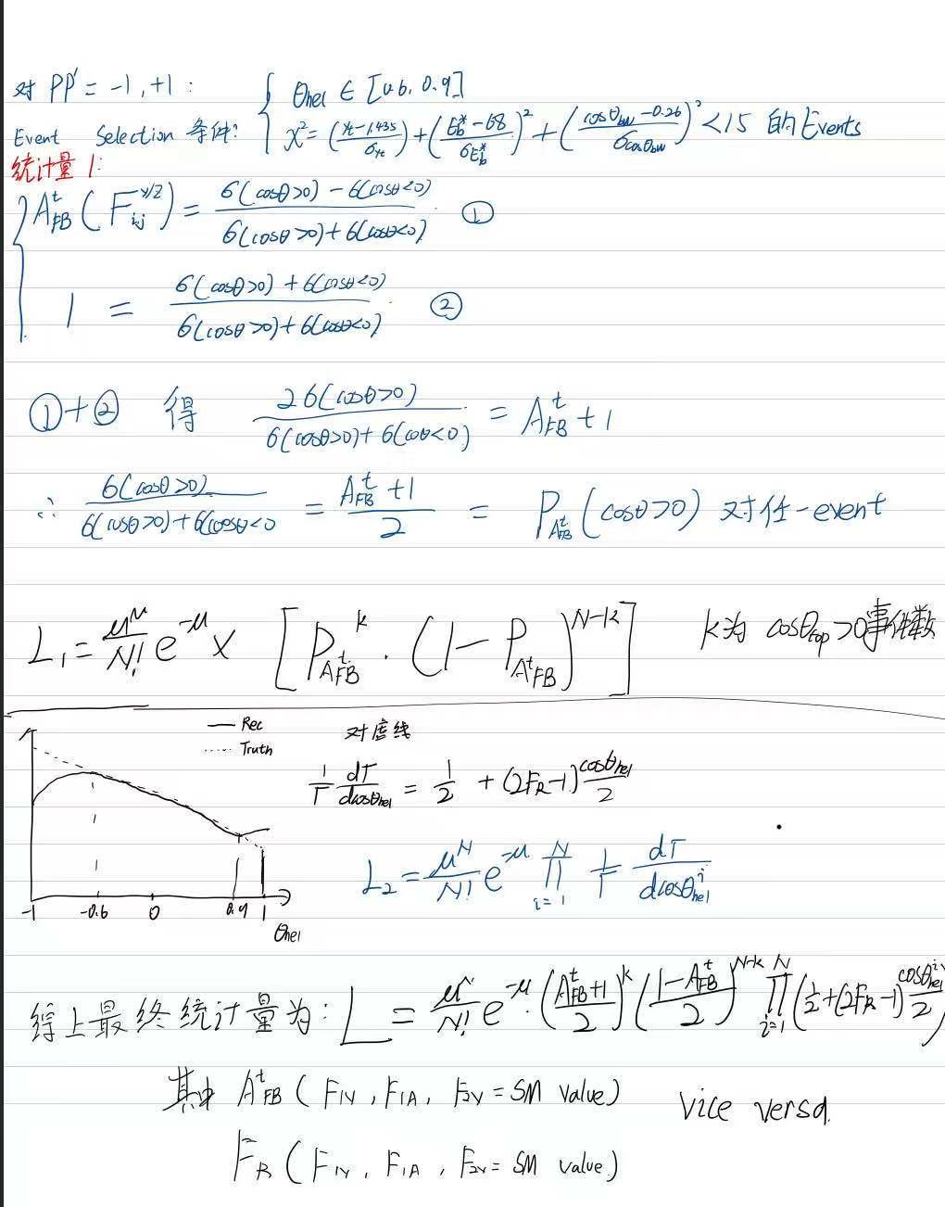
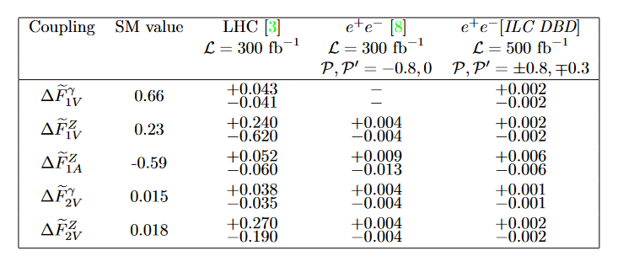
Precision of Form Factors
Calculation of Form Factors:
The results on the reconstruction efficiency $A_{FB}^{t}$and $λ_{t}$ presented in the previous sections are transformed into precisions on the form factors .
Construct the negative Log-likelihood to minimize:
Result compared with LHC and TESLA TDR

Slide 18
Summary and outlook
This article presents a comprehensive analysis of $t\overline{t}$ quark production using the semi-leptonic decay channel. Results are given for a centre-of-mass energy of $\sqrt{s}=500GeV and an integrated luminosity of$ 500${fb}^{−1}$ and a beam polarization(P,P’=$∓0.8,±0.3$).
Semi-leptonic events, including those with τ leptons in the final state can be selected with an efficiency of about 55%.
The cross section of the semi-leptonic channel of tt quark production can therefore be measured to a statistical precision of about 0.5%.
It was shown that in particular for predominantly left handed polarisation of the initial electron beam the V − A structure leads to migrations, which distort the theoretical expected $A_{FB}^{t}$. These migrations can be remedied by tightening the selection criteria of the events.There is a a precision of better than 2% for both beam polarisations.
It is introduced the slope of the helicity angle distribution, which is a new observable for ILC studies. It can be measured to a precision of about 4%.
These couplings can be measured with high precision at the ILC and always more than one order of magnitude better than it will be possible at the LHC with L=300 ${fb}^{−1}$.
In extension of a future analysis will disentangle the CP violating form factors.

Slide 19
Schedule
Plot the distribution.
I have finished a code to find best combinaison to reconstruct the top from recon level data(signal).
I have finished a code to calculate the $A_{FB}^{t}$ and its form factors expanded form.
but I don’t sure it is the right form for CEPC Non-polarized beam(composed by 50% left-hand and 50% right-hand particles)

