Slide 1


BESIII粲强子物理研讨会
Two-body nonleptonic decays
of charmed baryons
报告人： 王 迪
单 位：湖南师范大学
arXiv:2406.14061
arXiv:2507.06914

Slide 2
BESIII粲强子物理研讨会
Contents
1
Motivation
2
Topological Amplitudes
3
Rescattering Dynamics
4
Summary

Slide 3
BESIII粲强子物理研讨会
Contents
1
Motivation
2
Topological Amplitudes
3
Rescattering Dynamics
4
Summary

Slide 4
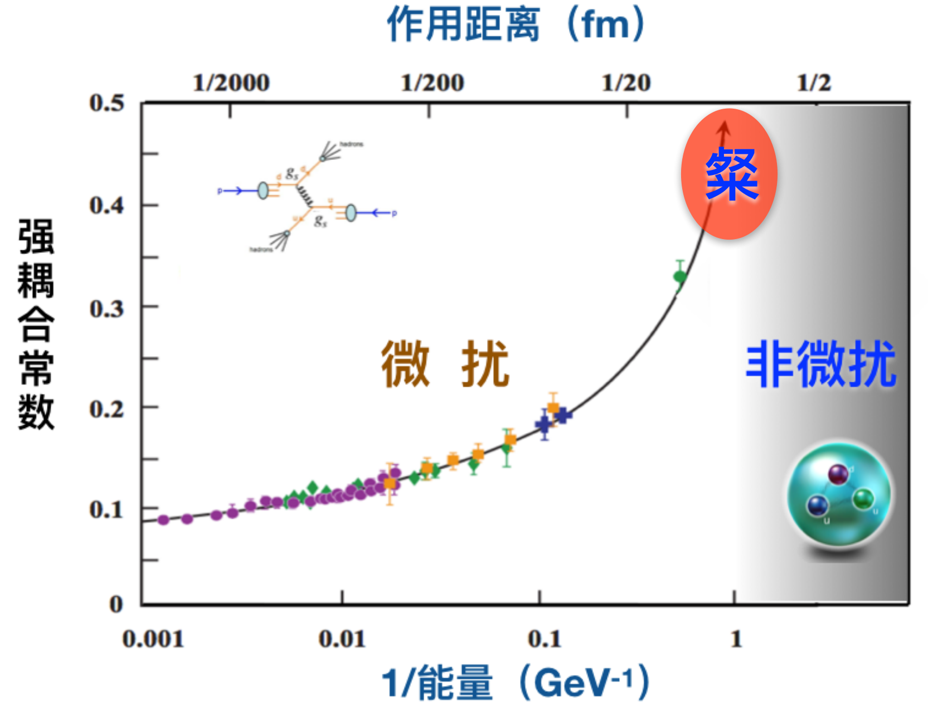
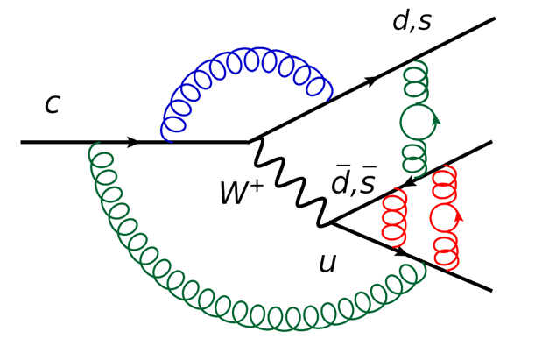
BESIII粲强子物理研讨会
Charmed hadron decays
Non-perturbative
Up-type quark decay in hadron, search for new physics
Complementary to the decay of the down-type quarks d, s, b
CP violation in the SM is suppressed
4

Slide 5
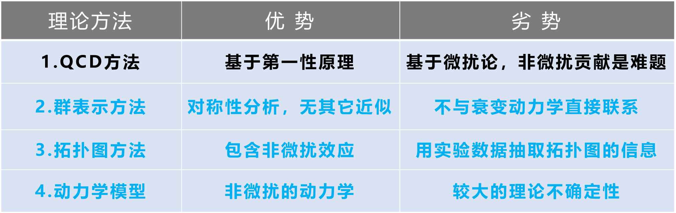
BESIII粲强子物理研讨会
Charmed baryon decays
Bridge
Cai-Ping Jia’ talk
Lu:2016ogy, Wang:2017azm, Shi:2017dto, Geng:2017esc, Geng:2017mxn, Wang:2017gxe, He:2018php, Wang:2018utj, He:2018joe, Geng:2018plk, Geng:2018bow, Jia:2019zxi, Geng:2019bfz, Wang:2020gmn, Li:2021rfj, He:2021qnc, Wang:2022wrb …
5

Slide 6
BESIII粲强子物理研讨会
Contents
1
Motivation
2
Topological Amplitudes
3
Rescattering Dynamics
4
Summary

Slide 7
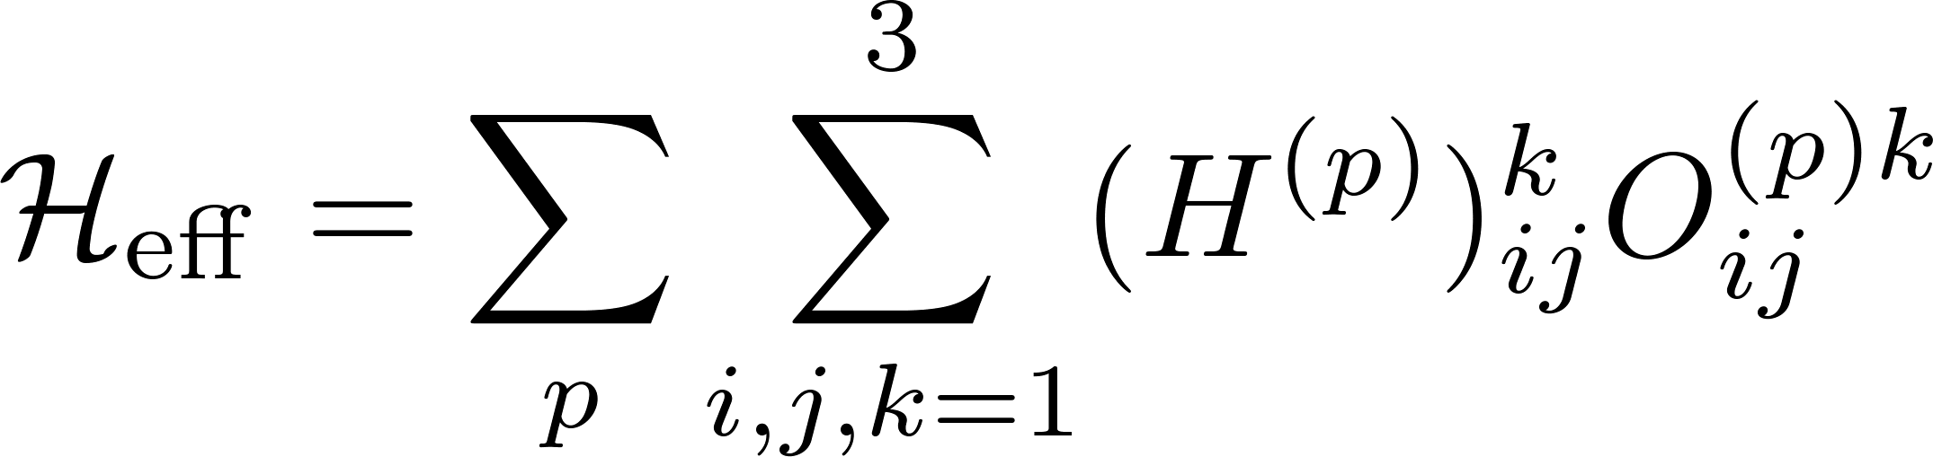
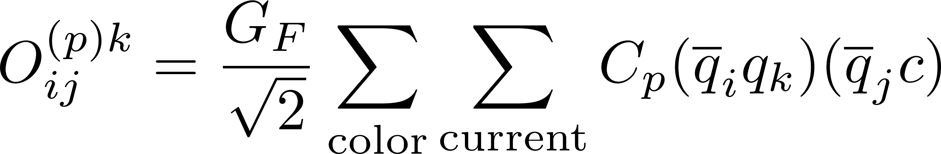
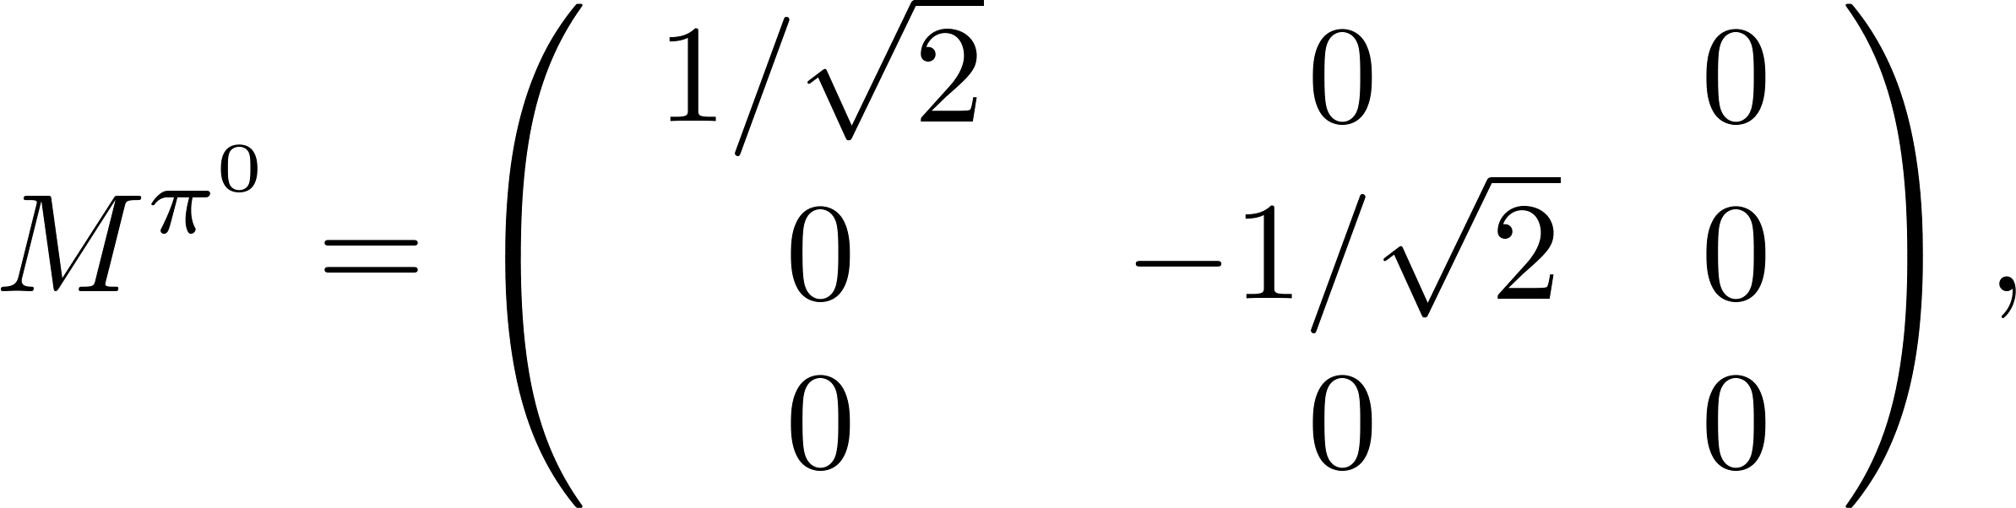
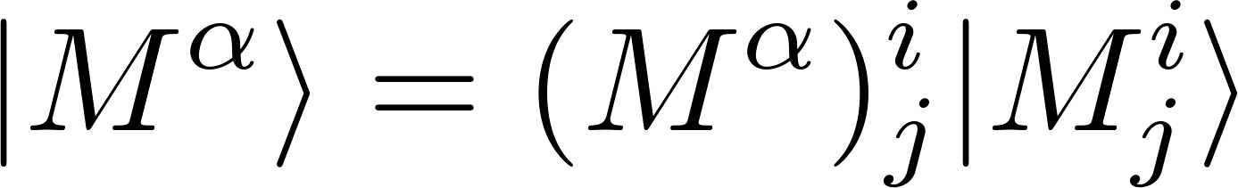
BESIII粲强子物理研讨会
Charmed baryon decays
Effective Hamiltonian
CKM
Operator
Hadrons
…
D. Wang, C. P. Jia and F. S. Yu, JHEP 09, 126 (2021).
7

Slide 8
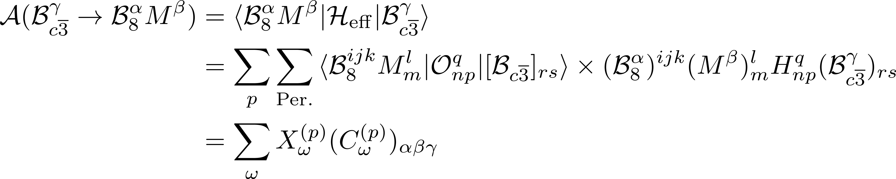
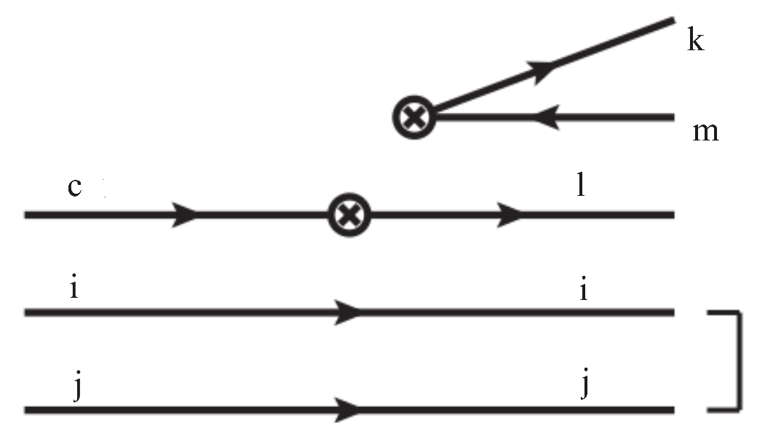
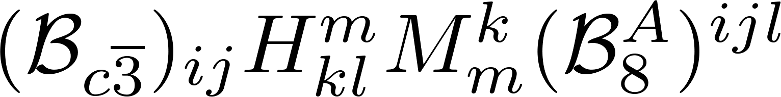
BESIII粲强子物理研讨会
Topology Invariant Tensor
CG coefficient, mode-dependent
Reduced matrix element, mode-independent
Wigner-Eckart theorem
Index-contraction Quark flowing
arXiv:2406.14061
8

Slide 9
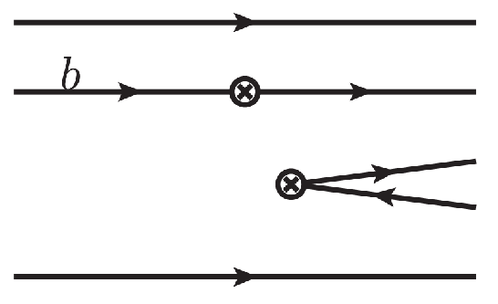
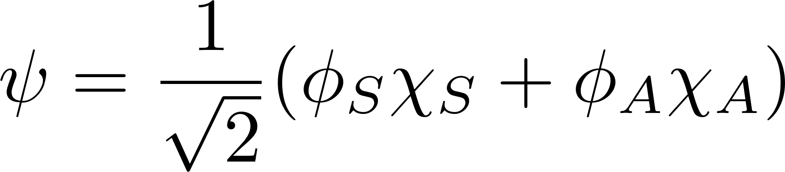
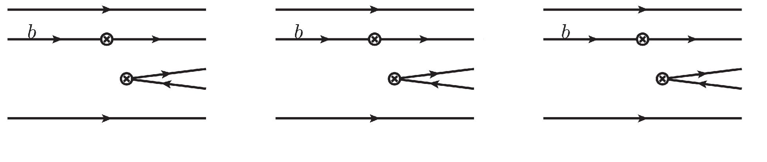
BESIII粲强子物理研讨会
Meson .vs. Baryon
Wavefunction
Pauli Exclusion Principle
9

Slide 10
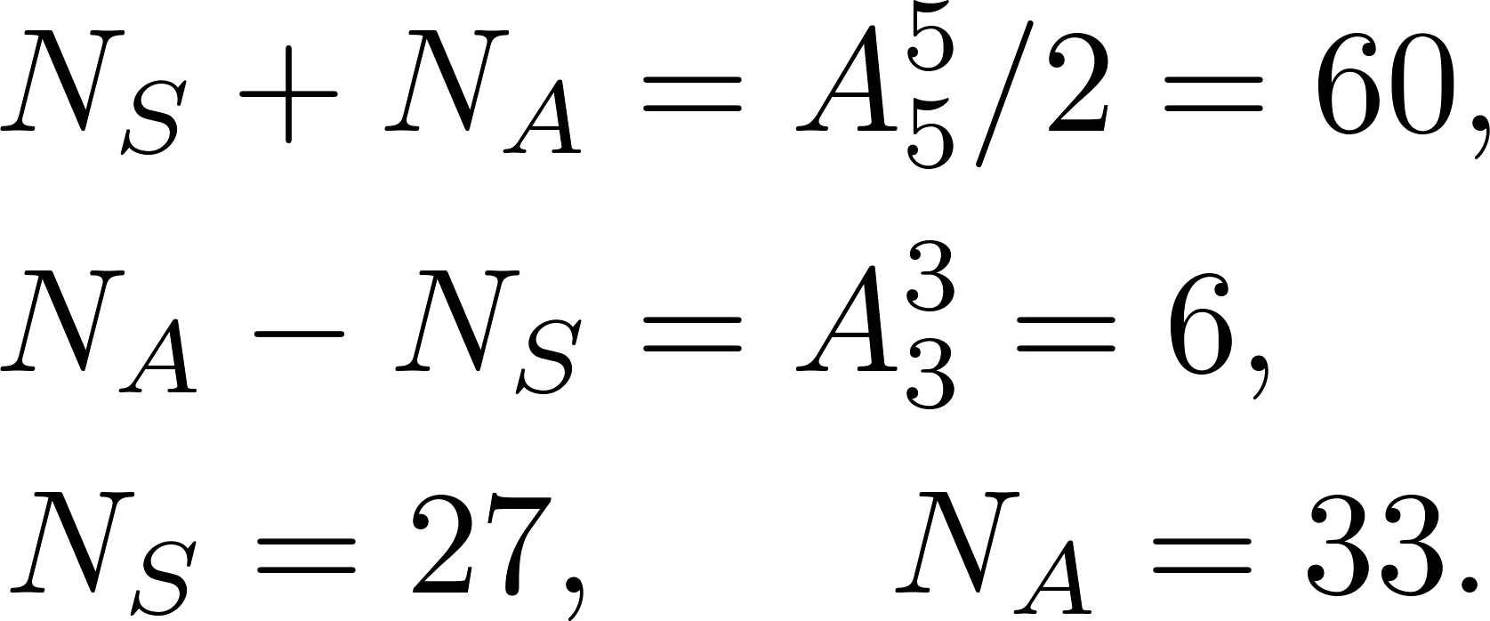
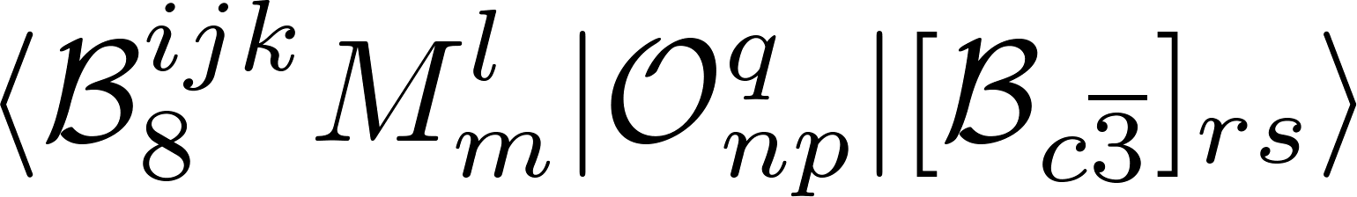
BESIII粲强子物理研讨会
Completeness of topologies
Decay amplitude
Completeness of topologies
Invariant tensor: all indices are contracted
Computed by permutation!
arXiv:2406.14061
10

Slide 11
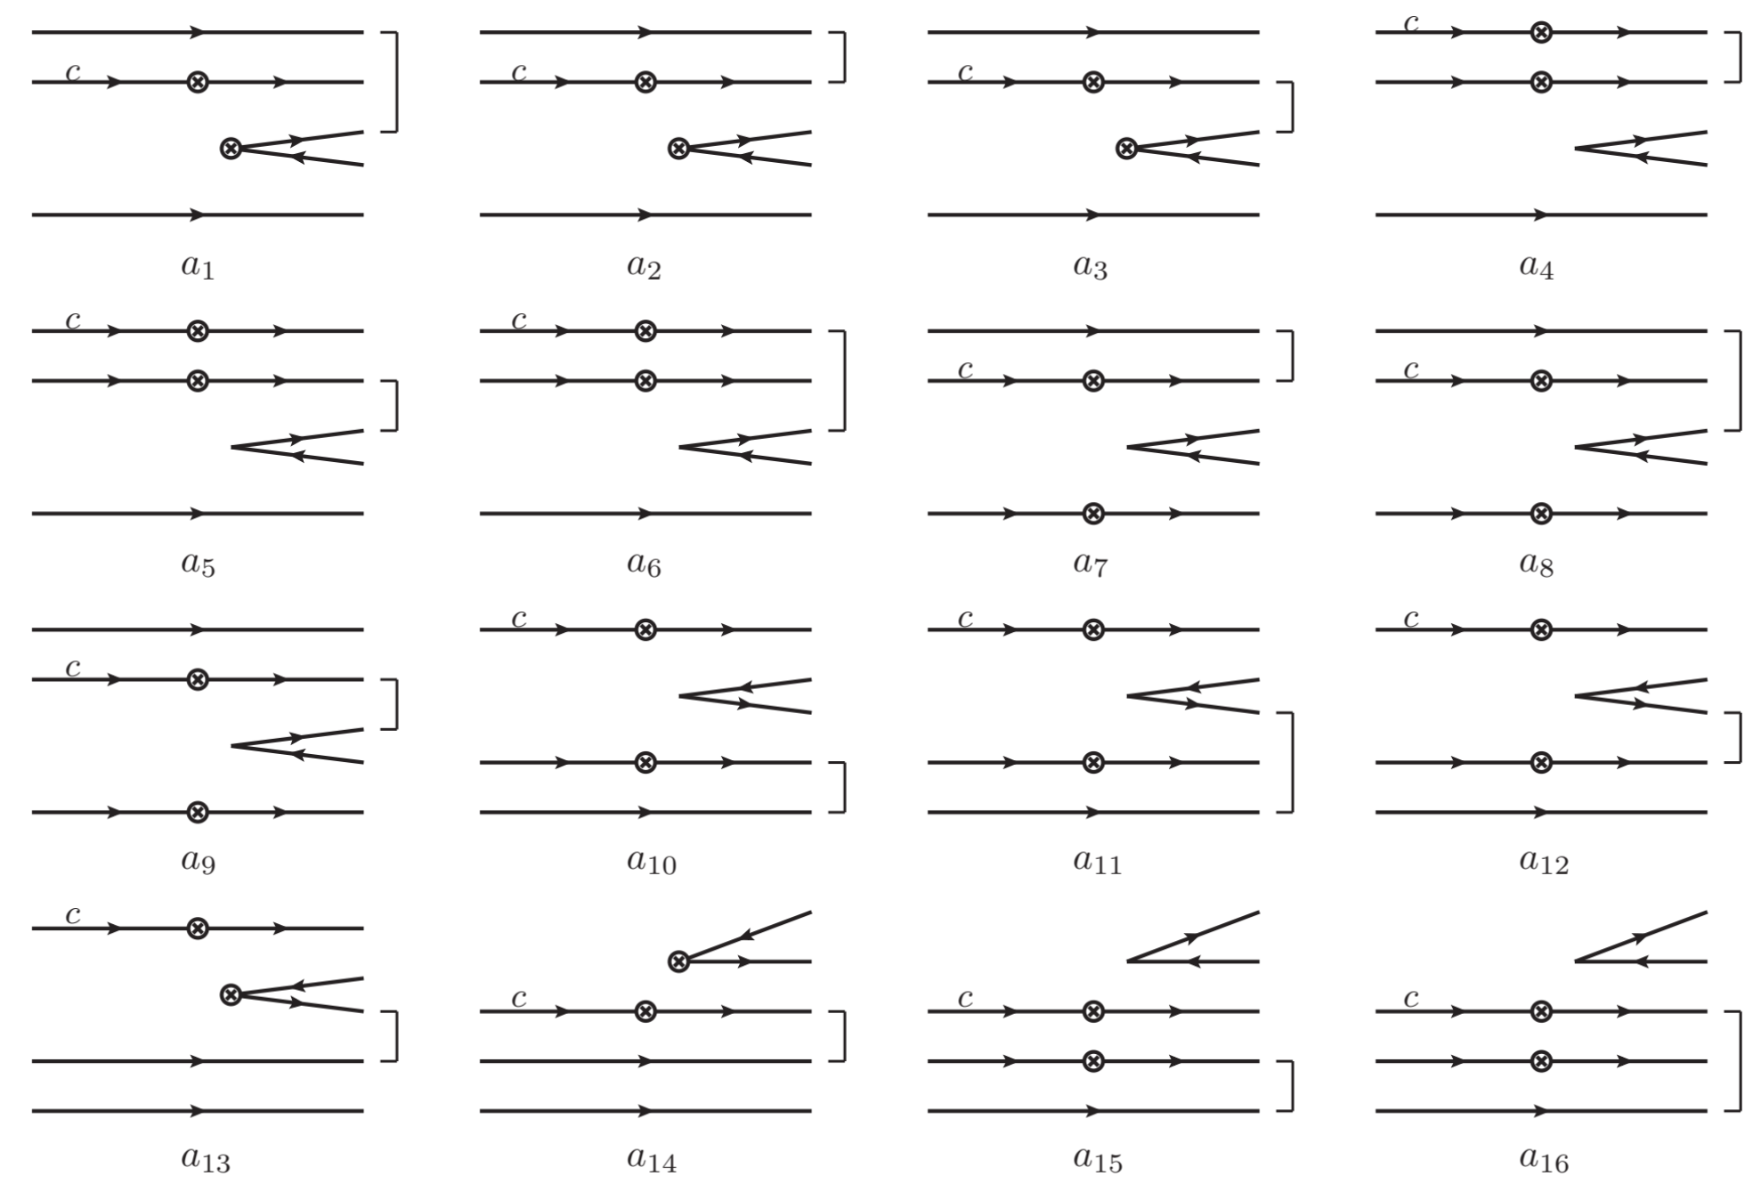
BESIII粲强子物理研讨会
Topologies in charmed baryon decays (A)
11

Slide 12
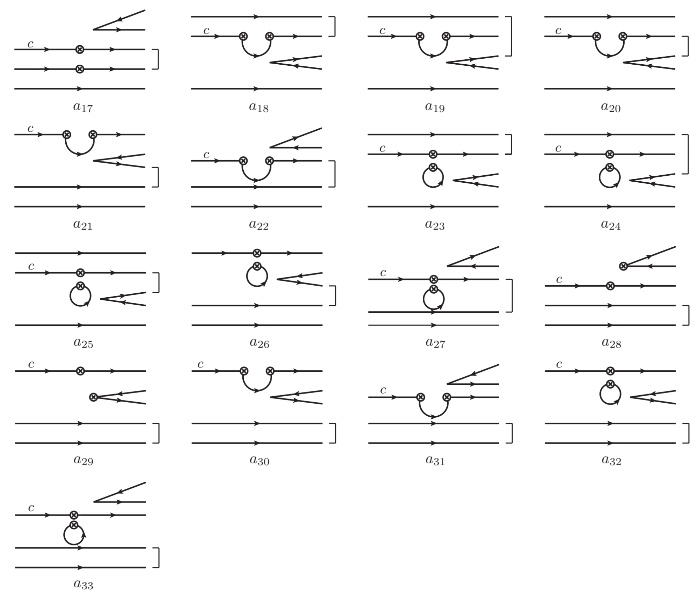
36 diagrams: without quark loop
24 diagrams: with quark loop
12

Slide 13
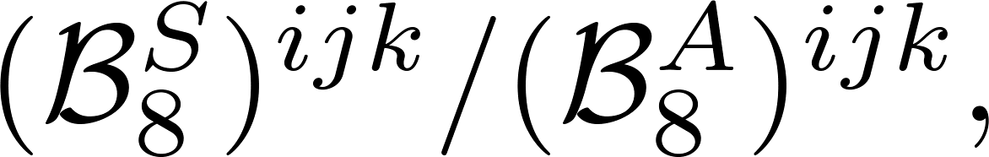
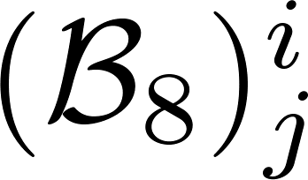
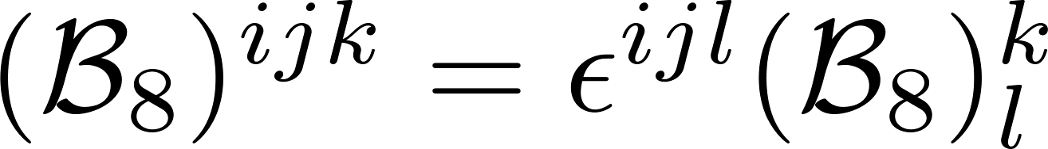
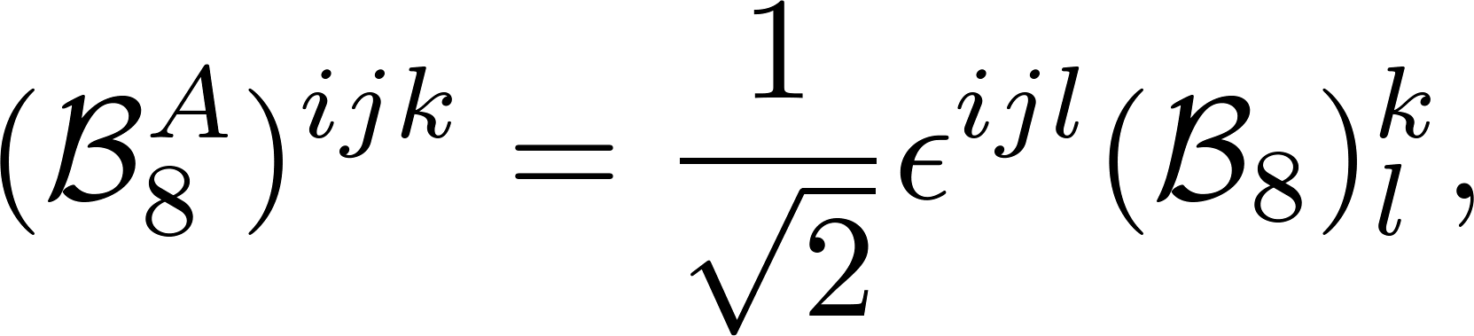
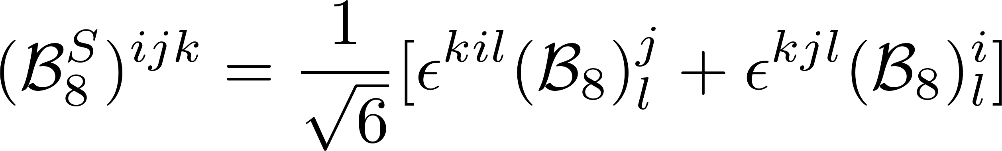
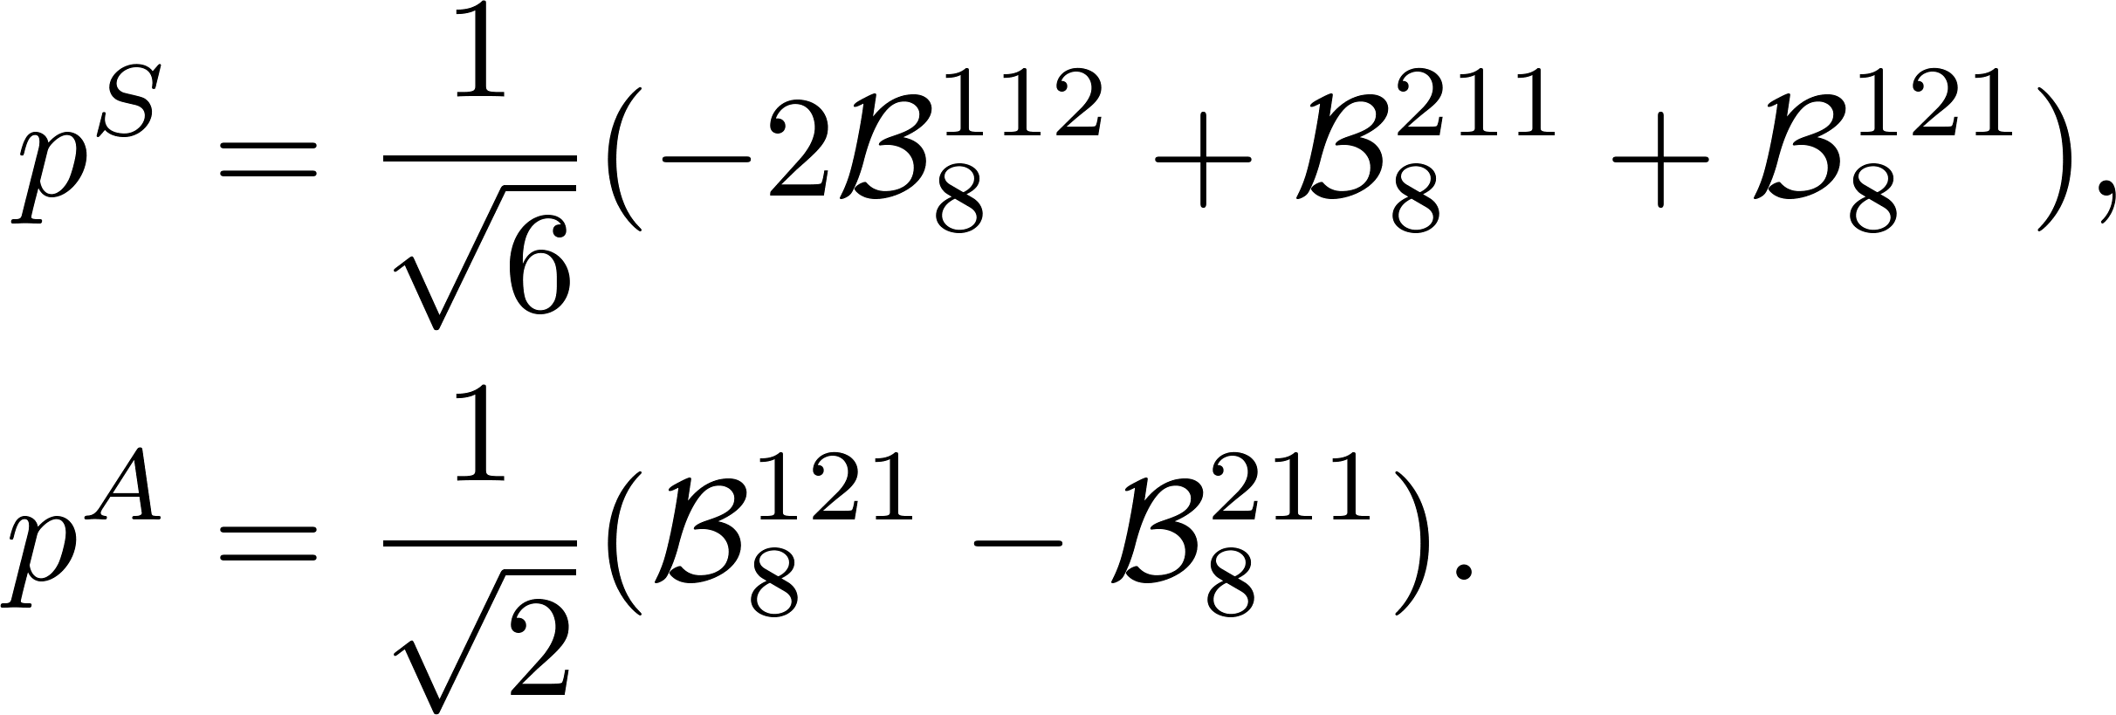
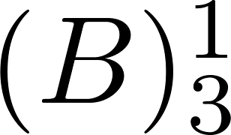
BESIII粲强子物理研讨会
Three indices Two indices
Relation between topologies and SU(3) irreducible amplitudes
?
Reducing indices
arXiv:2406.14061
13

Slide 14
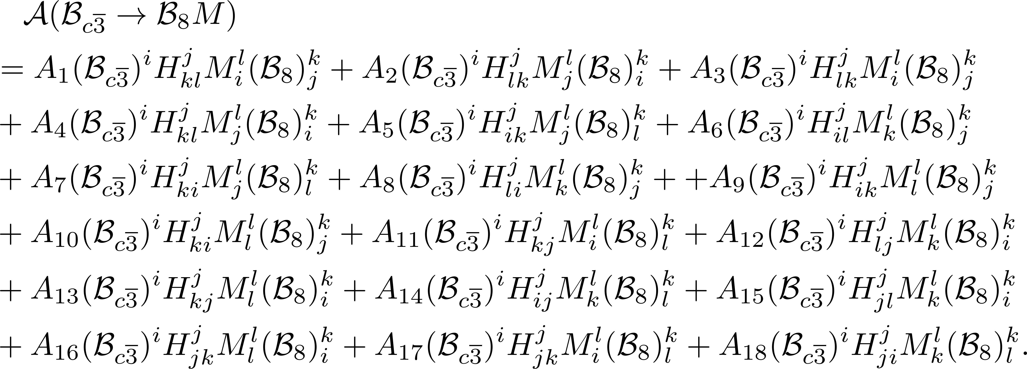
BESIII粲强子物理研讨会
(1,1)-rank topological amplitudes
18 terms
arXiv:2406.14061
14

Slide 15

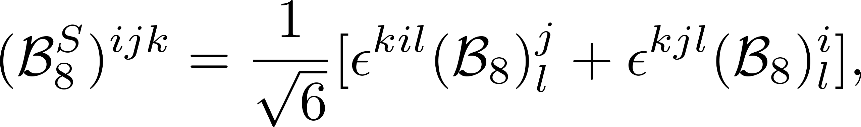
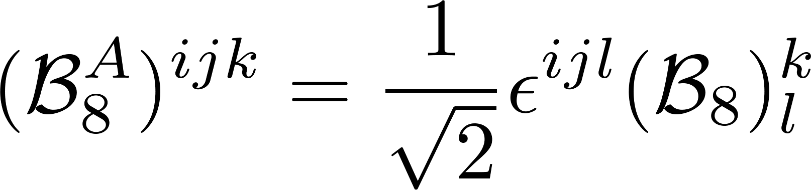
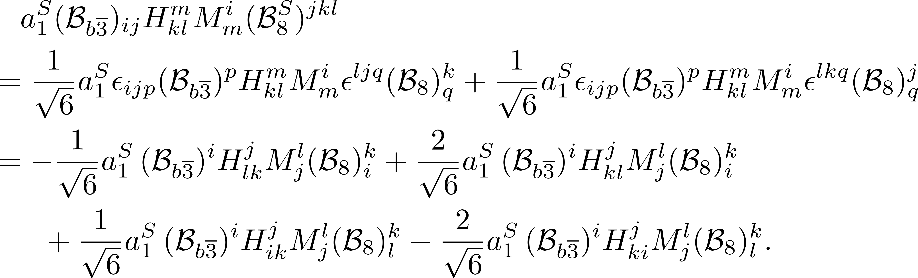
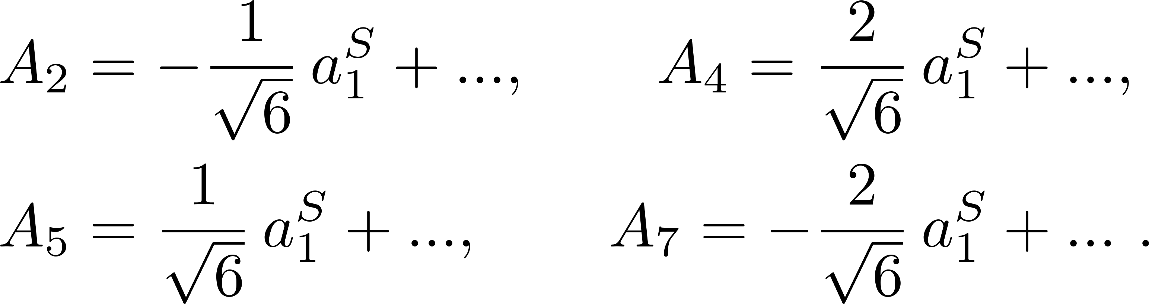
BESIII粲强子物理研讨会
Linear correlation of topologies
Relation between three- and (1,1)-rank octets
Example
arXiv:2406.14061
15

Slide 16
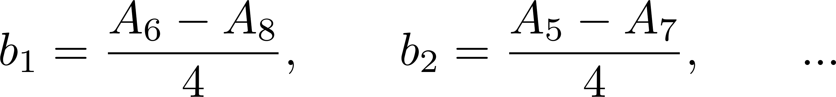
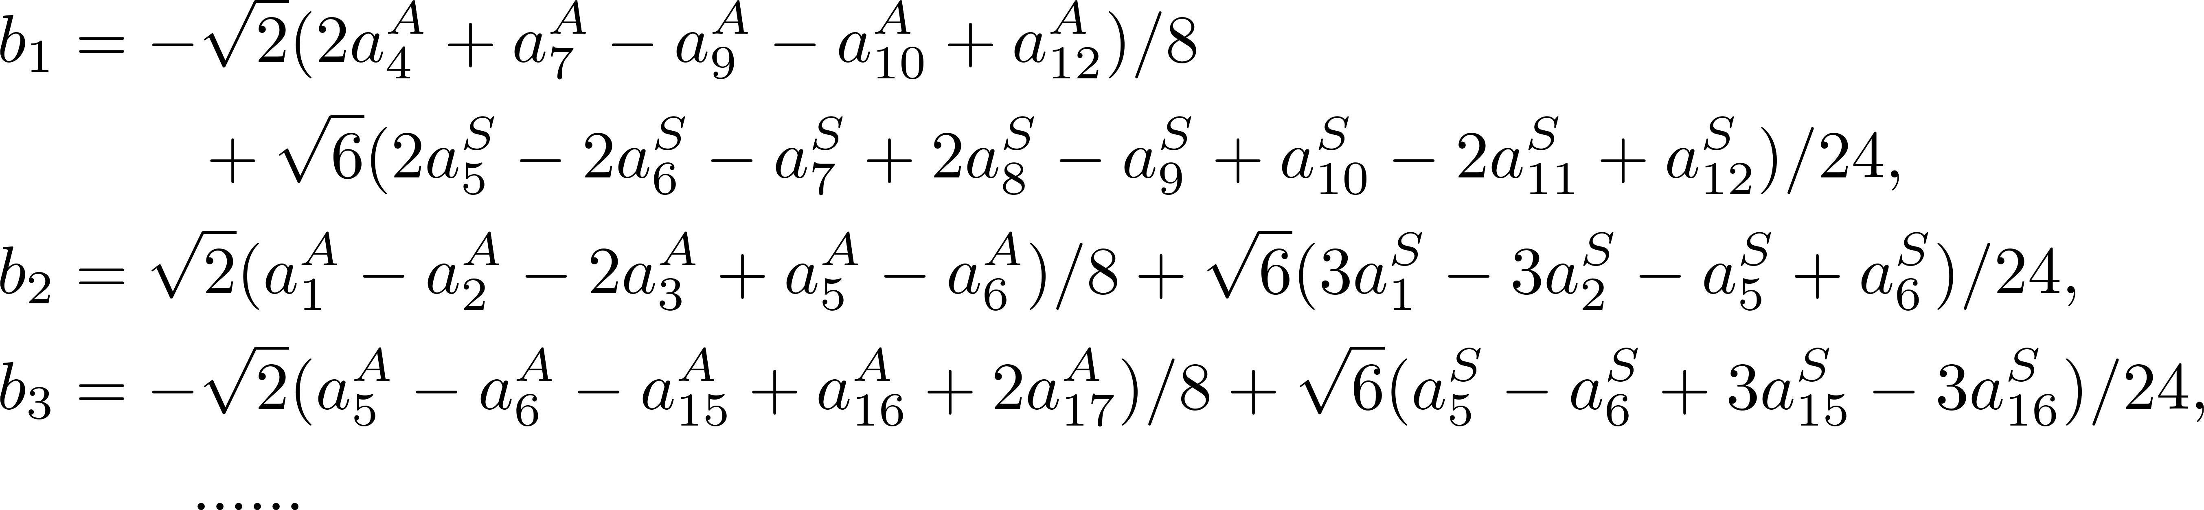
BESIII粲强子物理研讨会
SU(3) irreducible amplitude
2-rank TDA = IRA
3-rank TDA (1,1)-rank TDA (1,1)- rank IRA
arXiv:2406.14061
16

Slide 17
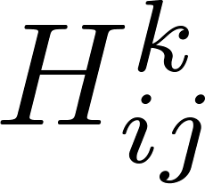
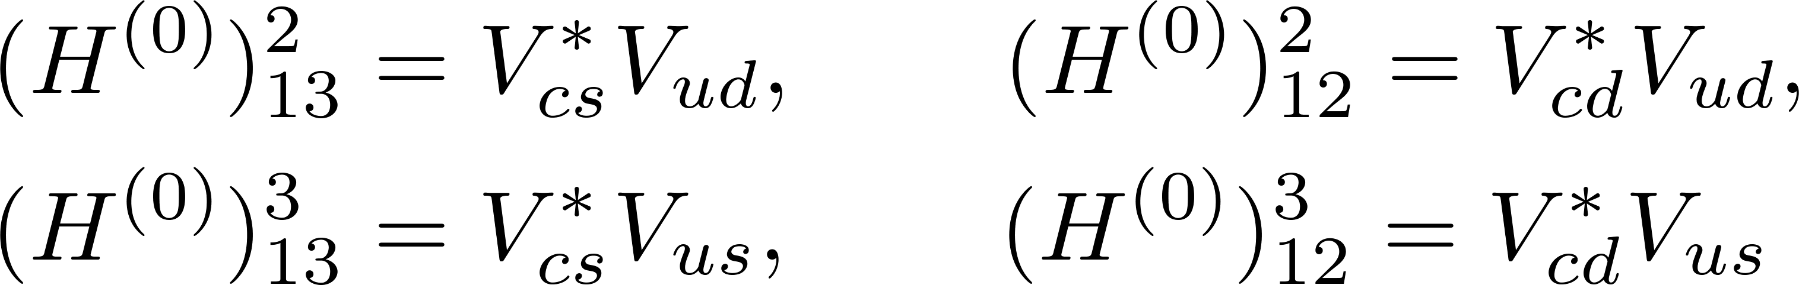
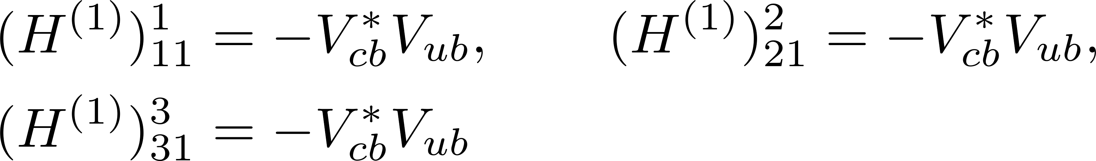
BESIII粲强子物理研讨会
Topologies in the Standard Model
Effective Hamiltonian of charm decay
Non-zero
Tree
Penguin
13 independent amplitudes in the SU(3)F limit: 9+4=13
arXiv:2406.14061
17

Slide 18
BESIII粲强子物理研讨会
QCD Calculation
Feynman diagram
Topological diagram
Model Calculation?
3-rank irreducible amplitude
(1,1)-rank topological amplitude
arXiv:2406.14061
Global fit
Irreducible amplitude
18

Slide 19
BESIII粲强子物理研讨会
Contents
1
Motivation
2
Topological Amplitudes
3
Rescattering Dynamics
4
Summary

Slide 20
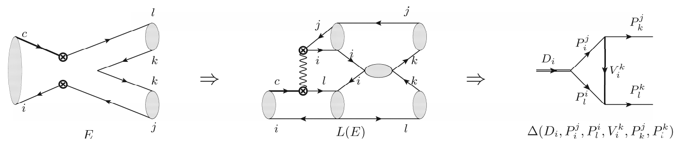

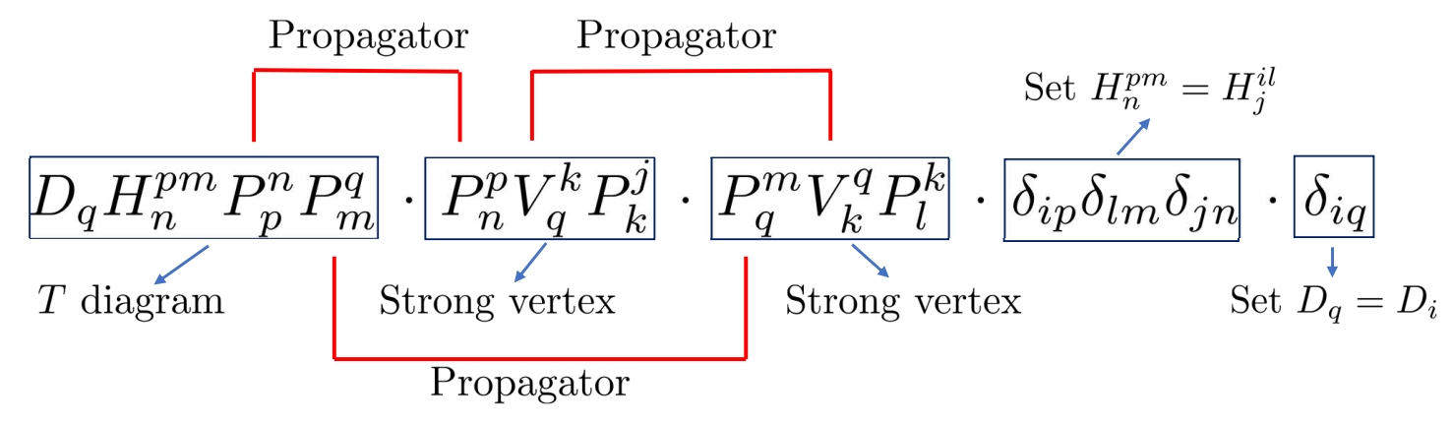
BESIII粲强子物理研讨会
From topology to rescattering – meson decay
Baryon decays ?
Di Wang, JHEP 03, 155 (2022).
Di Wang, Phys. Rev. D 105, no.7, 073002 (2022).
20
?

Slide 21
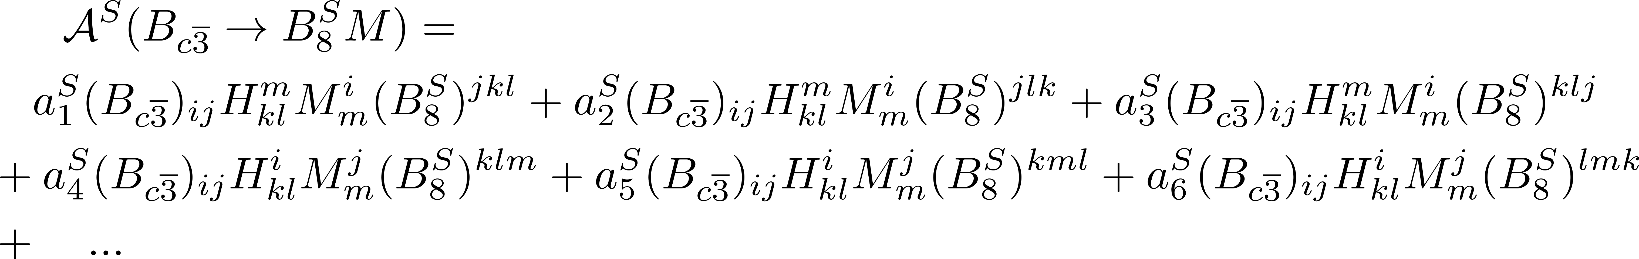
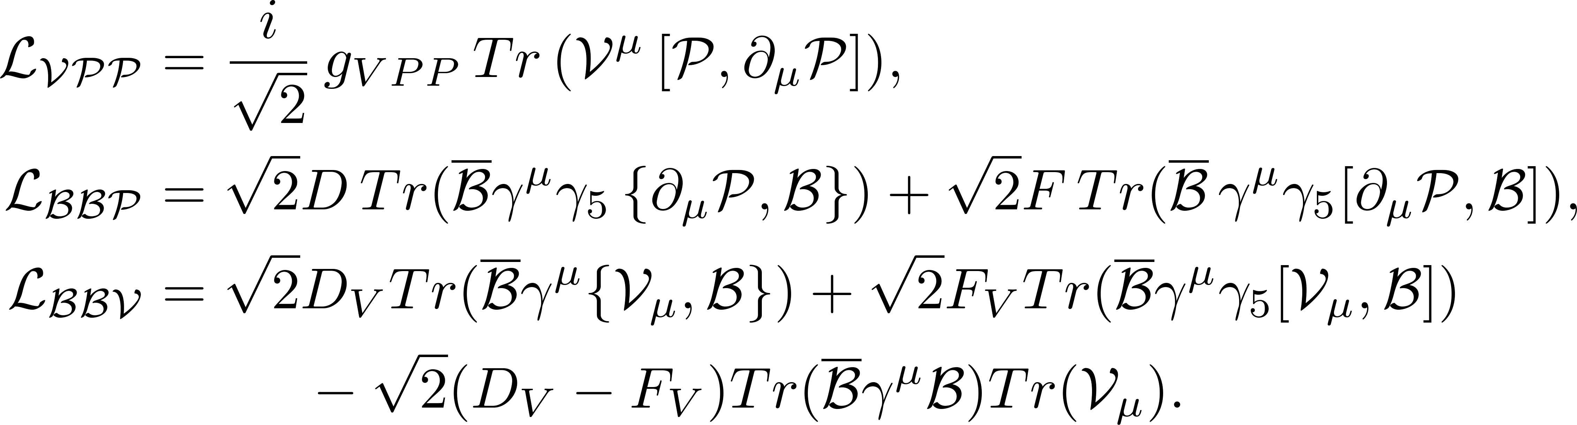
BESIII粲强子物理研讨会
TDA and ChPT
TDA: constructed via third-rank octet tensors
ChPT: constructed via second-rank octet tensors
?
21

Slide 22
BESIII粲强子物理研讨会
(1,1)-rank topological amplitudes
arXiv:2406.14061
22

Slide 23
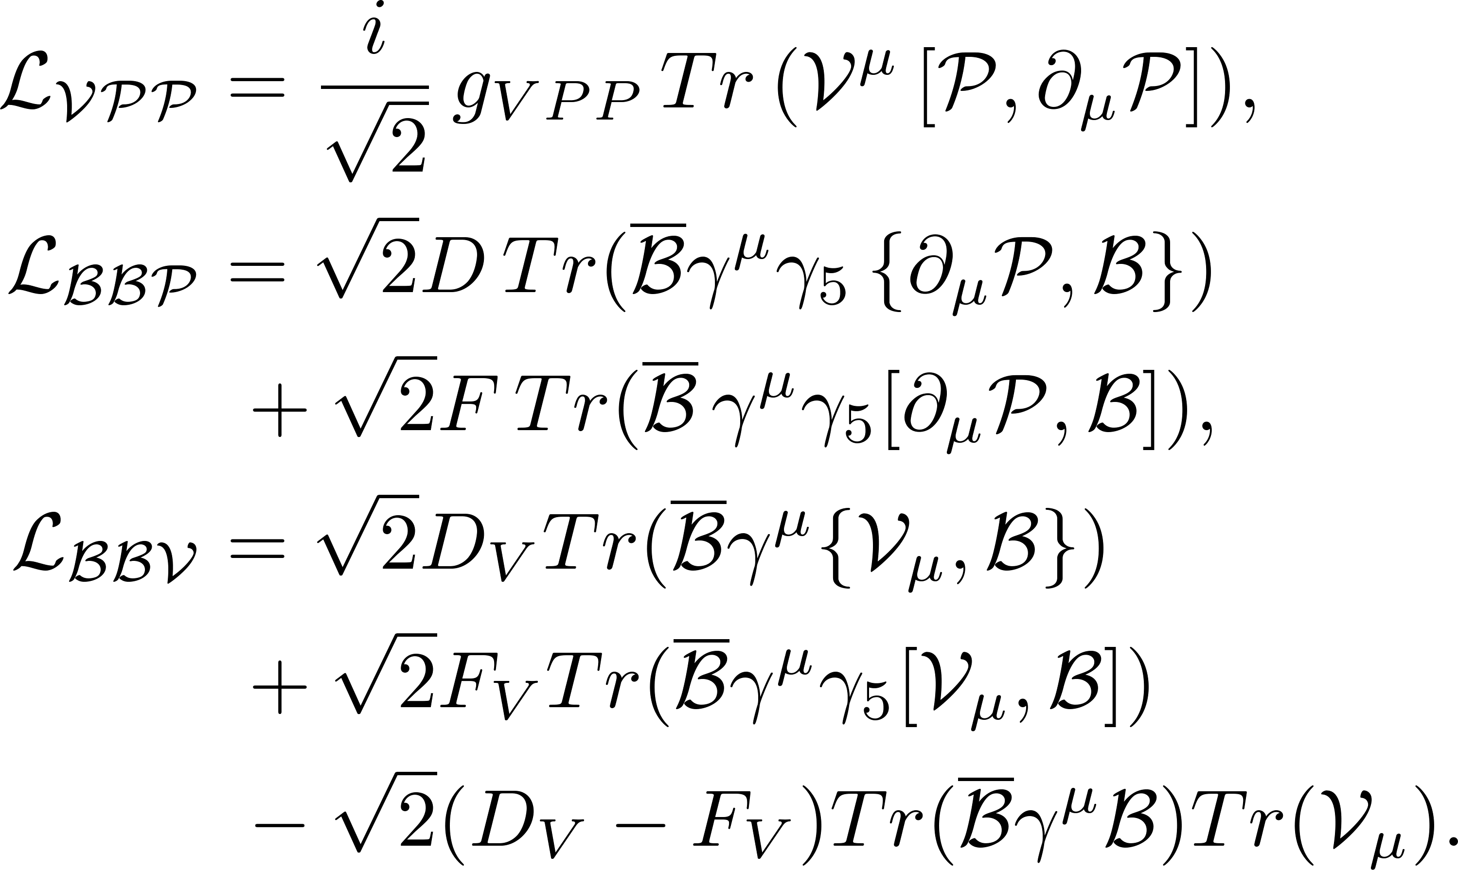
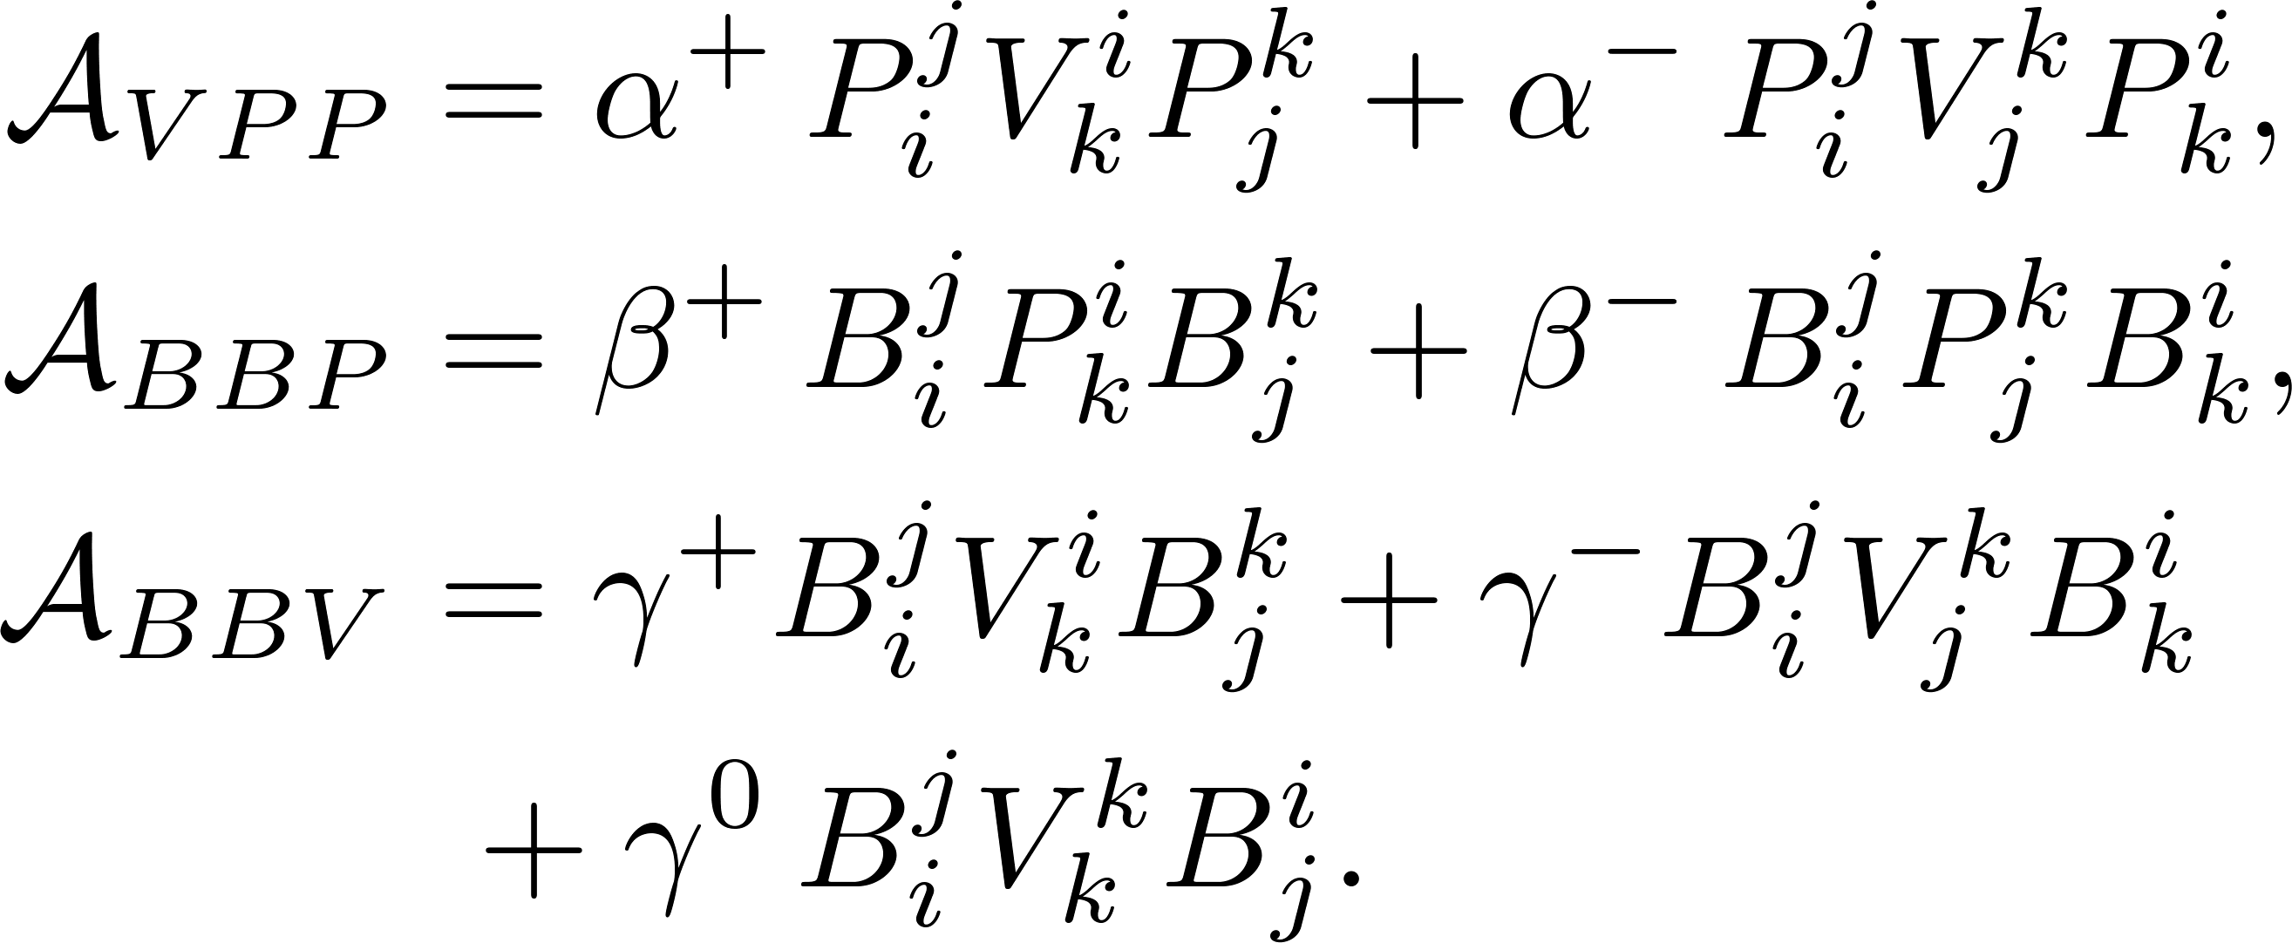
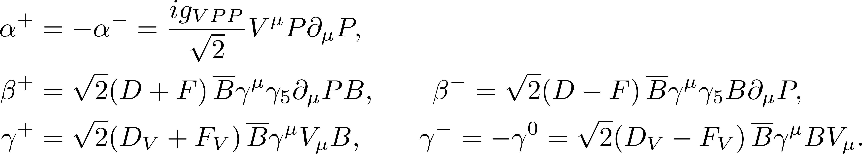
BESIII粲强子物理研讨会
Strong coupling
Strong coupling
Chiral Lagrangian
arXiv:2507.06914.
23

Slide 24
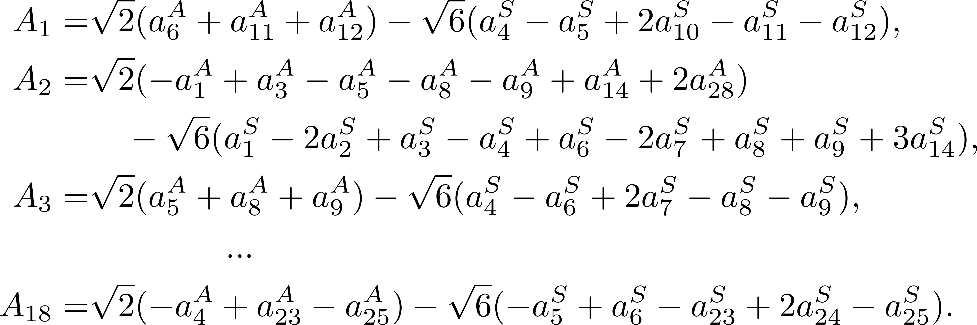
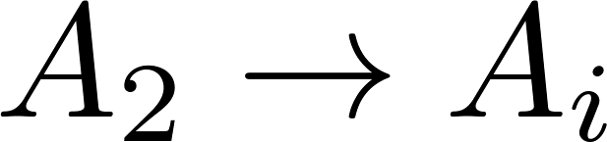
BESIII粲强子物理研讨会
Relations between 3- and 2-rank amplitudes
arXiv:2406.14061
24

Slide 25
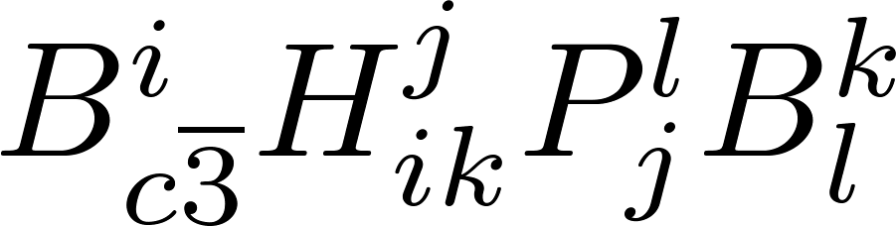
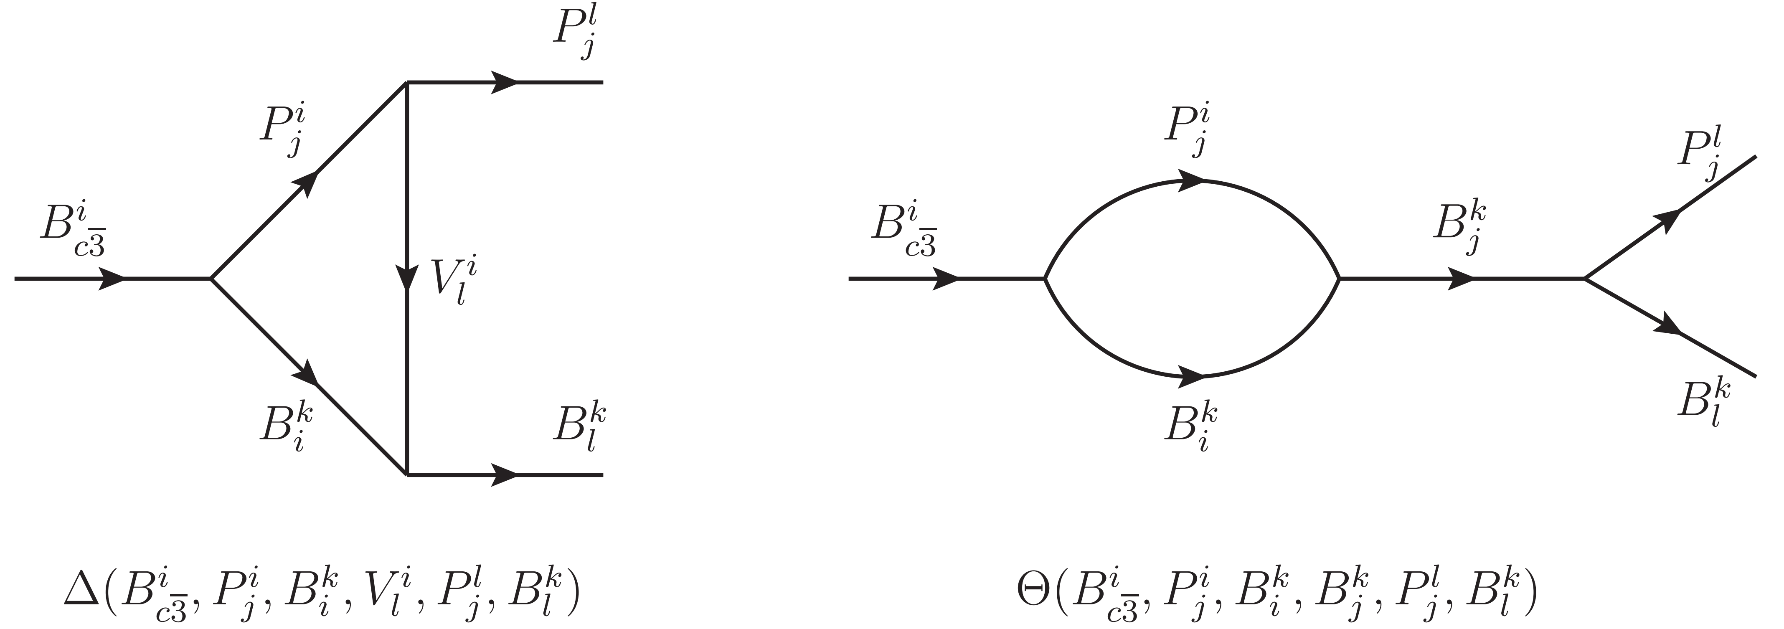
BESIII粲强子物理研讨会
From topologies to re-scattering
S- and T-channels
25

Slide 26

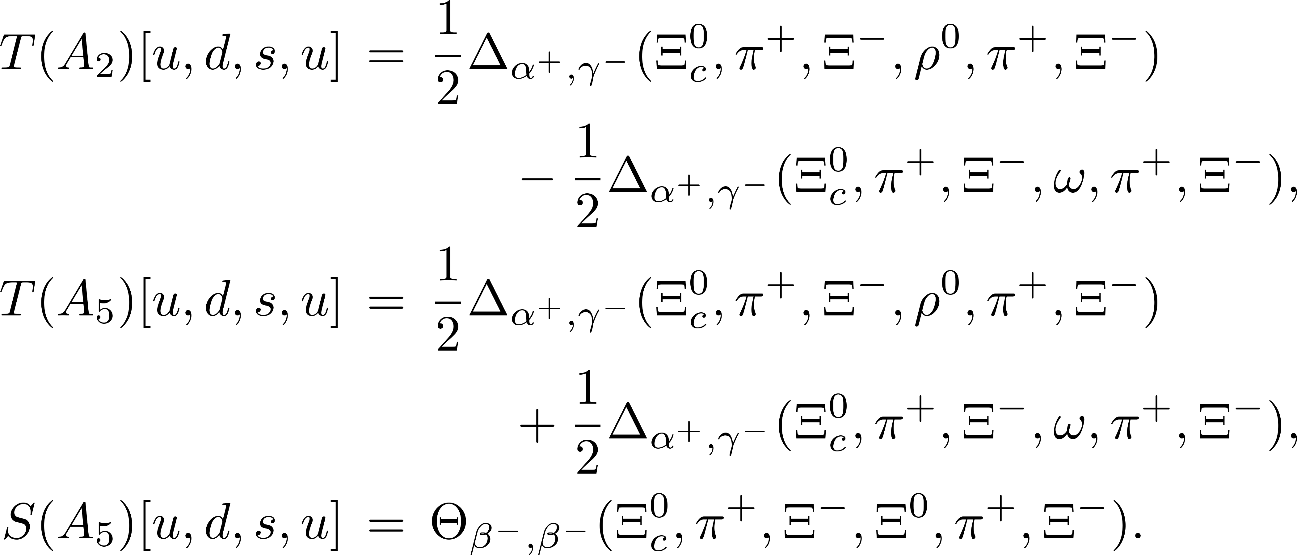

BESIII粲强子物理研讨会
Examples
system
The coupling cancel each other.
Be consistent with results from chiral Lagrangian.
26

Slide 27
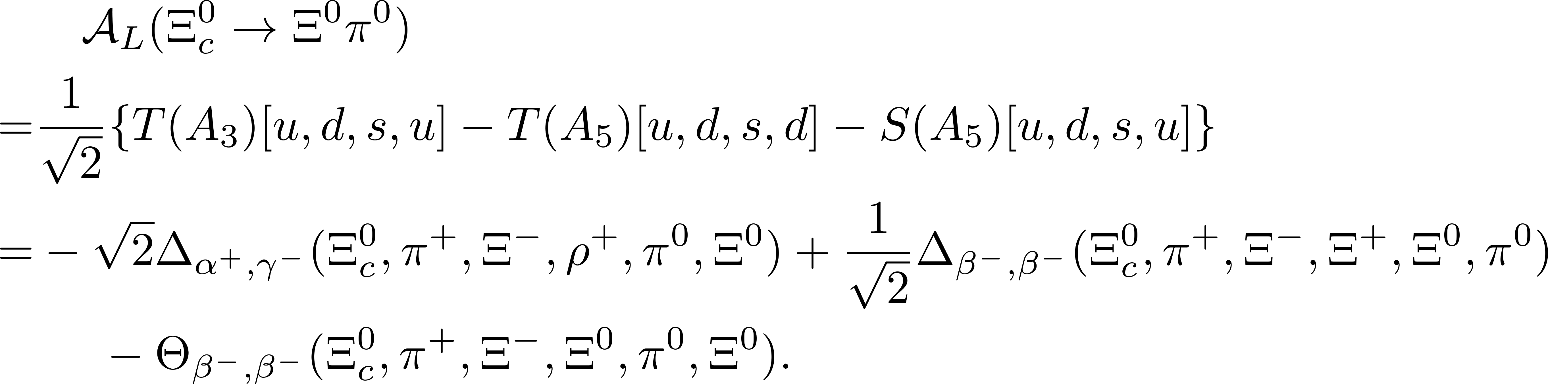
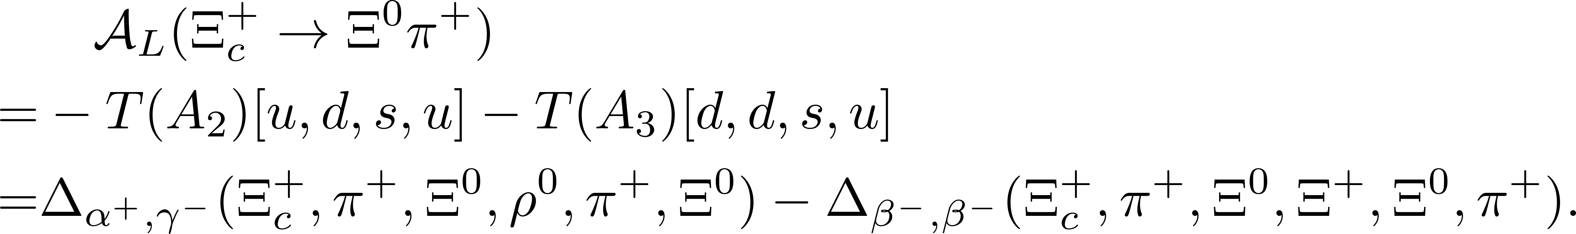
BESIII粲强子物理研讨会
Examples
Isospin:
27

Slide 28
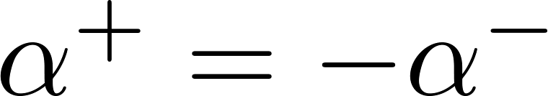
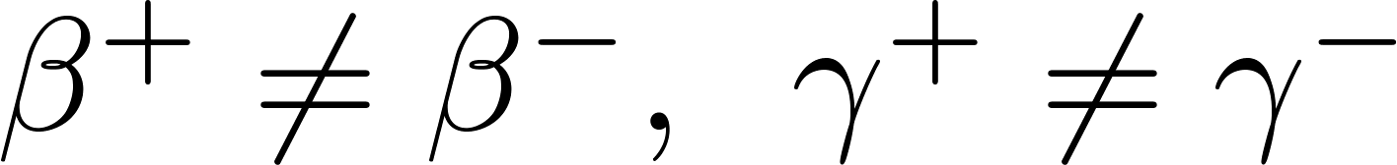


BESIII粲强子物理研讨会
Baryon .vs. Meson
CPV
Meson：
Baryon： |P/T|~1
Propagator
Meson：
Baryon：
arXiv:2507.06914.
SU(3) breaking
28

Slide 29



BESIII粲强子物理研讨会
The K$\ddot{o}$rner-Pati-Woo theorem
Four decay amplitudes are very small due to small λb.
The K$\ddot{o}$rner-Pati-Woo theorem: If two quarks produced by weak operators enter one baryon, they are anti-symmetric in flavor.
J. G. Korner, Nucl. Phys. B 25, 282-290 (1971).
J. C. Pati and C. H. Woo, Phys. Rev. D 3, 2920-2922 (1971).
Decay amplitudes: 9 5
Parameters:
Isospin symmetry + KPW theorem
C. Q. Geng, C. W. Liu and T. H. Tsai, Phys. Lett. B 794, 19-28 (2019).
29

Slide 30



BESIII粲强子物理研讨会
Final-state rescattering
Final-state rescattering
C. P. Jia, H. Y. Jiang, J. P. Wang and F. S. Yu, JHEP 11, 072 (2024).
H. Y. Cheng, F. Xu and H. Zhong, [arXiv:2505.07150 [hep-ph]].
30

Slide 31



BESIII粲强子物理研讨会
Final-state rescattering
arXiv:2507.06914.
31

Slide 32




BESIII粲强子物理研讨会
Final-state rescattering
Color favored
Color suppressed
32

Slide 33



BESIII粲强子物理研讨会
The K$\ddot{o}$rner-Pati-Woo theorem
Fierz transformation
symmetric
If two quarks enter baryon
antisymmetric
?
SU(3)C singlet
J. G. Korner, Nucl. Phys. B 25, 282-290 (1971).
J. C. Pati and C. H. Woo, Phys. Rev. D 3, 2920-2922 (1971).
antisymmetric
33

Slide 34


BESIII粲强子物理研讨会
Test the K$\ddot{o}$rner-Pati-Woo theorem
Isospin symmetry + KPW theorem
?
M. Ablikim et al. [BESIII], Phys. Rev. D 106, no.5, 052003 (2022).
L. K. Li et al. [Belle] Sci. Bull. 68, 583-592 (2023).
PDG
Isospin symmetry only
34

Slide 35
BESIII粲强子物理研讨会
Contents
1
Motivation
2
Topological Amplitudes
3
Rescattering Dynamics
4
Summary

Slide 36

BESIII粲强子物理研讨会
Summary
Topological amplitudes and rescattering dynamics can be described in one theoretical framework.
Test the K$\ddot{o}$rner-Pati-Woo theorem
Next: Global fit, Model calculation, …
Thanks for your attention!
36

