Slide 1
Latest charming results the LHCb experiment
钱文斌
中国科学院大学
2025/08/08
粲强子研讨会
2025/08/08
国科大 钱文斌
1

Slide 2
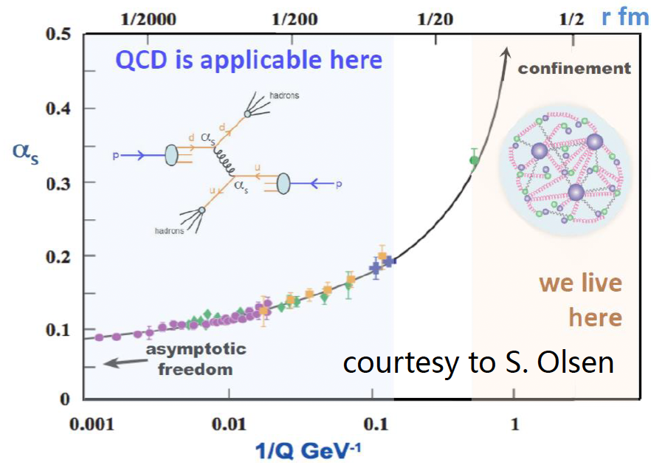
Flavor physics goals
SM model very successful;
Still an effective theory, many unexplained phenomena;
Most related to flavor and hadron physics
Understanding QCD at low energy
New Physics hunting
Properties of QCD confinement
Structures of hadrons
Matter and antimatter asymmetry observed in the Universe
Origin of dark matter? New particles or new forces? Flavor hierarchy
Non-perturbative!
2025/08/08
国科大 钱文斌
2

Slide 3
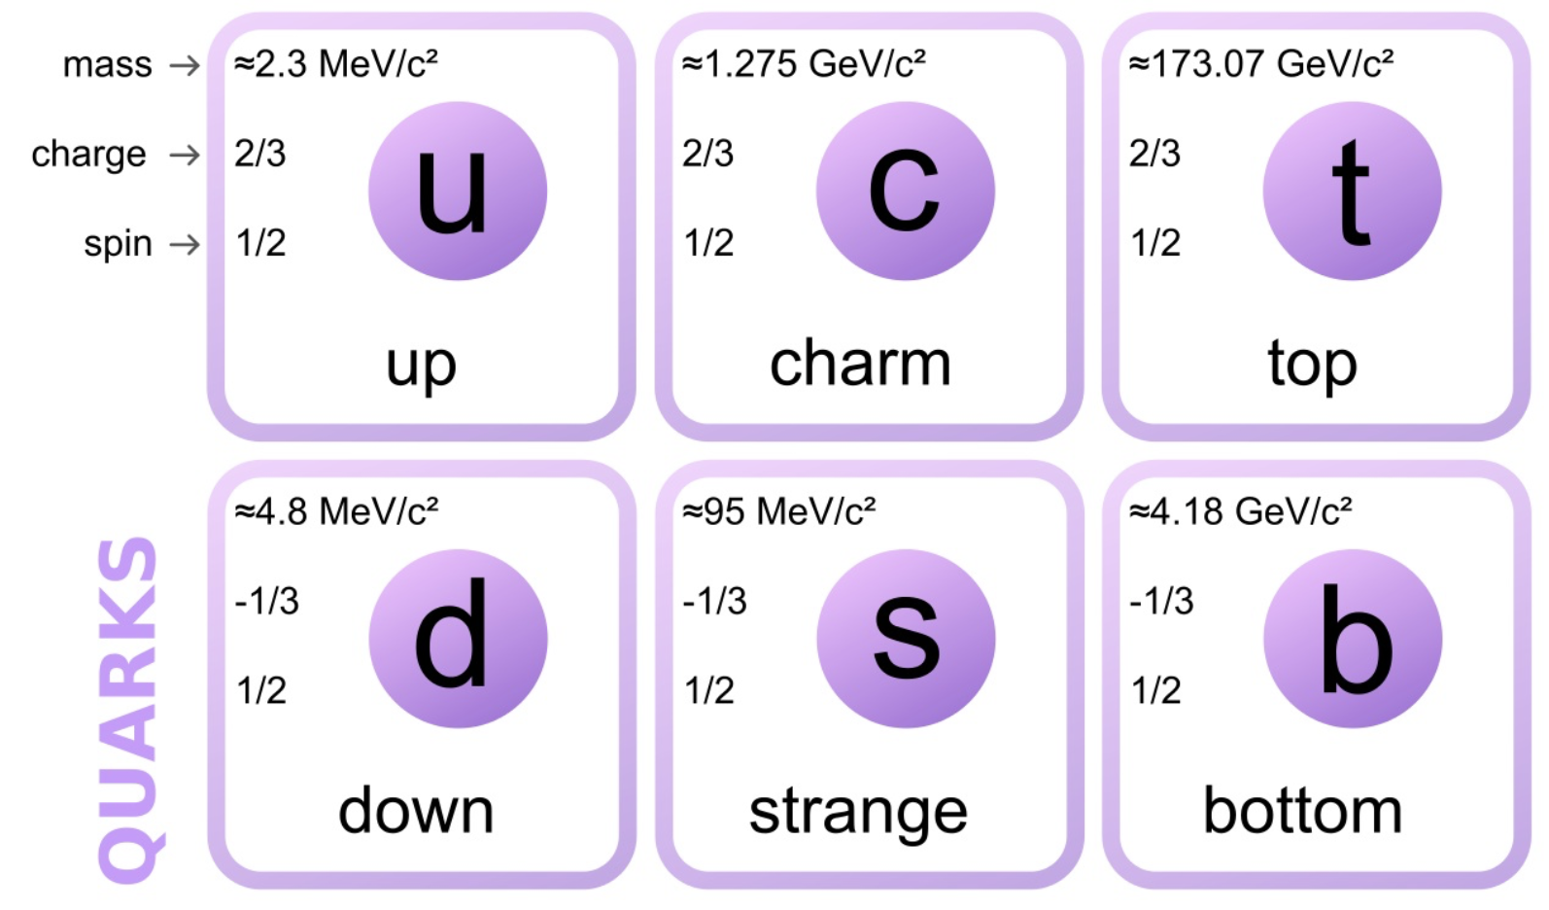
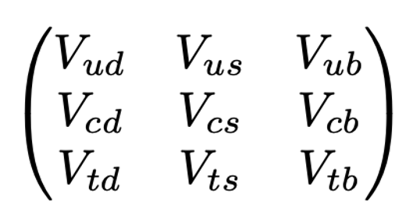

Charm in flavor
Search for New Physics related to up-type quarks
  Rare decays
  Precise measurements on tiny quantities
CKM physics: charm plays a special role
Properties of charmed hadrons ($m_{c}\sim 1.3$ GeV vs $Λ_{QCD}\sim 0.3$ GeV)
Unitary test of 2nd row
2025/08/08
国科大 钱文斌
3

Slide 4

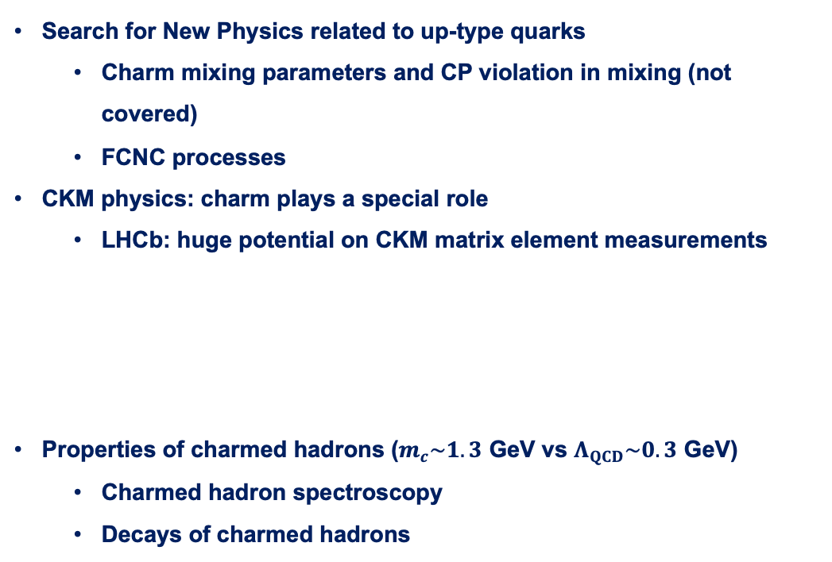



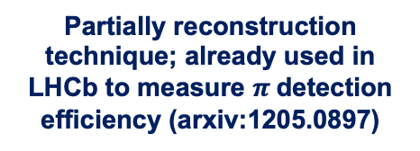


Charm programs in flavor
Search for New Physics related to up-type quarks
  Charm mixing parameters and CP violation in mixing (not covered)
  FCNC processes
CKM physics: charm plays a special role
  LHCb: huge potential on CKM matrix element measurements
Properties of charmed hadrons ($m_{c}\sim 1.3$ GeV vs $Λ_{QCD}\sim 0.3$ GeV)
  Charmed hadron spectroscopy
  Decays of charmed hadrons
Direct CP violation in charm decays already established; however, CP violation in mixing not yet; main focus of LHCb Charm program
Limited explored territory (at LHCb)
$$π$$
$$X$$
Partially reconstruction technique; already used in LHCb to measure $π$ detection efficiency (arxiv:1205.0897)
$$μ^{+}$$
$B/Λ_{b}^{0}$ $/D^{∗}$
$$D/Λ_{c}^{+}$$
pp
$$ν$$
2025/08/08
国科大 钱文斌
4

Slide 5
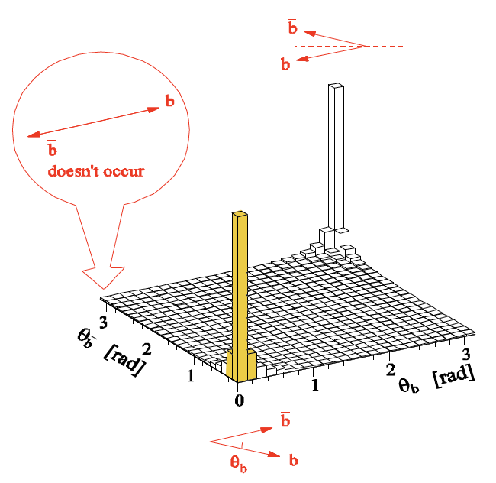
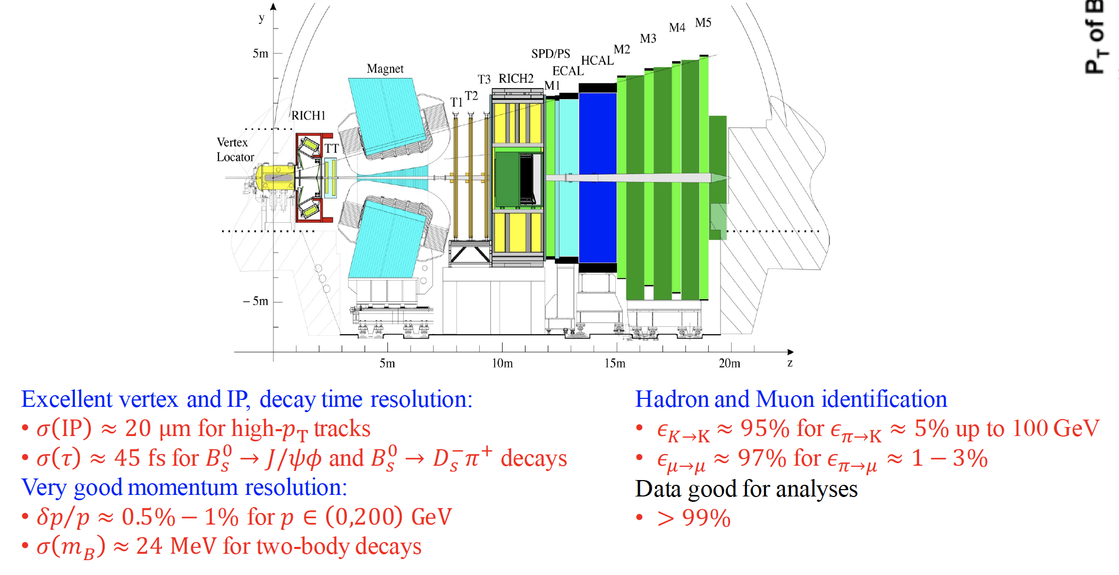
The LHCb detector (Run 1+2)
2008 JINST 3 S08005
Designed for CP violation and heavy flavor studies
2025/08/08
国科大 钱文斌
5

Slide 6
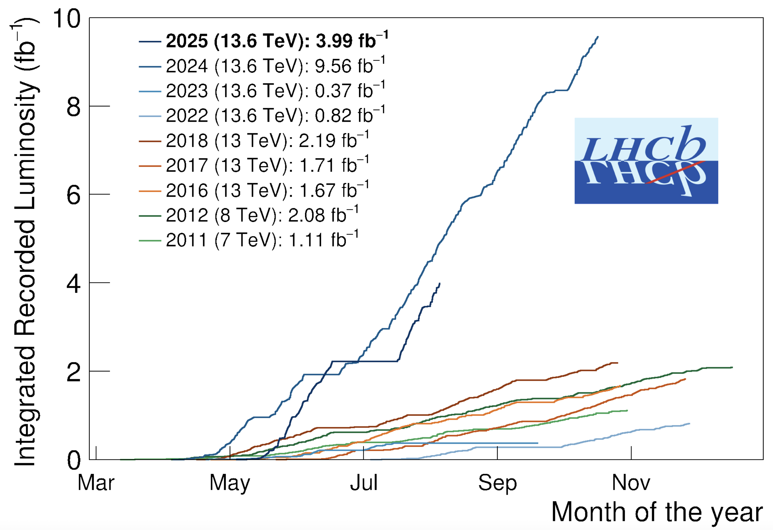
The LHCb status
Run 1:
  2011 (7 TeV): 1 fb⁻¹
  2012 (8 TeV): 2 fb⁻¹
Run 2:
  2015-2018 (13 TeV): 6 fb⁻¹
Run 3:
  2024 alone (13.6 TeV): 9.56 fb⁻¹
  2025 (13.6 TeV): > 3.99 fb⁻¹
A new LHCb detector for Run 3 operates at $×5$ higher instantaneous luminosity
Similar performance, while efficiency for hadron final states increased by a factor of 2
2025/08/08
国科大 钱文斌
6

Slide 7
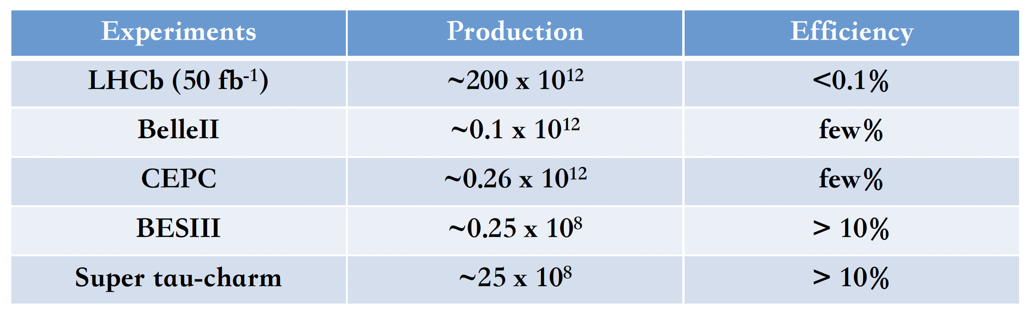
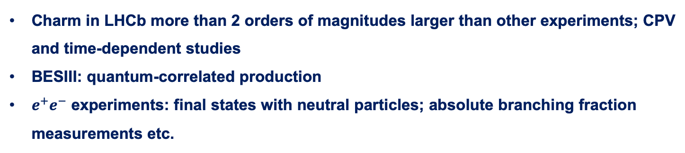
Charm production at LHCb
Charm in LHCb more than 2 orders of magnitudes larger than other experiments; CPV and time-dependent studies
BESIII: quantum-correlated production
$e^{+}e^{−}$ experiments: final states with neutral particles; absolute branching fraction measurements etc.
2025/08/08
国科大 钱文斌
7

Slide 8
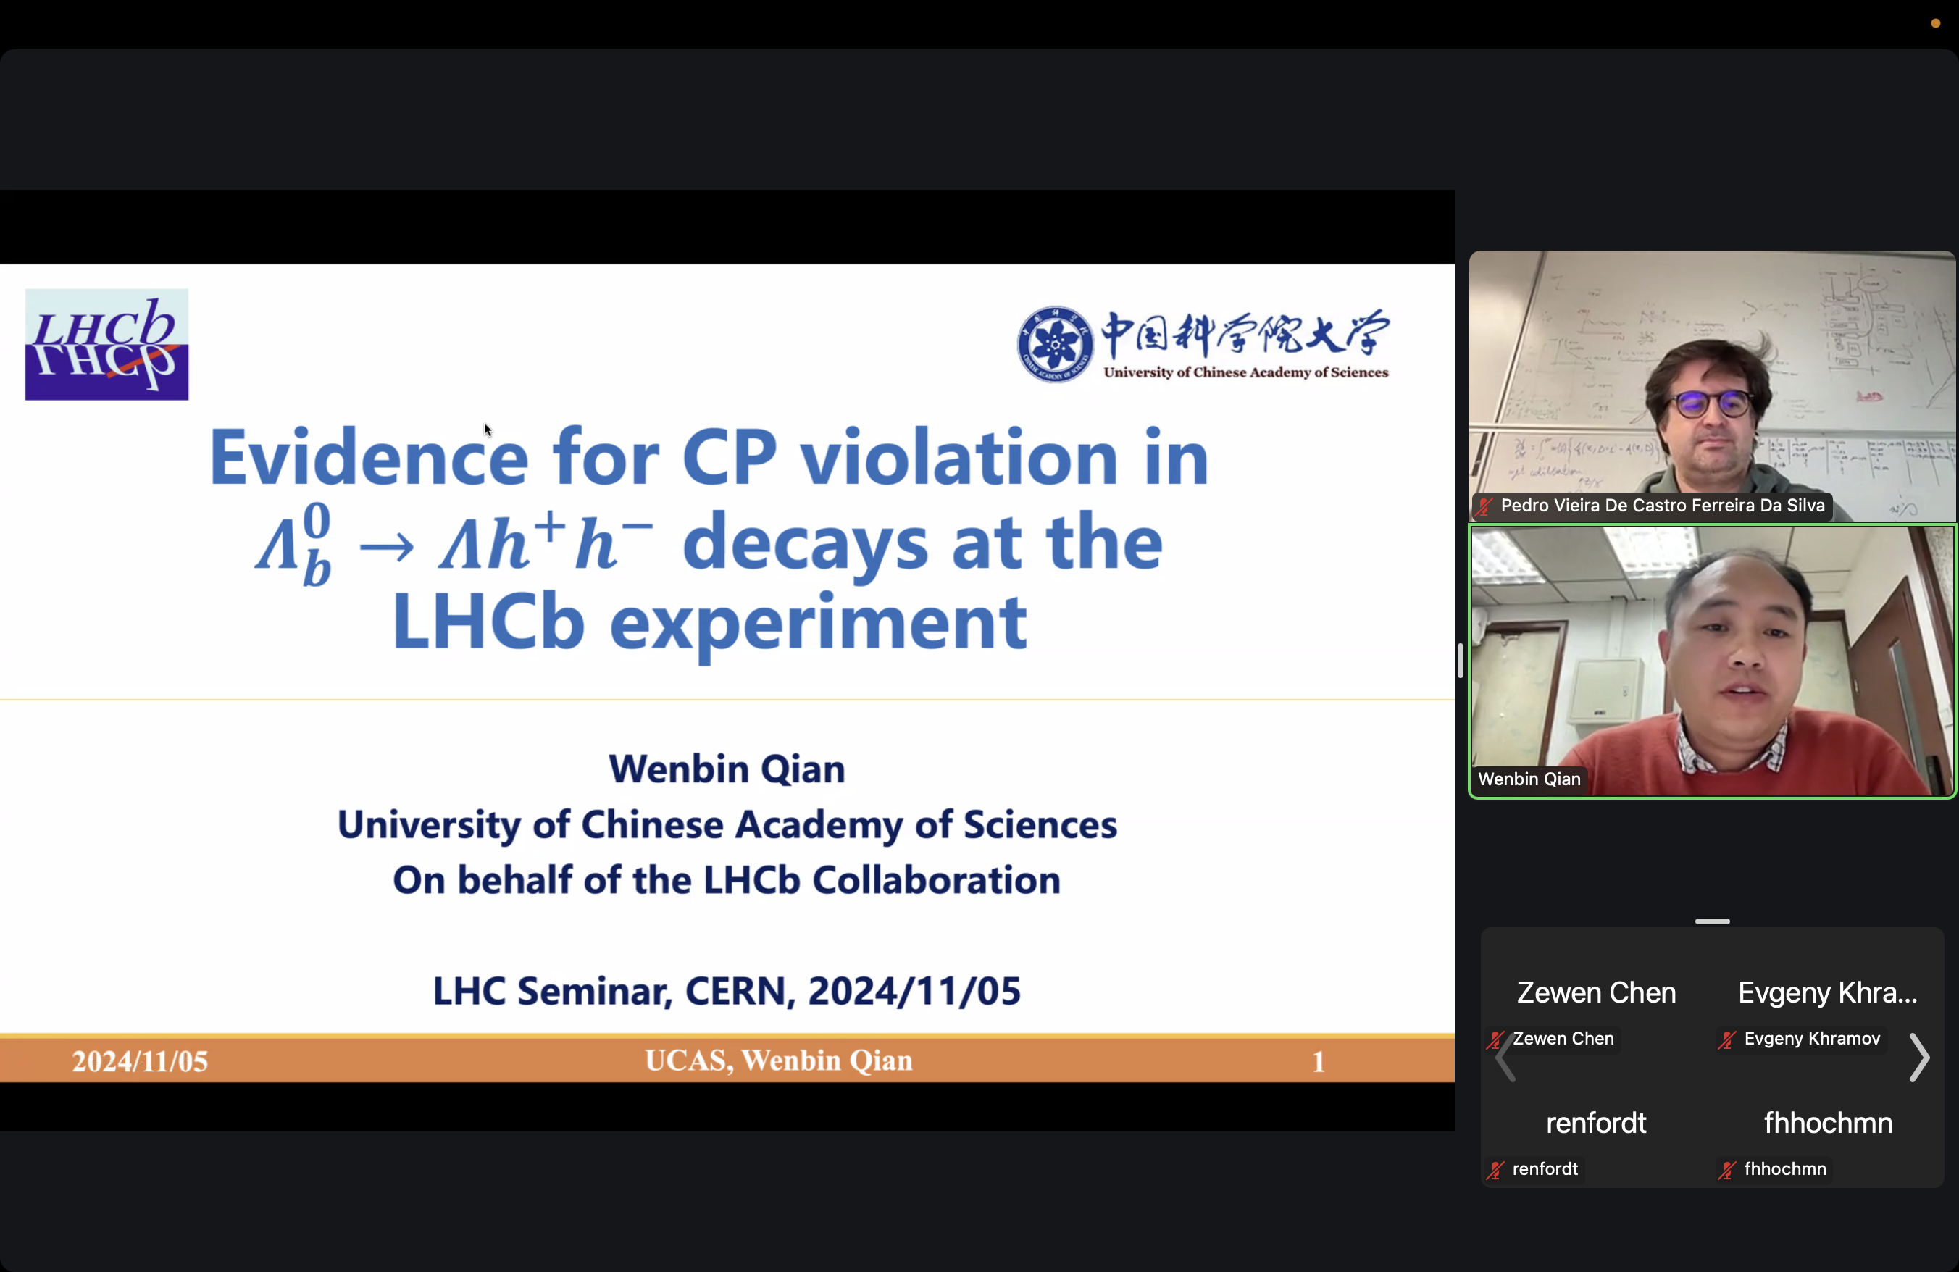
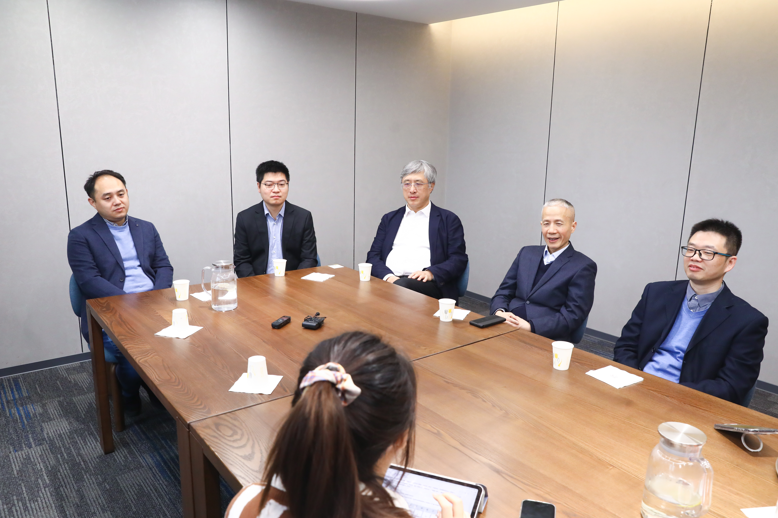
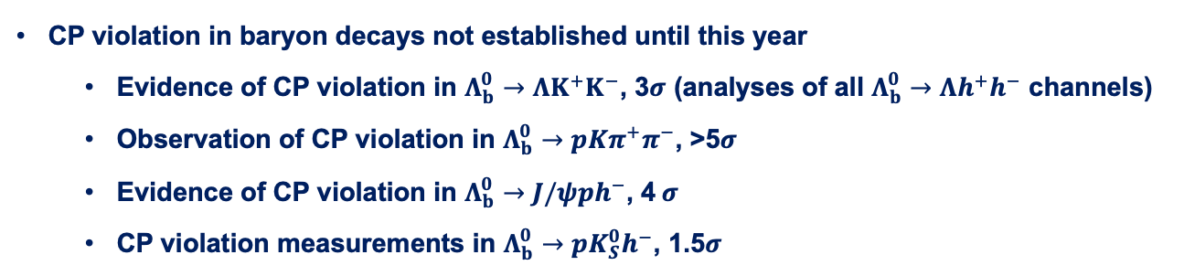
CP violation in baryon decays
CP violation in baryon decays not established until this year
  Evidence of CP violation in $Λ_{b}^{0}→ΛK^{+}K^{−}$, 3$σ$ (analyses of all $Λ_{b}^{0}→Λh^{+}h^{−}$ channels)
  Observation of CP violation in $Λ_{b}^{0}→pKπ^{+}π^{−}$, >5$σ$
  Evidence of CP violation in $Λ_{b}^{0}→J/ψph^{−}$, 4 $σ$
  CP violation measurements in $Λ_{b}^{0}→pK_{S}^{0}h^{−}$, 1.5$σ$
2025/08/08
国科大 钱文斌
8

Slide 9
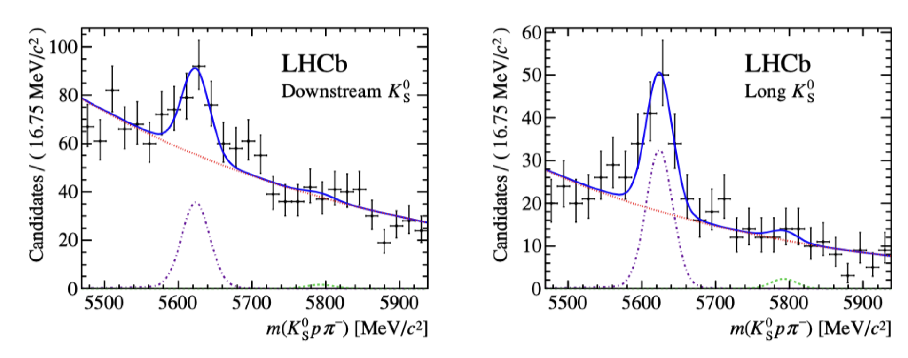
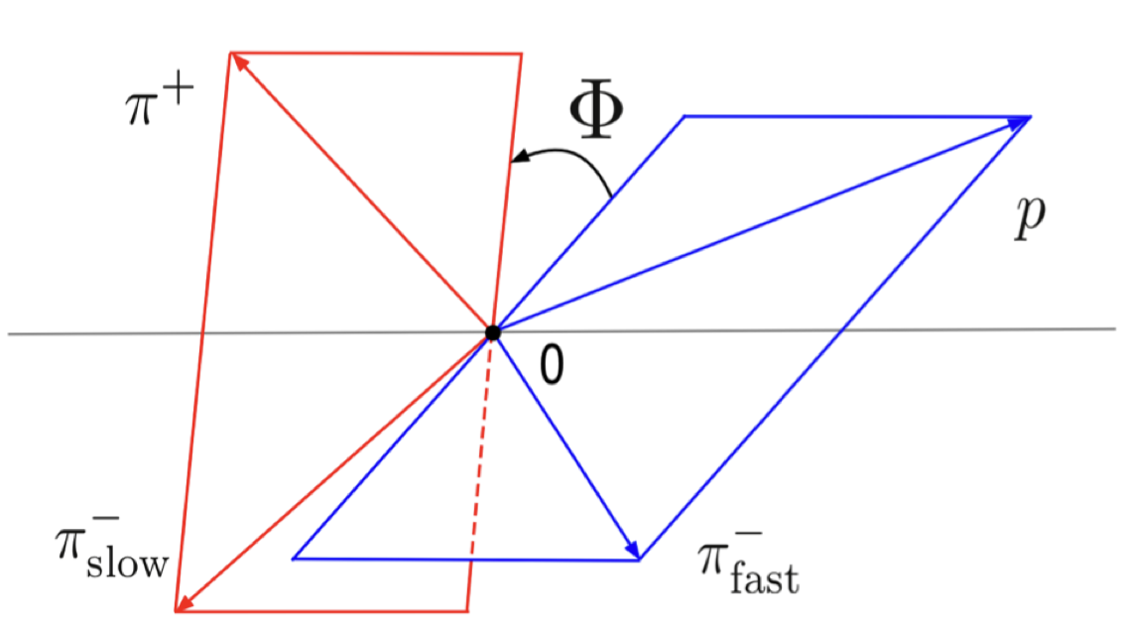
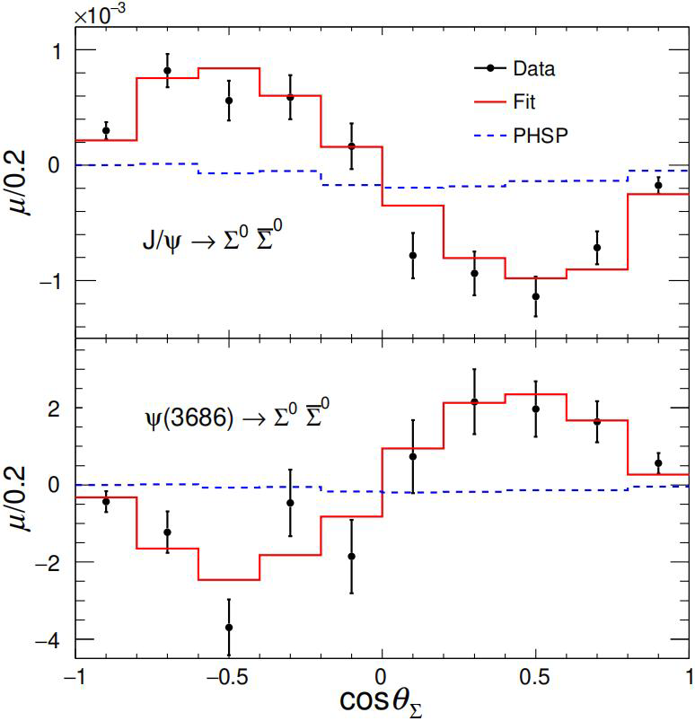
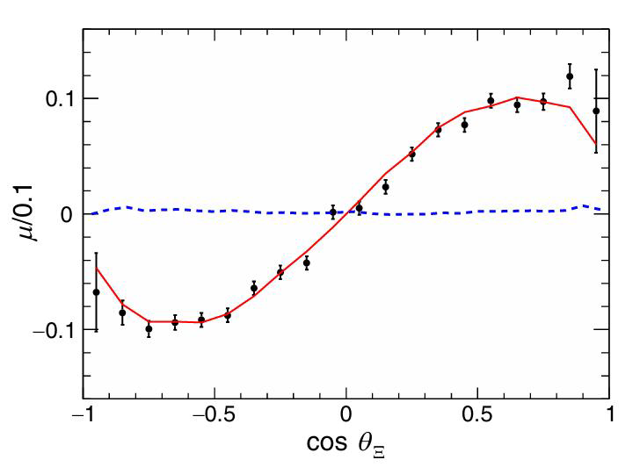




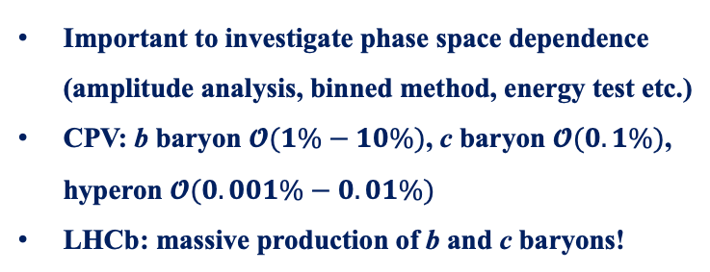
Methods to search for CP violation
JHEP04(2014)087
PRD108(2023)L011101
PRL133 (2024) 101902
Nature Phys.13(2017)391
Many methods have been explored to search for CP violation in baryon decays
Direct CP violation ($∝sin\left(Δδ_{ST}\right)sin(Δφ_{EW})$)
Triple-product asymmetry ($∝cos\left(Δδ_{ST}\right)sin(Δφ_{EW})$)
$$Λ_{b}^{0}→pK_{S}^{0}π^{−}$$
$$Λ_{b}^{0}→pπ^{+}π^{−}π^{+}$$
Decay parameters asymmetry
Important to investigate phase space dependence (amplitude analysis, binned method, energy test etc.)
CPV: b baryon $𝓞(1\%−10\%)$, c baryon $𝓞(0.1\%)$, hyperon $𝓞(0.001\%−0.01\%)$
LHCb: massive production of b and c baryons!
$J/ψ$ $→Ξ^{0}{\overline{Ξ}}^{0}, Ξ^{0}→Λπ^{0}$
2025/08/08
国科大 钱文斌
9

Slide 10
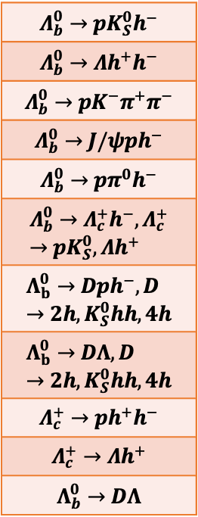
CP violation searches by LHCb China group
2016 | 2017 | 2018 | 2019 | 2020 | 2021 | 2022 | 2023 | 2024 | 2025
$$Λ_{b}^{0}→pK_{S}^{0}h^{−}$$
$$Λ_{b}^{0}→Λh^{+}h^{−}$$
$$Λ_{b}^{0}→pK^{−}π^{+}π^{−}$$
$$Λ_{b}^{0}→J/ψph^{−}$$
$$Λ_{b}^{0}→pπ^{0}h^{−}$$
$$Λ_{b}^{0}→Λ_{c}^{+}h^{−}, Λ_{c}^{+}→pK_{S}^{0}, Λh^{+}$$
$$Λ_{b}^{0}→Dph^{−}, D→2h, K_{S}^{0}hh, 4h$$
$$Λ_{b}^{0}→DΛ, D→2h, K_{S}^{0}hh, 4h$$
$$Λ_{c}^{+}→ph^{+}h^{−}$$
$$Λ_{c}^{+}→Λh^{+}$$
$$Λ_{b}^{0}→DΛ$$
CCNU
CCNU +UCAS
CCNU +UCAS +PKU
CCNU +UCAS
CCNU +UCAS +PKU
CCNU +UCAS +PKU + IHEP
UCAS + Tsinghua
Joint efforts from LHCb China
UCAS + PKU + WHU
UCAS
CCNU +UCAS +PKU
UCAS
9 years of studies
Covering all modes
UCAS
UCAS
UCAS + LZU
CCNU
CCNU +UCAS
2024/07/14
UCAS, Wenbin Qian
UCAS
10

Slide 11

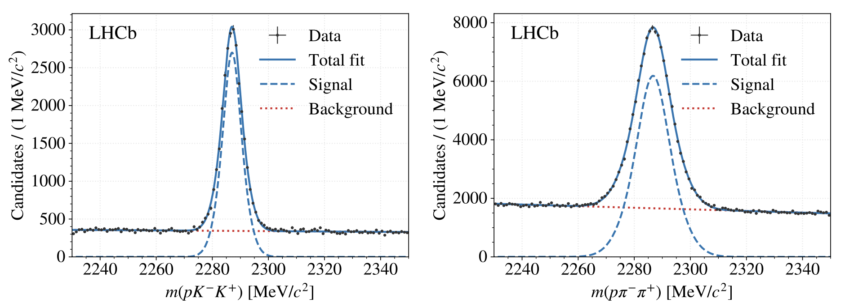

CP violation in charmed baryon decays
JHEP 03 (2018) 182
Published results only with Run1+2 data using samples from $H_{b}→Λ_{c}^{+}μ^{−}X$ (semi-leptonic)
24K
161K
Current efforts on prompt $Λ_{c}^{+}$ decays and secondary $Λ_{c}^{+}$ decays may reduce uncertainty by 1/10
CP violation from other $Λ_{c}^{+}$ decay may also yield interesting results
2025/08/08
国科大 钱文斌
11

Slide 12
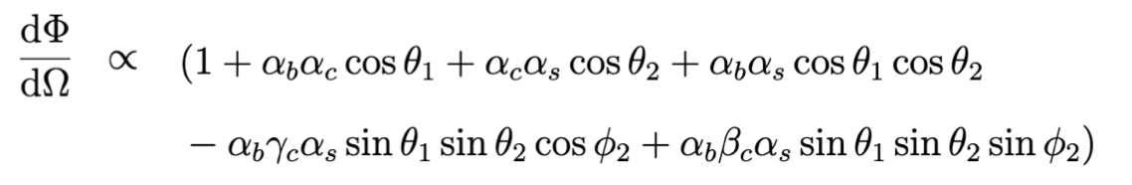
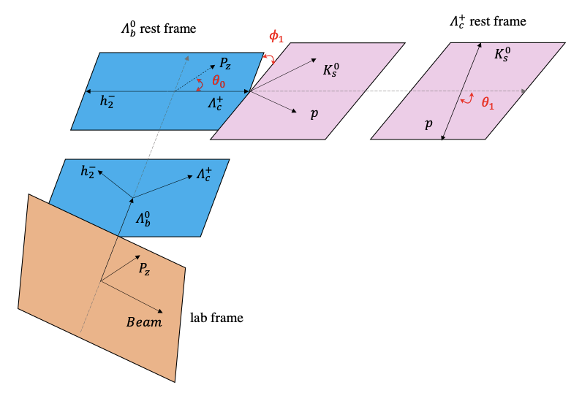
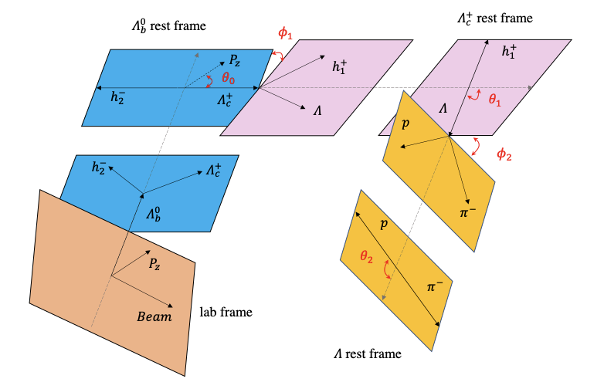
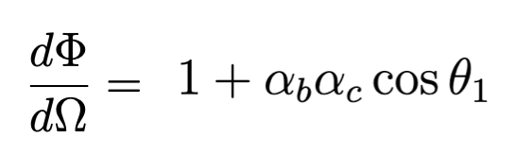






Decay parameter measurements
PRL 133 (2024) 261804
Several decay chains considered:
$$Λ_{b}^{0}→Λ_{c}^{+}{(→Λh^{+})h}^{−}, Λ→pπ^{−}$$
$$Λ_{b}^{0}→Λ_{c}^{+}{(→pK_{S}^{0})h}^{−}$$
$$α_{b}:Λ_{b}^{0}→Λ_{c}^{+}h^{−}$$
$$α_{c}:Λ_{c}^{+}→pK_{S}^{0}$$
$$α_{b}:Λ_{b}^{0}→Λ_{c}^{+}h^{−}$$
$$α_{c},β_{c},γ_{c}:Λ_{c}^{+}→Λh^{+}$$
$$α_{s}:Λ→pπ^{−}$$
2025/08/08
国科大 钱文斌
12

Slide 13
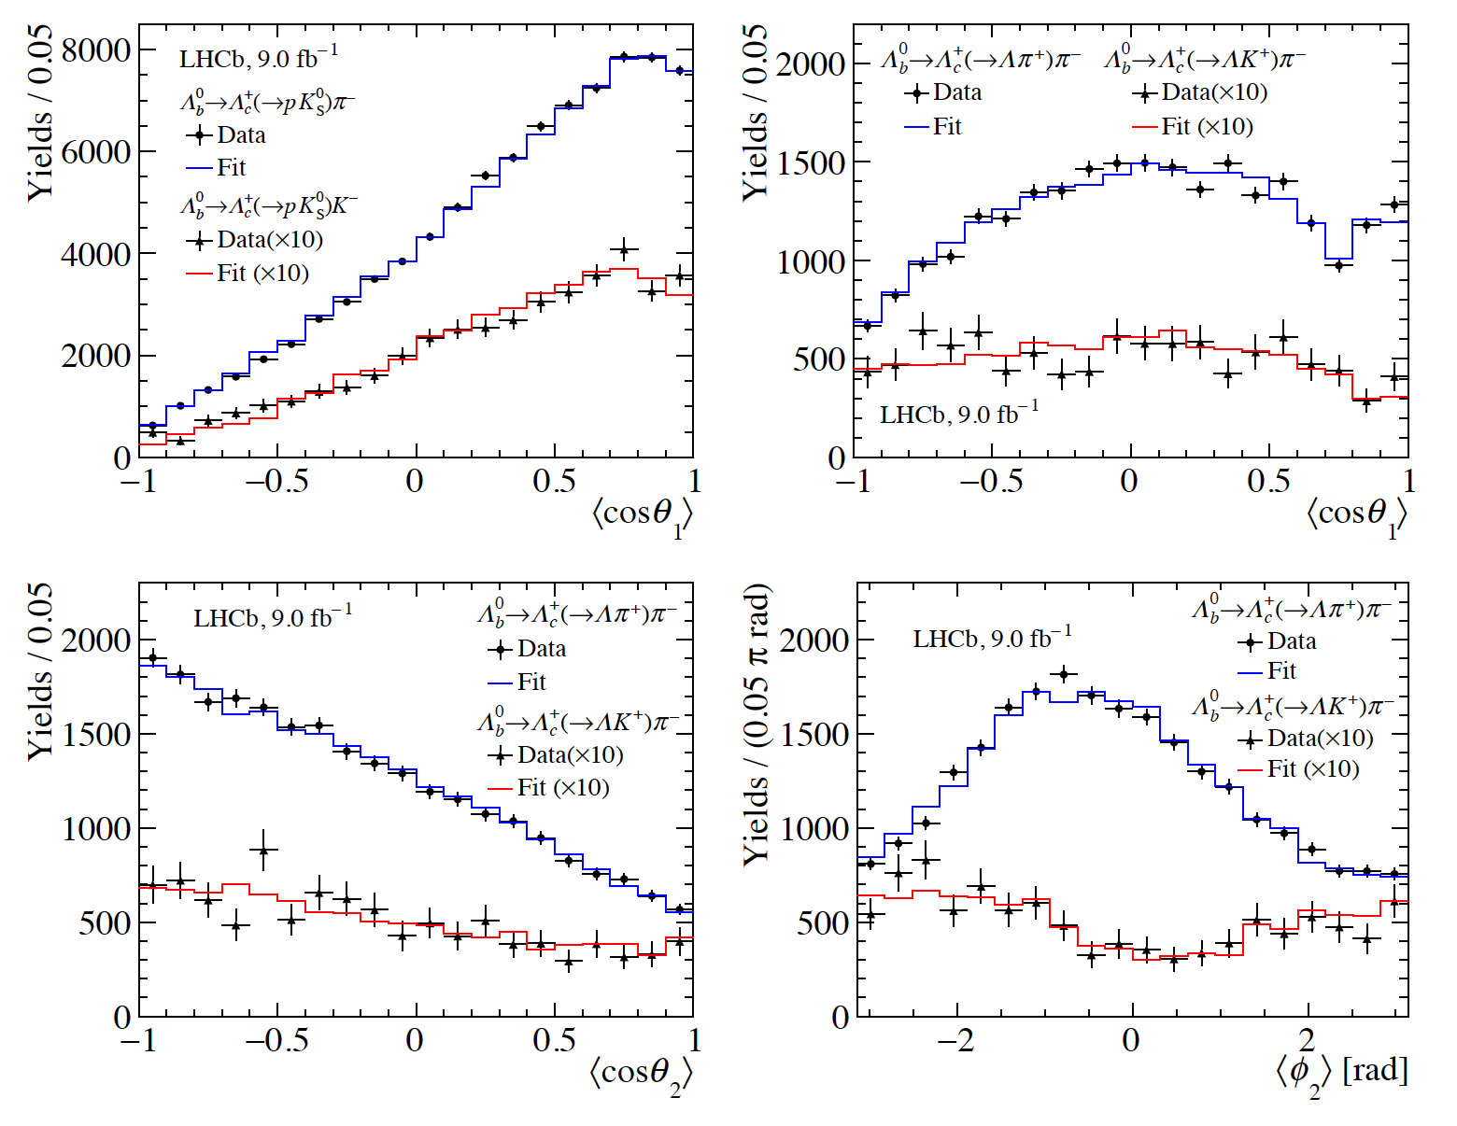
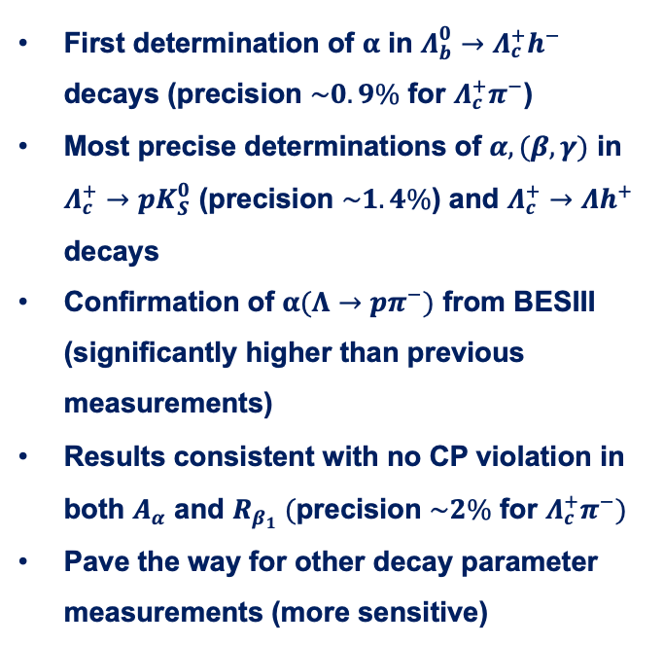












Results of decay parameters
PRL 133 (2024) 261804
$$Λ_{b}^{0}→Λ_{c}^{+}(→pK_{S}^{0})h^{−}$$
$$Λ_{b}^{0}→Λ_{c}^{+}{\left(→Λh^{+}\right)π}^{−}$$
First determination of $α$ in $Λ_{b}^{0}→Λ_{c}^{+}h^{−}$ decays (precision $\sim 0.9\%$ for $Λ_{c}^{+}π^{−}$)
Most precise determinations of $α,(β,γ)$ in $Λ_{c}^{+}→pK_{S}^{0}$ (precision $\sim 1.4\%$) and $Λ_{c}^{+}→Λh^{+}$ decays
Confirmation of $α(Λ→pπ^{−})$ from BESIII (significantly higher than previous measurements)
Results consistent with no CP violation in both $A_{α}$ and $R_{β_{1}} (\text{precision} \sim 2\% \text{for} Λ_{c}^{+}π^{−})$
Pave the way for other decay parameter measurements (more sensitive)
$$Λ_{b}^{0}→Λ_{c}^{+}π^{−}$$
$$Λ_{c}^{+}→Λπ^{+}$$
$$Λ_{b}^{0}→Λ_{c}^{+}K^{−}$$
$$Λ_{c}^{+}→ΛK^{+}$$
$$Λ_{c}^{+}→Λπ^{+}$$
$$Λ_{c}^{+}→Λπ^{+}$$
$$Λ_{c}^{+}→ΛK^{+}$$
$$Λ_{c}^{+}→ΛK^{+}$$
$$Λ_{b}^{0}→Λ_{c}^{+}{\left(→Λh^{+}\right)π}^{−}$$
$$Λ_{b}^{0}→Λ_{c}^{+}{\left(→Λh^{+}\right)π}^{−}$$
2025/08/08
国科大 钱文斌
13

Slide 14
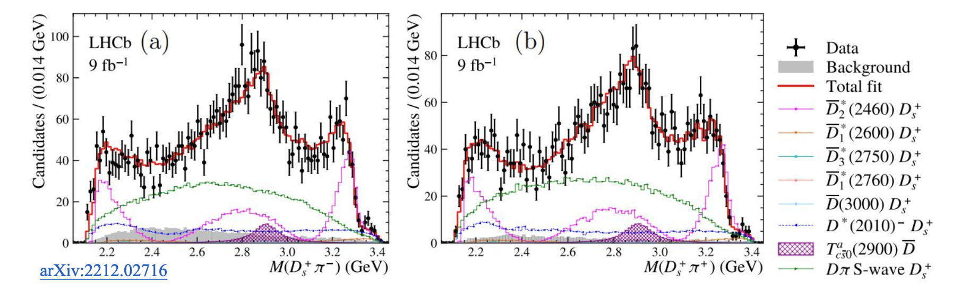
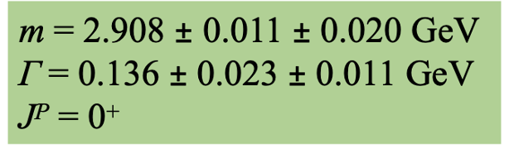
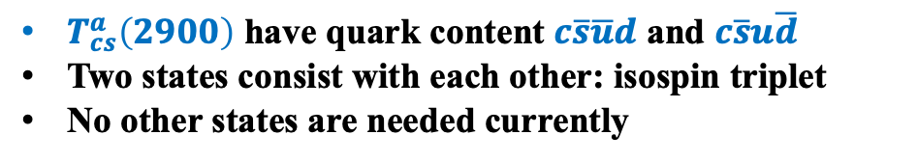






Doubly charged tetraquark and its Isospin partner
Around 4K signal events
PRL 131 (2023) 041902
PRD 108 (2023) 012017
$$B^{0}→\overline{D^{0}}D_{s}^{+}π^{−}$$
$$B^{+}→D^{−}D_{s}^{+}π^{+}$$
$$T_{c\overline{s}}^{a}{\left(2900\right)}^{0}$$
$$T_{c\overline{s}}^{a}{\left(2900\right)}^{++}$$
$$FF:\left(4.8±1.1±1.4\right)\%$$
$$FF:\left(1.96±0.87±0.88\right)\%$$
$T_{cs}^{a}\left(2900\right) \text{have} \text{quark} \text{content} c\overline{s}\overline{u}d \text{and} c\overline{s}u\overline{d}$
Two states consist with each other: isospin triplet
No other states are needed currently
2025/08/08
国科大 钱文斌
14

Slide 15
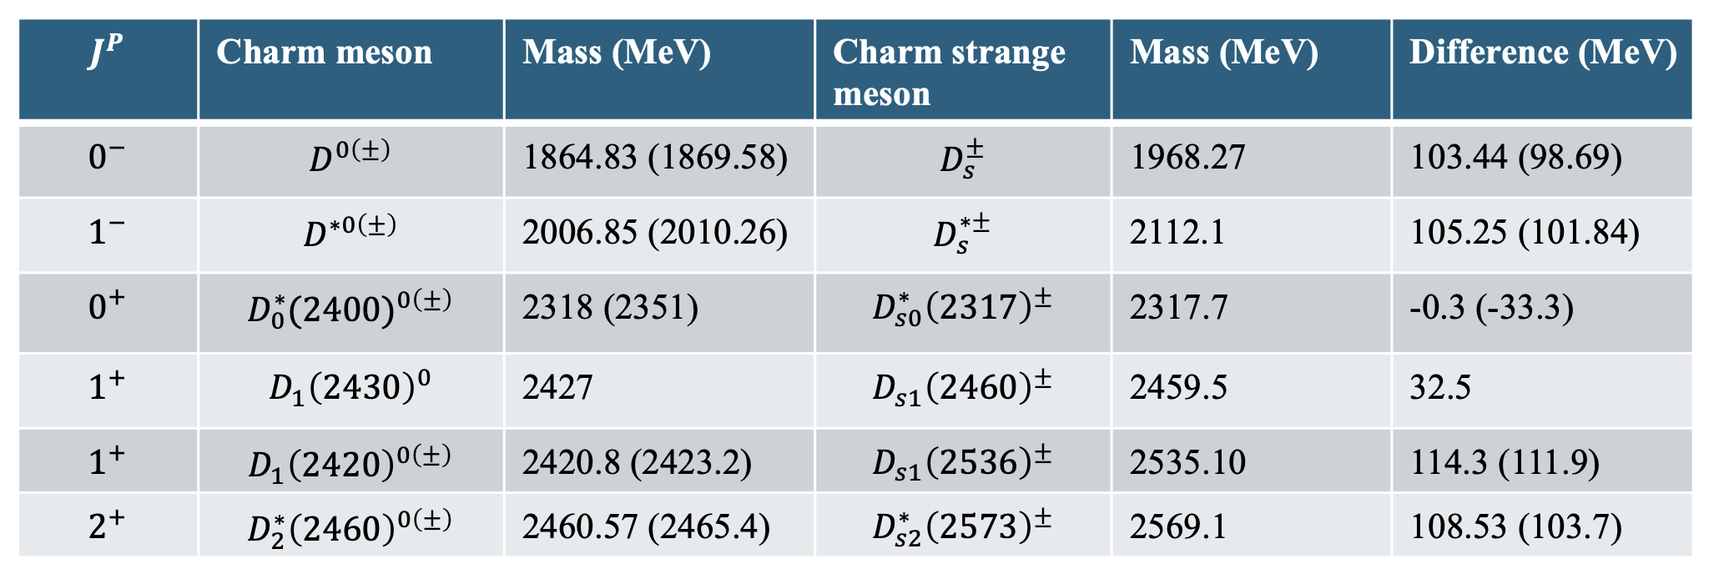





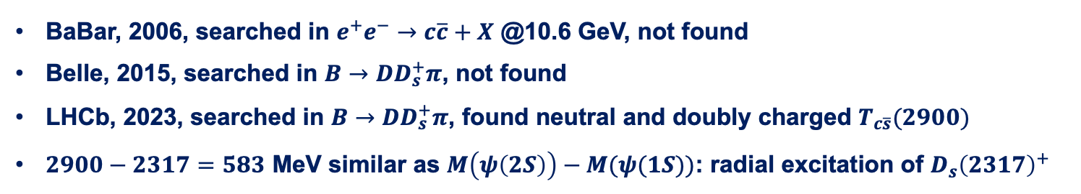
Nature of $D_{s}^{+}(2317)$ and its isospin partner
Discovered more than 20 years ago, however, its structure remains puzzling
$$\vec{s_{l}}$$
$$1/2$$
$$1/2$$
$$3/2$$
BaBar, 2006, searched in $e^{+}e^{−}→c\overline{c}+X$ @10.6 GeV, not found
Belle, 2015, searched in $B→DD_{s}^{+}π$, not found
LHCb, 2023, searched in $B→DD_{s}^{+}π$, found neutral and doubly charged $T_{c\overline{s}}(2900)$
$2900−2317=583$ MeV similar as $M\left(ψ\left(2S\right)\right)−M(ψ(1S))$: radial excitation of $D_{s}{\left(2317\right)}^{+}$
2025/08/08
国科大 钱文斌
15

Slide 16
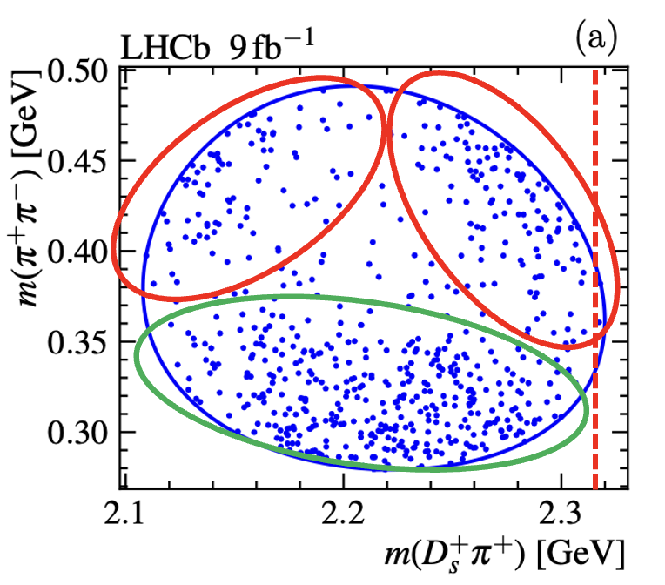
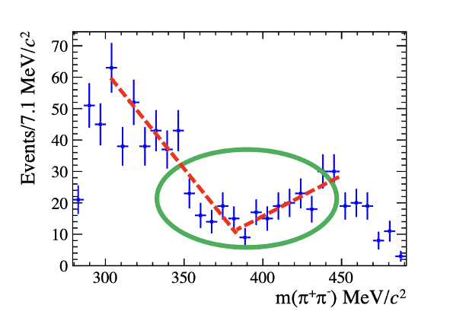
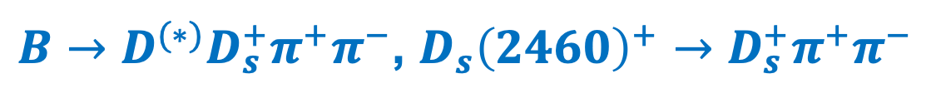
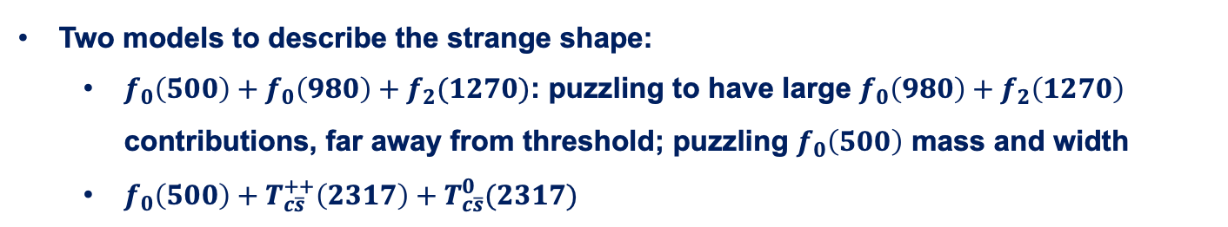
$B→D^{(∗)}D_{s}^{+}π^{+}π^{−}$, $D_{s}{\left(2460\right)}^{+}→D_{s}^{+}π^{+}π^{−}$
Science Bulletin 70 (2025) 1432
Interesting structures seen on Dalitz plot and projections
Very puzzling structures, rarely seen before
Two models to describe the strange shape:
  $f_{0}\left(500\right)+f_{0}\left(980\right)+f_{2}(1270)$: puzzling to have large $f_{0}\left(980\right)+f_{2}\left(1270\right)$ contributions, far away from threshold; puzzling $f_{0}\left(500\right)$ mass and width
  $f_{0}\left(500\right)+T_{c\overline{s}}^{++}\left(2317\right)+T_{c\overline{s}}^{0}(2317)$
2025/08/08
国科大 钱文斌
16

Slide 17
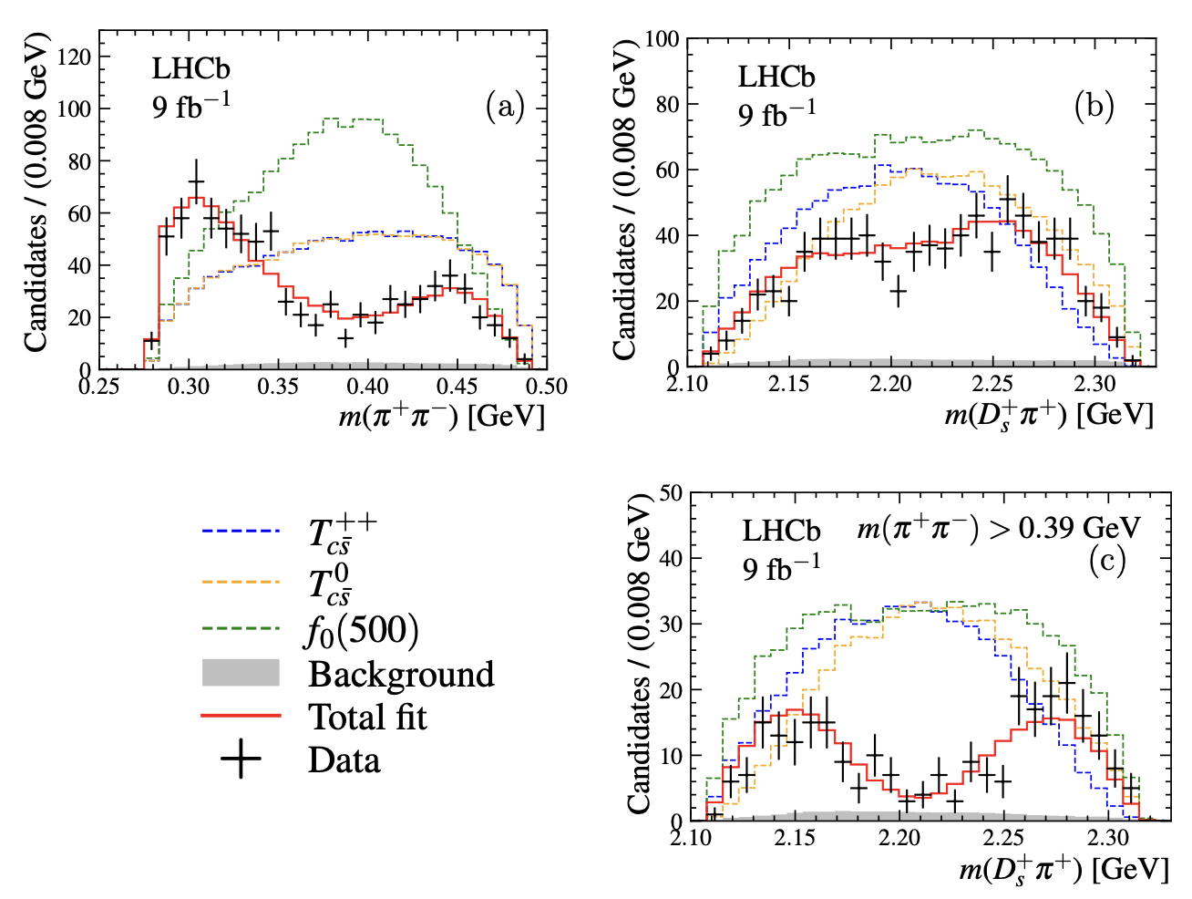
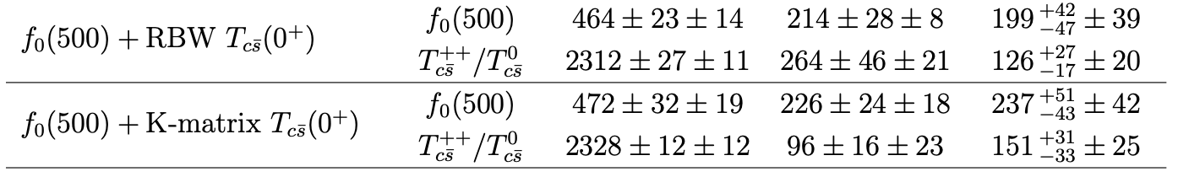

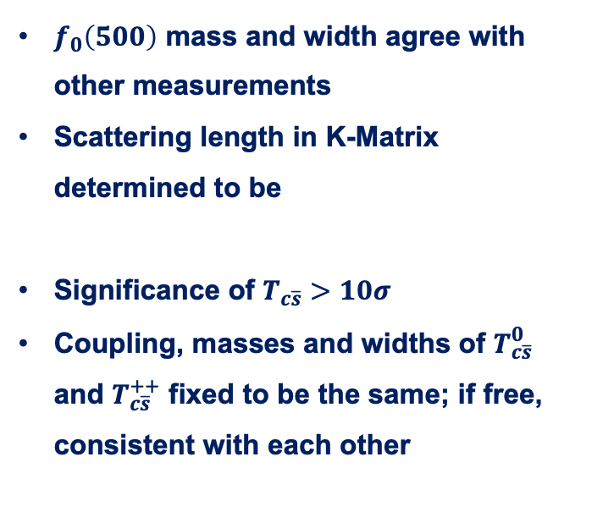

Fit results for models with $T_{c\overline{s}}$
$m\left(π^{+}π^{−}\right)∈\left[279.2, 491.2\right]$ MeV
$f_{0}\left(500\right)$ mass and width agree with other measurements
Scattering length in K-Matrix determined to be
Significance of $T_{c\overline{s}}>10σ$
Coupling, masses and widths of $T_{c\overline{s}}^{0}$ and $T_{c\overline{s}}^{++}$ fixed to be the same; if free, consistent with each other
2025/08/08
国科大 钱文斌
17

Slide 18
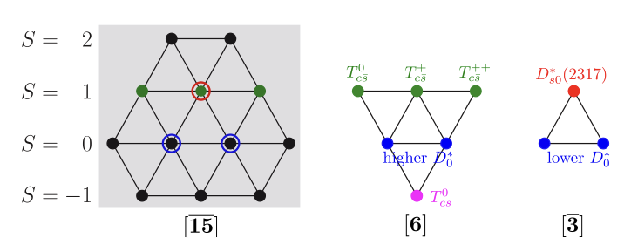

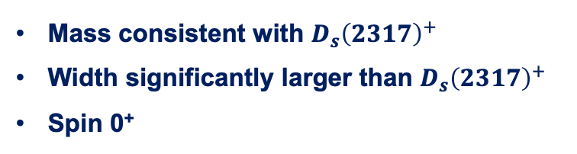
Discussion
Both models with and without $T_{c\overline{s}}$ states can describe data
However, models without $T_{c\overline{s}}$ states have some deficiencies and implausible
Model with $T_{c\overline{s}}$ states:
Relationship with $D_{s}{\left(2317\right)}^{+}?$
Indication of exotic structures in $D_{s}{\left(2460\right)}^{+}$?
Mass consistent with $D_{s}{\left(2317\right)}^{+}$
Width significantly larger than $D_{s}{\left(2317\right)}^{+}$
Spin 0⁺
Fengkun Guo et al.
2025/08/08
国科大 钱文斌
18

Slide 19
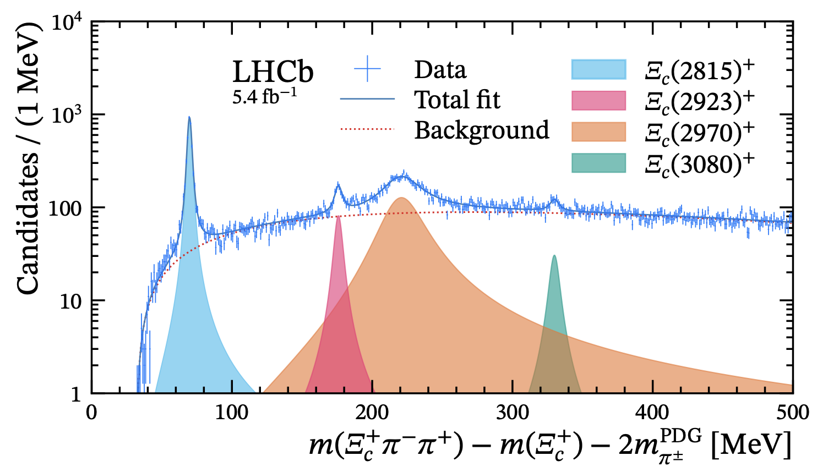
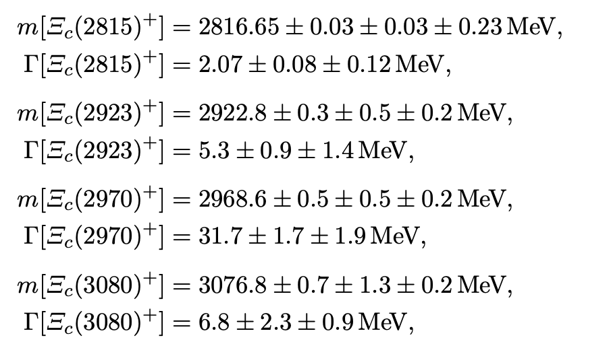
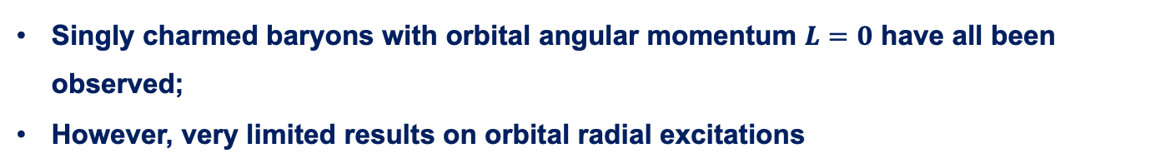

New results on charmed baryon spectroscopy
arXiv:2502.18987
Singly charmed baryons with orbital angular momentum $L=0$ have all been observed;
However, very limited results on orbital radial excitations
$$Ξ_{c}^{∗∗+}→Ξ_{c}{\left(2645\right)}^{0}(→Ξ_{c}^{+}π^{−})π^{+}$$
First observation
2025/08/08
国科大 钱文斌
19

Slide 20
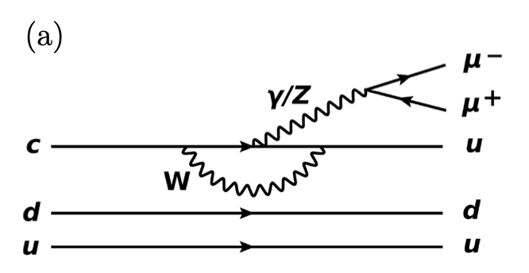
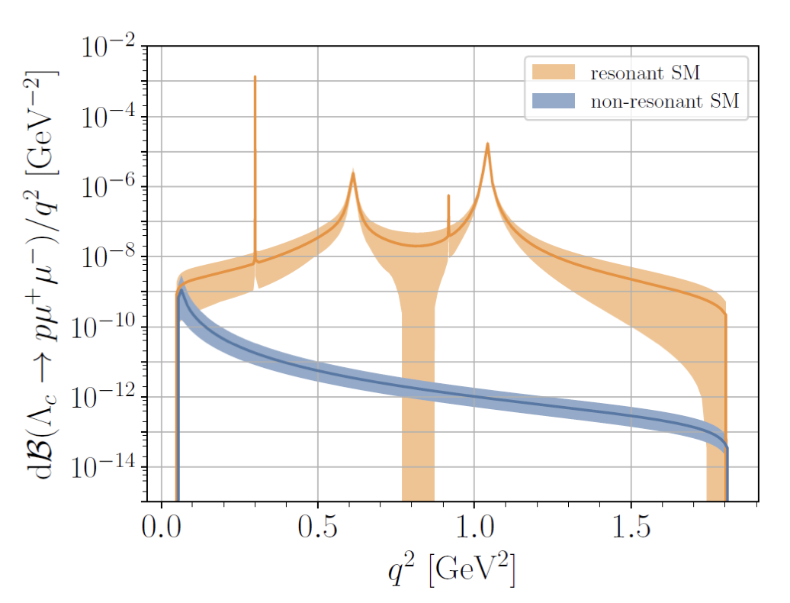
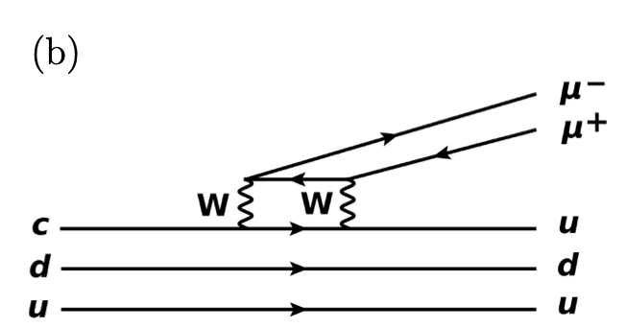
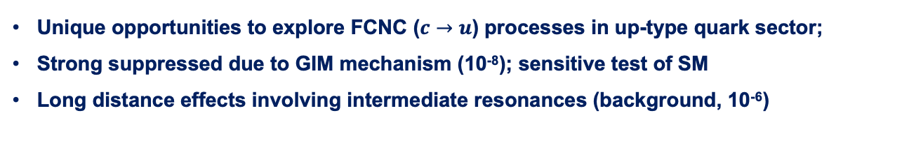
Rare charm decays
Unique opportunities to explore FCNC ($c→u$) processes in up-type quark sector;
Strong suppressed due to GIM mechanism (10⁻⁸); sensitive test of SM
Long distance effects involving intermediate resonances (background, 10⁻⁶)
2025/08/08
国科大 钱文斌
20

Slide 21
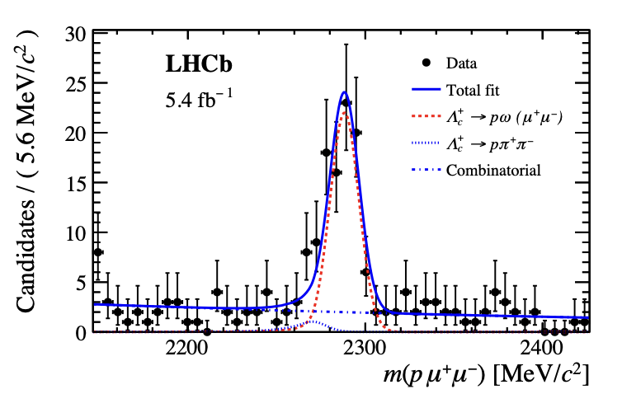

















$Λ_{c}^{+}→pμ^{+}μ^{−}$ results
PRD 110 (2024) 052007
$$ρ$$
$$ω$$
$$η$$
$$ω$$
$$φ$$
low
$$φ$$
high
$$ρ$$
signal
low
high
$$η$$
signal
2025/08/08
国科大 钱文斌
21

Slide 22







Asymmetries in $Λ_{c}^{+}→pμ^{+}μ^{−}$
PRD 111 (2025) L091102
Asymmetry measurements offers null test of SM
Currently performed in $φ$ region due to limited statistics
Results consistent with zero
2025/08/08
国科大 钱文斌
22

Slide 23

Prospects
Belle II
0.4 ab⁻¹
15 ab⁻¹
50 ab⁻¹
250 ab⁻¹
2019-2022
2024-2027
Run 1
LS1
Run 2
LS1
Run 3
upgrade
2015-2018
2019-2022
2022-2025
2025-2029
2029-2032
2032-2035
2035-future
Run2
LS2
Run3
LS3
Run4
LS4
Run5-6
Phase I
Upgrade
Phase Ib
Upgrade
Phase II
Upgrade
LHCb
23 fb⁻¹
50 fb⁻¹
300 fb⁻¹
HL-LHC
CMS/ATLAS
200 fb⁻¹
3000 fb⁻¹
BESIII/super $τ$-charm/CEPC
BEPCII upgrade + running of super $τ$-charm/CEPC
2025/08/08
国科大 钱文斌

Slide 24



A new LHCb detector
With our new LHCb detector, already collected more data than Run1+2
More importantly, full software trigger ➜ better performance on hadronic final states
New pixel Velo
New UT
New SciFi
Removed M1 and new readout
Similar PID performance
Twice trigger efficiencies (hadronic)
Removed PS/SPD and new readout
New RICH optics and PMS
2025/08/08
国科大 钱文斌
24

Slide 25



Prospects on mixing parameters
Prospects from $D→Kπ$
Prospects from $D→K3π$: variation of strong phase over phase space provide higher sensitivity to CP violation variables $φ$ and $|q/p|$
Similar sensitivity also from $D→K_{S}^{0}π^{+}π^{−}$
2025/08/08
国科大 钱文斌
25

Slide 26
Conclusion
Charm hadrons offers unique platform to search for New Physics and to understand low-energy QCD
LHCb produces unprecedent amount of charm hadrons: leading experiments in charm physics
Many interesting results already achieved, stay tuned for more results
Limited explored territory in semi-leptonic decays and in charm baryon spectroscopy; more efforts needed
2025/08/08
国科大 钱文斌

Slide 27
Thank you for your attention!
2025/08/08
国科大 钱文斌
27

