Slide 1
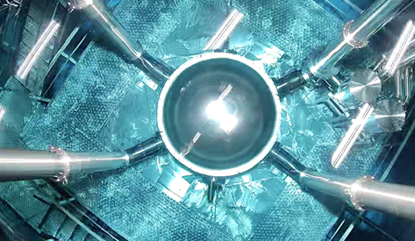

A Low-background Multi-channel Photomultiplier Tube for Next-generation Xenon Detectors
Zhixing Gao
On behalf of the low-background team of PandaX Collaboration
@LINDINE2025, Oct 22, 2025
Notes:
Good afternoon everyone. I’m Gao Zhixing, from the PandaX Collaboration. Today I’ll present a novel low-background photomultiplier tube, R12699, developed for Next-generation xenon-based detectors. I’ll focus on the motivation, radiopurity, cryogenic performance, and integration outlook.

Slide 2
Contents
Introduction of PandaX experiment
Radiopurity improvement
Cryogenic electrical performance
Summary
Notes:
This talk is organized as follows: first, scientific background and the PandaX experiment; second, the R12699 PMT‘s radioactive bkg control; third, cryogenic testing performance; and last, the prototype validation and summary.

Slide 3
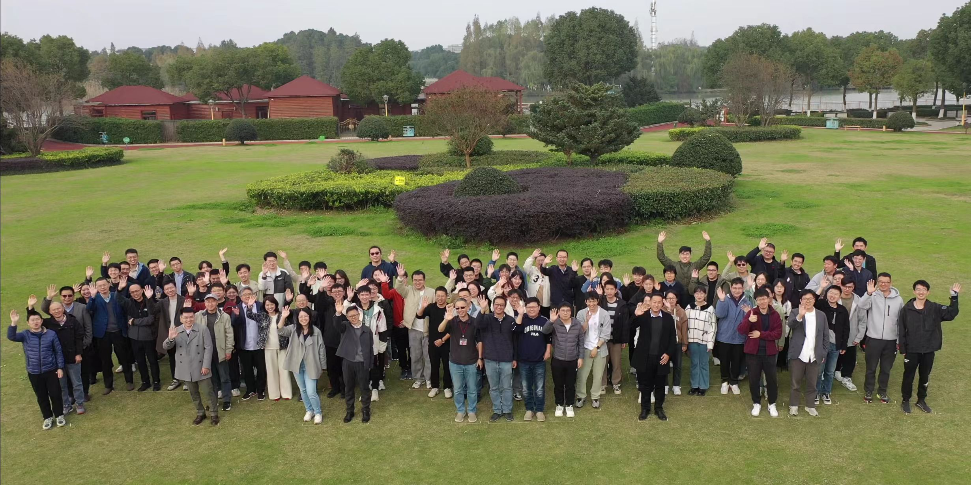
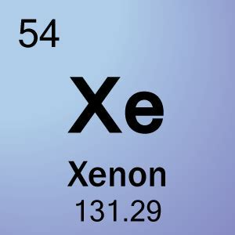
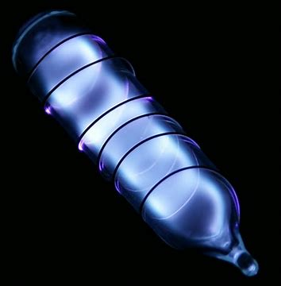
PandaX collaboration
PandaX: Particle and Astrophysical Xenon experiment
dark matter, Majorna neutrino, astrophysical neutrino
Notes:
PandaX is the Particle and Astrophysical Xenon experiment focused on rare-event searches such as dark matter, majorona neutrinos, and astrophysical neutrinos. We operate at China Jinping Underground Laboratory, one of the deepest underground labs, enabling extremely low cosmogenic backgrounds.

Slide 4
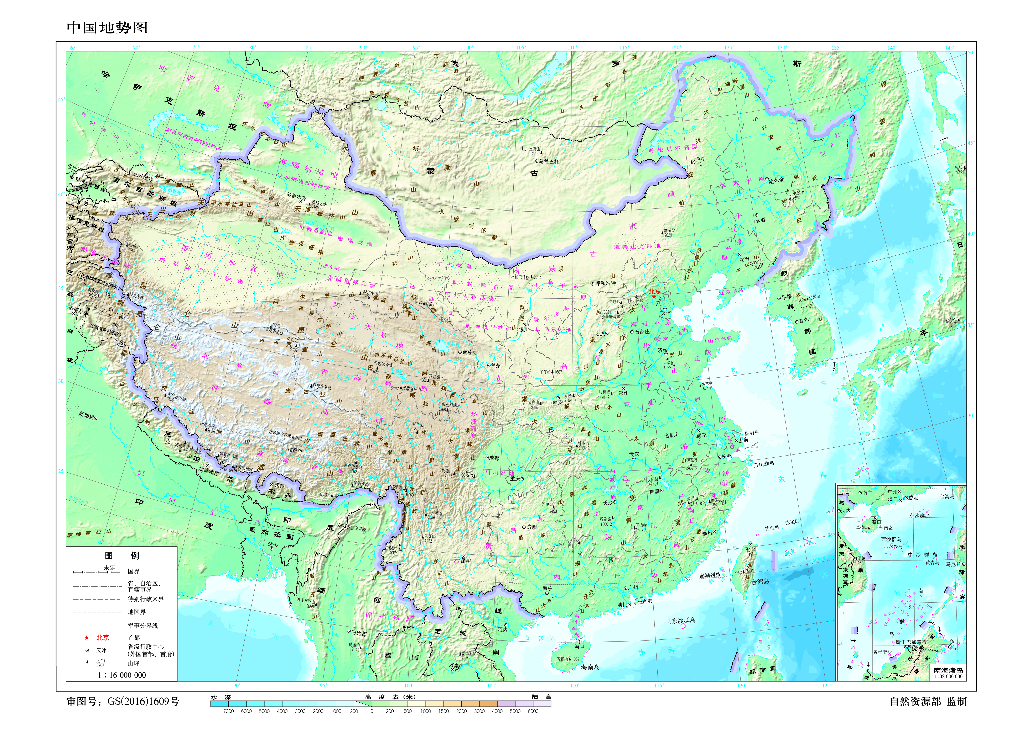
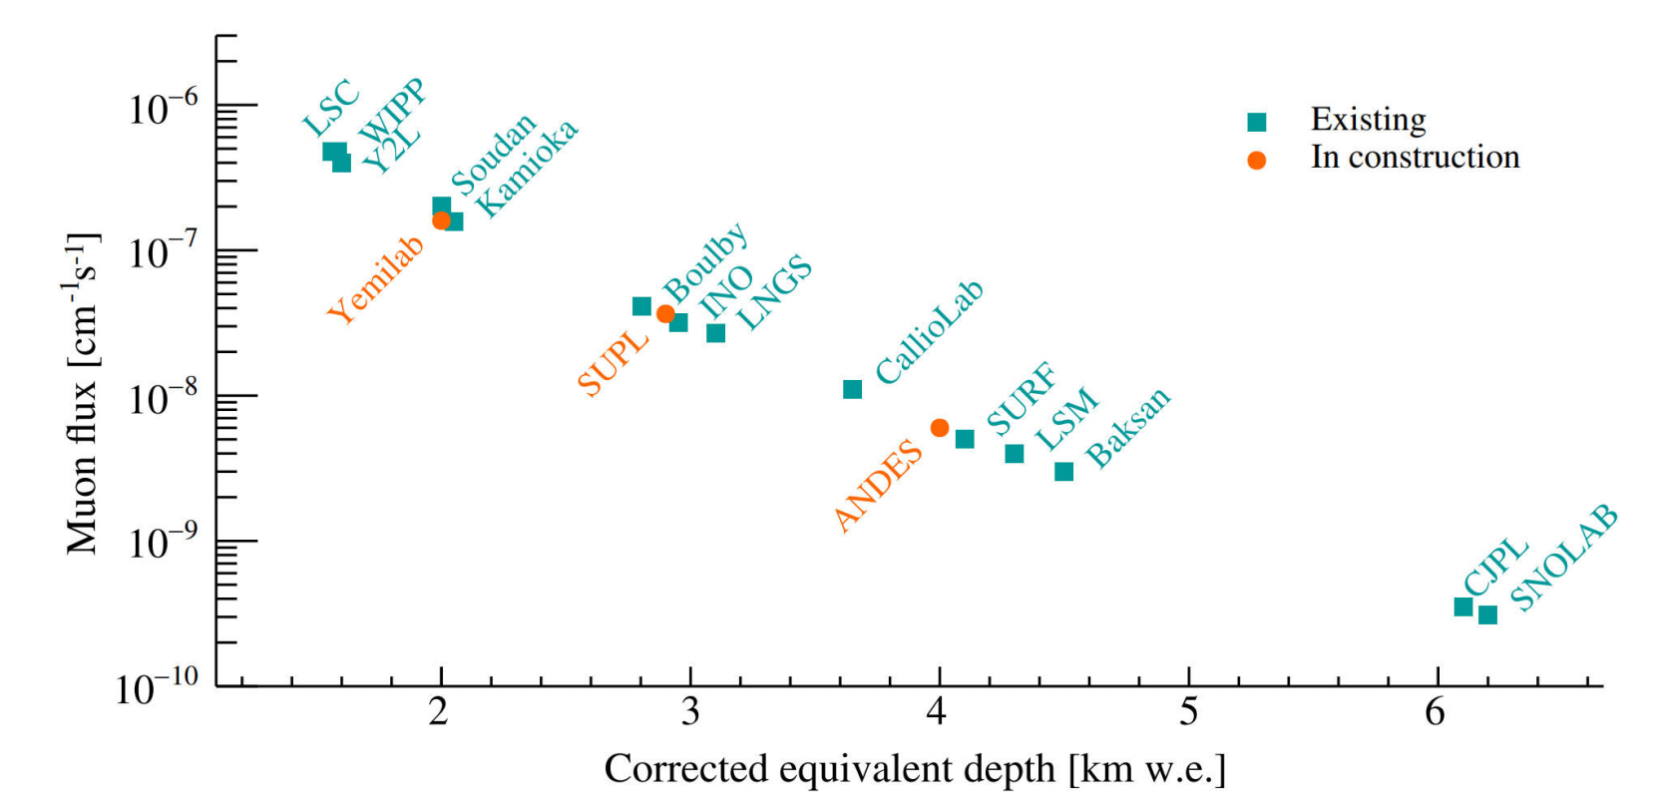
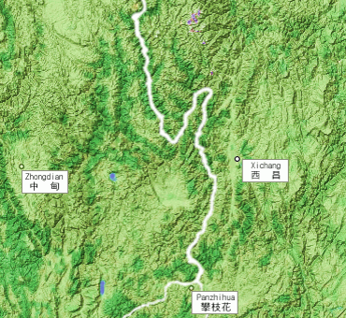
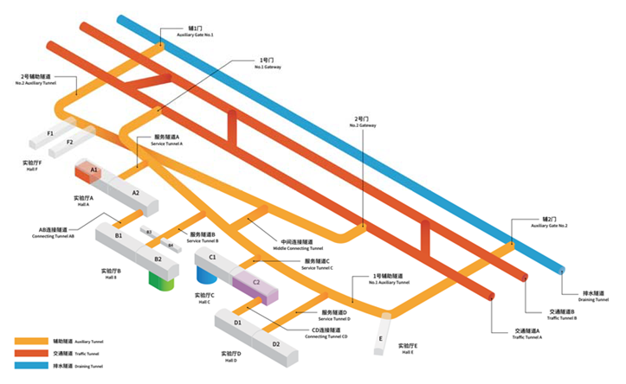
Sichuan Mount Jinping Yalong River
Cosmic-ray Flux vs Water-equivalent Depth (km w.e.) for Underground Laboratories Worldwide.[1]
Ref:[1] Rev. Mod. Phys. 95 (2023) 025002
Notes:
This is the China Jinping underground laboratory‘s site in Sichuan. The 2400-meter rock overburden and infrastructure provide an ideal environment for ultra-low background and long-term detector operation. The cosmic muon rate of CJPL is one of the lowest among all underground labs in the world of about 1.2 count/week/square meter as the picture shows.

Slide 5
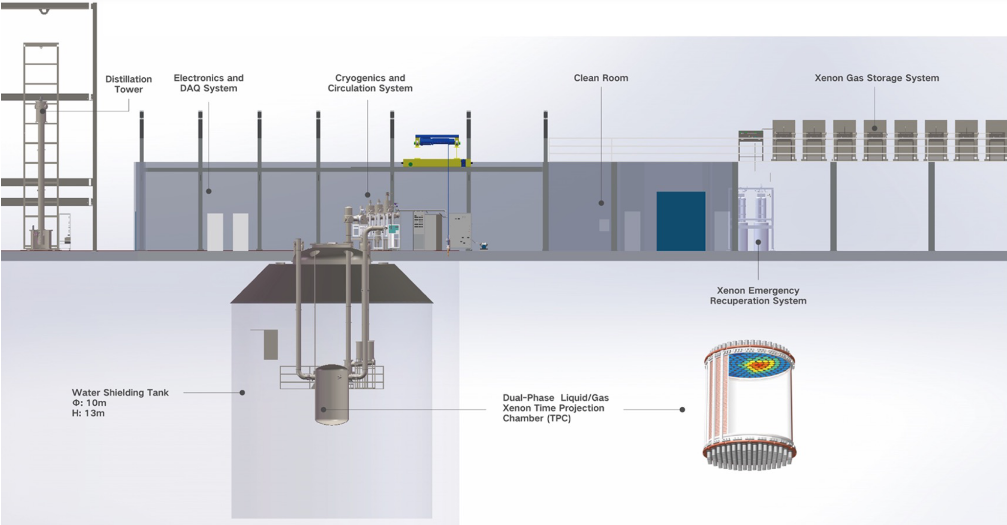
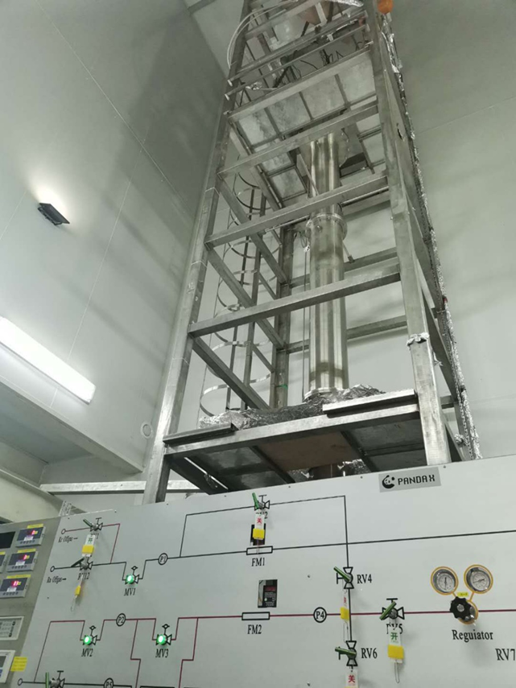
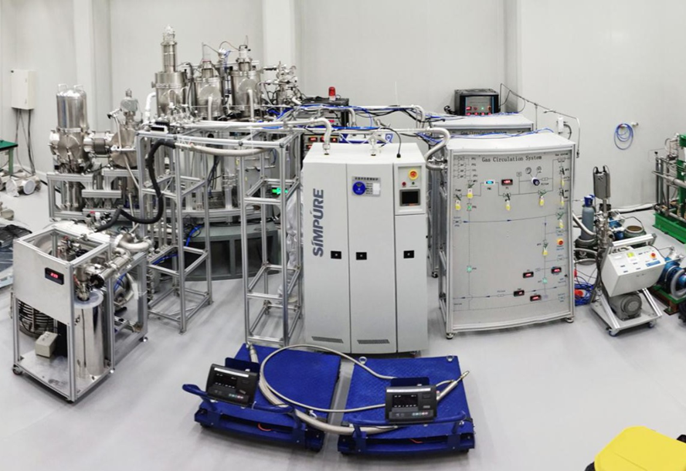
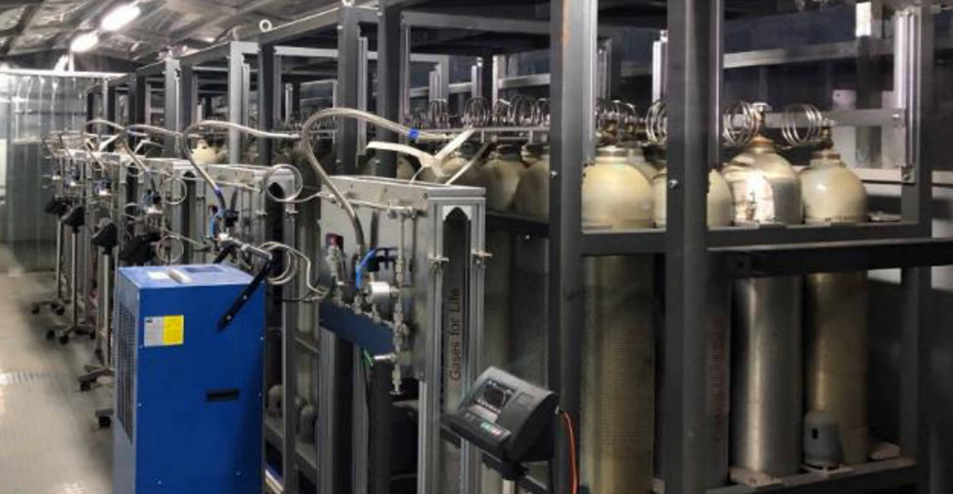
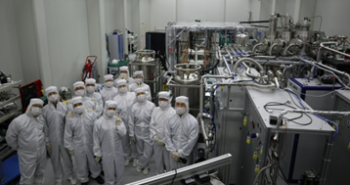
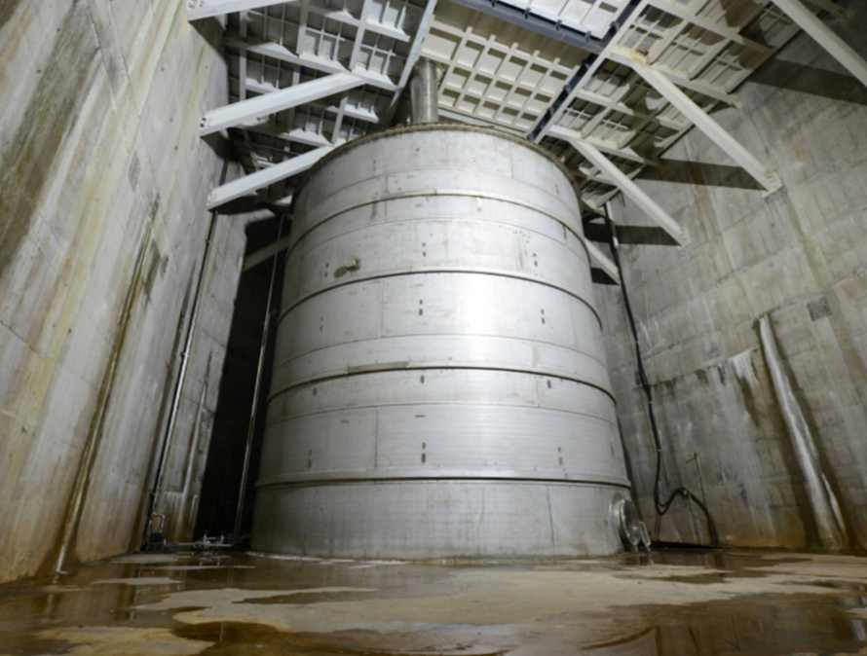
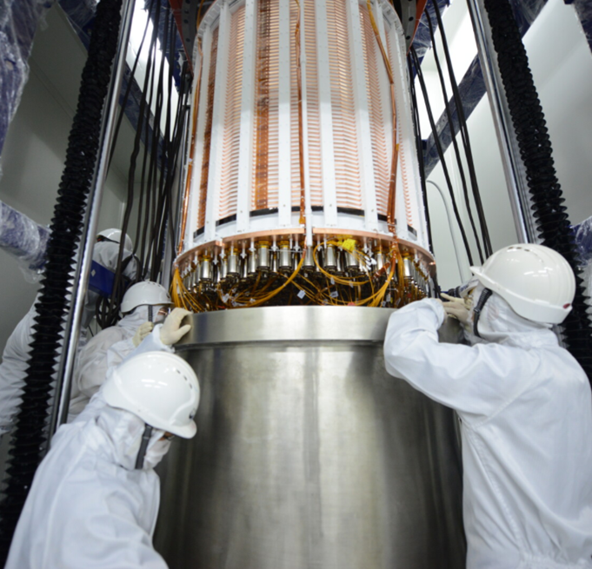
PandaX-4T Experiment Layout
【简单描述，慢一点】
Notes:
Here is a quick look at our experimental layout. This is the pure water shielding tank, the cryogenics and circulation system, the distillation tower, our clean room, xenon gas storage system, and the dual-phase time projection chamber located in the shielding.

Slide 6
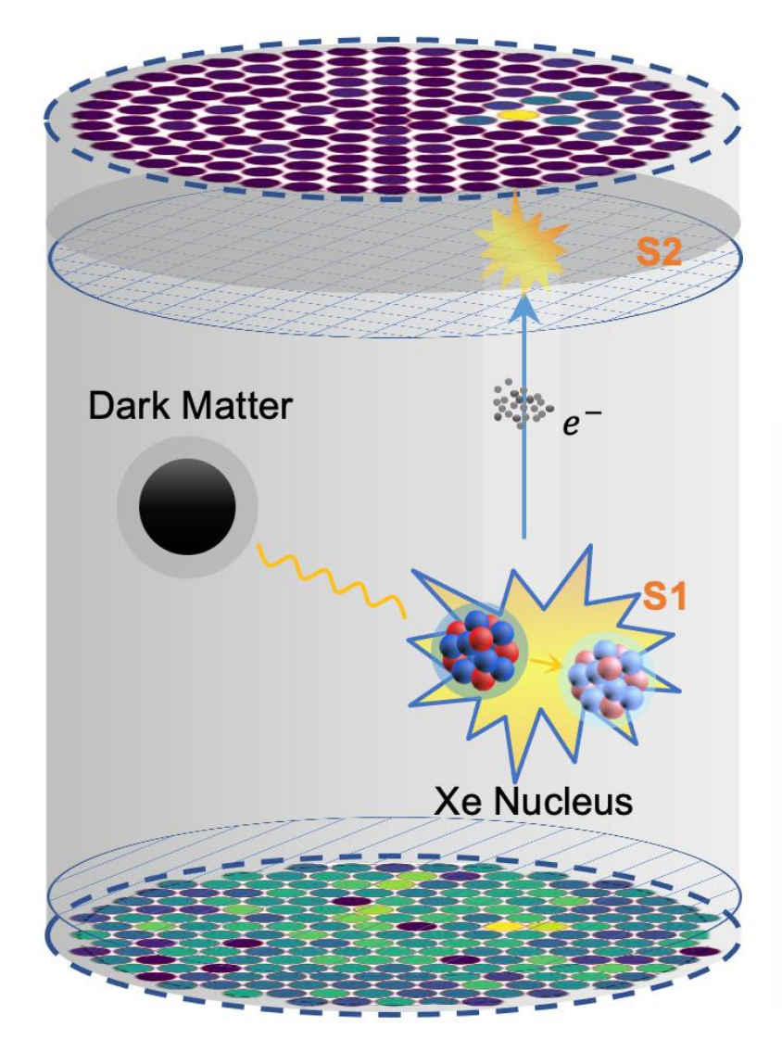
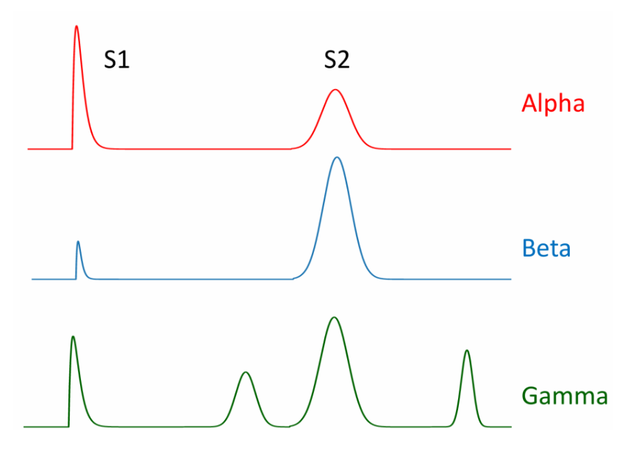
PandaX-4T dual-phase xenon detector
TPC: paired scintillation (S1) and ionization (S2) signals
• Precise energy measurement
• 3D position reconstruction
• Discrimination between nuclear recoil and electron recoil signals
Principle Schematic of a dual-phase TPC
Notes:
PandaX-4T is a dual-phase xenon time projection chamber. The particle interaction in the liquid produces prompt scintillation (S1) and ionization electrons. Under a drift field, the electrons travel to the liquid–gas interface, extracted into the gas, and generate proportional electroluminescence (S2). The top PMT array reconstructs the transverse x–y position from the S2 light pattern and z determination from the S1–S2 time difference, while the bottom PMT array efficiently collects S1 and complements S2 for energy reconstruction. The combined S1 and S2 observables enable high-fidelity 3D event reconstruction and discrimination between nuclear-recoil signals and electron-recoil backgrounds via the S2 to S1 ratio. These capabilities make dual-phase TPCs among the most sensitive and reliable technologies for rare-event searches.

Slide 7
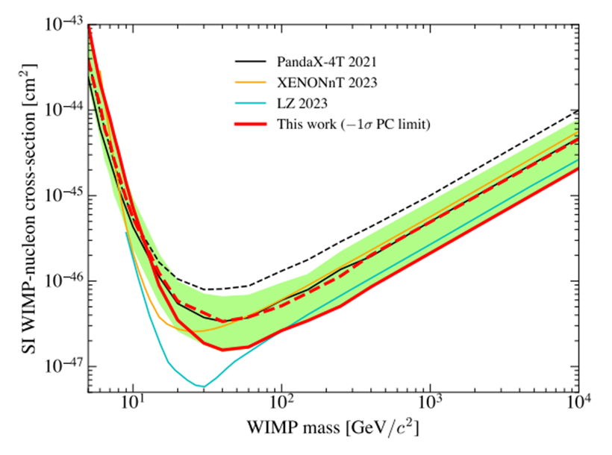
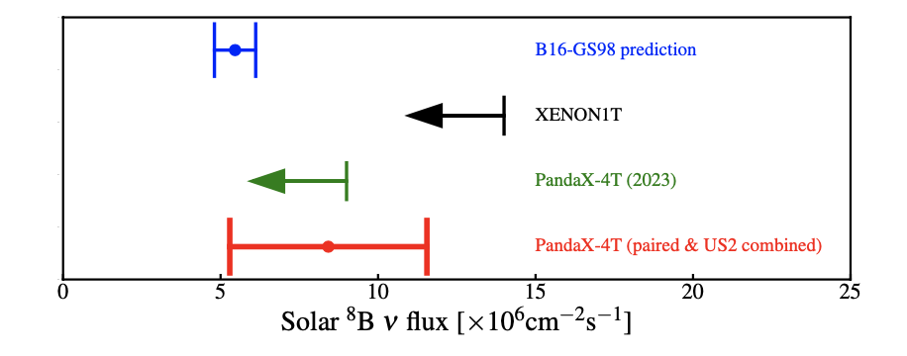
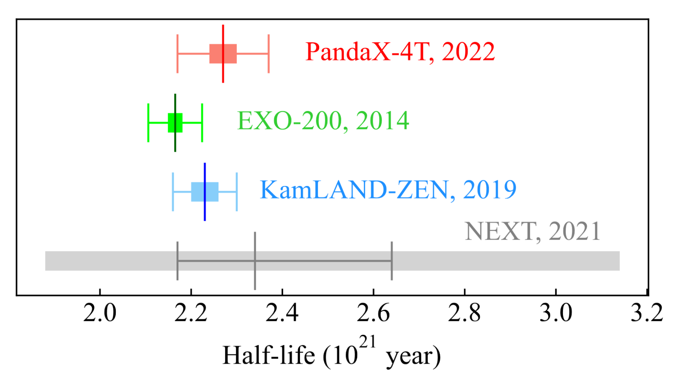
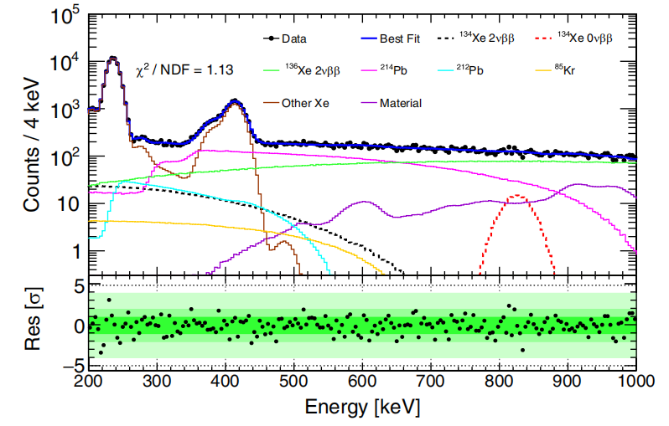
PandaX-4T physical result
6.9×10⁻⁴⁸ cm²
@ 40 GeV/c²
8.4±3.1 × 10⁶/cm²/s
PRL 134 (2025) 1, 011805
PRL 133, 191001 (2024), APS highlights of the year
15.5kg·y
2vbb 2.27 ± 0.03(stat.) ± 0.10(syst.) × 10²¹ y
Ovbb > 2.1 × 10²⁴ y
2vbb >2.8 × 10²² y
0vbb >3.0 × 10²³ y
Research Vol 2022, 9798721 (2022)
PRL 132 (2024) 15, 152502
Notes:
With its large target mass and ultra-low background, PandaX-4T enables a multi-purpose search: the WIMP search sets the one of the leading upper limit on spin-independent WIMP–nucleon scattering, reaching a minimum sensitivity of six point nine times ten to the minus forty-eighth square centimeters at a WIMP mass near forty GeV per c squared; the solar-neutrino measurement via coherent elastic neutrino–nucleus scattering yields a boron-eight flux of eight point four plus or minus three point one times ten to the sixth per square centimeter per second, demonstrating sub–keV nucleus-recoil sensitivity. Beyond dark-matter and solar-neutrino channels, PandaX-4T also advances double-beta decay physics. With a xenon exposure of fifteen point five kilogram–years, we measure the two-neutrino half-life of xenon136 as two point two seven statistical zero point zero three; systematic zero point one zero times ten to the twenty-first years and set a ninety-percent-confidence lower limit on the neutrinoless mode greater than two point one times ten to the twenty-fourth years. For xe134, we set the most stringent constraints to date: the two-neutrino double beta decay half-life exceeds two point eight times ten to the twenty-second years and the neutrinoless double beta decay half-life exceeds three point zero times ten to the twenty-third years, both at ninety percent confidence.

Slide 8
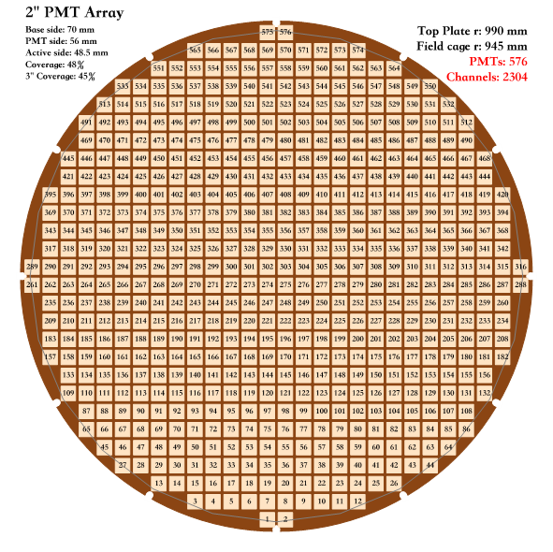
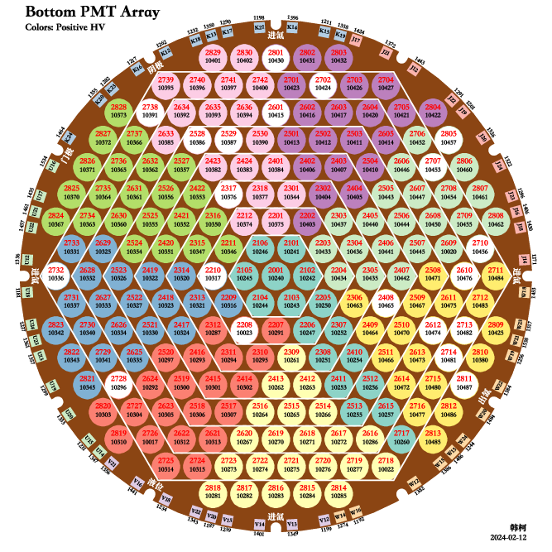
Future Plan: PandaX-20T ( 2027 - )
Next generation liquid xenon experiment
with 20 tonne sensitive volume, decisive test on WIMP
PandaX-4T ： 169 3-inch R11410 PMTs in top array
→ PandaX-20T ：576 2-inch R12699 PMTs in top array
Top PMT array of the PandaX-4T detector
Top PMT array of the PandaX-20T detector
Notes:
The leading sensitivities achieved by PandaX-4T validate the effectiveness of our background mitigation. And achieving still better sensitivity demands further background reduction and larger exposure. Consequently, we come to the next-generation PandaX-20T, aiming for a multi-ton fiducial mass. As the detector scales up, photosensor background and readout granularity become critical bottlenecks, requiring lower intrinsic radioactivity, stable cryogenic performance, low afterpulsing and dark rate, and denser tiling for better reconstruction. To meet these demands, we are upgrading the top array from 169 3-inch R11410 PMTs in PandaX-4T to 576 2-inch R12699 PMTs in PandaX-20T. The smaller pixels and tighter coverage are expected to improve XY position reconstruction. And we go on to develop R12699: an ideal choice for the next generation of xenon detectors.

Slide 9
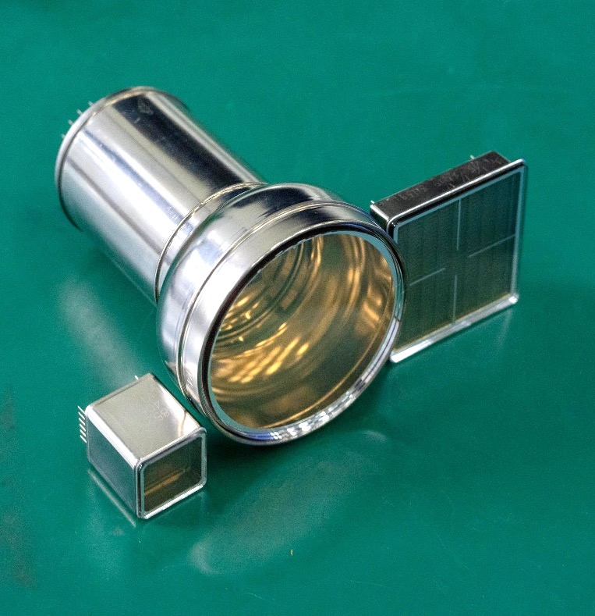
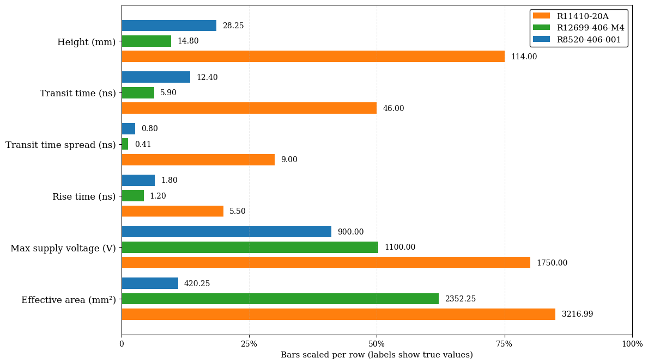
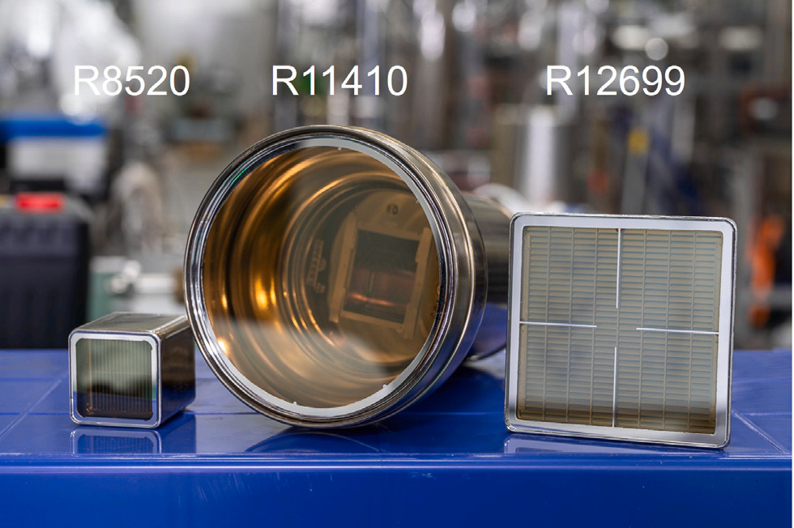
Novel 2-inch PMT: R12699
Hamamatsu Photonics K.K corporation & PandaX team
Low background
Compact, high granularity, 4 individual channels
Quick transit time and rise time
Parameter comparison of different Hamamatsu PMT models
Ref: Nucl.Instrum.Meth.A 1073(2025)170290
Notes:
Co-developed by Hamamatsu Photonics and PandaX low bkg team, R12699 is a novel low-background, 2-inch PMT with four independent 1 by 1 inch channels. The three types of PMTs shown in the left figure are applied to the three generations of xenon detectors. The R8520 PMT on the left is for the first generation, the R11410 PMT in the middle is currently used, and the R12699 PMT on the right is a potential candidate for the next generation detectors. Among Hamamatsu’s all types of PMTs, R12699 delivers the best electronic performance: the transit time 5.90 ns versus 46.0 ns for R11410, transit time spread only 0.41 ns vs 9 ns for R11410, and rise time 1.2 ns vs 5.5 ns for R11410, while keeping only 28.25 mini-meter height for less skin xenon loss. Designed for cryogenic operation and low noise, R12699 lets us build a denser, higher-granularity top array that improves XY position-reconstruction uniformity and accuracy.

Slide 10
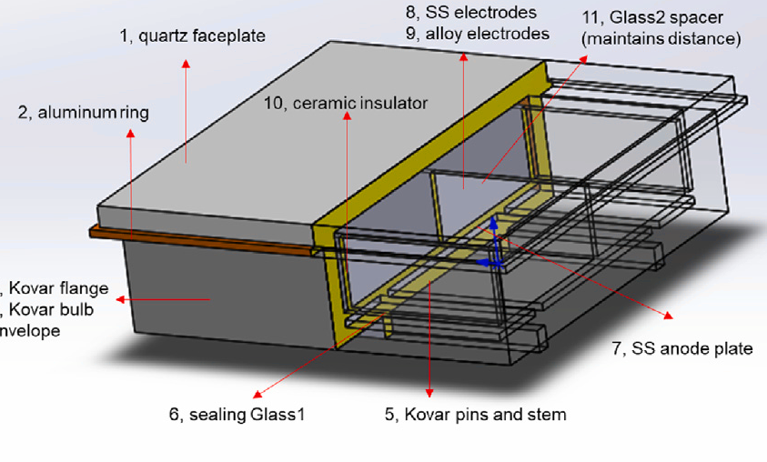
R12699 radioactivity: bulk material
The structure of the R12699 PMT
Radioactivity Contributions from Different Parts of R12699
⁶⁰Co from Kovar metal plate, pin and pipe
²³⁸U(late) & ²³²Th (late) from sealing Glass-1
⁴⁰K from Glass-1
Ref：Nucl.Instrum.Meth.A 1073(2025)170290
Notes:
As for the radioactive bkg control: The first step is component screening. Each PMT sub-part: quartz, sealing glass-1, glass-2 spacer, ceramics, Kovar (Fe–Co–Ni) flange/pins, stainless plates/electrodes, alloy electrodes, and so on is all measured with underground HPGe gamma-spectroscopy to build a material budget and isolate dominant lines and the result is shown as the right figure. We focus on the main long-life material bkg Co60、Th232、U238、K40 and find that the budget shows:
⁶⁰Co is primarily composed of Kovar metal/pin/pipe.
²³⁸U(late) and ²³²Th(late) is dominated by sealing Glass-1.
Potassium-40 is primarily in glass components
These findings guide vendor selection and material substitutions before assembly.【K40 光阴极碱金属Alkaline metal in photocathode，enrich K39】

Slide 11
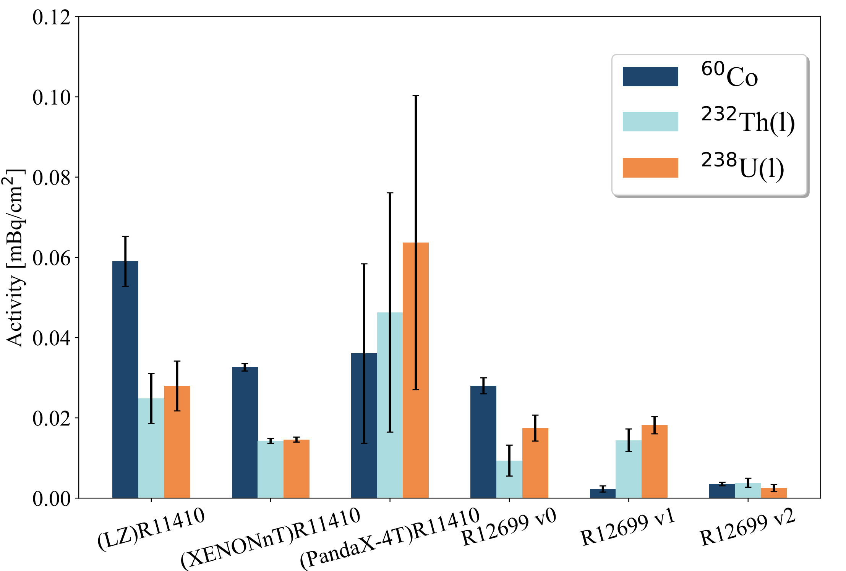
R12699 radioactivity: in one piece
V0 → V1:
Replacing Fe-Co-Ni Kovar alloy with Fe-Ni alloy
V1 → V2:
Selecting new raw materials of Glass-1
Intrinsic radioactivity of PMTs employed in LXe detectors
Ref：Nucl.Instrum.Meth.A 1073(2025)170290
Notes:
Step two is the whole-tube counting: we measure each assembled PMT to control the total background and cross-check the budget. From v0 → v1, we replaced Kovar alloy for an Fe–Ni alloy, and—see the dark-blue bars at the third vs. the fourth group—60Co fell to about one-eighth of the original. From v1 to v2, we tightened the sealing-glass 1 feedstock; accordingly, the late-chain 238U and 232Th components dropped sharply as well, as shown by the orange and light-blue bars in the last group.

Slide 12
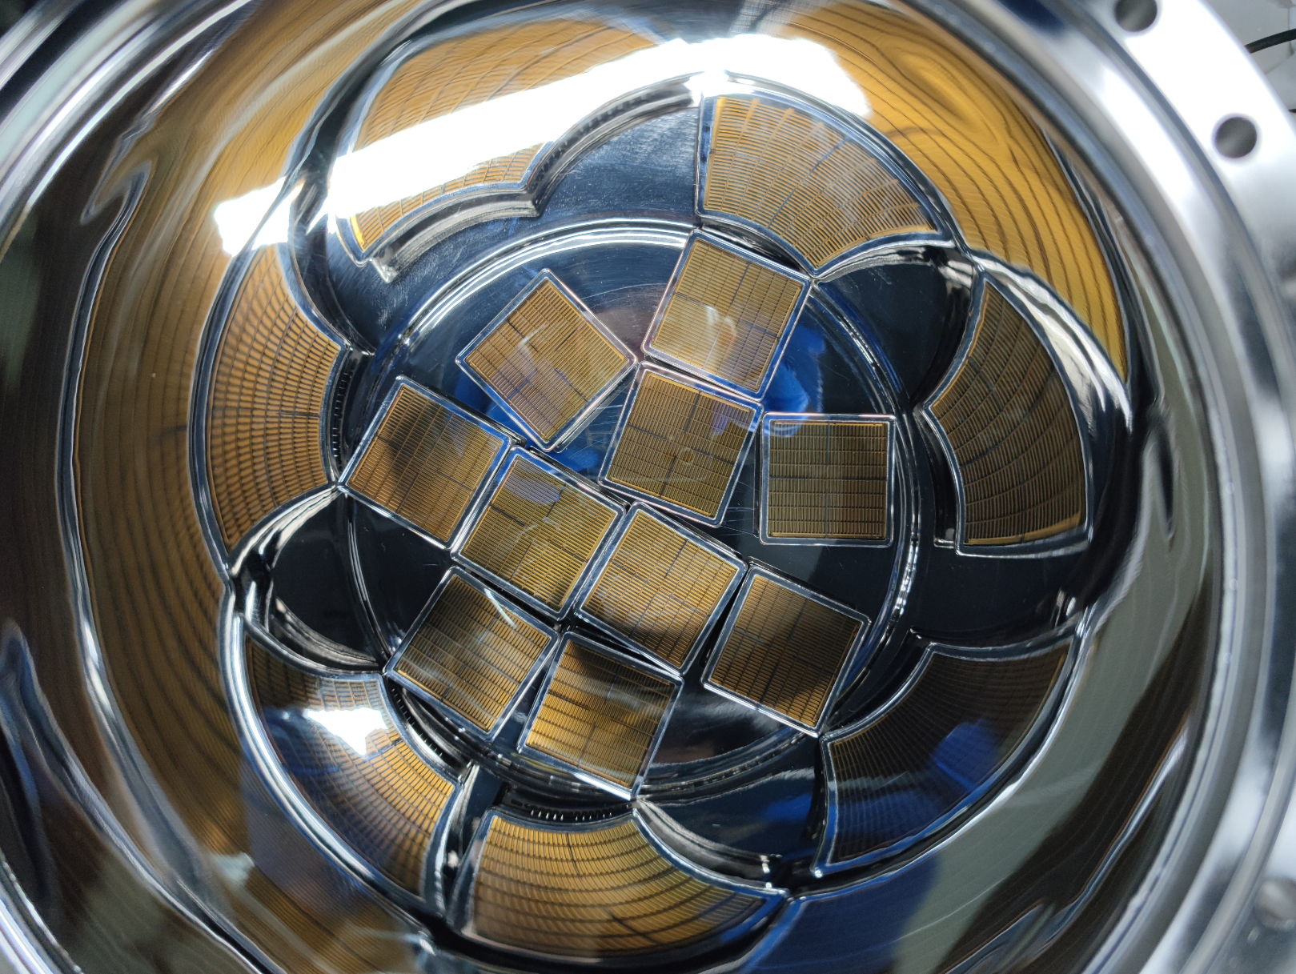

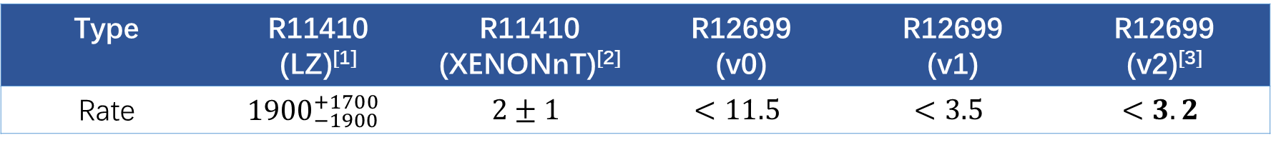
R12699 radioactivity: radon and surface
Radon emanation rate (@90% confidence level, unit: $μ$Bq/PMT)
Type | R11410 (LZ)^{[1]} | R11410 (XENONnT)^{[2]} | R12699 (v0) | R12699 (v1) | R12699 (v2)^{[3]}
Rate | $${1900}_{−1900}^{+1700}$$ | $$2±1$$ | $$<11.5$$ | $$<3.5$$ | $$<3.2$$
R12699 PMTs in the radon detector.
Ref：
[1] Eur. Phys. J. C 80 (2020) 1044
[2] Eur. Phys. J. C 82 (2022) 599
[3] Nucl.Instrum.Meth.A 1073(2025)170290
Notes:
Also, we focus on radon emanation and surface contamination. Because the PMTs are positioned very close to the liquid-xenon fiducial volume, any radon released from the PMT can enter the liquid xenon and contribute to the detector background; therefore, the radon emanation must be tightly controlled. After iterative improvements, the latest batch of R12699 (version 2) PMTs shows an emanation rate of less than 3.2 μBq per tube @90% confidence level, comparable to that of the R11410 PMTs used now.

Slide 13
R12699 radioactivity: radon and surface
Surface radioactivity mainly comes from Po210 alpha:
wiping with alcohol is efficient
PMT Other Part
α
PMT Quartz Window
GXe
α
neutron
PTFE
LXe
neutron
Table: Cleaning performance of the R12699 quartz window surface (µBq/cm²)
The initial | Spiked with radon source | The 1st clean | The 2nd clean
$$<18.4$$ | $$236.9±27.8$$ | $$27.8±8.1$$ | $$<22.5$$
Notes:
And since the quartz window faces the LXe target, adsorbed radon progeny on the PMT surface can create α. The neutron coming from the alpha-n reaction between radon progeny & nucleus in the material can contribute to BKG. We evaluated a simple, quartz-safe alcohol-wipe procedure by first spiking the quartz window with a radon source to reach Po210 of 236.9 ± 27.8 µBq/PMT. Two round of wipe cleaning reduced the activity to less than 22.5 µBq/PMT, consistent with the pre-installation baseline (< 18.4 µBq/PMT). Thus, alcohol wiping effectively removes Po210 surface contamination while remaining easy to apply during assembly.

Slide 14
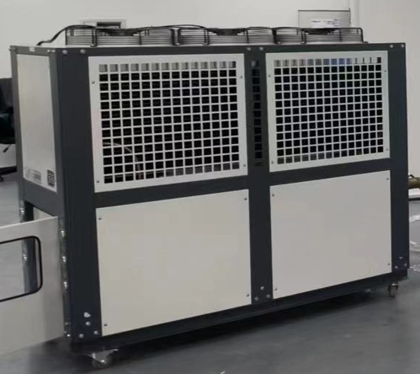
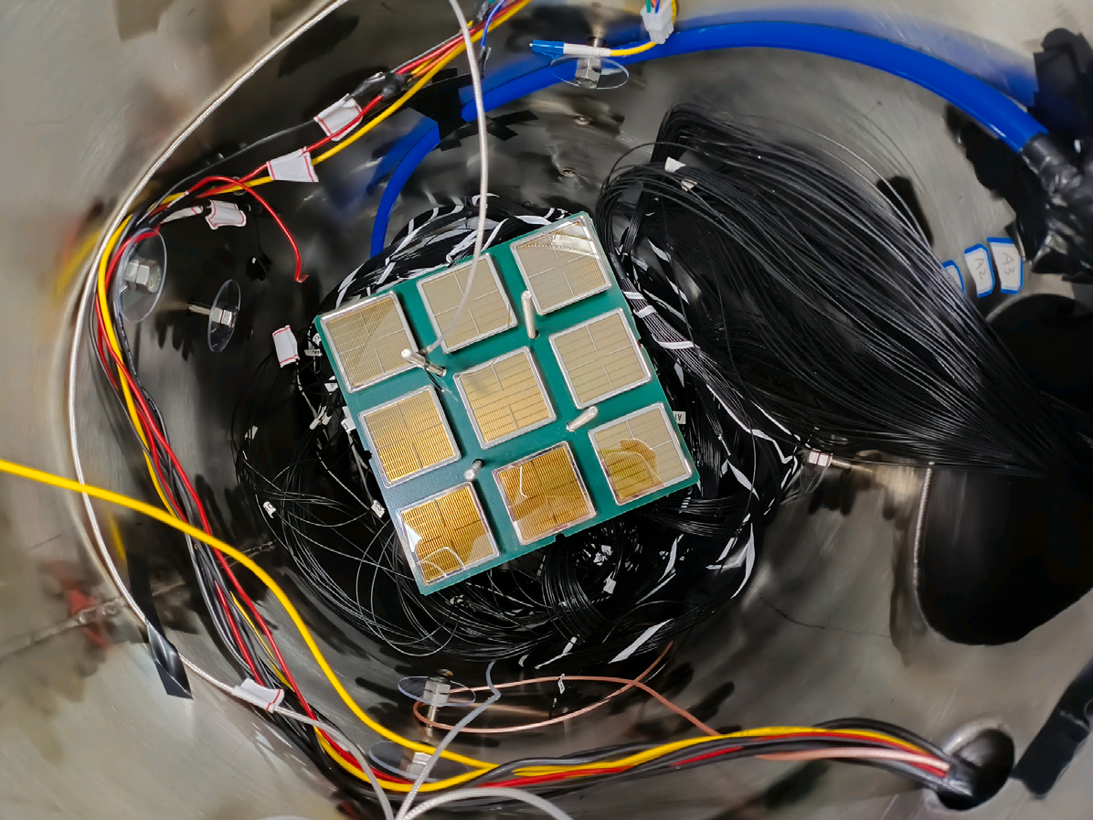
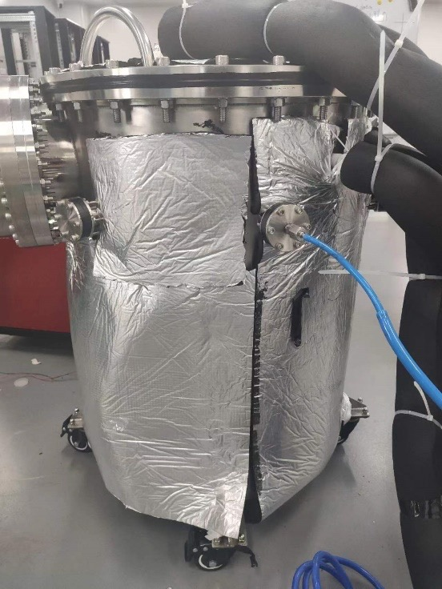
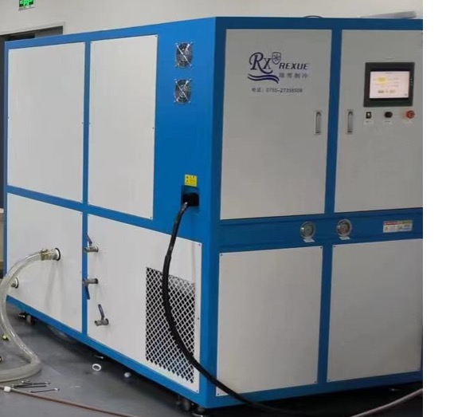
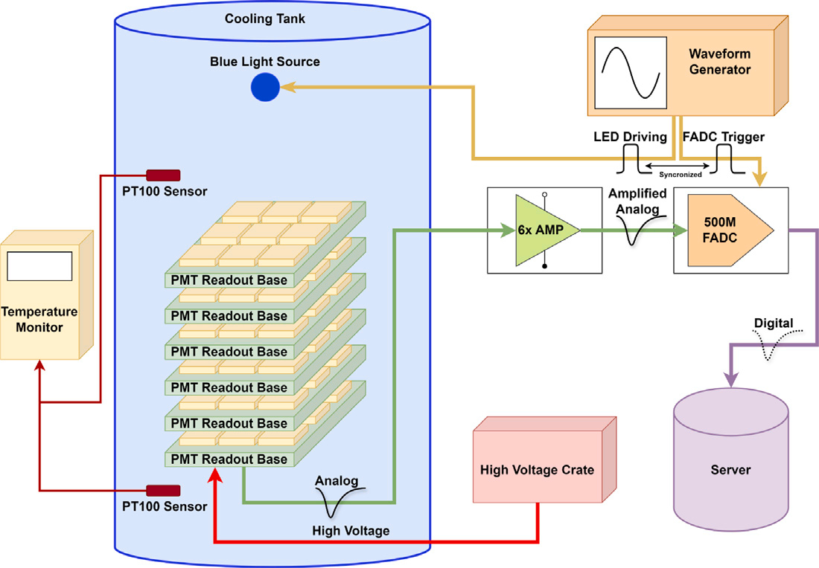
Cryogenic test platform
Cooling
dewar
Water cooling
Nitrogen filled
Water
20 ℃ ~ -100 ℃
Nitrogen environment
Anhydrous
alchohol
Refrigerator
(also heater)
Ref：Nucl.Instrum.Meth.A 1073(2025)170290
Notes:
To validate cryogenic electronic stability after the material substitutions, we tested R12699-V2 PMTs in a dry nitrogen environment throughout cooldown and operation. The setup reproduces detector-like conditions with nitrogen purges and staged cooldowns to LXe temperatures. Each tube is cycled three times from room temperature to cryogenic conditions while we track gain, dark count rate, afterpulsing, and overall stability.

Slide 15
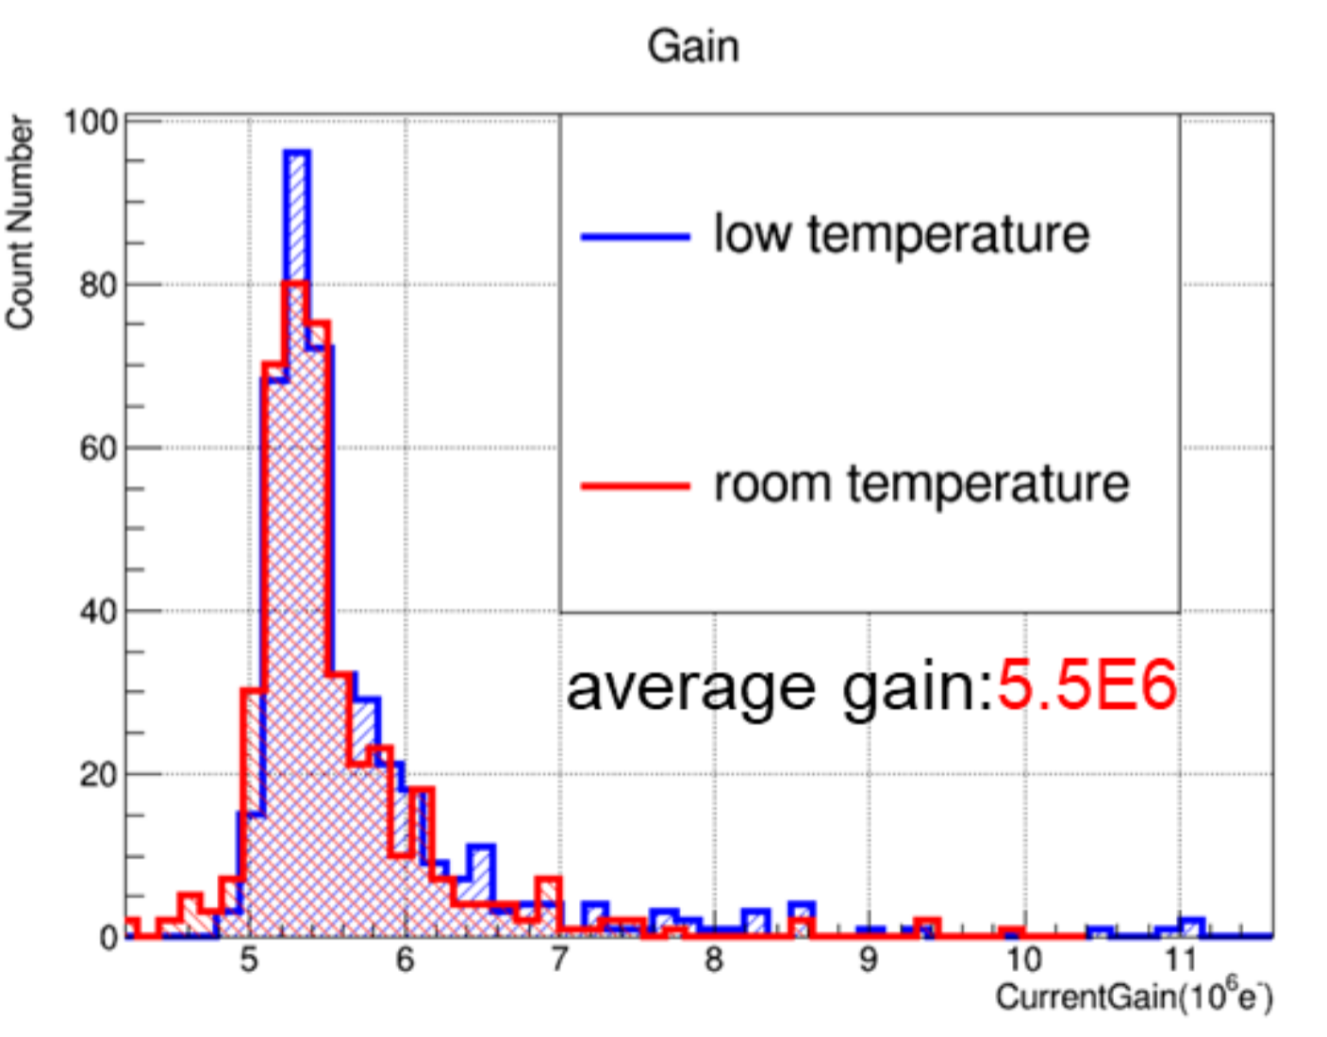
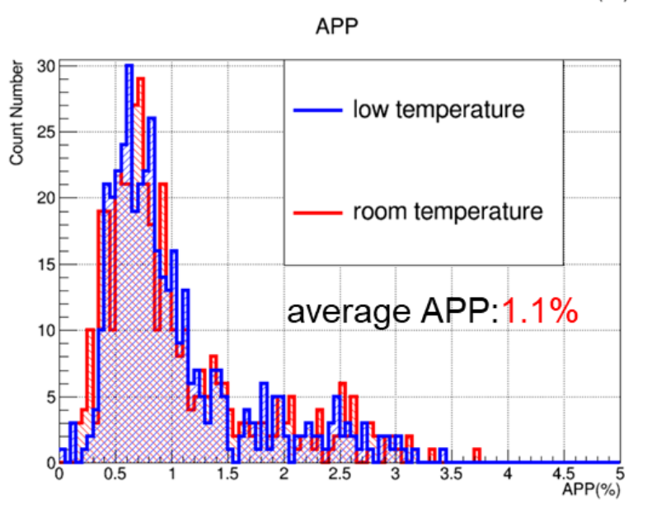
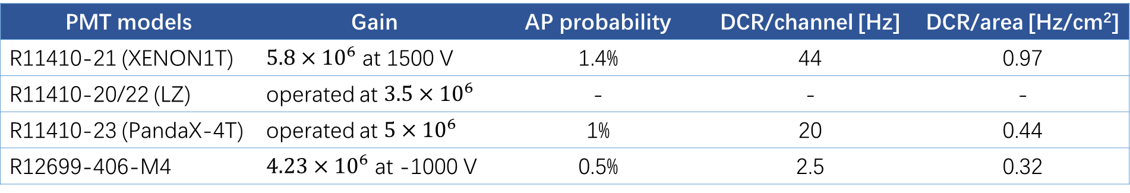
R12699 electrical performance
Stable gain
Low DCR
Comparable AP
Stable at -100℃
PMT models | Gain | AP probability | DCR/channel [Hz] | DCR/area [Hz/cm²]
R11410-21 (XENON1T) | $5.8×{10}^{6}$ at 1500 V | 1.4% | 44 | 0.97
R11410-20/22 (LZ) | operated at $3.5×{10}^{6}$ | - | - | -
R11410-23 (PandaX-4T) | operated at $5×{10}^{6}$ | 1% | 20 | 0.44
R12699-406-M4 | $4.23×{10}^{6}$ at -1000 V | 0.5% | 2.5 | 0.32
Ref：Nucl.Instrum.Meth.A 1073(2025)170290
Notes:
At cryogenic temperature, R12699 maintains a stable gain, low dark count, and suppressed afterpulsing even after repeated thermal cycles, demonstrating robust construction and stability. Measured performance metrics are summarized below: Gain: ~4.23×10 ⁶ . Afterpulsing probability: ~3.2 %. Dark count rate per channel: ~43 Hertz. Dark count rate per unit area: ~0.32 Hz/cm². These characteristics enable clean single-photoelectron calibration, tight trigger thresholds, and minimal spurious activity in long-term operation, supporting stable detector performance under LXe conditions.

Slide 16
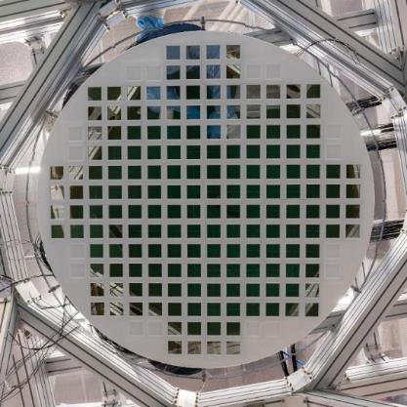
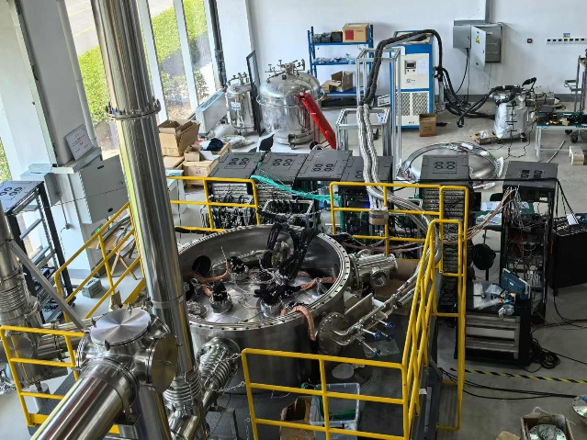
PandaX-xT: prototype
A prototype detector with 800kg of liquid xenon is operating in Shanghai.
Xenon environment verification.
Position reconstruction is testing in a small array.
20-ton prototype detector at the Tsung-Dao Lee Institute
Top PMT array of the 20-ton prototype detector
Notes:
Finally, we are integrating R12699 arrays into prototype setups at the Tsung-Dao Lee Institute (SJTU) to study array-level behavior in xenon environment, as the left figure shows —we tested parameters including tiling density, optical uniformity, timing, and reconstruction. Liquid-xenon (LXe) tests are still ongoing: so far, the tubes exhibit stable gain and low dark-rate under cryogenic operation. Next, we will complete the LXe runs and quantitatively validate the expected position reconstruction improvements with data. 液氙环境测试ongoing，gain、暗噪声电子学参数稳定度still，后面继续确认重建效果】

Slide 17


Summary & Outlook
Summary
Outlook
Radiopurity meets next-gen budgets: full chain control (components → assembled PMTs → surface radon) keeps Co, U/Th, and radon within targets.
Cryogenic stability: gain 4.23×10⁶, AP 0.5%, DCR 2.5 Hz/channel maintained after thermal cycling.
Compact & scalable: layout supports dense packing, simplified cabling, and large-area deployment.
Quality surveillance: continue HPGe screening and radon-emanation quality assurance for batch-to-batch consistency.
System tests: integrate into larger LXe platforms (e.g., PandaX-20T) to finalize operating points and reliability statistics.
Production scale-up: expand manufacturing and acceptance criteria for mass application in xenon experiments (XENONnT, LZ class).
Notes:
To summarize:
A radiopurity pathway spanning components, assembled tubes, and radon keeps the activity within next-generation budgets.
Cryogenic tests show stable gain and low spurious rates through thermal cycling.
2-inch, multi-channel tiling enhances uniformity and reconstruction at the top array.
Next steps include scaling production, continuing HPGe & radon emanation surveillance, and system-level tests in larger xenon platforms to finalize operating points and reliability statistics.

Slide 18



Thank You for Your
Attention

Slide 19
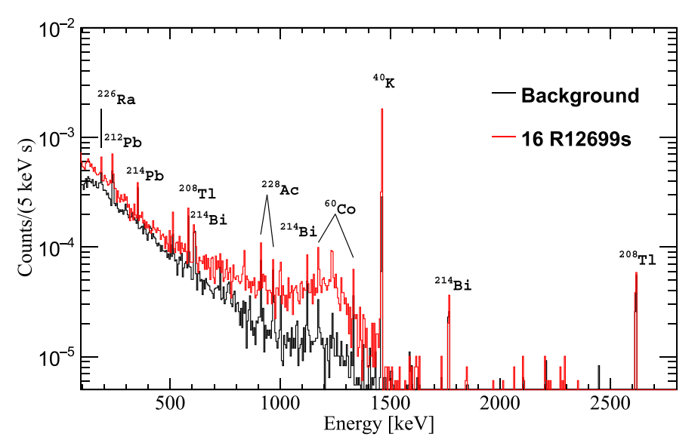
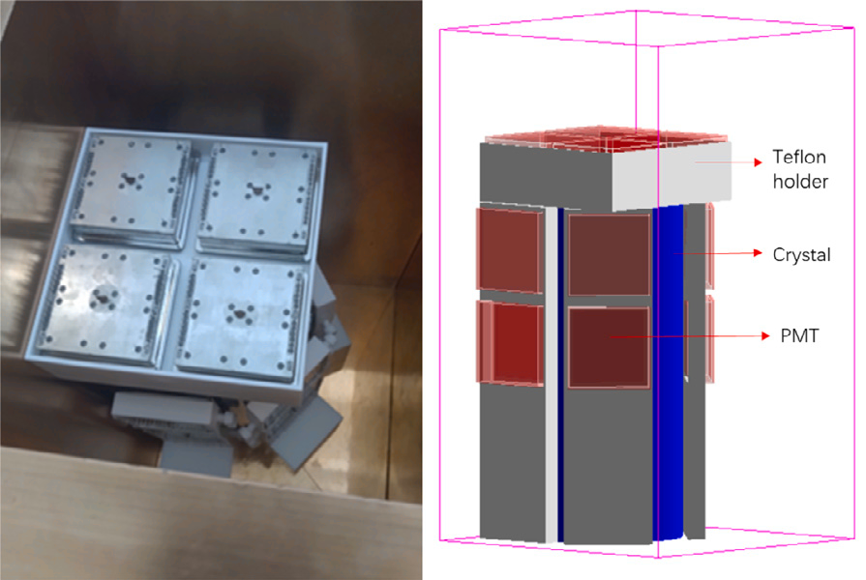
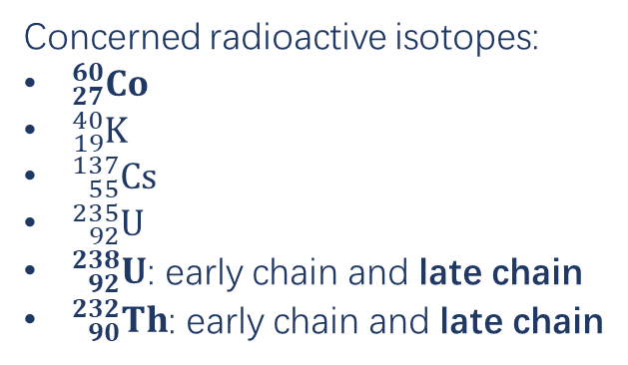
Radioactivity measurement
2400 m
Concerned radioactive isotopes:
${}_{27}^{60}{Co}$
${}_{19}^{40}K$
${}_{55}^{137}{Cs}$
${}_{92}^{235}U$
${}_{92}^{238}U$: early chain and late chain
${}_{90}^{232}{Th}$: early chain and late chain
HPGe detector
Notes:
p8去掉，实为转折，口头讲出：低放射性和低dcr，先讲第一个部分

Slide 20
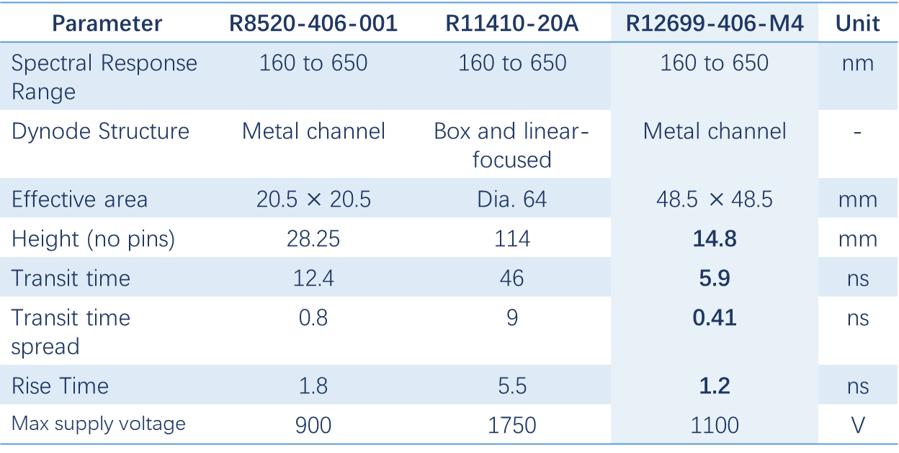
PMT Comparision
Parameter | R8520-406-001 | R11410-20A | R12699-406-M4 | Unit
Spectral Response Range | 160 to 650 | 160 to 650 | 160 to 650 | nm
Dynode Structure | Metal channel | Box and linear-focused | Metal channel | -
Effective area | 20.5 $×$ 20.5 | Dia. 64 | 48.5$×$48.5 | mm
Height (no pins) | 28.25 | 114 | 14.8 | mm
Transit time | 12.4 | 46 | 5.9 | ns
Transit time spread | 0.8 | 9 | 0.41 | ns
Rise Time | 1.8 | 5.5 | 1.2 | ns
Max supply voltage | 900 | 1750 | 1100 | V

Slide 21
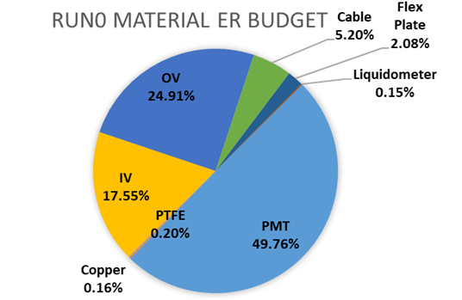
ER budget in PandaX-4T

Slide 22
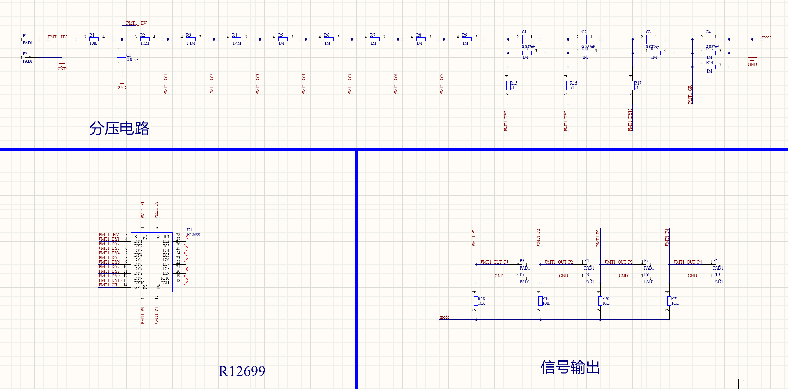
Cryogenic Testing

