Slide 1
Gas Electroluminescence in a Dual Phase Xenon-Doped Argon TPC
James Kingston (UC Davis, LLNL)
LIDINE 2025
October 24th, 2025
LLNL-CFPRES-2012745

Slide 2
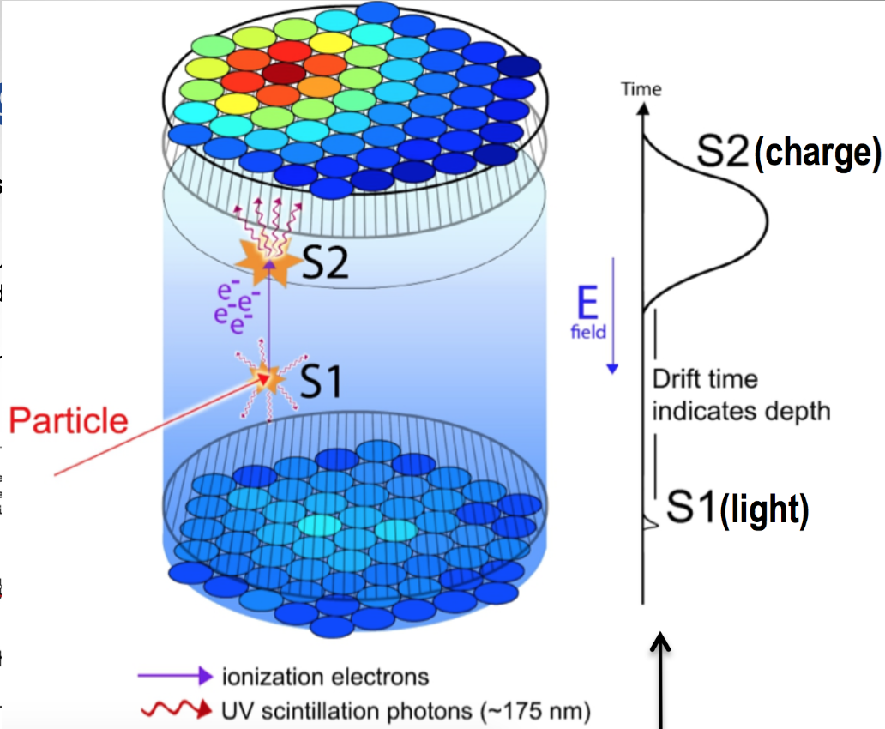
Review of Xenon and Argon Time Projection Chambers (TPCs)
A noble element dual phase TPC contains a noble element in the liquid and gas phase.
An energetic particle will generate:
Scintillation light (S1)
Ionization electrons (S2)
Photosensors detect S1, electric field drifts electrons
S1 and S2 can tell you:
Amount of energy deposited
Particle ID
3D Position Reconstruction

Slide 3
Comparison of Xenon and Argon
Property | Argon | Xenon
Scintillation wavelength | 128 nm | 175 nm
Kinetic Match to Light Particles | A = 39.95 | A = 131.29
Operation Temperature | ~90 K | ~160 K
Liquid phase ionization energy | 14.3 eV | 9.3 eV
Excitation Energy | 11.6 eV | 8.3 eV
Scintillation lifetime | 3 us (gas phase, triplet component) | 100 ns
Price | Inexpensive | Expensive
Notes:
Neon and He: no radioactive isotopes but have very poor electron mobility and long scintillation lifetimes
Kr and Rd are radioactive

Slide 4
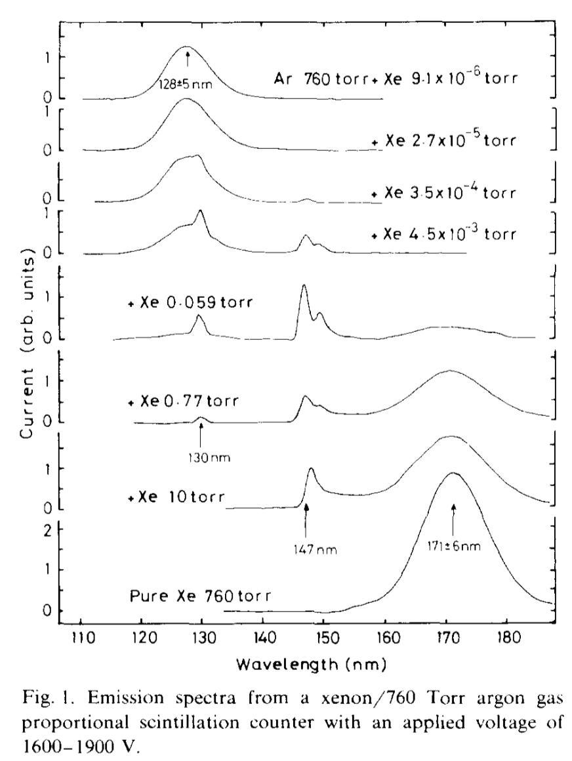
Xenon-Doping in Argon
We expect most of the S2 light will be converted from Ar₂* to ArXe*/Xe* and Xe₂* with ~50 ppm of Xe addition to Ar gas, granting:
Energy transfer from 128 nm to 149 nm or 175 nm -> better PDE
Hopefully sharper scintillation pulses -> better timing and less pileup
Possible boost to ionization yield -> more electrons for same energy deposition
Lower excitation energy -> easier to see individual electrons and potentially more photons per extracted electron
Ar₂
5.9 ppm
78 ppm
ArXe or Xe*
Xe₂
Emission spectra of xenon-doped argon gas mixtures at 1 atm in a gas proportional counter (T. Takahashi et al. NIM 205 591-596 (1983))
Notes:
So how much xenon must we add to argon to change the optical properties of the S2 light? Fortunately, something similar has already been done. Here is a proportional counter operating at room temperature. They start with pure argon and slowly add xenon. The xenon concentration is increasing as you move from the top to the bottom. You can see the pure argon peak vanish and Argon-xenon dimer peak grow in at 147 nm. The change in wavelength corresponds to a large improvement in VUV SiPM quantum efficiency, from 17% to 28%. Based on this experiment, we expect to realize most of the benefits of xenon doping with 50 ppm of xenon in the gas.
When liquid argon is doped with xenon at the O(ppm) level, the dominant excitation path transitions from Ar₂ dimers to Xe-containing excimers (ArXe and Xe₂)
This implies numerous detection benefits:
Wavelength shifting from 128 nm to 178 nm: better PDE!
Sharper scintillation pulses: better timing on non-beam events and less pileup!
Boost to ionization yield (due to lower ionization threshold of xenon): bigger signal!

Slide 5
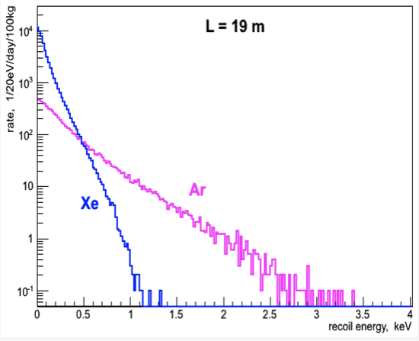
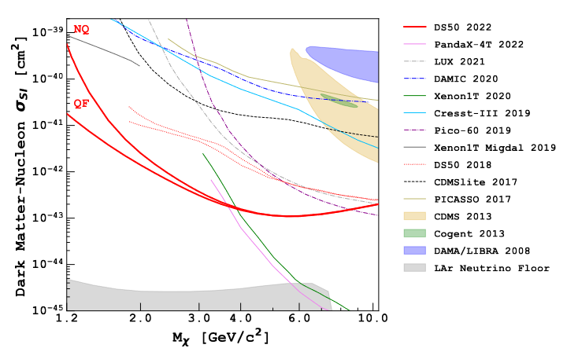
Applications of Xenon-Doped Argon
Low energy nuclear recoils:
  Reactor monitoring via CEvNS, sub-GeV dark matter
  Tradeoff: counts vs recoil energy
  Xe: large cross section, low energy recoils
  Ar: smaller cross section, higher (but still low) energy recoils
Enhanced detector performance:
  Potentially faster pulses (important for ionization-only!)
  Easier to detect EL light
  Reduced Raleigh scattering of scintillation light
  Improved S2 energy resolution
Argon vs Xenon expected CEVNS rate 19 m from the 3 GW Kalanin Nuclear Power Plant core (RED-100, https://www.mdpi.com/2624-8174/5/2/34)
Darkside 50 Ionization-only limits
(PHYSICAL REVIEW D 107, 063001)
Notes:
Improving the ionization response of argon has an immediate physics impact. WIMP dark matter detection and CEVNS neutrino detection both observe low energy nuclear recoils. Their energy spectra fall quickly with increasing energy, which means energy threshold is very important, and even a modest increase in ionization signal results in a large increase in detector sensitivity.
There are also improvements benefitting single-phase high energy experiments, in the S1 scintillation light. That’s been explored by others, so it is not the focus of our project.

Slide 6
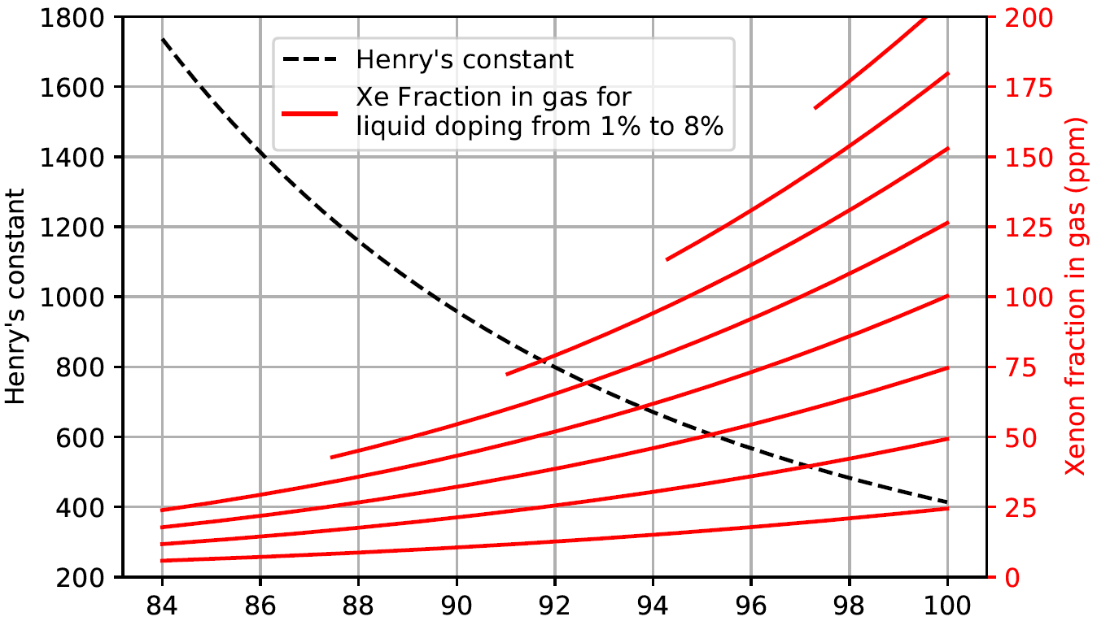
Thermodynamics of Xenon-Doped Argon
8%
Recall: Energy transfer from Ar₂* at O(10 ppm) level
%-levels in the liquid for O(10 ppm) in the gas
Solubility limit at 92K: ~ 6%
Doable in theory!
7%
6%
5%
4%
3%
2%
1%
Temperature (K)
Bernard et. al (Phys. Rev. C 108, 045503)

Slide 7
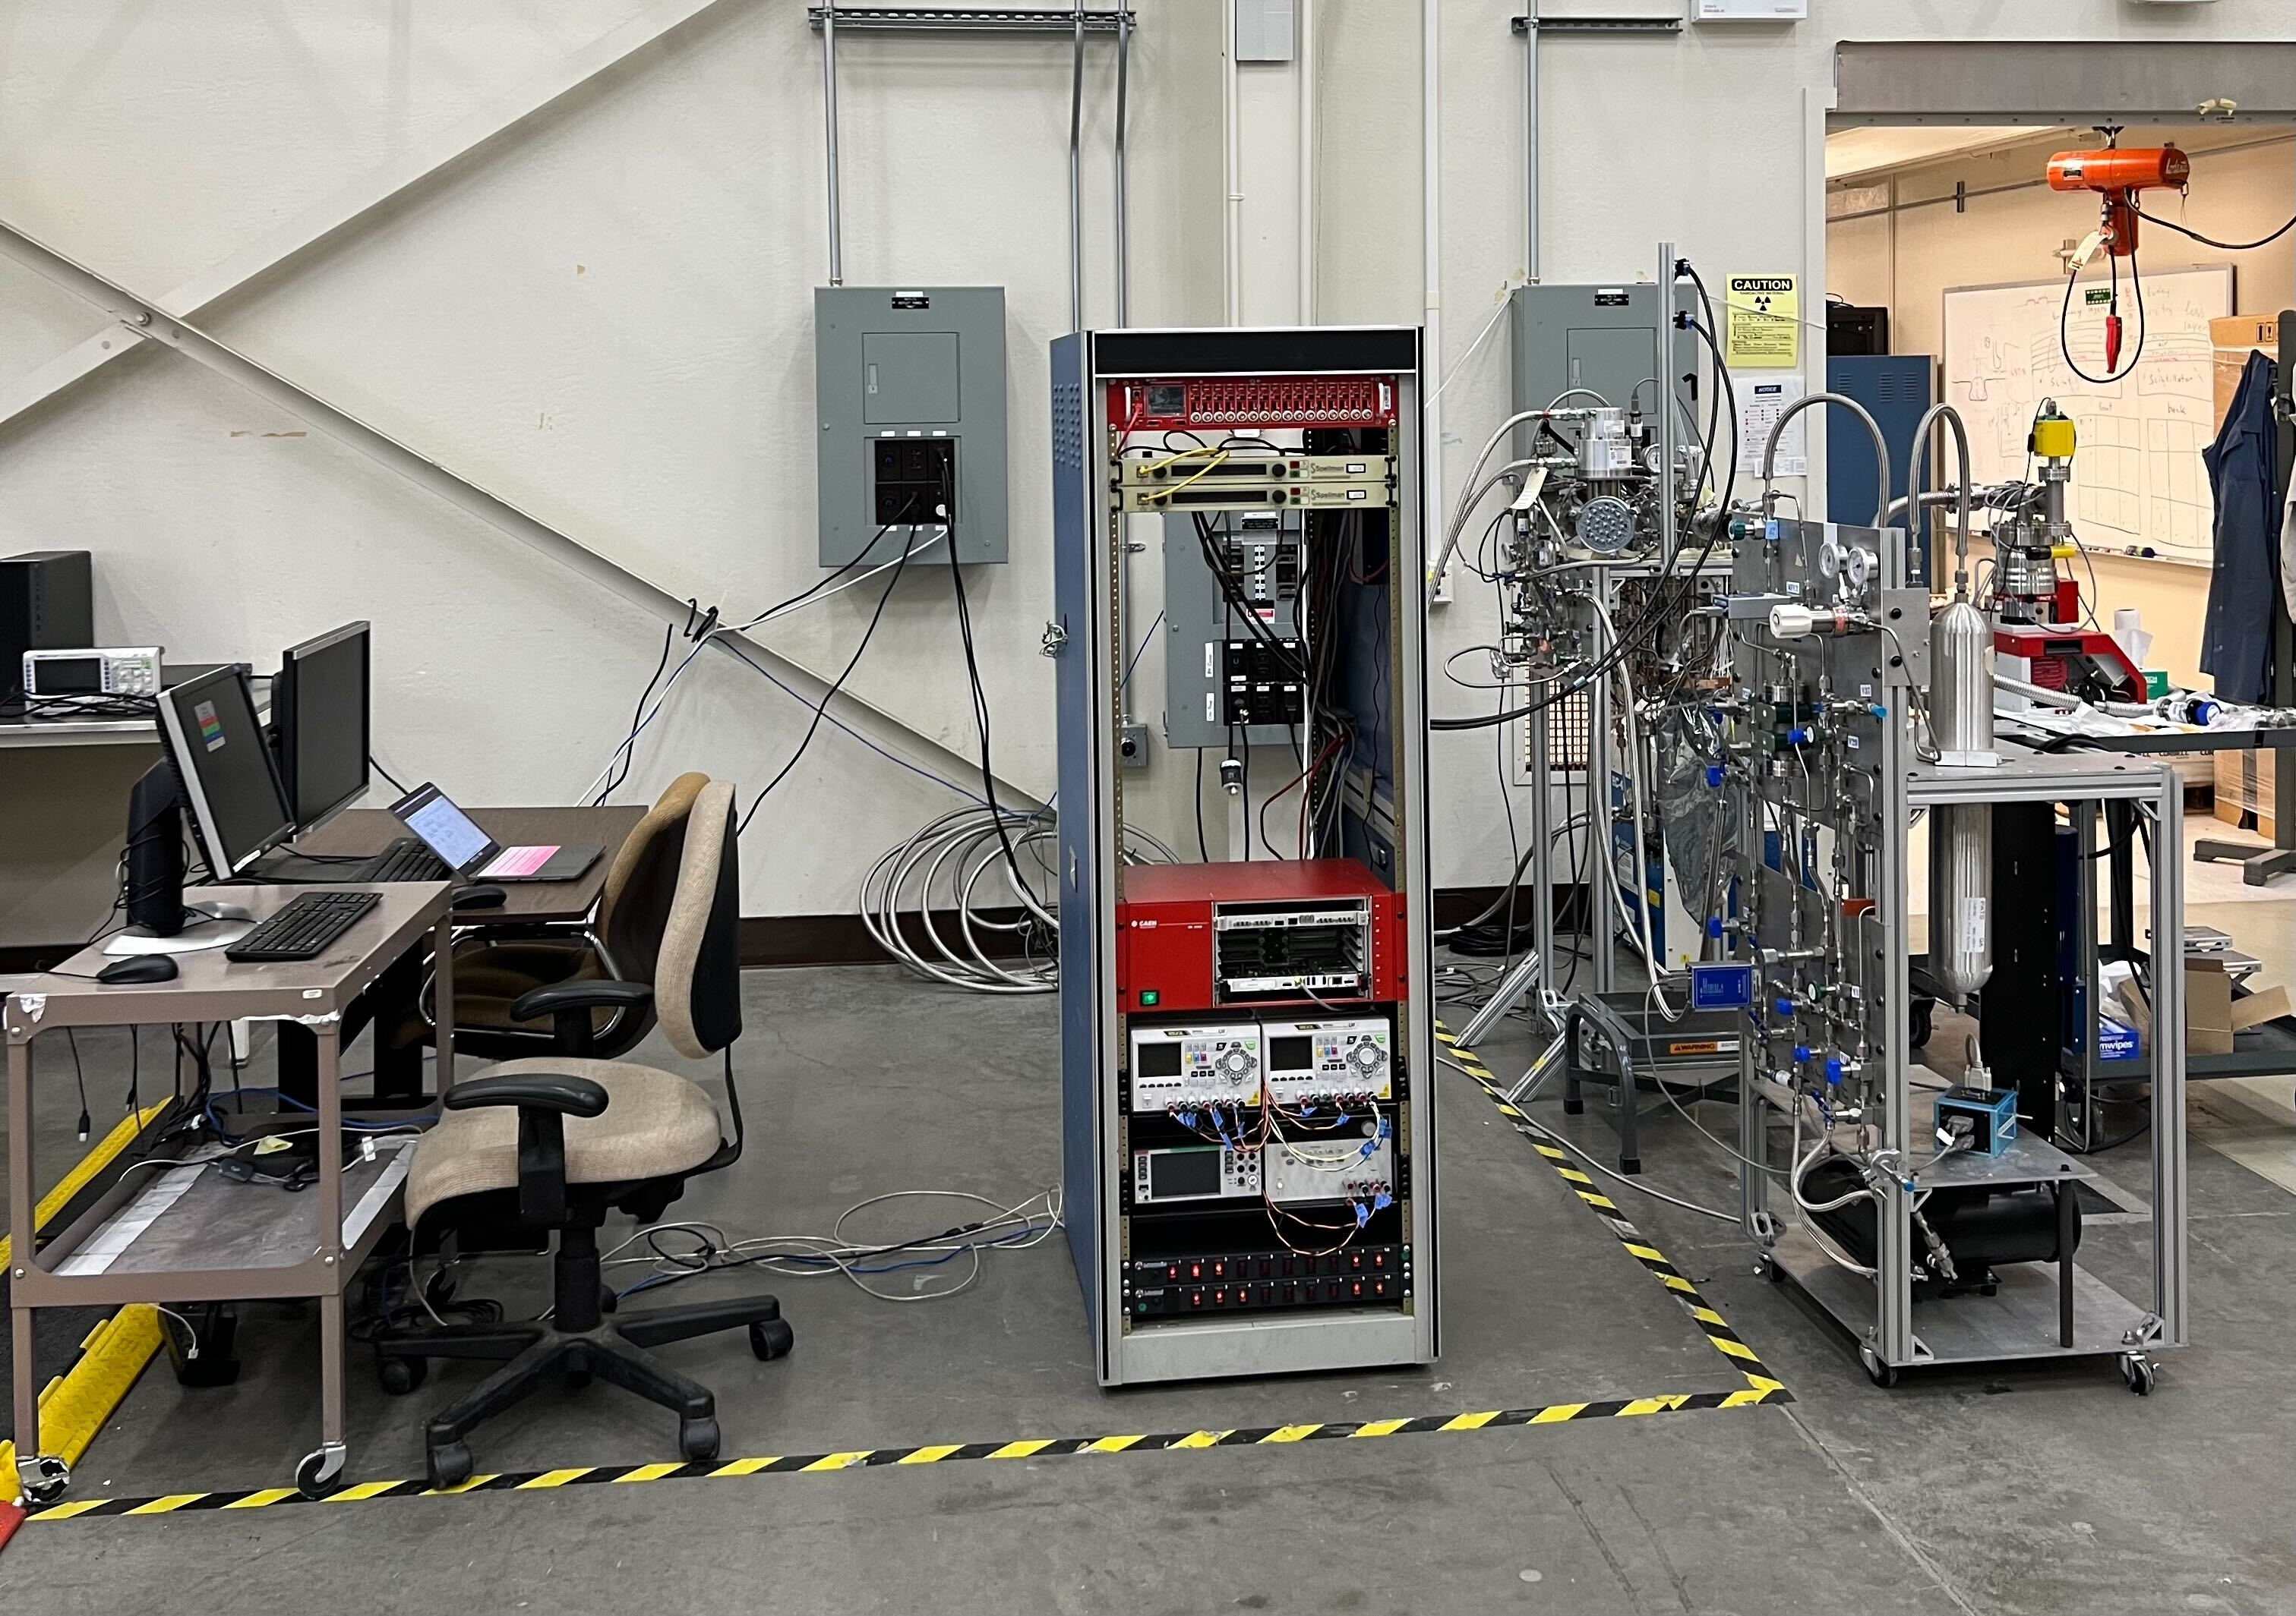
CHILLAX: CoHerent Ionization Limit of Liquid Argon and Xenon
Concept: A liter-scale dual phase xenon-doped argon TPC
Goals:
Obtain a stable mixture of percent level Xe in LAr
Quantify potential benefits to dual phase argon TPC’s ionization signal from xenon doping

Slide 8
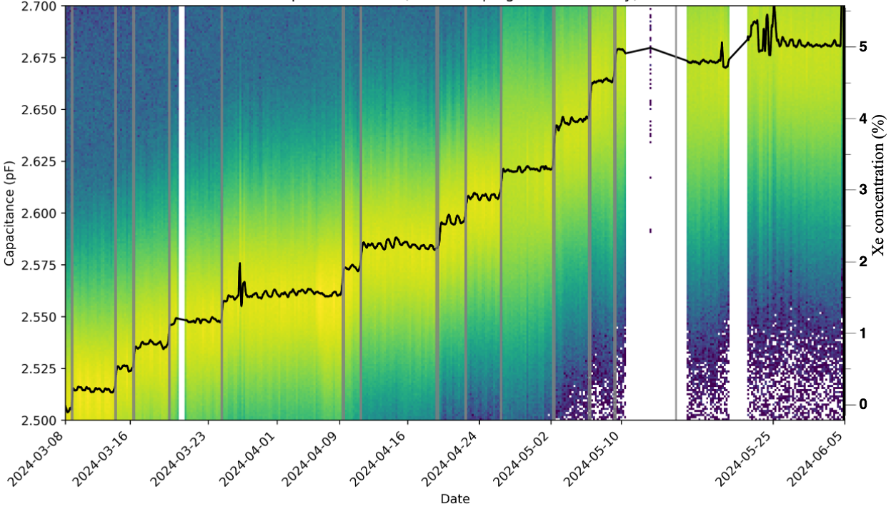
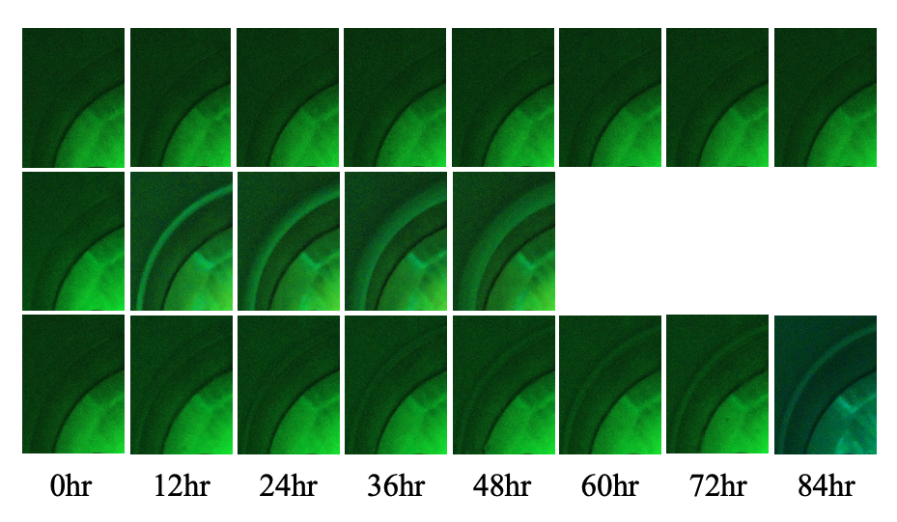
Demonstration of Xe-Ar Mixture Stability (Past Work)
Unstable mixture:
5.27% Xe!
Cryostat view
Xe ice
Stable mixture:
Xenon Doping Periods in Gray
Instabilities at the end of the run correspond to a failing heater
Bernard et. al (Phys. Rev. C 108, 045503)

Slide 9
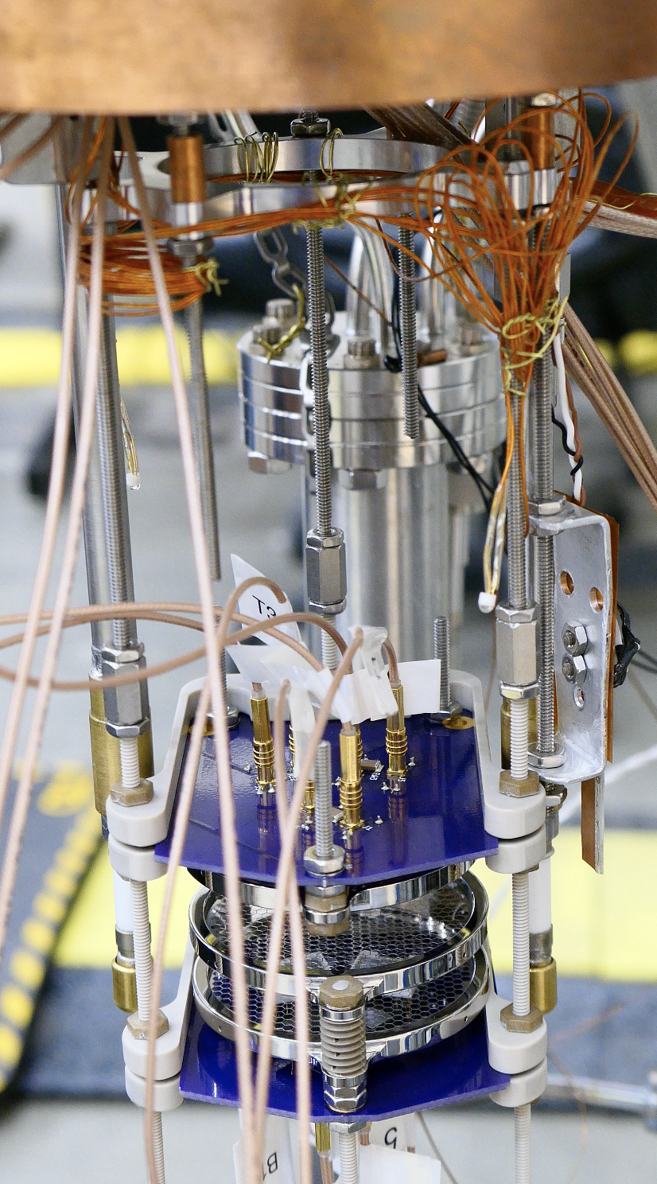
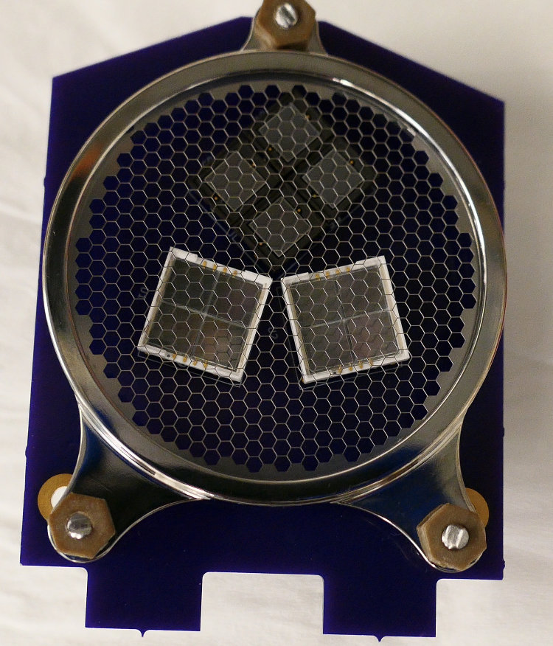
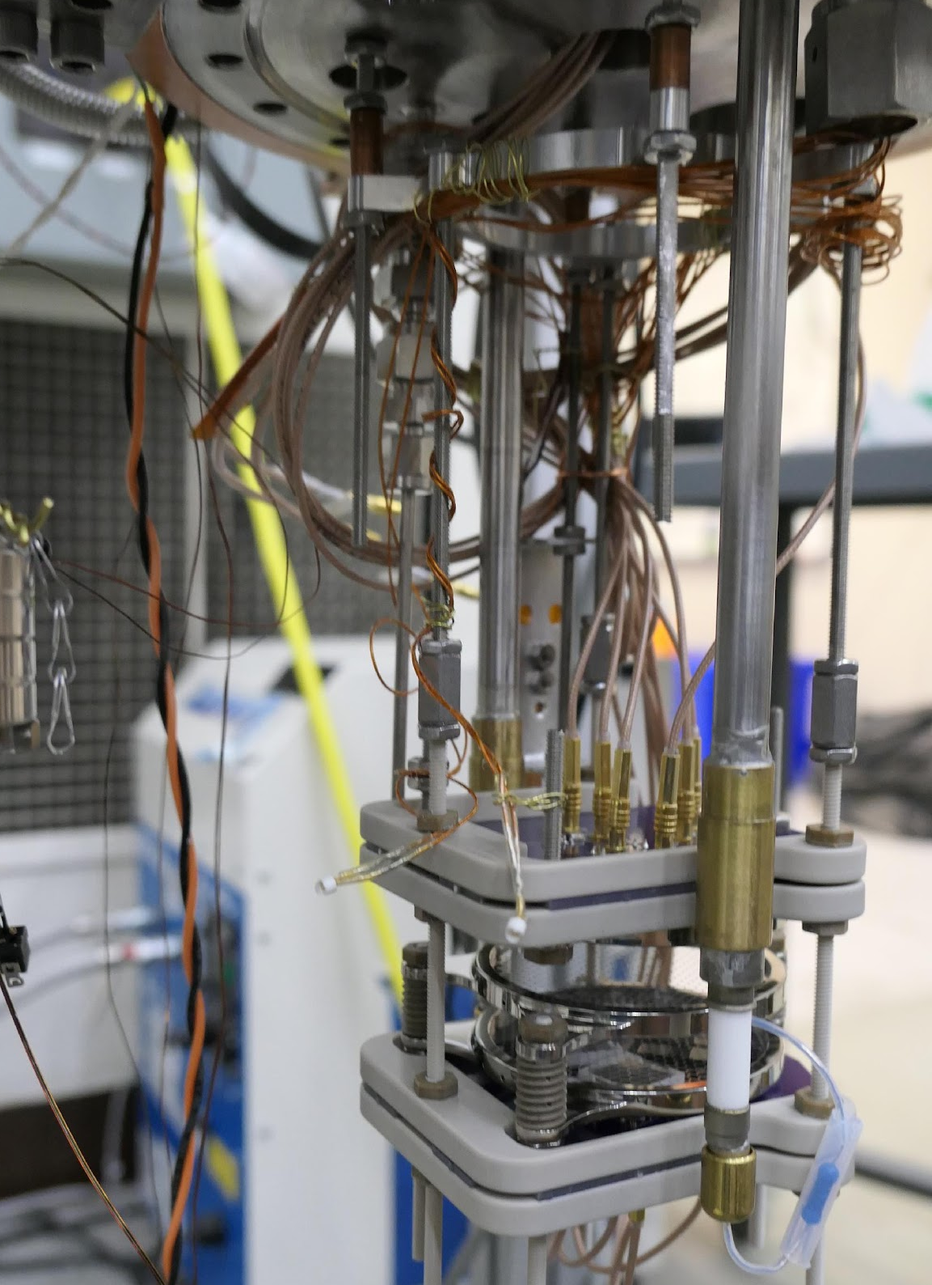
TPC Internals: 2 Grid TPC Prototype (Current Work)
2x2 Windowless VUV SiPMs (S13370)
Windowed VUV SiPM (S13371)
Not shown: RGA ”straw” and capacitor (for measuring Xe)
LEDs
Liquid Level meter
Anode (0 kV)
Cathode (10 kV – 14 kV (negative))
Shield (0kV)
Windowless VUV SiPM (S13371)
Front view
Back view

Slide 10
Data Taking Configurations
-14 kV
Cathode HV | E-Field (liquid) | E-Field (gas) | Reduced E-Field
-10 kV | 4.6 kV/cm | 6.8 kV/cm | 4.0 Td
-12 kV | 5.5 kV/cm | 8.2 kV/cm | 4.8 Td
-14 kV | 6.4 kV/cm | 9.6 kV/cm | 5.6 Td
Cathode Voltage
-12 kV
-10 kV
0%
Calibration Source
1%
2%
Xe Concentration (liquid) | Xe Concentration (gas, predicted) | Xe Concentration (gas, measured)
1% | 19 ppm | 14 ± 4 ppm
2% | 32 ppm | 34 ± 4 ppm
3% | 49 ppm | 57 ± 4 ppm
4% | 61 ppm | 61 ± 6 ppm
3%
bg
4%
Am-241
(60 keV gamma)
Xenon concentration (liquid)
Notes:
We didn’t take background with 14 kV because of stability concerns
Sometimes we used a weak source for Am-241, sometimes hot

Slide 11
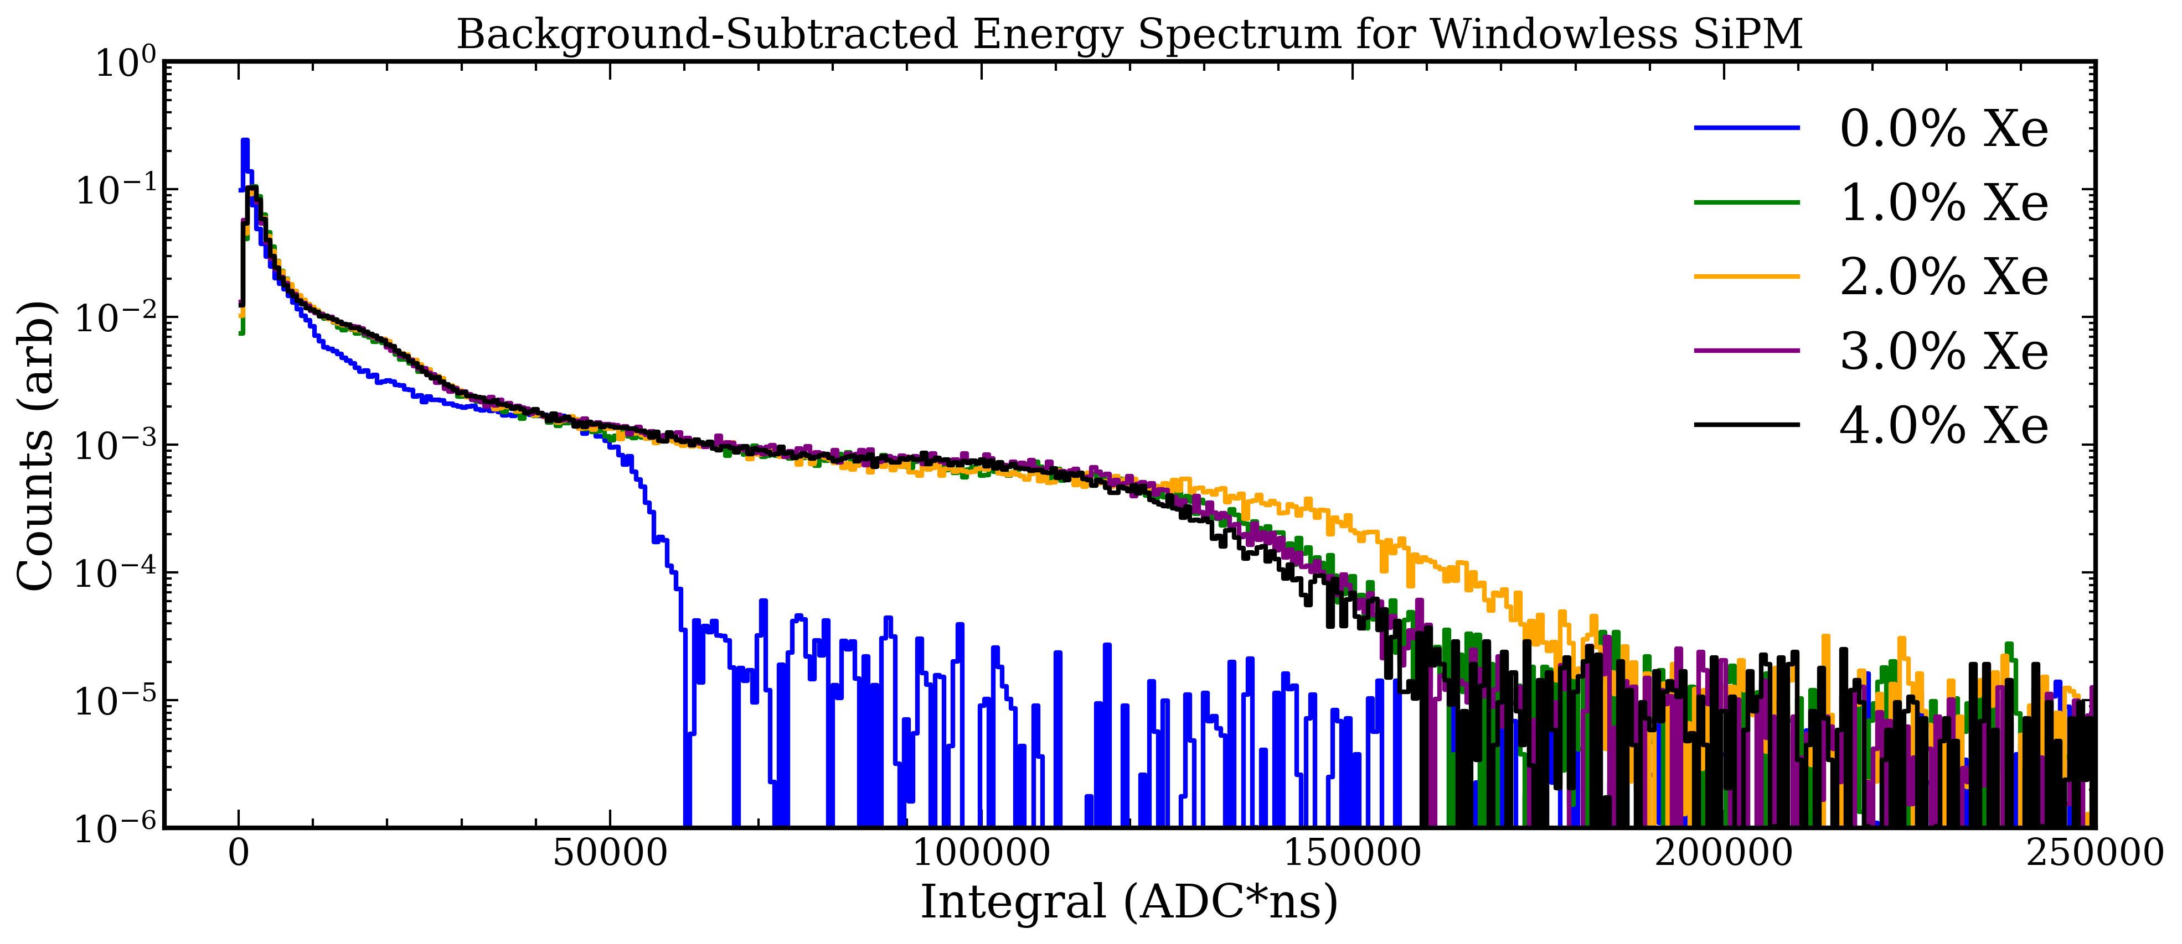
Effects of Doping: Total Light Production
Endpoint gets significantly larger from 0% to 1%, slightly larger for 2%, then gets marginally smaller at 3-4%.
Kingston et al. (https://arxiv.org/pdf/2510.02261)

Slide 12
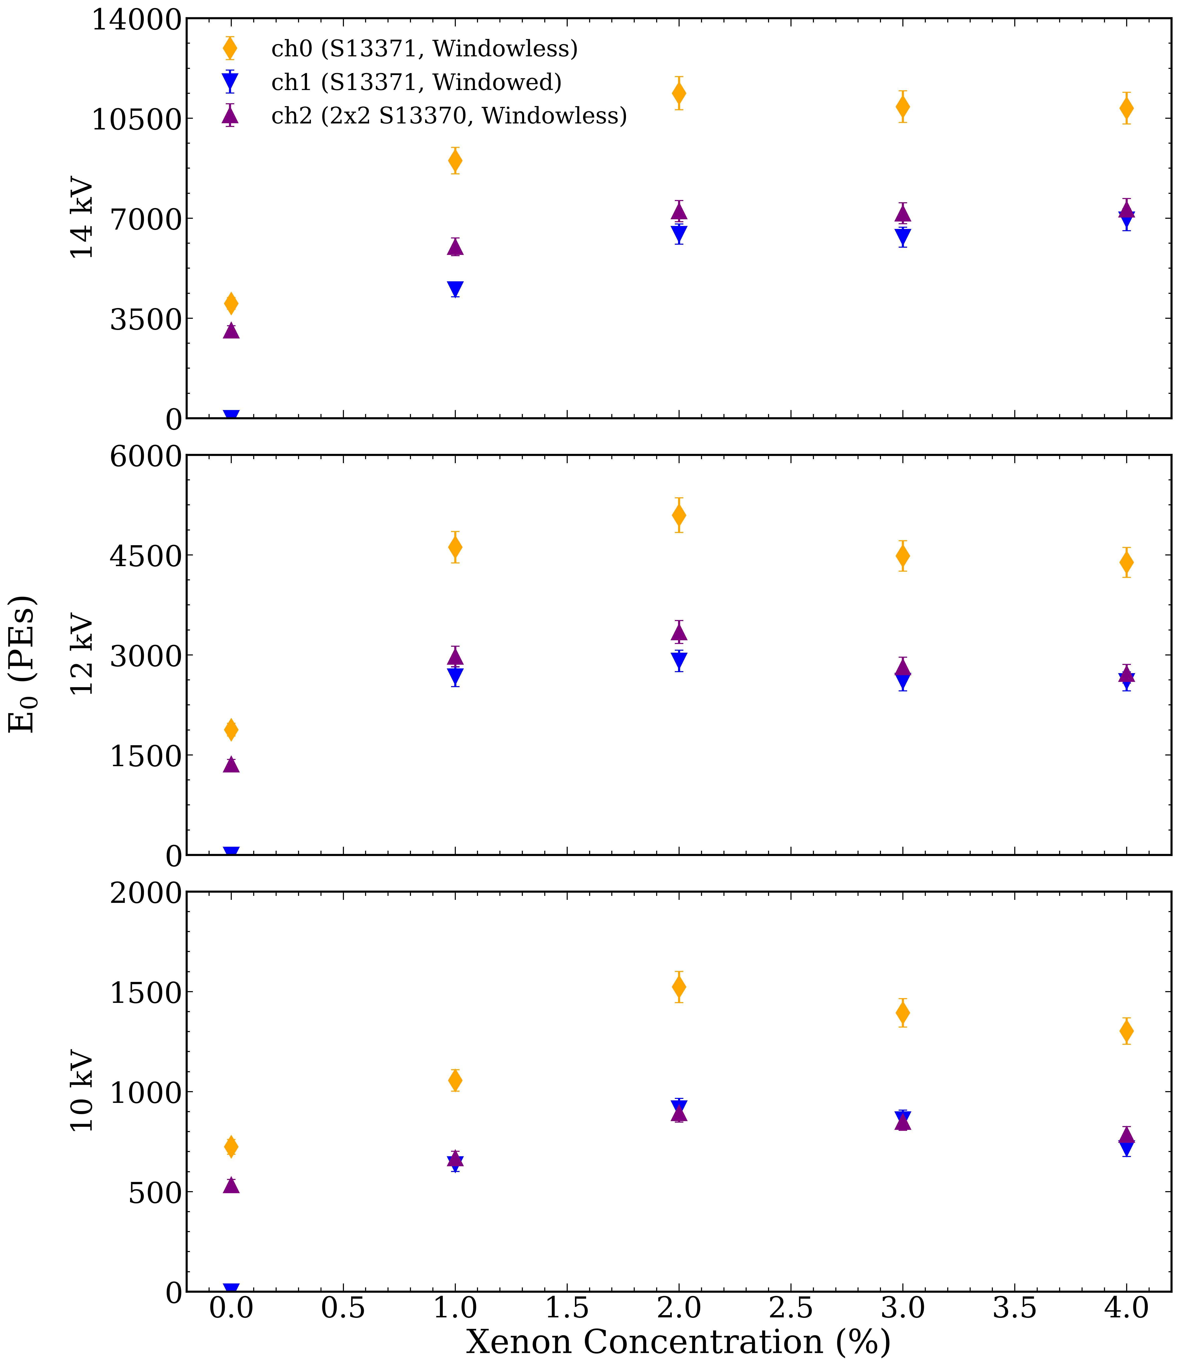
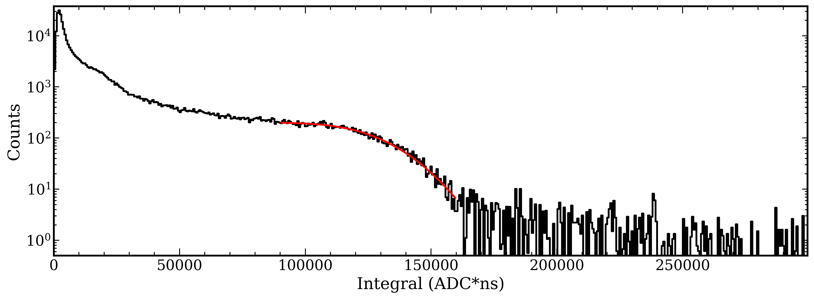
Effects of Doping: Total Light Production
Energy spectrums are fit to a model (Step Function with Gaussian Smear and exponential contribution)
We find a x2.5 increase in the top S13770 SiPM channel
The same SiPM model with a quartz window goes from seeing no light to substantial light (~0.55 of the windowed SiPM)

Slide 13
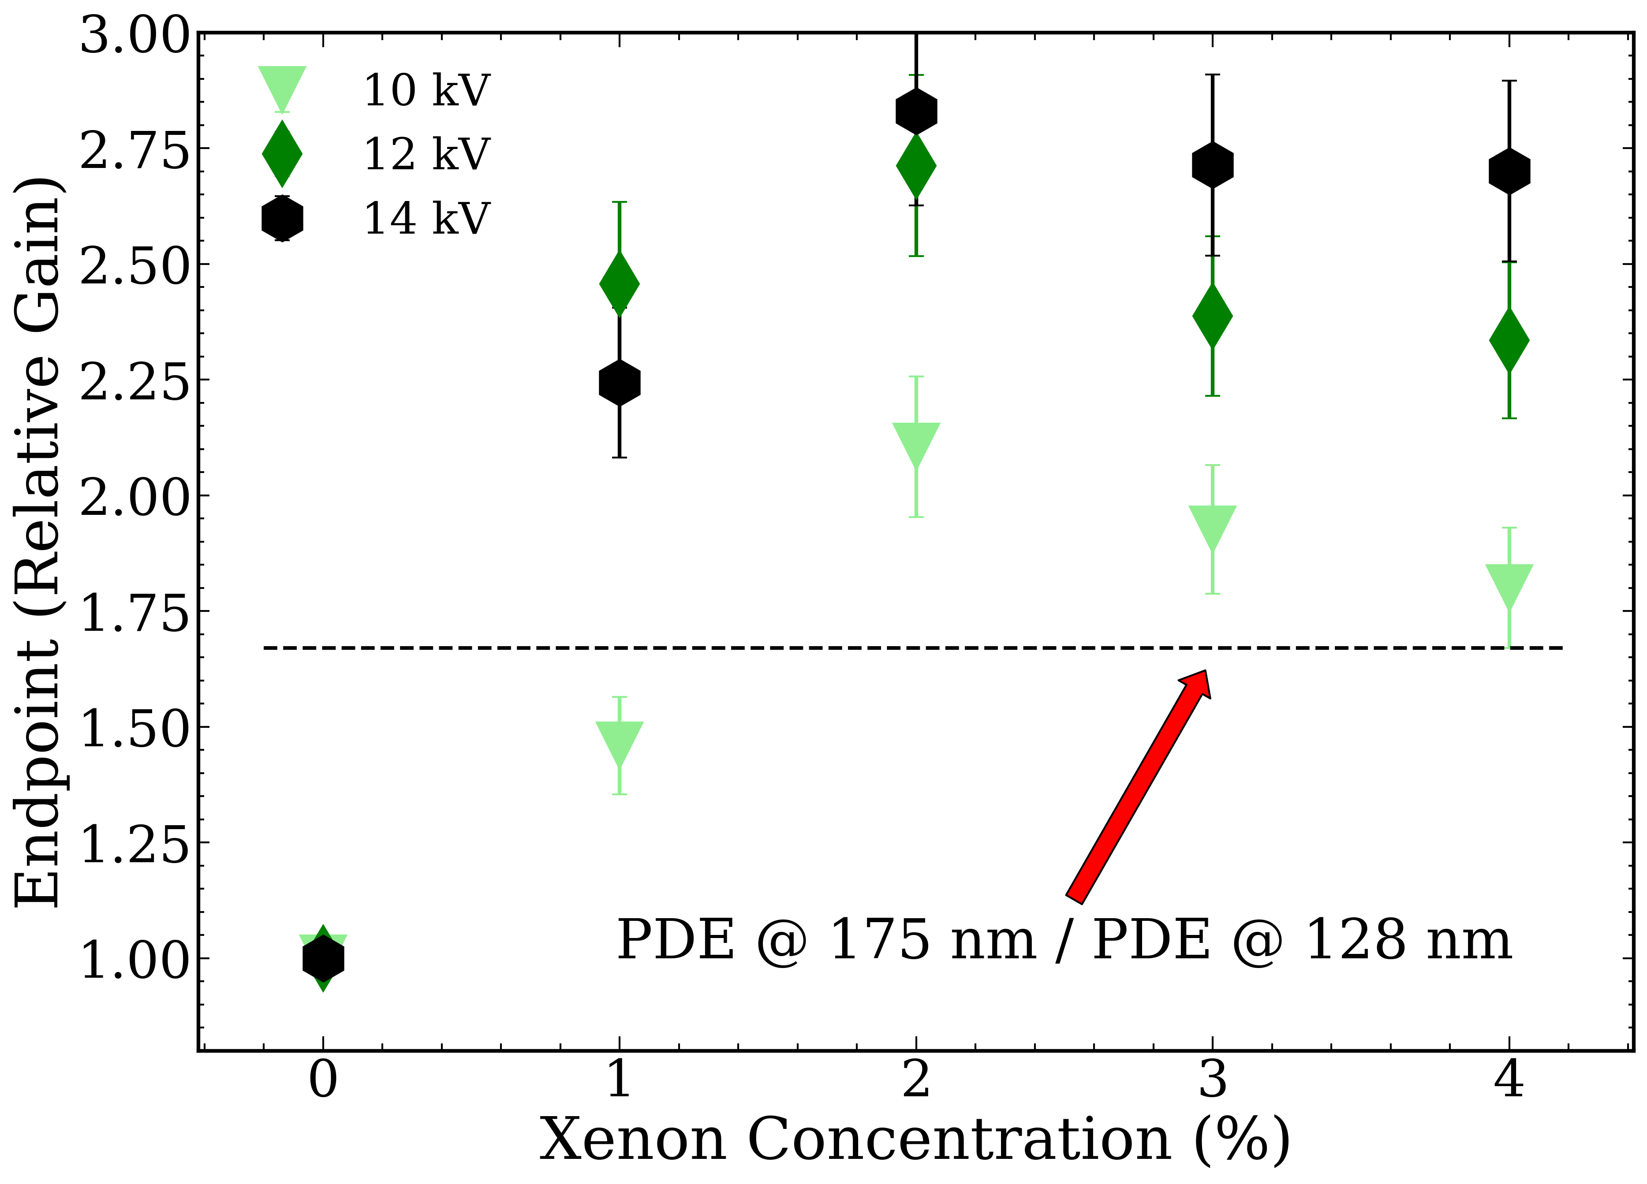
More than Wavelength-Shifting is happening here…
If scintillation light is 100% wavelength-shifted from 128 nm to 175 nm we expect a ~x1.67 boost to the S2 size
We see a substantially higher boost: must be more going on!
Higher ionization yield? Greater SE gain?

Slide 14
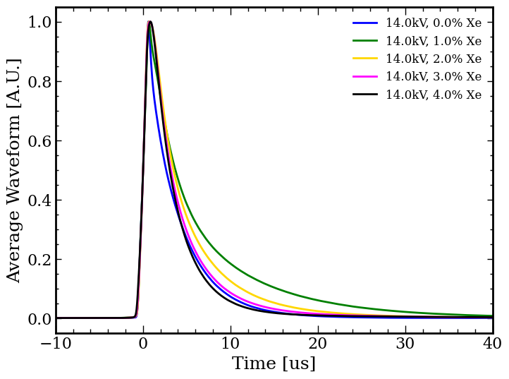
Pulse Shape (Windowless Top SiPM)
Average S2 waveform gets broader at 1% xenon-doping, then narrower at ≥2%
Consistent with prior runs
What would we see if we removed all but the 175 nm light?

Slide 15
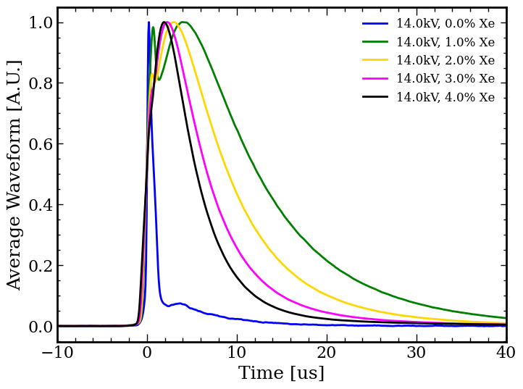
Pulse Shape (Windowed Top SiPM)
Quartz window blocks < 160 nm light
Only light seen:
Xe light
Neutral Bremsstrahlung
Noticeable ”double hump” structure seen, particularly at 1%

Slide 16
Proposed Scintillation Mechanism
Ar₂^{*1}Σ
Ar₂^{*3}Σ
Ar2 excitation can either deexcite or transfer energy to Xe
Xe* (or ArXe*) can result in two competing processes (Xe2*->175 nm or 147 nm light)
Let’s model it!
n_{Xe}k₁
Some slowly decaying state
1/τ₂
1/τ₁
Xe*
ArXe*
n_{Xe}k₂
1/τ₃
Xe₂^{*3}Σ
Xe₂^{*1}Σ
128 nm
175 nm
147 nm
Notes:
Know sources that say decay could go either way

Slide 17
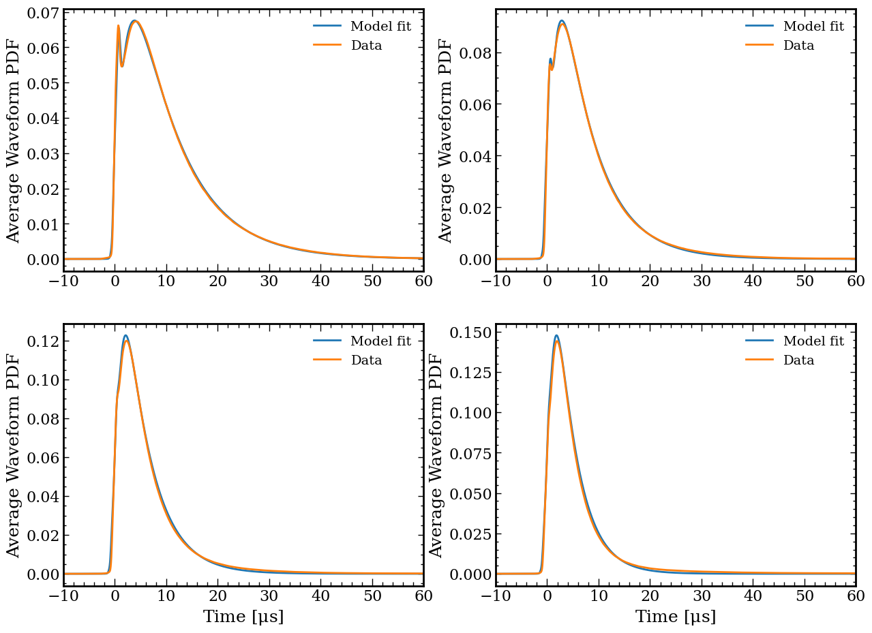
Pulse Shape Fits (Windowed SiPM)
Windowed SiPM light modeled as neutral bremsstrahlung + exponential with two competing terms (xenon buildup -> xenon decay)
Provides kernel for what 175 nm + 147 nm time profile looks like
Model matches data very well!

Slide 18
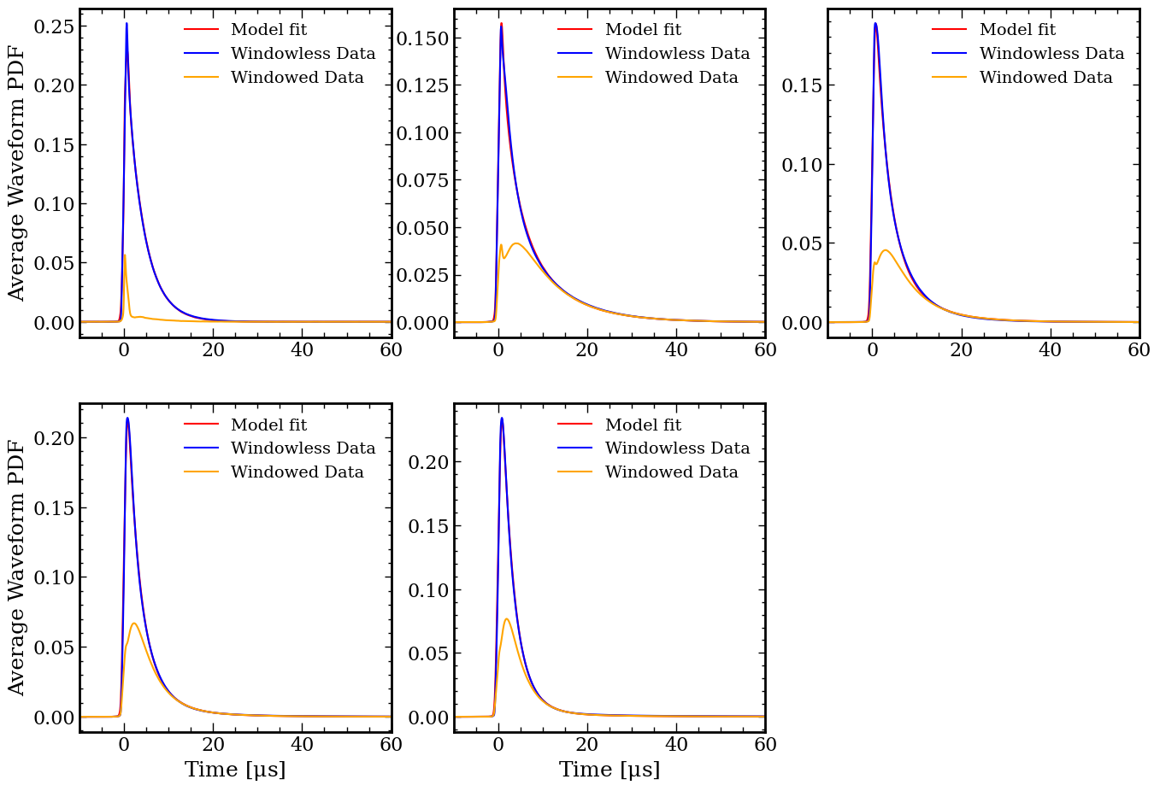
Pulse Shape Fits (Windowless SiPM)
Windowed data must be a subset of the light seen in windowless SiPM
Windowless SiPM has additional Ar2 term
Model again matches data very well!
Submitted for Publication!
https://arxiv.org/pdf/2510.02261

Slide 19
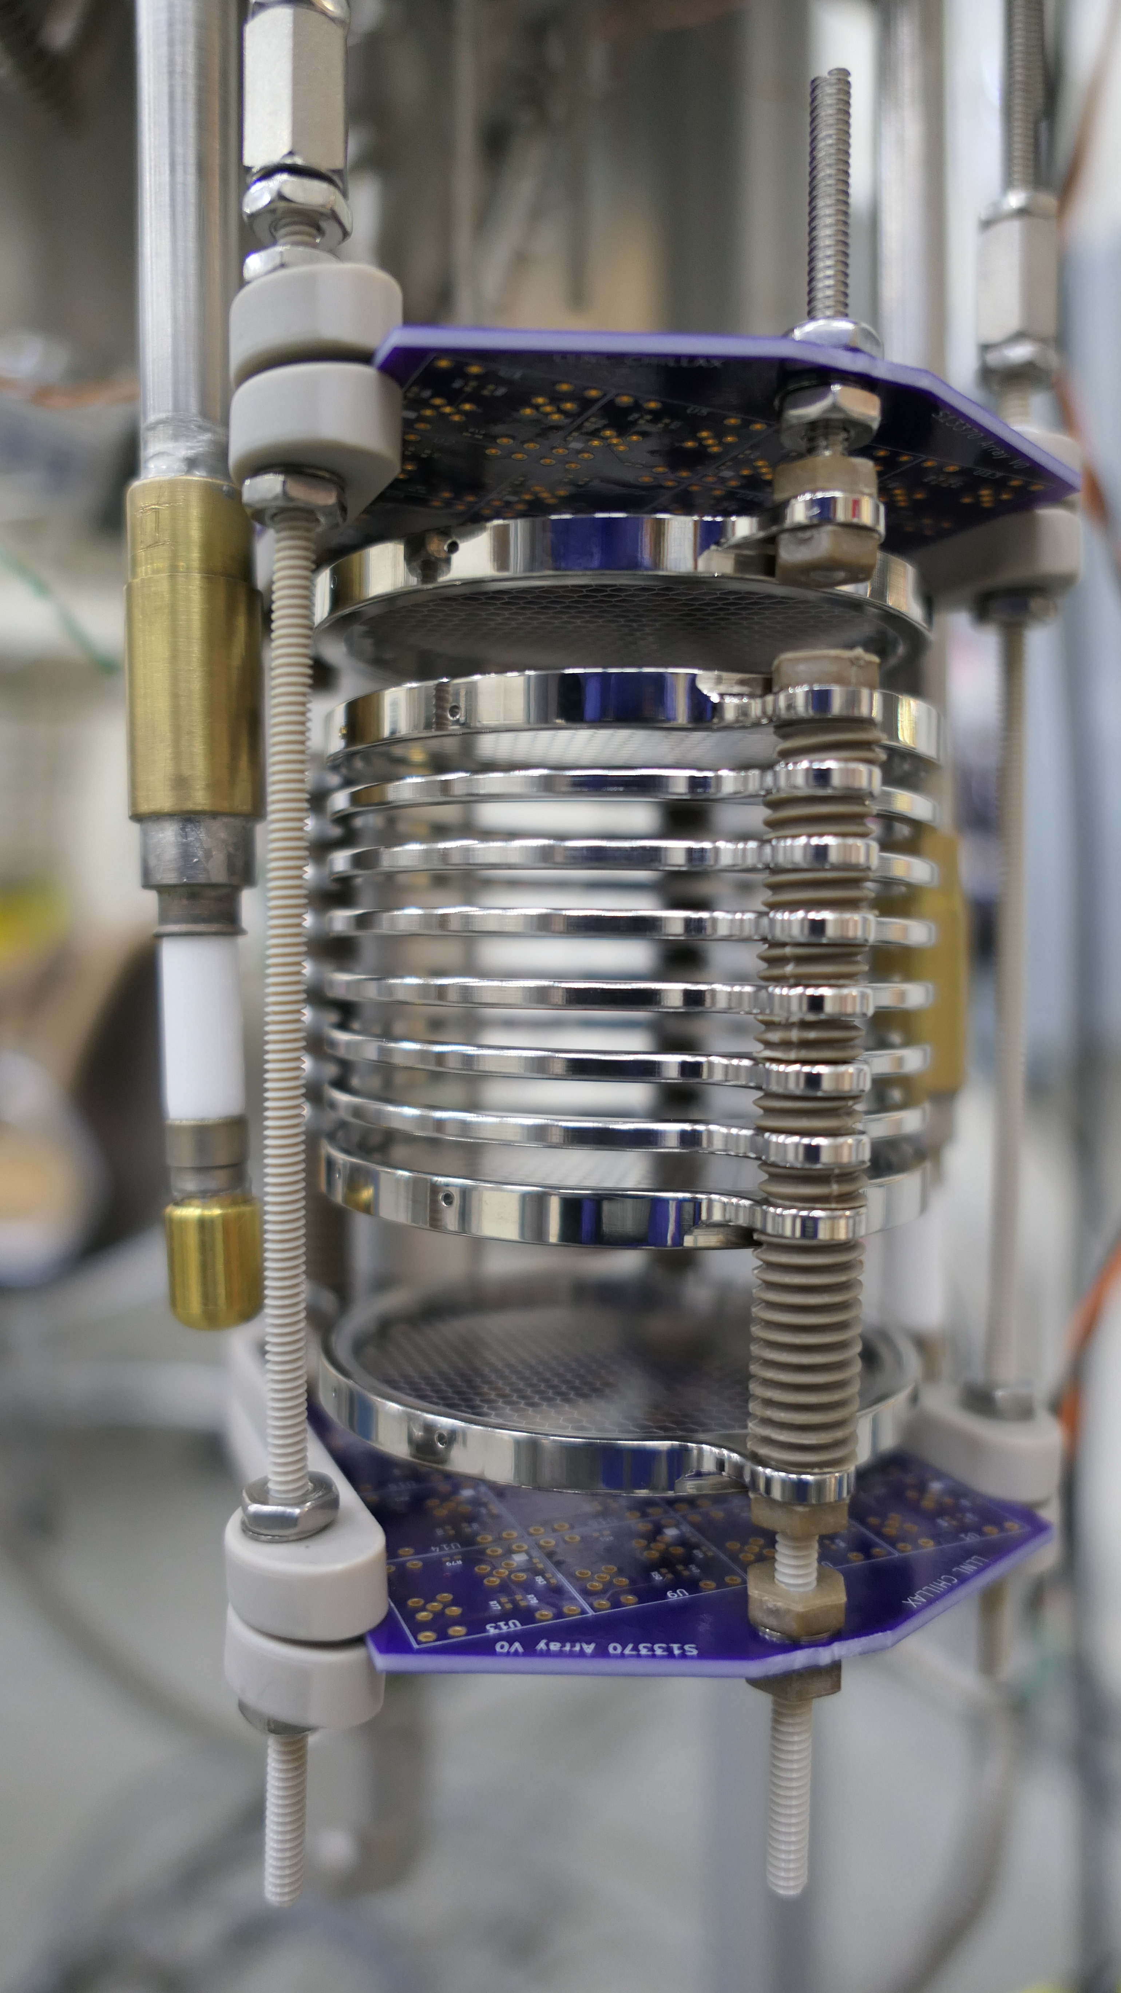
Future Plans
Add more SiPMs + reflector -> improved light collection efficiency + single electron sensitivity
Utilize both HV feedthroughs and additional grid -> independent drift and extraction field control
Improvement of liquid level meter -> reduce liquid uncertainty and faster measurements

Slide 20
Conclusion
We are operating the world’s first dual phase O(1%) xenon-doped argon two-grid TPC.
We see substantial S2 gain from xenon-doping .
S2 average waveform gets broader at 1%, then narrows for ≥2%, our proposed model matches the observed data well.
S2 light is likely 50% from Xe₂* by 1%.
Plan to upgrade CHILLAX with more SiPMs, full TPC, and reflector coming soon!

Slide 21
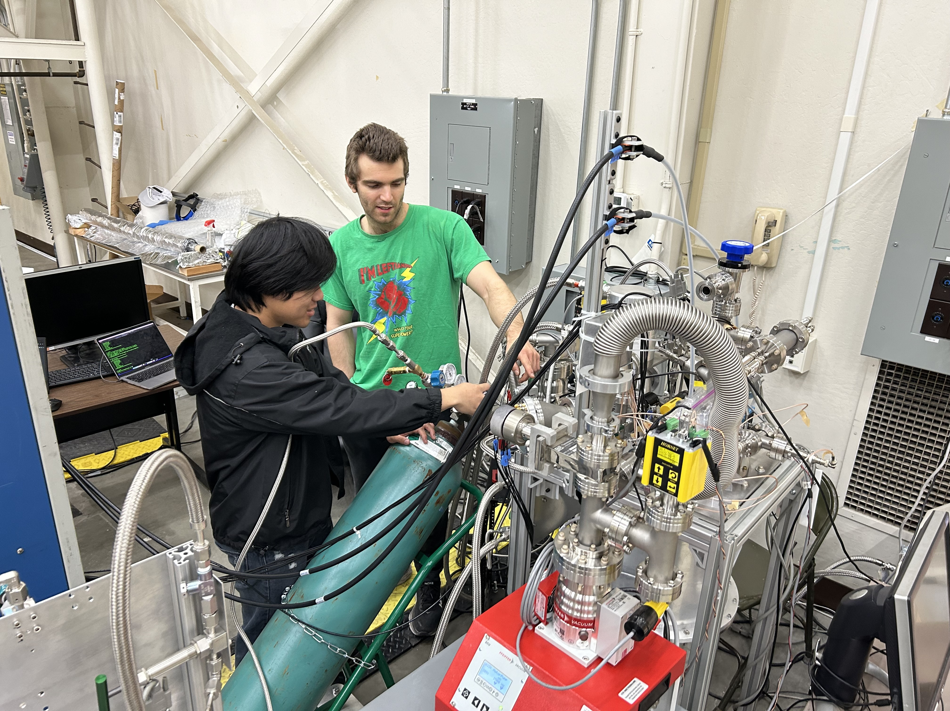
Thank you! Questions?
This material is based upon work supported by the Department of Energy National Nuclear Security Administration under Award Number DE-NA0000979 and DE-NA0003996.
This project is partially supported by the U.S. Department of Energy (DOE) Office of Science, Office of High Energy Physics under Work Proposal Number SCW1676 and SCW1504 awarded to Lawrence Livermore National
Laboratory (LLNL).
This material is also based upon work supported by HEPCAT (High Energy Physics Consortium for Advanced Training) under Department of Energy, Office of High Energy Physics (award number: DE-SC0022313).
Notes:
\

Slide 22
Backup Slides

Slide 23
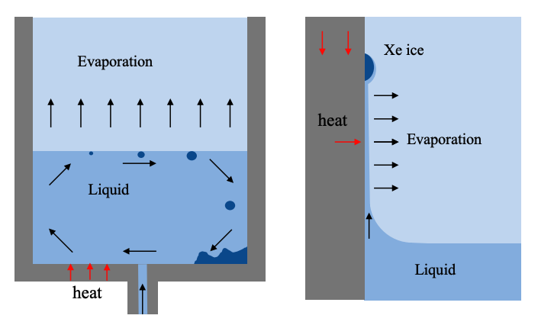
Complications from Xenon-Doping
The large temperature discrepancy between xenon and argon boiling points are a major source of system instability
T
Xe Condenses (1.8 bar): 176 K
Gas
Xe Freezes (1.8 bar): 162 K
Cooling source
Ar Condenses (1.8 bar): 93 K
Left: Condensation of Xe-rich Ar gas causes Xe to freeze if Xe pressure exceeds saturation vapor pressure
Middle: Evaporation of liquid mixture causes Xe concentration to increase in the liquid
Right: Unintended evaporation of liquid isolated by surface tension can cause Xe ice to form
0 K

Slide 24
Gas Sampling
Expansion volume
Sample
ResidualGas Analyzer (RGA)
Integrating Xe partial pressure effectively “counts” the xenon in the integration volume!
Initial pressure: ~2 atm
Operates at <10⁻⁴ Torr
Gas Xe concentration determines S2 response
RGA operates in vacuum
Integration volume
Leak valve
Turbo pump

Slide 25
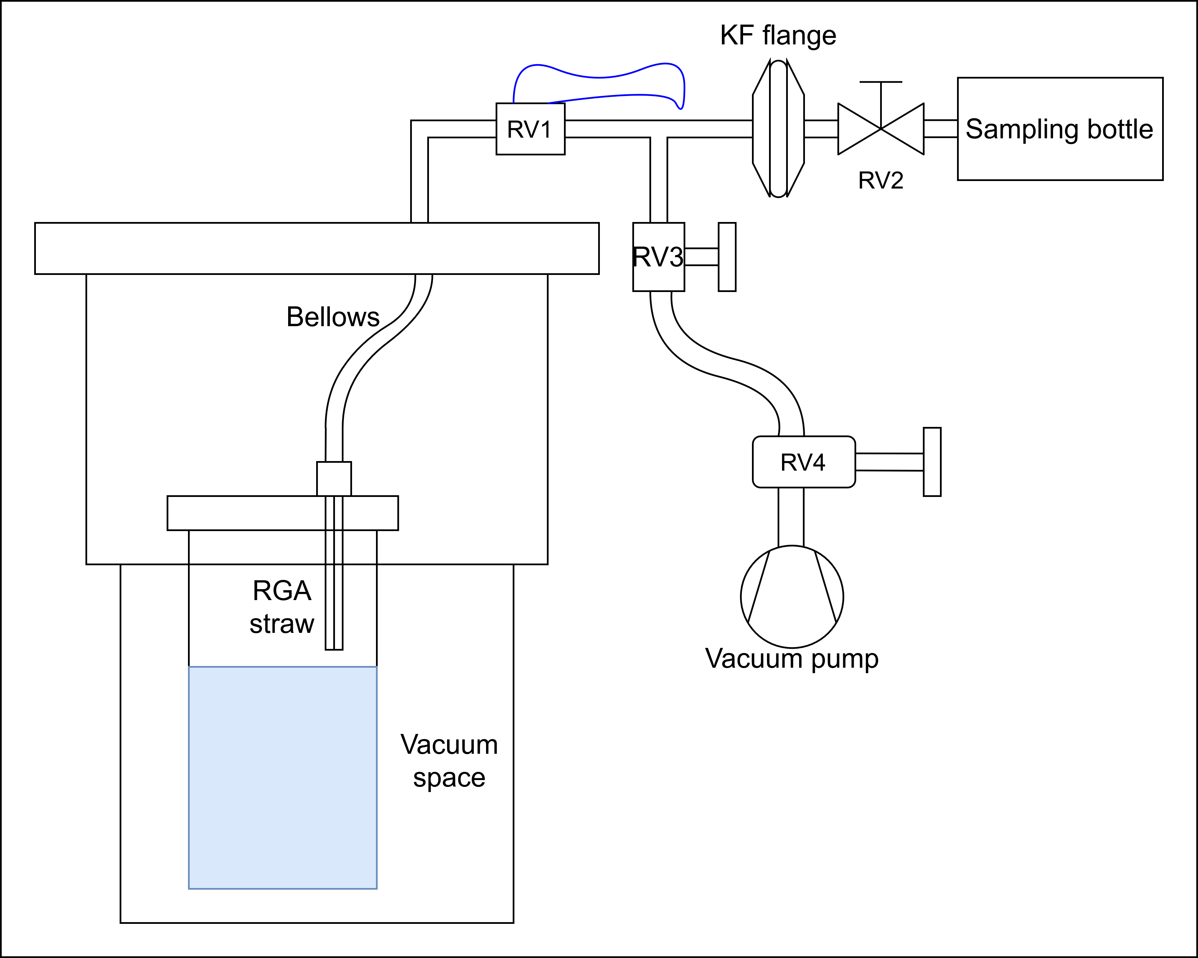
Gas Sampling During Operation
Liquid Xe concentration | Gas Xe concentration (measured) | Gas Xe concentration (predicted)
2% | 34 ± 4 ppm | 32 ppm
3% | 57 ± 4 ppm | 49 ppm
4% | 65 ± 4 ppm | 66 ppm
Gas sampled via a straw right above the anode
Samples the gas approximately near S2 production
In practice, small ice build-up can affect the measurement

Slide 26
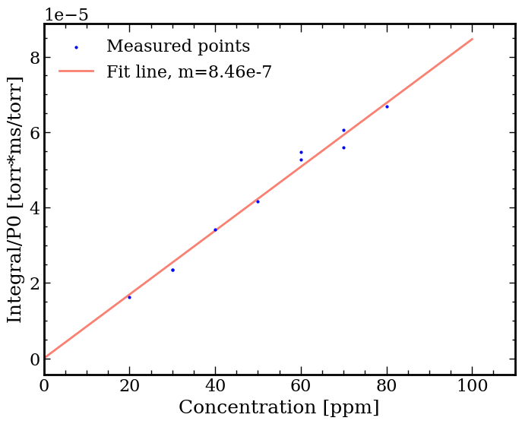
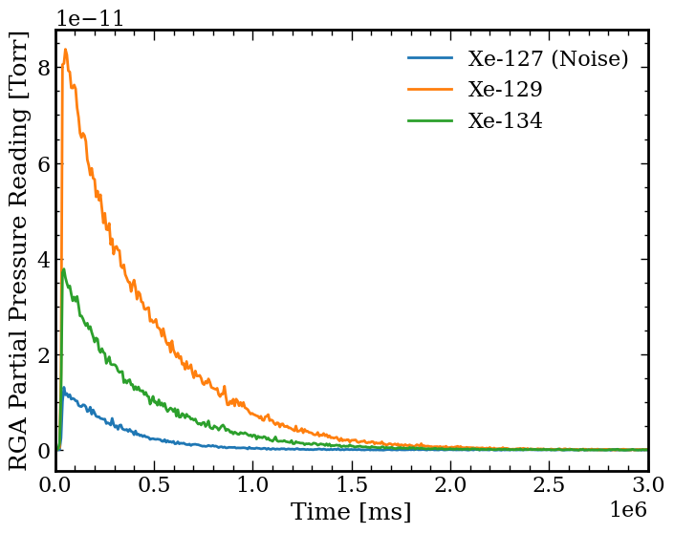

Gas Sampling Calibrations and Measurements
$$\frac{∫P_{Xe}\left(t\right)dt}{P_{0}}∝f_{Xe}$$
Clear Linearity
Xe-127 is not a real isotope, it’s noise associated with turning on the leak valve
Fixed volume ➔ fixed calibration curve
Measured 63±4 ppm of Xe in Ar gas at 5% Xe concentration in LAr!*
*Actual gas concentration is likely higher, see backup slides

Slide 27
Xenon-Doped Argon S2 Experiment (2-grid TPC)
SiPM signals
Argon Gas + Xenon doping ~ 50 ppm
S1
S2
SiPM Array
Time
S2
S1
Anticipated data
SiPM Array
S2 Doped / S2 Pure Ar
1
Solubility limit
Liquid Argon + Xenon doping
0
Xe fraction in gas
Detector Vessel
Notes:
The experiment to measure the improvement in the ionization channel is simple enough: We operate a two phase argon TPC and measure the S2 signal. Then we slowly add xenon and watch the S2 signal improve. Eventually we will reach the solubility limit, where no more xenon can mix with the argon.

Slide 28
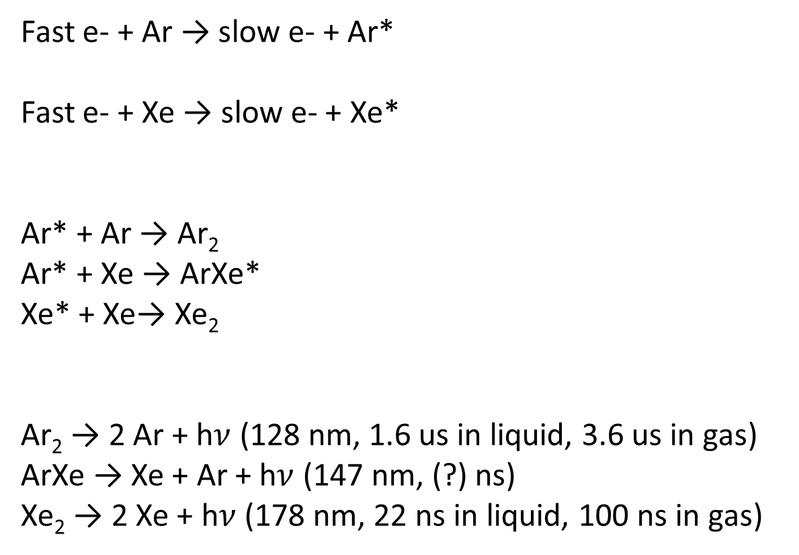
Chemistry of Xenon-Doped Argon
Fast e- + Ar → slow e- + Ar*
Fast e- + Xe → slow e- + Xe*
Ar* + Ar → Ar₂
Ar* + Xe → ArXe*
Xe* + Xe→ Xe₂
Ar₂ → 2 Ar + h$ν$ (128 nm, 1.6 us in liquid, 3.6 us in gas)
ArXe → Xe + Ar + h$ν$ (147 nm, (?) ns)
Xe₂ → 2 Xe + h$ν$ (178 nm, 22 ns in liquid, 100 ns in gas)
Example: Electrons inelastically colliding with xenon or argon
Threshold 11.8 eV
Threshold 8.4 eV
Argon and xenon form metastable excimers
Excimers decompose and release scintillation light
28
Notes:
Recoils happen in argon
Excited states get transferred to Xenon

Slide 29
Thermodynamics of Xenon-Doped Argon
Xenon-argon miscibility is highly dependent on temperature
Xenon-doping past the solubility limit results in unwanted xenon solid formation
Solubility Limit

Slide 30
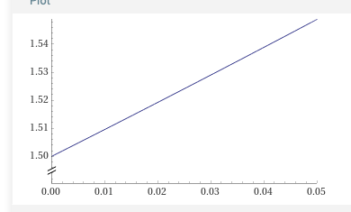
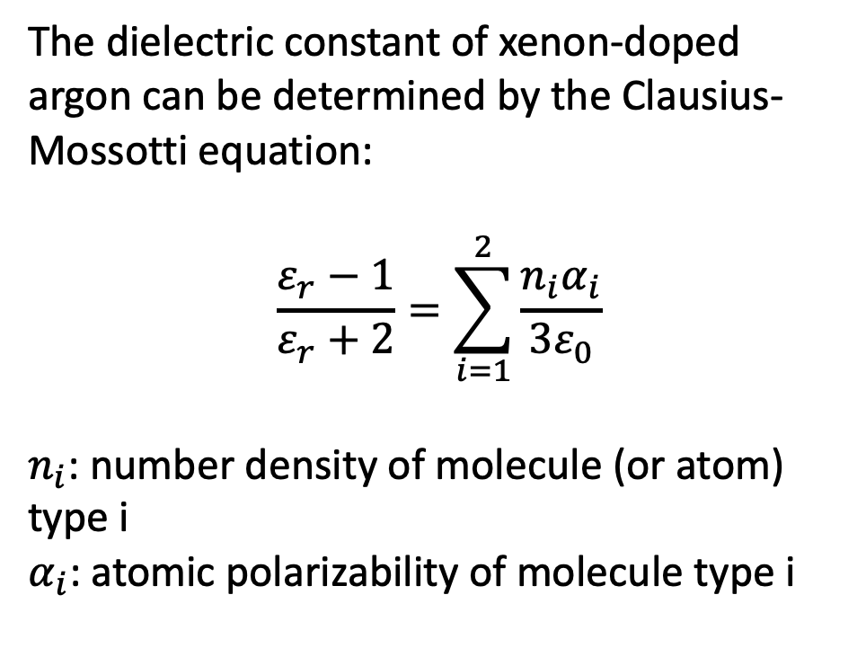
Capacitive Technique to Measure Xenon Concentration in Argon
One can derive a nearly linear dependence of $ε_{r}$on $F_{Xe}:$
The dielectric constant of xenon-doped argon can be determined by the Clausius-Mossotti equation:
$$\frac{ε_{r}−1}{ε_{r}+2}=\sum_{i=1}^{2}{\frac{n_{i}α_{i}}{3ε_{0}}}$$
$n_{i}$: number density of molecule (or atom) type i
$α_{i}$: atomic polarizability of molecule type i
Dielectric Constant
Xenon Concentration (%)
Then the capacitance of a capacitor with a xenon-doped argon dielectric medium is linearly dependent on the xenon concentration

Slide 31
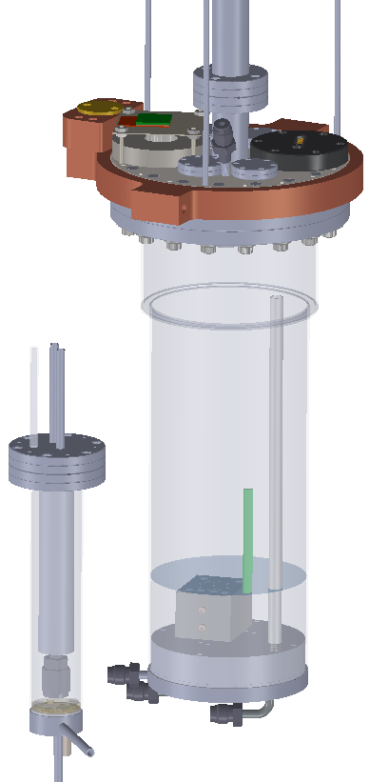
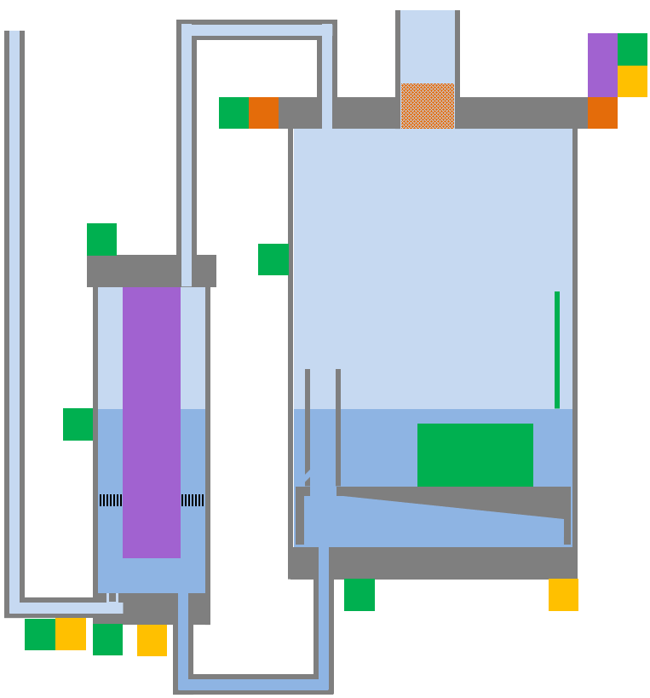
Circulation Design
Camera
Level meter
Conc meter
Bubble router
Thermometers
Heaters
Notes:
The large Henry’s law coefficient has strong implications for circulation design, because the argon preferentially evaporates, leaving the xenon behind. This immediately rules out the standard two-phase heat exchanger used in many noble liquid systems, because the xenon concentrates at the location of evaporation, which would move it all into the heat exchanger.
In our system, we evaporate at the detector liquid surface, which leaves the xenon in the detector, where we want it. Argon is pumped from above the detector, cleaned through a getter, and returned to the heat exchanger, where it is condensed. Note that the concentration of xenon in the heat exchanger is much lower than in the detector, by a factor of Henry’s constant. This greatly reduces the chance of xenon ice accumulation in the heat exchanger.

Slide 32
Circulation Design
To pump and getter
Gas << 35 ppm Xe
Secondary Cooling
Bubble router
+ liquid return
Gas ~10s of ppm Xe
Evaporation &
Condensation
Gas 35 ppm Xe from pump and getter
Primary cooling
Liquid %-level Xe
Conc.
meter
Liq ~35 ppm Xe
Heater
Heater
Ar Condenser
Detector Vessel
Notes:
Quite complicated but the thing to focus on are:
Hot Xe-Ar mixture is input to a condenser
Boiling of the detector bottom during doping puts Xe-poor gas into the Ar condenser
Xe-rich liquid flows to the detector vessel
During circulation, Xe conc. Is maintained via small temperature difference between detector vessel and Ar condenser

Slide 33
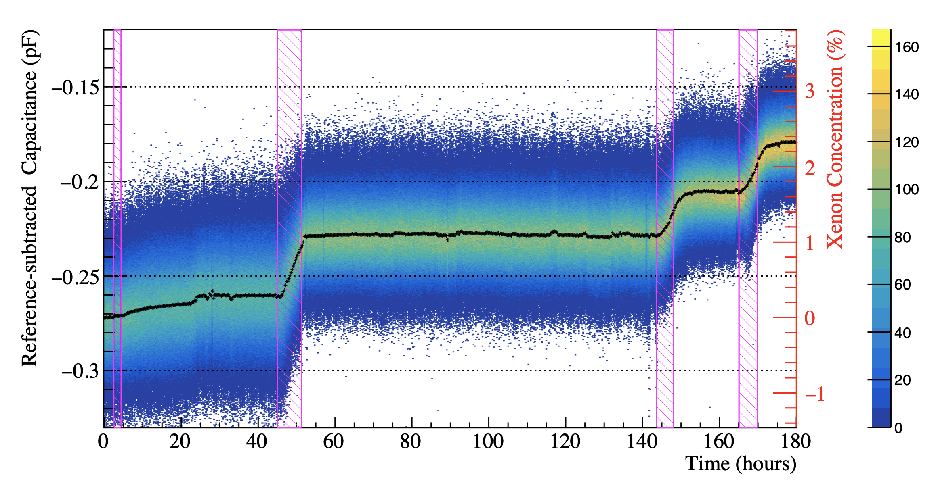
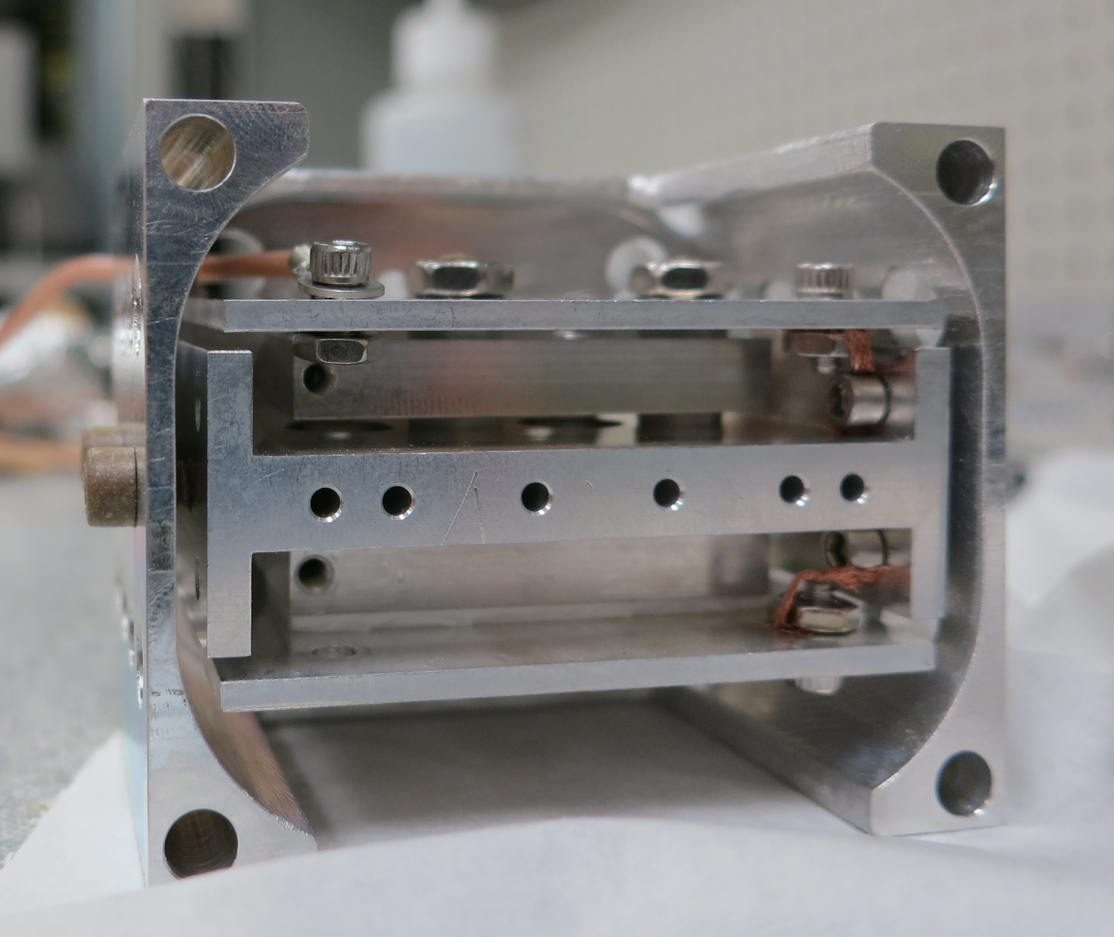
Capacitance and Xenon Concentration in Response to Doping
The CHILLAX capacitor tracks xenon concentration throughout the doping process with 0.05% precision
The capacitor is sensitive to variations in doping conditions (fast vs slow introduction of xenon)
Drifts in capacitance should be attributed to changes in xenon concentration or temperature
Capacitance and xenon concentration in CHILLAX over time, with doping stages highlighted in pink

Slide 34
Stability Tests with Controlled vs Uncontrolled Detector Temperature Gradient
Camera
TSU off
Camera
TSU on
Controlling thermal profile with thermosiphon at top of detector greatly enhances xenon stability in detector volume
Change in xenon concentration results in change in signal characteristics. Detrimental for any detector’s performance!
170K
93.5k
heat
heat
Ice
93K
93K
Capacitance meter
Capacitance meter
A 95 K temperature gradient results in rapid ice buildup
Maintaining a 0.5 K temperature gradient prevents ice buildup for at least 3.5 days

Slide 35
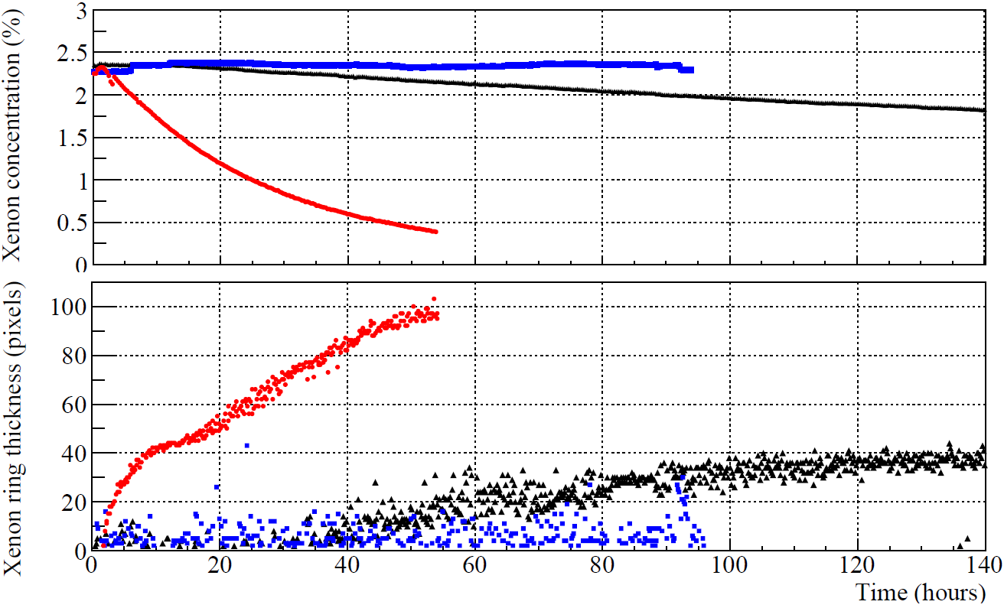
Capacitive and Pixel Measurements of Xenon Stability Tests
< 0.5 K gradient
10 K gradient
Heat flow
75 K gradient
Detector can wall
Notes:
Now we look at a subsequent experiment that includes additional secondary cooling at the top of the detector can. This has reduced the thermal gradient along can wall from 80 K down to 6 K, and the downward heat flux is correspondingly reduced. You can see there is much less xenon frozen in the ring above the liquid surface, and no xenon frozen to the descending cable which is now properly anchored.

