Slide 1
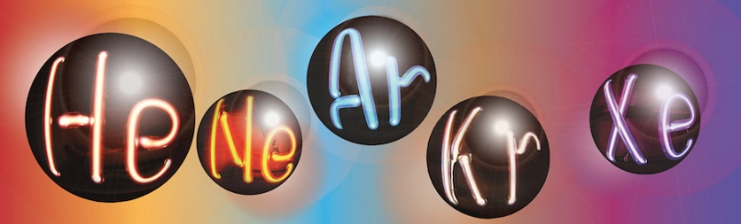


LIDINE2025 – Hong Kong
Scaling Up TPCs for Rare Event Searches:
Space Charge and Pile-Up Effects
Roberto Santorelli
CIEMAT – Madrid
24/Oct/2025

Slide 2
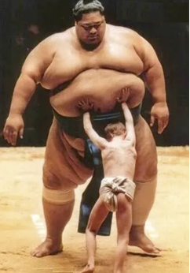
Signal vs Background

Slide 3
Strategy for rare event research:
Lower background
Bigger detector

Slide 4
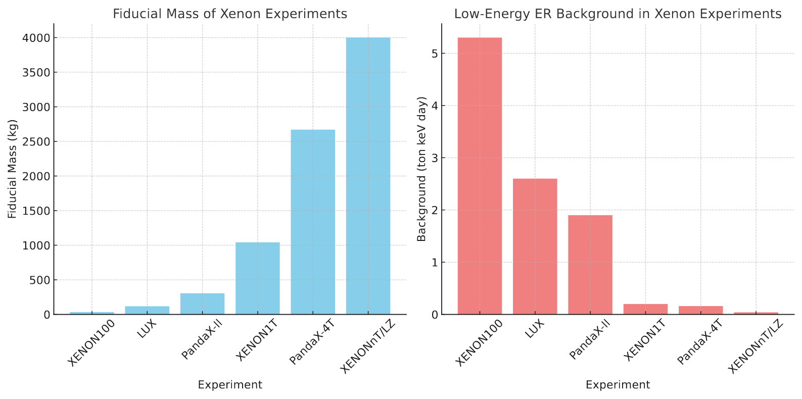

Slide 5
What we need to explore the WIMP parameter space:
Better radiopurity
Bigger detector

Slide 6
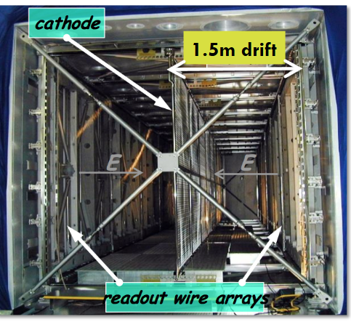
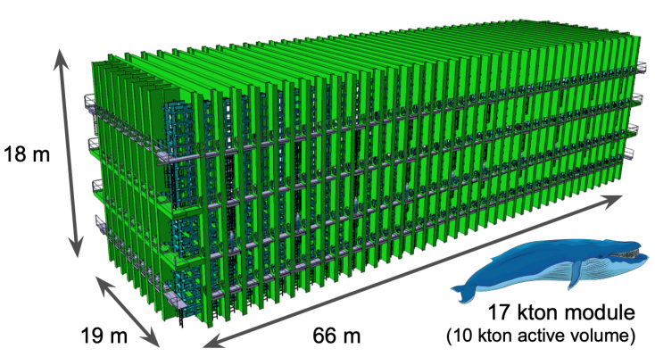
A successful technology
LAr-TPCs have been extremely successful over the last 20 years.
Well proven technology: such types of particle detectors have been used in different fields, spanning 7-8 orders of magnitude difference in energy.
There is currently a strong effort to extend this technology to extreme levels. There are plans for 10 kton-scale detectors with drift length of more than 10 meters.

Slide 7
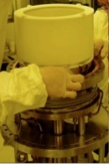
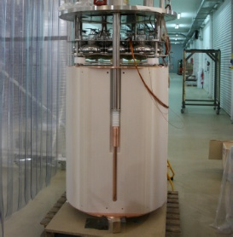
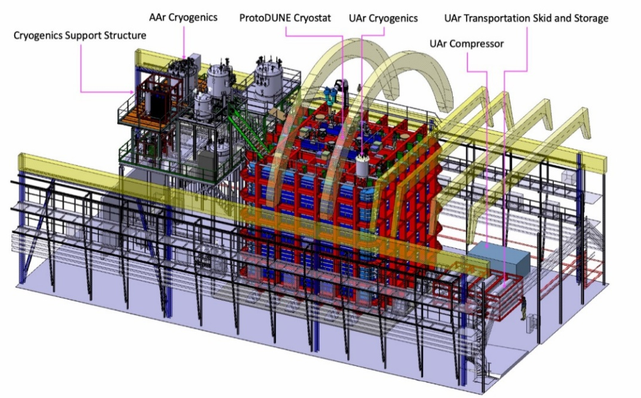
Scaling up
’00s ∼kg-scale
’10s ∼ton-scale
’20s ∼tens of ton

Slide 8
A successful story
Have we investigated everything about this technology?

Slide 9
A successful story
Have we investigated everything about this technology?
Is it possible that instrumental effects, negligible at a small scale, become relevant at a “giant” detector?

Slide 10
Frontiers
Signal reconstruction
Charge drift
Light emission

Slide 11
Frontiers
Signal reconstruction
Charge drift
Light emission

Slide 12
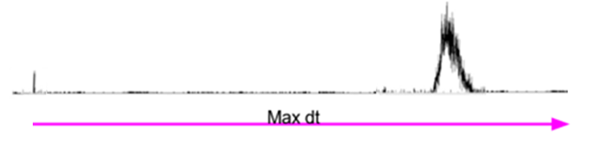
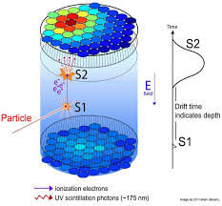
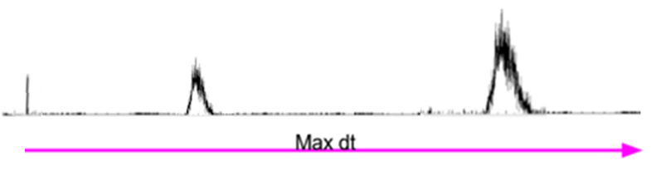
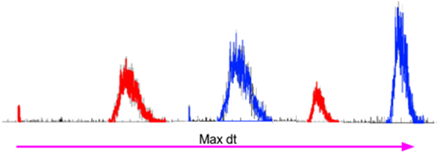
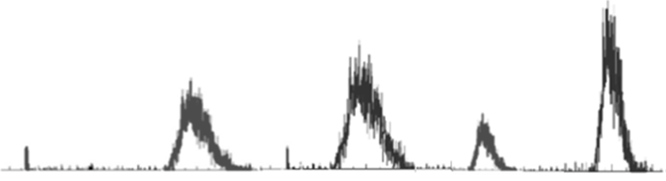
Reconciling S2 and S1
time
Conceptual example

Slide 13
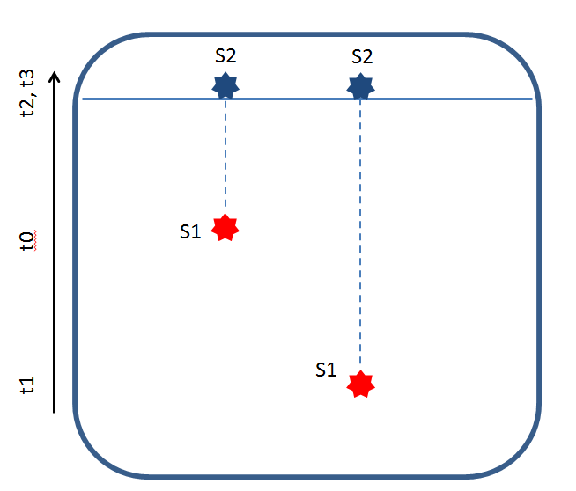
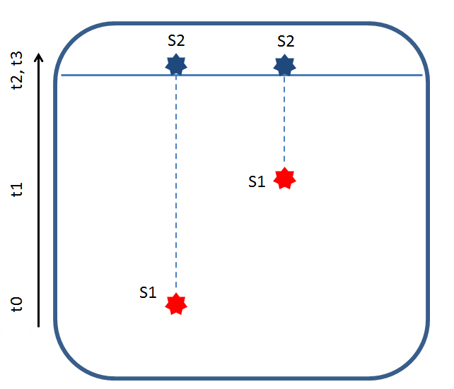
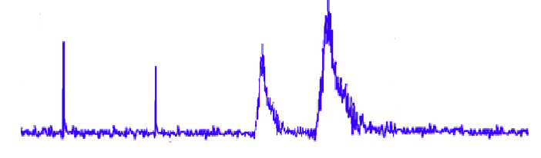
Pile-up problems
time
S2
S1
S2
S1
Max drift time

Slide 14
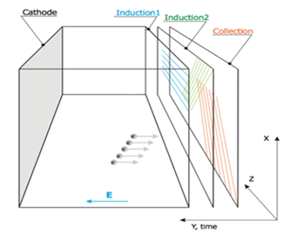
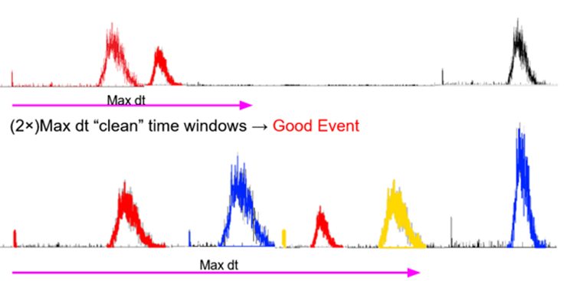
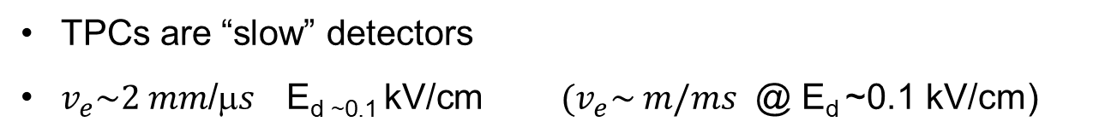
Pile-up problem
TPCs are “slow” detectors
${v_{e}\sim 2 mm\text{/}μs \text{E}\text{d}\text{ \sim 0.1 }\text{kV}\text{/}\text{cm} (v}_{e}\sim m/ms$ @ E_{d} ~0.1 kV/cm)
time

Slide 15
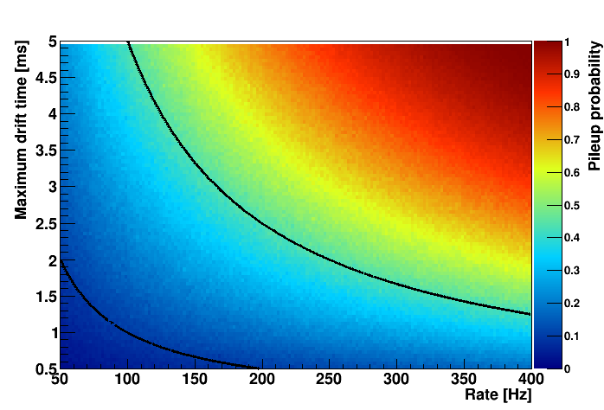
Pile-up probability
This widely limits the maximum allowed interaction rate in a TPC → setting very stringent limits on the material contamination (gamma)
Pile-up limits the max drift distances (i.e. size of the detector)
Possible mitigation strategies based on M.L.
50%
10%

Slide 16
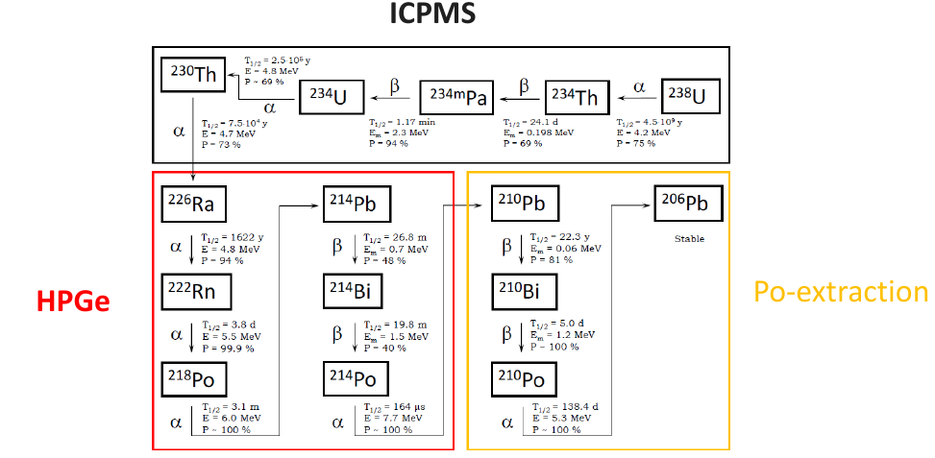
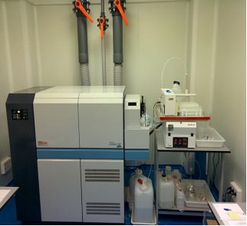
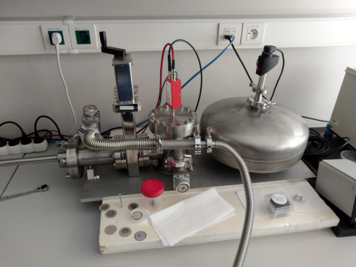
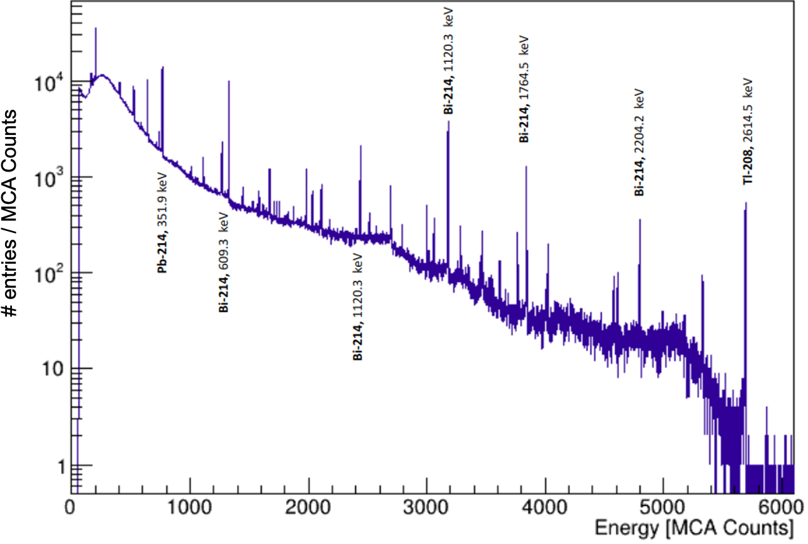
Equilibrium in the U-238 chain
Radiochemical
Little mass needed
Relatively fast
Digestion
Destructive
Only Po-210 (Pb-210)
ICPMS
Very little mass needed
Relatively fast
Digestion
Destructive
Only U-238 (Th-232)
HPGe
Larger mass needed
Slow
Non-destructive
Gamma activity (⁴⁰K+...)

Slide 17
Back-of-the envelope calculation
Future DM detector: ~100 m² sensor coverage
Sensor radioactivity ~1 mBq/cm²
1 kHz event rate in the detector

Slide 18


Slide 19
Frontiers
Signal reconstruction
Charge drift
Light emission

Slide 20
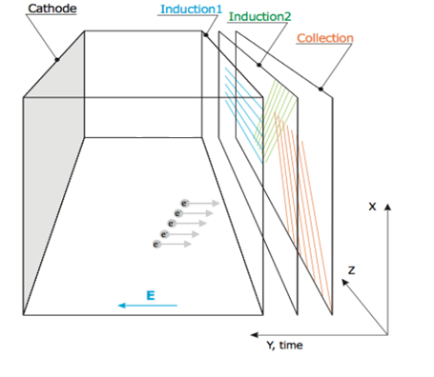
Charge signal in a TPC

Slide 21
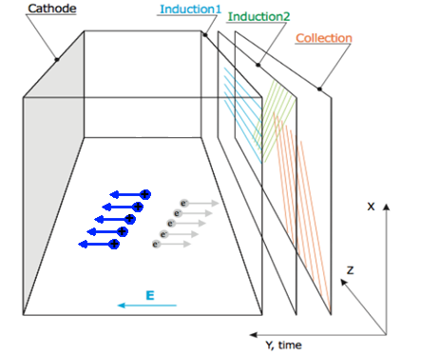
Charge signal in a TPC
how about the positive charges?

Slide 22

Space charge
Ions have drift velocity which is five to six orders of magnitude lower than the el.
Without taking into account the liquid motion:
${ }_{i}\sim 2∙{10}^{−4}{cm}^{2}V^{−1}s^{−1}$ (T.H. Dey , T.J. Lewis , J. Phys. D: Appl. Phys. 1 (8) - 1968)
  ${ }_{i}\sim 1.6∙{10}^{−3}{cm}^{2}V^{−1}s^{−1}$ (M. Torti , Proceedings of the Fourth International Conference on New Frontiers in Physics - 2015 )
  At $E_{d}$=1 kV/cm, ${ v}_{i}\sim 1.6∙{10}^{−5}mm$/$s$ to be compared to ${ v}_{e}\sim 2 mm$/$s$
${ v}_{i} ≪$ $v_{e}  _{i} ≫$ $_{e}$ Depending on drift field, ionization rate,
(+liquid motion ...etc)
The electrons drift to the anode, the ions stay!
The space charge can locally modify the electric field, the drift lines and the velocity of electrons
The electron drift in a positively charged volume (neutral target only when the field is off)

Slide 23

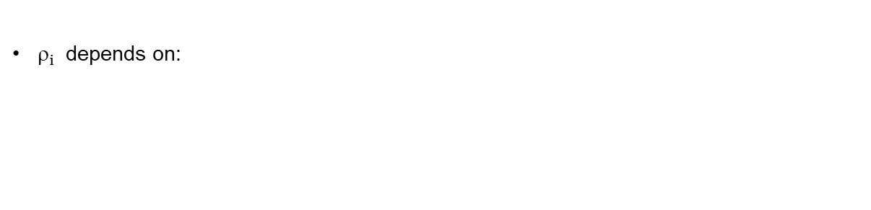
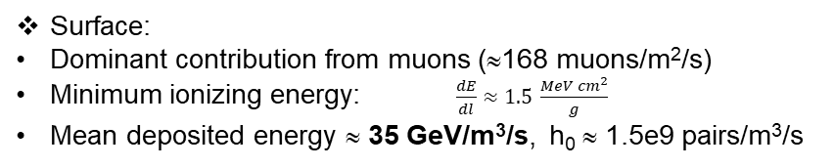
Space charge
$_{i}$ depends on:
Amount of ionization (event energy and rate)
Total drift length
Ion velocity ($E_{d}$ and mobility)
Drift velocity:
${ v}_{i}\sim 10 mm$/$s$ (to be compared to ${ v}_{e}\sim 2 m/ms$ for $E_{d}$=1 kV/cm)
Drift distance:
…up to 12 m !
“Ion yield”:
Underground:
“Dominant” contribution from ³⁹Ar (~1 Bq/kg or ~1.4 kBq/m3)
Q-value of 565 keV, 1/3 mean energy, One decay 8e3 pairs,
Mean deposited energy 263 MeV/m³/s, h₀ ~ 1.1e7 pairs/m³/s
Surface:
Dominant contribution from muons (≈168 muons/m²/s)
Minimum ionizing energy: $\frac{dE}{dl}≈1.5 \frac{MeV {cm}^{2}}{g}$
Mean deposited energy ≈ 35 GeV/m³/s, h₀ ≈ 1.5e9 pairs/m³/s

Slide 24
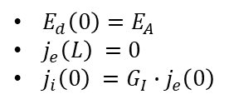
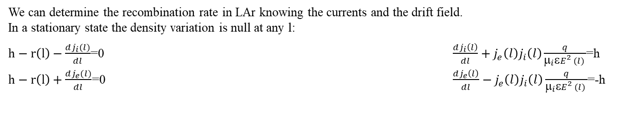
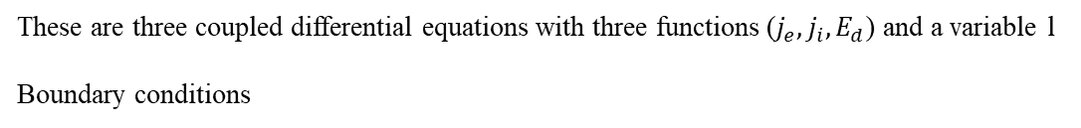
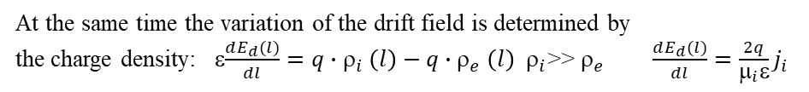
Mathematical framework - I
Electron and ion fluxes as $j_{i,e}(l)=v_{i,e}\left(l\right)ρ_{i,e}\left(l\right)$ $v_{i,e}(l)=μ_{i,e}E_{d}\left(l\right)$
The recombination rate is given by $r(l)=j_{e}\left(l\right)ρ_{i}\left(l\right)S_{cs}(l)$ ⇒ $r(l)=j_{e}\left(l\right)j_{i}\left(l\right)\frac{q}{μ_{i}εE_{}^{2}(l) }$
d
We can determine the recombination rate in LAr knowing the currents and the drift field.
In a stationary state the density variation is null at any l:
$h−r\left(l\right)−\frac{dj_{i}(l)}{dl}$=0 $\frac{dj_{i}\left(l\right)}{dl}+j_{e}\left(l\right)j_{i}\left(l\right)\frac{q}{μ_{i}εE_{}^{2}(l) }$=h
$h−r\left(l\right)+\frac{dj_{e}(l)}{dl}$=0 $\frac{dj_{e}\left(l\right)}{dl}−j_{e}\left(l\right)j_{i}\left(l\right)\frac{q}{μ_{i}εE_{}^{2}(l) }$=-h
(h constant ionization rate)
d
d
At the same time the variation of the drift field is determined by
the charge density: ε$\frac{dE_{d}(l)}{dl}=q{∙ρ}_{i}\left(l\right)−q{∙ρ}_{e}\left(l\right)$ $_{i}$>> $_{e}$ $\frac{dE_{d}(l)}{dl}=\frac{2q}{μ_{i}ε}j_{i}$
2
These are three coupled differential equations with three functions ($j_{e},j_{i},E_{d}$) and a variable l
Boundary conditions
$E_{d}\left(0\right)=E_{A}$
$j_{e}\left(L\right) =0$
$j_{i}\left(0\right) ={G_{I}∙j}_{e}\left(0\right)$
Astropart.Phys. 92 (2017) 11-20

Slide 25
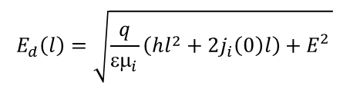
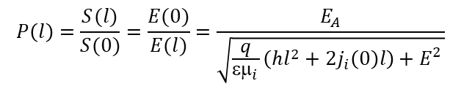
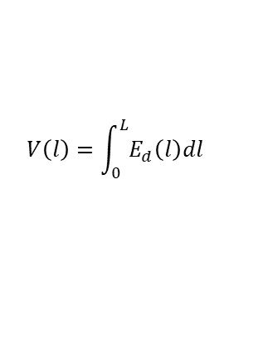
Mathematical framework - I
$$E_{d}\left(l\right)=\sqrt{\frac{q}{εμ_{i}}\left(hl^{2}+2j_{i}\left(0\right)l\right)+E_{}^{2}}$$
The field variation is a function of l
A
The field is minimum at 0 (${E_{d}\left(L\right)=E}_{A}$) and maximum at the cathode
The cathode voltage necessary to obtain a given field can be calculated integrating the drift field
$$V\left(l\right)=\int_{0}^{L}{E_{d}\left(l\right)dl}$$
The secondary recombination probability is equal to the fraction of the surface S(l) spanned the filed lines ending on the anode with respect to the total anode (cathode) area.
$$P\left(l\right)=\frac{S(l)}{S(0)}=\frac{E(0)}{E(l)}=\frac{E_{A}}{\sqrt{\frac{q}{εμ_{i}}\left(hl^{2}+2j_{i}\left(0\right)l\right)+E_{}^{2}}}$$
A
Field variation, cathode voltage and secondary recombination probability can be calculated knowing the constant ionization rate, the field at the anode and ion gain $G_{i}$

Slide 26
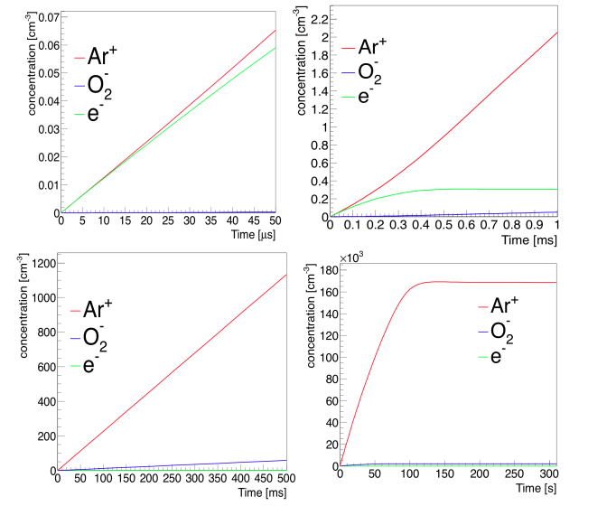
Finite element analysis
COMSOL Multiphysics
Electrostatics and Transport of Diluted Species modules
1 × 1 × 1 m3 box filled with liquid Argon, 100 kV between the top and the bottom surface.
JINST 13 (2018) 04, C04015

Slide 27
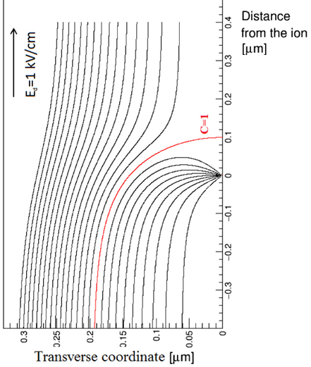



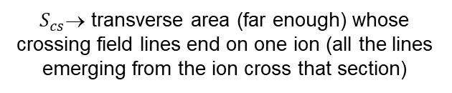


Field distortion, “Secondary”recombination and volume light emission
l=0
A
$E_{d}=$1 kV/cm
Ed
l
Free ion
Free electron
l=L
K
$S_{cs}$→ transverse area (far enough) whose crossing field lines end on one ion (all the lines emerging from the ion cross that section)
Displacement of the reconstructed position
“Uncorrelated” light emission due to “secondary recombination”
$S_{cs}$= $1.2∙{10}^{−7}{mm}^{2}$
${with E}_{d}$=1 kV/cm

Slide 28
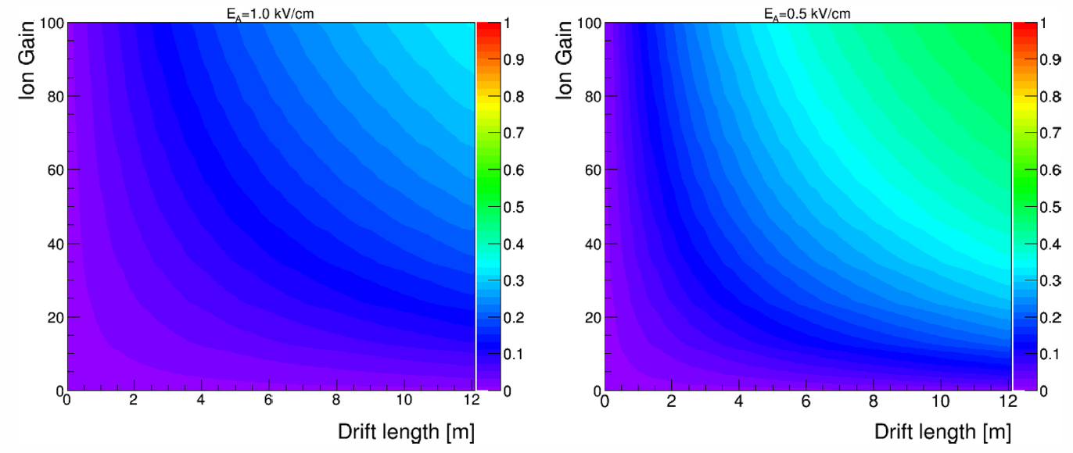
Underground case L=12 m
Astropart.Phys. 92 (2017) 11-20

Slide 29
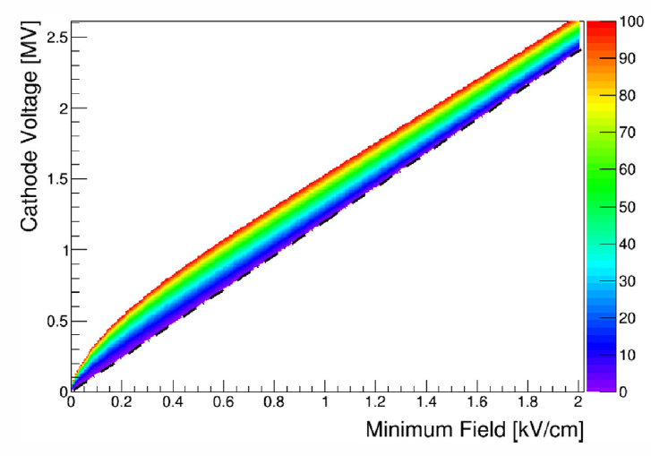
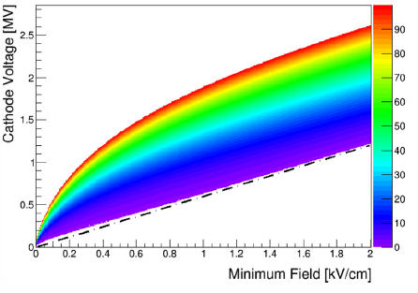


HV and electric field
Detector with 12 m drift UG
Dominant contribution from ³⁹Ar
(h₀ ~ 1.1e7 pairs/m³/s)
Detector with 6 m drift UG
Dominant contribution from ³⁹Ar
(h₀ ~ 1.1e7 pairs/m³/s)
L=12 m
$$G_{i}$$
L=6 m
$$G_{i}$$

Slide 30
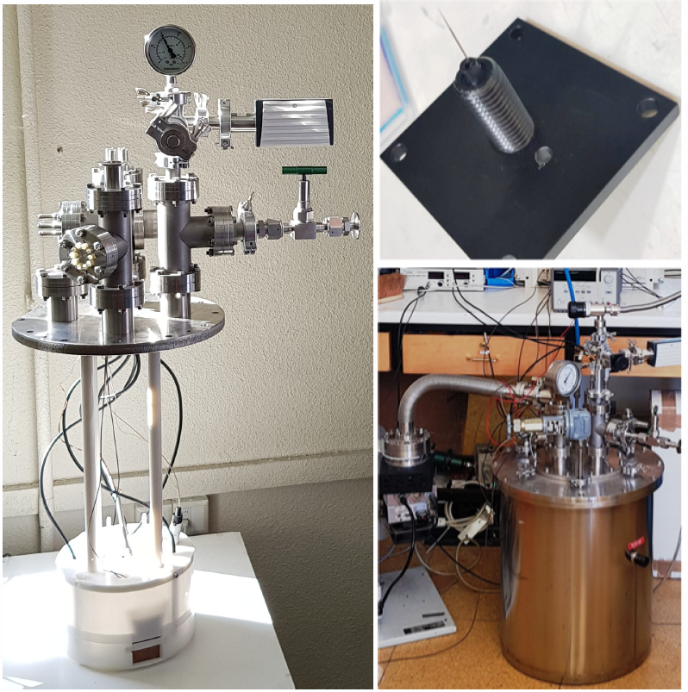
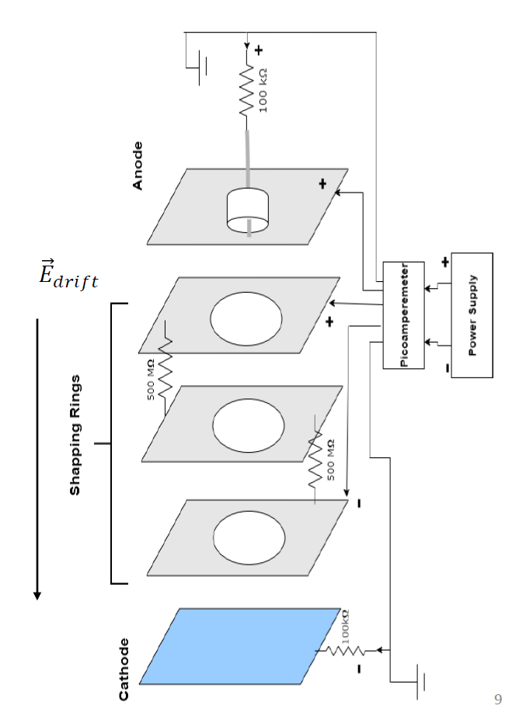

ArIon: Experimental setup

Slide 31
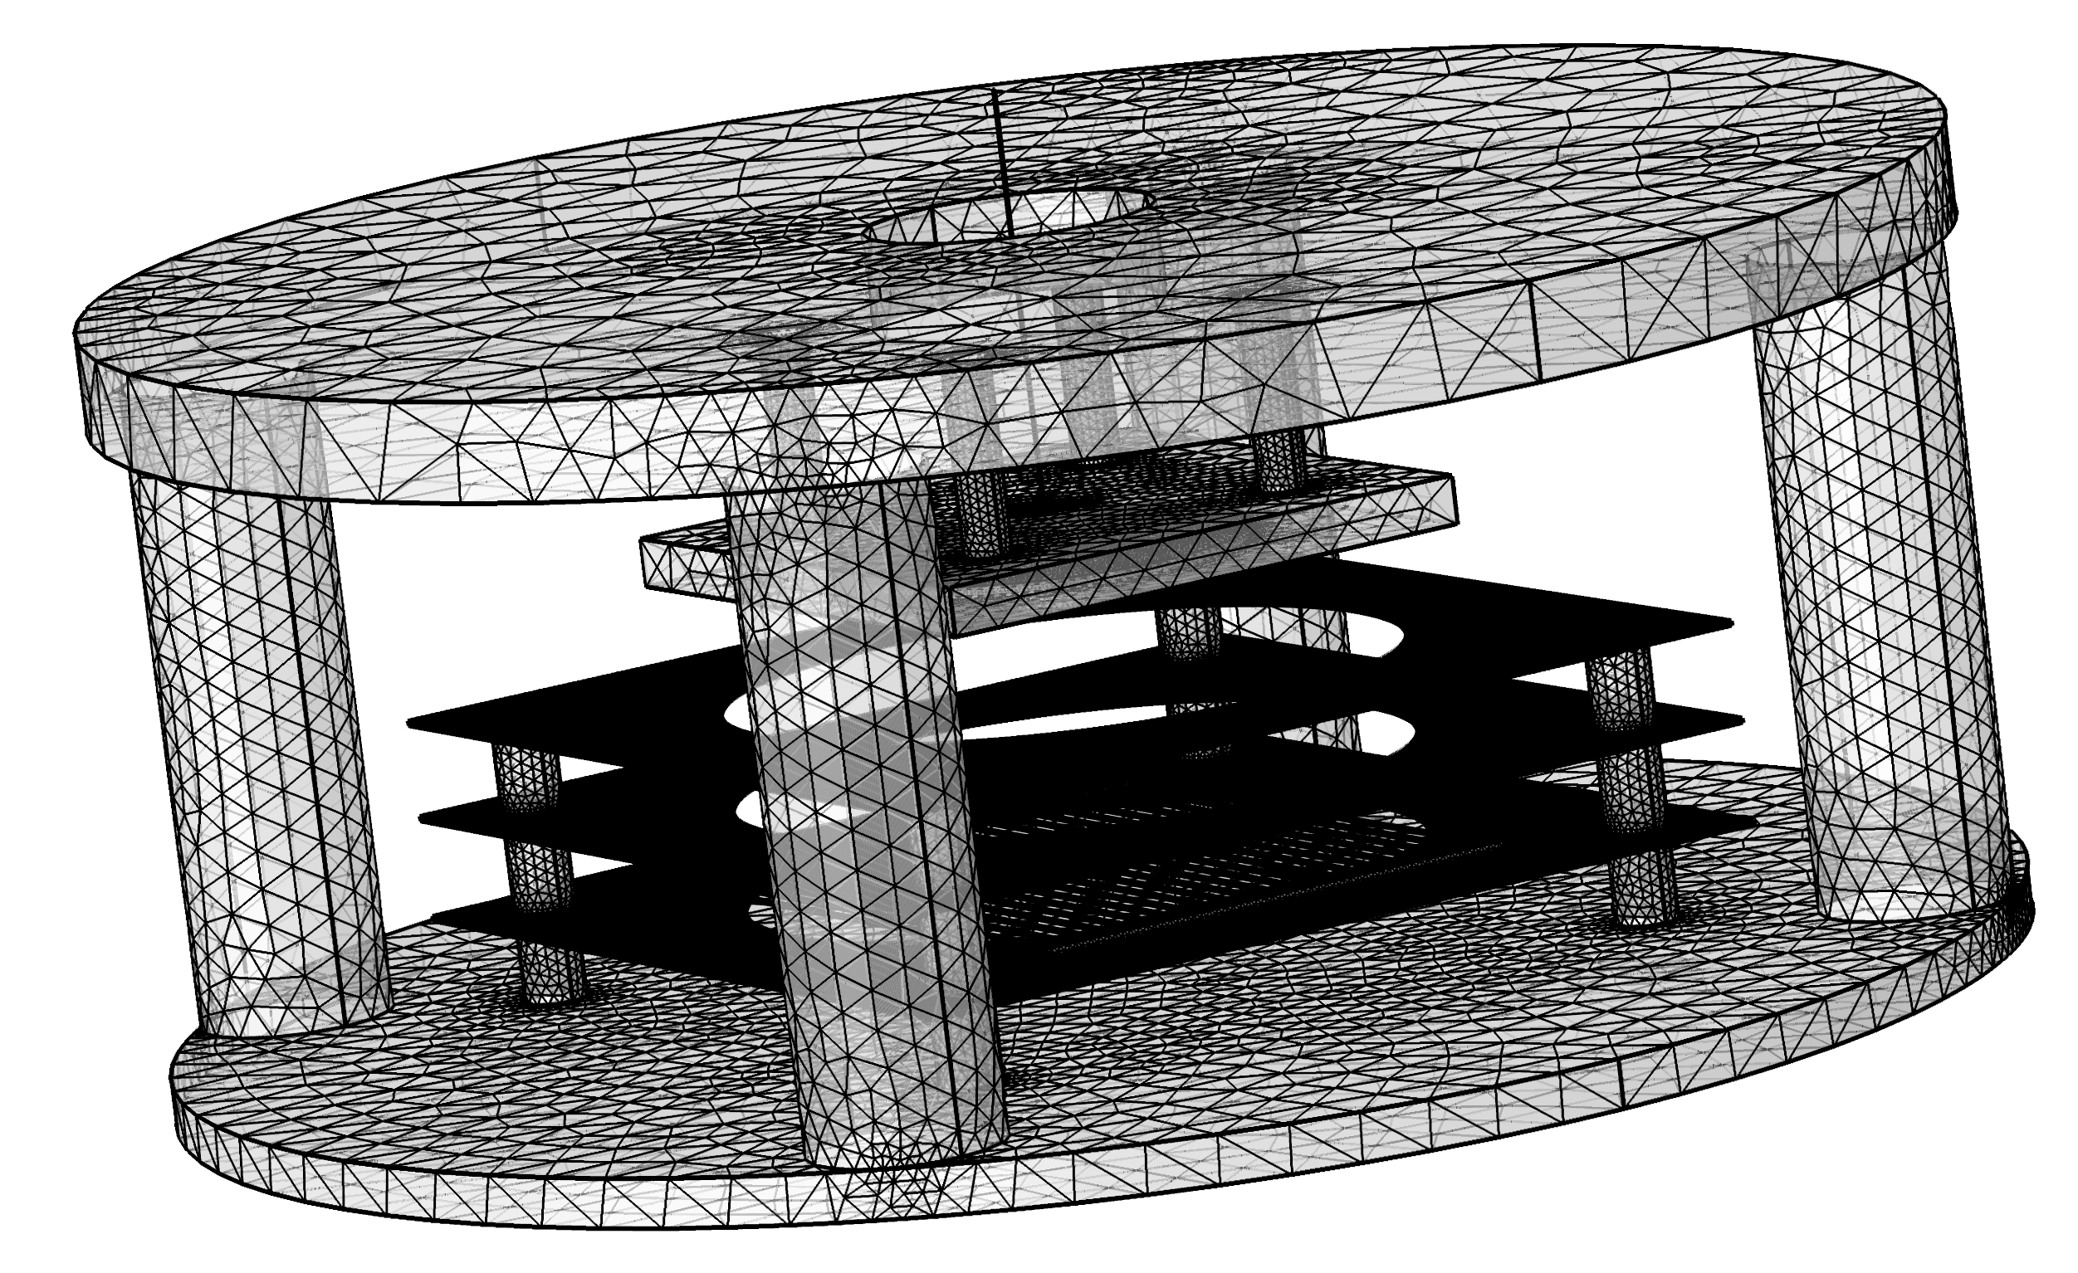
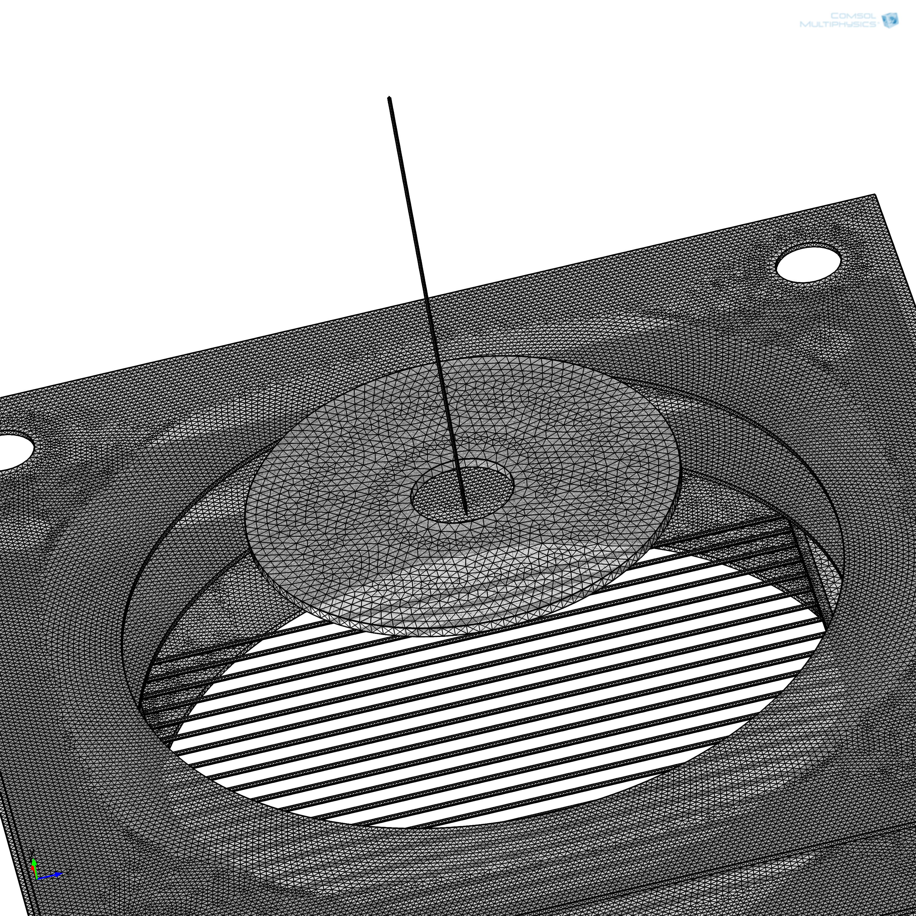
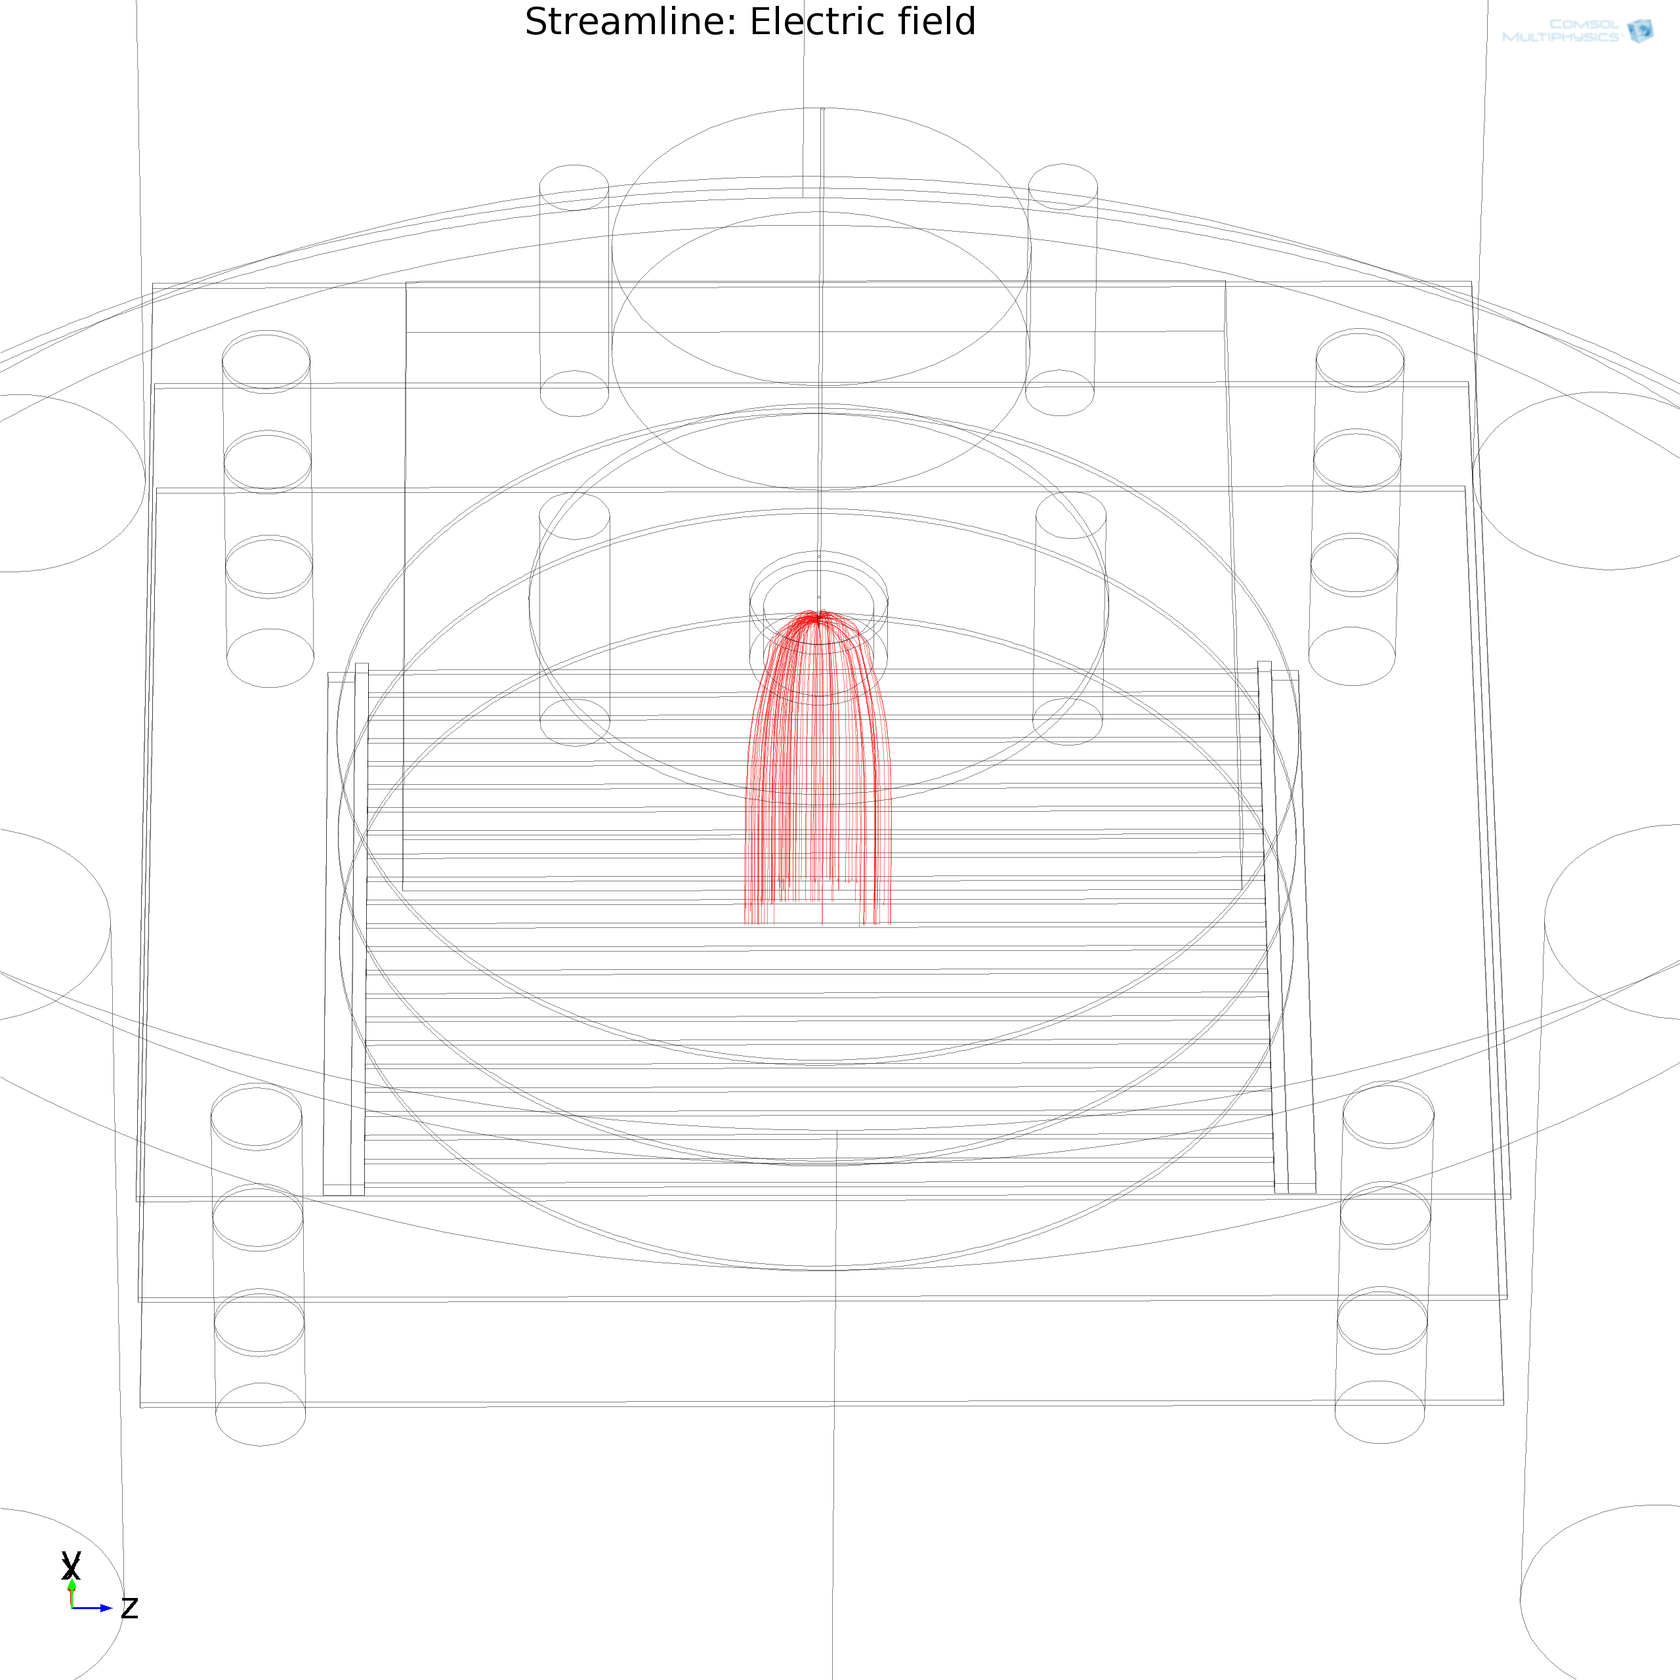
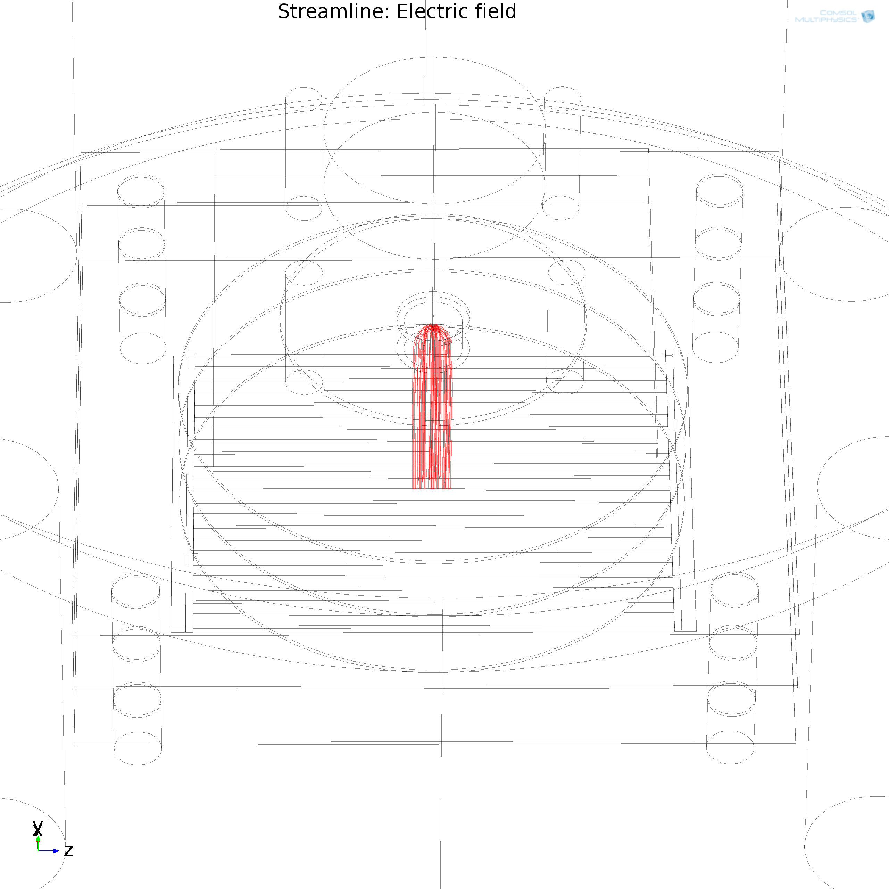
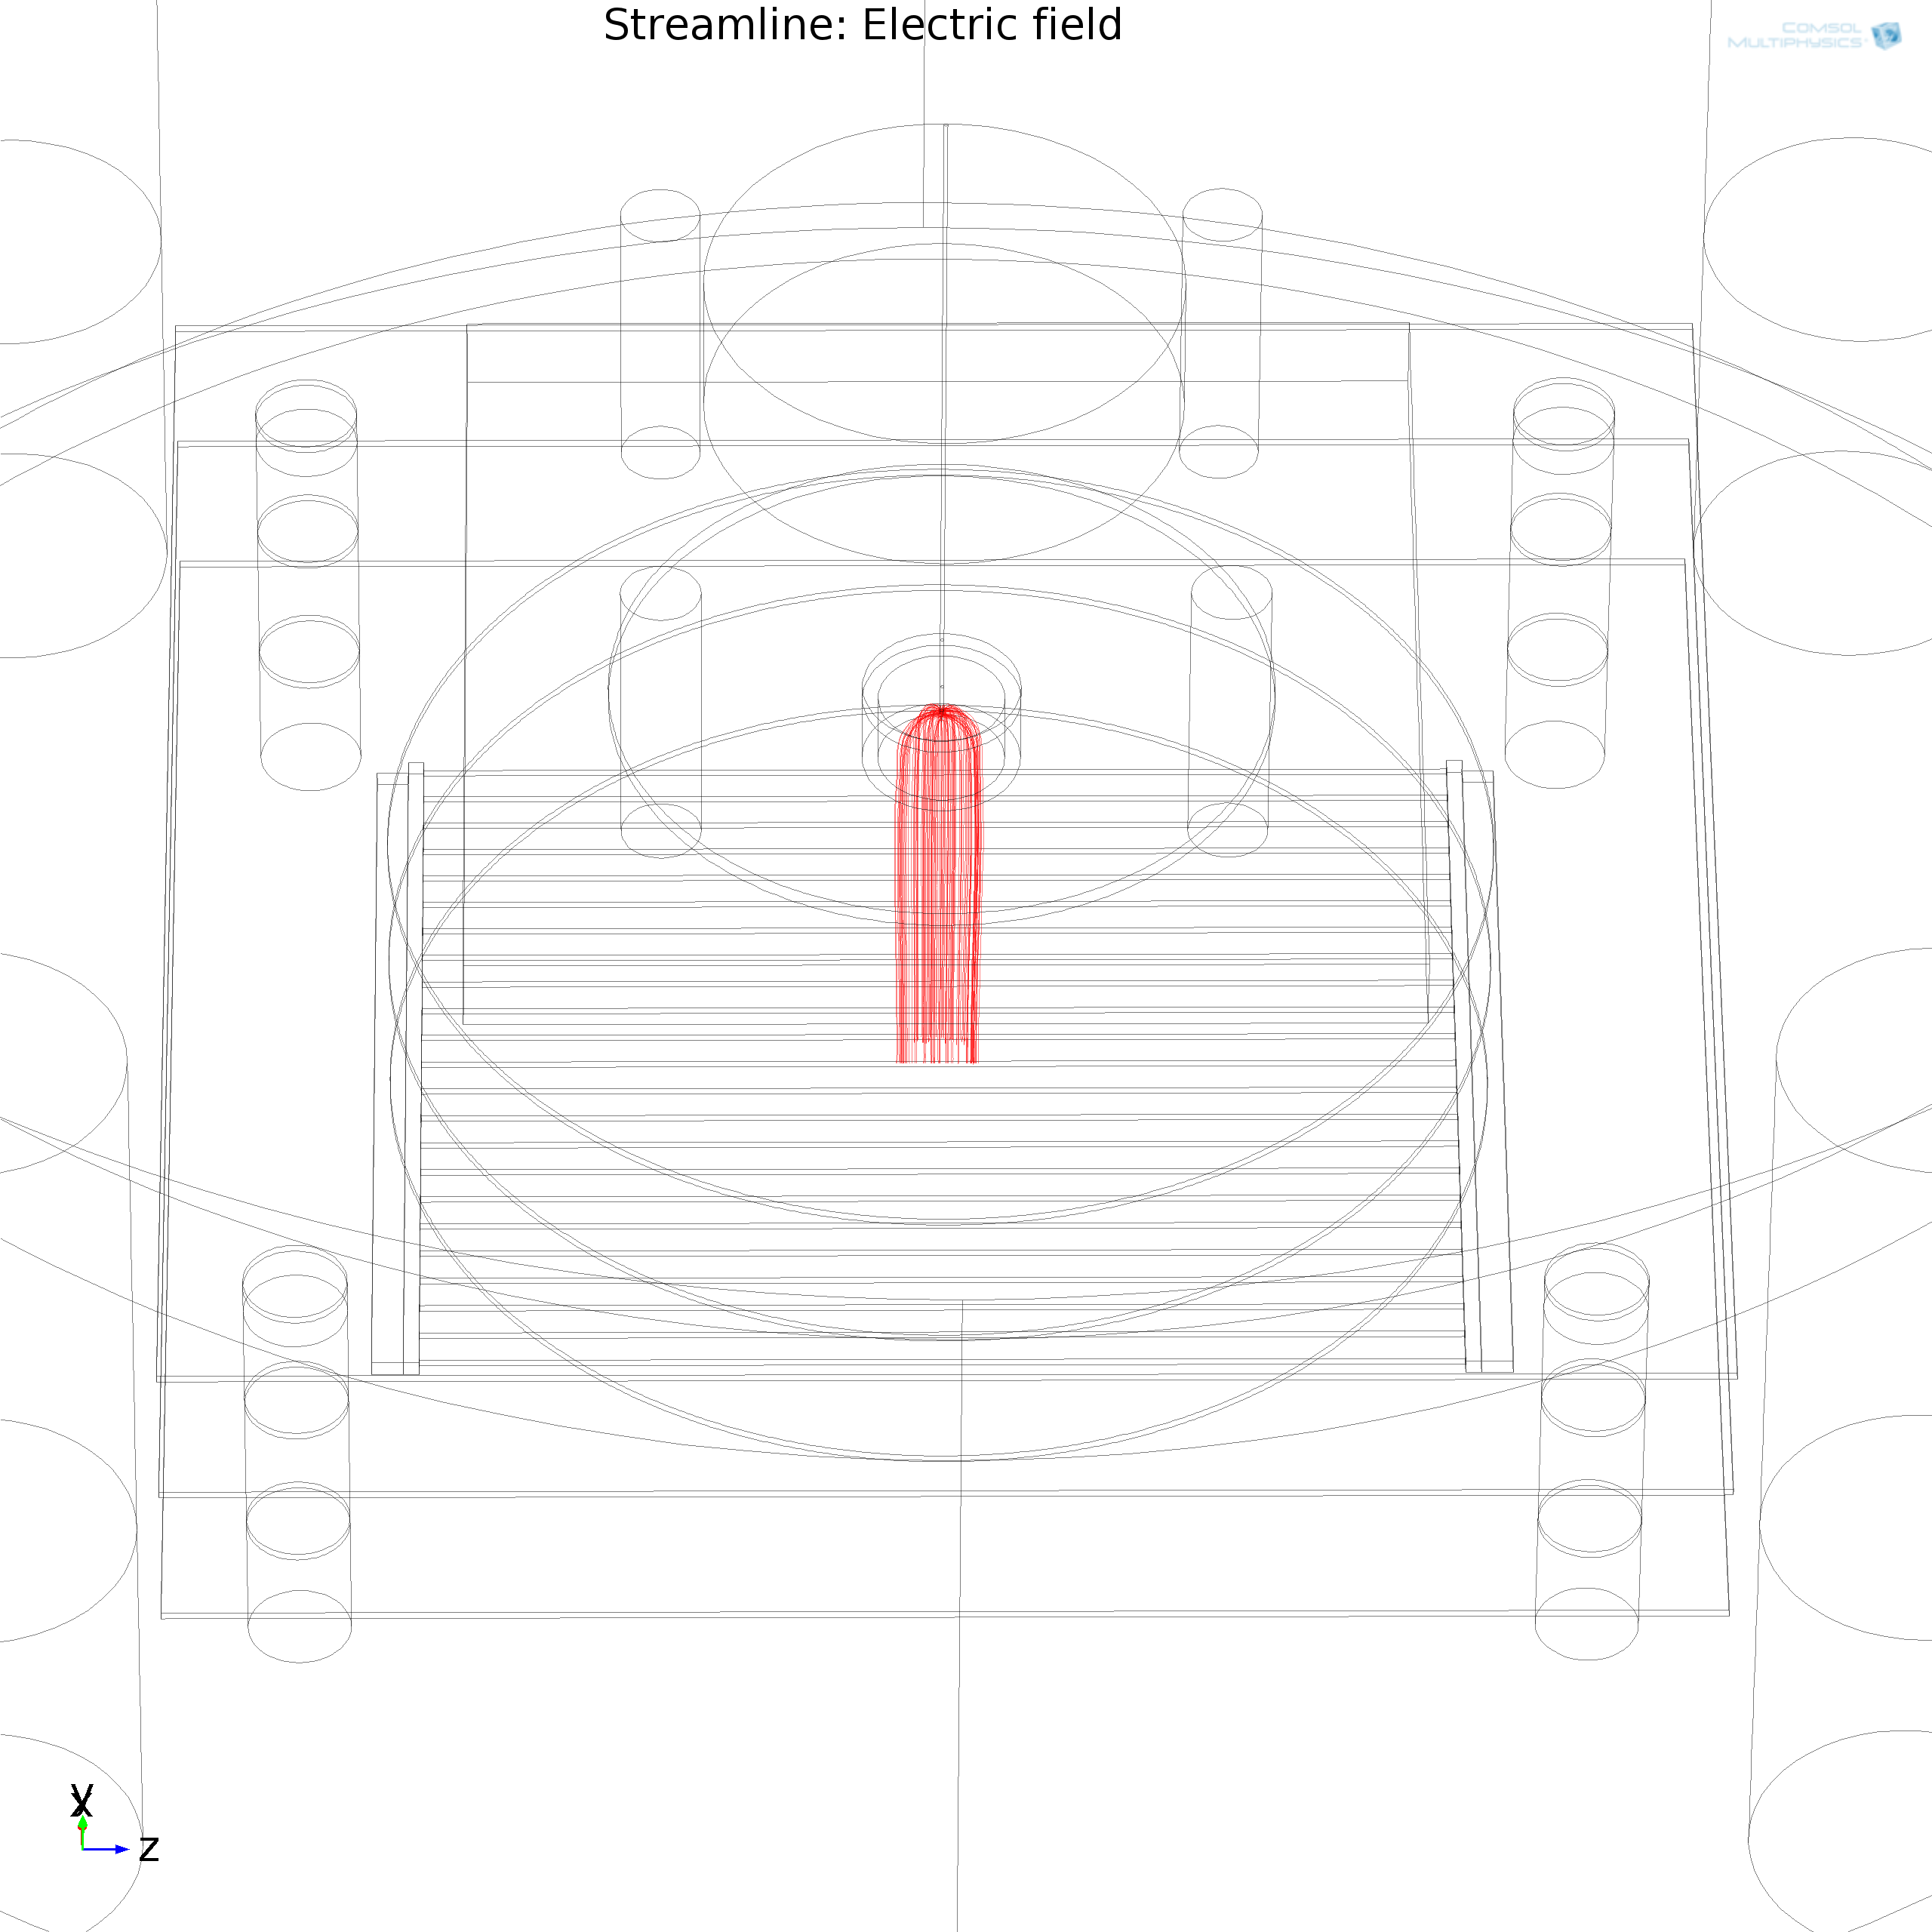
Field lines from the tip of the needle
COMSOL
  Liquid + gas
  Warm gas
  Cold gas
Universe 8 (2022) 2, 134,

Slide 32
Summary & conclusions
LAr-TPCs: a proven, versatile technology! Now scaling up to unprecedented sizes.
Rare event searches need very large exposures, and extraordinary background mitigation/rejection.
Ongoing worldwide R&D (materials radiopurity, UAr, GADMC) trying to address these challenges.
Key open issues: pile-up, space charge effects, light emission.
Roberto Santorelli - LIDINE25, 24/Oct/25 32

Slide 33

谢谢大家！

Slide 34

^{Bonus Slides}

