Slide 1
Vector Meson Gravitational Form Factors at finite temperature within the AdS/QCD Model
2025.1.24

Slide 2
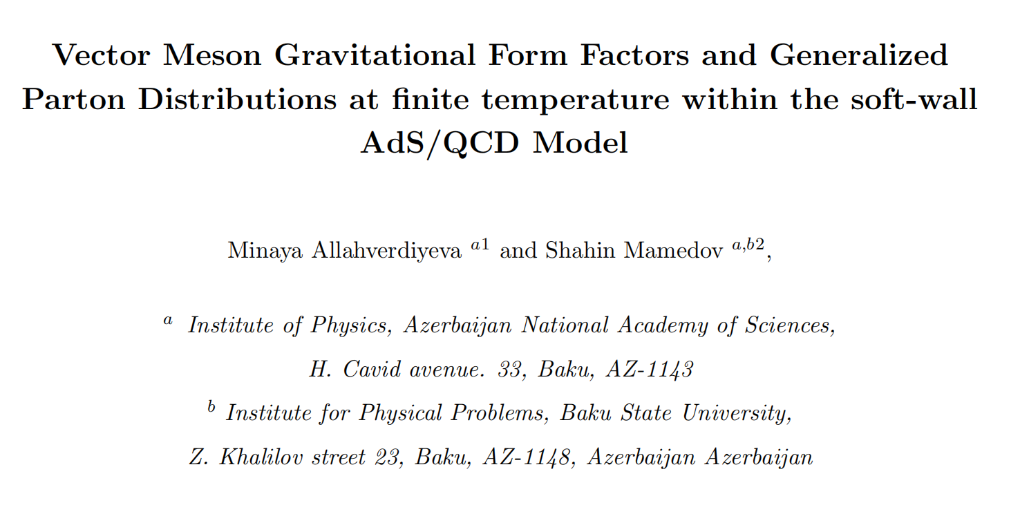
arXiv: 2302.03383

Slide 3
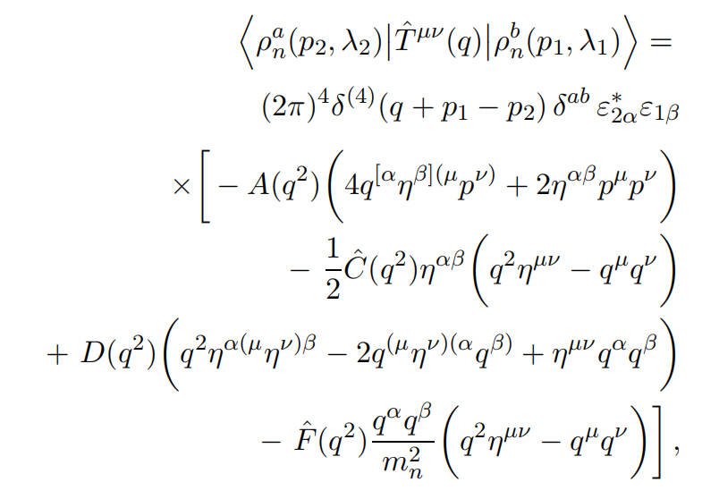
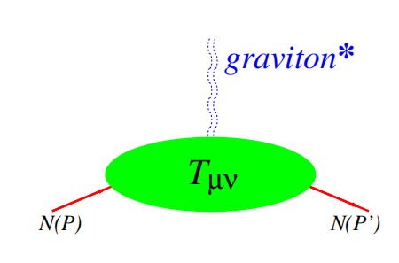
GFFs of Vector Meson

Slide 4
GFFs of Vector Meson in Holography
Stress tensor matrix elements of ρ meson can be extracted from the 3-point function
using
According to AdS/CFT correspondence

Slide 5
Holographic Model
5D Action
Metric at zero temperature

Slide 6
Holographic Model
The 4D metric g_{µν} is linearly perturb around its static solution
The gravity part of the action in the second order of the h_{µν} perturbation becomes
EoM

Slide 7
Holographic Model
Thermalization of the model is done by introducing the thermal dilaton field[1]
The AdS-Schwarzschild metric in terms of r coordinate gets a form:
[1]. arXiv:hep-th/1902.01312

Slide 8
Holographic Model
The action for the graviton at finite temperature in the second-order perturbation in the thermal dilaton approach will be obtained from the zero temperature action by replacing

Slide 9
Holographic Model
Vector fields have Kaluza-Klein decomposition
where satisfy
The solution for the first Kaluza-Klein mode, i.e. ρ meson’s profile function ψ_{n}(z), is expressed as follows

Slide 10
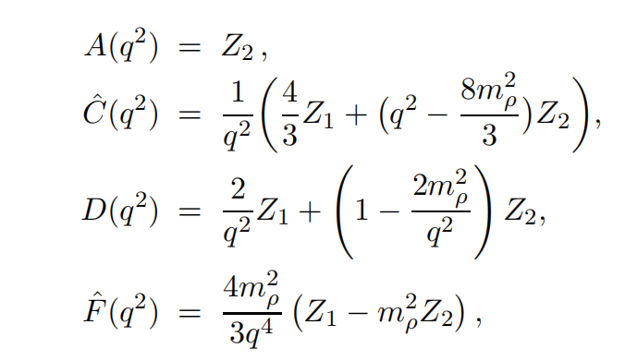
GFFs of Vector Meson in Holography
These GFFs can be expressed by the invariant functions Z₁ and Z₂.
At finite temperature

Slide 11
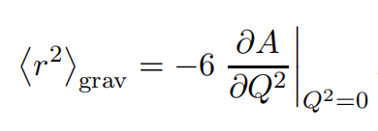
GFFs of Vector Meson in Holography
The gravitational RMS (root mean square) radius is defined through taking the derivative from the gravitational form factor A(q²):
The charge radius of the rho-meson is
The result indicates that while the charge is spread over a certain volume, the energy that contributes to the mass of the particle is concentrated in a smaller kernel.

Slide 12
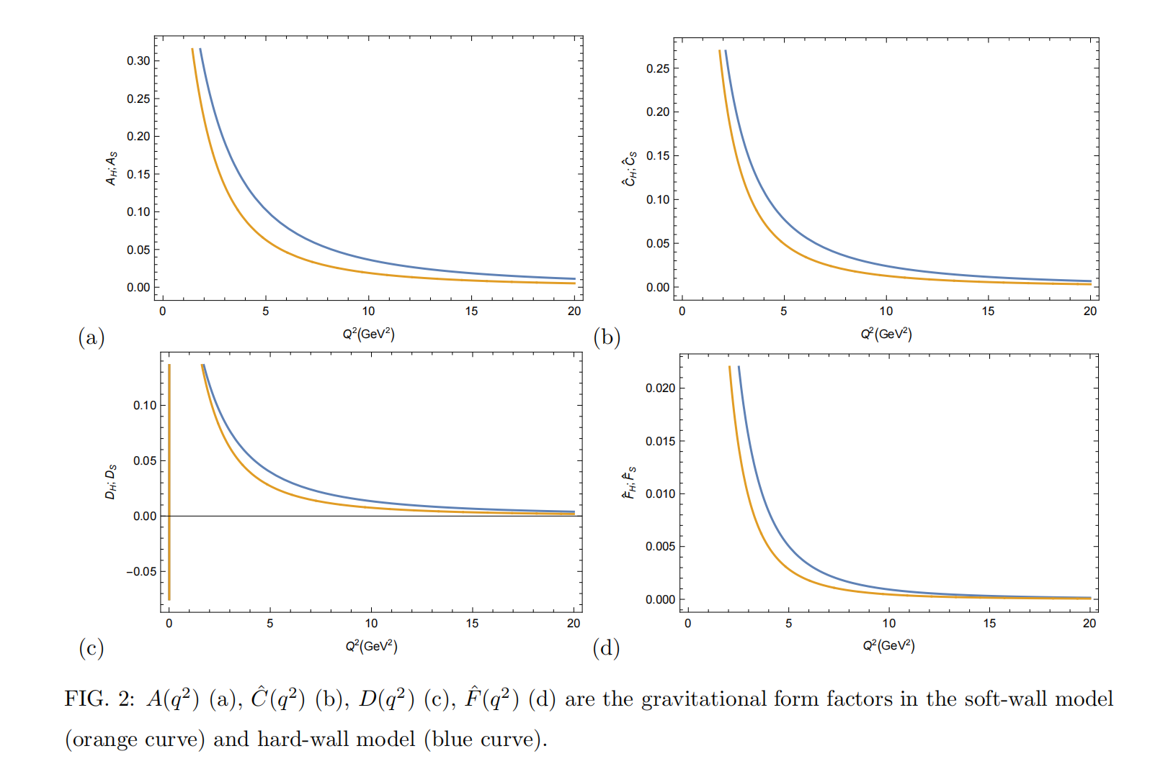
Numerical Result(Zero temperature)

Slide 13
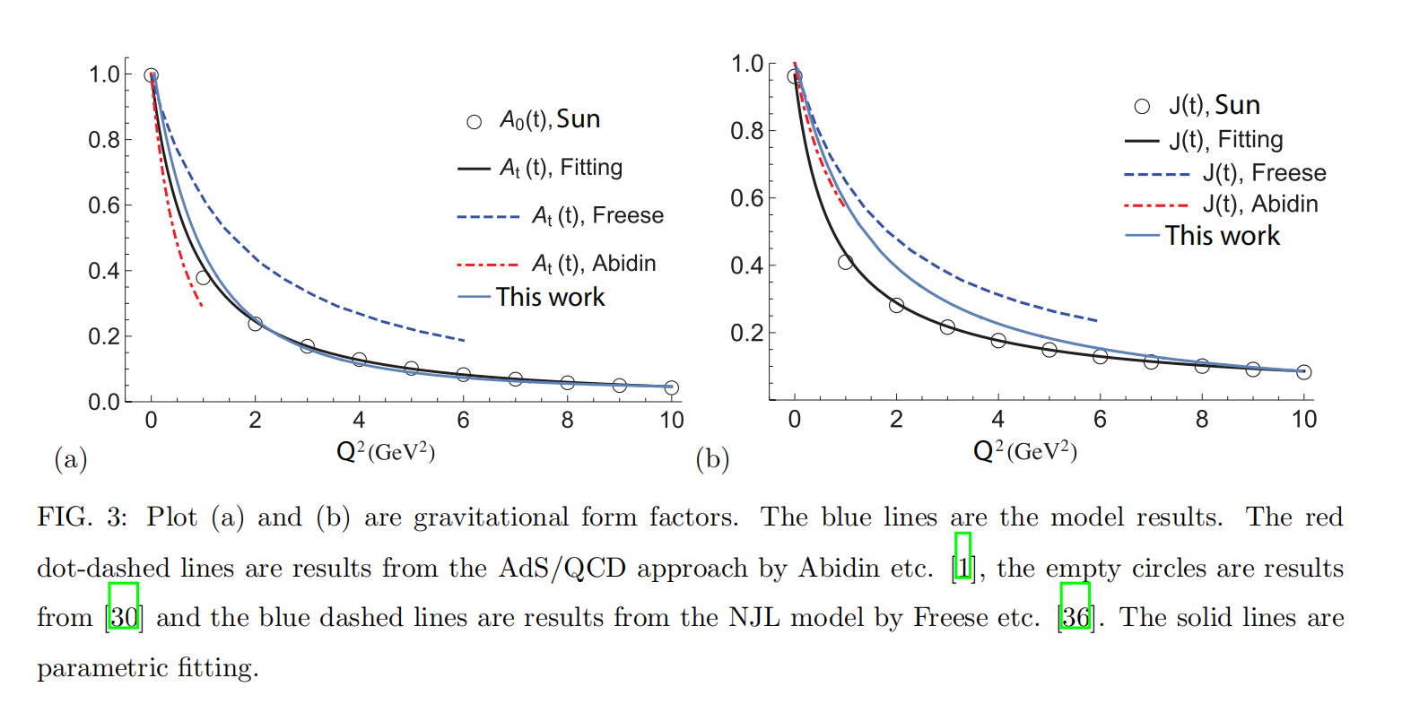
Numerical Result(compare with other method)

Slide 14
Numerical Result(Finite temperature)

Slide 15
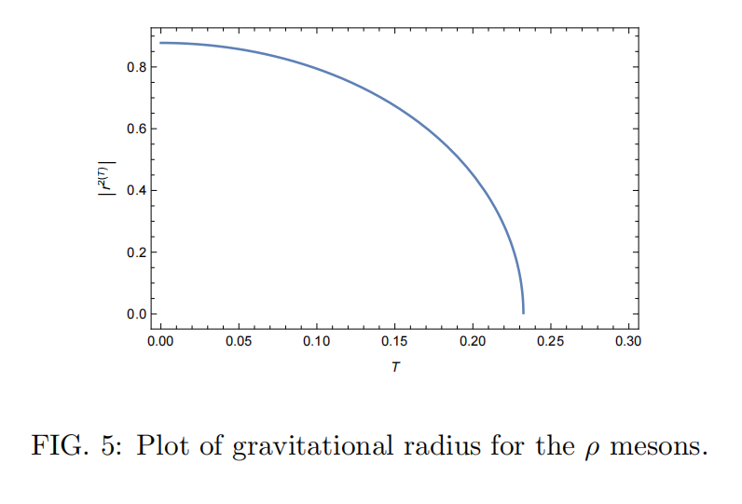
Numerical Result(Gravitational radius)

Slide 16
NUMERICAL ANALYSIS
Z₁, Z₂ and radius decreases on temperature increases and becomes zero around the critical temperature T_{c} temperature.
The vanishment of these quantities was interpreted as a meson splitting into quarks and ending meson state in the result of high temperature.

Slide 17
Thanks

