Slide 1

CEPC Control System
Design Progress Status
环形正负电子对撞机
Circular Electron Positron Collider
20 Feb., 2025
Dapeng Jin
Institute of High Energy Physics, CAS, Beijing

Slide 2
Outline
Overall of the control system
Key issues in EDR and manpower
About the central control room
Summary & discussion

Slide 3
Overall of the control system

Slide 4
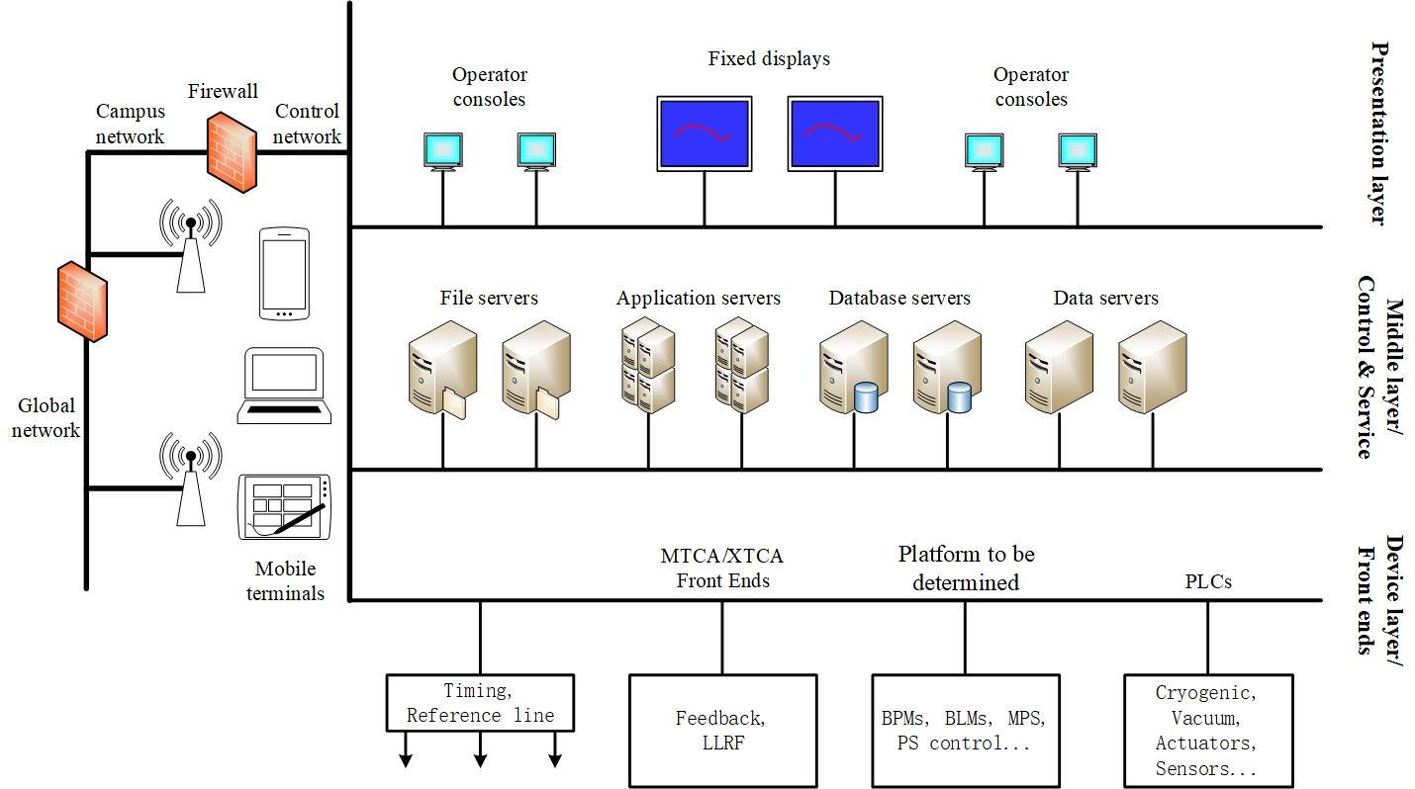
System structure

Slide 5
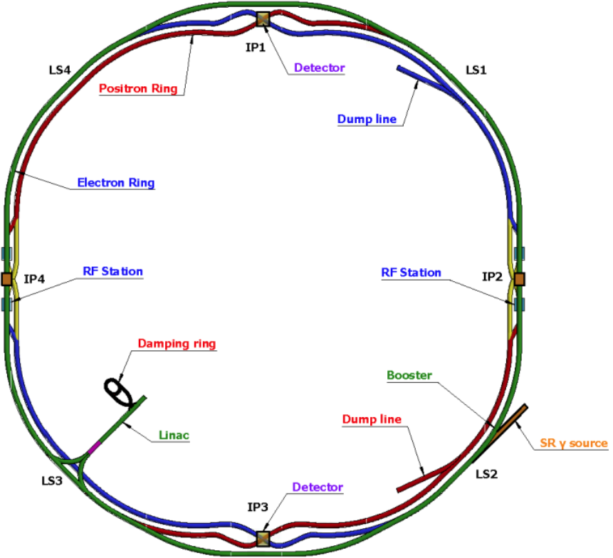
Tasks and key issues
Control network to all stations
Timing system to all stations
Clock to all stations
Fast Protection for whole facility
Orbit feedback for the rings
Information database(Components, cables…)
Synchronized data acquisition & analysis
Power supply remote control
Vacuum control…
Optical
fibers
Central Control Station

Slide 6
Key issues in EDR & manpower

Slide 7
Information database
A network of devices, their connections, related static and dynamic data.
Table design of Component Database (CDB) of APS is referenced with adaption to our own requirement.
Programming to be done by ourselves.
Gang Li, Feng Bing, Xuehui Wu, Ge Lei, Dapeng Jin.

Slide 8
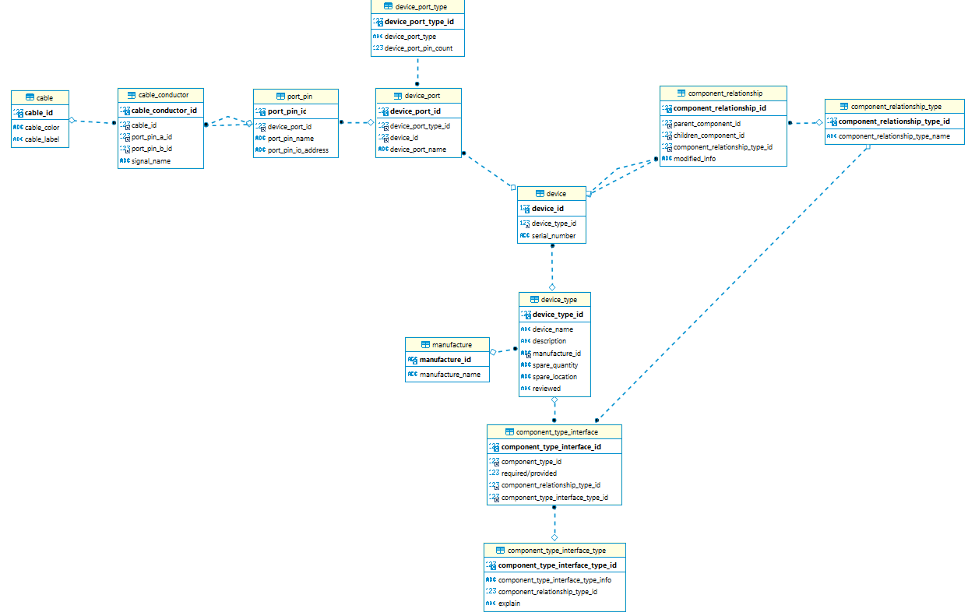
Information database
Table design of CDB of APS

Slide 9
Synchronized data acquisition & applications
High performance & high efficient accelerators need high quality data.
High time-correlated data is really high quality data.
Data ring-buffered in front end memory with high frequency sampling clock for a period of time (~10s), then synchronously readout with timing signal in need or in case of faults.

Slide 10
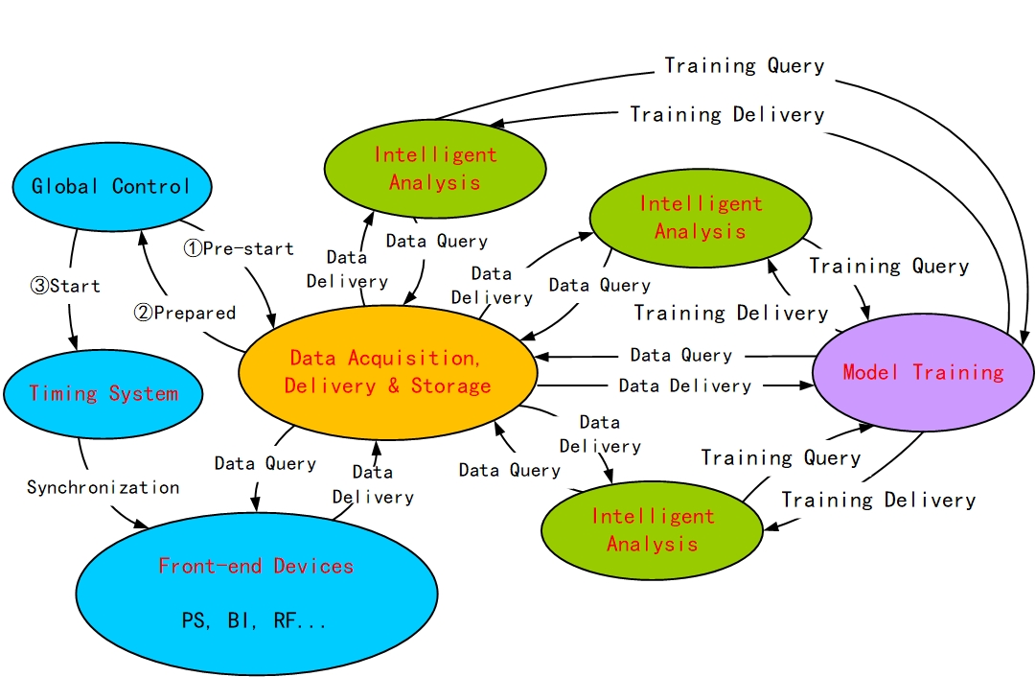
Synchronized data acquisition & applications
Project - Intelligent renovation of BEPCII/BESIII to be approved.
Gang Li, Yu Liu, Nian Xie, Ge Lei, Dapeng Jin for DAQ. Cooperation with other groups

Slide 11
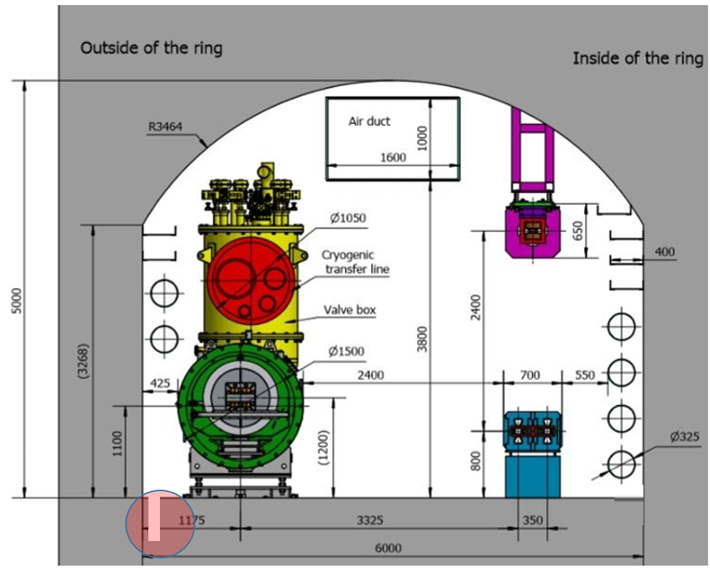
Fiber routing
Fiber routing topology
Least length of fiber routing in tunnel ~ 6.3km.
Global fiber routing in tunnel preferred.
Drainage ditches along the tunnel with a depth < 1m considered, radiation simulation in progress.
Fiber routing method
Silicon core tube based. As long as ~3km with cable blowing machine.
Direct routing with a trolley with the ditch cover open.
Dapeng Jin, Guanglei Xu, Zhongjian Ma, Guangyi Tang, Jinshu Huang

Slide 12
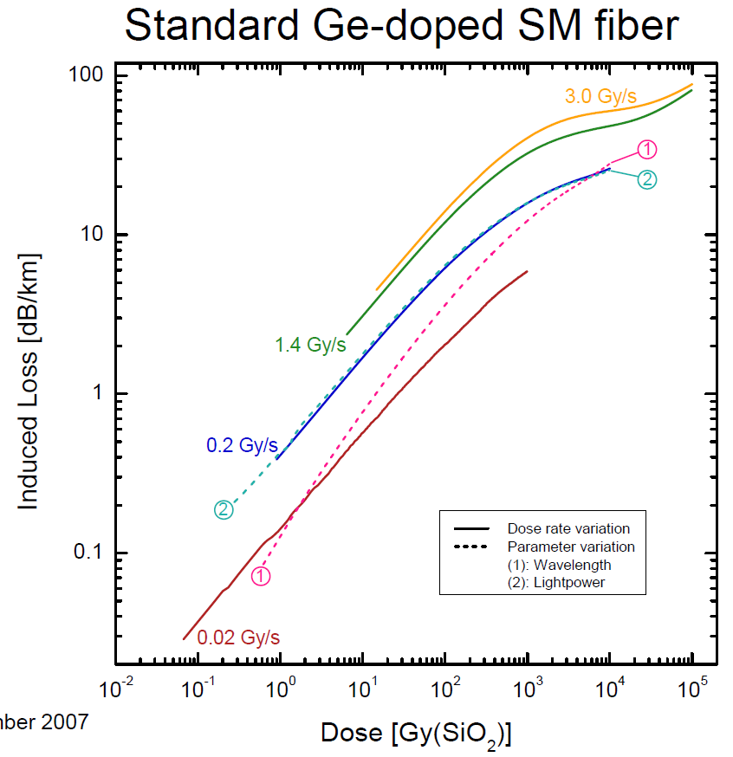
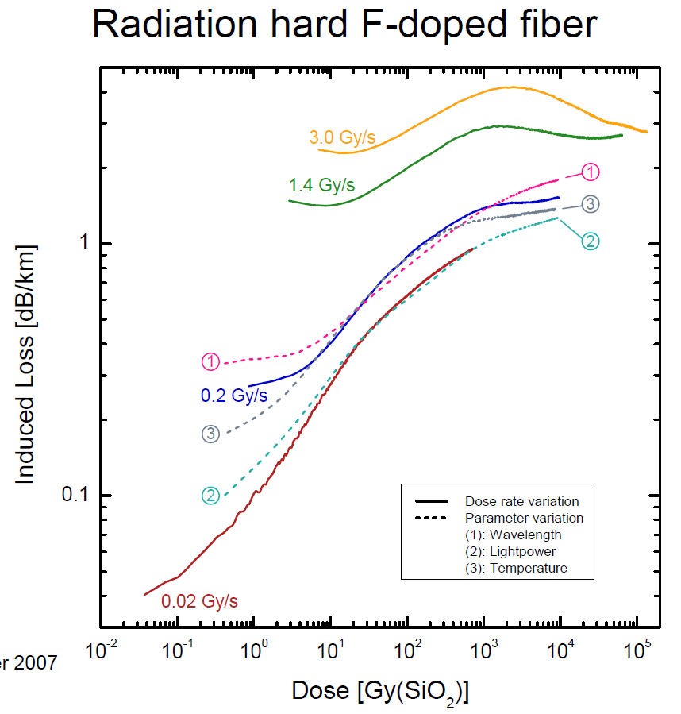
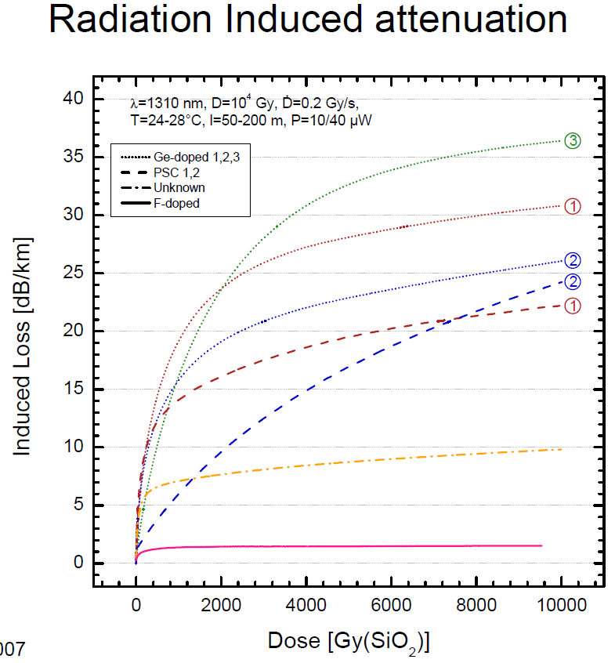
Fiber routing
Fiber radiation experiment
From “Optical absorption in commercial single mode optical fibers for the LHC machine”

Slide 13
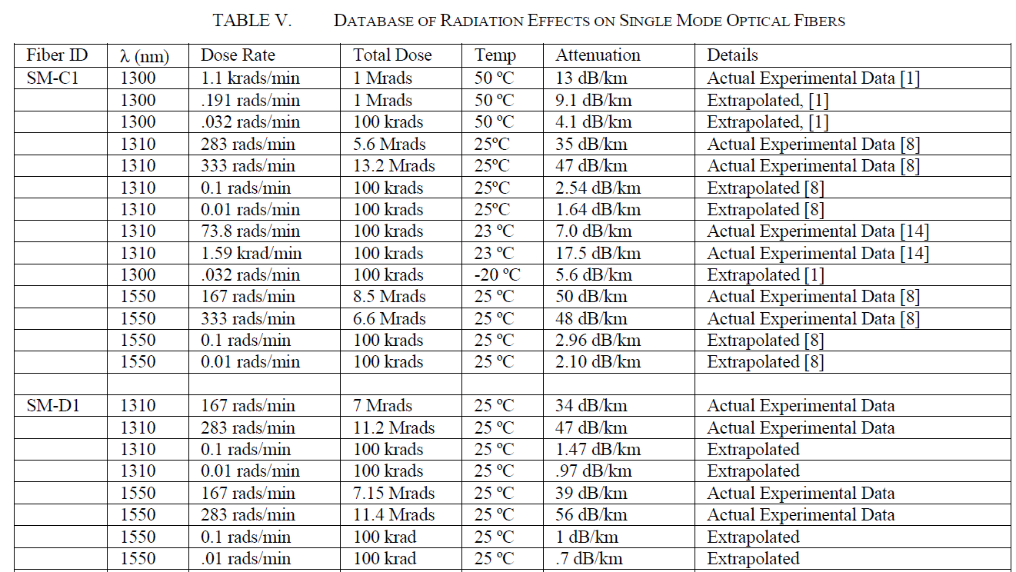
Fiber routing
Fiber radiation experiment
Corning
SMF-28
0.01rads/min = 0.01/100*1000(mGy)/(1/60h) = 6mGy/h
Self-attenuation of OS2 single mode fiber <= 0.4dB/km, normally ~0.35
Draka
268
From “Radiation Effects Data on Commercially Available Optical Fiber: Database Summary”

Slide 14
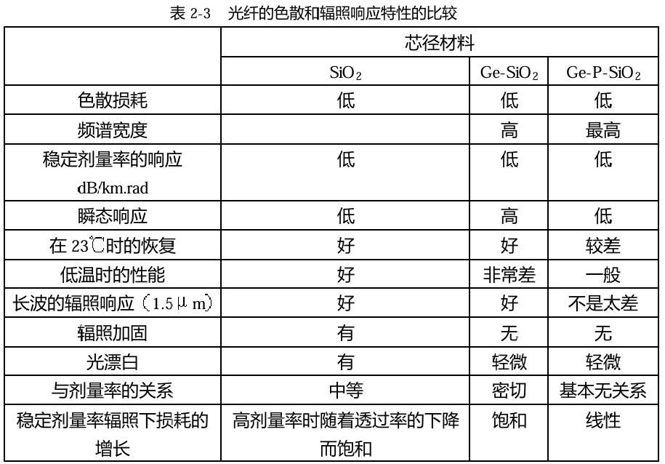
Fiber routing
硕士论文：航天用光纤抗辐照特性研究，张犇，上海交通大学，2005

Slide 15
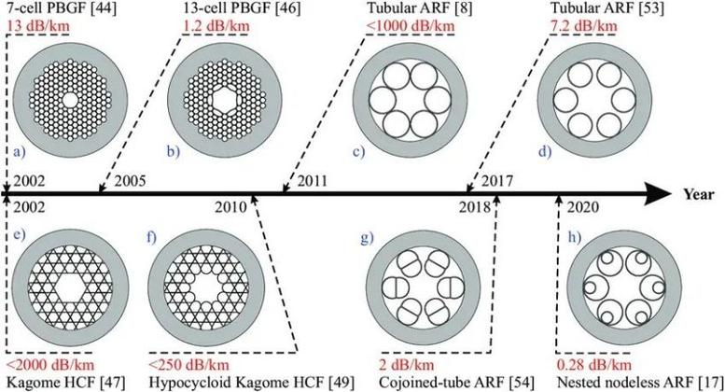
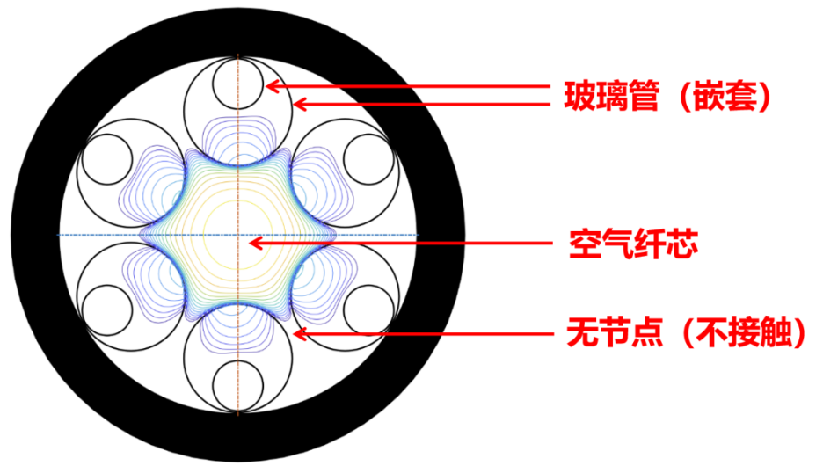
Fiber routing
Hollow-Core Fibers?
Radiation hard, very expensive now, ~hundreds of RMB/m/core. Hope for a big price reduction to tens of RMB/m/48core.
~ 0.1dB/km @ 1550 nm in 2024.11
Radiation Induced Attenuation : < 1/10 that of radiation hard solid core fibers

Slide 16
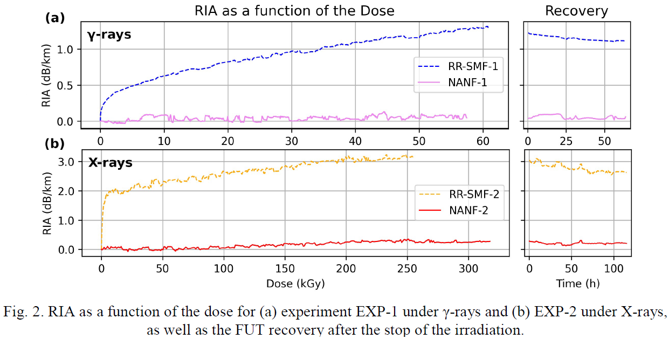
Fiber routing
Radiation experiment of RR-SMF & HC-ANF
“Near-zero Radiation Induced Attenuation in Nested Anti-resonant Nodeless Hollow-core Fibers at 1550 nm”

Slide 17
Fiber routing
Fiber radiation experiment
Preliminary target dose rate 20Gy/5000h = 4mGy/h = 0.02Gy/s/18000
Radiation induced attenuation : <0.1dB/km preferred
Dose rate range: 1 – 20mGy/h
Budget （~430,000 RMB）
Fiber : ~20,000 RMB
Dosemeters : ~80,000 RMB
Light source & power meter :
~300,000 RMB, multi-channel
Data acquisition: ~30,000 RMB

Slide 18
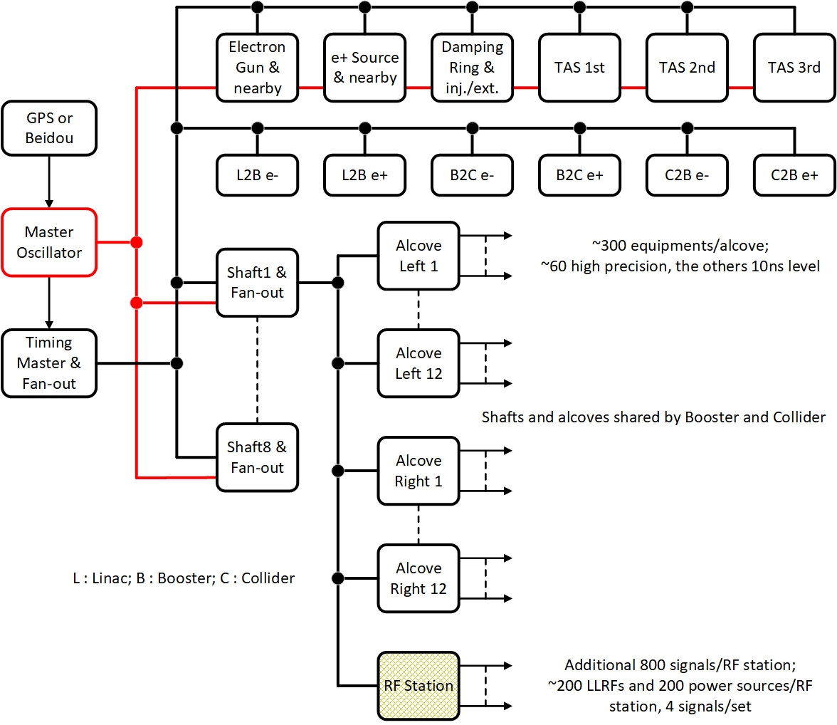
Timing system & reference line
Timing system
Fan-out to the whole facility
Tree type as the baseline
(Ge Lei, Zhonghui Ma…)
Loop type in the ring under study
(Jun Hu, Xiaoshan Jiang …)
Accurate and real time delay
compensation under study
Reference line (Xinpeng Ma)
Fan-out to linac & 8 shafts
Accurate and real time phase
compensation under study

Slide 19
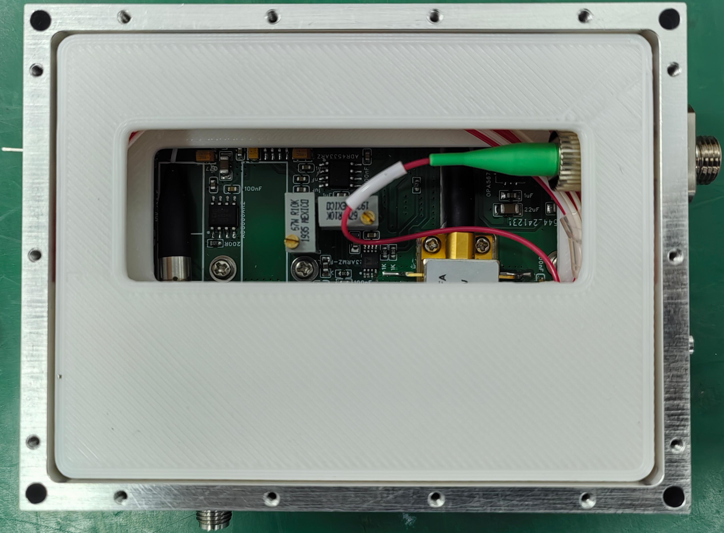

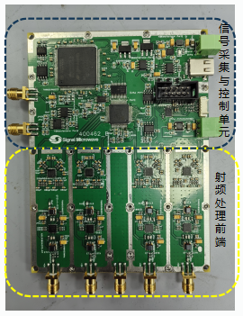
Timing system & reference line
Reference line
Hardwares are fully updated from HEPS/BEPCII-U 499.8MHz version, better lasers are meausred and used for higher frequency 1300MHz/650MHz
Digitally I/Q modulator phase shifter is used for multiple period phase (>360°) compensation
DAQ and analog circuits are seperated for clean noise on the PCB board
RF front-end
Laser module
DAQ and control
PCB circuits
RF_monitor
RF_IN
phase shifter
RF_OUT

Slide 20
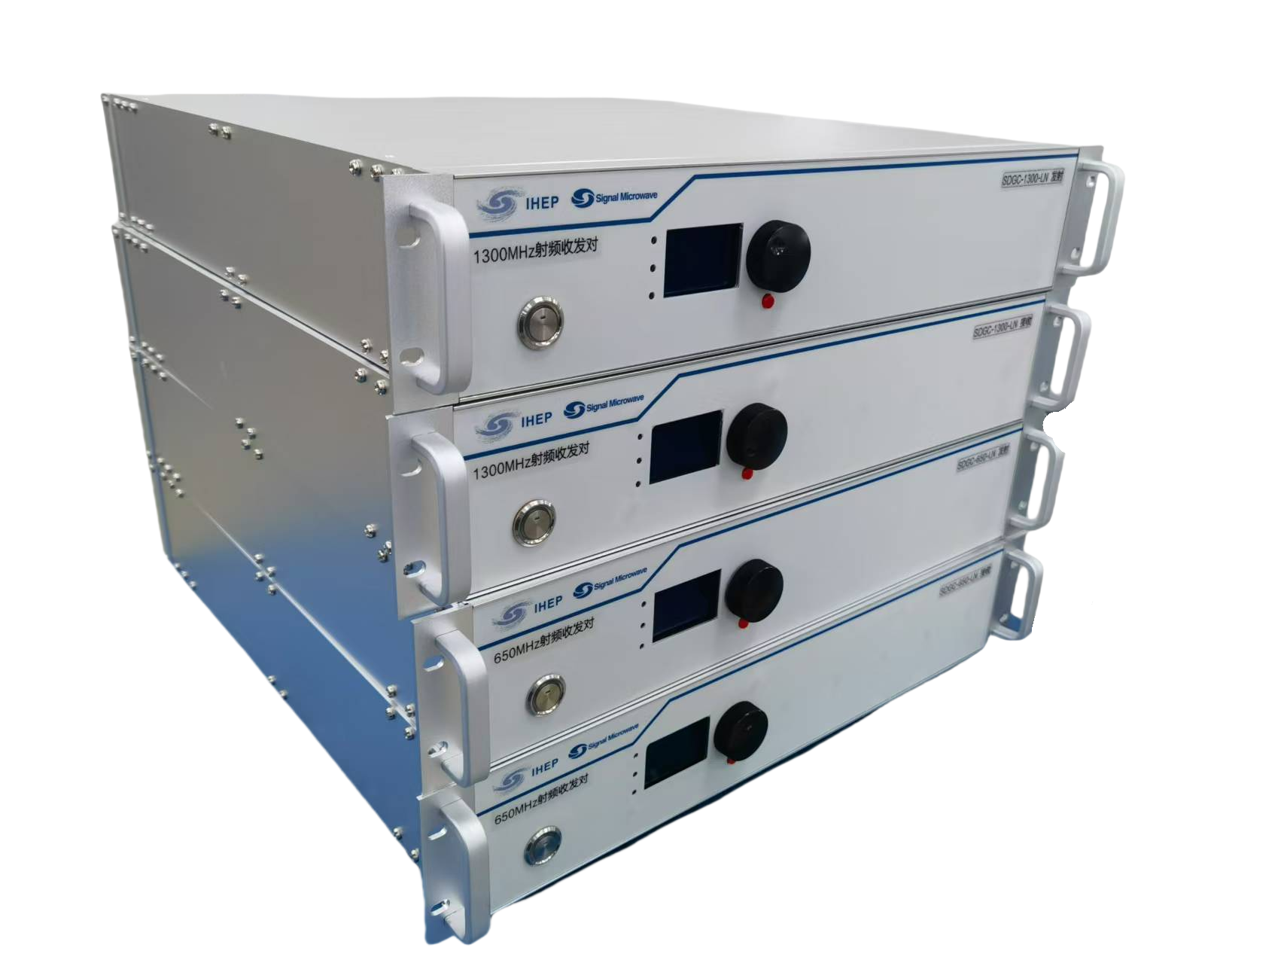
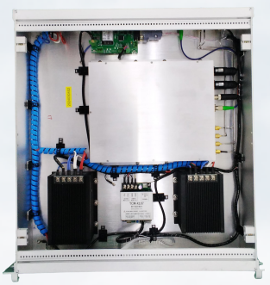
Timing system & reference line
Reference line
Self developed module prototype: SDGC-1300M-LN and SDGC-650M-LN, each pair: one Tx and one Rx module
Transfer 1300MHz/650MHz from master oscillator to Linac/shafts/... with ultra-low additive jitter of RF reference signals
RF is modulated on the low-noise laser, wavelengths are 1550nm, phase can be stablized by measuring the return laser and Tx laser phases error, with digital PID contoller in the FPGA and MCU, phase stabilized within 0.01deg, or 20fs for 1300MHz signal
Temperature of the module is also stabilized within 0.01degC, to keep the system stable
All the data are accessed by LAN and EPICS

Slide 21
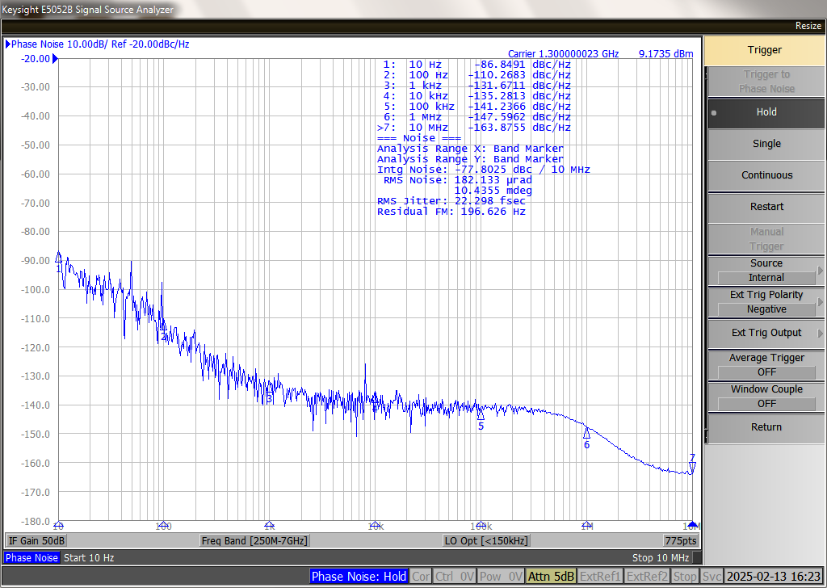
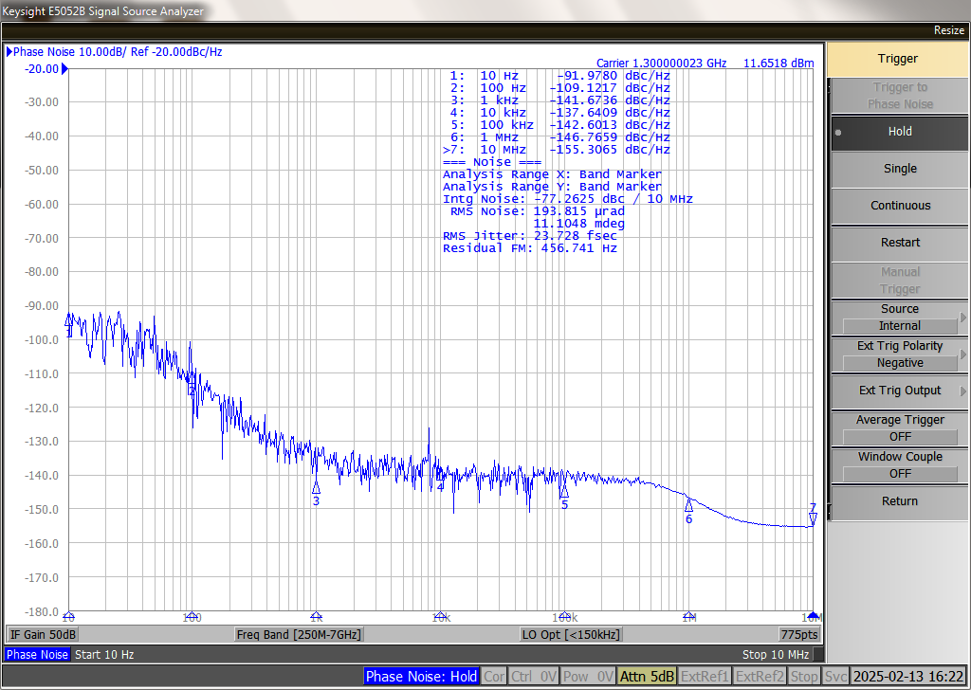
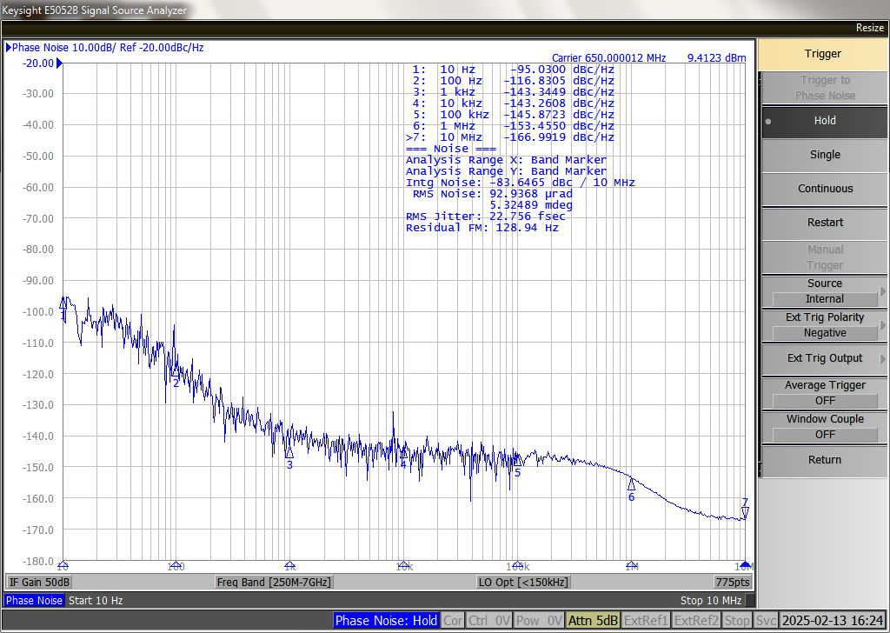
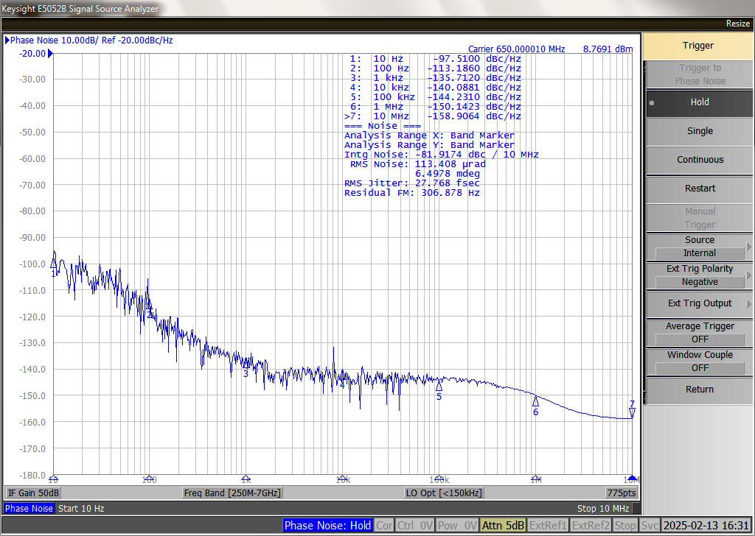
Timing system & reference line
Measurement (preliminary result)
  signal generator：SMA100B
  phase noise analyzer：E5052B
  signal remains good after transmission, even better than HEPS version
  software / remote control / close loop performance are still under test, because lack of measurement condition, very long distance(>10km) and phase compensation is being studied now, later system will be totally tested
1300MHz
input signal jitter：22.29fs
output signal jitter：23.72fs
650MHz
input signal jitter：22.75fs
output signal jitter：27.77fs

Slide 22
Fast orbit feedback & fast machine protection
Loop structure, to be done in construction phase
Normal
Fault
Data driven & fast computation with DSP in FPGA
Logical signal driven & fast interlock, heartbeat for health monitoring

Slide 23
High performance network
One network for both control
& data acquisition preferred
VLAN & data flow design & management
To be done in construction phase

Slide 24
About the central control room

Slide 25
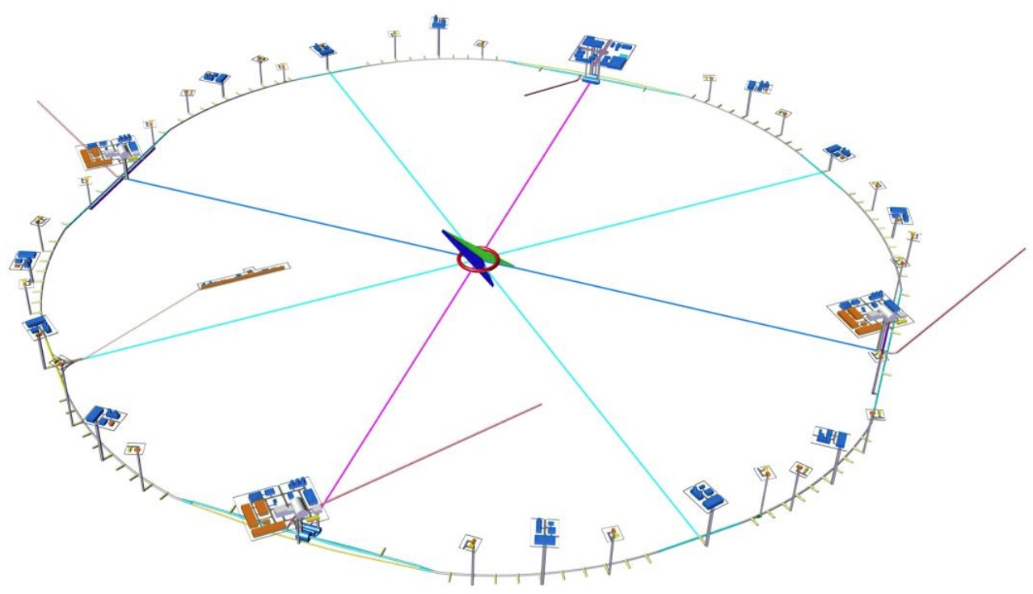
Central control room
800 m² (LHC 625 m² )
Preliminary location : IP3
Other locations possible with high
performance network link to IP3

Slide 26
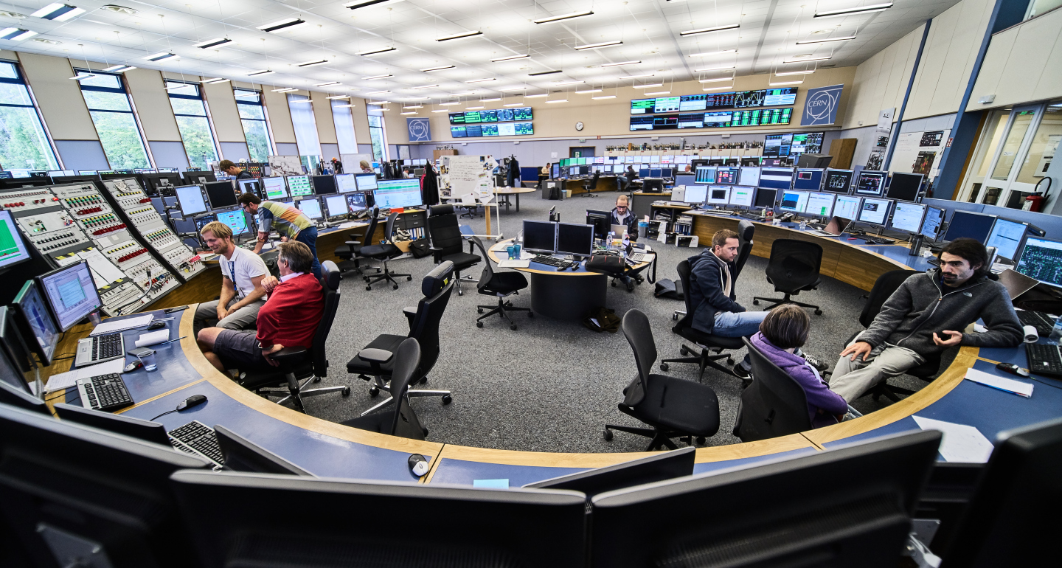
Central control room
LHC control room

Slide 27
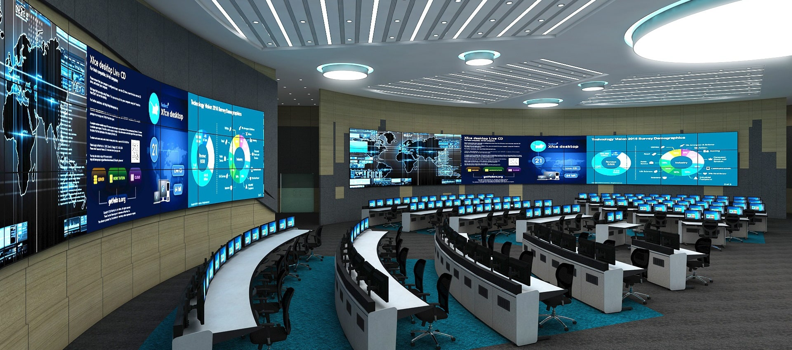
Central control room

Slide 28
Summary & discussion

Slide 29
Summary & discussion
Tasks & key issues in EDR of control system has been made clear.
Preliminary design has been done.
Manpower is short, although preliminary allocation has been done. Uncertainty will arise since the completion of HEPS.
Thanks for your attention!

