Slide 1
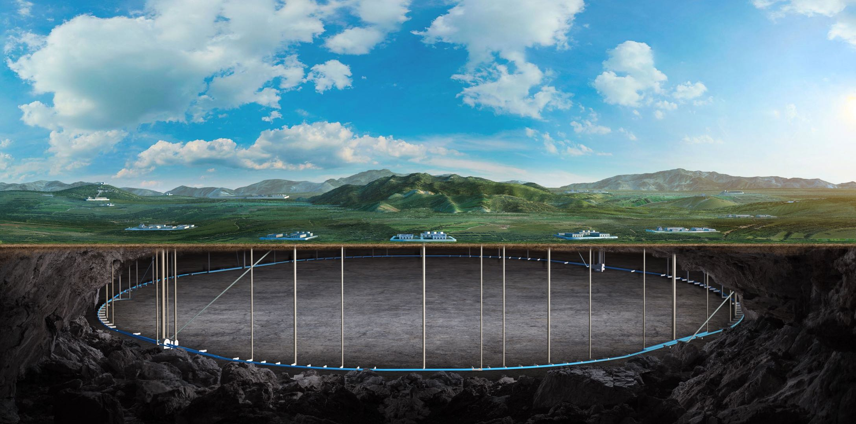
CEPC vertex Detector
Zhijun Liang

Slide 2
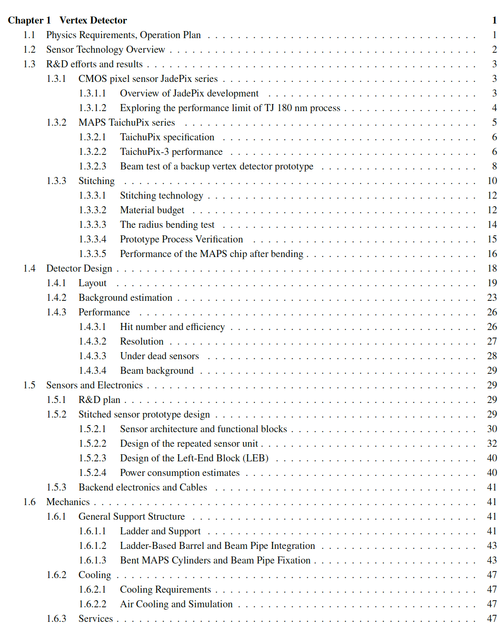
Ref-TDR
More than 50 pages ready
Introduction part (ready)
R & D part
Jadepix/Taichu (1st draft ready)
Stitching (1st draft ready)
Detector design
Physics Layout (1st draft ready)
Background ( Z pole estimation to be updated)
Stitching design (1st draft ready)
Mechanics (1st draft ready, more )
https://latex.ihep.ac.cn/project/6745179fef5108a66841008a

Slide 3
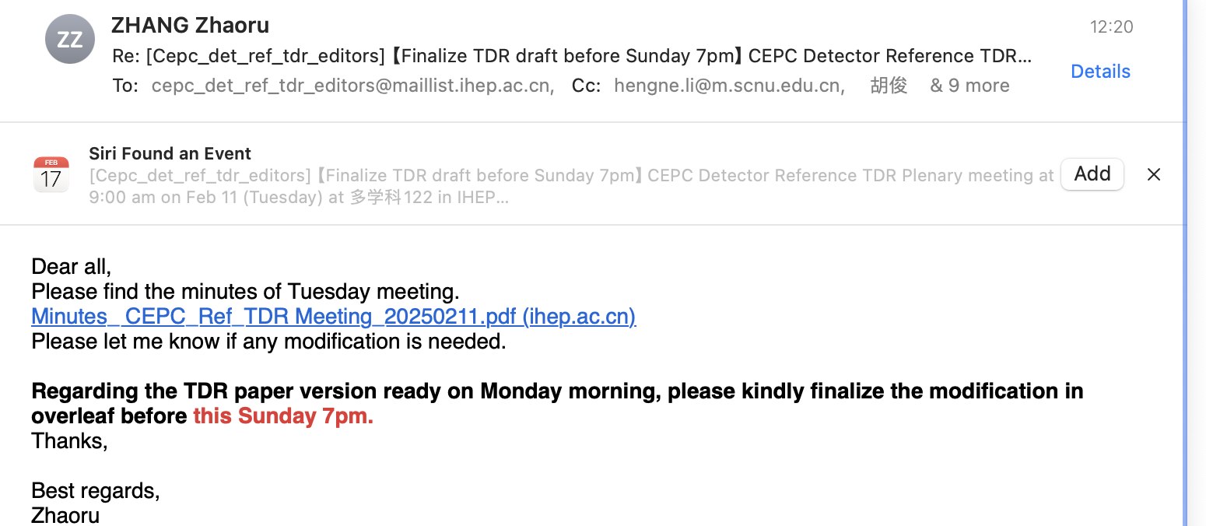
TDR version for Sunday this week

Slide 4
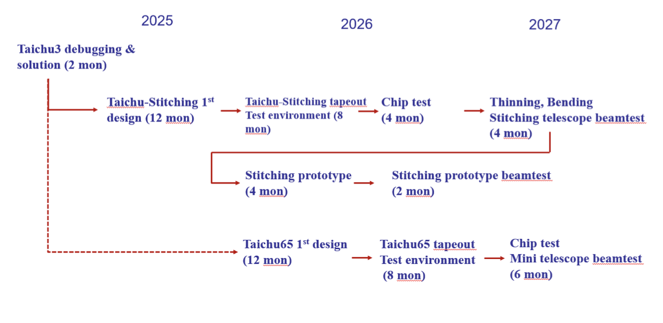
R & D plan

