Slide 1
$Gravitational waves from$ $$cosmological chiral phase transitions \\ in softwall AdS/QCD$$
Yidian Chen(陈亦点)
School of Physics, Hangzhou Normal University
Feb. 7, 2025

Slide 2
Introduction
Nf=2+1 Soft-Wall Model
III. Chiral Phase Transition Dynamics
VI. Summary

Slide 3
I. Introduction

Slide 4
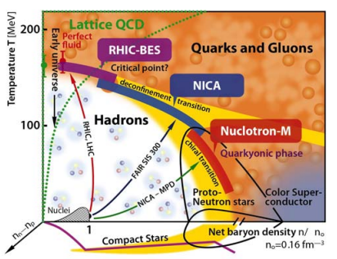
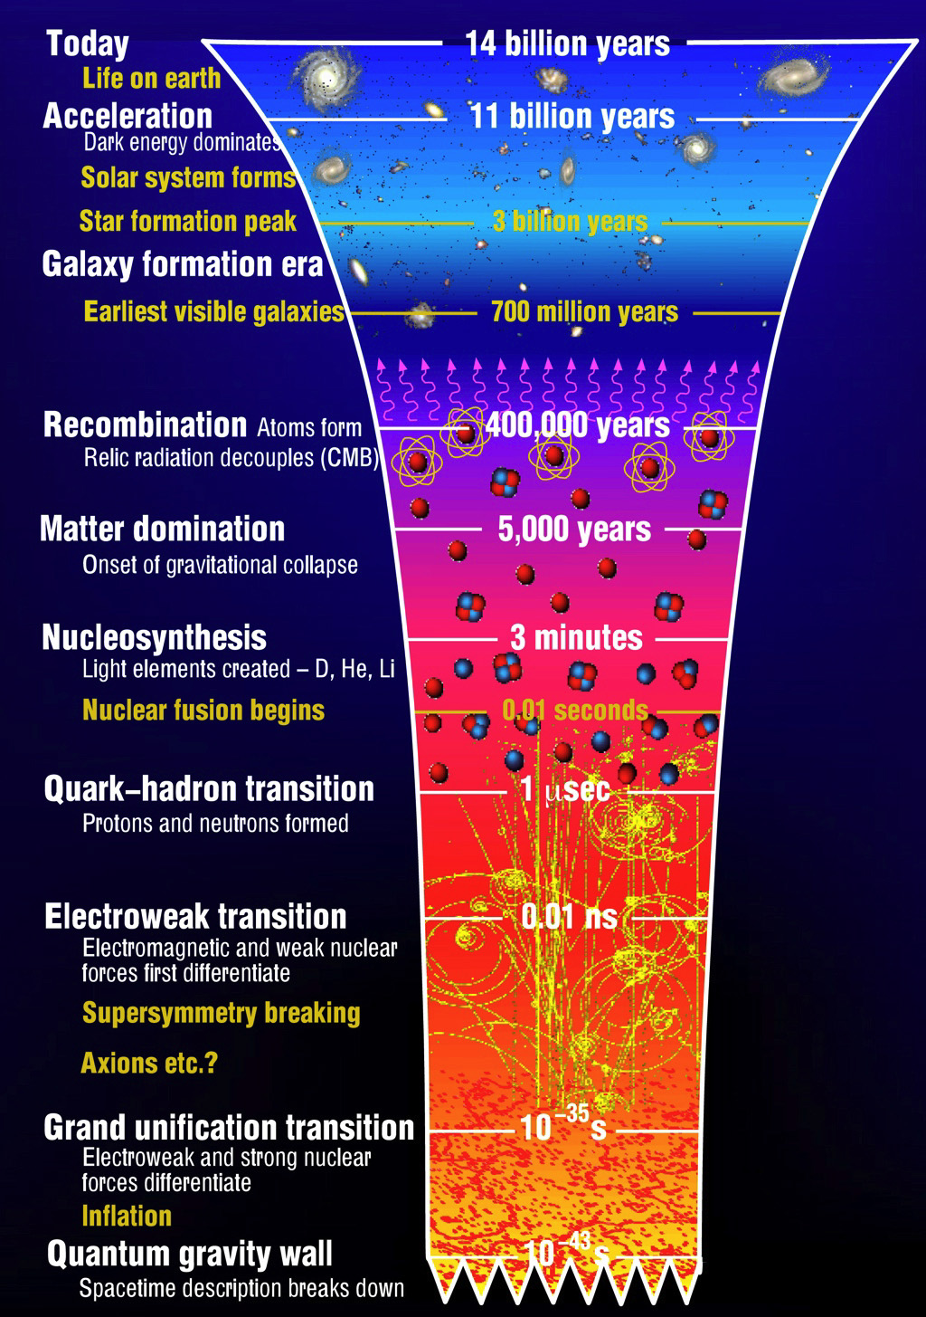
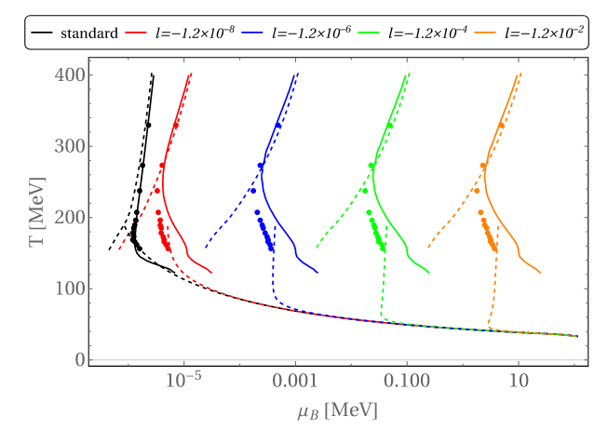
Cosmic QCD phase transition
Gao et al., PRL(2022)

Slide 5
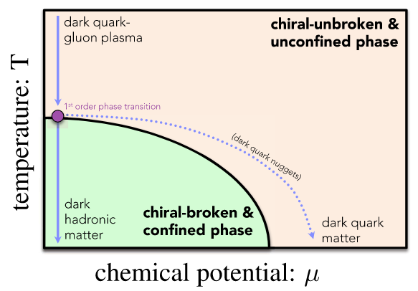
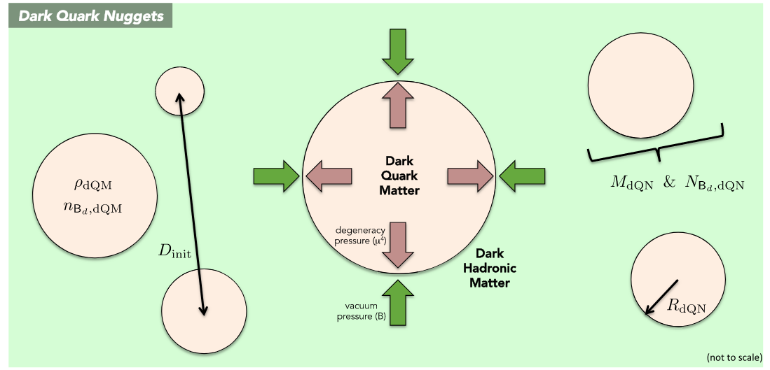
Dark QCD phase transition?
Bai et al., PRD(2019)

Slide 6
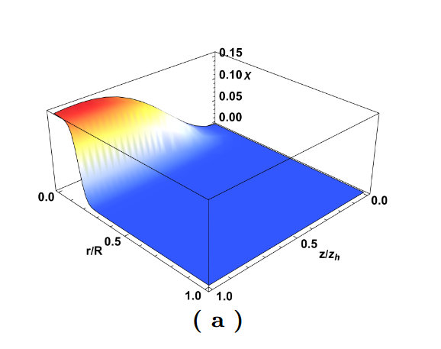
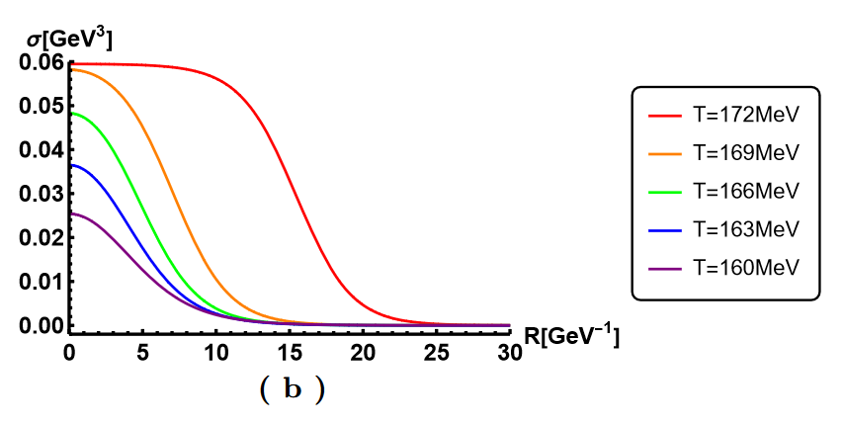
Holographic Bounce Solution
Y. Chen, Danning Li and M. Huang, JHEP(2023)
the condensate σ as a function of the radial coordinate r at different temperatures.
the bounce solution of the scalar field χ as a function of the fifth dimensional coordinate z and the radial coordinate r

Slide 7
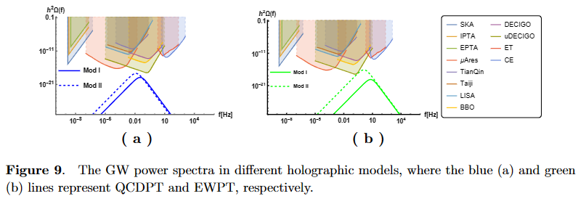
GW Power Spectra
Y. Chen, Danning Li and M. Huang, JHEP(2023)
NANOGrav-15
β ⇧
α ⇧

Slide 8
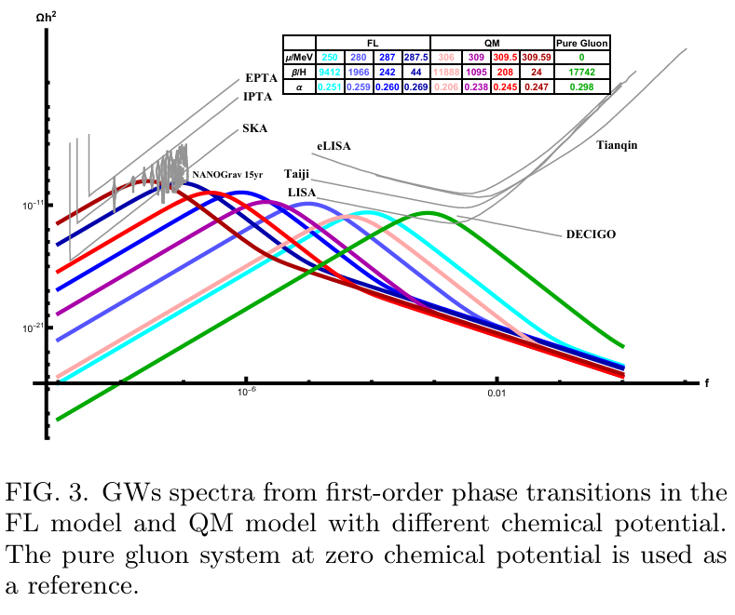
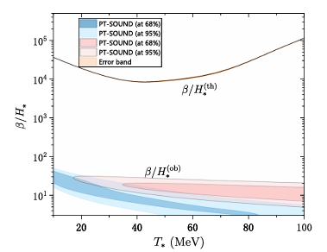
GW from QCD phase transition
Athron et al., PRL(2024)
Zheng et al., PRD(2025)
J. Shao, H. Mao and M. Huang, PRD(2025)

Slide 9
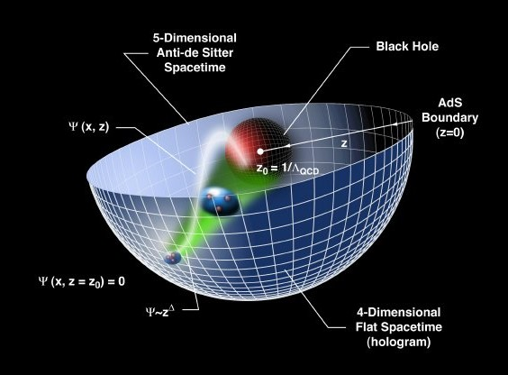
Holographic Dictionary: d-QFT/d+1-Gravity
AdS/CFT: original discovery of duality
relates gravity theories on anti-de Sitter spacetimes to conformal field theories
General Gauge/Gravity duality

Slide 10
Holographic dictionary
Boundary QFT Gravity
Local operator Field
conformal dimension $Δ$, p-form field $p$
$$z^{4−Δ}Φ_{0}\left(x\right)+z^{Δ}⟨𝒪(x)⟩ =Φ(x,r→0)$$
Strongly coupled Weakly coupled semi-classical

Slide 11
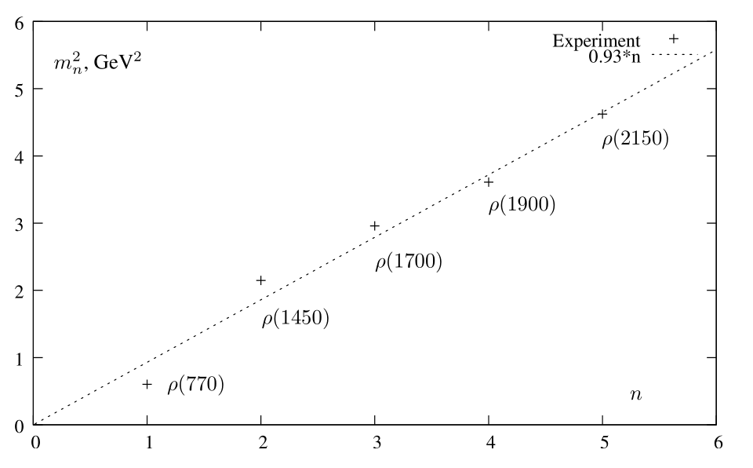
KKSS model (soft-wall model)
Karch et al., arXiv: 0602229[hep-ph]
5D action
Dilaton profile
Conformal AdS₅
e.o.m

Slide 12
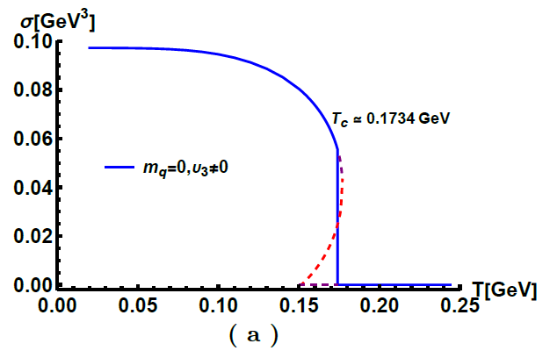
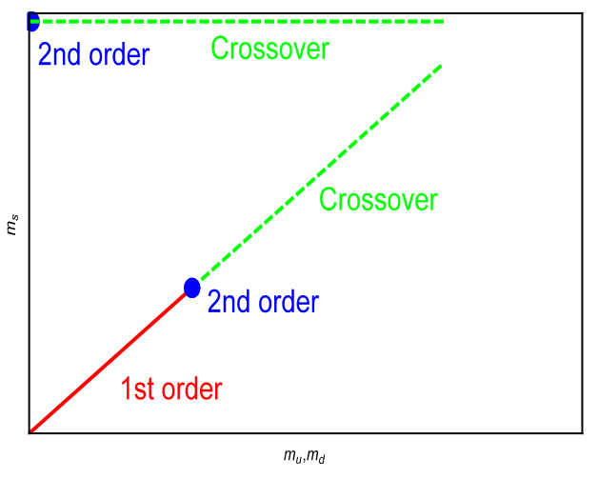
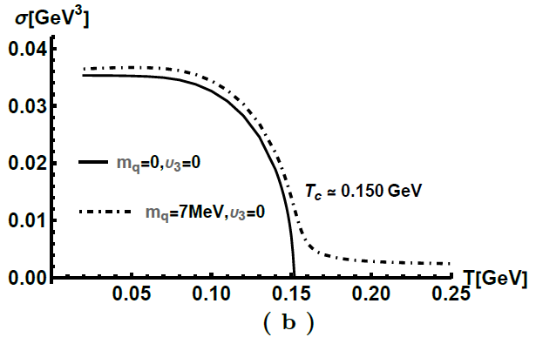
Chiral condensate
Chelabi et al., PRD(2016), arXiv: 1511.02721
Chelabi et al., JHEP(2016), arXiv: 1512.06493
5D action

Slide 13
II. Nf=2+1 Soft-Wall Model

Slide 14
5D Model
Φ denotes the dilaton field and the complex scalar field X corresponds to the quark condensation.
$$X=\frac{χ}{\sqrt{2N_{f}}}I_{N_{f}}⇔⟨\overline{Q}Q⟩$$
5D action
Dilaton profile
Fang et al., PRD(2019)
Metric

Slide 15
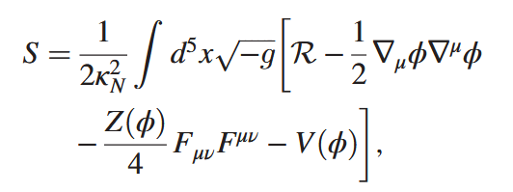
5D Model
The five-dimensional EMD theory
$$Δ=3$$
Cai et al., PRD(2022)
$φ$ is quark condensation in Song He’s Model? This may be the reason why his model fails to produce meson spectra.

Slide 16
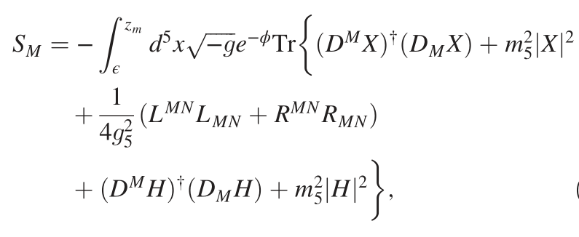
5D Model
Y. Chen and M. Huang, PRD(2022)
5D action
$$X=e^{iπ^{a}t^{a}}X_{0}e^{iπ^{b}t^{b}}, X_{0}=diag[v_{l},v_{l},v_{s},v_{c}]$$
EOM for X:
EOM for H:

Slide 17
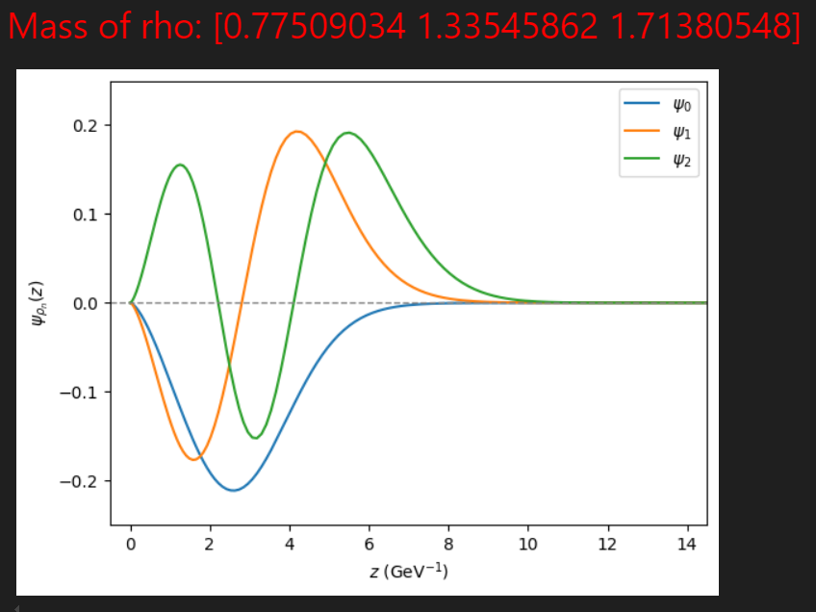
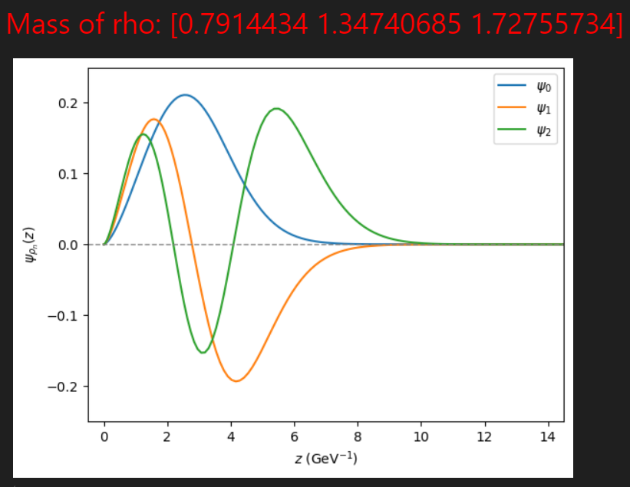
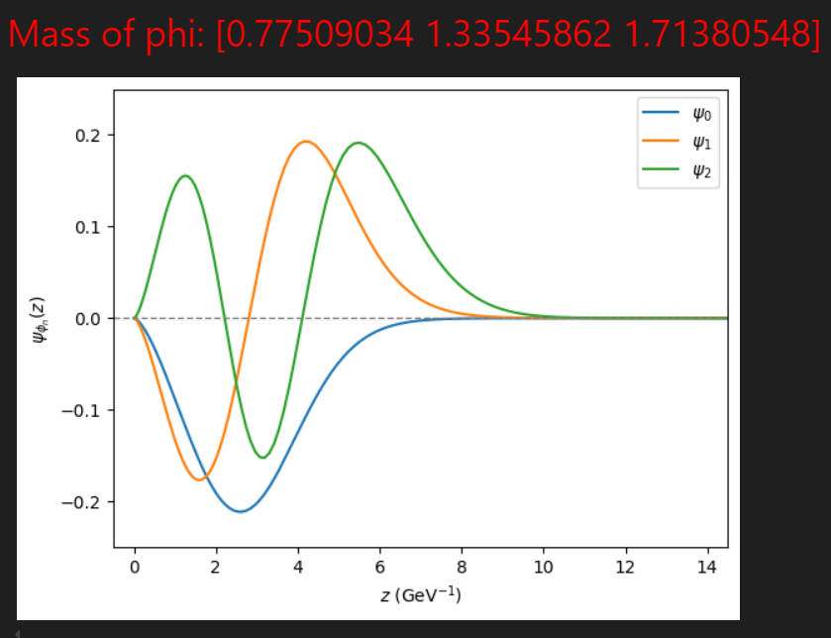
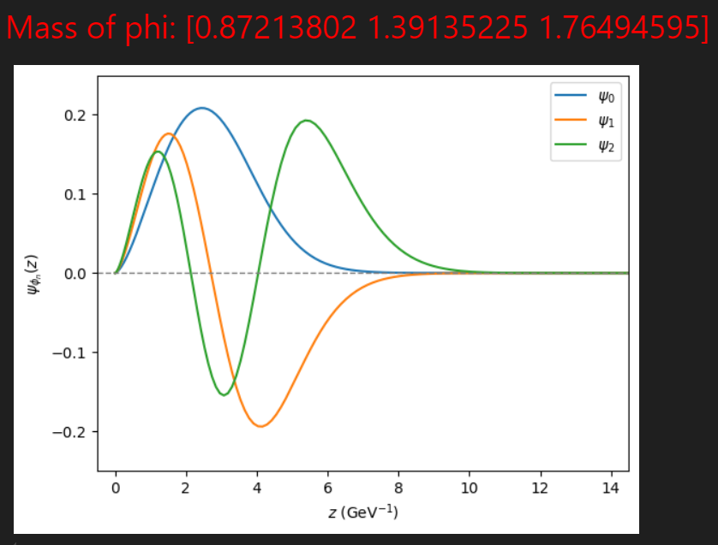
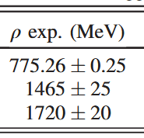
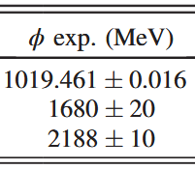
5D Model
Without $λ_{2}$
With $λ_{2}$

Slide 18
Meson Spectra
139.9 1464.1 1837.5
499.5 1563.9 1936.9
596.4 1614.0 1997.0
791.4
1347.4
1727.6
847.6
1375.2
1750.0
872.1
1391.4
1764.9
1145.2 1555.2 1888.1
1260.9 1665.7 1994.5
1307.2 1730.2 2064.1
Fang et al., PRD(2019)

Slide 19
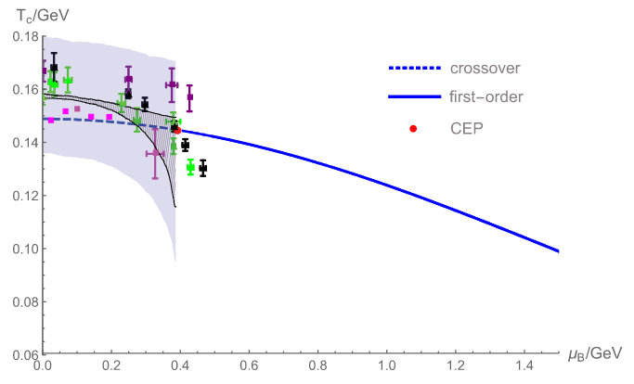
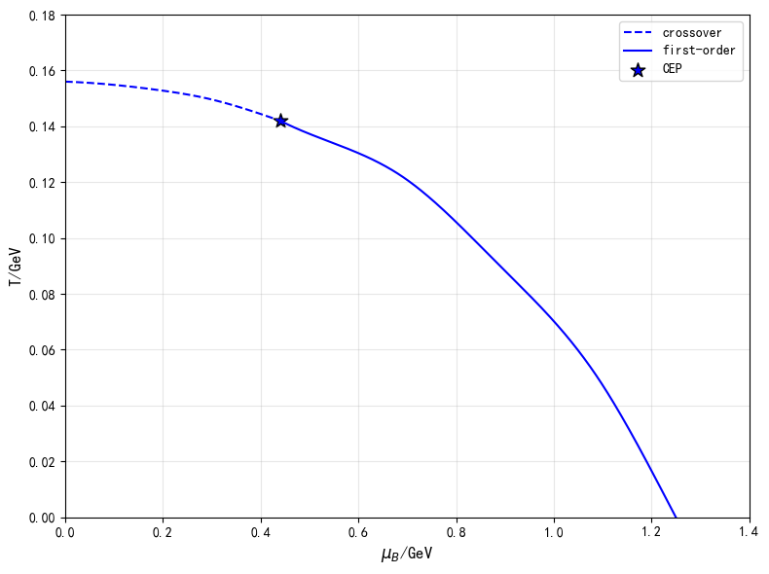
Chiral Phase Transition
Fang et al., PRD(2019)
Without $λ_{2}$
With $λ_{2}$

Slide 20
III. Chiral Phase Transition Dynamics

Slide 21
GW power spectra
Y. Chen, Danning Li and M. Huang arXiv: 2212.06591
Within the linear approximation, the total GW power spectra can be written as
we have found that for the holographic model, the final velocity of the bubble wall is less than the speed of sound, i.e., the non-runaway case. According to Ref. [C. Caprini et al., JCAP(2016)], the GWs generated by collisions in the non-runaway case can be neglected with respect to acoustic waves and magnetohydrodynamic turbulence. Therefore, the total power spectrum is approximated to
Due to the complexity of turbulence, the contribution from the turbulence is dropped in this paper to make a conservative estimate.

Slide 22
GW power spectra
Y. Chen, Danning Li and M. Huang arXiv: 2212.06591
The key quantities which determine these power spectra are the following:
The percolation temperature Tp is defined as the temperature at which the probability to have the false vacuum is about 0.7.
The phase transition strength parameter α, which is related to the scalar potential energy released during the phase transition
The bubble wall speed vw
The transition rate parameter β, which can be thought of as the inverse phase transition duration

Slide 23
GW power spectra
Y. Chen, Danning Li and M. Huang arXiv: 2212.06591
The nucleation temperature is defined as one bubble per unit Hubble volume and is written as
the probability of a false vacuum is defined as
The percolation temperature is defined as $I\left(T_{p}\right)≃0.34$, which is the temperature when the probability of false vacuum is about $P\left(T_{p}\right)≃0.7$.

Slide 24
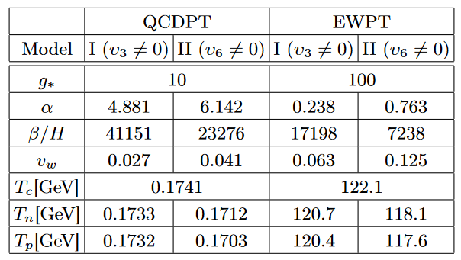
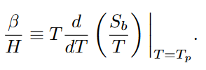
GW power spectra
Y. Chen, Danning Li and M. Huang arXiv: 2212.06591
The parameter α is defined as
Near-conformal model α~O(1)
The inverse of the duration time is defined as
Strongly coupled theory β~10000 ?
F.R. Ares et al., Phys.Rev.Lett.(2022);
J. Shao, Mei Huang, Phys.Rev.D(2023)

Slide 25
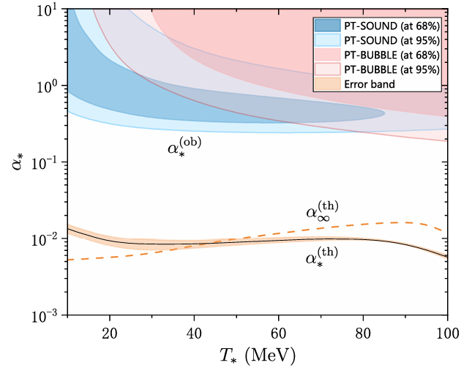
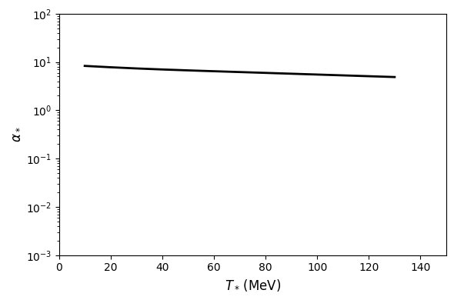
PT strength $α$
J. Shao, H. Mao, M. Huang, PRD(2025)
Zheng et al., PRD(2025)

Slide 26
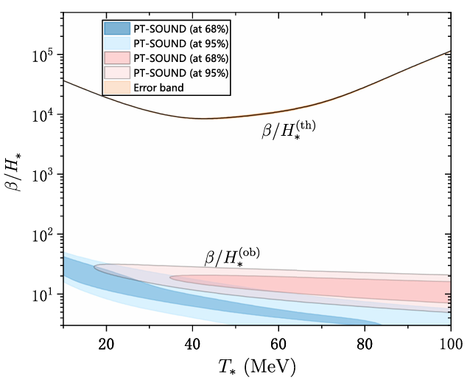
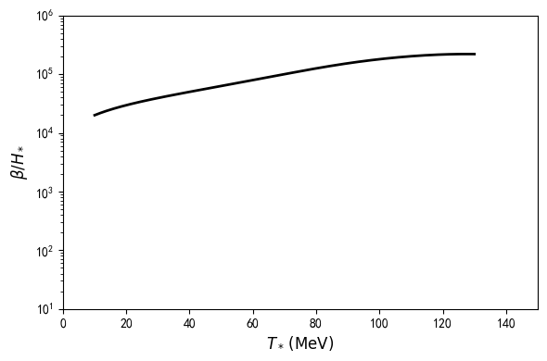
inverse PT duration $β/H$
J. Shao, H. Mao, M. Huang, PRD(2025)
Zheng et al., PRD(2025)

Slide 27
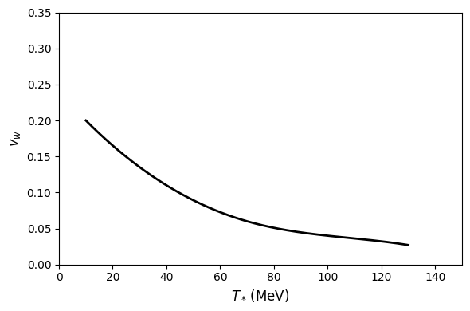
Bubble wall velocity

Slide 28
GW power spectra
In the holographic model, gravitational waves from QCD phase transitions cannot explain the NANOGrav observations.
J. Shao, H. Mao and M. Huang, PRD(2025)

Slide 29
V. Summary

Slide 30
Summary
The $λ_{2}$ term has the potential for better meson spectra. I have tried to extend to SU(5) model.
Along the phase transition line in the QCD phase diagram, we find that the bubble velocity $v_{w}$ increases as the temperature decreases, while the inverse duration time $β/H$ decreases and the strength parameter $α$ grows. This behavior indicates that the transition becomes stronger and lasts longer at lower temperatures and higher chemical potentials.

Slide 31
Thanks！

