Slide 1


The Future of Heavy-Ion Physics
C3NT Inaugural Symposium
19 May 2025, Wuhan, China
NT builds on top of existing knowledge
Urs Achim Wiedemann
CERN Theory Department
NT builds bridges to neighboring fields

Slide 2
Heavy-ion physics
is an interdisciplinary research field, combining concepts and techniques from nuclear physics, high energy physics, hadronic physics, statistical physics … and reaches out neighboring fields.
is driven by fundamental questions (How do material properties emergy from fundamental interactions of non-abelian quantum field theories?) and strives for answers from 1st principles.
A world-leading center for nuclear theory
provides a forum that fosters the interdisciplinary exchange between nuclear theory and related areas.
that brings together scientists from the entire world to advance fundamental questions and that has the potential to grow the local community in doing so.
The worldwide heavy-ion physics community is looking forward to C3NT.
Yayun He et al, arXiv:2201.08408

Slide 3




Slide 4
The future of heavy ion physics
- at least some aspects of it
(thorough/comprehensive discussion lies
beyond the scope of this talk)
Yayun He et al, arXiv:2201.08408

Slide 5
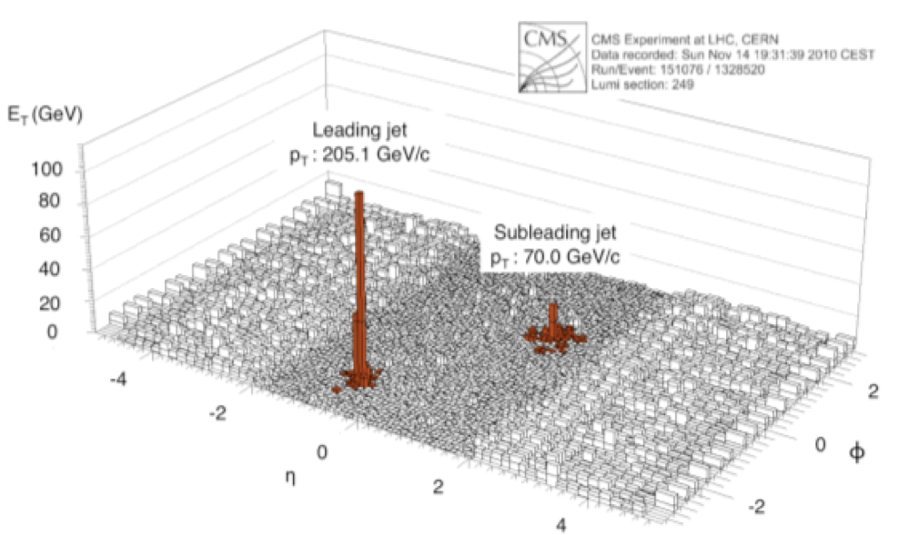
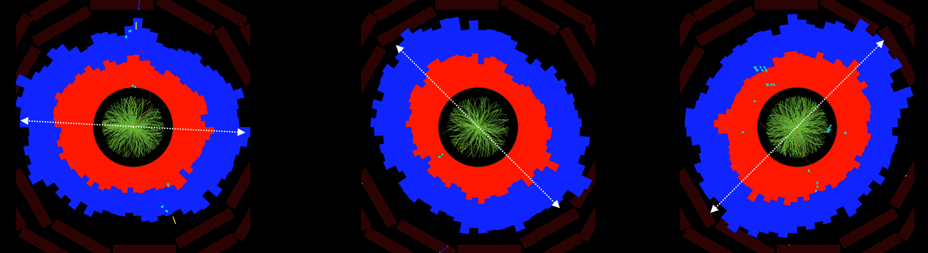
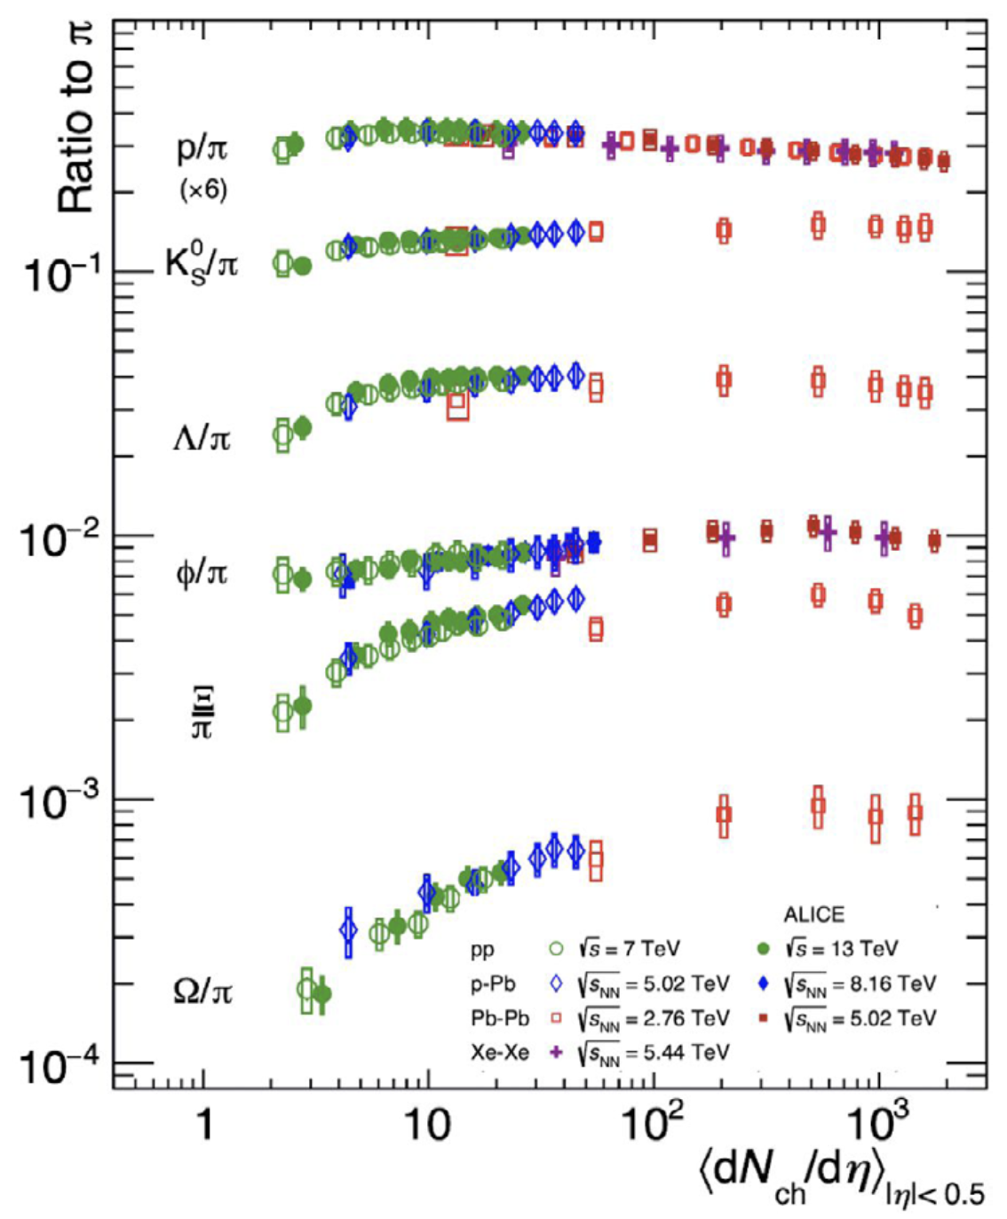
Major discoveries of heavy-ion physics
Jet Quenching
Flow
These phenomena are:
Numerically large
Generic
Quantified on top of pp baseline.
Allows for detailed experimentation of collective phenomena.
LHC discovery of collectivity in
small systems
and more …
Yayun He et al, arXiv:2201.08408

Slide 6
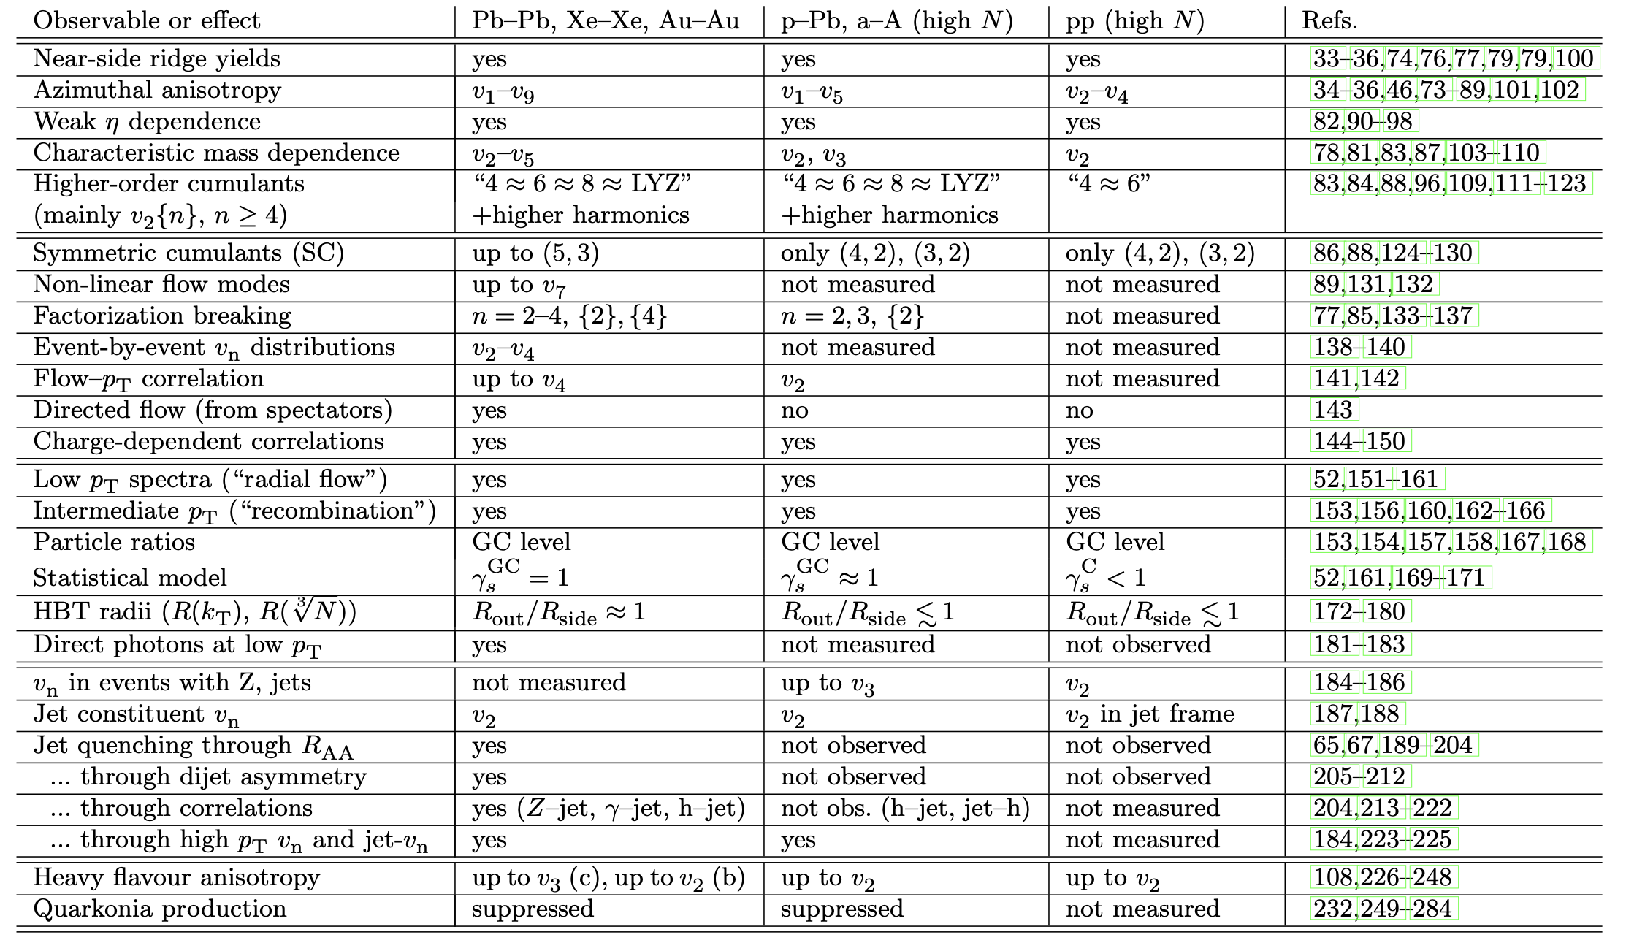
LHC discovery of collectivity in small systems
200 publications from all LHC and RHIC collaborations:
Precursor phenomena of collectivity seen in pp and pA.
Table from: Jan Fiete Grosse-Oertringhaus & UAW, arXiv:2407.07484
Yayun He et al, arXiv:2201.08408

Slide 7
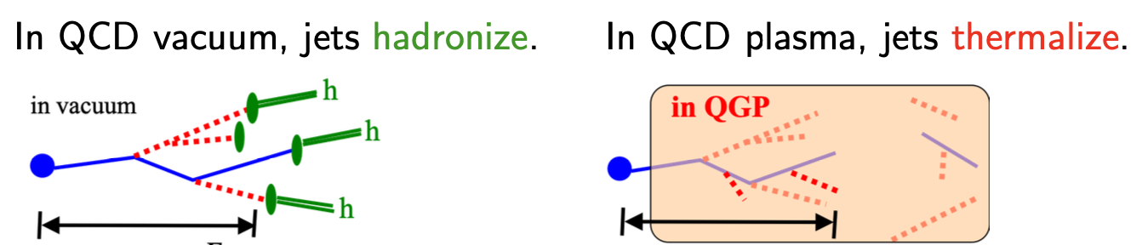
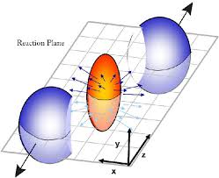
Why is this of fundamental interest?
Access to the phenomenology of QCD thermodynamics.
Flow translates spatial gradients
into momentum gradients.
(sensitive to pressure gradients,
equation of state, dissipation …)
Yayun He et al, arXiv:2201.08408

Slide 8
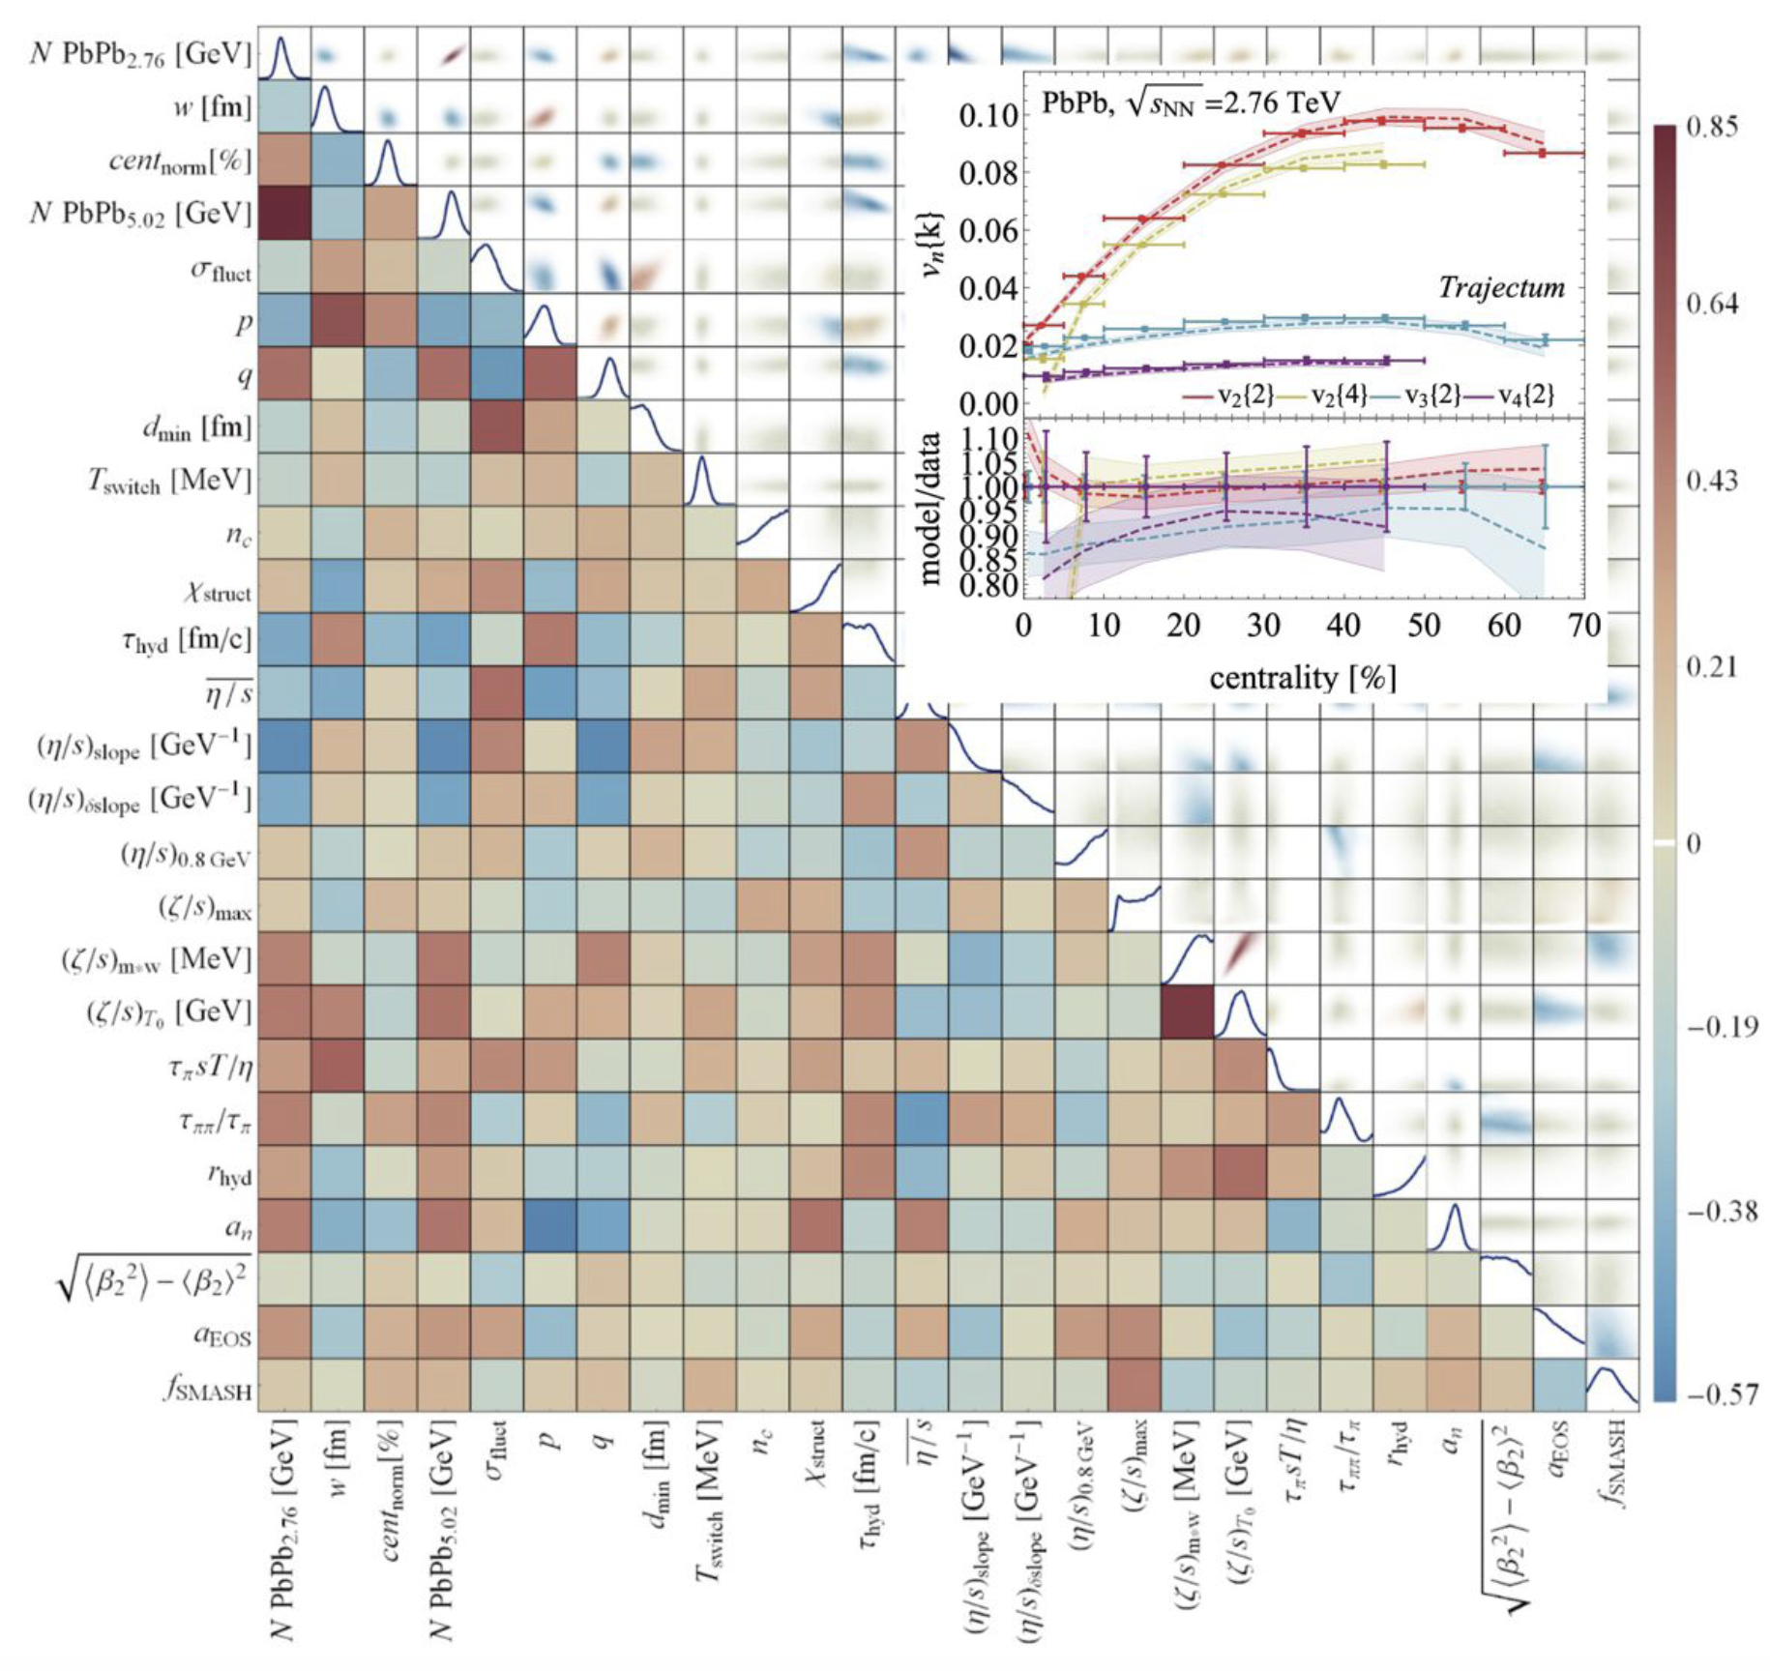
Healthy interplay of EXP and broad TH community
Constraints on:
Temperature
Eq. of state (sound velocity)
QCD transport coefficients
(shear, bulk viscosities)
Relaxation times
…
Model dependencies under scrutiny,
Connection to hard probes in progress.
Heavy flavor sector still missing.
Bayesian inference analysis involving 670 LHC data points.
* Giacalone, Nijs, van der Schee, Phys.Rev.Lett.131 (2023) 2, reproduced in NUPECC Long Range Plan
Yayun He et al, arXiv:2201.08408

Slide 9
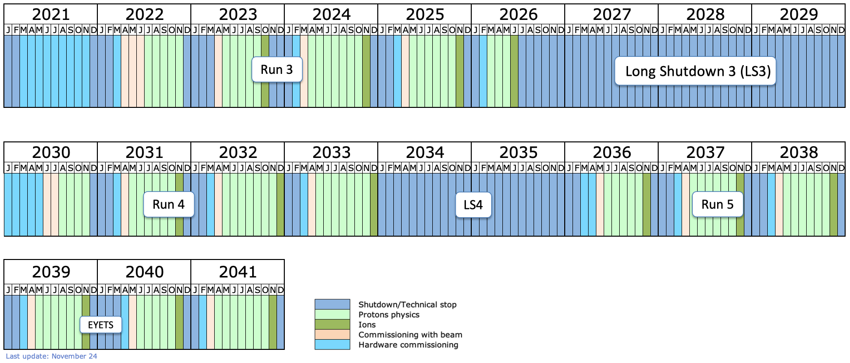
Future of experimental HI-LHC heavy-ion program
Yayun He et al, arXiv:2201.08408

Slide 10
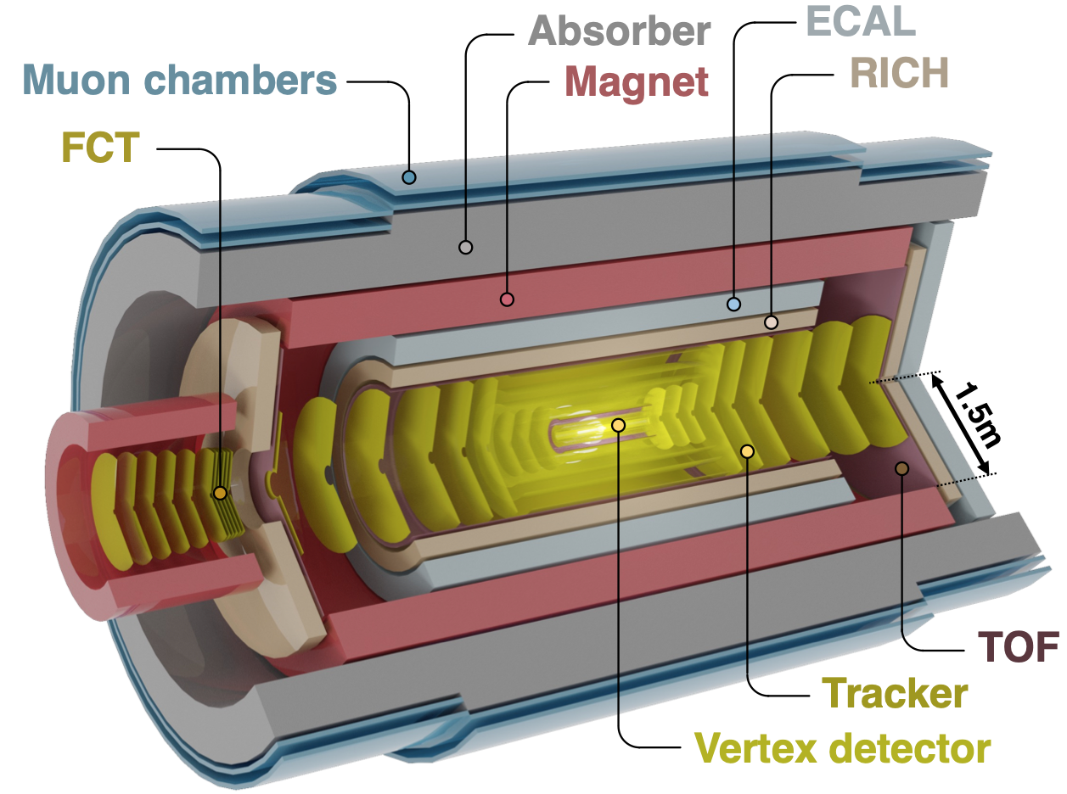
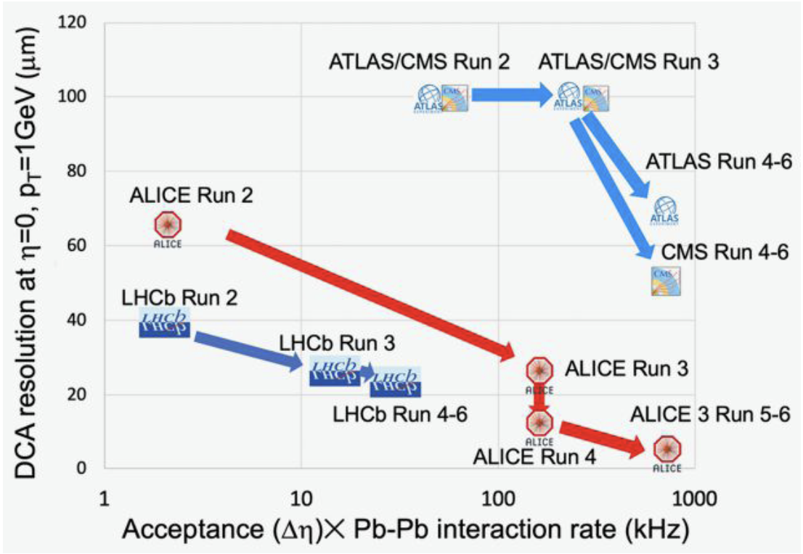
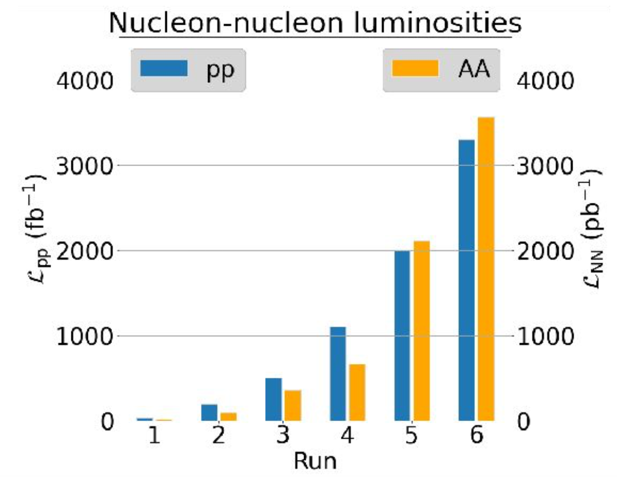
Novel experimental opportunities in the 2030s
ALICE 3 LoI: CERN-LHCC-2022-009
Large quantitative and qualitative gains after run 4
20 x luminosity: unique access to rare probes
How do heavy quarks thermalize ?
How does the QGP shine ?
QGP temp. via dileptons
Discovering charmed hadrons & hypernuclei
Hadron correlation functions
Yayun He et al, arXiv:2201.08408
Notes:
Interplay between system size and scattering length can lead to a size-dependent modification of the correlation function in presence of a bound state
.

Slide 11
Future opportunities with heavy quarks
Some examples
from work I was involved in
Yayun He et al, arXiv:2201.08408

Slide 12
Example 1: access to g-> c cbar
Calculable perturbatively
and high-pT spectra
Hard production is short distance*,
Conserved on QGP time scale
yield unaffected by QCD medium
Traceable experimentally
In the collinear limit
via displaced vertices or
No soft singularity in
Advantage for reconstructing splitting via grooming
In this limit, the g-> c cbar splitting function is modified by the QCD medium.
=> Charm yield medium-modified in a small sliver of phase space.
Formation time is boosted
* M. Cacciari et al, JHEP 10 (2012) 137

Slide 13
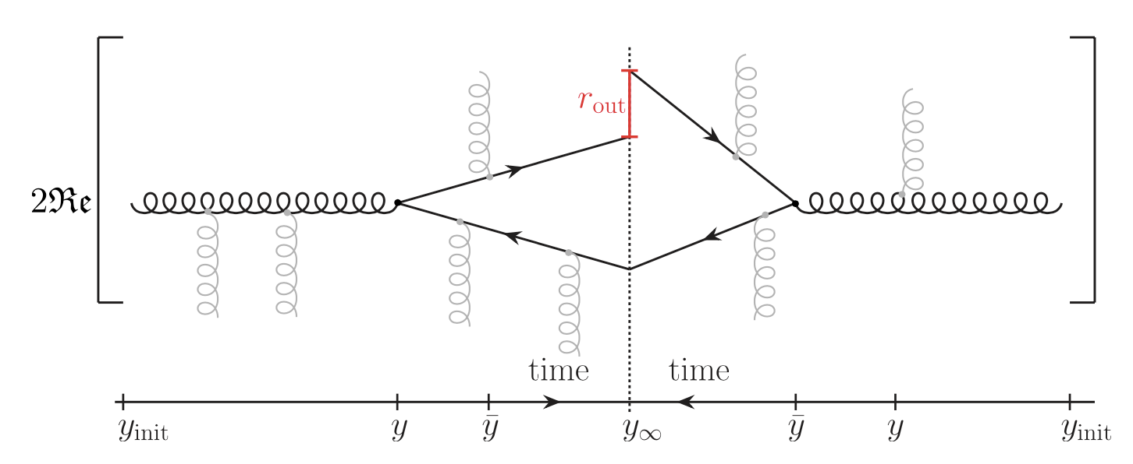
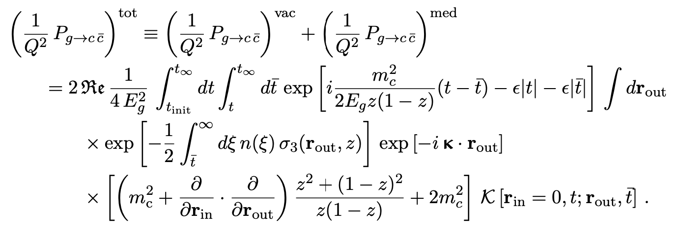
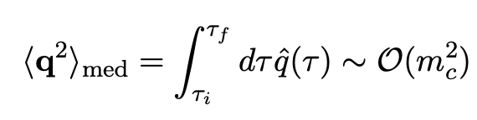
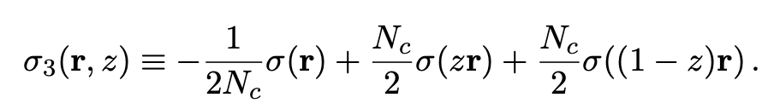
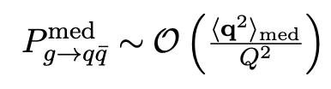
What we have calculated …
Medium-modified g-> c cbar splitting function* in Baier-Dokshitzer-Mueller-Peigné-Schiff / Zakharov formalism
(many other recent developments**)
Confirms formation time estimate
Sensitive to color field strength of medium
Numerically sizeable for
Geometrically enhanced power-correction
* ABIMSSW, JHEP 01 (2023) 080 ** L. Apolinario et al, 1407.0599, F. Dominguez et al., 1907.03653, Isaksen et al., 2107.02542, 2206.02811
M. Sievert et al, 1903.06170, S. Caron-Huot&Gale, 1006.2379

Slide 14
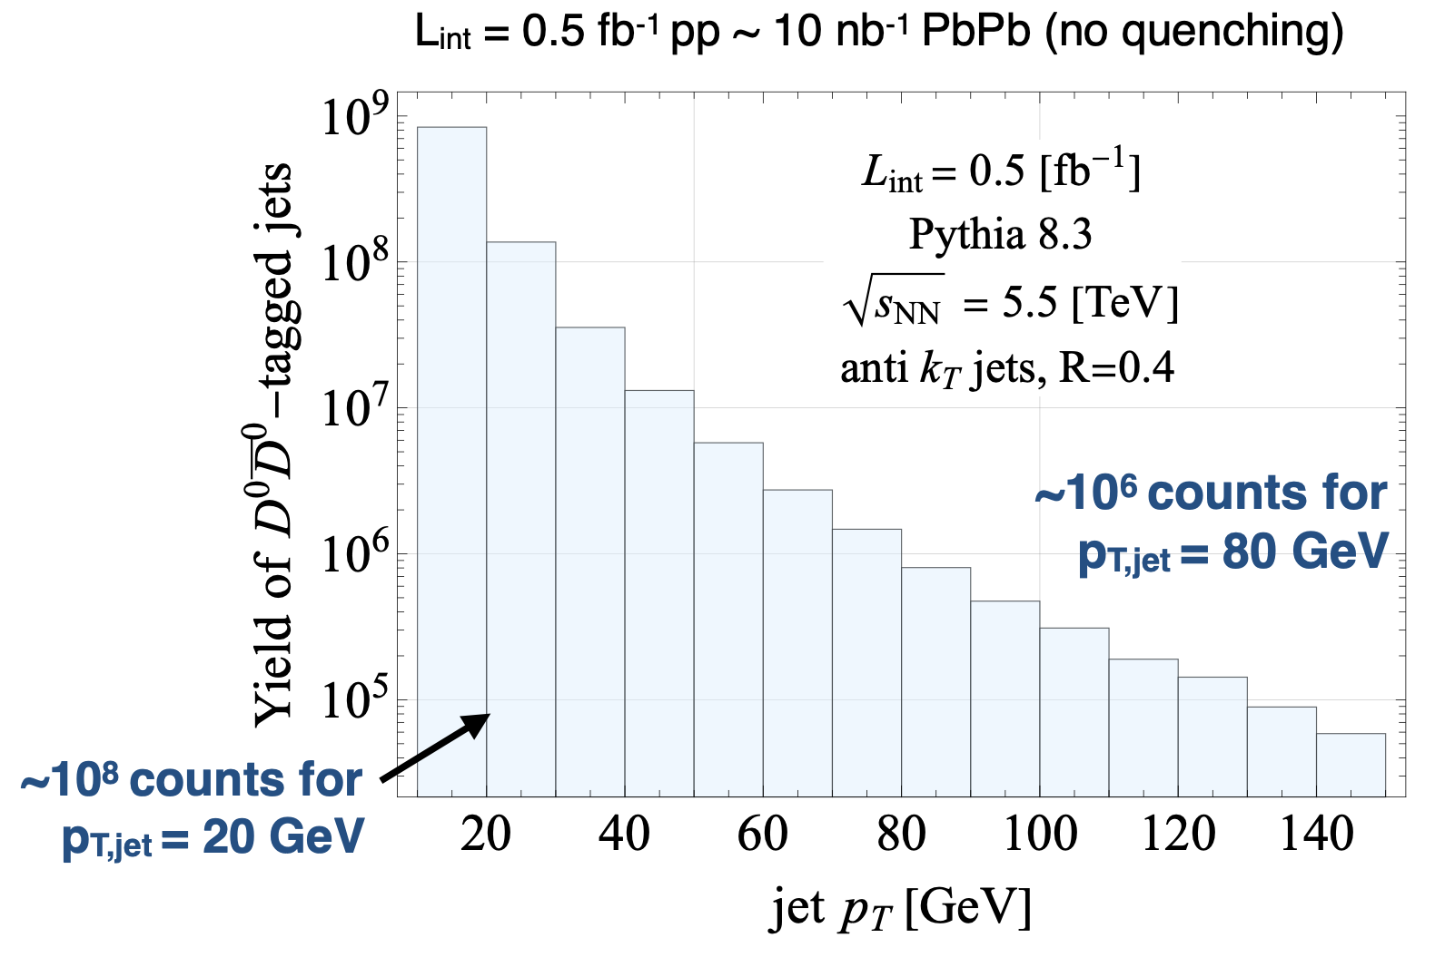
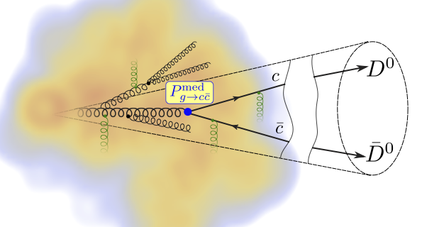
Integrated luminosity requirements
To measure medium-enhanced c-cbar, one needs
boosted gluons (i.e. jets) and identified charm
HL-LHC luminosity
The two-body decay of D⁰ can be reconstructed, but
The more abundant semi-leptonic decays of open charm remains to be explored.
* ABIMSSSW, PRL 132 212301 (2024)

Slide 15
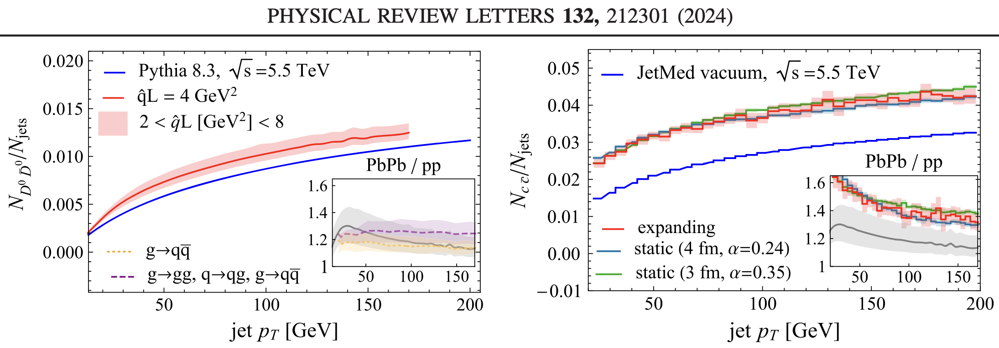
anti-k_{T}, R=0.4
Three independent model implementations:
  Reweighting vacuum with P^{med}
  Parton shower with BDMPS splittings
  JetMed supplemented by g-> c cbar
Prediction of enhanced cc-bar radiation.
Control over confounding factors
  Jet-pT is medium modified
  Medium modifies also g-> gg
* ABIMSSSW, PRL 132 212301 (2024)

Slide 16
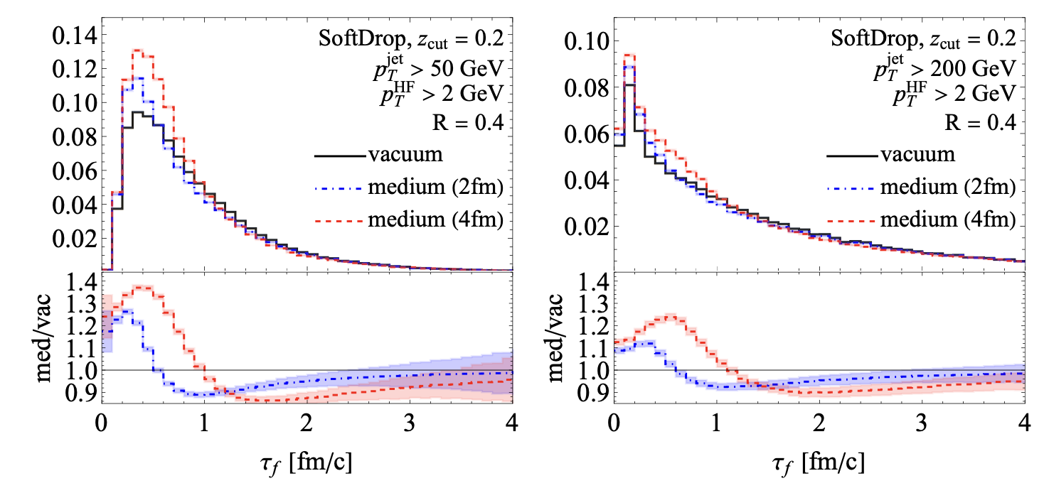
Example 2: QCD formation time via quenched jets
To measure the
formation time
.
we need to determine E_{g}, z and k_{c}
Strategy:
  reconstruct kinematic by tracing c and cbar to common vertex.
  compare kinematic -distribution in medium and vacuum.
QGP is unique in providing a spatial reference scale against which the QCD formation time can be measured.
J. Brewer, W. v.d.Schee, U.A. Wiedemann, 2503.11764

Slide 17
Example 3: Heavy quark transport – beyond Foker-Planck
Langevin / Fokker-Planck describes random medium-induced momentum kicks
Drag and momentum broadening calculable from 1st principles in QFT
Einstein relation needed for Langevin / Fokker-Planck to thermalize
In strongly coupled N=4 SYM, Einstein relation is violated at finite velocity.*
“Because of the dramatic failure of the Einstein relation, it doesn’t make sense to
plug the trailing string predictions into a Langevin description … “ Gubser 2006
* violation beyond leading log also in finite temperature QCD, G.D. Moore & D. Teaney PRC71 (2005) 064904

Slide 18
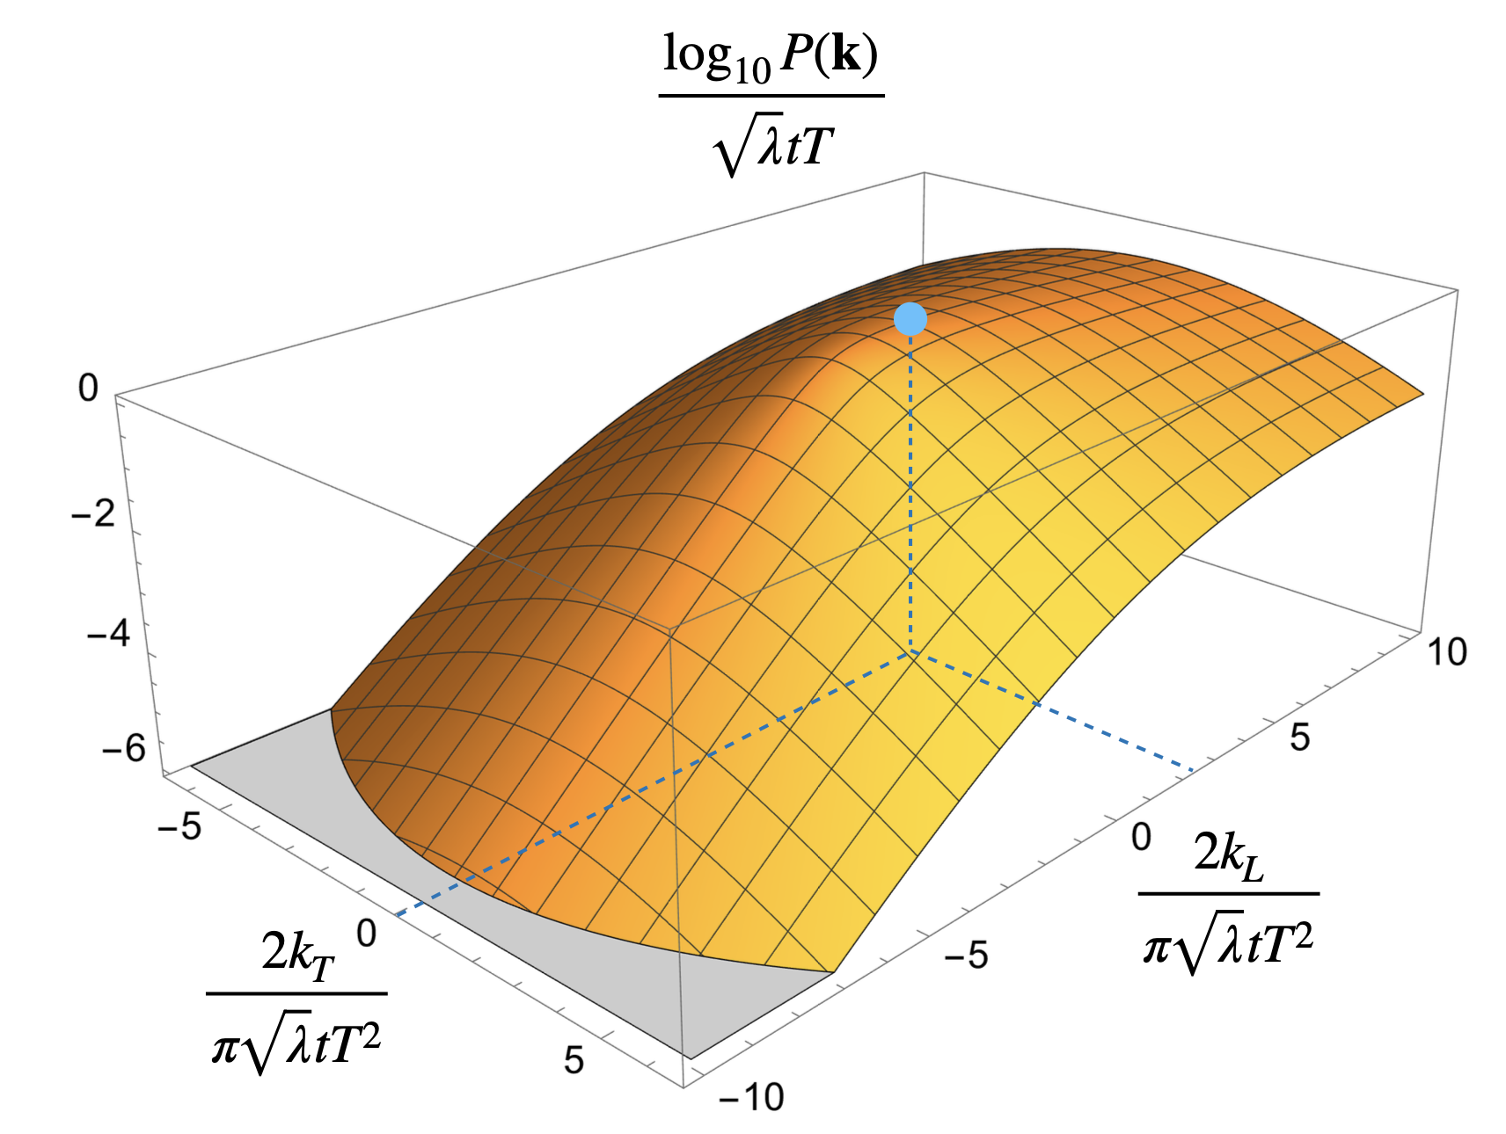
Solution if Foker-Planck fails: Kolmogorov-equation (Keq)
We have calculated in N=4 SYM the entire probability distribution ,
analytic control over all higher moments
This specifies the Kolmogorov evolution eq. of heavy quark momentum distribution
The kernel is defined in terms of
We find: FP eq = K-eq truncated to 2nd moments => FP does not thermalize
But: all order K-eq thermalizes
This solves Gubser’s problem.
We have derived an equilibration condition for the kernel of the K-eq that replaces the Einstein relation and is valid irrespective of coupling strength 2504.21139
K. Rajagopal, B. Scheihing-Hitschfeld, U.A. Wiedemann, 2501.06289

Slide 19
I gave three (out of many) examples
how novel experimental opportunities in the 2030s
can be followed by new theoretical developments
back to more general remarks
Yayun He et al, arXiv:2201.08408

Slide 20
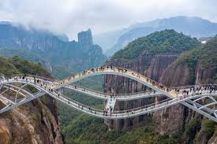
Building Bridges … examples
Hard Probes, Jet quenching
  Multiple bridges with high energy particle physics
  - perturbative QCD in nuclear environment,
  - NLO baselines, adapting Monte Carlo event generators and transport codes
  - adopting and rethinking Jet Finding Algorithms (Fastjet etc.)
  - Energy correlators (C3NT workshop https://indico.ihep.ac.cn/event/24880/)
Collective Flow
  Extending the textbooks of relativistic hydrodynamics to the smallest droplets
  - 1st principle finite temperature field theory predicitons of transport coefficients
  - relativistic fluid dynamic simulations / inference and uncertainty quantification
  (C3NT workshop https://indico.ihep.ac.cn/event/25126/)
  AdS/CFT: understanding non-abelian plasmas with string theory techniques
  - understanding perfect fluidity in QFT, plasmas without quasi-particle d.o.f.
  - novel strong coupling techniques
Yayun He et al, arXiv:2201.08408

Slide 21
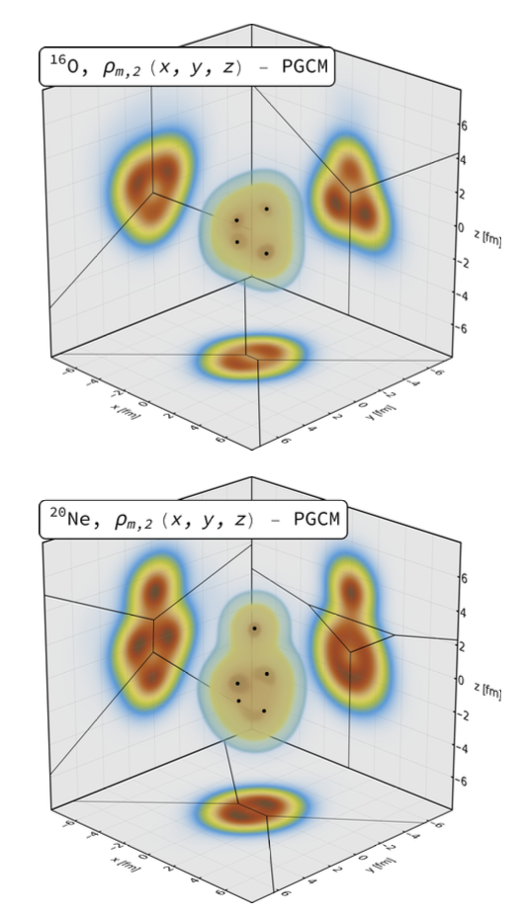
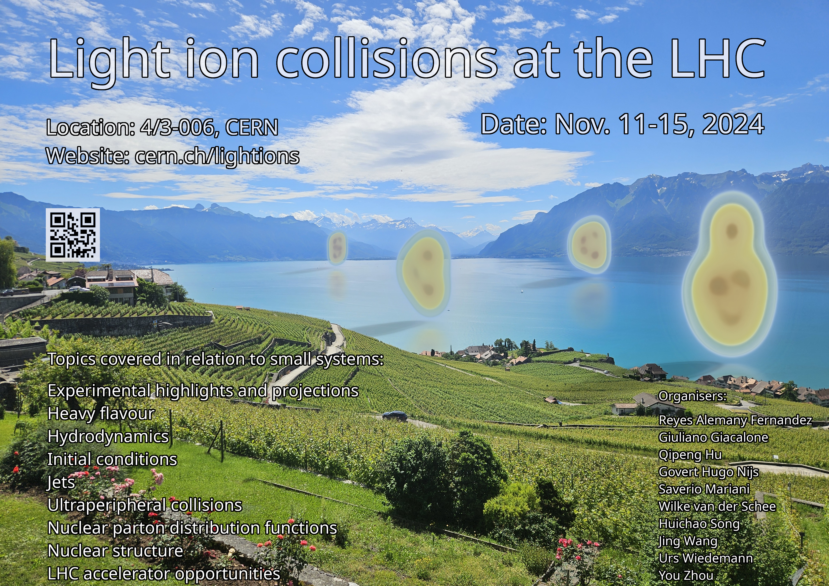
… more examples
LHC discovery of collectivity in small(est) systems
  - Thermo/hydro-dynamization in non-abelian plasmas
  - Sensitivity to fine details of initial conditions
  Synergies with nuclear structure*
G. Giacalone et al., 2402.05995
Yayun He et al, arXiv:2201.08408

Slide 22
My best wishes for the success of C3NT.
May it strive to grow into one of the world-leading meeting points for nuclear theory.
I am looking forward to discussing and shaping the future of our field here in Wuhan.
Yayun He et al, arXiv:2201.08408

Slide 23
END
Yayun He et al, arXiv:2201.08408

