Slide 1
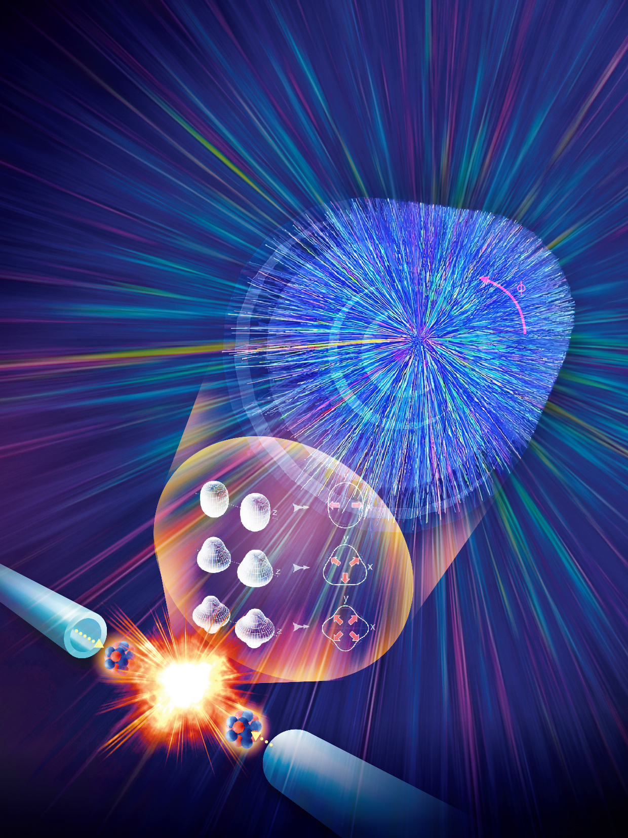
Nuclear Physics across Energy Scales
-- Personal view from heavy ion collisions
Huichao Song
Peking University
Inaugural Symposium of the Central China Center for Nuclear Theory (C3NT) on Frontiers in Nuclear Theory"
Wuhan May 17-18 2025
中国科学 物理学 力学 天文学《高能核-核碰撞和原子核结构专题》封面
05/17/2025

Slide 2
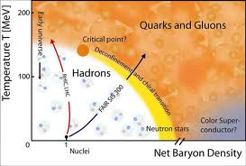
Landscape of nuclear physics
degrees of freedeom
-intermediate and high energy nuclear physics
quarks
& gluons
Energy
(MeV)
Quark Gluon Plasma
Hadron
Gas
hadrons
-nuclear structure physics
nuclei

Slide 3
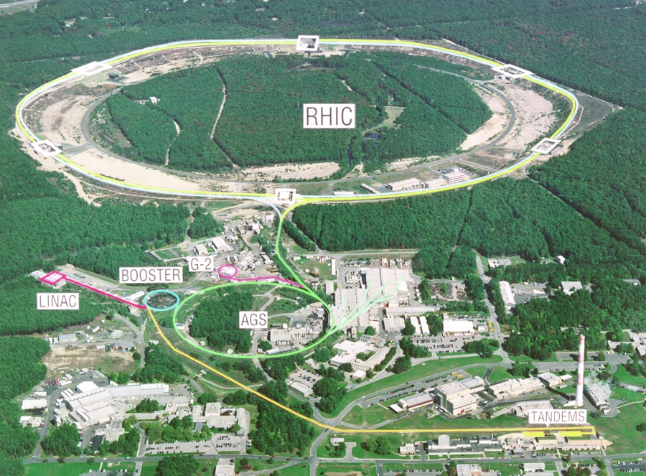
Relativistic heavy ion physics
QGP
RHIC
Relativistic heavy ion collisions
- create and study QGP
- the QCD phase diagram
- the deconfinement & chiral phase
transition
- the QCD vacuum
Quark Gluon Plasma
Hadron
Gas

Slide 4


The QGP has been created in relativistic heavy ion collisions
Quark Gluon Plasma
QGP
Most Perfect Liquid
Most Vortical Fluid

Slide 5
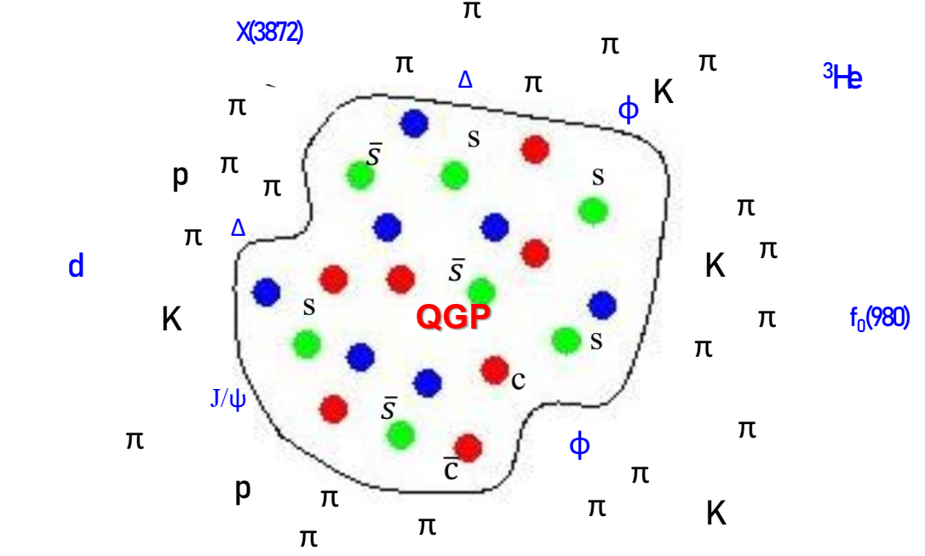
Rich collision systems
Various
Observables
²⁰⁸Pb+²⁰⁸Pb ¹⁹⁷Au+¹⁹⁷Au ²³⁸U+²³⁸U ¹²⁹Xe+¹²⁹Xe ⁹⁶Zr+⁹⁶Zr ⁹⁶Ru+⁹⁶Ru ¹⁶O+¹⁶O p+¹⁶O p+²⁰⁸Pb p+p …
Stable hadrons
All charged
π K p … …
QGP
resonances
φ meson …
Light nuclei
Hyper nuclei
deuteron
³He ⁵_{Ʌ}He …
Exotic hadrons
X(3872)
f₀(980) …

Slide 6
Exploring Nuclear Physics across Energy Scales
-- Personal view from heavy ion collisions
QGP
Initial conditions:
Intersection study with nuclear structure
QGP evolution:
main goal: QGP & QCD phase diagram
Final Hadrons:
intersection study with hadron physics

Slide 7
Flow & QGP（signature） in large and small systems of heavy-ion / light-ion collisions
QGP
Initial conditions:
Intersection study with nuclear structure
QGP evolution:
main goal: QGP & QCD phase diagram
Final Hadrons:
intersection study with hadron physics

Slide 8
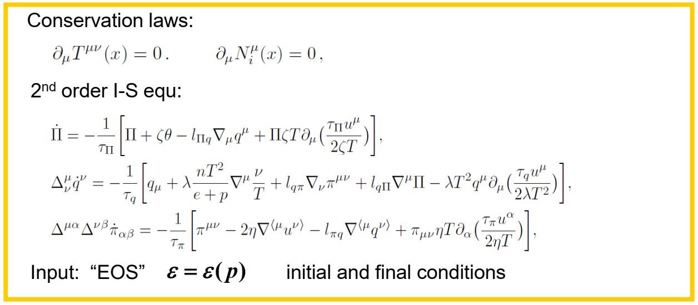
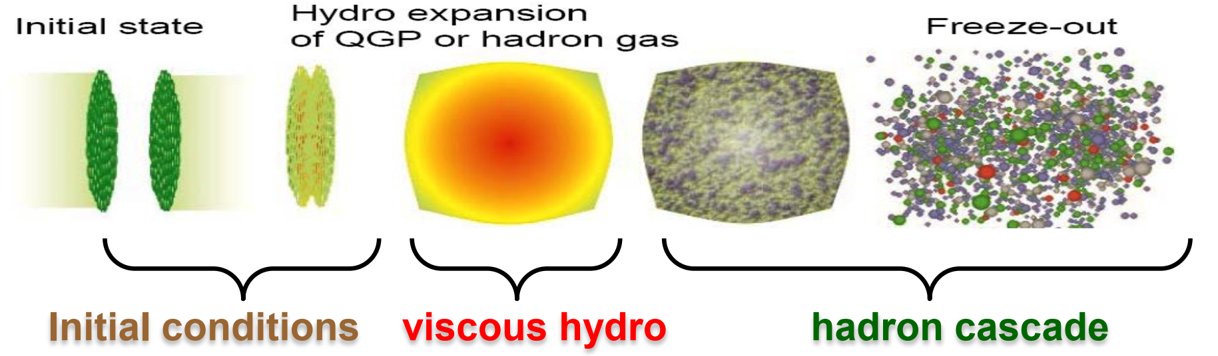
Viscous hydro & hybrid model

Slide 9
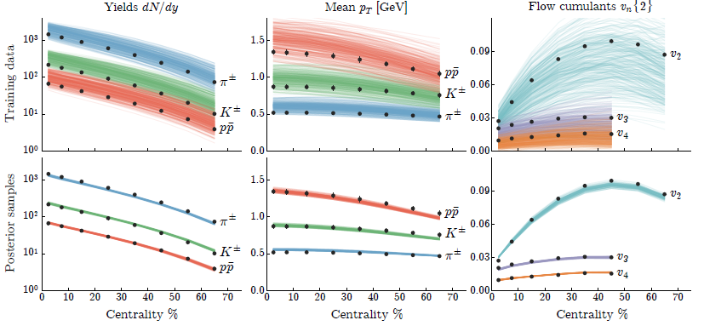
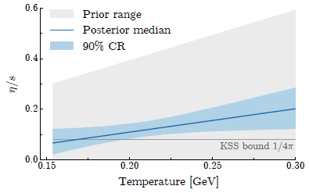
Extract the QGP viscosity
-An quantitatively extraction of the QGP viscosity with iEBE-VISHNU and the massive data evaluation
-η/s(T) is very close to the KSS bound of 1/4π
J. Bernhard, S. Moreland, S.A. Bass, J. Liu, U. Heinz, PRC 2015

Slide 10
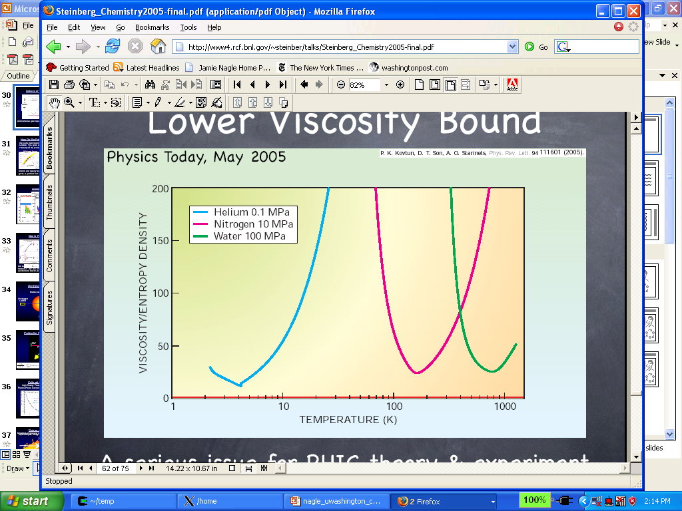
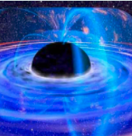
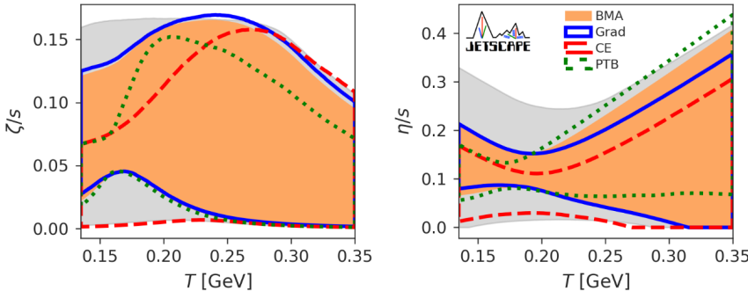
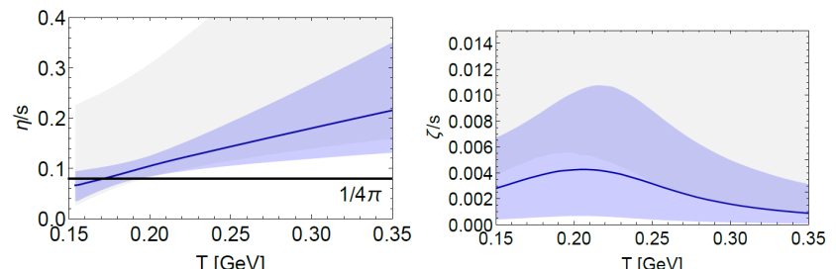
QGP: most perfect liquid
AdS/CFT
QGP specific shear viscosity
Extracted from exp data

Slide 11
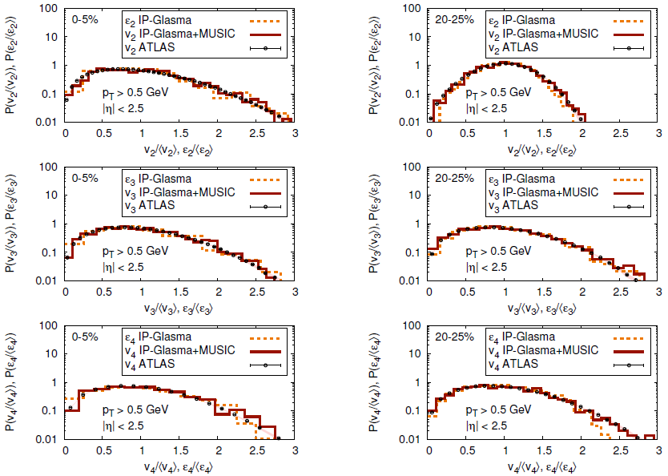
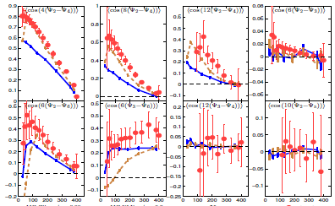
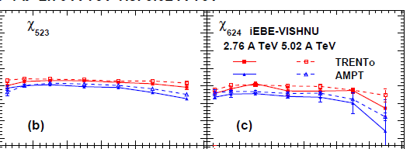
Powerful predictions from hydrodynamics
-Vn distributions
-non-linear response coeff.
-Correlations of Flow Harmonics
… … … …
-Hydrodynamics can quantitatively describe / predict various flow data
-perfect liquid for large systems
H. Xu, Z. Li and H. S*, Phys. Rev. C93, no. 6, 064905 (2016); W. Zhao, H. Xu and H. S*, Eur. Phys. J. C 77, no. 9, 645 (2017); X. Zhu, Y. Zhou, H. Xu and H. S*, Phys. Rev. C95, no. 4, 044902 (2017); W. Zhao, L. Zhu, H. Zheng, C. M. Ko and H. S*., Phys. Rev. C 98, no. 5, 054905 (2018); Li, Zhao, Zhou, H.S*, in preparation (2020) … … … …
-- How tiny the QGP droplet could be?

Slide 12
Small collisions systems at RHIC & LHC
System size scan:
Pb+Pb Xe+Xe O+O p-Pb p-p collisions …
Geometry scan:
p-Au d+Au He-Au collisions …
Other collision systems:

Slide 13
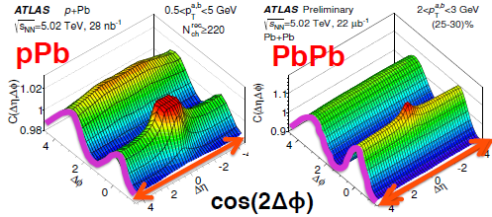
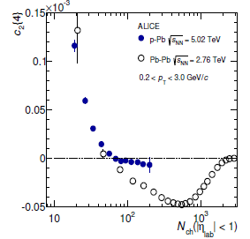
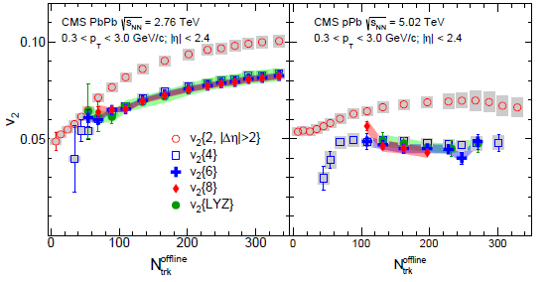
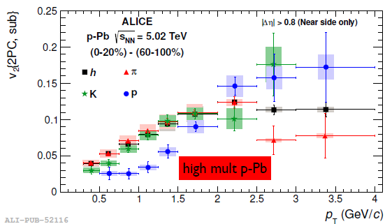
Correlations & Flow in small systems
PLB 2013
-Many flow-like signals have been observed in high multiplicity p-Pb collisions

Slide 14
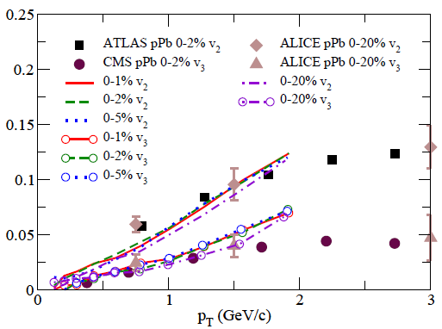
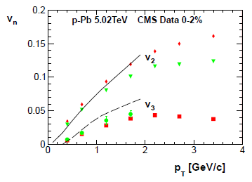
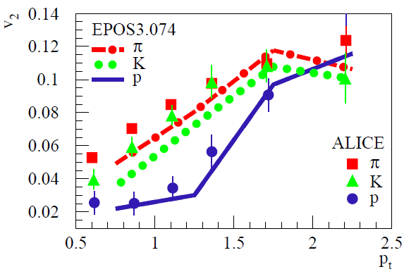
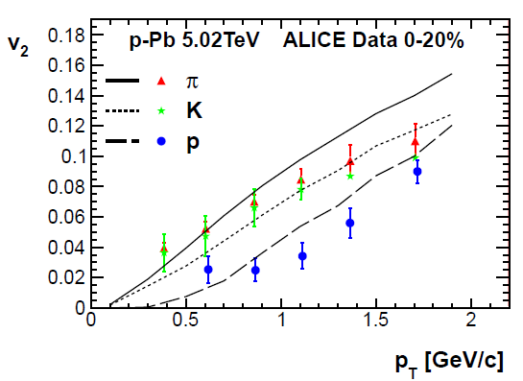
Hydrodynamic calculations for small systems
in p+Pb collisions at 5.02 TeV
P. Bozek, W. Broniowski, G. Torrieri, PRL2013
G.-Y. Qin, B. Muller. PRC2014
K. Werner, et. Al., PRL2014
P. Bozek, W. Broniowski, G. Torrieri, PRL2013

Slide 15
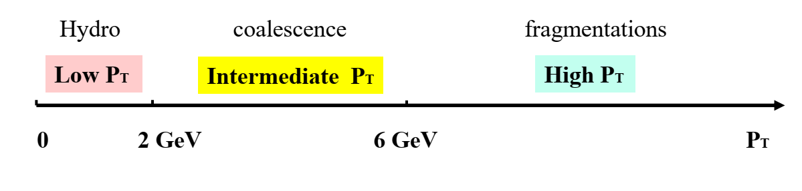
Partonic flow and QGP signals in small systems with VQS
p+Pb

Slide 16
Zhao, Ko, Liu, Qin & Song.
Phys. Rev. Lett. 125 7 072301(2020)in
Hydro-Coal-Frag Hybrid Model
Thermal hadrons (VISH2+1):
-generated by hydro.
with Cooper-Frye.
-Meson: P_{T}< 2P₁; baryon: P_{T} < 3P₁.
Coalescence hadrons (Coal Model):
-generated by coalescences model
including thermal-thermal,
thermal-hard & hard-hard parton
coalescence.
Fragmentation hadrons (LBT):
-Hard partons generated by PYTHIA8,
then suffered energy loss by LBT
Main Parameters:
-Thermal hadrons from hydro with P_{T} <P₁.
UrQMD afterburner:
-Hard partons from LBT with P_{T} > P₂.
-All hadrons are feed into UrQMD for
hadronic evolution, scatterings and decays.
Fixed by the p_{T} spectra
P_{T1} = 1.6GeV and P_{T2} = 2.6GeV

Slide 17
VCQ scaling of v₂ & partonic degree of freedom
-Hydro-Coal-Frag model gives a nice description of v2(pT ) of pion, kaon and proton from 0 to 6 GeV.
-At intermediate pT , Hydro-Coal-Frag model obtains an approximate NCQ scaling as shown by the data.
Zhao, Ko, Liu, Qin & Song. Phys. Rev. Lett. 125 7 072301(2020)

Slide 18
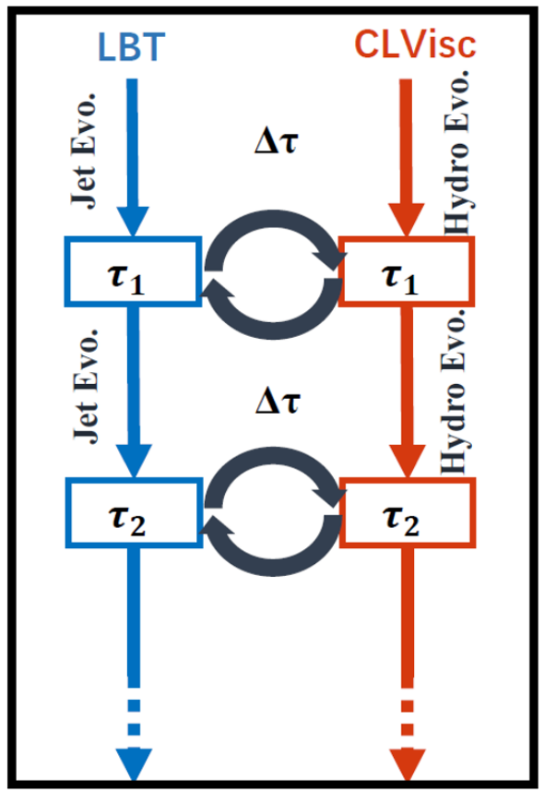
CoLBT-Hydro Model + Coal Model for Pb+Pb collisions
CoLBT-Hydro Model
Chen, Cao, Luo, Pang & Wang.
Phys. Lett. B 810, 135783 (2020).
Linear Boltzmann Transport Model
3+1D hydrodynamic model
LBT CLVis
-Evolve the energetic partons and the bulk medium concurrently.
-Hadronization by Hydro-Coal-Frag followed by the UrQMD.
- thermal - thermal parton coal
- thermal - hard parton coalescence
- hard - hard parton coalescence
Zhao, Chen, Luo, Ke & Wang.
Phys. Rev. Lett. 128 2 022302(2022).

Slide 19
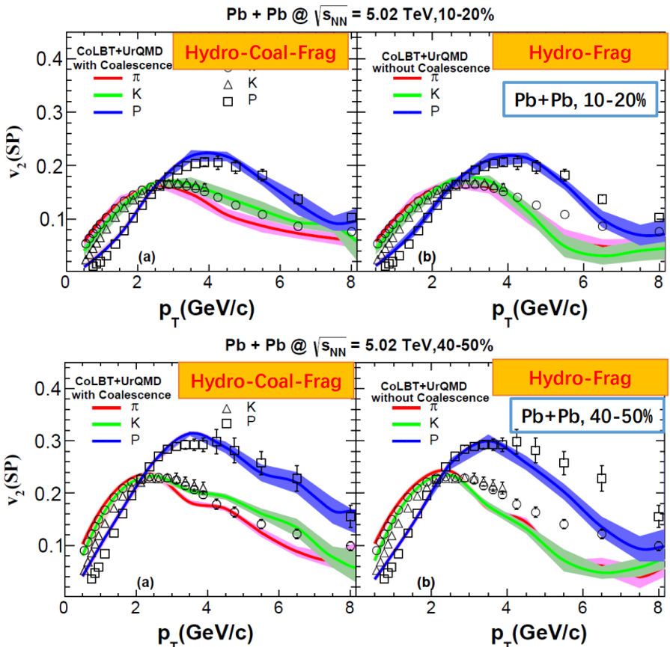
Quark coalescence for Pb+Pb collisions
Hydro-Frag
-CoLBT-hydro with coalescence works well for PID flow of Pb+Pb collisions from 0 to 8 GeV.
Quark coalescence is important at intermediate P_{T}
Hydro-Coal-Frag
thermal-hard parton
Coalescence &
Fragmentation
Breaks up the NCQ
scaling of v2 in Pb+Pb collisions
Hydro-Coal-Frag
Hydro-Frag
Zhao, Chen, Luo, Ke & Wang.
Phys. Rev. Lett. 128 2 022302(2022).
Notes:
CERN 12-22 small system intermediate PT 4 20 min 1-22 8min

Slide 20

QGP
Theory: Hydrodynamics & hybrid approach are powerful tool to simulate the QGP fireball evolution and study its properties
-We are ready to focus on the initial state of the QGP
nuclear structure of colliding nuclei
Notes:
2 30 inreo 1-9

Slide 21
Exploring Nuclear Physics across Energy Scales
-- Personal view from heavy ion collisions
QGP
Initial conditions:
Intersection study with nuclear structure
QGP evolution:
main goal: QGP & QCD phase diagram
Final Hadrons:
intersection study with hadron physics

Slide 22

Rich collision systems at
RHIC & the LHC
neutron skin
clusters
clusters
deformation
neutron skin
Notes:
3, 20

Slide 23
Probe nuclear structure with relativistic heavy ion collisions
- Relativistic heavy collisions
start from nuclei
-Collision time < 10⁻²⁴ s
directly probe the ground state of nuclei
-Well calibrated calculations for QGP evolution; to focus on the initial state
initial state with deformation
Well calibrated calculations
Notes:
1-12 4分30秒

Slide 24
Study nuclear deformation with heavy ion collisions

Slide 25
⁹⁶Ru+⁹⁶Ru and ⁹⁶Zr+⁹⁶Zr Collisions @ RHIC isobar run
- To search the Chiral Magnetic Effect (CME)
- Obviously different early magnetic field for Ru+Ru and Zr+Zr collisions
Deformation of ⁹⁶Ru and ⁹⁶Zr
ADNDT107,1 (2016) ADNDT80,35(2002)

Slide 26
Deformation of ⁹⁶Ru & ⁹⁶Zr (nuclear structure)
Gogny energy density functional |(Tiaxial) T R. Rodríguez EMMI RRTF 2022
W Ryssens EMMI RRTF 2022
Skyrme EDF
Beyond-mean-field
Rong, Lu, arXiv:2201.02114
Nuclear structure physics
obtain the deformation information from the spectrum with certain
model calculations
(not directly image the deformation in position space)

Slide 27
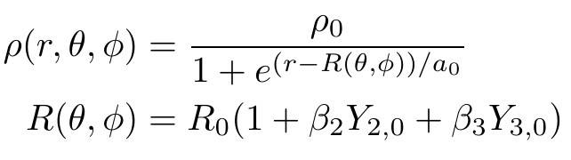
Probe the deformation (mass distributions) of ⁹⁶Ru & ⁹⁶Zr
Relativistic heavy ion collisions
⁹⁶Ru
⁹⁶Ru
⁹⁶Zr
⁹⁶Zr
initial conditions:
(deformation / mass distributions)
Initial conditions (TRENTO)
- Sample nucleon position in deformed nuclei with:
Quadrupole:
Octupole:

Slide 28
ac₂{3} for Ru+Ru and Zr+Zr collisions
ac₂{3} is sensitive to quadrupole and octupole deformations
S. Zhao, H. Xu, Y. Liu, H. Song. PLB2023, arXiv: 2204.02387
Notes:
13-21

Slide 29
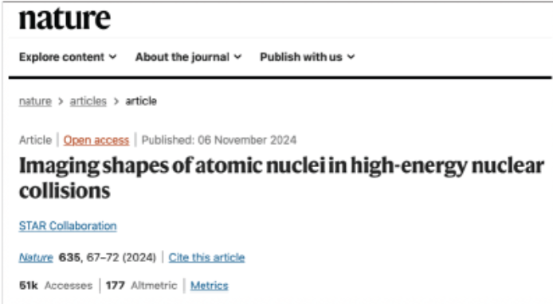
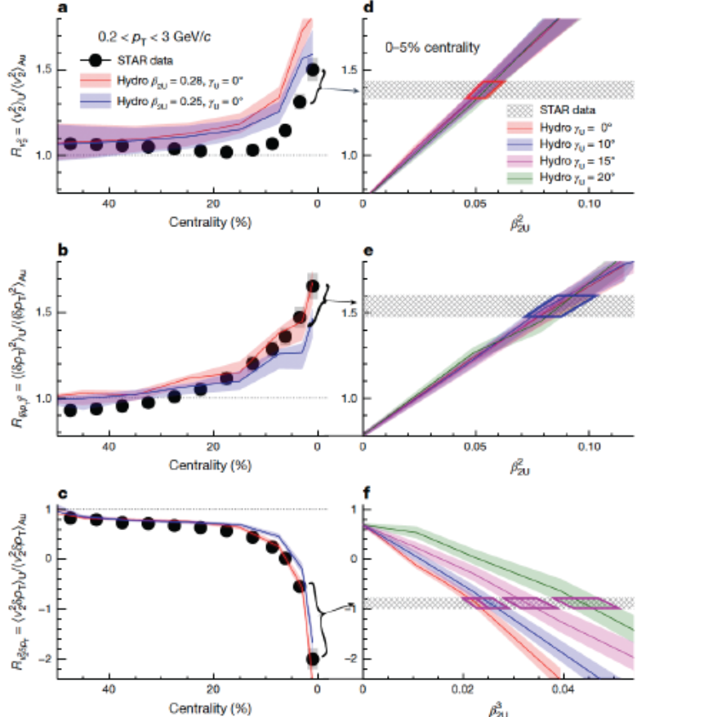
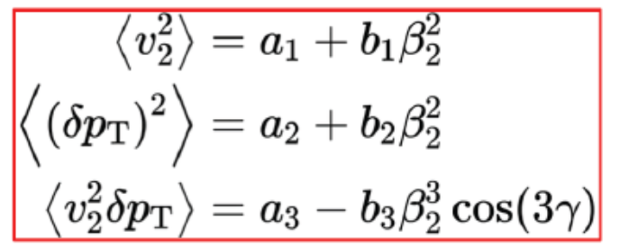
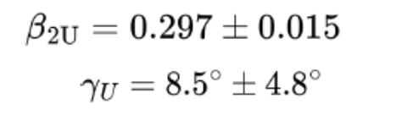
Imaging the deformation ²³⁸U at RHIC
Notes:
13-21

Slide 30
Probe the shape phase transition with Xe +Xe collisions
shape phase transition

Slide 31
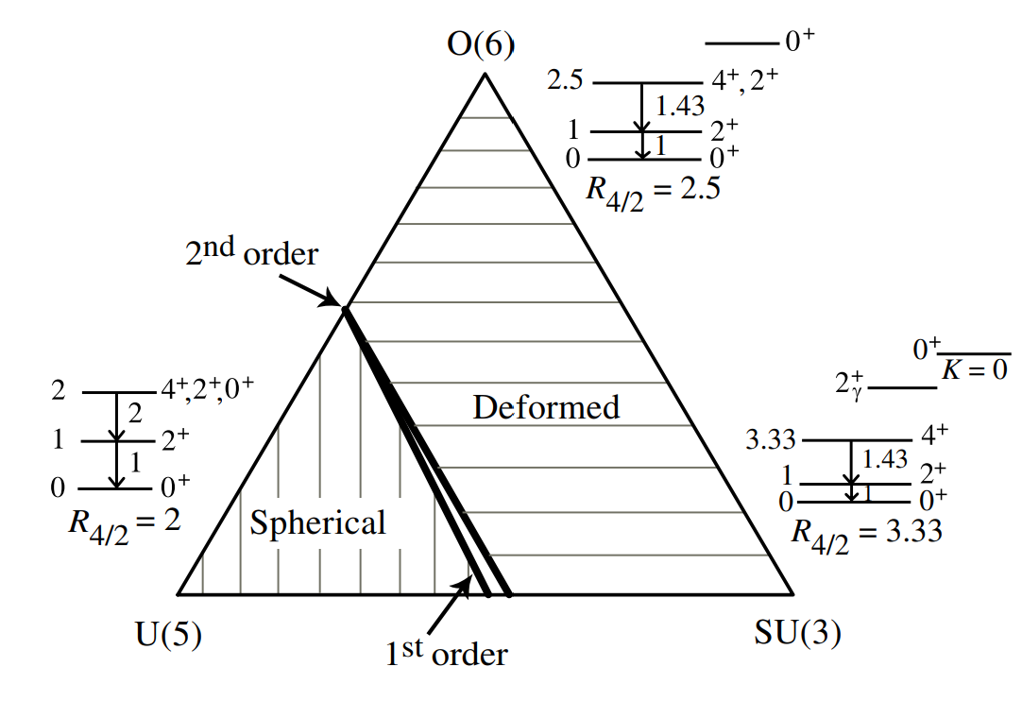
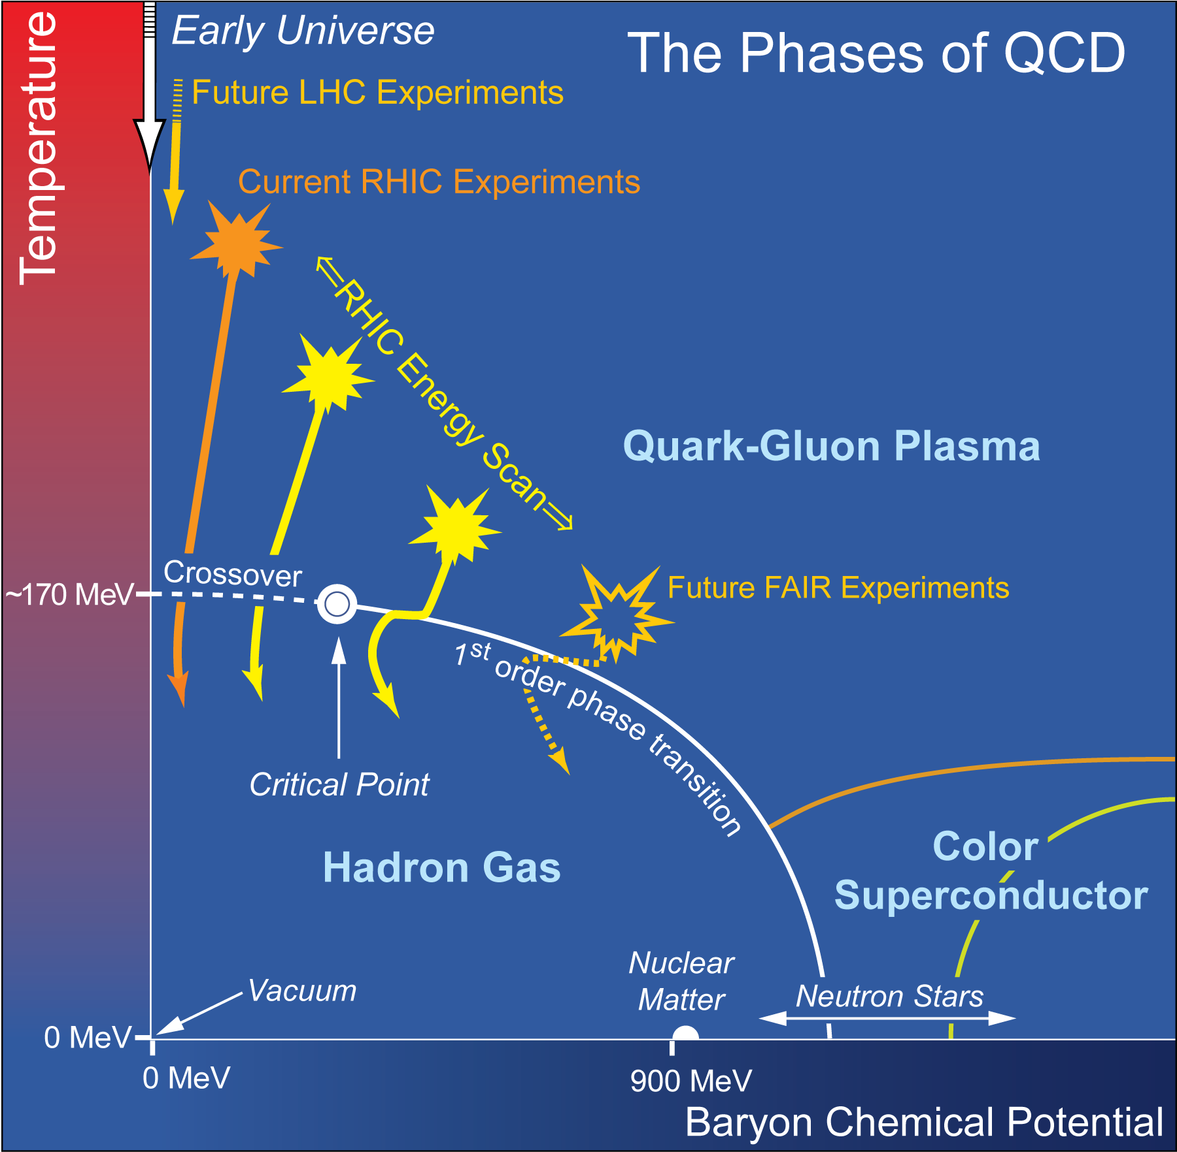
The Phase Transition
¹²⁹Xe+¹²⁹ Xe collision
-explore the second-order shape phase transition occurring in the vicinity of ¹²⁸⁻¹³⁰Xe
S. Zhao, H. Xu, Y. Zhou, Y. Liu, H. Song, arXiv: 2403.07441 [nucl-th]
Relativistic heavy ion collisions
-mainly aim to explore QCD Phase Transition
The critical point symmetries
γ-soft rotor
E(5)
Spherical vibrator
Axially deformed rotor
X(5)

Slide 32
Shape phase transition for Xe isotopes
The shape phase transition:
-rapid structural change along certain isotope or isotone chains
-the dynamic interplay between the spherical-driving pairing interaction and the deformation-driving proton-neutron interaction
The shape phase transition for the Xe isotopes:
-Within the the framework of the interacting boson model (IBM), the Xe isotopes undergo a shape phase transition from a
γ-soft rotor to a spherical vibrator
The critical point symmetries
γ-soft rotor
R. F. Casten, Nucl. Phys. A 439, 289 (1985). G. Puddu, O. Scholten, and T. Otsuka, Nucl. Phys. A 348, 109 (1980). R. F. Casten and P. Von Brentano, Phys. Lett. B 152, 22 (1985).
E(5)
-Exp data and model calculations:
¹²⁸⁻¹³⁰Xe: E(5) symmetry, associated with a 2nd order shape phase transition
F. Iachello, Phys. Rev. Lett. 87, 052502 (2001);Phys. Rev. Lett. 85, 3580 (2000); R. M. Clark, et. al. Phys. Rev. C 69, 064322 (2004); R. Rodriguez-Guzman, et. al. Phys. Rev. C 76, 064303 (2007); L.M.Robledo, et. al. Phys. Rev.C 78 (2008) 034314
Spherical vibrator
Axially deformed rotor
X(5)

Slide 33
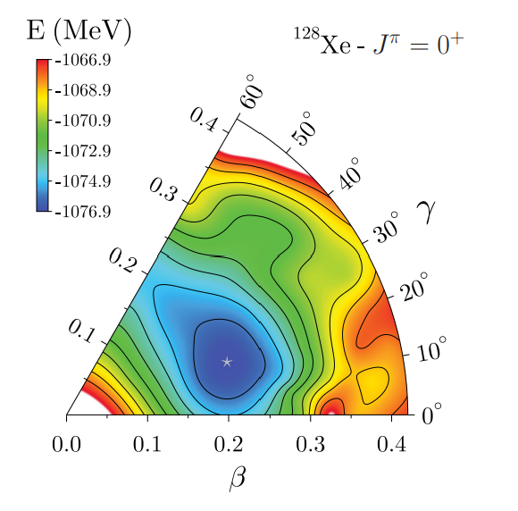
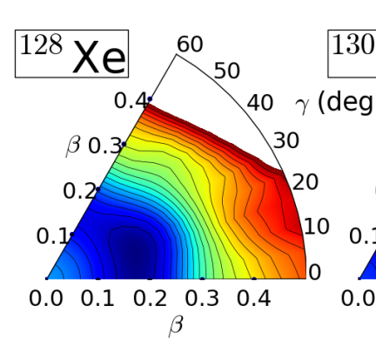
Probe the γ-soft deformation of ¹²⁹Xe
¹²⁹Xe
¹²⁹Xe
Relativistic heavy ion collisions
initial conditions:
(deformation / mass distributions)
Rigid triaxial deformation (γ=30⁰)
Bally et. al. Eur.Phys.J.
A 58 (2022) 9, 187,
Initial conditions (TRENTO)
- Sample nucleon position in deformed nuclei with:
γ-soft (flat distribution in 0≤γ≤60⁰)
Z. P. Li, et. al. Phys. Rev. C 81, 034316 (2010),

Slide 34
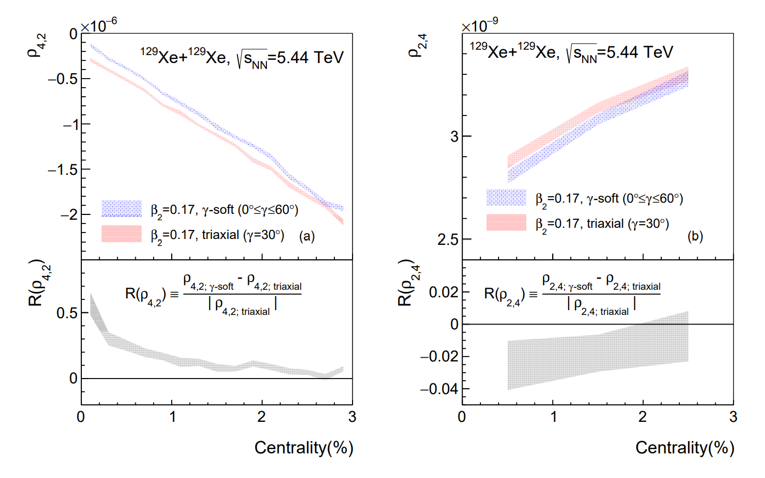
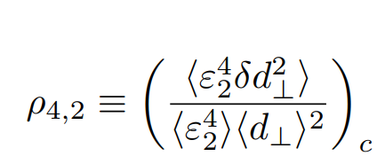
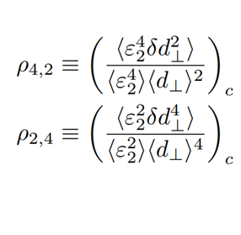
6-particle correlations-Theoretical Predictions
The γ-soft deformation of ¹²⁹Xe lead to a clear enhancement of 6-particle correlations ρ_{4,2} in ultra-central Xe+Xe collisions
S. Zhao, H. Xu, Y. Zhou, Y. Liu, H. Song Phys. Rev. Lett. 133, 192301(2024)
Notes:
CERN 33-46 APP 7

Slide 35
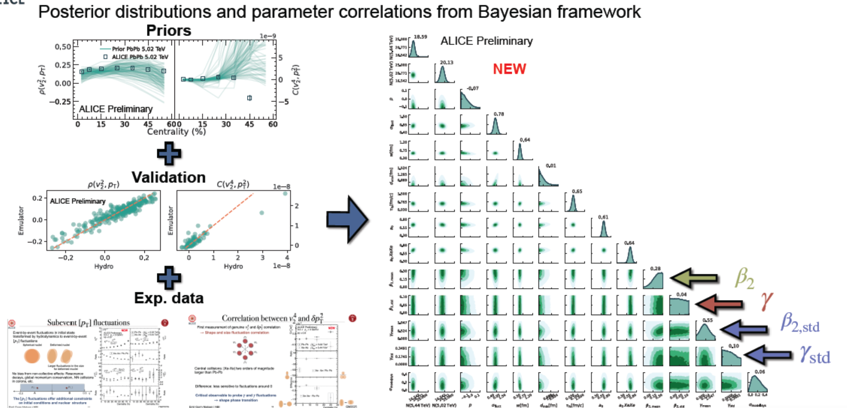
ALCE Measurements & Bayesian Analysis
Y. Zhou, E.G. Nielsen QM 2025 talk
Notes:
CERN 33-46 APP 7

Slide 36
Probe nuclear structure
with heavy ion collisions at RHIC & LHC
neutron skin
octupole vibration
Shape phase transitions
clusters
Notes:
3, 20

Slide 37
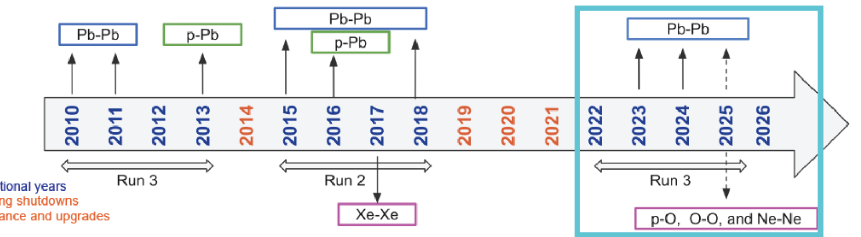
Physics opportunities from light ion collisions at the LHC
Also refer to the exp. talk of N. Triantafyllou (LHCP 2025)

Slide 38
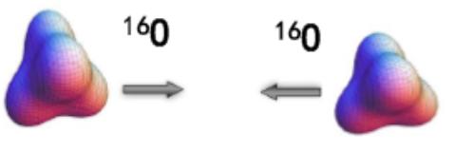
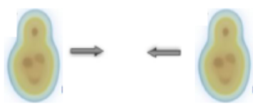

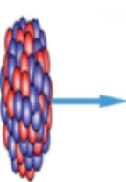
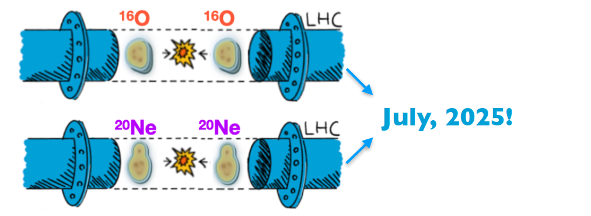
Probe cluster structure with light ion collisions
Probe the structure of ¹⁶O with O+O collisions
Li, Zhang &Ma, Phys. Rev. C 102,054907 (2020)
Wang, Zhao, Cao, Xu and Song. Phys.Rev.C 109 5, L051904 (2024)
… … … …
Probe the Bowling pin structure of ²⁰Ne with Ne+Ne collisions
Giaclaone,Bally, Nijs, Shen,et al, arXiv: 2402.05995
Li, Zhou and Ma,arXiv:2504.04688 [nucl-th].
… … … …
Probe the cluster structure Pb+Ne/Pb+O run at LHCb (SMOG)
Giaclaone,Zhao, et al, Phys. Rev. Lett.134 082301 (2025)
Lu, Zhao, Nielsen, Li and Zhou, arXiv:2501.14852 [nucl-th]
… … … …

Slide 39

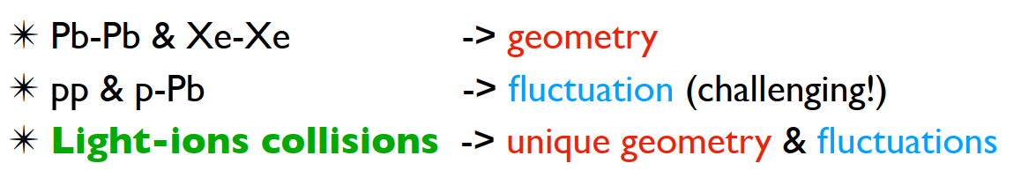
Collectivities in small systems with light ion collisions
Key questions: Origin of collective flow in small systems
-"We strongly argue that short light ion runs should become part of the full exploitation of the scientific opportunities arising from HL-LHC"
— Summary report for Light ion collisions at the LHC CERN Nov2024

Slide 40
Exploring Nuclear Physics across Energy Scales
-- Personal view from heavy ion collisions
QGP
Initial conditions:
Intersection study with nuclear structure
QGP evolution:
main goal: QGP & QCD phase diagram
Final Hadrons:
intersection study with hadron physics

Slide 41
Rich collision systems
Various
Observables
²⁰⁸Pb+²⁰⁸Pb ¹⁹⁷Au+¹⁹⁷Au ²³⁸U+²³⁸U ¹²⁹Xe+¹²⁹Xe ⁹⁶Zr+⁹⁶Zr ⁹⁶Ru+⁹⁶Ru ¹⁶O+¹⁶O p+¹⁶O p+²⁰⁸Pb p+p …
Stable hadrons
All charged
π K p … …
QGP
resonances
φ meson …
Light nuclei
Hyper nuclei
deuteron
³He ⁵_{Ʌ}He …
Exotic hadrons
X(3872)
f₀(980) …

Slide 42
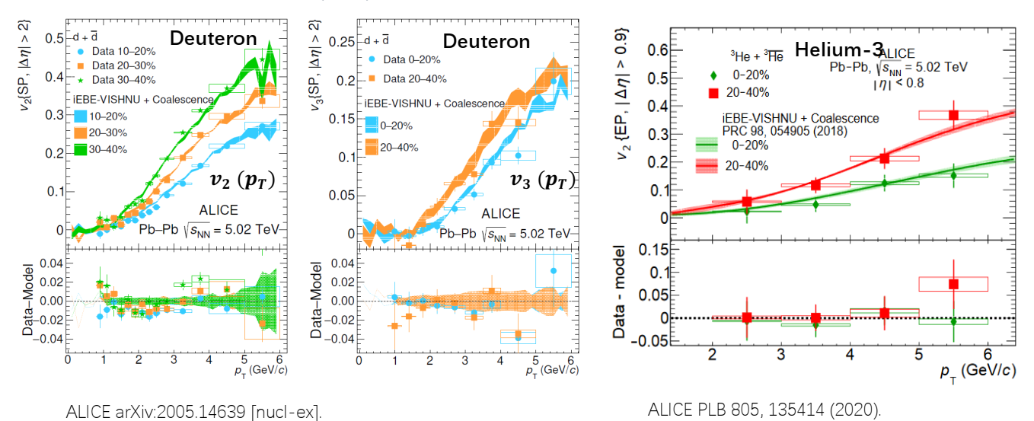
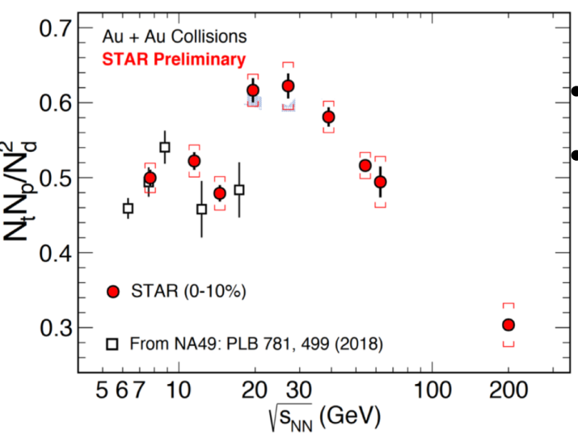
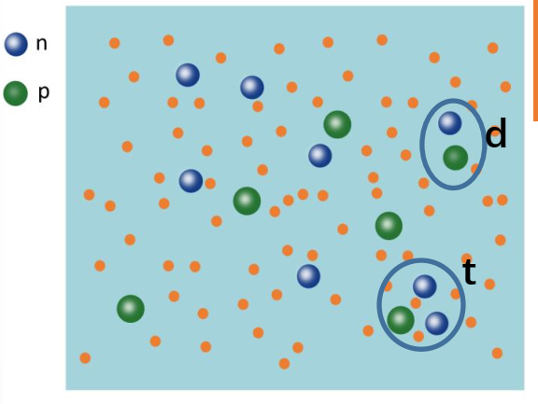
Light Nuclei
System sizes
²⁰⁸Pb+²⁰⁸Pb ¹⁹⁷Au+¹⁹⁷Au ²³⁸U+²³⁸U ¹²⁹Xe+¹²⁹Xe ⁹⁶Zr+⁹⁶Zr ⁹⁶Ru+⁹⁶Ru ¹⁶O+¹⁶O p+²⁰⁸Pb p+p … …
Observables
large systems
QGP properties
QCD phase diag
….
Initial condi. (nuclear structure)
deformation shape phase transition
neutron skin α-cluster ….
Small systems
Possible formation
of QGP…
Stable hadrons
All charged h
π K p … …
φ meson: nice probe for the QGP
long life time (45fm/c),
weakly interact with hadron gas
reconstruct with φ ---K⁺K⁻
resonances
φ meson …
Light nuclei
Hyper nuclei
deuteron
³He ⁵_{Ʌ}He …
Light nuclei: produced by coalescence of n & p at kinetic freezeout
probe critical fluctuations & hadronic flow

Slide 43
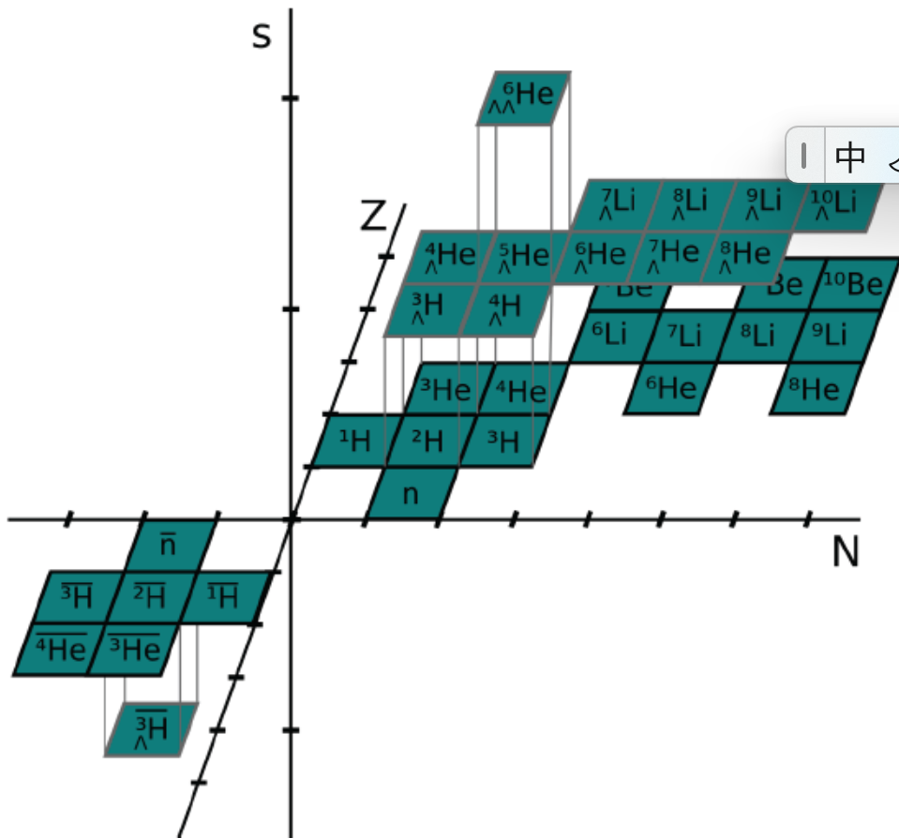
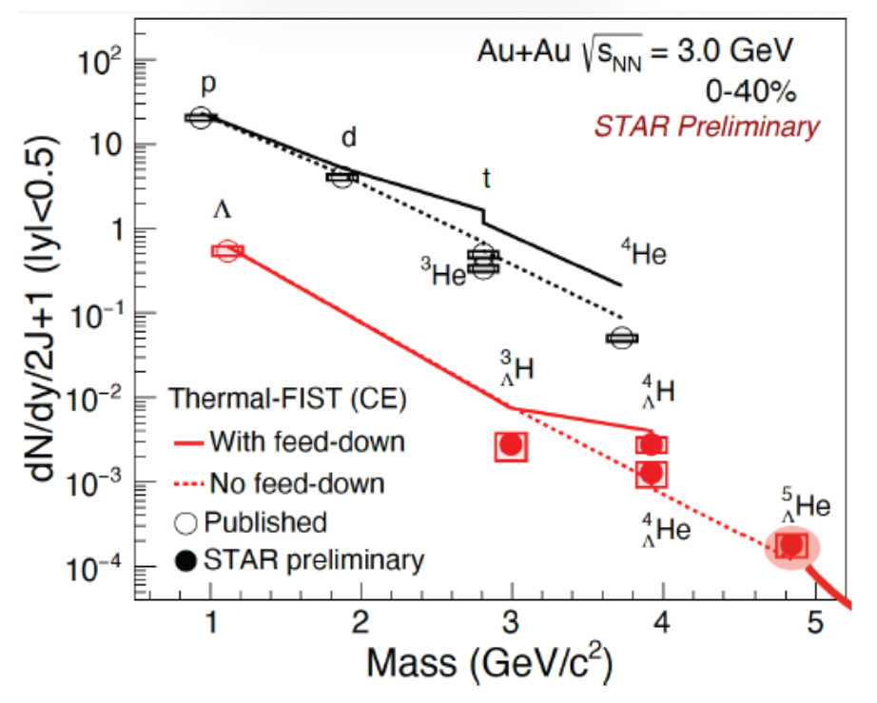









Hyper Nuclei
System sizes
²⁰⁸Pb+²⁰⁸Pb ¹⁹⁷Au+¹⁹⁷Au ²³⁸U+²³⁸U ¹²⁹Xe+¹²⁹Xe ⁹⁶Zr+⁹⁶Zr ⁹⁶Ru+⁹⁶Ru ¹⁶O+¹⁶O p+²⁰⁸Pb p+p … …
Observables
Stable hadrons
All charged h
π K p … …
resonances
φ meson …
Light nuclei
Hyper nuclei
deuteron
³He ⁵_{Ʌ}He …
Hyper nuclei: production mechanism
in-medium Y-N interactions

Slide 44



Exotic hadrons
System sizes
²⁰⁸Pb+²⁰⁸Pb ¹⁹⁷Au+¹⁹⁷Au ¹²⁹Xe+¹²⁹Xe ²⁰Ne +²⁰⁸Pb ¹⁶O+¹⁶O p+¹⁶O p+²⁰⁸Pb p+p … …
Observables
Stable hadrons
All charged
π K p … …
resonances
φ meson …
Light nuclei
Hyper nuclei
deuteron
³He ⁵_{Ʌ}He …
Exotic hadrons
X(3872)
f₀(980) …
Exotic hadrons: easier to be produced with QGP formation;
less background contaminations in small systems
compact or molecular structure？

Slide 45






Probing exotic hadrons in relativistic heavy ion collisions
Predicted yield
CMS observation

Slide 46




Advantage to study exotic hadrons in heavy ion collisions?
Particle physics
High energy nuclear physics
A large amount of particles produced
→ momentum distributions
-particle yield
- p_{T} spectra
- flow anisotropy
→
More info
Advantage: provide complimentary information to constrain properties of hadrons
disadvantage: background is huge
→small systems

Slide 47




Probing the exotic hadron f₀(980) in p-Pb collisions
particle yield
Reconstruction of f₀(980)
CMS 2312.17092
p_{T} spectra
Elliptic flow
ALICE Phys.Lett.B 853 138665 (2024)

Slide 48




Coalescence calculations for f₀(980) in p-Pb collisions
Spectra
elliptic flow
effects from string frag.
f₀(980) : $(K\overline{K}$ molecule) produced at kinetic freezeout by coalescence of $K$& $\overline{K}$
probe hadronic flow of kaons

Slide 49


Nuclear Physics across Energy Scales
-- Personal view from heavy ion collisions
QGP
Initial conditions:
Intersection study with nuclear structure
QGP evolution:
main goal: QGP & QCD phase diagram
Final Hadrons:
intersection study with hadron physics
Happy 0th birthday C3NT

Slide 50
Many Thanks

