Slide 1
Ab initio nuclear structure theory for unstable nuclei
Furong Xu
What is nuclear structure ab initio theory?
Nucleus as an open quantum system: weakly bound or unbound nuclei
Ab initio calculations with the coupling to the continuum
C3NT Inaugural Symposium on Frontiers of Nuclear Theory Central China Normal University May 17-18, 2025

Slide 2
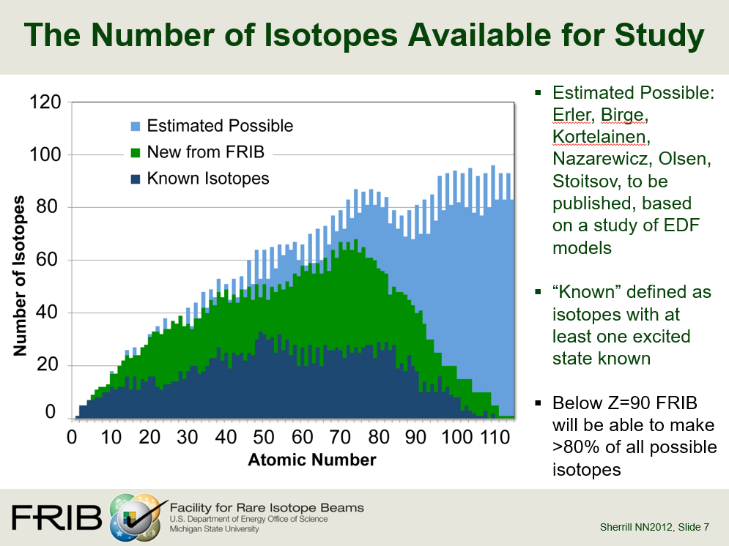
HIAF …

Slide 3
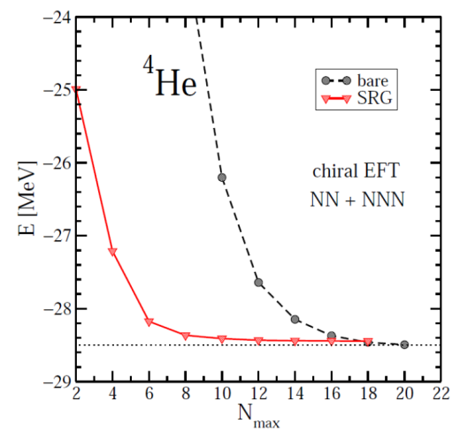
Nuclear first principles (ab initio) calculations
Realistic nuclear forces
Chiral EFT, CD Bonn, AV18 …
Renormalizations to speed up convergence
To soften the force: SRG, V_{low-k} , UCOM, …
To decouple a valence space: MBPT, VS-IMSRG, CCEI, …
Ab-initio many-body methods
No Core Shell Model (NCSM)
Configuration-interaction shell model
Many-Body Perturbation Theory (MBPT)
Coupled Cluster (CC)
In-medium Similarity Renormalization Group (IMSRG)
Self-consistent Green’s Function
Lattice Nuclear Chiral EFT
Diffusion Monte Carlo
(Dirac-) Bruckner-Hartree-Fock
……

Slide 4
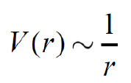
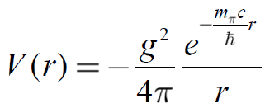

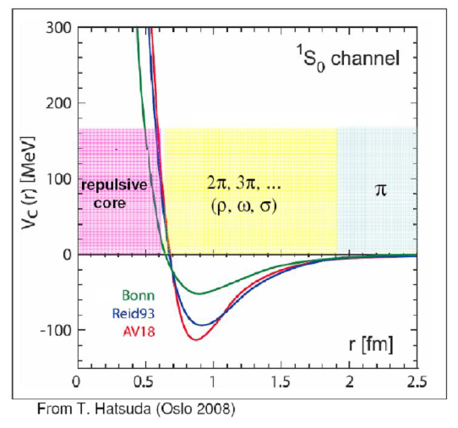
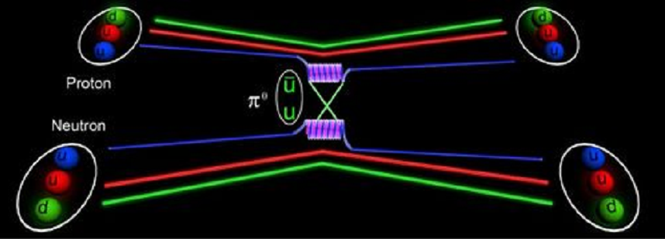
Yukawa nuclear force with a finite range
Realistic nuclear forces
Electromagnetic force has an infinite range!
(exchange photon m_{γ}=0)
Exchange π meson

Slide 5
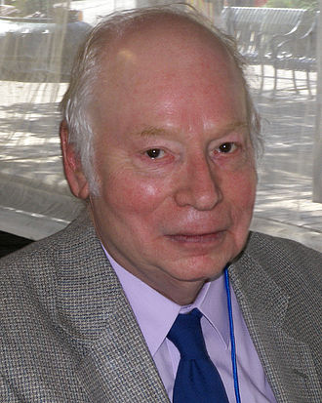
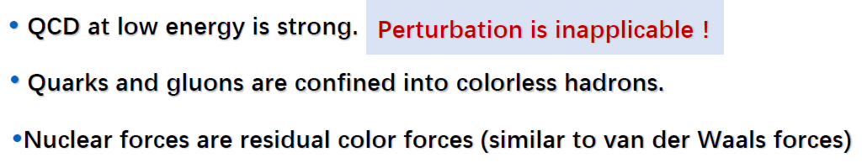
QCD=quarks + gluons (symmetries: spin, isospin, parity, chiral symmetry broken spontaneously)
From QCD to nuclear physics via Chiral EFT
Weinberg (1990’s)
Chiral EFT=nucleon + pion (symmetries: spin, isospin, parity, chiral symmetry broken spontaneously)
At low energy, the effective degrees of freedom are nucleon and pion, rather than quark and gluon!
Notes:
Hamiltonian可能包含的对称性：I, T, parity? CP symmetry? In Chiral EFT （手征有效场理论），由于pion的质量不为零，所以手征对称性是破缺的,但是具有CP对称性？正像QCD中，由于u和d夸克的质量不为零，所以QCD强相互作用的手征对称性是破缺的，但具有CP对称性（CP=手征×宇称），弱相互作用又破坏CP对称性。
理论方法要好。
第二项公式的第一项是质心系动能，但（p_i-p_j)不是相对动量，如果两个物体质量相同，则相对动量是(p_i-p_j)/2，具体推导见笔记。

Slide 6
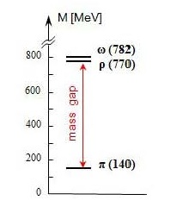
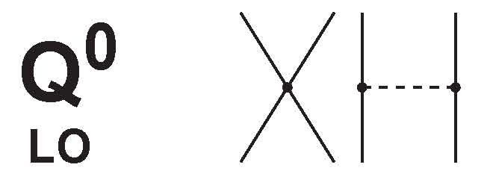
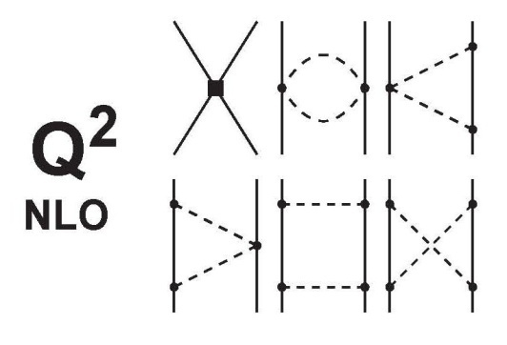

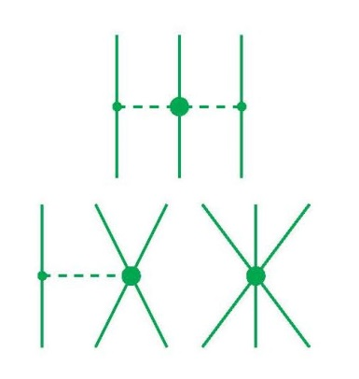
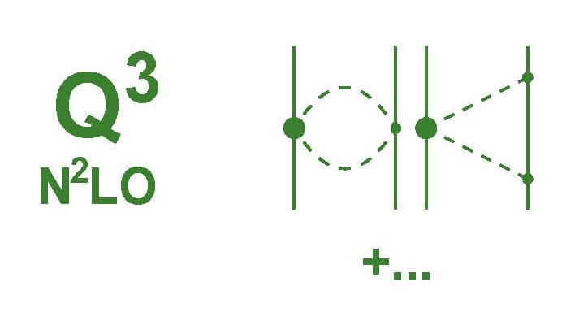
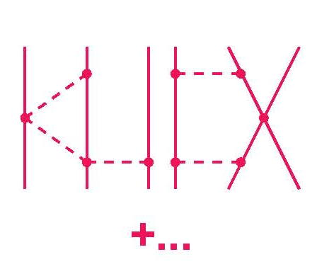
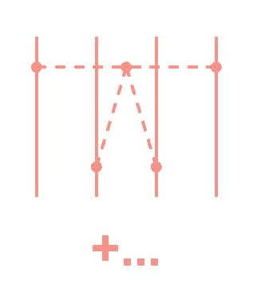
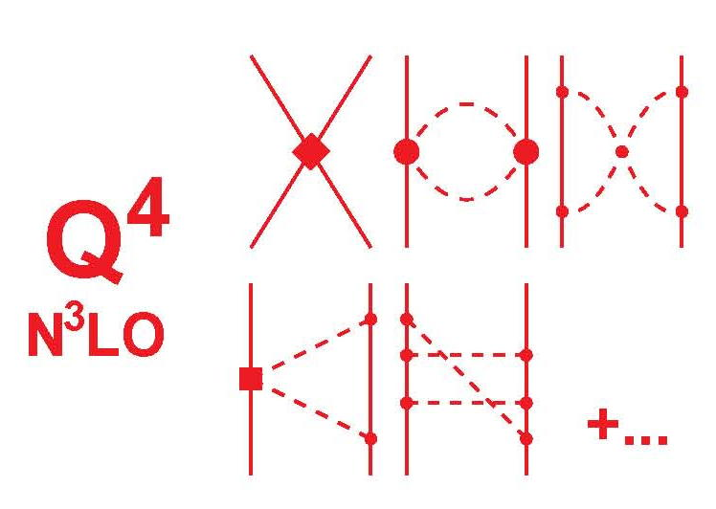
2N forces
3N forces
4N forces
Leading Order
Chiral EFT
Next-to Leading Order
Advantages:
Gives hierarchy of nuclear force;
Naturally generates 3NF, 4NF…
Control the uncertainty of each hierarchy.
……
Power counting ：
Next-to-Next-to Leading Order
Next-to-Next-to-Next-to Leading Order

Slide 7
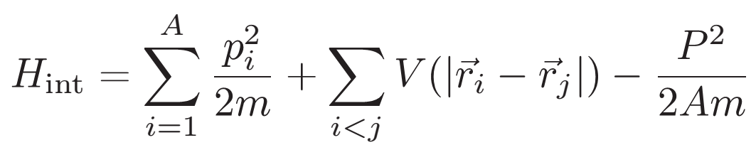
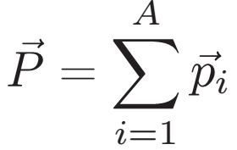
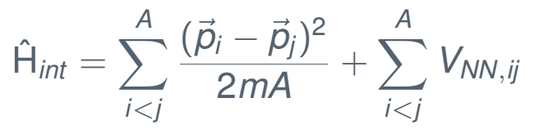
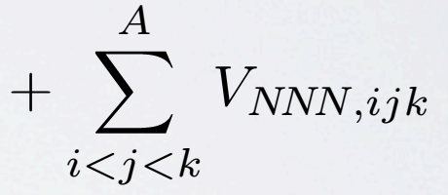
Ab initio many-body methods
How to solve a many-body problem ?
Shell model usually uses harmonic oscillator basis

Slide 8
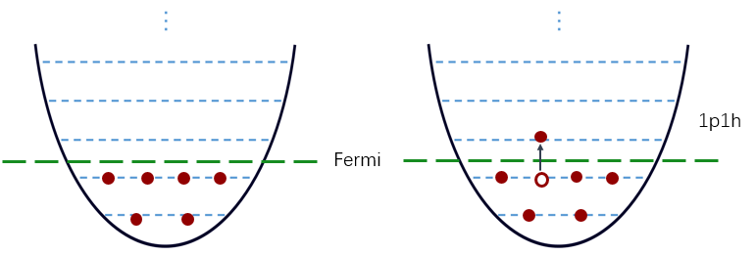
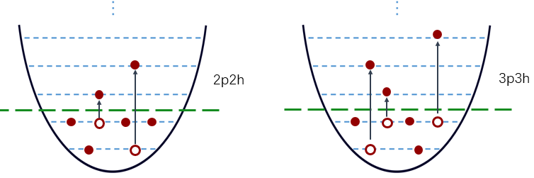
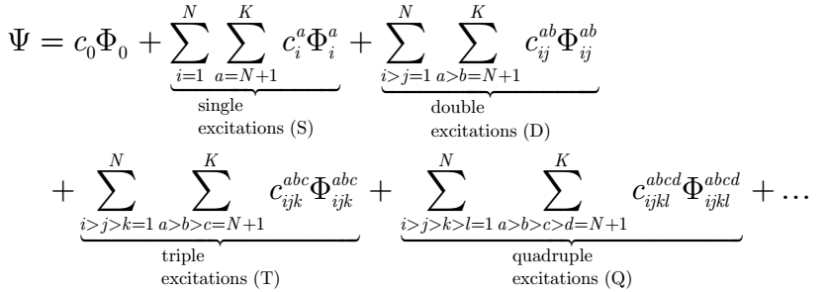
Convergence in many-body calculations

Slide 9
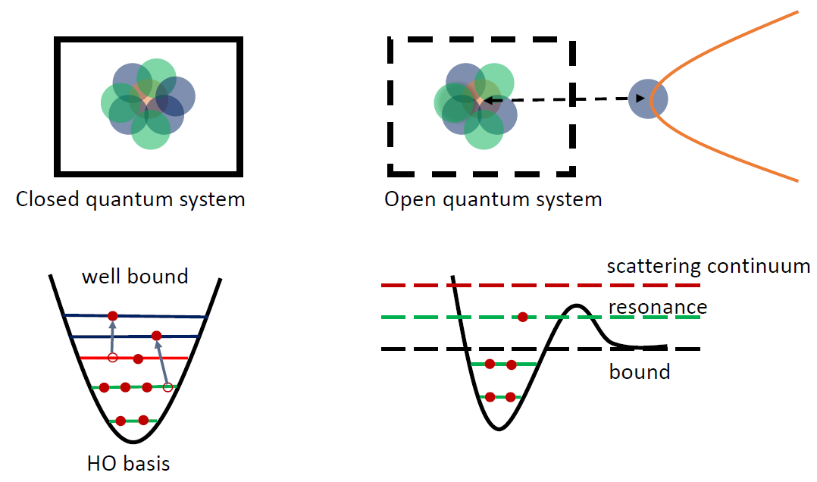
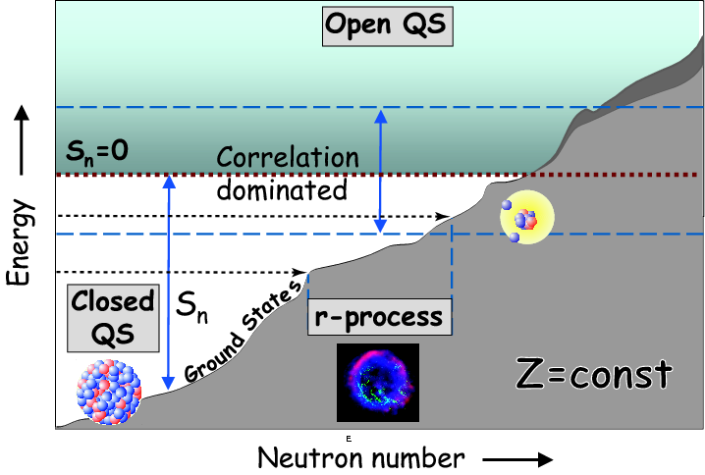
Open Quantum Systems: resonance and continuum
Q
P
A time-dependent many-body problem
Core
Ab initio Gamow shell model (GSM) using Berggren basis

Slide 10

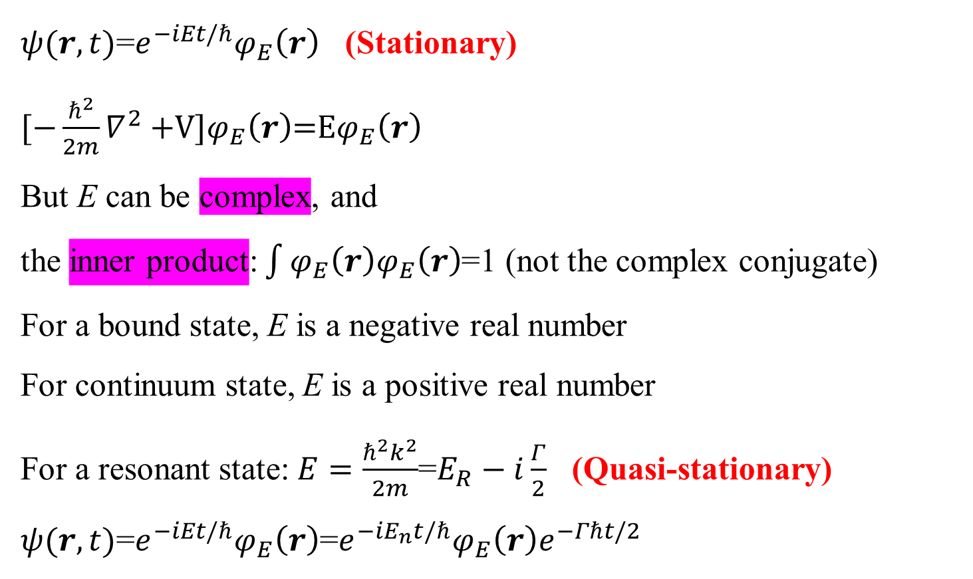
$ψ(r,t)$=$e^{−iEt/ℏ}φ_{E}\left(r\right)$ (Stationary)
$[−\frac{ℏ^{2}}{2m}∇^{2}+$V]$φ_{E}\left(r\right)$=E$φ_{E}\left(r\right)$
But E can be complex, and the inner product: $\int{φ_{E}\left(r\right)φ_{E}\left(r\right)}$=1 (not the complex conjugate)
For a bound state, E is a negative real number
For continuum state, E is a positive real number
For a resonant state: $E=\frac{ℏ^{2}k^{2}}{2m}$=$E_{R}−i\frac{Γ}{2}$ (Quasi-stationary)
$ψ(r,t)$=$e^{−iEt/ℏ}φ_{E}\left(r\right)$=${e^{−iE_{n}t/ℏ}φ}_{E}\left(r\right)e^{−Γℏt/2}$
One-body Berggren (Gamow) basis: T. Berggren, Nucl. Phys. A109 (1968) 265
A time-independent approach to the time-dependent problem
The Berggren ensemble provides a good basis for many-body calculations of nuclei as OQS’s
Notes:
conjugate ['kɒndʒʊgeɪt]

Slide 11
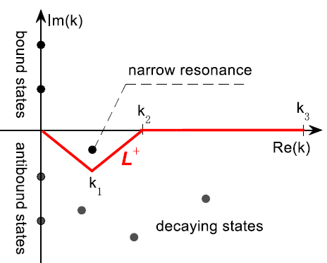
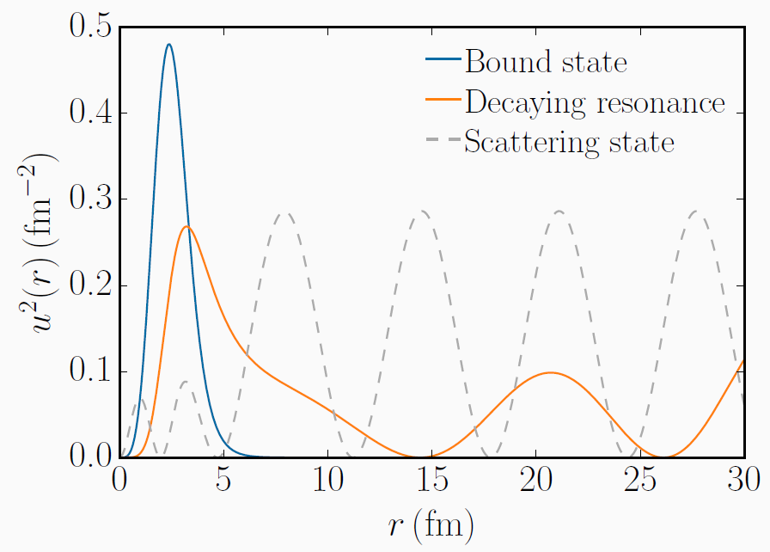
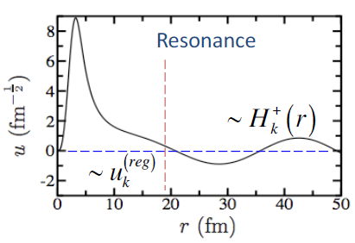

Complex-momentum coordinates
$$E=\frac{ℏ^{2}k^{2}}{2m}$$

Slide 12
Gamow Shell Model (GSM)
Using phenomenological interactions:
1. R. Id Betan, R.J. Liotta, N. Sandulescu, T. Vertse, PRL 89, 042501 (2002) .
2. N. Michel, W. Nazarewicz, M. Płoszajczak, K. Bennaceur, PRL 89, 042502 (2002).
Complex ab initio calculations
Ab initio GSM (one usually needs to construct a realistic effective valence-space interaction)
1. G. Hagen, M. Hjorth-Jensen, N. Michel, PRC 73, 064307 (2006)
K. Tsukiyama, M. Hjorth-Jensen, G. Hagen, PRC 80, 051301(R) (2009)
using MBPT but without folded diagrams
G. Papadimitriou, J. Rotureau, N. Michel, M. Płoszajczak, B.R. Barrett, PRC 88, 044318
(2013):
NCGSM does not need to construct a realistic effective shell-model
4. Z.H.Sun, Q.Wu, Z.H.Zhao, B.S.Hu, S.J.Dai, FRX, PLB 769, 227 (2017)
Full Q-box folded diagrams
Complex coupled cluster: G. Hagen et al., PLB 656 (2007) 169; PRL 108, 242501 (2012)
Notes:
Tritium [`trɪtɪəm], hydrogen

Slide 13
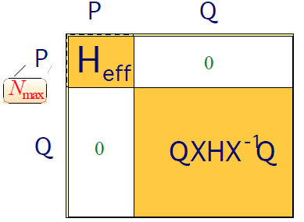
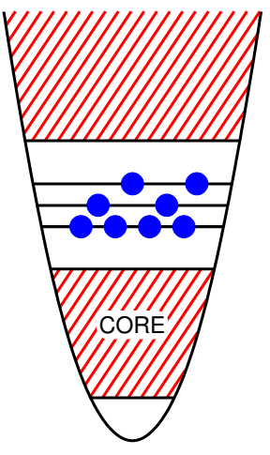

Valence-space realistic effective Hamiltonian
Q space
P space
……
MBPT:
S-, Q-box folded diagrams in complex-k Berggren basis
g_{9/2} …
Continua
Continua
1p_{1/2}, 2p_{1/2}…
f_{5/2} …
d_{3/2} continuum
1p_{3/2}, 2p_{3/2}…
f_{7/2}…
0d_{3/2}
0d_{3/2}
1s_{1/2}
1s_{1/2}
0d_{5/2}
0d_{5/2}
Bound
0p_{1/2}
For complex-energy ab initio calculations, the renormalization in complex space is a big task!
0p_{3/2}
2
0s_{1/2}

Slide 14
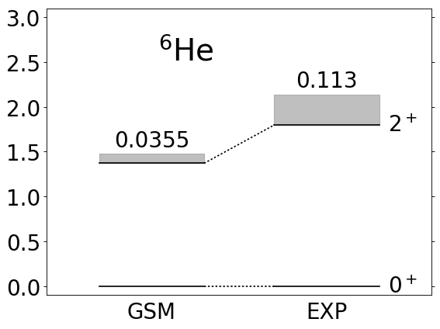
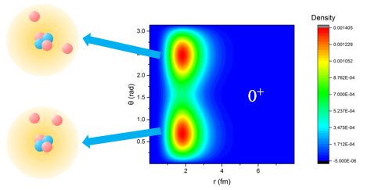
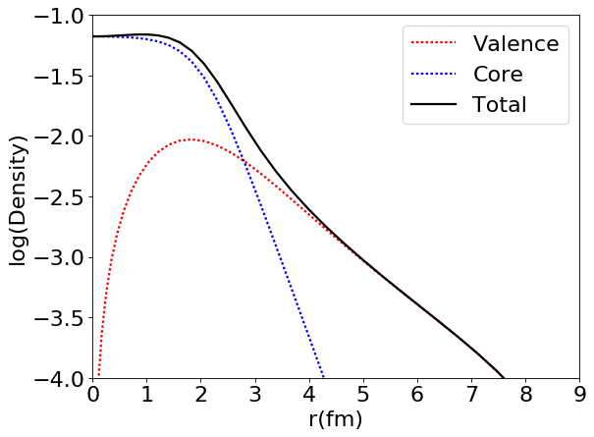
⁶He halo
density
⁶He correlated density distribution
0⁺
⁶He halo

Slide 15
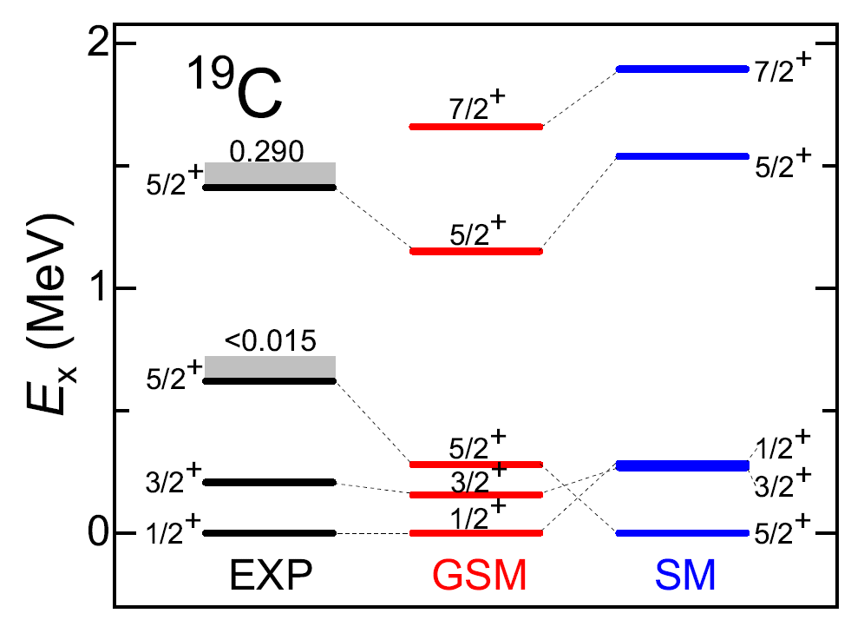
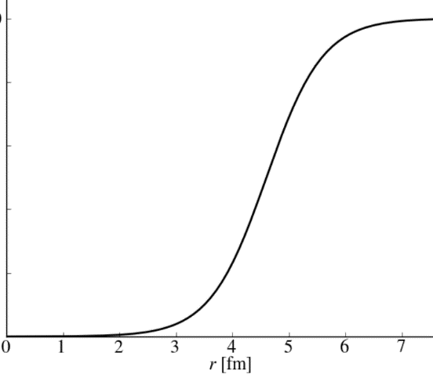
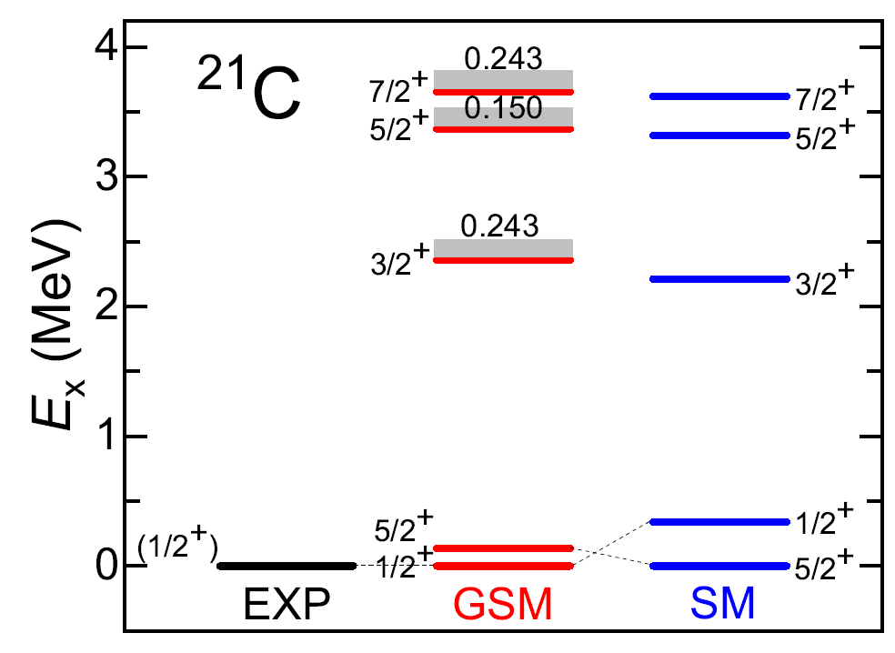
The continuum coupling is important in descriptions of carbon spectra, giving correct orders of levels
CD Bonn GSM with ¹⁴C core
d_{3/2,} d_{5/2}
_{continua}
V
3.56 − i0.87
0d_{3/2}
s_{1/2}
_{continuum}
Calculations without the continuum effect cannot give the correct g.s. and level order.
0.0
−0.48
0d_{5/2}
−1.22
1s_{1/2}
Neutrons
−60.0
GSM space:
0d_{5/2}, 1s_{1/2}+s-continuum, 0d_{3/2} (resonance)+d_{3/2}-continuum
Y. F. Geng, J. G. Li, Y. Z. Ma, B. S. Hu, Q. Wu, Z. H. Sun, S. Zhang, and FRX, PRC 106, 024304 (2022)

Slide 16
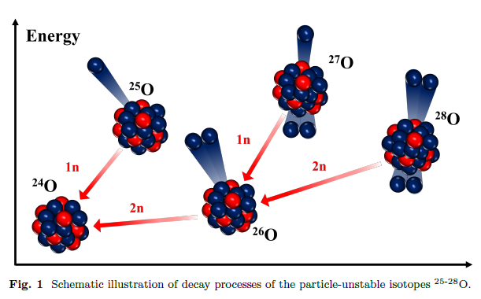
^{27, 28}O
J.G. Li, B.S. Hu, S. Zhang, FRX, NST 35, 21 (2024)
Y. Kondo et al., Nature 620, 965 (2023)
Kondo & Nakamura, Nucl. Phys. News 35, 9 (2025)
S. Zhang, Y.Z. Ma, J.G. Li, B.S. Hu, Q. Yuan, Z.H. Cheng, FRX, PLB 827, 136958 (2022)

Slide 17
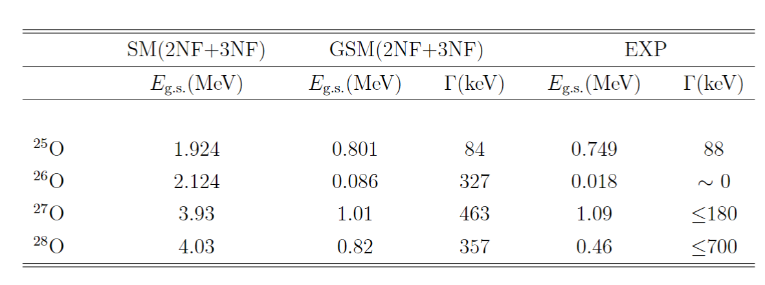
Ground-state energies relative to ²⁴O
Y. Kondo et al., Nature 620, 965 (2023)
S. Zhang, Y.Z. Ma, J.G. Li, B.S. Hu, Q. Yuan, Z.H. Cheng, FRX, PLB 827, 136958 (2022)

Slide 18
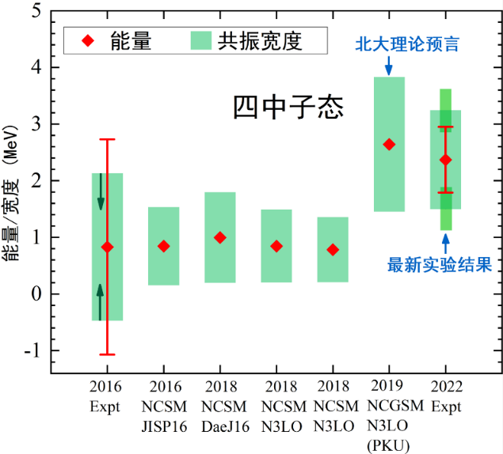
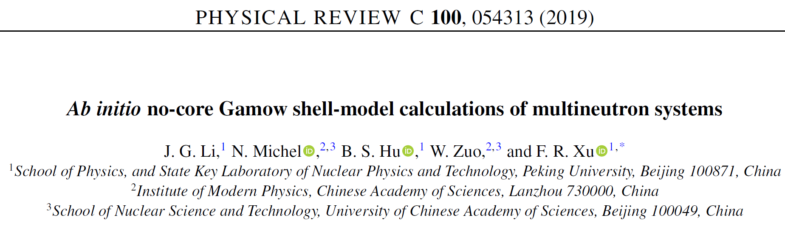
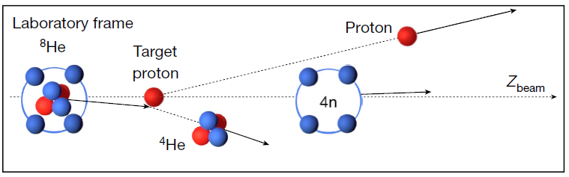
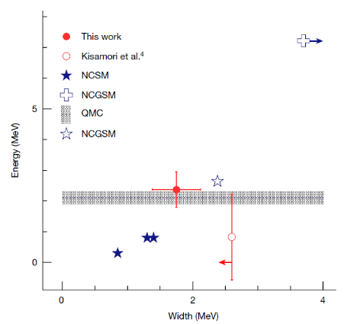
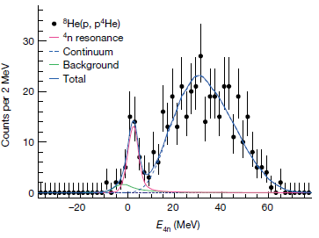
4n resonance
M. Duer et al., Nature 606, 678 (2022)

Slide 19
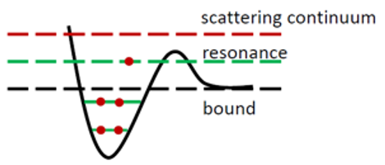
Summary
Complex ab initio studies of nuclear structure
Ab initio nuclear structure calculations with the coupling to the continuum
Complex 2NF + 3NF
Gamow shell model
Complex S-box, Q-box, Θ-box folded diagrams
3. Both continuum coupling and 3NF are important for nuclei around driplines

Slide 20
Perspectives on ab initio theories
Better EFT nuclear forces
to give better calculations of energies (spectra), radii, EM transitions, beta decays…
Rigorous theories for softening forces/speeding convergence
Powerful many-body methods
“Exact" few-body methods (Faddeev, hyperspherical harmonics, etc)
Rigorous ab initio density functional theory for heavy nuclei
Ab initio reaction theories
Unified description of structure and reactions
……

Slide 21


C3NT Inaugural Symposium on Frontiers of Nuclear Theory Central China Normal University (May 17-18, 2025)
SCNT: Southern Center for Nuclear-Science Theory (Huizhou city, the location of HIAF)：
Thanks To: J.G. Li, S. Zhang, Y.Z. Ma, Y.F. Geng, B.S. Hu, Z.H. Sun, Q. Wu,
N. Michel, W. Zuo, L. Coraggio, T. Fukui, L. DeAngelis, N. Itaco, A. Gargano

