Slide 1


Grant no. 12135007
Craig Roberts … http://inp.nju.edu.cn/
Emergence of Hadron Mass and Structure
Notes:
25+5

Slide 2








Basic Questions for 21st Century Science
How Does the Mass of the Nucleon Arise?
How Does the Spin of the Nucleon Arise?
What Are the Emergent Properties of Dense Systems of Gluons?
Response … International community is operating, building and planning facilities with the potential for delivering answers

Slide 3
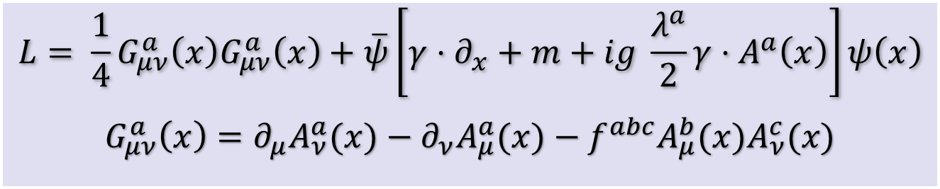

Quantum Chromodynamics
$$L= \frac{1}{4}G_{μν}^{a}\left(x\right)G_{μν}^{a}\left(x\right)+\overline{ψ}\left[γ⋅∂_{x}+m+ig \frac{λ^{a}}{2}γ⋅A^{a}\left(x\right)\right]ψ\left(x\right)$$
$$G_{μν}^{a}\left(x\right)=∂_{μ}A_{ν}^{a}(x)−∂_{ν}A_{μ}^{a}(x)−f^{abc}A_{μ}^{b}{(x)A}_{ν}^{c}(x)$$
One-line Lagrangian – expressed in terms of
massless gluon ($A_{μ}^{a}$) and Higgs-mass quark ($ψ$) partons
Which are NOT the degrees-of-freedom measured in detectors
Gluon and Quark Confinement
Advantages of the Color Octet Gluon Picture,
H. Fritzsch, Murray Gell-Mann, H. Leutwyler, Phys. Lett. B 47 (1973) 365-368
“The quarks come in three "colors," but all physical states and interactions are supposed to be singlets with respect to the SU(3) of color. Thus, we do not accept theories in which quarks are real, observable particles; nor do we allow any scheme in which the color non-singlet degrees of freedom can be excited.”

Slide 4
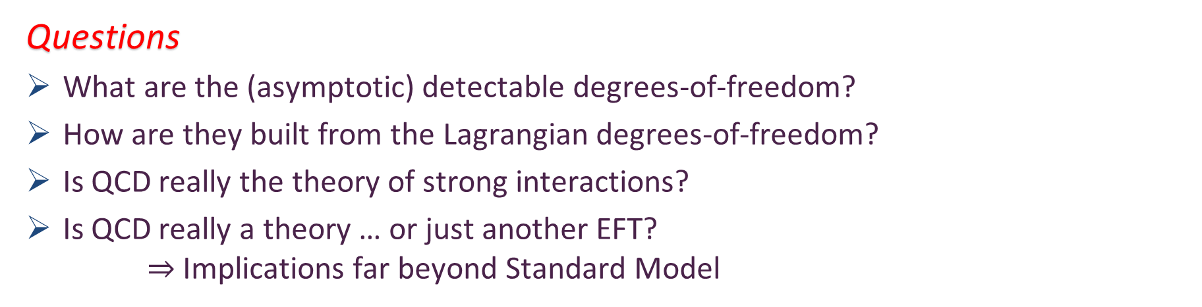
Quantum Chromodynamics
$$L= \frac{1}{4}G_{μν}^{a}\left(x\right)G_{μν}^{a}\left(x\right)+\overline{ψ}\left[γ⋅∂_{x}+m+ig \frac{λ^{a}}{2}γ⋅A^{a}\left(x\right)\right]ψ\left(x\right)$$
$$G_{μν}^{a}\left(x\right)=∂_{μ}A_{ν}^{a}(x)−∂_{ν}A_{μ}^{a}(x)−f^{abc}A_{μ}^{b}{(x)A}_{ν}^{c}(x)$$
Gluon and Quark Confinement
One-line Lagrangian – expressed in terms of gluon and quark partons
Which are NOT the degrees-of-freedom measured in detectors
Questions
What are the (asymptotic) detectable degrees-of-freedom?
How are they built from the Lagrangian degrees-of-freedom?
Is QCD really the theory of strong interactions?
Is QCD really a theory … or just another EFT?
$⇒$ Implications far beyond Standard Model

Slide 5
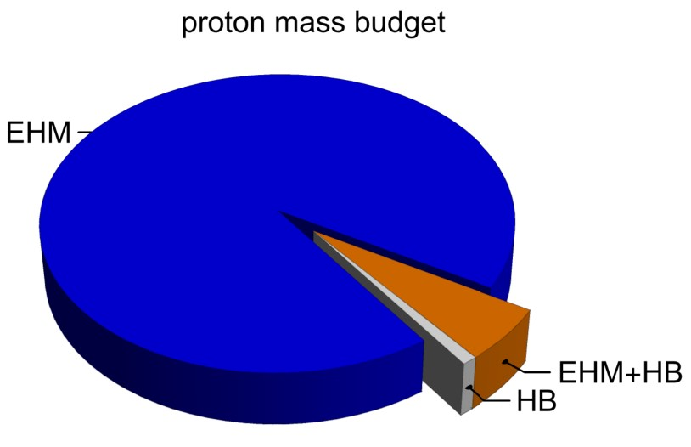
Emergence of Hadron Mass
Standard Model of Particle Physics has one obvious mass-generating mechanism
= Higgs Boson … impacts are critical to evolution of Universe as we know it
However, Higgs boson alone is responsible for just ∼ 1% of the visible mass in the Universe
Proton mass budget … only 9 MeV/939 MeV is directly from Higgs
Decomposition is
gauge invariant
Poincaré invariant
scale invariant
Evidently, Nature has another very effective mechanism for producing mass:
Emergent Hadron Mass (EHM)
  Alone, it produces 94% of the proton’s mass
  Remaining 5% is generated by constructive interference between EHM and Higgs-boson
What is the origin of EHM?

Slide 6


In the Beginning…

Slide 7
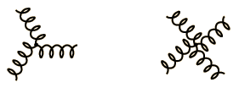
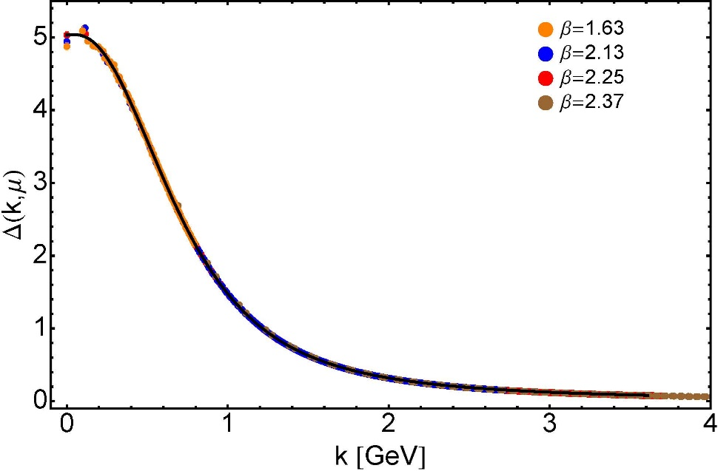

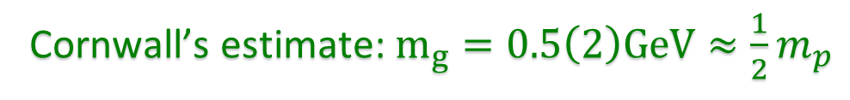

Ancient History
Cornwall’s estimate: $m_{g}=0.5\left(2\right)GeV≈\frac{1}{2}m_{p}$
$≈$ 45 years ago
  Dynamical mass generation in continuum quantum chromodynamics,
  J.M. Cornwall, Phys. Rev. D 26 (1981) 1453 … $>1100$ citations
Owing to strong self-interactions, gluon partons $⇒$ gluon quasiparticles,
described by a mass function that is large at infrared momenta
3-gluon vertex
4-gluon vertex
$$\frac{1}{m_{g}^{2}}$$
Truly mass from nothing
An interacting theory, written in terms of massless gluon fields, produces dressed gluon fields that are characterised by a mass function that is large at infrared momenta
Gluon propagator … continuum and lattice QCD agree
QCD fact
Continuum theory and lattice simulations agree
Empirical verification?

Slide 8

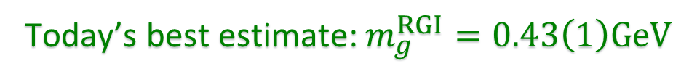

Ancient History
D. Binosi, Emergent Hadron Mass in Strong Dynamics, Few Body Syst. 63 (2022) 42.
M. N. Ferreira, J. Papavassiliou, Gauge Sector Dynamics in QCD, Particles 6 (1) (2023) 312–363.
Today’s best estimate: $m_{g}^{RGI}=0.43\left(1\right)GeV$
Gauge Invariance and Mass,
J. S. Schwinger
Phys. Rev. 125 (1962) 397-398
It is argued that the gauge invariance of a vector field does not necessarily imply zero mass for an associated particle if the current vector coupling is sufficiently strong.
EHM means
Gluons are massive via Schwinger Mechanism
More than 40 years ago
  Dynamical mass generation in continuum quantum chromodynamics,
  J.M. Cornwall, Phys. Rev. D 26 (1981) 1453 … $∼1050$ citations
Owing to strong self-interactions, gluon partons $⇒$ gluon quasiparticles,
described by a mass function that is large at infrared momenta
3-gluon vertex
4-gluon vertex
$$\frac{1}{m_{g}^{2}}$$
Truly mass from nothing
An interacting theory, written in terms of massless gluon fields, produces dressed gluon fields that are characterised by a mass function that is large at infrared momenta
Gluon propagator … continuum and lattice QCD agree
QCD fact
Continuum theory and lattice simulations agree
Empirical verification?

Slide 9

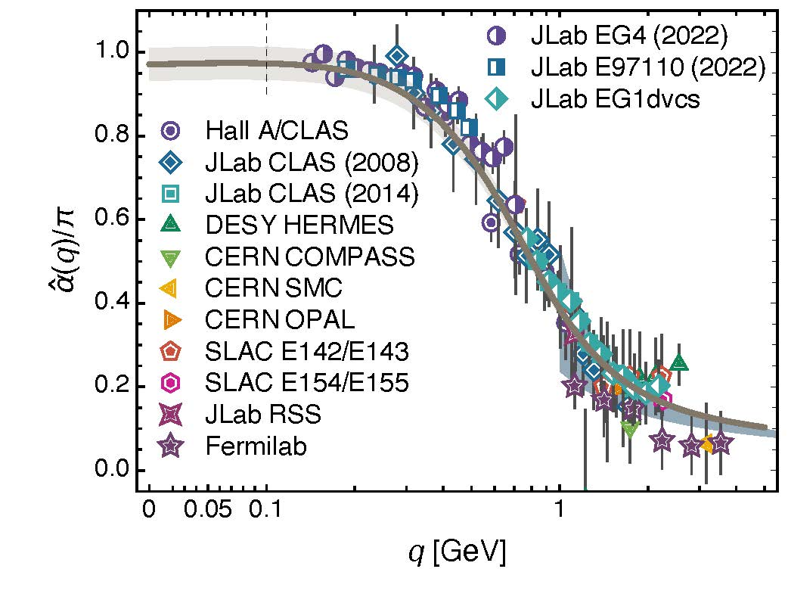
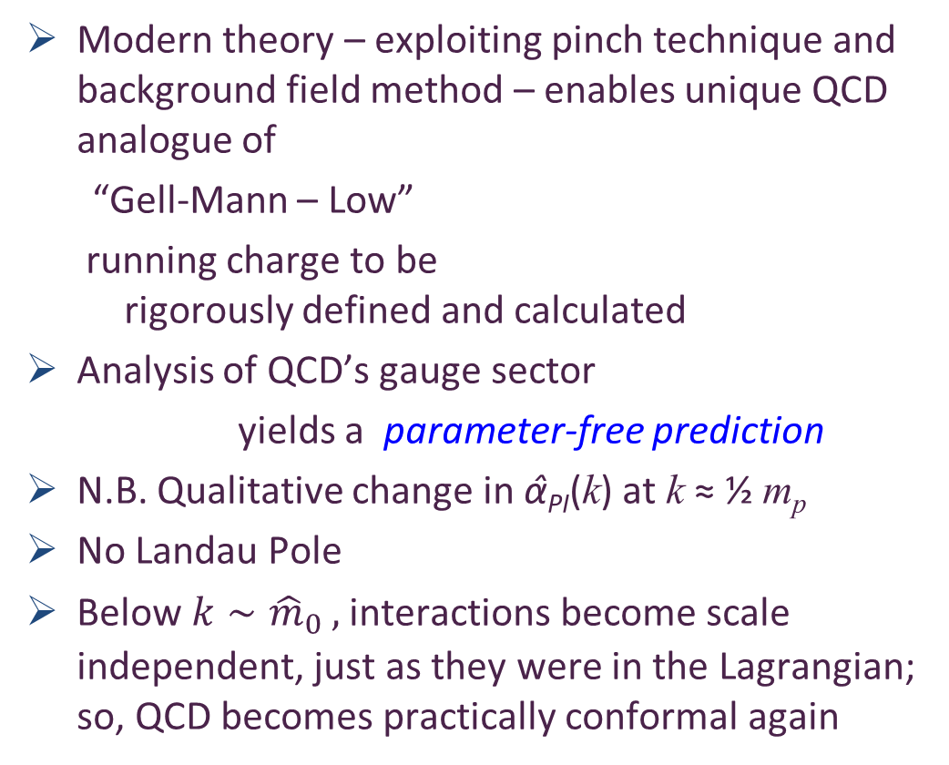

Process independent effective charge = running coupling
W orkshop on Dyson-Schwinger Equations in Modern Mathematics
and Physics (DSEMP2014) Trento, Italy, September 22-26, 2014
Effective charge from lattice QCD, Zhu-Fang Cui, Jin-Li Zhang et al.,
NJU-INP 014/19, arXiv:1912.08232 [hep-ph], Chin. Phys. C 44 (2020) 083102/1-10
$2696$ total downloads
Modern theory – exploiting pinch technique and background field method – enables unique QCD analogue of
“Gell-Mann – Low”
  running charge to be
  rigorously defined and calculated
Analysis of QCD’s gauge sector
  yields a parameter-free prediction
N.B. Qualitative change in α̂_{PI}(k) at k ≈ ½ m_{p}
No Landau Pole
Below $k∼{{\hat{m}}_{0}}_{ },$interactions become scale independent, just as they were in the Lagrangian; so, QCD becomes practically conformal again
Process independent strong running coupling
Daniele Binosi et al., arXiv:1612.04835 [nucl-th], Phys. Rev. D 96 (2017) 054026/1-7
Experimental determination of the QCD effective charge α_{g1}(Q).
A. Deur; V. Burkert; J.-P. Chen; W. Korsch, Particles 5 (2022) 171
QCD Running Couplings and Effective Charges, Alexandre Deur, Stanley J. Brodsky and Craig Roberts, e-Print: 2303.00723 [hep-ph], Prog. Part. Nucl. Phys. 134 (2024) 104081

Slide 10
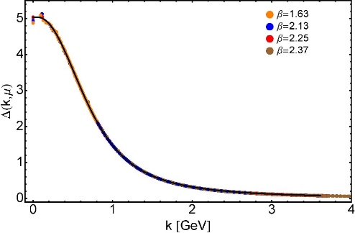
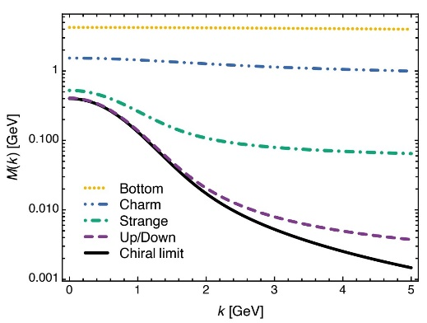

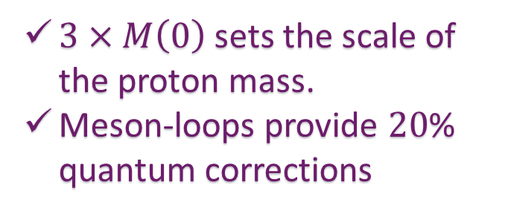
EHM Basics
Absent Higgs boson couplings,
QCD Lagrangian is scale invariant … yet …
  Massless gluons become massive
  A momentum-dependent, IR saturating charge is produced
  Massless quarks become massive
Three pillars of EHM
$3×M\left(0\right)$ sets the scale of the proton mass.
Meson-loops provide $20$% quantum corrections

Slide 11




Charting EHM using
High Intensity, High Luminosity Facilities

Slide 12
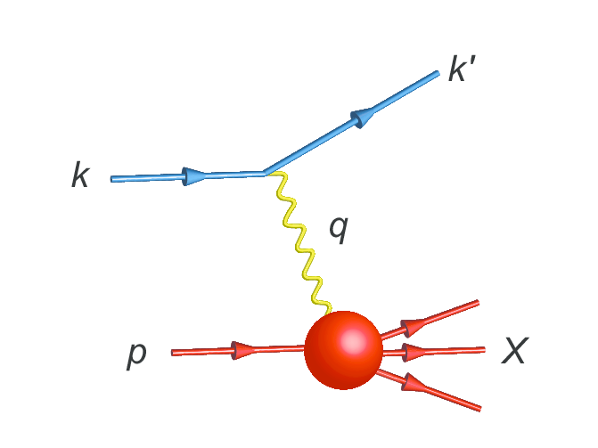
Parton Distribution Functions

Slide 13
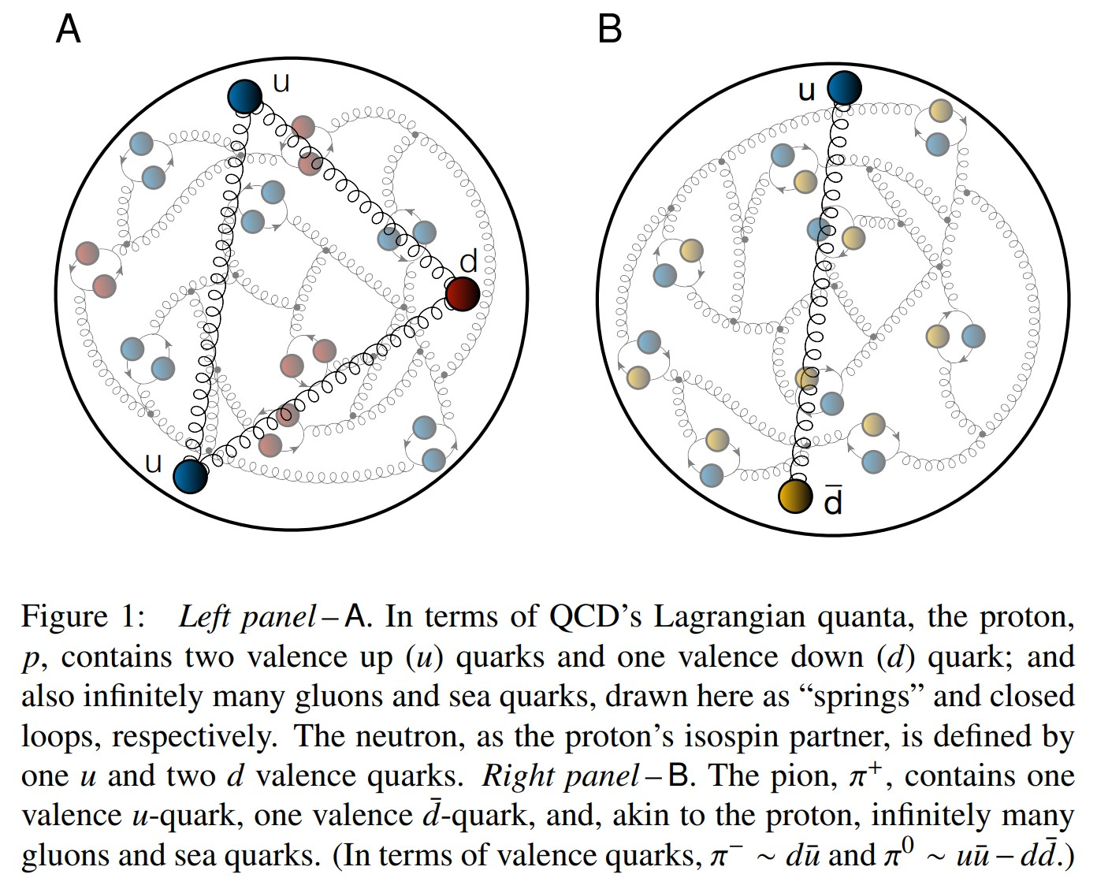
Proton and pion distribution functions in counterpoint
massive
almost massless
Today, despite enormous expense of time and effort, much must still be learnt before proton and pion structure may be considered understood in terms of DFs
Most simply, what are the differences, if any, between the distributions of partons within the proton and the pion?
How are obvious macroscopic differences between protons and pions expressed in the structural features of these two bound-states?
proton
pion

Slide 14
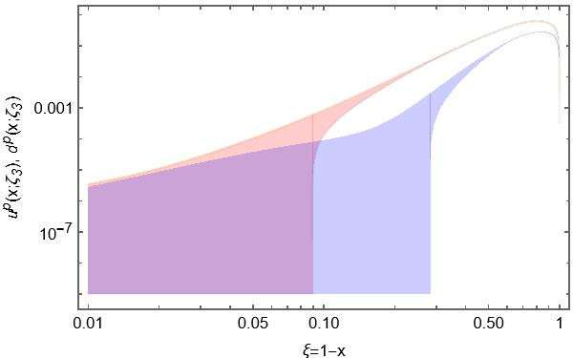
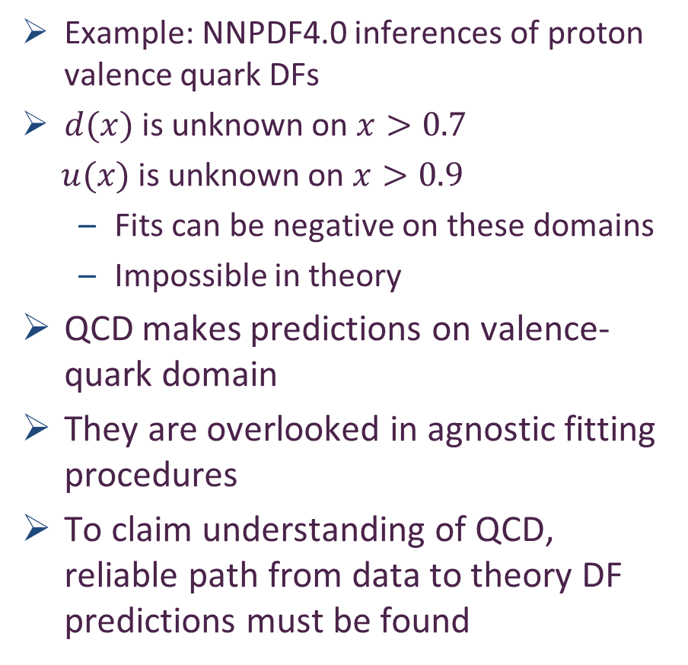
Phenomenology – global fits – of proton valence quark DFs
Example: NNPDF4.0 inferences of proton valence quark DFs
$d(x)$ is unknown on $x>0.7$
$u(x)$ is unknown on $x>0.9$
  Fits can be negative on these domains
  Impossible in theory
QCD makes predictions on valence-quark domain
They are overlooked in agnostic fitting procedures
To claim understanding of QCD, reliable path from data to theory DF predictions must be found
Far valence domain

Slide 15
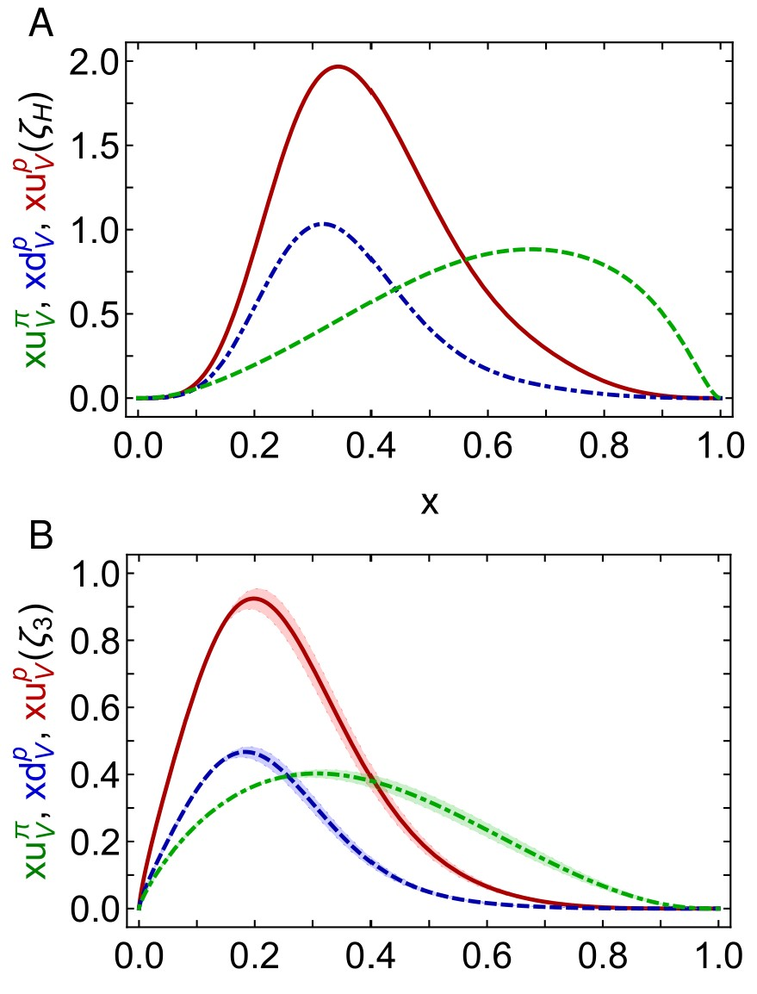

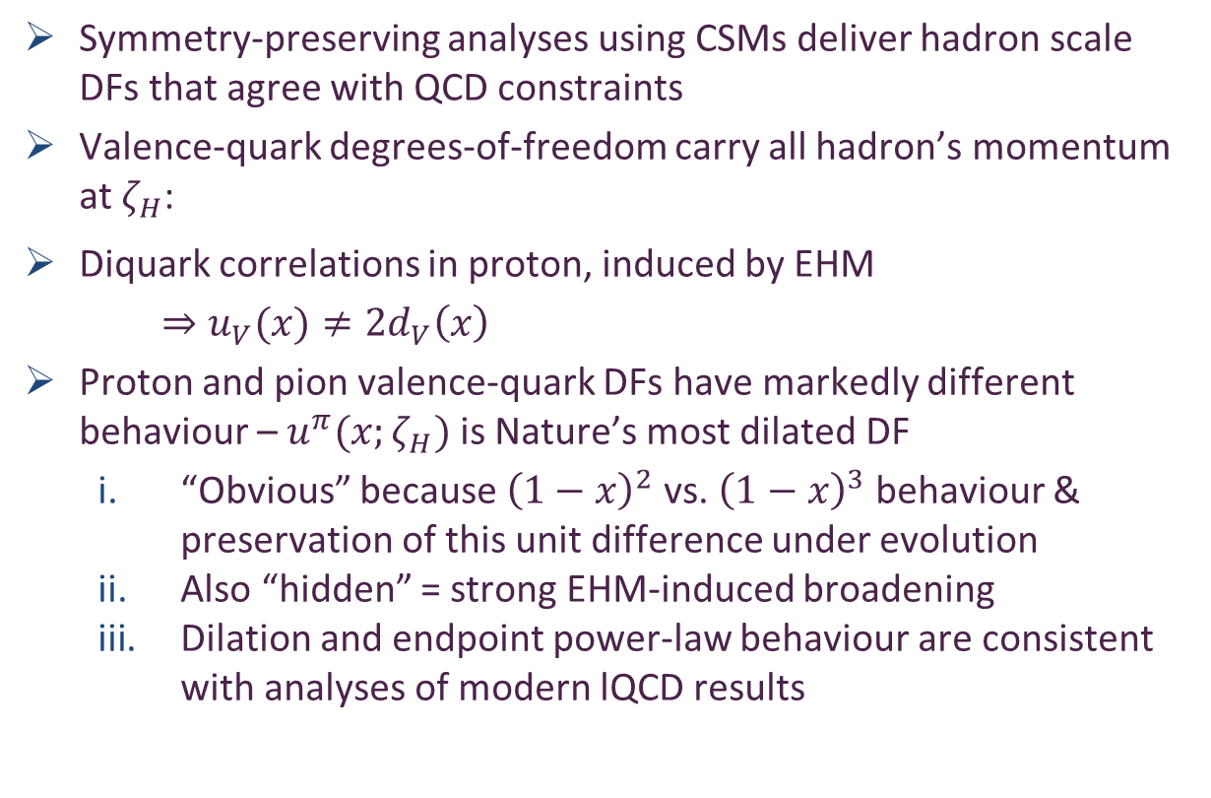
Proton and pion DFs in counterpoint
Proton and pion distribution functions in counterpoint, Ya Lu (陆亚) et al.,
e-Print: 2203.00753 [hep-ph], Phys. Lett. B 830 (2022) 137130
Pion distribution functions from low-order Mellin moments, Ya Lu et al., e-Print: 2311.01613 [hep-ph], Phys. Lett. B 850 (2024) 138534/1-6
Contact interaction study of proton parton distributions, Yang Yu (俞杨) et al., e-Print: 2402.06095 [hep-ph], Eur. Phys. J. C 84 (2024) 7, 739/1-23
Symmetry-preserving analyses using CSMs deliver hadron scale DFs that agree with QCD constraints
Valence-quark degrees-of-freedom carry all hadron’s momentum at $ζ_{H}$:
Diquark correlations in proton, induced by EHM
    $⇒u_{V}(x)≠2d_{V}\left(x\right)$
Proton and pion valence-quark DFs have markedly different behaviour – $u^{π}(x;ζ_{H})$ is Nature’s most dilated DF
  “Obvious” because ${\left(1−x\right)}^{2}$ vs. ${\left(1−x\right)}^{3}$ behaviour & preservation of this unit difference under evolution
  Also “hidden” = strong EHM-induced broadening
  Dilation and endpoint power-law behaviour are consistent with analyses of modern lQCD results
dilation
u in proton
d in proton
u in pion
dilation

Slide 16
Proton and pion DFs in counterpoint
Proton and pion distribution functions in counterpoint, Ya Lu (陆亚) et al.,
e-Print: 2203.00753 [hep-ph], Phys. Lett. B 830 (2022) 137130
Pion distribution functions from low-order Mellin moments, Ya Lu et al., e-Print: 2311.01613 [hep-ph], Phys. Lett. B 850 (2024) 138534/1-6
Contact interaction study of proton parton distributions, Yang Yu (俞杨) et al., e-Print: 2402.06095 [hep-ph], Eur. Phys. J. C 84 (2024) 7, 739/1-23
Symmetry-preserving analyses using CSMs deliver hadron scale DFs that agree with QCD constraints
Valence-quark degrees-of-freedom carry all hadron’s momentum at $ζ_{H}$:
Diquark correlations in proton, induced by EHM
    $⇒u_{V}(x)≠2d_{V}\left(x\right)$
Proton and pion valence-quark DFs have markedly different behaviour – $u^{π}(x;ζ_{H})$ is Nature’s most dilated DF
  “Obvious” because ${\left(1−x\right)}^{2}$ vs. ${\left(1−x\right)}^{3}$ behaviour & preservation of this unit difference under evolution
  Also “hidden” = strong EHM-induced broadening
  Dilation and endpoint power-law behaviour are consistent with analyses of modern lQCD results
dilation
Numerous predictions – similarities and differences
All of which can be tested
with high-luminosity, high-energy facilities
u in proton
d in proton
u in pion
dilation

Slide 17
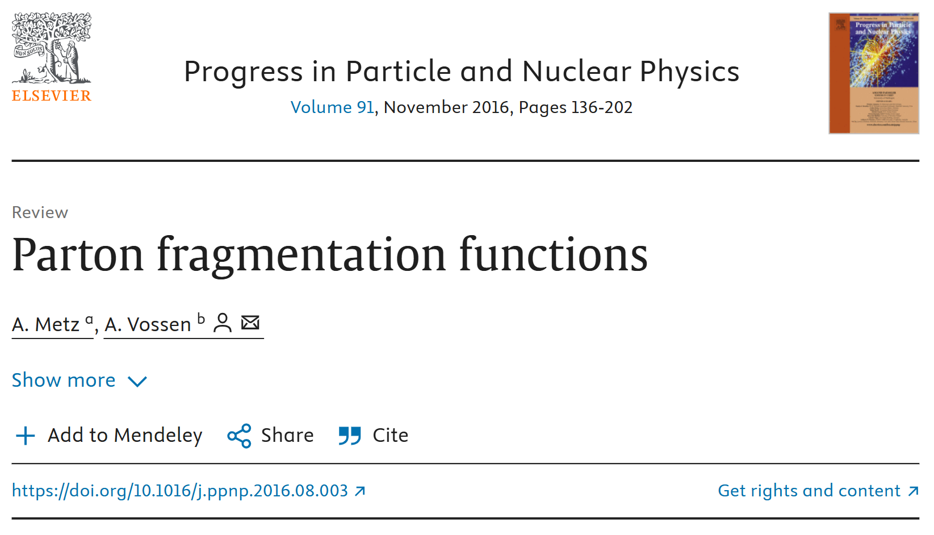

Slide 18
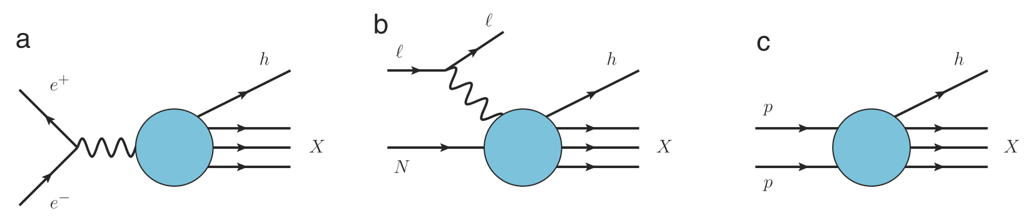
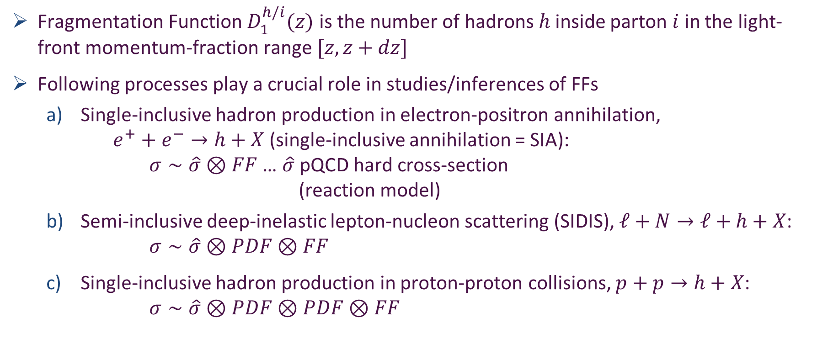
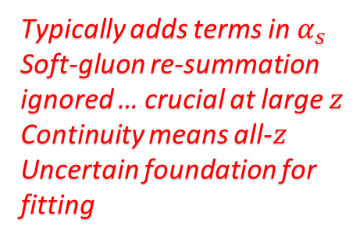
Fragmentation Functions
Fragmentation Function $D_{1}^{h/i}(z)$ is the number of hadrons $h$ inside parton $i$ in the light-front momentum-fraction range $[z,z+dz]$
Following processes play a crucial role in studies/inferences of FFs
  Single-inclusive hadron production in electron-positron annihilation,
  $e^{+}+e^{−}→h+X$ (single-inclusive annihilation = SIA):
  $σ∼\hat{σ}⊗FF$ … $\hat{σ}$ pQCD hard cross-section
  (reaction model)
  Semi-inclusive deep-inelastic lepton-nucleon scattering (SIDIS), $ℓ+N→ℓ+h+X$: $σ∼\hat{σ}⊗PDF⊗FF$
  Single-inclusive hadron production in proton-proton collisions, $p+p→h+X$:
  $σ∼\hat{σ}⊗PDF⊗PDF⊗FF$
Typically adds terms in $α_{s}$
Soft-gluon re-summation ignored … crucial at large $z$
Continuity means all-$z$
Uncertain foundation for fitting

Slide 19
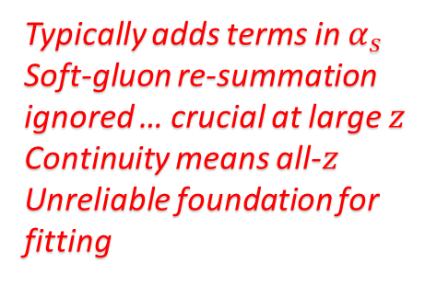
Fragmentation Functions
Fragmentation Function $D_{1}^{h/i}(z)$ is the number of hadrons $h$ inside parton $i$ in the light-front momentum-fraction range $[z,z+dz]$
Following processes play a crucial role in studies/inferences of FFs
  Single-inclusive hadron production in electron-positron annihilation,
  $e^{+}+e^{−}→h+X$ (single-inclusive annihilation = SIA):
  $σ∼\hat{σ}⊗FF$ … $\hat{σ}$ pQCD hard cross-section
  (reaction model)
  Semi-inclusive deep-inelastic lepton-nucleon scattering (SIDIS), $ℓ+N→ℓ+h+X$: $σ∼\hat{σ}⊗PDF⊗FF$
  Single-inclusive hadron production in proton-proton collisions, $p+p→h+X$:
  $σ∼\hat{σ}⊗PDF⊗PDF⊗FF$
Can’t extract information about
PDFs from such processes
unless FFs are known
Typically adds terms in $α_{s}$
Soft-gluon re-summation ignored … crucial at large $z$
Continuity means all-$z$
Unreliable foundation for fitting

Slide 20
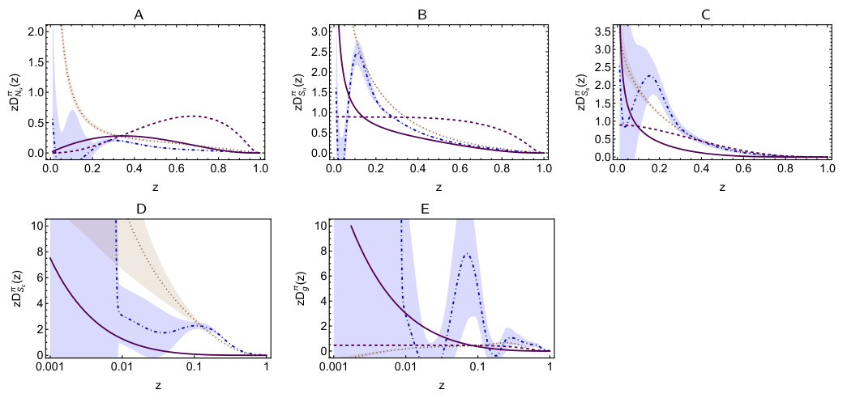
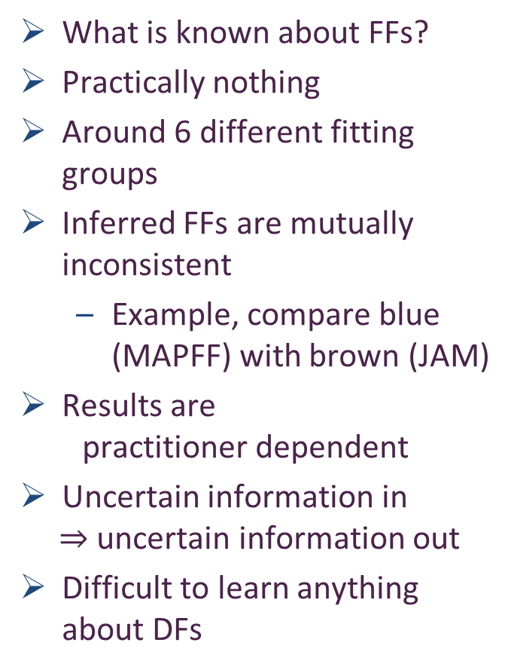


Unpolarised FFs
What is known about FFs?
Practically nothing
Around 6 different fitting groups
Inferred FFs are mutually inconsistent
  Example, compare blue (MAPFF) with brown (JAM)
Results are
practitioner dependent
Uncertain information in
$⇒$ uncertain information out
Difficult to learn anything about DFs
Serious impediment to interpretation of data from modern and anticipated facilities
$$N … u→π$$
$$S … u→π$$
Purple dashed: elementary FF
Purple solid: FF after solving cascade equations

Slide 21

Polarised FFs
Today, for most polarized FFs, there is no information
… not from experiment and not from theory.
Majority of cases where experimental data exist, it’s for fragmentation into $Λ$ and/or $Λ^{−}$ hyperons, which are self-analyzing, i.e., they reveal their polarization through the angular dependence of the decay products.
The analysis of such experiments is difficult, since a large fraction of the produced $Λ$ particles comes from the decay of heavier hyperons rather than direct production.
For physics programmes at modern and anticipated facilities:
JLab-12, EIC, EicC, precise knowledge of FFs will be crucial.
Especially true for international TMD program.
Input from Belle II, at the next generation B-factory, SuperKEKB, will be important to provide multi-differential observables for identified light quark FFs.
For progress, for assisting phenomenology,
Theory predictions instead of fits are essential

Slide 22
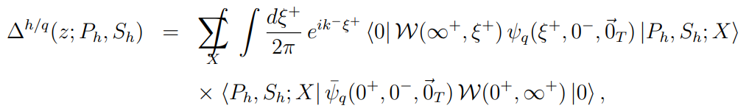
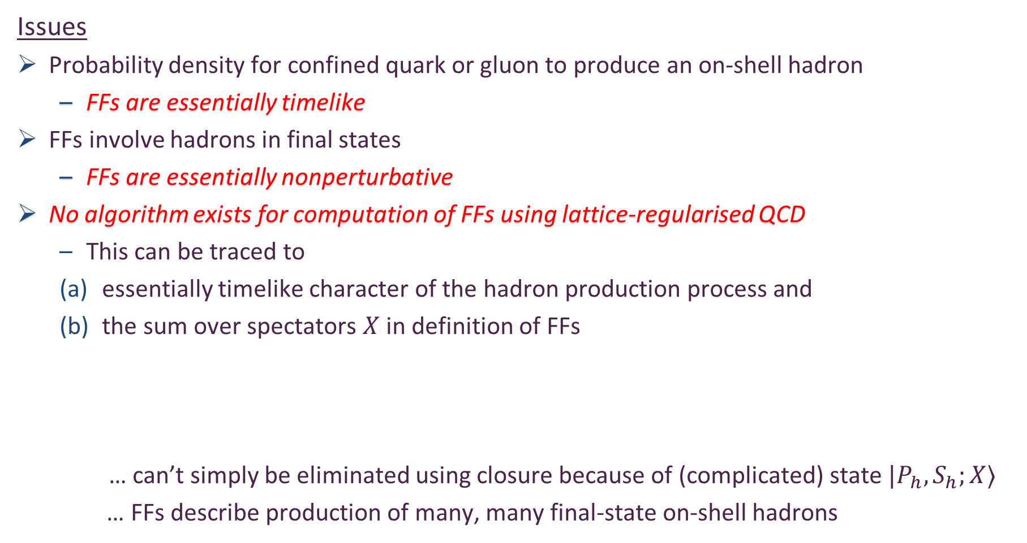
Calculation of FFs
Issues
Probability density for confined quark or gluon to produce an on-shell hadron
  FFs are essentially timelike
FFs involve hadrons in final states
  FFs are essentially nonperturbative
No algorithm exists for computation of FFs using lattice-regularised QCD
  This can be traced to
  essentially timelike character of the hadron production process and
  the sum over spectators $X$ in definition of FFs
    … can’t simply be eliminated using closure because of (complicated) state $|P_{h},S_{h};X⟩$
  … FFs describe production of many, many final-state on-shell hadrons

Slide 23
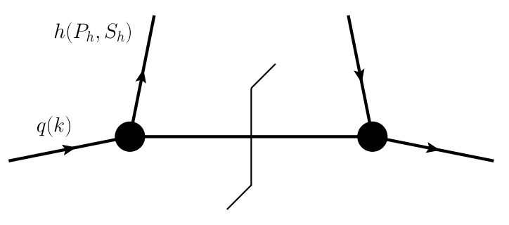
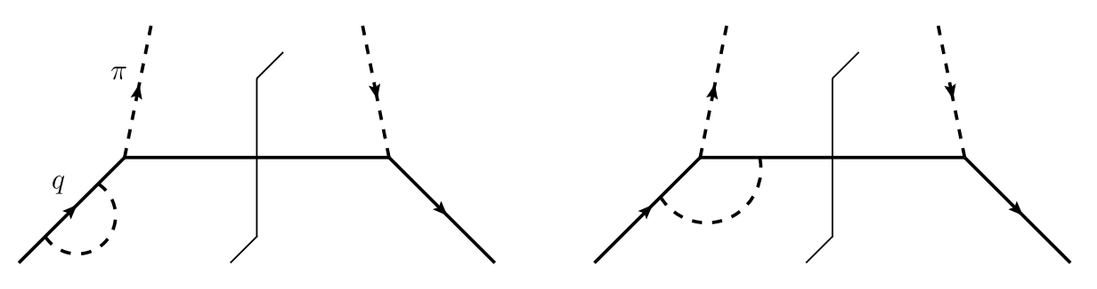
Calculation of FFs
Models
Simplest version = spectator models
  a time-like off-shell parton fragments into a hadron and a single (real) spectator particle
Practitioner uses (favourite) quark + hadron Lagrangian to compute a (short) series of diagrams
Practitioner fits parameters to some selected data

Slide 24
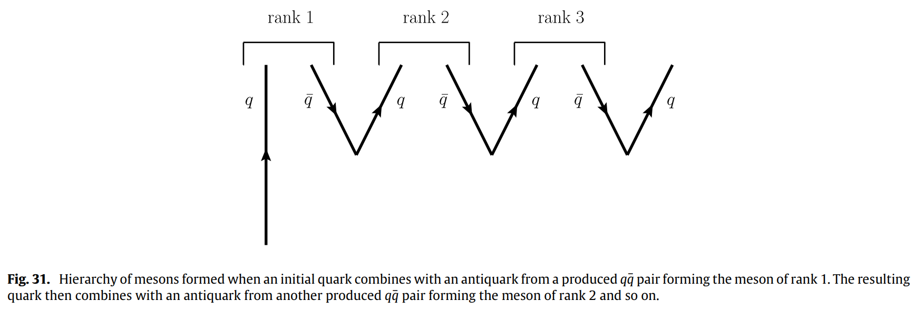

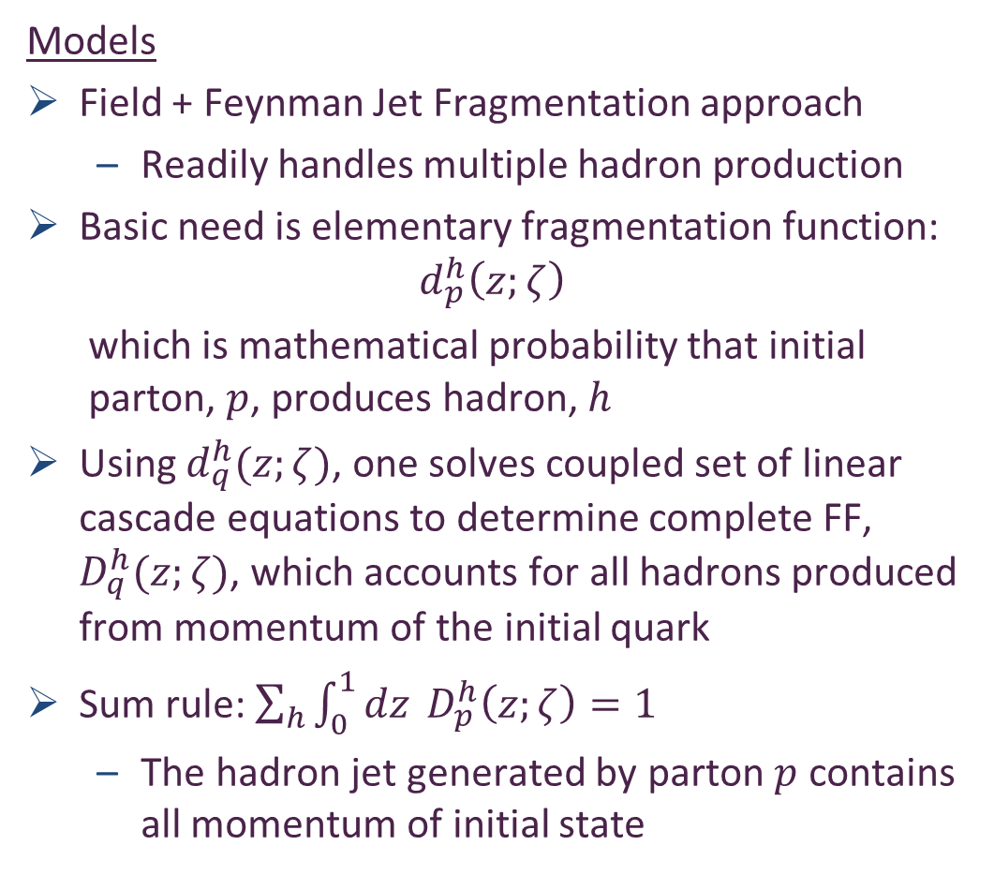
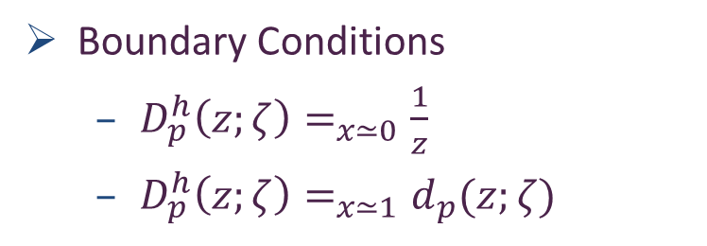
Calculation of FFs
Models
Field + Feynman Jet Fragmentation approach
  Readily handles multiple hadron production
Basic need is elementary fragmentation function:
$$d_{p}^{h}\left(z;ζ\right)$$
  which is mathematical probability that initial parton, $p$, produces hadron, $h$
Using $d_{q}^{h}(z;ζ)$, one solves coupled set of linear cascade equations to determine complete FF, $D_{q}^{h}(z;ζ)$, which accounts for all hadrons produced from momentum of the initial quark
Sum rule: $\sum_{h}{\int_{0}^{1}{dz} D_{p}^{h}\left(z;ζ\right)=1}$
  The hadron jet generated by parton $p$ contains all momentum of initial state
Boundary Conditions
  $D_{p}^{h}\left(z;ζ\right)=_{x≃0}\frac{1}{z}$
  $D_{p}^{h}\left(z;ζ\right)=_{x≃1}d_{p}(z;ζ)$

Slide 25
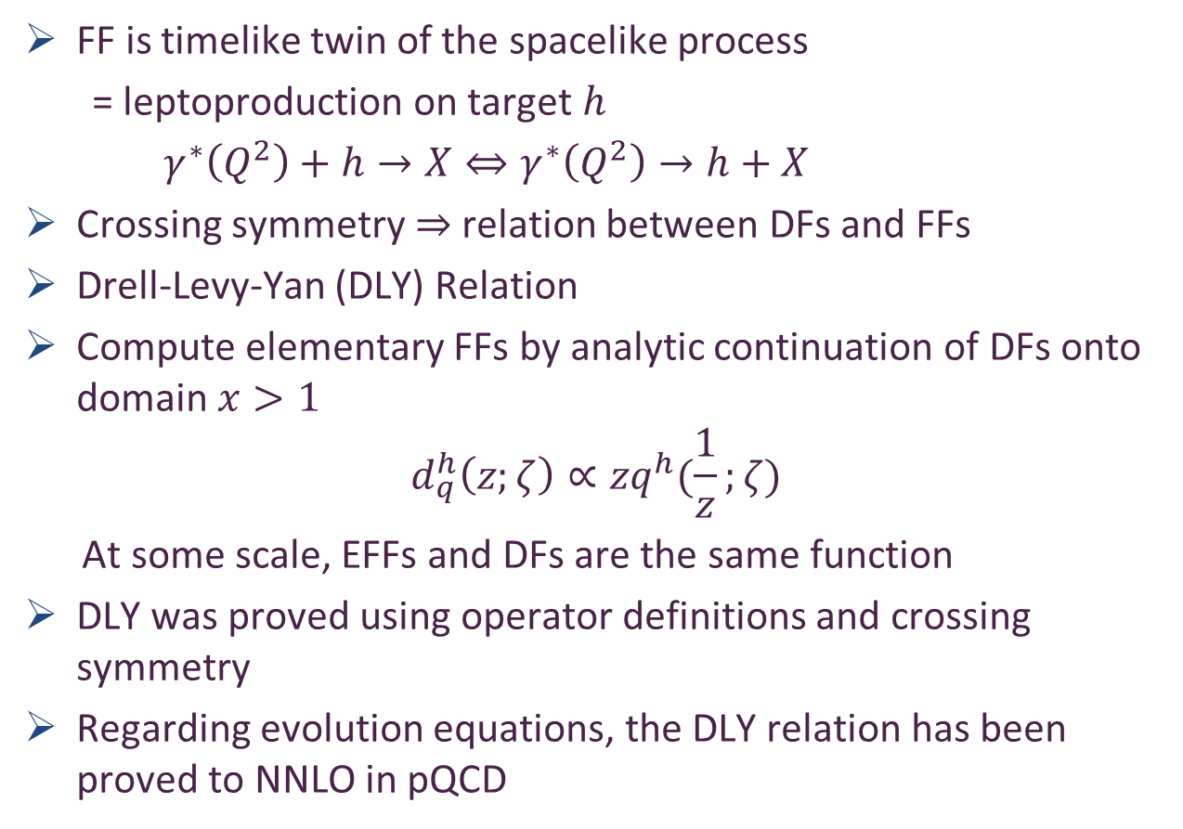
Elementary Fragmentation Functions
FF is timelike twin of the spacelike process
= leptoproduction on target $h$
$γ^{∗}\left(Q^{2}\right)+h→X⇔γ^{∗}\left(Q^{2}\right)→h+X$
Crossing symmetry $⇒$ relation between DFs and FFs
Drell-Levy-Yan (DLY) Relation
Compute elementary FFs by analytic continuation of DFs onto domain $x>1$
$$d_{q}^{h}\left(z;ζ\right)∝zq^{h}(\frac{1}{z};ζ)$$
At some scale, EFFs and DFs are the same function
DLY was proved using operator definitions and crossing symmetry
Regarding evolution equations, the DLY relation has been proved to NNLO in pQCD
S. D. Drell, D. J. Levy, T.-M. Yan, A Theory of Deep Inelastic Lepton-Nucleon Scattering and Lepton Pair Annihilation Processes. 1., Phys. Rev. 187 (1969) 2159–2171.
S. D. Drell, D. J. Levy, T.-M. Yan, A Theory of Deep Inelastic Lepton Nucleon Scattering and Lepton Pair Annihilation Processes. 2. Deep Inelastic electron Scattering,
Phys. Rev. D 1 (1970) 1035–1068.
S. D. Drell, D. J. Levy, T.-M. Yan, A Theory of Deep Inelastic Lepton-Nucleon Scattering and Lepton Pair Annihilation Processes. 3. Deep Inelastic electron-Positron Annihilation, Phys. Rev. D 1 (1970) 1617–1639.
V. Gribov, L. Lipatov, Deep inelastic e p scattering in perturbation theory, Sov. J. Nucl. Phys. 15 (1972) 438–450.
V. N. Gribov, L. N. Lipatov, e+ e- pair annihilation and deep inelastic e p scattering in perturbation theory, Sov. J. Nucl. Phys. 15 (1972) 675–684.

Slide 26
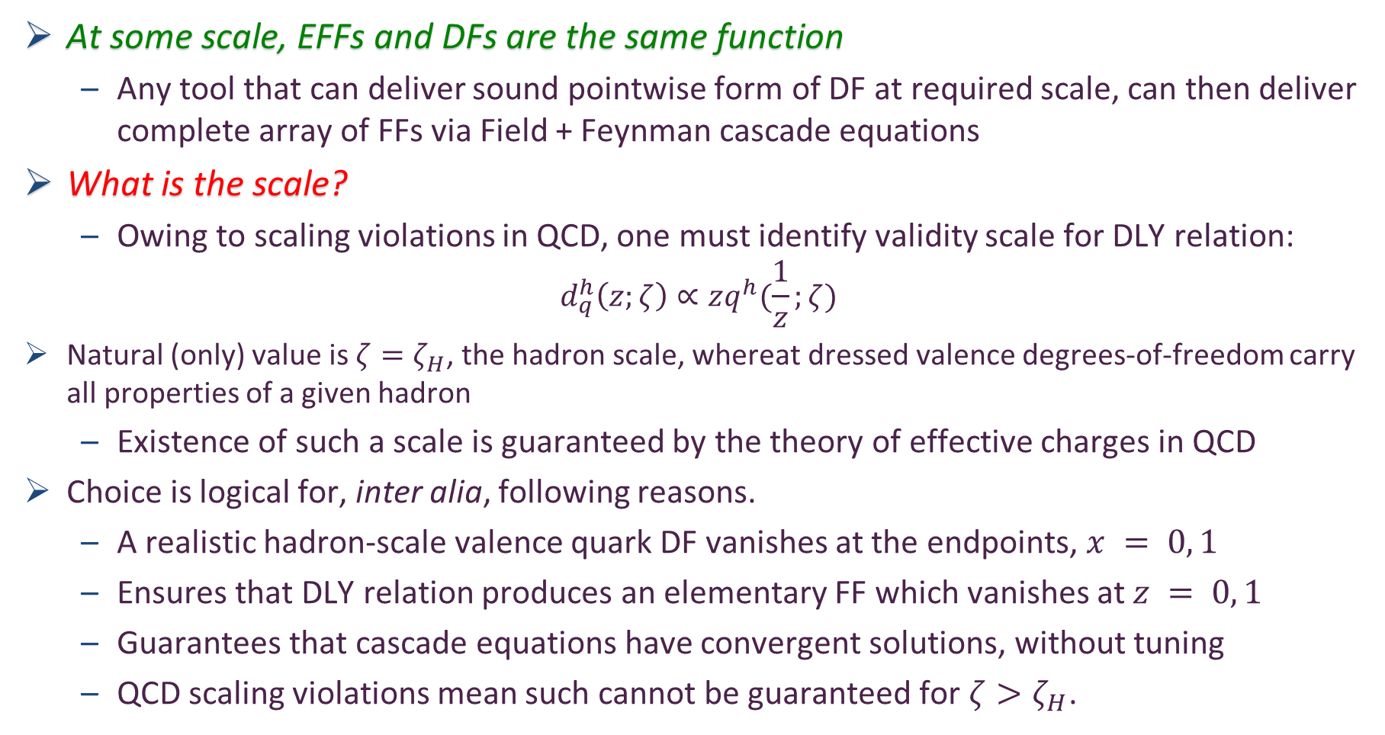
Elementary Fragmentation Functions
At some scale, EFFs and DFs are the same function
  Any tool that can deliver sound pointwise form of DF at required scale, can then deliver complete array of FFs via Field + Feynman cascade equations
What is the scale?
  Owing to scaling violations in QCD, one must identify validity scale for DLY relation:
$$d_{q}^{h}\left(z;ζ\right)∝zq^{h}(\frac{1}{z};ζ)$$
Natural (only) value is $ζ=ζ_{H}$, the hadron scale, whereat dressed valence degrees-of-freedom carry all properties of a given hadron
  Existence of such a scale is guaranteed by the theory of effective charges in QCD
Choice is logical for, inter alia, following reasons.
  A realistic hadron-scale valence quark DF vanishes at the endpoints, $x = 0, 1$
  Ensures that DLY relation produces an elementary FF which vanishes at $z = 0, 1$
  Guarantees that cascade equations have convergent solutions, without tuning
  QCD scaling violations mean such cannot be guaranteed for $ζ>ζ_{H}$.

Slide 27
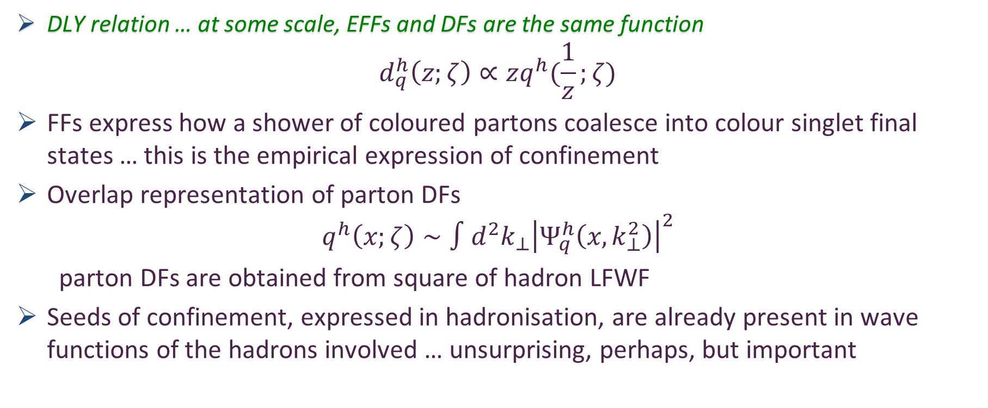
Fragmentation Functions and Confinement
DLY relation … at some scale, EFFs and DFs are the same function
$$d_{q}^{h}\left(z;ζ\right)∝zq^{h}(\frac{1}{z};ζ)$$
FFs express how a shower of coloured partons coalesce into colour singlet final states … this is the empirical expression of confinement
Overlap representation of parton DFs
$$q^{h}\left(x;ζ\right)∼∫d^{2}k_{⊥}{\left|Ψ_{q}^{h}\left(x,k_{⊥}^{2}\right)\right|}^{2}$$
parton DFs are obtained from square of hadron LFWF
Seeds of confinement, expressed in hadronisation, are already present in wave functions of the hadrons involved … unsurprising, perhaps, but important

Slide 28
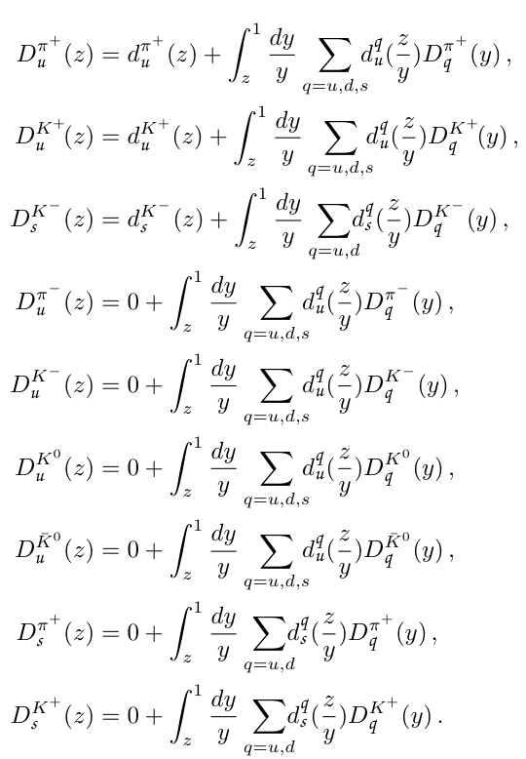
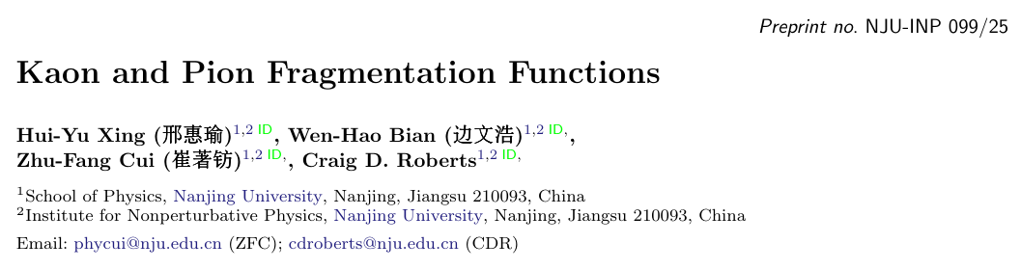

Predictions for Fragmentation Functions using cascade equations
favoured
Empirically, at energies below $∼100$ GeV,
$π, K$ dominate (98%) particle production
in SIA: $e^{+}+e^{−}→h+X$
So, illustrate procedure via predictions for $π, K$ FFs
Exploit $G$-parity symmetry, one has set of 9 coupled Volterra integral equations of 2nd kind
unfavoured

Slide 29
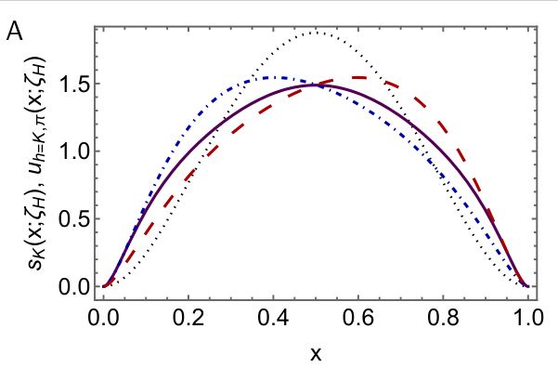
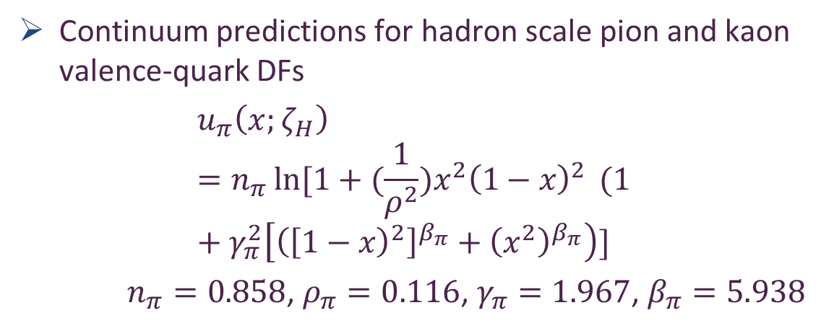


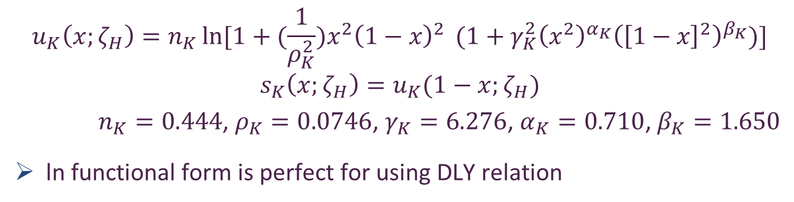
Pion and Kaon DFs $⇒$ EFFs
Continuum predictions for hadron scale pion and kaon valence-quark DFs
$$u_{π}\left(x;ζ_{H}\right)=n_{π}\ln{[1+{(\frac{1}{ρ^{2}})x}^{2}{\left(1−x\right)}^{2}} (1+γ_{π}^{2}\left[{\left({\left[1−x\right)}^{2}\right]}^{β_{π}}+{\left(x^{2}\right)}^{β_{π}}\right)]$$
$n_{π}=0.858$, $ρ_{π}=0.116$, $γ_{π}=1.967$, $β_{π}=5.938$
$$s_{K}\left(x;ζ_{H}\right)$$
Dilation and flattening are expressions of EHM
Skewing for kaon is expression of EHM + Higgs-Boson interference
$$u_{K}\left(x;ζ_{H}\right)=n_{K}\ln{[1+{(\frac{1}{ρ_{K}^{2}})x}^{2}{\left(1−x\right)}^{2}} (1+γ_{K}^{2}{\left(x^{2}\right)}^{α_{K}}{\left({\left[1−x\right]}^{2}\right)}^{β_{K}})]$$
$$s_{K}\left(x;ζ_{H}\right)=u_{K}(1−x;ζ_{H})$$
$n_{K}=0.444$, $ρ_{K}=0.0746$, $γ_{K}=6.276$, $α_{K}=0.710$, $β_{K}=1.650$
ln functional form is perfect for using DLY relation
Kaon and pion parton distributions, Zhu-Fang Cui et al., Eur. Phys. J. C 80 (2020) 11, 1064 ... 97 citations
CSM predictions confirmed, e.g., Quark and Gluon Momentum Fractions in the Pion and in the Kaon, ETMC, Phys. Rev. Lett. 134 (2025)

Slide 30
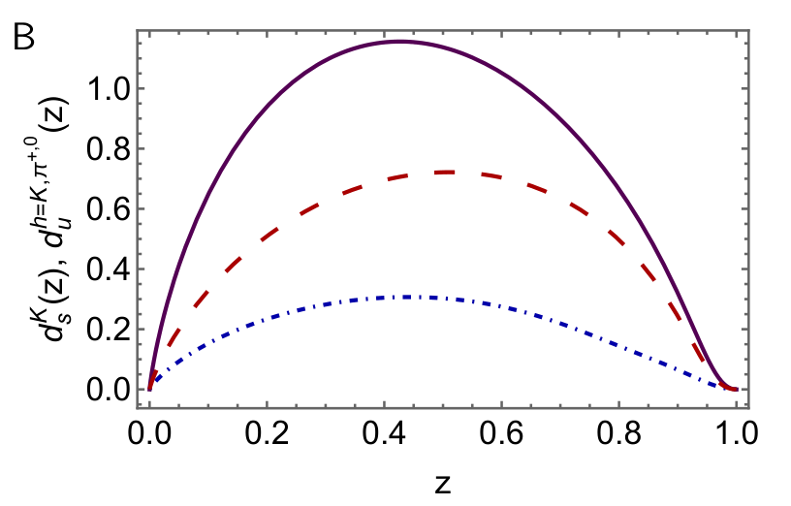

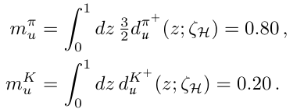
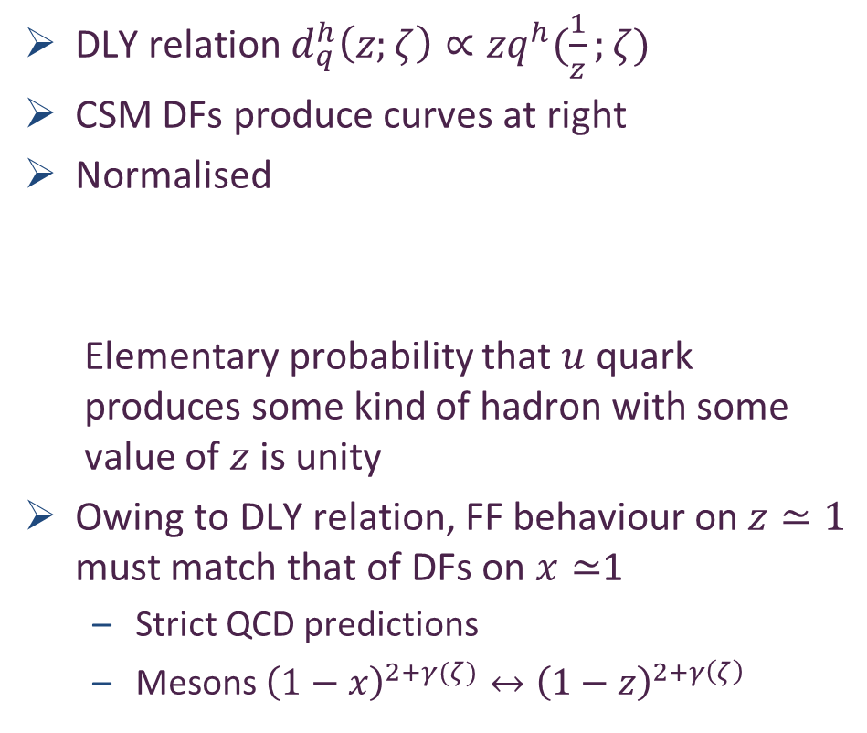




Elementary Fragmentation Functions
DLY relation $d_{q}^{h}\left(z;ζ\right)∝zq^{h}(\frac{1}{z};ζ)$
CSM DFs produce curves at right
Normalised
  Elementary probability that $u$ quark produces some kind of hadron with some value of $z$ is unity
Owing to DLY relation, FF behaviour on $z≃1$ must match that of DFs on $x≃$1
  Strict QCD predictions
  Mesons ${{\left(1−x\right)}^{2+γ(ζ)}↔\left(1−z\right)}^{2+γ\left(ζ\right)}$
$$d_{u}^{π^{+}+π^{0}}(x;ζ_{H})$$
$$d_{s}^{K^{−}}(x;ζ_{H})$$
$$d_{u}^{K^{+}}(x;ζ_{H})$$
Prediction: EFF multiplicities
Determine multiplicities at all scales
Baryons … $2→3$

Slide 31
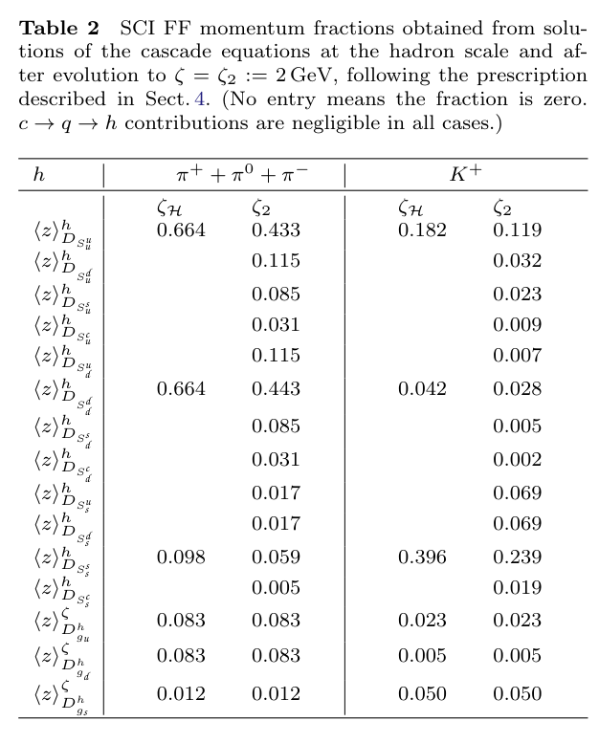
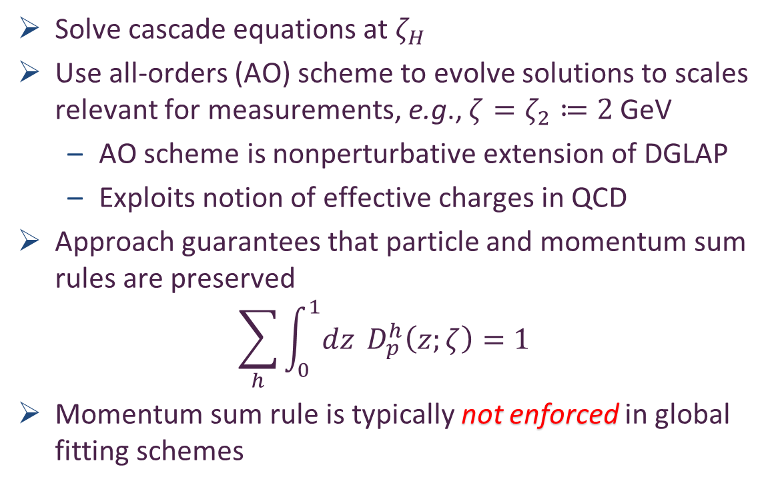
Empirical Fragmentation Functions
Solve cascade equations at $ζ_{H}$
Use all-orders (AO) scheme to evolve solutions to scales relevant for measurements, e.g., $ζ=ζ_{2}≔2$ GeV
  AO scheme is nonperturbative extension of DGLAP
  Exploits notion of effective charges in QCD
Approach guarantees that particle and momentum sum rules are preserved
$$\sum_{h}{\int_{0}^{1}{dz} D_{p}^{h}\left(z;ζ\right)=1}$$
Momentum sum rule is typically not enforced in global fitting schemes

Slide 32

Empirical Fragmentation Functions
Solve cascade equations at $ζ_{H}$
Use all-orders (AO) scheme to evolve solutions to scales relevant for measurements, e.g., $ζ=ζ_{2}≔2$ GeV
  AO scheme is nonperturbative extension of DGLAP
  Exploits notion of effective charges in QCD
Approach guarantees that particle and momentum sum rules are preserved
$$\sum_{h}{\int_{0}^{1}{dz} D_{p}^{h}\left(z;ζ\right)=1}$$
Momentum sum rule is typically not enforced in global fitting schemes

Slide 33
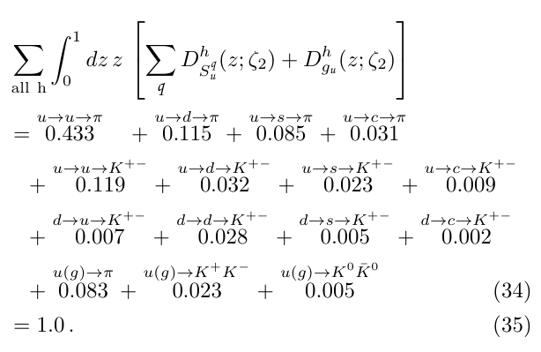
Empirical Fragmentation Functions
Solve cascade equations at $ζ_{H}$
Use all-orders (AO) scheme to evolve solutions to scales relevant for measurements, e.g., $ζ=ζ_{2}≔2$ GeV
  AO scheme is nonperturbative extension of DGLAP
  Exploits notion of effective charges in QCD
Approach guarantees that particle and momentum sum rules are preserved
$$\sum_{h}{\int_{0}^{1}{dz} D_{p}^{h}\left(z;ζ\right)=1}$$
Momentum sum rule is typically not enforced in global fitting schemes

Slide 34


Empirical
Fragmentation
Functions
Focus on pion & compare CSM predictions (solid purple curves) with fits
N.B. Between groups, fits are mutually incompatible.
5 A, B … $u→π^{+,0}$ (favoured) nonsinglet and singlet.
  Agreement only on $z>0.5$, i.e., valence quark domain
  JAM nonsinglet FF result ($zD_{N}$) exhibits unexpected & unphysical divergence on $z≃0$.
  This is the domain of glue and sea dominance; so, $zD_{N}=\frac{3}{2} z[D_{q}^{π^{+}}\left(z\right)−D_{\overline{q}}^{π^{+}}\left(z\right)]$ should vanish.

Slide 35

Empirical
Fragmentation
Functions
Focus on pion & compare CSM predictions (solid purple curves) with fits
N.B. Between groups, fits are mutually incompatible.
5 C … $s→π$ (unfavoured).
  One might say there is qualitative agreement on the far valence domain, but only in the sense that this FF is small.
  Otherwise, any agreement is only the result of an accidental curve crossing

Slide 36

Empirical
Fragmentation
Functions
Focus on pion & compare CSM predictions (solid purple curves) with fits
N.B. Between groups, fits are mutually incompatible.
5 D, E … $c, g→π$ (unfavoured).
  There is no agreement on these FFs, which are very poorly constrained by data.

Slide 37

Empirical
Fragmentation
Functions
Focus on pion & compare CSM predictions (solid purple curves) with fits
N.B. Between groups, fits are mutually incompatible.
Continuum predictions provide coherent picture of fragmentation across all parton types
Quite generally, MAPFF fits (blue) highlight that FFs are practically unconstrained on $z ≲ 0.2$
The study indicates that, today, phenomenology does not deliver objective FF results:
results obtained are practitioner specific
This must improve if anything objective is to be learnt from modern and anticipated facilities

Slide 38





Hadron Jet Multiplicities
Relative multiplicity of charged and neutral kaons in $e^{+}+e^{−}→h+X$
Data exist, most recently from BESIII, last year
BESIII
Parameter-free prediction
Predictions for hadron jet multiplicities reveal SU$(3)$-flavour symmetry breaking in $R_{K}\left(ζ\right)$
Breaking significant at reaction energy scales $ζ≈3m_{p}$, but decreases in size with increasing reaction energy

Slide 39
Theory Frontier

Slide 40


Electron Ion Collider
Now available: unified set of empirically benchmarked, parameter-free predictions for …
pion, kaon, proton, neutron elastic electromagnetic and gravitational form factors
and their species decompositions
with direct connections to three pillars of emergent hadron mass
  Also … ab initio predictions for pion and kaon structure and fragmentation functions
Next step … nucleon structure function predictions with equal QCD fidelity

Slide 41
Emergent Hadron Mass
Grant no. 12135007
QCD is unique amongst known fundamental theories of natural phenomena
  The degrees-of-freedom used to express the scale-free Lagrangian are not directly observable
  Massless gauge bosons become massive, with no “human” interference
  Gluon mass ensures a stable, infrared completion of the theory through the appearance of a running coupling that saturates at infrared momenta, being everywhere finite
  Massless fermions become massive, producing
    Massive baryons and simultaneously Massless mesons
These emergent features of QCD are expressed in every strong interaction observable
They can also be revealed via
EHM interference with Nature’s other known source of mass = Higgs
We are capable of building facilities that can validate these concepts, proving QCD to be
the 1st well-defined four-dimensional quantum field theory ever contemplated
This may open doors that lead far beyond the Standard Model

Slide 42


Can’t build a Theory of Everything
before status of QCD is decided
$${\text{L}}_{Nature}= ?$$
There are theories of many things,
But is there a theory of everything?
Thankyou

Slide 43


Slide 44

Proton Mass Budget
Decomposition is
gauge invariant
Poincaré invariant
scale invariant
Higgs boson couplings into QCD produce current quark masses. Nothing else.
${\hat{m}}_{u}=3.11$MeV & ${\hat{m}}_{d}=6.78$ MeV
This adds up to just 1.4% of the proton mass
Nucleon $σ$-term is product of these current masses with in-hadron condensates
$$\left\langle N\left|\overline{u}u\right|N\right\rangle ≈\left\langle N\left|\overline{d}d\right|N\right\rangle$$
Such condensates are order parameters for EHM
$σ$-term minus Higgs-only term $≈47$ MeV $≈5$% of the nucleon mass
This leaves 94% of the nucleon mass owing to EHM

Slide 45
Gauge Invariance
The issue of gauge invariance is sometimes raised in connection with the CSM analyses
Any related concerns are baseless.
Continuum calculations are typically performed in Landau gauge for three practical reasons
  Landau gauge is a fixed point of the QCD renormalisation group; so, the gauge parameter does not run and, once fixed, Landau gauge remains Landau gauge
  In delivering manifestly Poincaré covariant n-point functions, Landau gauge ensures Poincaré invariant results for all calculated observables
  Landau gauge can readily be fixed in studies employing lattice-regularised QCD (lQCD); so, valid comparisons can straightforwardly be made between results obtained using these two complementary nonperturbative approaches. Few other gauges are accessible using lQCD.
Point (iii) is significant because lQCD is a manifestly gauge invariant approach. Thus, agreement between the Landau gauge continuum prediction for a given n-point function and the Landau gauge projection of lQCD simulations that yield the same Schwinger function is practical confirmation of the gauge covariance of the continuum result.

Slide 46
Gauge Invariance
It is worth adding that solutions of QCD's quantum equations of motions, e.g., Dyson-Schwinger equations, are gauge covariant.
Gauge transforms are nugatory, in the sense that they introduce non-dynamical transformations of gauge covariant objects.
Consequently, such quantities, properly combined into a gauge invariant matrix element, will deliver gauge invariant results.
These remarks are confirmed, in practice, by comparisons between continuum predictions and experimental observables because the measured quantities are plainly gauge invariant and an approach that directly connects elementary n-point Schwinger functions with measured quantities must be preserving gauge invariance if it is delivering agreement with the bulk of those observables.
These last remarks entail that all features of the Landau-gauge elementary n-point functions are expressed in calculated observables. Thus, for instance, whilst the nonperturbative running of the dressed quark mass may not itself be directly observable, its impacts on observables are.

Slide 47



Slide 48





Process-independent Effective Charge
https://1drv.ms/b/s%21Apbnb6VLY1RplPRdL0J4Wm-tlzQd-Q?e=hdZxHH
May 2024
Most-read article in the May issue of SciAm
Translated into Chinese, French, German, Italian
Cover story on Chinese and German editions
SciAm is one of the Top-5 popular science magazines in the world.
International circulation that exceeds 10,000,000 readers per month in subscriptions and millions more via social media etc.

Slide 49




All-orders evolution
All-Orders Evolution of Parton Distributions: Principle, Practice, and Predictions
Pei-Lin Yin (尹佩林), NJU-INP 075/23, e-Print: 2306.03274 [hep-ph]
P1 – In the context of Refs. [73, 74], there exists at least one effective charge, $α_{1ℓ}(k^{2})$, which, when used to integrate the leading-order perturbative DGLAP equations, defines an evolution scheme for parton DFs that is all-orders exact.
CSM Process-Independent charge serves this purpose
Hadron scale, $ζ_{H}$
  Scale at which all properties of a given hadron are carried by valence degrees-of-freedom

Slide 50

AO Evolution
Principle
  Hadron scale, $ζ_{H}$, is rigorously defined in connection with a Grunberg charge, in terms of which leading-order DGLAP evolution is promoted to the status of an all-orders exact procedure.
  The AO scheme is not a model, and neither is $ζ_{H}$.
  Instead, the AO approach, involving and defining $ζ_{H}$, is complete by definition.
As explained by Grunberg, there is always an effective (process-dependent) effective charge for which the AO propositions are true.
  Consequently, there is no room for doubt about the existence of $ζ_{H}$.
Crucially, such a Grunberg effective charge is
  consistent with the renormalization group;
  renormalization scheme independent;
  everywhere analytic and finite;
  and supplies an infrared completion of any standard running coupling.

Slide 51

AO Evolution
Crucially, such a Grunberg effective charge is
  consistent with the renormalization group;
  renormalization scheme independent;
  everywhere analytic and finite;
  and supplies an infrared completion of any standard running coupling.
These features entail that all calculations of a DF at a scale within a domain of pQCD applicability are compatible with this effective charge.
Moreover, and especially important, is the fact that one does not need to know the pointwise form of the effective charge
  Its existence alone is sufficient to deliver
  the definition of $ζ_{H}$ and all attendant consequences
  N.B. glue and sea DFs are identically zero at $ζ_{H}$

Slide 52
AO Evolution
The potential issue with a Grunberg effective charge is
that reference to a specific process may make it globally useless
We know that is not the case
  The class of process-dependent (Grunberg) charges,
    defined in connection with the AO scheme,
    may be characterized by our unique, predicted process-independent effective charge
Thus far, the AO class of charges – in particular, our PI charge – has served in the same form for all known parton DFs
  Namely, for a large array of structure functions and fragmentation processes.
This is a very broad domain of applicability for one single Grunberg charge.

Slide 53




Gravitational Form Factors
Mass, Spin, Pressure Distributions
Prediction built from
  Zhao-Qian’s results
Lattice results in left panel from [Hackett:2023rif]
Authors acknowledge these are first results.
Statistical errors are very large.
Results on only one lattice spacing & one lattice volume are available.
Only one unphysical pion mass is used.
Renormalisation scheme is not gauge invariant and renormalisataion constants were calculated on a different lattice from the one used to compute the GFFs.
No other computed observable is available on the lattice setup the authors used.
Follows, inter alia, that the systematic errors on [Hackett:2023rif] are completely unknown and therefore uncontrolled.
Hence, no one can know whether it is better to agree or disagree with the lQCD results – Nevertheless, authors claimed “benchmark for future”
CSM prediction (parameter-free) in precise agreement with inference from $ππ, K\overline{K}$ scattering data [Cao:2024zlf]

Slide 54
Gravitational Form Factors
Mass, Spin, Pressure Distributions
Prediction built from
  Zhao-Qian’s results
CSM prediction (parameter-free) in precise agreement with inference from $ππ, K\overline{K}$ scattering data [Cao:2024zlf]
CSM results
Systematic errors considered and controlled
Statistical errors associated with numerical algorithms small
Parameter-free unification of nucleon gravitational form factors with data-consistent predictions for pion, kaon, and nucleon electromagnetic form factors [Yao:2024drm, Yao:2024uej]
CSM predictions are fully benchmarked

Slide 55
Gravitational Form Factors
Mass, Spin, Pressure Distributions
Prediction built from
  Zhao-Qian’s results
CSM prediction (parameter-free) in precise agreement with inference from $ππ, K\overline{K}$ scattering data [Cao:2024zlf]
My position
Breadths of application & success of the parameter-free framework employed suggest that predictions delivered should serve as benchmarks for future phenomenology and theory.
No improvement on CSM study can be anticipated before lattice-QCD analyses have simultaneously delivered infinite-volume, continuum-limit, carefully renormalised, physical pion mass studies of all physical properties discussed, viz. pion, kaon, nucleon electromagnetic and gravitational FFs.
CSM predictions are truly setting the standard against which future calculations/inferences should be judged

Slide 56

Photoproduction of heavy vector mesons

Slide 57

EHM Measurements
How does the mass of the nucleon arise?
Once considered viable …
    Electromagnetic process ($V=J/ψ, Υ$) … $e+p→e^{′}+V+p$
    to access purely hadronic process … $V+p→V+p$
But …
  Deciphering the mechanism of near-threshold J/ψ photoproduction, M.-L. Du, V. Baru, F.-K. Guo et al., Eur. Phys. J. C 80, 1053 (2020)
  Vector-meson production and vector meson dominance, Yin-Zhen Xu, Si-Yang Chen, Zhao-Qian Yao et al., Eur. Phys. J. C 81 (2021) 895/1-11
  Near threshold heavy quarkonium photoproduction at large momentum transfer, P. Sun, X.-B. Tong, F. Yuan, Phys. Rev. D 105 (2022) 5, 054032
There is no objective, model-independent means by which to connect $e+p→e^{′}+V+p$ with $V+p→V+p$
Hence, vector meson photoproduction
    does not provide a path to the QCD trace anomaly
    (or anything else)

Slide 58




$J/ψ$ photoproduction: from threshold to very high energies
J/ψ photoproduction: threshold to very high energy, Lin Tang (唐淋), Yi-Xuan Yang (杨逸轩), Zhu-Fang Cui (崔著钫) and Craig D. Roberts, NJU-INP 089/24, e-Print: 2405.17675 [hep-ph], Phys. Lett. B 856 (2024) 138904/1-7
If GPD scheme valid at all, then only very near threshold.
All $W$ unification impossible
Some modern proposals for reaction model:
  GPD treatment – gain access to in-proton gluon gravitational form factors
  Coupled channels treatment – $P+ J/ψ p rescattering$
    S. Sakinah, T. S. H. Lee, H.-M. Choi, Dynamical Model of J/Ψ photoproduction on the nucleon – arXiv:2403.01958 [nucl-th] Phys. Rev. C 109 (2024) 6, 065204
    Suggestion = Final state interactions dominate cross-section near-threshold, so obscuring any connection with in-proton gluon distributions and/or gluon gravitational form factors.
  $γ+p→c+\overline{c}+P+p→J/ψ+p$
    Lin Tang (唐淋) et al. NJU-INP 089/24
    Exposes $c+\overline{c}$ content of the dressed photon
    Couples the intermediate $c+\overline{c}$system to
    proton’s valence quarks via Pomeron exchange

Slide 59



$J/ψ$ photoproduction: threshold differential cross-section
GPD model (dotted blue)
  overfitting issue
  concave differential cross-section with max. at low $\left|t\right|$
  trying to reconcile GlueX and $J/ψ$-007 data (some tension)
  all other reaction models produce convex $\frac{dσ}{dt}$
$P+J/ψp$ rescattering
  dashed green – $χ_{dof}^{2}=8$
$P+quark loop$
  solid purple – $χ_{dof}^{2}=7$

Slide 60




$J/ψ$ photoproduction: total cross-section, threshold to high-$W$
Reported ZEUS uncertainty in W is large, but uncertainty in $σ$ is small
Distorts $χ^{2}$
GPD model (dotted blue)
  Inapplicable on $W>5$ GeV
  $χ_{dof}^{2}$ undefined
$P+J/ψp$ rescattering
  dashed green
    ZEUS+H1 $χ_{dof}^{2}=2.1$
    H1 $χ_{dof}^{2}=1.6$
$P+quark loop$
  solid purple
    ZEUS +H1 $χ_{dof}^{2}=3.5$
    H1 $χ_{dof}^{2}=1.0$

Slide 61

$J/ψ$ photoproduction: from threshold to very high energies
Two reaction models provide viable unification
  differential and total cross-section data
GPD model does NOT
  Premature to connect γ + p → J/ψ + p photoproduction data with anything derived from/connected with GPDs
  Theory predicts that proton mass radius < proton charge radius – see Empirical Determination of the Pion Mass Distribution, Y-Z. Xu (徐胤禛) et al., NJU-INP 070/23, e-Print: 2302.07361 [hep-ph], Chin. Phys. Lett. Express 40 (2023) 041201/1-7.
Best description of data is provided by CSM reaction model
  $(W,t)$ dependence of quark loop is important to differential cross-section near threshold
  Photoproduction probes quark structure of $γ→J/ψ$ not glue in proton

