Slide 1
CGEM DAQ status
2025-02-11

Slide 2
OUTLINE
Autonomous Interrupt Handling & Data Processing
Commissioning in BESIII experiment Hall with full system
Conclusion

Slide 3
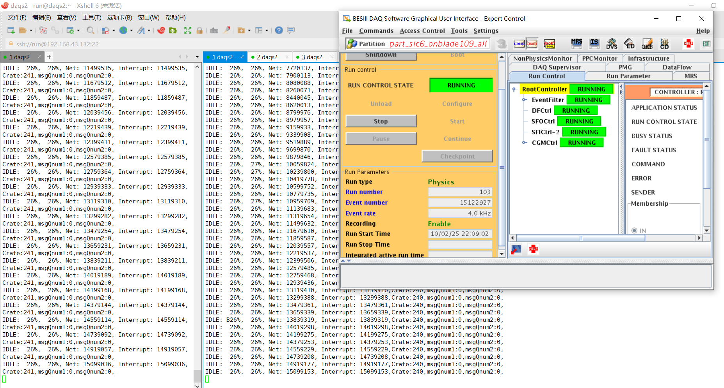
Autonomous Interrupt Handling & Data Processing
4 kHz Interrupt Generation:
PPC autonomously generates interrupts at 4 kHz frequency.
Real-Time Packet Generation :
Upon interrupt response, produces 2 KB simulated data packets and forwards them downstream.
Stable Operation: System sustains continuous operation under high-frequency interrupt-driven workloads with data recording enabled.
Throughput Calculation: Two chassis configuration achieves 16MB/s throughput (4 kHz × 2 KB ×2 ).

Slide 4
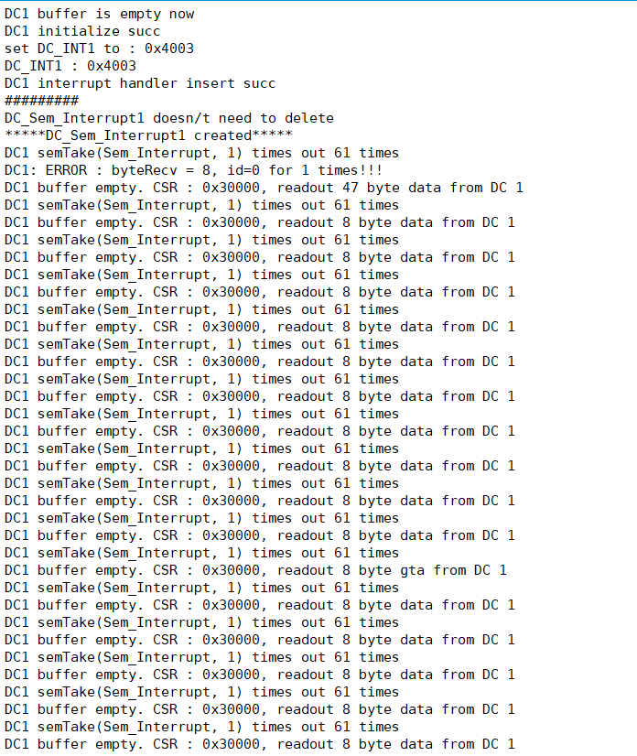
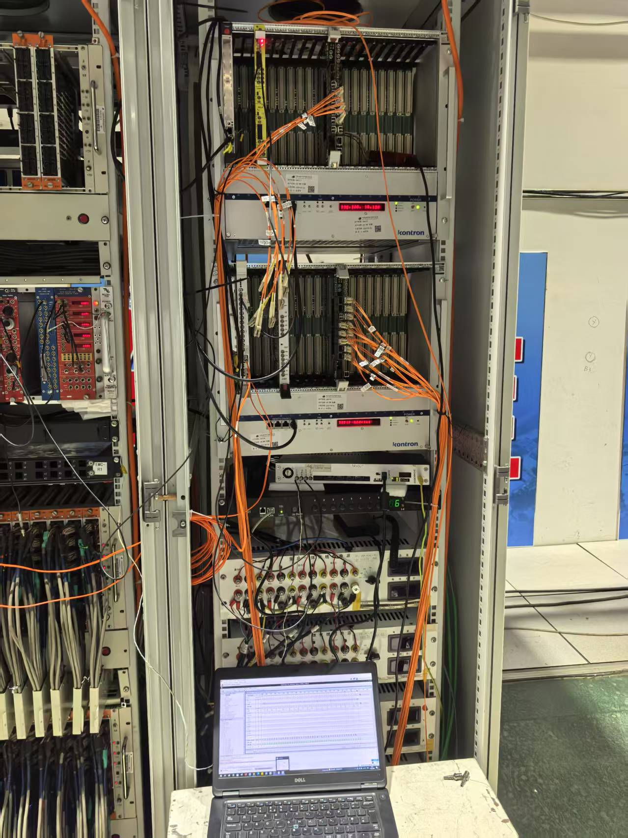
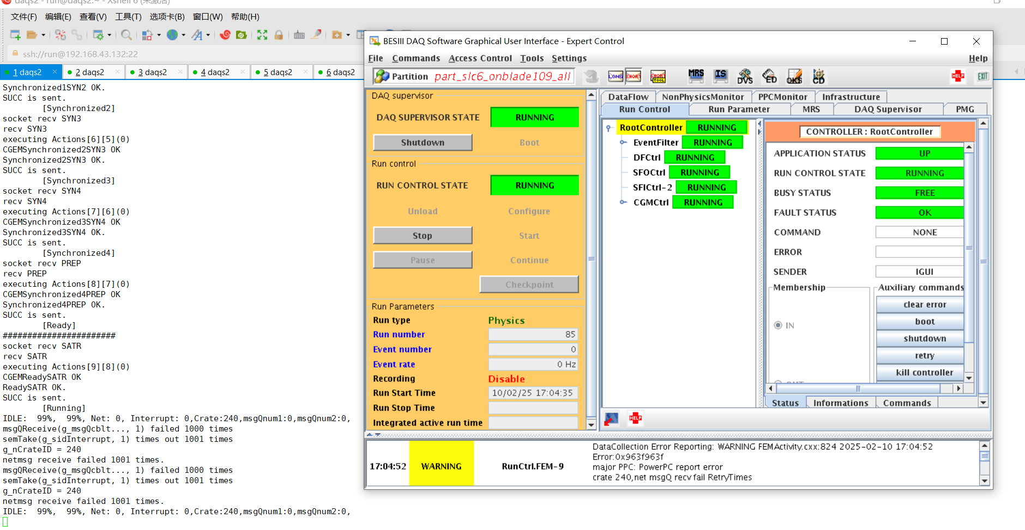
Commissioning in BESIII experiment Hall with full system
Connected all the fibers and modules between GEMROCs to the two DC boards in the 2 VME crates.( east 11 + west 10)
Test with BESIII real trigger 4KHz.
DAQ Report: no interrupt received from DC board,
no data received.
DC buffer is empty.

Slide 5
Commissioning in BESIII experiment Hall with full system
Connected all the fibers and modules between GEMROCs to the two DC boards in the 2 VME crates.( east 11 + west 10)
Test with BESIII real trigger 4KHz.
west side
east side

Slide 6
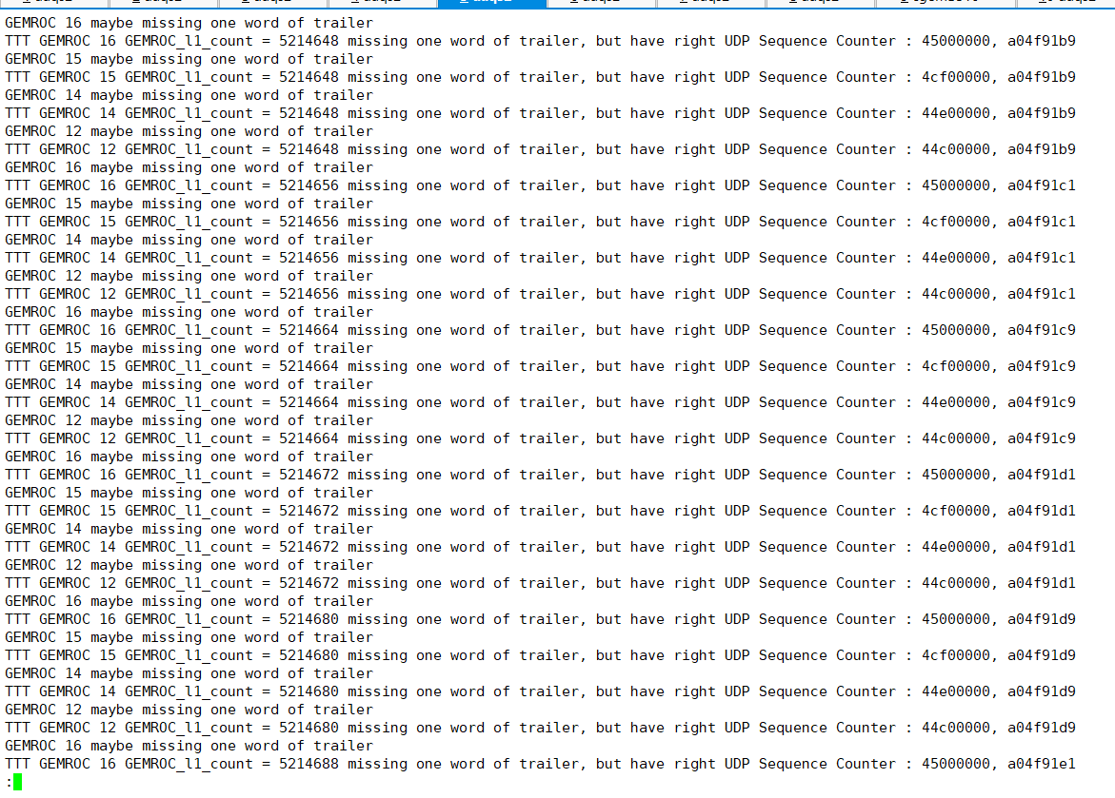
Commissioning in BESIII experiment Hall with full system
Test with BESIII real trigger 313Hz.
DC 1 can only take some data with not more than 4 GEMROCs.
Take some data and check data file. (with GEMROC 12 14 15 16)
Some data format issues found.
GEMROC L1 count jumps
GEMROC trailer missing one word frequenctly.

Slide 7
conclusion
Finished the hardware and software deployment of DAQ system.
Simulation tests proves the DAQ can work continuously with interrupt read out mode with 16MB/s throughput.
Test with the full system with real BESIII trigger 4KHz, receive no interrupt and no data with DC buffer empty.
Test with partial system with real BESIII trigger 313Hz, data format had some issues.
Next:
Test with BESIII CLOCK，CHECK, with FULL enabled to see if it helps.
Test with other subdetectors.
Thank you !

