Slide 1


CEPC Muon Detector
--- Ref-TDR status
Xiaolong Wang (Fudan U.)
on behalf of the Muon Detector Group
Tuesday Meeting, 02/22/2025

Slide 2
Current Focus: TDR Edition
Current status:
  Main structure finished.
  XiaoLong is working on the overall.
  Now, it’s > 30 pages.
Pavel Pakhlov and Tagir Aushev are visiting Fudan and IHEP for cooperation in the future.

Slide 3
Electronics
uMB: Muon management board
–Up to 24 RJ45 connectors, CAT6 shielded cable (up to 2.5 m) to uMB
– Fiber to backend
– Power input (AWG16 x4), 48V

Slide 4
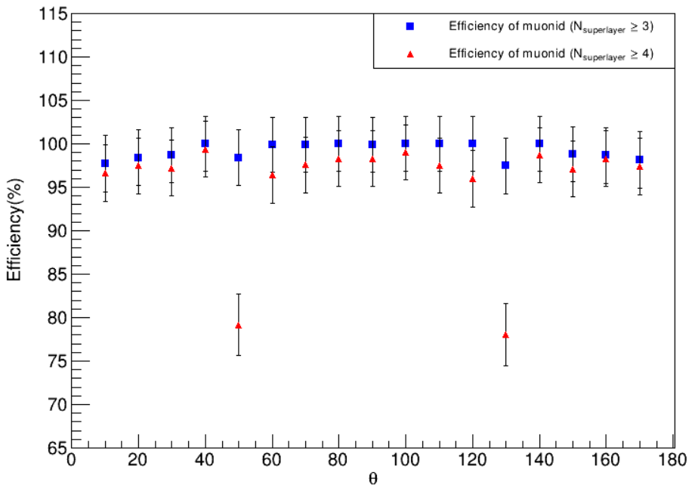
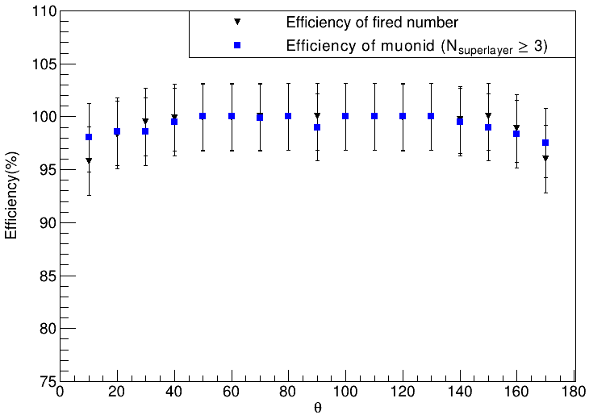
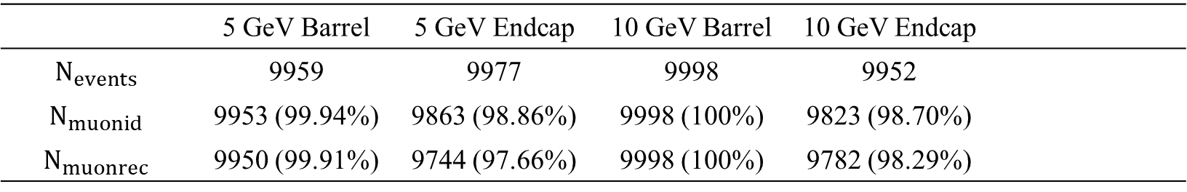
Software and simulation
--- Muon ID and fake rate
 | 5 GeV Barrel | 5 GeV Endcap | 10 GeV Barrel | 10 GeV Endcap
$$N_{events}$$ | 9959 | 9977 | 9998 | 9952
$$N_{muonid}$$ | 9953 (99.94%) | 9863 (98.86%) | 9998 (100%) | 9823 (98.70%)
$$N_{muonrec}$$ | 9950 (99.91%) | 9744 (97.66%) | 9998 (100%) | 9782 (98.29%)
$$7 GeV μ$$
$$10 GeV μ$$

Slide 5
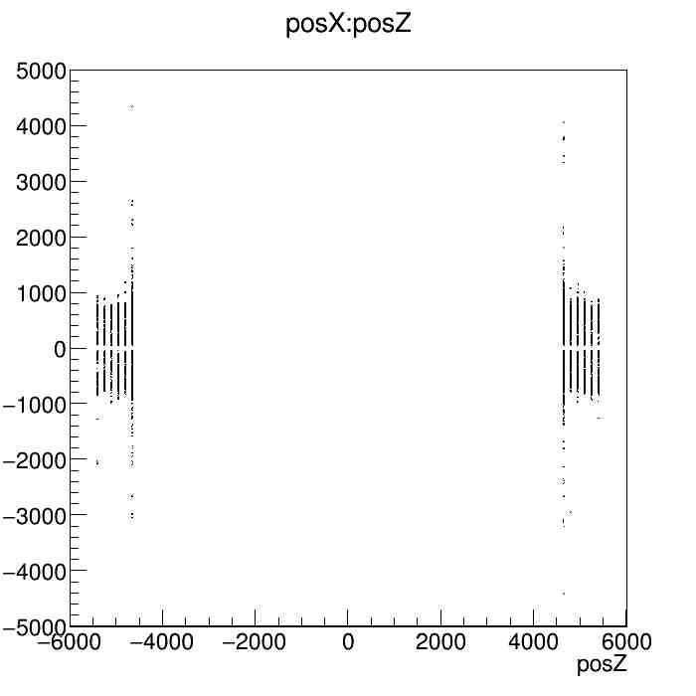
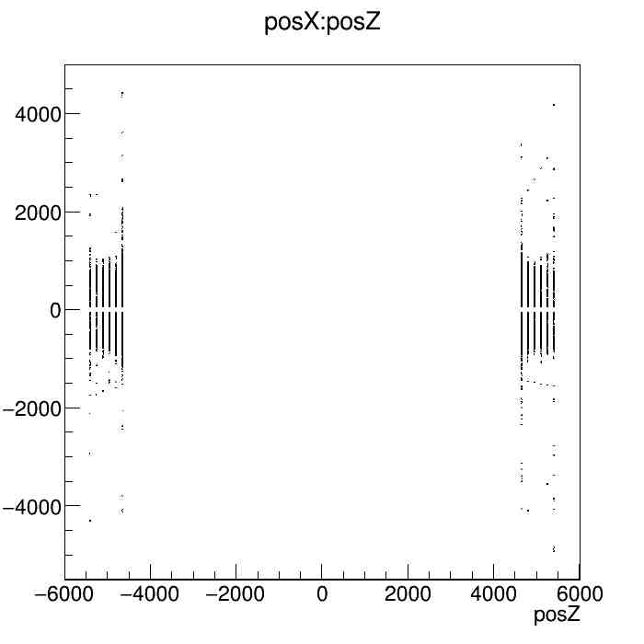
Hit rate due to beam backgrounds
Whole_H_241204, endcap, 10 files, 10BX:
cellid | hit count in 10BX, 2000files | Average time interval between hits (ns per hit)
34637931 | 7427 | 931.74
34636939 | 7424 | 932.11
34637963 | 7253 | 954.09
cellid | hit count in 10BX, 2000files | Average time interval between hits (ns per hit)
34636907 | 14549 | 94.85
34637931 | 14238 | 96.92
34637963 | 14160 | 97.46
Whole_Z_241203, endcap, 10 files, 10BX:

Slide 6
Thank you!

Slide 7
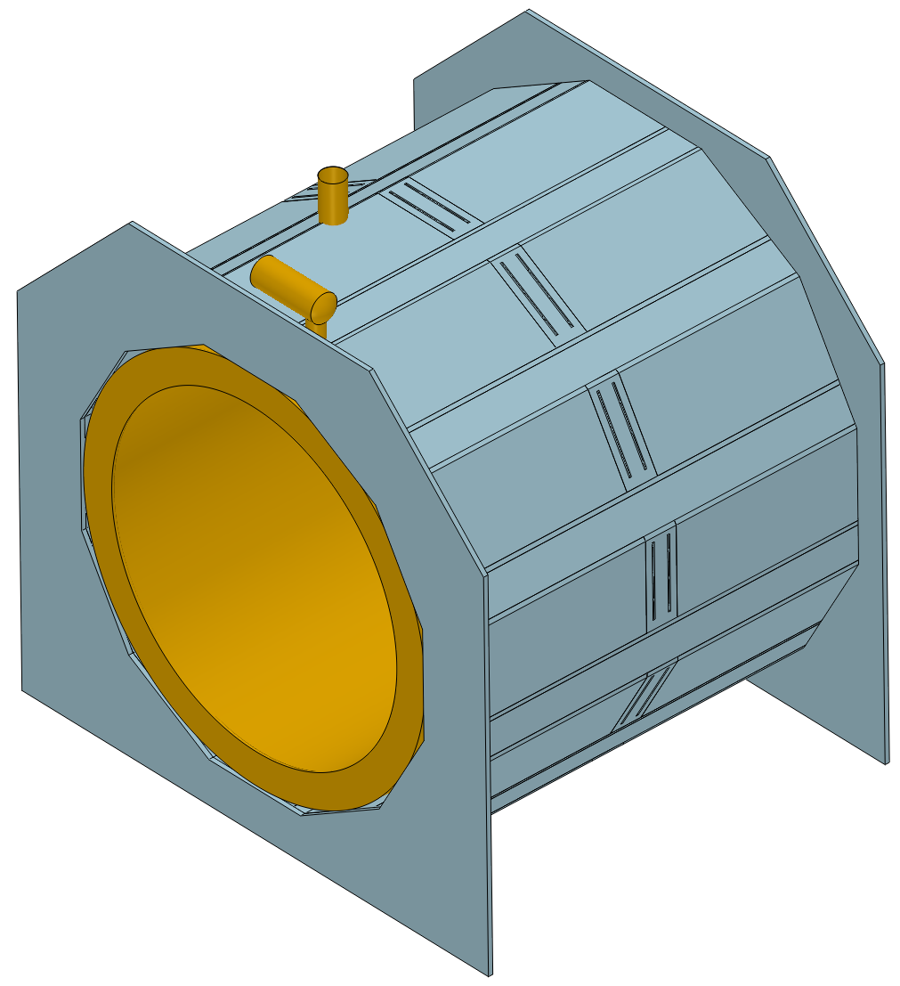
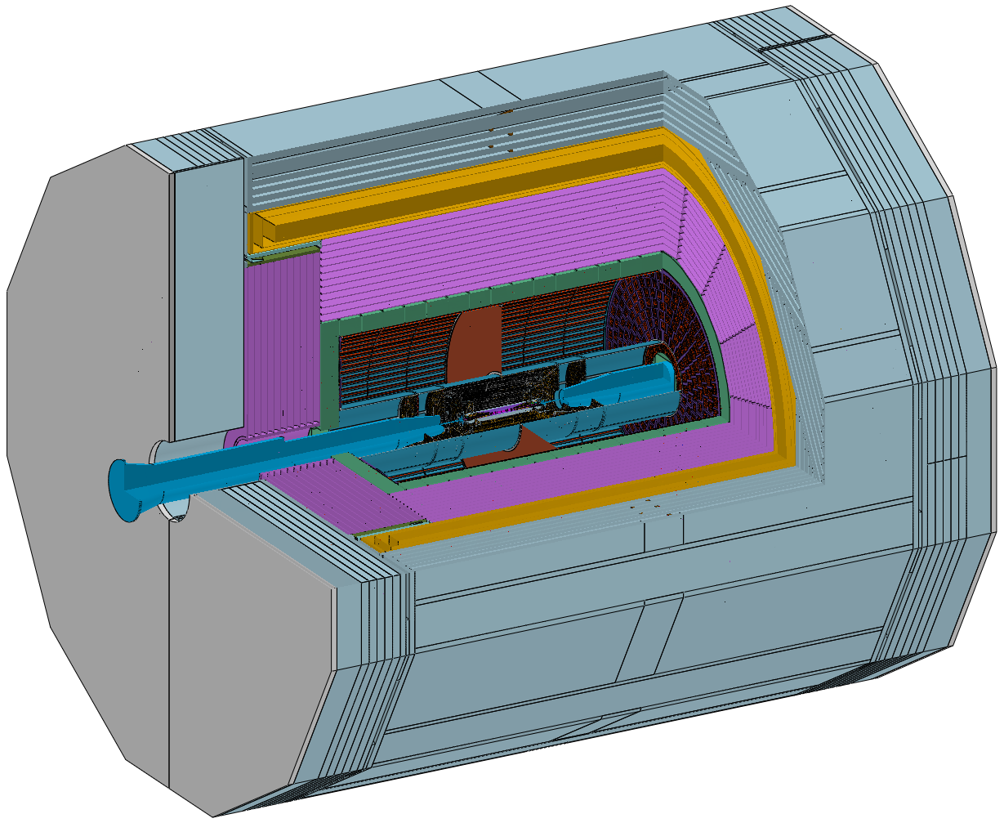
Barrel - installation
线缆出口
Install from the side.
线缆挪到两边输出，尽可能与其他系统的走线一致。

Slide 9
Current Focus: TDR Edition
Main structure and editors
  Software and simulation: Hengne Li
  Electronics: Jie Zhang
  Mechanics and testing: Zhi Wu
  Backgrounds: Junhao Yin
  RPC option: Jun Guo, Yuguang Xie
  Overall: Xiaolong Wang
Two more options:
1. Pasha + Russian group to join the edition
2. Weihu Ma starts to work on radiation hardness testing.

