Slide 1
Progress in the overall mechanical design of CEPC detectors
(TDR report and Review)
Ji Quan
(On behalf of the CEPC Mechanics Working Group)
Feb. 11, 2025

Slide 2
Discuss:
1. TDR chapter
2. Chapter content and details
3. Cost content
4. Summary

Slide 3
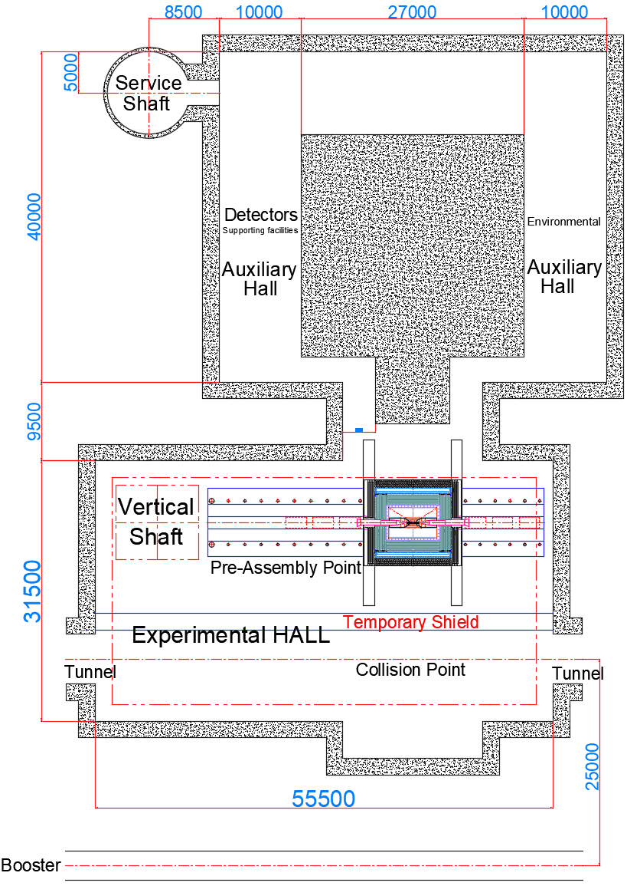
1. TDR Chapters
Chapter 14 Mechanics and Integration
14.1 Overall design of Detector Machinery
14.1.1 Overall layout of detectors machinery
14.1.2 Overall design requirement
14.1.2.1 Sub-detector boundary dimensions and constraints
14.1.2.2 Dimensional tolerances, installation clearances,
and installation accuracy of sub detectors
14.1.2.3 Design requirements for the connection of each sub detector
14.1.2.4 Design Requirements for MDI Interface
14.2 Design of Connection structure between sub detectors
14.2.1 Iron Yoke design
14.2.2 Design of connection structures for magnet
14.2.3 Design of the connection structure for barrel HCAL
14.2.4 Design of the connection structure for barrel ECAL
14.2.5 Design of the connection structure for TPC
14.2.6 Design of the connection structure for ITK
14.2.7 Design of the connection structure for beampipe
14.2.8 Design of the connection structure for end ECAL
14.2.9 Design of the connection structure for end HCAL
14.2.10 Overall reliability and safety assessment
14.3 Installation design of each sub detector
14.3.1 Overall installation design
14.3.2 Detailed installation design
14.3.2.1 Alternating installation
14.3.2.2 Core shaft installation
14.3.2.3 Cantilever installation
14.3.2.4 Positioning and Alignment of the Entire Detector System
14.4 Design of detector auxiliary facilities
14.5 Design of Underground Experimental Hall and Auxiliary Hall for Detectors

Slide 4
2. Chapter content and details
Chapter 14 Mechanics and Integration
本章节全面介绍……

Slide 5
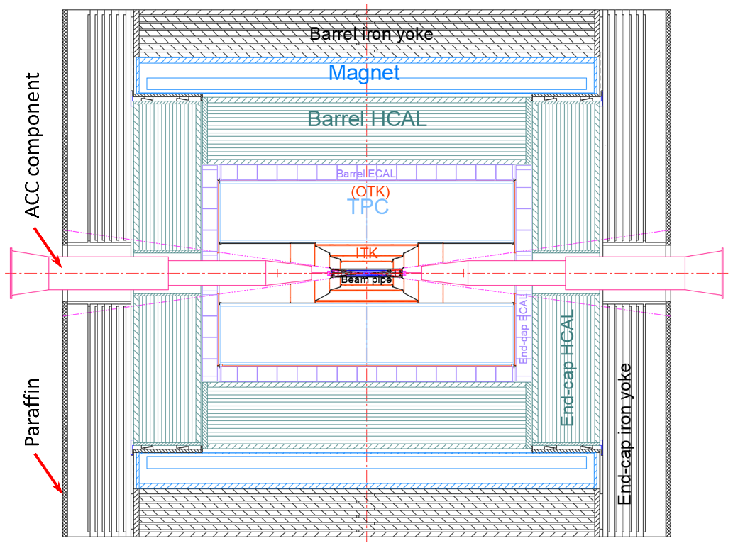
2. Chapter content and details
14.1 Overall design of Detector Machinery
……
14.1.1 Overall layout of detectors machinery
From outmost to innermost
Barrel(7)
Endcap(3)
MDI(1)
Yoke
(Muon)
Magnet
HCAL
ECAL
TPC
(OTK)
ITK
Beam pipe
(VTX LumiCal)
Yoke
(Muon)
HCAL
ECAL
(OTK)
ACC component
Total weight :
≈ 5,120 t

Slide 6
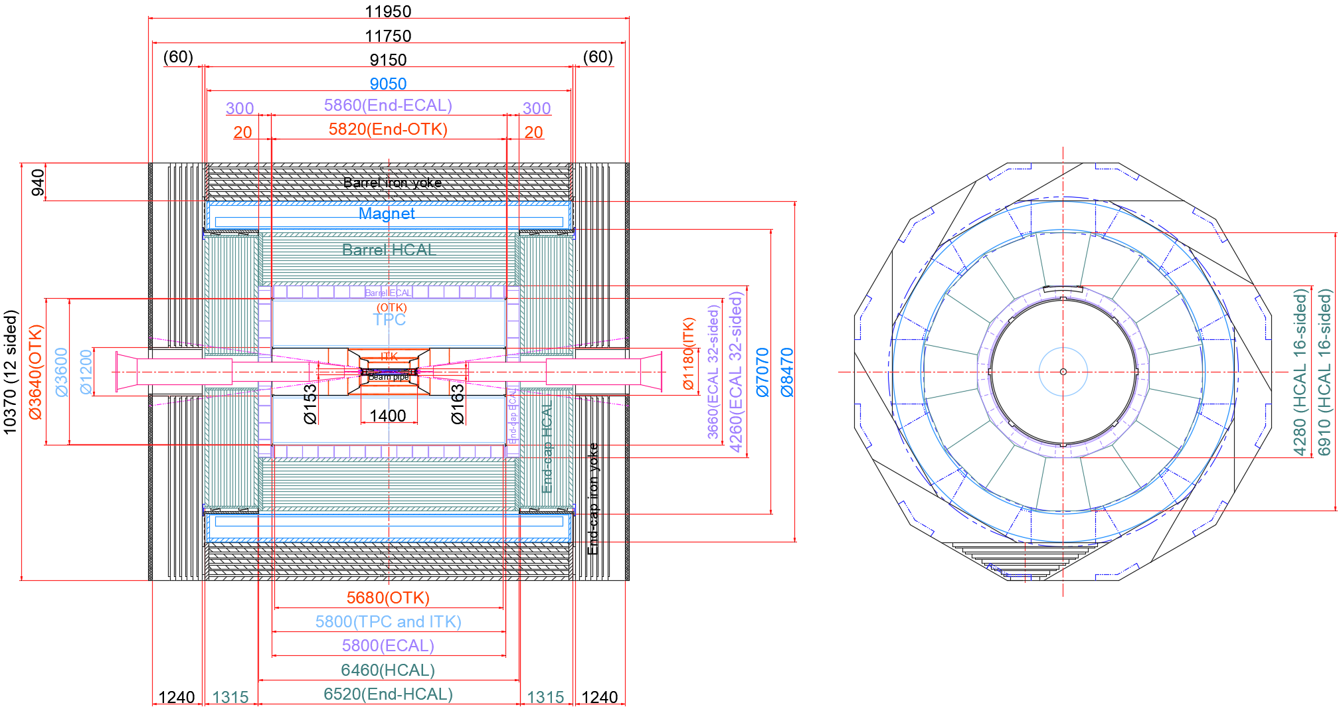
2. Chapter content and details
14.1 Overall design of Detector Machinery
14.1.2 Overall design requirement
……
14.1.2.1 Sub-detector boundary dimensions and constraints

Slide 7
2. Chapter content and details
14.1 Overall design of Detector Machinery
14.1.2 Overall design requirement
……
14.1.2.2 Dimensional tolerances, installation clearances, and installation accuracy of sub detectors
Profile Tolerance(mm) |  | installation accuracy(mm) |  | positioning accuracy Coaxiality(mm)
 |  | Collimation accuracy (mm) | GAP (mm)
Yoke | ± 1 | < 1 |  | ±0.5
Magnet | Outer: 0 to -5, inner: 0 to +5 | < 2 | 10 | ± 1
HCAL | Outer: 0 to -5, inner: 0 t0 +5 | ± 2 | 10 | ± 0.5
ECAL | Outer: 0 to -5, Inner: 0 t0 +5 | ± 2 | 10 | ± 0.5
TPC | Outer: 0 to -2, Inner: 0 t0 +2 | ± 1 | 10 | ± 0.1
ITK | Outer: 0 to -2, Inner: 0 t0 +2 | ± 1 | 10 | ± 0.1
Beampipe | Outer: 0 to -0.3, Inner: 0 t0 +0.3 | ± 0.5 | 2 | ± 0.1

Slide 8
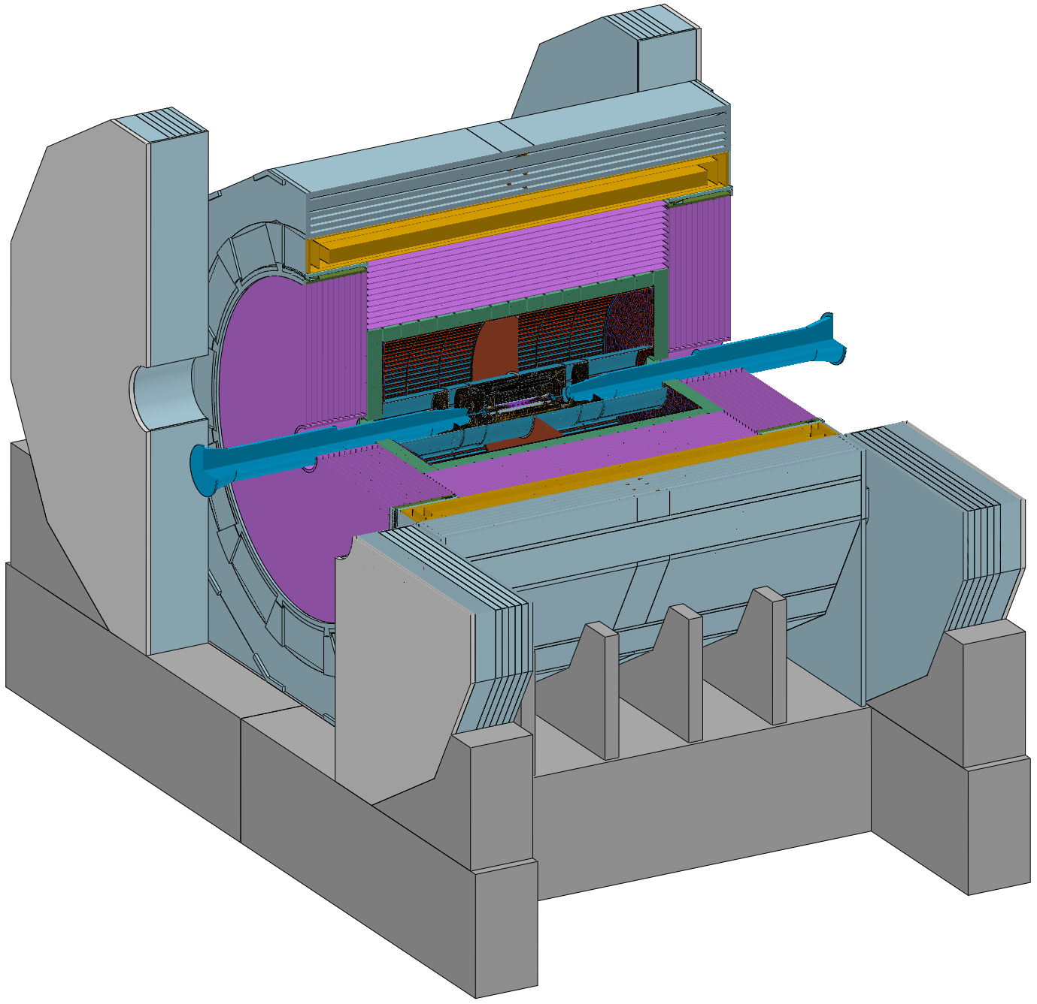
2. Chapter content and details
14.1 Overall design of Detector Machinery
14.1.2 Overall design requirement
……
14.1.2.3 Design requirements for the connection of each sub detector
Barrel Yoke : Fixed on the ground Base
Magnet : Fixed on the Barrel Yoke
Barrel HCAL : Fixed on the Barrel Yoke
Barrel ECAL : Fixed on the Barrel HCAL
TPC+OTK : Fixed on the Barrel ECAL
ITK : Fixed on the TPC
Beampipe(Vertex and LumiCal) : Fixed on the ITK
End-cap ECAL+OTK : Fixed on the Barrel HCAL
End-cap HCAL : Fixed on the Barrel HCAL
(Auxiliary ring or Flange)
End Yoke : Fixed on the ground Base
Base

Slide 9
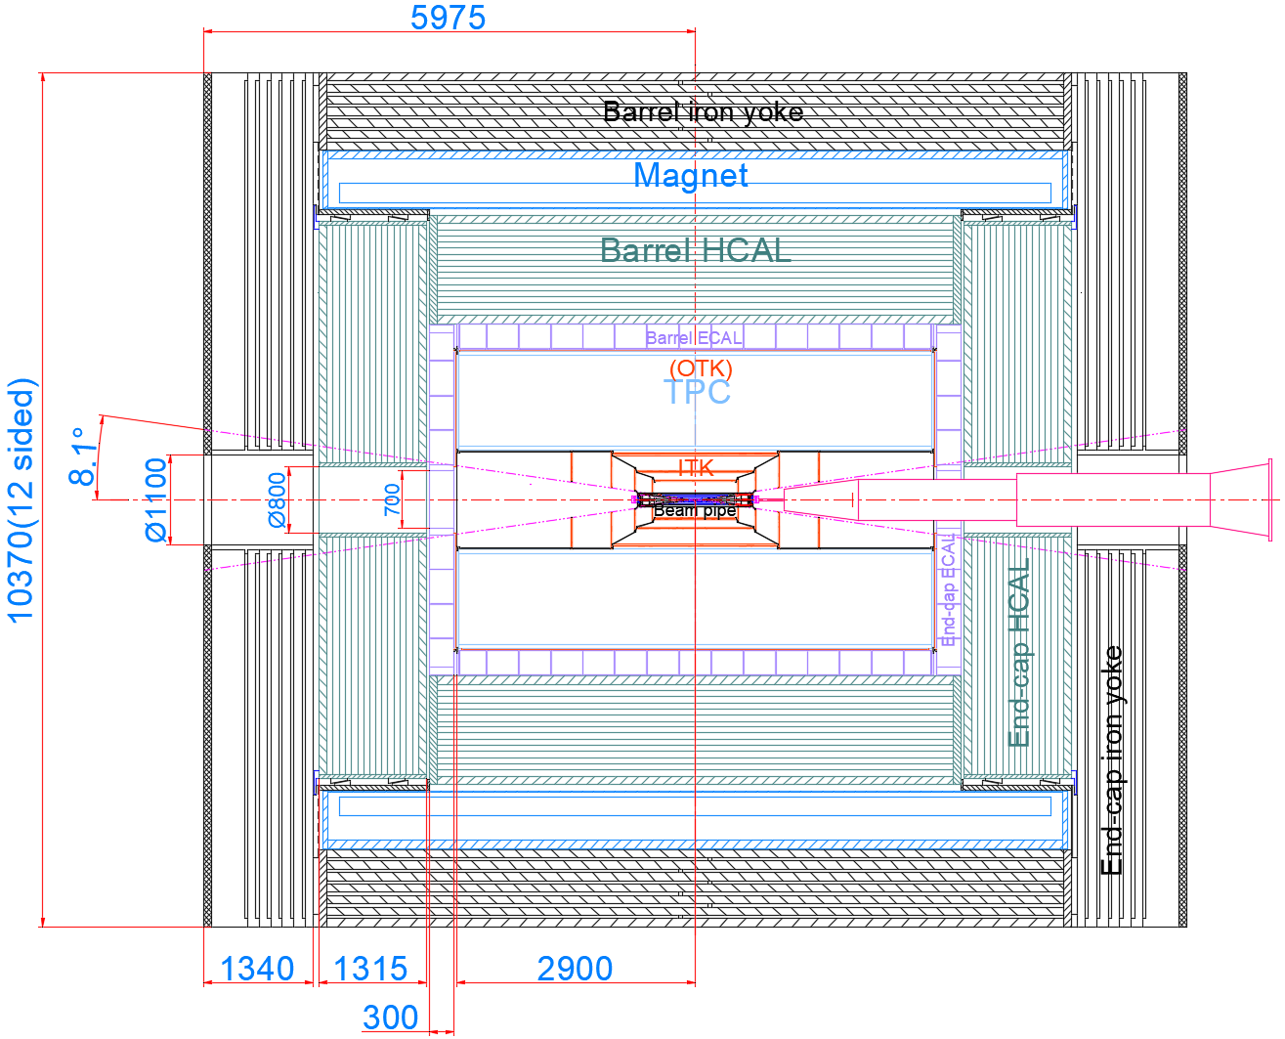
2. Chapter content and details
14.1 Overall design of Detector Machinery
14.1.2 Overall design requirement
……
14.1.2.4 Design Requirements for MDI Interface

Slide 10
2. Chapter content and details
14.2 Design of Connection structure between sub detectors
……
14.2.1 Iron Yoke design (夏商)

Slide 11
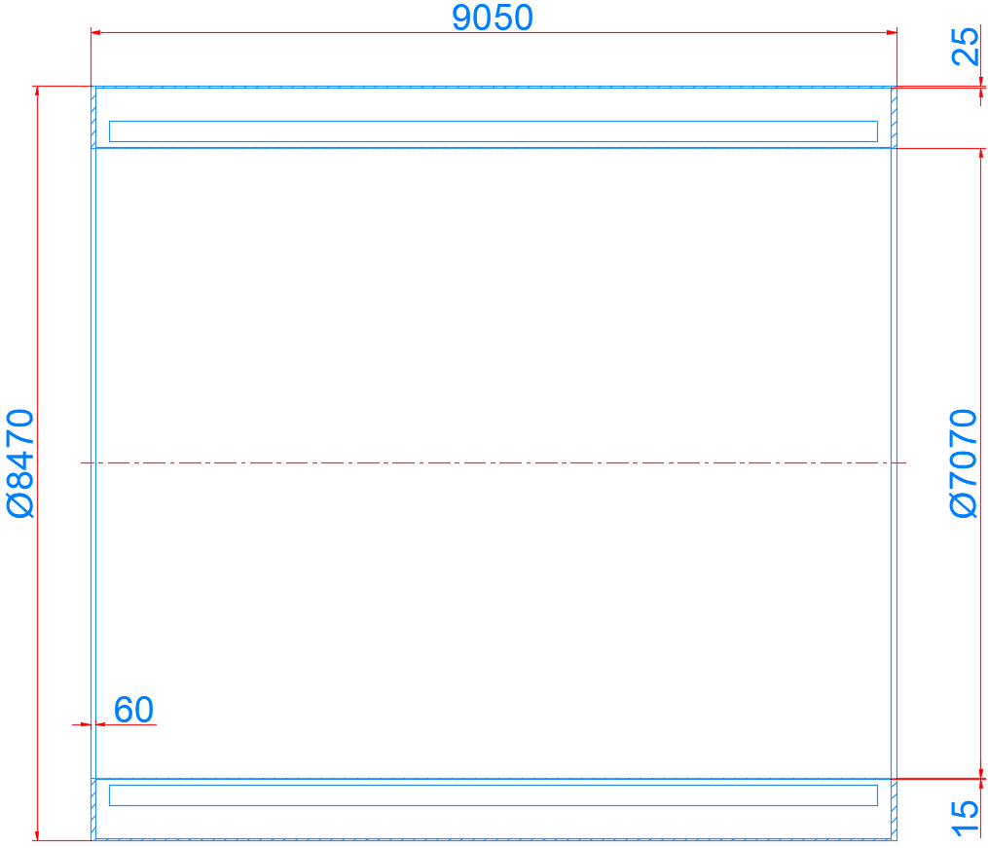
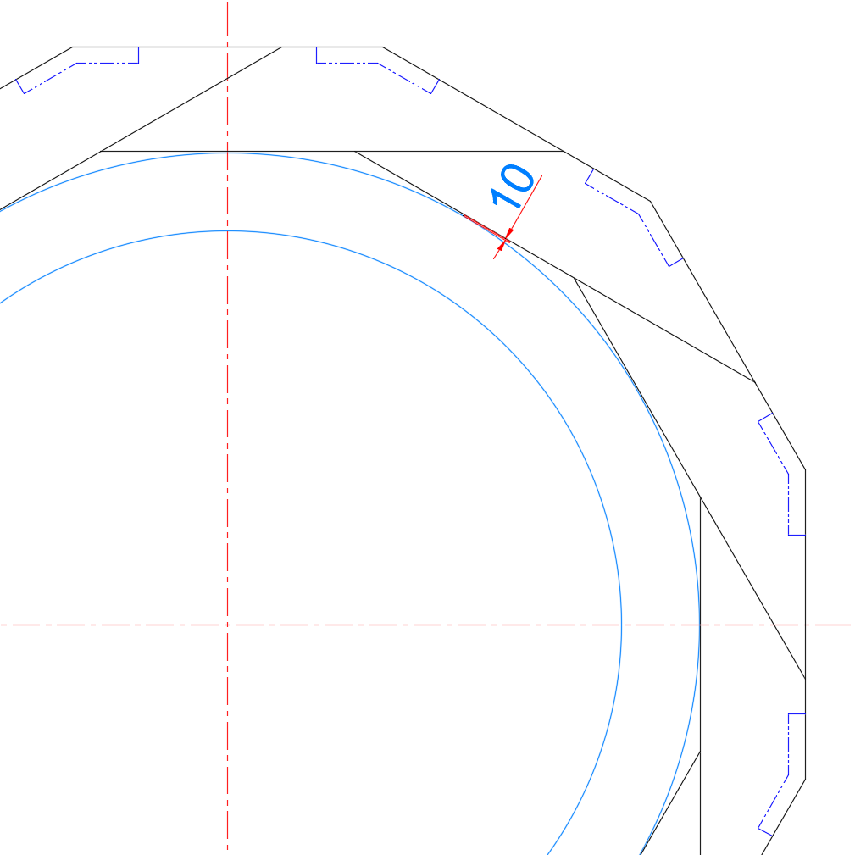
2. Chapter content and details
14.2 Design of Connection structure between sub detectors
……
14.2.2 Design of connection structures for magnet
Barrel
Yoke
Magnet
Magnet

Slide 12
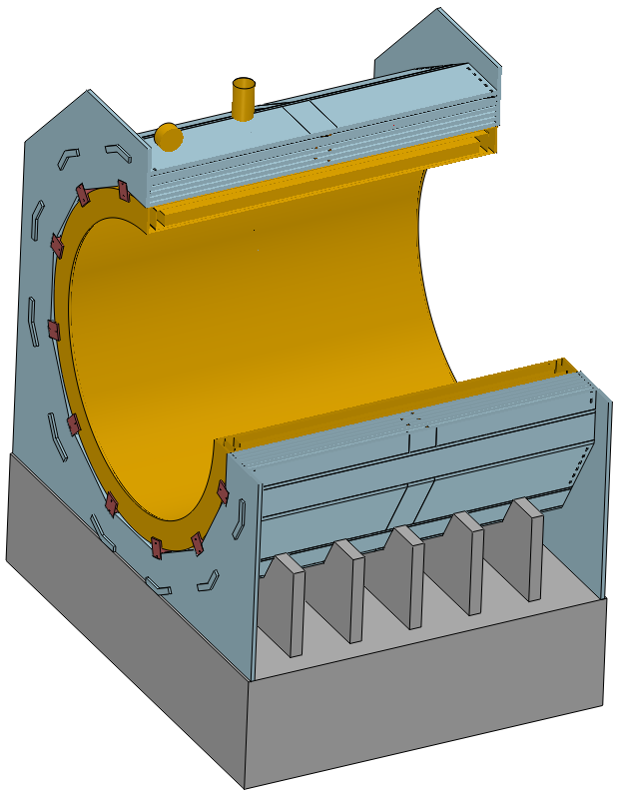
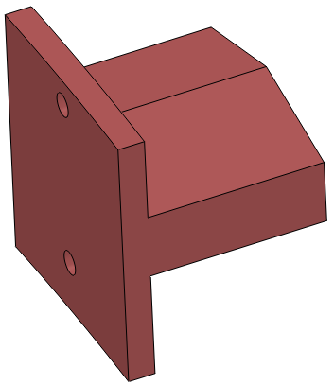
2. Chapter content and details
14.2 Design of Connection structure between sub detectors
……
14.2.2 Design of connection structures for magnet
Weight :
≈ 1560(Yoke) + 290(Magnet) t
“T” Shape Connection Structure

Slide 13
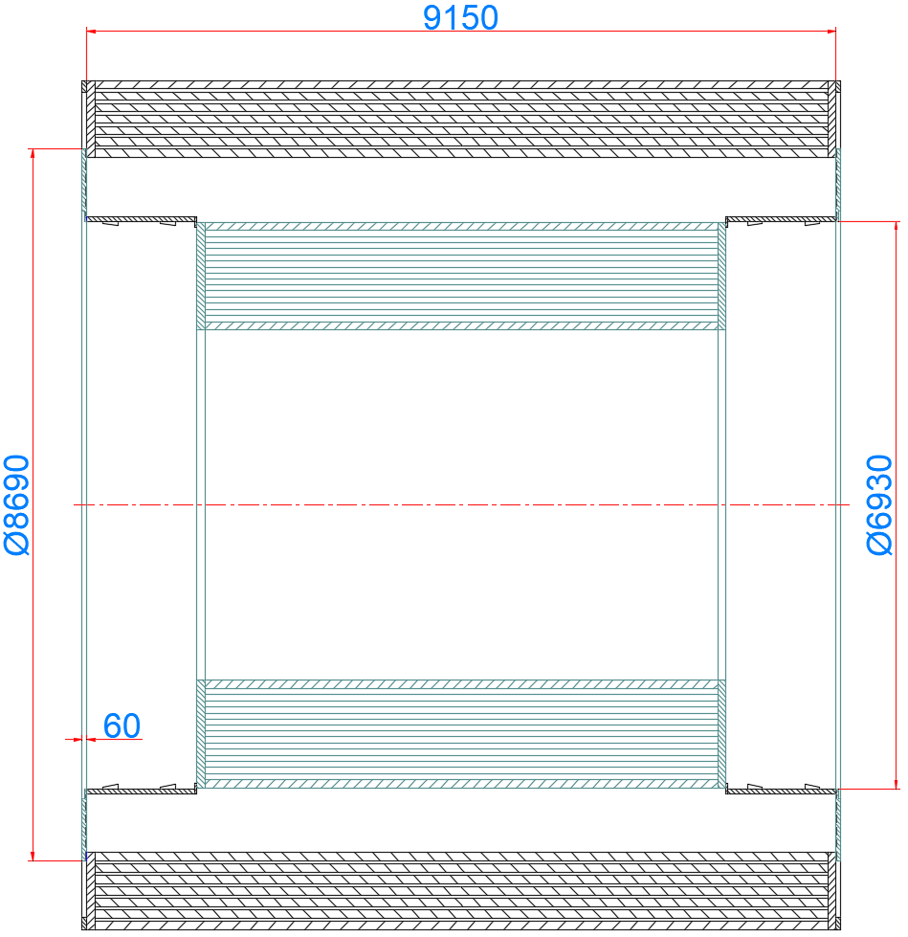
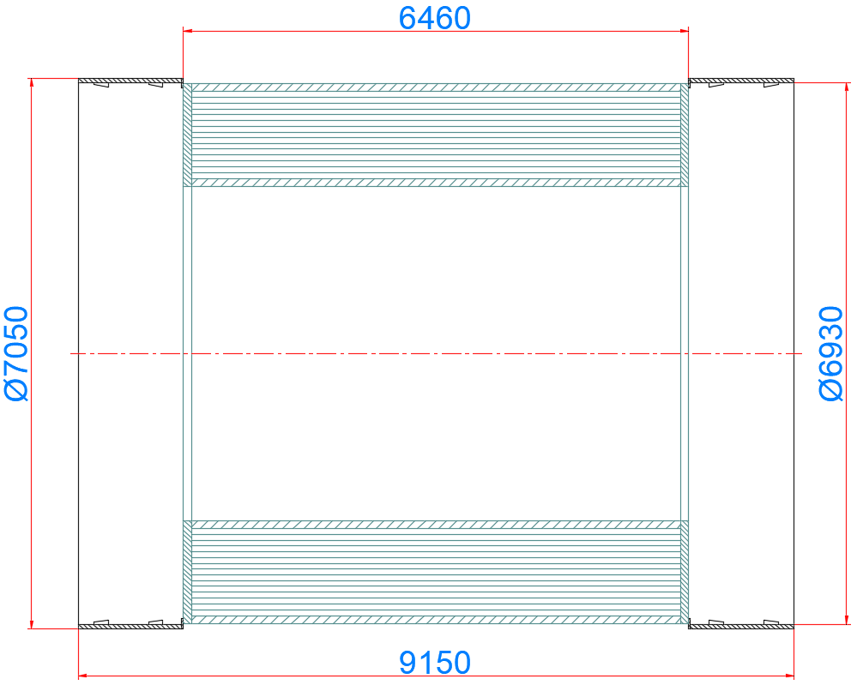
2. Chapter content and details
14.2 Design of Connection structure between sub detectors
……
14.2.3 Design of the connection structure for barrel HCAL
Barrel Yoke
Connection
Rings
Barrel HCAL

Slide 14
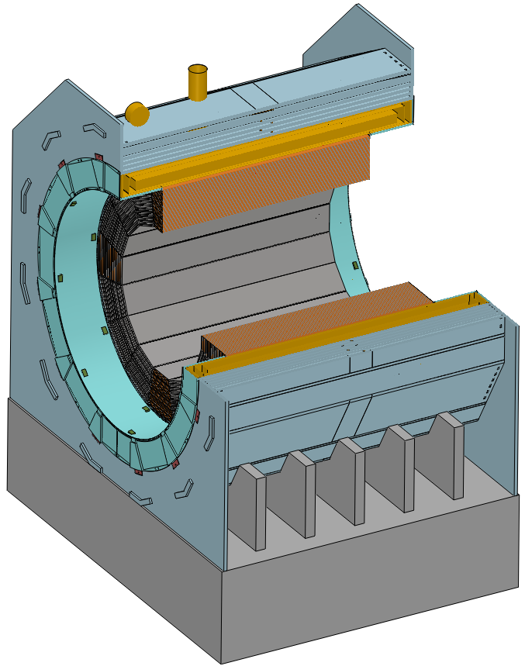
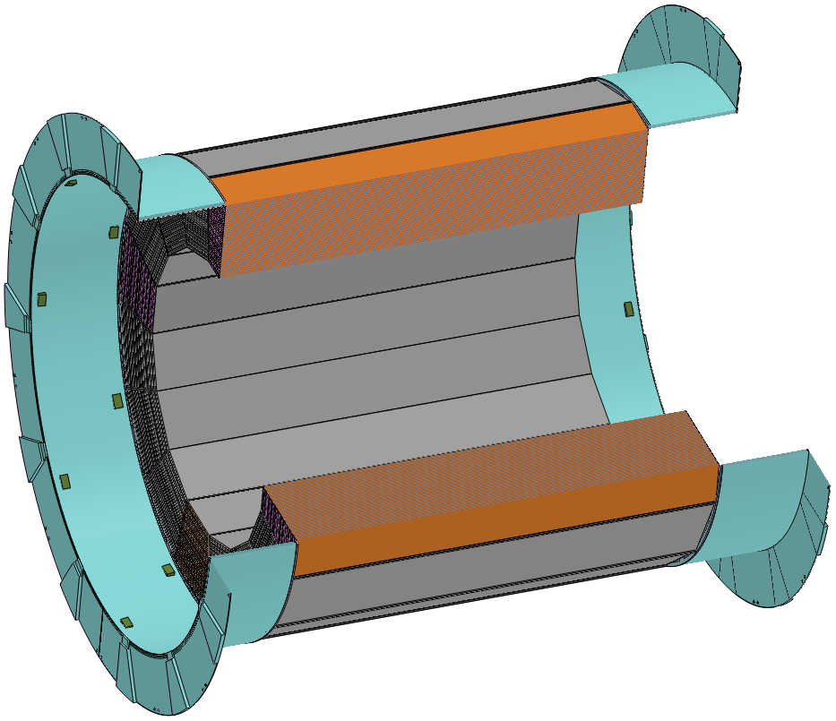
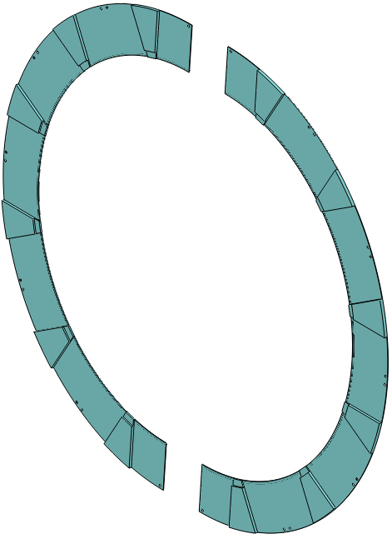
2. Chapter content and details
14.2 Design of Connection structure between sub detectors
……
14.2.3 Design of the connection structure for barrel HCAL
Weight :
≈ 960 t
Half connection rings Structure

Slide 15
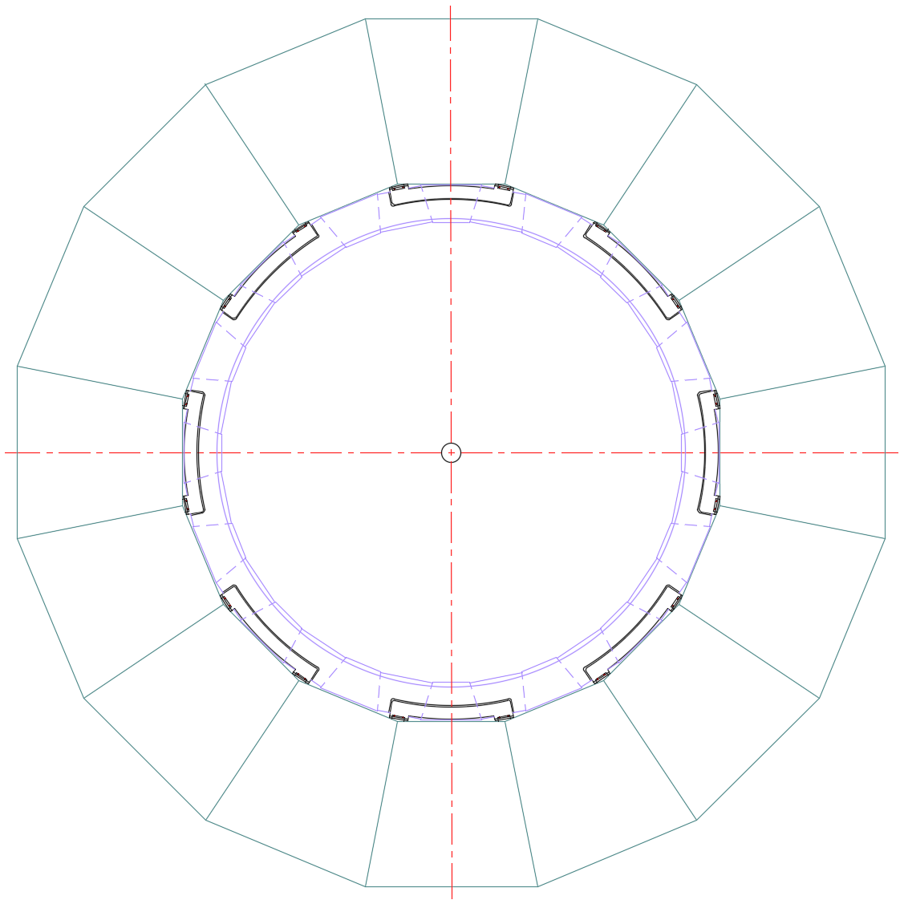
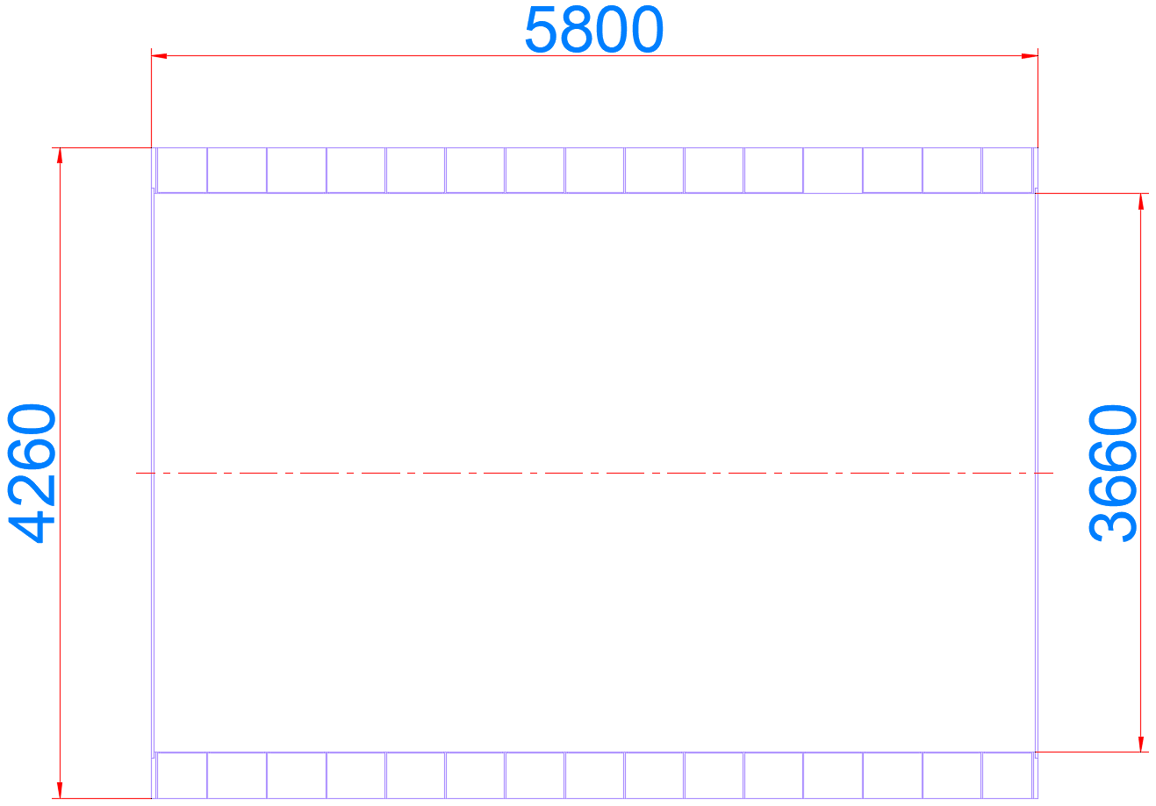
2. Chapter content and details
14.2 Design of Connection structure between sub detectors
……
14.2.4 Design of the connection structure for barrel ECAL
Barrel ECAL

Slide 16
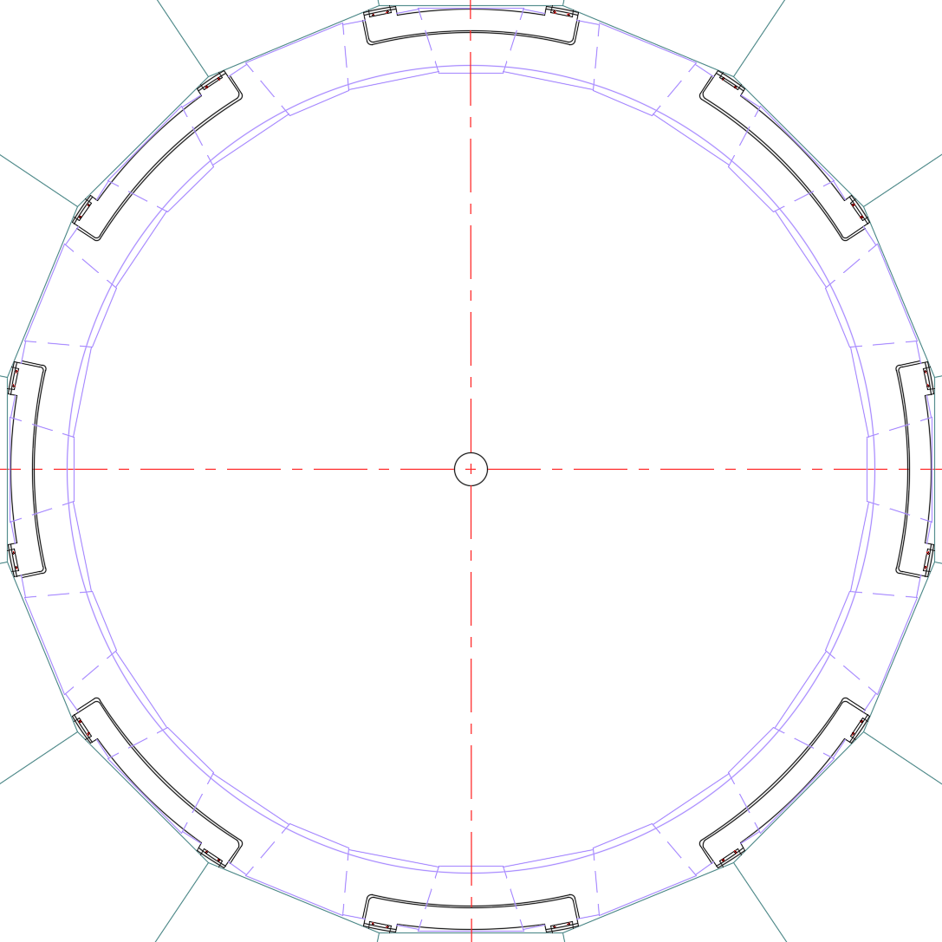
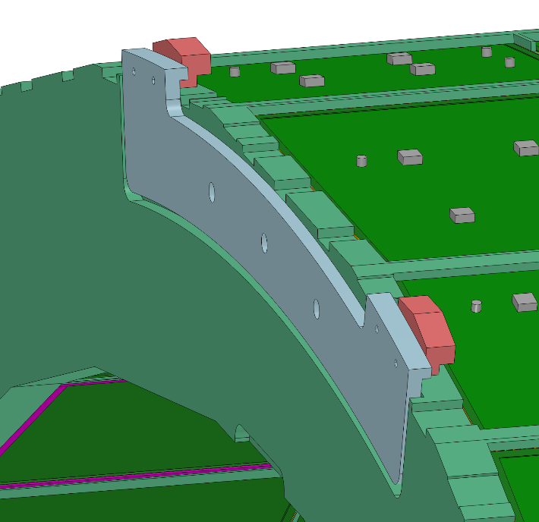
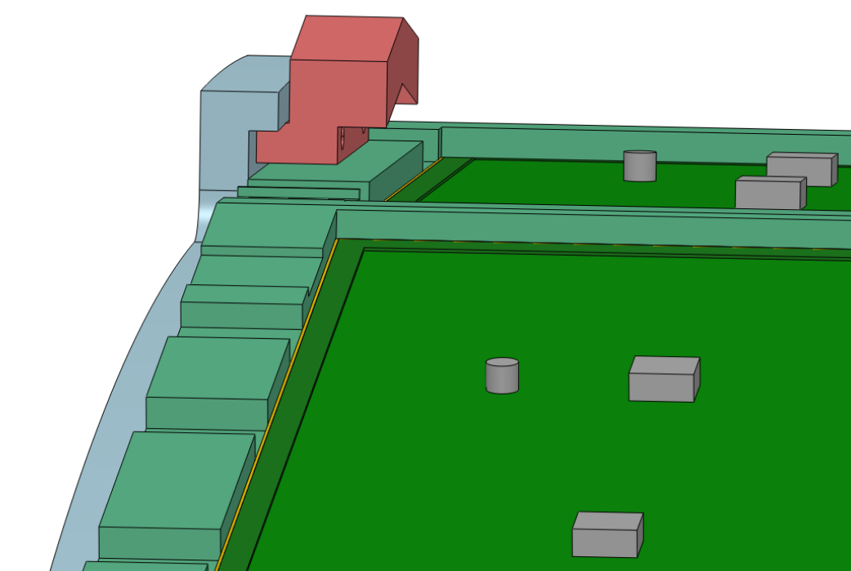
2. Chapter content and details
14.2 Design of Connection structure between sub detectors
……
14.2.4 Design of the connection structure for barrel ECAL
Weight :
≈ 150 t
“Z” Shape Suspended Structure

Slide 17
2. Chapter content and details
14.2 Design of Connection structure between sub detectors
……
14.2.5 Design of the connection structure for TPC

Slide 18
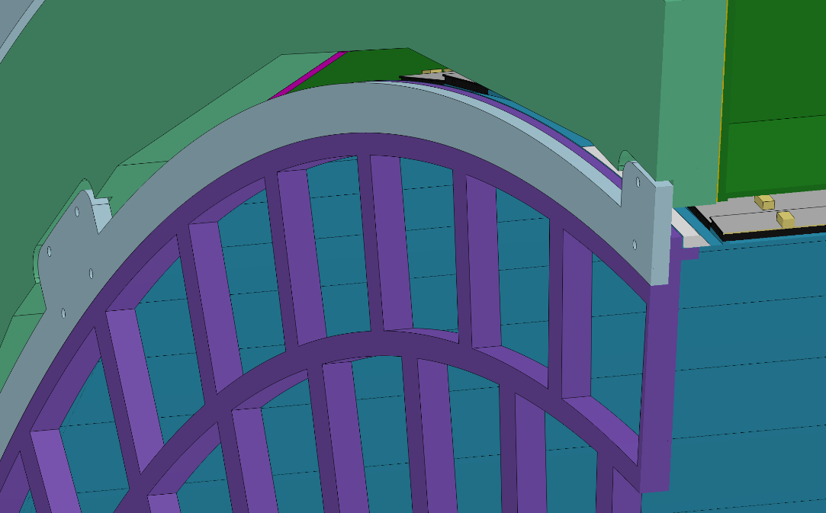
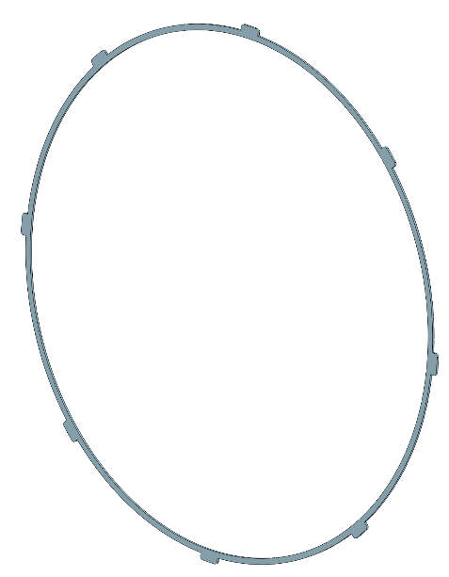
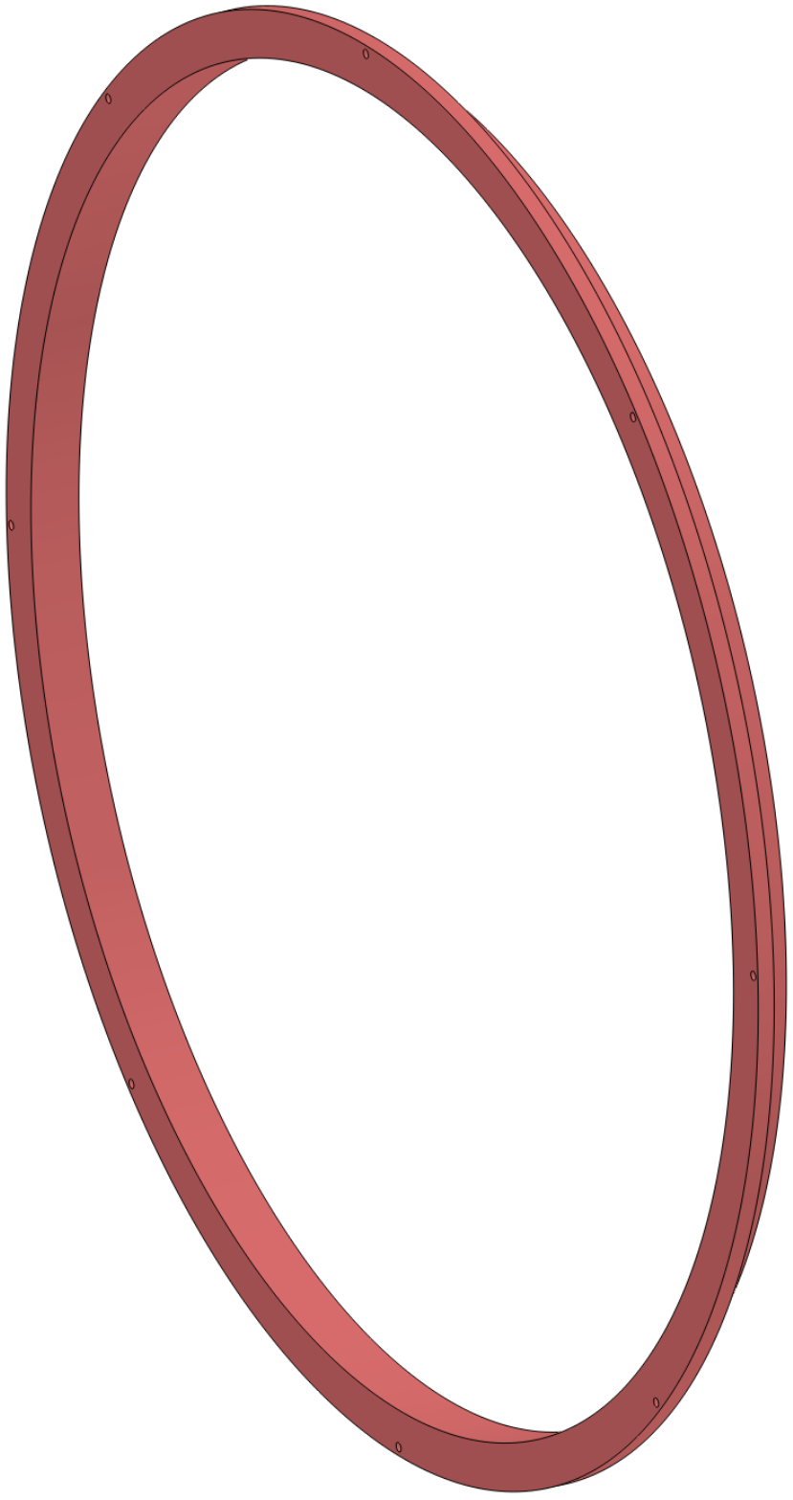
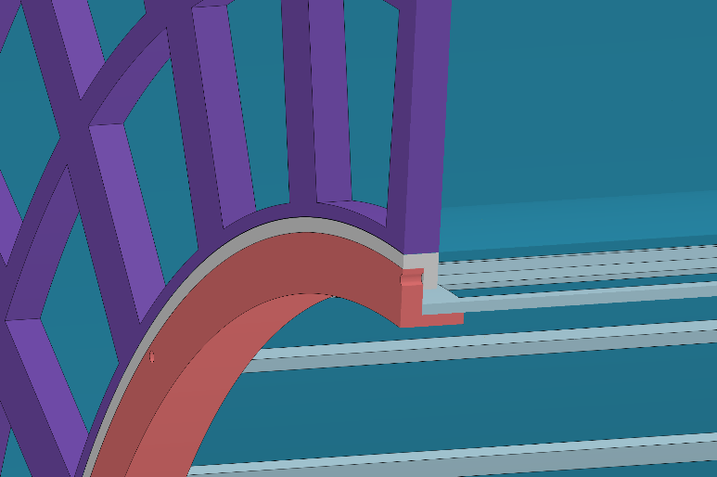
2. Chapter content and details
14.2 Design of Connection structure between sub detectors
……
14.2.5 Design of the connection structure for TPC
ECAL
OTK
Eight-point
suspension structure
TPC
Weight :
≈ 2 t
ITK

Slide 19
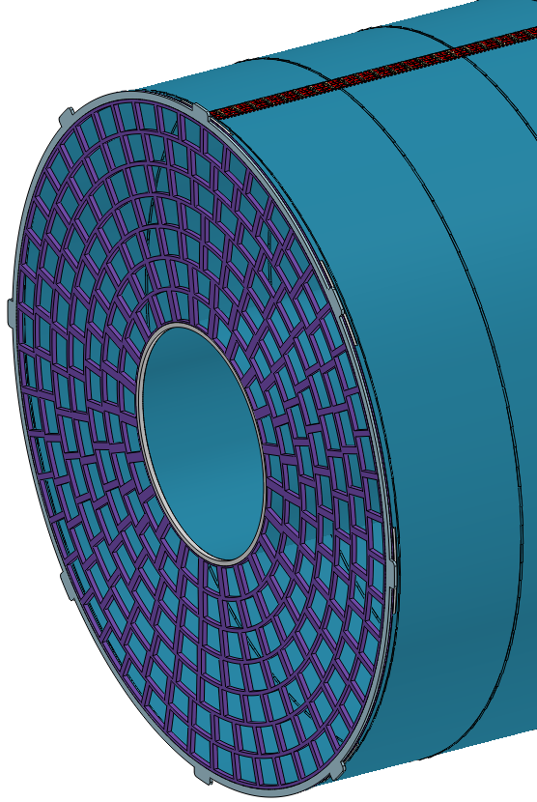
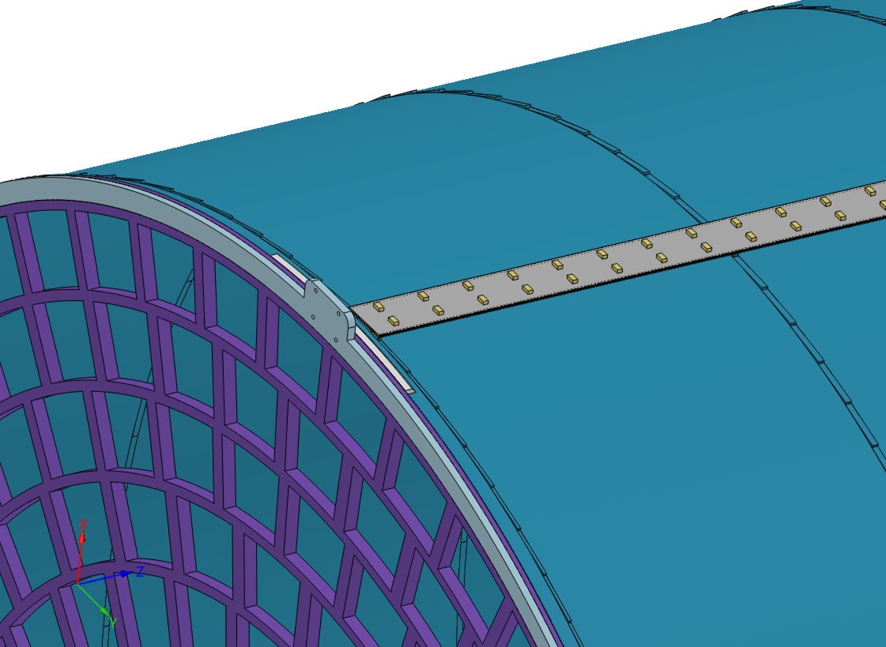
2. Chapter content and details
14.2 Design of Connection structure between sub detectors
……
14.2.5 Design of the connection structure for TPC (+OTK)
OTK
Weight :
≈ 1.5 t

Slide 20
2. Chapter content and details
14.2 Design of Connection structure between sub detectors
……
14.2.6 Design of the connection structure for ITK

Slide 21
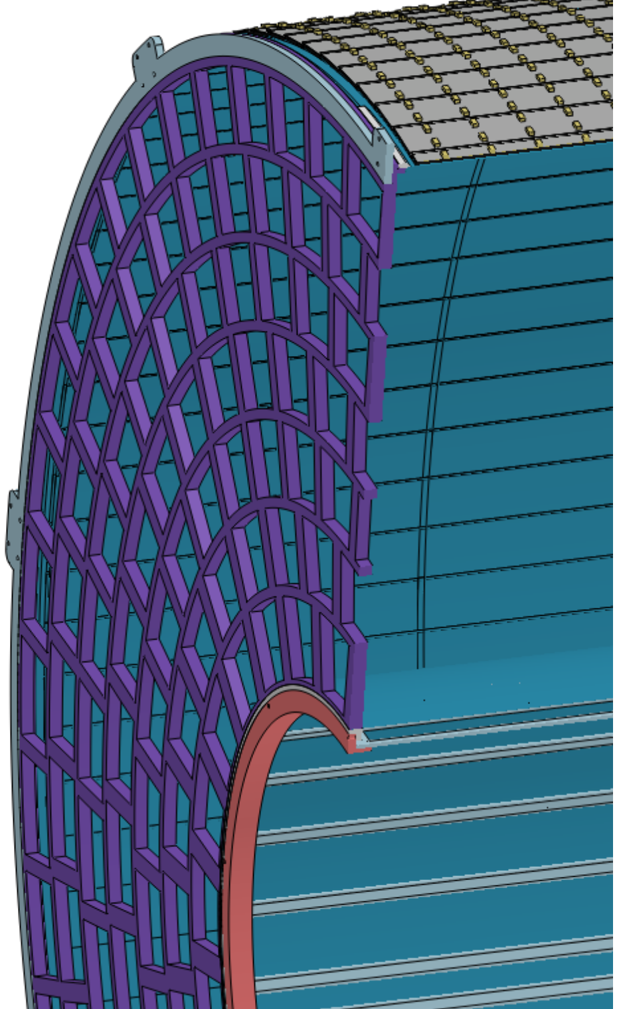
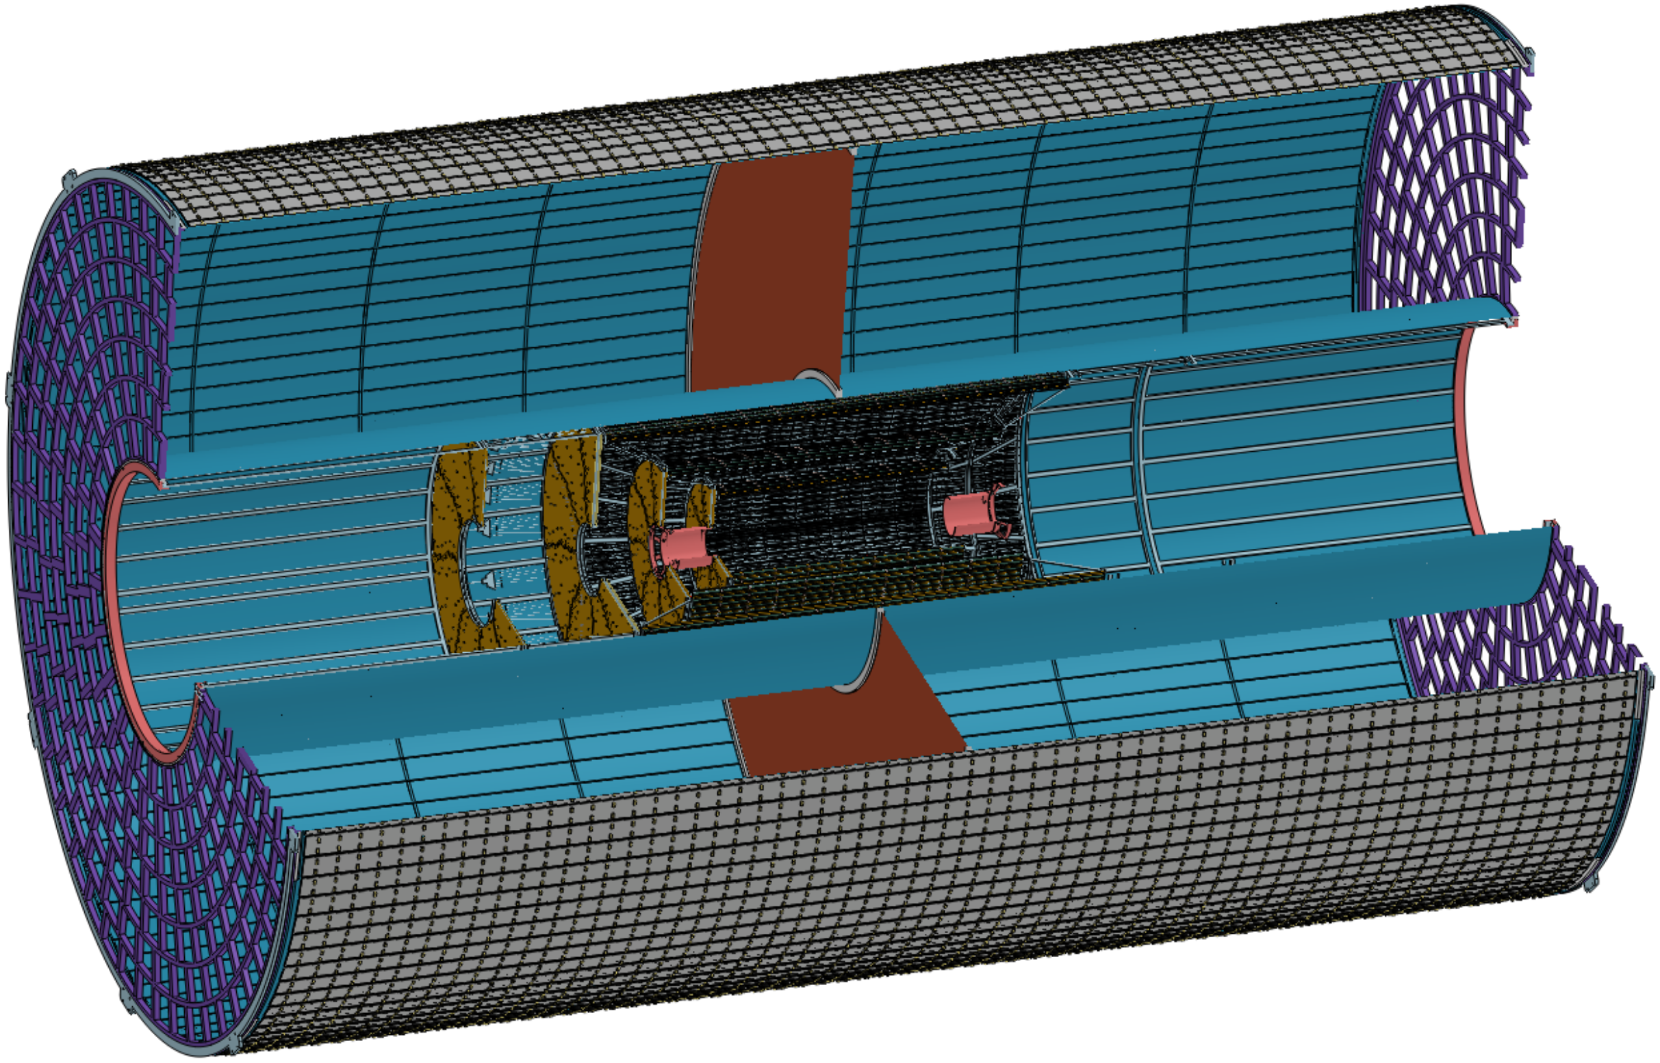
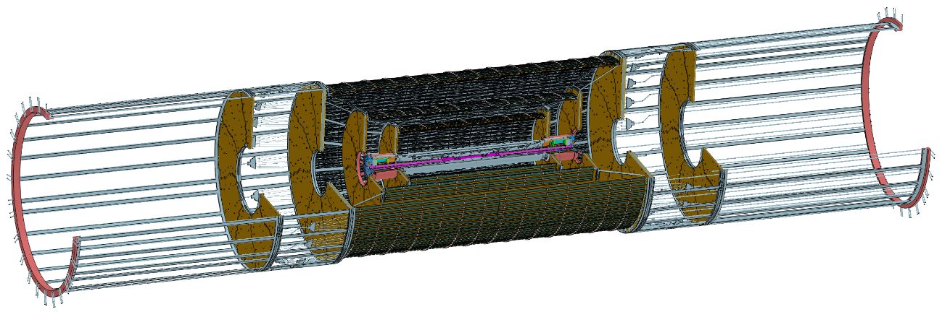
2. Chapter content and details
14.2 Design of Connection structure between sub detectors
……
14.2.6 Design of the connection structure for ITK
Weight :
≈ 80 kg

Slide 22
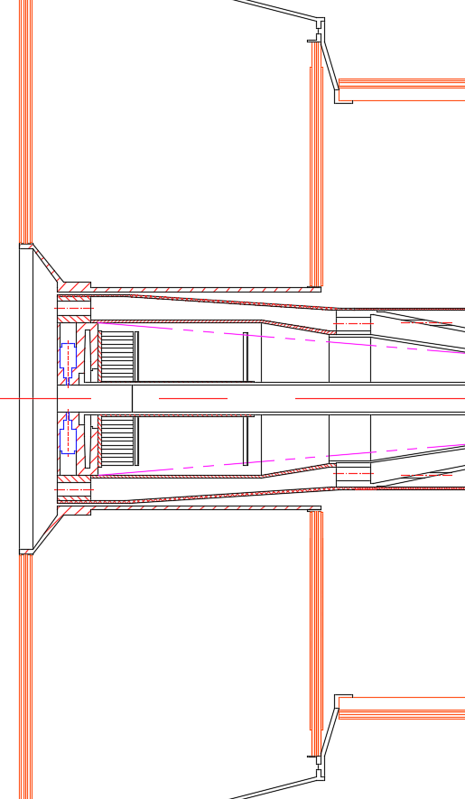
2. Chapter content and details
14.2 Design of Connection structure between sub detectors
……
14.2.7 Design of the connection structure for beampipe
End
ITK

Slide 23
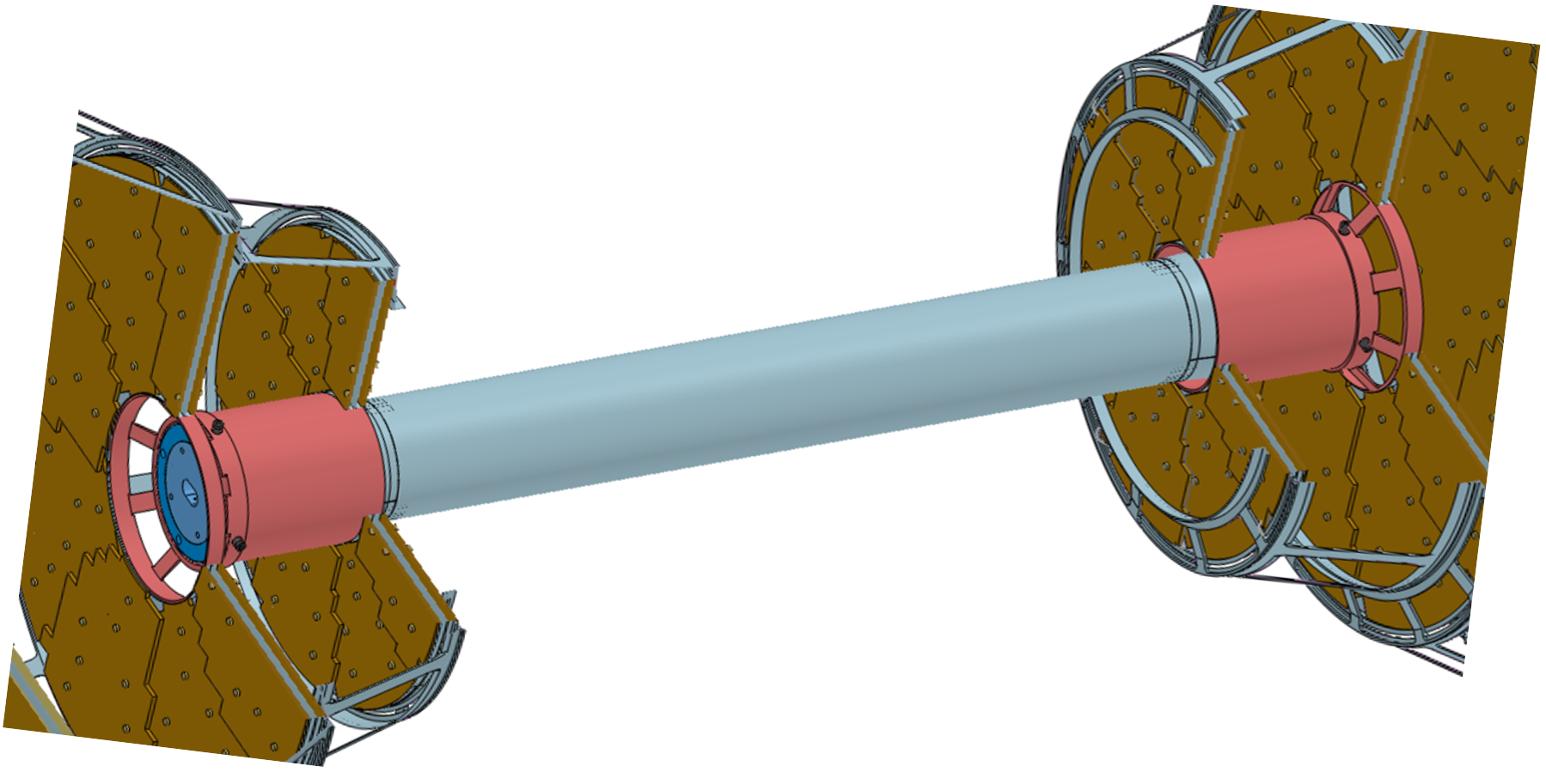
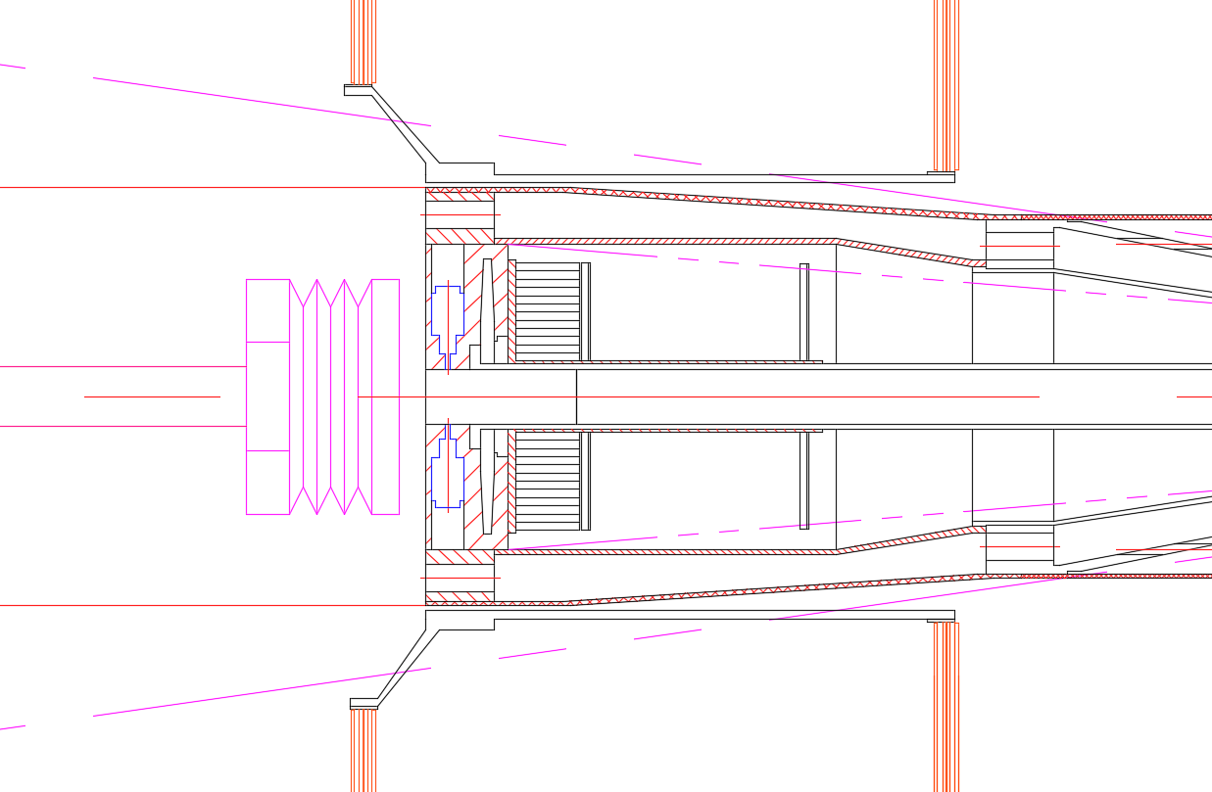
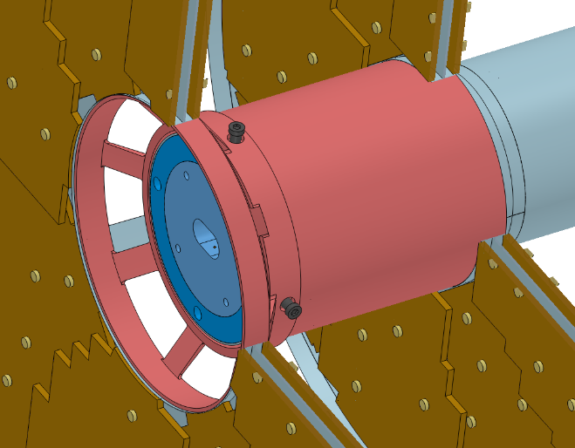
2. Chapter content and details
14.2 Design of Connection structure between sub detectors
……
14.2.7 Design of the connection structure for beampipe
Vertex
LumiCAL
BPM
Weight :
≈ 10 kg
Pillow Seal

Slide 24
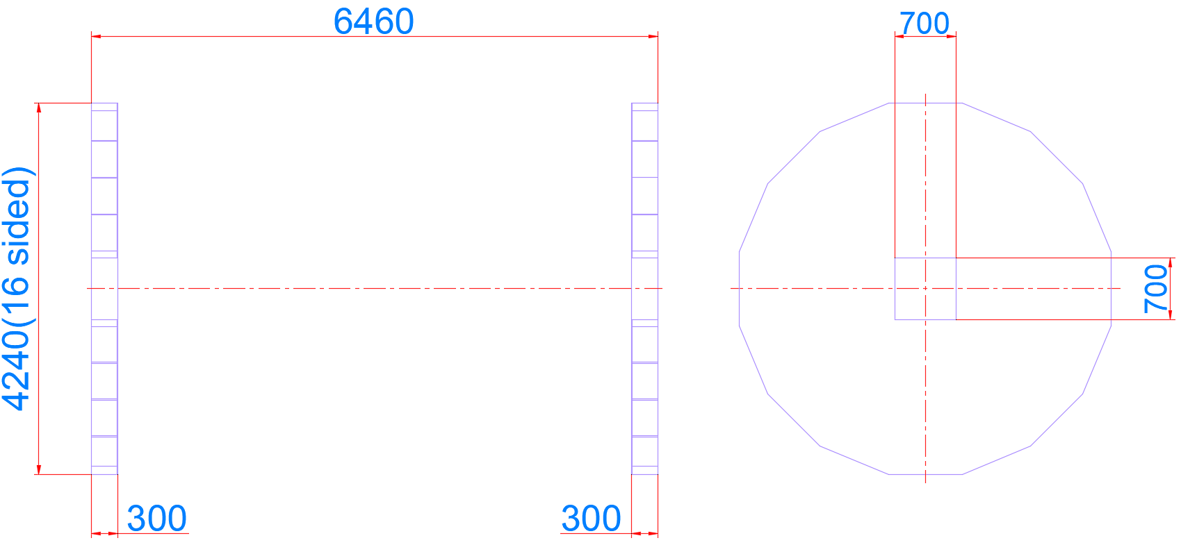
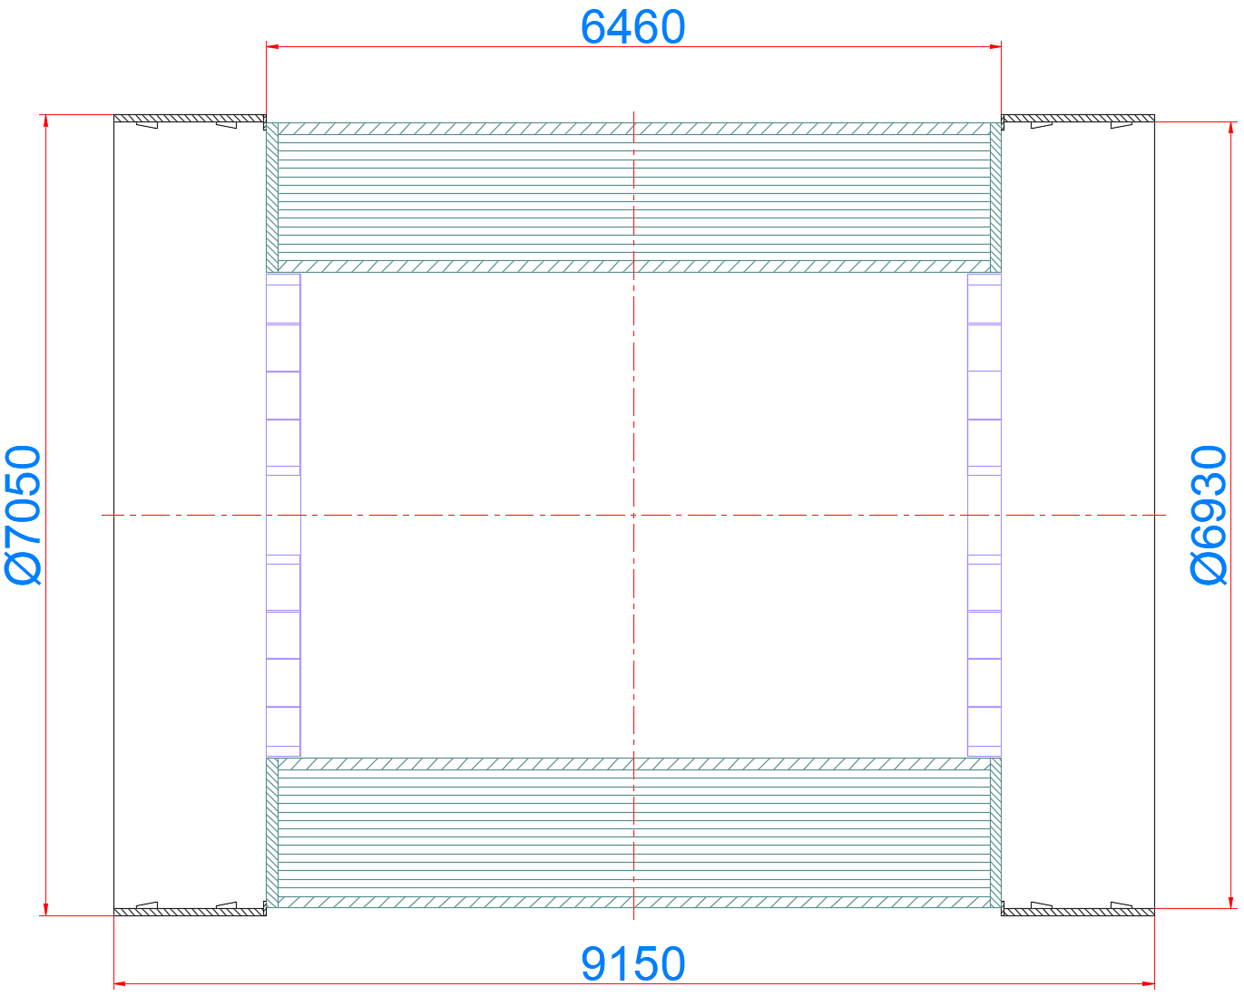
2. Chapter content and details
14.2 Design of Connection structure between sub detectors
……
14.2.8 Design of the connection structure for end ECAL (+end OTK)

Slide 25
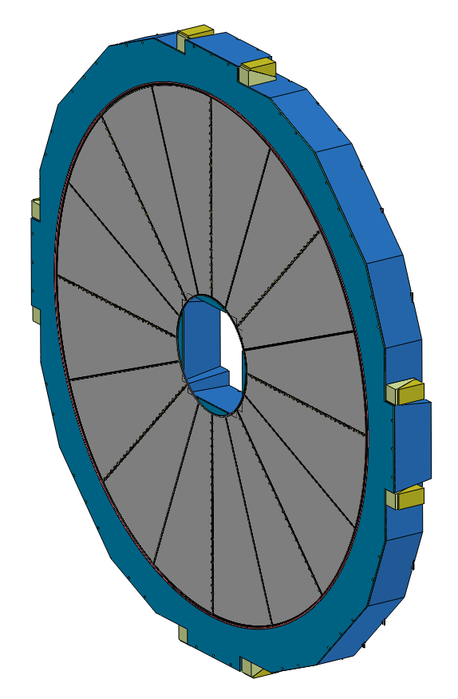
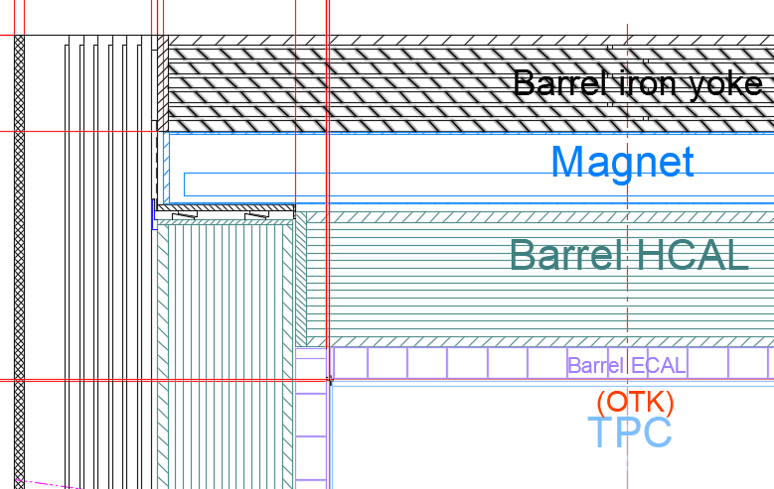
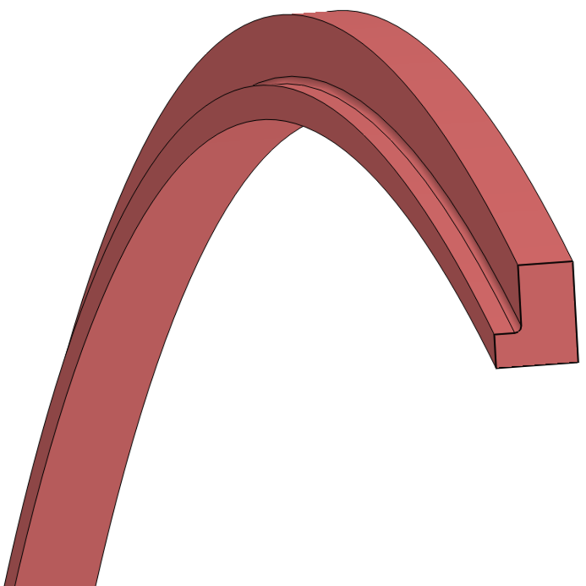
2. Chapter content and details
14.2 Design of Connection structure between sub detectors
……
14.2.8 Design of the connection structure for end ECAL (+end OTK)
Weight :
≈ 25X2 t
L Connection Ring
End ECAL

Slide 26
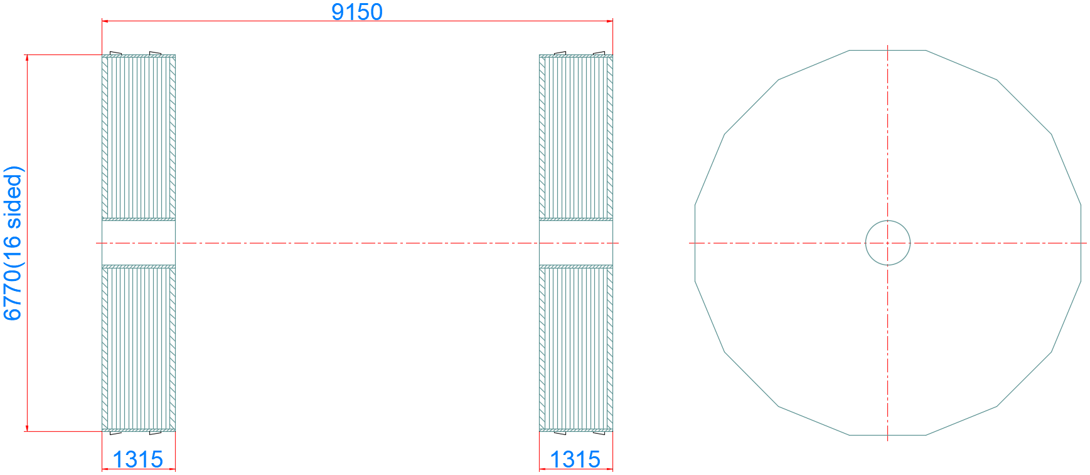
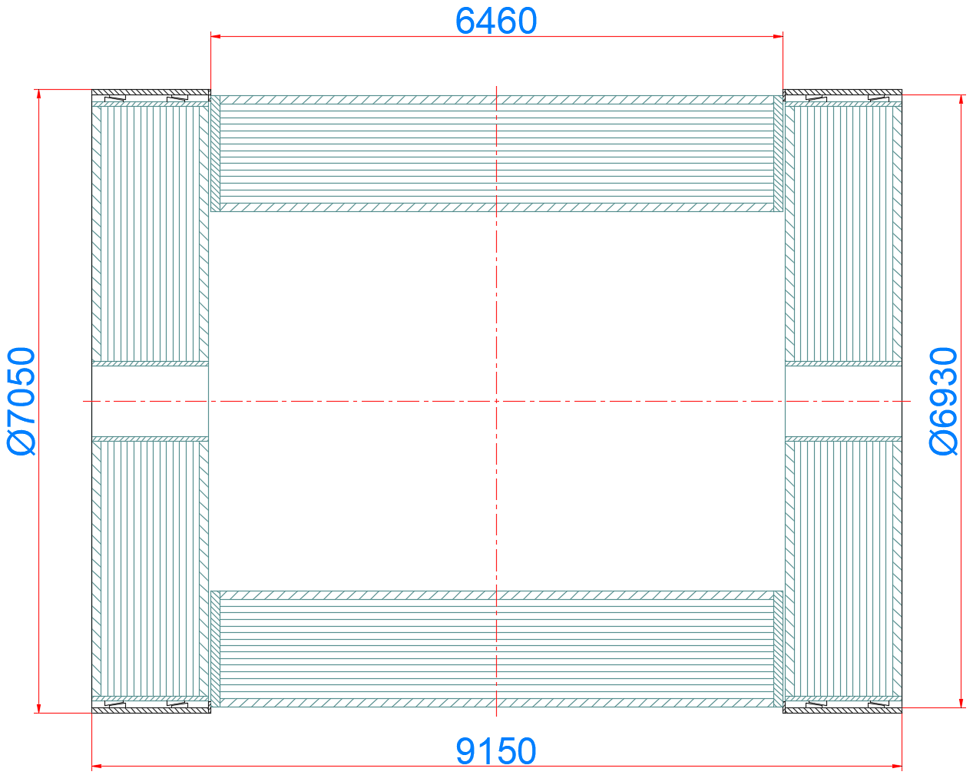
2. Chapter content and details
14.2 Design of Connection structure between sub detectors
……
14.2.9 Design of the connection structure for end HCAL

Slide 27
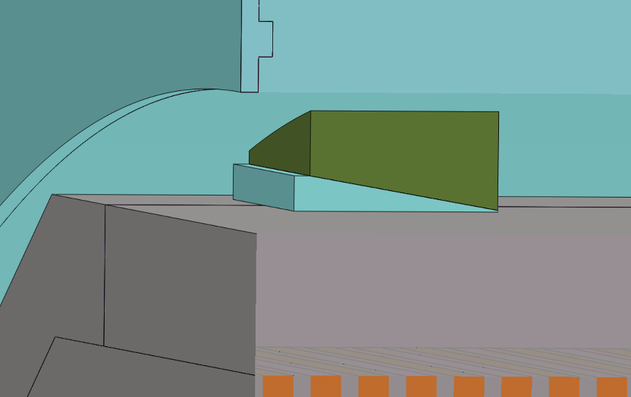
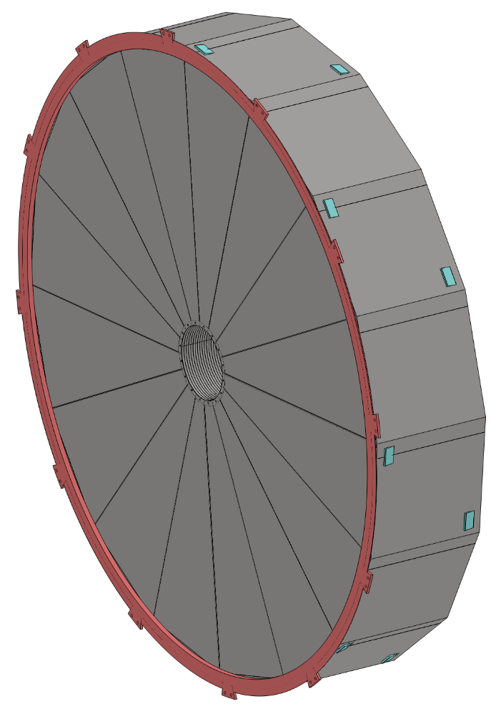
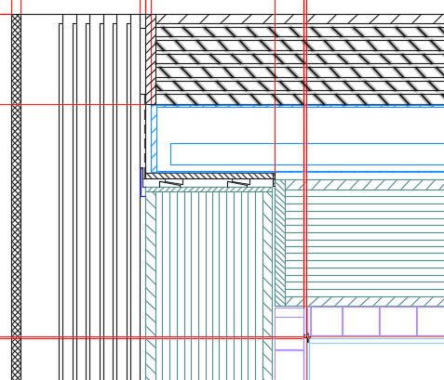
2. Chapter content and details
14.2 Design of Connection structure between sub detectors
……
14.2.9 Design of the connection structure for end HCAL
Eight pairs Adjustable Pad Irons
Weight :
≈ 350X2 t
End HCAL

Slide 28
2. Chapter content and details
14.2 Design of Connection structure between sub detectors
……
14.2.10 Overall reliability and safety assessment

Slide 29
2. Chapter content and details
14.3 Installation design of each sub detector
……
14.3.1 Overall installation design
The main procedures are as follows :
1. In the ground hall
Complete the assembly work of each sub-detector, including electronics, etc.
2. Transport through the shaft
Each sub-detector is lifted into the underground experimental hall through the vertical shaft one by one
3. In the underground experimental hall
Assemble each sub detector on the guide rails and push them into the yoke in sequence

Slide 30
2. Chapter content and details
14.3 Installation design of each sub detector
……
14.3.1 Overall installation design
Installation sequence of detectors(As shown in the following exploded view) :
Step 1 Install the barrel sub-detector first, in the following order :
Yoke, Magnet, HCAL, ECAL, TPC(OTK), ITK, Beampipe(Vertex)
Step 2 Install the endcap sub-detectors, in the following order :
End ECAL(OTK), End HCAL, End Yoke
ACC Component
Beampipe
(Vertex)
End HCAL
End ECAL(OTK)
ITK
TPC(OTK)
ECAL
HCAL
Magnet
Yoke

Slide 31
2. Chapter content and details
14.3 Installation design of each sub detector
……
14.3.2 Detailed installation design
凸出两点：
1. 逻辑更合理
2. 连接过程
Step 1 Alternating installation : Yoke and Magnet (3) --- Barrel and End Yoke, Magnet
Step 2 Core shaft installation : Barrel HCAL and Barrel ECAL (2) --- Barrel Detectors
Step 3 Cantilever installation : TPC(OTK) ITK + Beampipe(Vertex + LumiCal) (3) --- Barrel Detectors
End HCAL and End ECAL (2) --- End Detectors
Step 4 Positioning and Alignment of the Entire Detector System
Move the detectors from the Pre-assembly point to the Collision point
Push the accelerator vacuum component into the center of the detector and connect it with the Be beampipe

Slide 32
2. Chapter content and details
14.3 Installation design of each sub detector
……
14.3.2 Detailed installation design
14.3.2.1 Alternating installation
Step 1 Alternating installation : Yoke and Magnet (3) --- Barrel and End Yoke, Magnet

Slide 33
2. Chapter content and details
14.3 Installation design of each sub detector
……
14.3.2 Detailed installation design
14.3.2.2 Core shaft installation
Step 2 Core shaft method installation : HCAL and ECAL (2) --- Barrel Detectors
Continue to optimize :
Merge Animation

Slide 34
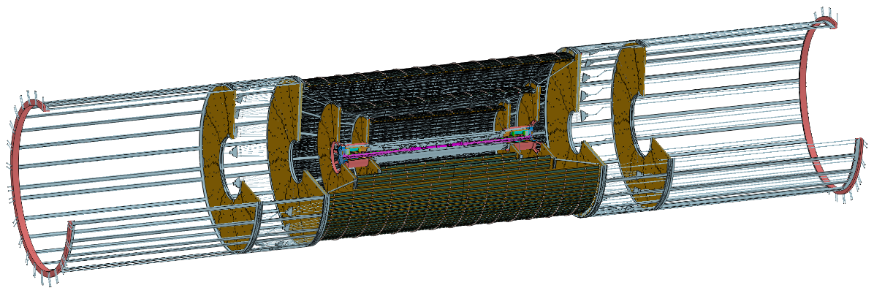
2. Chapter content and details
14.3 Installation design of each sub detector
……
14.3.2 Detailed installation design
14.3.2.3 Cantilever installation
Step 3 Cantilever installation : TPC(OTK) ITK + Beampipe(Vertex + LumiCal) (3) --- Barrel Detectors
End HCAL and End ECAL (2) --- End Detectors
Pre-assembly between of the ITK and Beampipe
TPC
Installing
ITK
Beampipe
End ECAL
End HCAL
Optimize : Display the installation process in animation

Slide 35
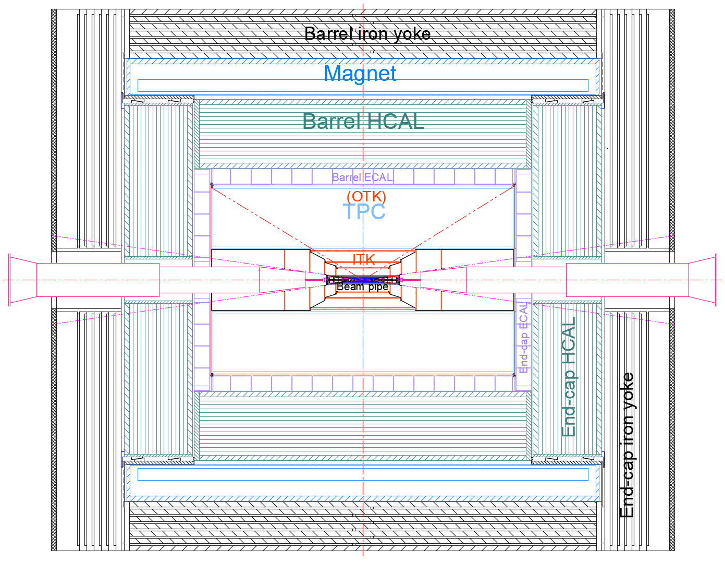
2. Chapter content and details
14.3 Installation design of each sub detector
……
14.3.2 Detailed installation design
14.3.2.3 Cantilever installation
Pipeline path

Slide 36
2. Chapter content and details
14.3 Installation design of each sub detector
……
14.3.2 Detailed installation design
14.3.2.4 Positioning and Alignment of the Entire Detector System
1. Move the detectors
2. Connect the beampipe and Acc component

Slide 37
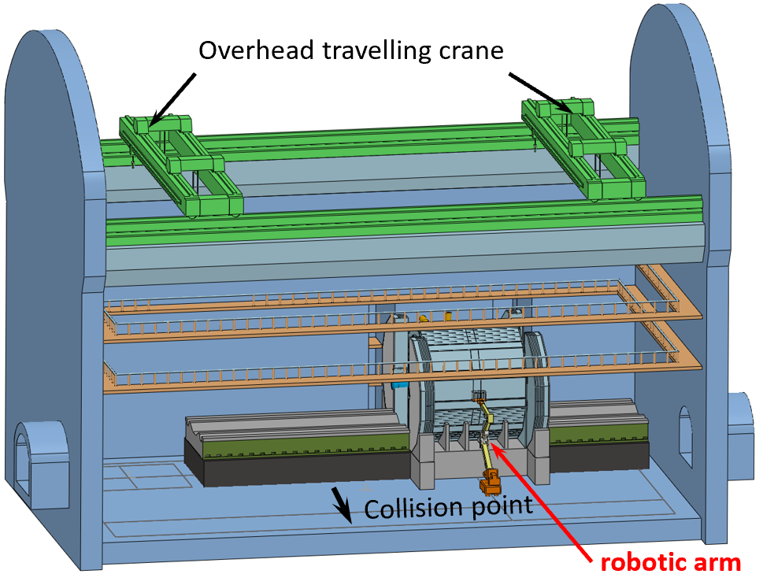
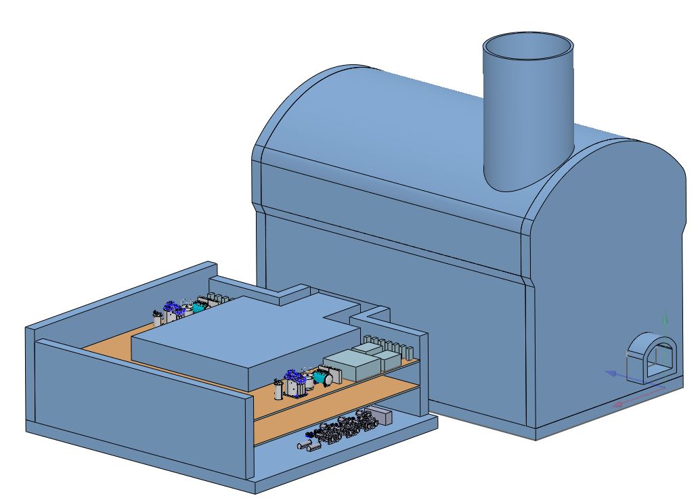
2. Chapter content and details
14.4 Design of detector auxiliary facilities
14.5 Design of Underground Experimental Hall and Auxiliary Hall for Detectors
Auxiliary facilities
ambient temperature : 20 ℃
ambient humidity : ＜60%
1. Water-cooling system
Inlet temperature
Overall layout
ECAL
HCAL
TPC
Beampipe
15℃
ITK
OTK
5℃
2. Air-cooling system
Vertex
5℃
3. Electronics Cabinet
Power Cabinet
4. Cryogenic system
5. Gas System
Magnet(Det. and ACC.)
TPC (Ground)

Slide 38
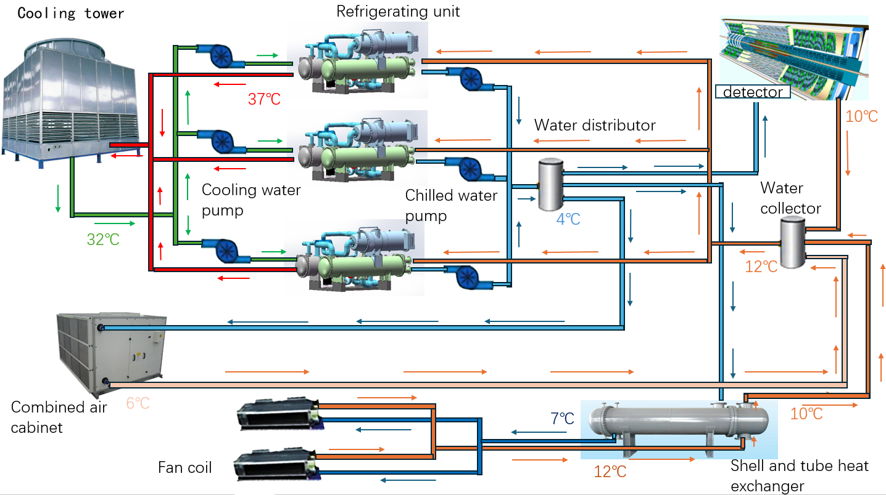
Water cooling and Air cooling system
Hall
Design Features :
1. Two for use and one for backup
2. Energy conservation
3. integrated design

Slide 39
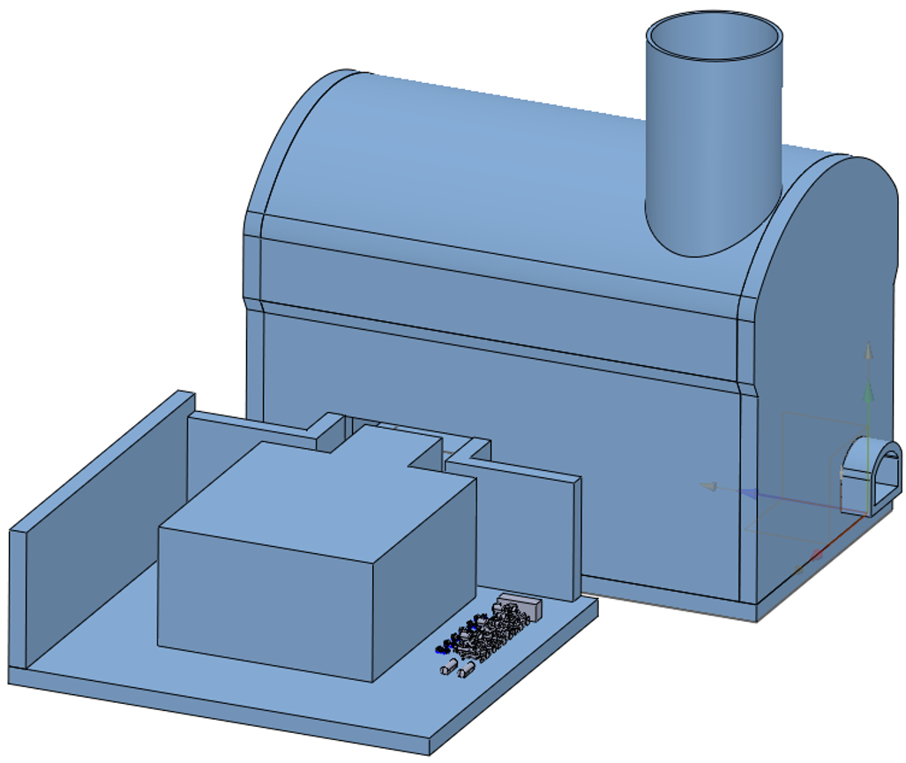
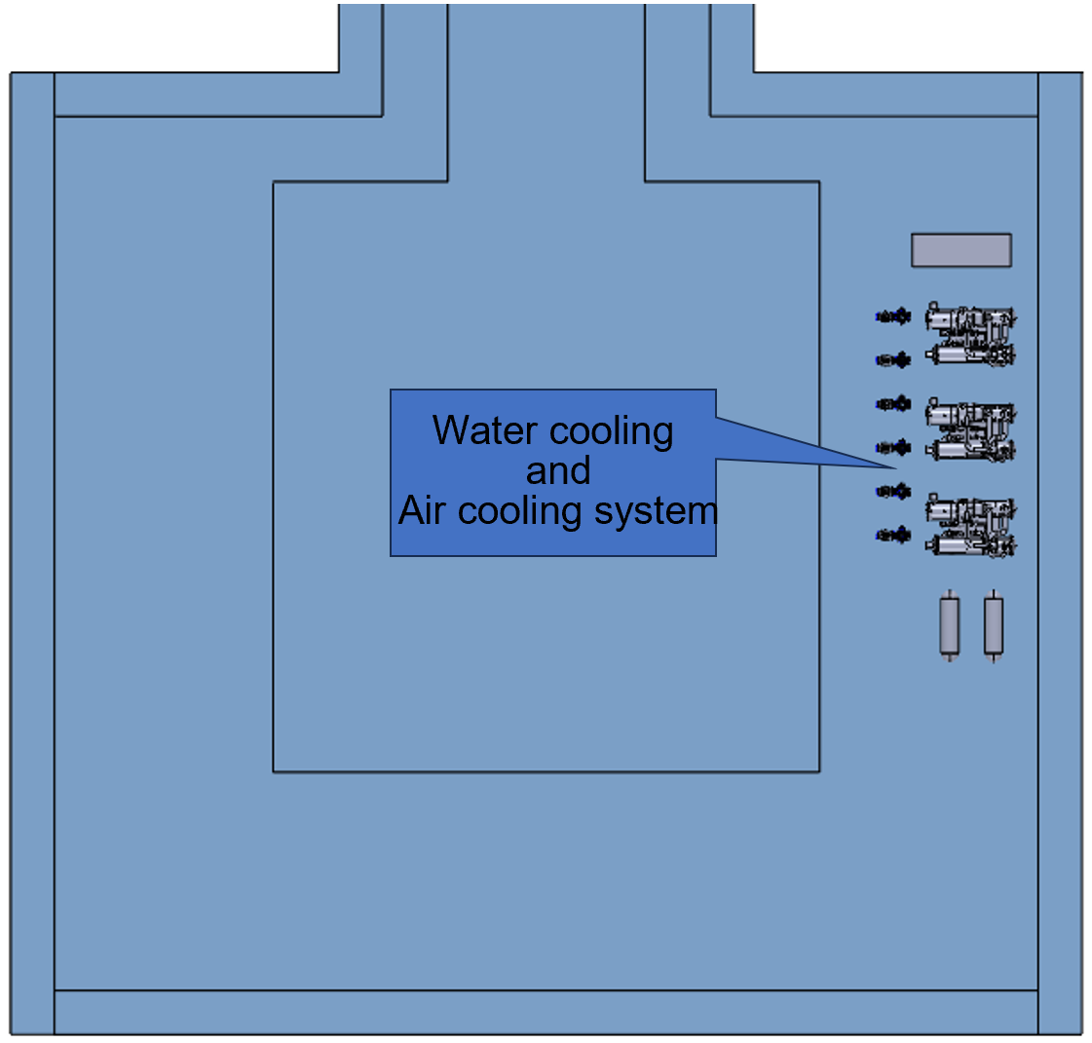
Experimental Hall --- Water cooling and Air cooling system
郑州轻工业大学 吴学红(热能与动力学院 院长)
严琪, 李刚, 祁辉荣, ……

Slide 40
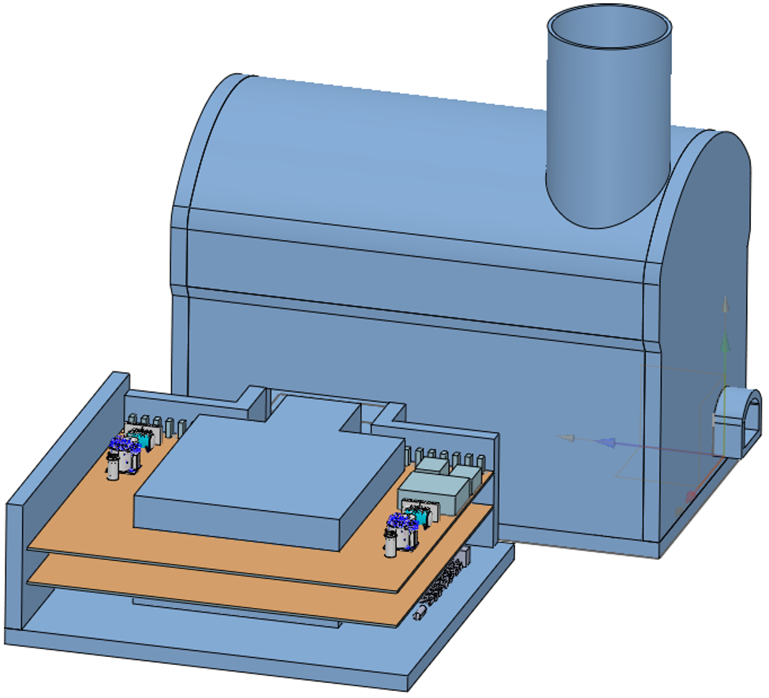
Experimental Hall --- Cryogenic system
宁飞鹏, 朱应顺, 杨啸辰, 张祥镇, 陈兵, 王海静, 石澔玙, ……
Total power : Collecting and confirming

Slide 41
Experimental Hall --- Electronics Cabinet and Power Cabinet
Minimum crates from current MDI
110 data crates, 237 power crates, 91 Det-HV crates, 20 Trigger crates
Minimum racks from current MDI
37 data racks, 24 power racks, 23 Det-HV racks, 10 trigger racks (94 in total)
More 2 racks for AC-DC power for all the above racks
96 racks in total
王铮, 魏微, 黄金书, ……

Slide 42
3. Cost content

Slide 43
3. Cost content

Slide 44
4. Summary
The design content of the Ref TDR report is basically completed
Next plan :
1. Improve the design of auxiliary facilities
2. Complete Mechanical Integration TDR Report
3. Review Mechanical Integration TDR Report
4. Review Mechanical Chapter of Sub-detector TDR Report
Aim :
Familiarize each other and lay a solid foundation for the next design improvement

Slide 45
Thank you for your attention!

