Slide 1
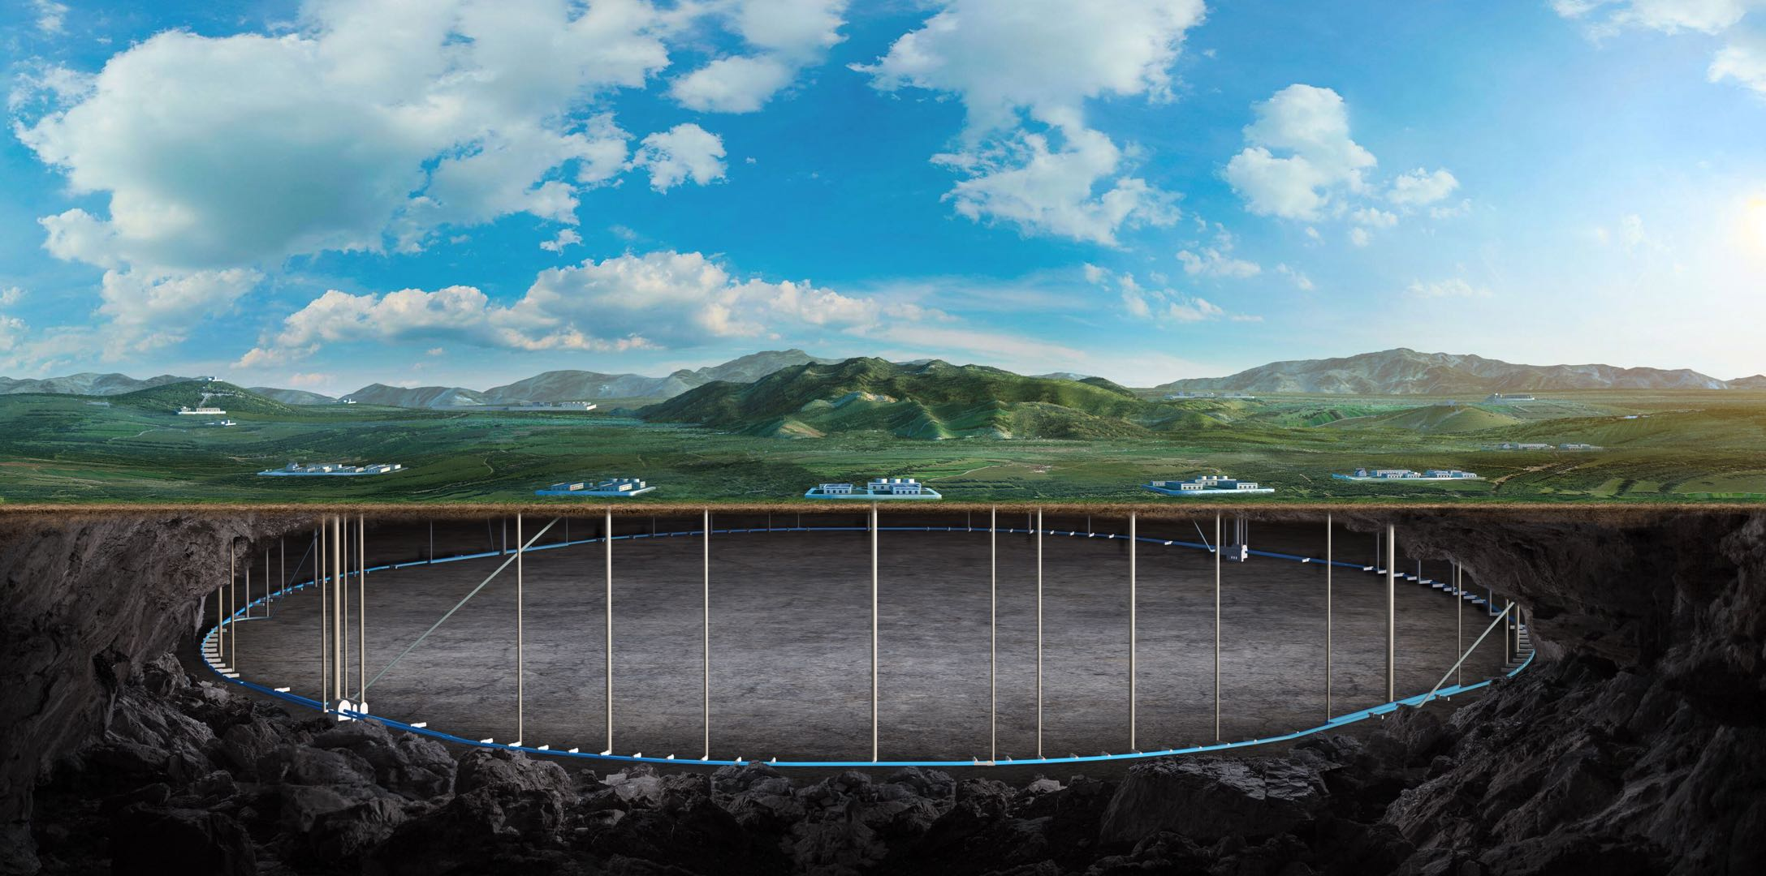
CEPC vertex Detector
Zhijun Liang

Slide 2
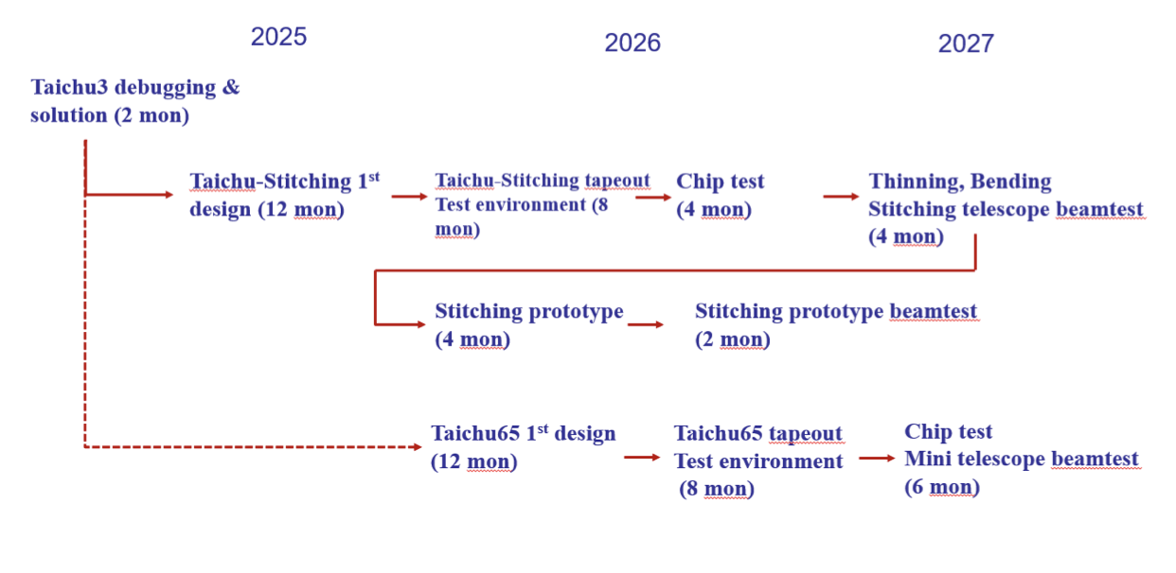
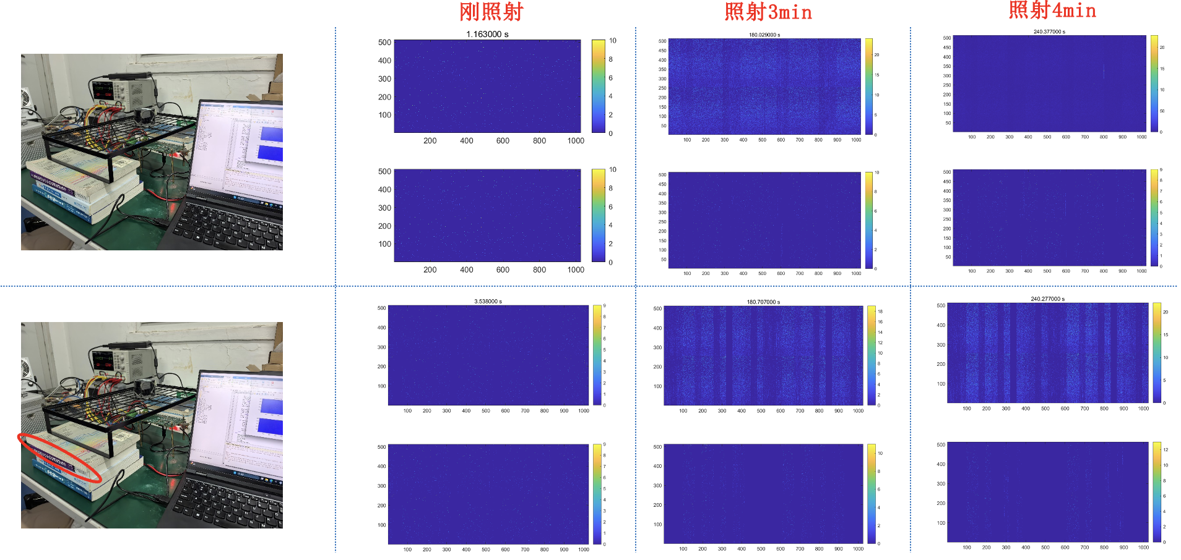
R & D Status and plan
Taichu-stitching design kickoff meeting before Chinese new year
Start with TJ180, And then switched to TPSCO 65nm
Started fixing the remaining bug in Taichu3, and started stitching design
Remaining issue in Taichu3, Data loss after long data taking time

Slide 3
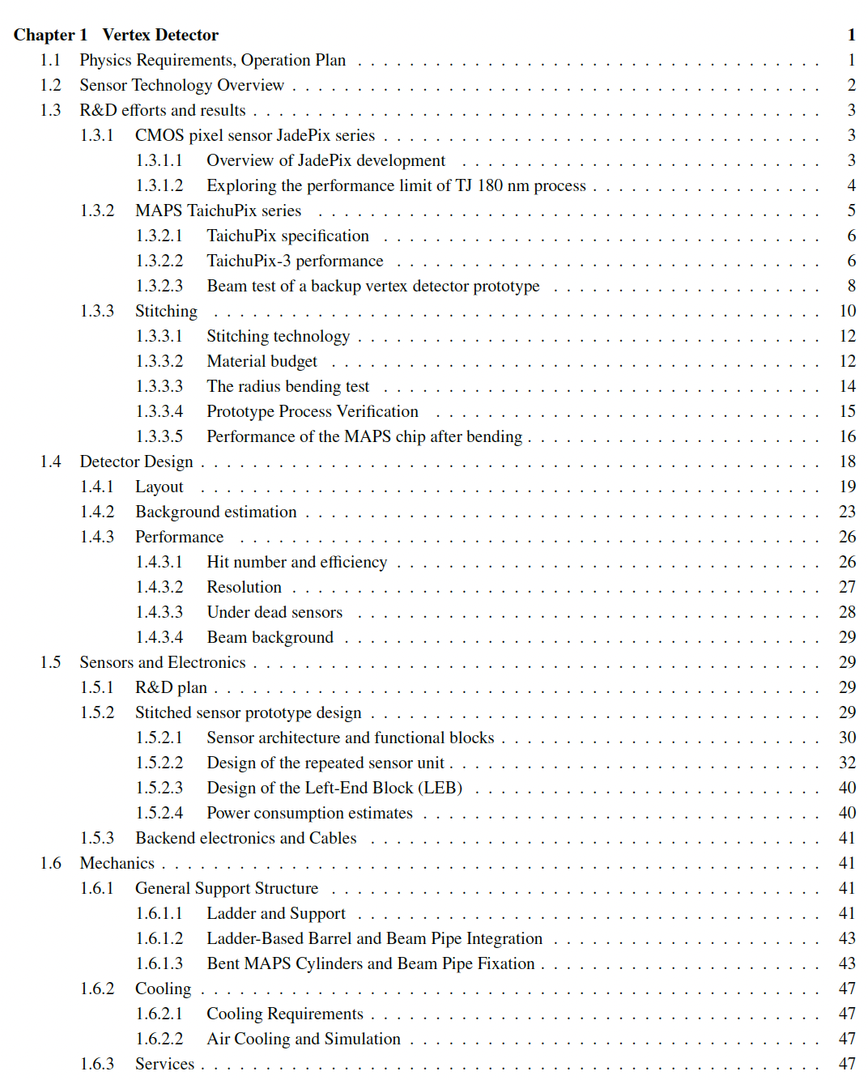
Ref-TDR
More than 50 pages ready (95%)
Introduction part (ready)
R & D part
Jadepix/Taichu (1st draft ready)
Stitching (1st draft ready)
Detector design
Physics Layout (1st draft ready)
Background ( Z pole estimation to be updated)
Stitching design (1st draft ready)
Mechanics (1st draft ready)
https://latex.ihep.ac.cn/project/6745179fef5108a66841008a

