Slide 1
Generator：BHLUMI,ReneSANCe,GPIG++
1.IP点偏移：σx,σy,σz
2.IP角度偏移：σθ
3.Beam-Beam Interaction（GPIG+BHLUMI?)
Beamstralung
EM Deflection
4.本底：Pairs,Single,Gas Bremstralung……
5.NLO photon

Slide 2
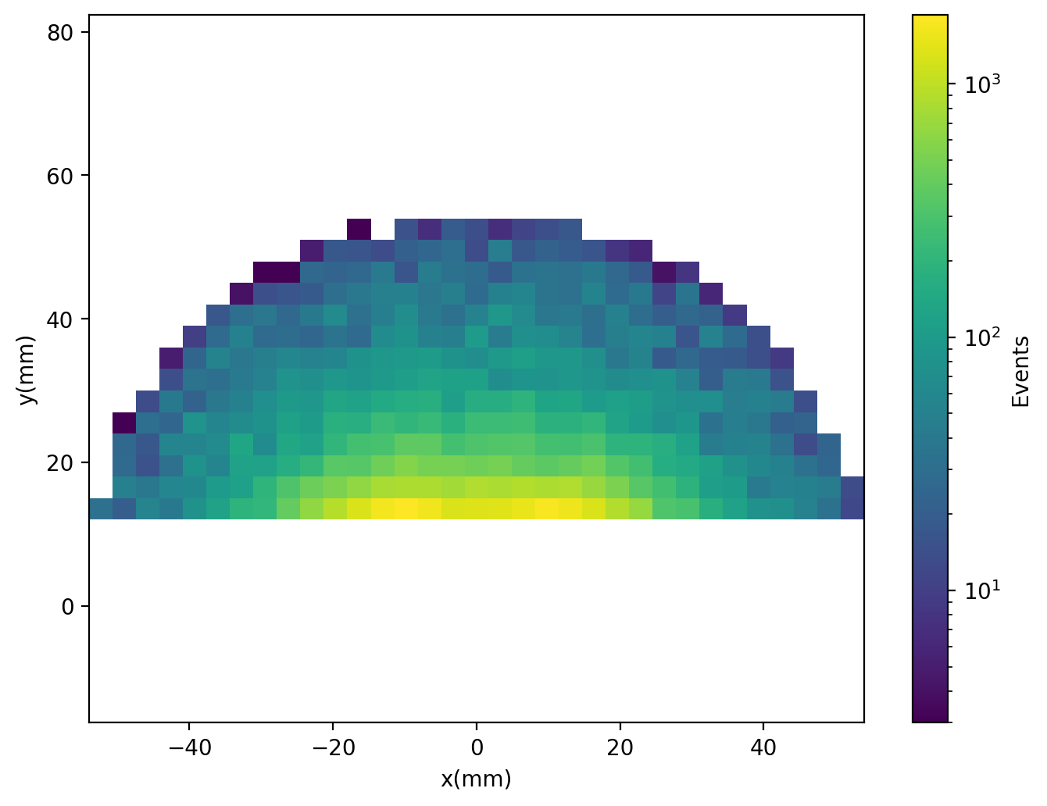
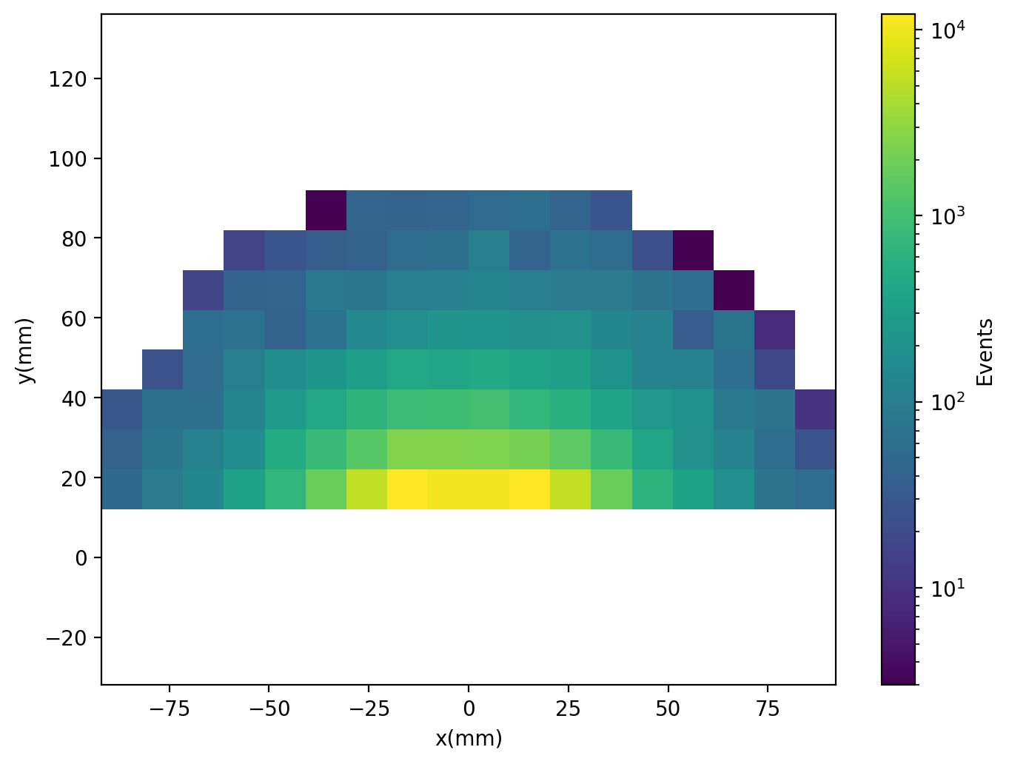
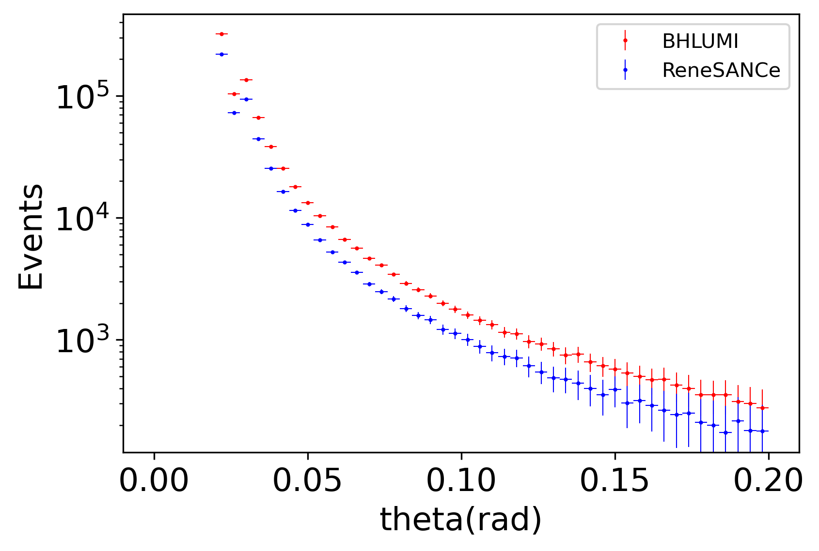
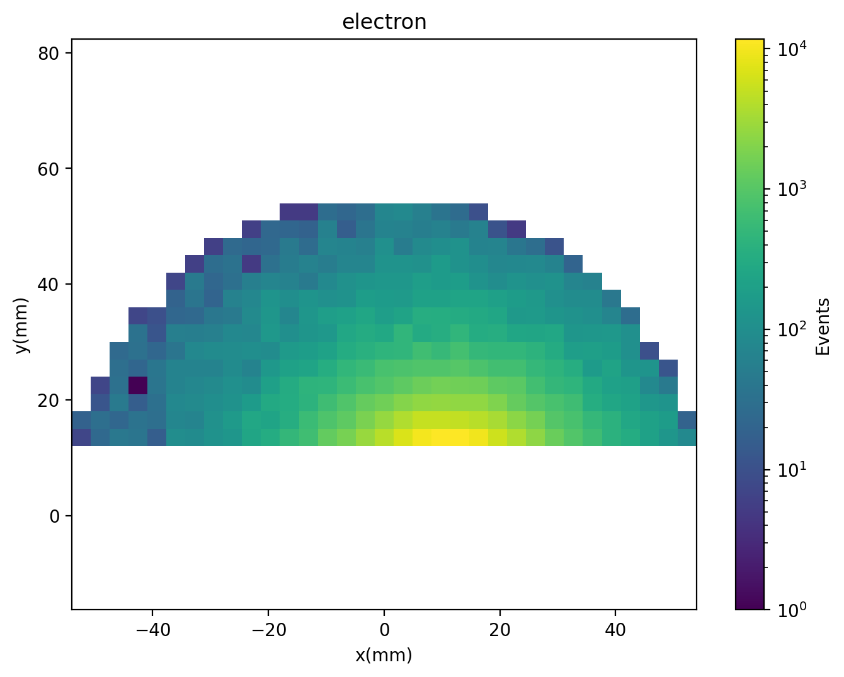
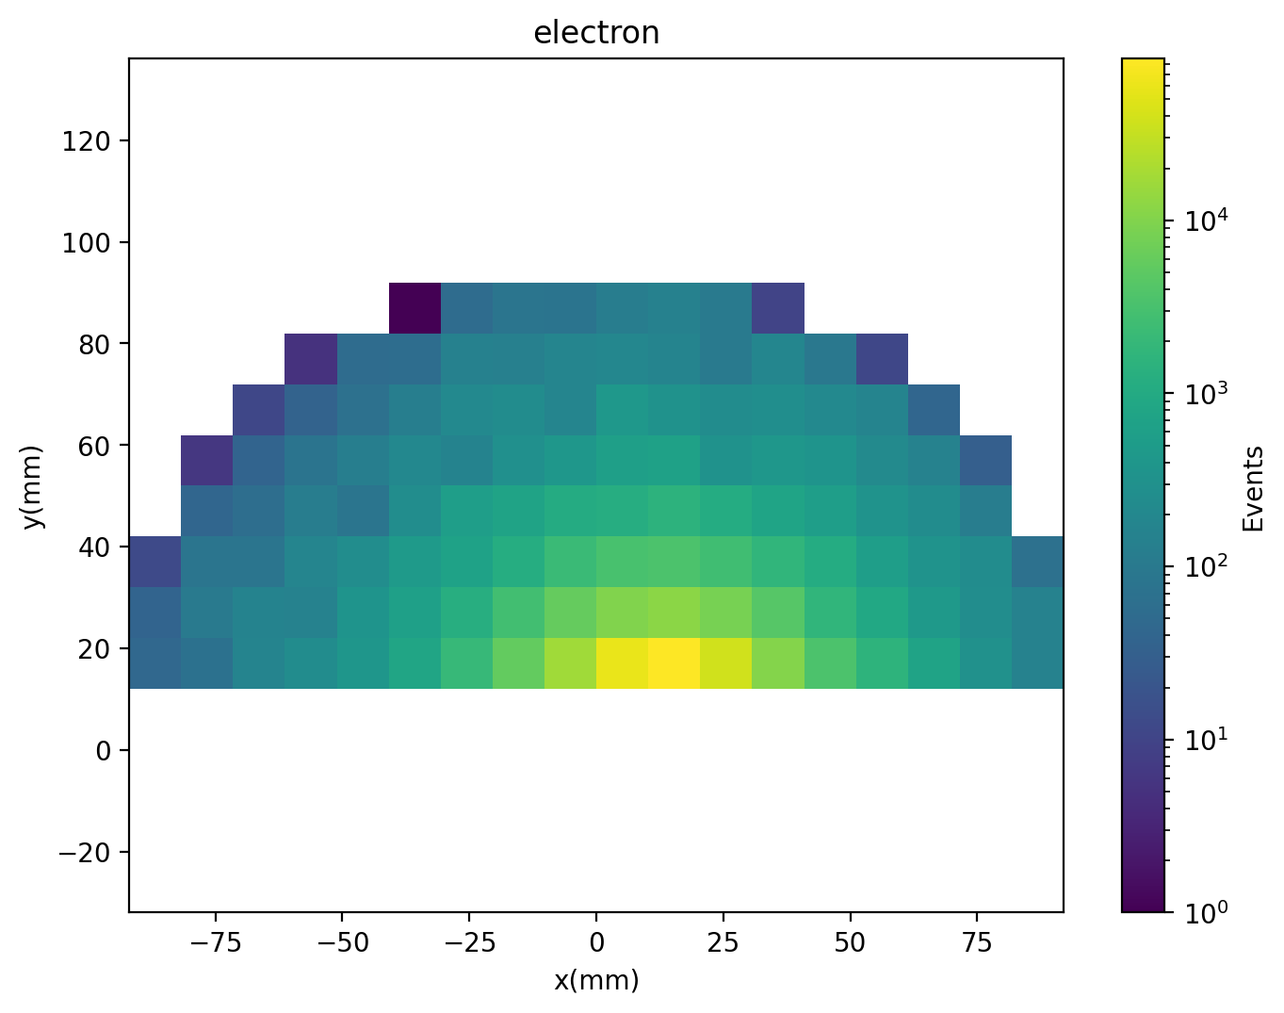
BHLUMI Photon >100MeV,Opening angle>5mrad
σ=2560nb,TotalEvents=1e6
Ecm=92.3GeV
LYSO1
LYSO2
LYSO范围内
NLO photon/electron~10%
和电子对比
Boost后光子轻子开角最小值也
>5mrad

