Slide 1
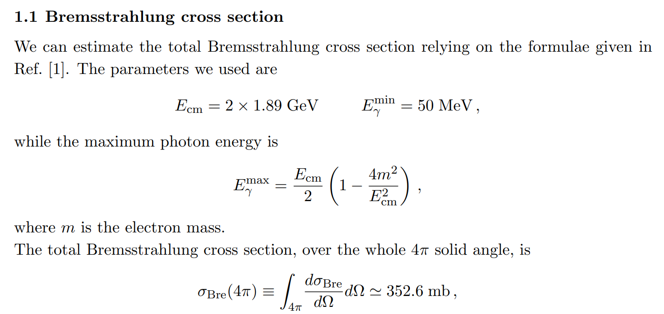
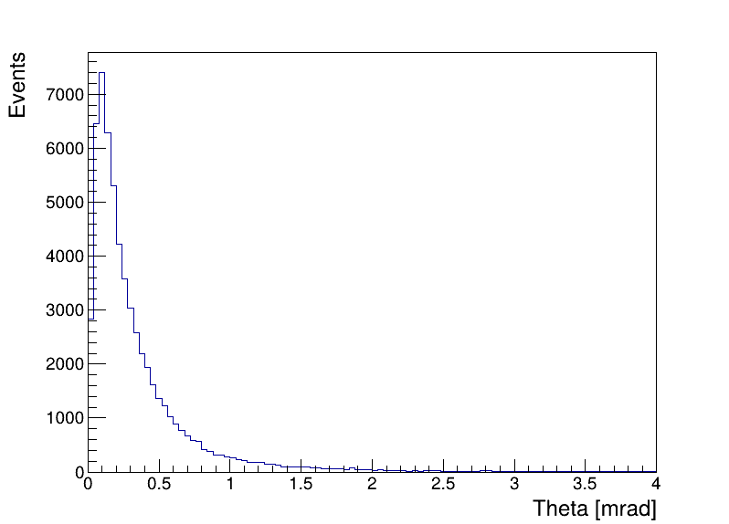
BBBrem
$$E_{CM}=2×1.89 GeV E_{γ}^{min}=50 MeV$$
BBBrem 20000 events
$$σ=176.845 mb$$
产生子仅计算电子发射光子，产生的光子均沿 z- 方向，双侧截面应 x2
$$2σ=353.690 mb$$
BBBrem
Photon
Distribution

Slide 2
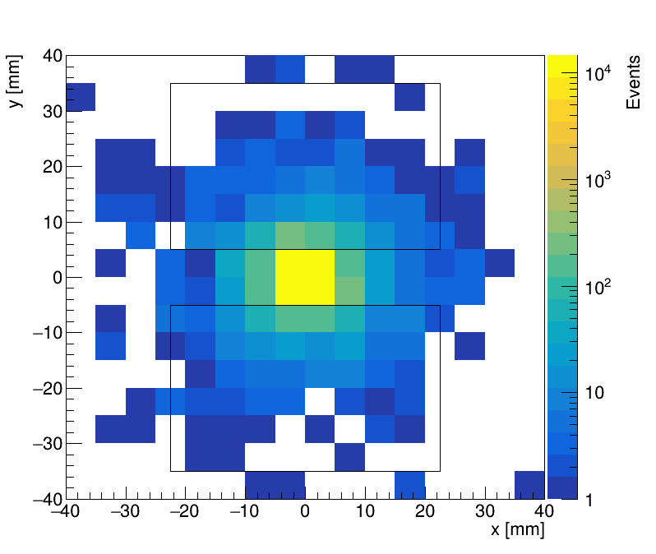
BBBrem @ Ecm = 3.78 GeV (跟文章中相同)
ZDD at z = ±3500 mm
60000 Events ~176.845 mb (353.690 mb)
(Total 120000 e+ e-, 60000 photon)
ZDD receiving：
1 electron 1180 events 1.9667 %
2 electron 154 events 0.2567 %
1e + γ 185 events 0.3083 %
2e + γ 98 events 0.1633 %
γ only 1078 events 1.7967 %
Events with γ 1361 events 2.2683 %
Events with γ or e 2695 events 4.4917 %
Photon

Slide 3
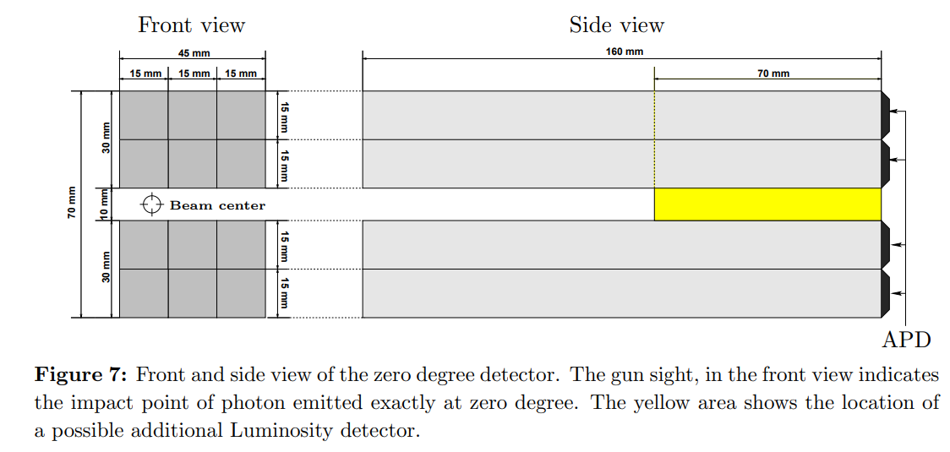
若以远端下沿为探测范围，即考虑粒子从探测器侧面击中，结果约为
ZDD receiving：
1 electron 1231 events 2.0517 %
2 electron 155 events 0.2583 %
1e + γ 199 events 0.3317 %
2e + γ 106 events 0.1767 %
γ only 1183 events 1.9717 %
Events with γ 1488 events 2.48 %
Events with γ or e 2874 events 4.79 %
结果与不考虑侧面击中相差不大

Slide 4
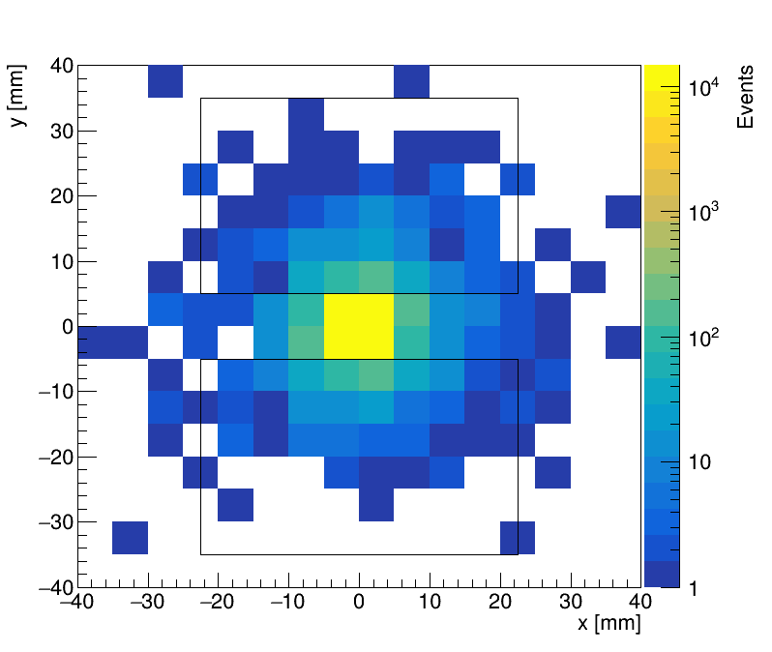
BBBrem @ Ecm = 4.68 GeV
ZDD at z = ±3500 mm
60000 Events ~245.564 mb (491.128 mb)
(Total 120000 e+ e-, 60000 photon)
ZDD receiving：
1 electron 742 events 1.2367 %
2 electron 125 events 0.2083 %
1e + γ 83 events 0.1383 %
2e + γ 80 events 0.1333 %
γ only 750 events 1.2500 %
Events with γ 913 events 1.5217 %
Events with γ or e 1780 events 2.9667 %
Photon

Slide 5
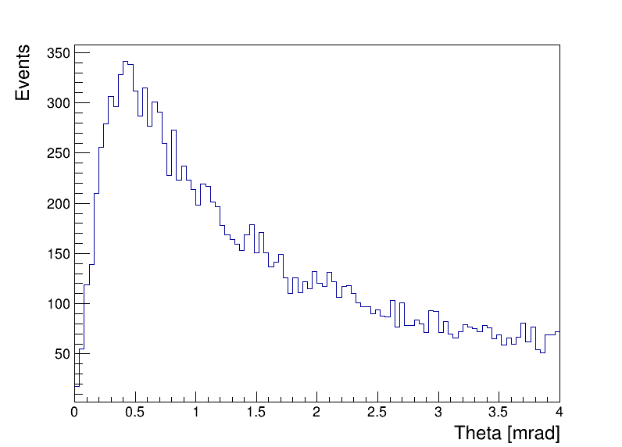
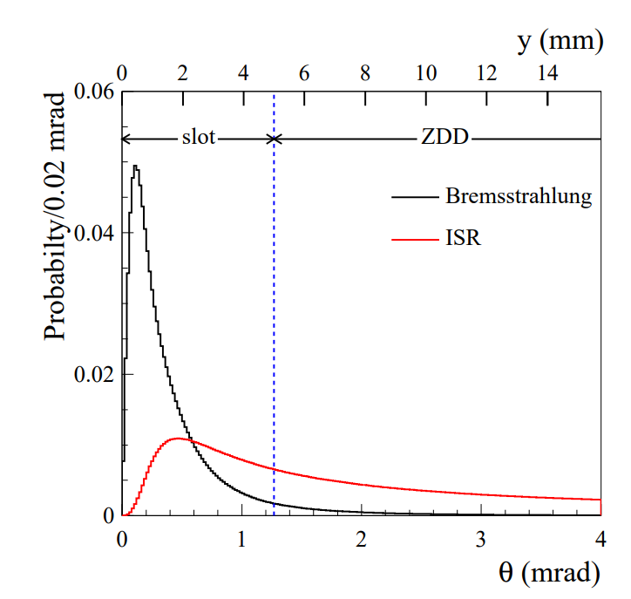
ISR Photon
Phokhara ISR photon
$$ee→μμ+γ_{ISR}$$
文献图

Slide 6
问题：
ZDD 处截面计算结果
$$353.690 mb×2.2683 \%=8.023 mb$$
低于文章[1]中 10.5 mb
若将探测器放置在 z = ±4000 mm，截面为
$$353.690 mb×\frac{1760}{60000}=10.375 mb$$
接近文章中 10.5 mb
[1] Proposal for a new zero degree photon detector at BESIII

