Slide 1
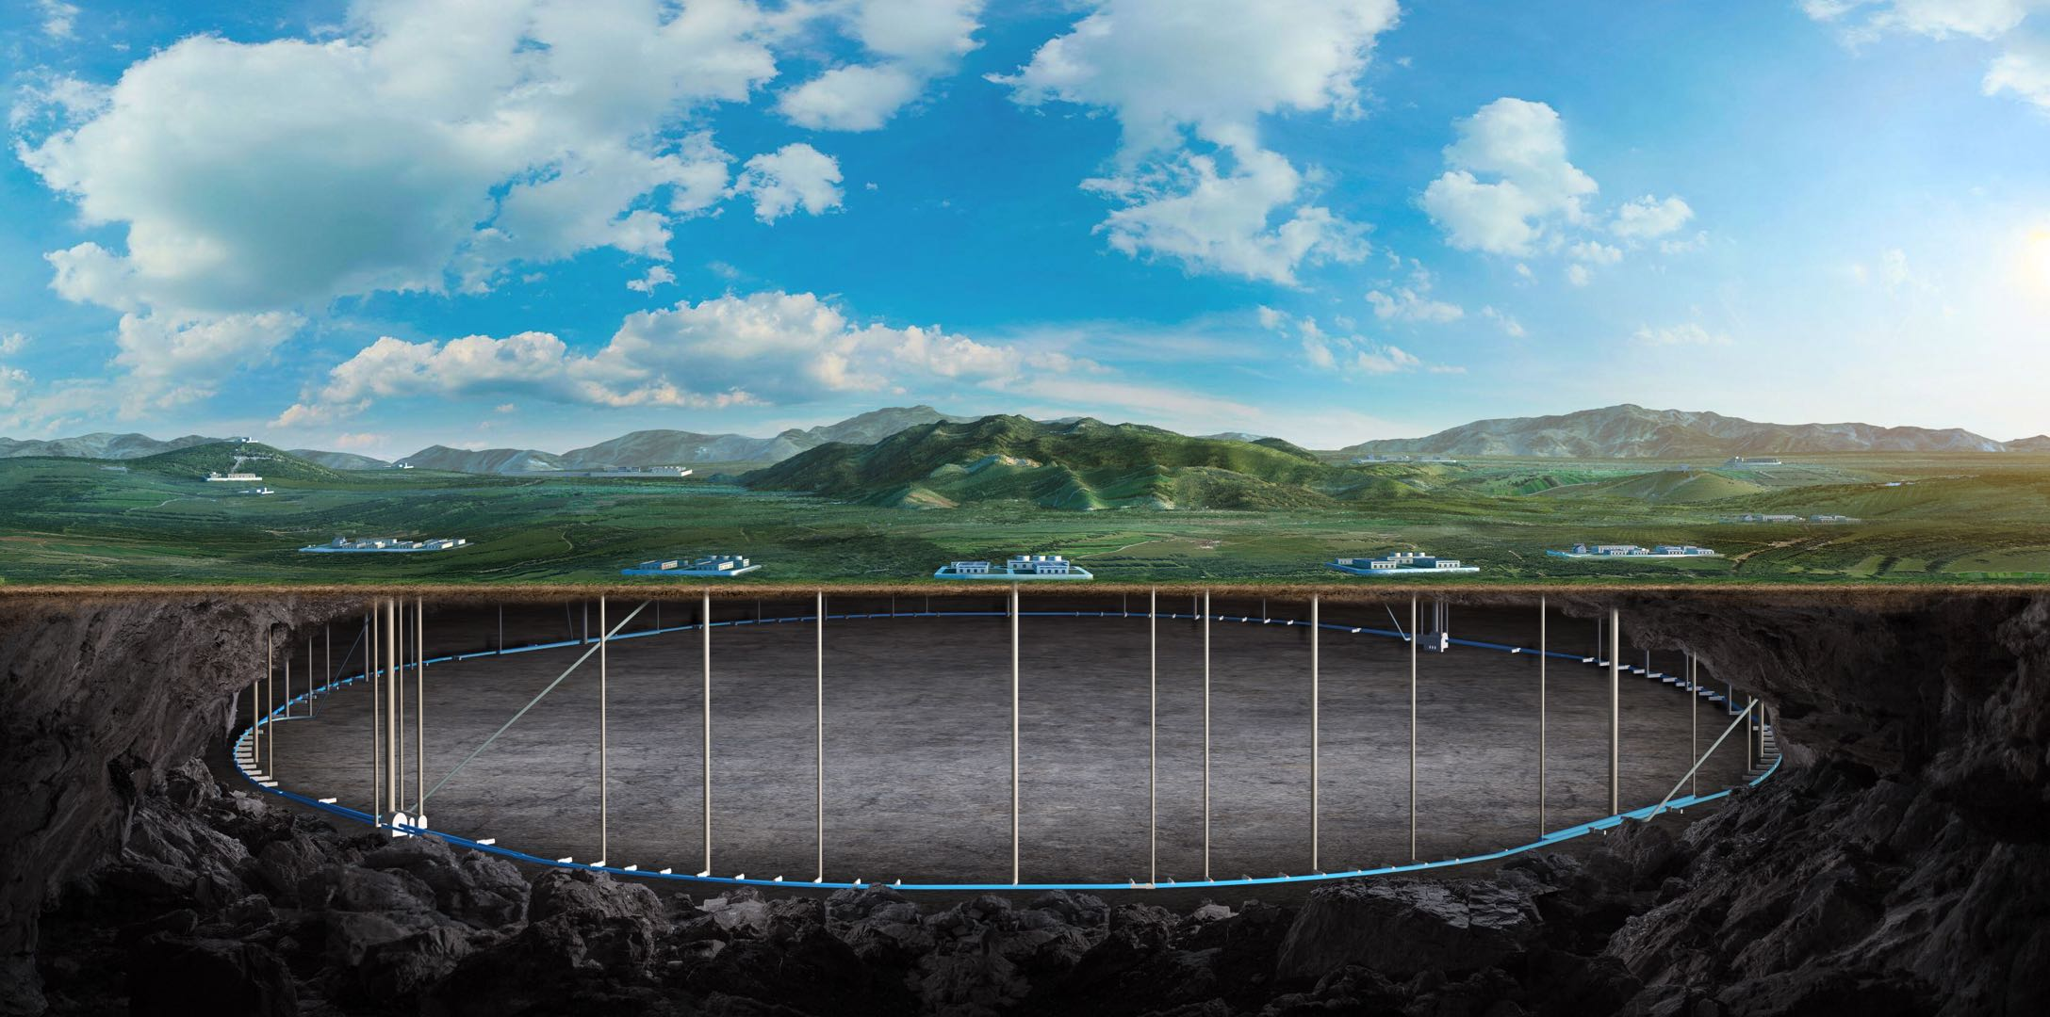
Mechanical Design for the silicon tracker
汇报人：李宇杰
2025 02 15

Slide 2
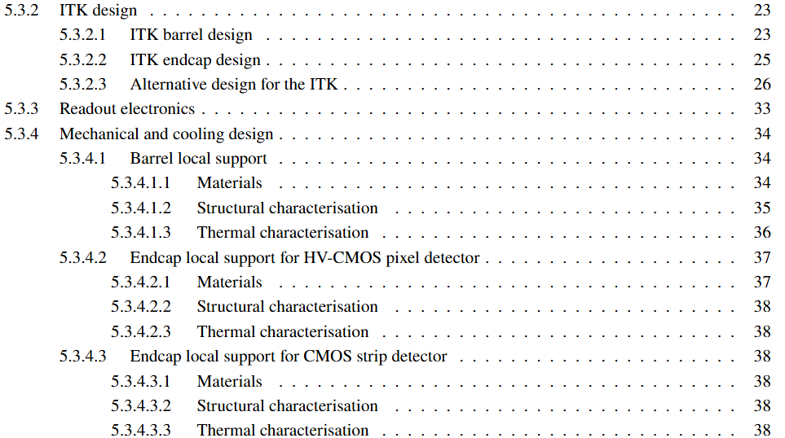
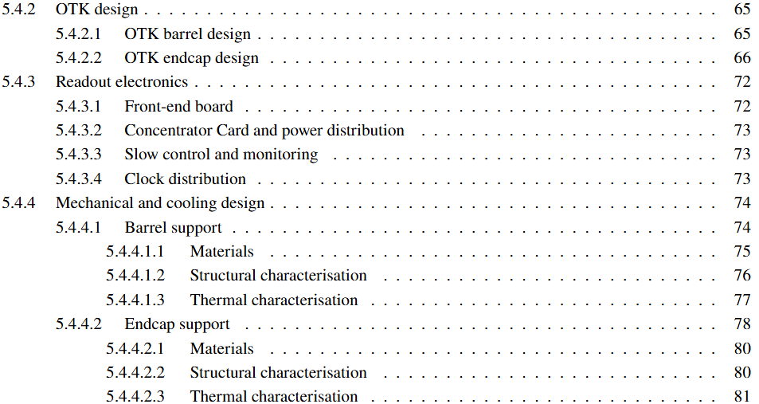
Outline
Mechanical and cooling design for the
ITK and OTK

Slide 3
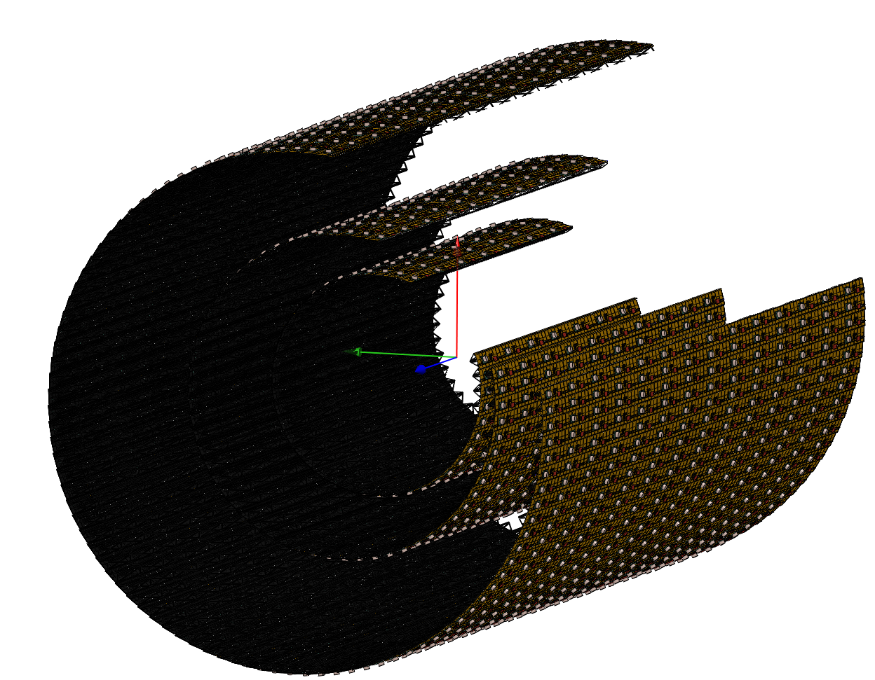
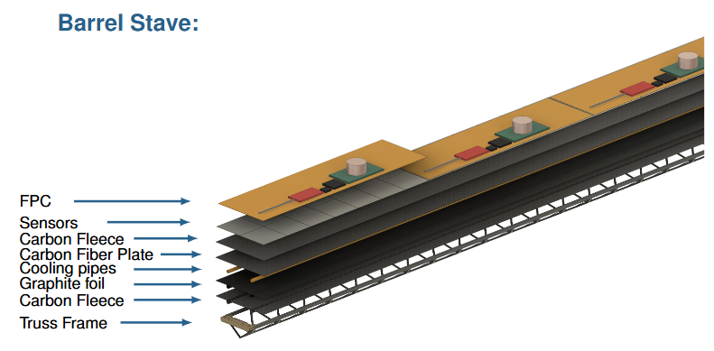
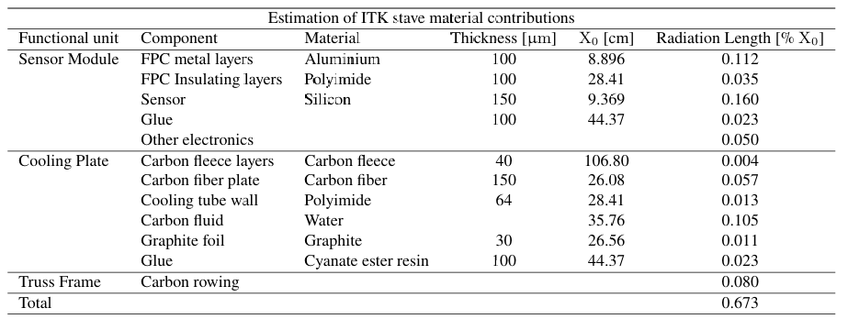
5.3.4.1 ITK barrel local support
Estimation of ITK stave material contributions

Slide 4
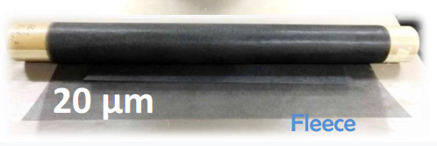
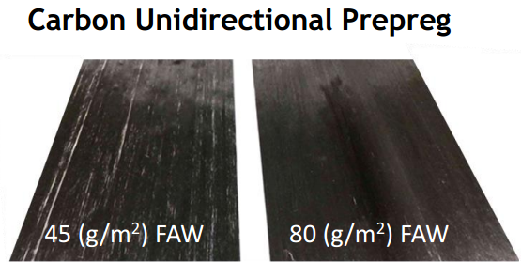
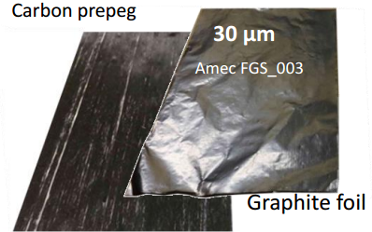
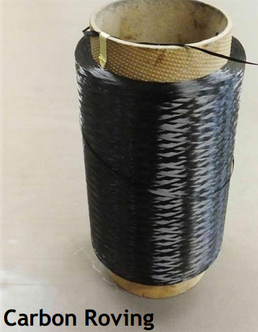
5.3.4.1.1 Materials
Filling layer, enhanced heat conduction
Heat dissipation, maintaining chip temperature stability
Cooling fluid circulating passage
Enhance heat transfer between cold plate and cooling tube
Support, provide structural rigidity

Slide 5
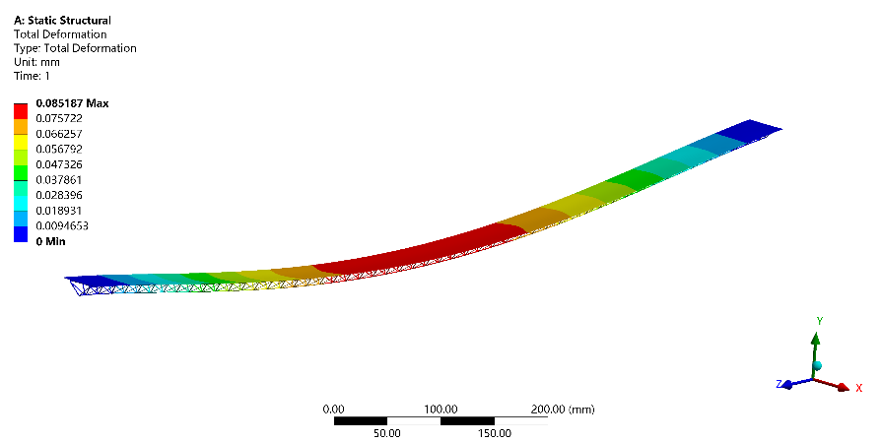
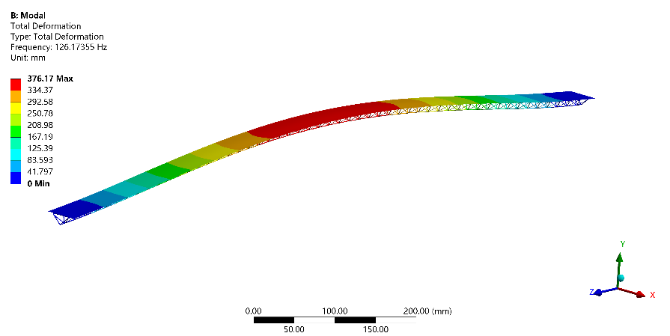
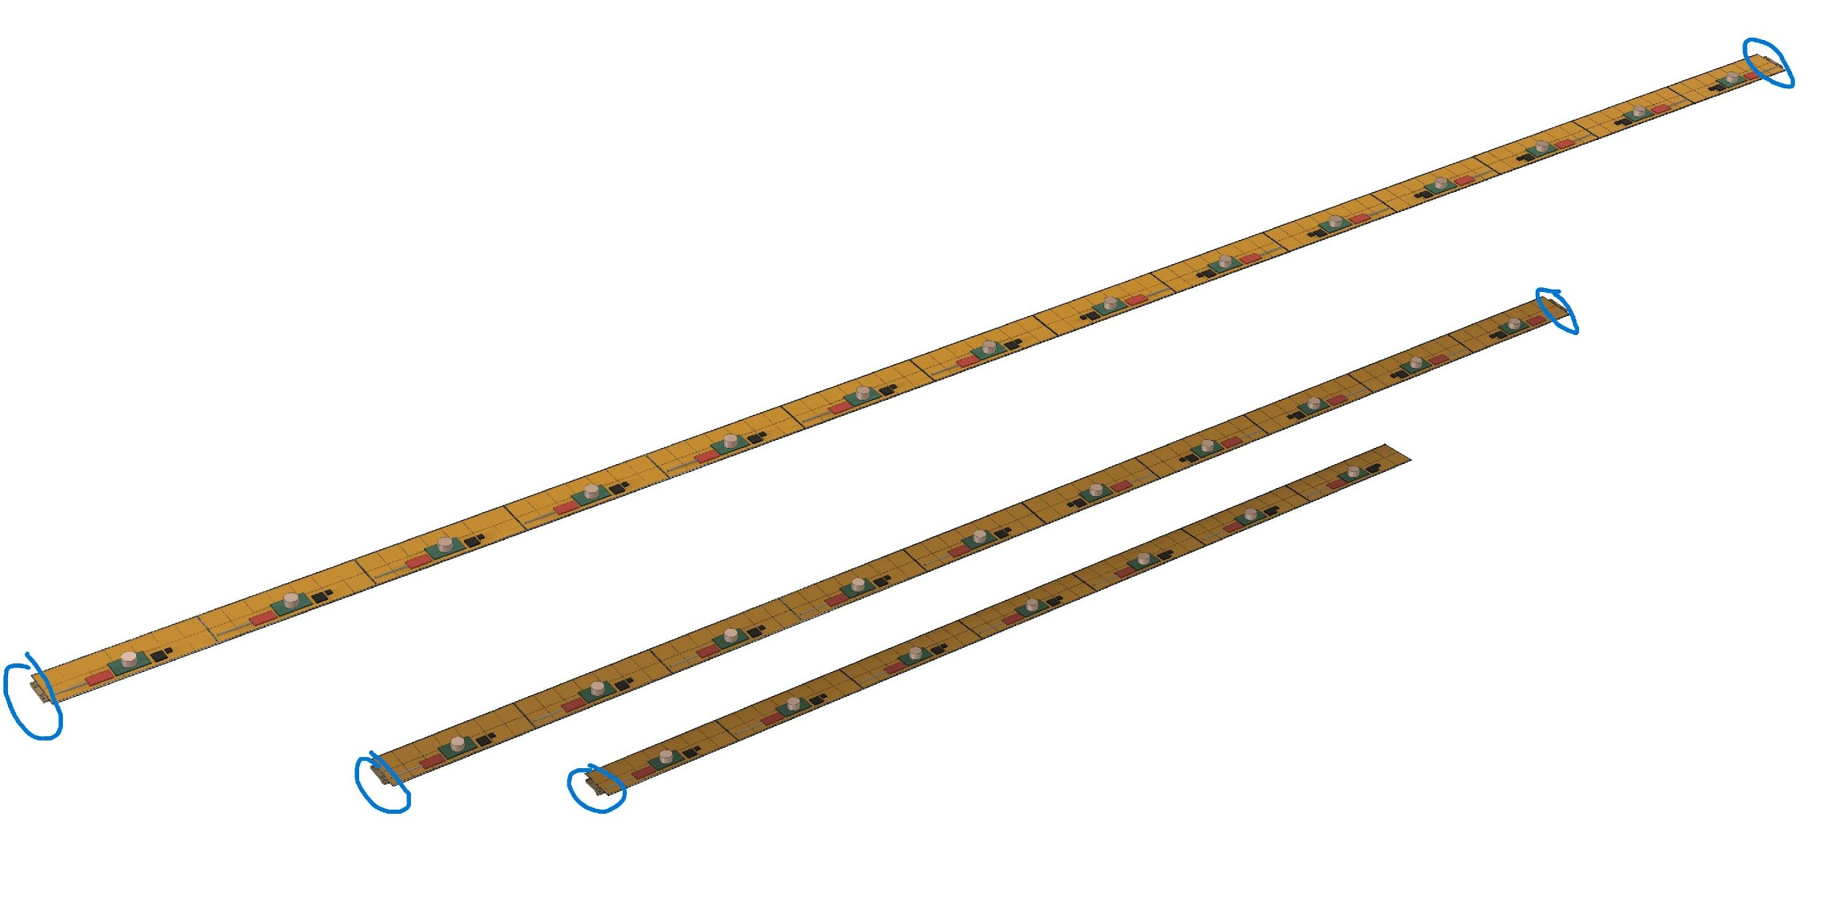
5.3.4.1.2 Structural characterisition
ITKB1 stave deformation
First order mode and first natural frequency
ITK Stave | ITKB1 | ITKB2 | ITKB3
Stave length [mm] | 987 | 1410 | 1974
Maximum sag [μm] | 85 | 289 | 896
First natural frequency [Hz] | 126 | 69 | 34

Slide 6
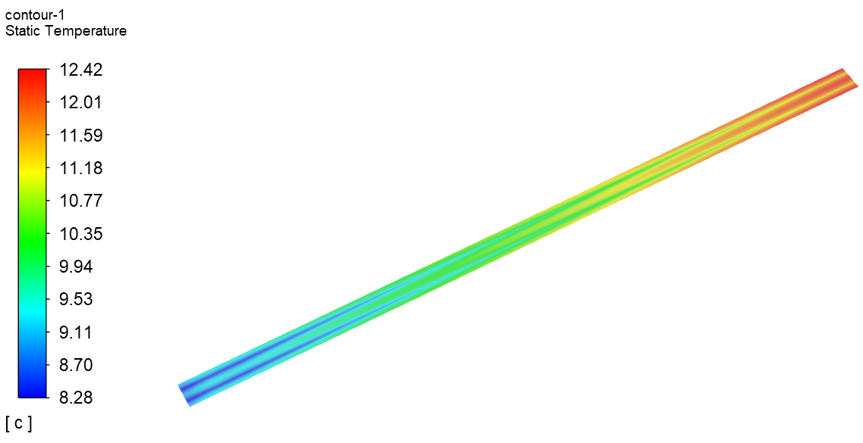
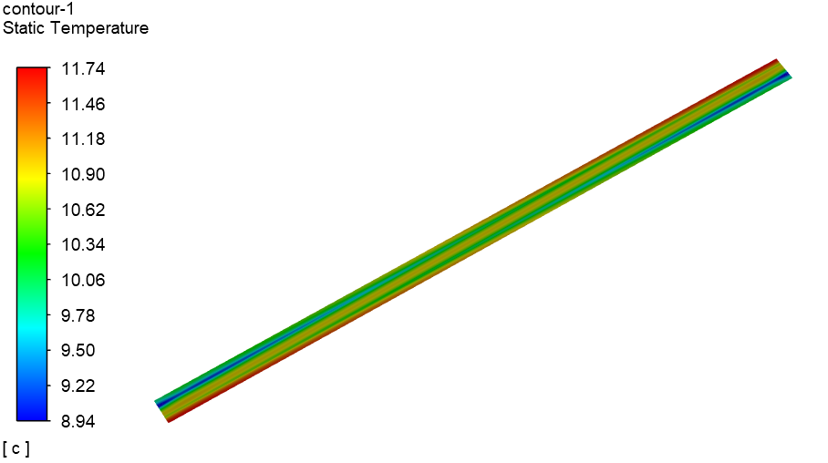
5.3.4.1.3 Thermal characterisition
The heat generated by ITK sensors with a magnitude of 200 mW/cm². The cooling design should achieve the following:
The overall sensor operating temperature <30℃.
The temperature uniformity across a single sensor <5℃.
200 mW/cm²
200 mW/cm²
1 m/s 5℃
1 m/s 5℃
The temperature gradient along the 987 mm length of the stave can be controlled within 5℃. The water cooling meets the detector’s requirements.

Slide 7
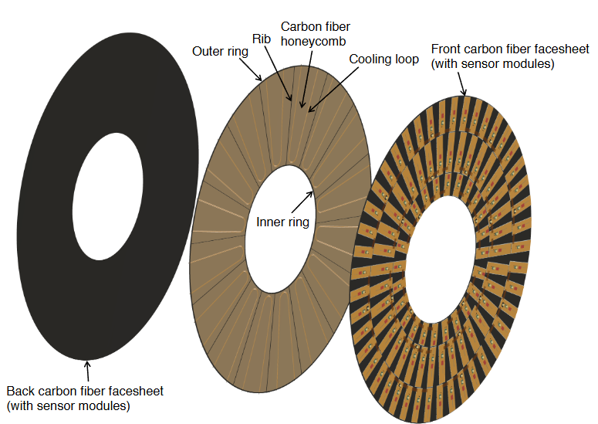
5.3.4.2 Endcap local support for HV-CMOS pixel detector
Estimation of ITK HV-CMOS pixel endcap material contributions
Additional new materials（the same with OTK）：
Honeycomb（light weight high strength）
filled with poco foam（Light weight and high thermal conductivity）

Slide 8
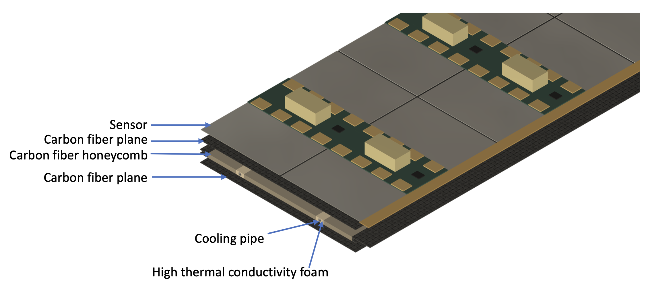
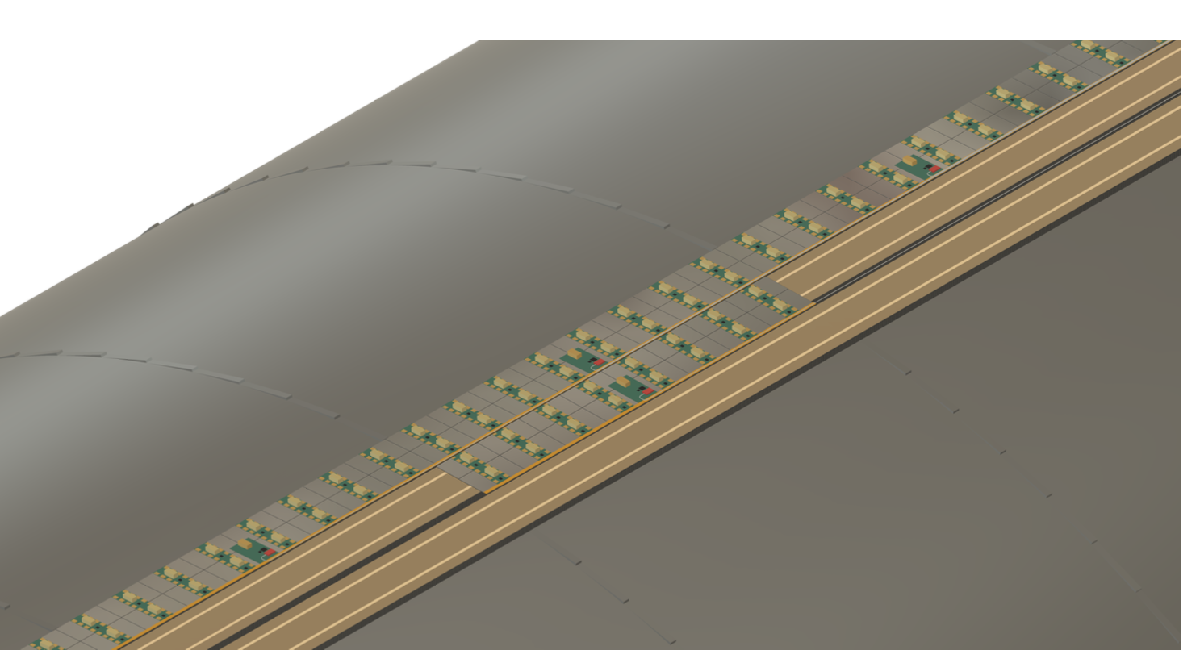
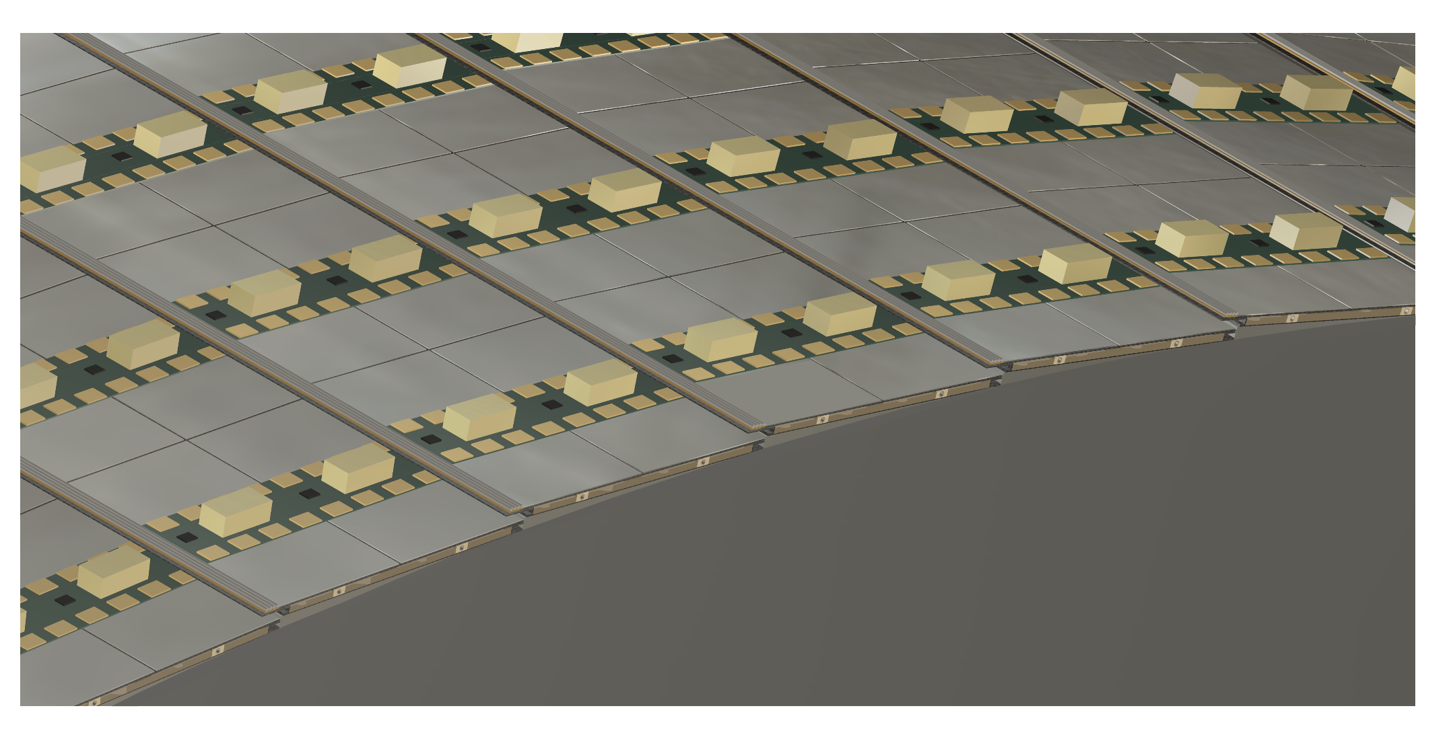
5.4.4.1 OTK barrel local support
Estimation of OTK stave material contributions

Slide 9
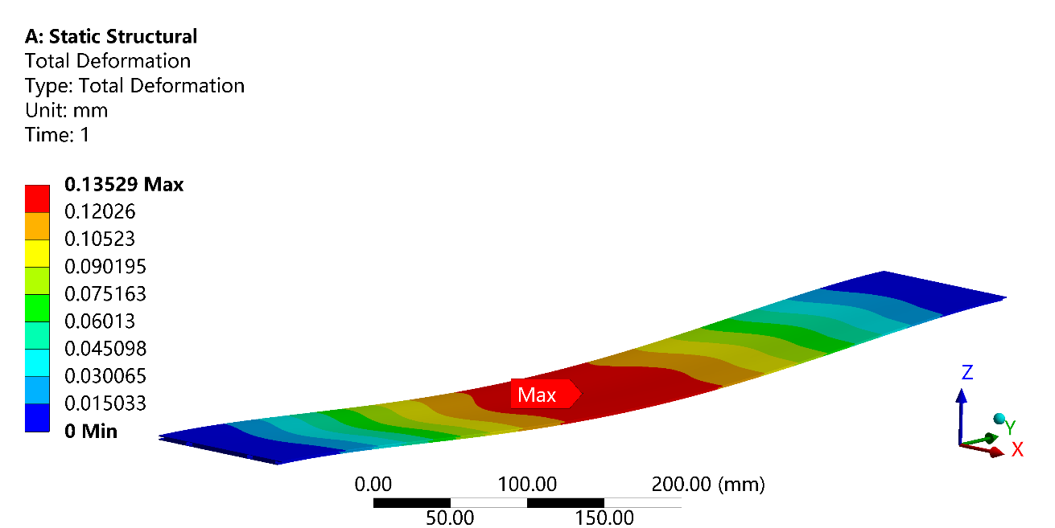
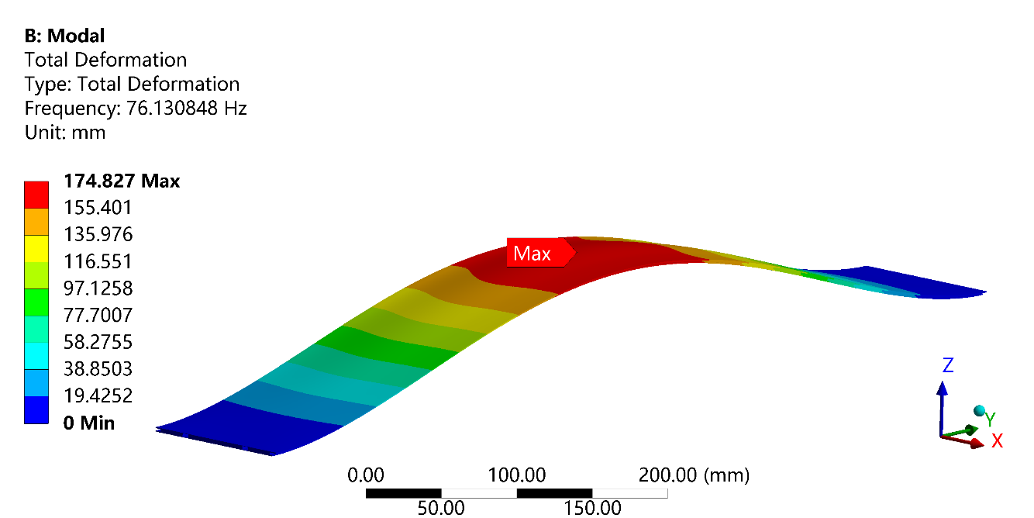
5.4.1.1.2 Structural characterisition
Maximum sag: 0.135 mm
First natural frequency: 76.1 Hz
OTK stave deformation（719.6mm）
First order mode and first natural frequency（719.6mm）

Slide 10
5.4.4.1.3 Thermal characterisition
ID: 5 mm
Honeycomb filled with poco foam to increase thermal conductivity
Using a 5 ℃ and 2 m/s water inlet (ID: 5 mm), the maximum temperature difference across one sensor is <2.9 ℃ for inlet from one end and <4 ℃ for inlet from two ends.
Water cooling can meet the thermal requirements for the OTK over ~6 m stave length.

Slide 11
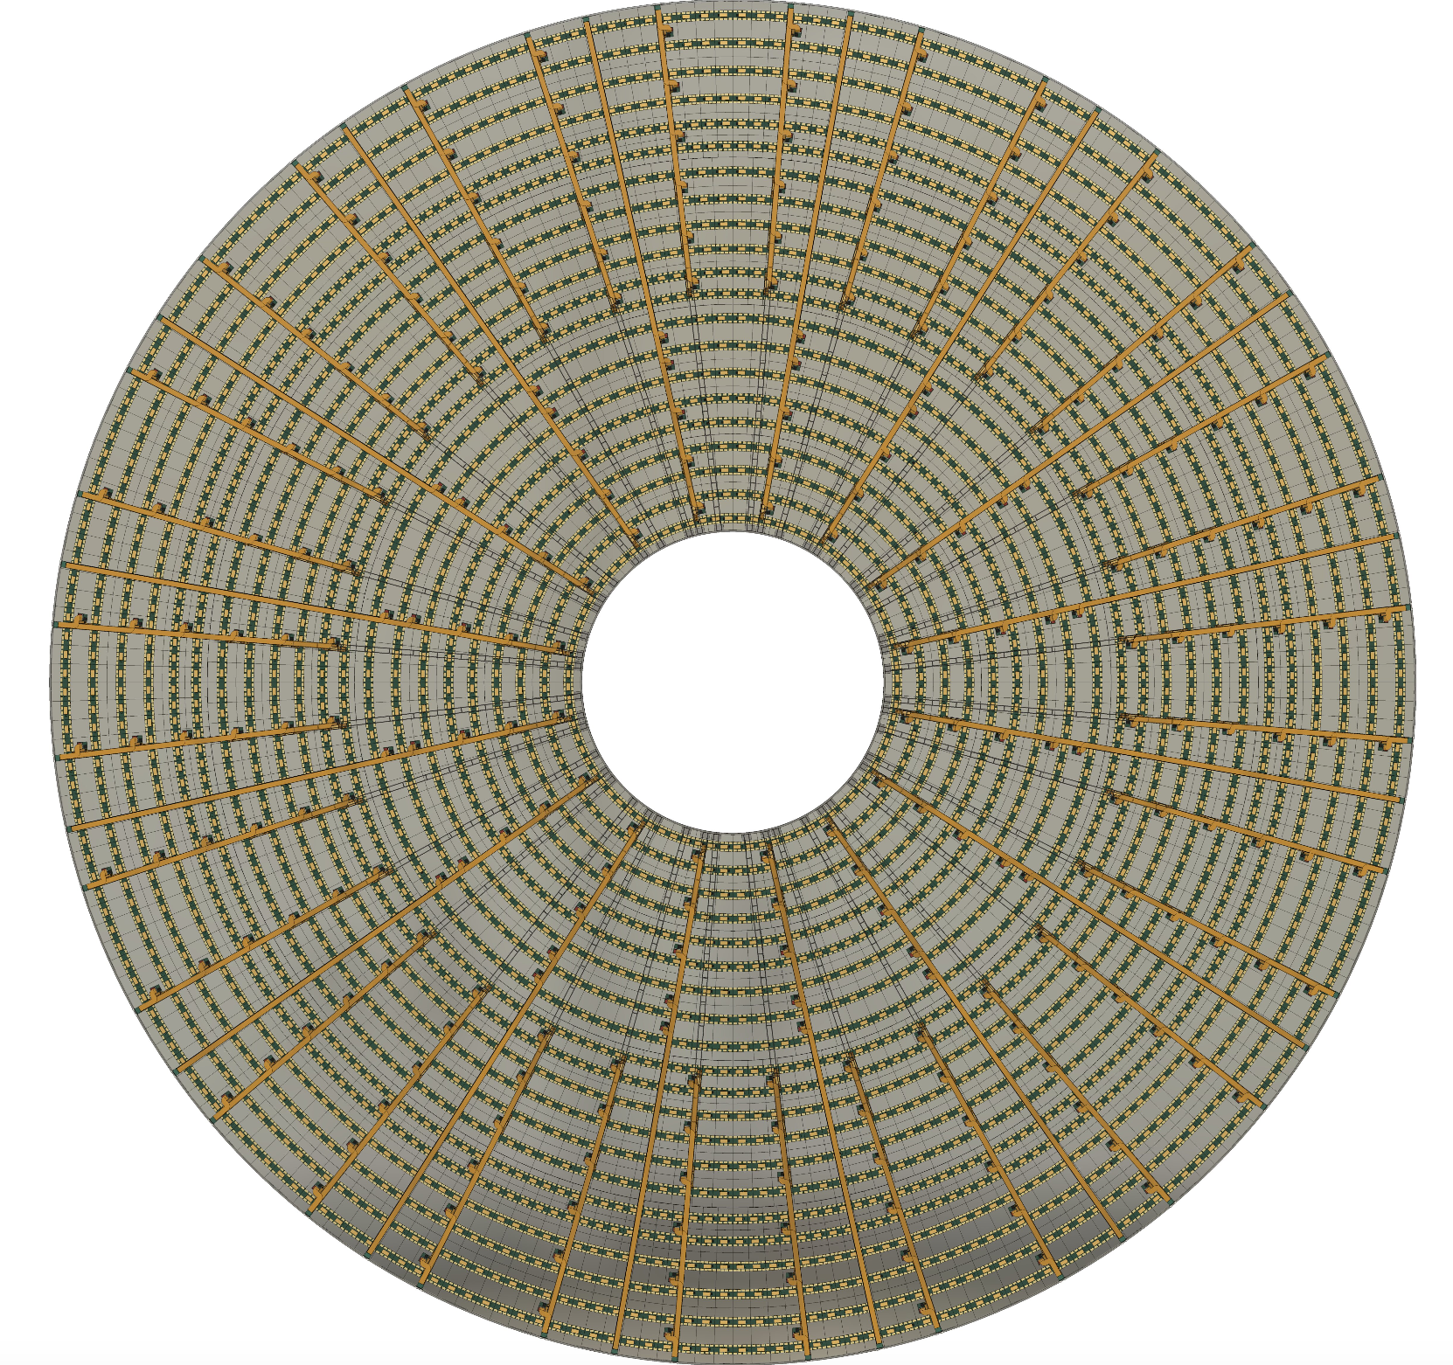
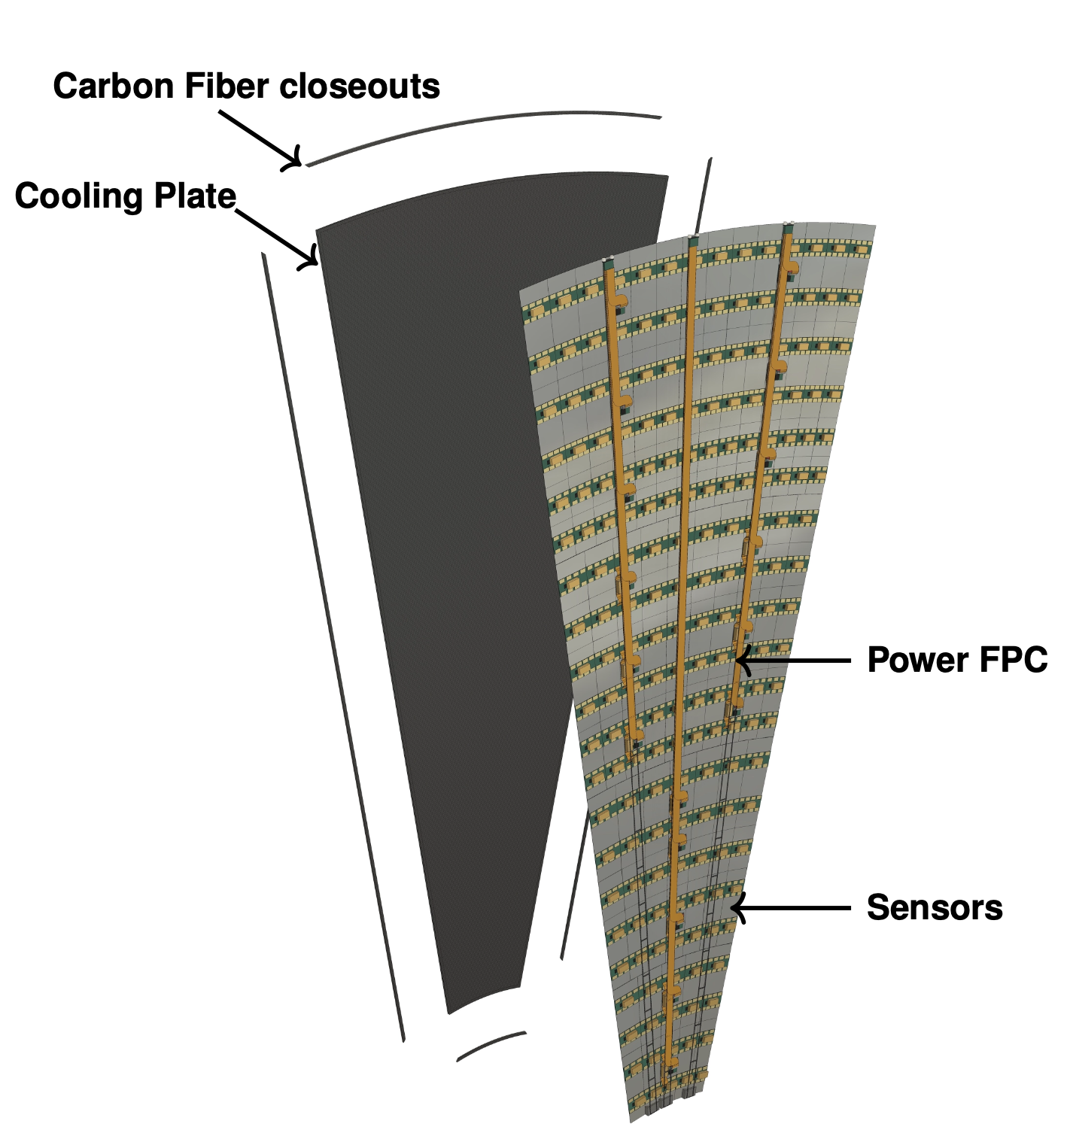
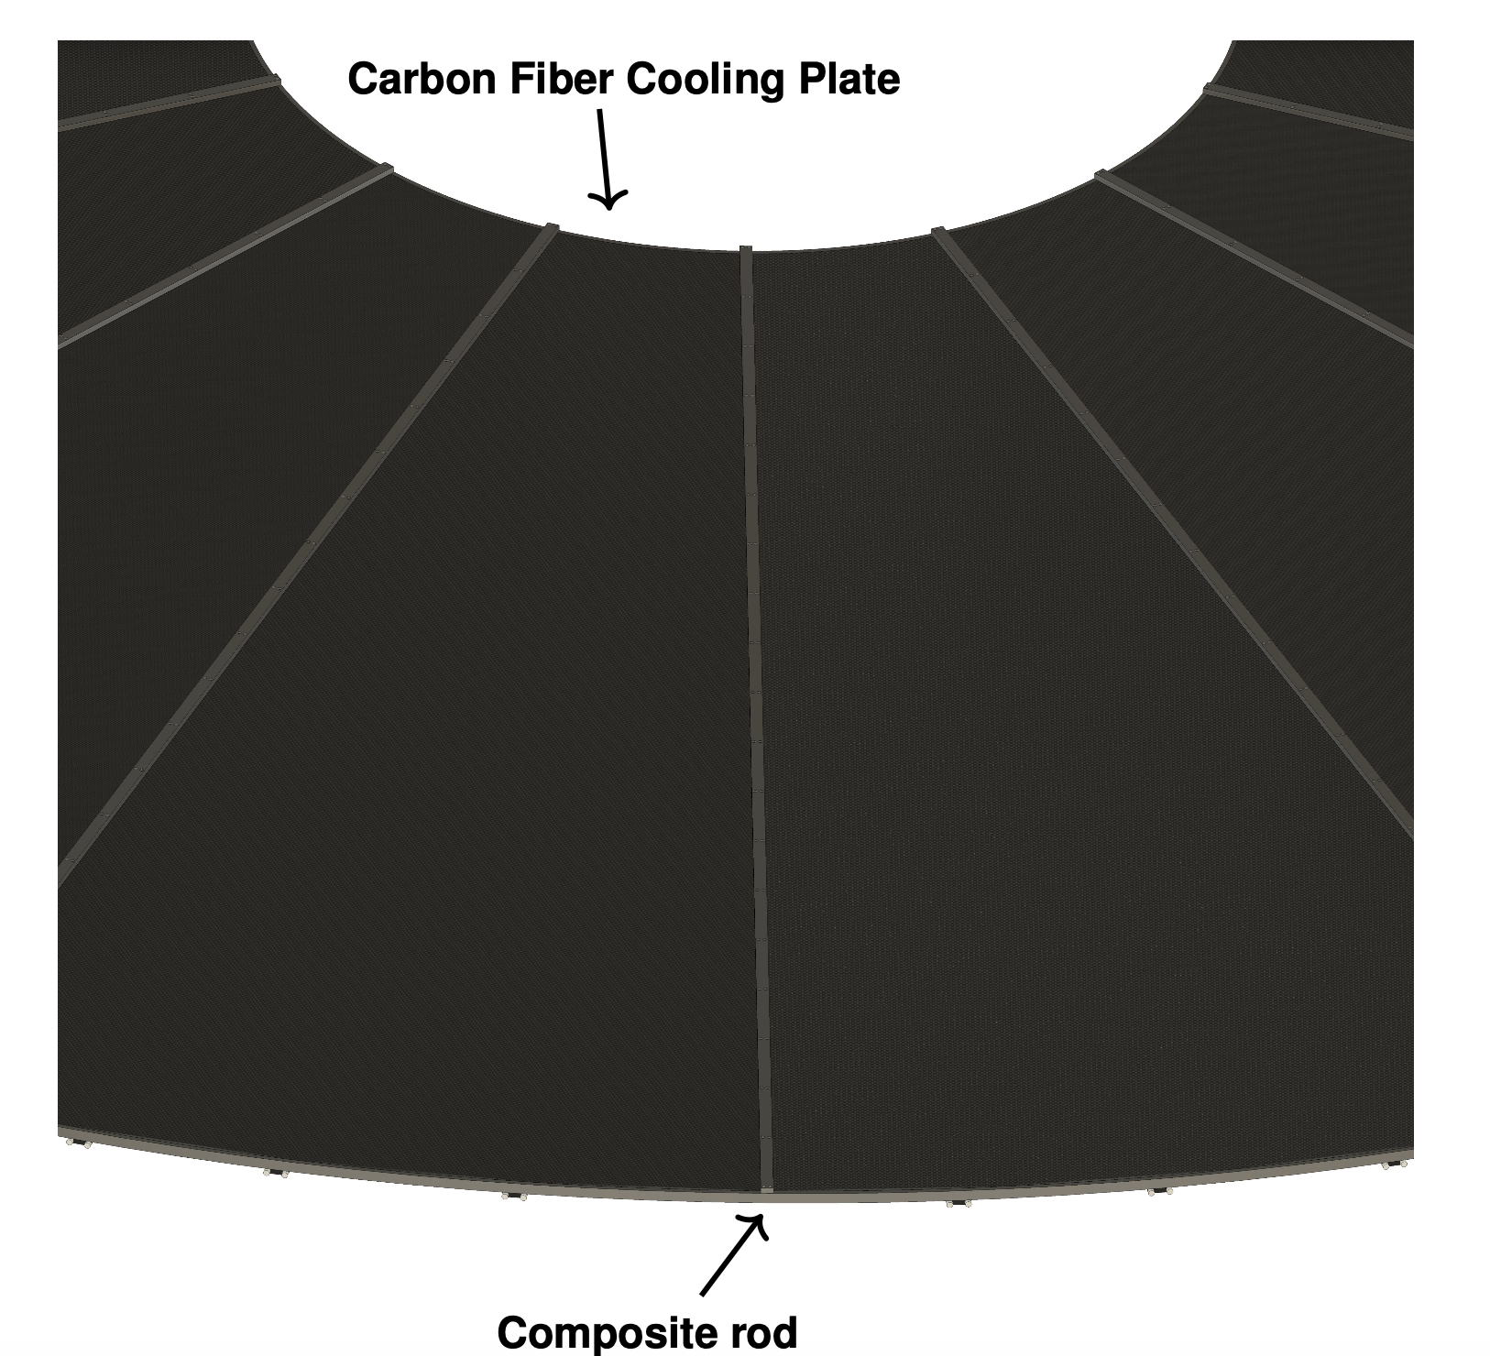
5.4.4.2.2 Structural characterisition
OTK endcap 1/16 sector
OTK Endcap
Maximum sag: 0.5 mm
Mounting neighboring 1/16 sectors

Slide 12
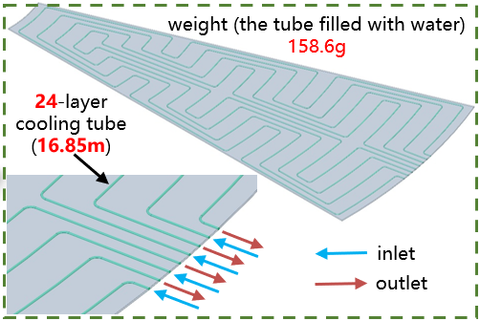
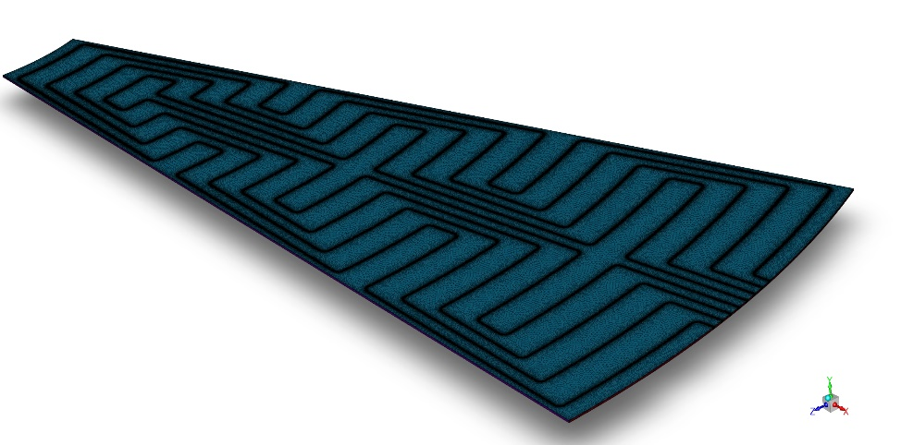
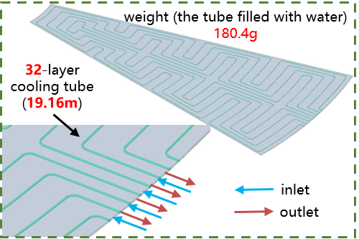
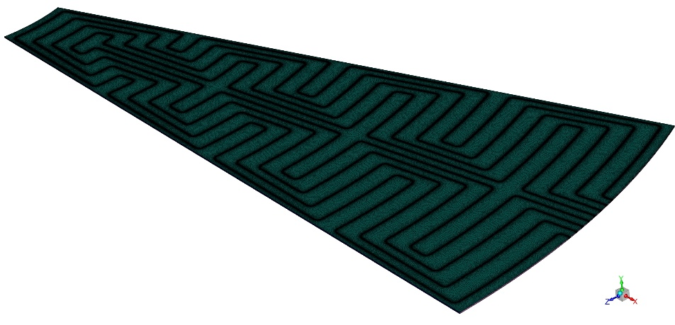
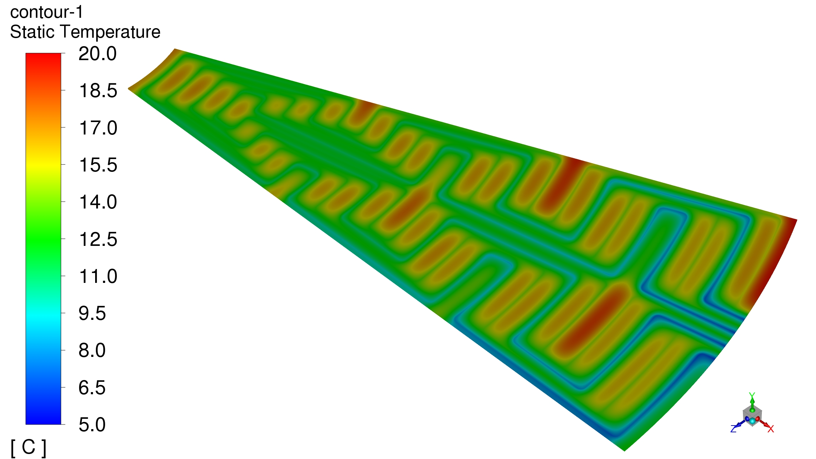
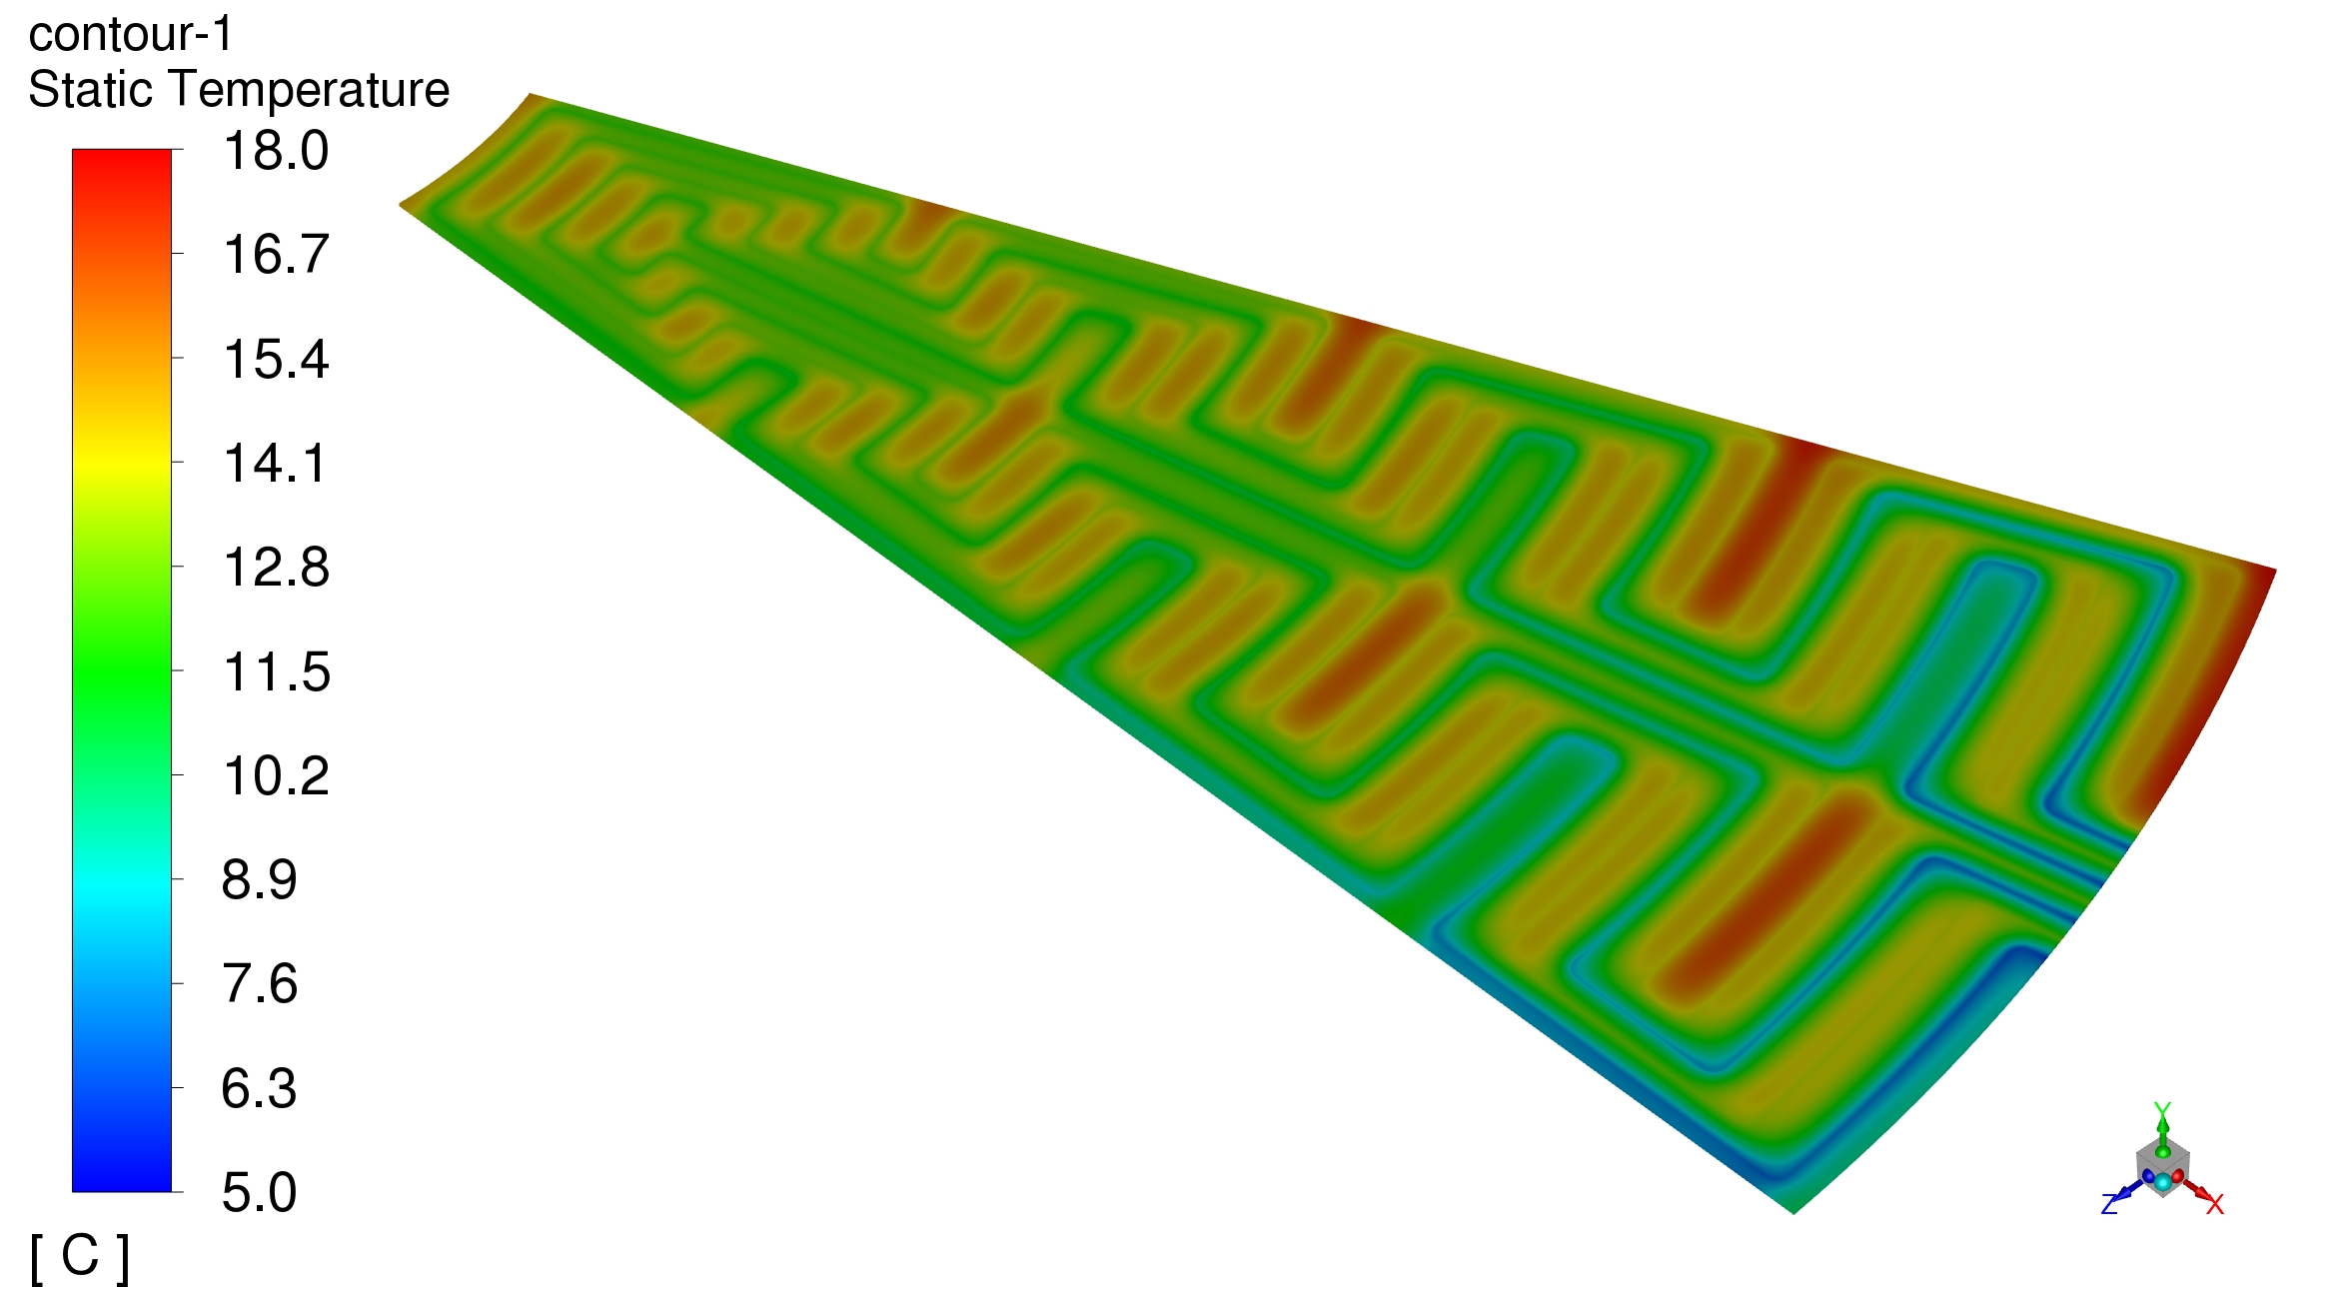
5.4.4.2.3 Thermal characterisition
The mesh generation is performed for two different cooling tube arrangements, and numerical solutions are obtained using the finite volume method.
The cooling performance of both arrangements is analyzed and compared.
Cooling tube diameter: 2.6 mm
Water inlet velocity: 2.5m/s
Continuous optimization is ongoing!
Xuedong Wu, Yong Liu, … (郑州轻工业大学)
24-layer cooling tube
32-layer cooling tube

Slide 13
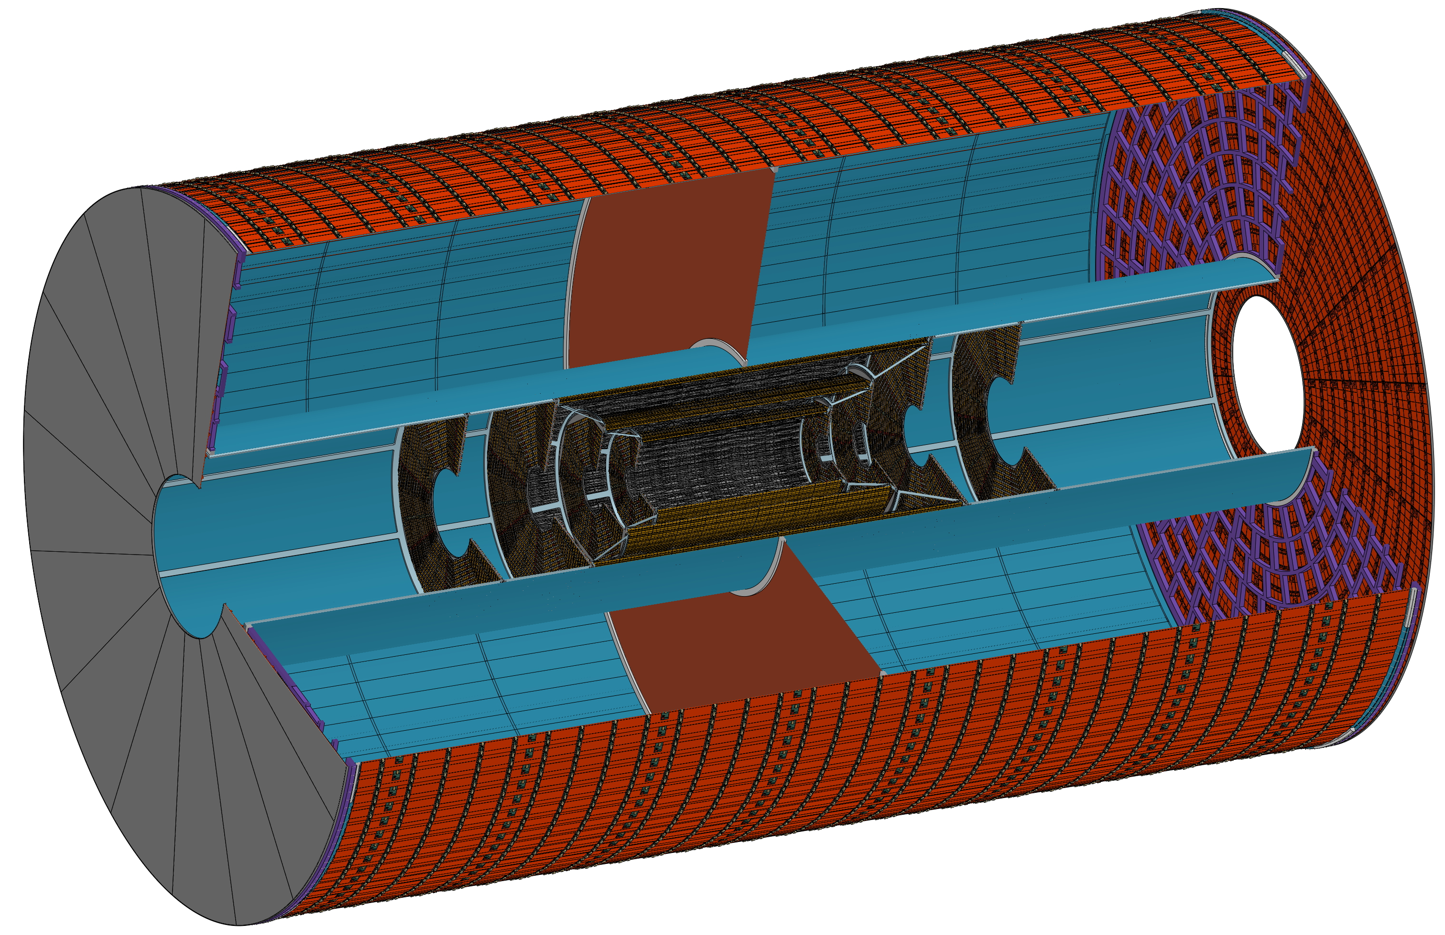
OTK Barrel
TPC
OTK Endcap
ITK Endcaps
ITK Barrels

Slide 14
Thank you！

