Slide 1

Transverse Momentum Dependent Distributions from Lattice QCD
Wei Wang
Shanghai Jiao Tong University
第五届量子场论及其应用研讨会
Notes:
各位老师，同学，大家下午好，我是来自上海交通大学的谭金鑫，很荣幸能来到这次重味高精度计算研讨会和各位同行进行交流。我的报告题目是Collins-Soper Kernel from Lattice QCD
1

Slide 2
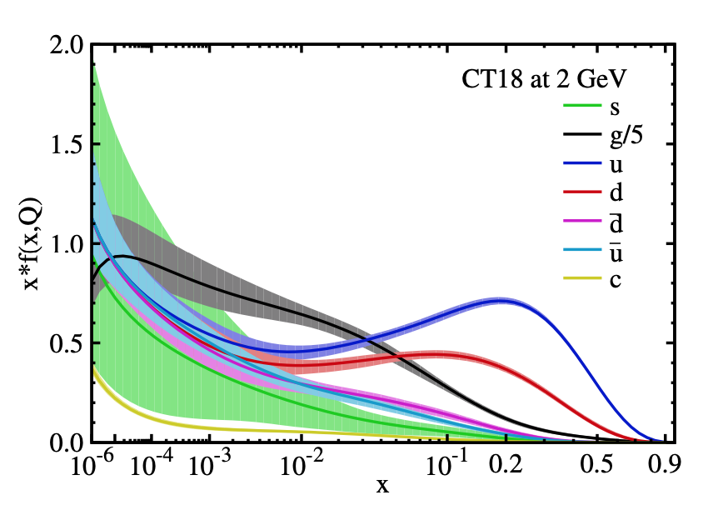
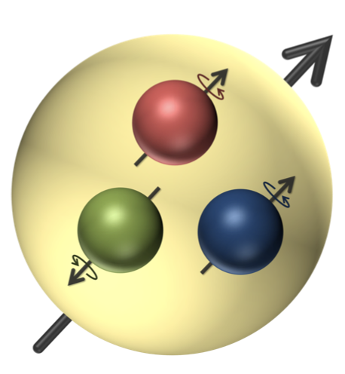
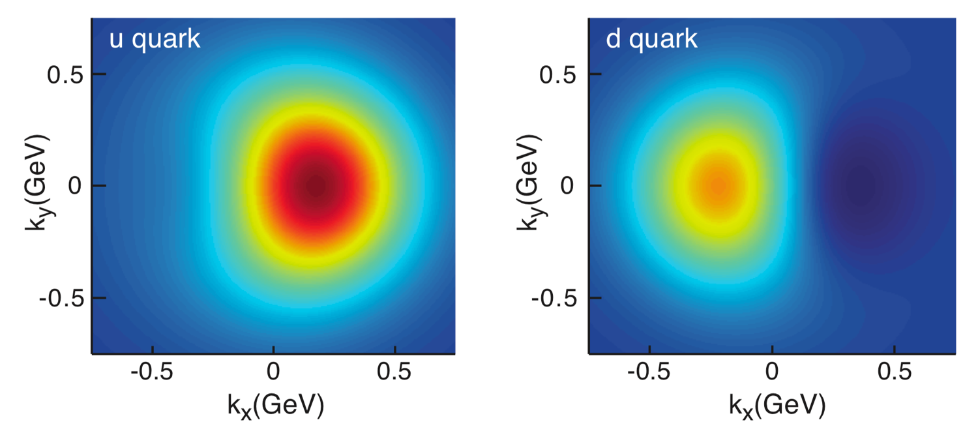

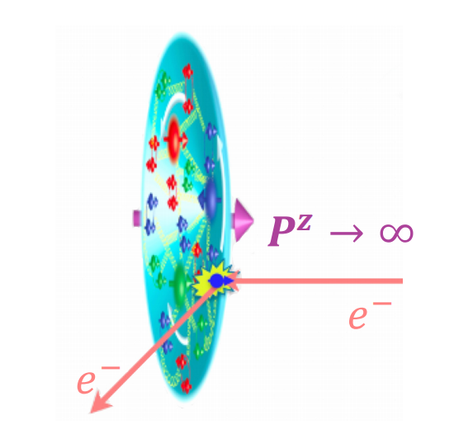
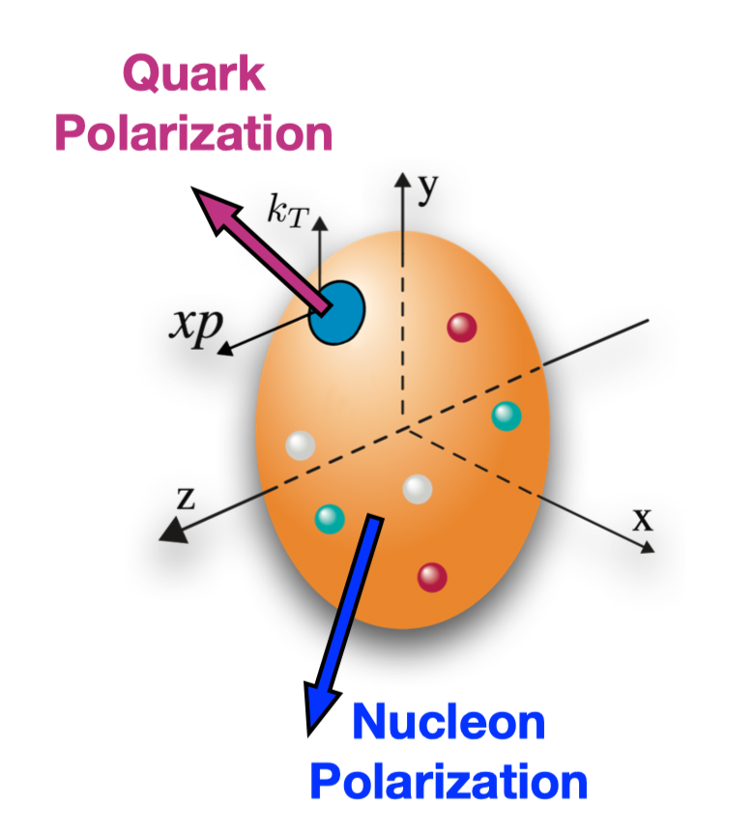



TMDs: 3D hadron Structure
2
EIC and EicC
PRD103, 014013 (2021)
0D: spin and mass
1D: PDF
3D: TMDs

Slide 3
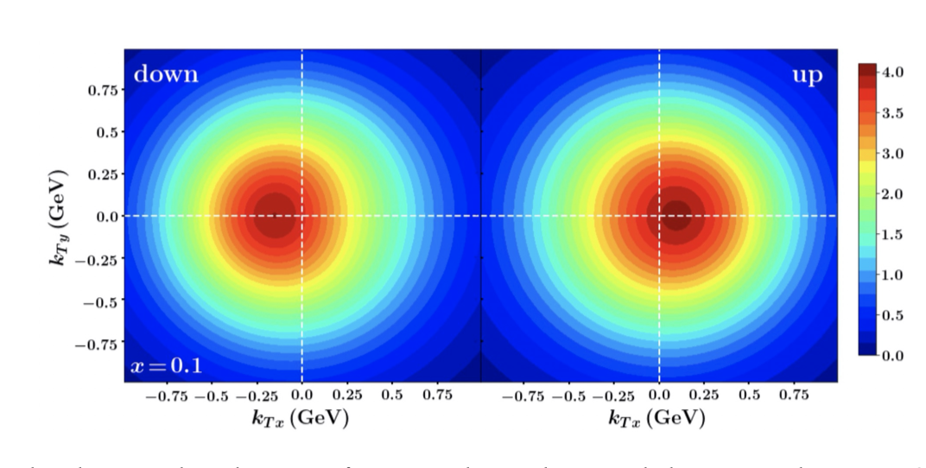
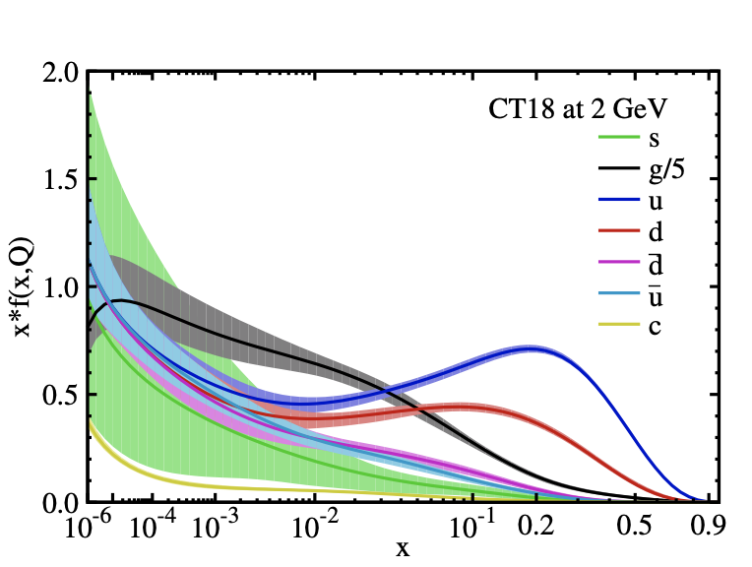
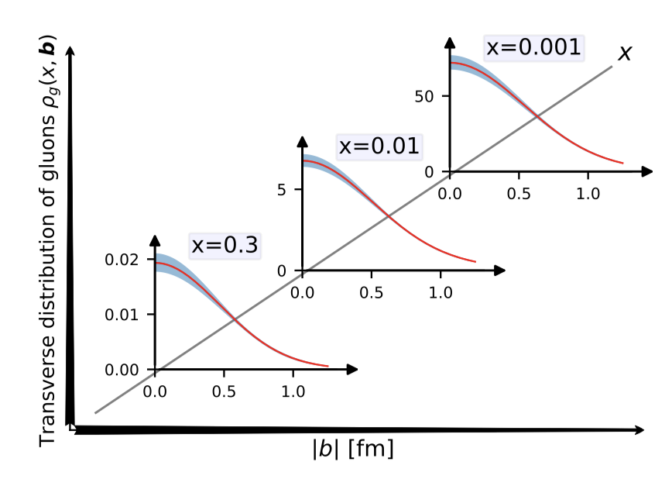
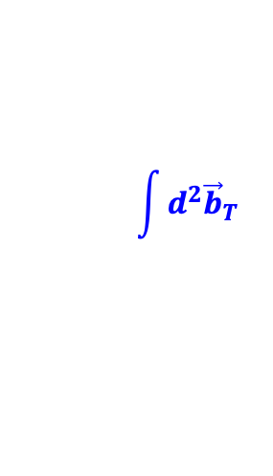
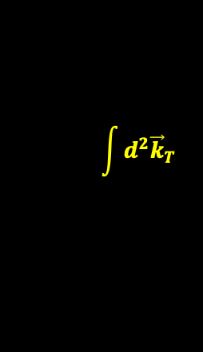
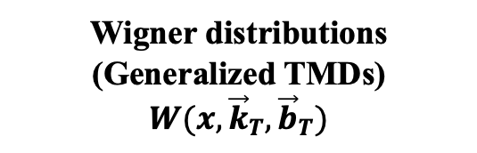
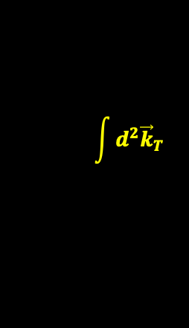

TMDs: 3D hadron Structure
3
Transvers momentum distributions (TMDs)
Wigner distributions
(Generalized TMDs)
$$W(x,{\vec{k}}_{T},{\vec{b}}_{T})$$
$$\int{d^{2}{\vec{b}}_{T}}$$
JAM, PRD102, 054002 (2020)
$$\int{d^{2}{\vec{k}}_{T}}$$
$$\int{d^{2}{\vec{k}}_{T}}$$
Generalized parton distributions (GPDs)
Parton distribution functions (PDFs)
$$\int{d^{2}{\vec{b}}_{T}}$$
Guo, 2509.08037
CTEQ, PRD103, 014013(2021)

Slide 4
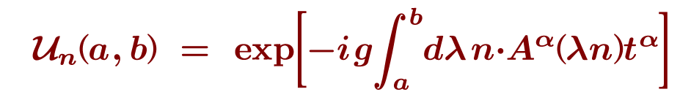











TMDs: 3D hadron Structure
4
Gauge link:
$$⊥$$
SIDIS in IMF
Drell-Yan in IMF
$$(ξ^{−},ξ_{⊥})$$
$$t$$
$$+$$
$$t$$
$$+$$
$$0$$
Struck Quark
Virtual Photon
Virtual Photon
$$z$$
$$z$$
Target Hadron
$$−$$
Target Hadron
Struck Quark
$$−$$
Ensures gauge invariance of the distribution.
Gauge links generate initial and final state interactions.
Notes:
4

Slide 5
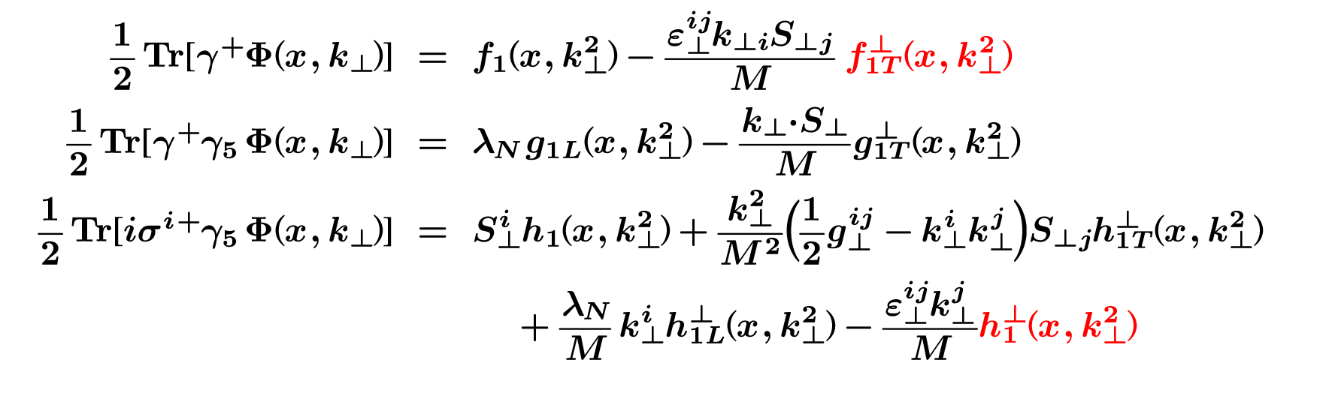

TMDs: 3D hadron Structure
5
Individual TMDs can be projected out of the correlator:
Unpolarized Quarks:
Longitudinally Polarized Quarks:
Transversely Polarized Quarks:
Notes:
5

Slide 6
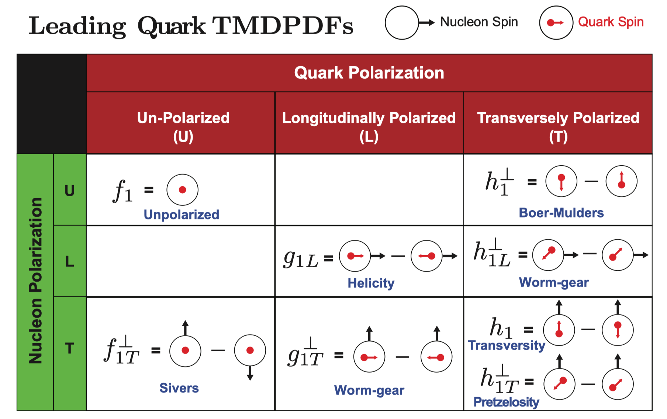
TMDs: 3D hadron Structure
6
Spin-dependent TMDPDFs
    Figure Credit:
    TMD Handbook, 2304.03302

Slide 7
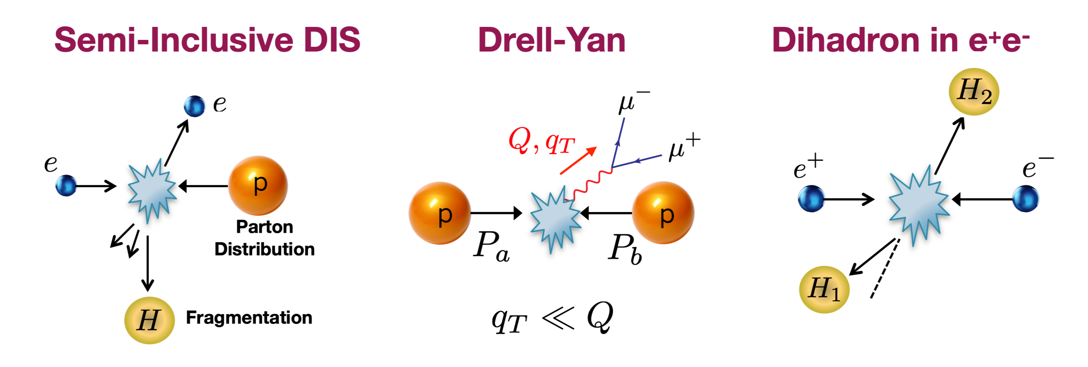
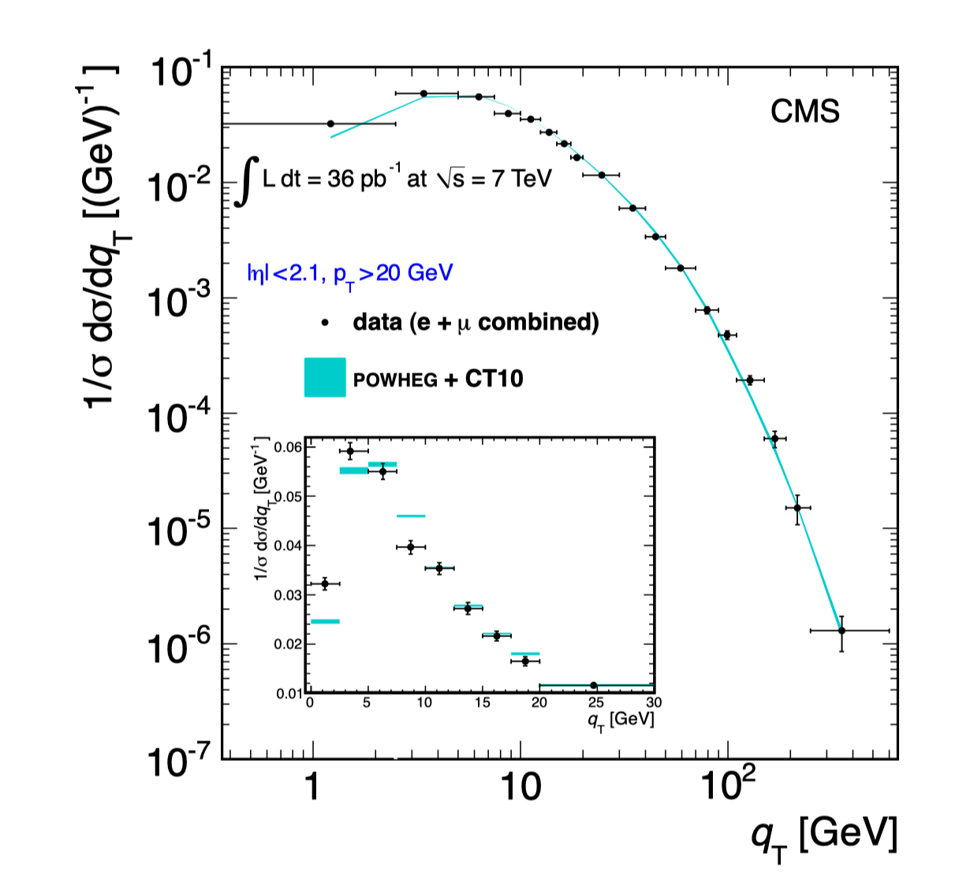

TMDPDF
7
High-$q_{T}$ region:
Collinear factorization => PDF
Phys.Rev. D85 (2012) 032002.
Notes:
7

Slide 8



TMDPDF
8
Low-$q_{T}$ region
Soft
High-$q_{T}$ region:
Collinear factorization => PDF
Low-$q_{T}$ region:
Phys.Rev. D85 (2012) 032002.
TMD factorization
=> Generalize to TMDPDFs
TMDPDF and TMDFFs are mandatory in hadron processes
Notes:
8

Slide 9
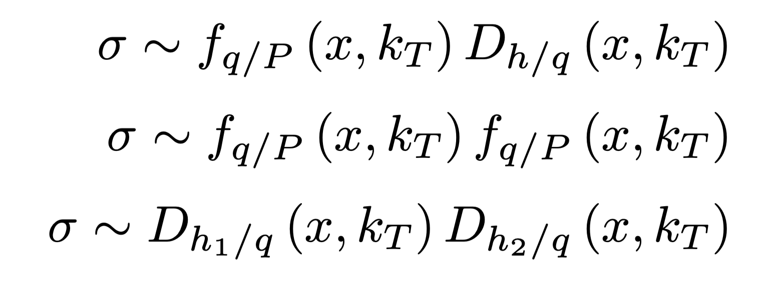
TMDPDF
9
LHC, FermiLab, RHIC, …
HERMES, COMPASS, JLab, EIC, …
BESIII, Babar, Belle, …
    Figure Credit: TMD Handbook, 2304.03302
TMDPDF and TMDFFs are mandatory in hadron processes

Slide 10
















TMD wavefunctions
10
PQCD for B-meson decays:
$$π^{+}$$
$$W^{+}$$
$${\hat{n}}_{z}$$
$$\overline{s}$$
$$\overline{u}$$
$${\hat{n}}_{⊥}$$
$$B$$
$$g$$
$$π^{−}$$
$$d$$
$$d$$
$$P^{z}$$
$$L$$
$$π$$
Keum, Li, Sanda, PRD,63,054008(2001)
Lu, Ukai, Yang, PRD, 63, 074009,2001
TMDWFs are necessary inputs for heavy meson decays.

Slide 11
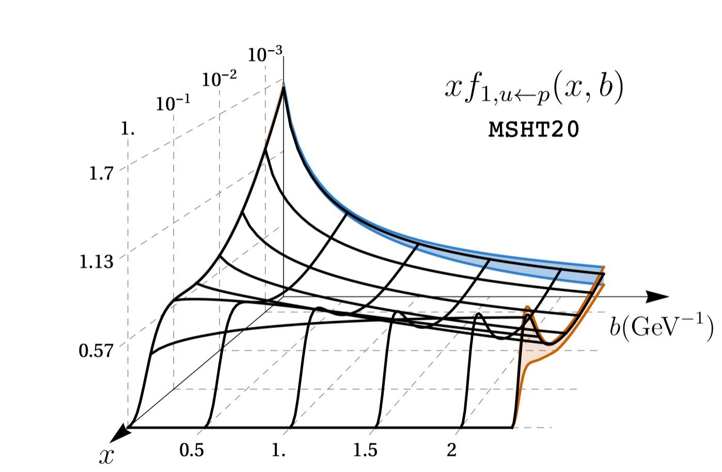
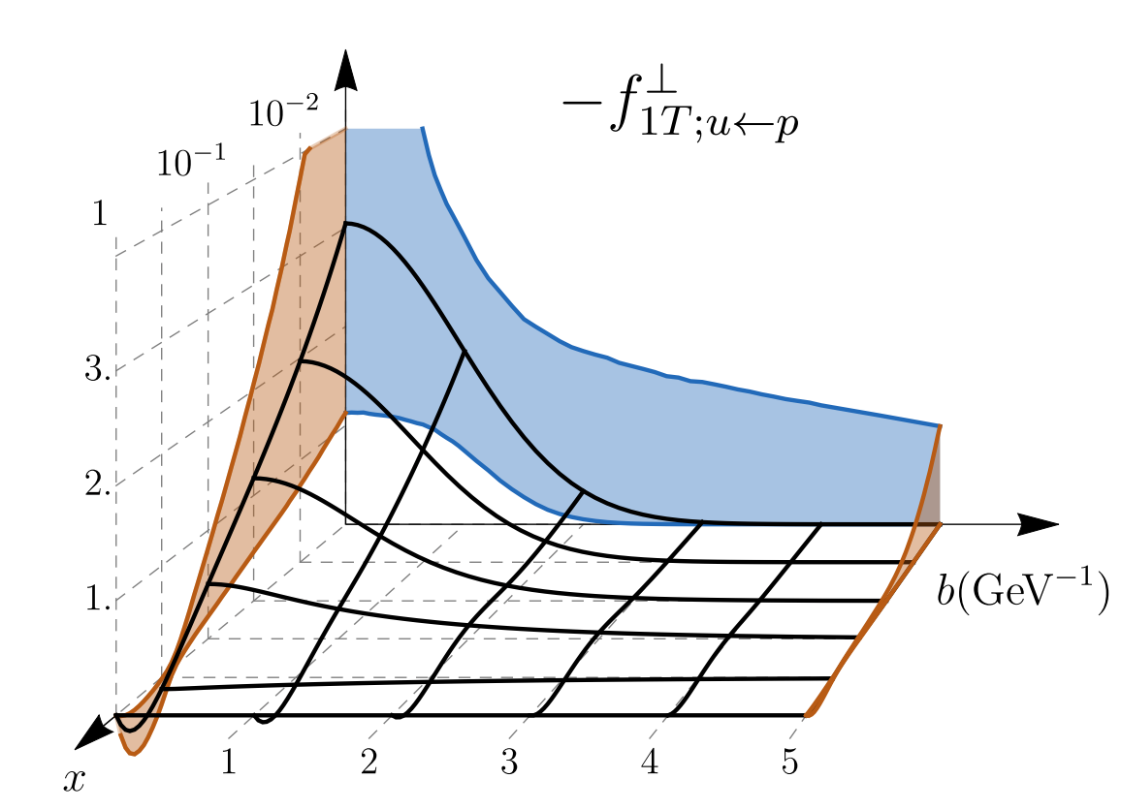
Progress in the Study of TMDPDFs
11
Theoretical analysis
  TMD factorization, evolution and resummation:
    Boussarie et al., TMD Handbook, 2304.03302;
    Collins, Foundations of perturbative QCD; ……
    Phenomenological parametrizations and extractions
      Unpolarized:
    Moos, JHEP05 (2024); Bacchetta, JHEP10 (2022);
    Scimem, JHEP06 (2020); Bacchetta, JHEP06 (2017); ……
      Sivers, Boer-Mulders：
    Bury, PRL126 (2021), JHEP05 (2021) ; Cammarota, PRD102(2020);
    Zhang, PRD77 (2008), Lu, PRD81 (2010) ; ……
      Others: worm-gear, gluon TMDs, ……
u-quark unpolarized TMDPDF, 2201.07114
u-quark Sivers function, PRL126 (2021)

Slide 12
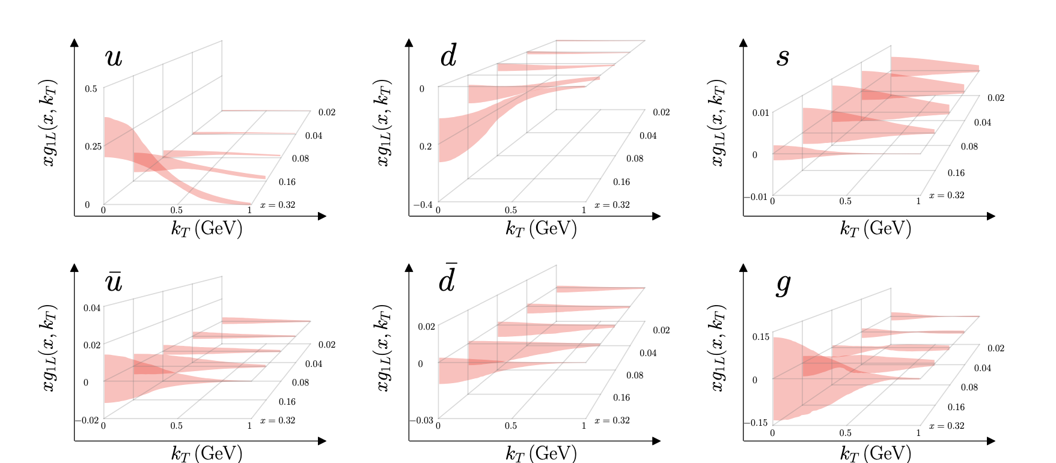
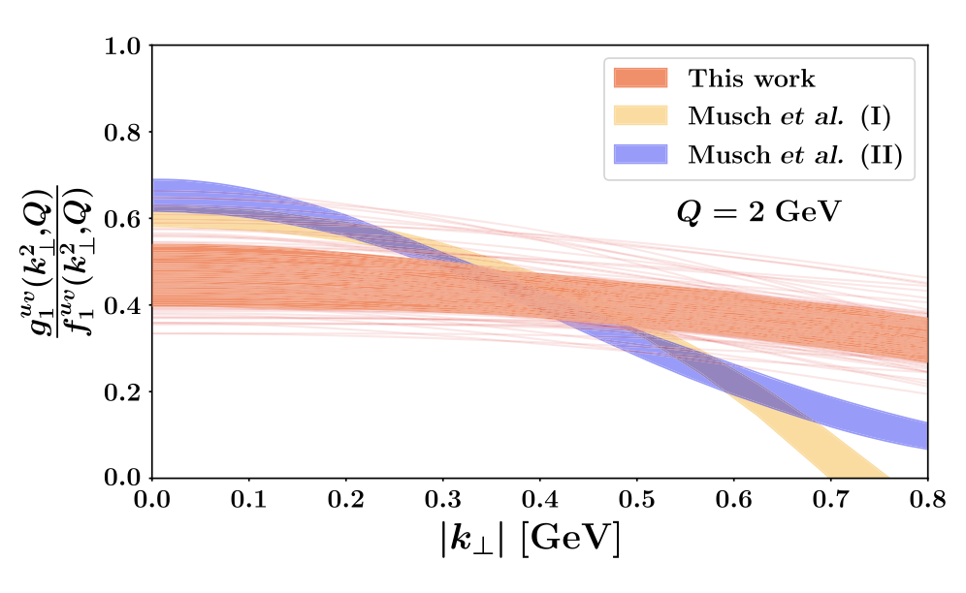
Experimental Extraction of TMDPDFs
12
Yang, Liu, Sun, Zhao, Ma, PRL 134, 121902 (2025)
MAP, PRL 134,121901 (2025)

Slide 13
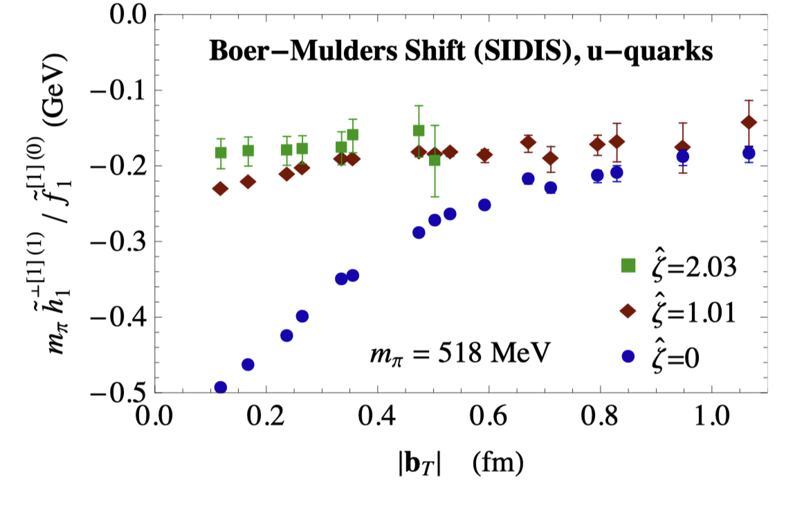
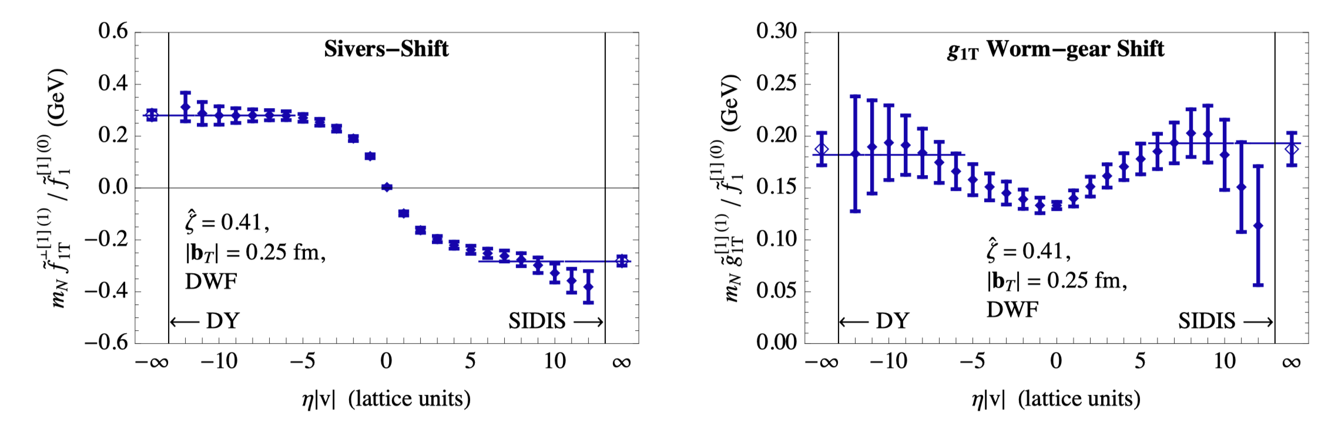
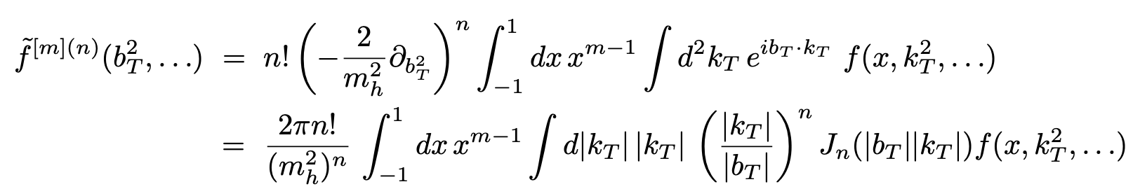
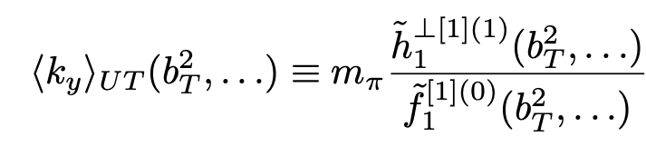
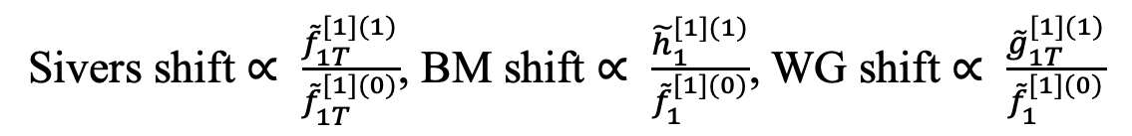
TMD from Lattice: Ratios of Mellin Moments
13
Through the OPE, TMDs can be converted into local moments that are straightforward to compute on the lattice.
The ratio eliminates the soft function.
One can extract the Boer-Mulders shift, Sivers shift, worm-gear shift, etc. from the ratio of lowest order moments:
Sivers shift $∝ \frac{{\tilde{f}}_{1T}^{[1](1)}}{{\tilde{f}}_{1T}^{[1](0)}}$, BM shift $∝ \frac{{\tilde{h}}_{1}^{[1](1)}}{{\tilde{f}}_{1}^{[1](0)}}$, WG shift $∝ \frac{{\tilde{g}}_{1T}^{[1](1)}}{{\tilde{f}}_{1}^{[1](0)}}$
Engelhardt, et.al.. PRD93, 054501 (2016)
Yoon, et.al., PRD96, 094508 (2017)

Slide 14
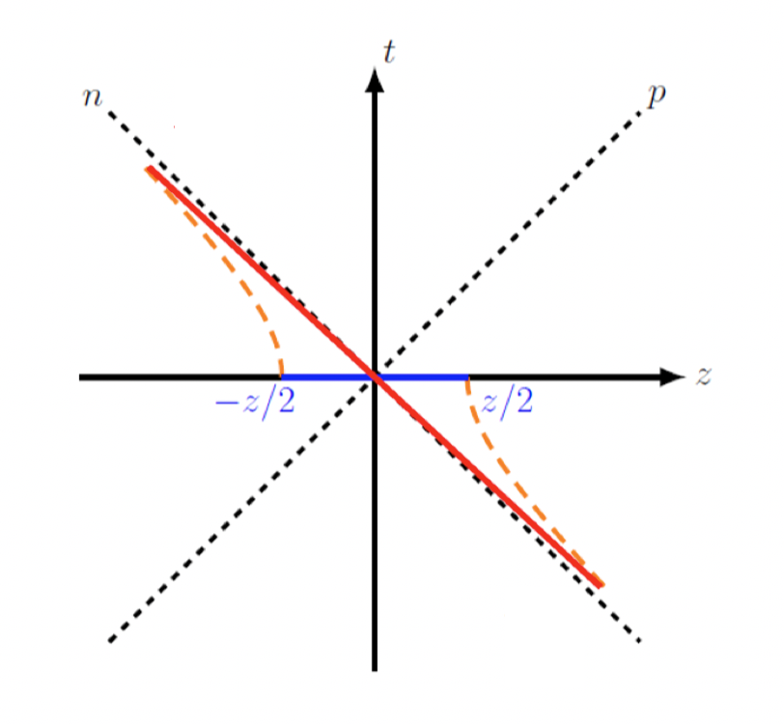
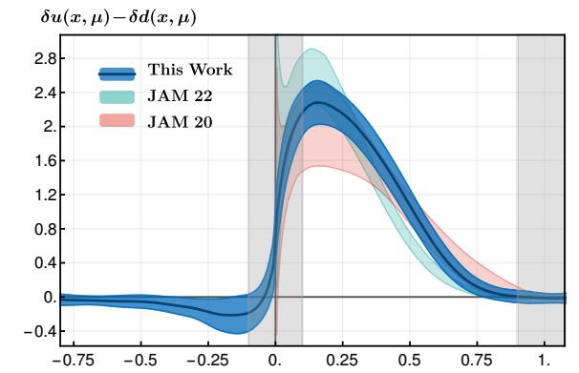
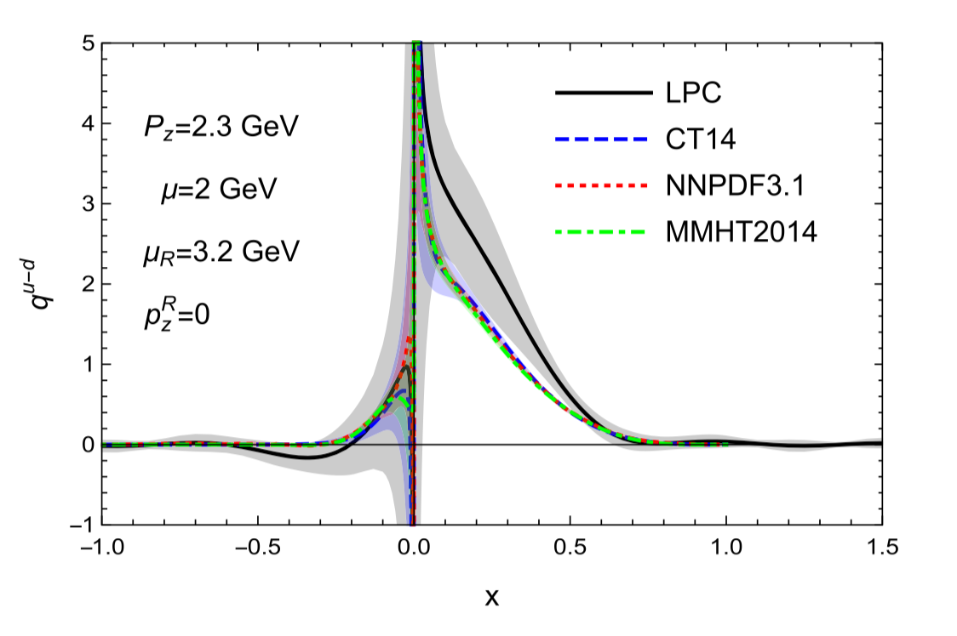
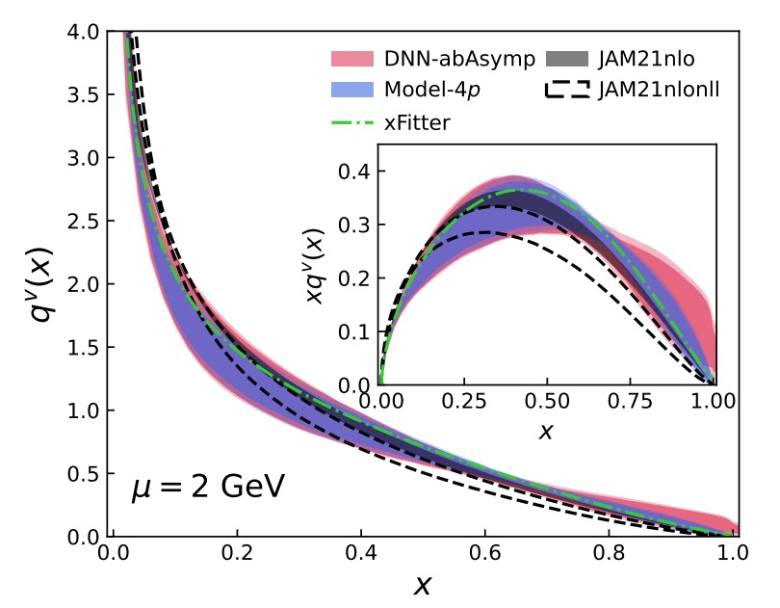

LaMET: PDFs at Lattice QCD
14
Large-momentum effective theory: connecting Euclidean lattice and physical observables
$$\frac{ξ^{−}}{\sqrt{2}}$$
Lorentz boost
EFT
$$−\frac{ξ^{−}}{\sqrt{2}}$$
Ji, PRL110(2013)
Achieved great success in the studies of PDFs and LCDA:
Proton transversity PDF, PRL131(2023)
Unpolarized isovector quark PDF PRD 101 (2020)
Pion valance PDF, PRD106(2022)

Slide 15
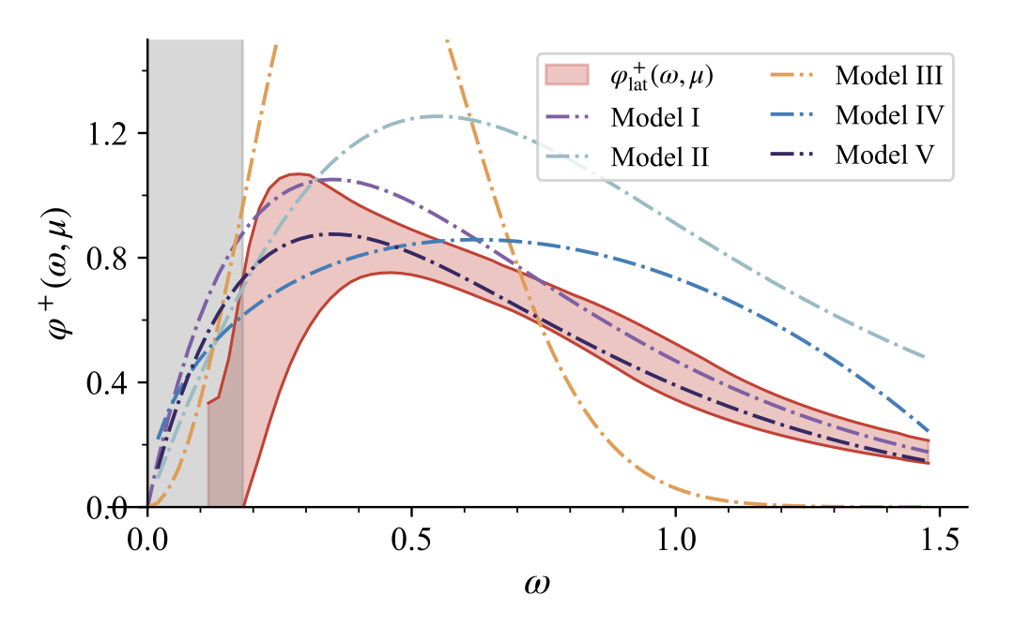
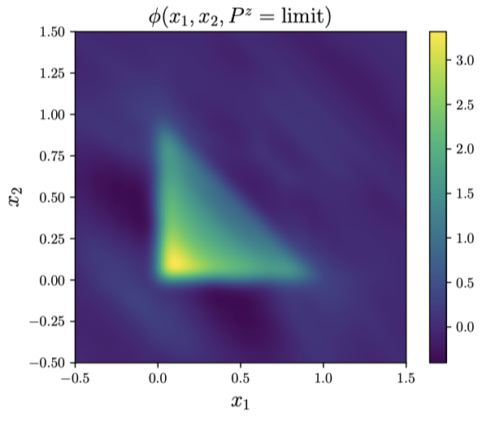
Recent Progress in LaMET
15
PDFs:
  Quark: unpolarized/helicity/transversity
  Gluon:
GPDs:
TMDPDFs：
Deuteron PDFs：
LCDAs:
  Pion, K, K*
  Heavy meson LCDA:
  Baryon LCDA：
PRD 111, L111503 & 034503(2025)
PRD 111, 034510 (2025)
Apologize for unable list all relevant references and many results can be found in:
Ji, Liu, Liu, Zhang, Zhao,Rev. Mod. Phys. 93, 035005 (2021)
Notes:
我将从以下三个方面进行汇报！10s
15

Slide 16
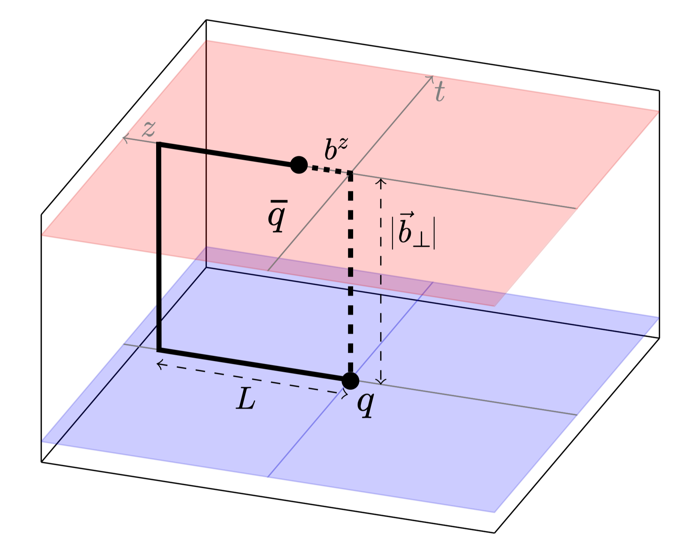
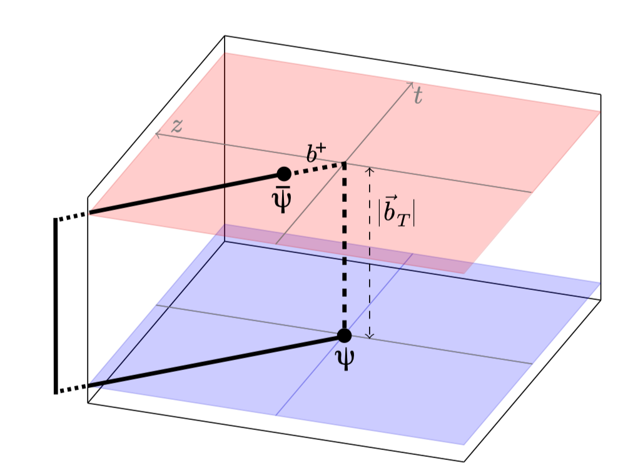

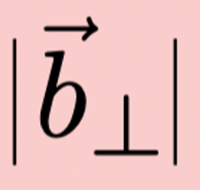

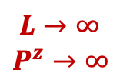
TMDs on Lattice QCD -- LaMET
16
External states
Lorentz boost
$$L→∞$$
$$P^{z}→∞$$
Equal-time correlators,
directly calculable on lattice
Space-like correlators,
NO effective method for directly calculation
Connected at large-momentum limit
Ji, PLB811(2020); Ebert, JHEP 09 (2019), JHEP04(2022)
Perturbative matching kernel
$${\tilde{f}}_{Γ}(x,b_{⊥},μ,ζ^{z})S_{I}^{\frac{1}{2}}(b_{⊥},μ)=H_{Γ}(ζ^{z},μ)\exp\left[\frac{1}{2}K(b_{⊥},μ)\ln{\frac{ζ^{z}−iε}{ζ}}\right]f(x,b_{⊥},μ,ζ)+𝓞(\frac{Λ_{\text{QCD}}^{2}}{ζ^{z}},\frac{M^{2}}{(P^{z})^{2}},\frac{1}{b_{⊥}^{2}ζ^{z}})$$
Quasi TMDs
Intrinsic soft function
Collins-Soper kernel
TMDs

Slide 17

TMDs on Lattice QCD -- LaMET
17
External states
Lorentz boost
$$L→∞$$
$$P^{z}→∞$$
Equal-time correlators,
directly calculable on lattice
Space-like correlators,
NO effective method for directly calculation
Connected at large-momentum limit
Ji, PLB811(2020); Ebert, JHEP 09 (2019), JHEP04(2022)
Perturbative matching kernel
LQCD
LQCD
LQCD
$${\tilde{f}}_{Γ}(x,b_{⊥},μ,ζ^{z})S_{I}^{\frac{1}{2}}(b_{⊥},μ)=H_{Γ}(ζ^{z},μ)\exp\left[\frac{1}{2}K(b_{⊥},μ)\ln{\frac{ζ^{z}−iε}{ζ}}\right]f(x,b_{⊥},μ,ζ)+𝓞(\frac{Λ_{\text{QCD}}^{2}}{ζ^{z}},\frac{M^{2}}{(P^{z})^{2}},\frac{1}{b_{⊥}^{2}ζ^{z}})$$
Quasi TMDs
Intrinsic soft function
Collins-Soper kernel
TMDs

Slide 18
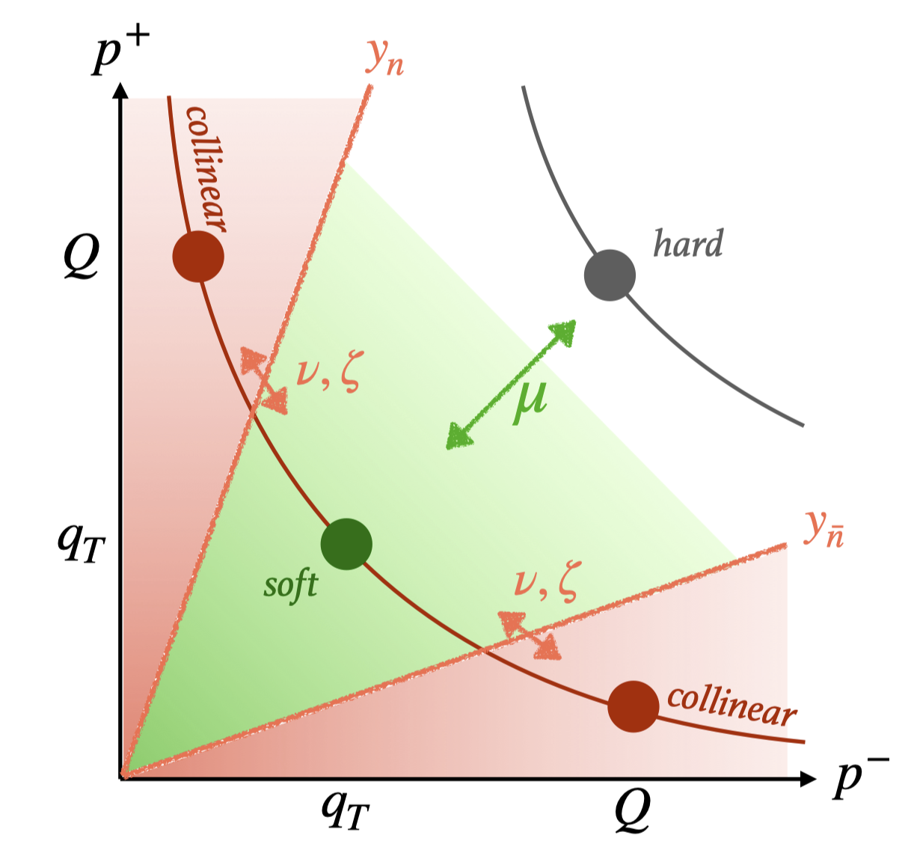
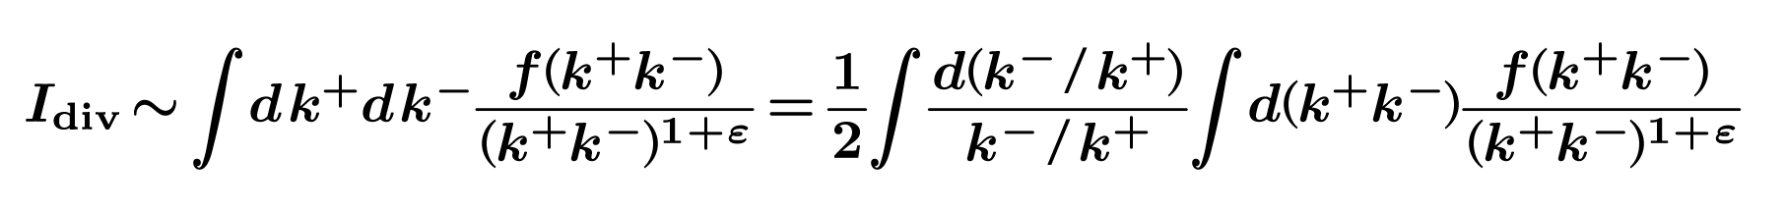
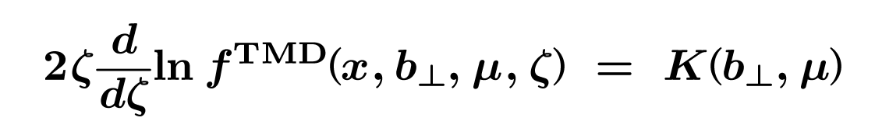


TMDs on Lattice QCD: CS kernel
18
Rapidity divergence from gluons radiation collinear to lightlike gauge link:
The divergences can be regularized by different regulators with the remanent rapidity scale depenence of TMDs governed by the Collins-Soper equation:
$$y_{k}=\frac{1}{2}\ln{\frac{k^{+}}{k^{−}}}$$
$y_{k}→±∞$: rapidity divergence
Figure: TMD Handbook, 2304.03302

Slide 19
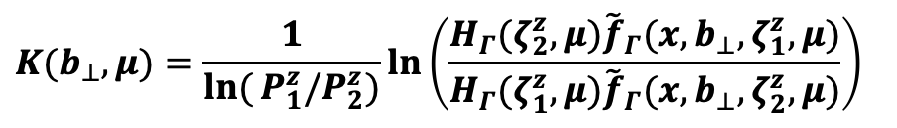
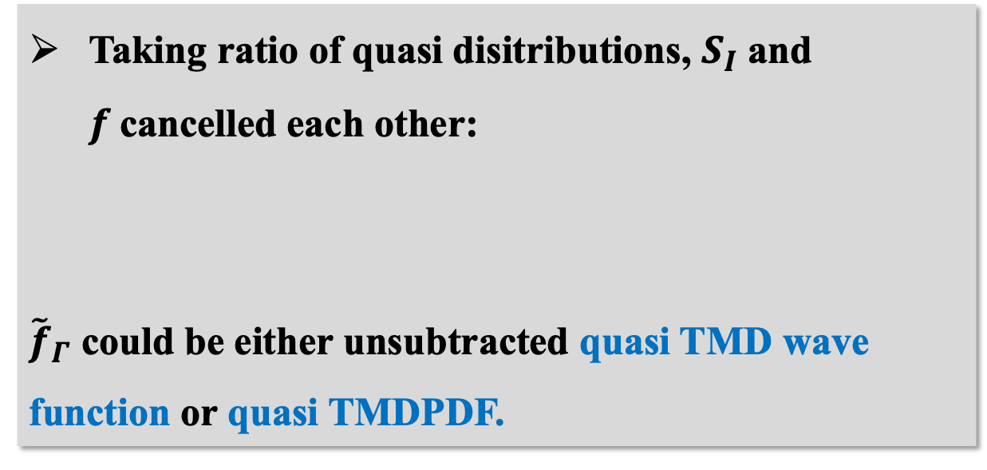
TMDs on Lattice QCD: CS kernel
19
Taking ratio of quasi disitributions, $S_{I}$ and $f$cancelled each other:
${\tilde{f}}_{Γ}$ could be either unsubtracted quasi TMD wave function or quasi TMDPDF.
$$K(b_{⊥},μ)=\frac{1}{\ln{(}P_{1}^{z}/P_{2}^{z})}\ln\left(\frac{H_{Γ}(ζ_{2}^{z},μ){\tilde{f}}_{Γ}(x,b_{⊥},ζ_{1}^{z},μ)}{H_{Γ}(ζ_{1}^{z},μ){\tilde{f}}_{Γ}(x,b_{⊥},ζ_{2}^{z},μ)}\right)$$
Figure: TMD Handbook, 2304.03302
$${\tilde{f}}_{Γ}(x,b_{⊥},μ,ζ^{z})S_{I}^{\frac{1}{2}}(b_{⊥},μ)=H_{Γ}(ζ^{z},μ)\exp\left[\frac{1}{2}K(b_{⊥},μ)\ln{\frac{ζ^{z}−iε}{ζ}}\right]f(x,b_{⊥},μ,ζ)+𝓞(\frac{Λ_{\text{QCD}}^{2}}{ζ^{z}},\frac{M^{2}}{(P^{z})^{2}},\frac{1}{b_{⊥}^{2}ζ^{z}})$$

Slide 20
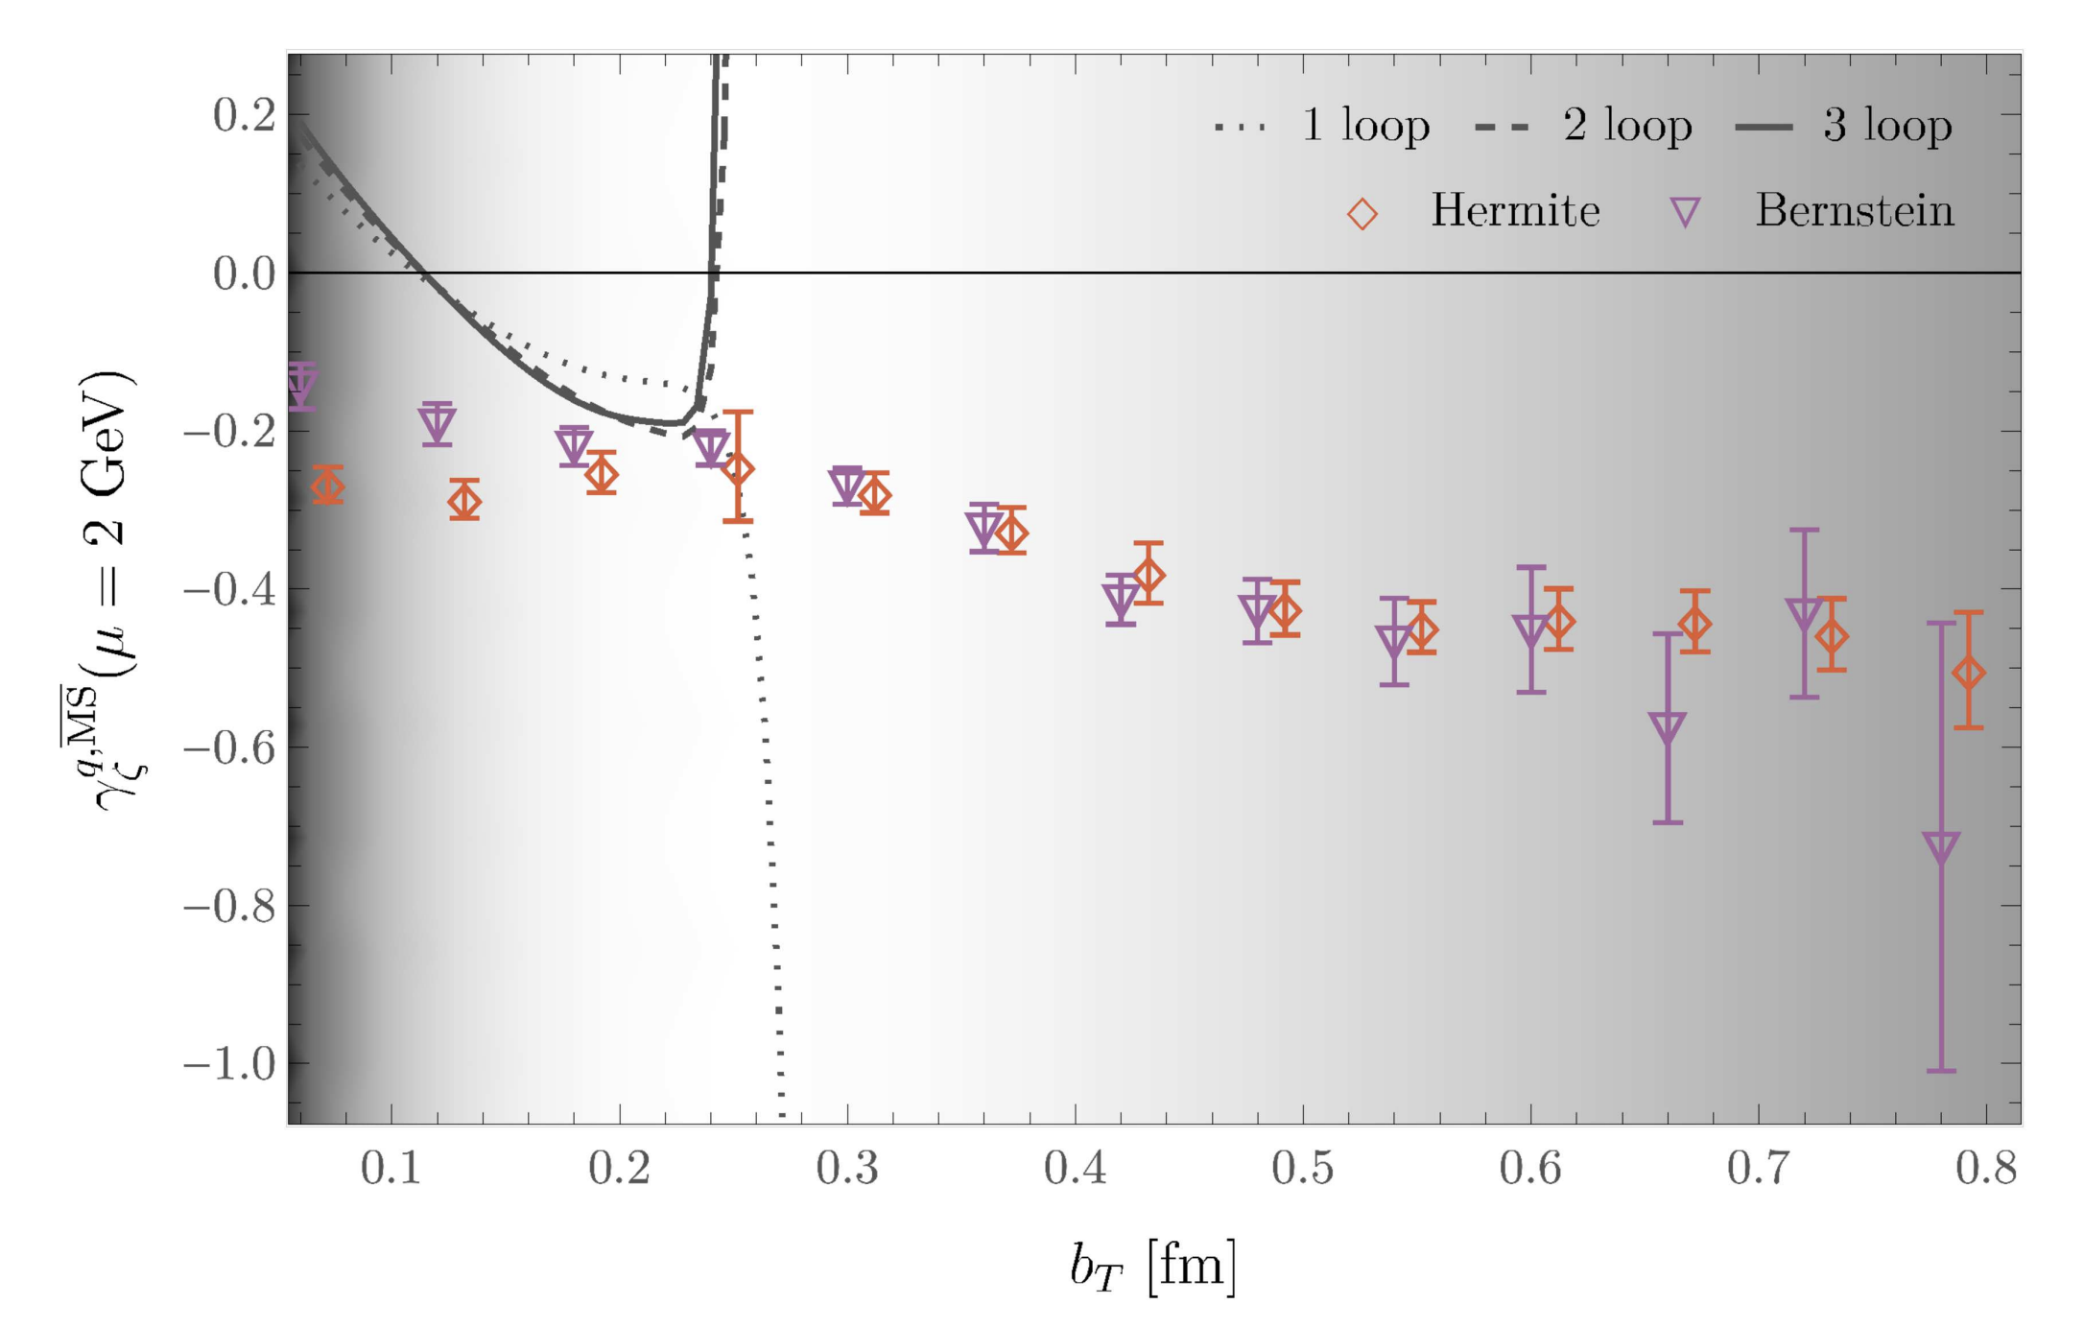
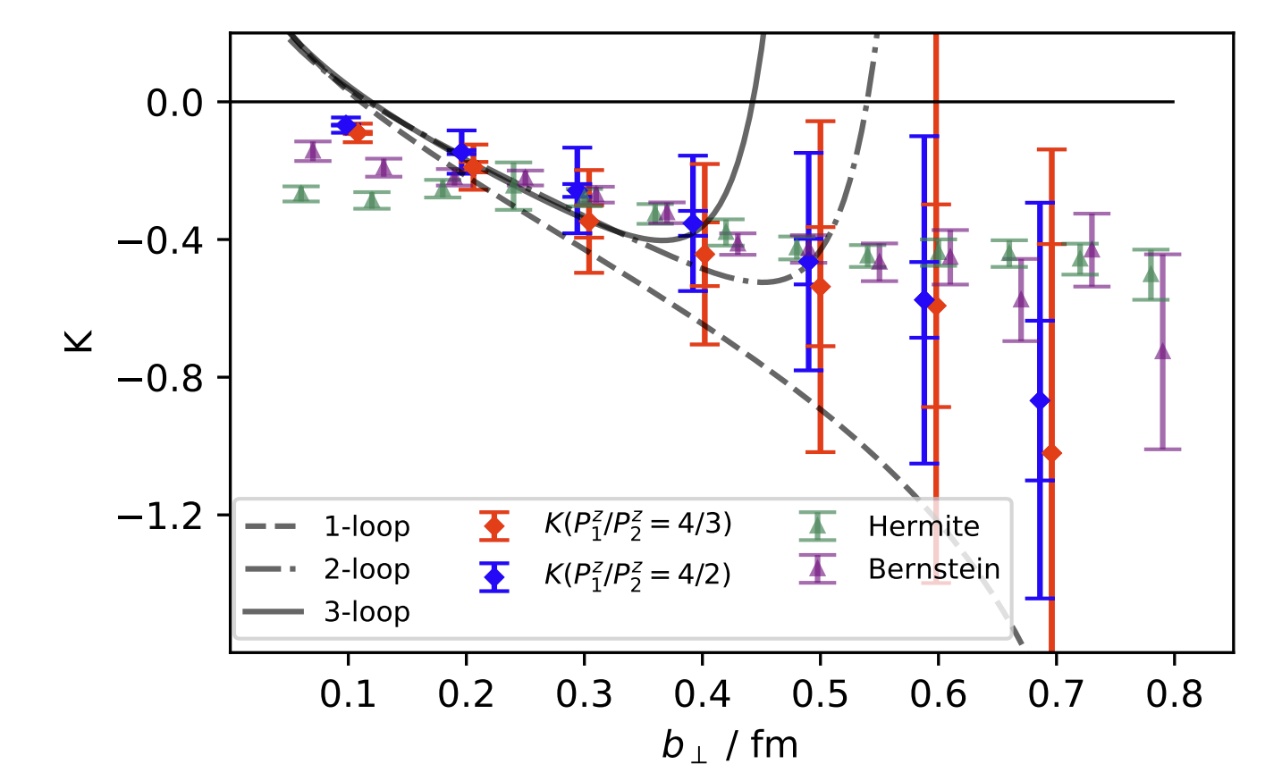
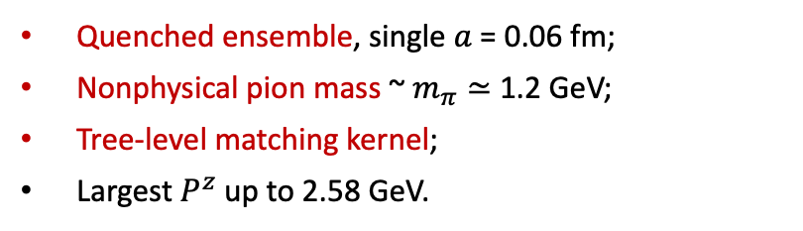
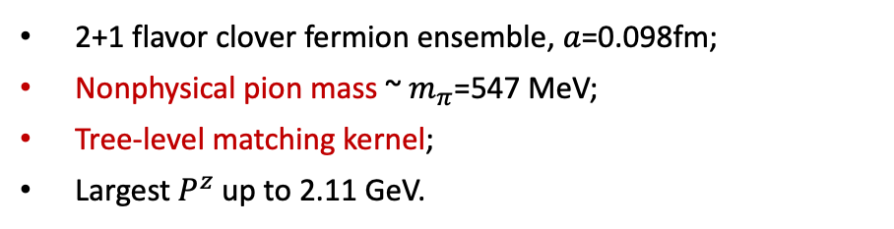
TMDs on Lattice QCD -- LaMET
20
The Origins: Two Routes to the Collins–Soper Kernel
From quasi beam function
From quasi TMDWF
LPC, PRL125,
192001 (2020)
Shanahan, Wagman and Zhao,
PRD102, 014511 (2020)
Quenched ensemble, single $a$ = 0.06 fm;
Nonphysical pion mass ~ $m_{π}≃$ 1.2 GeV;
Tree-level matching kernel;
Largest $P^{z}$ up to 2.58 GeV.
2+1 flavor clover fermion ensemble, $a$=0.098fm;
Nonphysical pion mass ~ $m_{π}$=547 MeV;
Tree-level matching kernel;
Largest $P^{z}$ up to 2.11 GeV.
Notes:
20

Slide 21
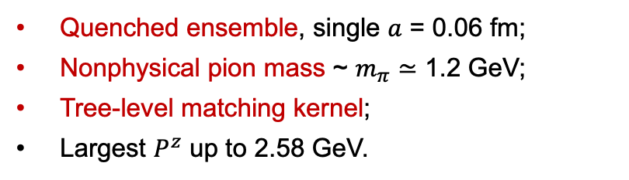
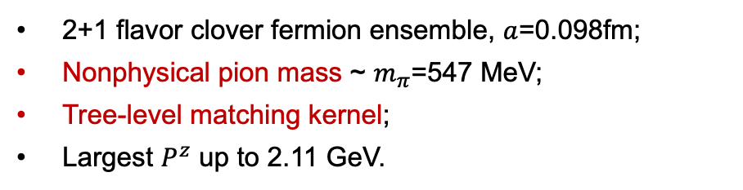
TMDs on Lattice QCD -- LaMET
21
The Origins: Two Routes to the Collins–Soper Kernel
From quasi beam function
From quasi TMDWF
LPC, PRL125,
192001 (2020)
Shanahan, Wagman and Zhao,
PRD102, 014511 (2020)
Quenched ensemble, single $a$ = 0.06 fm;
Nonphysical pion mass ~ $m_{π}≃$ 1.2 GeV;
Tree-level matching kernel;
Largest $P^{z}$ up to 2.58 GeV.
2+1 flavor clover fermion ensemble, $a$=0.098fm;
Nonphysical pion mass ~ $m_{π}$=547 MeV;
Tree-level matching kernel;
Largest $P^{z}$ up to 2.11 GeV.
2pts have better signals than 3pts on lattice, so with increasing precision, the quasi TMDWF approach is becoming mainstream.
Notes:
21

Slide 22
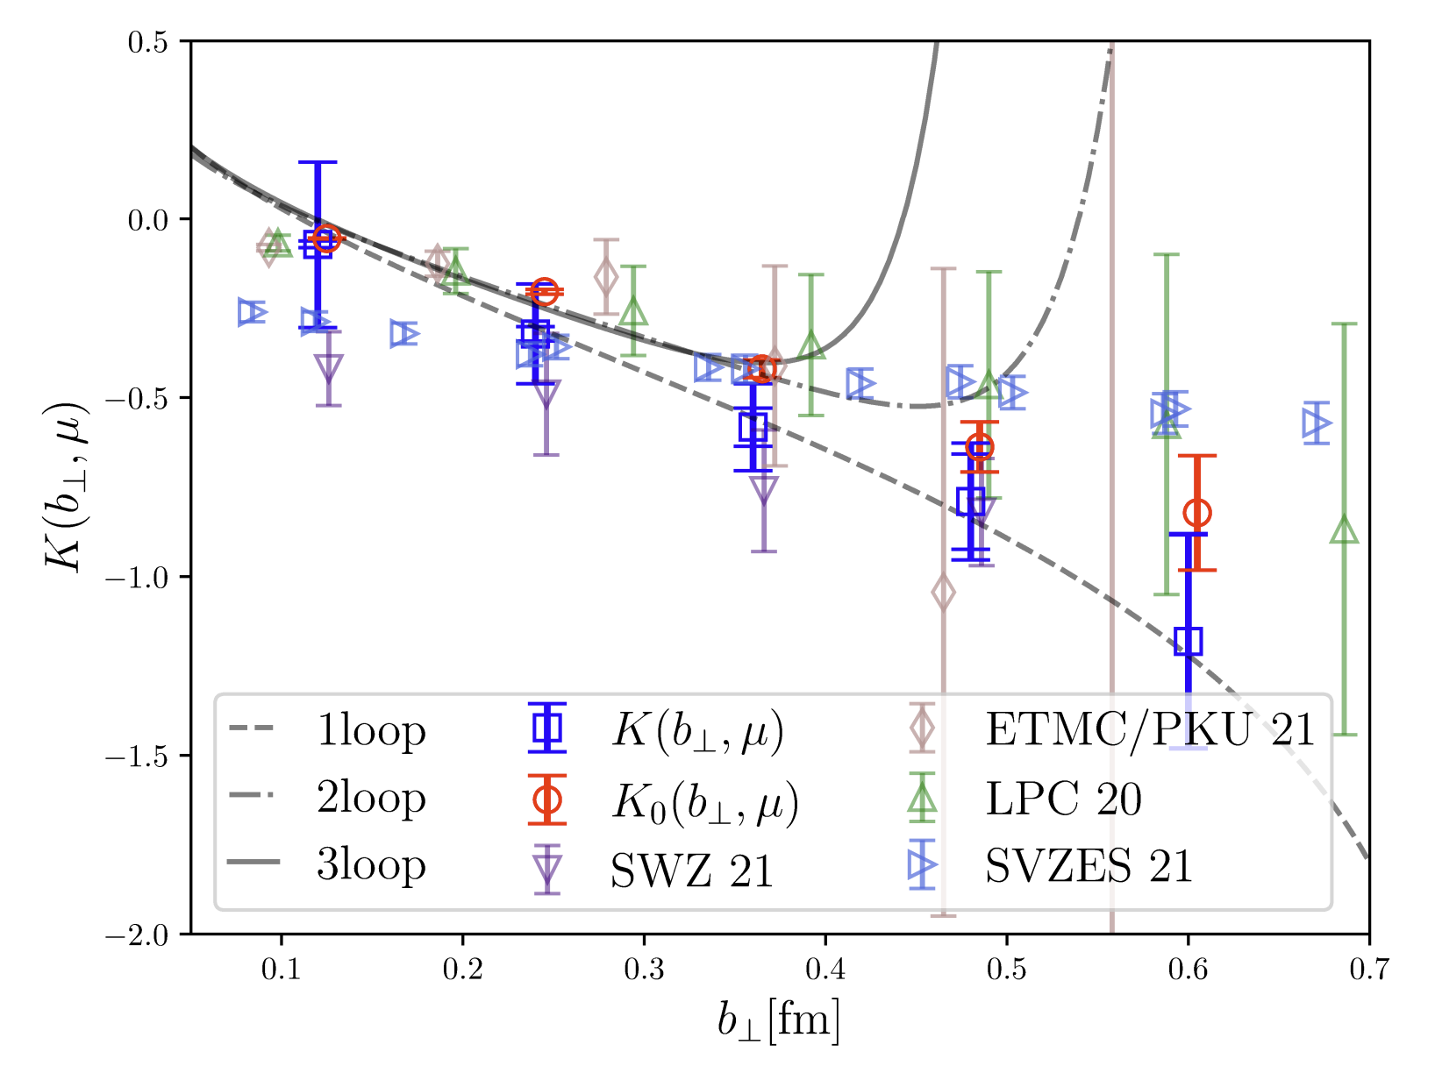
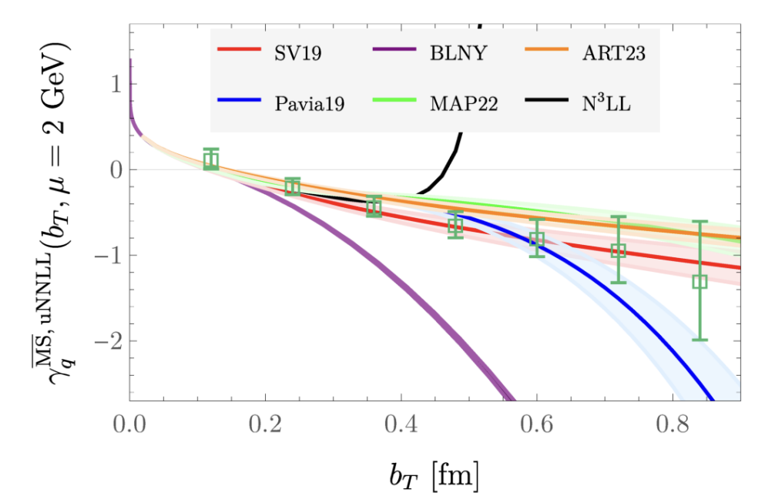


TMDs on Lattice QCD -- LaMET
22
Continuous Improvements:
LPC, PRD106, 034509 (2022)
Avkhadiev, Shanahan, Wagman and Zhao, PRD108, 114505 (2023)
Better NPR scheme for nonlocal correlators;
Infinite $P^{z}$ extrapolation;
Systematic uncertainties taken into account;
Unexpected imaginary part from NLO matching kernel.
$b_{⊥}$-unexpanded matching coefficient mitigate the unexpected imaginary part.
Perturbative matching up to NNLL accuracy.
Notes:
22

Slide 23



TMDs on Lattice QCD -- LaMET
23
Continuous Improvements:
LPC 2025, in progress
Avkhadiev, Shanahan, Wagman and Zhao, PRL132, 231901 (2024)
Physical pion mass;
Continuum limit;
Largest $P^{z}$ up to 3GeV;
Well-controlled systematic uncertainties;
Precision calculation up to 1fm.
Physical pion mass;
Continuum limit from model constrain;
Precision results with well-controlled systematic uncertainties.
Notes:
23

Slide 24

TMDs on Lattice QCD -- LaMET
24
Authors/ Collaboration | Pion mass | Continuum | Method | Matching Kernel | Largest $P^{z}$ | Reliable $b_{⊥}^{max}$ | Systematic Uncertainty | Highlights
SWZ PRD102, 2020 | 1.2 GeV | No | Quasi beam function | LO | 2.58 GeV | 0.8 fm | No | First CS kernel extraction via quasi beam function. Quenched ensemble. Long-range extrapolation via models.
LPC PRL125, 2020 | 547 MeV | No | Quasi TMDWF | LO | 2.11 GeV | 0.4 fm | No | First extraction via quasi TMDWF. Dynamical ensemble.
SVZES JHEP08, 2021 | 422 MeV | No | Mellin moments of quasi TMDPDF | -- | 2.27 GeV | 0.5 fm | Estimated but not included | Extraction from the ratios of first Mellin moments. Discussed the sources of systematic uncertainties.
SWZ PRD104, 2021 | 538 MeV | No | Quasi beam function | NLO | 1.5 GeV | 0.5 fm | No | Operator mixing effect in NPR. Power corrections and higher-twist effects. Considering NLO matching effects.
PKU/ETMC PRL128, 2022 | 827 MeV | No | Quasi TMDWF | LO | 3.3 GeV | 0.3 fm | No | RI’/MOM renormalization.
LPC PRD106, 2022 | 670 MeV | No | Quasi TMDWF | NLO | 2.58 GeV | 0.6 fm | Yes | Wilson loop renormalization. Higher-twist effects in operators. Direction of staple-shaped Wilson link. Infinite-$P^{z}$ extrapolation. Systematic uncertainties are taken into account.
S⁴VWEY PRD108, 2023 | 686 MeV | No | Mellin moments of quasi TMDPDF | -- | 1.36 GeV | 0.4 fm | No | Universality of CS kernel from twist-2/3 quasi TMDPDFs of pion and proton
Notes:
24

Slide 25

TMDs on Lattice QCD -- LaMET
25
Authors/ Collaboration | Pion mass | Continuum | Method | Matching Kernel | Largest $P^{z}$ | Reliable $b_{⊥}^{max}$ | Systematic Uncertainty | Highlights
LPC JHEP08, 2023 | 220 MeV | No | Quasi TMDWF | NLO | 3.16 GeV | 0.6 fm | Yes | Consistency check between two different actions. Multiple lattice spacings and pion masses, but without extrapolation.
ASWZ PRD108, 2023 | 148.8 MeV | No | Quasi TMDWF | uNNLL | 2.15GeV | 0.8 fm | Yes | Physical pion mass. $b_{⊥}$-unexpanded matching coefficient up to NNLL. Mitigate unexpected imaginary part in matching coefficient.
ASWZ PRL132, 2024 | 148.8 MeV | Model | Quasi TMDWF | uNNLL | 2.3GeV | 0.8 fm | Yes | Multiple lattice spacings, and model constrained continuum limit extrapolation. Calculation directly at physical pion mass.
BGHMZ PRD112, 2025 | 300 MeV | No | Quasi TMDWF | NLO | 4.3 GeV | -- (Large err.) | Yes | Coulomb gauge fixed correlators.
ABC²S³T 2509.26316 | 640 MeV | No | Quasi TMDWF | NLO | 3.33GeV | 0.5 fm | No | Higher-twist effects in quasi TMDWF.
LPC In preparation | 135.5 MeV | Yes | Quasi TMDWF | uNLO | 3.0 GeV | 1.0 fm | Yes | Precision calculation at transverse separations beyond the nucleon radius ($b_{⊥}$≈1fm). Multiple lattice spacings, continuum limit extrapolation. Multiple pion mass (including physical), and chiral extrapolation.
(*) Only the results that deviate from 0 by more than 2σ are considered.
Adapted from Yong Zhao， thanks to Huey-Wen Lin for useful comments
Notes:
25

Slide 26

















TMDs on Lattice QCD: Intrinsic Soft Function
26
Rapidity divergence from gluons radiation collinear to lightlike gauge link:
$$y_{k}=\frac{1}{2}\ln{\frac{k^{+}}{k^{−}}}$$
$y_{k}→±∞$: rapidity divergence
Rapidity divergence in TMDPDF is canceled by that in soft function:
$$l^{−}$$
TMDs
$$l^{+}$$
$$Q, q_{T}$$
$$P_{⊥}$$
$$P_{b}$$
Physical TMDs are defined as
$$b_{⊥}$$
$$P^{−}$$
$$P^{+}$$
$$P_{⊥}$$
$$P_{a}$$
$$b_{⊥}$$
$$\sim Λ_{QCD}$$
Notes:
26

Slide 27








TMDs on Lattice QCD: Intrinsic Soft Function
27
Four-quark form factor with large $P^{z}$:
$$b_{⊥}$$
$$P^{z}$$
$$P^{z}$$
$$π$$
$$π$$
$$0$$
$$t_{sep}$$
Ji, Nucl.Phys.B 955, 115054 (2020)
Factorization of form factor in the framework of LaMET:
$${\hat{n}}_{z}$$
$${\hat{n}}_{⊥}$$
perturbative matching kernel
subtracted quasi-TMD wave function
$$P^{z}$$
$$L$$
$$π$$

Slide 28

TMDs on Lattice QCD: Intrinsic Soft Function
28
Subtracted quasi-TMD wave function:
$${\hat{n}}_{z}$$
$${\hat{n}}_{⊥}$$
Intrinsic soft function:
$$P^{z}$$
$$L$$
$$π$$
Ji, Nucl.Phys.B 955, 115054 (2020)

Slide 29


TMDs on Lattice QCD: Intrinsic Soft Function
29
First Lattice Realization of the Intrinsic Soft Function:
LPC, PRL125, 192001 (2020)
2+1 flavor clover fermion CLS ensemble, $a$=0.098 fm;
Nonphysical pion mass ~ $m_{π}$=547 MeV;
LO matching kernel;
Largest $P^{z}$ up to 2.11 GeV;
Partial systematic uncertainties have been taken into account.
Notes:
29

Slide 30



TMDs on Lattice QCD: Intrinsic Soft Function
30
Continuous Improvements:
LPC, JHEP08, 172 (2023)
Alexandrou et.al, arXiv:2509.26316
Li et.al, PRL128, 062002 (2022)
Verified the robustness of the results from different ensembles.
Considering higher-twist effects in quasi TMDWF.
Eliminated higher-twist contaminations in form factors from combinations of different Dirac structures;
Verified that the intrinsic soft function is essentially independent of the meson mass.
🤔
The key obstacle lies in improving the signal-to-noise ratio of the form factor.
Notes:
30

Slide 31


TMDs on Lattice QCD: Intrinsic Soft Function
31
Continuous Improvements:
Under Coulomb gauge fixing, Wilson lines vanish, signal-to-noise ratio can be significantly improved.
Yong Zhao, Phys.Rev.Lett. 133 , 241904 (2024)
Preliminary results for the Collins-Soper kernel and intrinsic soft function have been performed.
Bollweg, Gao, He, Mukherjee, Zhao, PRD 112, 034501 (2025).

Slide 32

TMDs on Lattice QCD: Intrinsic Soft Function
Authors/ Collaboration | Pion mass | Continuum | Matching Kernel | Largest $P^{z}$ | Reliable $b_{⊥}^{max}$ | Systematic Uncertainty | Highlights
LPC PRL125, 2020 | 547 MeV | No | LO | 2.11 GeV | 0.7 fm | No | First lattice QCD calculation. Operator mixing effects in NPR.
PKU/ETMC PRL128, 2022 | 350-827 MeV | No | LO | 3.3 GeV | 0.7 fm | No | Higher-twist effects in form factors. Verified the independent of meson mass.
LPC JHEP08, 2023 | 670 MeV | No | NLO | 2.58 GeV | 0.6 fm | No | Consistency check between different actions.
BGHMZ PRD112, 2025 | 300 MeV | No | NLO | 2.58 GeV for FF, 4.3 GeV for qWF | 1.1 fm | No | Coulomb gauge fixed correlators. Greatly improved the signal-to-noise ratio problem.
ABC²S³T 2509.26316 | 640 MeV | No | NLO | 3.33 GeV | 0.5 fm | No | Higher-twist effects in quasi TMDWF.
LPC In progress | 200-300 MeV | No | NLO | 3GeV | 1 fm | Yes
(*) Only the results that deviate from 0 by more than 2σ are considered.

Slide 33


TMDs on Lattice QCD in LaMET
33
Factorization in LaMET:
Ji, PLB811(2020); Ebert, JHEP04(2022)
Perturbative matching kernel
Intrinsic soft function
Collins-Soper kernel
Everything is ready……
Notes:
33

Slide 34




TMDs on Lattice QCD: TMD wave functions
34
The quasi-TMD wave functions can be defined as:
where the bare quasi-TMD wave function can be constructed as :
$${\tilde{Ψ}}^{±}\left(x,b_{⊥},μ,ζ_{z}\right)=\lim_{L→∞}{\int{\frac{dzP^{z}}{2π}}}e^{ixzP^{z}}\frac{{\tilde{Φ}}^{±0}\left(z,b_{⊥},P^{z},a,L\right)}{Z_{O}(μ,a)\sqrt{Z_{E}(2L+z,b_{⊥},μ,a)}},$$
$${\tilde{Φ}}^{±0}\left(z,b_{⊥},P^{z},a,L\right)=⟨0|\bar{q}(z{\hat{n}}_{z}+b_{⊥}{\hat{n}}_{⊥})ΓU_{⊐,±}(L,z,b_{⊥})q(0)|P^{z}⟩.$$
LPC, PRD109(2024); LPC, PRD 106(2022)

Slide 35


TMDs on Lattice QCD: TMD wave functions
35
LPC, PRD 109, L091503 (2024)
CLS, $a$ = 0.098 fm, and MILC, $a$ = 0.12 fm.
$m_{π}≃$ 670 MeV;
Largest $P^{z}$ up to 2.64 GeV;

Slide 36


TMDs on Lattice QCD: TMDPDFs
36
The quasi-TMD PDFs can be constructed as:
where the bare quasi-TMDPDF matrix element is:
LPC. PRD 109 (2024) 11, 114513

Slide 37

TMDs on Lattice QCD: TMDPDFs
37
The first lattice QCD calculation of nucleon unpolarized TMDPDF:
[ART 25: see talk by Valentin Moos on Tuesday ]
LPC. PRD 109 (2024) 114513

Slide 38


TMDs on Lattice QCD: TMDPDFs
38
MILC ensemble, $a=$ 0.12 fm; $m_{π}$ = (220, 310) MeV, largest $P^{z}$ up to 2.58 GeV;
Chiral and infinity momentum extrapolation;
NNLO + RGR matching kernel
The systematic uncertainty from the operator mixing has been taken into account
LPC. PRD 109 (2024) 114513

Slide 39


TMDs on Lattice QCD: Boer-Mulders Functions
39
The Boer-Mulders function is related to the probability of finding a transversely polarized quark inside an unpolarized proton:
The Boer-Mulders function is time-reversal odd (T-odd):
The Boer-Mulders function inbeds the correlation between the quark spin and its transverse momentum.
Some similarity with quantum anamolous Hall effect.
Notes:
39

Slide 40


TMDs on Lattice QCD: Boer-Mulders Functions
40
Comparison of physical Boer-Mulders TMDPDFs at different $P^{z}$and $b_{⊥}:$
LPC, PRD 111, 094507 (2025)
LPC, JHEP 08 (2025) 086

Slide 41


TMDs on Lattice QCD: Boer-Mulders Functions
41
CLS ensemble, $a=$ 0.098 fm;
$m_{π}$ = 338 MeV, largest $P^{z}$ up to 2.11 GeV;
Infinity momentum extrapolation;
NNLO + RGR matching kernel;
compare the results in the nucleon and pion.
LPC, JHEP 08 (2025) 086

Slide 42


TMDs on Lattice QCD: CG method
42
Under Coulomb gauge fixing, Wilson lines vanish, signal-to-noise ratio can be significantly improved. Yong Zhao, Phys.Rev.Lett. 133 , 241904 (2024)
Calculations of CS kernel have demonstrated this improvement, and its accuracy remains to be validated for larger separation
Preliminary result for the ratio of helicity to unpolarized TMDPDFs has been performed.
Bollweg, et.al.. PLB 852 (2024), 138617; 2505.18430

Slide 43

TMDs on Lattice QCD
43
 | Authors/ Collaboration | Pion mass | Continuum | Matching Kernel | Largest $P^{z}$ | Systematic Uncertainty
Nucleon Unpolarized TMDPDF | LPC PRD109, 2024 | 310, 220 MeV (extra to continuum) | No | NNLO | 2.58 GeV | Yes
Pion Boer-Mulders Function | LPC PRD111, 2025 | 338 MeV | No | NNLO | 2.21 GeV | No
Pion Unpolarized TMDPDF | BGHMZ PRD112, 2025 | 300 MeV | No | NLO | 3.04 GeV | No
Nucleon Boer-Mulders Function | LPC JHEP08, 2025 | 338 MeV | No | NNLO | 2.21 GeV | No
Pion TMD Wave Function | LPC PRD109, 2024 | 670 MeV | No | NLO | 2.64 GeV | No
Notes:
43

Slide 44
Summary and Outlook
44
Lattice QCD + LaMET provides a new perspective on exploring the TMD structure of hadrons.
Collins-Soper Kernel:
Intrinsic Soft Function:
TMD distributions:
Continuum limit
Physical pion mass
Power corrections
Systematic uncertainties
Reliable predictions ~ 1fm
Continuum limit
Physical pion mass
Power corrections
Systematic uncertainties
Precision predictions
Continuum limit
Physical pion mass
Power corrections
Systematic uncertainties
Spin-dependent predictions
Thank you for your attention!
Notes:
44

Slide 45
敬祝李老师八十华诞生日快乐
福寿康宁，岁月沉香
愿晨起有清欢，落日有安康，
三餐四季皆如意，岁岁年年常喜乐！

Slide 46
30
Backup
Notes:
46

Slide 47

Lattice QCD configurations
47
Lattice QCD configurations from CLQCD
PRD 109, 054507 (2024)
A new set of dynamical lattice configurations is generated.
Notes:
47

