Slide 1



第五届量子场论及其应用研讨会
Electroweak Corrections to Higgs boson production and decay
毕业论文答辩
陈龙斌
2025-10-31
答辩人：小不点 答辩时间：5.5 指导老师：大不点
With: Hai Tao Li, Wen-Long Sang, JHEP 10,194(2025)
With: Zi-qiang Chen, Cong-Feng Qiao, Ruilin Zhu, PRD 110, L051301(2024)

Slide 2

OutLine
Motivation
Electroweak corrections to Higgs boson + jet production
Precise Higgs boson rare decay study
Conclusion and Outlook

Slide 3
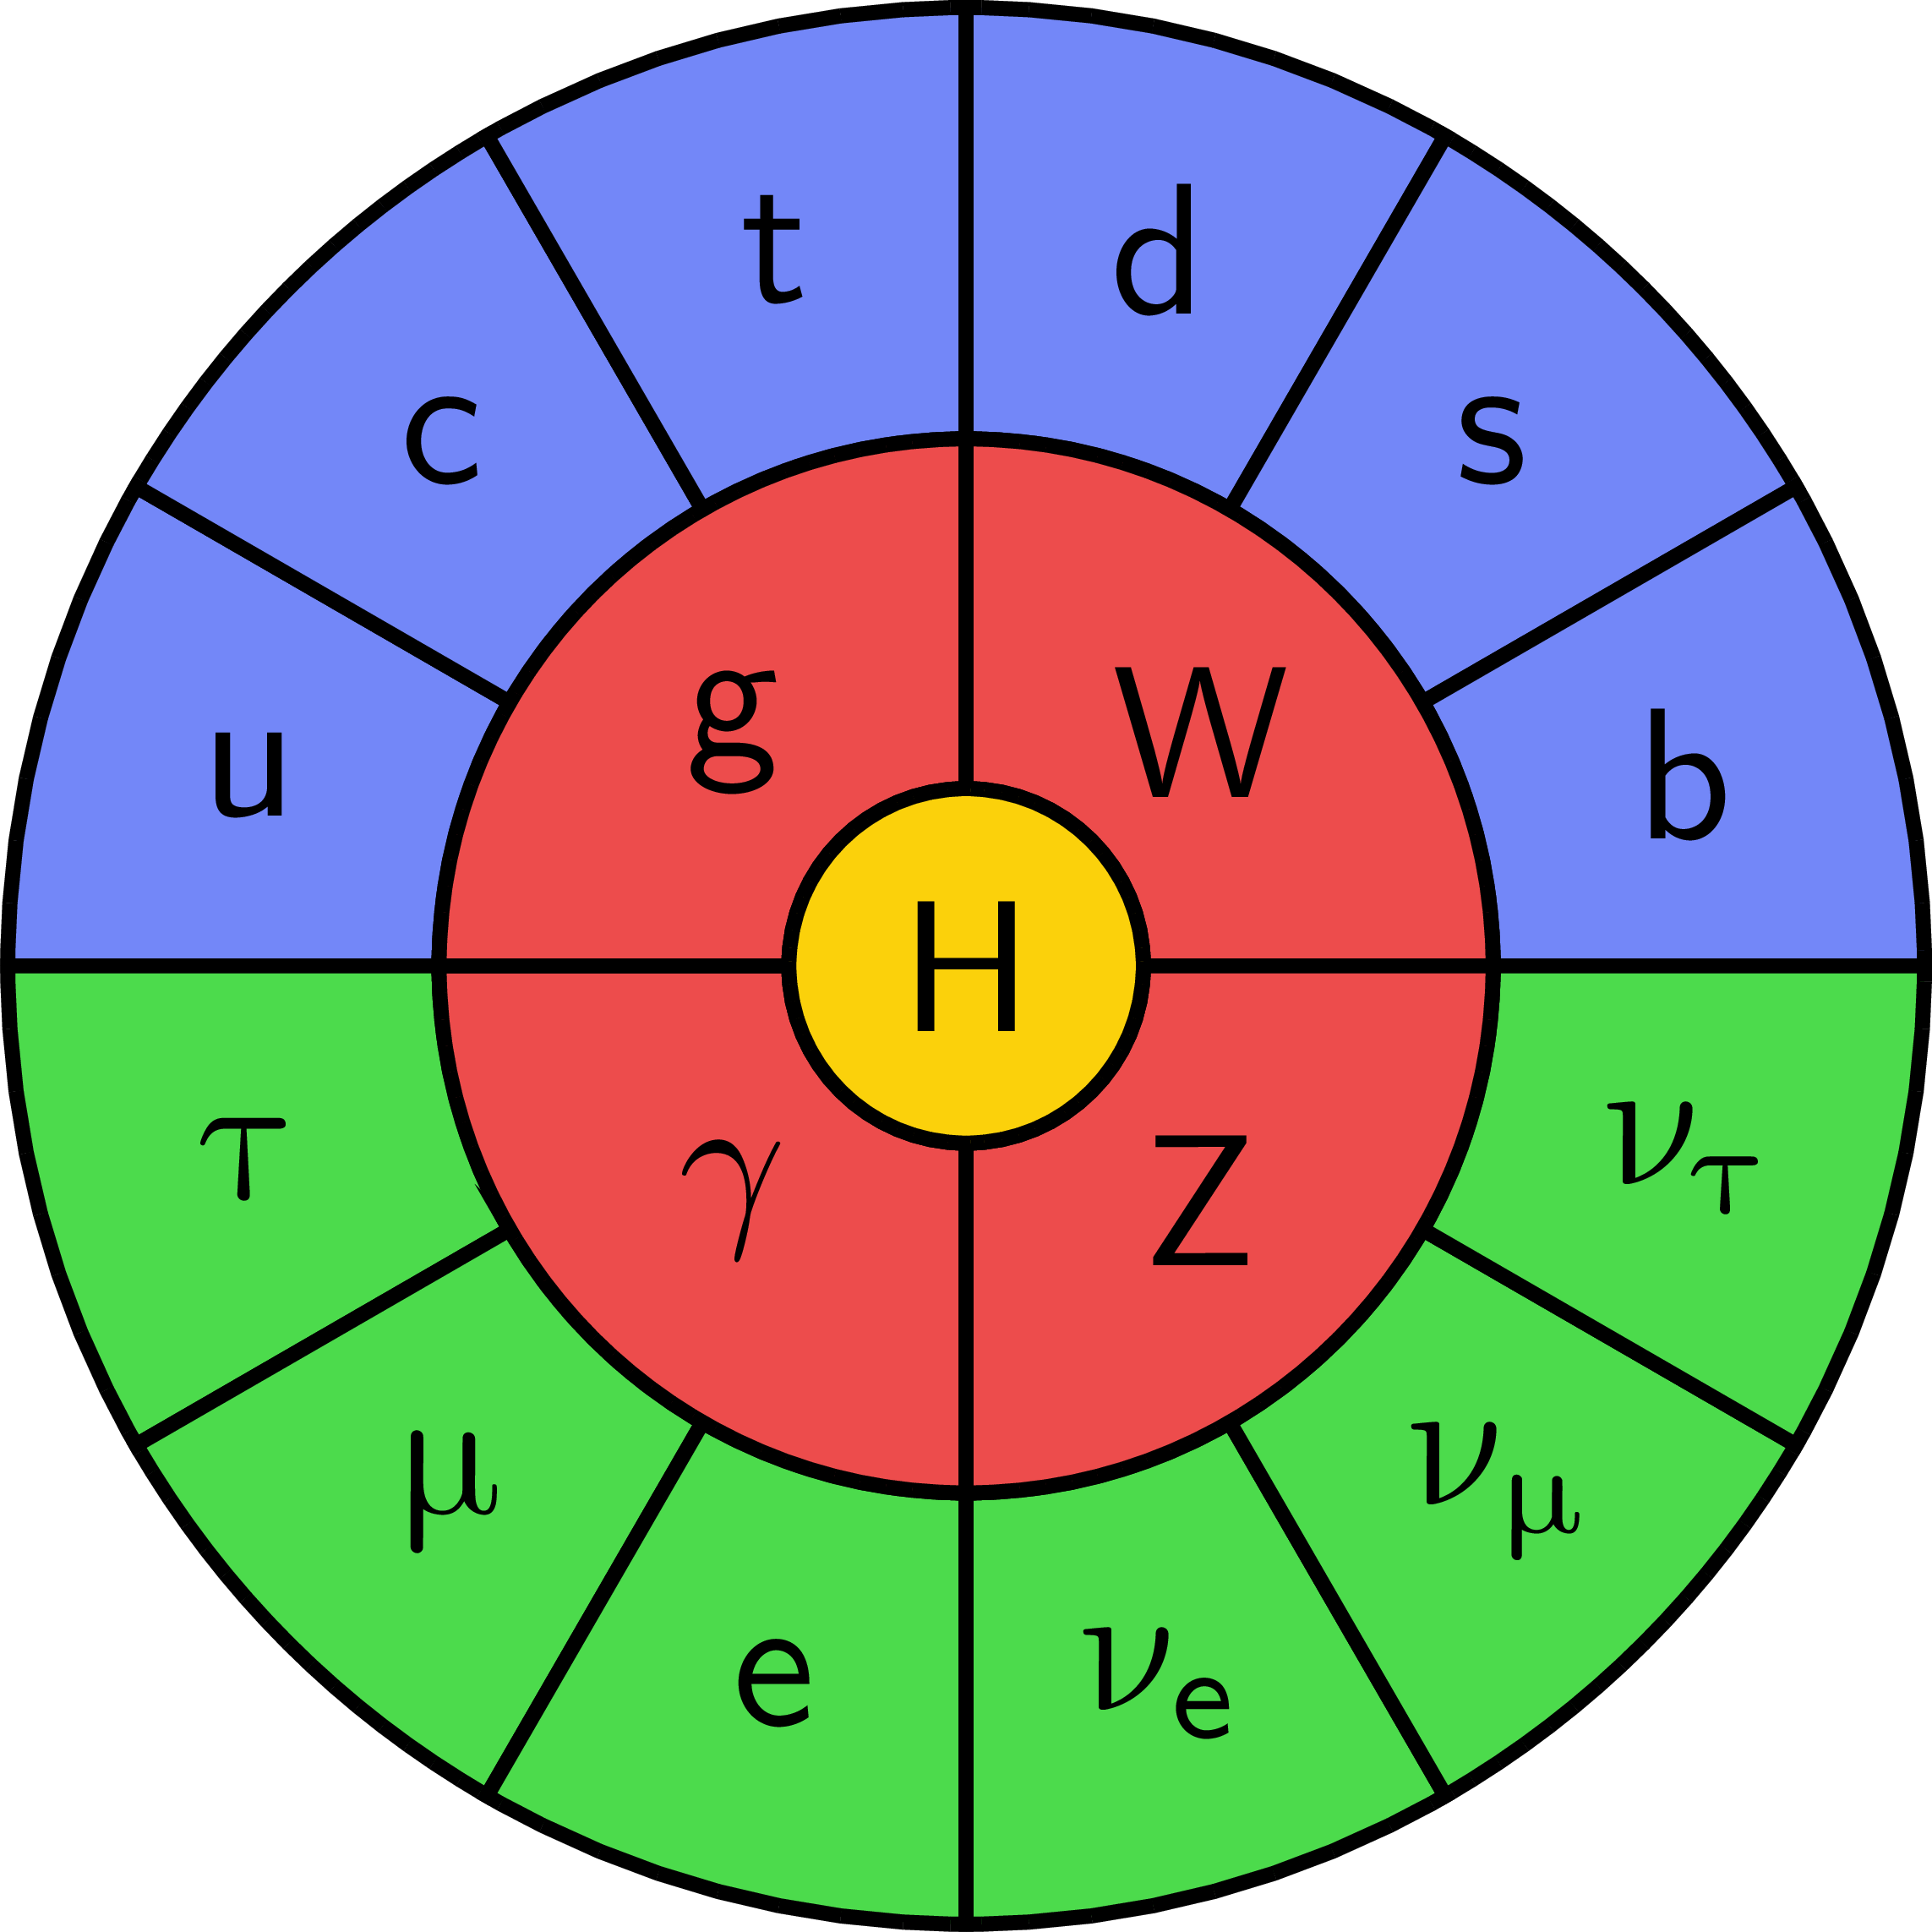
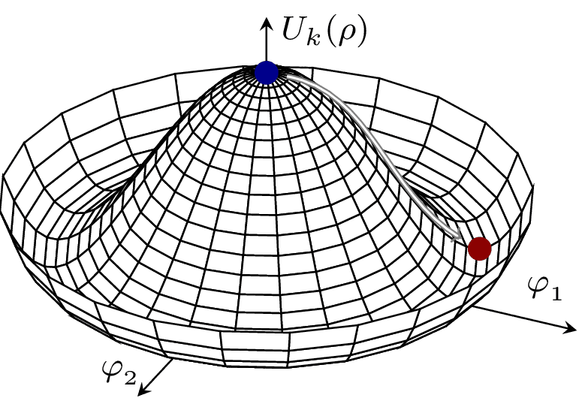
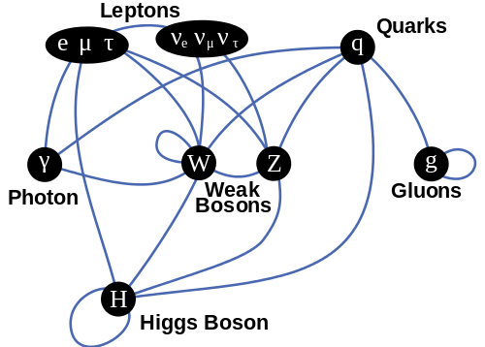
Standard Model
毕业论文答辩
答辩人：小不点 答辩时间：5.5 指导老师：大不点
The Higgs boson enables mass via electroweak symmetry breaking, underpinning the Standard Model and linking to vacuum stability via its potential.
Interactions between particles

Slide 4
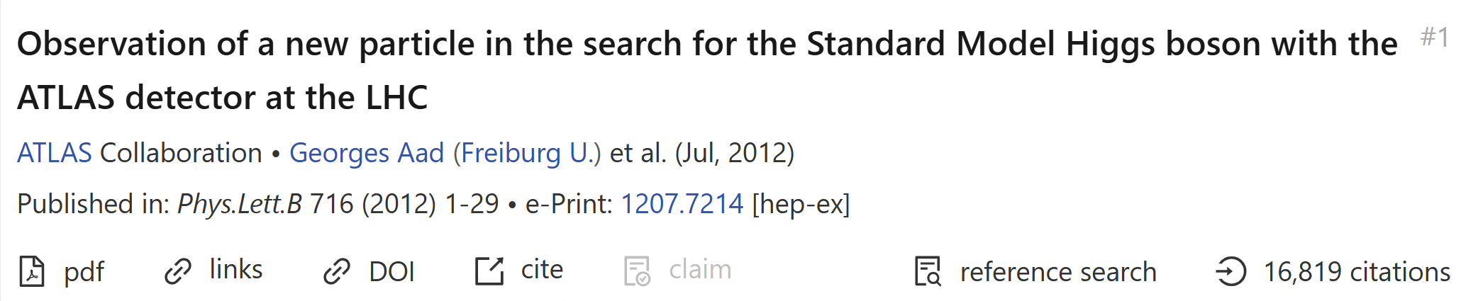
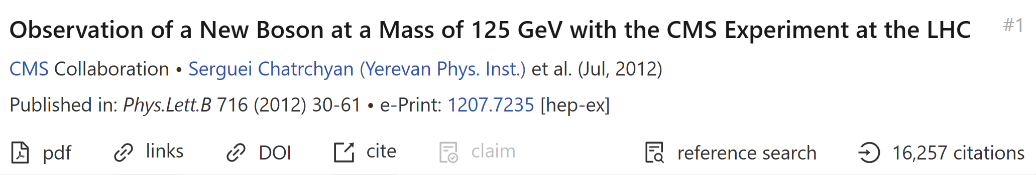
01
Motivation
Discovery of Higgs boson
毕业论文答辩
答辩人：小不点 答辩时间：5.5 指导老师：大不点

Slide 5
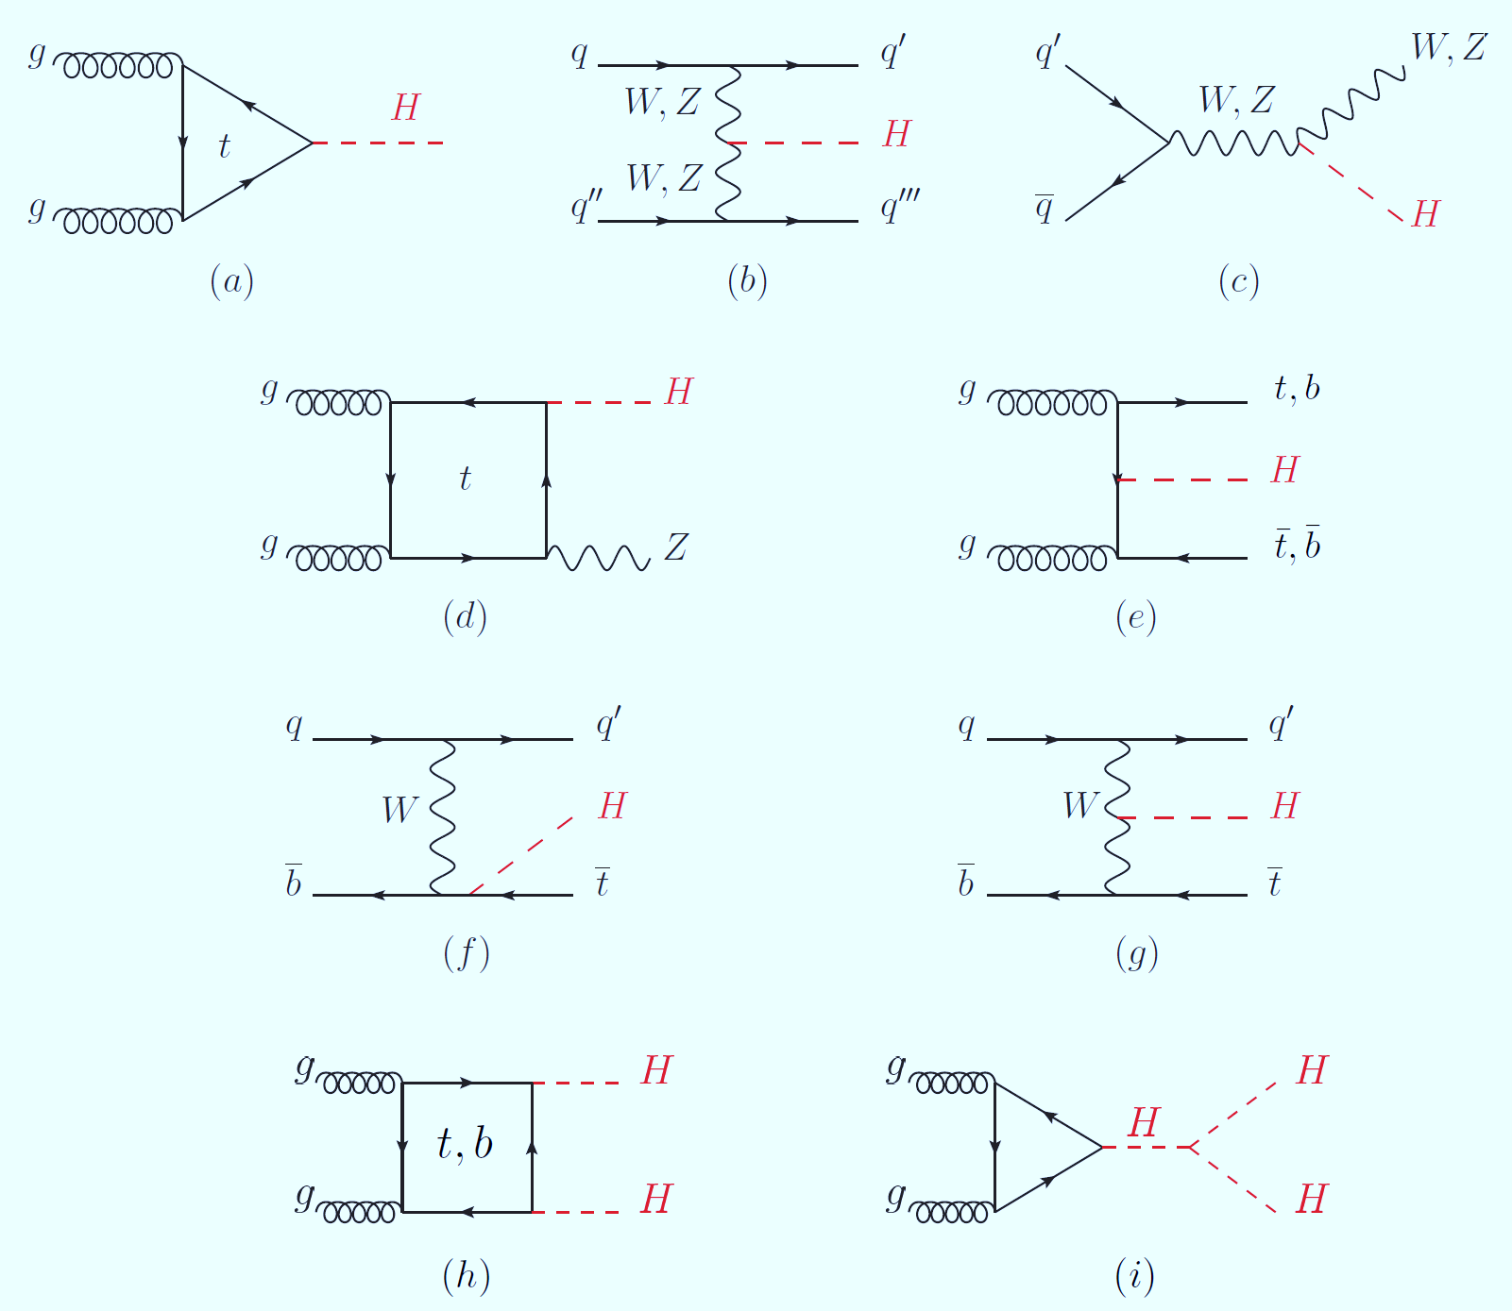
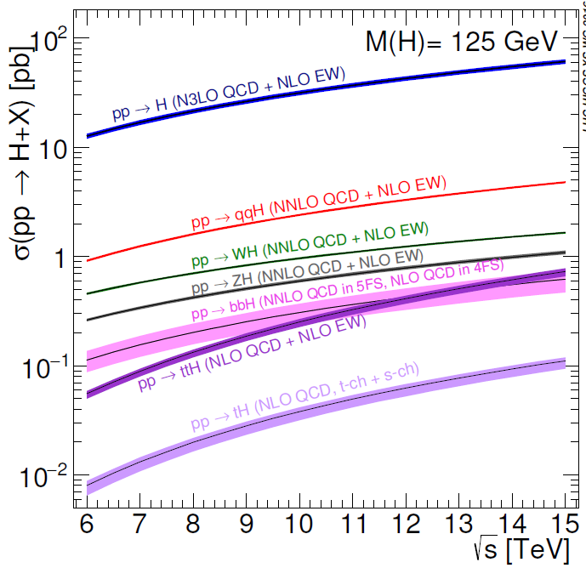
Higgs boson production at LHC
PDG
Precise Higgs boson physics study is crucial to understand SM and probe new physics.

Slide 6
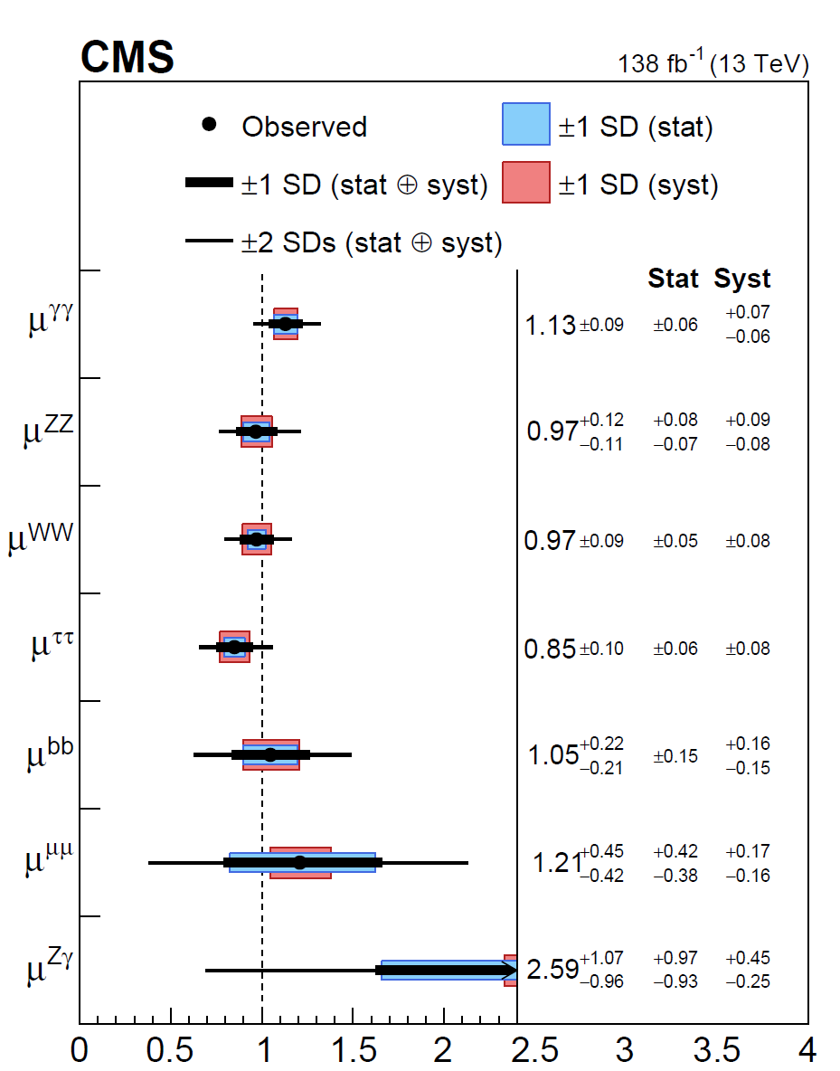
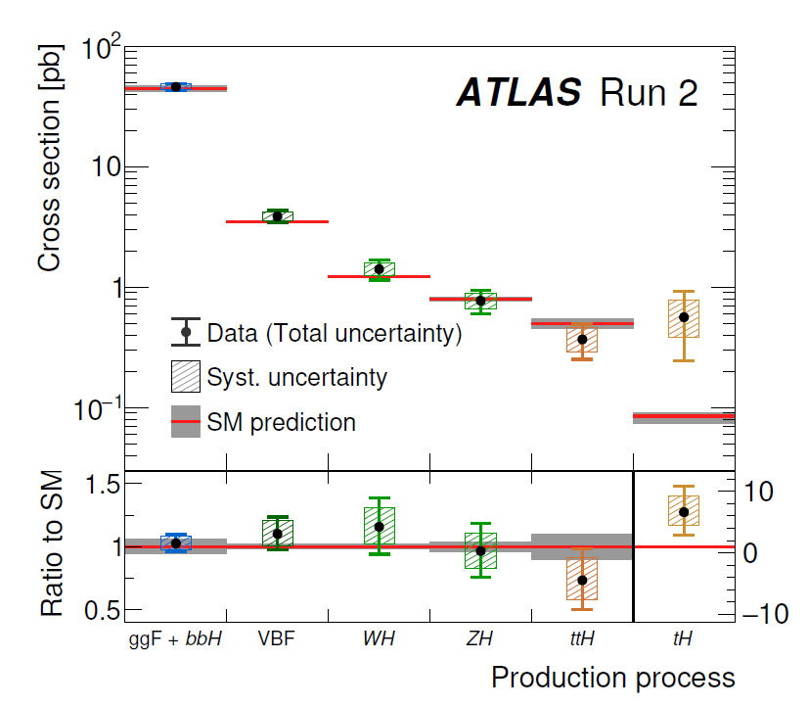
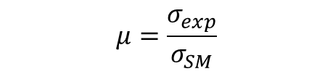
States of Higgs measurement
$$μ=\frac{σ_{exp}}{σ_{SM}}$$
ATLAS
CMS
毕业论文答辩
答辩人：小不点 答辩时间：5.5 指导老师：大不点
Nature 2022

Slide 7

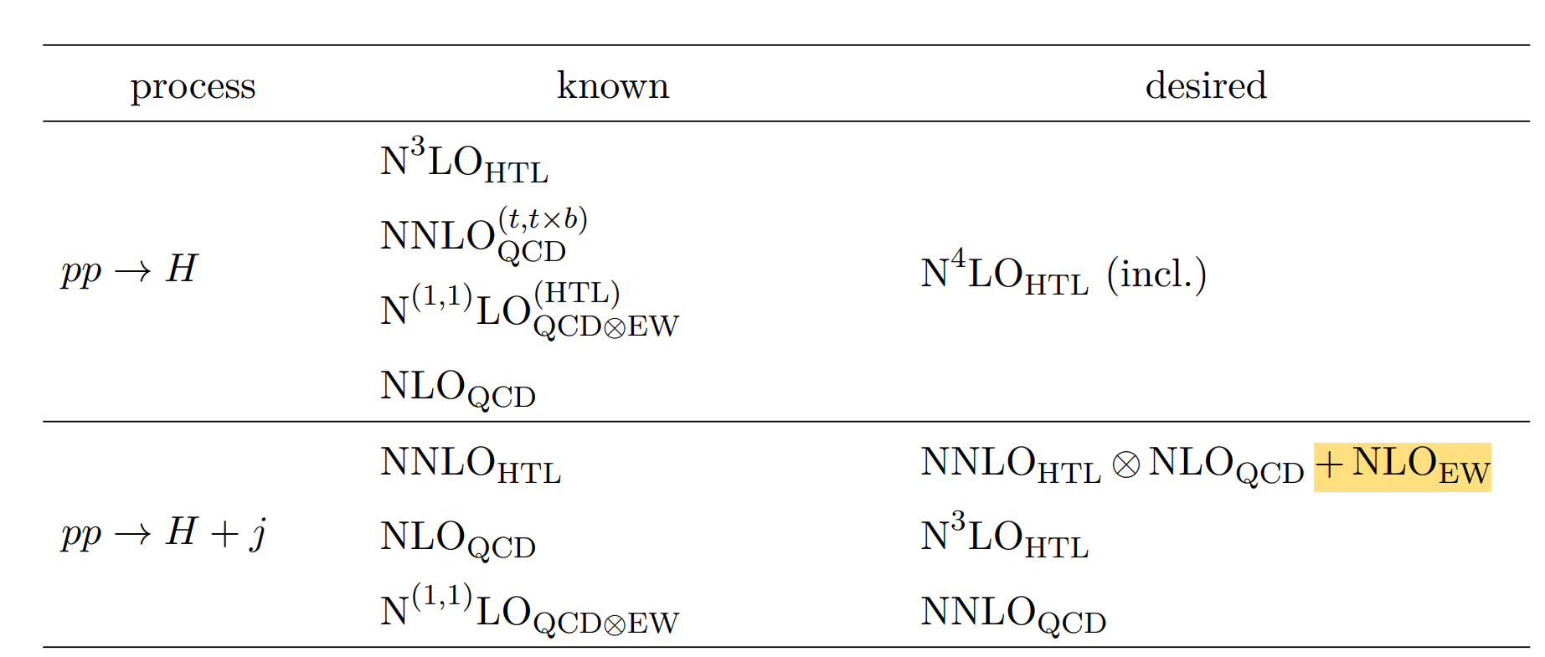
02
毕业论文答辩
EW corrections to Higgs+jet production in gluon fusion
答辩人：小不点 答辩时间：5.5 指导老师：大不点
With: Hai Tao Li, Wen-Long Sang, JHEP 10,194(2025)

Slide 8
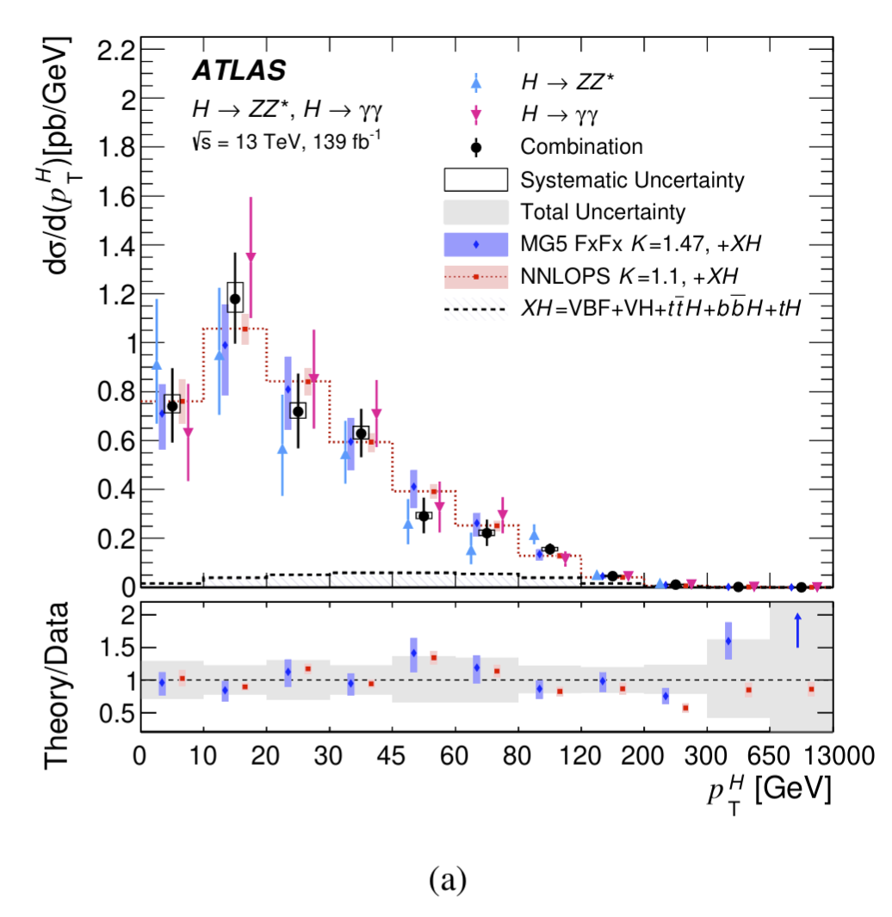
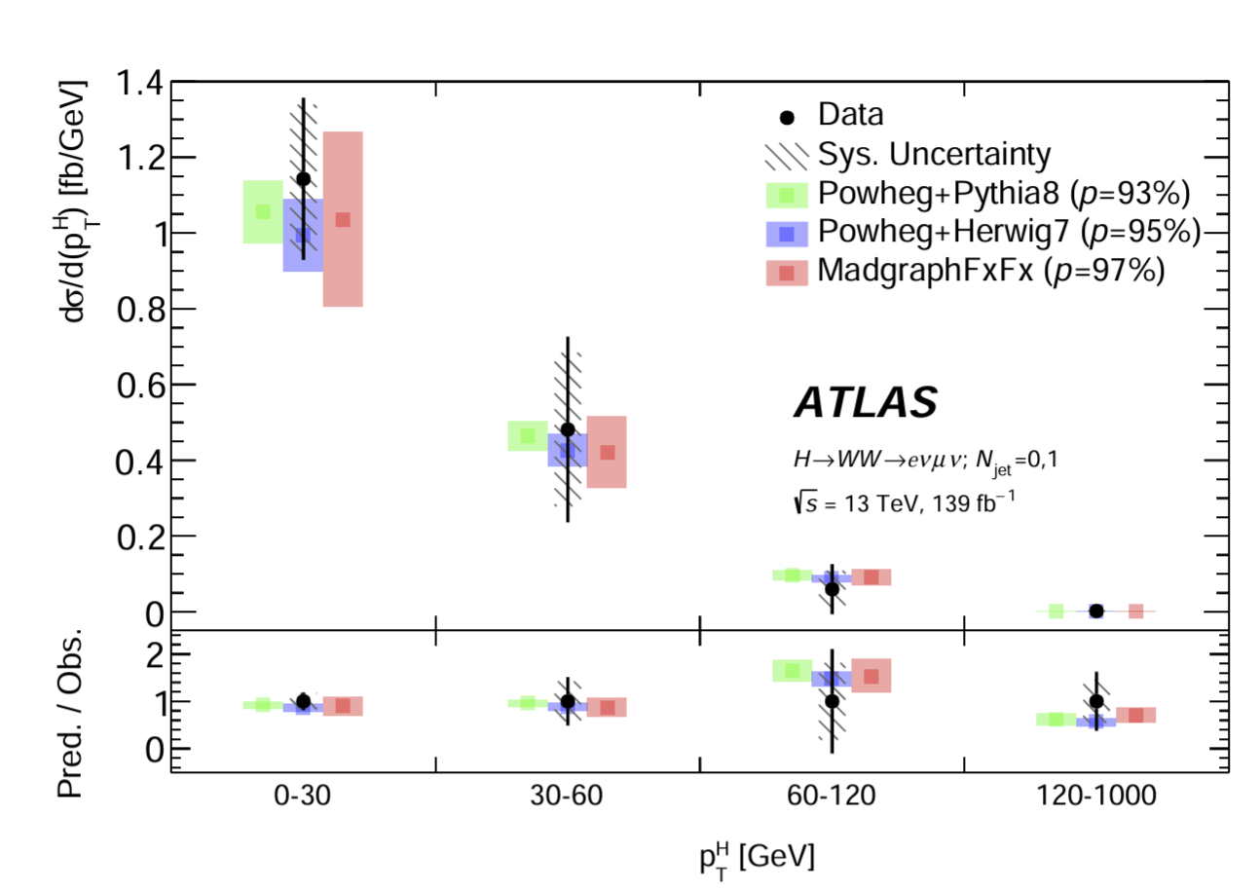

Higgs boson $p_{T}$ distribution measurement
produce an even more accurate calculation within
the SM.
ATLAS 2301.06822
ATLAS 2207.08615

Slide 9
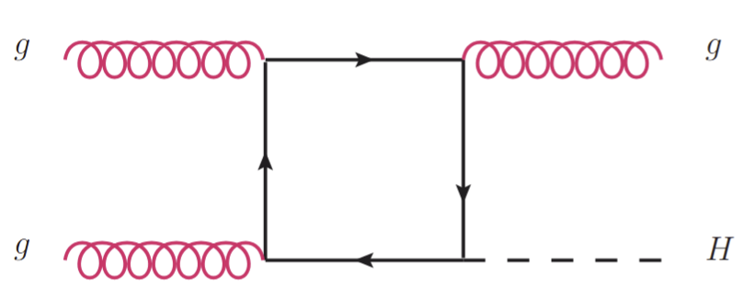
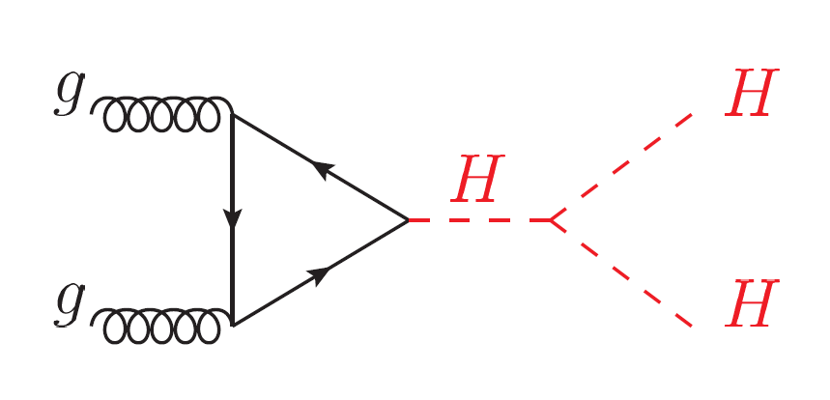
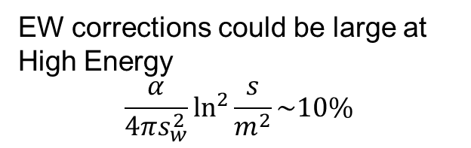
Status of Higgs+jet production perturbative calculation
NLO QCD with full top mass dependence,
Jones et al. 1802.00349, Chen et al. 2110,06953, Bonciani et al. 2206.10490.
NNLO QCD (Heavy top limit)
Boughezal et al. 1302.6216, Chen et al. 1408.5325
Boughezal et al. 1504.07922, Chen et al. 1607.08817
NLO EW (Heavy top limit / Light quark contribution/Trilinear self-coupling)
Bonetti et al. 2007.09813, Gao et al. 2302.04160,
Davis et al. 2007.09813, Haisch et al. 2007.09813.
Resummation
Huang et al. 1406.2591, Becher et al. 1407.4111.
produce an even more accurate calculation within
the SM.
EW corrections for Higgs pair production
Bi et al. 2311.16963,
Li et al. 2407.14716.
EW corrections could be large at High Energy
$$\frac{α}{4πs_{w}^{2}}\ln^{2}{\frac{s}{m^{2}}\sim 10\%}$$

Slide 10
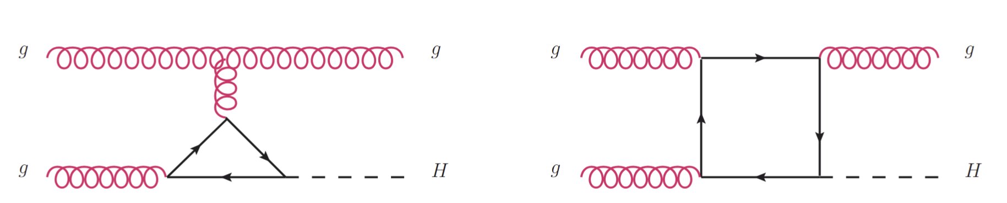
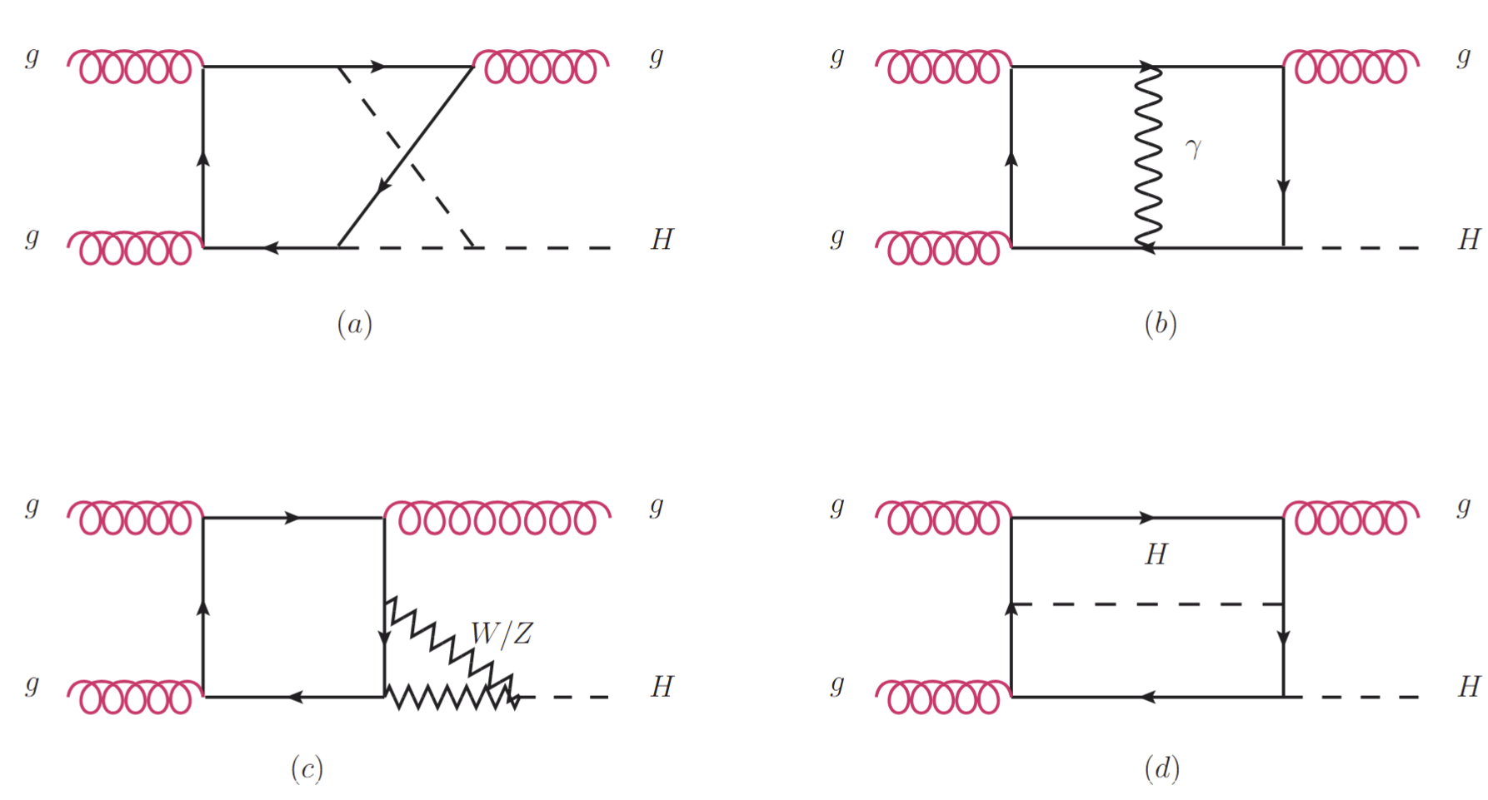
Leading-Order
12 Feynman Diagrams
produce an even more accurate calculation within
the SM.
Next-to-Leading-Order EW
1416 Feynman Diagrams

Slide 11
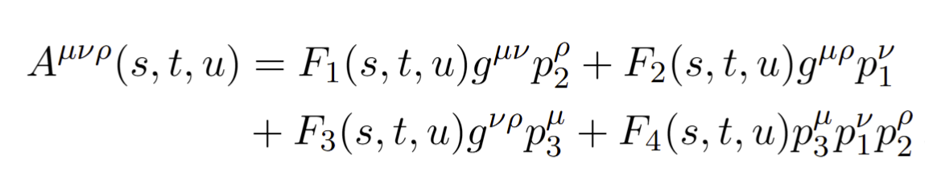

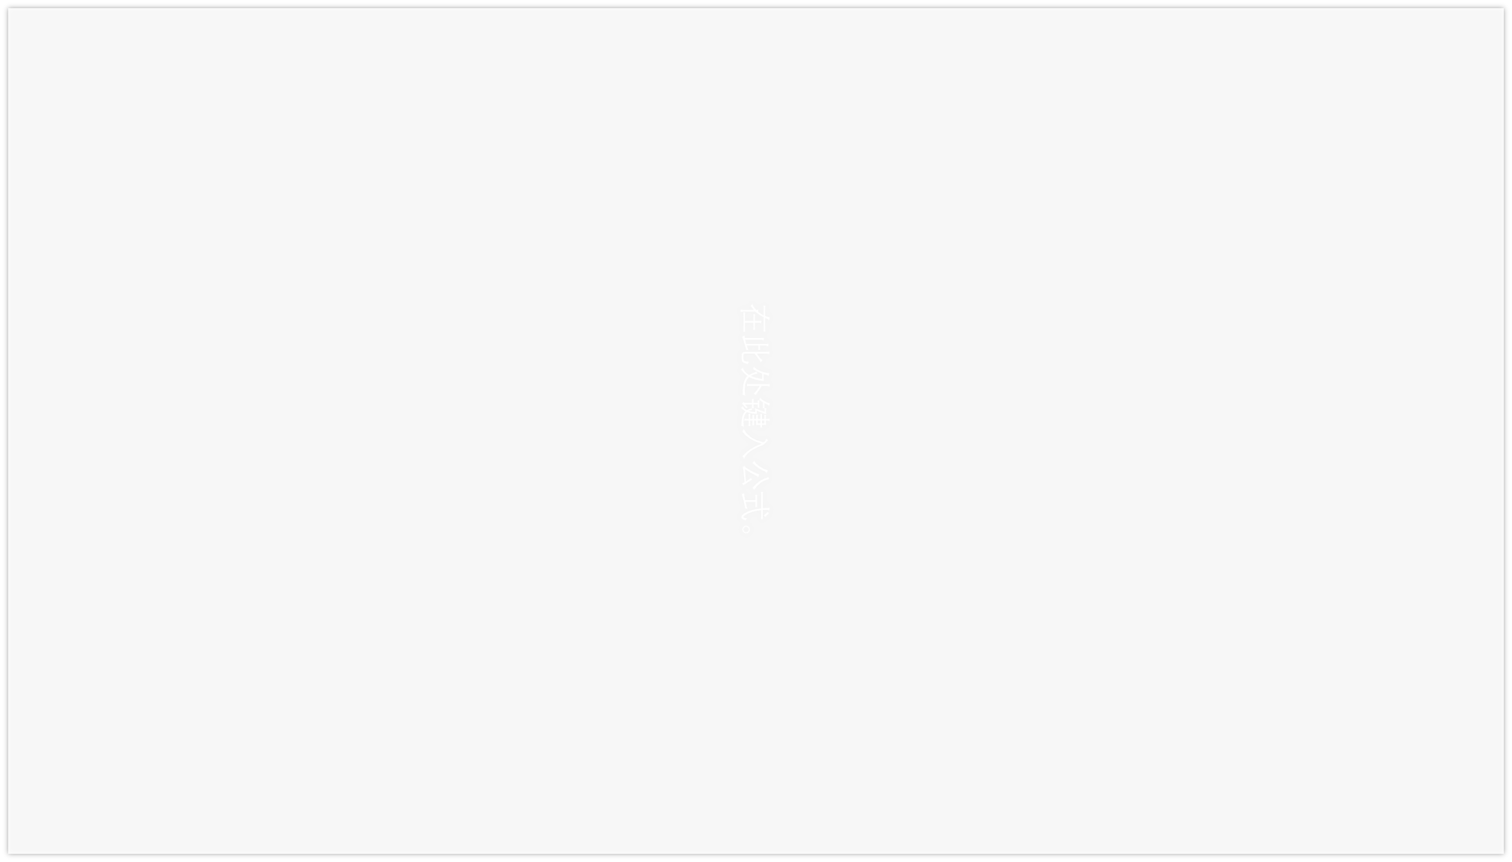
Calculation Framework
$$g\left(p_{1}\right)g\left(p_{2}\right)→g\left(p_{3}\right)H(p_{4})$$
produce an even more accurate calculation within
the SM.
Amplitude Structure $M^{abc}=f^{abc}ε_{1,μ}ε_{2,ν}ε_{3,ρ}^{∗}$
FeynCalc/FormLink
Fire&Kira
&Blade
Feynarts
DEs
EW-Renormalization

Slide 12
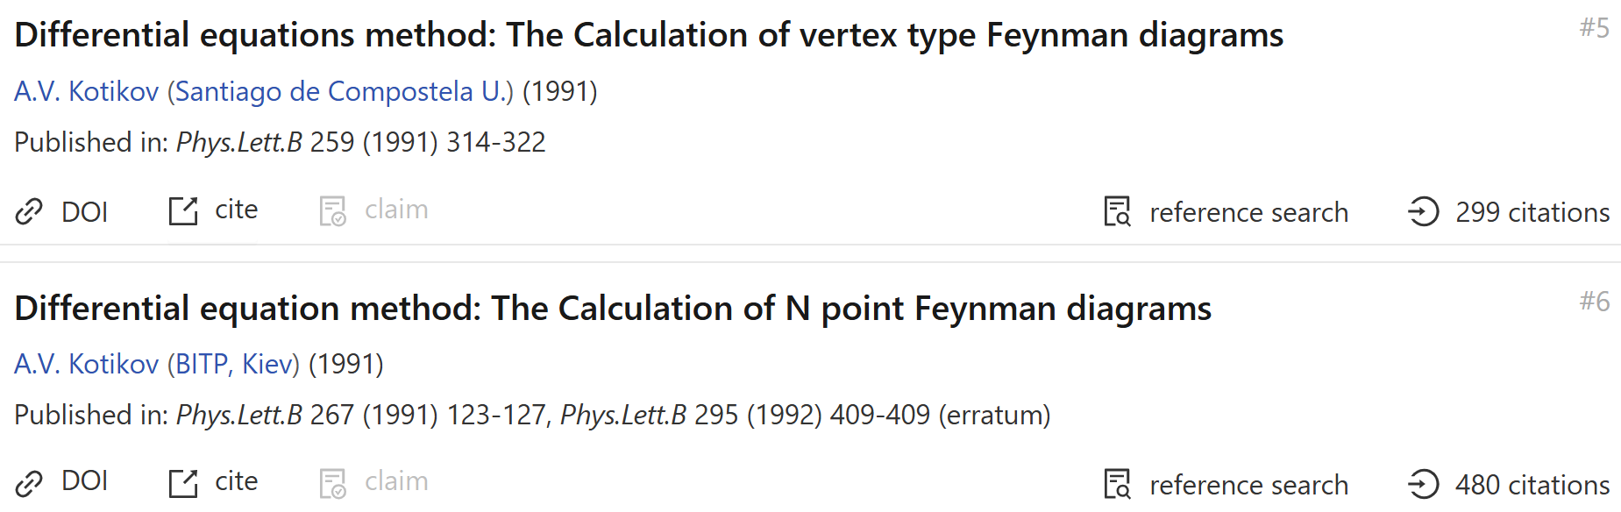
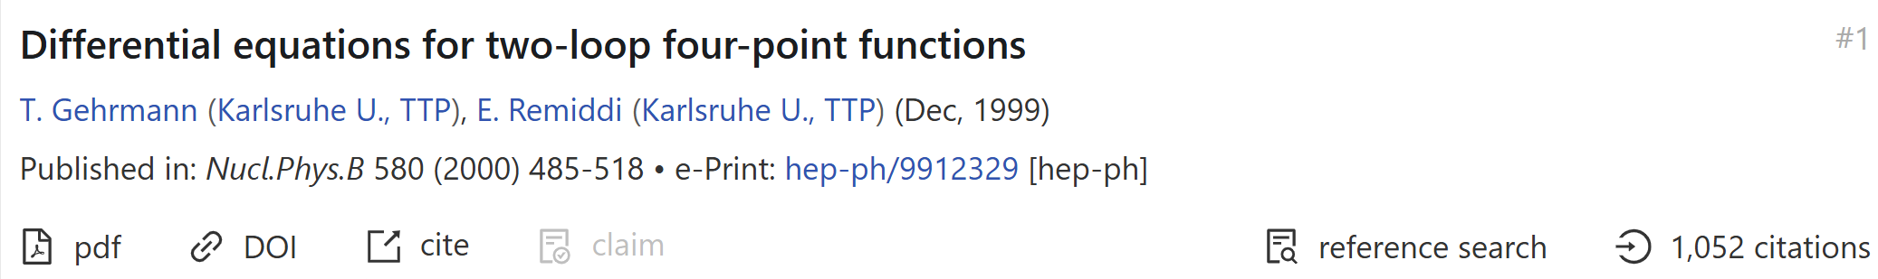
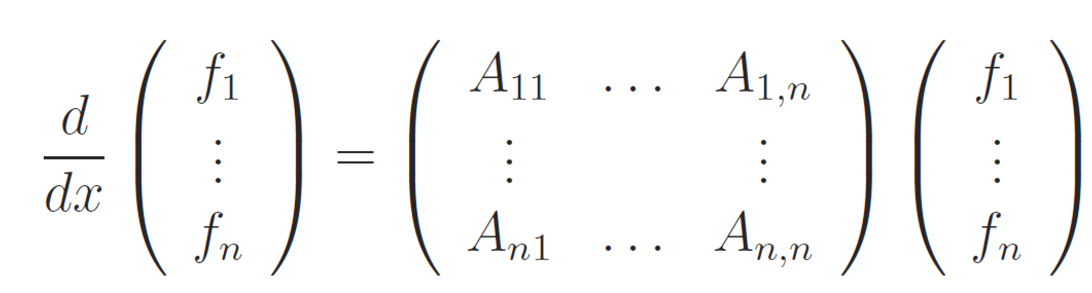
Method of Differential Equations
$f_{i}:$master integrals, x:Lorentz invariant kinematics

Slide 13
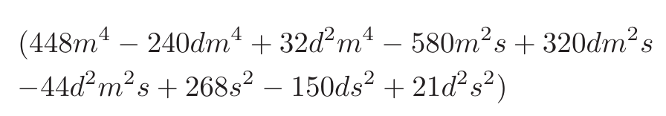
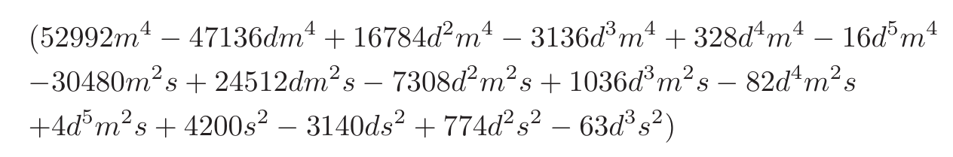
Choosing Good Basis
Bad Denominator could appear in the IBP reduction
Improvement
Develop a method to search good basis more efficient
Construct good basis for all 108 families
Derive More simple DEs
AMFLOW to Calculate boundary conditions
Solving DEs numerically at all phase space points
produce an even more accurate calculation within
the SM.
Slow down the IBP reduction, results in more complicate DEs.
Good Basis: basis whose IBP coefficients without bad denominators .
A.V. Smirnov, V.A. Smirnov, 2002.08042
Johann Usovitsch, 2002.08173

Slide 14
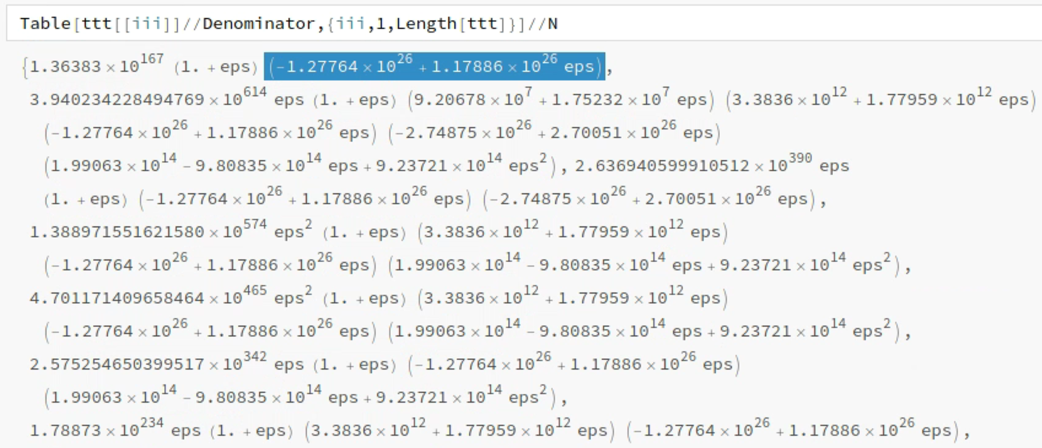
Choosing Good Basis More Efficient
Assign values (some big primes) to the variables (s, t, mt, mw, mh, mz)
Reduction Time: only a few minutes
produce an even more accurate calculation within
the SM.
Select Out Bad Denominators
Obtain good basis for all 108 families

Slide 15
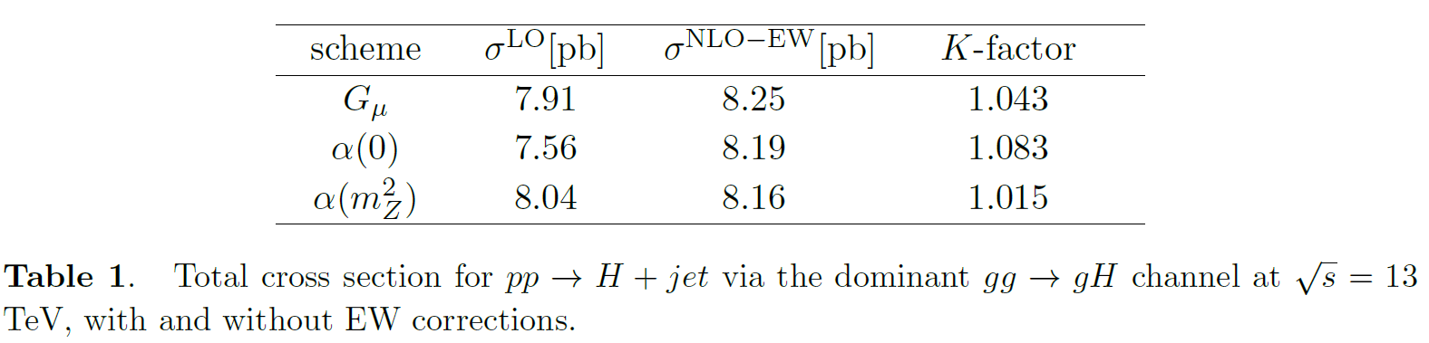
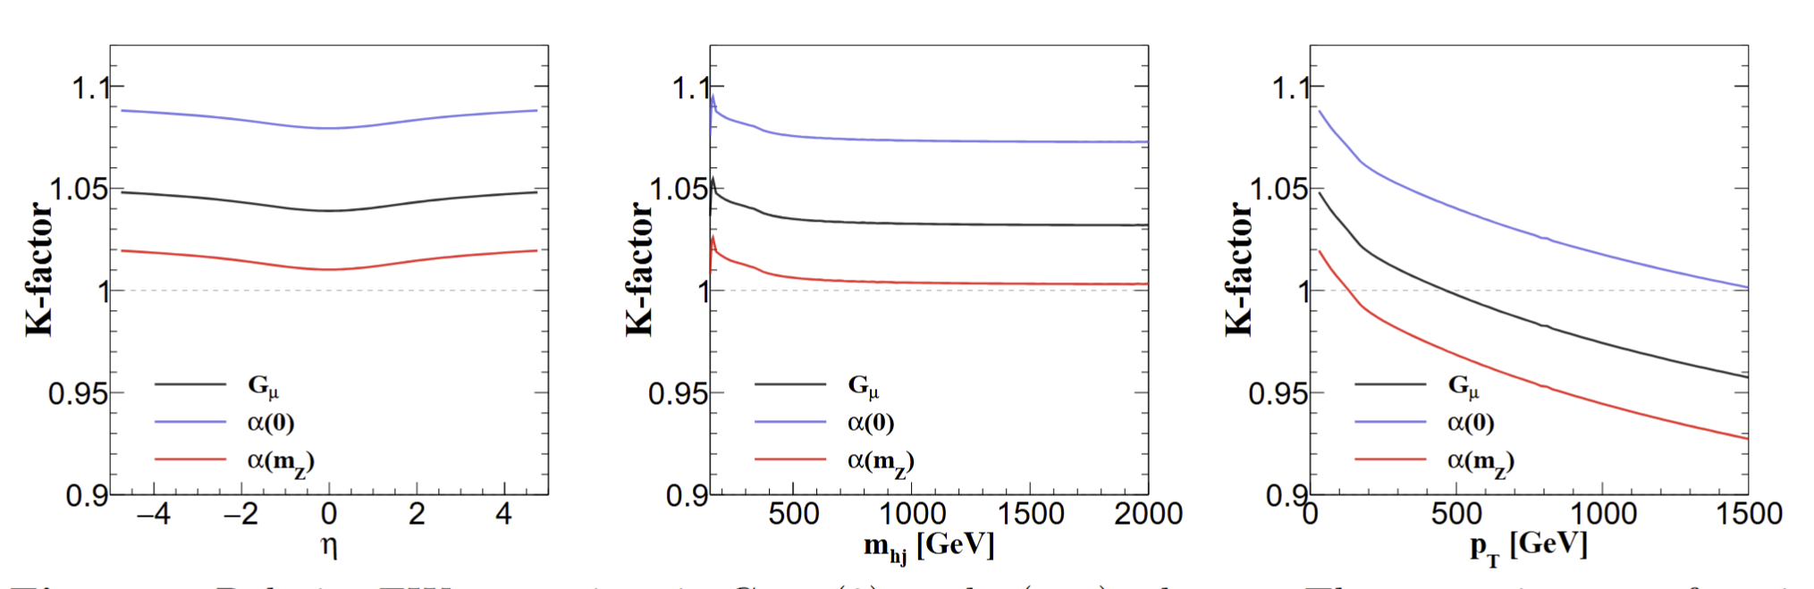
Results
produce an even more accurate calculation within
the SM.

Slide 16
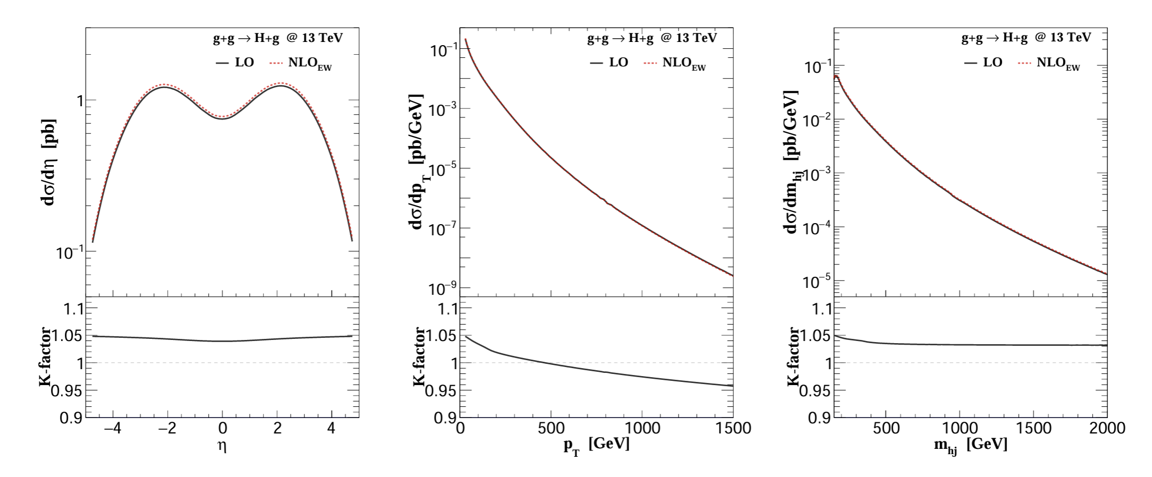
Results
produce an even more accurate calculation within
the SM.
Differential cross section with and without NLO EW corrections in Gµ scheme.

Slide 17
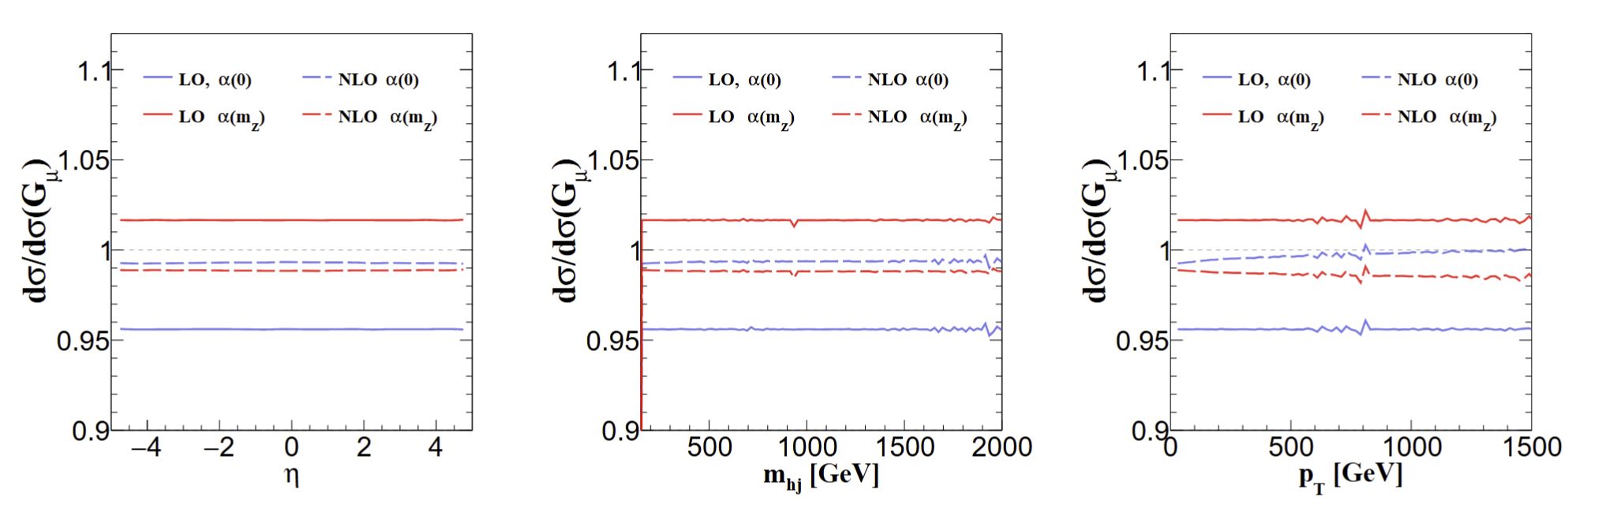
Significantly reduce the theoretical uncertainty
produce an even more accurate calculation within
the SM.
EW corrections bringing the theoretical uncertainty under much tighter control.
Agree with:
Bi, Ma, Mu, 2508.02588

Slide 18
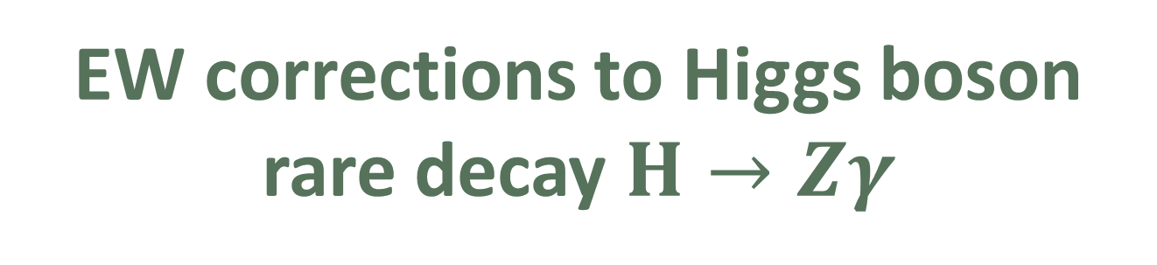
03
毕业论文答辩
EW corrections to Higgs boson rare decay $H→Zγ$
答辩人：小不点 答辩时间：5.5 指导老师：大不点
With: Zi-qiang Chen, Cong-Feng Qiao, Ruilin Zhu, PRD 110, L051301(2024)

Slide 19
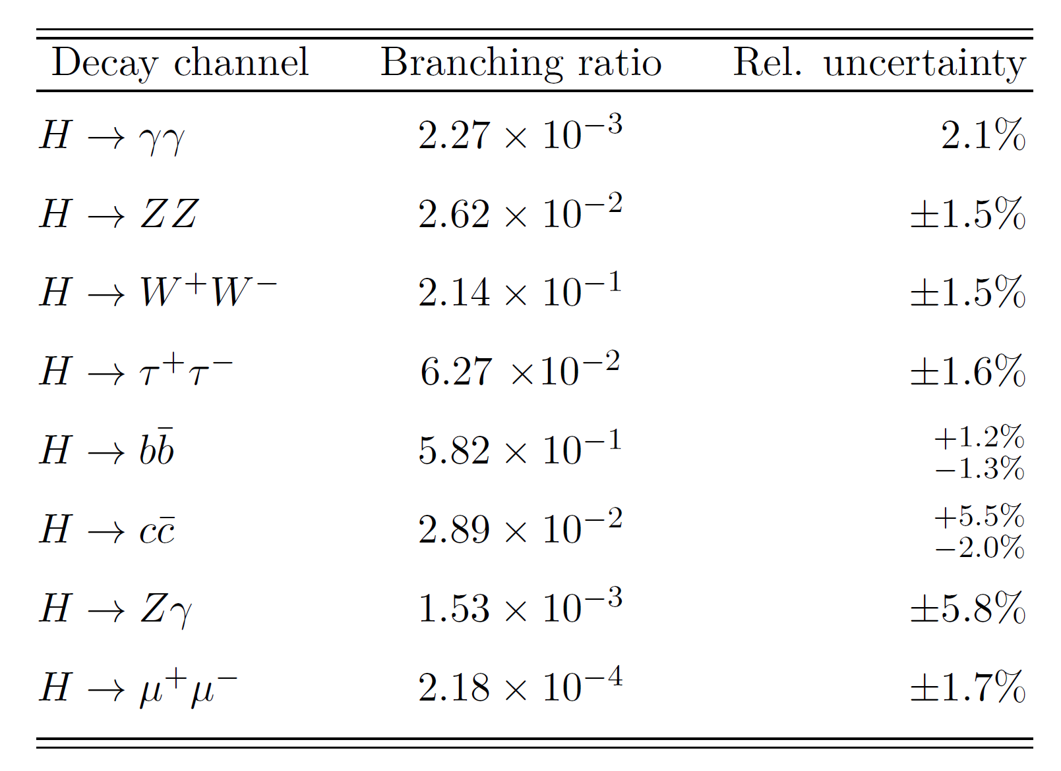
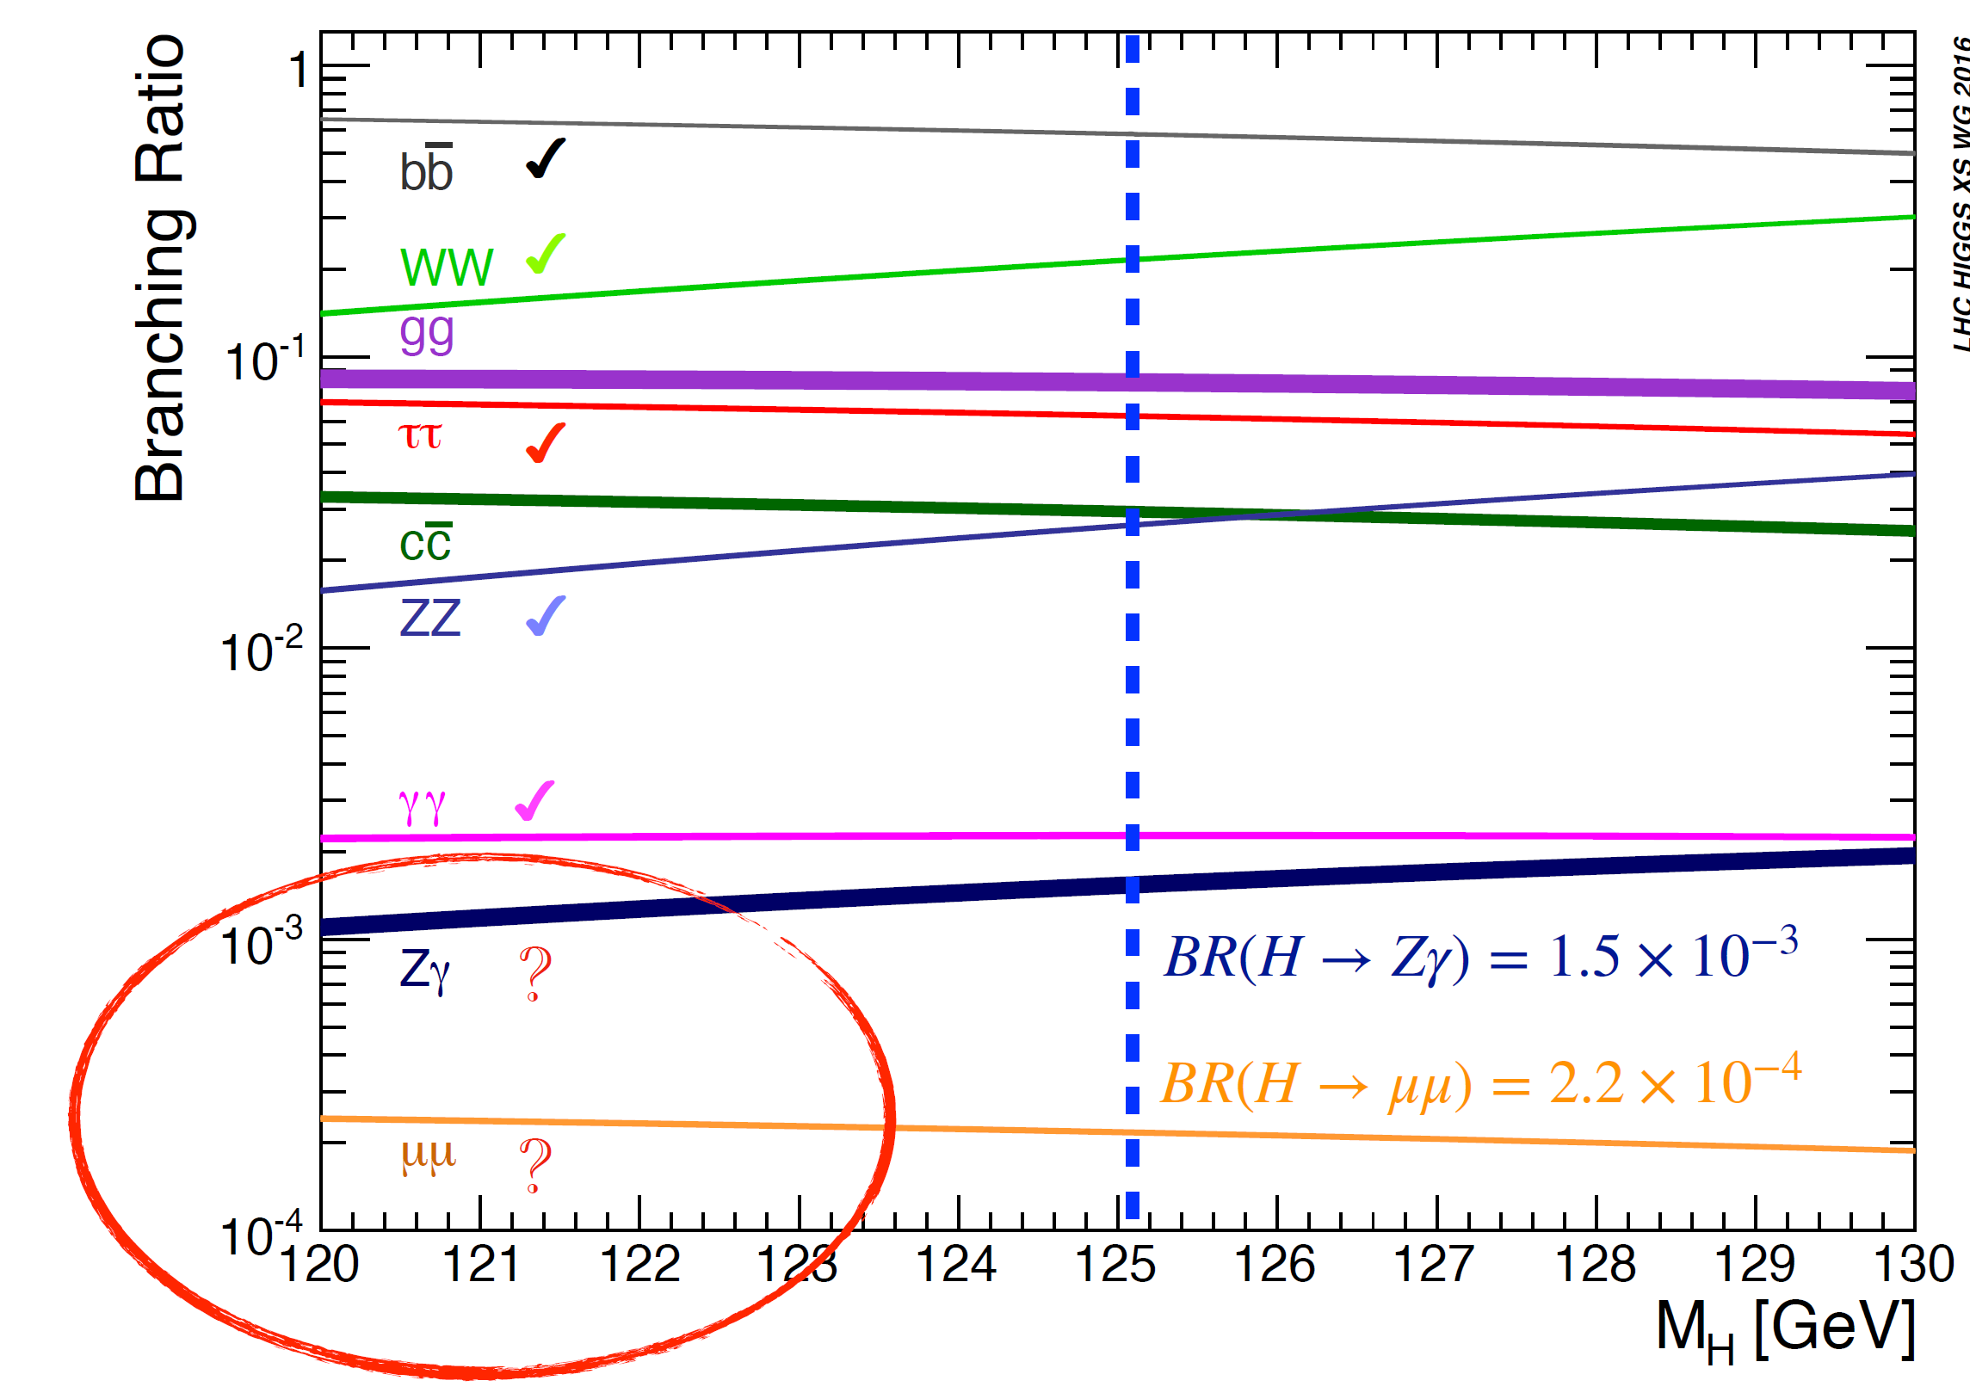
Higgs玻色子主要衰变道及分支比
毕业论文答辩
答辩人：小不点 答辩时间：5.5 指导老师：大不点

Slide 20
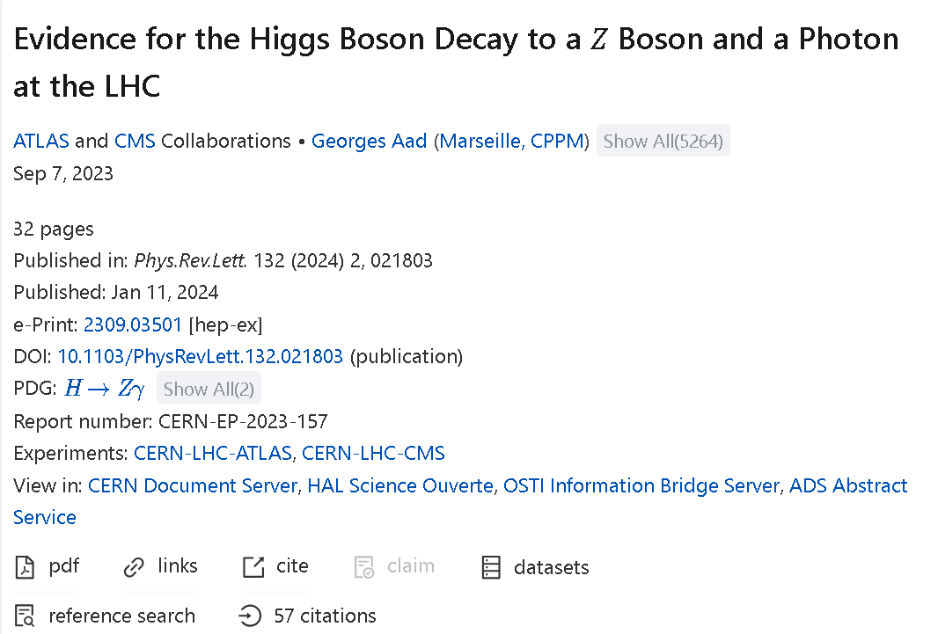

Experimental evidence
3.4 $σ$
Evidence (2309.03501) obtained from a combination of ATLAS (2005.05382) and CMS (2204.12945).
Previous searches: 1806.05996, 1402.3051, 1307.5515, 0806.0611 ...
毕业论文答辩
答辩人：小不点 答辩时间：5.5 指导老师：大不点
ATLAS and CMS, PRL 132 (2024) 021803 [2309.03501]

Slide 21
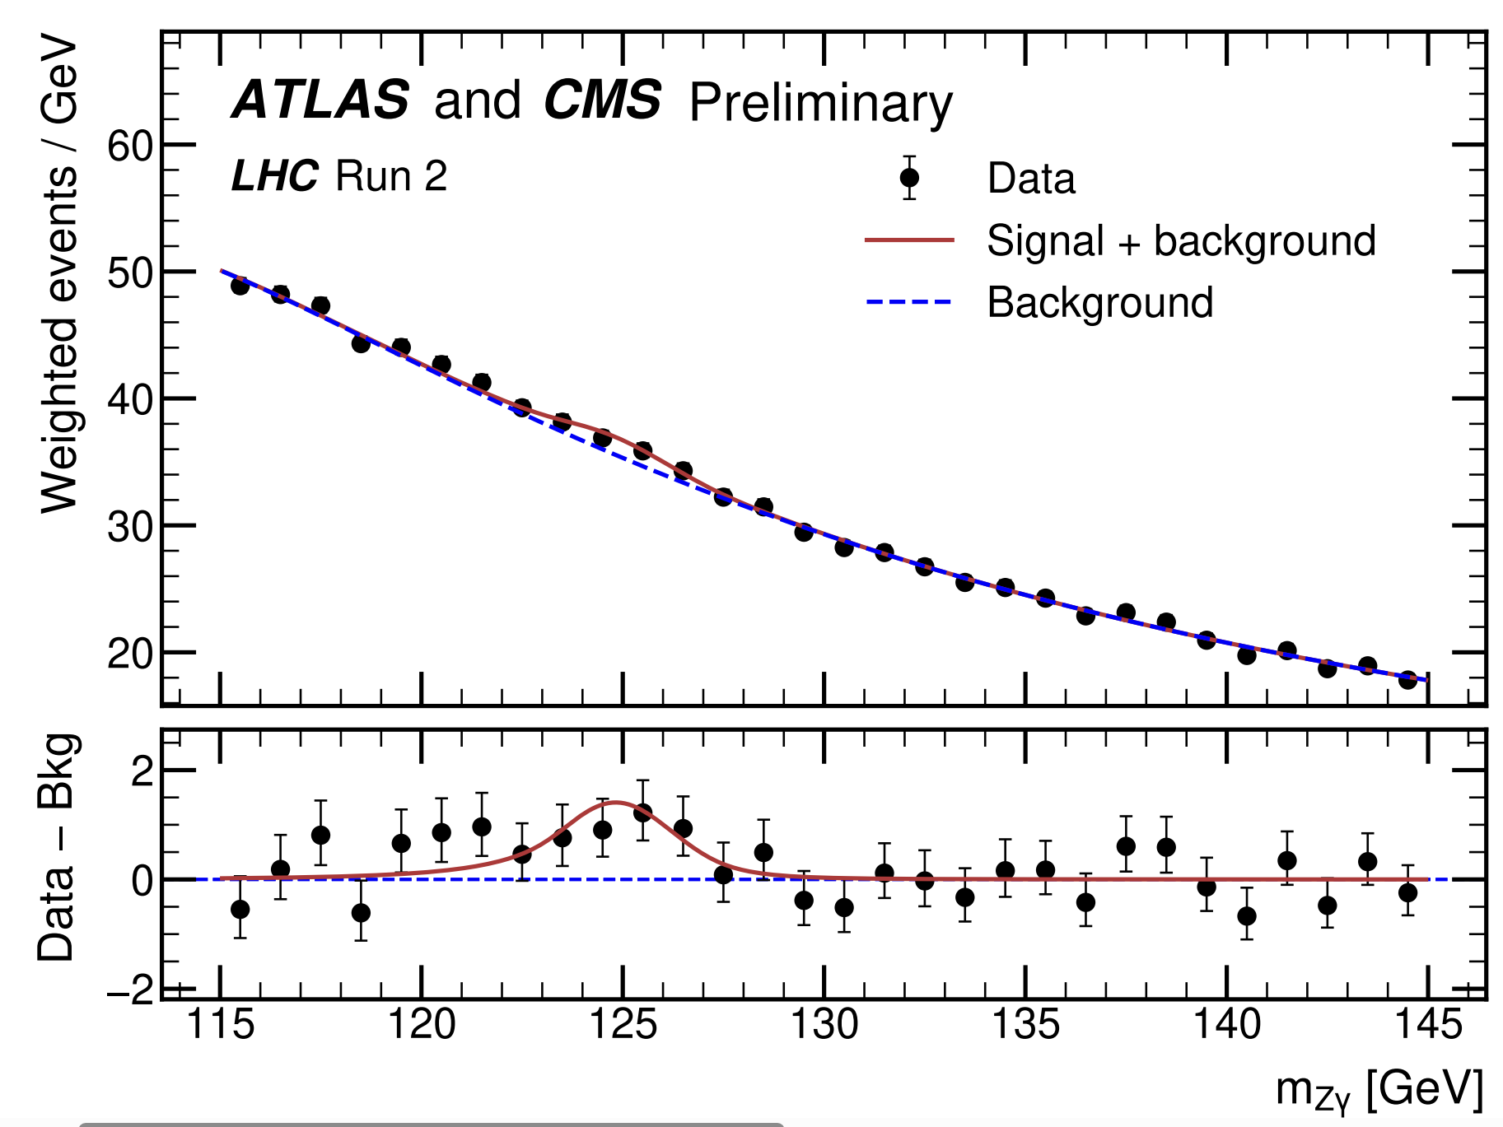


Experimental evidence
Branching Ratio:
$(3.4±1.1)×{10}^{−3}$
Signal Strength:
$μ=2.2±0.7$
produce an even more accurate calculation within
the SM.
$$(μ=σ_{exp}/σ_{SM})$$
Motivation: Provide SM prediction as precise as possible.
ATLAS and CMS, PRL 132 (2024) 021803 [2309.03501]

Slide 22
Previous calculations
Leading order:
J.R. Ellis, M. K. Gaillard, D. V. Nanopoulos, Nucl. Phys. B 106 (1976) 292
R.N. Cahn, M. S. Chanowitz, N. Fleishon, Phys. Lett. B 82 (1979) 113-116
QCD corrections:
M. Spira, A. Djouadi, P. M. Zerwas, Phys. Lett. B 276 (1992) 350-353
T. Gehrmann, S. Guns, D. Kara, JHEP 09 (2015) 038 [1505.00561]
R. Bonciani, V. D. Duca, et al, JHEP 08 (2015) 108 [1505.00567]
Having found that the two-loop QCD corrections, which correct
the heavy–quark loop, equal about 0.22% of the leading order width, it is reasonable to
expect that the two-loop electroweak corrections, which correct the electroweak loop, will
yield a larger contribution
Numerical
Analytic
Analytic

Slide 23
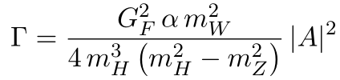



Why NLO EW?
The QCD corrections amount to 0.22% of the LO width. It is resonable to expect that the EW corrections will yield a larger contribution.
The theoretical uncertainty has not been fully discussed
1505.00561:
1505.00567:
Having found that the two-loop QCD corrections, which correct
the heavy–quark loop, equal about 0.22% of the leading order width, it is reasonable to
expect that the two-loop electroweak corrections, which correct the electroweak loop, will
yield a larger contribution
$$7.09 keV$$
$$6.68 keV$$

Slide 24
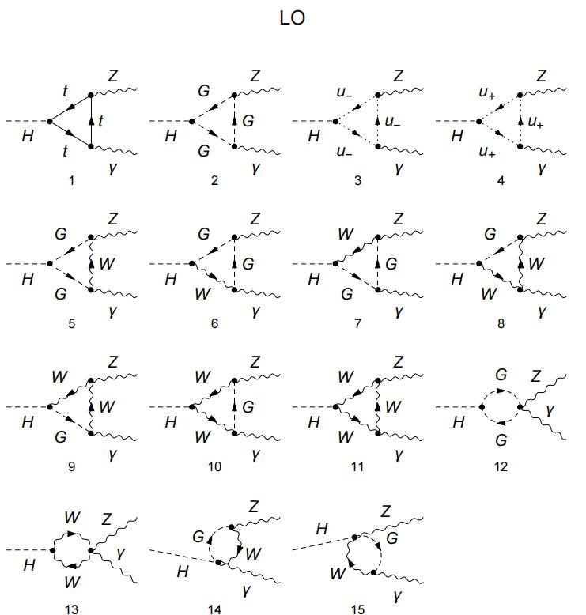
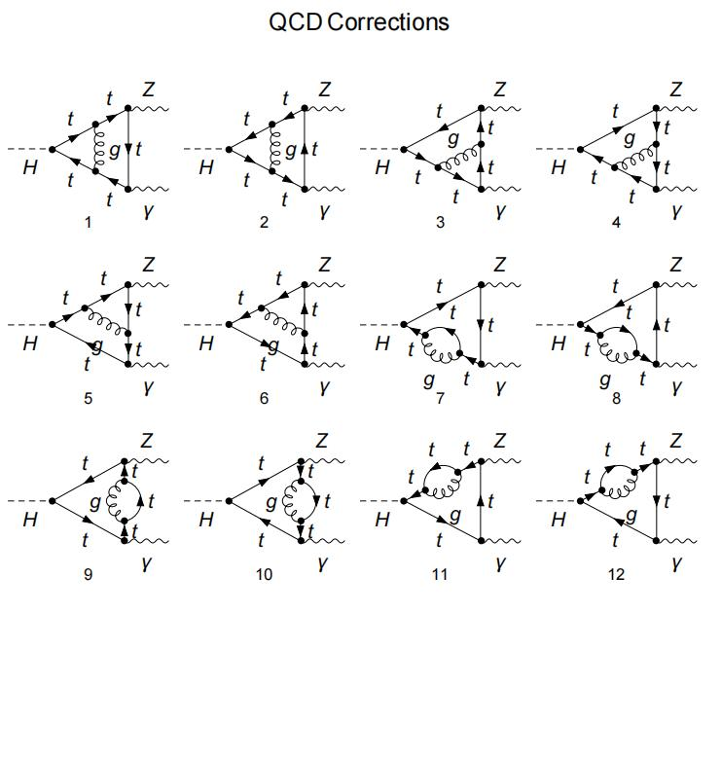

$${\left|Dia 1\right|}^{2}+intf. \sim −10\%$$
Why NLO EW?
The QCD corrections amount to 0.22% of the LO width. It is resonable to expect that the EW corrections will yield a larger contribution.
The theoretical uncertainty has not been fully discussed
1505.00561:
1505.00567:
Having found that the two-loop QCD corrections, which correct
the heavy–quark loop, equal about 0.22% of the leading order width, it is reasonable to
expect that the two-loop electroweak corrections, which correct the electroweak loop, will
yield a larger contribution
$$7.09 keV$$
$$6.68 keV$$

Slide 25
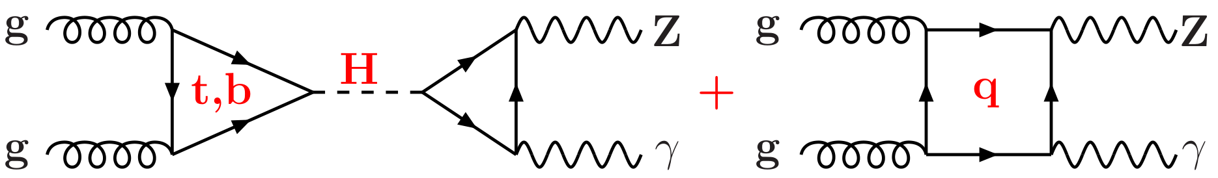
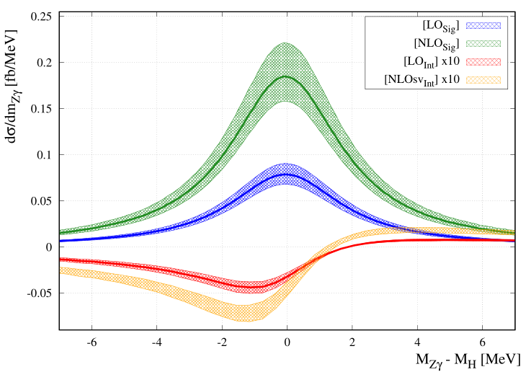
Previous work
Signal background interference: F. Buccioni, F. Devoto, A. Djouadi, et. al, Phys. Lett. B 851 (2024) 138596 [2312.12384]
Having found that the two-loop QCD corrections, which correct
the heavy–quark loop, equal about 0.22% of the leading order width, it is reasonable to
expect that the two-loop electroweak corrections, which correct the electroweak loop, will
yield a larger contribution
Interference effects (Higgs resonance & nonresonance) are small...

Slide 26
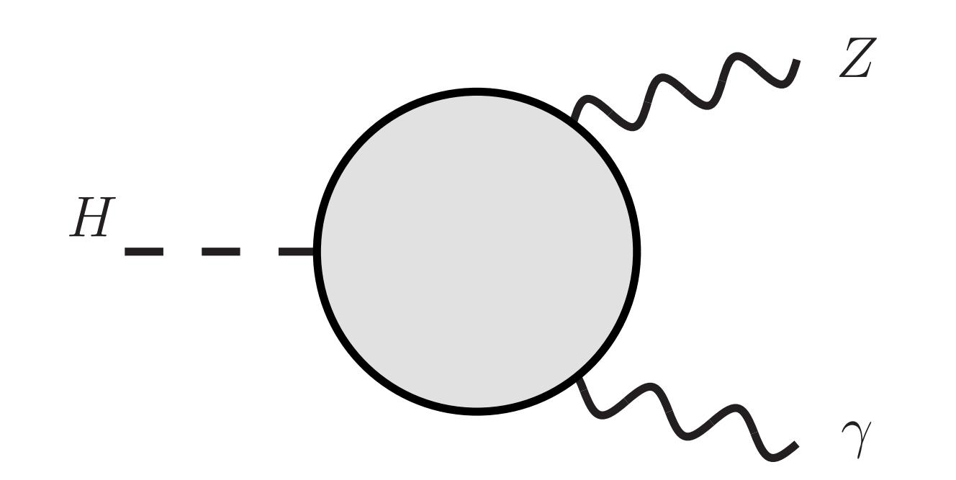
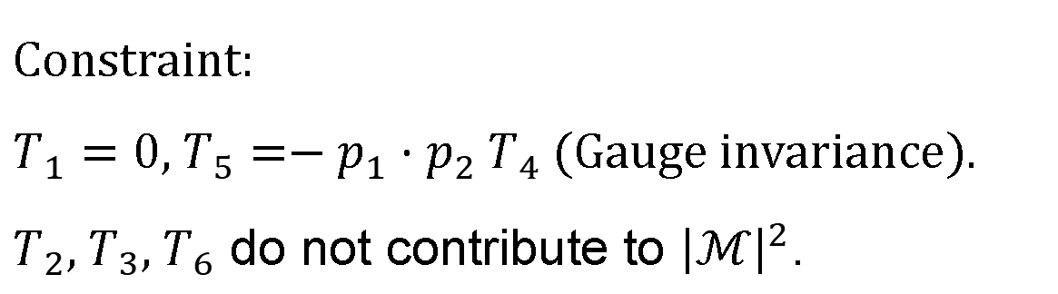

Lorentz structure
$H→Z(p_{1})γ(p_{2})$
$ℳ=T^{μν}ε_{μ}^{∗}(p_{1})ε_{ν}^{∗}(p_{2})$
毕业论文答辩
$$T^{μν}=T_{1}p_{1}^{μ}p_{1}^{ν}+T_{2}p_{2}^{μ}p_{2}^{ν}+T_{3}p_{1}^{μ}p_{2}^{ν}+T_{4}p_{2}^{μ}p_{1}^{ν}+T_{5}g^{μν}+T_{6}ε^{μνρσ}p_{1ρ}p_{2σ}$$
答辩人：小不点 答辩时间：5.5 指导老师：大不点
Constraint:
$T_{1}=0$, $T_{5}=−p_{1}⋅p_{2} T_{4}$ (Gauge invariance).
$T_{2}, T_{3}, T_{6}$ do not contribute to ${\left|ℳ\right|}^{2}$.

Slide 27
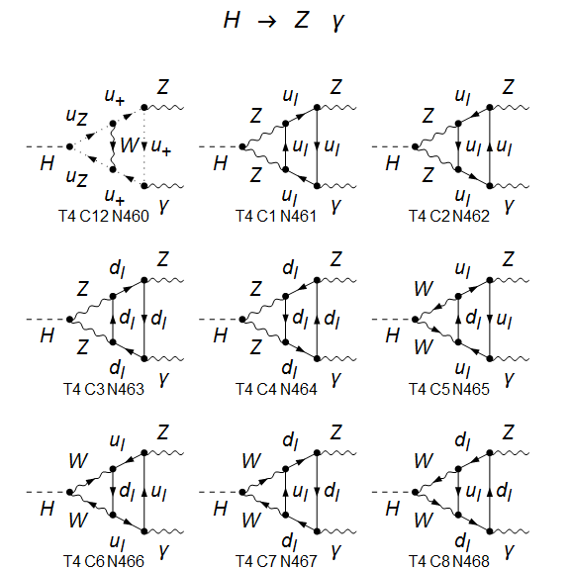
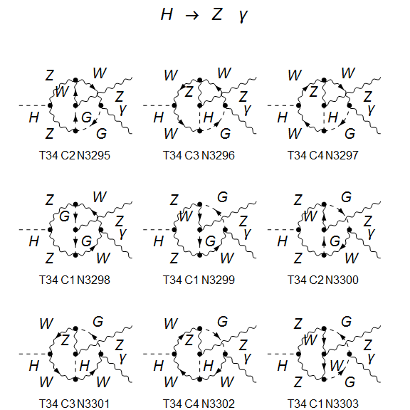
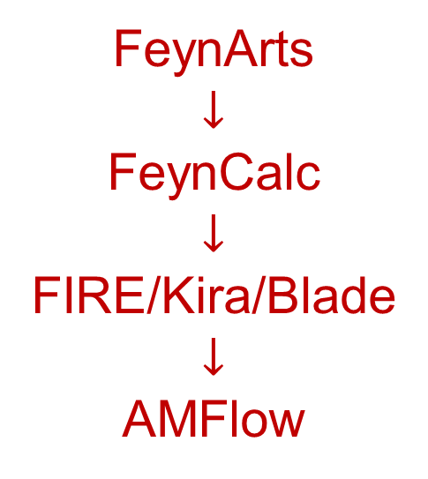
Calculation Framework
About 5000 Feynman diagrams (Feynman gauge)
FeynArts
$$↓$$
FeynCalc
$$↓$$
FIRE/Kira/Blade
$$↓$$
AMFlow

Slide 28
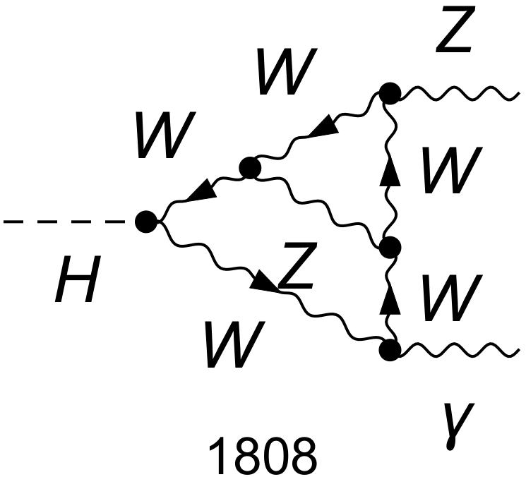


Electroweak coupling
Renomalization
Denner, arXiv:0709.1075
We work in the on-shell renormalization scheme.
Use five different electroweak coupling schemes:
$α(0)$ scheme: all to $α(0)$;
$α(M_{Z}^{2})$ scheme: all to $α(M_{Z}^{2})$;
$α_{G_{μ}}$ scheme: all to $α_{G_{μ}}$;
mixed 1: the one connecting to the external photon to $α(0)$, others to $α(M_{Z}^{2})$;
mixed 1: the one connecting to the external photon to $α(0)$, others to $α_{G_{μ}}$.
no $ln(m_{f})$ terms
毕业论文答辩
答辩人：小不点 答辩时间：5.5 指导老师：大不点

Slide 29
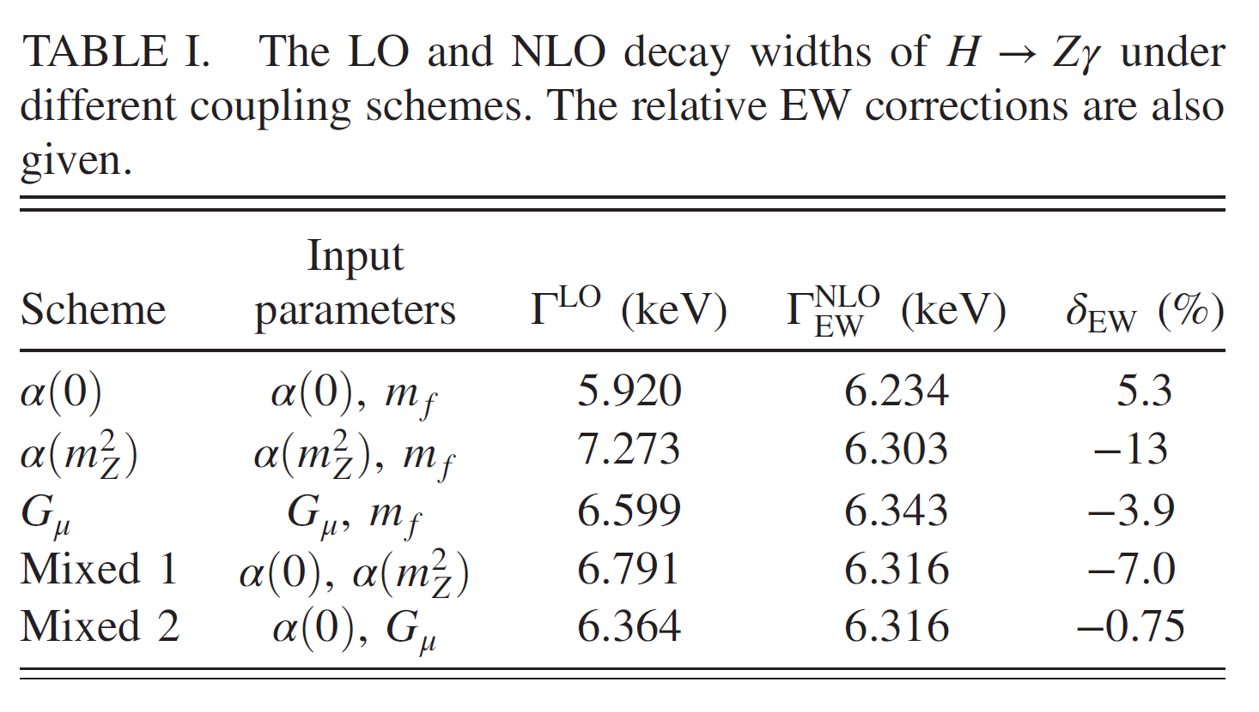


Numerical results
毕业论文答辩
答辩人：小不点 答辩时间：5.5 指导老师：大不点
$Γ^{LO}={6.364}_{−0.444}^{+0.909} keV$, $Γ_{EW}^{NLO}={6.316}_{−0.082}^{+0.027} keV$.
Agree with:
Sang, Feng, Jia, 2405.03464

Slide 30

Numerical results
The EW corrections
more significant than the QCD corrections
greatly suppress the theoretical uncertainty
毕业论文答辩
答辩人：小不点 答辩时间：5.5 指导老师：大不点
$Γ^{LO}={6.364}_{−0.444}^{+0.909} keV$, $Γ_{EW}^{NLO}={6.316}_{−0.082}^{+0.027} keV$.

Slide 31

Numerical results
Combining EW, QCD, $b$-mass corrections: $Γ^{H→Zγ}={6.348}_{−0.085}^{+0.028} keV$
Branching ratio (with SM total width):
毕业论文答辩
答辩人：小不点 答辩时间：5.5 指导老师：大不点

Slide 32
Numerical results
Combining EW, QCD, $b$-mass corrections: $Γ^{H→Zγ}={6.348}_{−0.085}^{+0.028} keV$
Branching ratio (with SM total width):
毕业论文答辩
The EW corrections exacerbate the tension.
答辩人：小不点 答辩时间：5.5 指导老师：大不点

Slide 33

https://indico.cern.ch/event/1567538/
毕业论文答辩
答辩人：小不点 答辩时间：5.5 指导老师：大不点

Slide 34



Recent experiment results
Run 3
毕业论文答辩
Run 2+Run3
答辩人：小不点 答辩时间：5.5 指导老师：大不点
Agree with SM prediction.
ATLAS arXiv: 2507.12598

Slide 35

Conclusion and Outlook
Electroweak corrections are non-negligible for the precise testing of the SM and the search for new physics.
For gg->Hg production, EW corrections amount to a few percent enhancement of the total cross section, with a value of approximately 4.3% in the $G_{μ}$scheme. The differential distributions reveal non-trivial kinematic dependence.
We calculate NLO electroweak corrections to $H→Z γ$, obtain most precise prediction for this channel. The SM prediction agree with the most recent measurement.
毕业论文答辩
答辩人：小不点 答辩时间：5.5 指导老师：大不点

Slide 36


毕业论文答辩
Thank You！
答辩人：小不点 答辩时间：5.5 指导老师：大不点

