Slide 1

Probing detection of dark photon oscillation in a waveguide
Wenyu Wang
Beijing University of Technology
2025.11 @Beijing

Slide 2
CONTENT
Introduction to dark matter
Dark U(1) Theory and oscillation of the photon in a wave guide
Detection of oscillation by OTDR
Conclusion
Collaboration with Yu-Xin Tian, Wen-Na Yang and Bin Zhu

Slide 3
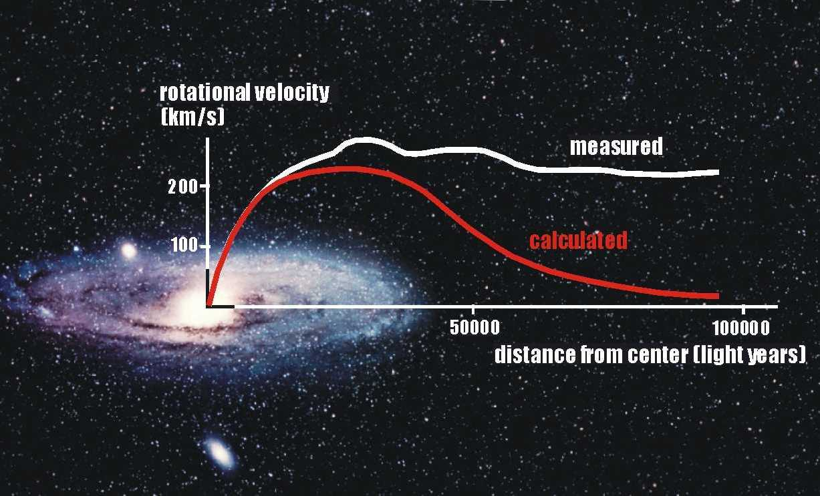

Slide 4
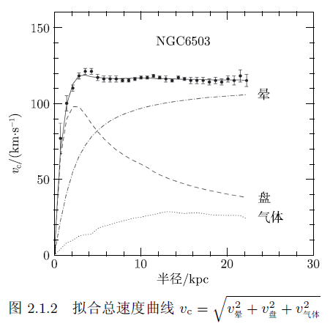

Slide 5
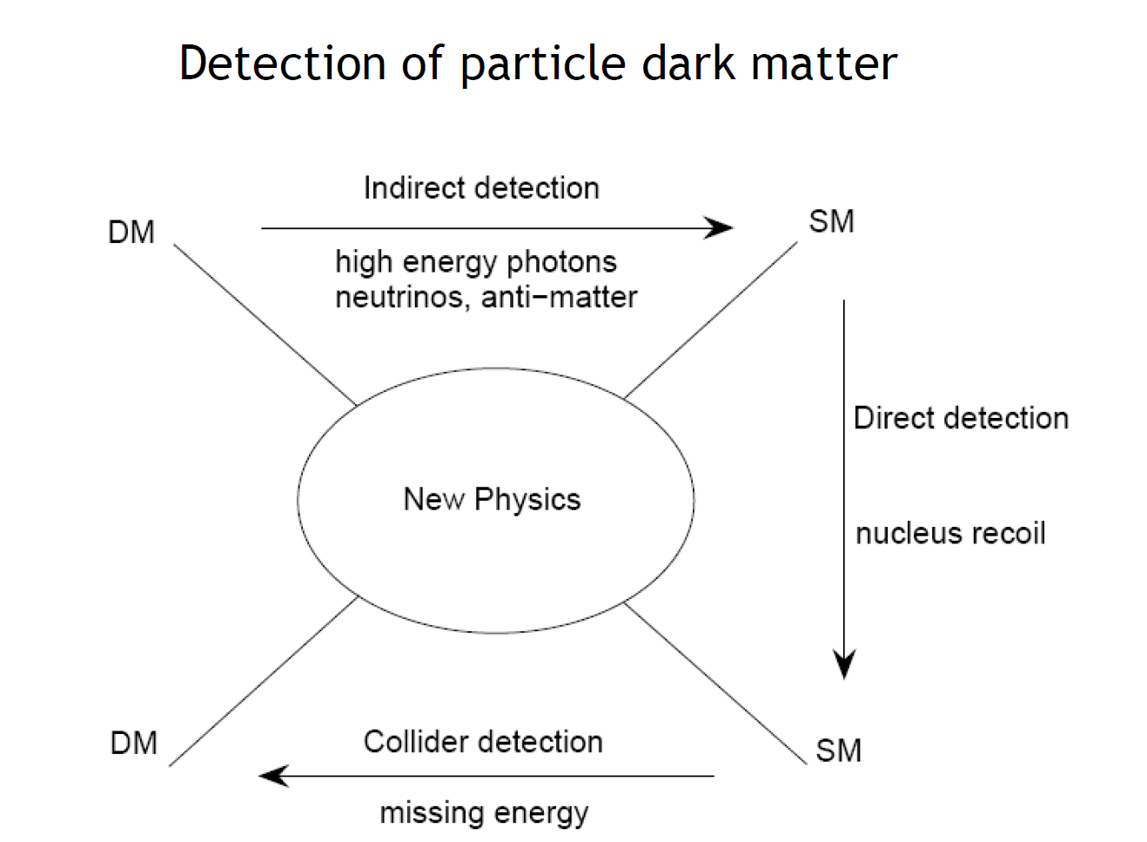
What is self-interactions?
WIMP, EW?

Slide 6
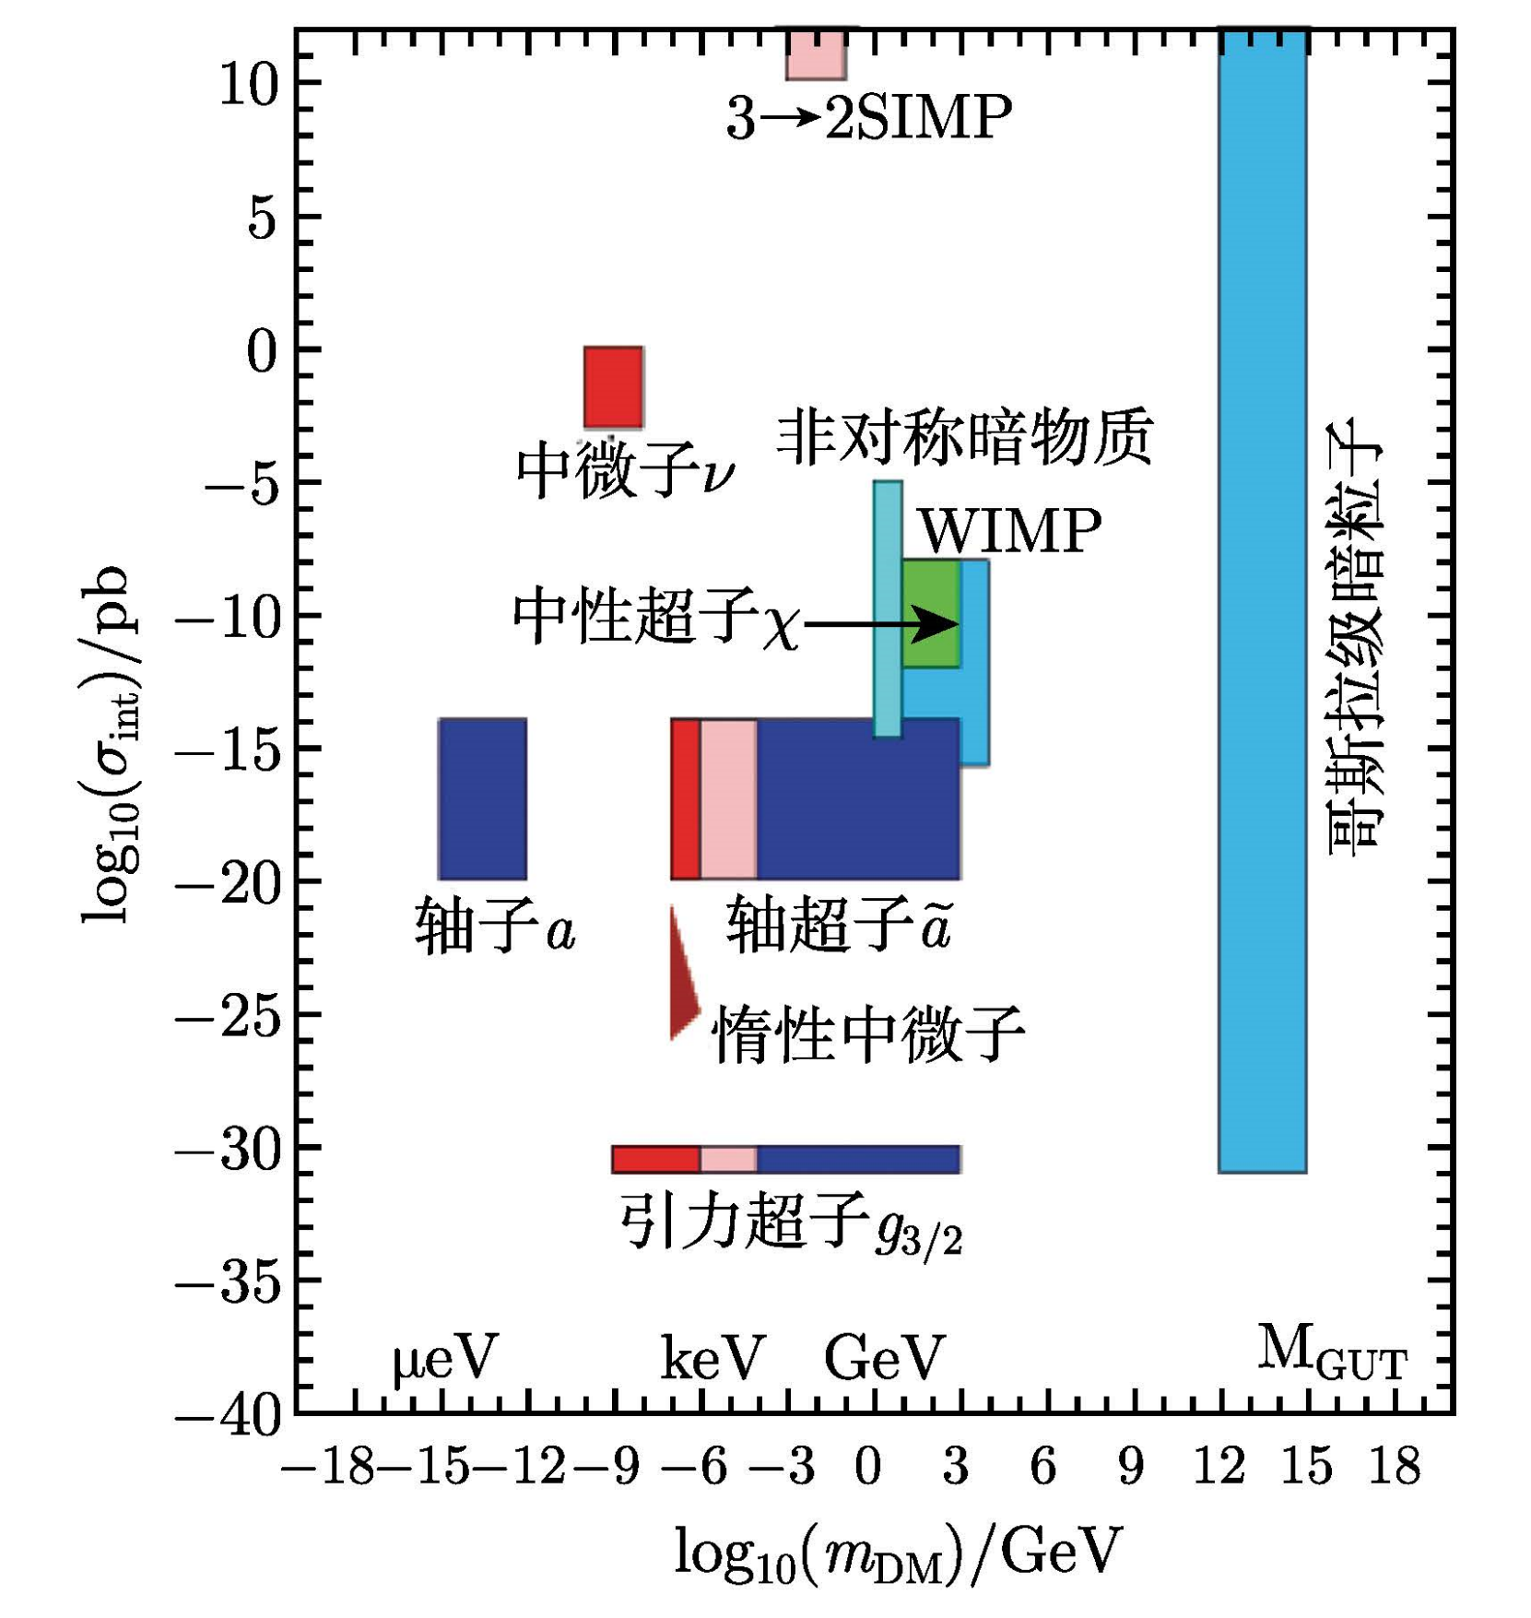

Slide 7
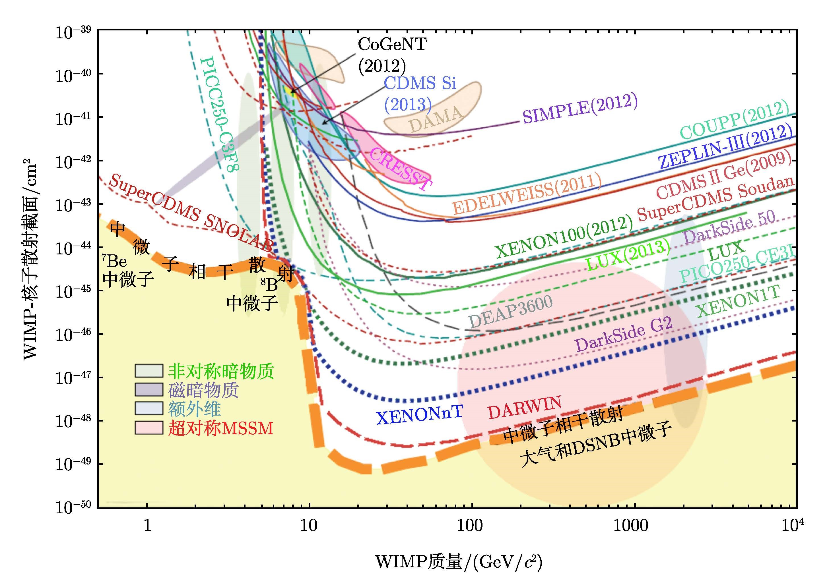
？
！

Slide 8
轴子和暗光子

Slide 9
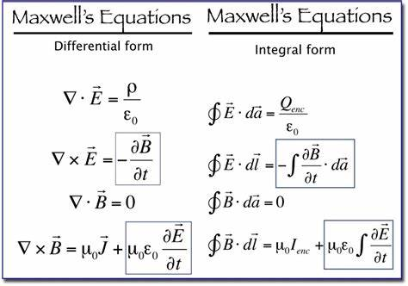
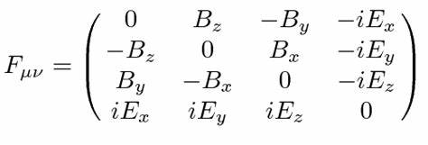


电磁场论
运动方程：
比安基恒等式：

Slide 10


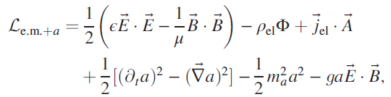
轴子
CP为-1
CP为-1
几何项

Slide 11

修正Maxwell equations

Slide 12
暗电磁作用

Slide 13
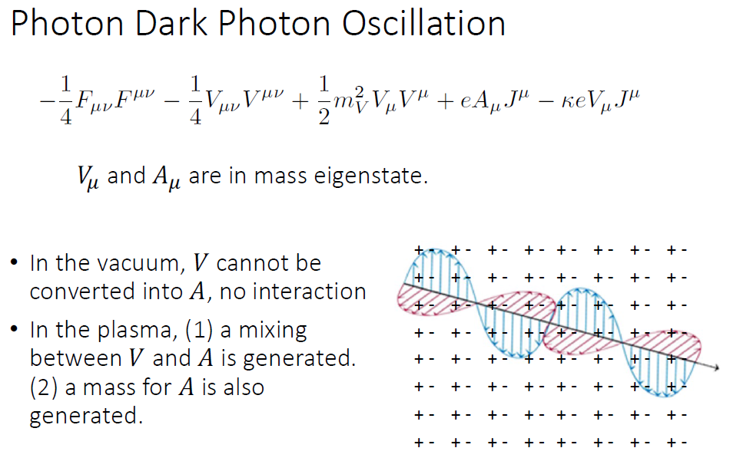

Slide 14
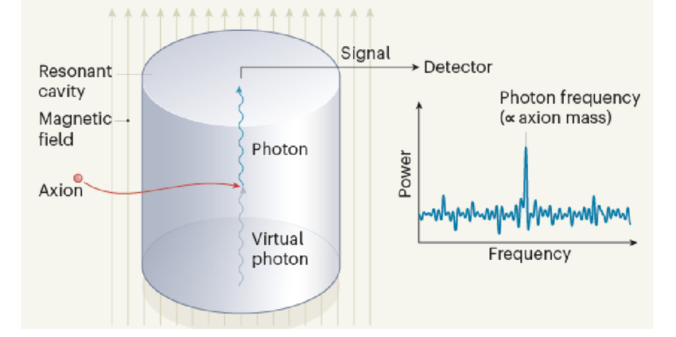
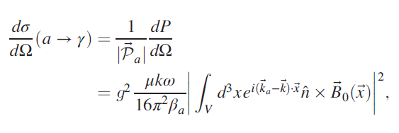

Slide 15
其它探测方案

Slide 16
其它探测方案

Slide 23
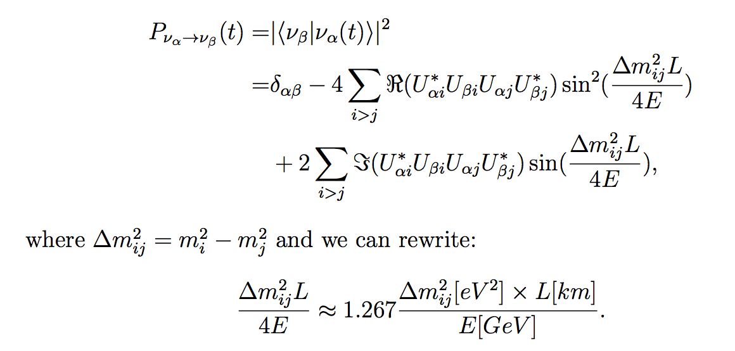
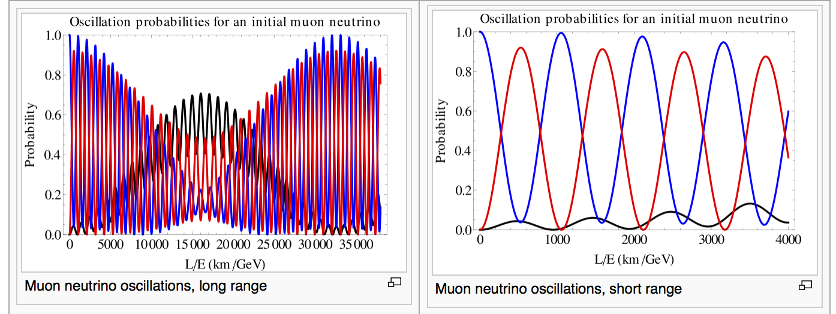
中微子振荡测量

Slide 24

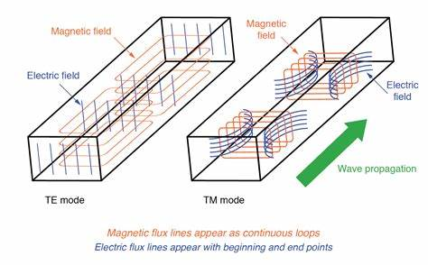
可否用波导或者光纤探测暗光子振荡行为？

Slide 25
Detection of Oscillation by OTDR

Slide 26
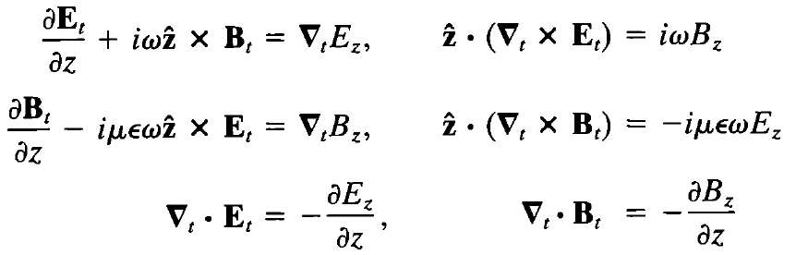

Slide 27
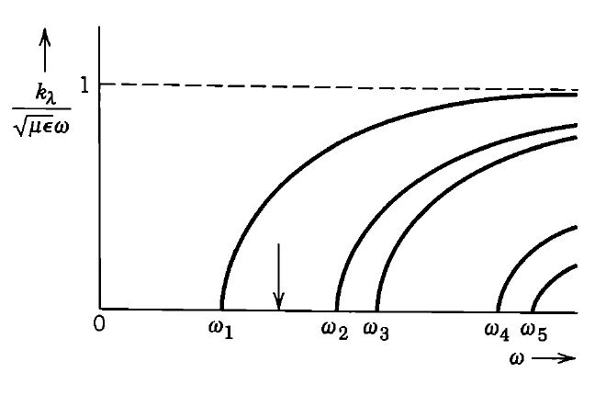
波导管电磁场

Slide 28
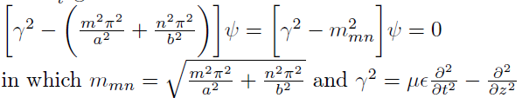
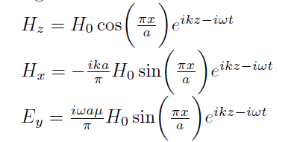
有效质量
TM01 mode:

Slide 29
能流
群速度

Slide 30
衰减

Slide 31

波导管振荡
可见光
暗光子

Slide 32


Slide 33

存在衰减情况

Slide 34
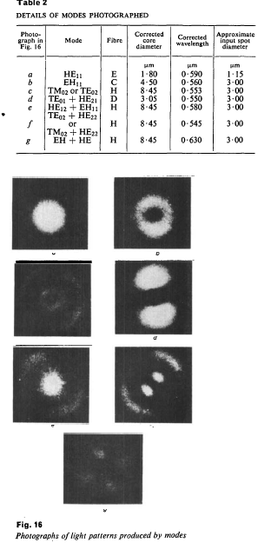
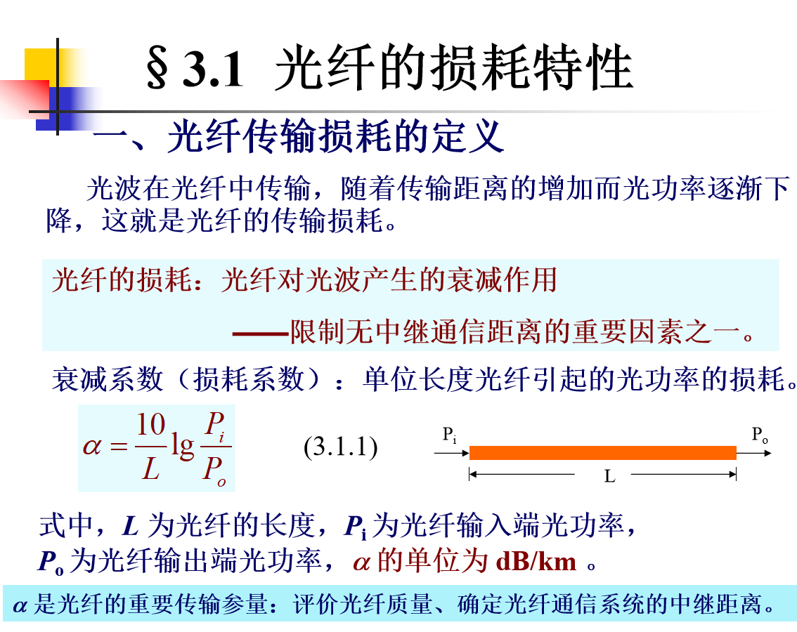

Slide 36
我想的方法：

Slide 38
NOTIFICATION
The reason for the proposal to scan of single mode of the optical fiber is only for a simplest demonstration.
The propagation of light in the real optical fiber may be is modified by medium of the fiber, such as the index of refraction, cladding, etc.
The differences caused by different setup, including interfaces, spools of the fiber, etc. need further mode detailed studies.

Slide 39


Slide 40




Slide 41





Slide 42



Slide 45
Conclusion
Motivated by neutrino oscillation mechanism, strategy for detection of the oscillation between visible and dark photon is proposed
The oscillation is the exchanging of the power flow between visible photon and dark photon, producing an oscillation in the amplitude and power flow. The darkness of dark photon distinguishes the oscillation from the ordinary measurements on the optical fiber.
The optical time-domain relectometry (OTDR) is adopted for the measurement of the oscillation which is found out to be very efficient in the exploration.
The operation in the lab and the data processing are simple. Thus the strategy proposed in the paper may give us a novel and better means to explore the mysterious dark universe.

Slide 46
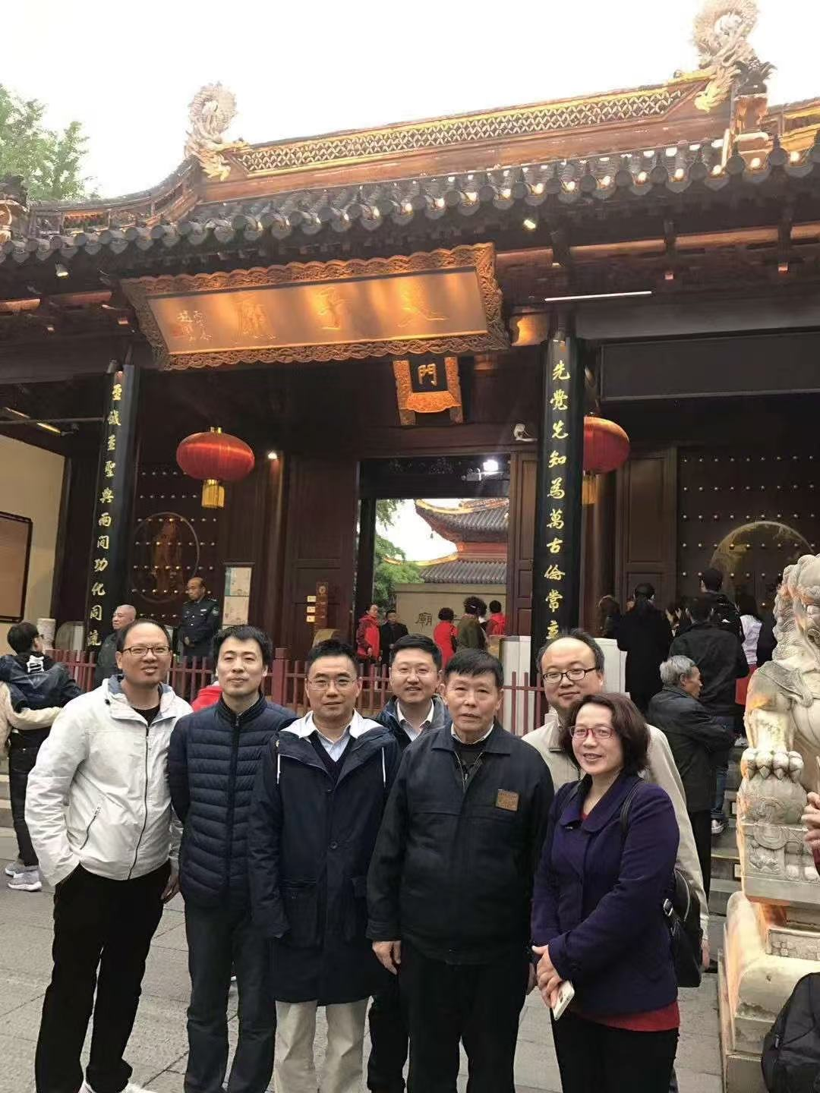

Slide 47

THANKS

