Slide 1


Uncovering Singularities in Feynman Integrals via Machine Learning
The 5th Symposium on Quantum Field Theory and its Applications
Yuanche Liu, Dept. of Mod. Phys., USTC
2025.10.31
Based on arXiv:2510.10099, in collaboration with Yingxuan Xu & Yang Zhang

Slide 2
Introduction on Symbology
01
About Feynman integrals, canonical differential equations and their symbol letters.

Slide 3
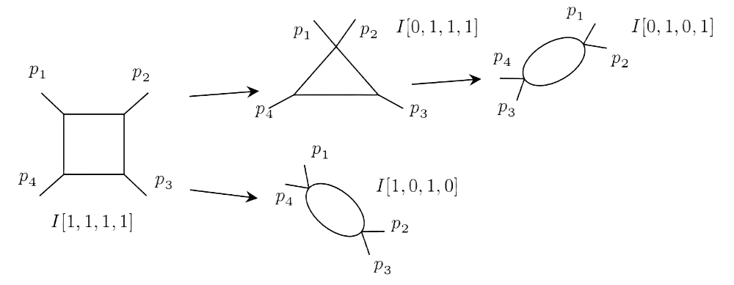
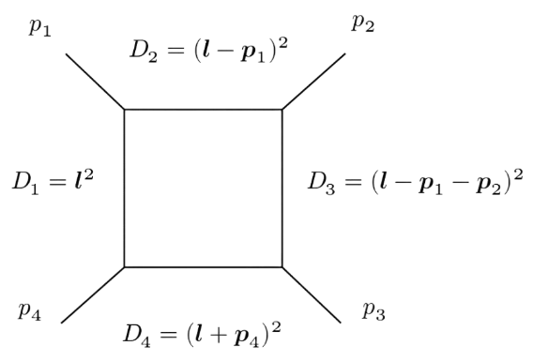
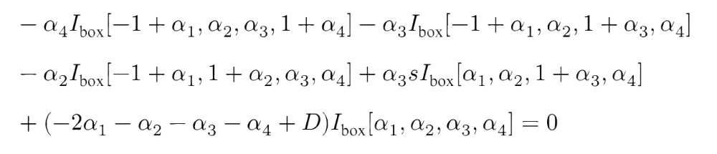
Feynman Integrals and their Family Structure
Feynman Integrals can be recursively built from top sector to sub sectors
Form a family structure, in which integrals are determined by combination of propagators.
The well-known IBP relations[F. Tkachov,1981] uncover the linear relations between different integrals
One can determine a basis in respect to linear relations – the Master Integrals
Top sector
Sub sectors

Slide 4
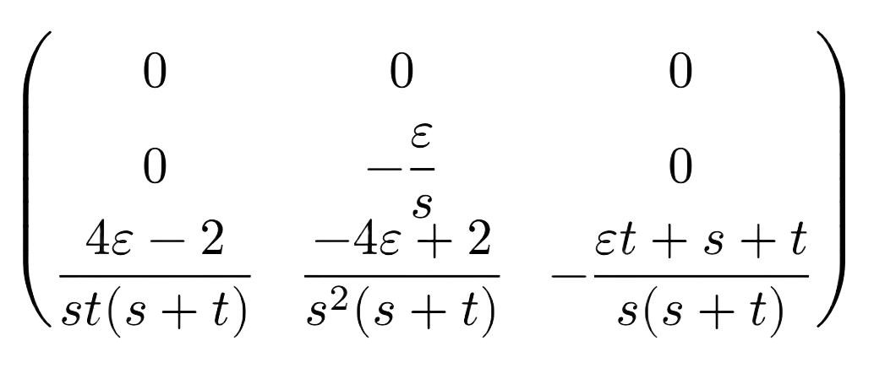
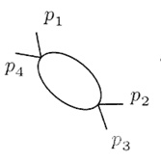
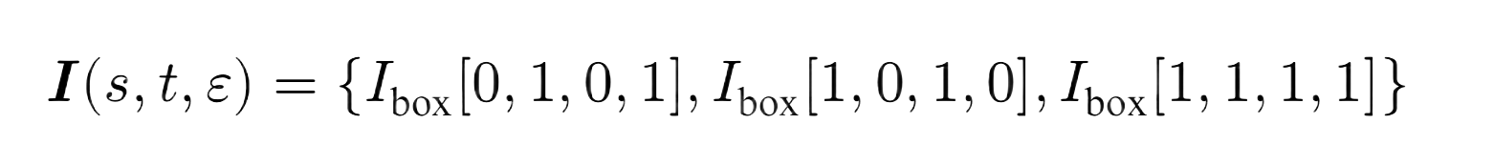
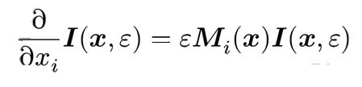
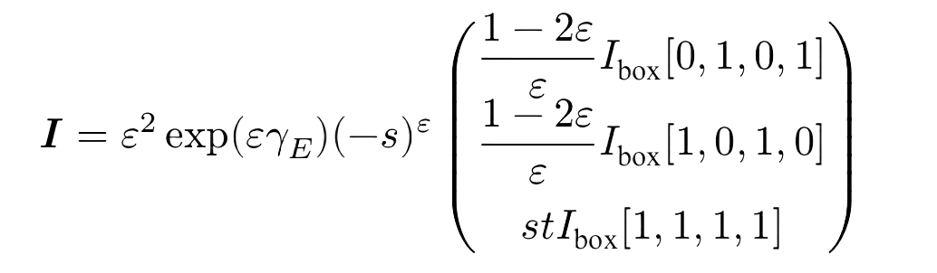
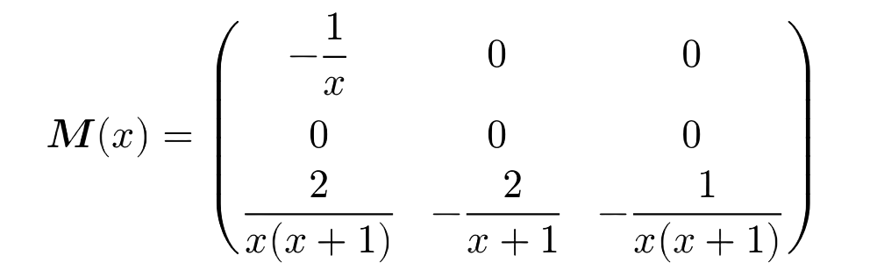


Canonical Differential Equations
Taking derivatives for master integrals in respect to kinematic variables lead to a differential equation system.
$$∂_{s}$$
$$=$$
Change to Canonical Basis, one obtain ε-factorized Canonical Differential Equations[J. Henn, 2013]
Sometimes this can be very complicated because of complicated function space, see [ε-collaboration, 2025]

Slide 5

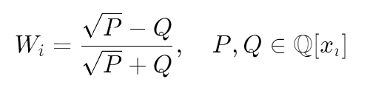
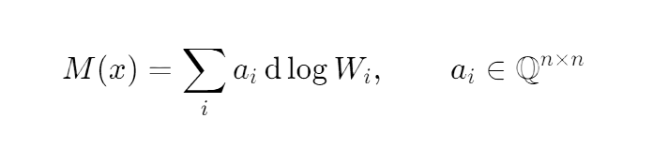
Symbol Letters
CDE Matrix contains different Symbol letters, revealing the analyticity(poles, regions) of Feynman Integrals.
Ingredients for analytical bootstrap on Feynman Integrals or Amplitudes[Carrolo, Chicherin, Henn, Yang, Zhang, 2025]
Cluster Algebra structures[Pokraka, Spradlin, Anastasia, Weng, 2025] from Mathematical Physics
parity even letter
Some previous algorithms to generate Symbol letters:
Effortless[Antonela, 2024] and SOFIA[Correia, Giroux, Mizera, 2025], using Landau analysis and some conjectures.
BaikovLetter[Jiang, Lian, Yang, 2024] using Baikov Rep.+ Maximal Cut.
parity odd letter
Symbol letters
Symbol Alphabet = {All Symbol Letters}
Very limited for a certain family!

Slide 6
Machine Learning And Symbolic Regression
02
An introduction about Machine Learning and Symbolic Regression.

Slide 7
Why Symbolic Regression?
Analytic Reduction
Canonical Basis
IBP Reduction
@ Finite Field
Analytic CDE
Entries
Symbol Letters
Analytic
Reconstruction
Extremely Time Consuming!
2l6p planar[Henn, Matijasic, Miczajka, Peraro, Xu, Yang, 2025]
2 hrs/pt for numerical CDE matrix
Unable to reconstruct all letters!

Slide 8
Why Symbolic Regression?
Black Box
Input:
Master Integrals
Output:
Analytic Coefficients
Hint:
Easy for numeric
Hard for analytic
Canonical Basis
Analytic CDE
Entries
Symbol Letters
This is a typical Symbolic Regression task!

Slide 9
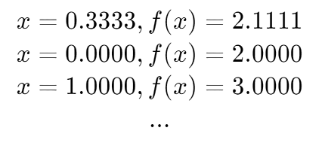

Machine Learning: Symbolic Regression
Numerical Data Set
Search & Verification
Symbolic Expressions
No | Expr | Comp | Error
1 | 0.4exp(x) | 3 | 0.132
2 | x²+2.000 | 4 | 0.000
3 | x+ln(x) | 4 | 0.143
4 | x³+x² | 5 | 0.475
Symbolic Regression: Search interpretable symbolic expressions from numerical samplings.
Various Routings:
PySR[M.Cranmer, 2023]—Genetic Programming,
SymbolicGPT[Valipour, Panju, You, Ghodsi, 2021]—LLM based,
IdeaSearch-Fit[Song, Cai, Zhang, Wei, Pan et.al, 2025]—GP + LLM based mixing strategy...

Slide 10

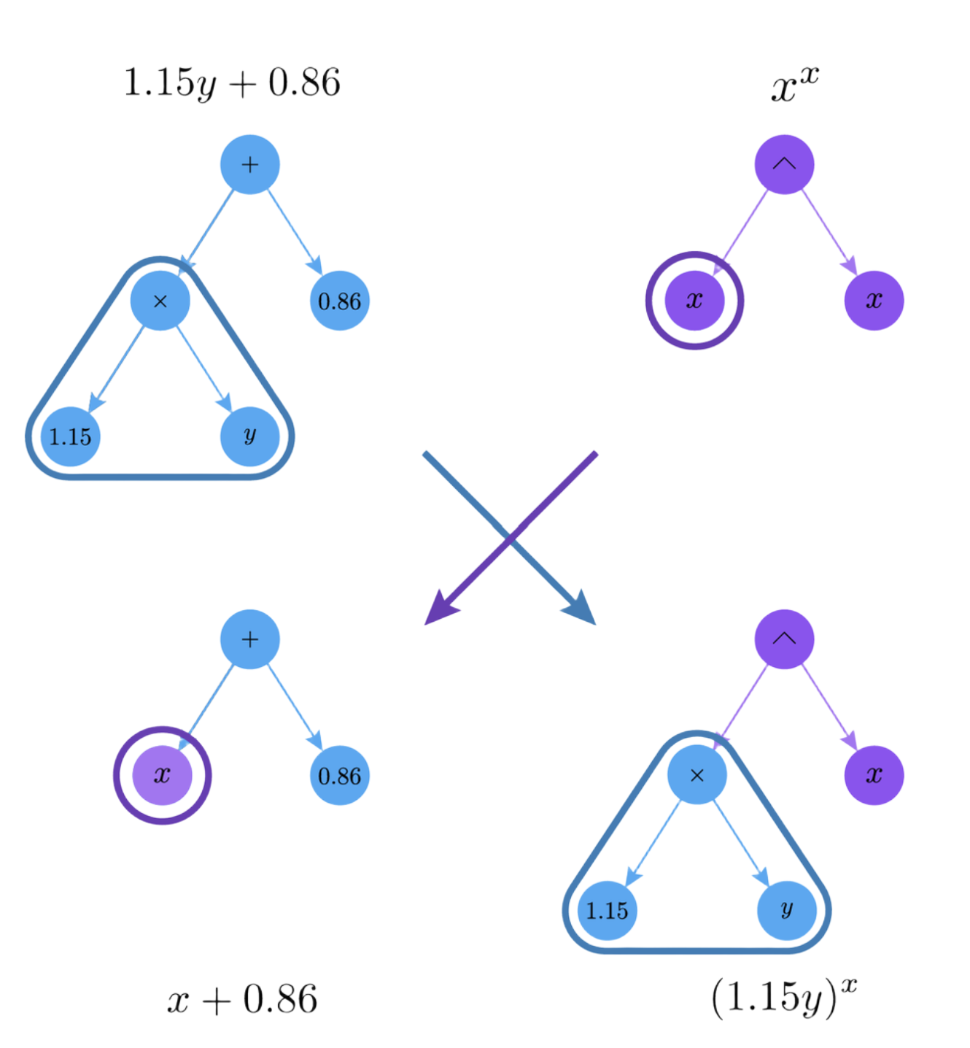
Machine Learning: Symbolic Regression
Input Data
X, y
Symbolic Regression
Selected Equation
“X+ln(y)”
PySR is a powerful Symbolic Regression toolkit.
No pre-train: Based on Genetic Programming. Easy to use, no GPU requirement.
Efficiency & Accuracy: Pareto Frontier from complexity and accuracy.
Sufficient Extension: Support Julia & Python user-defined functions, and many advanced math operations…
Searching Tree
Pareto Frontier
No | Expr | Comp | Error
1 | x+y | 3 | 0.132
2 | x²+0.1y | 5 | 0.329
3 | x+ln(y) | 4 | 0.003
4 | x³+y² | 5 | 0.475

Slide 11
Apply Machine Learning to Symbol Alphabet
03
Detailed workflows and examples for Symbol Alphabet building.

Slide 12
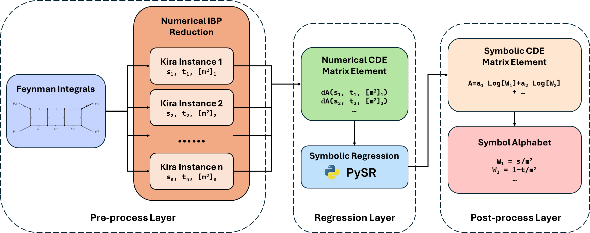
Workflow Introduction

Slide 13
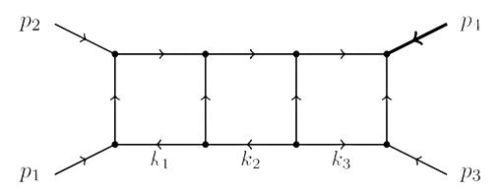
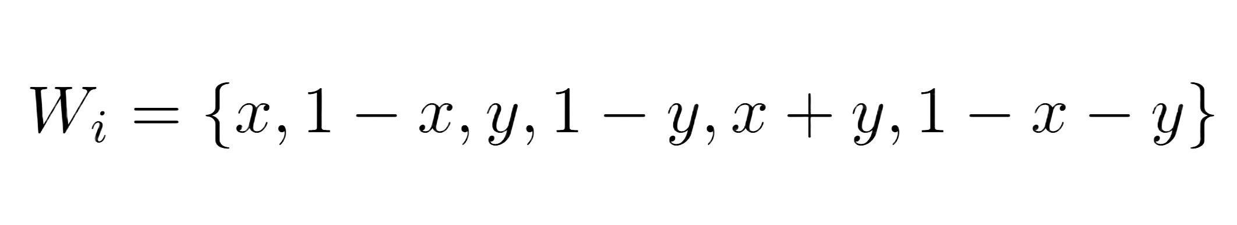
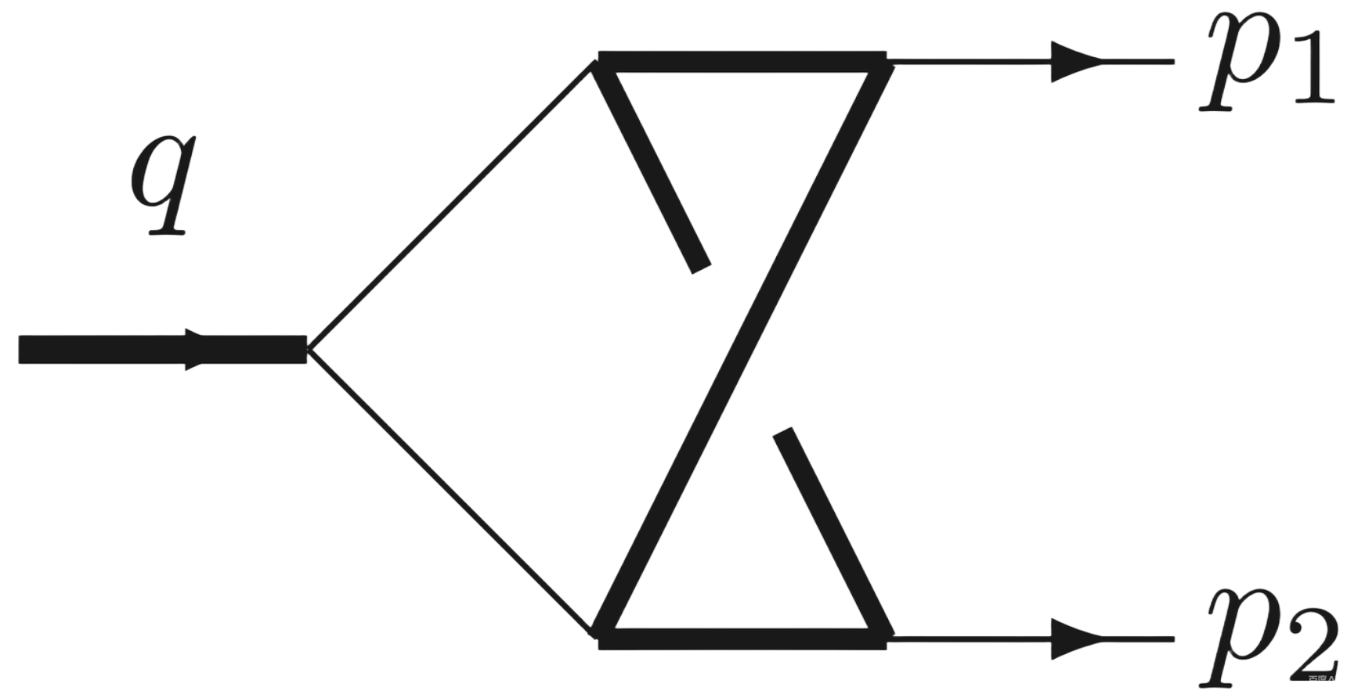
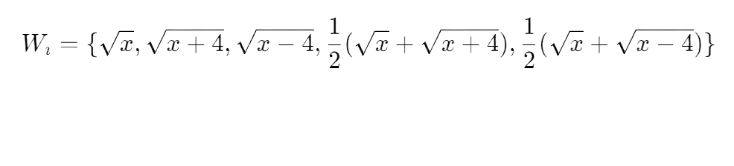
Examples: 3l4p1m & 2l3p1m-np
3l4p1m[Vita, Matrolia, Schubert, Yundin, 2014]
83MIs, 2(+1) scales: x=s/m², y=t/m²
6 different Symbol letters—all successfully built!
KIRA reduction:
Num:~20mins 12 threads of i9-13950HX CPU @ 5.30GHz
Ana: ~100mins 12 threads
p₄ has mass m², others are massless.
2l3p1m-np[Manteuffel, Tancredi, 2017]
9MIs(sub-topology), 1(+1) scales: x=s/m²
5 different Symbol letters—all successfully built!
Letters have square roots!
KIRA reduction:
Num:~10mins 12 threads of i9-13950HX CPU @ 5.30GHz
Ana: ~60mins 12 threads
q has mass s, others are massless.
4 propagators with coincide mass.

Slide 14
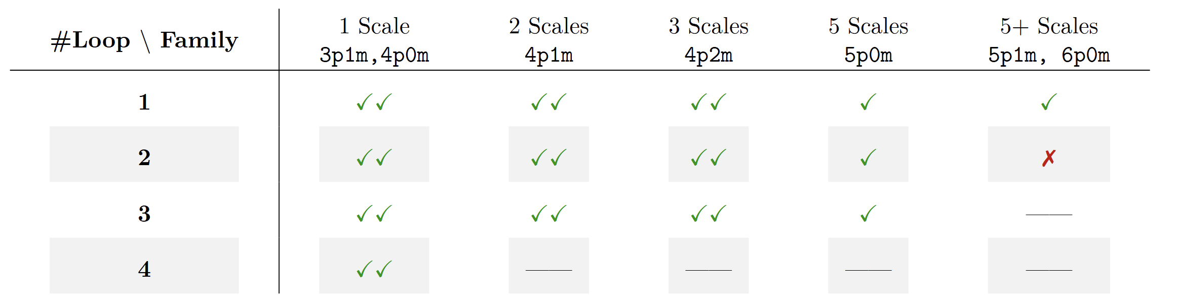




Trials on more Diagrams…
3l5p-PBB family
[Liu, Matijasic, Miczjka,
YX. Xu, YQ. Xu, Zhang, 2024]
316MIs, 5 scales
20+1 Even Letters Found.
10 Odd Letters manually built.
: Complete Symbol Alphabet reconstructed;
: All Even Letters obtained, remaining ones (Odd Letters) can be constructed manually;
: Some letters not found;
: Not tested because of incomplete reference.

Slide 15
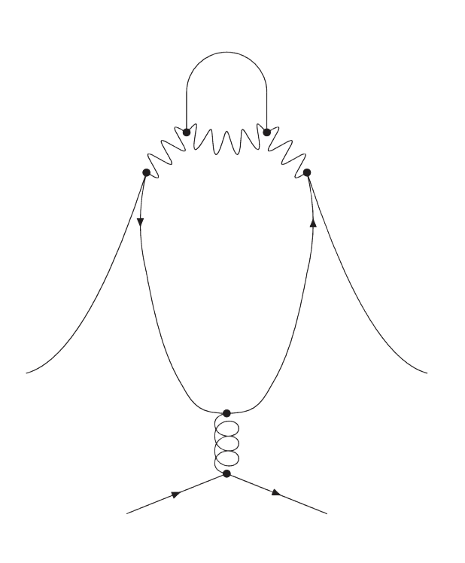
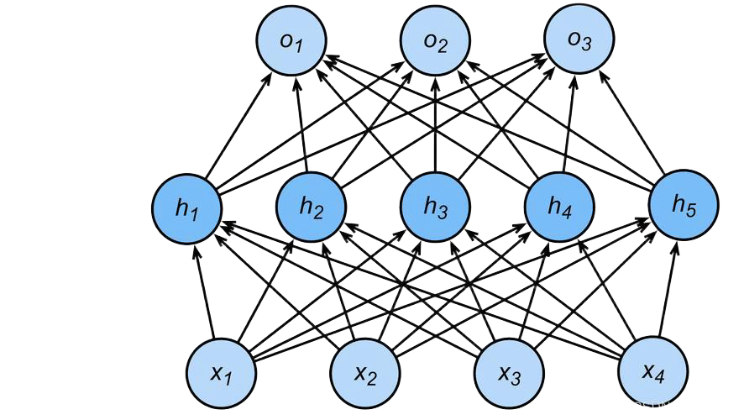
Discussions and Future…
Unlike traditional Machine Learning project…
We pursue a completely exact solution, instead of approximate computation.
To achieve this…
We “weirdly” tune Hyper-parameter to “force” the model over-fitting;
We also perform an early-terminate as soon as exact solution comes up.
In the future…
Improve accuracy and efficiency?
New areas for AI-ML to obtain exact & closed form solution?
……

Slide 16
Thank you!
Yuanche Liu, Dept. of Mod. Phys., USTC
2025.10.31

