Slide 1

CEPC Trk & PID meeting
Feb 14, 2025
H_recoil Status Report
Yuji Li(Fudan university)

Slide 2

Higgs recoil mass study
In ee collision in CEPC, H mass can be measured in recoil mass in ZH events, when a Z boson can be well-reconstructed by di-leption final-states.
The performance of this benchmark study gives a feedback for the quality of lepton reconstruction and tracking resolution.
Clear relation between Z boson momenta and H recoil.

Slide 3

Status
Though the H decay is not the input for recoil mass computing, but the mutilepton final state(HZZ, HWW) will bring inpacts on Z reconstruction.
We use a chi square method to find the best lepton pair.
In this formula, the width of Z/H should be measured as a constant with H invisible events.
Inputs: /cefs/higgs/liugeliang/CEPC/202501/Production/E240_e2e2Hinvi, /cefs/higgs/liugeliang/CEPC/202501/Production/E240_e1e1Hinvi

Slide 4
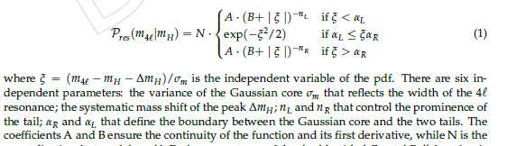
Lepton Selection
Status: Muon system is not well defined, and electron reconstruction is not corresponding to Z peak from Geliang’s report.
Lepton selection is performed by GenMatching.(DeltaR<0.1)
Z, H resonance is fitted with TwosidedCB. (unbinned fit)

Slide 5
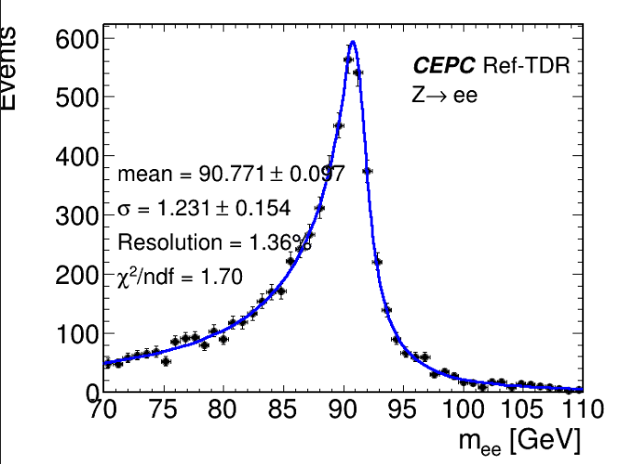
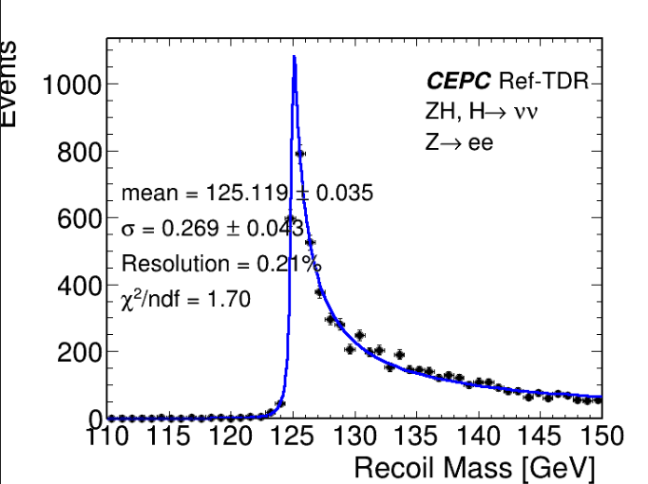
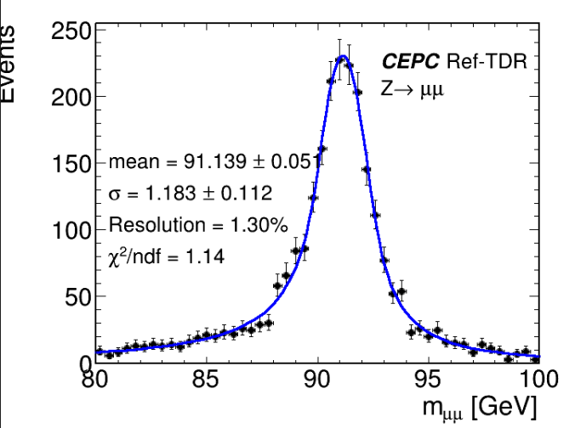
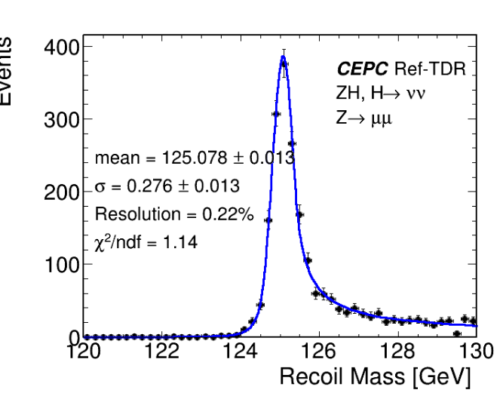
Results (Fitting with TwosidedCB)

Slide 6
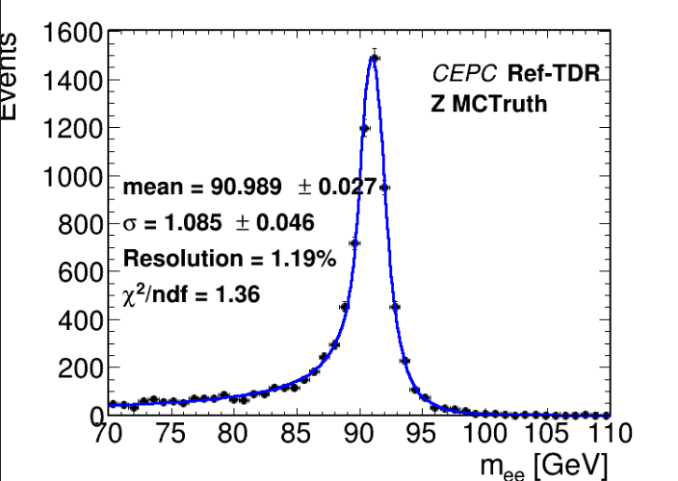
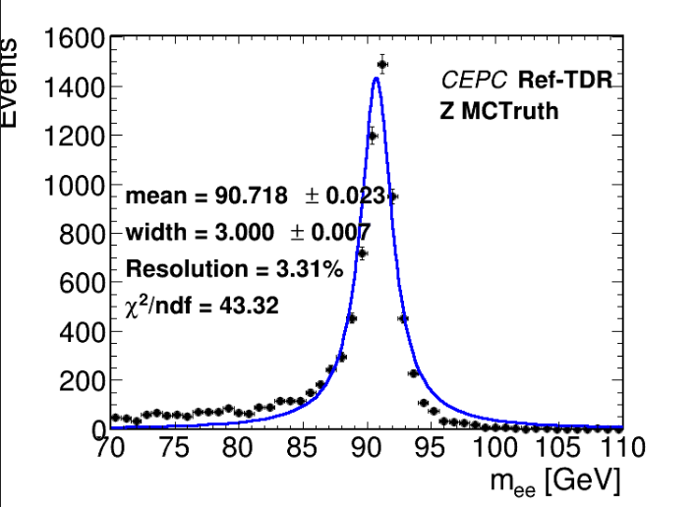
Z Truth (Fitting with TwosidedCB)

Slide 7
Summay and plans
The shape in H invisible decay is corresponding with kaili & Geliang’s study.
With the width parameters, best lepton pair study can be performed in HZZ & HWW samples. (Under generation)
Bkg samples includes Zgamma, eeWW and eeZZ will be checked for the optimazations of event selections, after finishing best lepton pair study in signal samples.
Final fit of H recoil shape will be performed including bkg shapes.

