Slide 1
Compact dwarfs made of light-quark nuggets
2406.00613
2025.02.14😙😭
Jingdong Shao
@Groupmeeting

Slide 2
Introduction
Strange quark matter (SQM)
More stable than normal matter
Strangelets, nuclearites, compact objects, strange stars…dark matter?
SQM becomes unstable due to a too large s quark mass while nonstrange quark matter (udQM) might be more stable
If the effects of spontaneous chiral symmetry breaking is considered.

Slide 3
Introduction
Unstable condition
A surface tentsion σ. If $σ<σ_{c}\sim$a few MeV/fm^2,
Large nuggets become unstable and fragment into “crystalline crust”
Electron gas
c
σ may increase substantially due to new terms stemming from vector interactions,
ultimately hindering the formation of quark star crusts and compact dwarfs.
crusts
Nuggets

Slide 4
Introduction
Formation
In violent astrophysical events such as strange star collisions,
more than 0.03 M⊙ of SQM may be ejected into space
→strangelet dwarfs and strangelet planets
Similarly udQM.
From dark matter directly?

Slide 5
Introduction
Stable condition
Coulomb barriers among stranglets or udQM nuggets. The fusion reactions does not take place for compact dwarfs with low temperature.
Electron capture or β-decay reactions do not take place

Slide 6
Light quark nuggets
Equivparticle model: density dependent quark masses.
Photon:
Linear confinement and leading-order perturbative interactions:
$$C=0.1, \sqrt{D}=150MeV$$

Slide 7
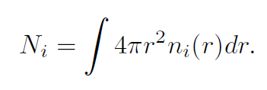
Dirac Equation
After integration of the angular component:
$ε$: single particle energy.
Mean field scalar and vector potential
KG equation for photons:

Slide 8
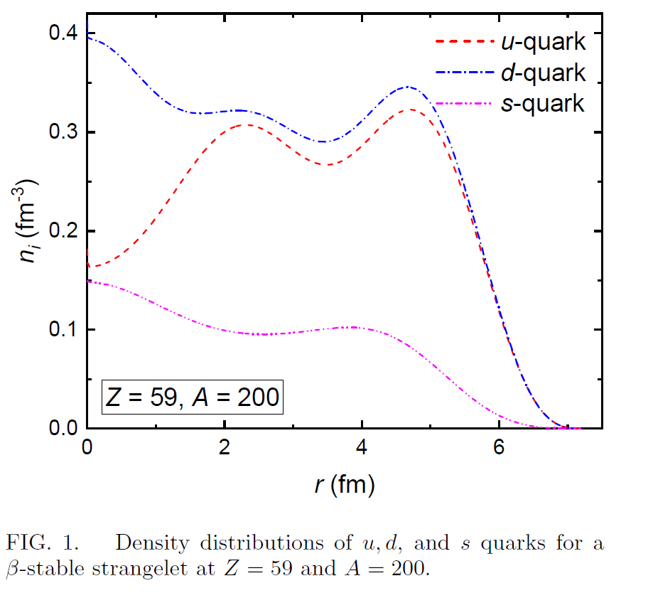
Solution
At fixed baryon number A.
Inside a box with narrow grid .
Iteratively.
Until convergency.
Minimize M by composition of u, d and s (β stable).
An extra symmetry energy correction term for udQM.

Slide 9
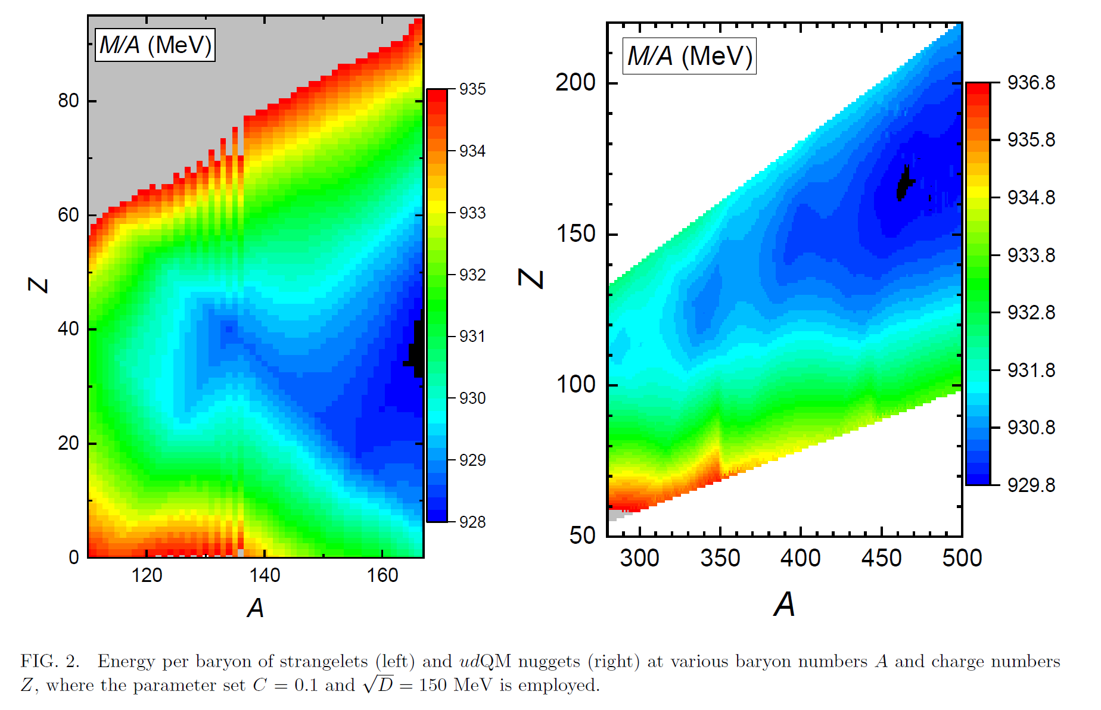

Slide 10
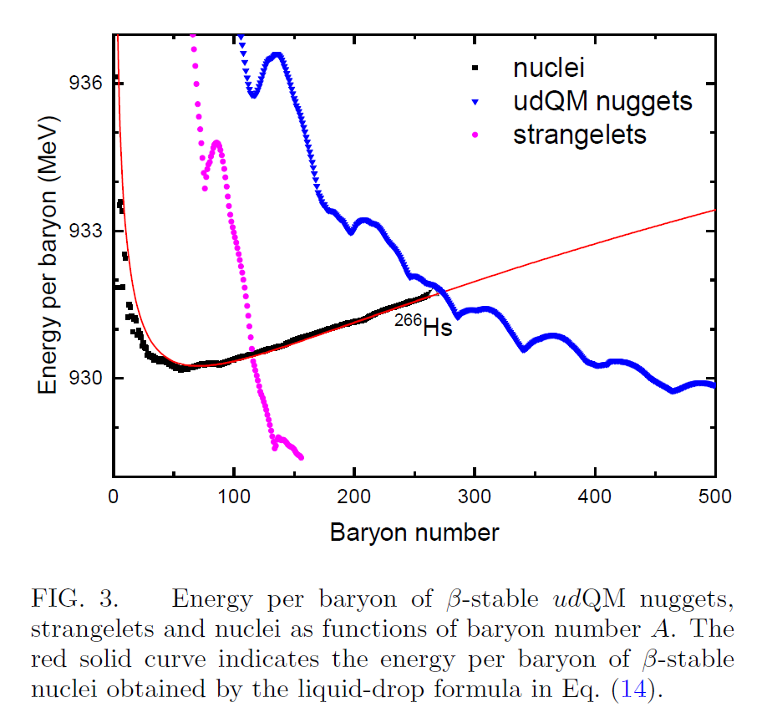

Slide 11
EOS
The BPS model
β stable:

Slide 12
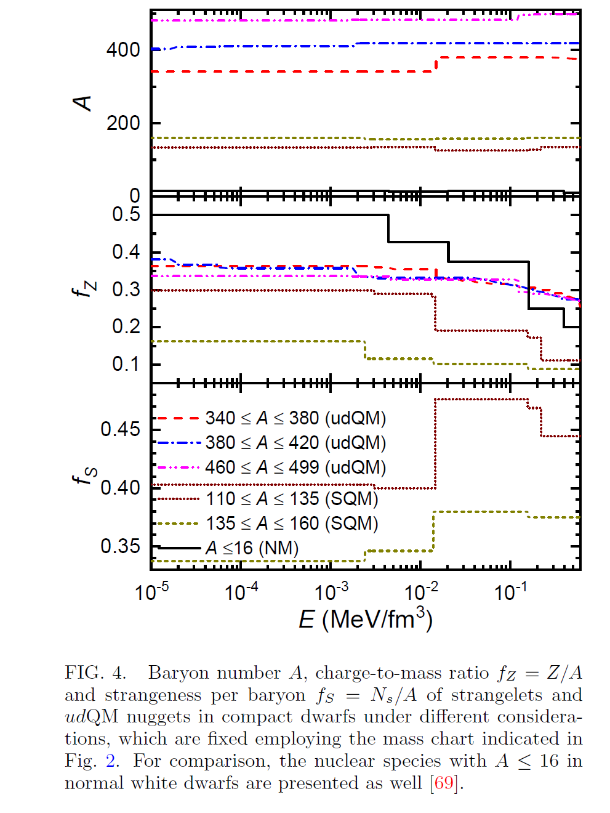
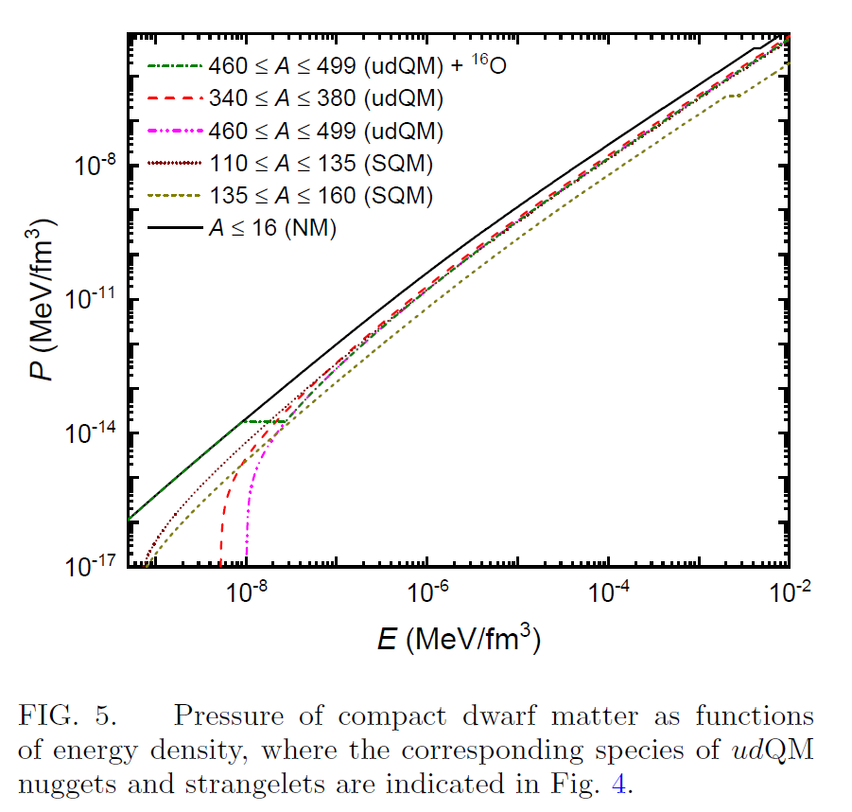

Slide 13
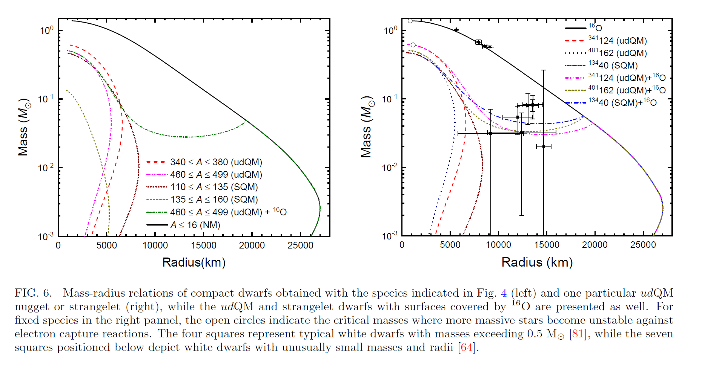
TOV Equation

Slide 14
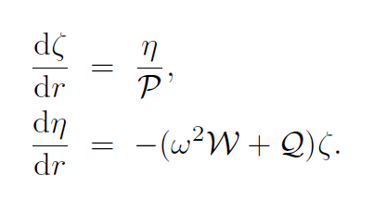
Radial oscillations
?
Master equation:

Slide 15
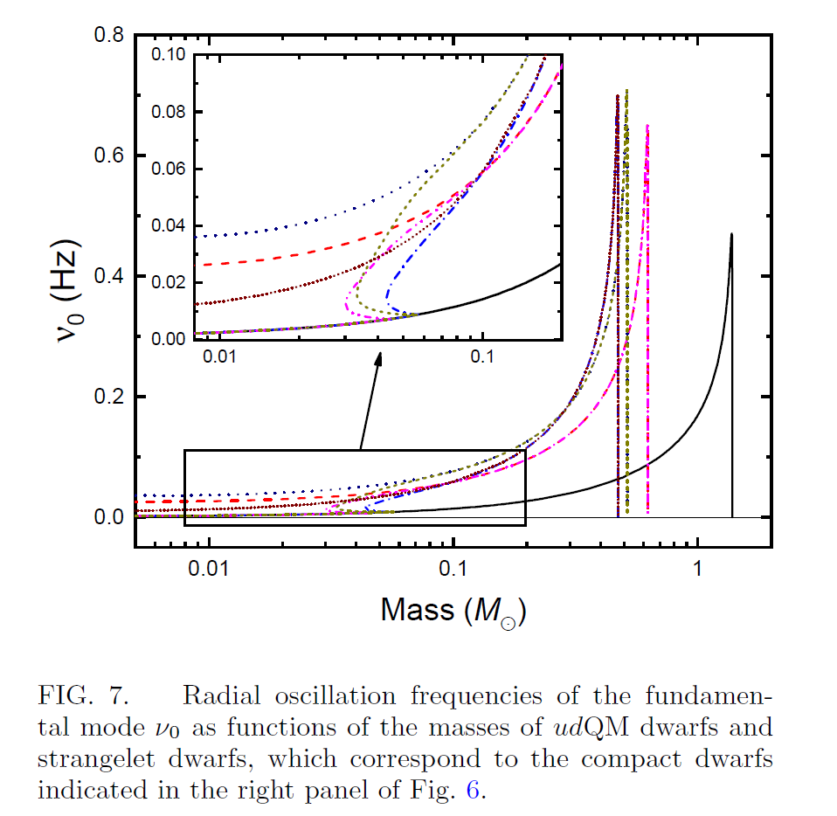
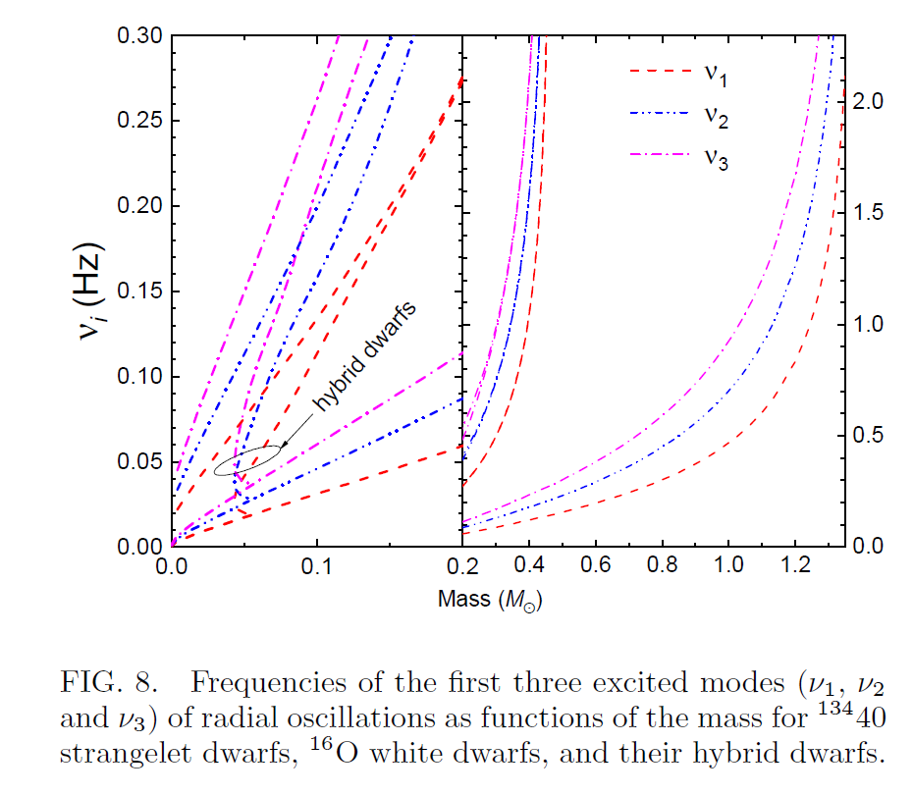
Ec: Coulomb potential barrier/Center energy ?

Slide 16
The frequencies of both the fundamental mode and excited modes of compact dwarfs are larger than those of ordinary white dwarfs, which may offer opportunities to identify those exotic objects.

