Slide 1
Digitization and Reconstruction of Muon Detector in CEPCSW
Weiqi Meng
2024.12.30

Slide 2
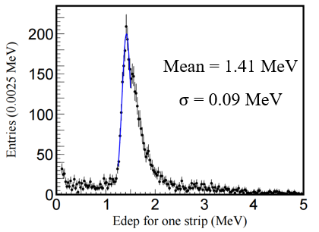
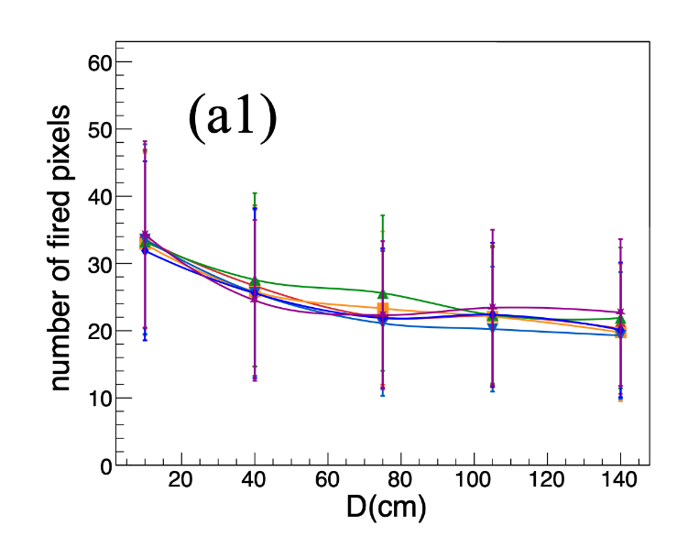
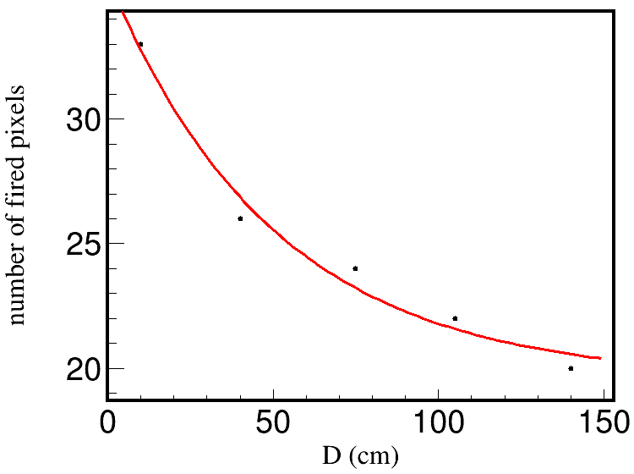

Digitization
$$1 mip=1.41 MeV$$
Zhang H, Wang X, Ma W, et al. Journal of Instrumentation, 2024, 19(06): P06020.
The relationship between the number of photons received by the SiPM at the scintillator endpoint and the distance from the hit point to the SiPM under 1 mip energy deposition.
$$N=16.0813×e^{−x/50.8147}+19.5474$$
The fitting results of the distribution shown in the left figure.

Slide 3
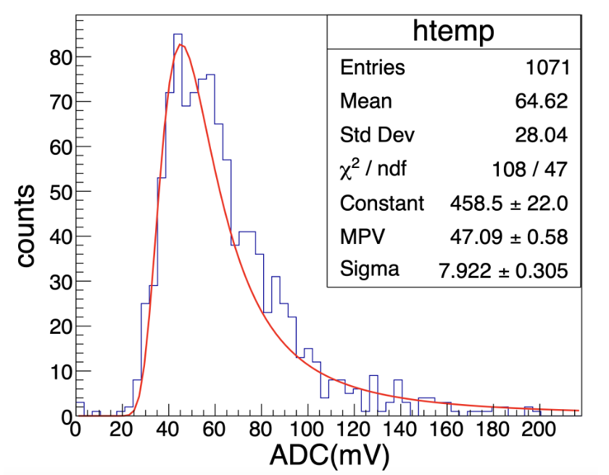
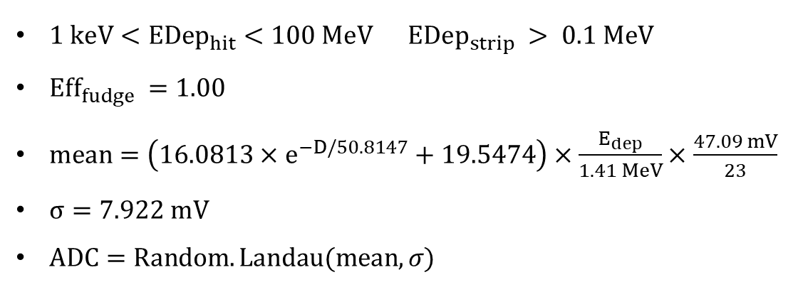

Digitization
$1 keV<EDep_{hit}<100 MeV EDep_{strip} > 0.1 MeV$
$Eff_{fudge} =1.00$
$mean=\left(16.0813×e^{−D/50.8147}+19.5474\right)×\frac{E_{dep}}{1.41 MeV}×\frac{47.09 mV}{23}$
$σ=7.922 mV$
$ADC=Random.Landau(mean,σ)$
$$1 mip→ADC=47.09$$
$$p. e.=23 σ=7.922$$
The ADC distribution corresponding to the SiPM output for a 1 MIP energy deposition.

Slide 4

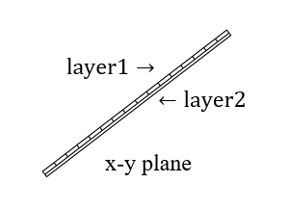
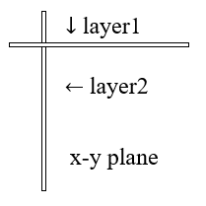
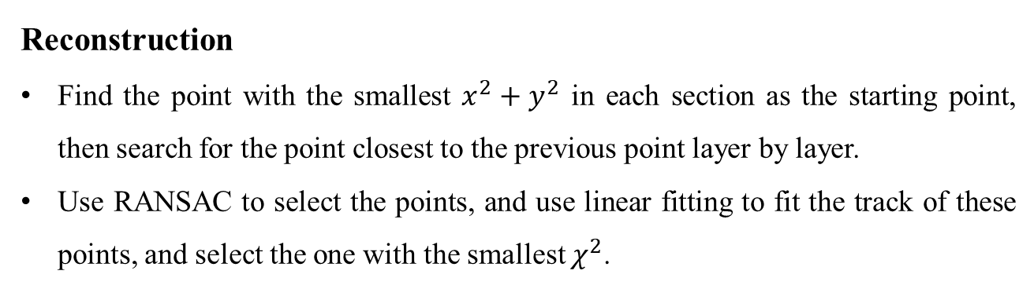
Reconstruction
Find the point with the smallest $x^{2}+y^{2}$ in each section as the starting point, then search for the point closest to the previous point layer by layer.
Use RANSAC to select the points, and use linear fitting to fit the track of these points, and select the one with the smallest $χ^{2}$.
In a superlayer of Barrel, layer1 gives pos.x and pos.y, layer2 gives pos.z.
In a superlayer of Endcap, layer1 gives pos.y, layer2 gives pos.x, both can give pos.z.

Slide 5
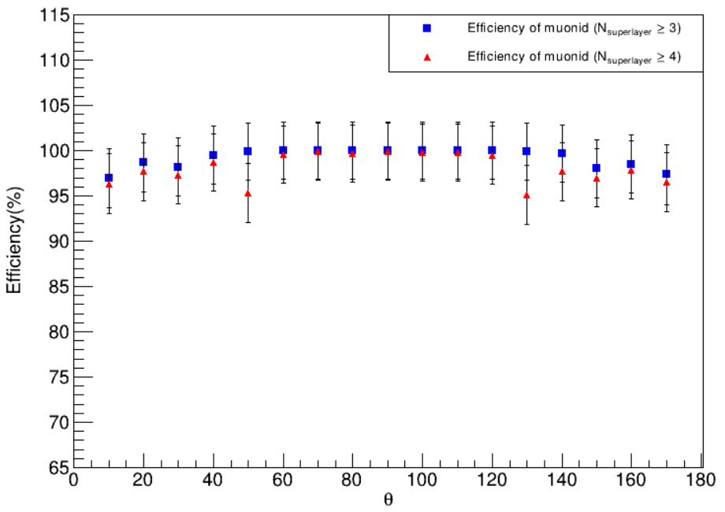
Muonid: Record the superlayers with scintillator signals.
For the barrel part: the particle is considered a muon when the number of superlayers with signals in one sector and its adjacent sector exceeds 3 or 4.
For the endcap part: the particle is considered a muon when the number of superlayers with signals inside one end of the endcap exceeds 3 or 4.
If the particle passes through both the barrel and the endcap, it is considered a muon when the sum of the number of superlayers with signals in the barrel and endcap exceeds 3 or 4.
$$10 GeV μ$$

Slide 6
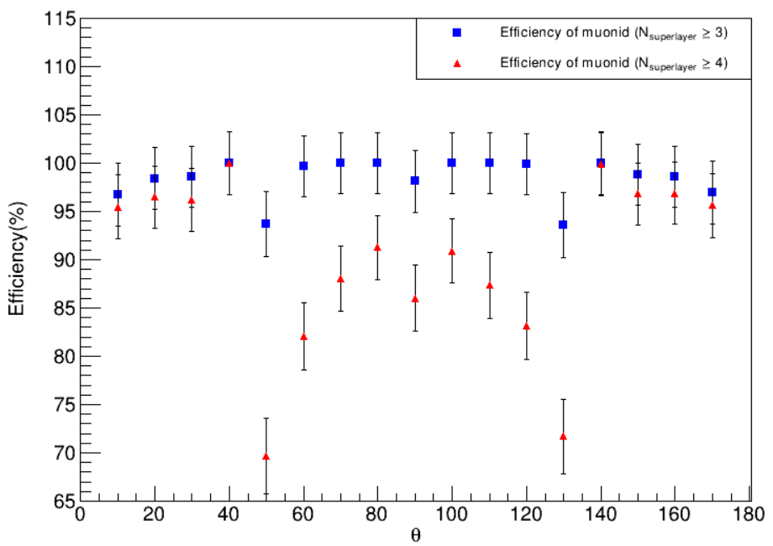
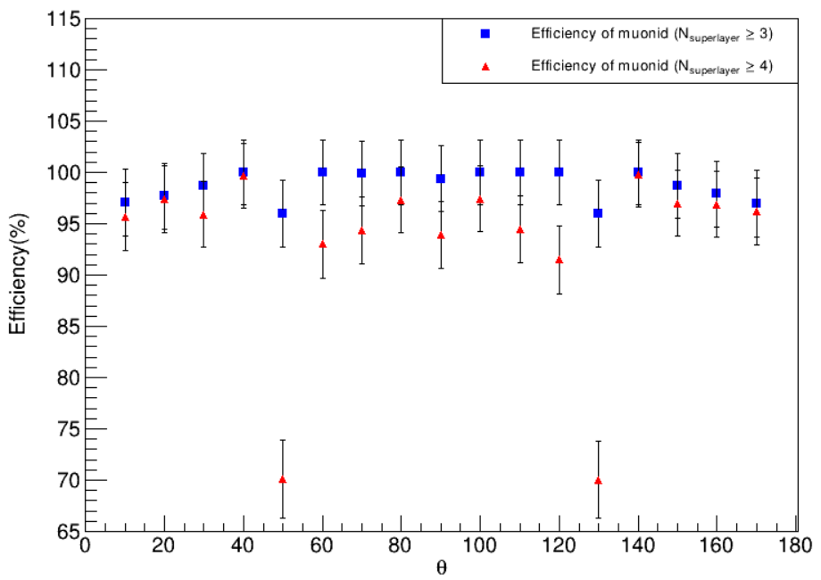
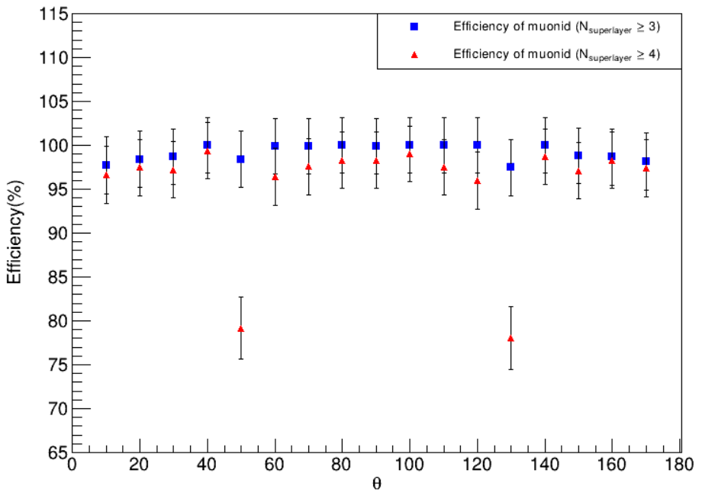
$$5 GeV μ$$
$$6 GeV μ$$
$$7 GeV μ$$
$$10 GeV μ$$

Slide 7
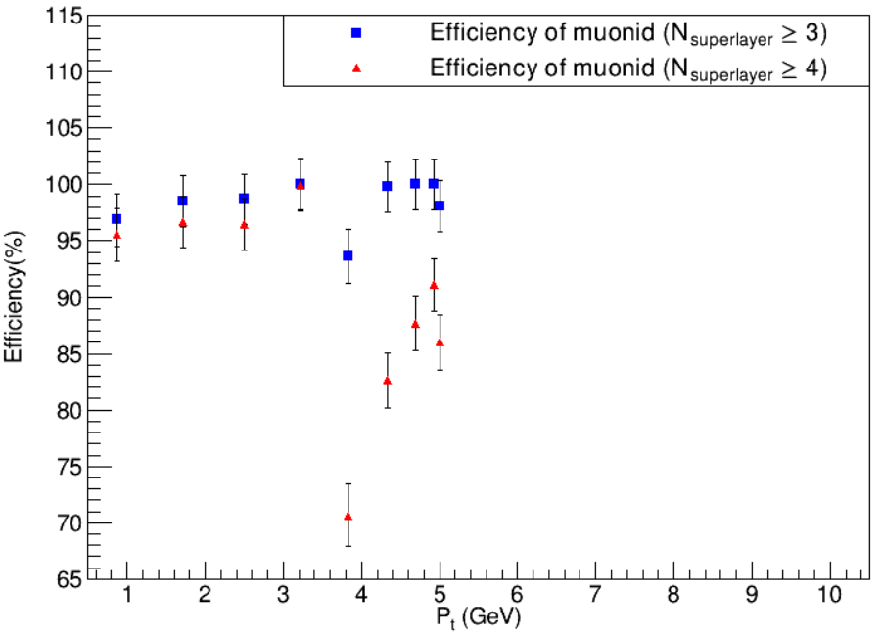
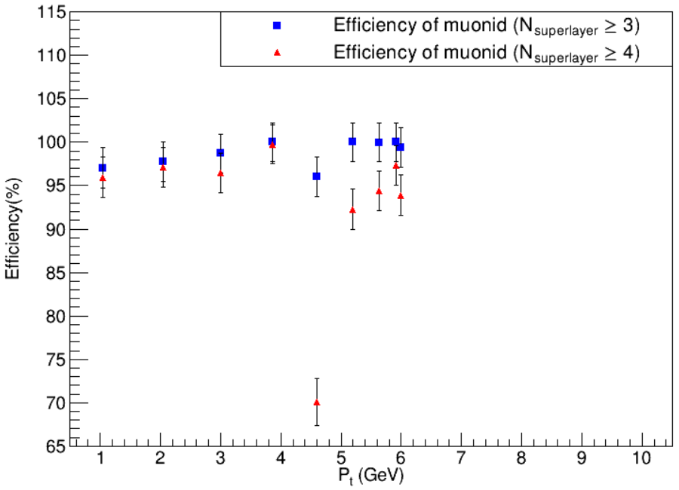
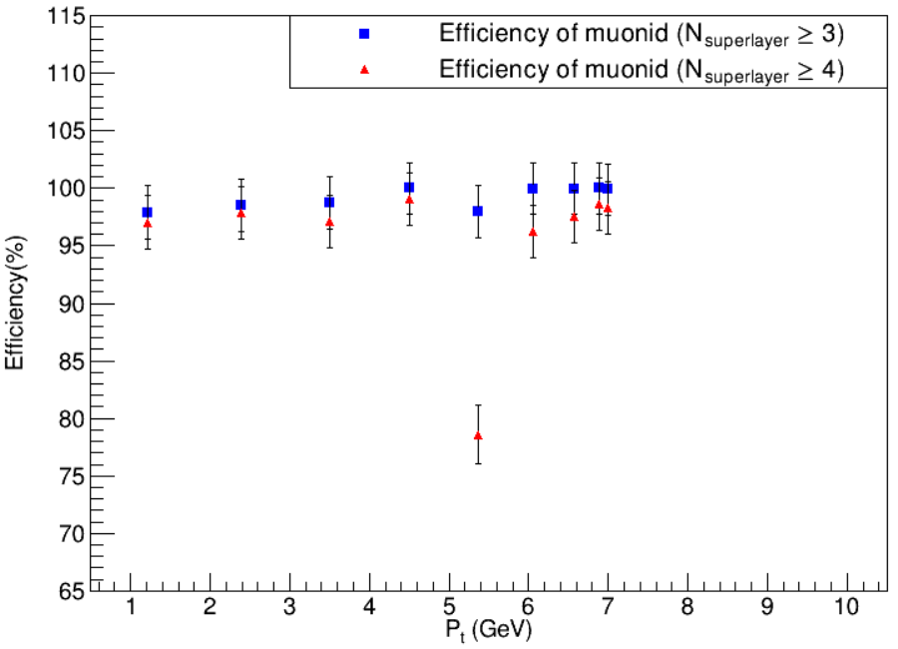
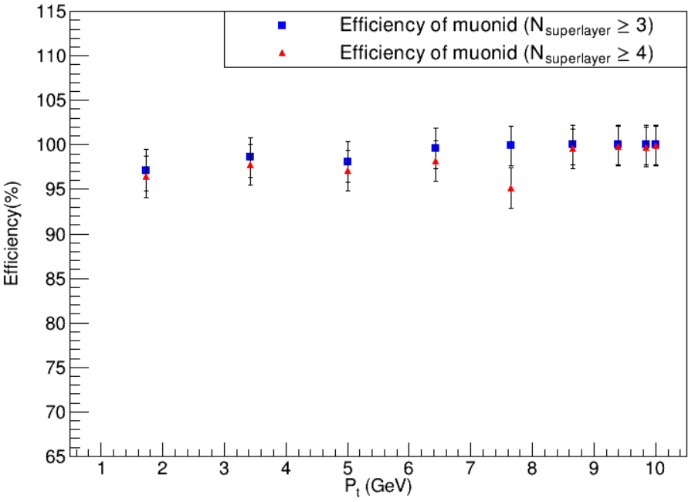
$$5 GeV μ$$
$$6 GeV μ$$
$$7 GeV μ$$
$$10 GeV μ$$

Slide 8
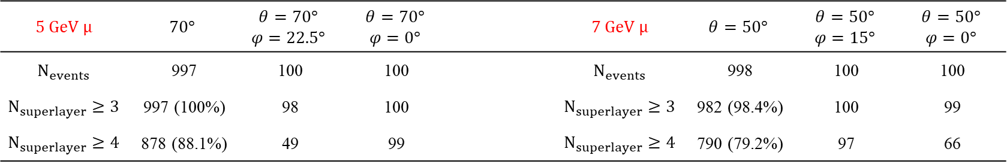
$$5 GeV μ$$ | $$70°$$ | $$θ=70°$$ $$φ=22.5°$$ | $$θ=70°$$ $$φ=0°$$ |  | $$7 GeV μ$$ | $$θ=50°$$ | $$θ=50°$$ $$φ=15°$$ | $$θ=50°$$ $$φ=0°$$
$$N_{events}$$ | 997 | 100 | 100 |  | $$N_{events}$$ | 998 | 100 | 100
$$N_{superlayer}≥3$$ | 997 (100%) | 98 | 100 |  | $$N_{superlayer}≥3$$ | 982 (98.4%) | 100 | 99
$$N_{superlayer}≥4$$ | 878 (88.1%) | 49 | 99 |  | $$N_{superlayer}≥4$$ | 790 (79.2%) | 97 | 66
$$5 GeV μ$$
$$7 GeV μ$$

Slide 9
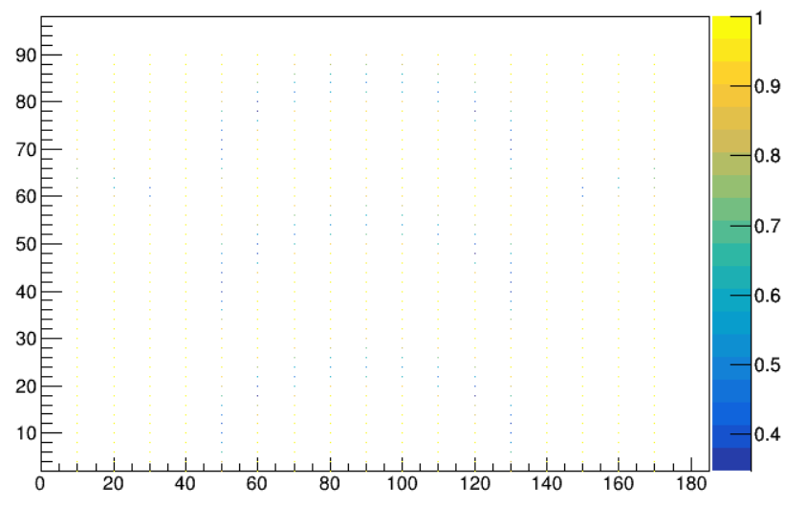


$$φ$$
$$θ$$

Slide 10
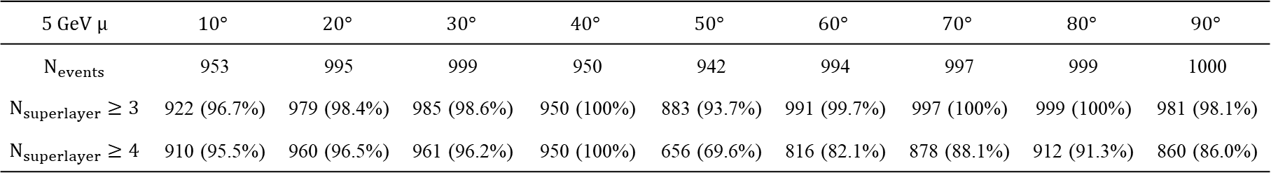
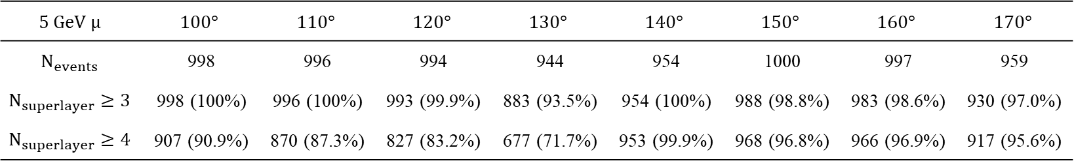

$Num_{layer}≥3$ $Eff_{fudge} =1$
$$5 GeV μ$$ | $$10°$$ | $$20°$$ | $$30°$$ | $$40°$$ | $$50°$$ | $$60°$$ | $$70°$$ | $$80°$$ | $$90°$$
$$N_{events}$$ | 953 | 995 | 999 | 950 | 942 | 994 | 997 | 999 | 1000
$$N_{superlayer}≥3$$ | 922 (96.7%) | 979 (98.4%) | 985 (98.6%) | 950 (100%) | 883 (93.7%) | 991 (99.7%) | 997 (100%) | 999 (100%) | 981 (98.1%)
$$N_{superlayer}≥4$$ | 910 (95.5%) | 960 (96.5%) | 961 (96.2%) | 950 (100%) | 656 (69.6%) | 816 (82.1%) | 878 (88.1%) | 912 (91.3%) | 860 (86.0%)
$$5 GeV μ$$ | $$100°$$ | $$110°$$ | $$120°$$ | $$130°$$ | $$140°$$ | $$150°$$ | $$160°$$ | $$170°$$
$$N_{events}$$ | 998 | 996 | 994 | 944 | 954 | 1000 | 997 | 959
$$N_{superlayer}≥3$$ | 998 (100%) | 996 (100%) | 993 (99.9%) | 883 (93.5%) | 954 (100%) | 988 (98.8%) | 983 (98.6%) | 930 (97.0%)
$$N_{superlayer}≥4$$ | 907 (90.9%) | 870 (87.3%) | 827 (83.2%) | 677 (71.7%) | 953 (99.9%) | 968 (96.8%) | 966 (96.9%) | 917 (95.6%)

Slide 11
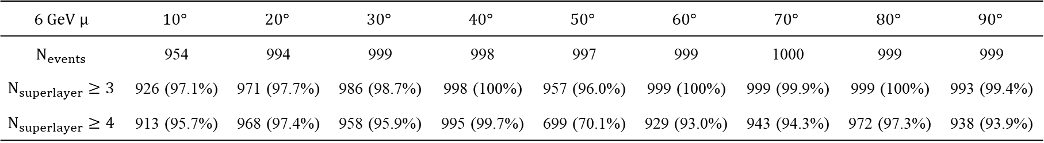
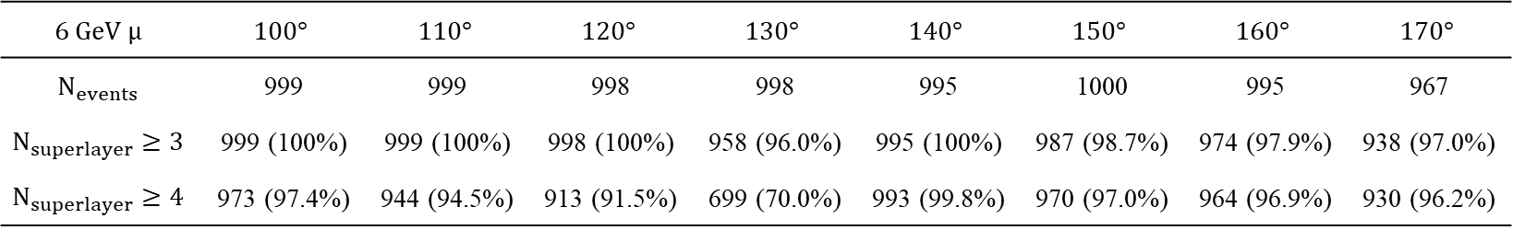
$Num_{layer}≥3$ $Eff_{fudge} =1$
$$6 GeV μ$$ | $$10°$$ | $$20°$$ | $$30°$$ | $$40°$$ | $$50°$$ | $$60°$$ | $$70°$$ | $$80°$$ | $$90°$$
$$N_{events}$$ | 954 | 994 | 999 | 998 | 997 | 999 | 1000 | 999 | 999
$$N_{superlayer}≥3$$ | 926 (97.1%) | 971 (97.7%) | 986 (98.7%) | 998 (100%) | 957 (96.0%) | 999 (100%) | 999 (99.9%) | 999 (100%) | 993 (99.4%)
$$N_{superlayer}≥4$$ | 913 (95.7%) | 968 (97.4%) | 958 (95.9%) | 995 (99.7%) | 699 (70.1%) | 929 (93.0%) | 943 (94.3%) | 972 (97.3%) | 938 (93.9%)
$$6 GeV μ$$ | $$100°$$ | $$110°$$ | $$120°$$ | $$130°$$ | $$140°$$ | $$150°$$ | $$160°$$ | $$170°$$
$$N_{events}$$ | 999 | 999 | 998 | 998 | 995 | 1000 | 995 | 967
$$N_{superlayer}≥3$$ | 999 (100%) | 999 (100%) | 998 (100%) | 958 (96.0%) | 995 (100%) | 987 (98.7%) | 974 (97.9%) | 938 (97.0%)
$$N_{superlayer}≥4$$ | 973 (97.4%) | 944 (94.5%) | 913 (91.5%) | 699 (70.0%) | 993 (99.8%) | 970 (97.0%) | 964 (96.9%) | 930 (96.2%)

Slide 12
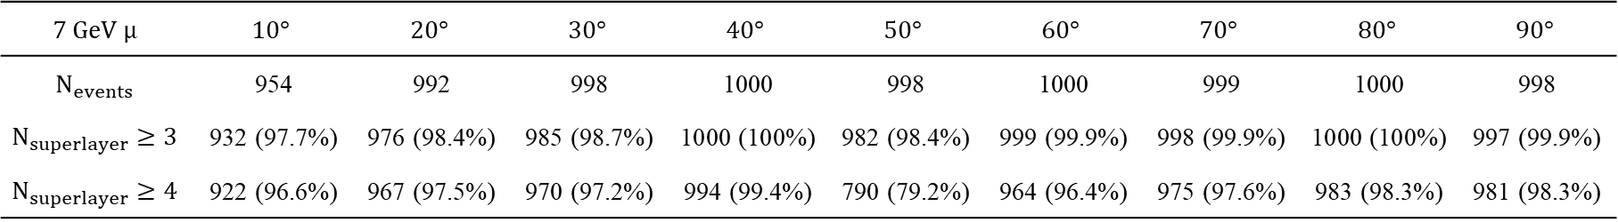
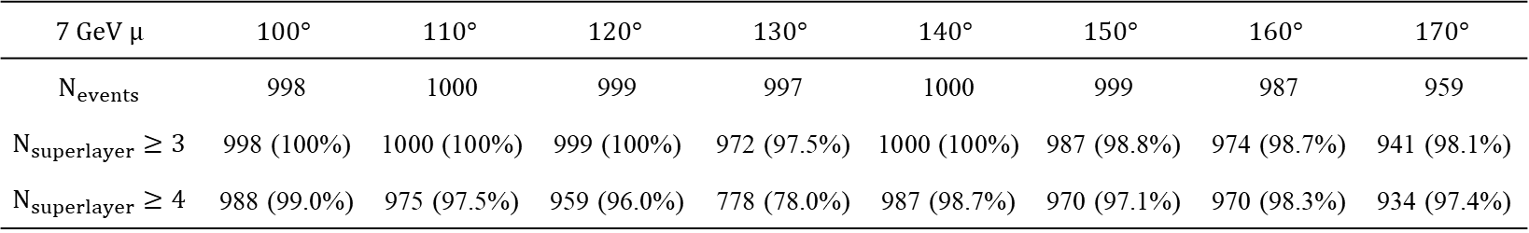
$Num_{layer}≥3$ $Eff_{fudge} =1$
$$7 GeV μ$$ | $$10°$$ | $$20°$$ | $$30°$$ | $$40°$$ | $$50°$$ | $$60°$$ | $$70°$$ | $$80°$$ | $$90°$$
$$N_{events}$$ | 954 | 992 | 998 | 1000 | 998 | 1000 | 999 | 1000 | 998
$$N_{superlayer}≥3$$ | 932 (97.7%) | 976 (98.4%) | 985 (98.7%) | 1000 (100%) | 982 (98.4%) | 999 (99.9%) | 998 (99.9%) | 1000 (100%) | 997 (99.9%)
$$N_{superlayer}≥4$$ | 922 (96.6%) | 967 (97.5%) | 970 (97.2%) | 994 (99.4%) | 790 (79.2%) | 964 (96.4%) | 975 (97.6%) | 983 (98.3%) | 981 (98.3%)
$$7 GeV μ$$ | $$100°$$ | $$110°$$ | $$120°$$ | $$130°$$ | $$140°$$ | $$150°$$ | $$160°$$ | $$170°$$
$$N_{events}$$ | 998 | 1000 | 999 | 997 | 1000 | 999 | 987 | 959
$$N_{superlayer}≥3$$ | 998 (100%) | 1000 (100%) | 999 (100%) | 972 (97.5%) | 1000 (100%) | 987 (98.8%) | 974 (98.7%) | 941 (98.1%)
$$N_{superlayer}≥4$$ | 988 (99.0%) | 975 (97.5%) | 959 (96.0%) | 778 (78.0%) | 987 (98.7%) | 970 (97.1%) | 970 (98.3%) | 934 (97.4%)

Slide 13
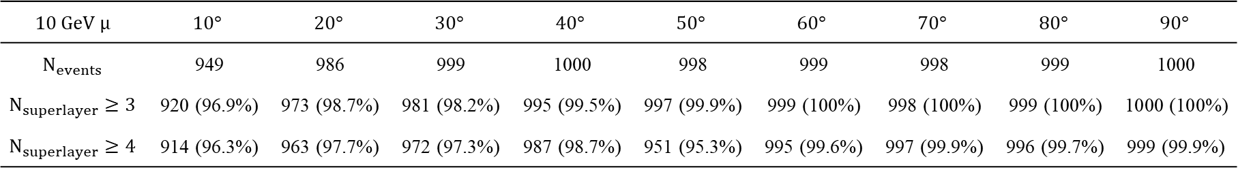
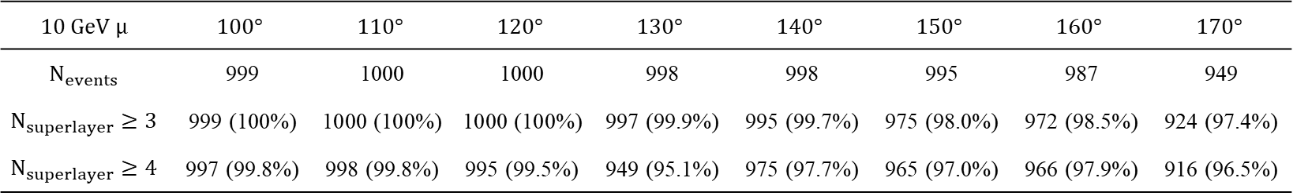
$Num_{layer}≥3$ $Eff_{fudge} =1$
$$10 GeV μ$$ | $$10°$$ | $$20°$$ | $$30°$$ | $$40°$$ | $$50°$$ | $$60°$$ | $$70°$$ | $$80°$$ | $$90°$$
$$N_{events}$$ | 949 | 986 | 999 | 1000 | 998 | 999 | 998 | 999 | 1000
$$N_{superlayer}≥3$$ | 920 (96.9%) | 973 (98.7%) | 981 (98.2%) | 995 (99.5%) | 997 (99.9%) | 999 (100%) | 998 (100%) | 999 (100%) | 1000 (100%)
$$N_{superlayer}≥4$$ | 914 (96.3%) | 963 (97.7%) | 972 (97.3%) | 987 (98.7%) | 951 (95.3%) | 995 (99.6%) | 997 (99.9%) | 996 (99.7%) | 999 (99.9%)
$$10 GeV μ$$ | $$100°$$ | $$110°$$ | $$120°$$ | $$130°$$ | $$140°$$ | $$150°$$ | $$160°$$ | $$170°$$
$$N_{events}$$ | 999 | 1000 | 1000 | 998 | 998 | 995 | 987 | 949
$$N_{superlayer}≥3$$ | 999 (100%) | 1000 (100%) | 1000 (100%) | 997 (99.9%) | 995 (99.7%) | 975 (98.0%) | 972 (98.5%) | 924 (97.4%)
$$N_{superlayer}≥4$$ | 997 (99.8%) | 998 (99.8%) | 995 (99.5%) | 949 (95.1%) | 975 (97.7%) | 965 (97.0%) | 966 (97.9%) | 916 (96.5%)

