Slide 1
Study Short-Range Correlations with Multiple Probes
Zhihong Ye (叶志鸿）
Department of Physics, Tsinghua University
Workshop of “Nuclear Physics across Energy Scales”
CCNU, Wuhan, 2025-09-21

Slide 2
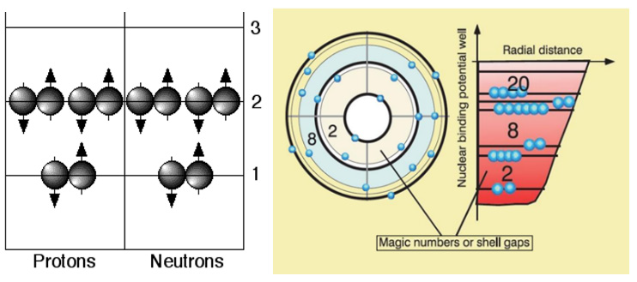
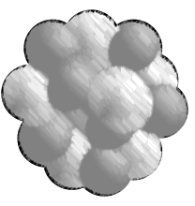
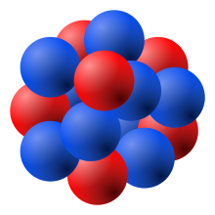
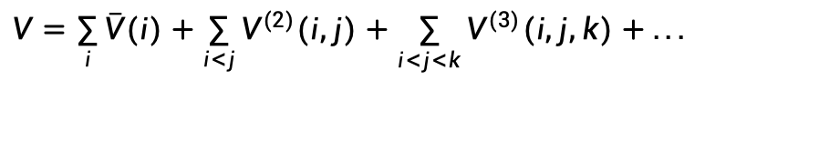
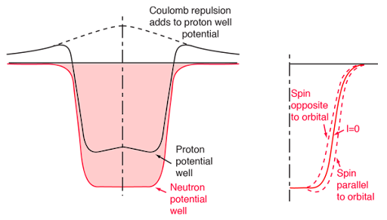
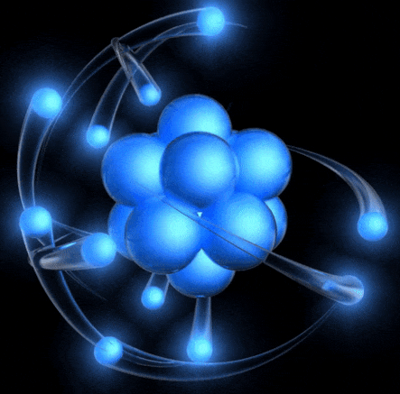
What is a Nucleus?
Mean-Field (Shells)
Many-Body Nuclear Forces
A nucleus is compact, but not too much!
Nucleons occupy “shells” , and point-like
Yukawa Potential → Modern Potentials (AV18)
Succesful (supprisely), but not very

Slide 3
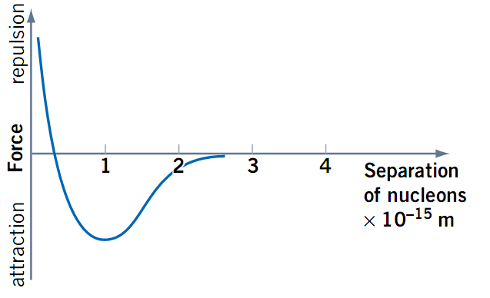
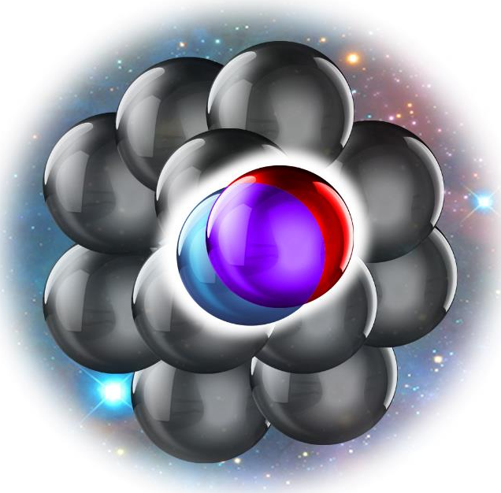
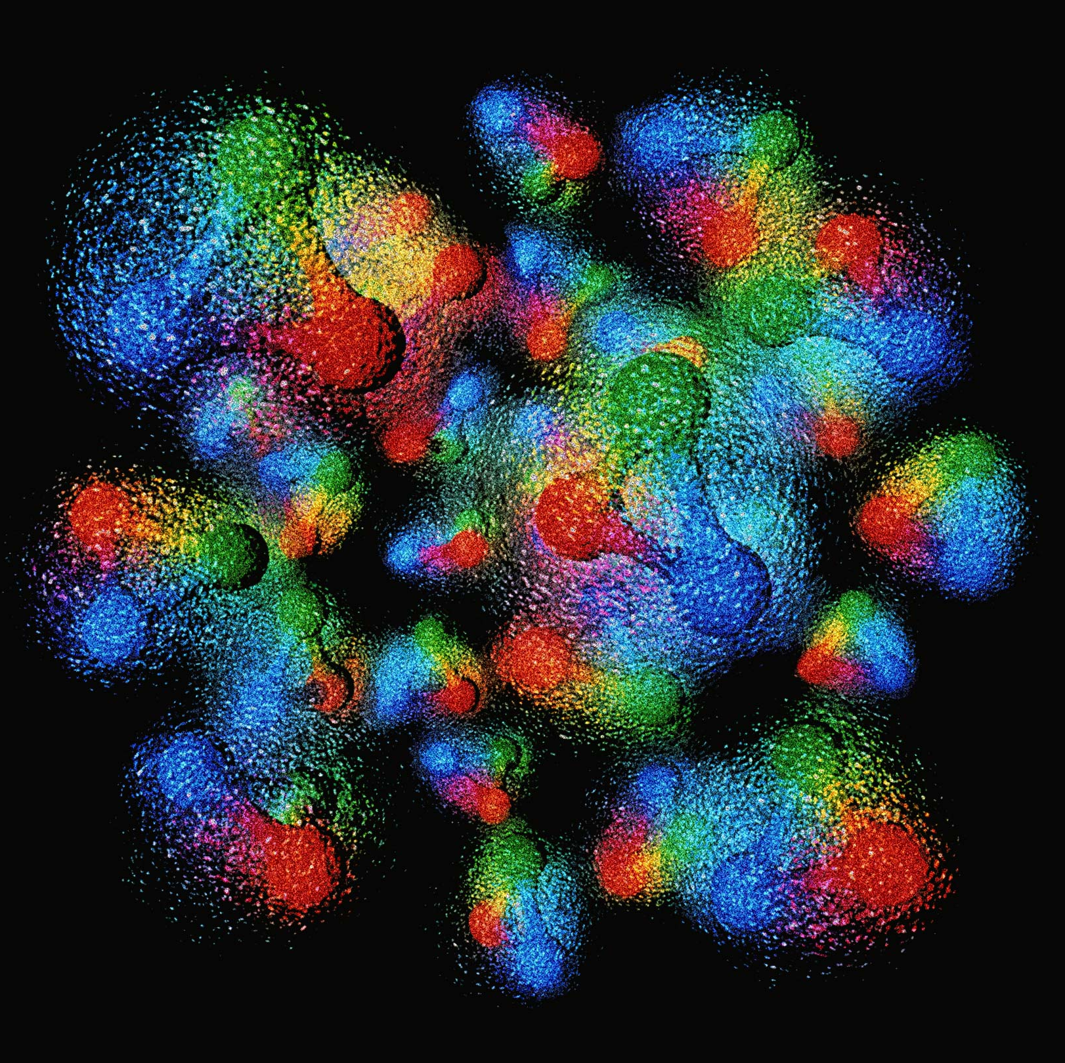
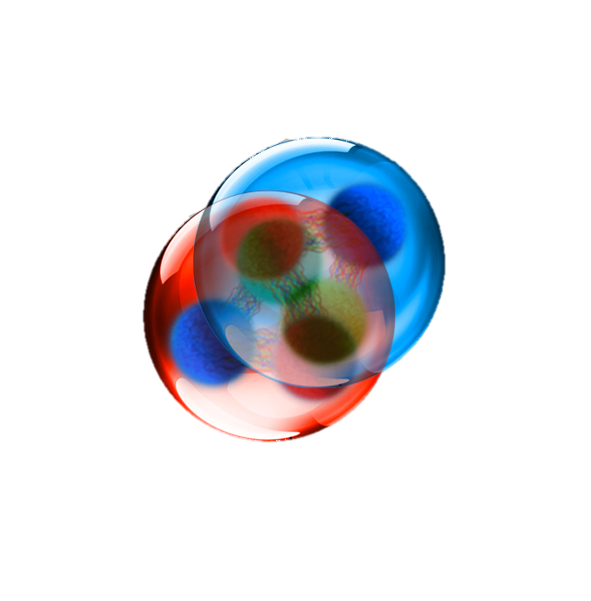
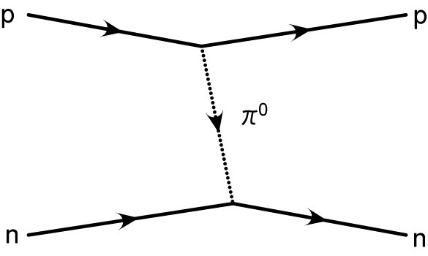
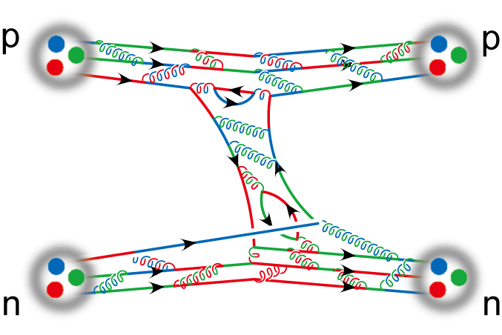
Short-Range Correlations
“Actual”
Nuclear Force
Short-Range Correlations(SRC)
Quarks in Nucleus
Nucleon Radius
Nucleon Separation
Nucleosn overlapped due to tensor forces, then pushed away
→ 20% nucleons offshells!
Dynamic balance leads to SRC
Nucleons largely overlapped (much dense vs. alpha clusters)
SRC
All mena-field models fail for SRC, but hard to use QCD
Heavily rely on measurements
Nuclear Models
QCD

Slide 4
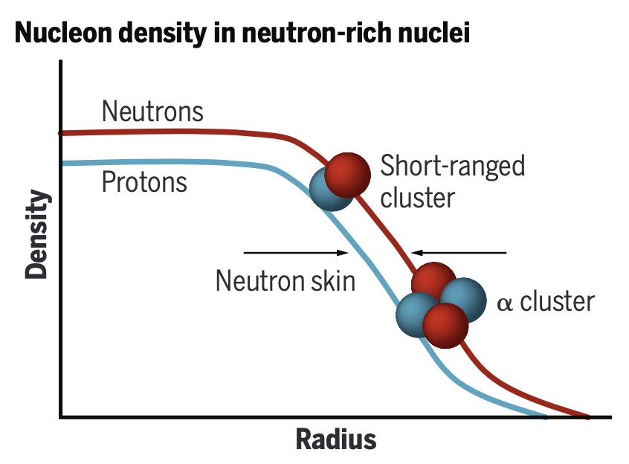
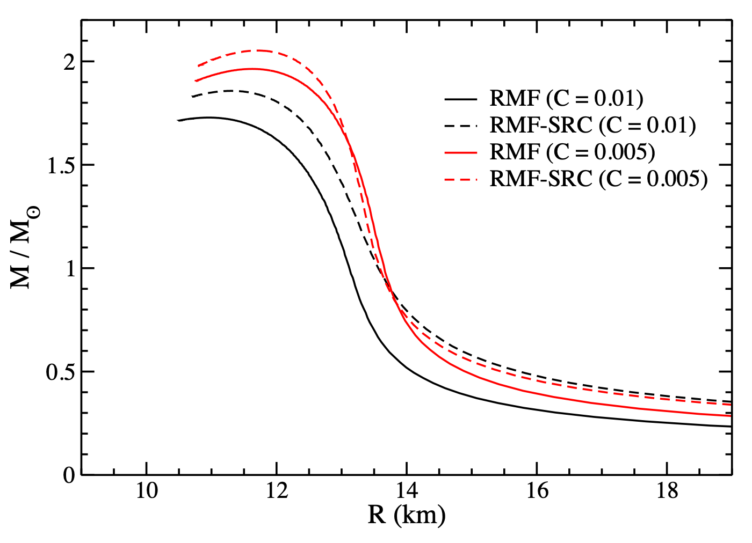
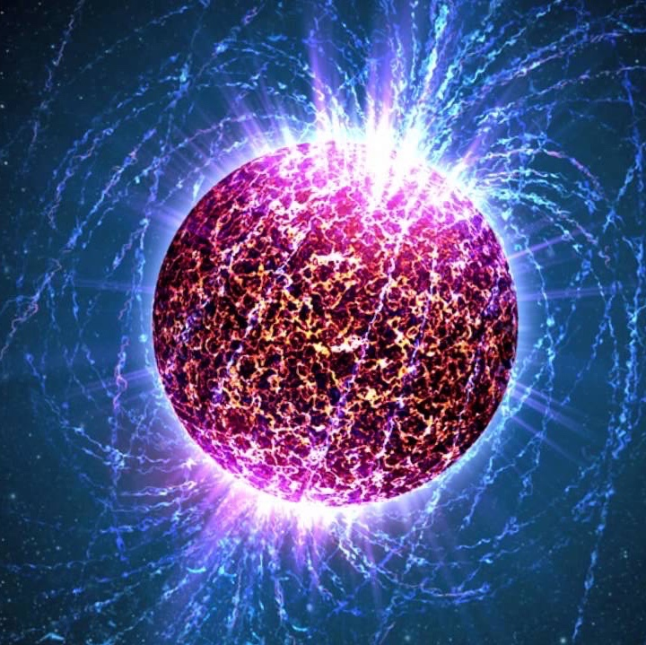
“Cross Energy Scales”
NN & NNN forces, nuclear structure, cold nuclear matter
Symmetric Energy in Neutron Star
Nuclear structure in QCD (nuclear PDF, EMC, heavy-ion, …)
Mass matrix for neutrino-less double beta decay?
Wang, Zhao, Meng, arXiv: 2304.12009, Song, Yao, Ring, Meng, Phys. Rev. C 95, 024305
Important in forming neutron-rich nuclei
Forming ultra-heavy neutron stars?
NPA 1021, 122408 (2022)
NPA 1011, 122200 (2021)
Hen, Science 371, 232 (2021)

Slide 5
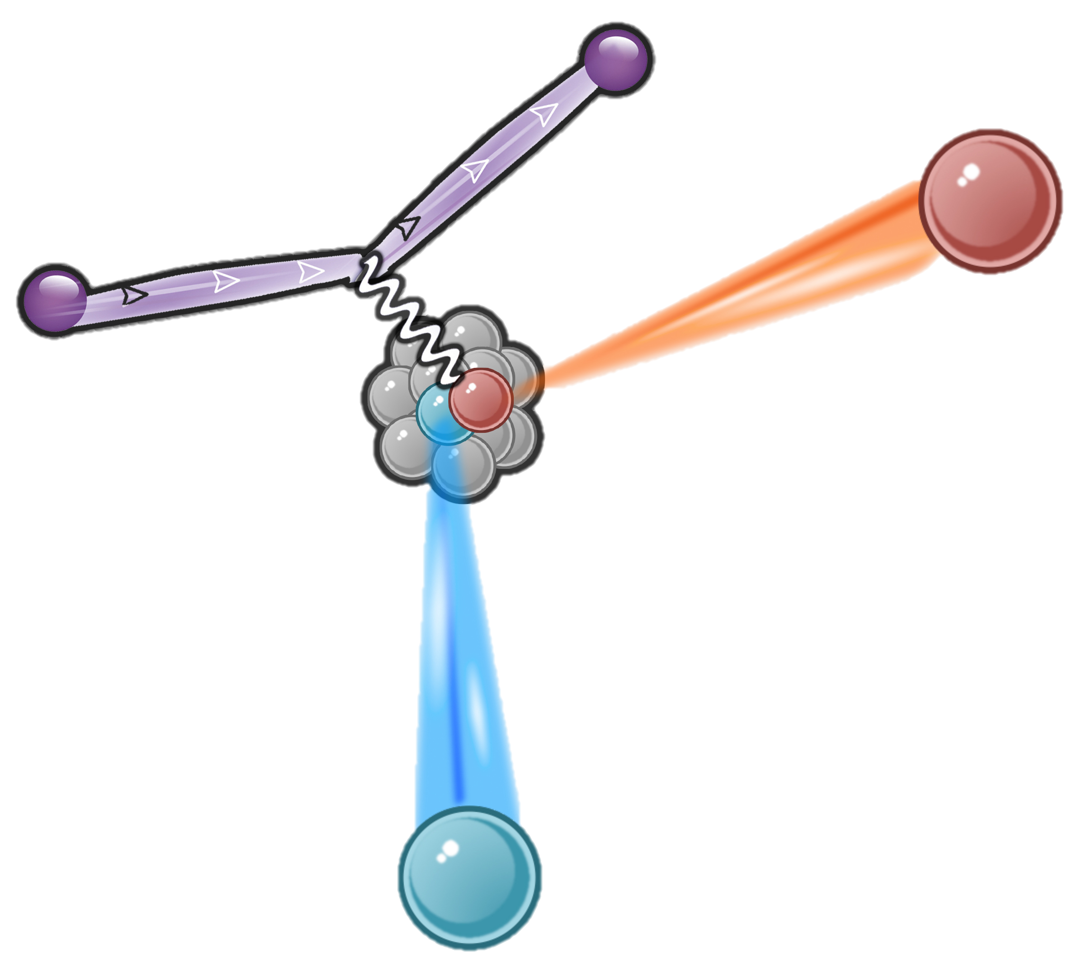
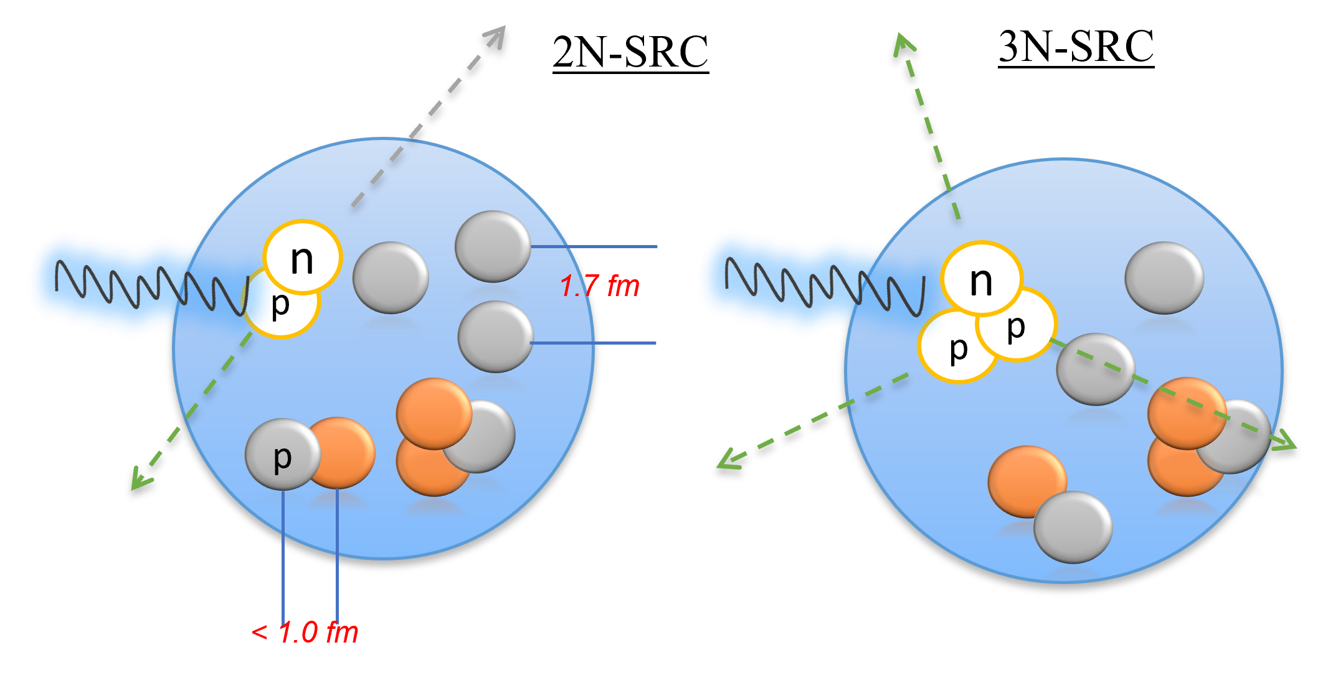
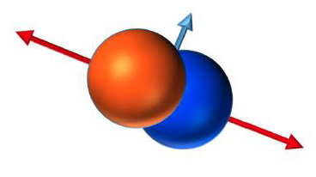
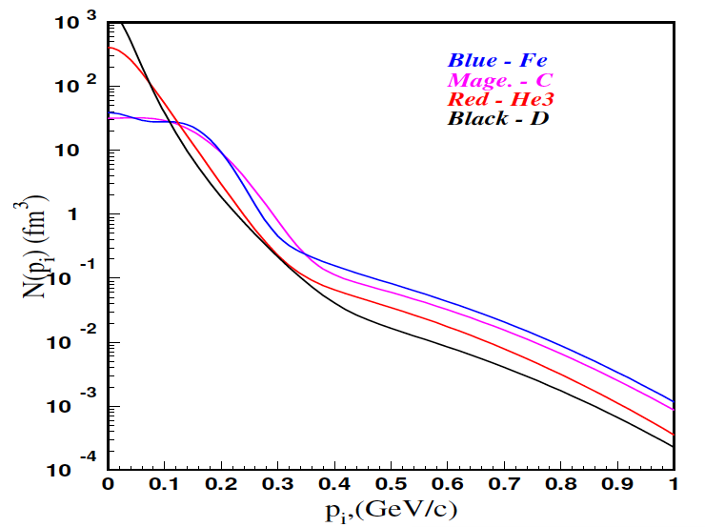
Short-Range Correlations
How to probe?
Lab Frame
Center-of-Mass Frame
probes
(p/n)
(p/n)
C.M. frame, SRC pairs move in opposite direction,
with high momentum (>300MeV/c)
In Lab frame, probes “kick” out one nucleon, then measure:
response to the “kick”, e.g. (e,e’)
high-P proton (>k_{F}), e.g. (e,e’p)
high-P nucleon in opposite direction (C.M.), e.g. (e,e’pN)
% of np-SRC vs. pp-SRC vs. nn-SRC?
C. Ciofi degli Atti and S. Simula, Phys. Rev. C 53 (1996).
3N-SRC?
Mean
Field
Momentum Distribution
2N-SRC
k_{F}
Key idea: Nuclear system → 2- or 3-body system

Slide 6
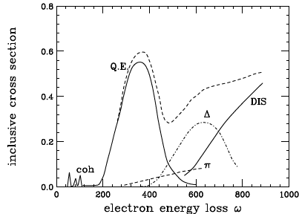
Short-Range Correlations
Experimental Method (2N-SRC case)
Final State:
SRC nucleons leave (A-2) w/o re-scattering, back-to-back (in CM)
(A-2) fragment is intact, not excited
Reject non-SRC back-to-back signals
Probe (electrons, photons, protons, ions):
High resolution (<0.84fm, ~r_{p})
“Snapshot” of initial state
Knock out but not break nucleons (clean!)
n
Benhar, Day, Sick, Rev. Mod. Phys. 80, 189 (2008)
p
Lab Frame
(Pp>k_{F})
SRC
probes
A-2
Initial State (factorization):
SRC nucleons large relative momenta
(P₁=-P₂), small total momentum (P_{total})
(A-2) momentum=-P_{total} (<<k_{F})
(Pmiss >k_{F})
Select SRC events (roughly!):
Q² >1GeV², x>1.2 (Quasi-elastic scattering, Q.E.)
Pp & Pmiss >> k_{F} (~>300MeV/c), back-to-back
Tagging (A-2), very hard for fixed targets

Slide 7
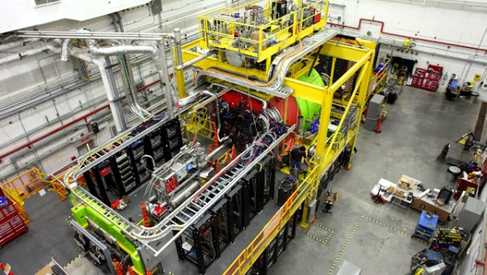
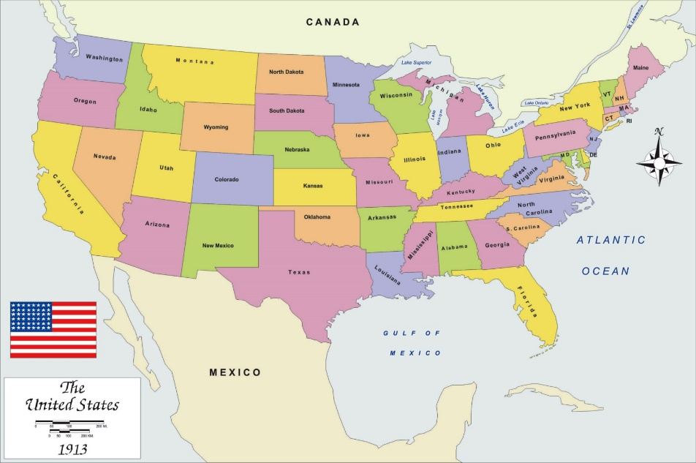
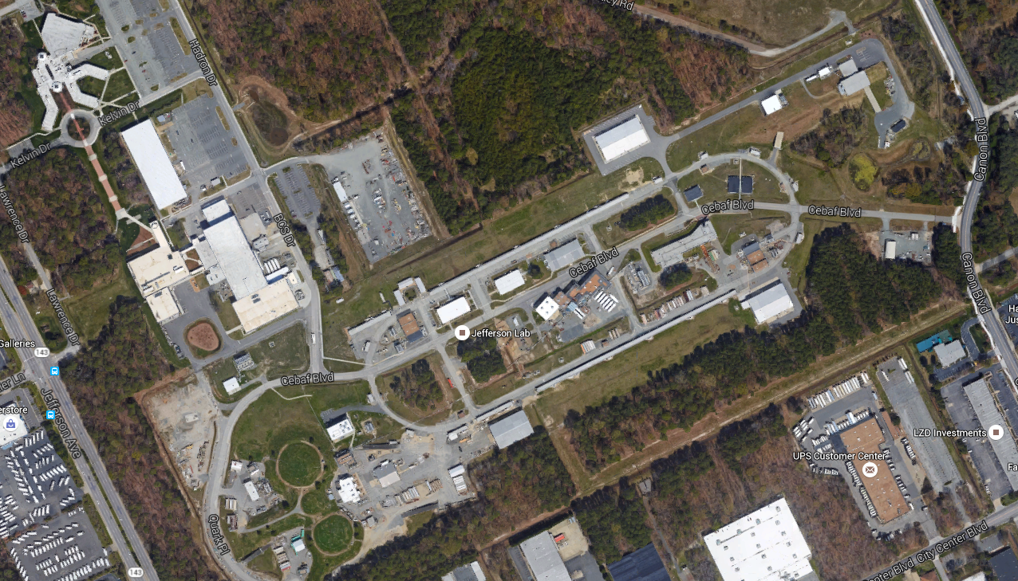
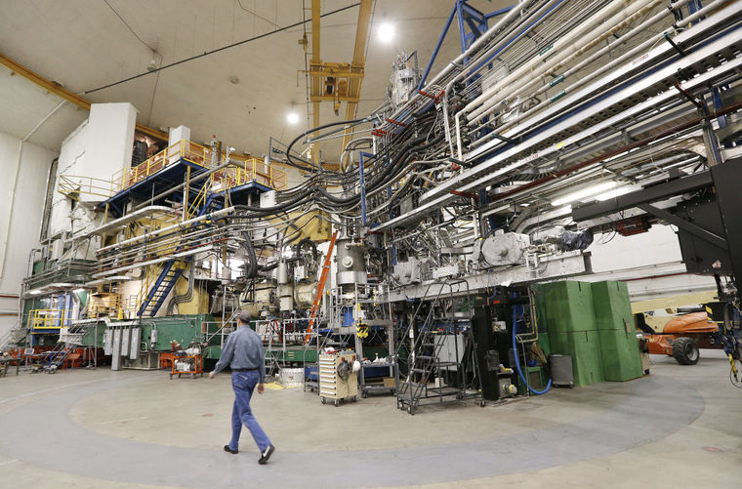
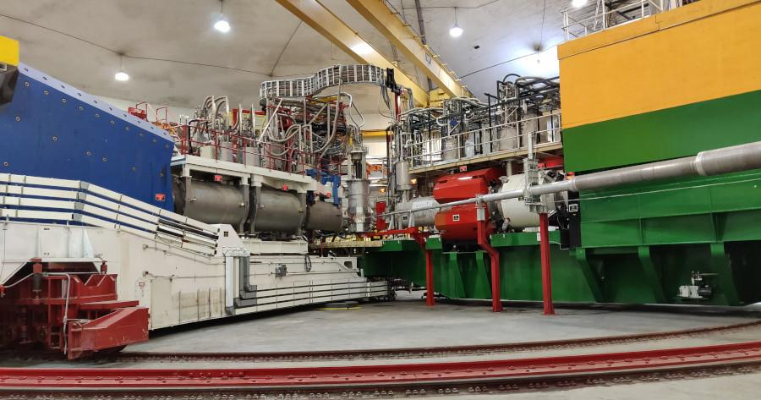
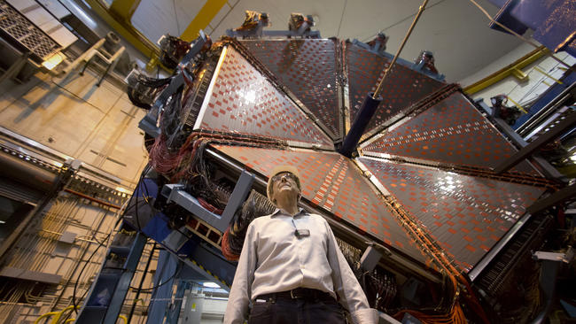
Electron-Scattering Experiments
Thomas Jefferson Lab (JLab)
Hall-D
Hall-A
Hall-C
Hall-B

Slide 8
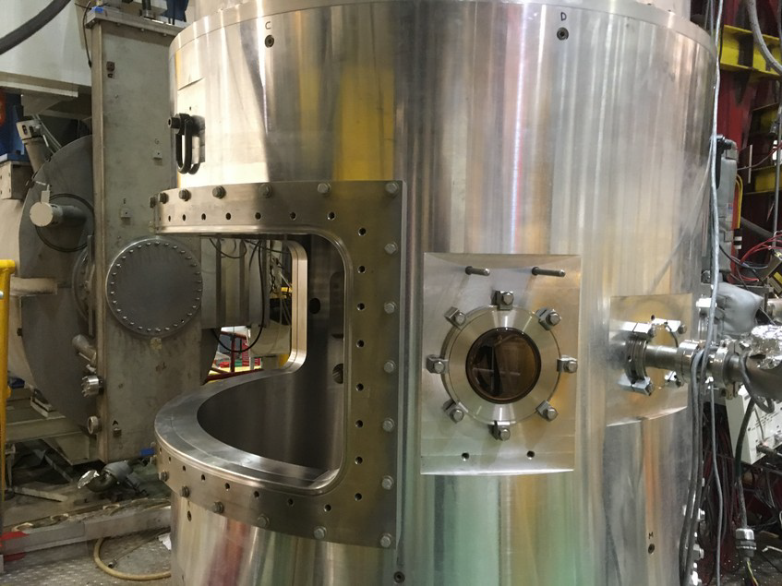
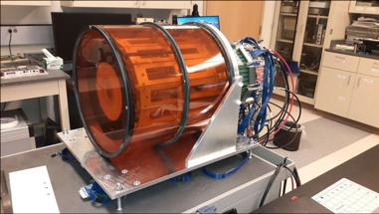
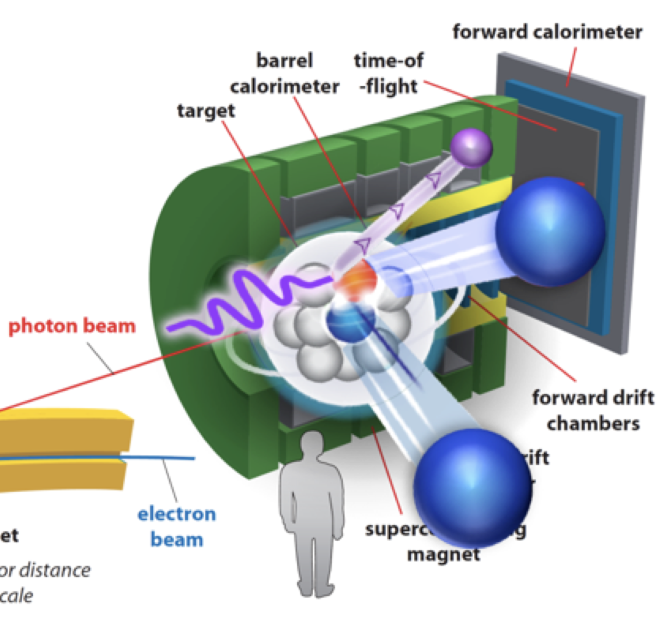
Electron-Scattering Experiments
Detector Systems (Precision vs Acceptance)
Hall-B CLAS6/CLAS12
(Low-Precision, Full Acceptation)
Vacuum Chambers for Targets
ALERT Recoil Detector
Hall-A HRS / Hall-C HMS
(High-Precision, Limited Acceptance);
Hall-D GlueX
(photon-beam, Full Acceptation)
Third-arm to detector p/n

Slide 9
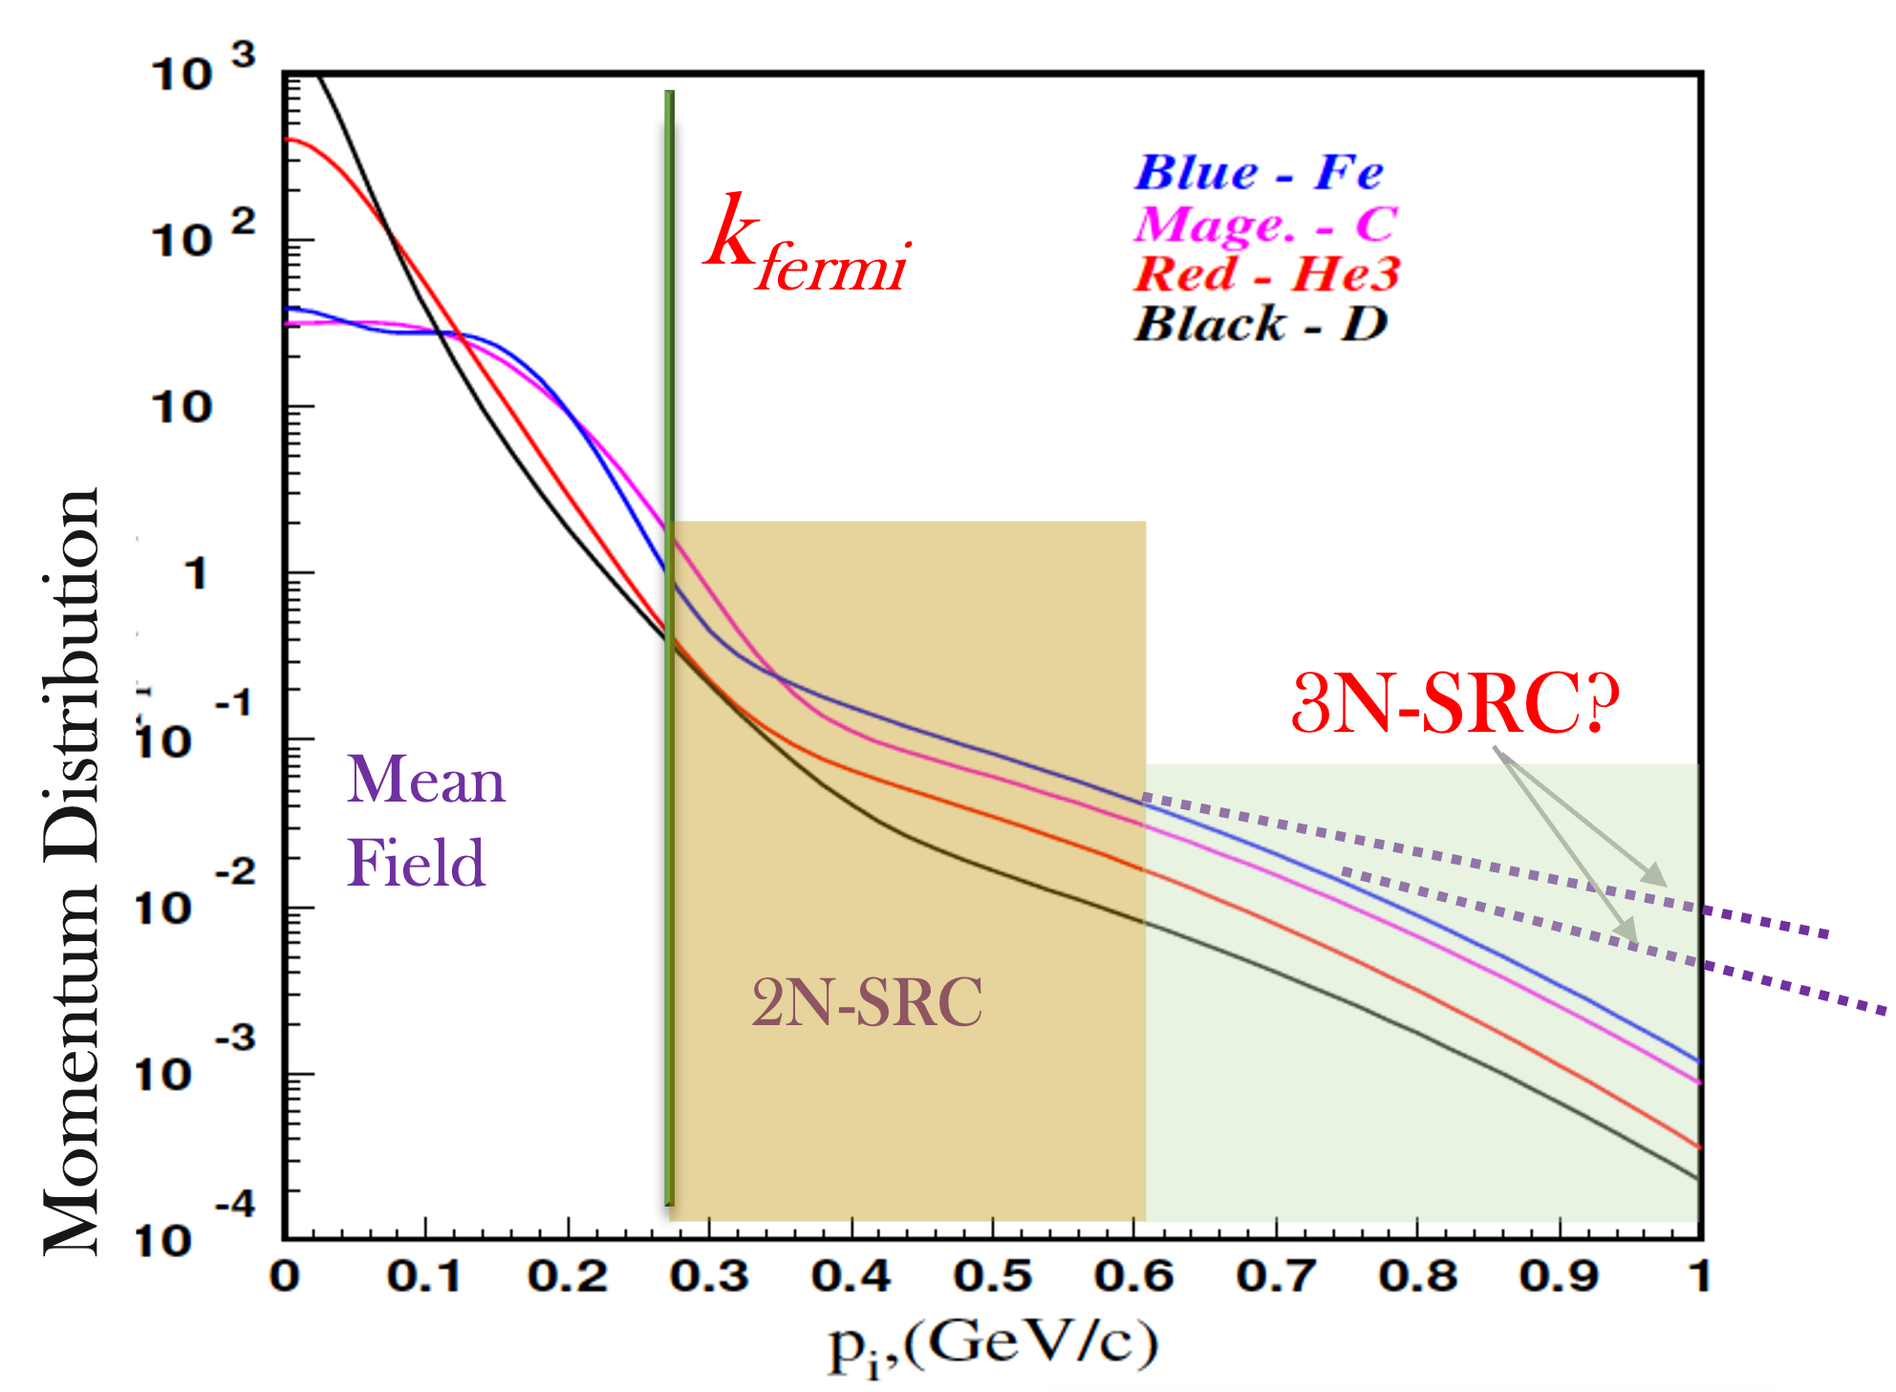
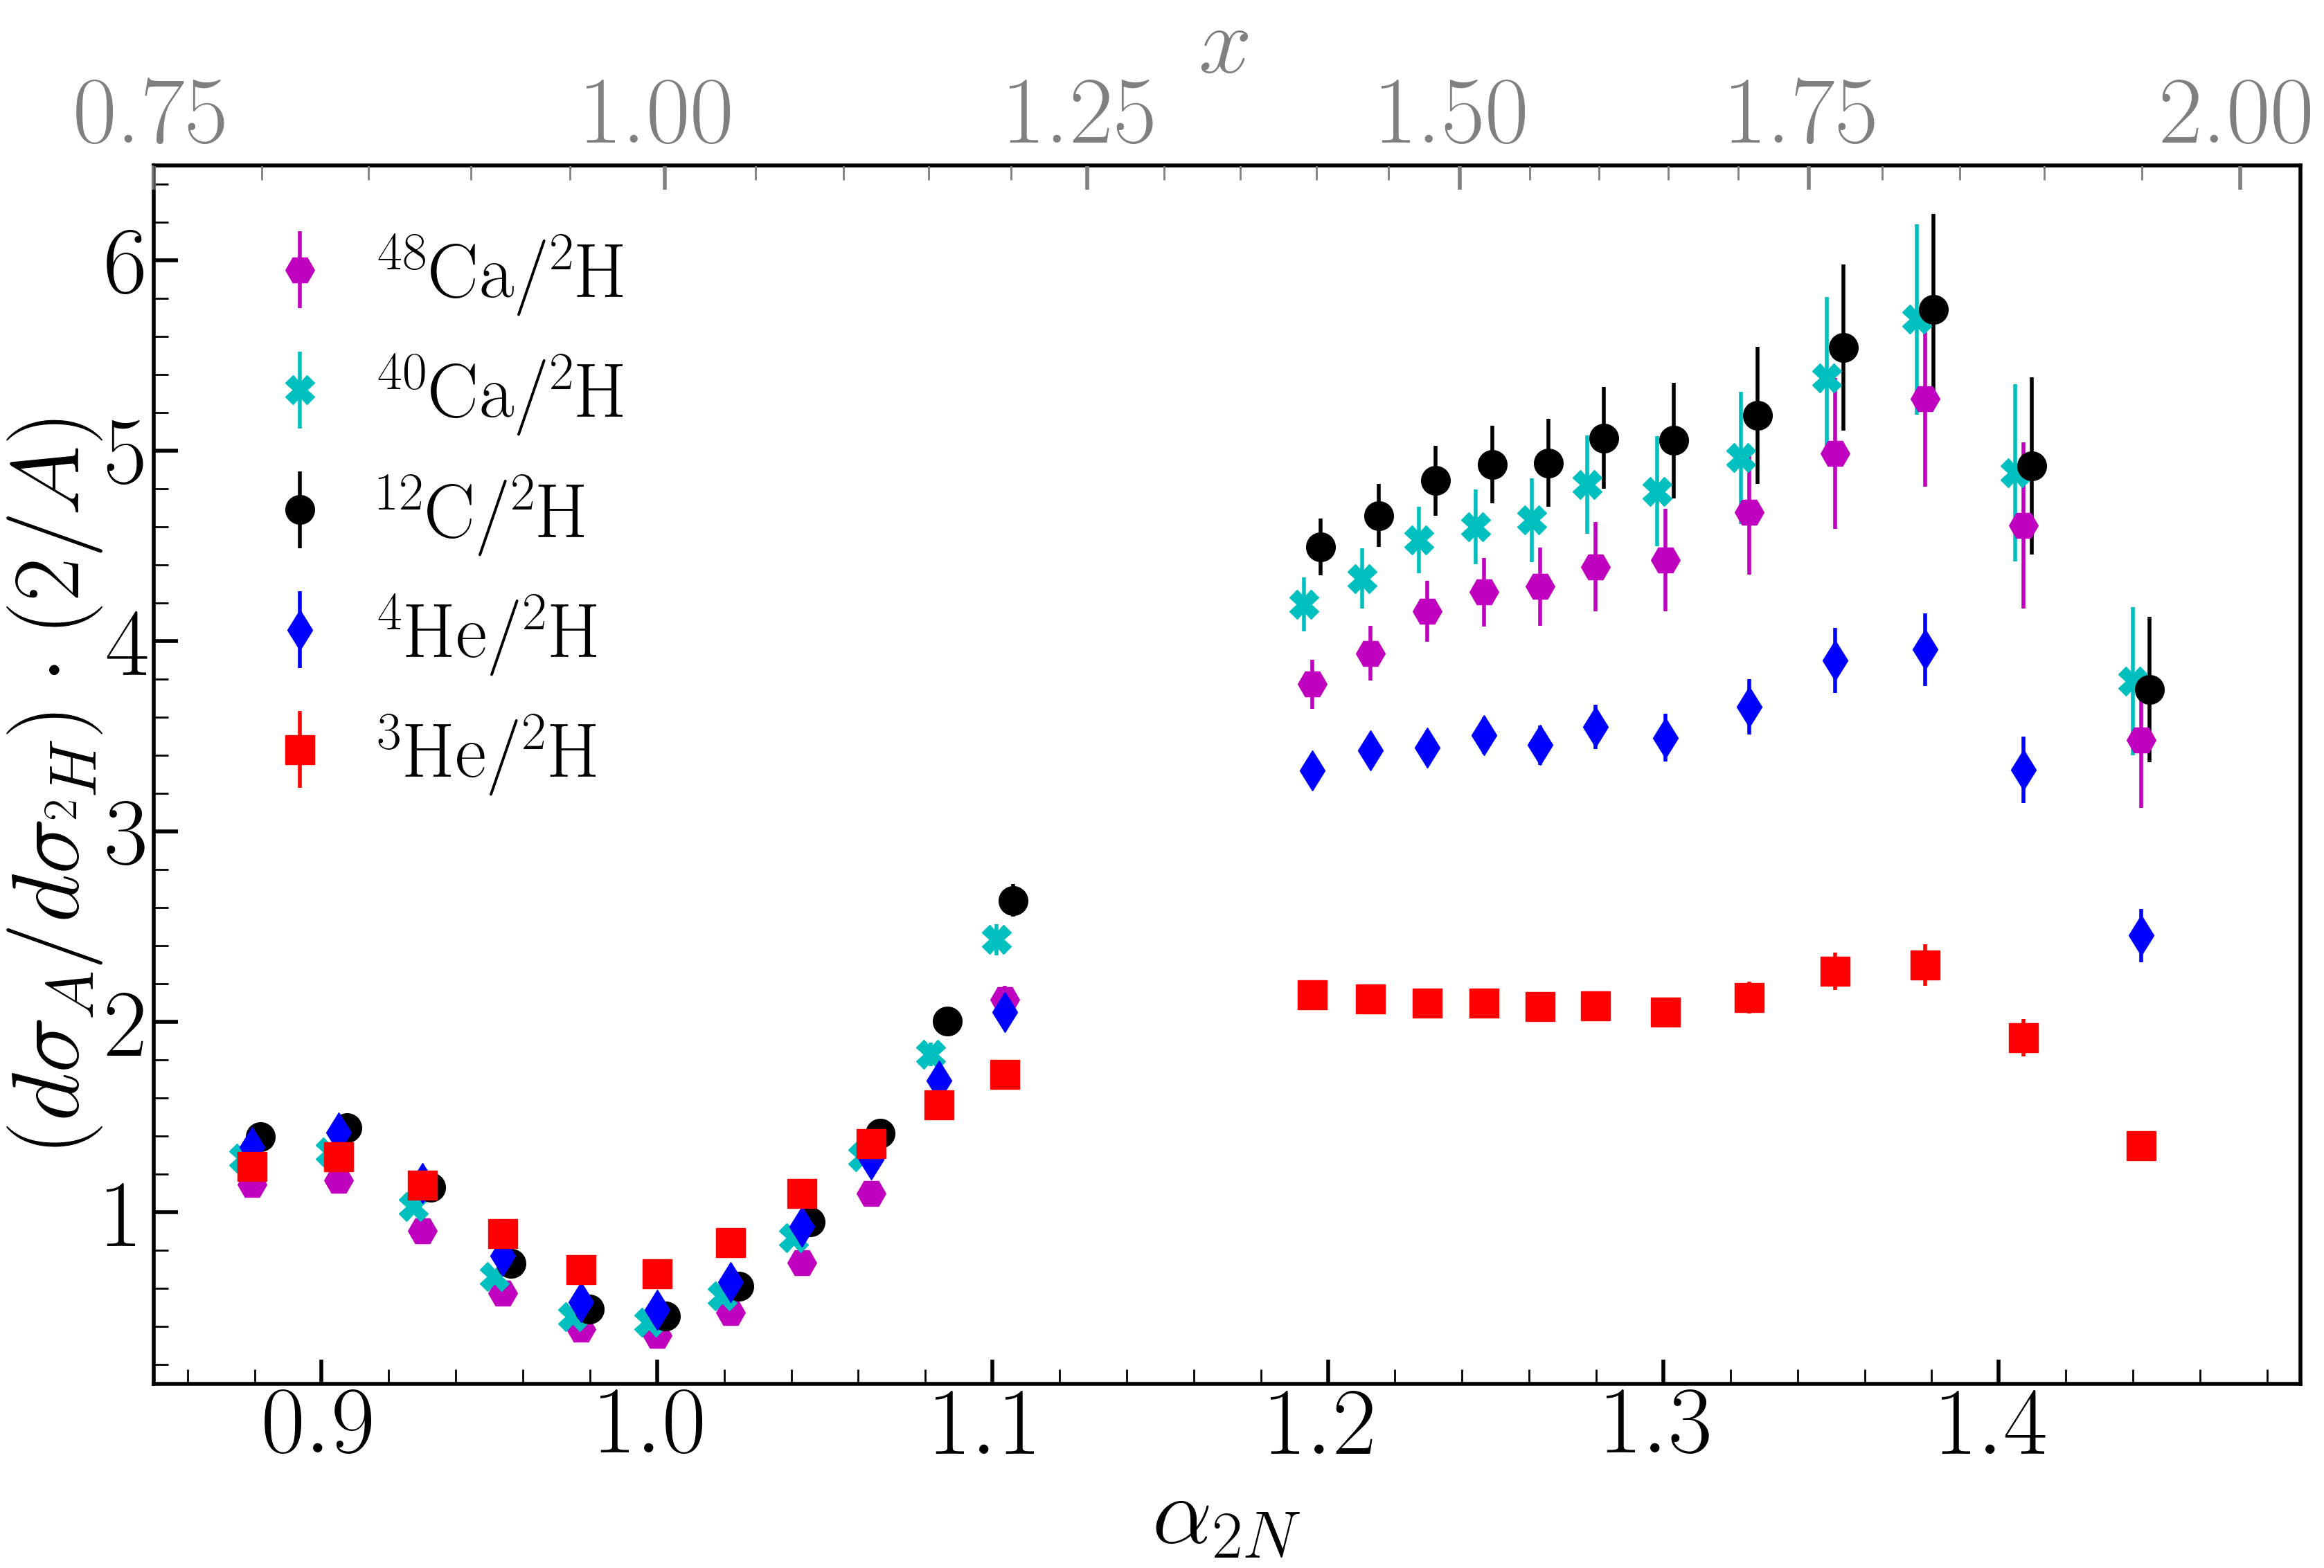
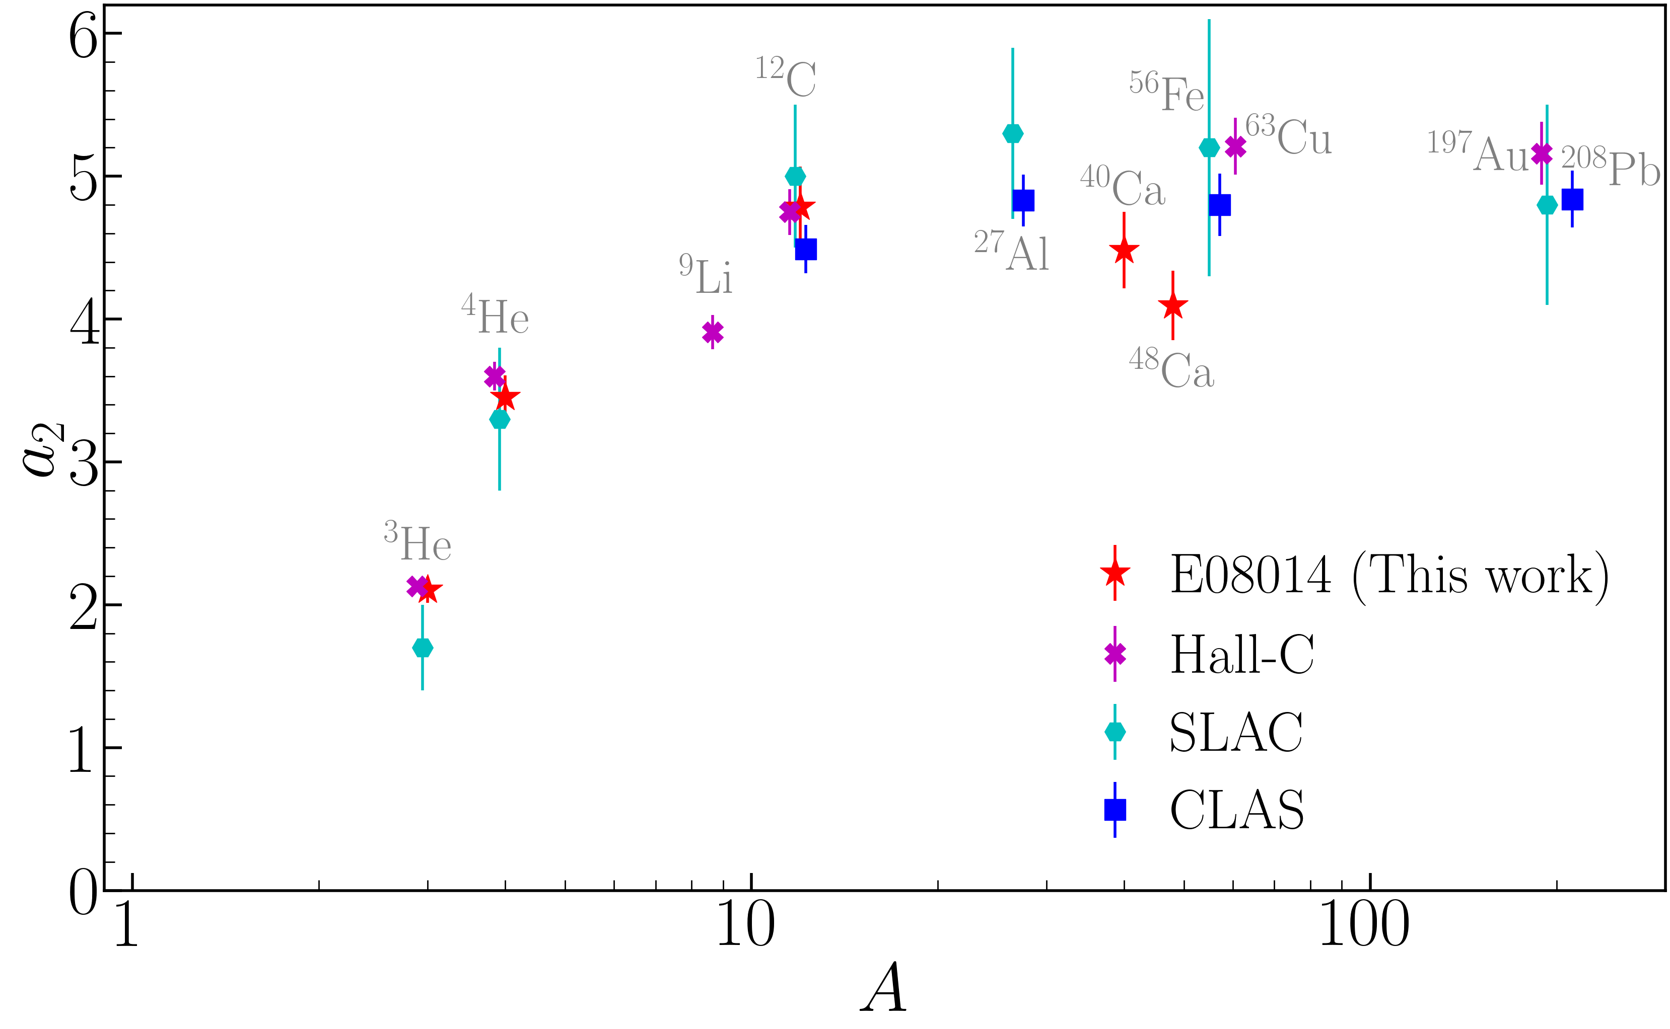
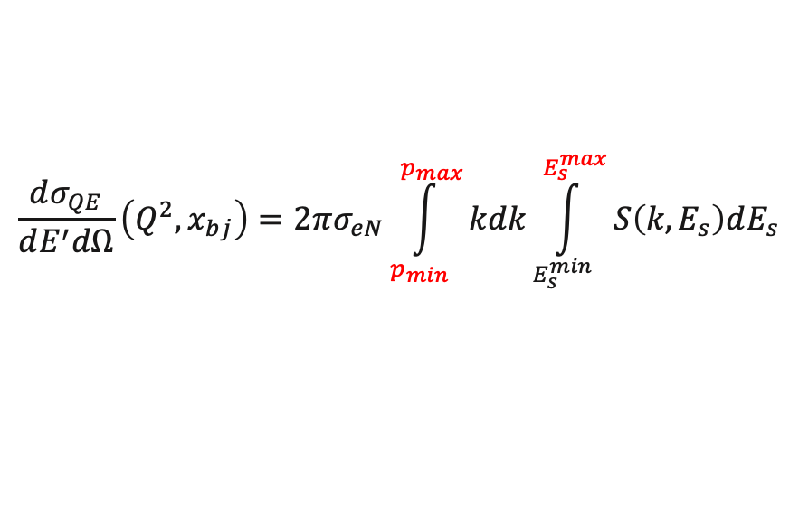

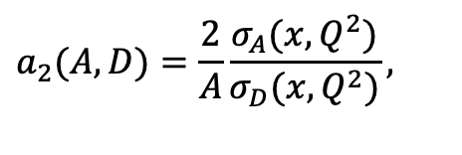
Electron-Scattering Experiments
Inclusive cross-sections in Q.E:
Nucleon momentum distribution
$$\frac{dσ_{QE}}{dE^{′}dΩ}\left(Q^{2},x_{bj}\right)=2πσ_{eN}\int_{p_{min}}^{p_{max}}{kdk\int_{E_{s}^{min}}^{E_{s}^{max}}{S\left(k,E_{s}\right)dE_{s}}}$$
“links” to momentum distribution
Similar high-P tails → look for a plateau
$$a_{2}(A,D)=\frac{2}{A}\frac{σ_{A}(x,Q^{2})}{σ_{D}(x,Q^{2})},$$
2N-SRC (1.3<x_{bj} <2)：
$a_{2}$ → probability of 2N-SRC in A
Arrington et al. PRC 86, 065204 (2012)
Schmookler et al., Nature (2019)
Y.P. Zhang, Z. Ye, et. al, arXiv:2504.17462 , submitted
2N-SRC vs densities
CLAS
Hall-A
2N-SRC vs A

Slide 10
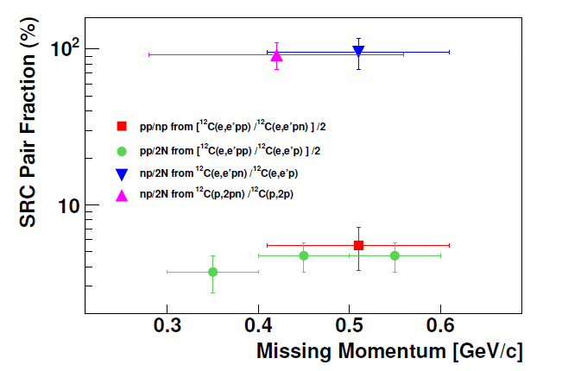
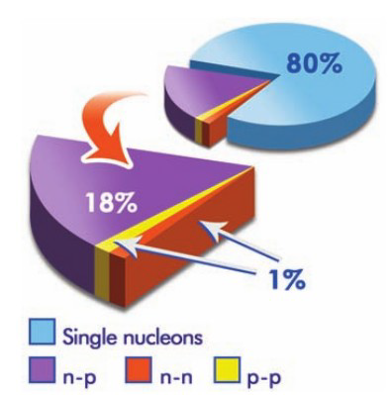
Isospin-Dependence
Exclusively count np-/pp-/nn-SRC pairs →np make up 90% of SRC pairs
R. Subedi, et al, Science 320 1476 (2008)
Similar np-dominances in heavy nuclei → universality?
Review: Hen RMP ‘17;

Slide 11
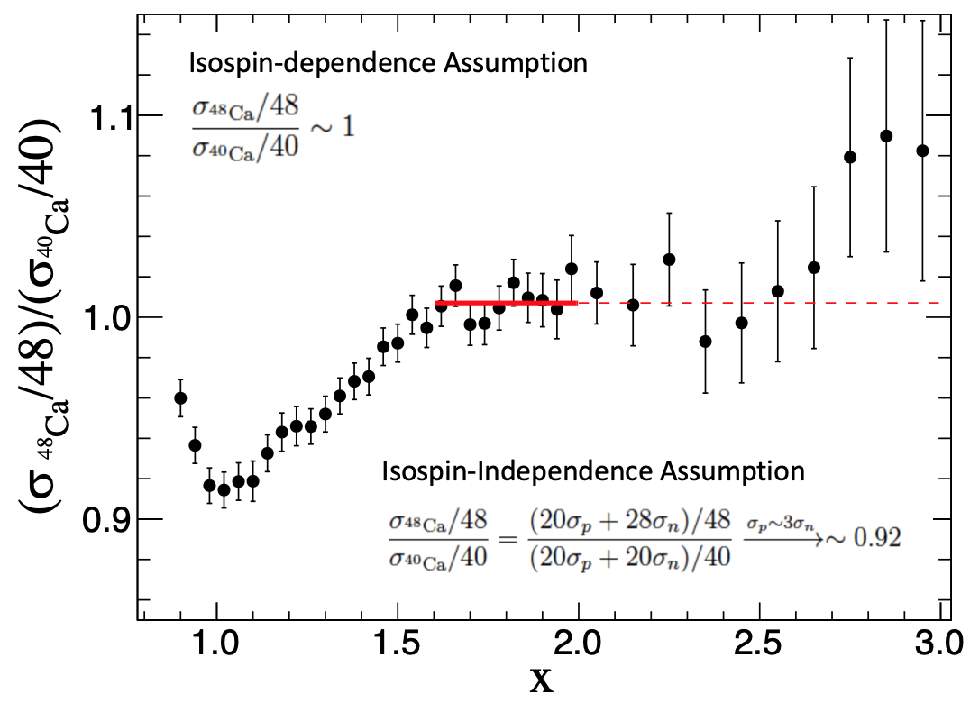
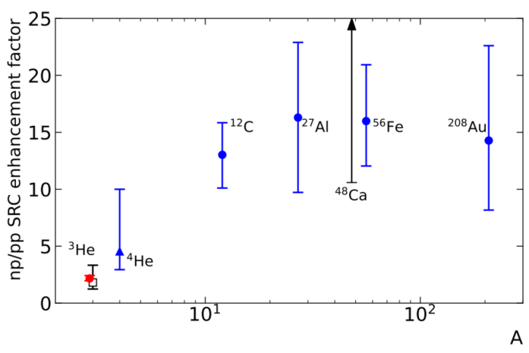
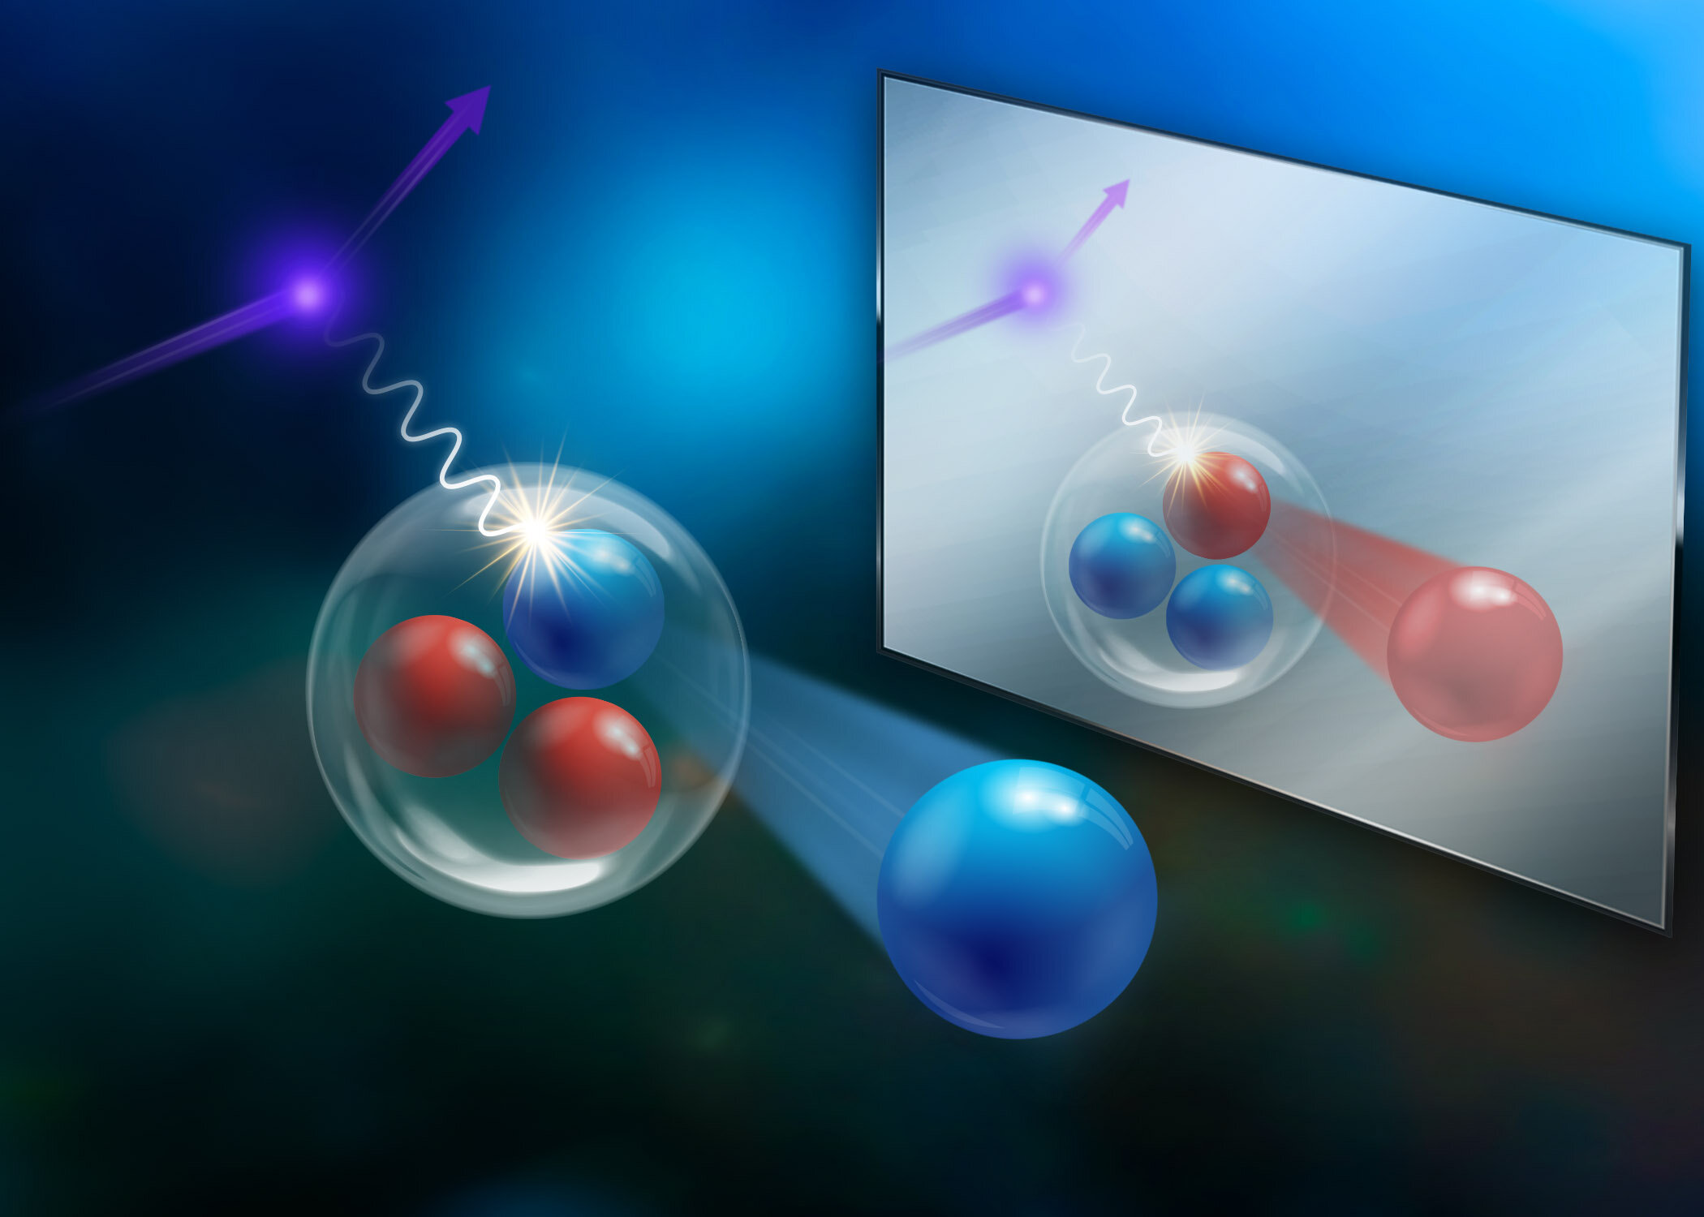
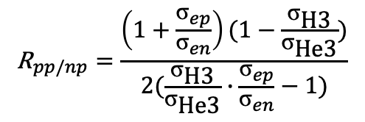
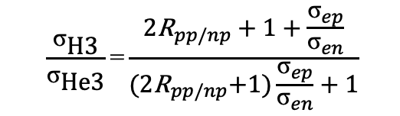
Isospin-Dependence
First inclusive measurement w/ Ca48 & Ca40 isotopes → not clear!
D. Nguyen, Z. Ye, et al, RPC 102, 064004 (2020)
Using Tritium and Helium-3 isotopes (E12-11-112)
$$\frac{{\text{σ}}_{\text{H}\text{3}}}{{\text{σ}}_{\text{He}\text{3}}}\text{=}\frac{{\text{2}\text{R}}_{pp/np}+1+\frac{{\text{σ}}_{ep}}{{\text{σ}}_{en}}}{{\text{(}\text{2}\text{R}}_{pp/np}+1)\frac{{\text{σ}}_{ep}}{{\text{σ}}_{en}}+1}$$
$${\text{R}}_{pp/np}=\frac{\left(1+\frac{{\text{σ}}_{ep}}{{\text{σ}}_{en}}\right)(1−\frac{{\text{σ}}_{\text{H}\text{3}}}{{\text{σ}}_{\text{He}\text{3}}})}{2(\frac{{\text{σ}}_{\text{H}\text{3}}}{{\text{σ}}_{\text{He}\text{3}}}∙\frac{{\text{σ}}_{ep}}{{\text{σ}}_{en}}−1)}$$
Small np-dominances in A=3 nuclei → Why?
Few-body nuclei vs heavy ones?
Neutron-rich nuclei vs. Isoscaler?
Li, Torres, Sentiestaben, ZYe, et. al, Nature, 2022, 609: 41
Need more neutron-rich radio-active isotopes!

Slide 12
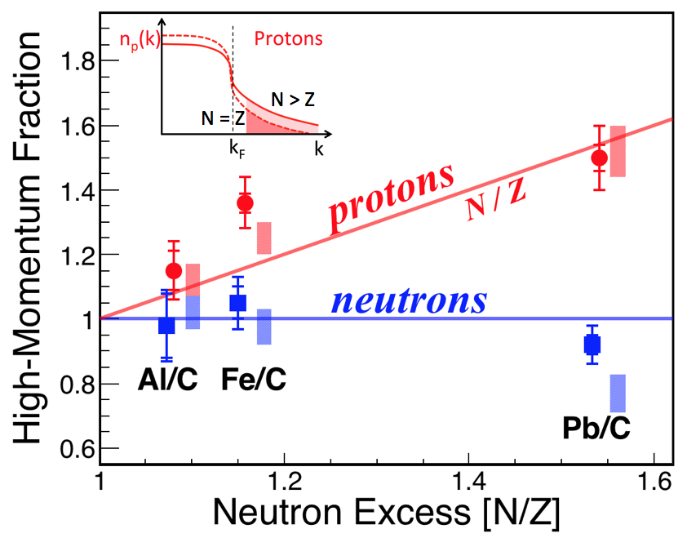
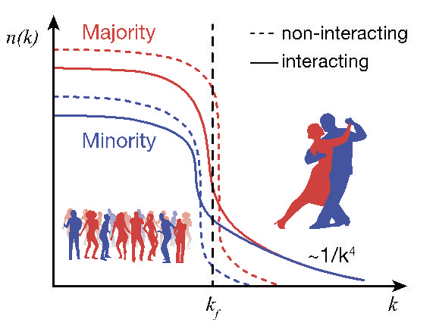
Isospin-Dependence
Proton “speed up” with neutron excess
M. Duer et. al., Nature (2018) , B. Schmookler et. al. Nature (2019), A. Schmidt et. al Nature (2020) + many others
Many problems:
Limited stable nuclei
Exclusive results are statistics limited
Complicated FSI corrections
Mixed with mean-field and long-range NN signals
New method!
New ALERT-SRC experiment!

Slide 13
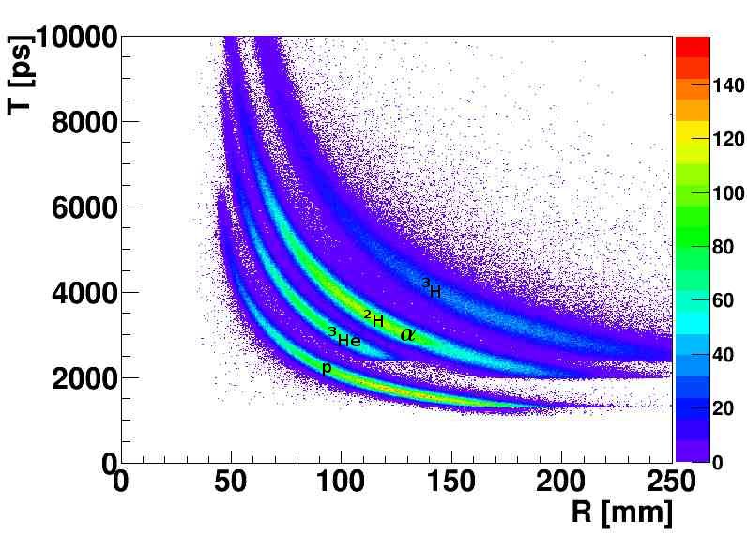
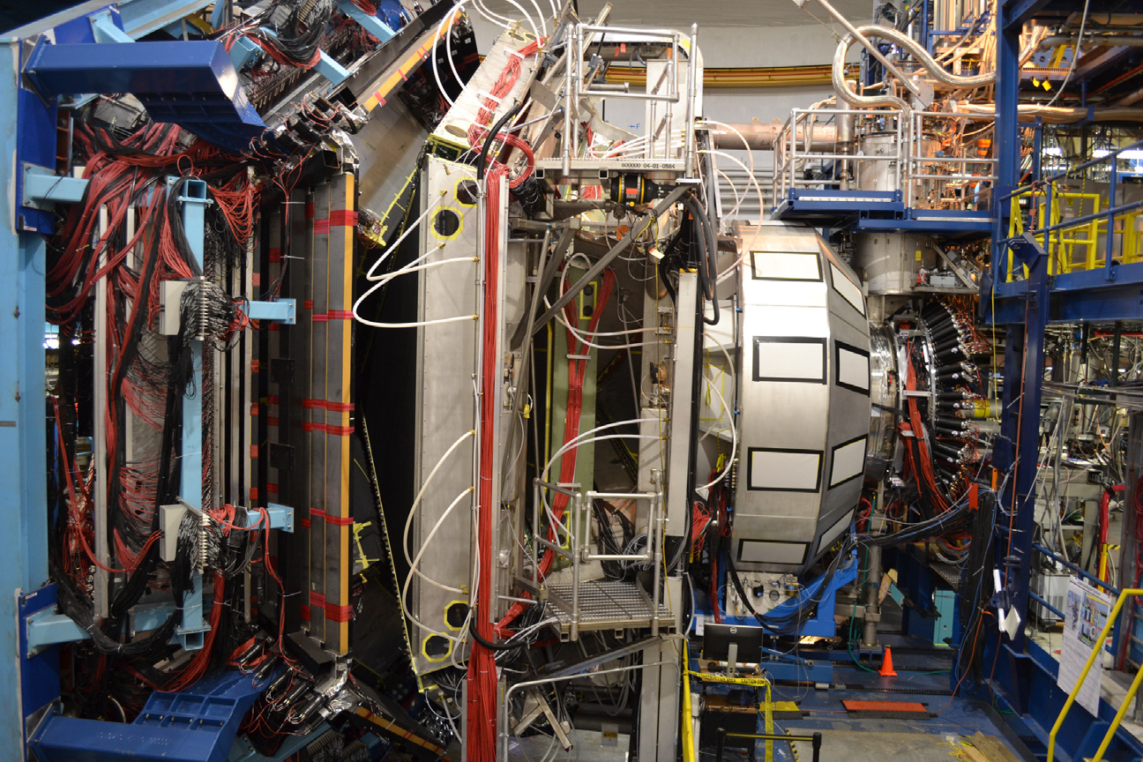
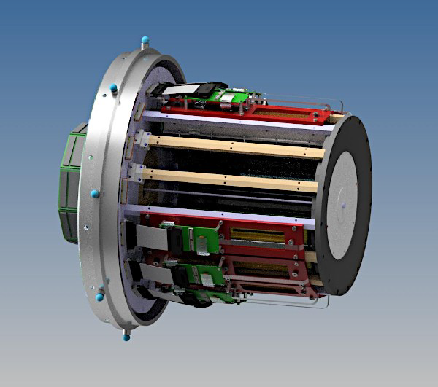
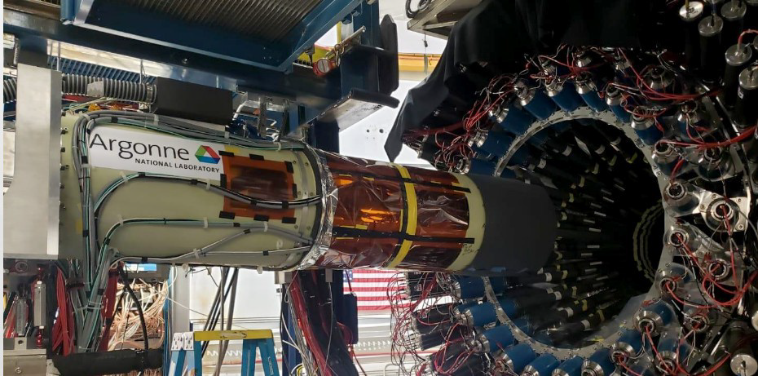
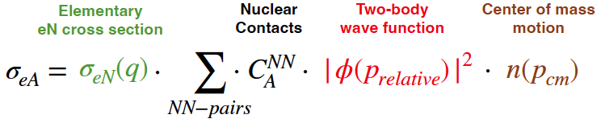
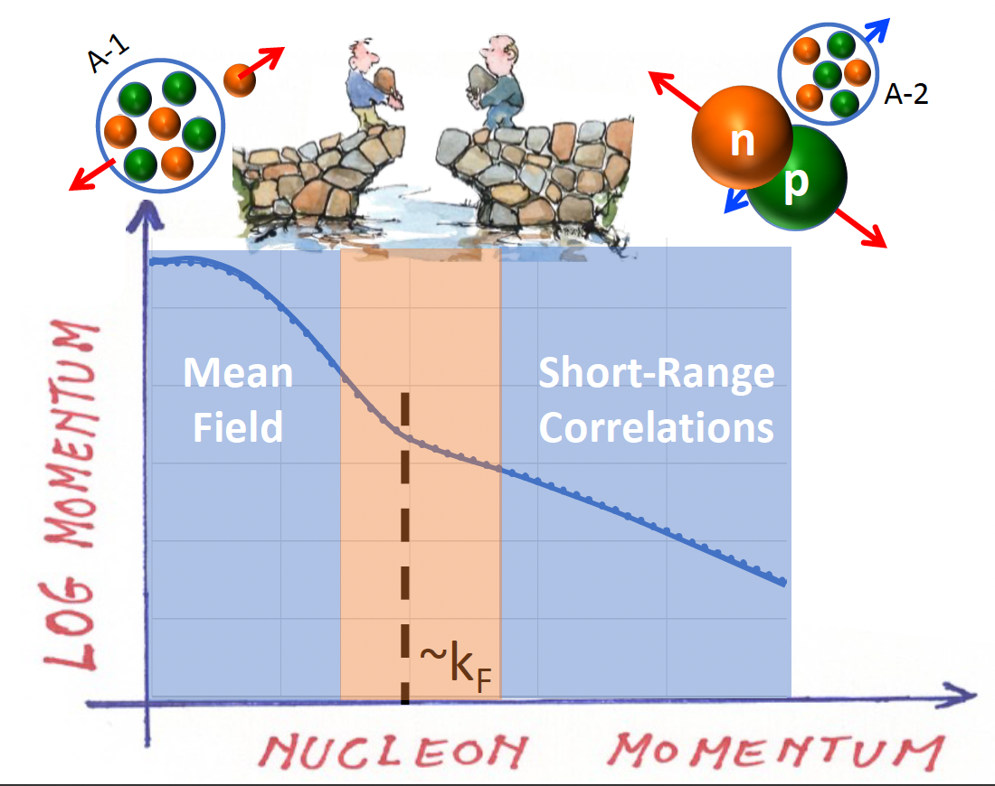

Mean-Field vs SRC
NEW: ALERT-SRC w/ CLAS12 in Hall-B (finished on Sep. 3rd 2025)
6.6 GeV electron beam on He4
CLAS12 measured e’ and p
ALERT recoil detector measure fragments (³He & ³H & ²H)
Goal#1: Test factorization
Goal#2：Transition from Mean-field to SRC?
Zeyu Zhang, Ph.D thesis students from Tsinghua

Slide 14
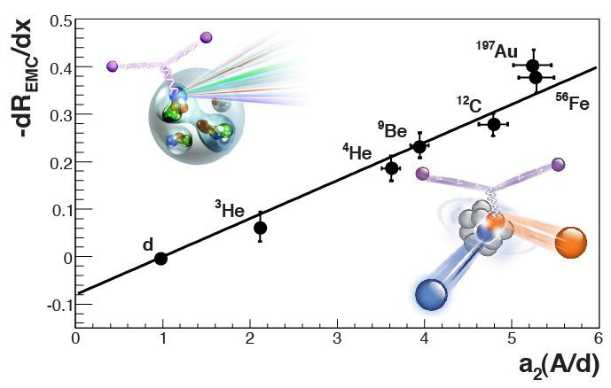


SRC vs EMC
EMC Effect:
EMC: Inclusive DIS cross-section ratio of A to D drops linearly in 0.3<x<0.7
Connection with SRC?
L. Weinstein et al, PRL 106, 052301 (2011)
Phys.Lett.B 123 (1983) 275-278
EMC Slope
Even modified in A=3 (likely D2 as well)
MARATHON Phy. Rev. Lett. 135, 062502 (2025), editor suggested
Modification in all nucleons or only SRC nucleons?
40 years after discovery, still unknown!

Slide 15




SRC vs EMC
NEW: LAD Experiment in Hall-C (finished on August 2025)
11 GeV e-beam on 20 cm liquid D2 (DIS)
Standard HMS & SHMS for electrons
LAD detector for recoil protons
PRAD GEMs for tracking
Duration: 34 PAC days
`
Haocen Zhao, Ph.D thesis student from THU

Slide 16


3N-SRC (still missing)
Higher P & densities → neutron stars
Link to unknown 3-body forces
Complicated initial and final states
Only can assess via inclusive method (so far)
~20%
<5%
3N-SRC (2<x<3)
No 3N-SRC plateau seen so far
S. Li, et. al. Phys. Lett. B 868 (2025) 139734
Z. Ye, Phys. Rev. C 97, 065204 (2018)
Y.P. Zhang, Z. Ye, et. al, arXiv:2504.17462 , submitted
⁴He/³He
³H/³He
¹²C/³He

Slide 17






SRC w/ Photons (new probe)
A(𝛄, J/𝜓 p)X reaction below threshold (Haiyan Gao & Or Hen):
~8GeV photons scatter on He4&C12 near threshold J/𝜓 ～（8.2GeV)
J.R. Pybus, et. al. PRL 134 (2025) 201903, w/ editor suggest.
Another approved GLUX SRC experiment in 2025
$${\overset{⃑}{P}}_{p−recoil}=−{\overset{⃑}{P}}_{p→J/ψ}$$
Near-threshold 𝛬-Production (LEPS2, SHINE?)
LEPS2@SPrint-8
Credit to Yue Ma
(RIKEN)

Slide 18

”Muti-messenger” era
Precision Frontier!

Slide 19


SRC Study w/ Inverse-pA
Could solve issues remained w/ eA Scattering
Larger cross-sections → map 2N-SRC & search 3N-SRC
Easier to detect fragments → Mean-field vs SRC
Better controlled FSI → Reduce theoretical systematic errors
Large asymmetric nuclei, radioactive isotopes
or Electron beam
Recoil detector (e.g. ALERT)

Slide 20



First Atemp at JINR BM@N
Pioneer run in BM@N in 2018
¹²С beam, 4 GeV/c/nucleon
SRC
MF
SRC
Detect two outgoing nucleons & (A-2)
Reconstruct initial nucleon momentum:
P_{miss} = P₁ + P₂ - P_{beam}
M. Patsyuk et al. Nature Physics 17, 693 (2021)
np pair: ¹²C(p,2p) ¹⁰B
pp pair: ¹²C(p,2p) ¹⁰Be
Select2N-SRC:
23 np & 2 pp SRC-pairs

Slide 21





Full BM@N SRC Run
Full run completed in 2022
JINR,GSI, MIT, Tel Aviv, Tsinghua …
Improve statics x100
Detect both n & p
Multi-fragment reconstruction
First extract absolute cross-section
Publishing soon
Maria Patsyuk
(JINR)
Julian Kahlbow
(MIT)

Slide 22




GSI SRC Run
SRC w/ rare radioactive isotope at R³B@GSI (2022)
~2 GeV/c beam, ¹⁶C(p,2pN)A-2*
Future：^{110,120,132}Sn （N/Z = 1.20, 1.40, 1.64）
See SRC signals even at lower energy
Link to sub-nuclear structure?
¹⁶C + p → np-SRC + ¹³B+n
¹⁶C + p → np-SRC + ¹⁴B
Data (total)
--- SRC
--- Mean-Field
Data (total)
--- SRC
--- Mean-Field
Preliminary
Preliminary

Slide 23





SRC Experiment @ HIRFL-CEE
CSR External-Target Experiment (CEE) device under commissioning
Using CEE w/ additional changes/upgrades:
Liquid hydrogen (LH2) target
Replace ZDC w/ a new detectors for nuclear fragments
+ new dipole + Neutron wall?
HIRFL-CSR beam
P：2.8 GeV
¹²C⁺：1 GeV/u
²³⁸U ⁺ ： 0.5 GeV/u
Neutron Wall
NEW
Eli Piasetzky @ IMP neutron detector
THU Students in CEE magnet

Slide 24





SRC Experiment @ HIRFL-CEE
Monte-Carlo simulation of SRC w/ CEE@HIRFL
Protons are within existing CEE detectors
¹²C⁺ (p,ppn)¹⁰B⁺
Nuclear fragments
@0.5T
Wall
TPC+MWDC
TPC+MWDC
4m
CEE-TPC
CEE-MWDC
ZDC
Missing-Mass

Slide 25


SRC Experiment @ HIRFL-CEE
Fragment detection w/ standard CEE setup
Fragment-Detector at 4m downstream
Increase magnetic field to 1.0T
Nuclear fragments
@1.0T
Wall
4m
Continue Improvement
→Add a new dipole?

Slide 26
SRC Experiment @ HIRFL-CEE
CEE will run with no magnet in 2025
proton
SRC study w/o B-field
Measure protons and neutrons (TOF method)
Detect fragments (A-1) or (A-2) (suppress FSI)
Find high momenta of protons & neutrons
A beam
A beam
fragments
LH2
neutron
proton
What are needed: Hydrogen target or CH2 & Neutron detector
Light ions to study SRC in few-body nuclei?
𝛂-cluster?
SRC?
𝛂 make final-state simpler, but prefer mostly in even-even N=Z nuclei, or excited states
Alternatively, learn nuclear formation if no intact (A-2) or (A-3) fragments.
+
⁶Li³⁺ =
⁷Li³⁺ =
+
+
⁷Be²⁺ =

Slide 27






SRC Experiment @HIAF
High-Intensity Heavy-Ion Accelerator Facility (Huizhou, Guandong):
C12, E=51 GeV/c (4.25GeV/c/u) → similar to NICA
1.8x10¹²pps (fast extr.), 4.5x10¹¹pps (slow extr.) vs. 3.5x10⁴ pps at JINR
First beam in end of 2025
HRFS
High-Energy Station (HES)
Beam Direction
Beam Direction

Slide 28




SRC Experiment @HIAF-HES
Precision frontier for SRC in HES：
Mapping 2N-SRC at all kinematic, Search 3N-SRC
2-week @ 3.5x10⁴pps
Monte-Carlo Simulation (¹²C⁶⁺ at 51GeV/c)
1-day @ (4.5~18)x10¹¹pps
HIAF
(full acceptance
+100% eff.)
BM@N
Z. Ye, et. al., Eur. Phys. J. A 60(6), 126 (2024).
Use full-acceptance spectrometer , e.g. H-NS (under discussio)

Slide 29




SRC Experiment @HIAF-HFRS
Radioactive ion beams are produced at HFRS(HIRIBL)
Nature, 560 (2018) 617-621.
by Hooi-Jin Ong@IMP
Study 2N-SRC w/ radioactive isotopes from HIRIBL
Light to large neutron-rich nuclei
Cannot be done in fixed target experiments
Li, et.al. Nature, 2022, 609: 41

Slide 30







Summary
SRC helps us to understand nuclear structure & forces, neutron stars, quarks in nuclei …
Many progresses made at JLab
np-SRC dominated, universal in heavy nuclei, less in light nuclei
no 3N-SRC found
hard to isolate SRC (mean-field, initial & final state interaction)
NEW`: below-threshold production with photons
SRC study with inverse kinematic (ion beams on hydrogen):
First in BM@N (JINR) and R3B (GSI)
with CEE@HIRFL & small upgrades
Precision frontier at HIAF→ Mean-Field vs SRC in few-body nuclei, 2N-SRC in neutron-rich isotopes, 3N-SRC …
Topical issue on short-range correlations and the EMC effect, EPJA (2025) 61:109
Many efforts made to realize SRC programs in China, welcome to join!
Works are supported by NSFC
(12275148 & 12361141822）

Slide 31
Thanks!
谢谢！

Slide 32



Isospin Dependence
Tensor Force is strongly attractive
NN Interaction Forces
$$−S_{12}=−3({\vec{σ}}_{1}⋅\hat{r})({\vec{σ}}_{2}⋅\hat{r})+({\vec{σ}}_{1}⋅{\vec{σ}}_{2})$$
= -3 σ₁σ₂
Repulsive cores
Attractive
==0→Repulsive
r
p
p
n
Total
n
Tensor Force
Tensor force favor neutron-proton pairs
R. Cruz-Torres et al. / Physics Letters B 785 (2018) 304–308

