Slide 1

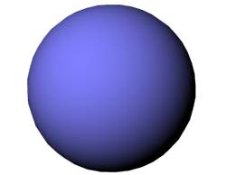

Probing nuclear structure in heavy-ion reactions
: similarities between subbarrier fusion and relativistic HIC
Kouichi Hagino
Kyoto University, Kyoto, Japan
Introduction
Low-energy Nuclear Reactions: overview
Role of deformation in sub-barrier fusion reactions
Probing nuclear structure in Relativistic heavy-ion collisions
5. Summary
Workshop on ”Nuclear physics across energy scales”, Central China Center for Nuclear Theory, Wuhan, 2025.9. 19-21

Slide 2






Snapshots
taking snapshots of a “slow” motion with a high-speed camera
https://www.sony.jp/ichigan/products/ILCE-7M3/feature_3.html
(photos with a Sony camera α7III)
a slow mode
a fast mode
taking snapshots of a nucleus with a “fast” nuclear reaction

Slide 3
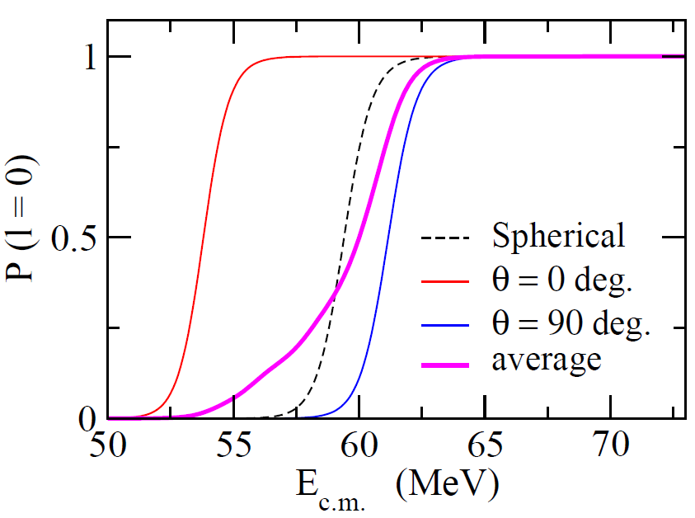
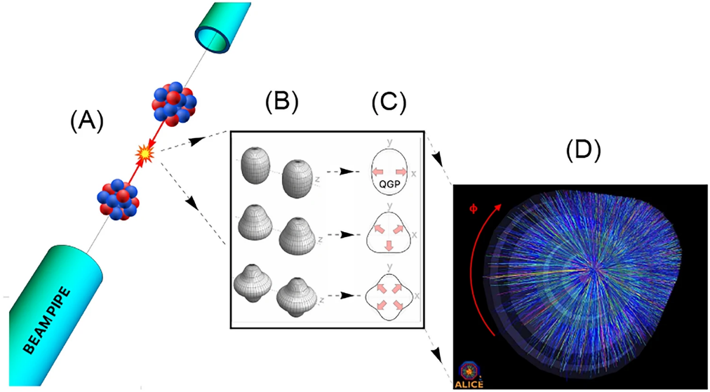
Snapshots
taking a snapshot of a nucleus with a “fast” nuclear reaction
low-energy H.I. fusion reactions
of a deformed nucleus
relativistic H.I. collisions
with a deformed nucleus
J. Jia et al., Nucl. Sci. Tech. 35, 220 (2024)
increasing interests in recent years
¹⁵⁴Sm
¹⁶O

Slide 4
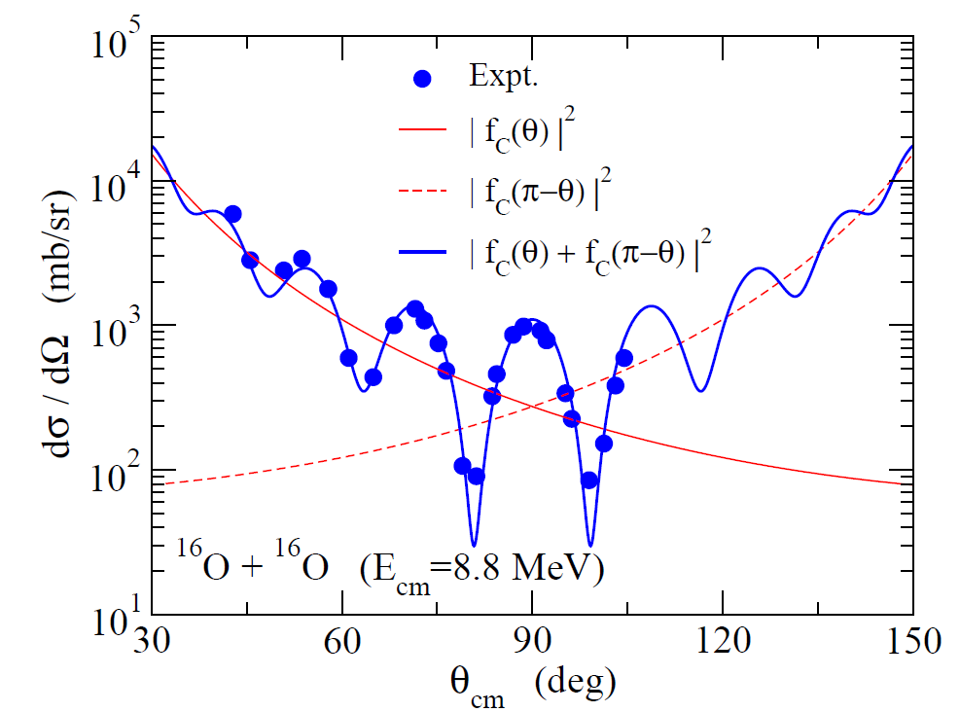




Introduction: low-energy nuclear reactions
nucleus: a composite system
various sort of reactions
an interplay between nuclear
structure and reaction
elastic scattering
inelastic scattering
transfer reactions
breakup reactions
fusion reactions
shapes, excitations, …..
elastic scattering
inel. scattering
fusion

Slide 5
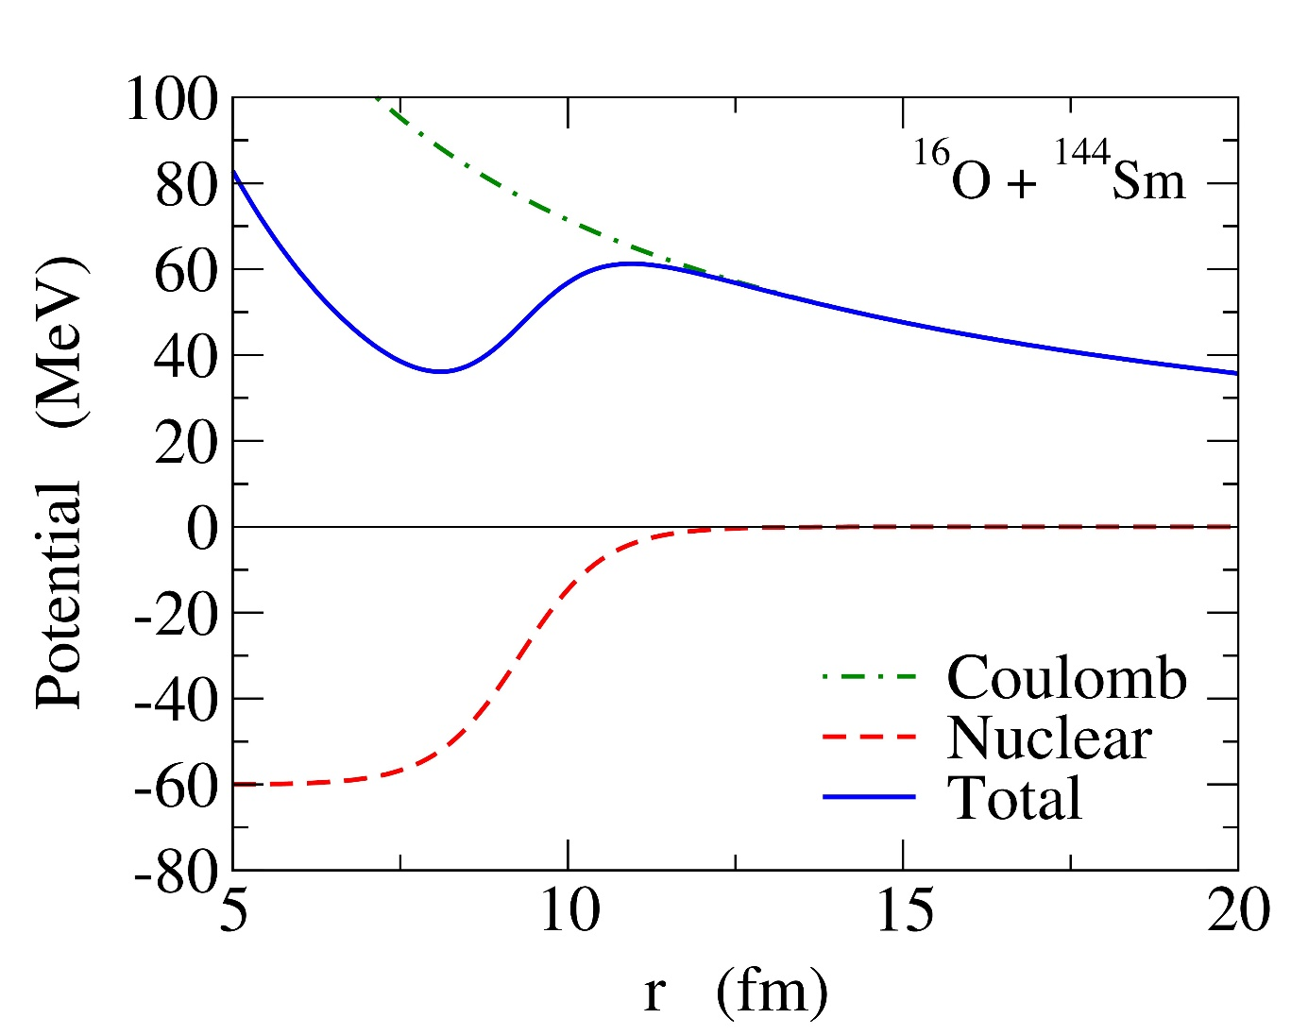
Coulomb barrier
1. Coulomb interaction
long range, repulsion
2. Nuclear interaction
short range, attraction
E
Quantum tunneling
Potential barrier (Coulomb barrier)
Fusion: takes place by overcoming
the barrier
the barrier height → defines the energy scale of a system
Fusion reactions at energies around the Coulomb barrier

Slide 6
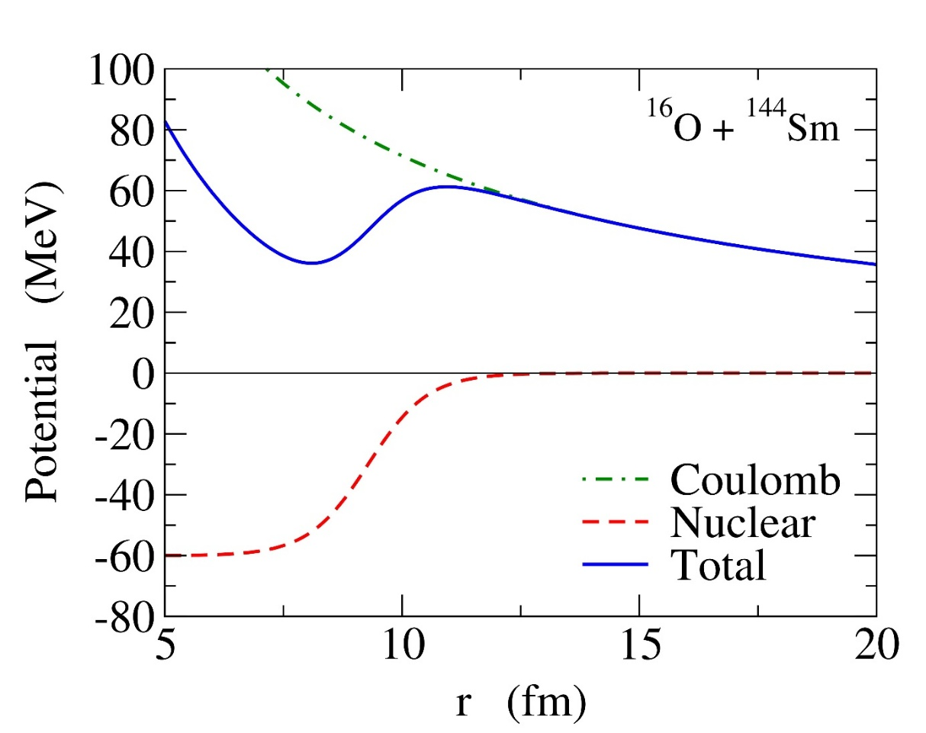
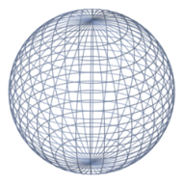
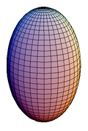
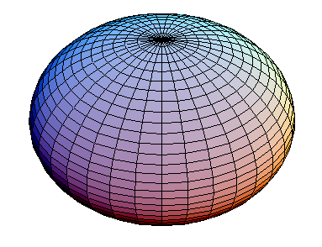
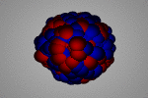
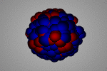
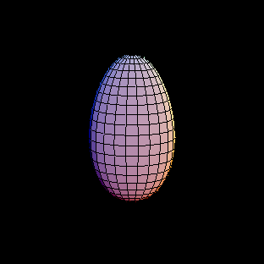
Sub-barrier fusion reactions and quantum tunneling
Fusion with quantum tunneling
with many degrees of freedom
Sub-barrier fusion reactions
- several nuclear shapes
- several surface vibrations
several modes and adiabaticities
- several types of nucleon transfers
Tunneling probabilities: the exponential E dependence
→ nuclear structure effects are amplified

Slide 7
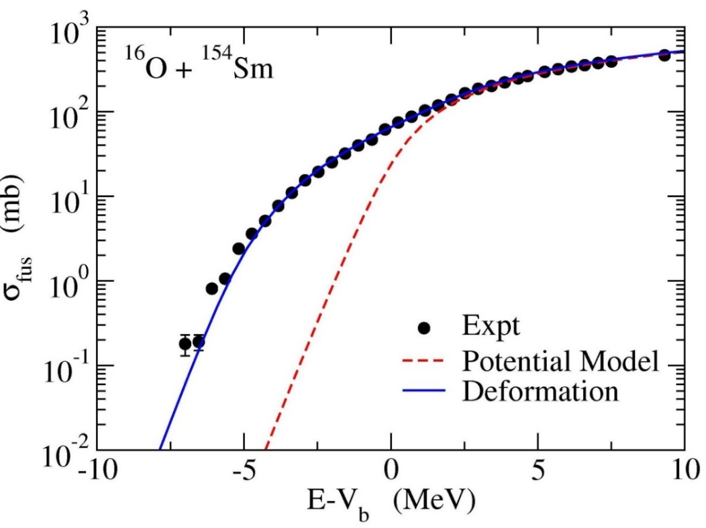
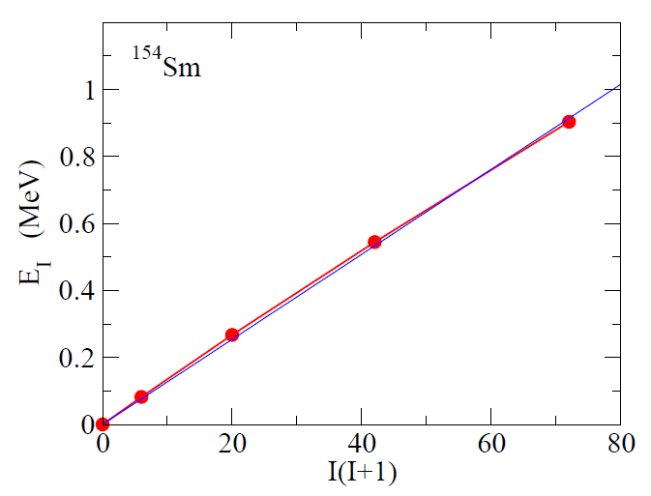
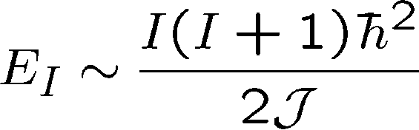
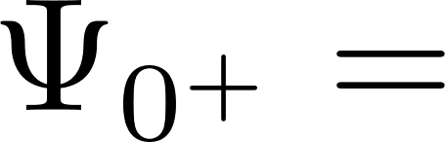
Sub-barrier fusion reactions and quantum tunneling
¹⁵⁴Sm
potential model
deformation of ¹⁵⁴Sm
rotational spectrum
K. Hagino and N. Takigawa, Prog. Theo. Phys.128 (2012)1061.

Slide 8
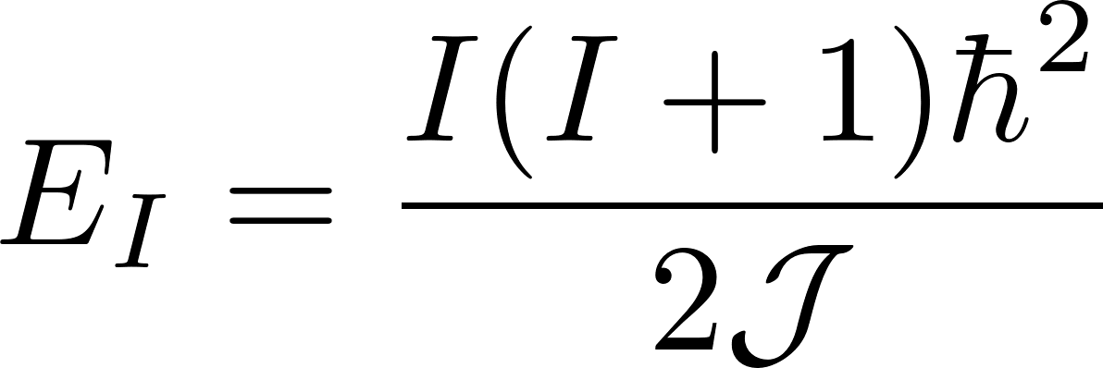
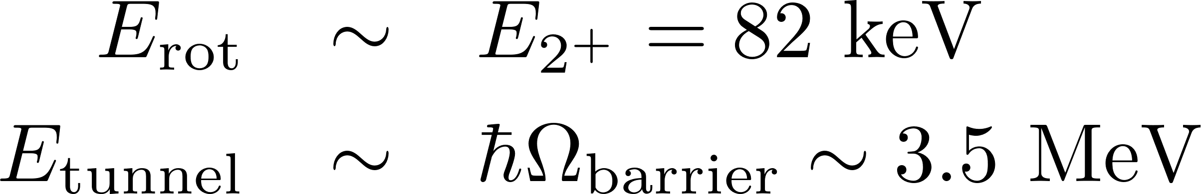
a small rotational energy
Effects of nuclear deformation on fusion
¹⁵⁴Sm
→ a large moment of inertia J
(MeV)
→ rotation: a slow deg. of freedom
0.903
8⁺
0.544
6⁺
+
+
+
0.267
4⁺
→ a spherical state in the lab. system
0.082
2⁺
0
0⁺
fix the orientation angle to calculate
the fusion probability
¹⁵⁴Sm
rotational spectrum
“a snapshot of a rotating nucleus”

Slide 9
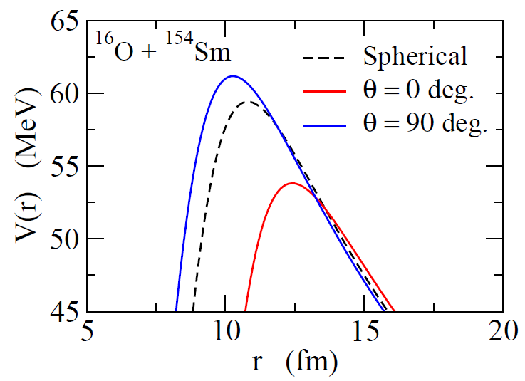
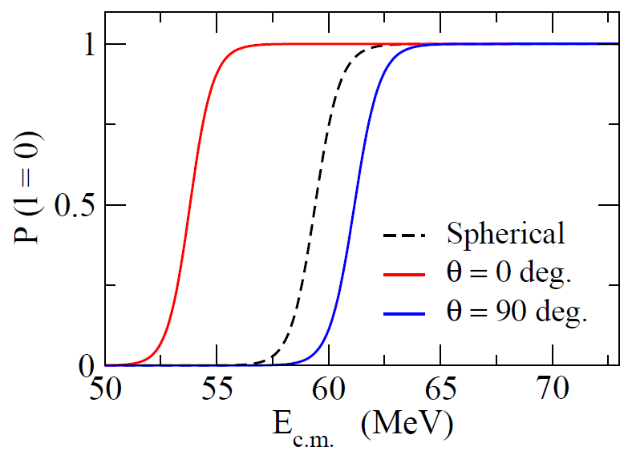

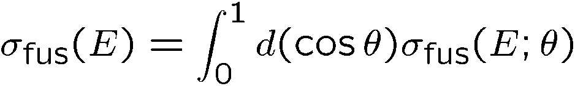
Effects of nuclear deformation on fusion
¹⁵⁴Sm
¹⁵⁴Sm : a typical deformed nucleus
¹⁵⁴Sm
¹⁶O
Fusion: strong interplay between nuclear structure and reaction

Slide 10
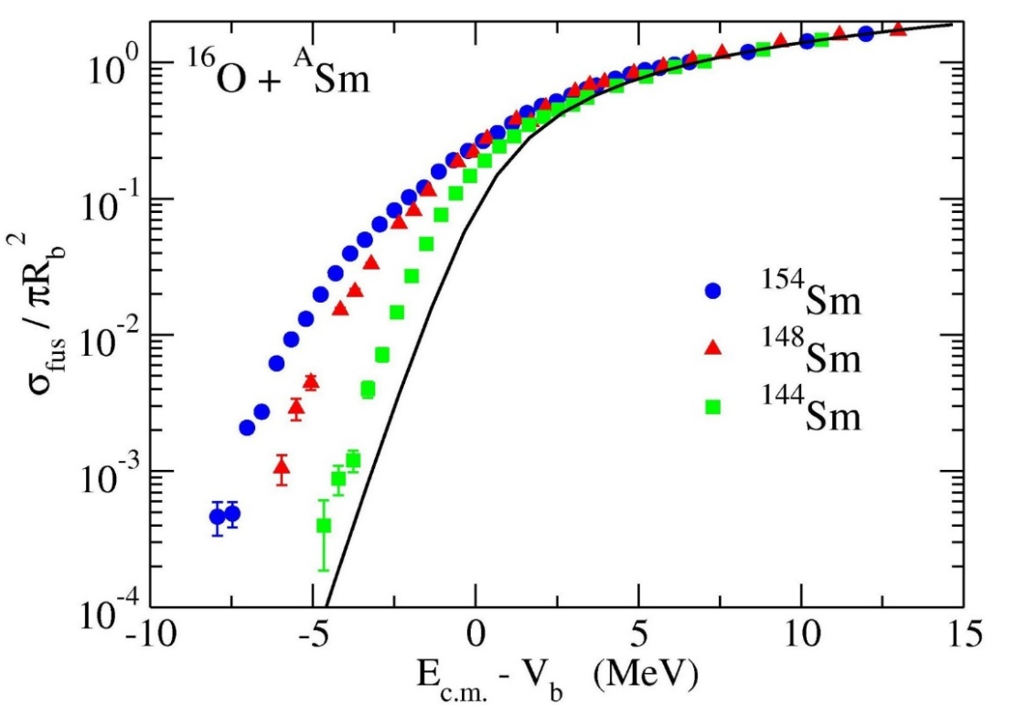
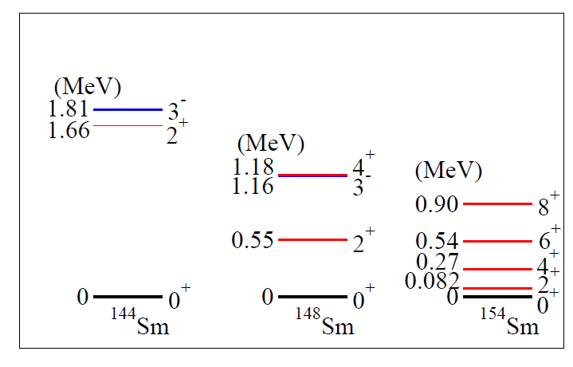
similar enhancement for non-deformed nuclei
static deformation
spherical, but with
vibration

Slide 11
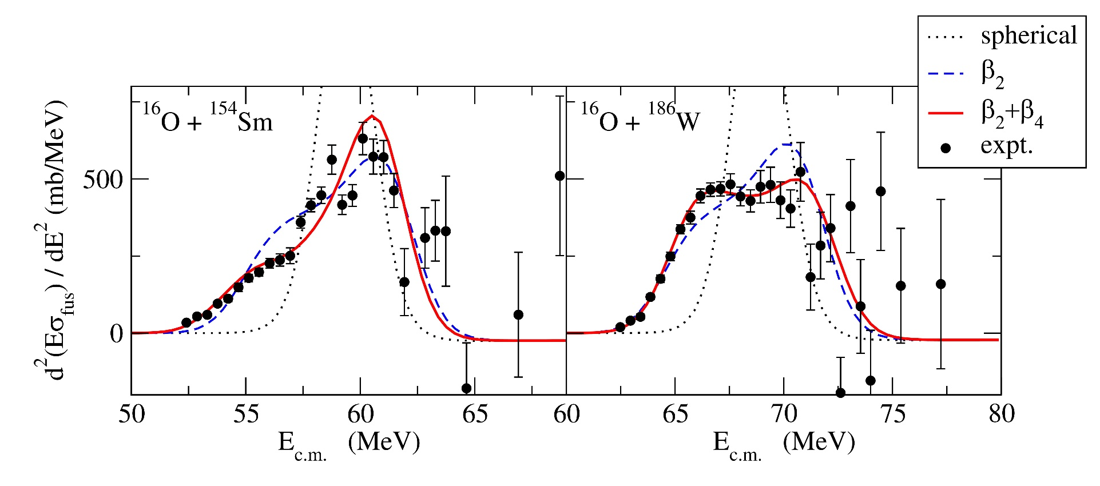
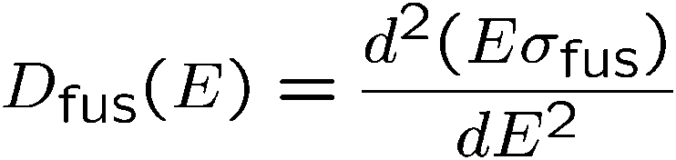
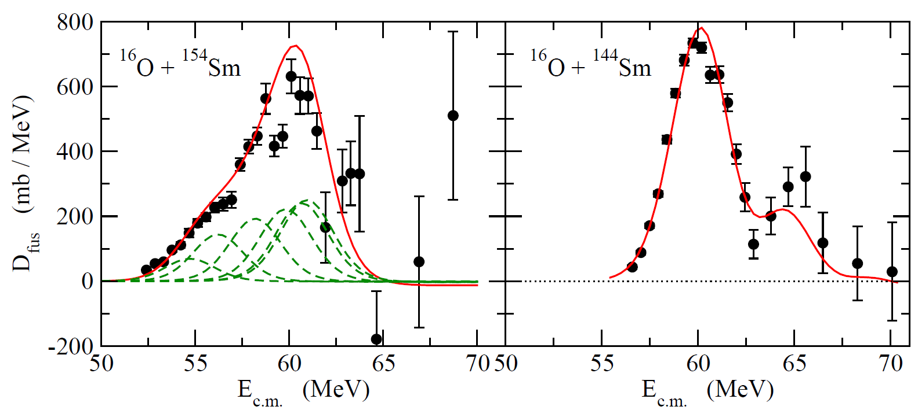
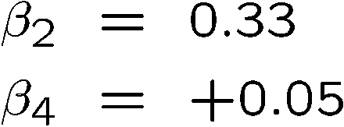
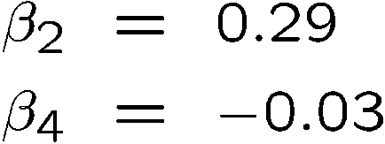
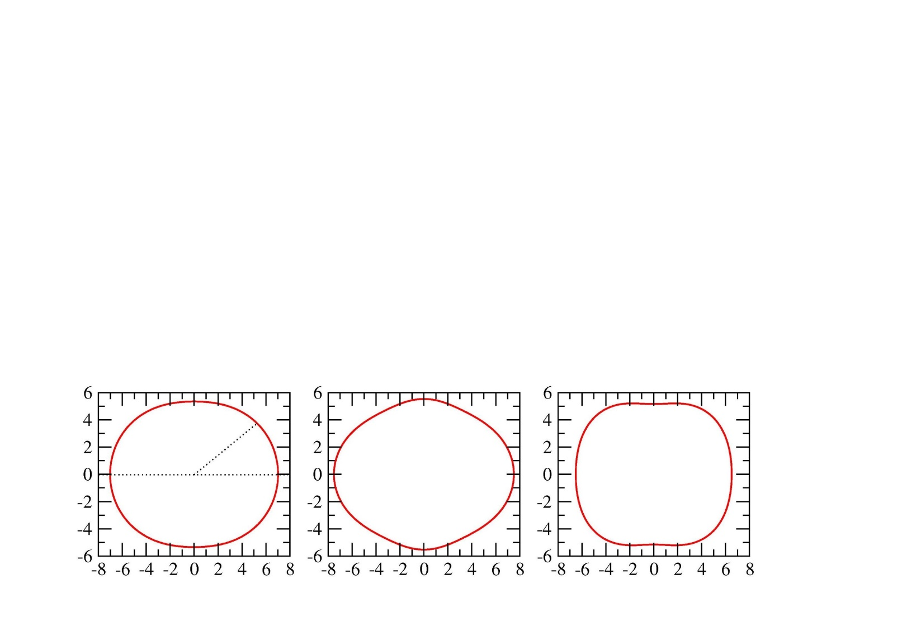
Fusion barrier distribution
N. Rowley, G.R. Satchler, and
P.H. Stelson, PLB254 (‘91) 25
sensitive to the sign of β₄!
Fusion as a quantum tunneling microscope for nuclei

Slide 12
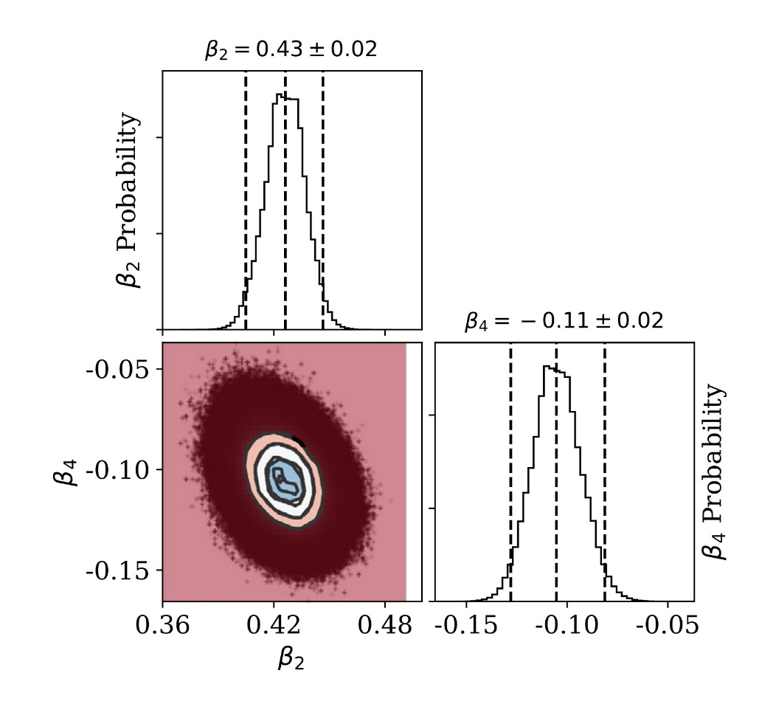
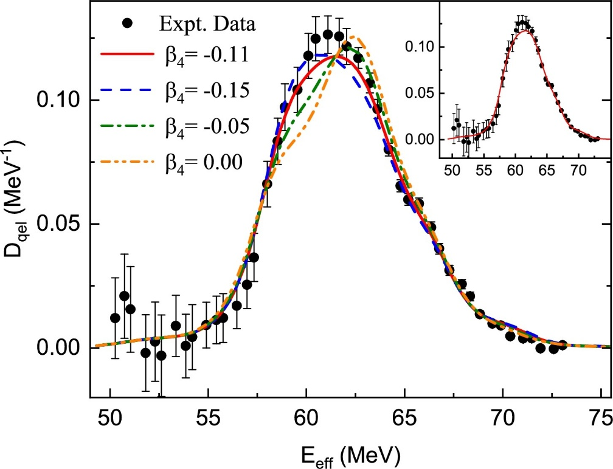
Determination of β₄ of ²⁴Mg and ²⁸Si with quasi-elastic barrier distributions
Y.K. Gupta, B.K. Nayak, U. Garg, K.H., et al., PLB806, 135473 (2020).
Y.K. Gupta et al., Phys. Lett. B845, 138120 (2023).
β₂ = 0.43 +/- 0.02
²⁴Mg + ⁹⁰Zr
Bayesian analysis
β₄ = -0.11 +/- 0.02
high precision determination of β₄
→ for the first time
cf. Construction of an emulator:
K. Hagino, Z. Liao, S. Yoshida, M. Kimura,
and K. Uzawa, Phys. Rev. C112, 024618 (2025).
cf. (p,p’): β₄ = -0.05 +/- 0.08
R. De Swiniarski et al., PRL23, 317 (1969)

Slide 13
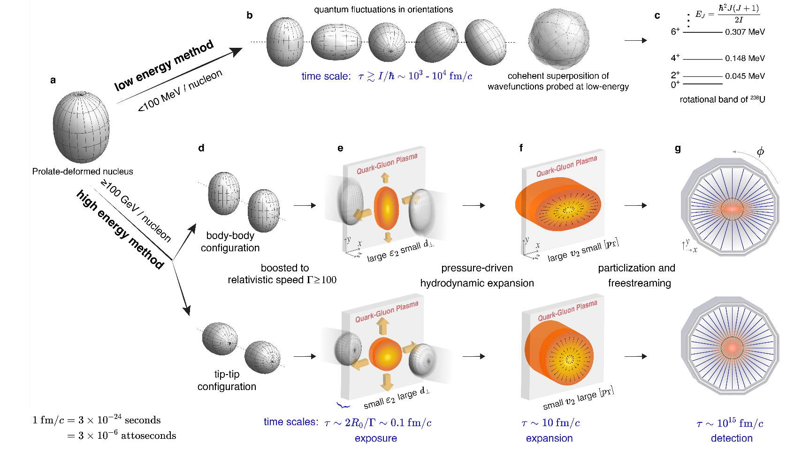
Probing nuclear shapes in Relativistic Heavy-Ion collisions
the initial shape
of QGP
expansion
detection
large similarities to
low-energy H.I. fusion reactions
of deformed nuclei
→ an intersection of
High E and Low E HI collisions
M.I. Abdulhamid et al. (STAR collaboration)
Nature 635, 67 (2024)

Slide 14
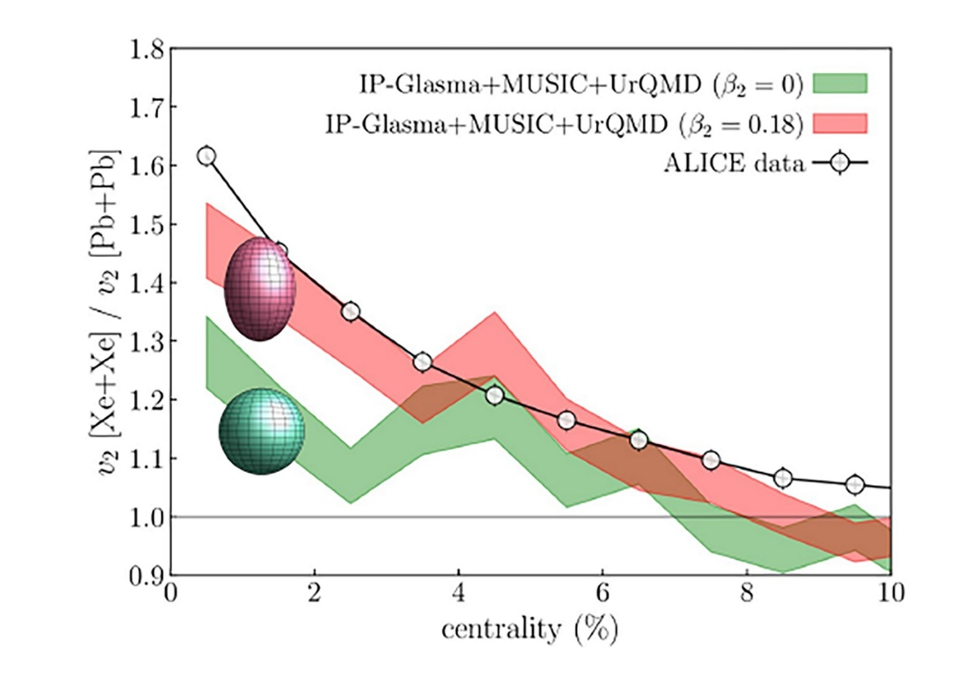
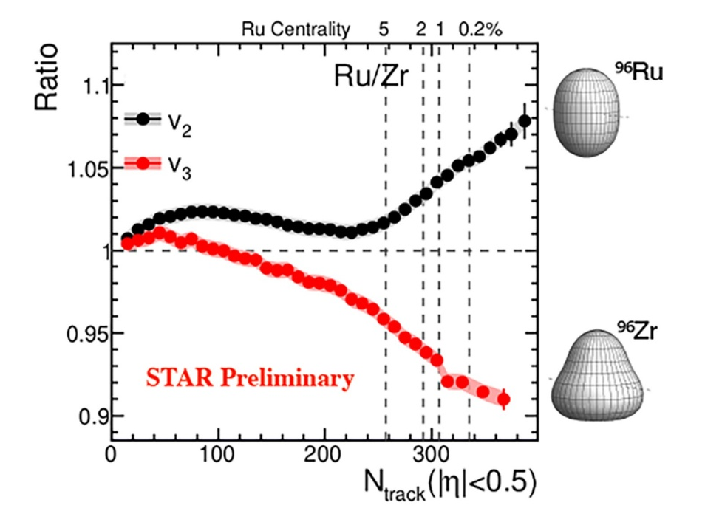
Probing nuclear shapes in Relativistic Heavy-Ion collisions
This has opened up a strong intersection between nuclear structure and relativistic HI collisions ← topics of this workshop
quadrupole deformation β₂
octupole deformation β₃
triaxial deformation γ
cluster structure
J. Jia et al.,
Nucl. Sci. Tech. 35, 220 (2024)

Slide 15
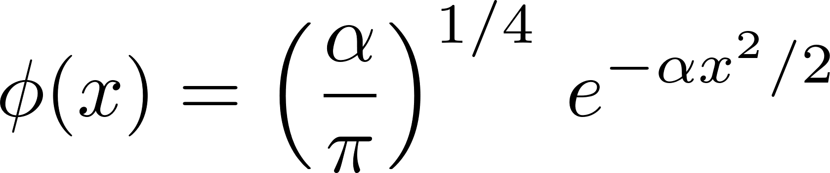
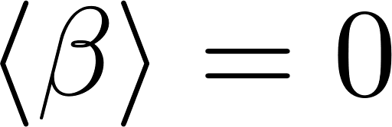
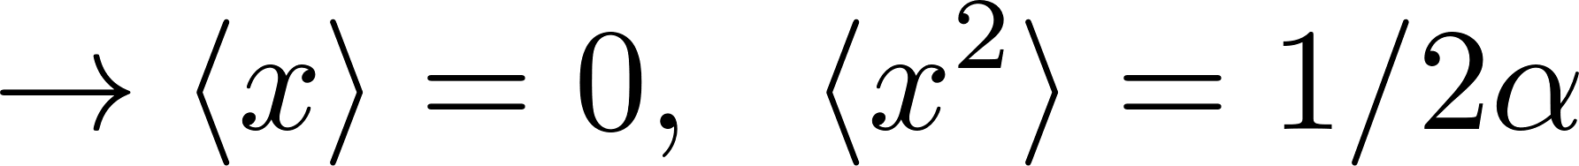
Probing nuclear shapes in Relativistic Heavy-Ion collisions
So far, the focus has been mainly on a static deformation of a deformed nucleus
There also exist several dynamical deformations of a spherical nucleus
cf. 1-dim. H.O.
but fluctuates around β=0
(zero-point motion)

Slide 16
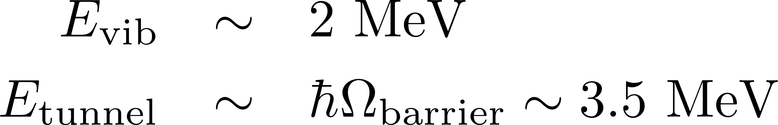
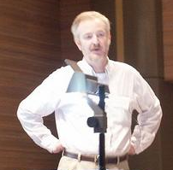
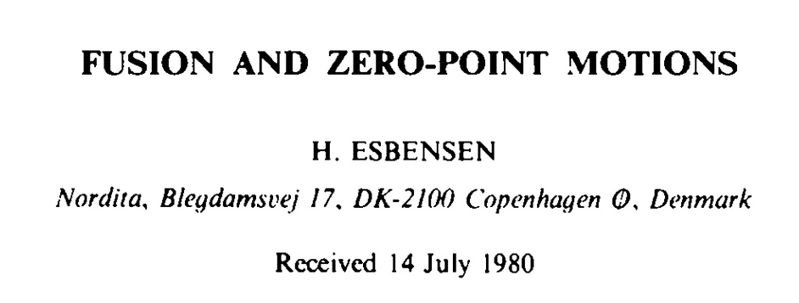
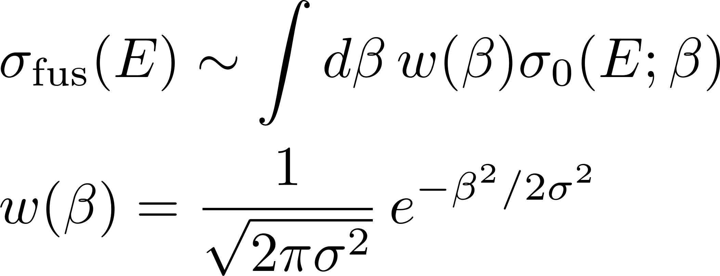
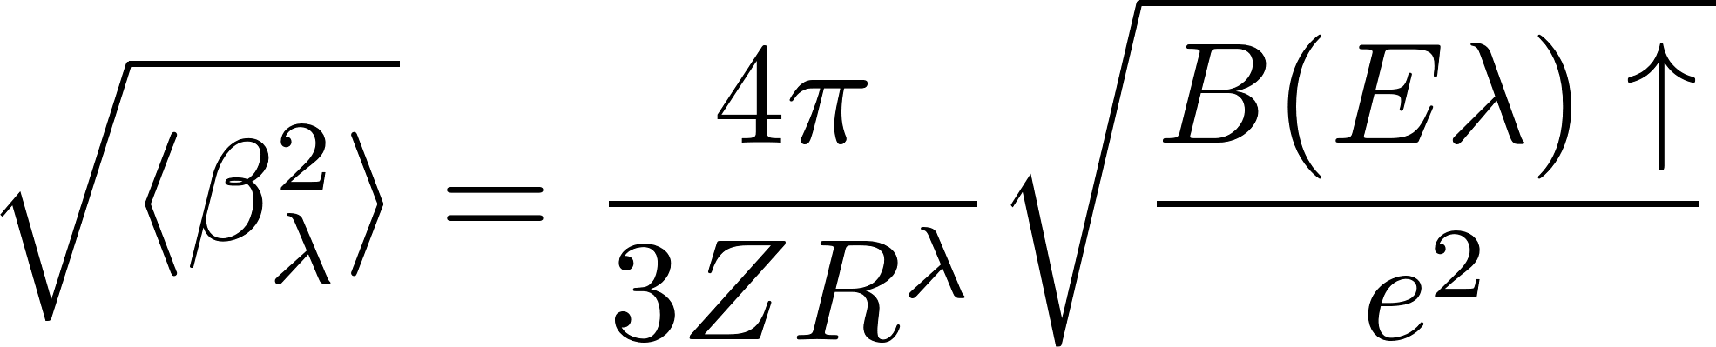
Probing nuclear shapes in Relativistic Heavy-Ion collisions
In most of the cases, the vibrational
motion is not slow for fusion:
but fluctuates around β=0
→ but this can be very slow
in rel. H.I. collisions!
the adiabatic approximation for vibrations:
H. Esbensen, Nucl. Phys. A352, 147 (1981)

Slide 17
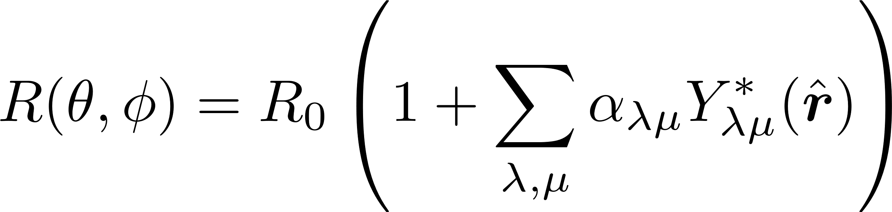
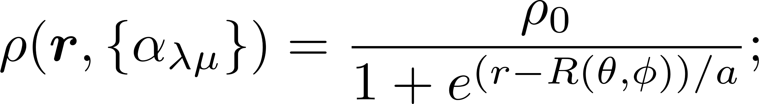
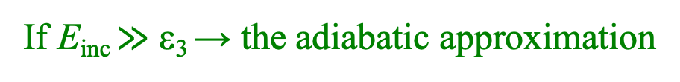
Probing nuclear shapes in Relativistic Heavy-Ion collisions
during a collision, a nucleus can be excited to the 3⁻ state
dynamical deformation parameter
ε₃
3⁻
0⁺
If E_{inc} $≫$ ε₃ → the adiabatic approximation
the eigen-channels
for H.O.
0⁺, 3⁻
= w_{i}

Slide 18
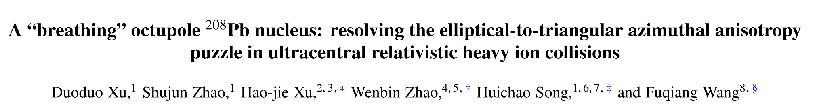
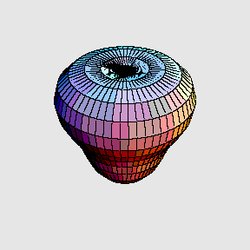
Probing nuclear shapes in Relativistic Heavy-Ion collisions
Very recent preprint: D. Xu et al., arXiv: 2504.19644
octupole vibration of ²⁰⁸Pb
2.6
MeV
3⁻
E3
0⁺
²⁰⁸Pb
https://web-docs.gsi.de/~wolle
/TELEKOLLEG /KERN/index-s.html

Slide 19
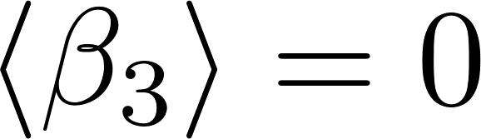
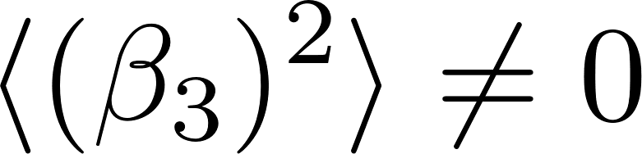
What is the nature of the 3₁⁻ state in ²⁰⁸Pb?
Linear response theory:
2.6
MeV
3⁻
E3
V_{ext}(t) on to the spherical g.s.
0⁺
²⁰⁸Pb
https://web-docs.gsi.de/~wolle
/TELEKOLLEG /KERN/index-s.html
²⁰⁸₈₂Pb₁₂₆: a double magic nucleus
→ spherical
but, the shape can fluctuate
→ octupole vibration
from the measured B(E3)
surface peaked (→ surface vibration)
n and p in phase (isoscalar)

Slide 20
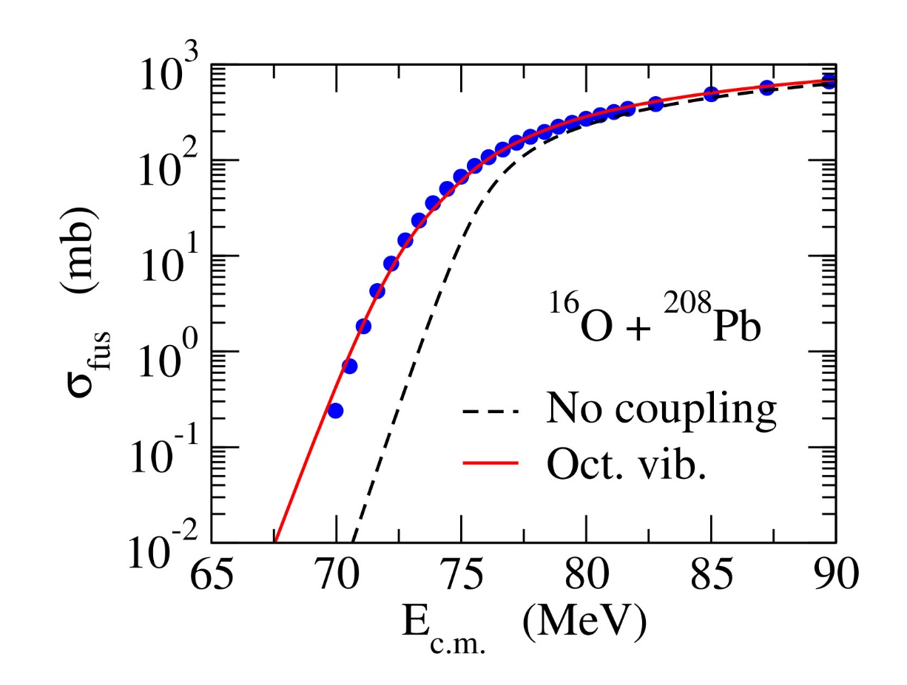

What is the nature of the 3₁⁻ state in ²⁰⁸Pb?
The effect of oct. vib. of ²⁰⁸Pb has been
well-known in sub-barrier fusion reactions
2.6
MeV
3⁻
E3
0⁺
²⁰⁸Pb
https://web-docs.gsi.de/~wolle
/TELEKOLLEG /KERN/index-s.html
²⁰⁸₈₂Pb₁₂₆: a double magic nucleus
→ spherical
but, the shape can fluctuate
→ octupole vibration
from the measured B(E3)
J.M. Yao and K. Hagino, PRC94 (‘16) 11303(R)
→ an application of a similar formalism
to relativistic heavy-ion collisions!

Slide 21





Probing nuclear shapes in Relativistic H.I. collisions
eccentricity parameter: deformation parameter of
deformed Woods-Saxon density
surface vibration
static deformation (axial symmetry)

Slide 22






Probing nuclear shapes in Relativistic H.I. collisions
⁵⁸Ni+⁵⁸Ni scattering (β₂ ~ 0.218)
(vib.)
(static def.)
Monte Carlo sampling (3000 samples)
the inverse area
K. Hagino and M. Kitazawa, arXiv: 2508.05125

Slide 23

Probing nuclear shapes in Relativistic H.I. collisions
⁵⁸Ni+⁵⁸Ni scattering (β₂ ~ 0.218)
triaxiality
cf. L. Liu, C. Zhang et al.,
arxiV: 2509.09376.
K. Hagino and M. Kitazawa, arXiv: 2508.05125

Slide 24




Summary
Heavy-ion fusion reactions around the Coulomb barrier
Strong interplay between nuclear structure and reaction
Quantum tunneling with various intrinsic degrees of freedom
Role of deformation in sub-barrier enhancement
deformation
→ a snapshot of the rotational motion
amplified
Similarities between low-E H.I. fusion and Relativistic H.I. Collisions
→ a snapshot of a nucleus
A tool to probe nuclear deformations
→ surface vibrations of a spherical nucleus

Slide 26




Probing nuclear shapes in Relativistic H.I. collisions
²⁰⁸Pb+²⁰⁸Pb scattering (β₃ ~ 0.144)
Monte Carlo sampling (3000 samples)
(vib.)
(static def.)
K. Hagino and M. Kitazawa, arXiv: 2508.05125

Slide 27


Probing nuclear shapes in Relativistic H.I. collisions
to the first order of α_{2μ} :
vib.
the inverse area
α₂₂ and α₂₀ : independent
static deformation.
K. Hagino and M. Kitazawa, arXiv: 2508.05125
→ correlation between ε₂ and d

Slide 28




Fusion barrier distribution
N. Rowley, G.R. Satchler, and P.H. Stelson, PLB254 (‘91) 25
V_{b}
K.H. and N. Takigawa, PTP128 (‘12) 1061
Notes:
very nice way to present the channel coupling effects

Slide 29


Fusion barrier distribution (Rowley, Satchler, Stelson, PLB254(‘91) 25)
Data: J.R. Leigh et al., PRC52 (1995) 3151

